Slide 1
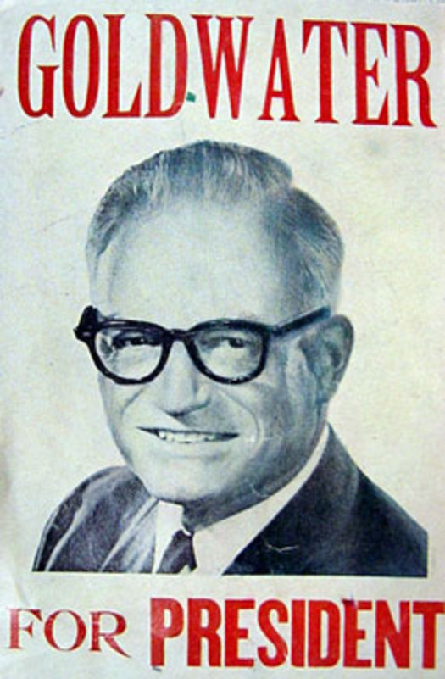

Slide 2
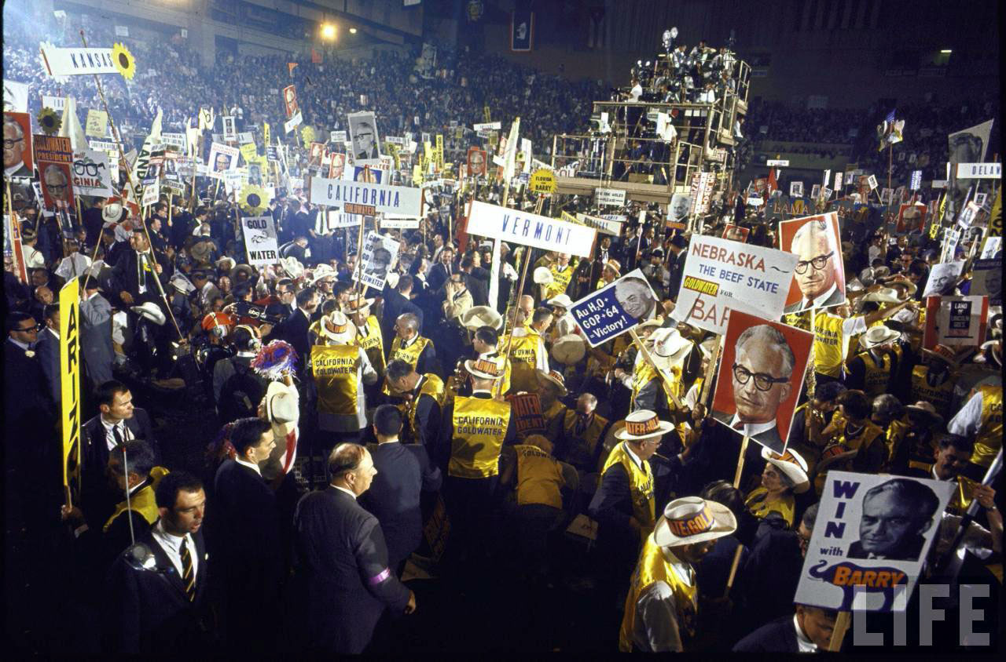

Slide 3
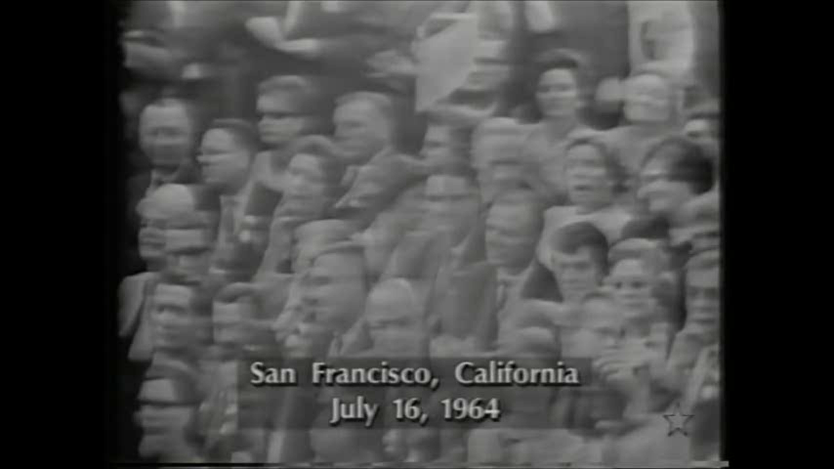

Slide 4


Slide 5
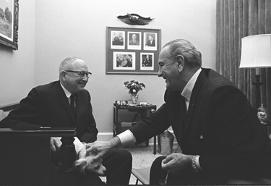

Slide 6
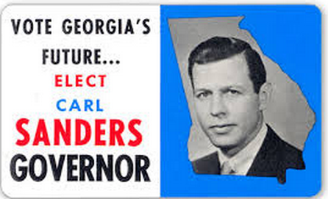

Slide 7

President Johnson: What’s happening is we’re doing four or five things. Number one: we’re coming in there and seating the state of Mississippi. Every damn one of them. Now, they oughtn’t to be, Carl. They oughtn’t to …
Carl Sanders: I don’t—
President Johnson: You and I just can’t survive our political modern life with these goddamned fellows down there [white Mississippi leaders] that are eating them for breakfast every morning. They’ve got to quit that. And they’ve got to let them [African-Americans] vote. And they’ve got to let them shave. And they’ve got to let them eat, and things like that. And they don’t do it.
However much we love [Democratic Senators] Jim Eastland and John Stennis, they get a governor like Ross Barnett, and he’s messing around there with [George] Wallace, and they won’t let one [black] man go in a precinct convention. We’ve got to put a stop to that, because that’s just like the old days, by God, when they wouldn’t let them go in and cast a vote of any kind.
You’ve put a stop to it in your state. But we’re going to ignore that. We’re going to say, “Hell, yes, you did it. You’re wrong. You violated the ’57 [civil rights] law, and you violated the ’60 [civil rights] law, and you violated the ’64 [civil rights] law, but we’re going to seat you—every damn one of you. [dripping with sarcasm] You lily white babies, we’re going to salute you.”

Slide 8
