Slide 1
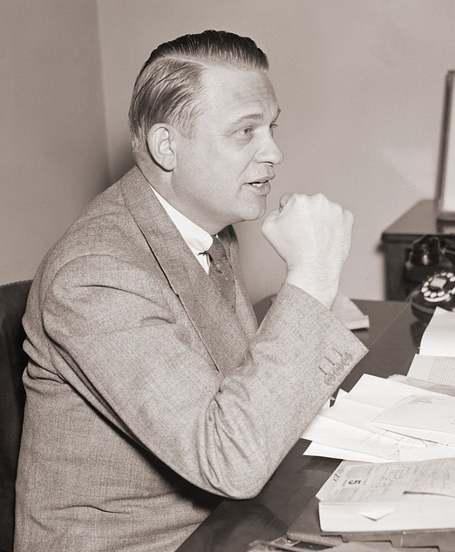
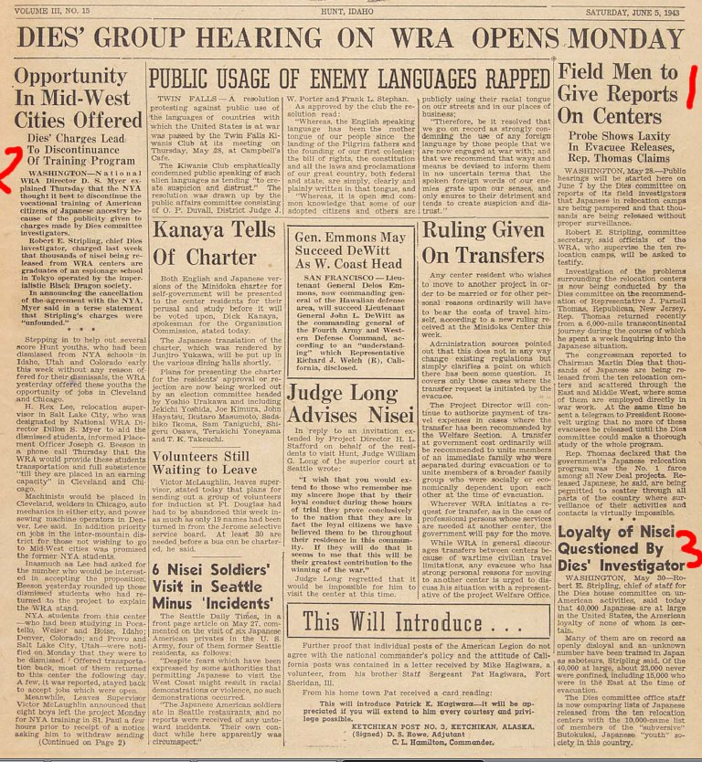

Slide 2
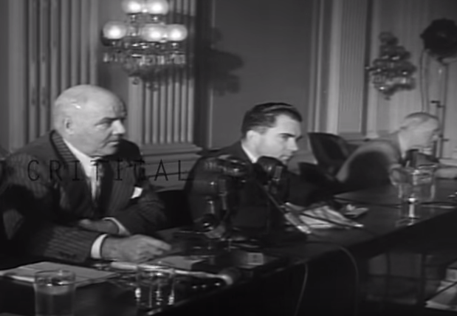

Slide 3
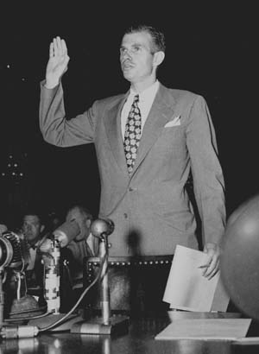

Slide 4
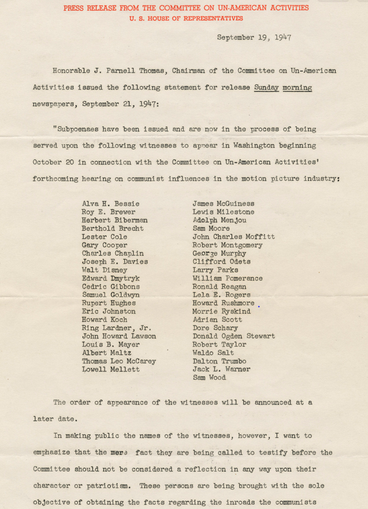

Slide 5
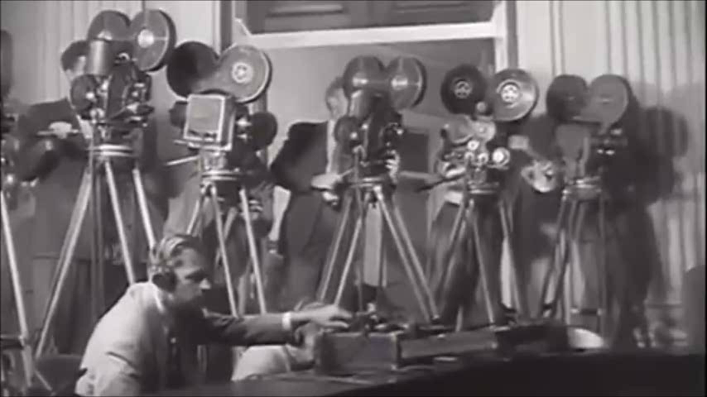

Slide 6


Slide 7
Dennis v. United States (1951)
Overthrow of the Government by force and violence is certainly a substantial enough interest for the Government to limit speech. Indeed, this is the ultimate value of any society, for if a society cannot protect its very structure from armed internal attack, it must follow that no subordinate value can be protected. If, then, this interest may be protected, the literal problem which is presented is what has been meant by the use of the phrase “clear and present danger” of the utterances bringing about the evil within the power of Congress to punish.
Obviously, the words cannot mean that, before the Government may act, it must wait until the putsch is about to be executed, the plans have been laid and the signal is awaited. If Government is aware that a group aiming at its overthrow is attempting to indoctrinate its members and to commit them to a course whereby they will strike when the leaders feel the circumstances permit, action by the Government is required.
Notes:
Vinson opinion

Slide 8
Dennis –Black dissent
The opinions for affirmance indicate that the chief reason for jettisoning the rule is the expressed fear that advocacy of Communist doctrine endangers the safety of the Republic. Undoubtedly a governmental policy of unfettered communication of ideas does entail dangers. To the Founders of this Nation, however, the benefits derived from free expression were worth the risk. They embodied this philosophy in the First Amendment's command that “Congress shall make no law . . . abridging the freedom of speech, or of the press. . . .” I have always believed that the First Amendment is the keystone of our Government, that the freedoms it guarantees provide the best insurance against destruction of all freedom. . .
Public opinion being what it now is, few will protest the conviction of these Communist petitioners. There is hope, however, that, in calmer times, when present pressures, passions and fears subside, this or some later Court will restore the First Amendment liberties to the high preferred place where they belong in a free society.

Slide 9
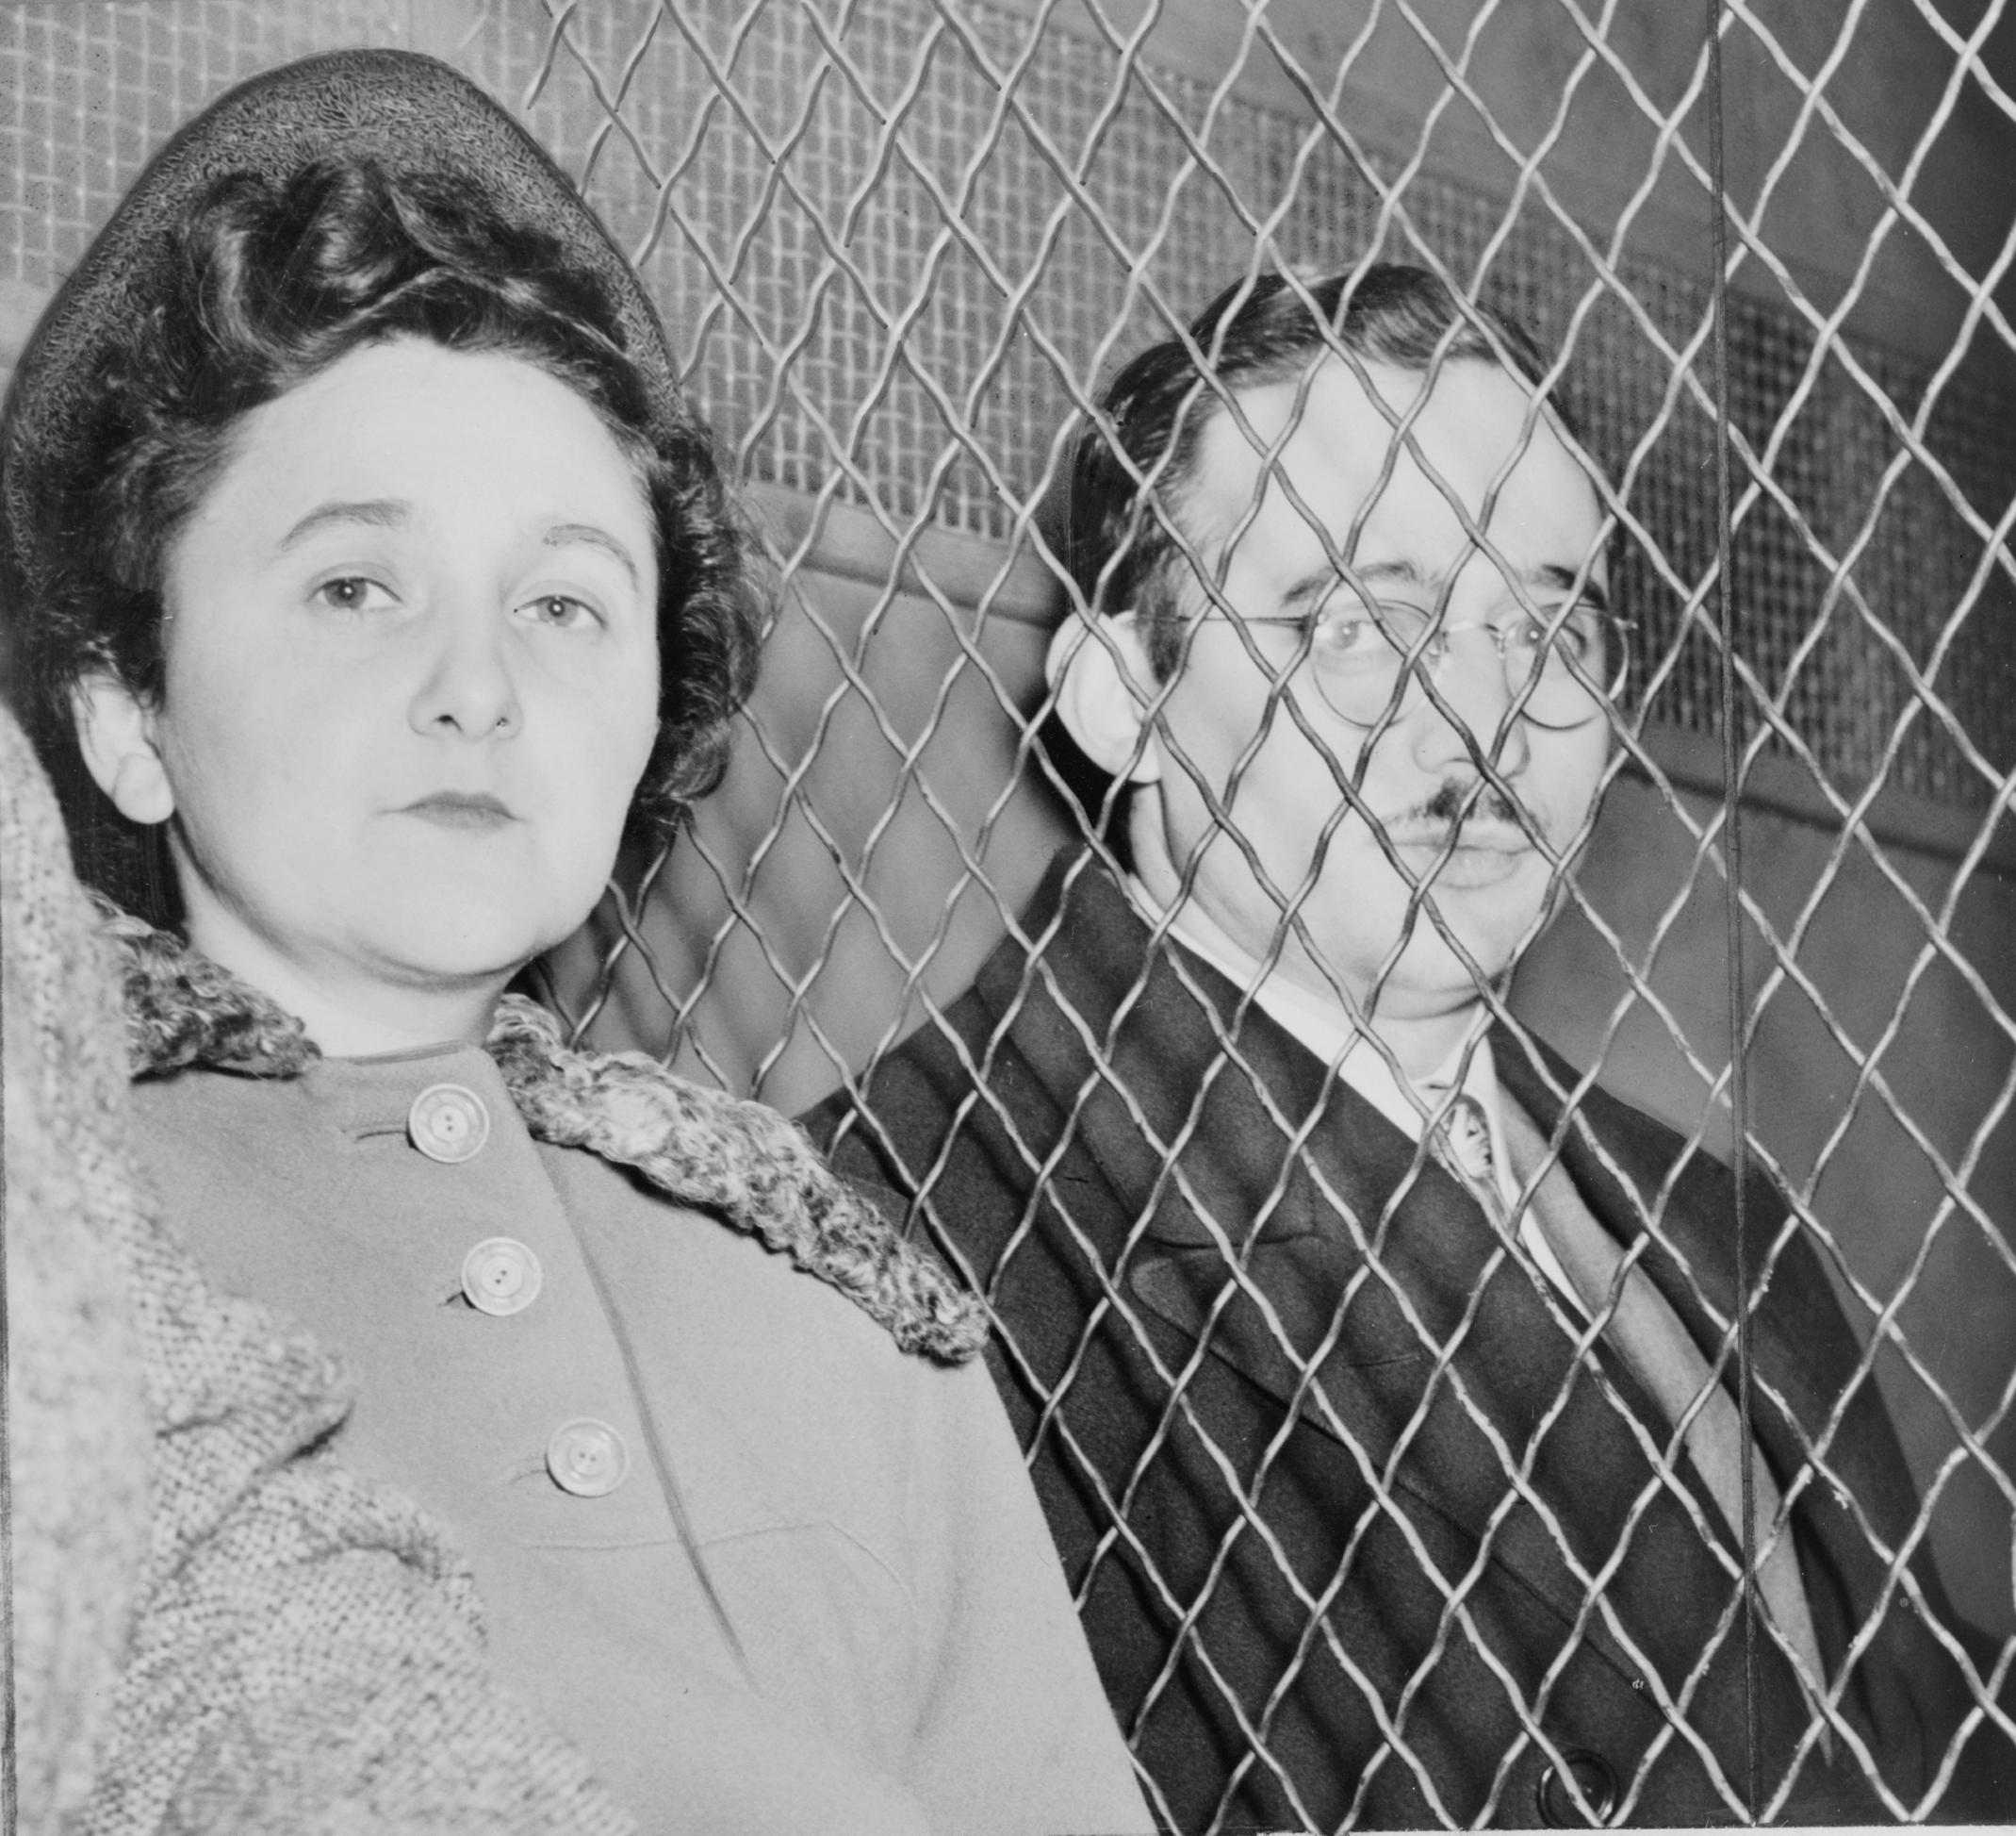

Slide 10
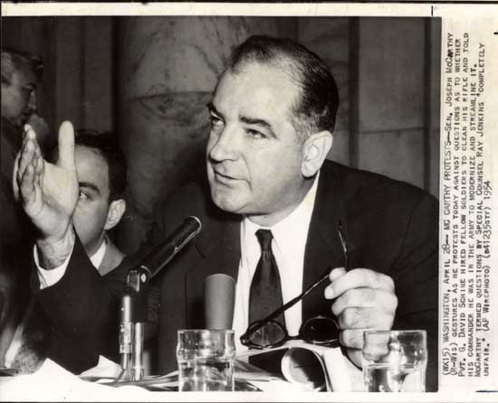

Slide 11
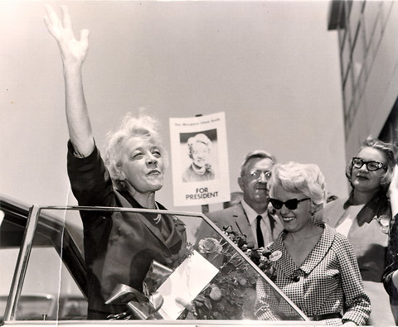

Slide 12
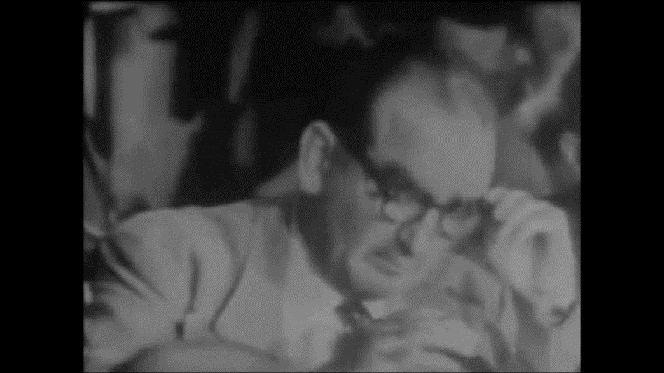

Slide 13


Slide 14
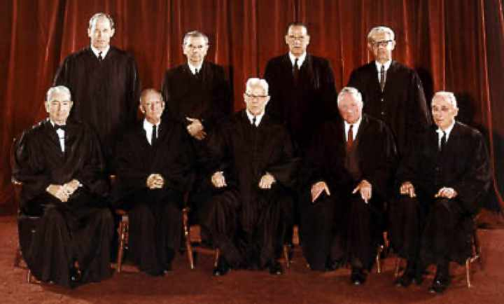

Slide 15
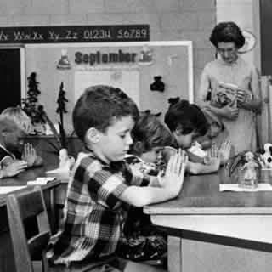
Regents’ prayer—New York
Almighty God, we acknowledge our dependence upon Thee, and we beg Thy blessings upon us, our parents, our teachers and our Country.

Slide 16
Engel v. Vitale (1962)
We think that, by using its public school system to encourage recitation of the Regents' prayer, the State of New York has adopted a practice wholly inconsistent with the Establishment Clause. There can, of course, be no doubt that New York's program of daily classroom invocation of God's blessings as prescribed in the Regents' prayer is a religious activity. It is a solemn avowal of divine faith and supplication for the blessings of the Almighty . . .
It has been argued that to apply the Constitution in such a way as to prohibit state laws respecting an establishment of religious services in public schools is to indicate a hostility toward religion or toward prayer. Nothing, of course, could be more wrong . . .
It is neither sacrilegious nor anti-religious to say that each separate government in this country should stay out of the business of writing or sanctioning official prayers and leave that purely religious function to the people themselves and to those the people choose to look to for religious guidance.

Slide 17
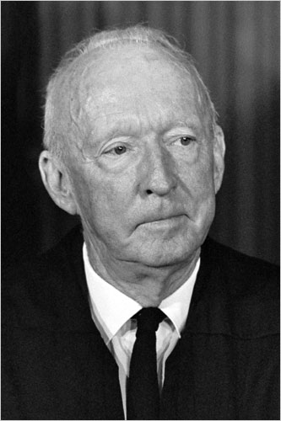
Notes:
Hugo black (wall of separation)

Slide 18
Tennessee House Districts—87th Congress
Congressional District | 1960 Population
1st | 460,583
2nd | 497,121
3rd | 412,664
4th | 389,563
5th | 399,372
6th | 324,337
7th (rural s’western Tenn.) | 232,652
8th (rural Western Tenn.) | 223,387
9th (Memphis) | 627,019

Slide 19
Baker v. Carr (1962)—Frankfurter dissent
The Court today reverses a uniform course of decision established by a dozen cases, including one by which the very claim now sustained was unanimously rejected only five years ago. The impressive body of rulings thus cast aside reflected the equally uniform course of our political history regarding the relationship between population and legislative representation . . . Disregard of inherent limits in the effective exercise of the Court's "judicial Power" not only presages the futility of judicial intervention in the essentially political conflict of forces by which the relation between population and representation has time out of mind been, and now is, determined… The Court's authority -- possessed of neither the purse nor the sword -- ultimately rests on sustained public confidence in its moral sanction. Such feeling must be nourished by the Court's complete detachment, in fact and in appearance, from political entanglements and by abstention from injecting itself into the clash of political forces in political settlements.

Slide 20
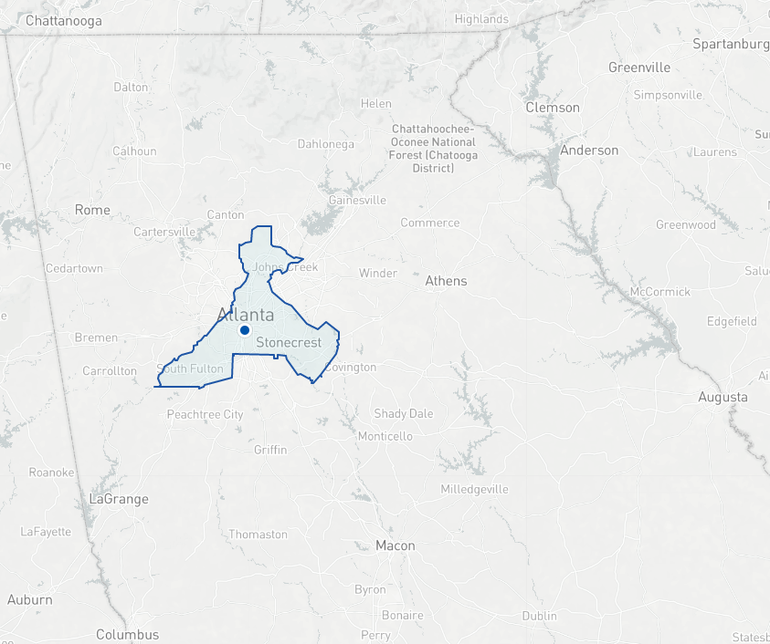

Slide 21
Wesberry v. Sanders (1964)
Other rights, even the most basic, are illusory if the right to vote is undermined. Our Constitution leaves no room for classification of people in a way that unnecessarily abridges this right. In urging the people to adopt the Constitution, Madison said in No. 57 of The Federalist:
“Who are to be the electors of the Federal Representatives? Not the rich more than the poor; not the learned more than the ignorant; not the haughty heirs of distinguished names more than the humble sons of obscure and unpropitious fortune. The electors are to be the great body of the people of the United States.”
Readers surely could have fairly taken this to mean, “one person, one vote.”
While it may not be possible to draw congressional districts with mathematical precision, that is no excuse for ignoring our Constitution's plain objective of making equal representation for equal numbers of people the fundamental goal for the House of Representatives. That is the high standard of justice and common sense which the Founders set for us.

Slide 22
 | Largest dist. | Smallest dist. | disparity
NH House | 3244 | 3 | 1081:1
VT House | 35,000 | 36 | 980:1
CA Senate | 6,000,000 | 14,000 | 428:1
CT House | 81,000 | 191 | 424:1
UT House | 32,380 | 165 | 196:1
Reynolds v. Sims (1964)
Legislators represent people, not trees or acres. Legislators are elected by voters, not farms or cities or economic interests.

Slide 23
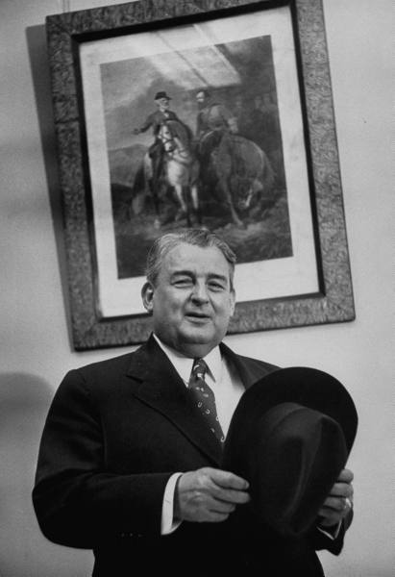
Notes:
Wm tuck

Slide 24
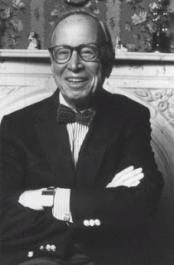
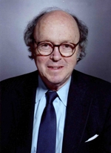

Slide 25

President Johnson: Why in the living hell they want to put it [a plank supporting the reapportionment decisions] in the platform, notify every little state. [Majority Leader] Carl Albert’s district [in Oklahoma] is put together and he’s abolished from Congress. Now who wants to do that to Carl Albert, when he’s the best instrument the liberals have for achievement in this town, since [former House Speaker] Sam Rayburn? Now, why would they want to abolish his district?
It’s not so bad if the Senate abolishes it, or the Court abolishes it. But it’s awful if he is asked—the [Democratic National] Platform Committee of which he heads—to abolish himself. That’s just cruel, inhuman punishment. Now, it looks like even a goddamned college professor could understand that.
Bill Moyers: All right.
President Johnson: Paul Douglas has got less sense than any man I know when judgment’s required. He’s always off chasing some damn balloon in the air.
Moyers: That’s right.
President Johnson: So . . .
Moyers: All right.
President Johnson: Bill, the pitch is this: they’re coming—the Congress hasn’t adjourned. It was due to adjourn; it didn’t adjourn. Does Doctor Douglas know that?
Moyers: I hope he does.
President Johnson: All right. Now, why didn’t they adjourn? What are they coming back for? They’re coming back to consider the Tuck bill, and the Dirksen bill, and the Mansfield bill.
Now, what they ought to do—if the liberals want a real plan of attack, [if New York Times reporter] Tony Lewis wants something to do, is get ten of them out here at a Georgetown house some night with [historian and former Kennedy aide] Arthur Schlesinger, and let ‘em all agree that one of ‘em will talk four hours and the other one will talk four hours. And that’s what they [the liberals] do best: is talk.
[Senate Majority Leader Mike] Mansfield won’t run after 6.00. They’ll do that for two weeks, and the show will be over. The Tuck bill will be dead. The Supreme Court will be riding high, and that’ll be it—period. That’s simple. You don’t have to be smart to know that. Hell, I knew that before I left Johnson City. [Snorts.]

Slide 26
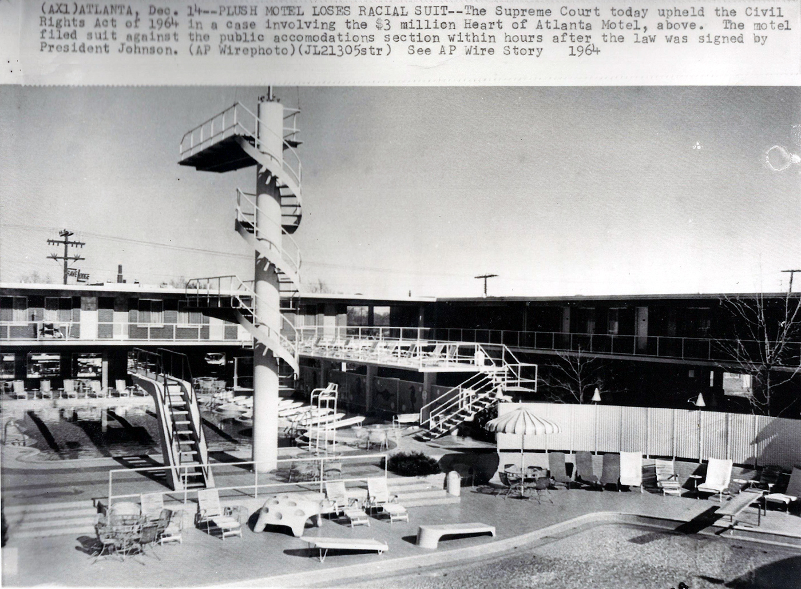

Slide 27
Heart of Atlanta Motel v. United States (1964)
That Congress was legislating against moral wrongs in many of these areas rendered its enactments no less valid. In framing Title II of this Act, Congress was also dealing with what it considered a moral problem. But that fact does not detract from the overwhelming evidence of the disruptive effect that racial discrimination has had on commercial intercourse. It was this burden which empowered Congress to enact appropriate legislation, and, given this basis for the exercise of its power, Congress was not restricted by the fact that the particular obstruction to interstate commerce with which it was dealing was also deemed a moral and social wrong…
Nor does the Act deprive appellant of liberty or property under the Fifth Amendment… There is nothing novel about such legislation. Thirty-two States now have it on their books either by statute or executive order, and many cities provide such regulation. Some of these Acts go back four-score years. It has been repeatedly held by this Court that such laws do not violate the Due Process Clause of the Fourteenth Amendment.

Slide 28


Slide 29
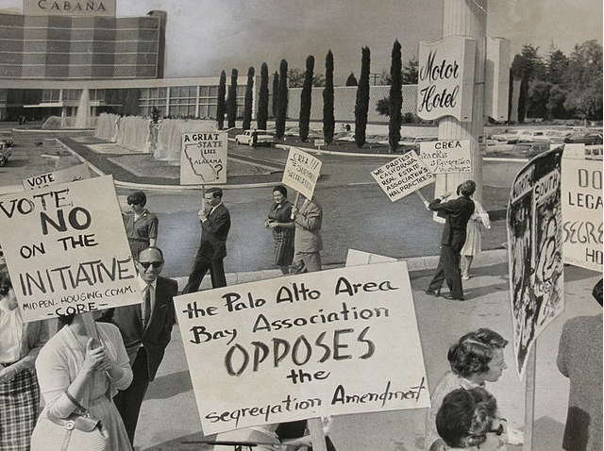

Slide 30


Slide 31
Reitman v. Mulkey (1967)
[We recognize] the necessity for a court to assess the potential impact of official action in determining whether the State has significantly involved itself with invidious discriminations. Here we are dealing with a provision which does not just repeal an existing law forbidding private racial discriminations…
[Proposition 14] was intended to authorize, and does authorize, racial discrimination in the housing market. The right to discriminate is now one of the basic policies of the State. The California Supreme Court believes that the section will significantly encourage and involve the State in private discriminations. We have been presented with no persuasive considerations indicating that these judgments should be overturned.

Slide 32
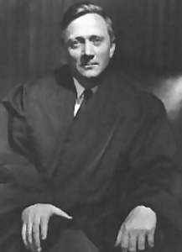

Slide 33
Griswold v. Connecticut (1965)
Specific guarantees in the Bill of Rights have penumbras, formed by emanations from those guarantees that help give them life and substance. Various guarantees create zones of privacy. The right of association contained in the penumbra of the First Amendment is one, as we have seen. The Third Amendment, in its prohibition against the quartering of soldiers “in any house” in time of peace without the consent of the owner, is another facet of that privacy. The Fourth Amendment explicitly affirms the “right of the people to be secure in their persons, houses, papers, and effects, against unreasonable searches and seizures.” The Fifth Amendment, in its Self-Incrimination Clause, enables the citizen to create a zone of privacy which government may not force him to surrender to his detriment. The Ninth Amendment provides: “The enumeration in the Constitution, of certain rights, shall not be construed to deny or disparage others retained by the people.”

Slide 34
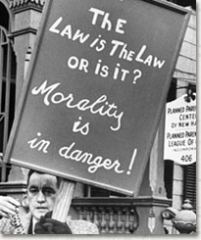
Notes:
Protester outside pp in new haven

Slide 35
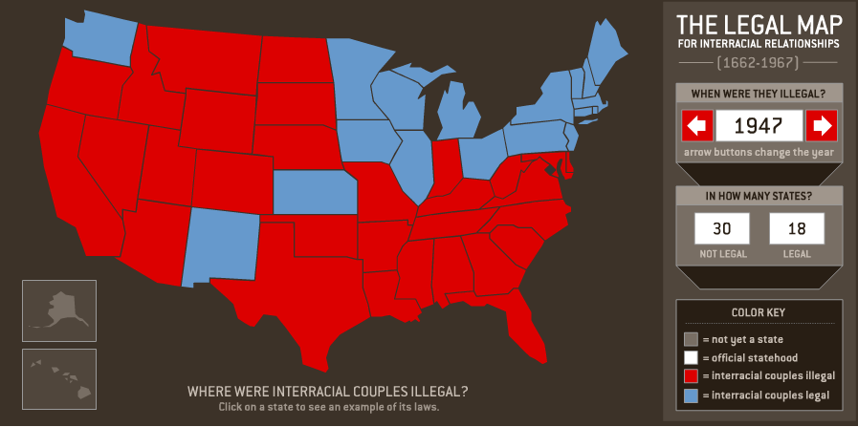

Slide 36
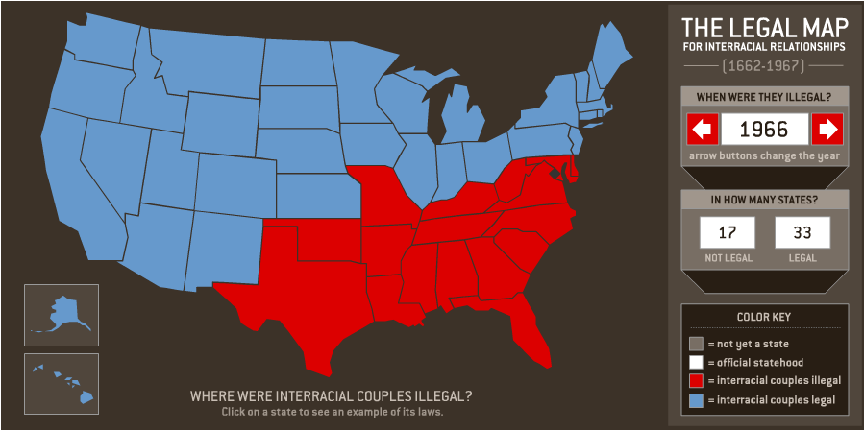

Slide 37
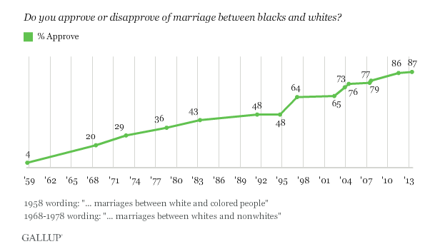

Slide 38
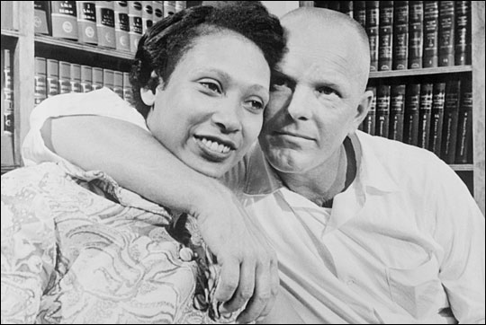

Slide 39
Section 259, Virginia criminal code (1958)
Leaving State to evade law. -- If any white person and colored person shall go out of this State, for the purpose of being married, and with the intention of returning, and be married out of it, and afterwards return to and reside in it, cohabiting as man and wife, they shall be punished as provided in § 20-59, and the marriage shall be governed by the same law as if it had been solemnized in this State. The fact of their cohabitation here as man and wife shall be evidence of their marriage.
Punishment for marriage. -- If any white person intermarry with a colored person, or any colored person intermarry with a white person, he shall be guilty of a felony and shall be punished by confinement in the penitentiary for not less than one nor more than five years.

Slide 40
Almighty God created the races, white, black, yellow, Malay, and red and placed them on separate continents, and but for the interference with his arrangement there would be no cause for such marriages. The fact that he separated the races shows that he did not intend the races to mix.
--Judge Leon Bazile (VA)
Naim v. Naim (VA Supreme Court, 1965)
“State's legitimate purposes were ‘to preserve the racial integrity of its citizens,’ and to prevent ‘the corruption of blood,’ ‘a mongrel breed of citizens,’ and ‘the obliteration of racial pride.’”

Slide 41
Loving v. Virginia (1967)
There is patently no legitimate overriding purpose independent of invidious racial discrimination which justifies this classification. The fact that Virginia prohibits only interracial marriages involving white persons demonstrates that the racial classifications must stand on their own justification, as measures designed to maintain White Supremacy. We have consistently denied the constitutionality of measures which restrict the rights of citizens on account of race. There can be no doubt that restricting the freedom to marry solely because of racial classifications violates the central meaning of the Equal Protection Clause . . .
Marriage is one of the “basic civil rights of man,” fundamental to our very existence and survival. To deny this fundamental freedom on so unsupportable a basis as the racial classifications embodied in these statutes, classifications so directly subversive of the principle of equality at the heart of the Fourteenth Amendment, is surely to deprive all the State's citizens of liberty without due process of law.
The Fourteenth Amendment requires that the freedom of choice to marry not be restricted by invidious racial discriminations. Under our Constitution, the freedom to marry, or not marry, a person of another race resides with the individual, and cannot be infringed by the State.

Slide 42
Mapp v. Ohio (1961)
Our holding that the exclusionary rule is an essential part of both the Fourth and Fourteenth Amendments is not only the logical dictate of prior cases, but it also makes very good sense. There is no war between the Constitution and common sense. Presently, a federal prosecutor may make no use of evidence illegally seized, but a State's attorney across the street may, although he supposedly is operating under the enforceable prohibitions of the same Amendment. Thus, the State, by admitting evidence unlawfully seized, serves to encourage disobedience to the Federal Constitution which it is bound to uphold.

Slide 43
Mapp v. Ohio (1961)—Harlan dissent
In overruling the Wolf case, the Court, in my opinion, has forgotten the sense of judicial restraint which, with due regard for stare decisis, is one element that should enter into deciding whether a past decision of this Court should be overruled . . . I am bound to say that what has been done is not likely to promote respect either for the Court's adjudicatory process or for the stability of its decisions . . .
The preservation of a proper balance between state and federal responsibility in the administration of criminal justice demands patience on the part of those who might like to see things move faster among the States in this respect . . .
I think this Court can increase respect for the Constitution only if it rigidly respects the limitations which the Constitution places upon it, and respects as well the principles inherent in its own processes. In the present case, I think we exceed both, and that our voice becomes only a voice of power, not of reason.

Slide 44
Miranda v. Arizona (1965)—White dissent
In some unknown number of cases, the Court’s rule will return a killer, a rapist or other criminal to the streets and to the environment which produced him, to repeat his crime whenever it pleases him. As a consequence, there will not be a gain, but a loss, in human dignity. The real concern is not the unfortunate consequences of this new decision on the criminal law as an abstract, disembodied series of authoritative proscriptions, but the impact on those who rely on the public authority for protection, and who, without it, can only engage in violent self-help with guns, knives and the help of their neighbors similarly inclined. There is, of course, a saving factor: the next victims are uncertain, unnamed and unrepresented in this case.

Slide 45
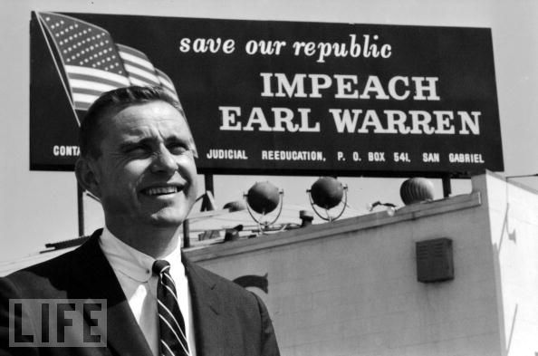

Slide 46
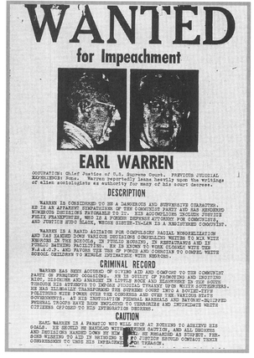

Slide 47
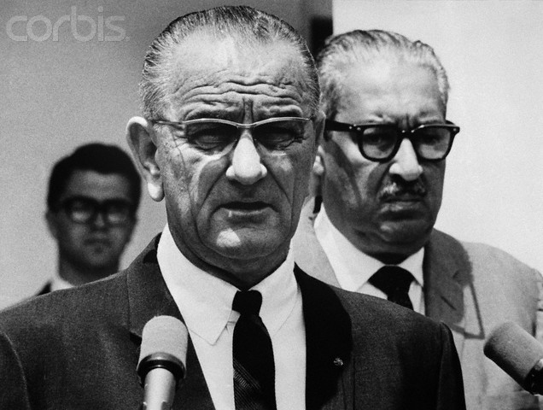

Slide 48
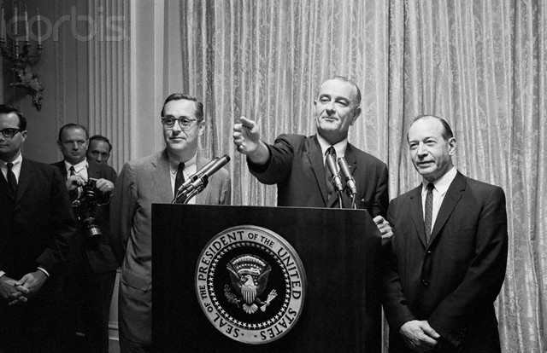

Slide 49
President Johnson: How are you going to rate these people—one, two, three, four, five?
Fortas: I—
President Johnson: From the standpoint of my practical problem, and what I may want to do here on all the other things. I’ve got geography, I’ve got the Senate, I’ve got these philosophies, I’ve got to have sure votes.
I want continuity, I want a little age—look at this not from your standpoint.
Fortas: Well—
President Johnson: Look at it from my standpoint, of knowing me as you know me, and what I want. I want somebody that I’ll always be proud of his vote. That’s the first thing. I may not be proud of his opinion, but I want to be proud of the side he was on. He may not be as eloquent as Hugo Black, or you, or somebody. But I want to be damn sure he votes right. That’s the first thing.

Slide 50
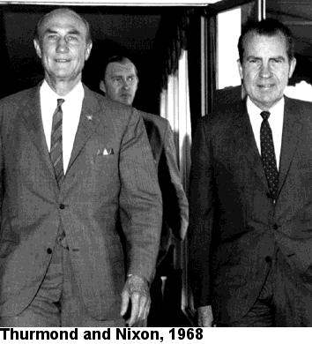

Slide 51
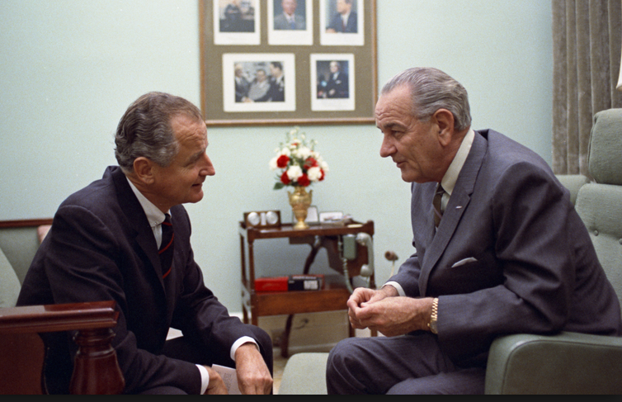

Slide 52
George Smathers: Now, you get a real nut like Strom Thurmond, who up to this point hadn’t really made much sense . . . There are just enough people who will fall for a line like this, that it worries me, very much. And they’ve invited Abe back to talk about it, and I just think that—frankly, my first reaction is that he just ought not to come. And just see . . .
And my other reaction is at the moment—[Michigan senator] Phil [Hart] went to see the movie. I said, “I’m not going to see the damn movie.” Because I want to be in a position to say, as far as I’m concerned, I don’t look at any kind of goddamned pornographic stuff. It’s all over the streets, and always has been. And it’s a man’s choice. And I choose not to look at it. But others may choose to look at it. And if a fella wants to look at it, why, the Court’s voted that he can. That’s a matter of choice.
I don’t look at it. I haven’t seen it, so I’m not passing judgment on whether or not this is the kind of thing that should be shown around, or it shouldn’t.
[Break.]
Smathers: [Arkansas senator] John [McClellan] was preaching, and rantin’ and ravin’ about how this kind of thing was ruining the life of his grandchildren, and everybody else. He wanted a long time to look into this, and he was going to look into it very deeply.
President Johnson: He ought to go see this Graduates [sic]. [Chuckles.]
Smathers: That’s right.
[Break.]
President Johnson: Well, will you vote on it next Wednesday?
Smathers: So, we’re due to vote on it next Wednesday.
President Johnson: Well, won’t they filibuster it?
Smathers: Yeah. They’re going to filibuster it again.
President Johnson: In the committee?!
Smathers: In the committee.
President Johnson: Well, can you just do that, constantly?
Smathers: Well, with the cooperation of [Jim] Eastland, I don’t know you’re going to stop it.

Slide 53
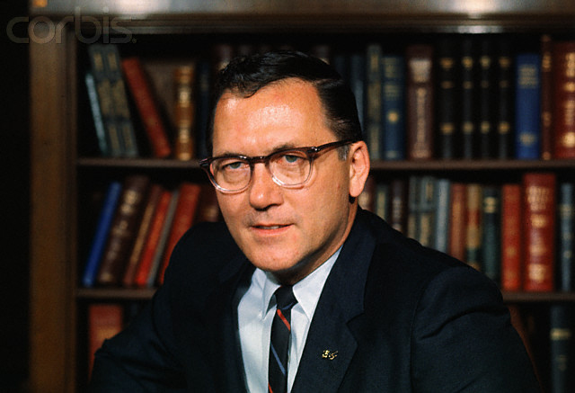
Notes:
griffin

Slide 54
President Johnson: But I just hear every 30 minutes, these fellows, they have press conferences—you know, [Robert] Griffin’s on all the time. He’s having a big press conference this morning. And they make 40 allegations, and we just get tried and convicted every day, and our side—the other side—doesn’t get in.
Ramsey Clark: Yeah.
[Break.]
President Johnson: Get somebody that can write some mean damn speeches that allege some things that they’ve got to deny. Let them do some research . . . That’s what you got to do: you’ve got to employ their resources and their talents doing research instead of attacking you.
Now, we don’t ever keep ‘em busy. I’d find some reason that Griffin’s in this thing. I don’t think anybody’s ever pointed out that Griffin said a week before the appointment that he was against anybody that was appointed. He wasn’t worried about pornography. Anybody’d look at his face and tell he’s not—that doesn’t bother him! [Clark chuckles.] Pornography!
He was just worried that, by God, he couldn’t make a partisan, political deal out of the Chief Justice [nomination]. And the Republican Chief Justice [Warren] hadn’t delayed it and played politics with it till he could get in.
Now, that’s what he said! He said it days before we even decided to name Fortas. Somebody ought to point that out.

Slide 55
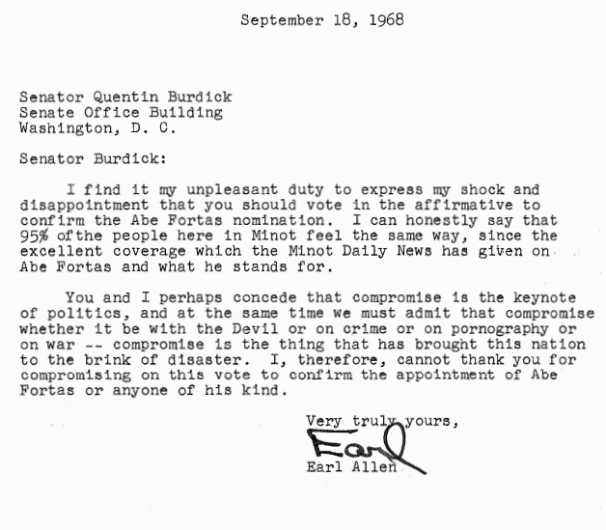
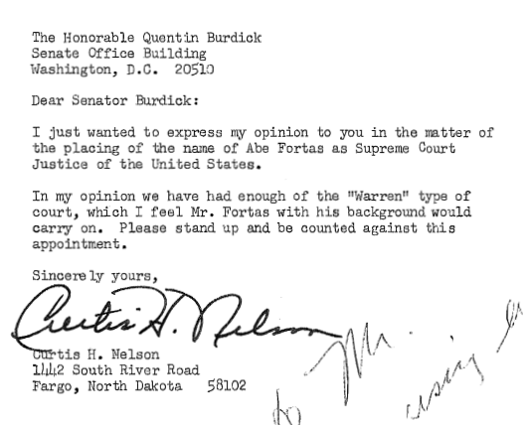

Slide 56


Slide 57


Slide 58
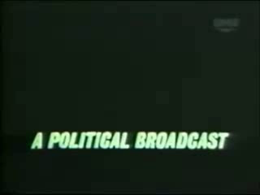

Slide 59
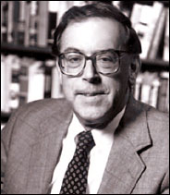
Kevin Phillips on “Southern Strategy” (1970)
From now on, the Republicans are never going to get more than 10 to 20 percent of the Negro vote and they don’t need any more than that... but Republicans would be shortsighted if they weakened enforcement of the Voting Rights Act. The more Negroes who register as Democrats in the South, the sooner the Negrophobe whites will quit the Democrats and become Republicans. That's where the votes are. Without that prodding from the blacks, the whites will backslide into their old comfortable arrangement with the local Democrats.

