Slide 1
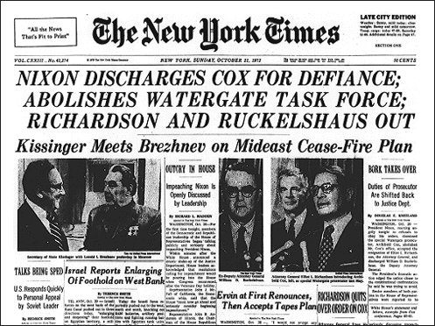

Slide 2
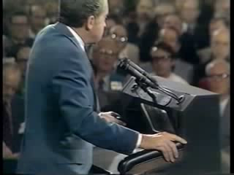

Slide 3
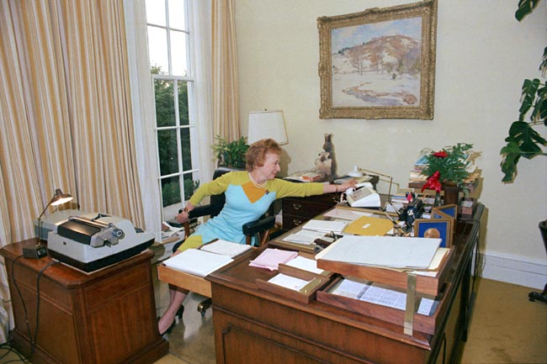

Slide 4
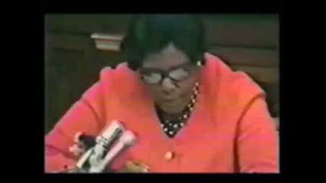

Slide 5
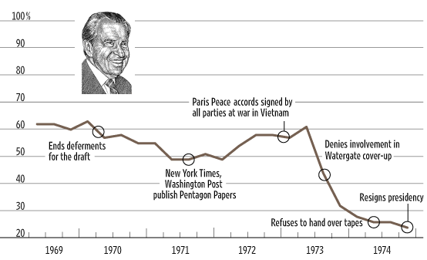

Slide 6


Slide 7
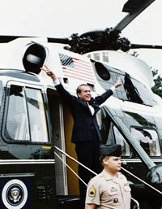

Slide 8
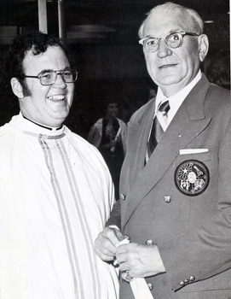
Notes:
hebert

Slide 9
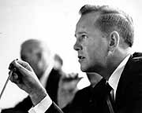

Notes:
adams

Slide 10
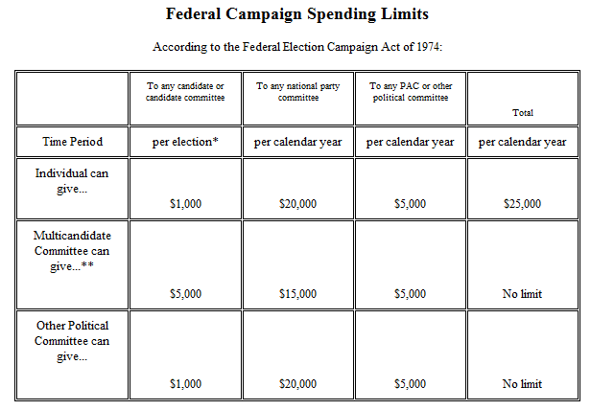

Slide 11
Buckley v. Valeo (1976)
A restriction on the amount of money a person or group can spend on political communication during a campaign necessarily reduces the quantity of expression by restricting the number of issues discussed, the depth of their exploration, and the size of the audience reached. This is because virtually every means of communicating ideas in today’s mass society requires the expenditure of money. The distribution of the humblest handbill or leaflet entails printing, paper, and circulation costs. Speeches and rallies generally necessitate hiring a hall and publicizing the event. The electorate’s increasing dependence on television, radio, and other mass media for news and information has made these expensive modes of communication indispensable instruments of effective political speech.
The expenditure limitations contained in the Act represent substantial, rather than merely theoretical, restraints on the quantity and diversity of political speech.

Slide 12
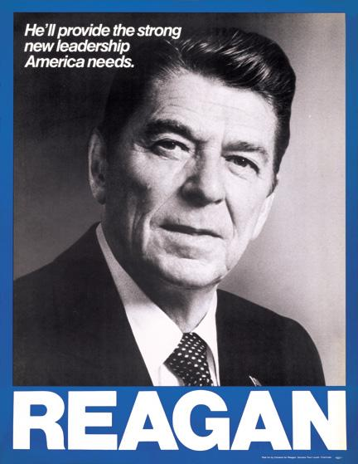

Slide 13
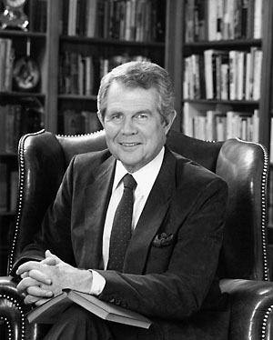
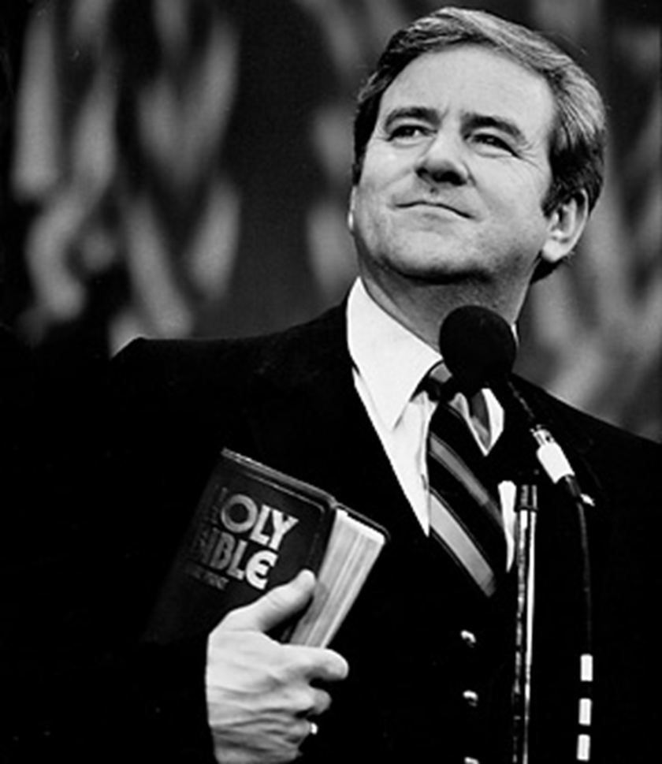

Slide 14
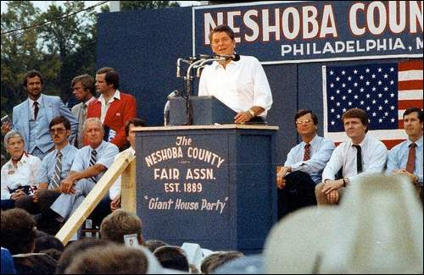

I believe in states' rights; I believe in people doing as much as they can for themselves at the community level and at the private level.
And I believe that we've distorted the balance of our government today by giving powers that were never intended in the constitution to that federal establishment.
And if I do get the job I'm looking for, I'm going to devote myself to trying to reorder those priorities and to restore to the states and local communities those functions which properly belong there.

Slide 15



Slide 16
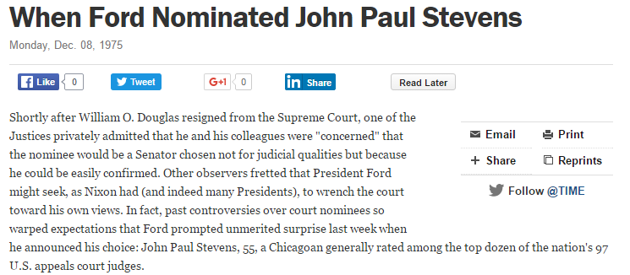
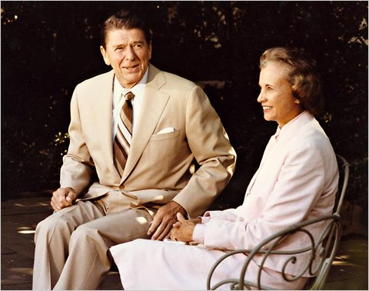

Slide 17
Thornburg v. Gingles (1986)
“Stated succinctly, a bloc voting majority must usually be able to defeat candidates supported by a politically cohesive, geographically insular minority group. The relevance of the existence of racial bloc voting to a vote dilution claim is twofold: to ascertain whether minority group members constitute a politically cohesive unit and to determine whether whites vote sufficiently as a bloc usually to defeat the minority's preferred candidate. ”
Test:
1. It is sufficiently large and geographically compact to constitute a majority in a single-member district;
2. It is politically cohesive; and
3. In the absence of special circumstances, that bloc voting by the white majority usually defeats the minority’s preferred candidate.

Slide 18
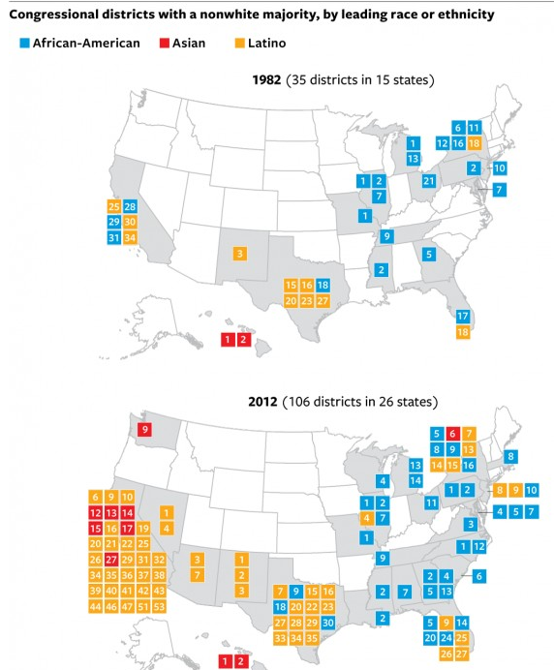
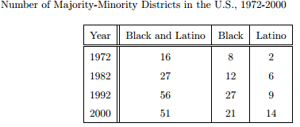

Slide 19
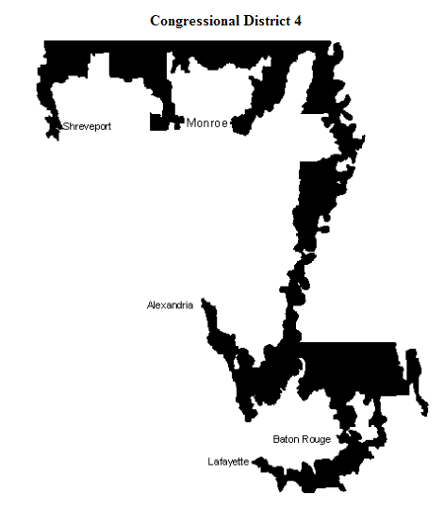
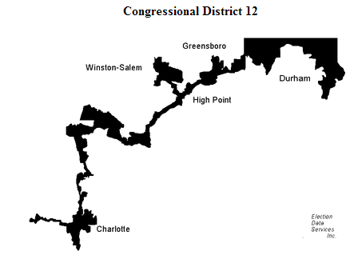

Slide 20
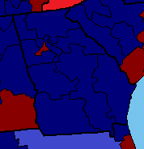
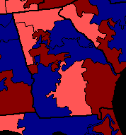
Georgia House Districts, 1990-1994

Slide 21
McCleskey v. Kemp (1987)
[McCleskey] argues that race has infected the administration of Georgia's statute in two ways: persons who murder whites are more likely to be sentenced to death than persons who murder blacks, and black murderers are more likely to be sentenced to death than white murderers…
Absent a showing that the Georgia capital punishment system operates in an arbitrary and capricious manner, McCleskey cannot prove a constitutional violation by demonstrating that other defendants who may be similarly situated did not receive the death penalty…
The Constitution does not require that a State eliminate any demonstrable disparity that correlates with a potentially irrelevant factor in order to operate a criminal justice system that includes capital punishment… McCleskey's arguments are best presented to the legislative bodies. It is not the responsibility -- or indeed even the right -- of this Court to determine the appropriate punishment for particular crimes.

Slide 22
City of Richmond v. J.A. Croson Co. (1989)
None of the evidence presented by the city points to any identified discrimination in the Richmond construction industry. We therefore hold that the city has failed to demonstrate a compelling interest in apportioning public contracting opportunities on the basis of race. To accept Richmond’s claim that past societal discrimination alone can serve as the basis for rigid racial preferences would be to open the door to competing claims for “remedial relief” for every disadvantaged group. The dream of a Nation of equal citizens in a society where race is irrelevant to personal opportunity and achievement would be lost in a mosaic of shifting preferences based on inherently unmeasurable claims of past wrongs…
We think such a result would be contrary to both the letter and spirit of a constitutional provision whose central command is equality.

Slide 23
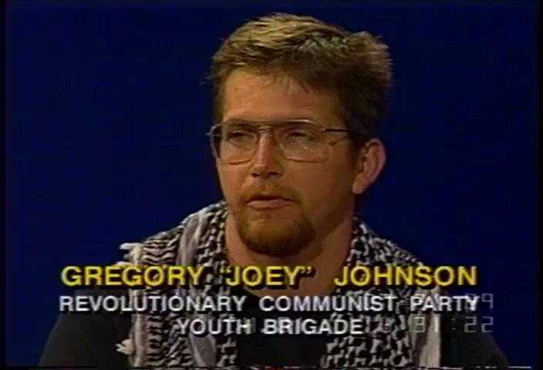
Notes:
Texas v johnson—1yr sentence

Slide 24
Texas v. Johnson (1989)—Brennan majority opinion
Texas argues that its interest in preserving the flag as a symbol of nationhood and national unity survives this close analysis . . . the State's claim is that it has an interest in preserving the flag as a symbol of nationhood and national unity, a symbol with a determinate range of meanings. According to Texas, if one physically treats the flag in a way that would tend to cast doubt on either the idea that nationhood and national unity are the flag's referents or that national unity actually exists, the message conveyed thereby is a harmful one, and therefore may be prohibited.
If there is a bedrock principle underlying the First Amendment, it is that the government may not prohibit the expression of an idea simply because society finds the idea itself offensive or disagreeable . . .
We are tempted to say, in fact, that the flag’s deservedly cherished place in our community will be strengthened, not weakened, by our holding today. . .
The way to preserve the flag's special role is not to punish those who feel differently about these matters. It is to persuade them that they are wrong.

Slide 25
Texas v. Johnson —Rehnquist dissent
The American flag, then, throughout more than 200 years of our history, has come to be the visible symbol embodying our Nation. It does not represent the views of any particular political party, and it does not represent any particular political philosophy. The flag is not simply another "idea" or "point of view" competing for recognition in the marketplace of ideas. Millions and millions of Americans regard it with an almost mystical reverence, regardless of what sort of social, political, or philosophical beliefs they may have. I cannot agree that the First Amendment invalidates the Act of Congress, and the laws of 48 of the 50 States, which make criminal the public burning of the flag . . .
The Court concludes its opinion with a regrettably patronizing civics lecture, presumably addressed to the Members of both Houses of Congress, the members of the 48 state legislatures that enacted prohibitions against flag burning, and the troops fighting under that flag in Vietnam who objected to its being burned.

Slide 26
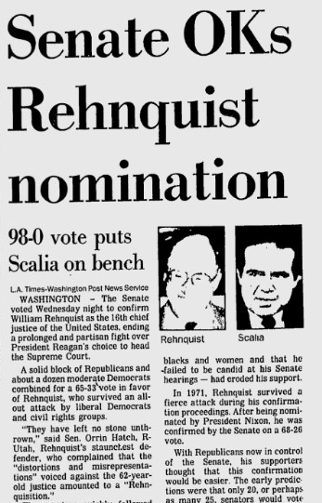

Slide 27
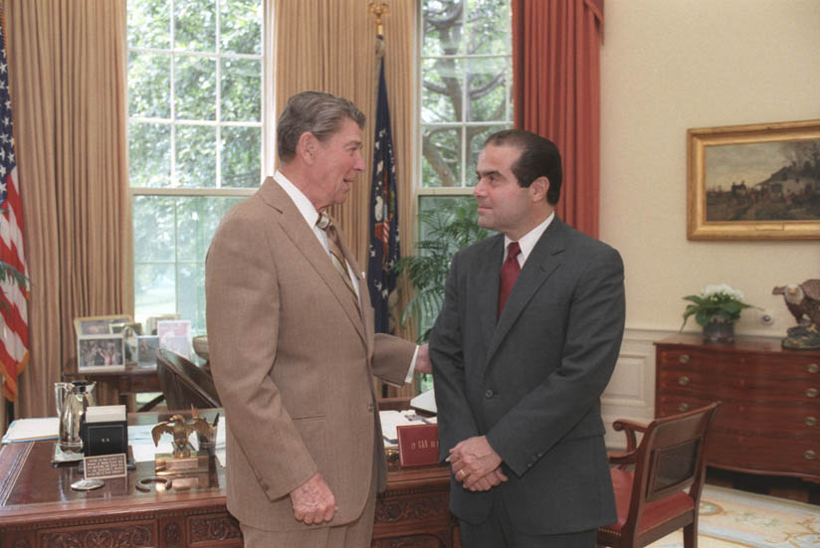

Slide 28
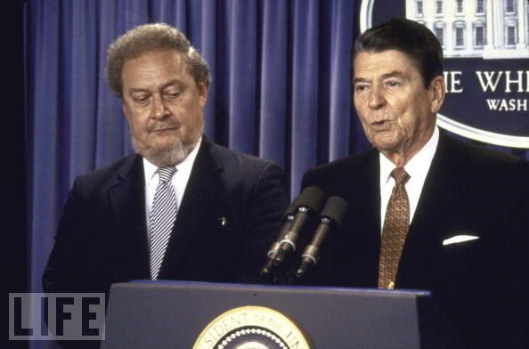

Slide 29
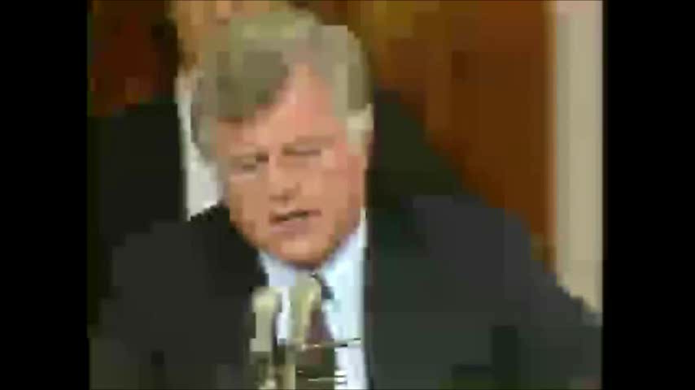

Slide 30
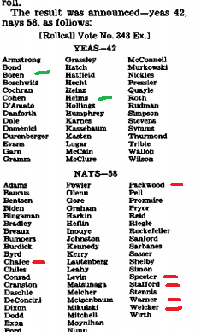

Slide 31
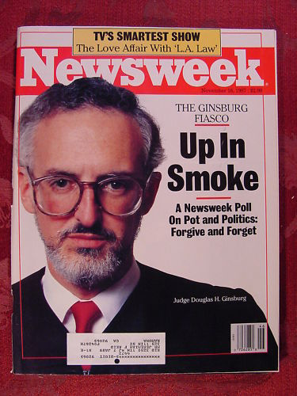

Slide 32
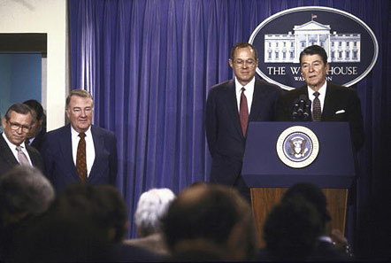

Slide 33
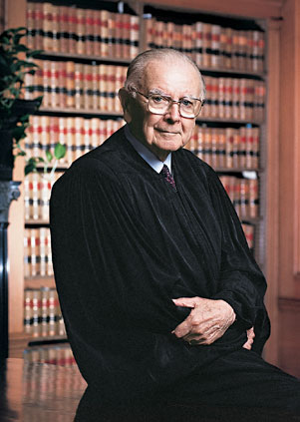

Slide 34
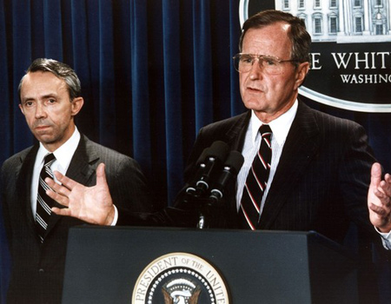
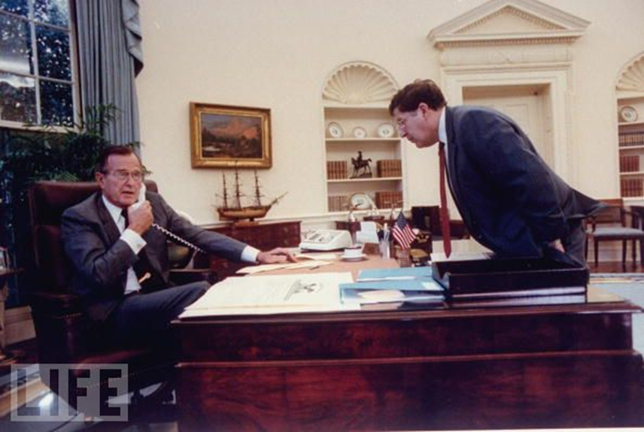

Slide 35

Molly Yard, president of National Organization of Women:
“Are you prepared to deny freedom to women? Are you prepared to deny reproductive health to women? Are you prepared for lawlessness, and for the death of your daughters and your granddaughters? I tremble for this country if you confirm David Souter. But most of all I tremble for the women of America and their families.”

Slide 36
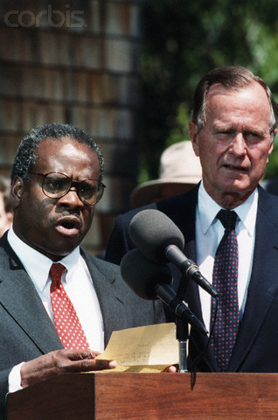

Slide 37
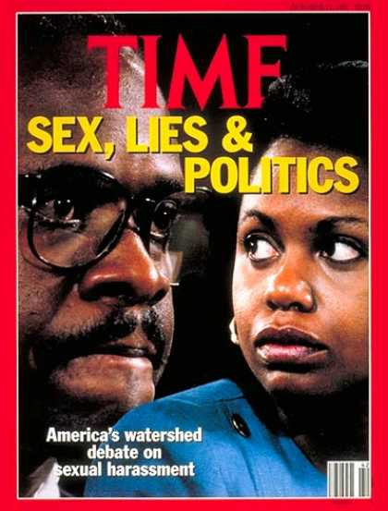

Slide 38


Slide 39
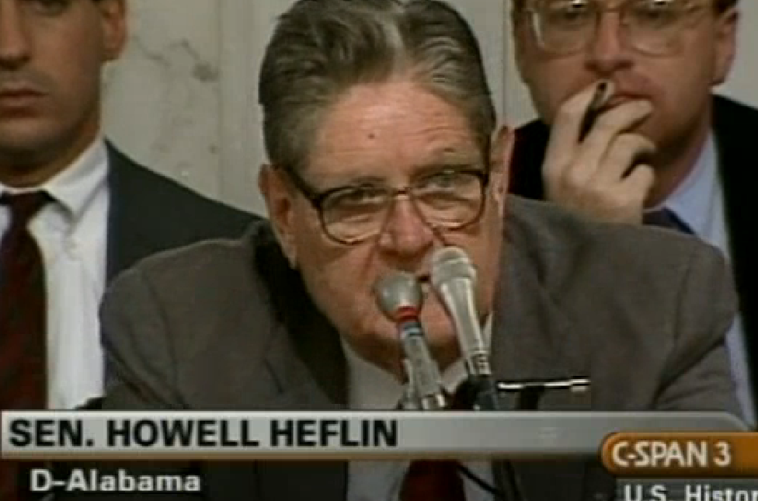

Slide 40
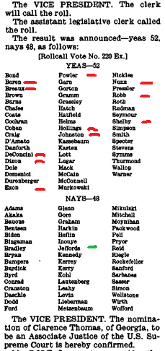

Slide 41
