Slide 1
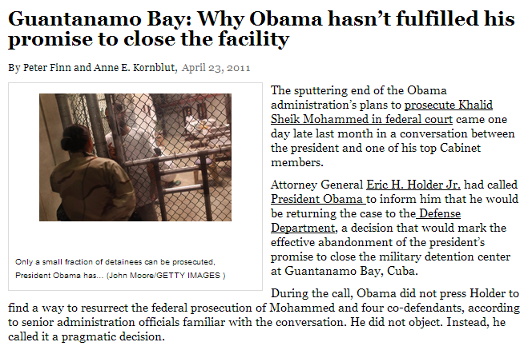

Slide 2
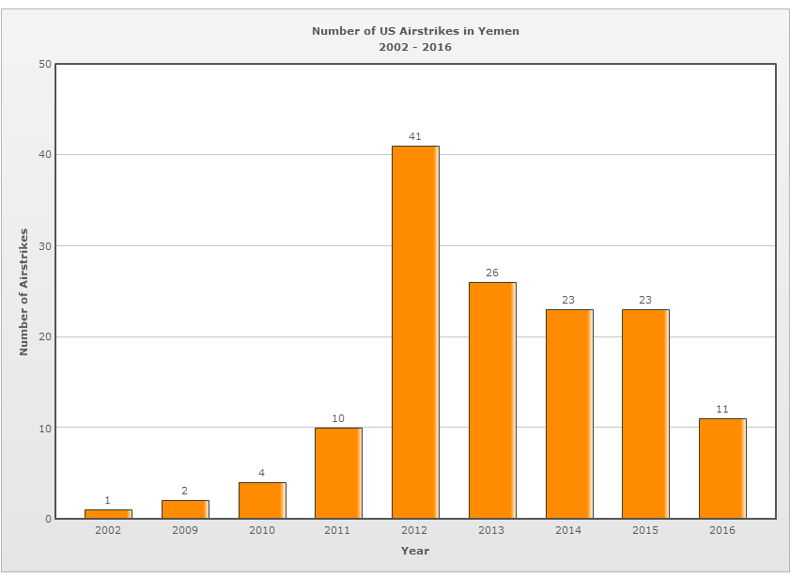
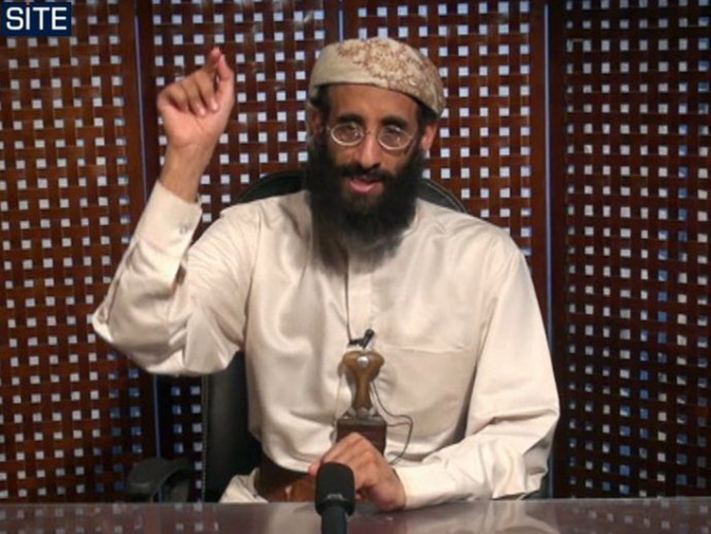

Slide 3
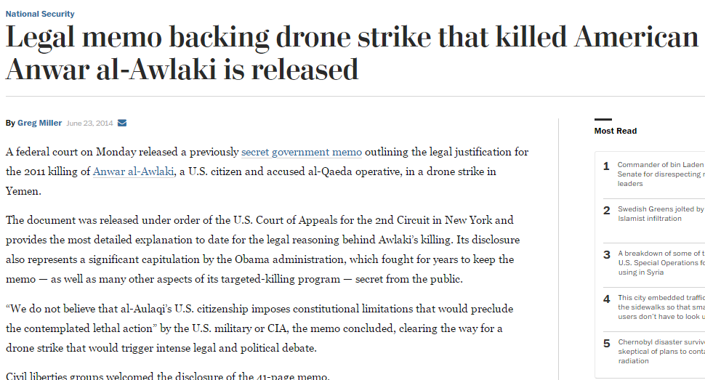

Slide 4
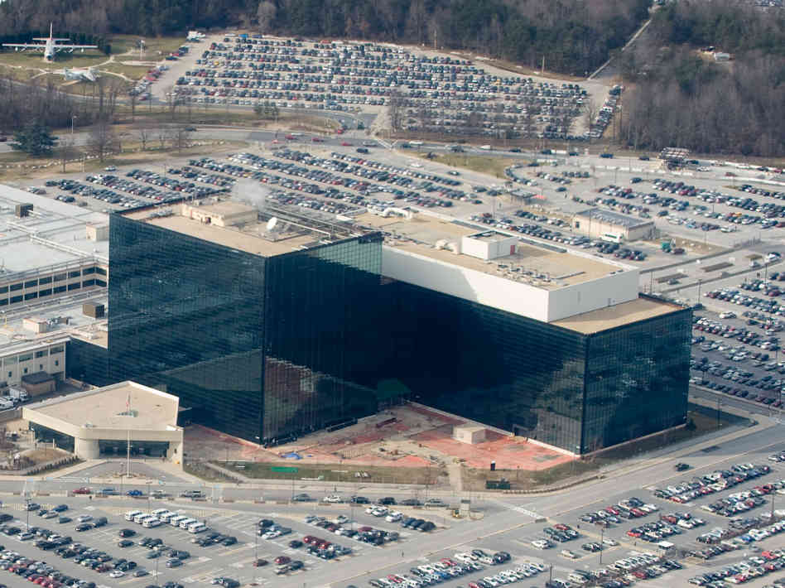

Slide 5
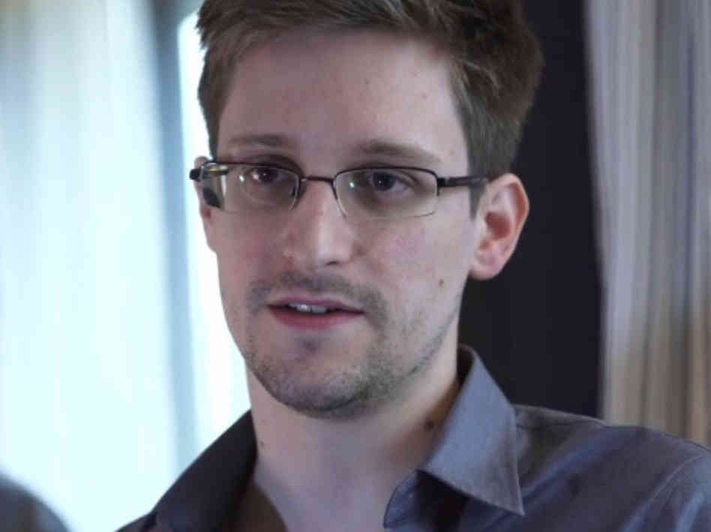
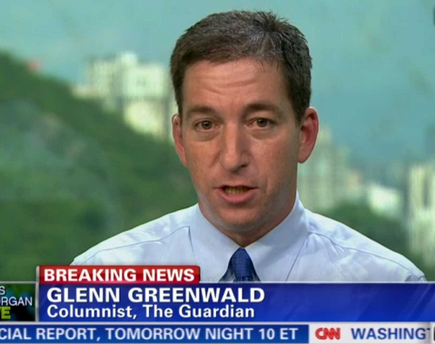

Slide 6
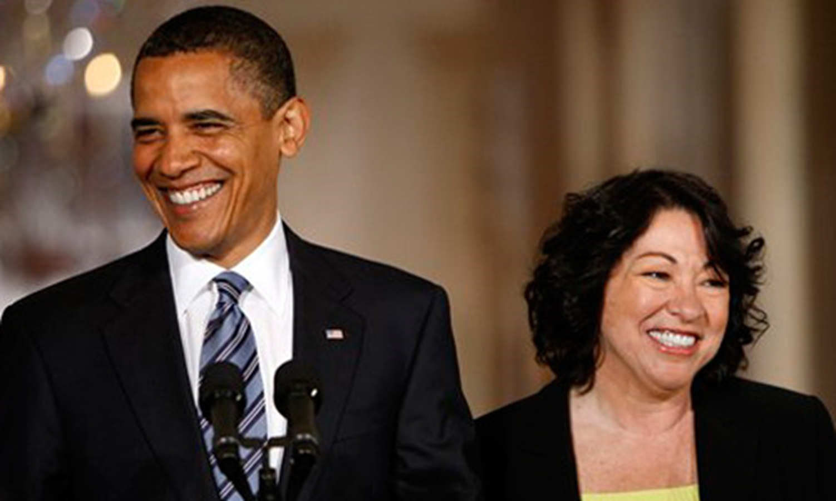
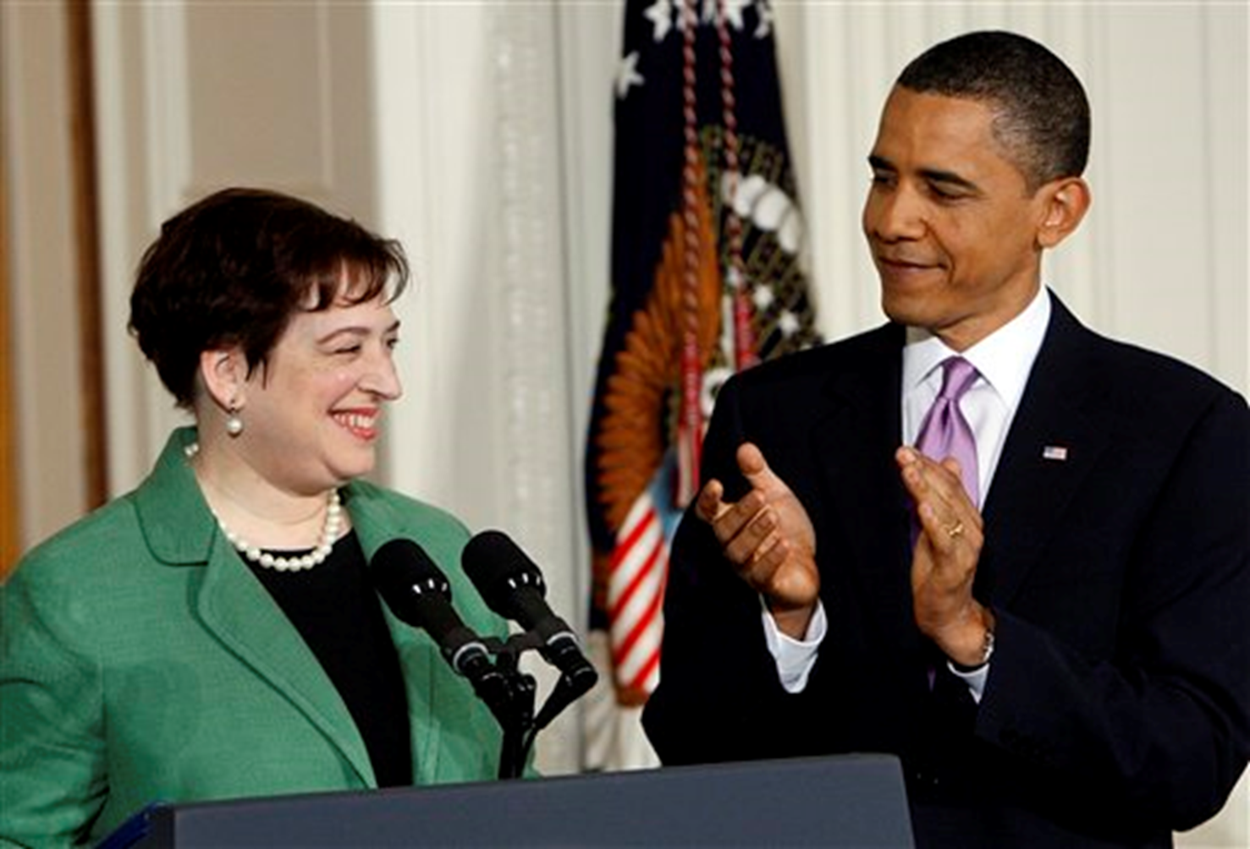

Slide 7
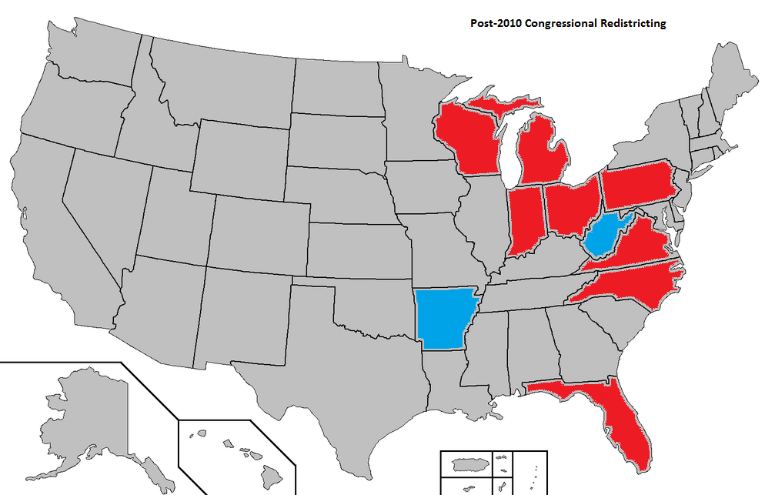

Slide 8
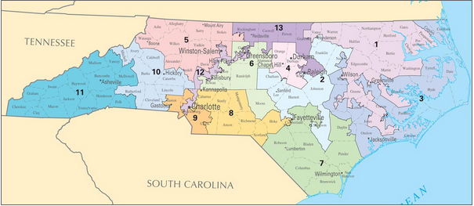
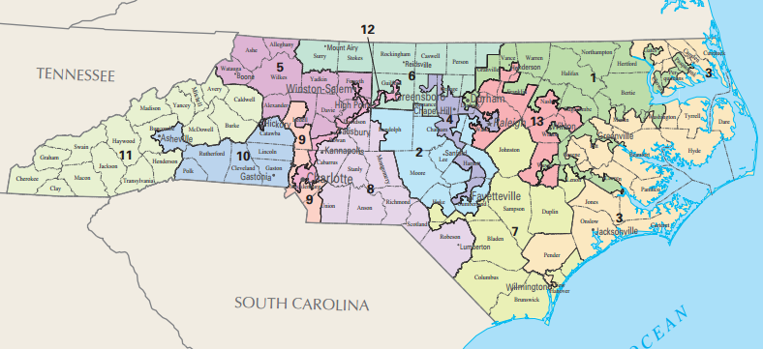
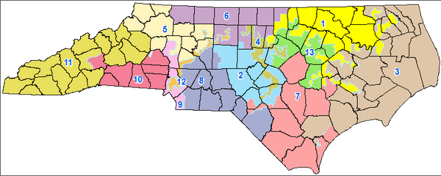

Slide 9
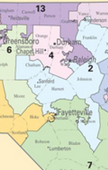


Slide 10
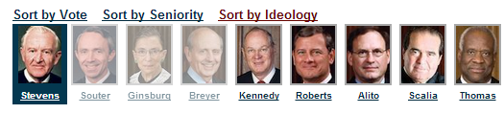
Crawford v. Marion County Election Board (2008)--Souter dissent
Without a shred of evidence that in-person voter impersonation is a problem in the State, much less a crisis, Indiana has adopted one of the most restrictive photo identification requirements in the country. …The State hardly even tries to explain its decision to force indigents or religious objectors to travel all the way to their county seats every time they wish to vote, and if there is any waning of confidence in the administration of elections it probably owes more to the State's violation of federal election law than to any imposters at the polling places. It is impossible to say, on this record, that the State's interest in adopting its signally inhibiting photo identification requirement has been shown to outweigh the serious burdens it imposes on the right to vote.
If more were needed to condemn this law, our own precedent would provide it, for the calculation revealed in the Indiana statute crosses a line when it targets the poor and the weak.

Slide 11
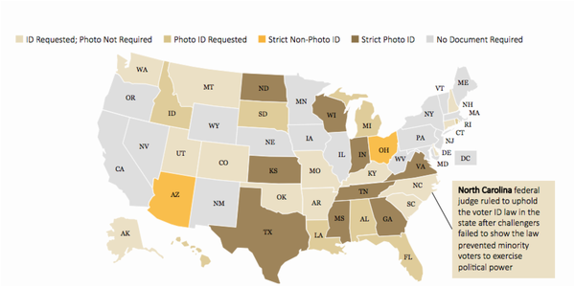

Slide 12
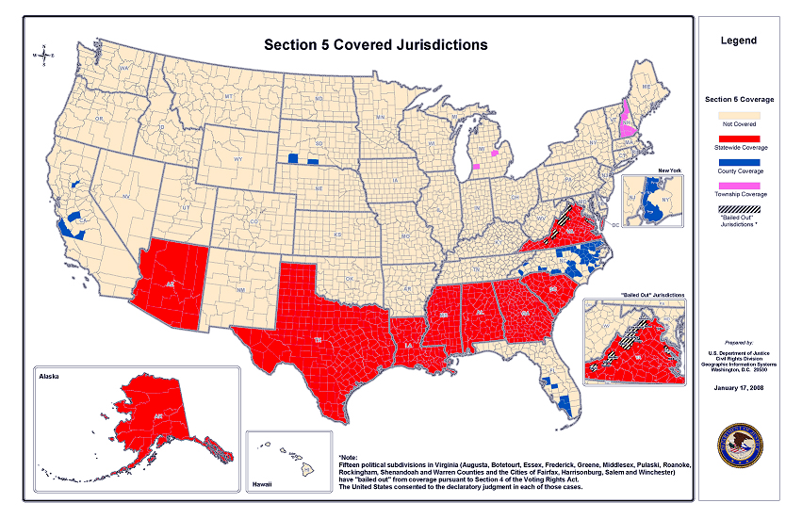

Slide 13

Solicitor General Verrilli: The covered jurisdictions [under Section 5 of the Voting Rights Act] contain only 14 percent of the subjurisdictions in the nation.
And so 14 percent of the subjurisdictions in the nation are generating up to 81 percent of the successful Section 2 litigation.
And I think--
Chief Justice Roberts: General, is it -- is it the government’s submission that the citizens in the South are more racist than the citizens in the North?
Solicitor General Verrilli: --It is not. And I do not know the answer to that, Your Honor, but I do think it was reasonable for Congress--
Chief Justice Roberts: Well, which: you said it is not, and [you said that] you don’t know the answer to it.
Solicitor General Verrilli: --I – it’s not our submission.
As an objective matter, I don’t know the answer to that question.

Slide 14
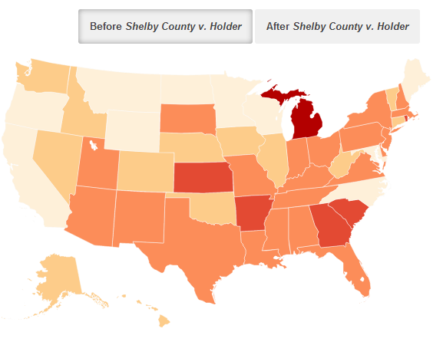
State—Restrictive Voting Policies

Slide 15
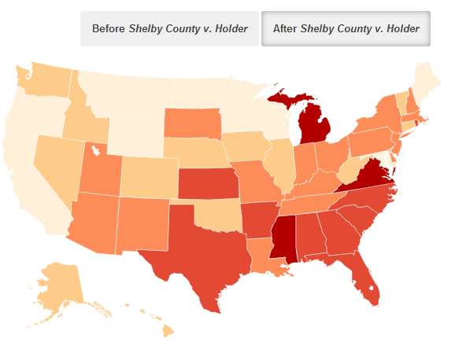
State—Restrictive Voting Policies

Slide 16
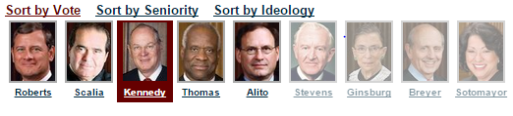
Citizens United v. FEC (2010)
Speech is an essential mechanism of democracy, for it is the means to hold officials accountable to the people. The right of citizens to inquire, to hear, to speak, and to use information to reach consensus is a precondition to enlightened self-government and a necessary means to protect it. The First Amendment “‘has its fullest and most urgent application’ to speech uttered during a campaign for political office.”…
The fact that a corporation, or any other speaker, is willing to spend money to try to persuade voters presupposes that the people have the ultimate influence over elected officials. This is inconsistent with any suggestion that the electorate will refuse “‘to take part in democratic governance’” because of additional political speech made by a corporation or any other speaker.

Slide 17
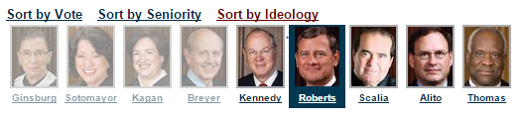
McCutcheon v. FEC (2014)
Spending large sums of money in connection with elections, but not in connection with an effort to control the exercise of an officeholder’s duties, does not give rise to quid pro quo corruption. Nor does the possibility that an individual who spends large sums may garner ‘influence over or access to’ elected officials . . .
The Government may no more restrict how many candidates or causes a donor may support than it may tell a newspaper how many candidates to endorse…
In assessing the First Amendment interests at stake, the proper focus is on an individual’s right to engage in political speech, not a collective conception of the public good.

Slide 18


Slide 19
Lawrence v. Texas (2003)
We think that our laws and traditions in the past half century are of most relevance here. These references show an emerging awareness that liberty gives substantial protection to adult persons in deciding how to conduct their private lives in matters pertaining to sex…
Bowers was not correct when it was decided, and it is not correct today. It ought not to remain binding precedent. Bowers v. Hardwick should be and now is overruled.
Had those who drew and ratified the Due Process Clauses of the Fifth Amendment or the Fourteenth Amendment known the components of liberty in its manifold possibilities, they might have been more specific. They did not presume to have this insight. They knew times can blind us to certain truths and later generations can see that laws once thought necessary and proper in fact serve only to oppress. As the Constitution endures, persons in every generation can invoke its principles in their own search for greater freedom.

Slide 20
Lawrence v. Texas (Scalia dissent)
Today’s opinion is the product of a Court, which is the product of a law-profession culture, that has largely signed on to the so-called homosexual agenda, by which I mean the agenda promoted by some homosexual activists directed at eliminating the moral opprobrium that has traditionally attached to homosexual conduct . . .
It is clear from this that the Court has taken sides in the culture war, departing from its role of assuring, as neutral observer, that the democratic rules of engagement are observed. Many Americans do not want persons who openly engage in homosexual conduct as partners in their business, as scoutmasters for their children, as teachers in their children’s schools, or as boarders in their home. They view this as protecting themselves and their families from a lifestyle that they believe to be immoral and destructive . . .
Today’s opinion dismantles the structure of constitutional law that has permitted a distinction to be made between heterosexual and homosexual unions, insofar as formal recognition in marriage is concerned. If moral disapprobation of homosexual conduct is “no legitimate state interest” for purposes of proscribing that conduct . . . what justification could there possibly be for denying the benefits of marriage to homosexual couples exercising “[t]he liberty protected by the Constitution”? Surely not the encouragement of procreation, since the sterile and the elderly are allowed to marry.

Slide 21
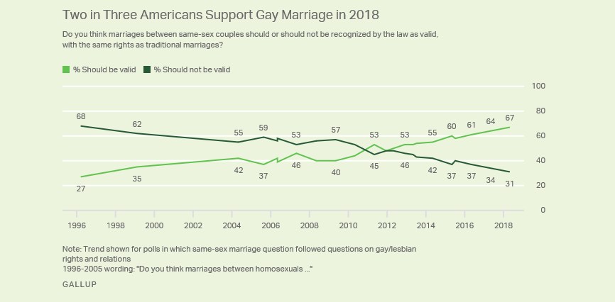

Slide 22
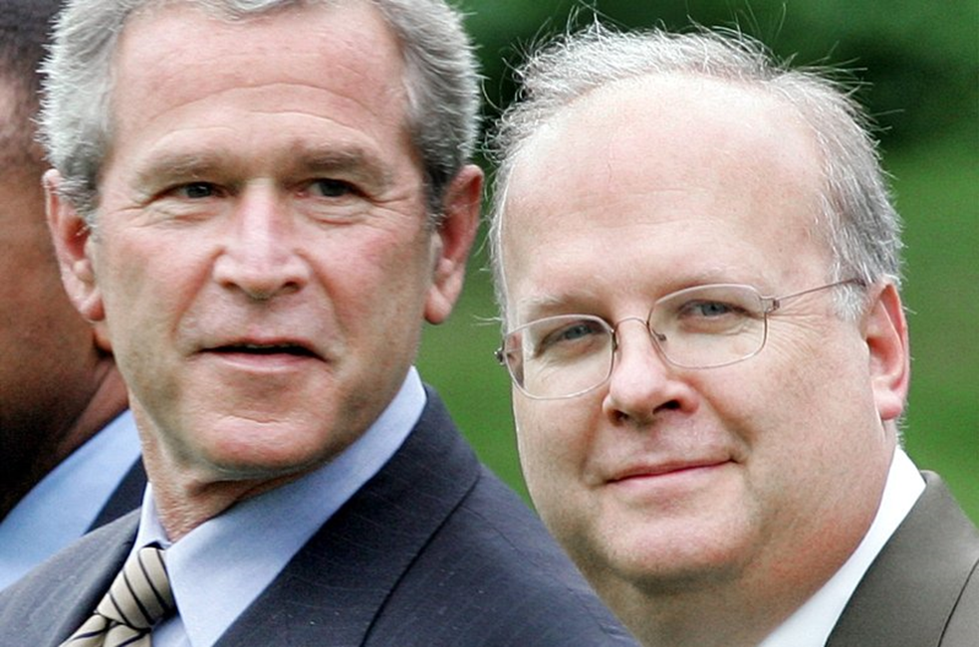
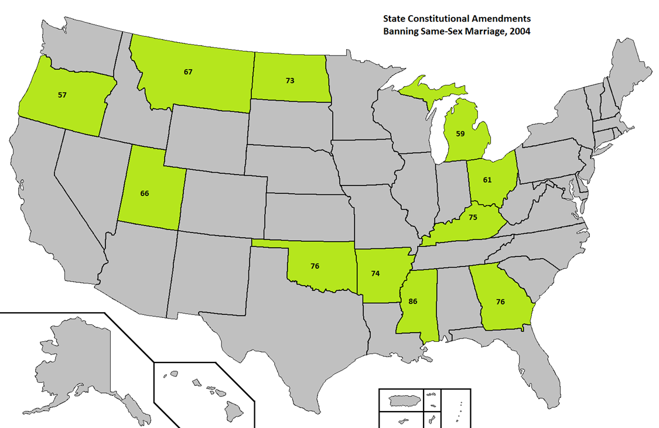

Slide 23
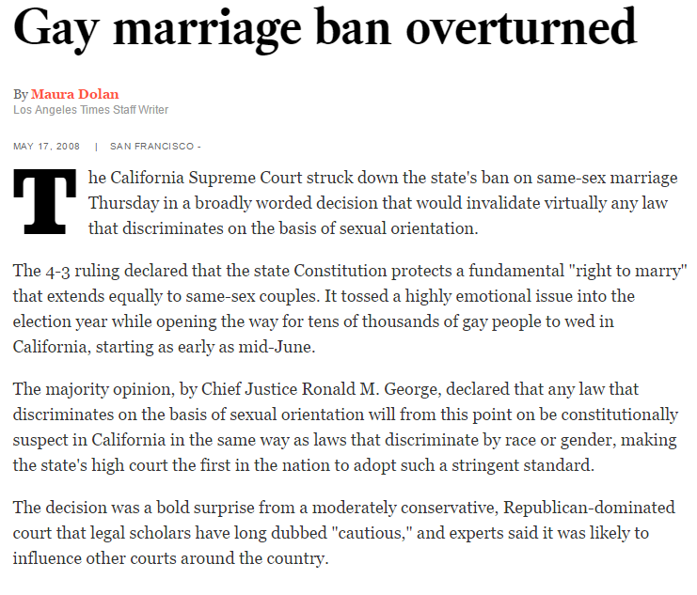

Slide 24
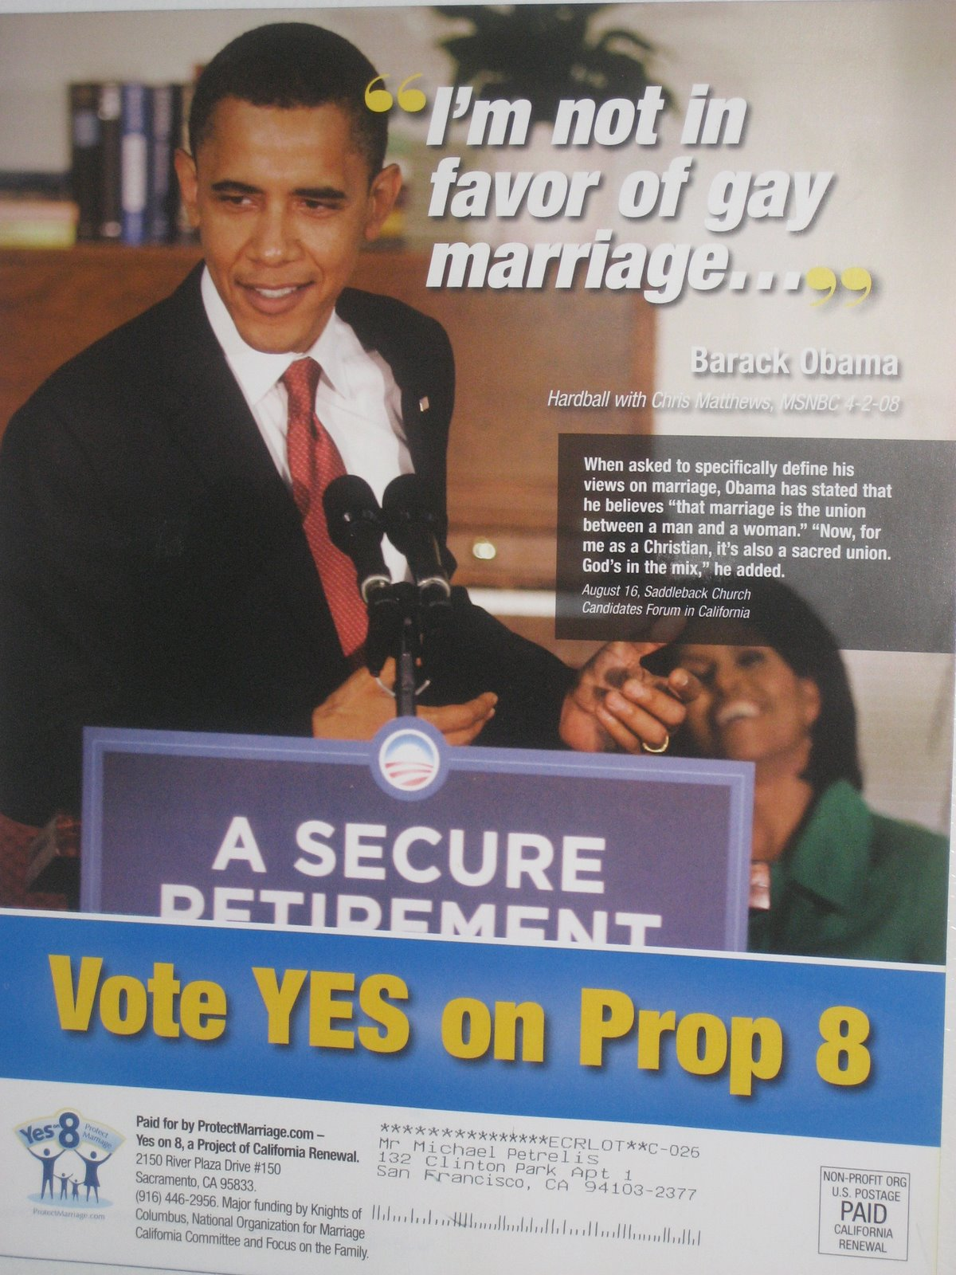
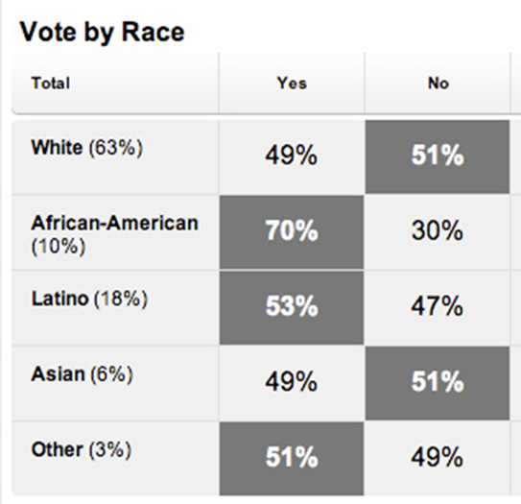

Slide 25
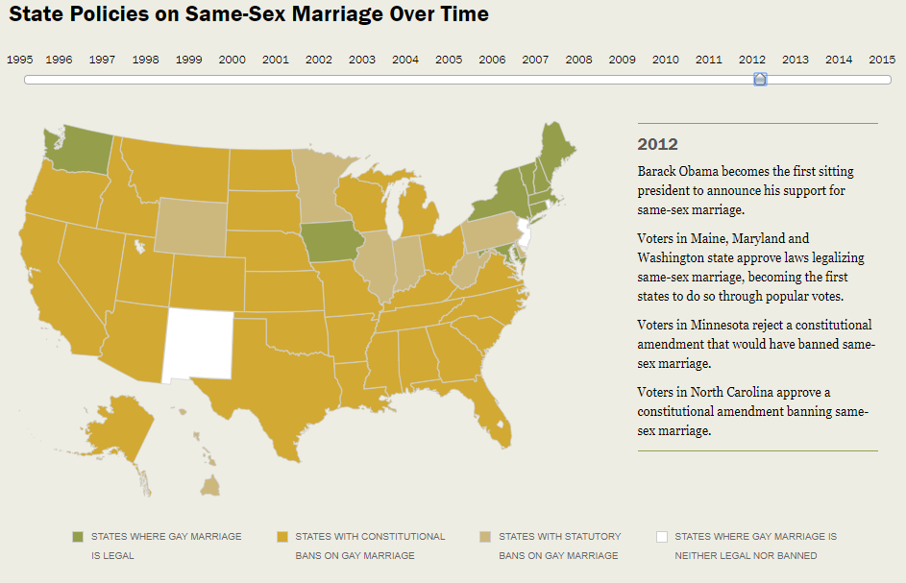

Slide 26
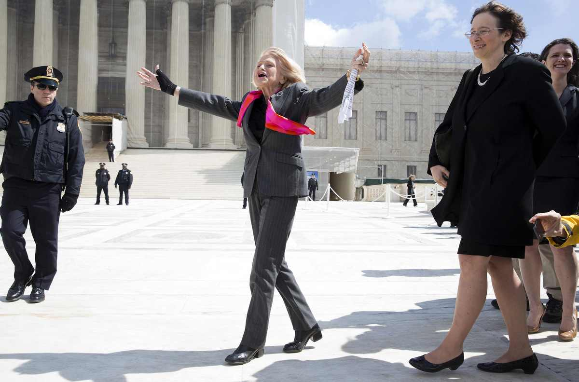
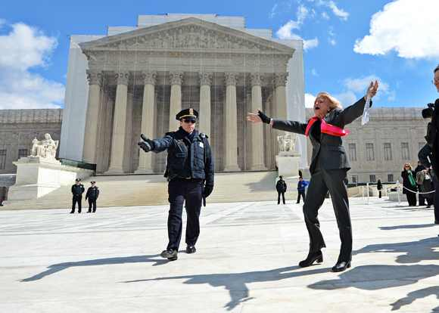

Slide 27
Windsor v. United States (Kennedy opinion)
DOMA writes inequality into the entire United States Code. The particular case at hand concerns the estate tax, but DOMA is more than a simple determination of what should or should not be allowed as an estate tax refund. Among the over 1,000 statutes and numerous federal regulations that DOMA controls are laws pertaining to Social Security, housing, taxes, criminal sanctions, copyright, and veterans’ benefits. DOMA’s principal effect is to identify a subset of state-sanctioned marriages and make them unequal. The principal purpose is to impose inequality, not for other reasons like governmental efficiency…
The differentiation demeans the couple, whose moral and sexual choices the Constitution protects, see Lawrence v. Texas, and whose relationship the State has sought to dignify. And it humiliates tens of thousands of children now being raised by same-sex couples. The law in question makes it even more difficult for the children to understand the integrity and closeness of their own family and its concord with other families in their community and in their daily lives…

Slide 28
Roberts dissent:
While I disagree with the result to which the majority’s analysis leads it in this case, I think it more important to point out that its analysis leads no further. The Court does not have before it, and the logic of its opinion does not decide, the distinct question whether the States, in the exercise of their “historic and essential authority to define the marital relation” may continue to utilize the traditional definition of marriage.
Scalia dissent:
The real rationale of today’s opinion, whatever disappearing trail of its legalistic argle-bargle one chooses to follow, is that DOMA is motivated by “‘bare . . . desire to harm’” couples in same-sex marriages. How easy it is, indeed how inevitable, to reach the same conclusion with regard to state laws denying same-sex couples marital status…
As far as this Court is concerned, no one should be fooled; it is just a matter of listening and waiting for the other shoe. By formally declaring anyone opposed to same-sex marriage an enemy of human decency, the majority arms well every challenger to a state law restricting marriage to its traditional definition.

Slide 29
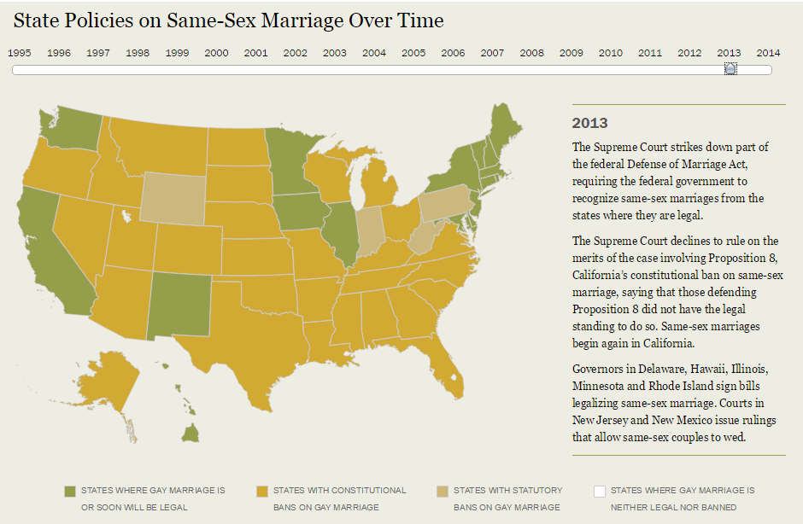

Slide 30
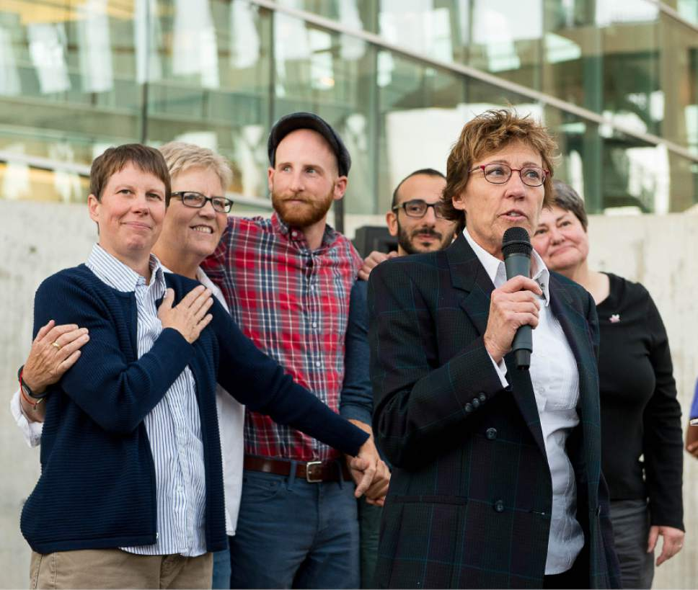
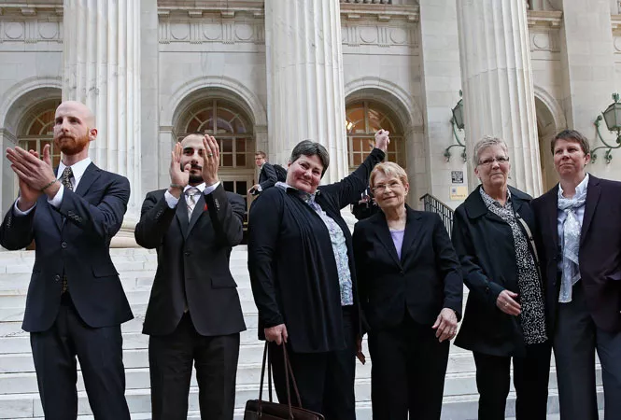

Slide 31
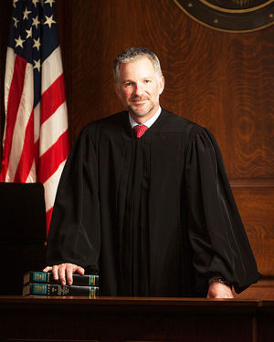
Kitchen v. Herbert (D. Utah)
Finally, the State contends that the fundamental right to marriage cannot encompass the right to marry someone of the same sex because this right has never been interpreted to have this meaning in the past. The court is not persuaded by the State’s argument. The Constitution is not so rigid that it always mandates the same outcome even when its principles operate on a new set of facts that were previously unknown…
Here, it is not the Constitution that has changed, but the knowledge of what it means to be gay or lesbian. The court cannot ignore the fact that the Plaintiffs are able to develop a committed, intimate relationship with a person of the same sex but not with a person of the opposite sex. The court, and the State, must adapt to this changed understanding.

Slide 32
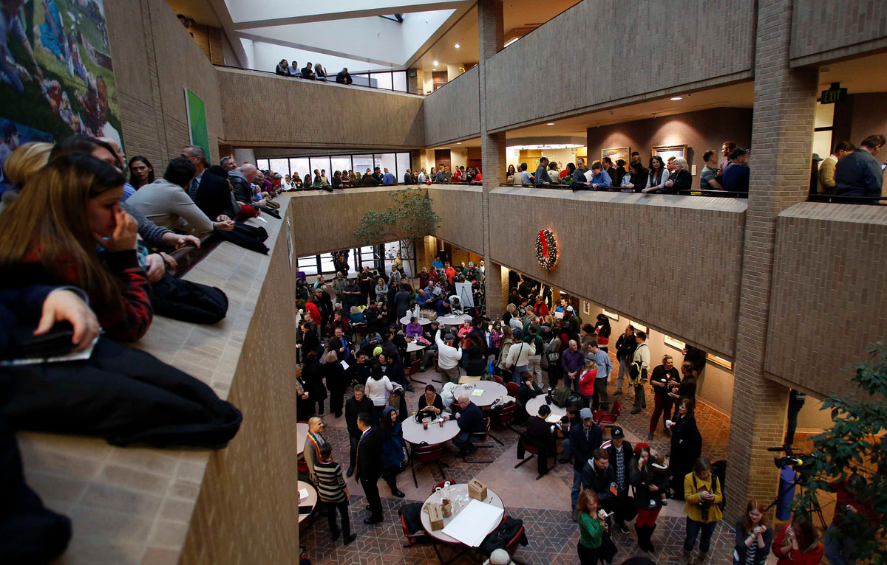

Slide 33
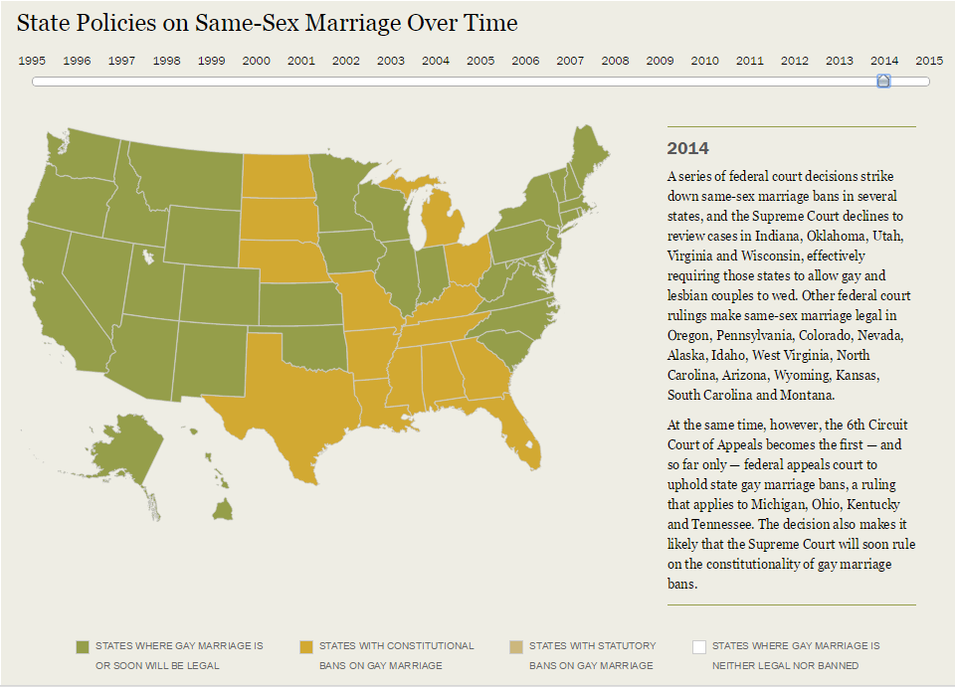
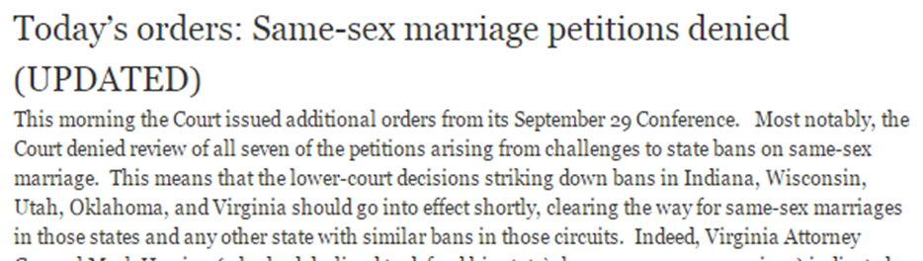

Slide 34
John Bursch: I want you to think about two couples that are identically situated. They’ve been married for 5 years and they each have a 3-year-old child. One grows up believing that marriage is about keeping that couple bound to that child forever. The other couple believes that marriage is more about their emotional commitment to each other, and if that commitment fades, they may not stay together.
A reasonable voter, which is what we're talking about here, could believe that there would be a different outcome if those two marriages were influenced by those two different belief systems. Ideas matter, Your Honors, and, you know, the out-of-wedlock birthrate—
Justice Kennedy: But that ­­assumes that same-­sex couples could not have the more noble purpose [of devoting themselves to their children], and that’s the whole point. Same­-sex couples say, “Of course, we understand the nobility and the sacredness of the marriage. We know we can’t procreate, but we want the other attributes of it, in order to show that we, too, have a dignity that can be fulfilled.”
[Break.]
Bursch: But here the state’s entire interest springs out of the fact that we want to forever link children with their biological mom and dad when that’s possible . . . And what they’re [the gay and lesbian couples] asking you to do is to take an institution, which was never intended to be dignitary-bestowing, and make it dignitary-bestowing. That’s their whole argument. And when you do that, tens of thousands of other children who don’t meet their definition will likewise be left out, and suffer those exact same dignitary harms.
When you’re talking about a spectrum of marriage definitions, different places to draw the line, and potential harms on both sides, that is the quintessential place for the democratic process to work. And there’s another harm—
Justice Kennedy: Just in fairness to you, I don’t understand this “not dignity-bestowing.” I thought that was the whole purpose of marriage. It bestows dignity on both man and woman in a traditional marriage.
Bursch: It’s supposed to—
Justice Kennedy: It’s dignity-bestowing and these parties say they want to have that–that same ennoblement.
Bursch: Sure.
Justice Kennedy: Or am I missing your point?

Slide 35
Obergefell v. Hodges (2015)
A first premise of the Court’s relevant precedents is that the right to personal choice regarding marriage is inherent in the concept of individual autonomy . . . As this Court held in Lawrence, same-sex couples have the same right as opposite-sex couples to enjoy intimate association . . .
Excluding same-sex couples from marriage thus conflicts with a central premise of the right to marry. Without the recognition, stability, and predictability marriage offers, their children suffer the stigma of knowing their families are somehow lesser. They also suffer the significant material costs of being raised by unmarried parents, relegated through no fault of their own to a more difficult and uncertain family life. The marriage laws at issue here thus harm and humiliate the children of same-sex couples . . .
The dynamic of our constitutional system is that individuals need not await legislative action before asserting a fundamental right. The Nation’s courts are open to injured individuals who come to them to vindicate their own direct, personal stake in our basic charter. An individual can invoke a right to constitutional protection when he or she is harmed, even if the broader public disagrees and even if the legislature refuses to act.

Slide 36
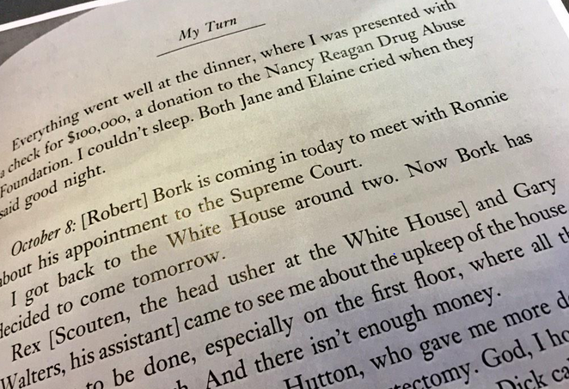
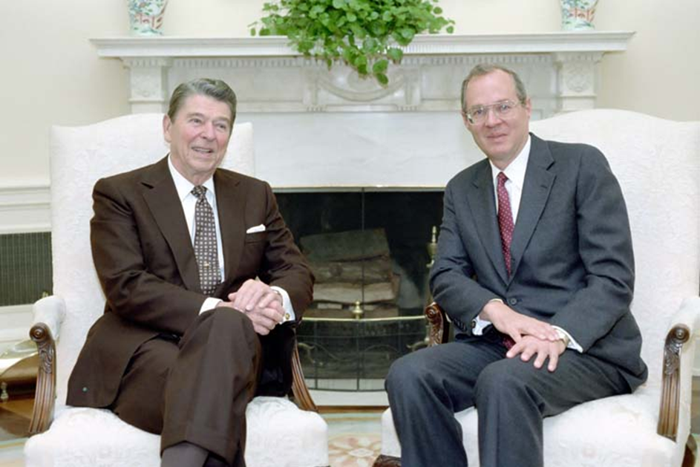

Slide 37
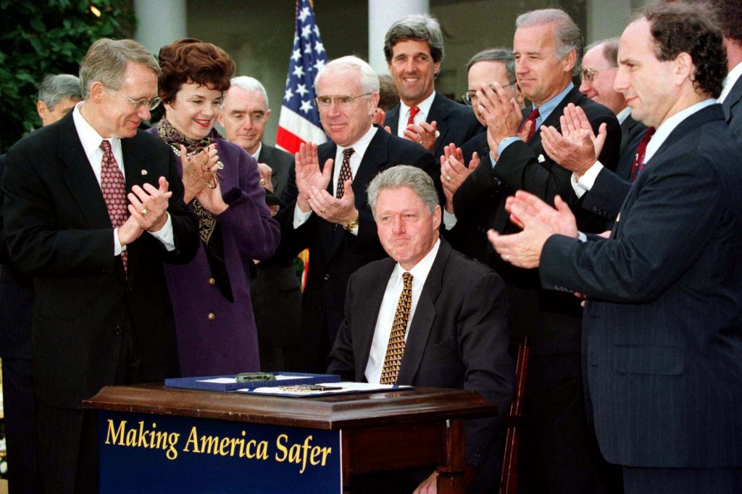

Slide 38
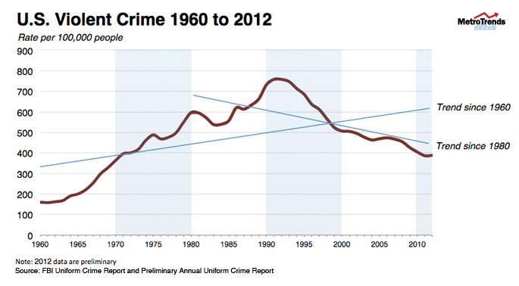

Slide 39
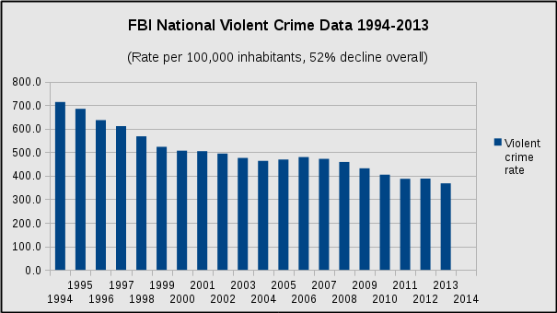

Slide 40
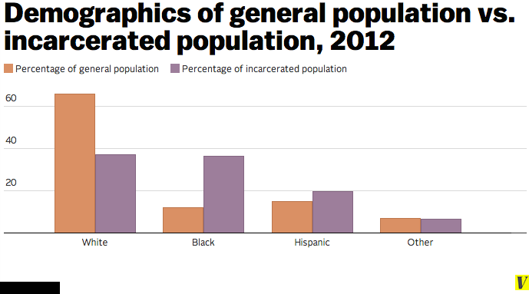
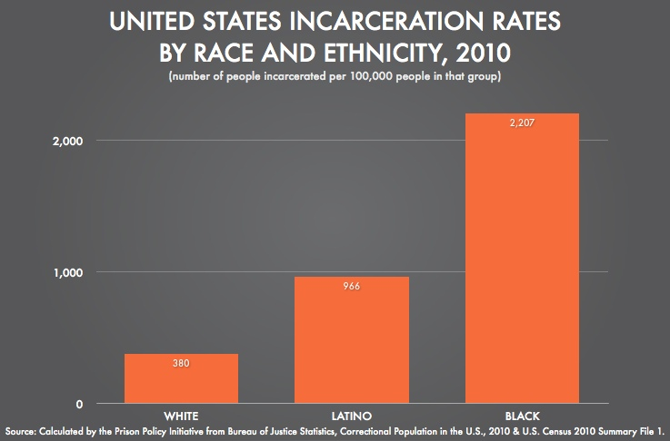

Slide 41
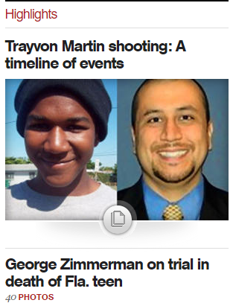
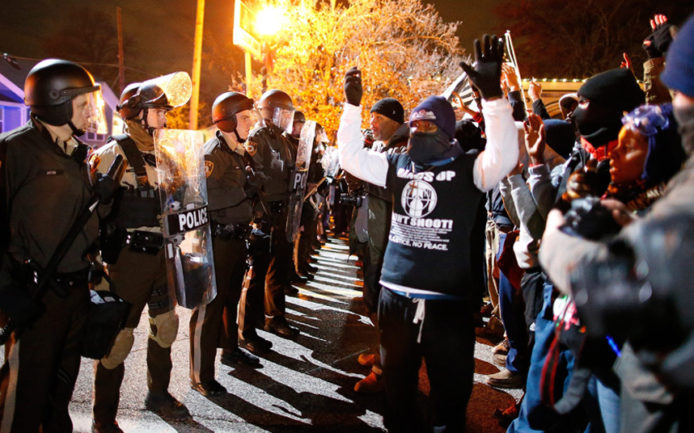

Slide 42
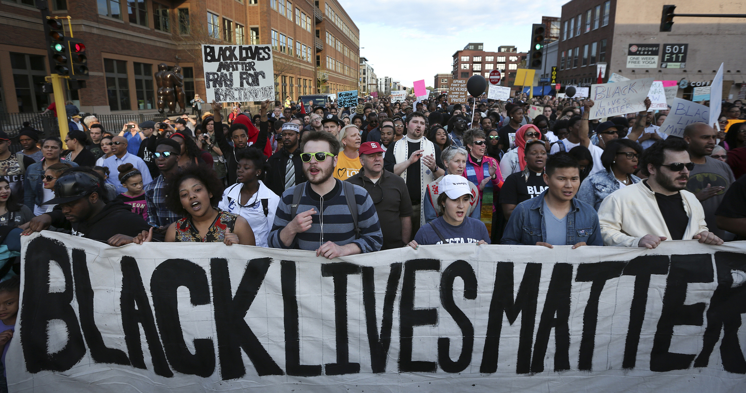
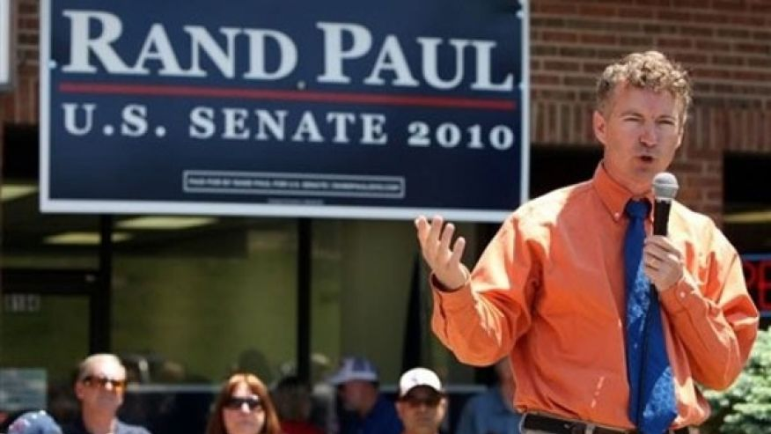

Slide 43
