Slide 1
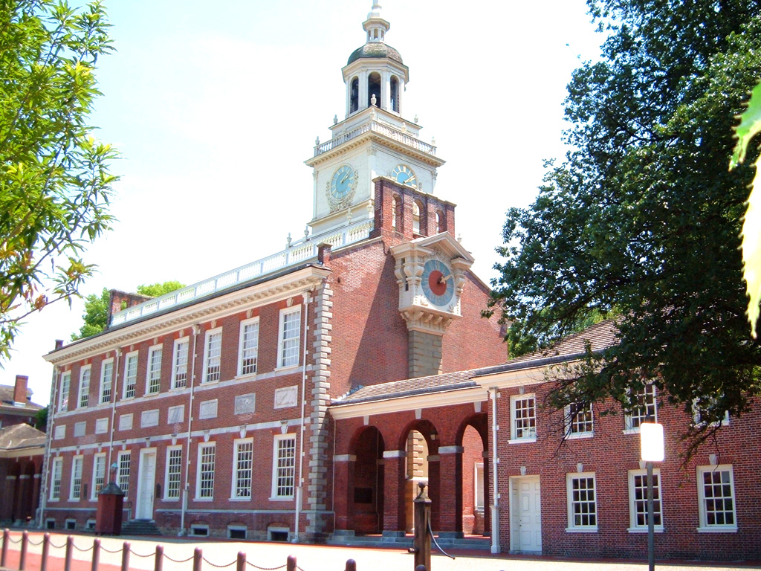
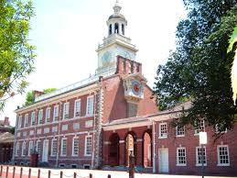

Slide 2


Slide 3


Slide 4


Slide 5
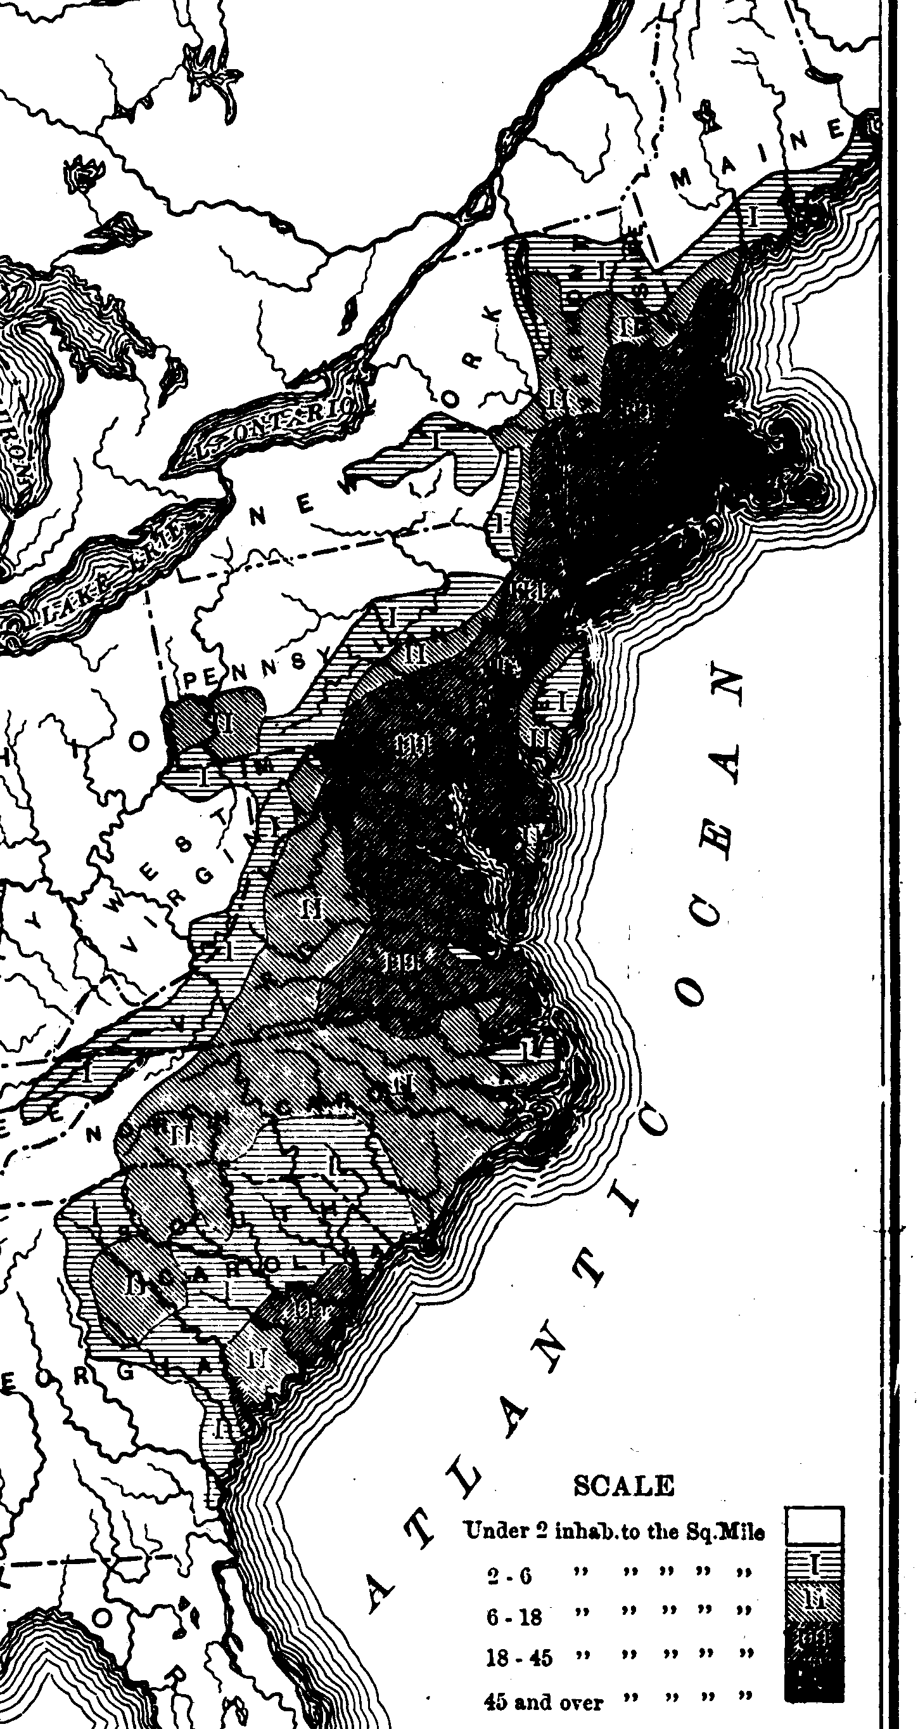

Slide 6
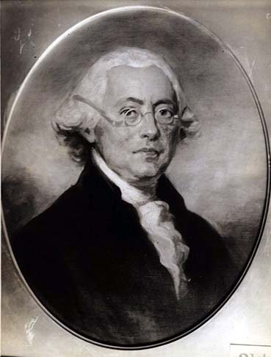
Notes:
James wilson

Slide 7
PA Minority (1787)
That the house of representatives be properly increased in number; that elections shall remain free; that the several states shall have power to regulate the elections for senators and representatives, without being controlled either directly or indirectly by an interference on the part of the Congress; and that elections of representatives be annual.
That no law shall be passed to restrain the legislatures of the several states from enacting laws for imposing taxes, except imposts and duties on goods imported or exported, and that no taxes, except imposts and duties upon goods imported and exported, and postage on letters shall be levied by the authority of Congress.
That the judiciary power of the United States shall be confined to cases affecting ambassadors, other public ministers and consuls; to cases of admiralty and maritime jurisdiction; to controversies to which the United States shall be a party; to controversies between two or more states — between a state and citizens of different states — between citizens claiming lands under grants of different states; and between a state or the citizens thereof and foreign states,

Slide 8
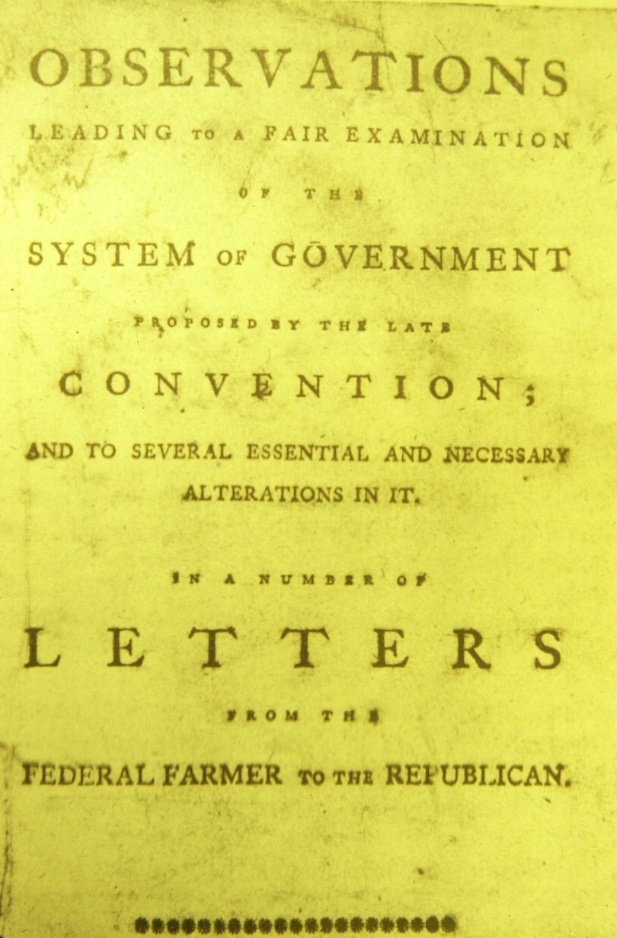

Slide 9
Article I, Section 9.
The privilege of the writ of habeas corpus shall not be suspended, unless when in cases of rebellion or invasion the public safety may require it.
No bill of attainder or ex post facto Law shall be passed.
No title of nobility shall be granted by the United States: and no person holding any office of profit or trust under them, shall, without the consent of the Congress, accept of any present, emolument, office, or title, of any kind whatever, from any king, prince, or foreign state.

Slide 10

Notes:
George mason

Slide 12
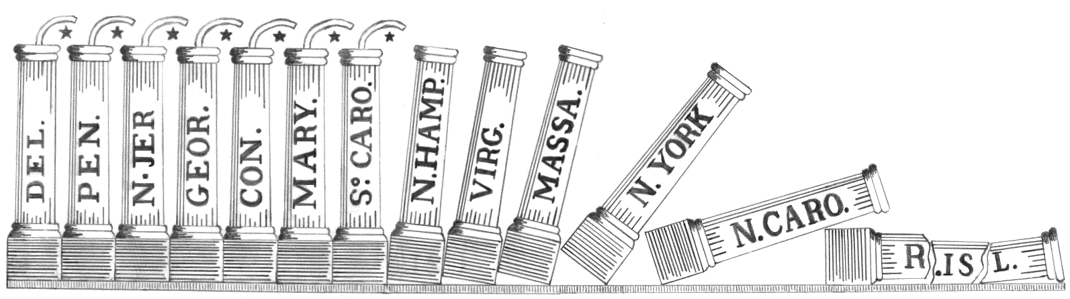

Slide 13
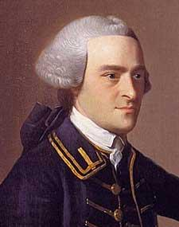
Notes:
John hancock

Slide 15
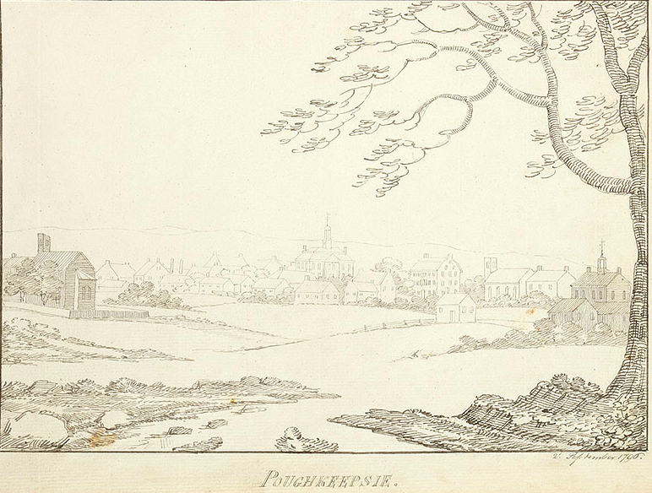

Slide 16
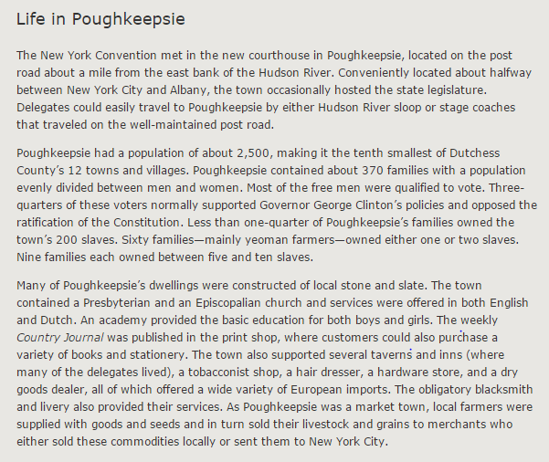

Slide 17
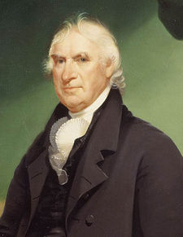
Notes:
George clinton

Slide 18
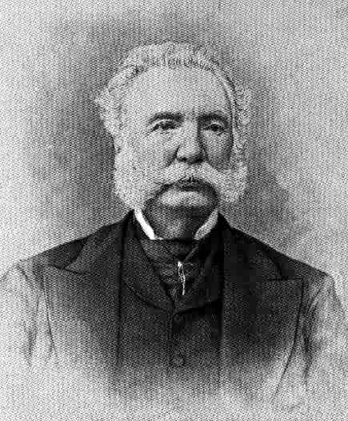
Notes:
MELANCON SMITH

Slide 19
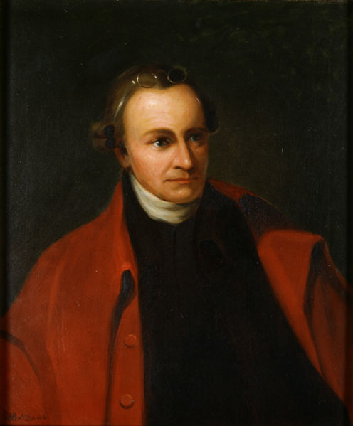
Notes:
Patrick henry

Slide 20
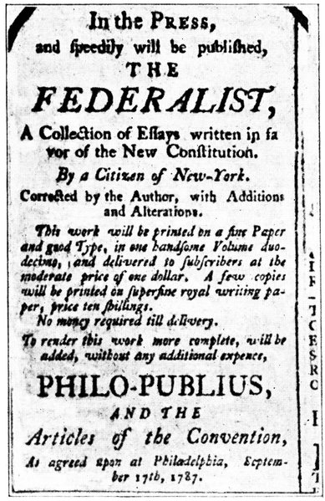

Slide 21
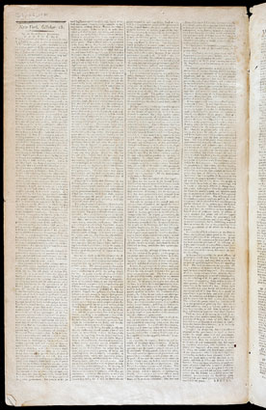
Notes:
Brutus I

Slide 22
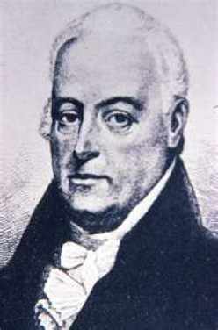
Notes:
Rbt yates

Slide 23
Brutus I
If respect is to be paid to the opinion of the greatest and wisest men who have ever thought or wrote on the science of government, we shall be constrained to conclude, that a free republic cannot succeed over a country of such immense extent, containing such a number of inhabitants, and these encreasing in such rapid progression as that of the whole United States . . .
History furnishes no example of a free republic, any thing like the extent of the United States. The Grecian republics were of small extent; so also was that of the Romans. Both of these, it is true, in process of time, extended their conquests over large territories of country; and the consequence was, that their governments were changed from that of free governments to those of the most tyrannical that ever existed in the world.

Slide 24
Federalist 10
From this view of the subject it may be concluded that a pure democracy, by which I mean a society consisting of a small number of citizens, who assemble and administer the government in person, can admit of no cure for the mischiefs of faction. A common passion or interest will, in almost every case, be felt by a majority of the whole; a communication and concert result from the form of government itself; and there is nothing to check the inducements to sacrifice the weaker party or an obnoxious individual. Hence it is that such democracies have ever been spectacles of turbulence and contention; have ever been found incompatible with personal security or the rights of property; and have in general been as short in their lives as they have been violent in their deaths.
A republic, by which I mean a government in which the scheme of representation takes place, opens a different prospect, and promises the cure for which we are seeking. Let us examine the points in which it varies from pure democracy, and we shall comprehend both the nature of the cure and the efficacy which it must derive from the Union.
The two great points of difference between a democracy and a republic are: first, the delegation of the government, in the latter, to a small number of citizens elected by the rest; secondly, the greater number of citizens, and greater sphere of country, over which the latter may be extended.

Slide 25
The other point of difference is, the greater number of citizens and extent of territory which may be brought within the compass of republican than of democratic government; and it is this circumstance principally which renders factious combinations less to be dreaded in the former than in the latter. The smaller the society, the fewer probably will be the distinct parties and interests composing it; the fewer the distinct parties and interests, the more frequently will a majority be found of the same party; and the smaller the number of individuals composing a majority, and the smaller the compass within which they are placed, the more easily will they concert and execute their plans of oppression. Extend the sphere, and you take in a greater variety of parties and interests; you make it less probable that a majority of the whole will have a common motive to invade the rights of other citizens; or if such a common motive exists, it will be more difficult for all who feel it to discover their own strength, and to act in unison with each other. Besides other impediments, it may be remarked that, where there is a consciousness of unjust or dishonorable purposes, communication is always checked by distrust in proportion to the number whose concurrence is necessary.

Slide 26
Federalist 78
Whoever attentively considers the different departments of power must perceive, that, in a government in which they are separated from each other, the judiciary, from the nature of its functions, will always be the least dangerous to the political rights of the Constitution; because it will be least in a capacity to annoy or injure them. The Executive not only dispenses the honors, but holds the sword of the community. The legislature not only commands the purse, but prescribes the rules by which the duties and rights of every citizen are to be regulated. The judiciary, on the contrary, has no influence over either the sword or the purse; no direction either of the strength or of the wealth of the society; and can take no active resolution whatever. It may truly be said to have neither FORCE nor WILL, but merely judgment; and must ultimately depend upon the aid of the executive arm even for the efficacy of its judgments.

Slide 27
Brutus V
The great objects then are declared in this preamble in general and indefinite terms to be to provide for the common defence, promote the general welfare, and an express power being vested in the legislature to make all laws which shall be necessary and proper for carrying into execution all the powers vested in the general government. The inference is natural that the legislature will have an authority to make all laws which they shall judge necessary for the common safety, and to promote the general welfare. This amounts to a power to make laws at discretion: No terms can be found more indefinite than these, and it is obvious, that the legislature alone must judge what laws are proper and necessary for the purpose. It may be said, that this way of explaining the constitution, is torturing and making it speak what it never intended. This is far from my intention, and I shall not even insist upon this implied power, but join issue with those who say we are to collect the idea of the powers given from the express words of the clauses granting them; and it will not be difficult to shew that the same authority is expressly given which is supposed to be implied in the forgoing paragraphs.

Slide 28
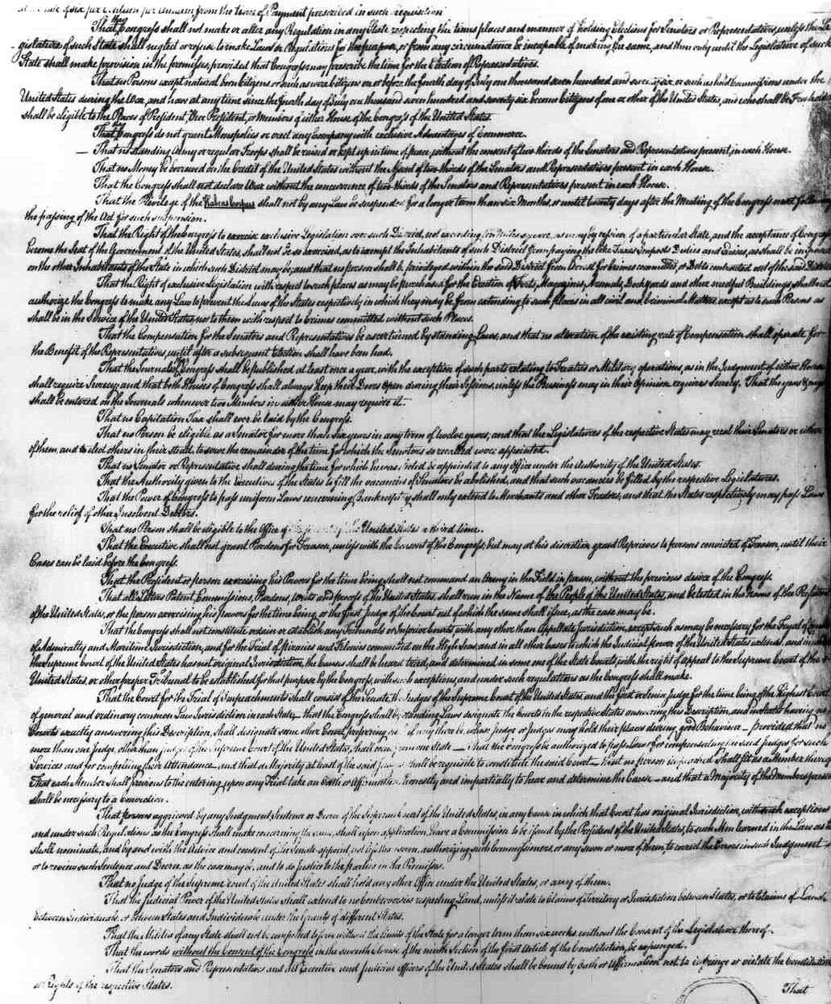
Notes:
NY AMENDMENTS

Slide 29
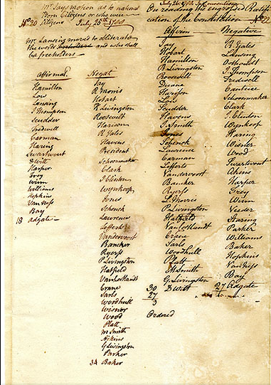

Slide 30
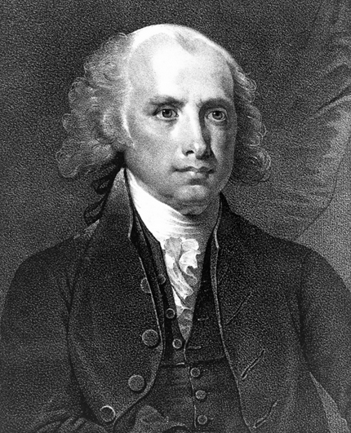
Notes:
madison

Slide 31
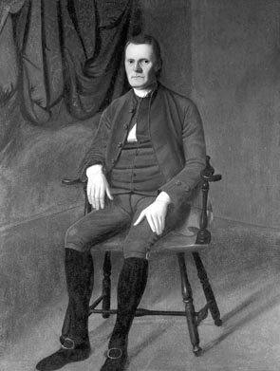
Notes:
Rep roger sherman

Slide 32
Madison: Original Bill of Rights
Art. I. After the first enumeration required by the first article of the Constitution, there shall be one representative for every thirty thousand, until the number shall amount to one hundred, after which the proportion shall be so regulated by Congress, that there shall not be less than one hundred representatives, nor less than one representative for every forty thousand persons, until the number of representatives shall amount to two hundred, after which the proportion shall be so regulated by Congress, that there shall not be less than two hundred representatives, nor more than one representative for every fifty thousand.
Art. II. No law varying the compensation for services of the senators and representatives shall take effect, until an election of representatives shall have intervened.
[Note: now amendment 27]

Slide 33
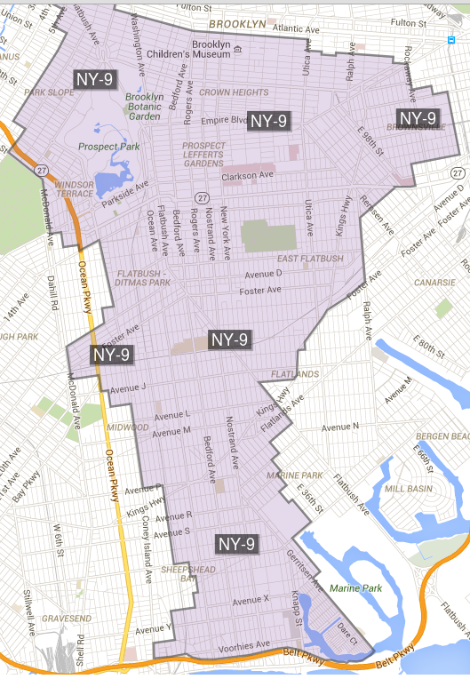

Slide 34
Bill of Rights in Context
Amendments 1-4: limitations on congressional power (speech, religion, assembly, right to bear arms, search/seizure, quartering soldiers)
Amendments 5-8: protections for accused criminals (5th amendment protections, speedy trial, jury, no excessive bail)
Amendments 9-10: structural (rights of the people, reservations of state powers)

