Slide 1
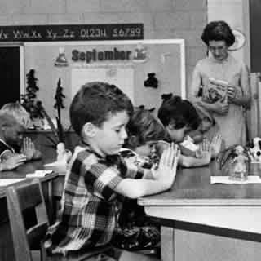
Regents’ prayer—New York
Almighty God, we acknowledge our dependence upon Thee, and we beg Thy blessings upon us, our parents, our teachers and our Country.

Slide 2
Engel v. Vitale (1962)
We think that, by using its public school system to encourage recitation of the Regents' prayer, the State of New York has adopted a practice wholly inconsistent with the Establishment Clause. There can, of course, be no doubt that New York's program of daily classroom invocation of God's blessings as prescribed in the Regents' prayer is a religious activity. It is a solemn avowal of divine faith and supplication for the blessings of the Almighty . . .
It has been argued that to apply the Constitution in such a way as to prohibit state laws respecting an establishment of religious services in public schools is to indicate a hostility toward religion or toward prayer. Nothing, of course, could be more wrong . . .
It is neither sacrilegious nor anti-religious to say that each separate government in this country should stay out of the business of writing or sanctioning official prayers and leave that purely religious function to the people themselves and to those the people choose to look to for religious guidance.

Slide 3
Tennessee House Districts—87th Congress
Congressional District | 1960 Population
1st | 460,583
2nd | 497,121
3rd | 412,664
4th | 389,563
5th | 399,372
6th | 324,337
7th (rural s’western Tenn.) | 232,652
8th (rural Western Tenn.) | 223,387
9th (Memphis) | 627,019

Slide 4
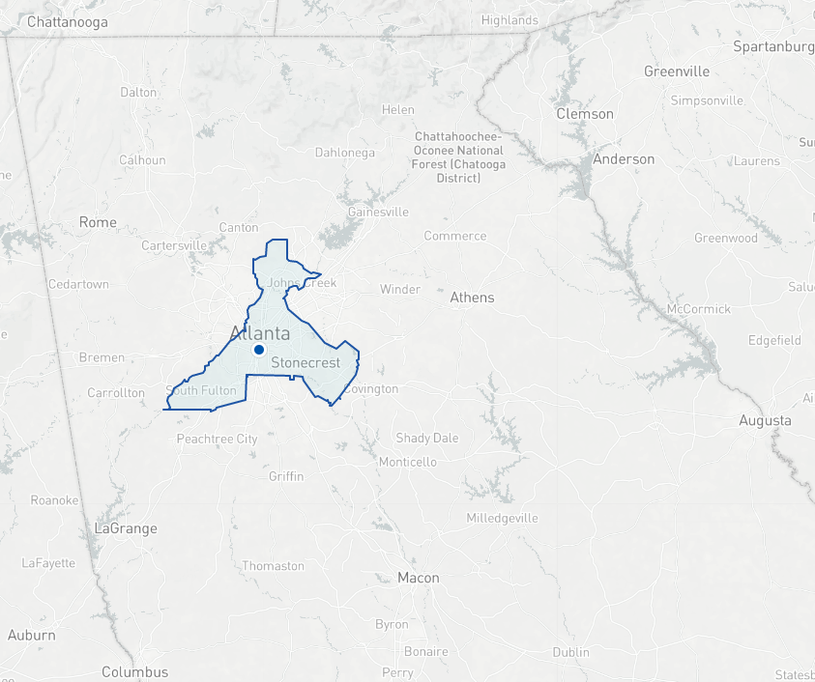

Slide 5
Wesberry v. Sanders (1964)
Other rights, even the most basic, are illusory if the right to vote is undermined. Our Constitution leaves no room for classification of people in a way that unnecessarily abridges this right. In urging the people to adopt the Constitution, Madison said in No. 57 of The Federalist:
“Who are to be the electors of the Federal Representatives? Not the rich more than the poor; not the learned more than the ignorant; not the haughty heirs of distinguished names more than the humble sons of obscure and unpropitious fortune. The electors are to be the great body of the people of the United States.”
Readers surely could have fairly taken this to mean, “one person, one vote.”
While it may not be possible to draw congressional districts with mathematical precision, that is no excuse for ignoring our Constitution's plain objective of making equal representation for equal numbers of people the fundamental goal for the House of Representatives. That is the high standard of justice and common sense which the Founders set for us.

Slide 6
 | Largest dist. | Smallest dist. | disparity
NH House | 3244 | 3 | 1081:1
VT House | 35,000 | 36 | 980:1
CA Senate | 6,000,000 | 14,000 | 428:1
CT House | 81,000 | 191 | 424:1
UT House | 32,380 | 165 | 196:1
Reynolds v. Sims (1964)
Legislators represent people, not trees or acres. Legislators are elected by voters, not farms or cities or economic interests.

Slide 7
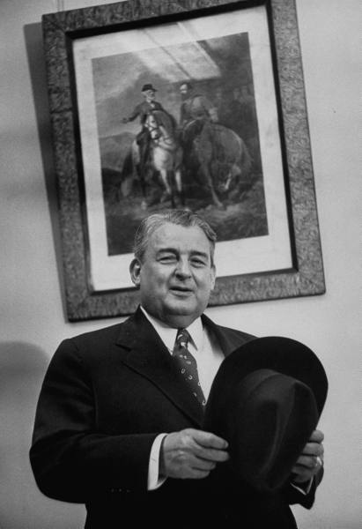
Notes:
Wm tuck

Slide 8
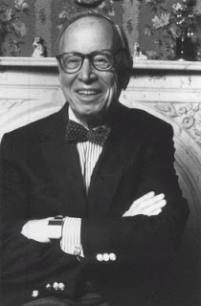
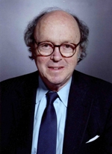

Slide 9

President Johnson: Why in the living hell they want to put it [a plank supporting the reapportionment decisions] in the platform, notify every little state. [Majority Leader] Carl Albert’s district [in Oklahoma] is put together and he’s abolished from Congress. Now who wants to do that to Carl Albert, when he’s the best instrument the liberals have for achievement in this town, since [former House Speaker] Sam Rayburn? Now, why would they want to abolish his district?
It’s not so bad if the Senate abolishes it, or the Court abolishes it. But it’s awful if he is asked—the [Democratic National] Platform Committee of which he heads—to abolish himself. That’s just cruel, inhuman punishment. Now, it looks like even a goddamned college professor could understand that.
Bill Moyers: All right.
President Johnson: Paul Douglas has got less sense than any man I know when judgment’s required. He’s always off chasing some damn balloon in the air.
Moyers: That’s right.
President Johnson: So . . .
Moyers: All right.
President Johnson: Bill, the pitch is this: they’re coming—the Congress hasn’t adjourned. It was due to adjourn; it didn’t adjourn. Does Doctor Douglas know that?
Moyers: I hope he does.
President Johnson: All right. Now, why didn’t they adjourn? What are they coming back for? They’re coming back to consider the Tuck bill, and the Dirksen bill, and the Mansfield bill.
Now, what they ought to do—if the liberals want a real plan of attack, [if New York Times reporter] Tony Lewis wants something to do, is get ten of them out here at a Georgetown house some night with [historian and former Kennedy aide] Arthur Schlesinger, and let ‘em all agree that one of ‘em will talk four hours and the other one will talk four hours. And that’s what they [the liberals] do best: is talk.
[Senate Majority Leader Mike] Mansfield won’t run after 6.00. They’ll do that for two weeks, and the show will be over. The Tuck bill will be dead. The Supreme Court will be riding high, and that’ll be it—period. That’s simple. You don’t have to be smart to know that. Hell, I knew that before I left Johnson City. [Snorts.]

Slide 10
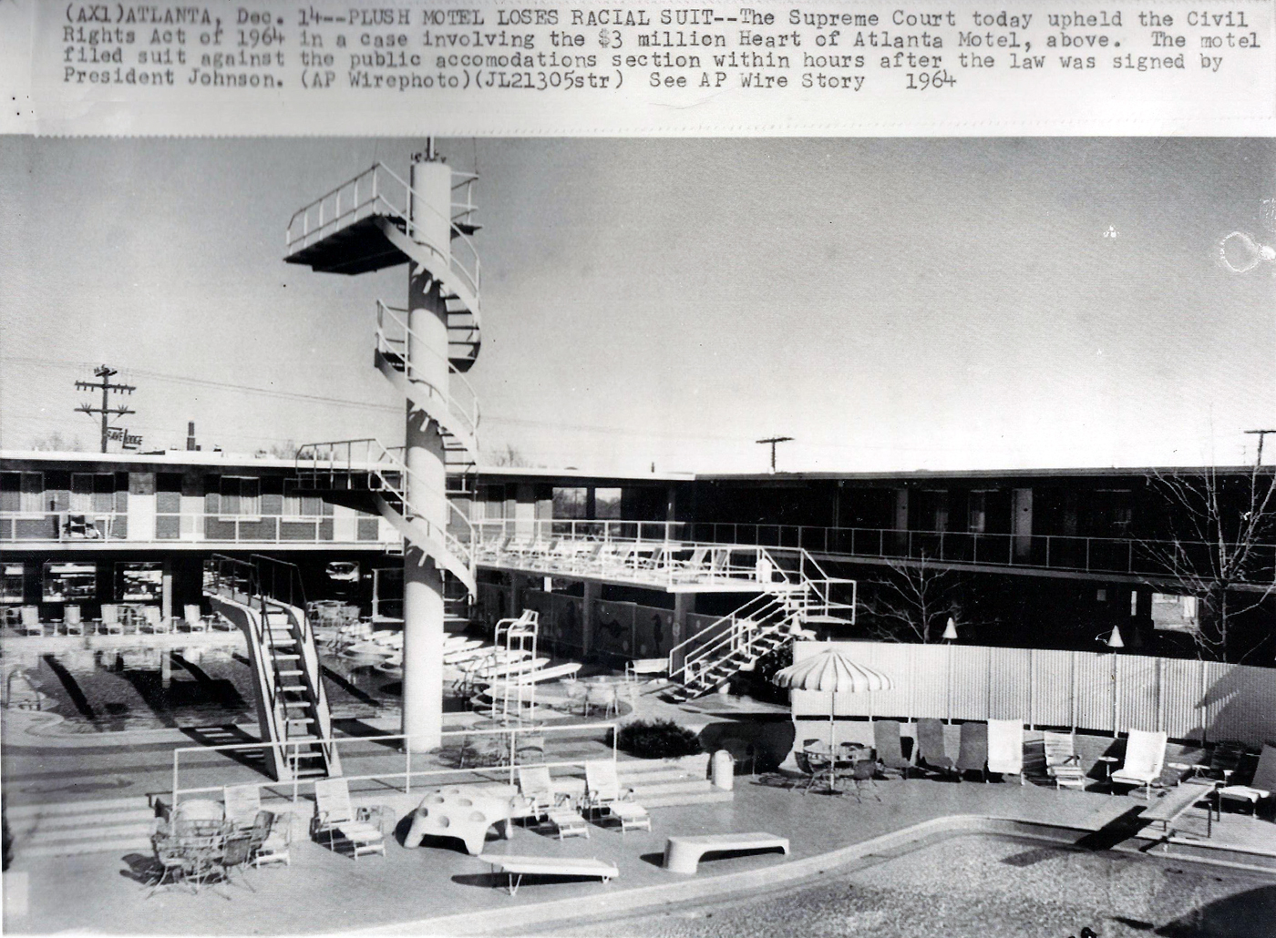

Slide 11
Heart of Atlanta Motel v. United States (1964)
That Congress was legislating against moral wrongs in many of these areas rendered its enactments no less valid. In framing Title II of this Act, Congress was also dealing with what it considered a moral problem. But that fact does not detract from the overwhelming evidence of the disruptive effect that racial discrimination has had on commercial intercourse. It was this burden which empowered Congress to enact appropriate legislation, and, given this basis for the exercise of its power, Congress was not restricted by the fact that the particular obstruction to interstate commerce with which it was dealing was also deemed a moral and social wrong…
Nor does the Act deprive appellant of liberty or property under the Fifth Amendment… There is nothing novel about such legislation. Thirty-two States now have it on their books either by statute or executive order, and many cities provide such regulation. Some of these Acts go back four-score years. It has been repeatedly held by this Court that such laws do not violate the Due Process Clause of the Fourteenth Amendment.

Slide 12
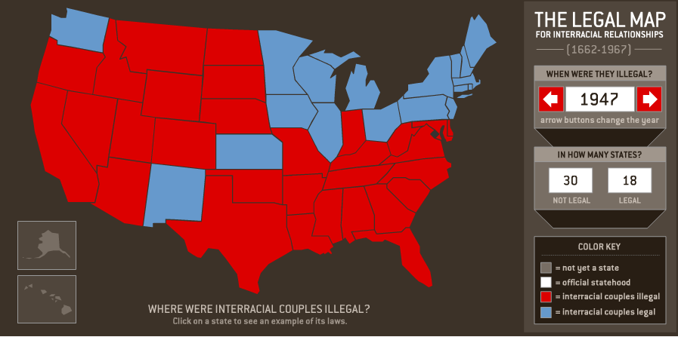

Slide 13
Naim v. Naim (VA Supreme Court, 1955)
We are unable to read in the Fourteenth Amendment to the Constitution, or in any other provision of that great document, any words or any intendment which prohibit the State from enacting legislation to preserve the racial integrity of its citizens, or which denies the power of the State to regulate the marriage relation so that it shall not have a mongrel breed of citizens. We find there no requirement that the State shall not legislate to prevent the obliteration of racial pride, but must permit the corruption of blood even though it weaken or destroy the quality of its citizenship. Both sacred and secular history teach that nations and races have better advanced in human progress when they cultivated their own distinctive characteristics and culture and developed their own peculiar genius.
Almighty God created the races, white, black, yellow, Malay, and red and placed them on separate continents, and but for the interference with his arrangement there would be no cause for such marriages. The fact that he separated the races shows that he did not intend the races to mix.
--Judge Leon Bazile (VA)

Slide 14
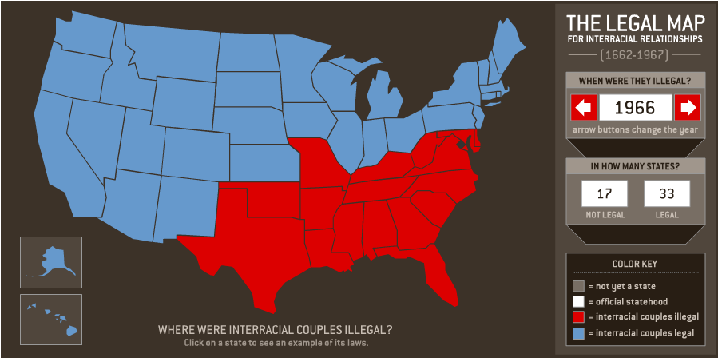

Slide 15
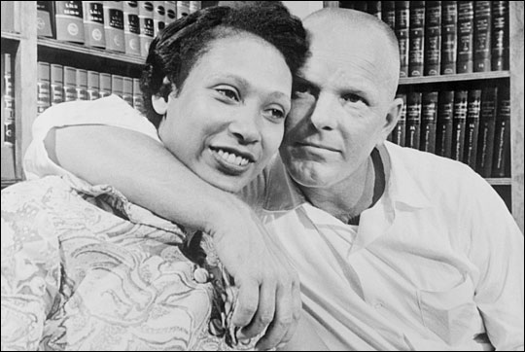

Slide 16
Loving v. Virginia (1967)
There is patently no legitimate overriding purpose independent of invidious racial discrimination which justifies this classification. The fact that Virginia prohibits only interracial marriages involving white persons demonstrates that the racial classifications must stand on their own justification, as measures designed to maintain White Supremacy. We have consistently denied the constitutionality of measures which restrict the rights of citizens on account of race. There can be no doubt that restricting the freedom to marry solely because of racial classifications violates the central meaning of the Equal Protection Clause . . .
Marriage is one of the “basic civil rights of man,” fundamental to our very existence and survival. To deny this fundamental freedom on so unsupportable a basis as the racial classifications embodied in these statutes, classifications so directly subversive of the principle of equality at the heart of the Fourteenth Amendment, is surely to deprive all the State's citizens of liberty without due process of law.
The Fourteenth Amendment requires that the freedom of choice to marry not be restricted by invidious racial discriminations. Under our Constitution, the freedom to marry, or not marry, a person of another race resides with the individual, and cannot be infringed by the State.

Slide 17
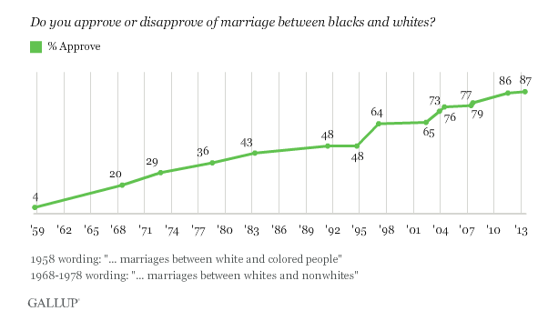

Slide 18
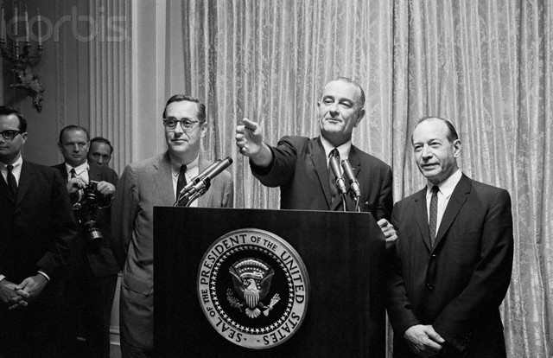

Slide 19
President Johnson: How are you going to rate these people—one, two, three, four, five?
Fortas: I—
President Johnson: From the standpoint of my practical problem, and what I may want to do here on all the other things. I’ve got geography, I’ve got the Senate, I’ve got these philosophies, I’ve got to have sure votes.
I want continuity, I want a little age—look at this not from your standpoint.
Fortas: Well—
President Johnson: Look at it from my standpoint, of knowing me as you know me, and what I want. I want somebody that I’ll always be proud of his vote. That’s the first thing. I may not be proud of his opinion, but I want to be proud of the side he was on. He may not be as eloquent as Hugo Black, or you, or somebody. But I want to be damn sure he votes right. That’s the first thing.

Slide 20
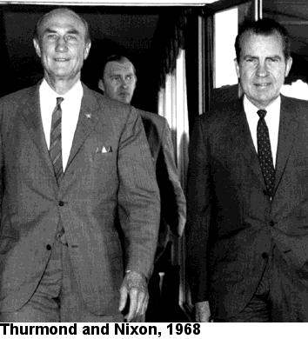

Slide 21
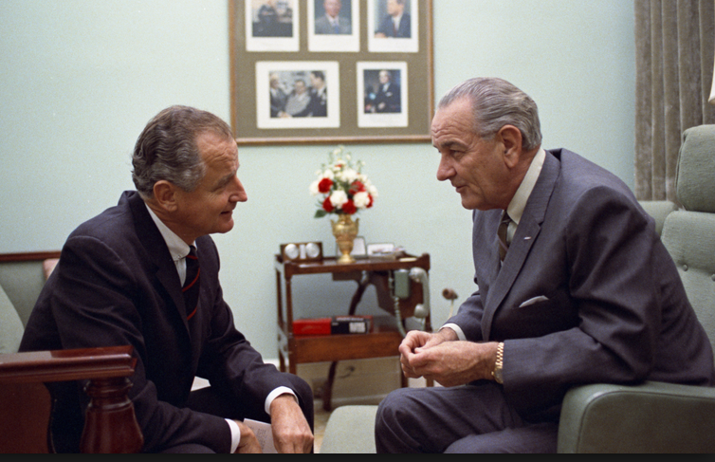

Slide 22
George Smathers: Now, you get a real nut like Strom Thurmond, who up to this point hadn’t really made much sense . . . There are just enough people who will fall for a line like this, that it worries me, very much. And they’ve invited Abe back to talk about it, and I just think that—frankly, my first reaction is that he just ought not to come. And just see . . .
And my other reaction is at the moment—[Michigan senator] Phil [Hart] went to see the movie. I said, “I’m not going to see the damn movie.” Because I want to be in a position to say, as far as I’m concerned, I don’t look at any kind of goddamned pornographic stuff. It’s all over the streets, and always has been. And it’s a man’s choice. And I choose not to look at it. But others may choose to look at it. And if a fella wants to look at it, why, the Court’s voted that he can. That’s a matter of choice.
I don’t look at it. I haven’t seen it, so I’m not passing judgment on whether or not this is the kind of thing that should be shown around, or it shouldn’t.
[Break.]
Smathers: [Arkansas senator] John [McClellan] was preaching, and rantin’ and ravin’ about how this kind of thing was ruining the life of his grandchildren, and everybody else. He wanted a long time to look into this, and he was going to look into it very deeply.
President Johnson: He ought to go see this Graduates [sic]. [Chuckles.]
Smathers: That’s right.
[Break.]
President Johnson: Well, will you vote on it next Wednesday?
Smathers: So, we’re due to vote on it next Wednesday.
President Johnson: Well, won’t they filibuster it?
Smathers: Yeah. They’re going to filibuster it again.
President Johnson: In the committee?!
Smathers: In the committee.
President Johnson: Well, can you just do that, constantly?
Smathers: Well, with the cooperation of [Jim] Eastland, I don’t know you’re going to stop it.

Slide 23


Slide 24


Slide 25
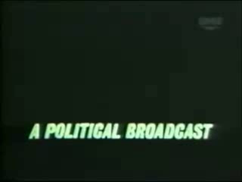

Slide 26
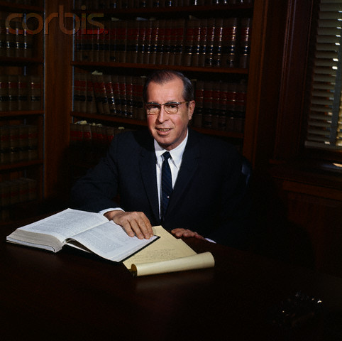

Slide 27
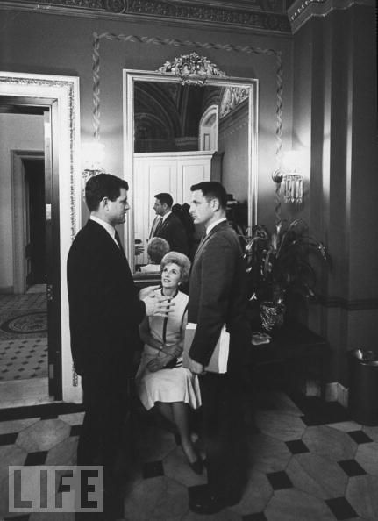
Notes:
Emk and bayh

Slide 28
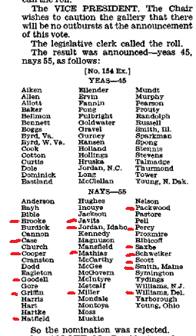

Slide 29
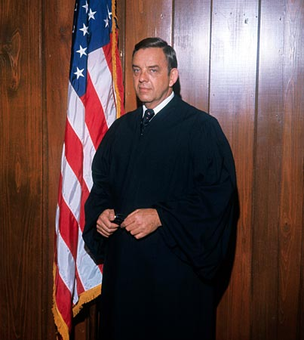
Notes:
carswell

Slide 30
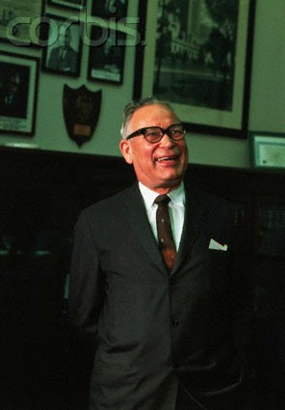
"Even if he were mediocre, there are a lot of mediocre judges and people and lawyers. They are entitled to a little representation, aren't they, and a little chance? We can't have all Brandeises, Frankfurters and Cardozos."
Notes:
hruska

Slide 31
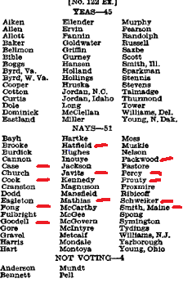

Slide 32
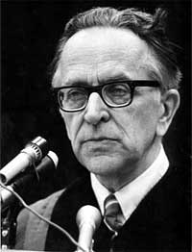

Slide 33
President Nixon: Now, on the other thing, John, on the second one, if it comes: can I urge you to try to examine everything to see if you can find a Catholic—a good Catholic?
John Mitchell: You want another [Justice William] Brennan?
President Nixon: No, Christ no! That’s what I mean. I mean—
Mitchell: You know, you went down—the Eisenhower administration went down that track before, you know . . .
President Nixon: And they got Brennan, I know. But you don’t have an honest Italian, do you?
Mitchell: [Chuckles.] God, they’re awful hard to find.
President Nixon: A Pole?
Mitchell: Uh . . .
President Nixon: No.
Mitchell: [California attorney and future Reagan AG] William French Smith—he isn’t one, is he?
President Nixon: Oh, Christ, no. He’s a Protestant.
Mitchell: WASP.
President Nixon: Rich and everything else.
Mitchell: All right.
President Nixon: Well, take a look at the Catholics, will you?
[Break.]
Mitchell: Do you think that’s a good line to take?
President Nixon: I do. Politically, we are going to gain a lot more from a Catholic. Look, the Protestants will just figure—if he’s a conservative, a Catholic conservative’s better than a Protestant conservative. We really need that—
Mitchell: Well, they’re more engrained, I’m sure.
President Nixon: Yeah. The point is, it’ll mean more to the Catholics—that’s my point—than it will to the Protestants. The Protestants expect to have things. The Catholics don’t.
Mitchell: When are you going to fill that Jewish seat on the Supreme Court?
President Nixon: Well, about . . . after I die. [Mitchell laughs.] You know and I know, there aren’t any.
Mitchell: There are no conservatives, I’ll say that.
President Nixon: Never.

Slide 34
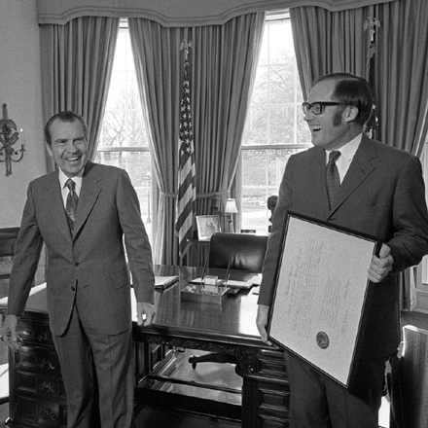

Slide 35
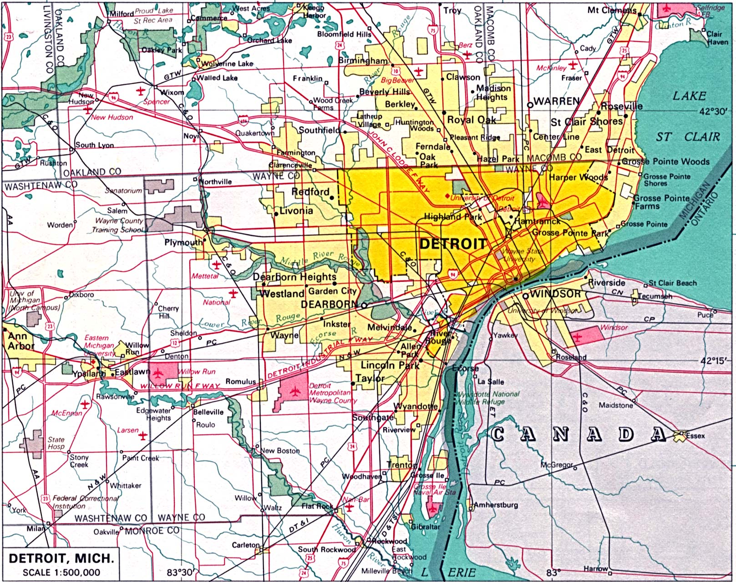

Slide 36
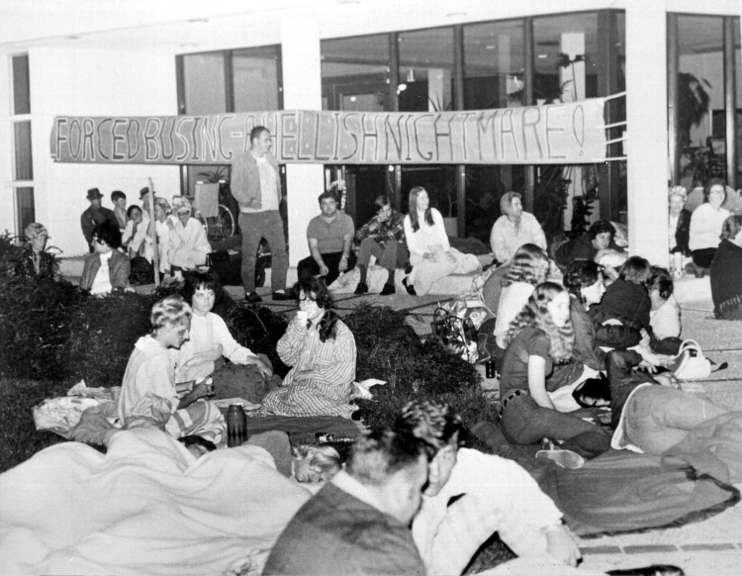
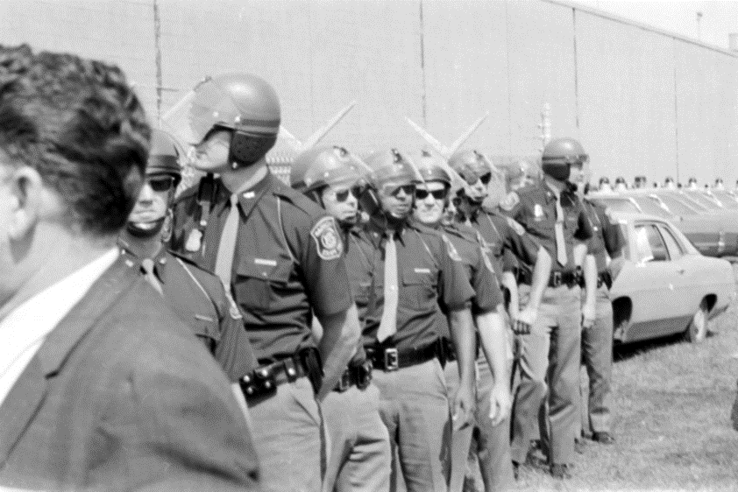

Slide 37
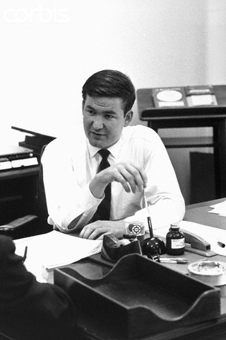

Slide 38
President Nixon: Well, I’ve basically—we’ve got to say that it’s only the extent that it is required by law—
Pat Buchanan: Right.
President Nixon: By a court order, do I think busing should be used.
Buchanan: Mm-hmm.
President Nixon: Don’t you think that’s really what you get down to?
Buchanan: Right. Right.
President Nixon: Because the line, actually, between my line and Muskie’s, is not as clear as—I mean, it’s just the way he said it. He starts at the other end. He says, “Well, I think busing is a legitimate tool—
Buchanan: Yeah.
President Nixon: And then, “but I’m against it.” I start at the other end. I say, “I’m against busing, but, if the law requires it, to the minimum extent necessary, I, of course, will not resist it.”
Buchanan: Mm-hmm.
President Nixon: Right?
Buchanan: Right.
President Nixon: It’s purely a question of tone.
Buchanan: Well, we’ve got to push Muskie’s emphasis up in the headlines; that’s the problem.
President Nixon: That’s right. That’s right. Yeah. It’s got to be—well, I think it probably is going to get some play in the South now—
Buchanan: I think, well, that’s something you could really move by various statements exaggerating his position, and then Muskie would come back sort of drawing it back and it raises—identifies him with it.
President Nixon: Yeah, the thing to do really is to praise him—have some civil rights people praise him for his defense of busing.
Buchanan: Mm-hmm.
President Nixon: That’s the way to really get that, you know. It’s much the better way than to have people attack him for it—
Buchanan: Mm-hmm.
President Nixon: —is to praise him for his defense of busing, see?
Buchanan: Mm-hmm. Mm-hmm.
President Nixon: And I don’t know if you’ve got any people that can do that or not. But I would think that would be very clever.
Buchanan: Mm-hmm. OK.

Slide 39
Milliken v. Bradley (1974)
The District Court and the Court of Appeals shifted the primary focus from a Detroit remedy to the metropolitan area only because of their conclusion that total desegregation of Detroit would not produce the racial balance which they perceived as desirable. Both courts proceeded on an assumption that the Detroit schools could not be truly desegregated -- in their view of what constituted desegregation -- unless the racial composition of the student body of each school substantially reflected the racial composition of the population of the metropolitan area as a whole . . .
Boundary lines may be bridged where there has been a constitutional violation calling for inter-district relief, but the notion that school district lines may be casually ignored or treated as a mere administrative convenience is contrary to the history of public education in our country. No single tradition in public education is more deeply rooted than local control over the operation of schools; local autonomy has long been thought essential both to the maintenance of community concern and support for public schools and to quality of the educational process . . .

