Slide 1
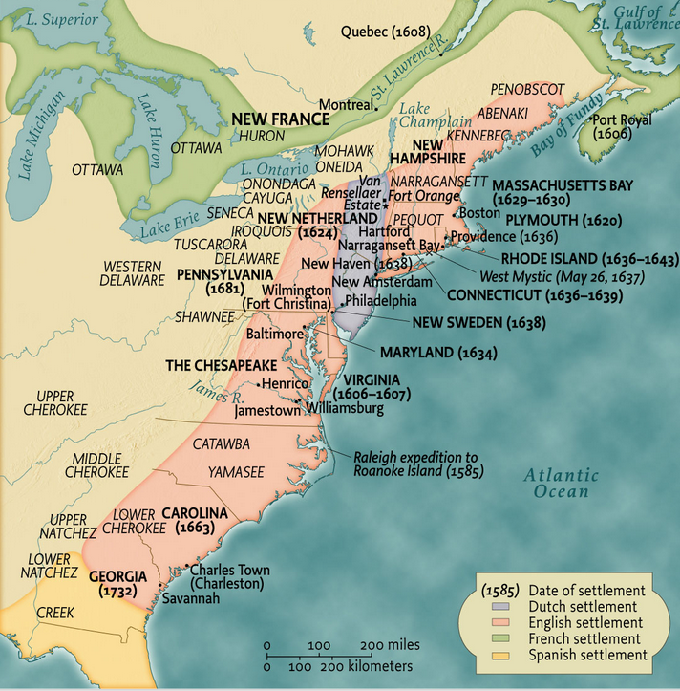

Slide 2
KC Johnson
https://kc-johnson.com/
kcjohnson9@gmail.com

Slide 3
Navigation Act (1660)
From and after the first day of December 1660, and from thenceforward, no goods or commodities whatsoever shall be imported into or exported out of any lands, islands, plantations or territories to his Majesty belonging or in his possession . . . but in such ships or vessels as do truly and without fraud belong only to the people of England or Ireland . . .
III. And it is further enacted, That no goods or commodities whatsoever, of the growth, production or manufacture of Africa, Asia, or America, or any part thereof . . . be imported into England, Ireland, or Wales . . . in any other ship or ships, vessel or vessels whatsoever, but in such as do truly and without fraud belong only to the people of England, Ireland or Wales. . . .
XVIII. And be it further enacted, That from and after the first day of April, 1661, no sugars, tobacco, cotton-wool, indigos, ginger, fustick, or other dying wood, of the growth, production or manufacture of any English plantations in America, Asia, or Africa, shall be shipped, carried, conveyed or transported from any of the said English plantations to any land . . . other than to such English plantations as do belong to his Majesty. . . .

Slide 4
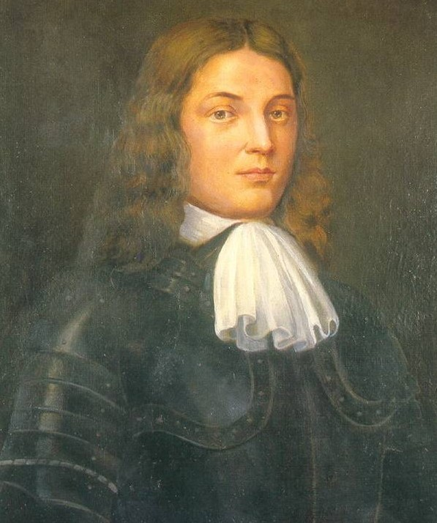
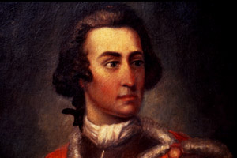
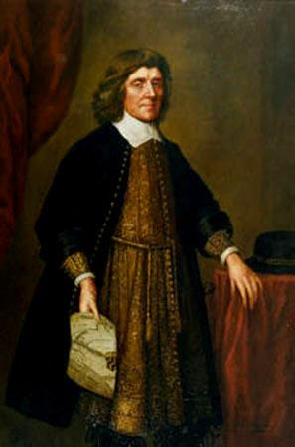
Notes:
Penn—baltimore-oglethorpe

Slide 5



Slide 6
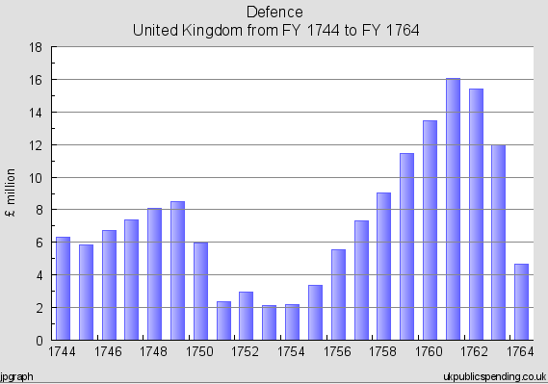
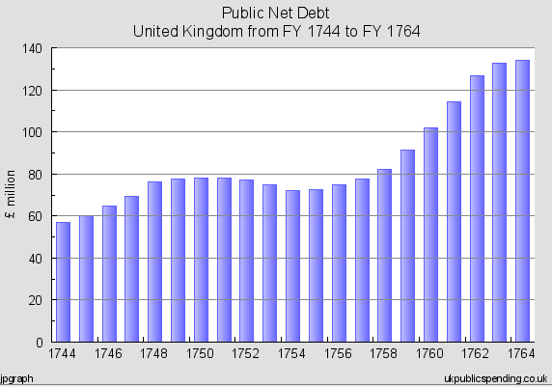

Slide 7


Slide 8
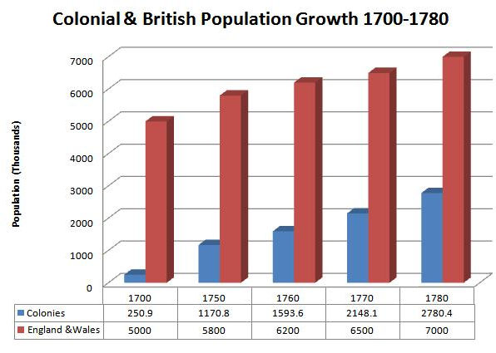

Slide 9

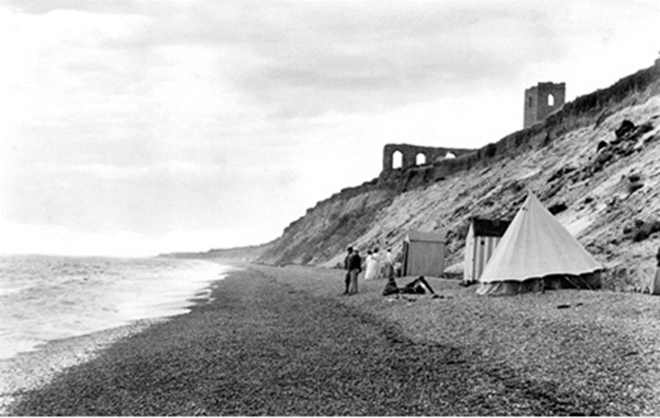
Notes:
Old sarum

Slide 10
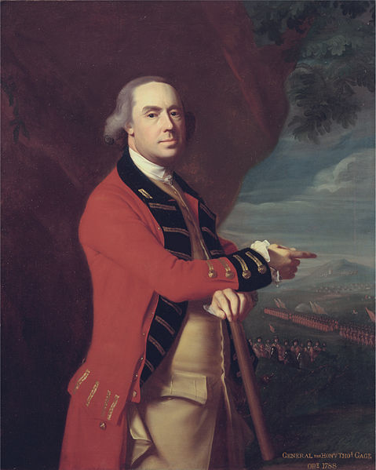
Notes:
Thomas gage

Slide 11
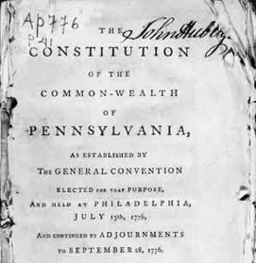

Slide 12
Pennsylvania (1776)—rights
That all men are born equally free and independent, and have certain natural, inherent and inalienable rights, amongst which are, the enjoying and defending life and liberty, acquiring, possessing and protecting property, and pursuing and obtaining happiness and safety.
IX. That in all prosecutions for criminal offences, a man hath a right to be heard by himself and his council, to demand the cause and nature of his accusation, to be confronted with the witnesses, to call for evidence in his favour, and a speedy public trial, by an impartial jury of the country, without the unanimous consent of which jury he cannot be found guilty; nor can he be compelled to give evidence against himself…
XII. That the people have a right to freedom of speech, and of writing, and publishing their sentiments; therefore the freedom of the press ought not to be restrained.
XVI. That the people have a right to assemble together, to consult for their common good, to instruct their representatives, and to apply to the legislature for redress of grievances, by address, petition, or remonstrance.

Slide 13
Pennsylvania (1776)—constitutional violations
The COUNCIL OF CENSORS . . . whose duty it shall be to enquire whether the constitution has been preserved inviolate in every part; and whether the legislative and executive branches of government have performed their duty as guardians of the people, or assumed to themselves, or exercised other or greater powers than they are intitled to by the constitution: They are also to enquire whether the public taxes have been justly laid and collected in all parts of this commonwealth, in what manner the public monies have been disposed of, and whether the laws have been duly executed. For these purposes they shall have power to send for persons, papers, and records; they shall have authority to pass public censures, to order impeachments, and to recommend to the legislature the repealing such laws as appear to them to have been enacted contrary to the principles of the constitution. These powers they shall continue to have, for and during the space of one year from the day of their election and no longer: The said council of censors shall also have power to call a convention….

Slide 14
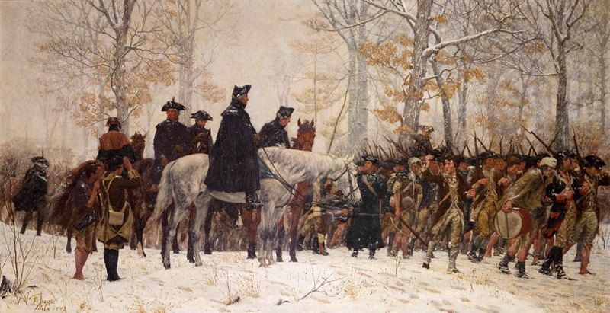

Slide 15
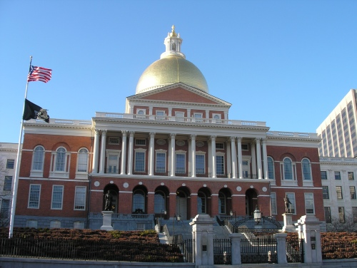

Slide 16
Massachusetts (1780)—legislative power
Article I. The department of legislation shall be formed by two branches, a senate and house of representatives; each of which shall have a negative on the other . . .
Art. II. The senate shall be the first branch of the legislature . . . Every male inhabitant of twenty-one year of age and upwards, having a freehold estate of the value of sixty pounds, shall have a right to give in his vote for the senators for the district of which he is an inhabitant.
--------------
Every male person being twenty-one years of age, and resident in any particular town in this commonwealth, for the space of one year next preceding, having a freehold estate within the same town, of the annual income of three pounds, or any estate of the value of sixty pounds, shall have a right to vote in the choice of a representative or representatives for the said town.

Slide 17
Massachusetts (1780)—Governor’s Council
Article IV. The governor shall have authority from time to time, at his discretion, to assemble and call together the councillors of this commonwealth for the time being; and the governor with the said councillors, or five of them at least, shall, and may, from time to time, hold and keep a council, for the ordering and directing the affairs of the commonwealth, agreeably to the constitution and the laws of the land…
All judicial officers, [the attorney-general,] the solicitor-general, [all sheriffs,] coroners, [and registers of probate,] shall be nominated and appointed by the governor, by and with the advice and consent of the council…

Slide 18
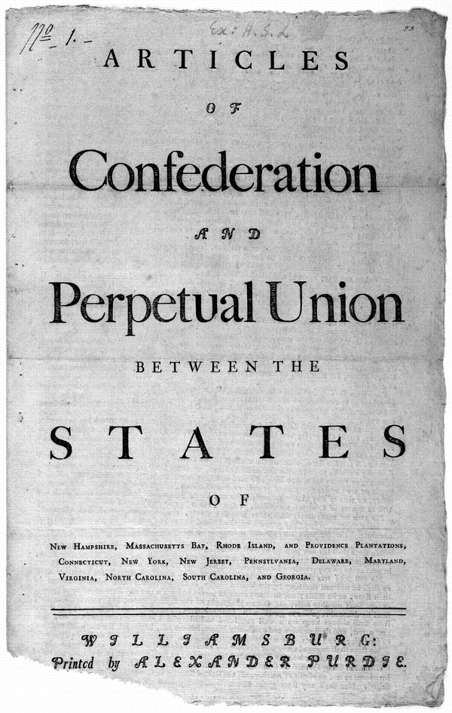

Slide 19
Article II. Each state retains its sovereignty, freedom, and independence, and every Power, Jurisdiction, and right, which is not by this confederation expressly delegated to the United States, in Congress assembled.
----------
Art. IX. All charges of war, and all other expenses that shall be incurred for the common defense or general welfare, and allowed by the united States in congress assembled, shall be defrayed out of a common treasury, which shall be supplied by the several States in proportion to the value of all land within each State, granted or surveyed for any person, as such land and the buildings and improvements thereon shall be estimated according to such mode as the united States in congress assembled, shall from time to time direct and appoint.
The taxes for paying that proportion shall be laid and levied by the authority and direction of the legislatures of the several States within the time agreed upon by the united States in congress assembled.

Slide 20
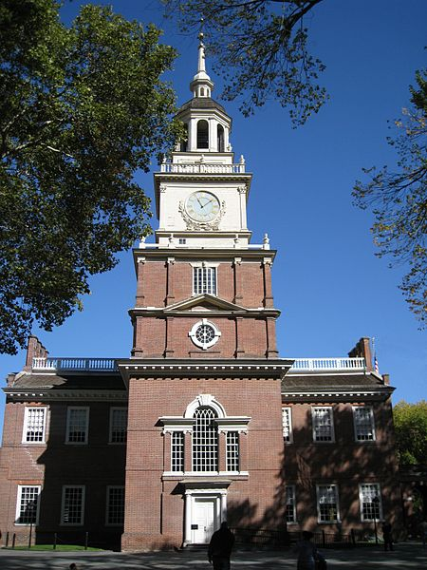
Notes:
Indpce hall

Slide 21
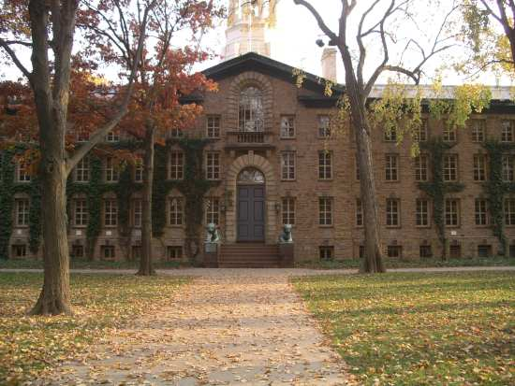
Notes:
Nassau hall princeton 1783

Slide 22
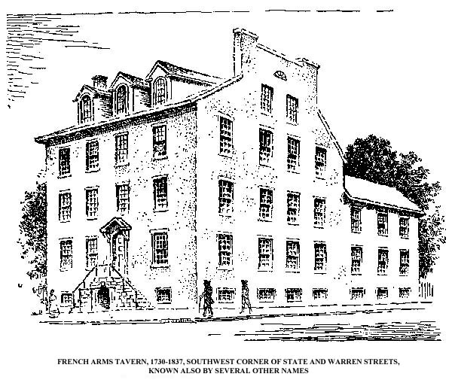
Notes:
French arms tavern 1785

Slide 23
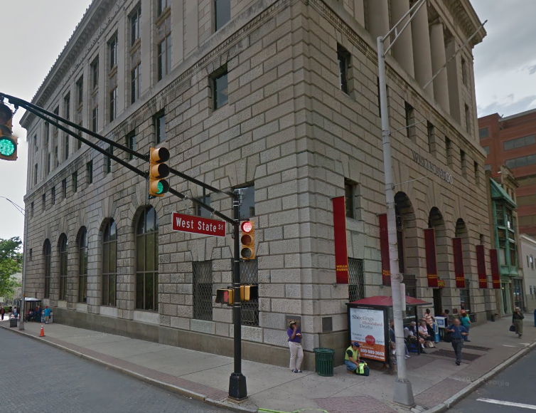

Slide 24


Slide 25
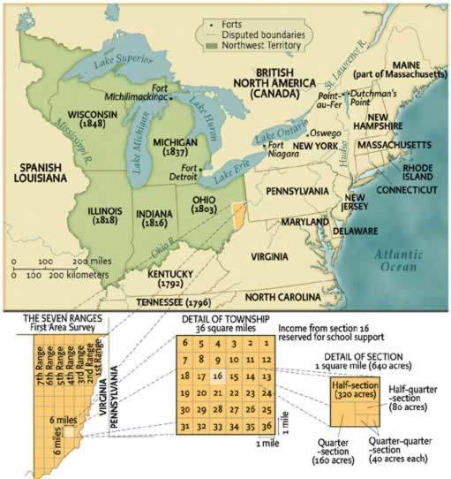

Slide 26
Northwest Ordinance (1787)
Art. 3. Religion, morality, and knowledge, being necessary to good government and the happiness of mankind, schools and the means of education shall forever be encouraged . . .
Art. 5. There shall be formed in the said territory, not less than three nor more than five States . . . And, whenever any of the said States shall have sixty thousand free inhabitants therein, such State shall be admitted, by its delegates, into the Congress of the United States, on an equal footing with the original States in all respects whatever, and shall be at liberty to form a permanent constitution and State government: Provided, the constitution and government so to be formed, shall be republican, and in conformity to the principles contained in these articles . . .
Art. 6. There shall be neither slavery nor involuntary servitude in the said territory, otherwise than in the punishment of crimes whereof the party shall have been duly convicted.

Slide 27


Slide 28
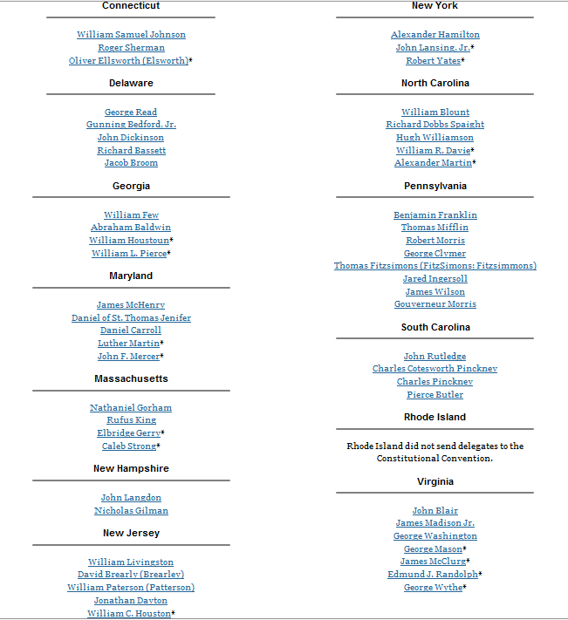

Slide 29
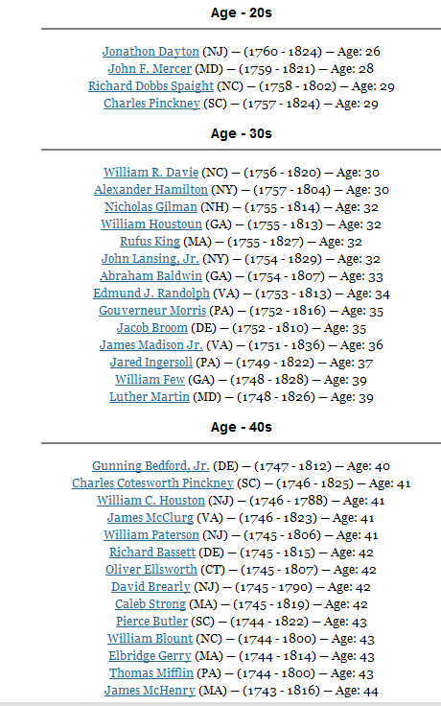
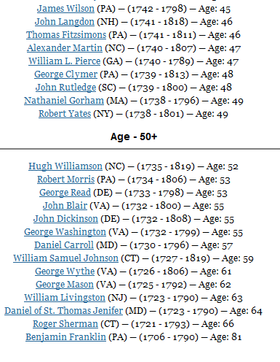

Slide 30
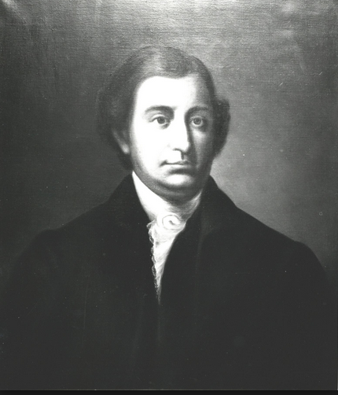

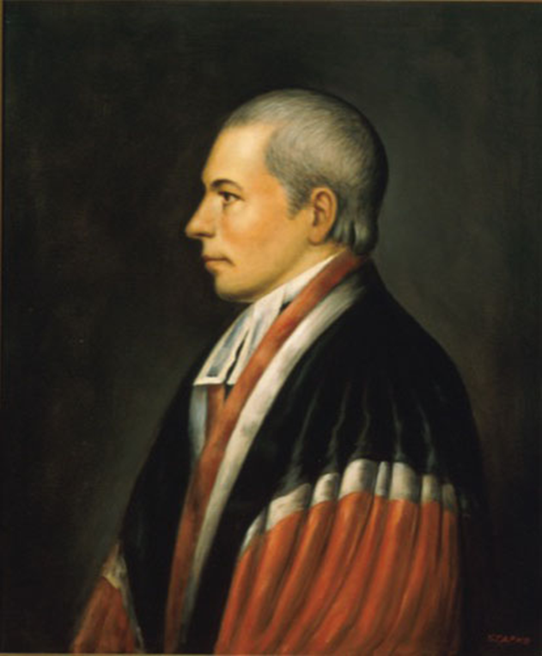
Notes:
Edmund randolph

Slide 31


Slide 32
Article I, Section 8
The Congress shall have power . . . to make all laws which shall be necessary and proper for carrying into execution the foregoing powers, and all other powers vested by this Constitution in the government of the United States, or in any department or officer thereof…
The Congress shall have power to lay and collect taxes, duties, imposts and excises, to pay the debts and provide for the common defense and general welfare of the United States; but all duties, imposts and excises shall be uniform throughout the United States . . .

Slide 33
Article II, Section 2.
[The President] shall have power, by and with the advice and consent of the Senate, to make treaties, provided two thirds of the Senators present concur; and he shall nominate, and by and with the advice and consent of the Senate, shall appoint ambassadors, other public ministers and consuls, judges of the Supreme Court, and all other officers of the United States, whose appointments are not herein otherwise provided for, and which shall be established by law: but the Congress may by law vest the appointment of such inferior officers, as they think proper, in the President alone, in the courts of law, or in the heads of departments.

Slide 34
Article II
Section 1. The executive power shall be vested in a President of the United States of America. He shall hold his office during the term of four years, and, together with the Vice President, chosen for the same term, be elected, as follows:
Each state shall appoint, in such manner as the Legislature thereof may direct, a number of electors, equal to the whole number of Senators and Representatives to which the State may be entitled in the Congress: but no Senator or Representative, or person holding an office of trust or profit under the United States, shall be appointed an elector.

Slide 35
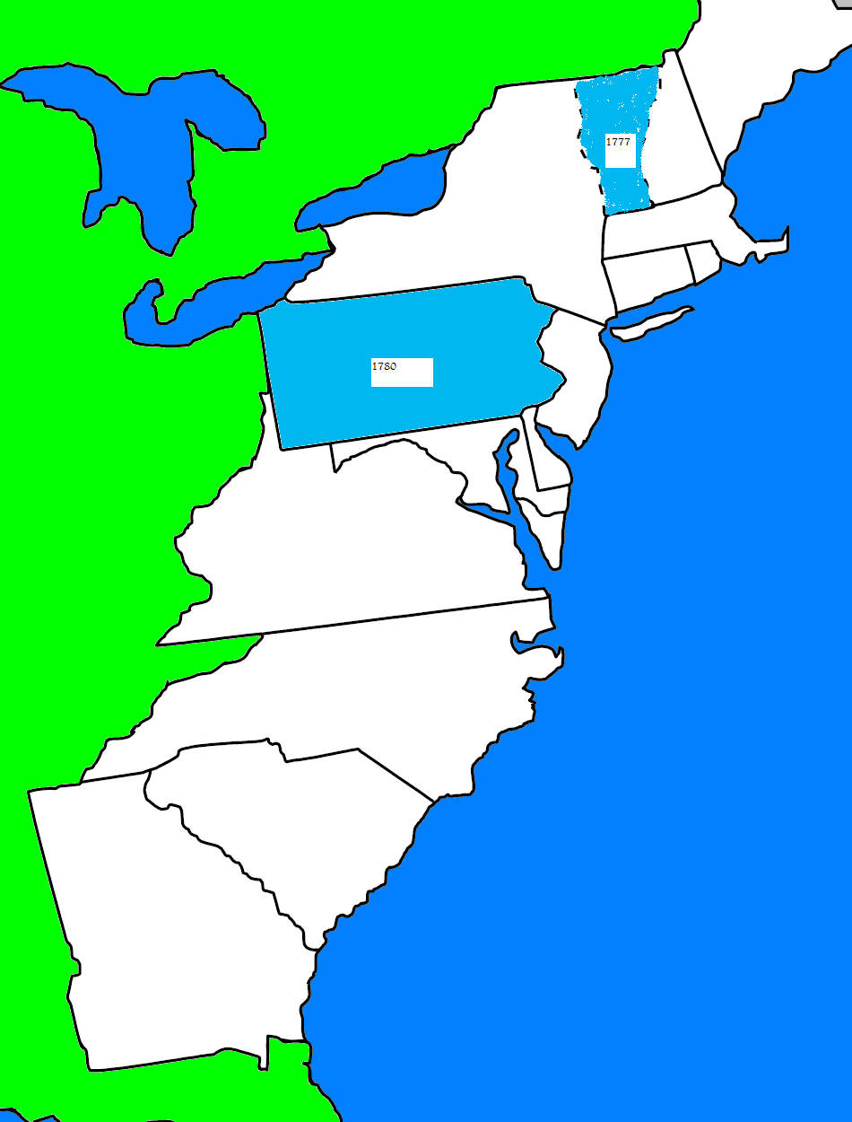

Slide 36
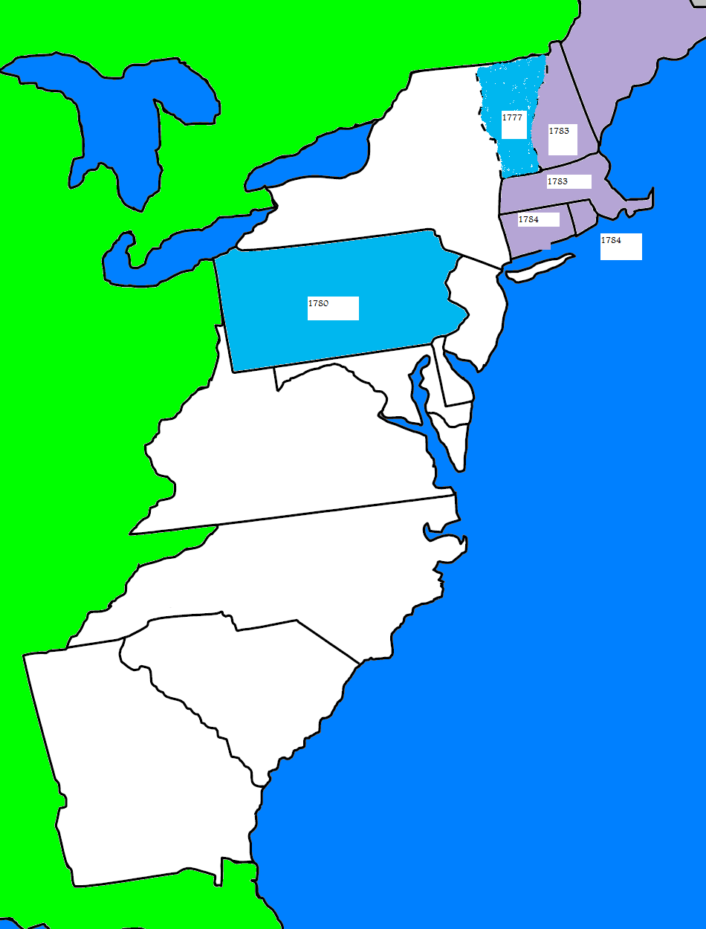

Slide 37
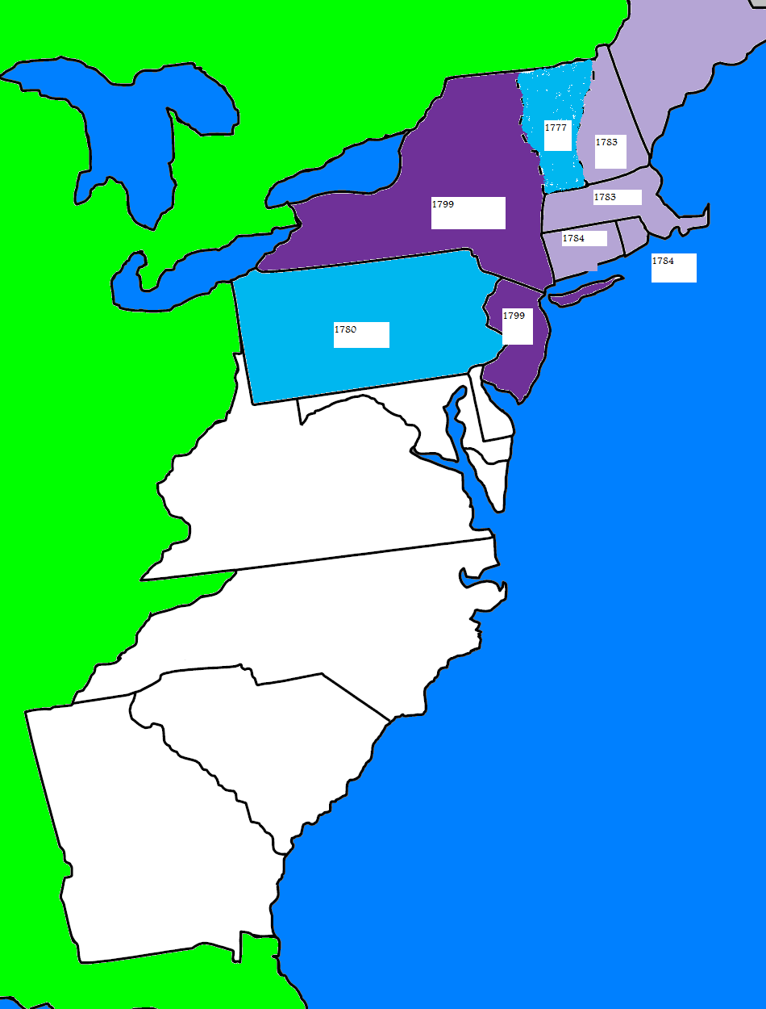

Slide 38
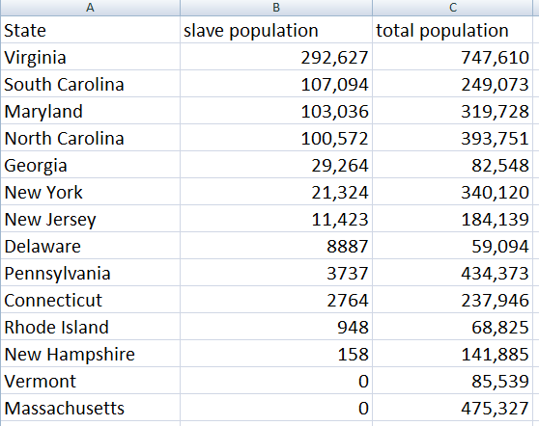

Slide 39
I: 2: Representatives and direct taxes shall be apportioned among the several states which may be included within this union, according to their respective numbers, which shall be determined by adding to the whole number of free persons, including those bound to service for a term of years, and excluding Indians not taxed, three fifths of all other Persons.
I:9: The migration or importation of such persons as any of the states now existing shall think proper to admit, shall not be prohibited by the Congress prior to the year one thousand eight hundred and eight, but a tax or duty may be imposed on such importation, not exceeding ten dollars for each person.
IV: 1: No person held to service or labor in one state, under the laws thereof, escaping into another, shall, in consequence of any law or regulation therein, be discharged from such service or labor, but shall be delivered up on claim of the party to whom such service or labor may be due.

Slide 40


Slide 41


Slide 42


Slide 43
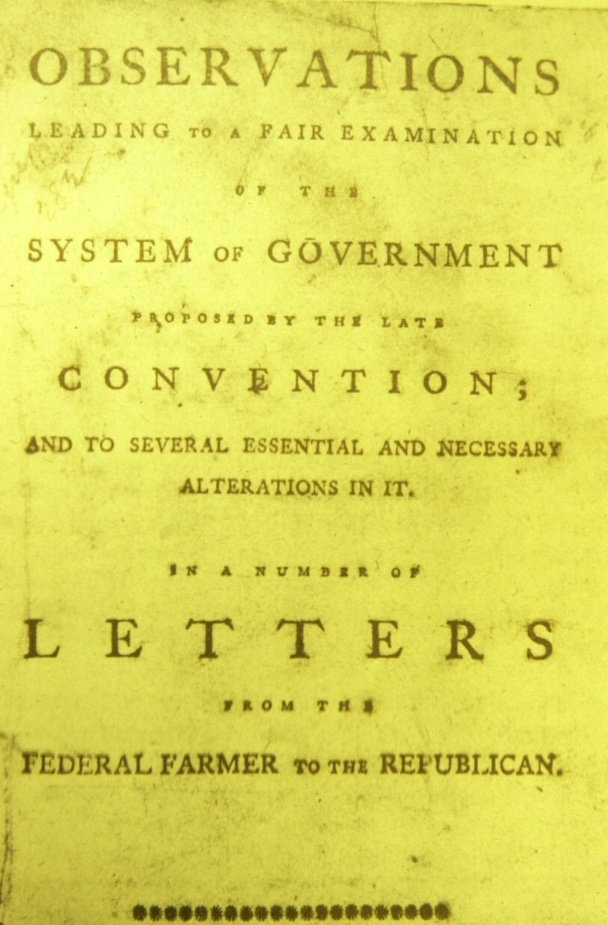

Slide 44
Article I, Section 9.
The privilege of the writ of habeas corpus shall not be suspended, unless when in cases of rebellion or invasion the public safety may require it.
No bill of attainder or ex post facto Law shall be passed.
No title of nobility shall be granted by the United States: and no person holding any office of profit or trust under them, shall, without the consent of the Congress, accept of any present, emolument, office, or title, of any kind whatever, from any king, prince, or foreign state.

Slide 45
Madison: Original Bill of Rights
Art. I. After the first enumeration required by the first article of the Constitution, there shall be one representative for every thirty thousand, until the number shall amount to one hundred, after which the proportion shall be so regulated by Congress, that there shall not be less than one hundred representatives, nor less than one representative for every forty thousand persons, until the number of representatives shall amount to two hundred, after which the proportion shall be so regulated by Congress, that there shall not be less than two hundred representatives, nor more than one representative for every fifty thousand.
Art. II. No law varying the compensation for services of the senators and representatives shall take effect, until an election of representatives shall have intervened.
[Note: now amendment 27]

Slide 46
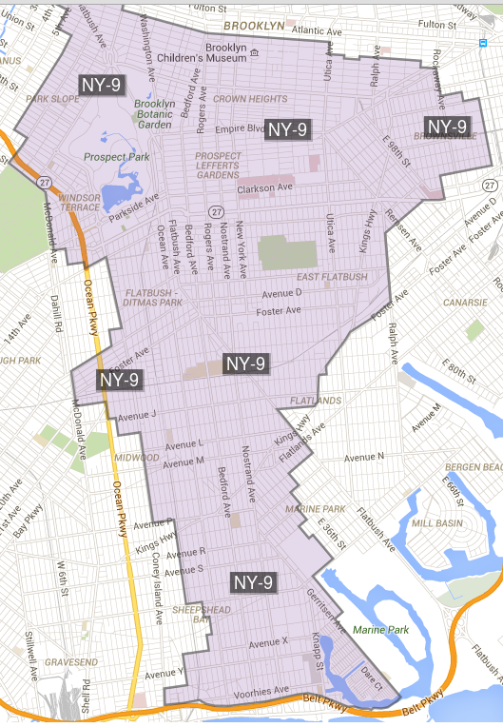

Slide 47
Bill of Rights in Context
Amendments 1-4: limitations on congressional power (speech, religion, assembly, right to bear arms, search/seizure, quartering soldiers)
Amendments 5-8: protections for accused criminals (5th amendment protections, speedy trial, jury, no excessive bail)
Amendments 9-10: structural (rights of the people, reservations of state powers)

