Slide 1
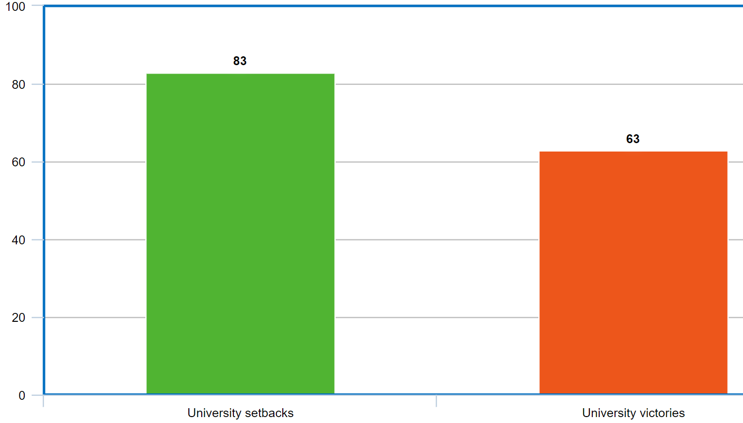

Slide 2
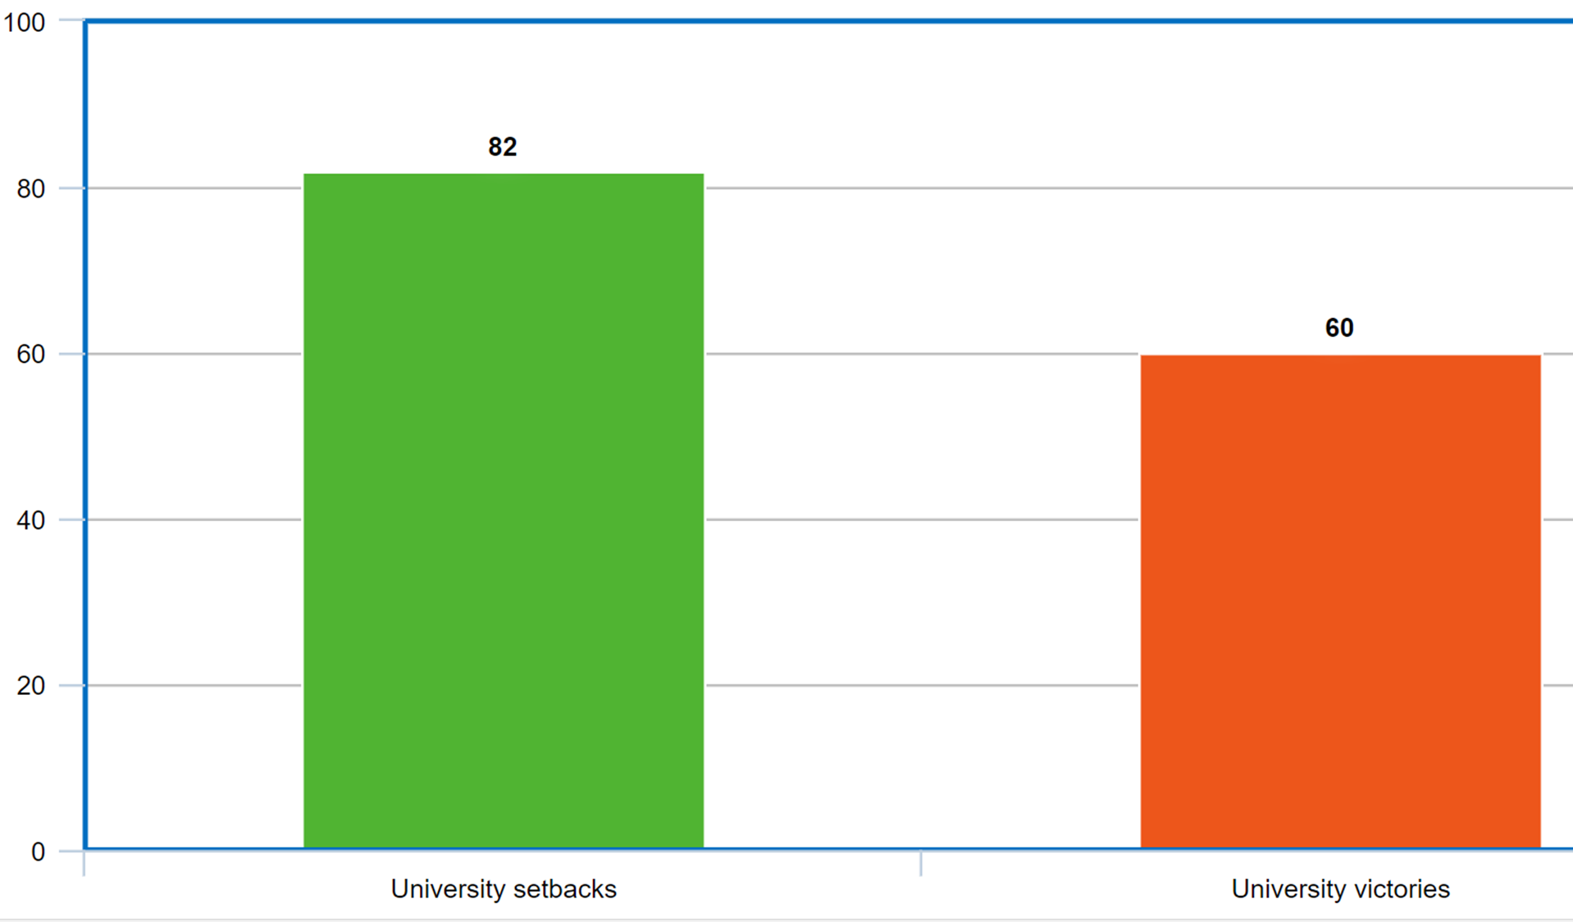
Schools are “losing case after case in federal court on what should be very basic due process protections. Never before have colleges been losing more cases than they are winning, but that is the trend as we write this.”
--NCHERM 2017 White Paper (https://www.ncherm.org/wordpress/wp-content/uploads/2017/04/TNG-Whitepaper-Final-Electronic-Version.pdf)
“In over 20 years of reviewing higher education law cases, I’ve never seen such a string of legal setbacks for universities, both public and private, in student conduct cases. Something is going seriously wrong. These precedents are unprecedented.”
--Gary Pavela (Inside Higher Ed: https://www.insidehighered.com/news/2016/04/14/several-students-win-recent-lawsuits-against-colleges-punished-them-sexual-assault)

Slide 3
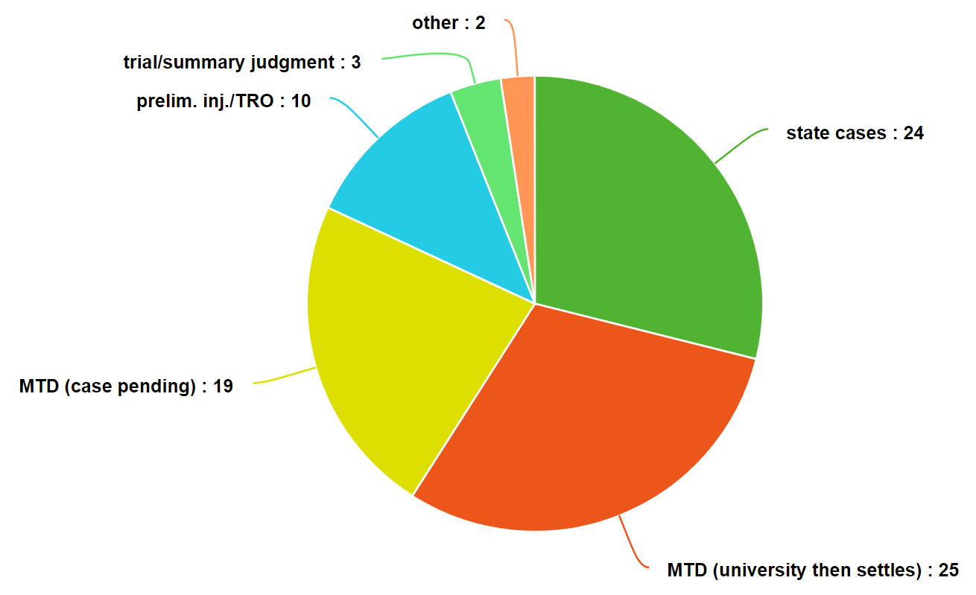

Slide 4
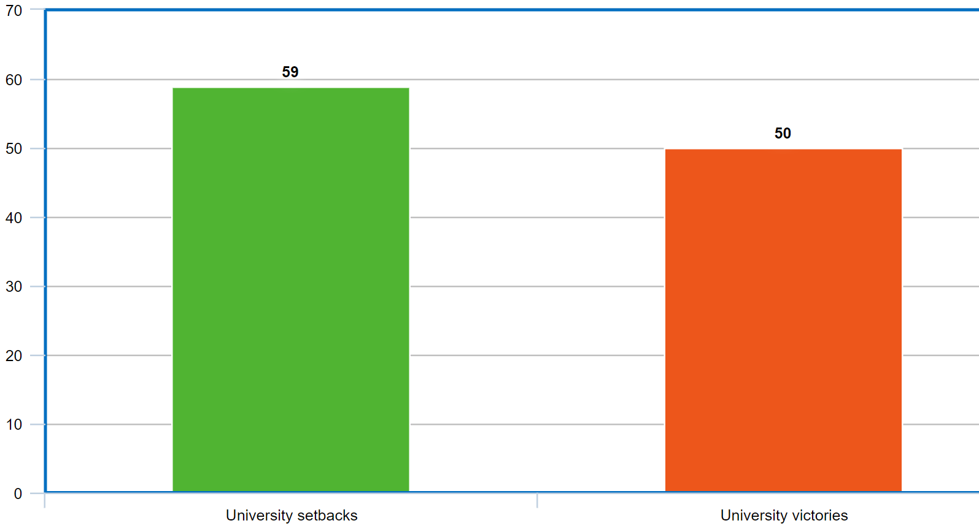
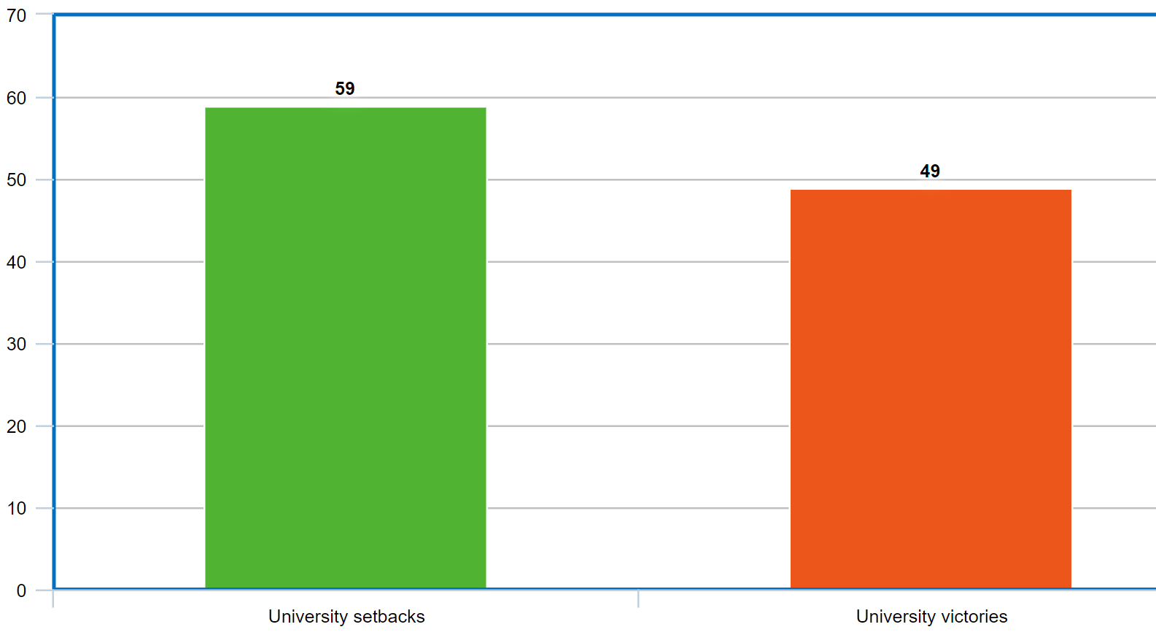
Federal decisions

Slide 5
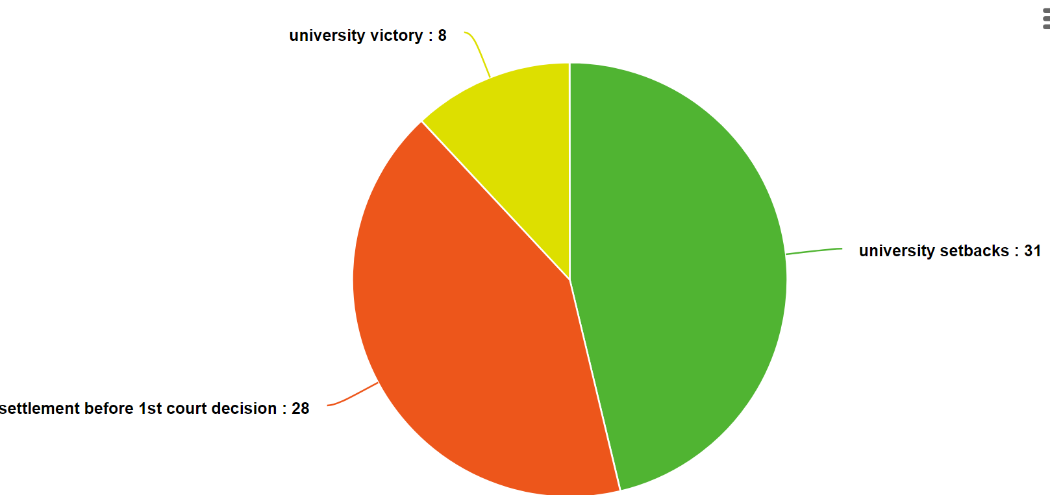
Settlements
(federal lawsuits)

Slide 6
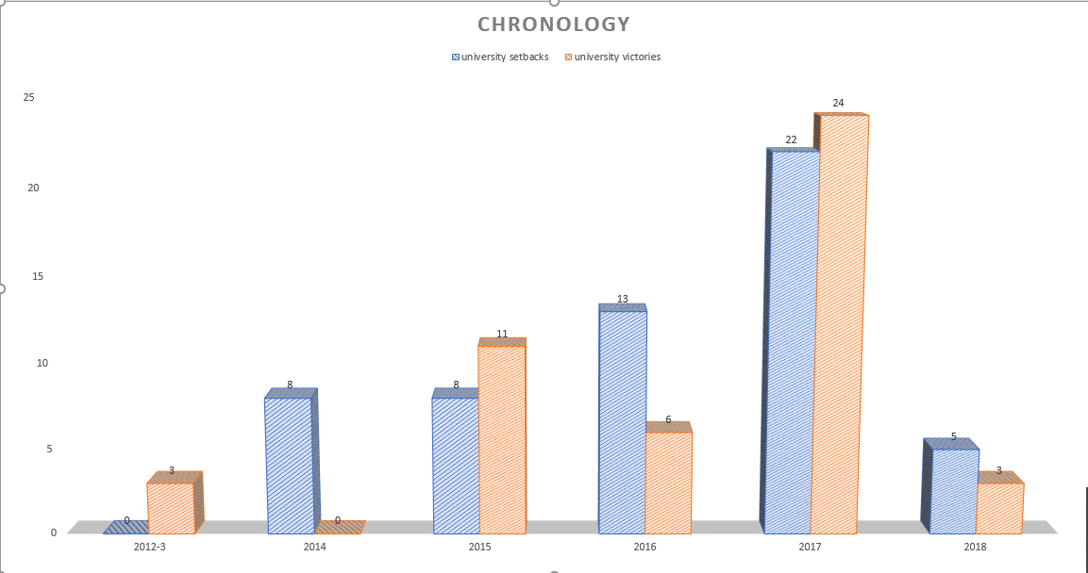

Slide 7
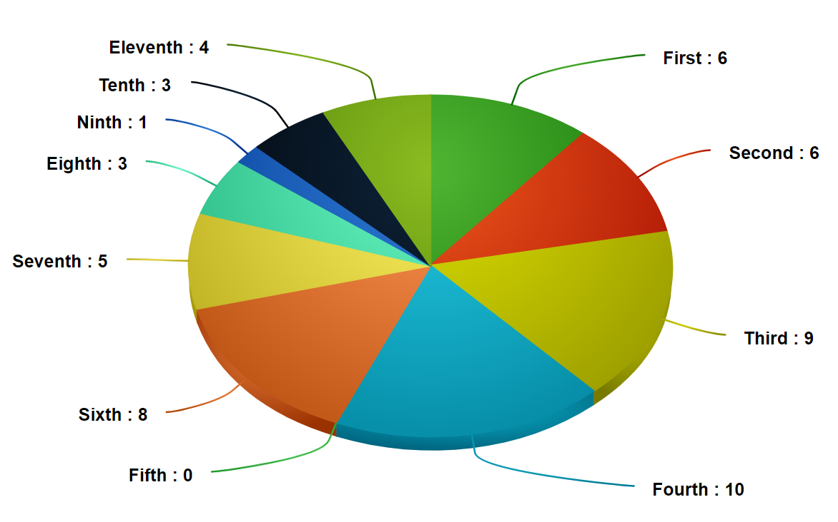
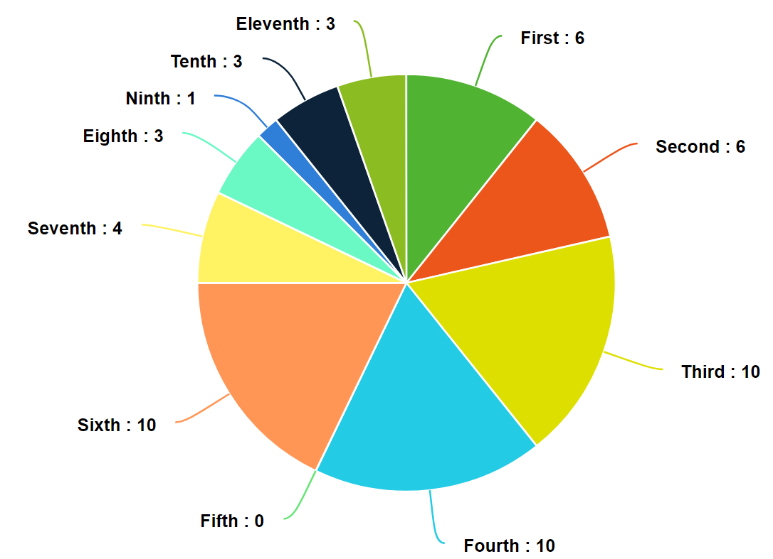
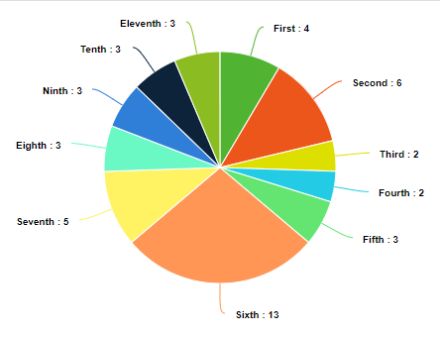
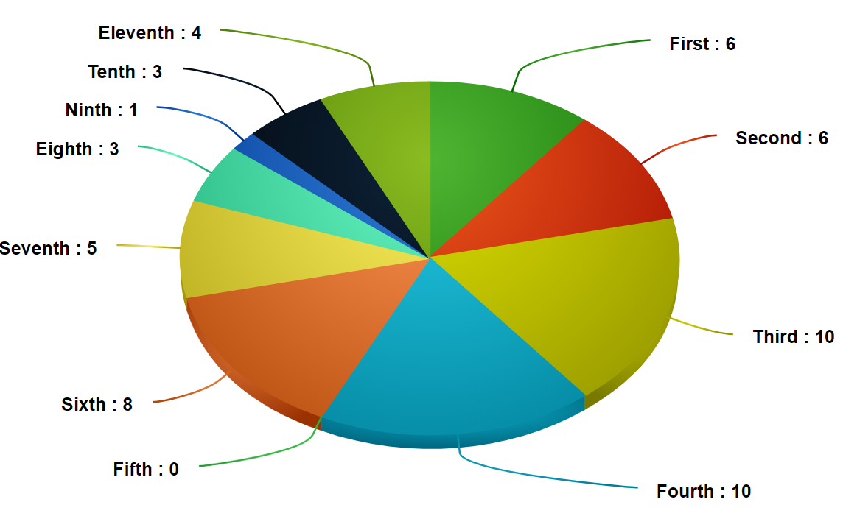
Location
University Setbacks
University Victories

Slide 8
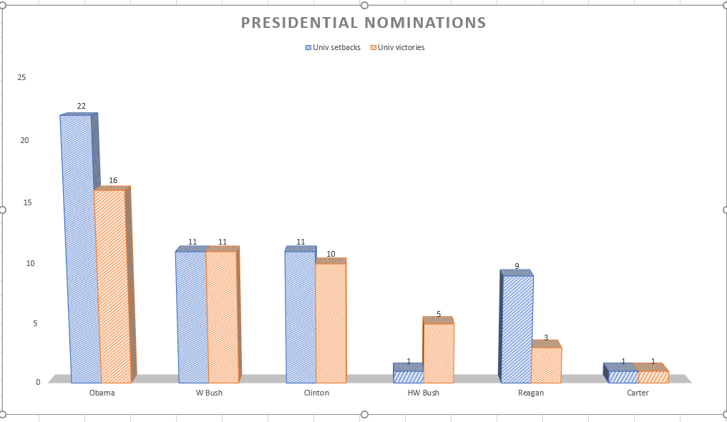

Slide 9
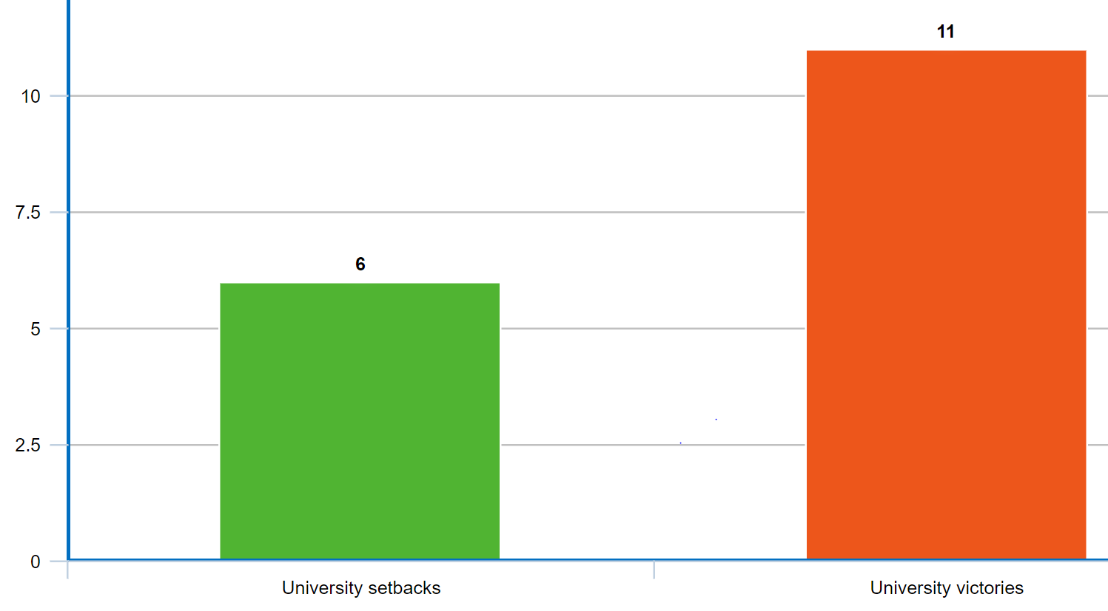
Obama—blue state nominees
Brandeis
Notre Dame
Marymount
Miami (Nokes)
Cincinnati (CA6)

Slide 10
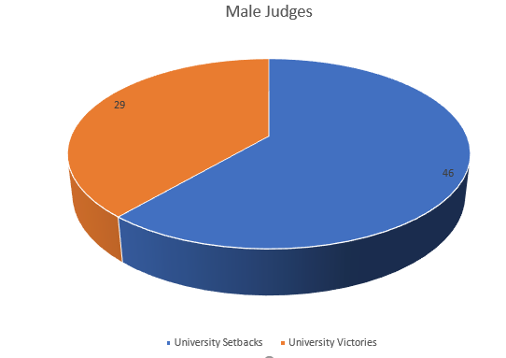
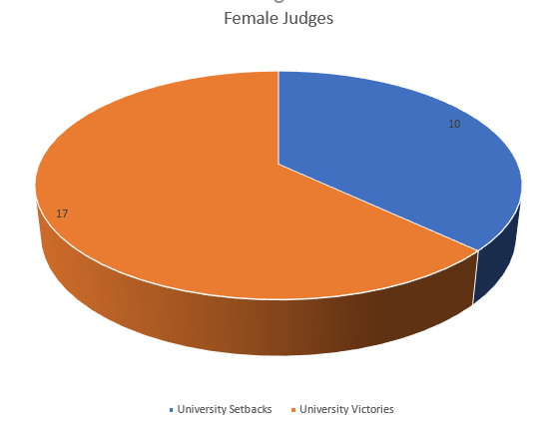
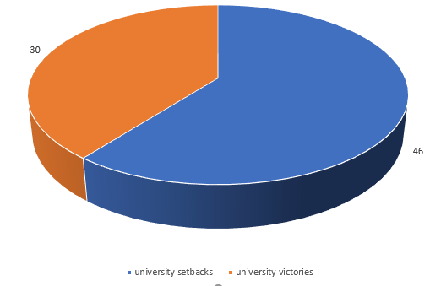
Gender (district court)
Male judges
Female judges

Slide 11
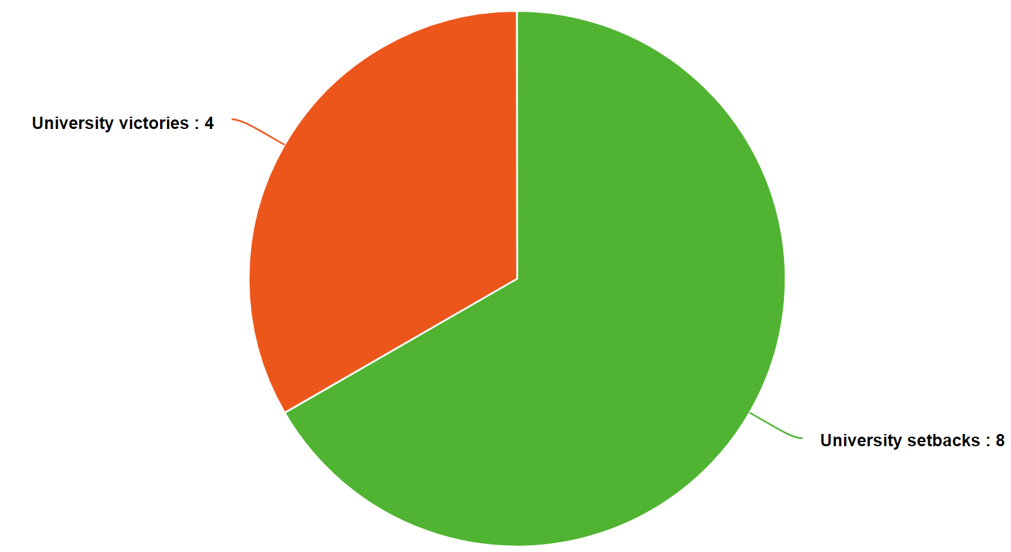
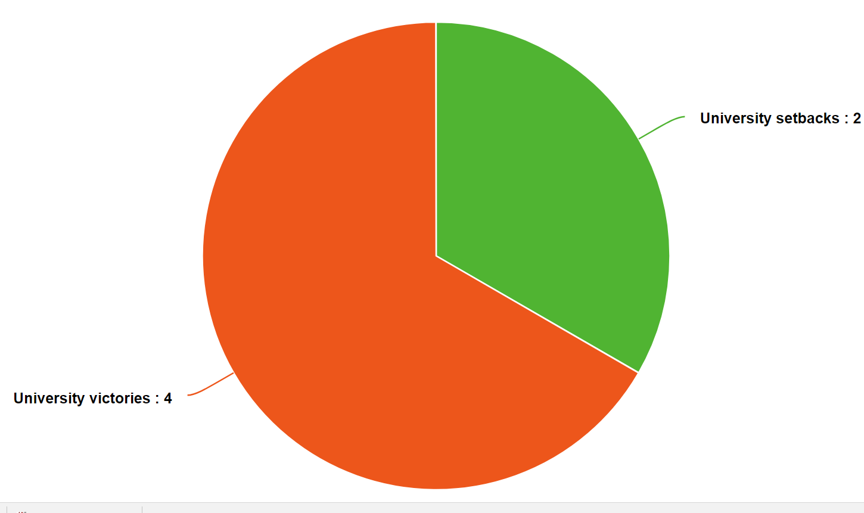
Gender (Appeals Court decisions)
Male judges
Female judges

Slide 12
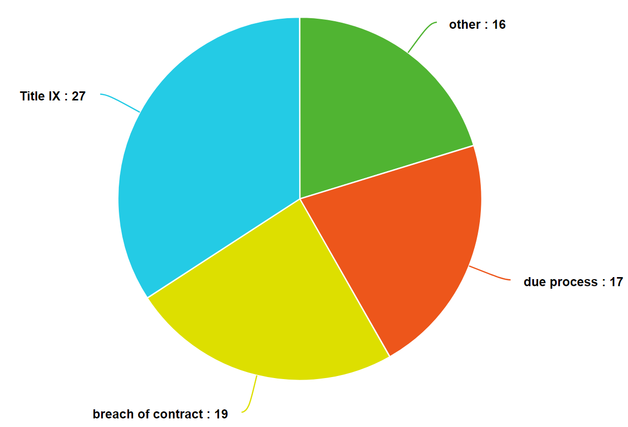
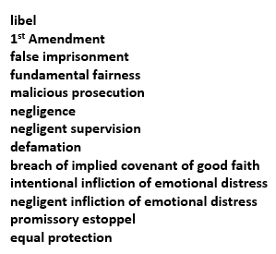
Successful claims
General rejections of MTD in three decisions (Temple, Philadelphia, Cornell Medical School).

Slide 13
Jeremiah Marshall v. Indiana University (15 March 2016)
Marshall has minimally pleaded a viable Title IX gender discrimination . . .
Although Marshall’s pleading may lack the contours of more particularized facts, the Defendants do not deny that they are in sole possession of all information relating to the allegations made by and against Marshall, notably refusing, at all times, to share such information with Marshall or his attorneys. In this regard, the Defendants cannot have it both ways, restricting access to the facts and then arguing that Marshall's pleading must be dismissed for failure to identify more particularized facts. Instead, whether the facts alleged sufficiently ultimately support a claim for intentional gender discrimination under Title IX is a question for a later stage in this litigation, after fair and robust discovery by both sides.

Slide 14
A Duke alumna and lawyer who lives in a residence hall, Dean Sue Wasiolek is the Assistant Vice President for Student Affairs and Dean of Students. She testified that the new expulsion protocol was implemented to assure sexual assault victims that their concerns were being heard . . .
Wasiolek testified last week that the McLeod case was the first to be considered under the new expulsion practice. Asked why the new protocol wasn't written into the university's Community Standard guide, she replied, “It is an understood practice. ... We didn't feel the need to make it public.” . . .
The difficulty of defining incapacitation and consent was underscored last week when Dean Wasilolek took the stand. Rachel B. Hitch, a Raleigh attorney representing [Lewis] McLeod, asked Wasiolek what would happen if two students got drunk to the point of incapacity, and then had sex.
“They have raped each other and are subject to expulsion?” Hitch asked.
“Assuming it is a male and female, it is the responsibility in the case of the male to gain consent before proceeding with sex,” said Wasiolek.
--https://www.indyweek.com/indyweek/a-duke-senior-sues-the-university-after-being-expelled-over-allegations-of-sexual-misconduct/Content?oid=4171302

Slide 15
Doe v. Amherst College (28 Feb. 2017)
Title IX provides a remedy for students, regardless of their sex or gender, who can establish a school's response to their allegations of sexual harassment, including claims of sexual violence, demonstrates deliberate indifference. See Davis, 526 U.S. at 653-54, 119 S.Ct. 1661.
The College's obligations, as clarified in the Dear Colleague letter, do not commence only upon the filing of a formal complaint, but whenever a school "knows, or reasonably should know, about possible harassment" of a student, regardless of whether the harassed student actually makes a complaint. Thus, while Doe never filed a formal complaint, the College certainly learned that Jones may have engaged in sexual activity with Doe while he was "blacked out" and yet, Doe asserts, the College did not take even minimal steps to determine whether Doe should have been viewed as a victim under the terms of the Policy. These allegations provide a sufficient basis for Doe to proceed with a Title IX deliberate indifference claim against the College.

Slide 16
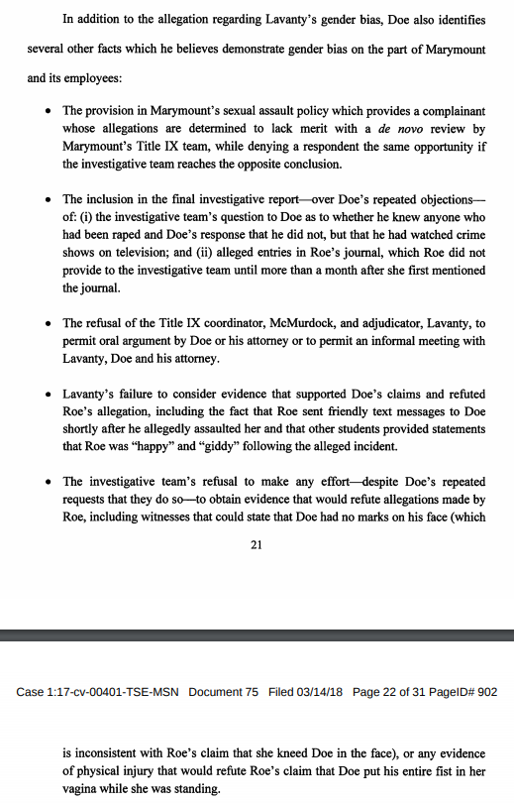
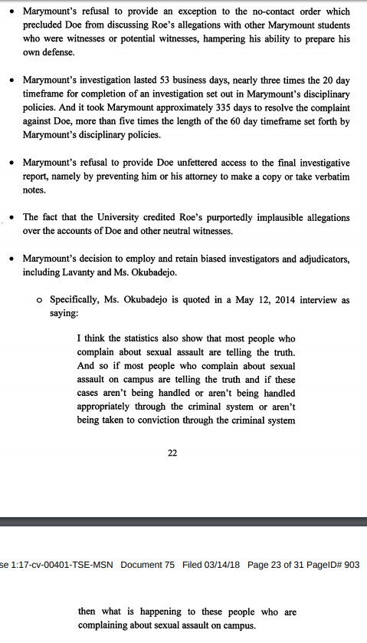

Slide 17
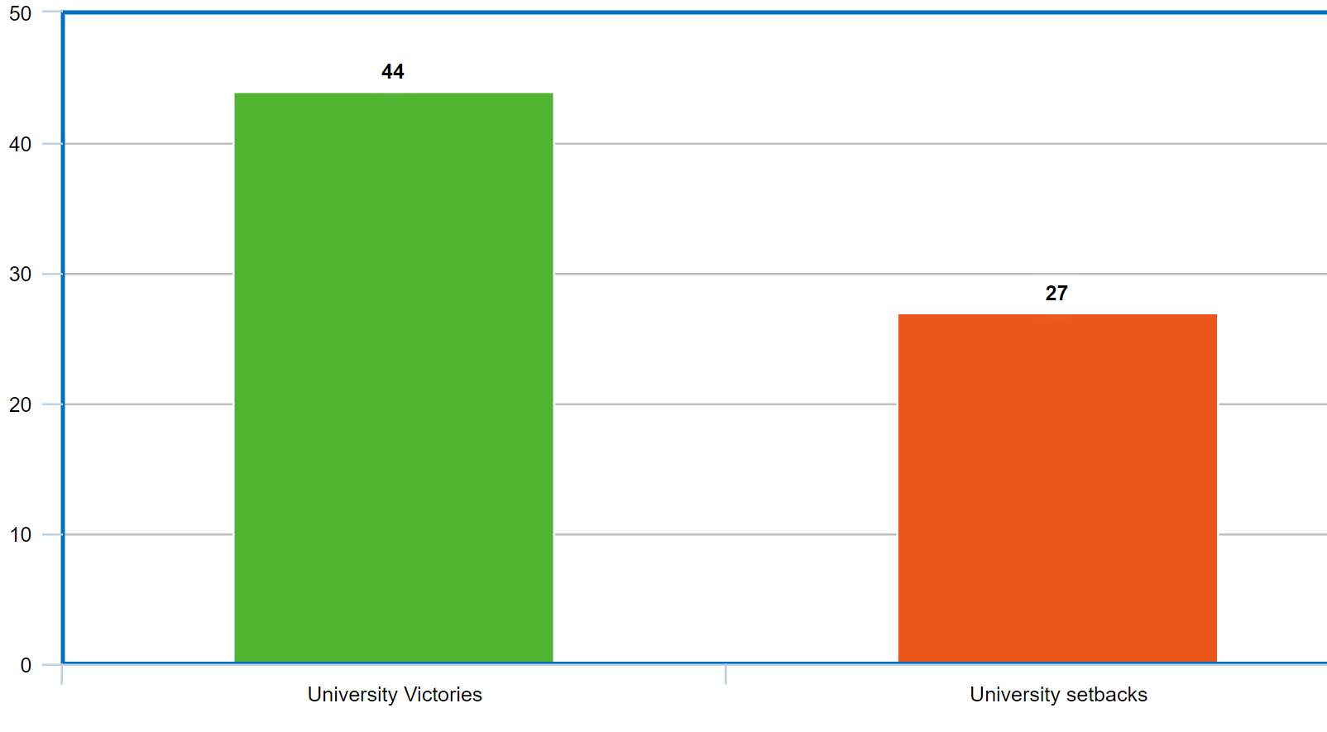
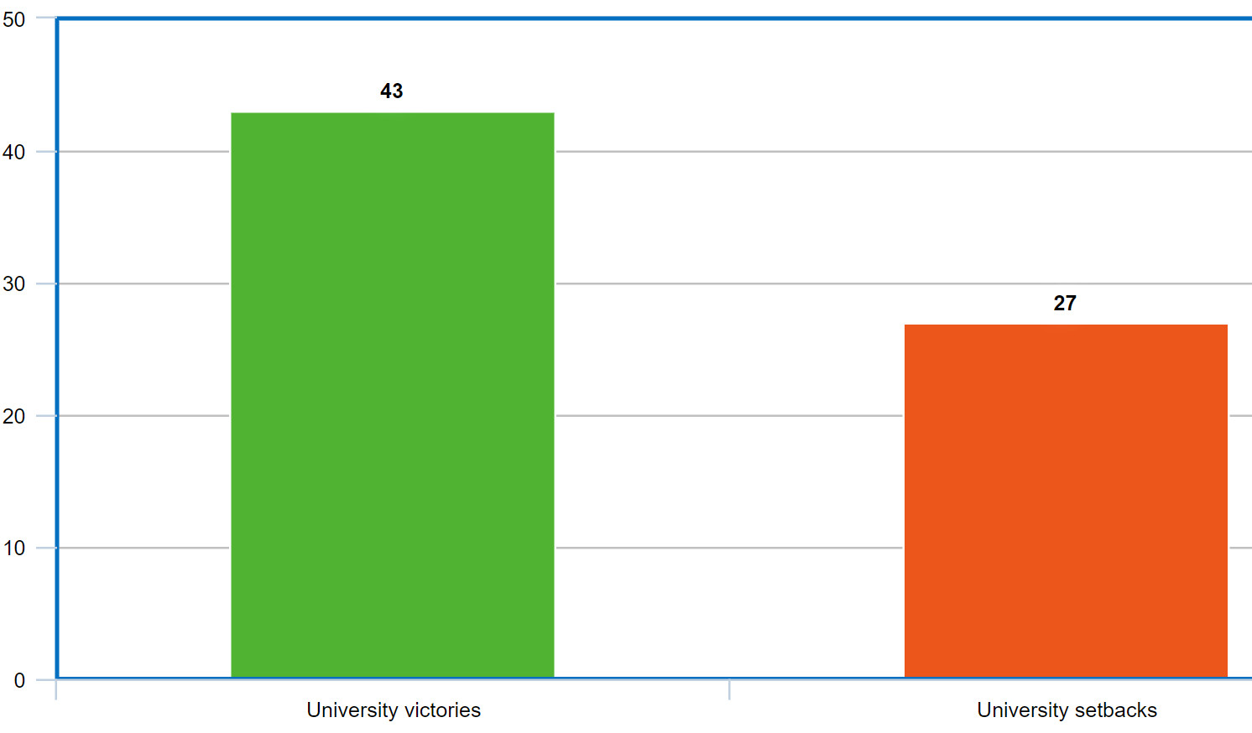
Title IX Rulings
“DePauw is not responsible for the gender makeup of those who are accused by other students of sexual misconduct, and the fact that a vast majority of those accused were found liable might suggest a bias against accused students, but says nothing about gender. “
(King v. DePauw University, 22 Aug. 2014)
“The factual assertion that [Investigator Tobergte] discouraged a witness from testifying at the disciplinary hearing is troubling. However, these facts pleaded against Tobergte do not suggest a gender bias against males so much as against students accused of sexual assault.” (Sahm v. Miami University, 20 May 2015, 25 citations)

Slide 18
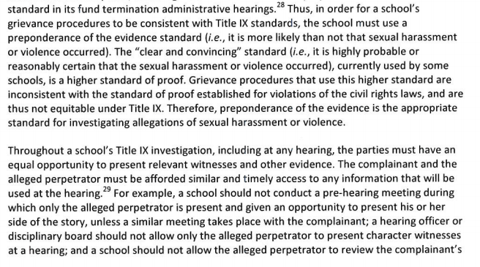
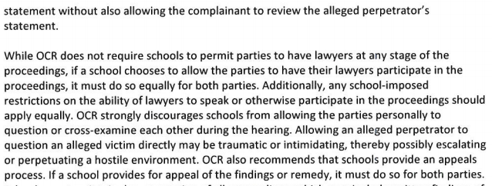

Slide 19
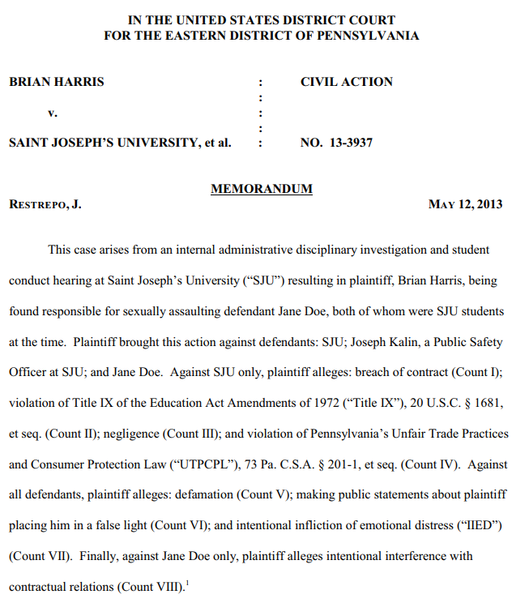

Slide 20
Doe v. Middlebury College (16 Sept. 2015)
While Plaintiff may recover money damages to compensate for lost wages, money damages cannot compensate for the loss of his senior year in college with his class, the delay in the completion of his degree, or the opportunity to begin his career in July 2016 with this particular employment. Further, Plaintiff would have to explain, for the remainder of his professional life, why his education either ceased prior to completion or contains a gap . . .
Specifically, Middlebury's policies did not authorize a second investigation and de novo evaluation of the allegation of sexual assault after it had been decided in Plaintiff's favor by SIT, the sponsor of the study abroad program during which the alleged misconduct occurred, to whose discipline Plaintiff was subject . . . The Court finds Plaintiff has demonstrated a sufficiently serious question regarding whether Middlebury violated its policies in conducting a second investigation of the charge of sexual assault against Plaintiff after he was exonerated by one U.S. institution following an investigation and hearing.

Slide 21
Doe v. George Mason (25 Feb. 2016)
To be clear, the conclusion reached here that plaintiff was not afforded adequate notice should not be taken to suggest that the Constitution requires some particular formula of words or specific means of communication . . . Instead, the dispositive principle as to notice on the undisputed record as it exists here is simply this: Failure to provide clear and specific notice at any point that might allow for a meaningful defense is constitutionally insufficient to provide due process . . .
Unlike high school students, who in a great many states are entitled to public education, plaintiff has no such guarantee with respect to post-secondary education. Thus, unlike high school students, plaintiff's lost opportunity to continue with his post-secondary education, coupled with the possibility that he may be unable to pursue meaningful educational opportunities elsewhere while his name remains associated with sexual misconduct, inevitably affects plaintiff's professional prospects. Moreover, unlike the assault in Watson and the vandalism in Boster, whether plaintiff committed sexual misconduct turns on Roe's consent, a complicated factual determination made all the more complex and nuanced by the unorthodox rules of plaintiff and Roe's BDSM relationship. And common sense suffices to understand that an adjudication of responsibility for sexual misconduct carries a much more powerful stigma than an adjudication of run-of-the-mill assault or vandalism. Given that the facts, contexts, and consequences of the instant case are so different from those in Watson and Boster, it is unsurprising that the requirements of due process are different here.

Slide 22
Doe v. Brandeis (31 March 2016)
When considering the issues presented in this case, it is impossible to ignore entirely the full context in which they arose. In recent years, universities across the United States have adopted procedural and substantive policies intended to make it easier for victims of sexual assault to make and prove their claims and for the schools to adopt punitive measures in response. That process has been substantially spurred by the Office for Civil Rights of the Department of Education, which issued a “Dear Colleague” letter in 2011 demanding that universities do so or face a loss of federal funding. The goal of reducing sexual assault, and providing appropriate discipline for offenders, is certainly laudable. Whether the elimination of basic procedural protections—and the substantially increased risk that innocent students will be punished—is a fair price to achieve that goal is another question altogether . . .
Brandeis appears to have substantially impaired, if not eliminated, an accused student’s right to a fair and impartial process. And it is not enough simply to say that such changes are appropriate because victims of sexual assault have not always achieved justice in the past. Whether someone is a “victim” is a conclusion to be reached at the end of a fair process, not an assumption to be made at the beginning. Each case must be decided on its own merits, according to its own facts. If a college student is to be marked for life as a sexual predator, it is reasonable to require that he be provided a fair opportunity to defend himself and an impartial arbiter to make that decision. Put simply, a fair determination of the facts requires a fair process, not tilted to favor a particular outcome, and a fair and neutral fact-finder, not predisposed to reach a particular conclusion.

Slide 23
Doe v. Amherst College (28 Feb. 2017)
After Doe left her room, Jones exchanged text messages with another student, DR, who lived on the same floor as Jones and EK and served as a residential counselor. In the course of the text message exchange, Jones stated that she "fucked" Doe and proposed lying to others about what happened, expressing concern about the fact that others, including RM, had seen her kissing Doe in the common room, and her belief that Doe "was too drunk to make a good lie out of shit." (Dkt. No. 102-6, AK Aff. & Jones and DR Text Exchange 9.) Jones also told DR that another student, ML, was coming to her room. After ML arrived, she complained to DR that ML was "just talking" rather than initiating sexual contact. Later, Jones complained to DR that "action did not happen til 5 in the ... morning." She also mentioned that Doe had come to her room in search of his phone, but that she had told him to go away because ML was still in her room. The text messages contain a significant back and forth between DR and Jones about what Jones would tell her roommate EK, who had been casually dating Doe. DR took the position that word would get out, stating Doe had told someone else and reminding Jones she too had also told someone, to which Jones responded that DR did not count . . .
Given the facts alleged by Doe, his proposed reading of the Policy and Procedures is not unreasonable. He asserts that a student reading the Policy and Procedures would expect the College to conduct its investigation and fact-finding process in such a manner that potentially exculpatory information would be obtained and presented to the Hearing Board in the same manner as inculpatory information, and that this was not done in his case.

Slide 24
Doe v. Illinois (18 Dec. 2017)
Also unsettling is the fact that Plaintiff alleges that he was provided no meaningful opportunity to cross examine the witnesses against him. Defendant attempts to argue that “Plaintiff’s case definitively did not hinge on determining whether to believe Plaintiff or Jane Roe.”
However, this court finds that argument preposterous. Arguing that a decision regarding an individual’s ability to consent at a time when only two individuals are present and each has a different version of the event requires a credibility determination. To suggest otherwise is nonsensical.
Therefore, the court finds Plaintiff’s allegation regarding his inability to cross-examine witnesses has merit and suggests, at this early stage in the litigation, that the process afforded Plaintiff may have been deficient.

Slide 25
Hearings:
--George Washington (12 April)
--UMass (17 April)
Fully briefed:
--Brown (summary judgment)
--Syracuse (MTD)
Complaints:
--Oberlin
--Coastal Carolina
--University of Mississippi (prelim. injunction)
--Johnson & Wales

Slide 26
Doe v. University of Pennsylvania (13 Sept. 2017)
Specifically, the Complaint alleges that officials who handled Plaintiff’s case were trained with, among other materials, a document called “Sexual Misconduct Complaint: 17 Tips for Student Discipline Adjudicators” (“17 Tips”). That document warns against victim blaming; advises of the potential for profound, long-lasting, psychological injury to victims; explains that major trauma to victims may result in fragmented recall, which may result in victims “recount[ing] a sexual assault somewhat differently from one retelling to the next”; warns that a victim’s “flat affect [at a hearing] does not, by itself, show that no assault occurred”; and cites studies suggesting that false accusations of rape are not common. At the same time, the document advises that the alleged perpetrator may have many “apparent positive attributes such as talent, charm, and maturity” but that these attributes “are generally irrelevant to whether the respondent engaged in nonconsensual sexual activity.” It also warns that a “typical rapist operates within ordinary social conventions to identify and groom victims” and states that “strategically isolating potential victims[] can show the premeditation” commonly exhibited by serial offenders . . .
In light of these allegations, we conclude that the Complaint plausibly alleges that Defendant breached the contractual requirement that it train Hearing Panel members “to fulfill their responsibilities as adjudicators according to the procedures and policies outlined” in the Disciplinary Procedures and “to ensure compliance with Title IX.” In light of these same allegations, we also conclude that the Complaint plausibly alleges that the investigators were not “appropriately trained as investigators in handling sexual violence cases.”

Slide 27
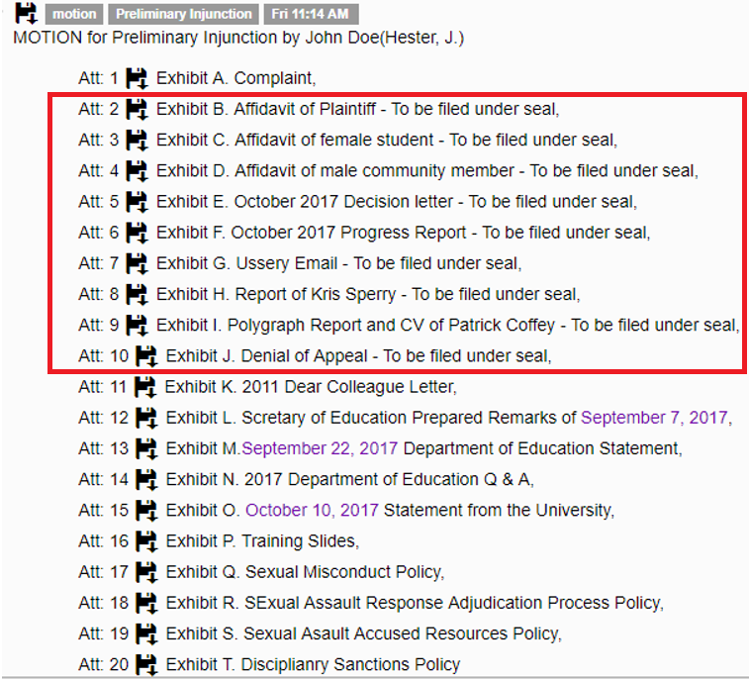

Slide 28
Doe v. Regents of the University of California (22 Nov. 2016)
UCSD’s procedure is not perfect. We have particular concerns in a case like the instant matter where there are allegations of sexual misconduct and/or assault and the determination of responsibility rests almost entirely on a credibility contest between the complainant and respondent. In such a case, no doubt the university would want to provide a procedure that both punishes and curbs violations of the Sex Offense Policy, but also attempts to be fair to both the complainant and the respondent.
Here, we are concerned that the procedure employed by UCSD has great potential to be unfair to a student accused of violating the Sex Offense Policy. Most troubling would be the limits placed on the respondent's opportunity to cross-examine the complainant, especially in response to the complainant's hearing testimony. In addition, we are perturbed by a procedure that also prohibits a respondent from receiving all information that may have a bearing on the complainant's credibility (e.g., [Investigator] Dalcourt's notes of her interviews with Jane, Jane's June 5, 2014 report). That said, on the record before us, we cannot say that the procedure used by UCSD violates due process.

Slide 29
Matter of Jacobson v. Blaise (11 Jan. 2018)
We also reject petitioner’s claim that he was denied due process because he was not permitted to cross-examine the reporting individual. In general, there is a limited right to cross-examine an adverse witness in an administrative proceeding . . .. The Enough is Enough Law does not require such cross-examination. To the contrary, in the event that charges are filed after a report of a violation is made, a reporting individual is not obligated to participate in the hearing . . . Contrary to the observation in the dissent, it would be undue pressure for an institution to advise a reporting person that a decision not to participate would hinder the conduct process. Moreover, the reporting person is entitled to keep his or her identity private at all times. . . .
Petitioner was informed that he could cross-examine Blaise as the complainant, but not the reporting individual. We conclude that this limitation on petitioner’s ability to question the reporting individual did not compromise his right to a fair hearing.

Slide 30
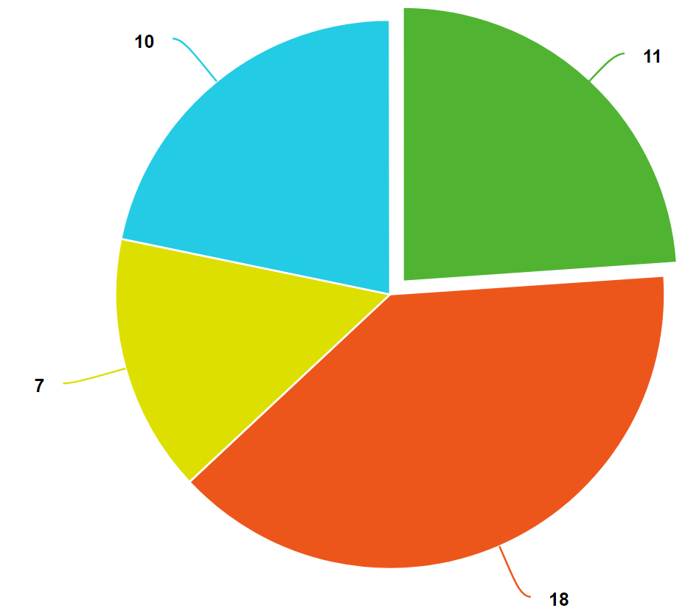
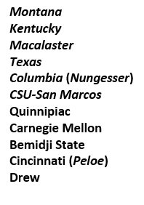

Slide 31
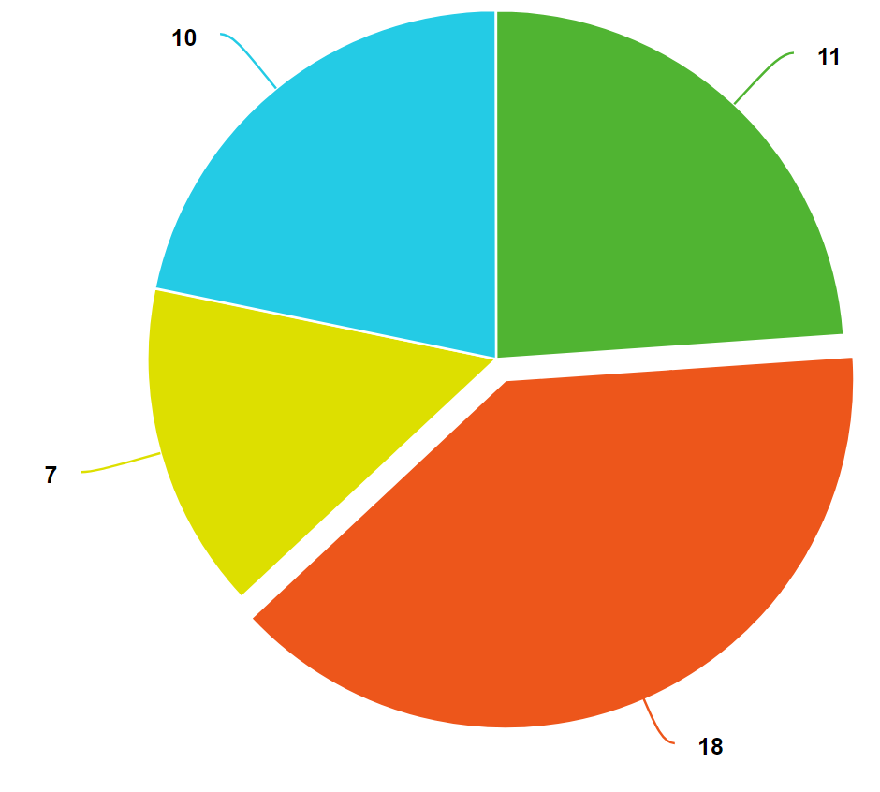
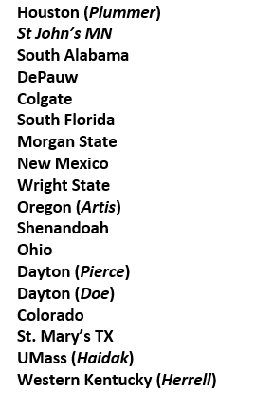

Slide 32
Plummer, et al. v. University of Houston, et al. (26 June 2017)
This case does not require that we determine whether confrontation and cross-examination would ever be constitutionally required in student disciplinary proceedings. The unique facts of this case demonstrate no procedural deficiency in this regard . . . The conduct depicted in the videos and photo—combined with Plummer’s subsequent distribution and publication—was sufficient to sustain the University’s findings and sanctions . . .
Although the University may have been better advised in a number of procedural respects, there is a stark contrast between McConnell’s and Plummer’s culpability and case procedures applied to them and the allegations of student innocence and official refusal to conduct a thorough investigation in Columbia Univ.

Slide 33
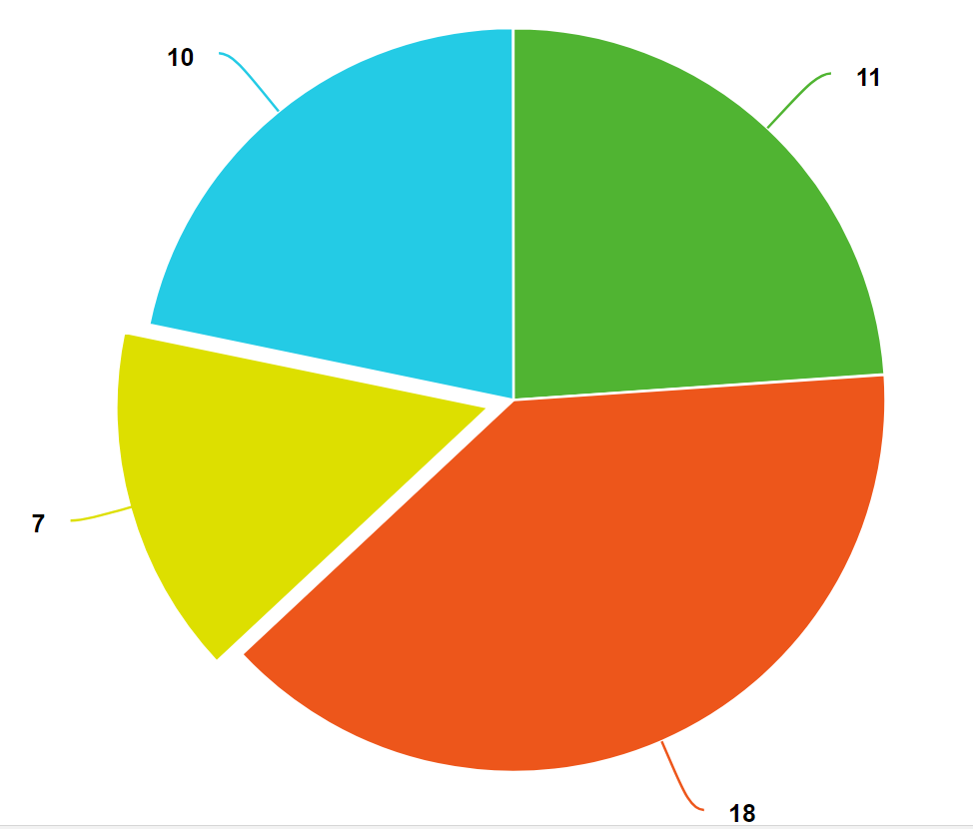
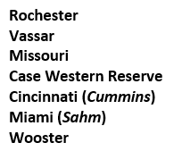

Slide 34
