Slide 1
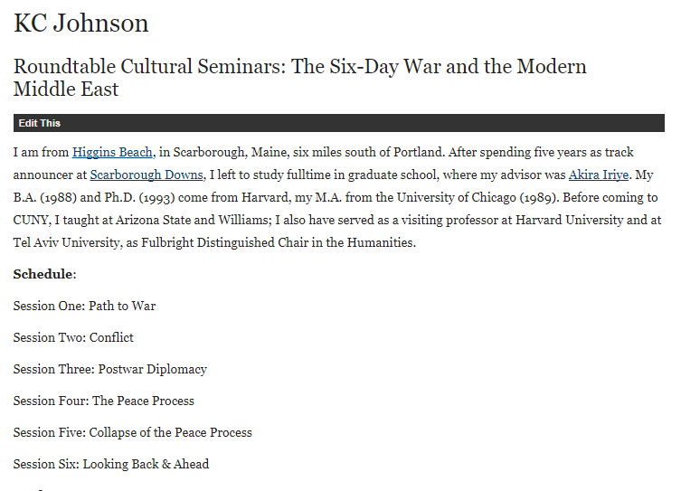

Slide 2
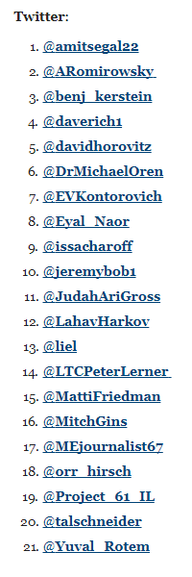

Slide 3
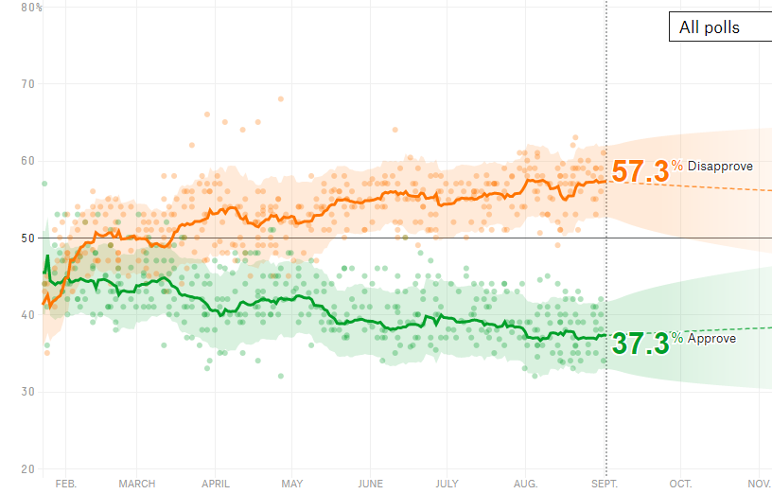

Slide 4
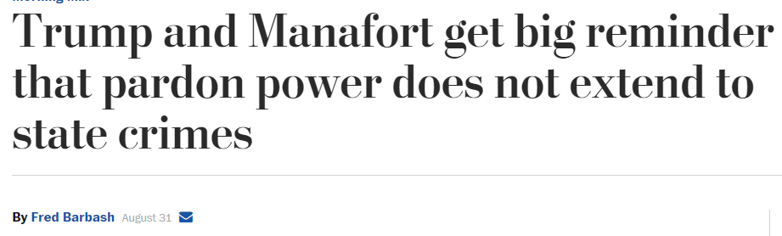
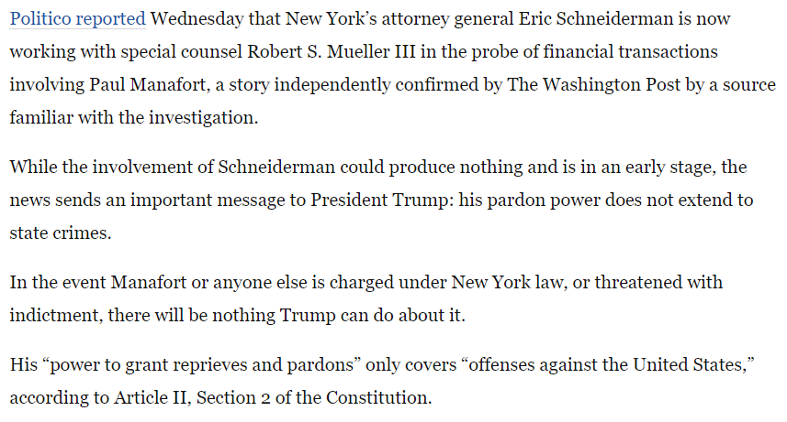

Slide 5
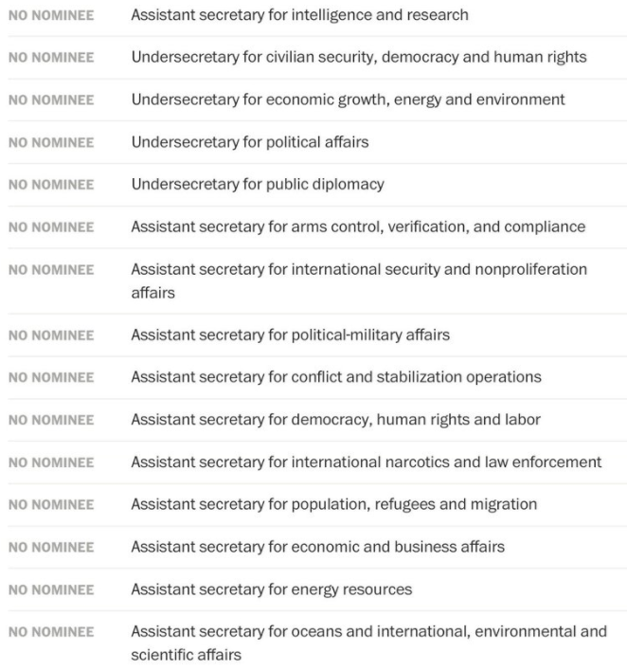

Slide 6
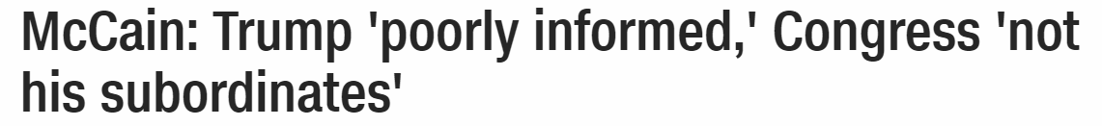
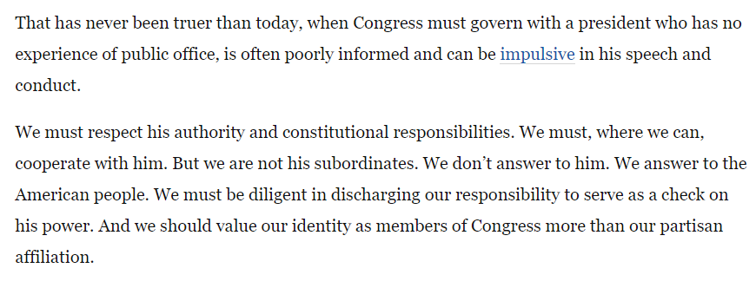

Slide 7


Slide 8
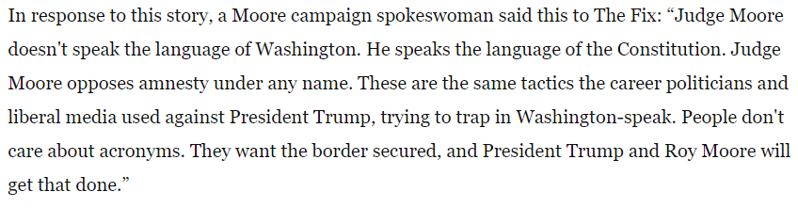

Slide 9
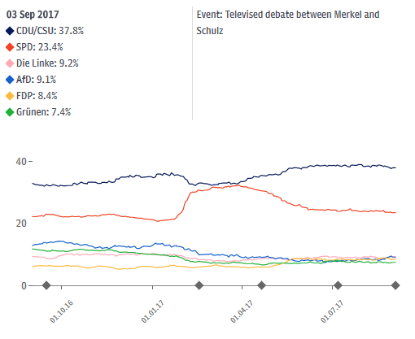

Slide 10
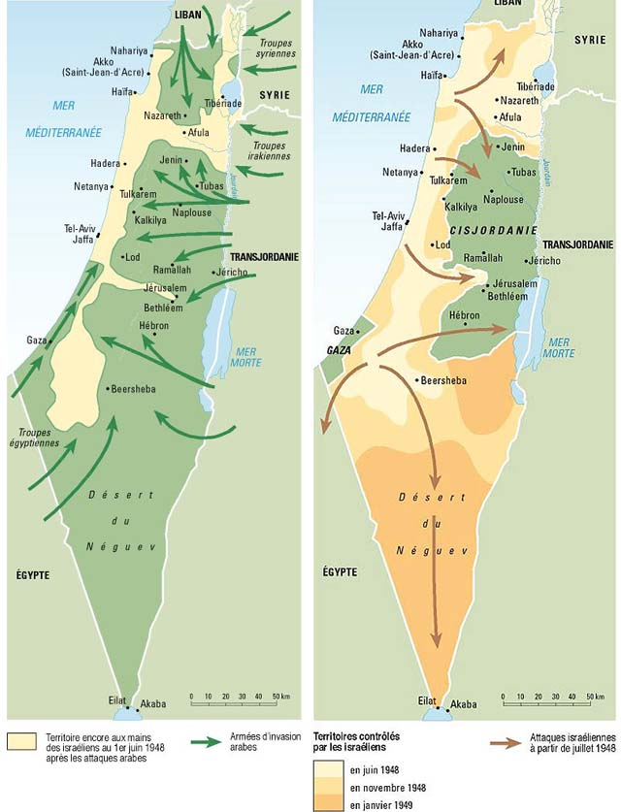

Slide 11
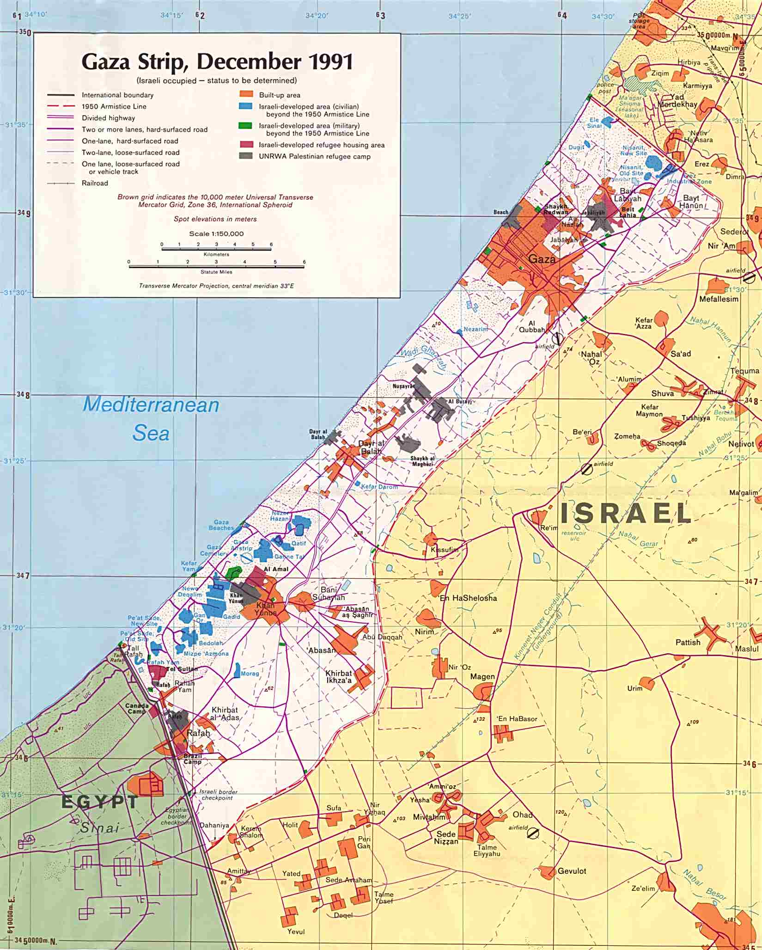
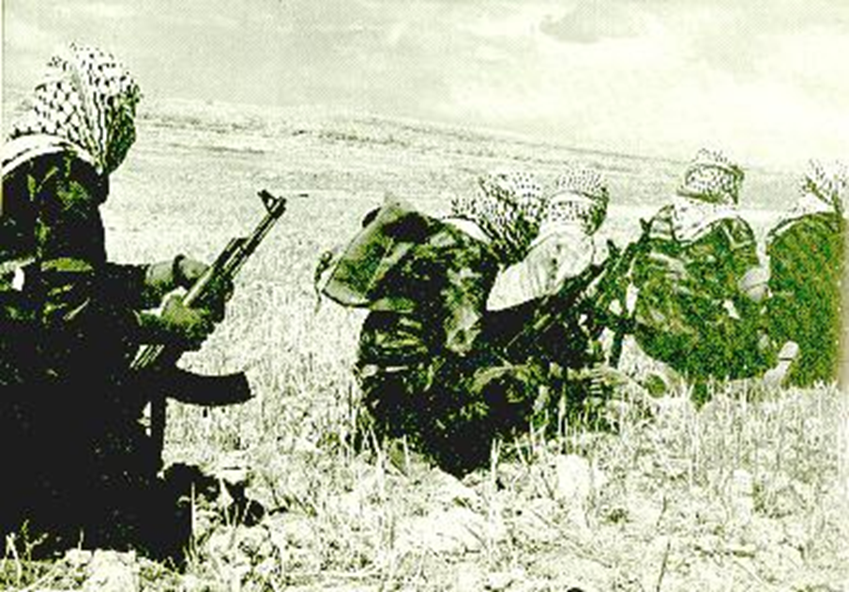

Slide 12
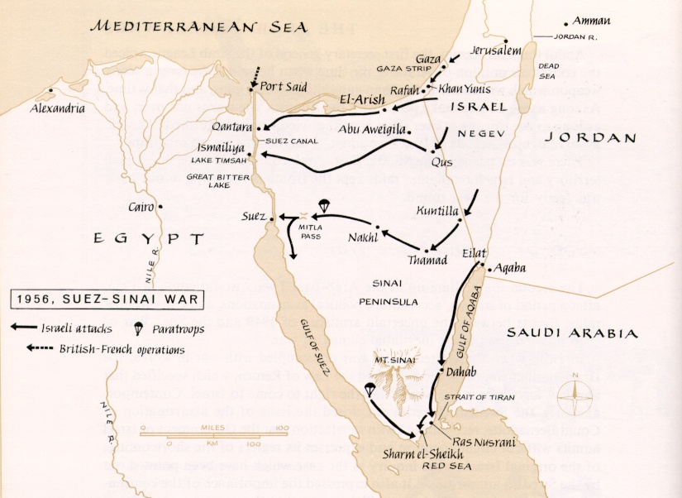

Slide 13
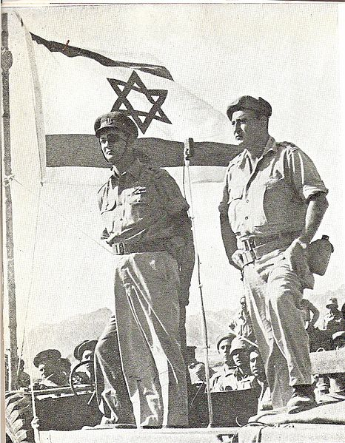
Notes:
Dayan at sharm el-shek

Slide 14
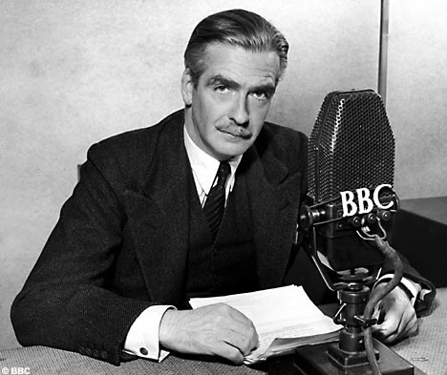

Slide 15
US aid to Israel, Eisenhower & Kennedy administrations
 | Total | Military aid | Economic aid | Food for Peace
1954 | 74.7M | 0 | 54M | 20.7M
1955 | 52.7M | 0 | 41.5M | 11.2M
1956 | 50.8M | 0 | 24M | 26.8M
1957 | 40.9M | 0 | 26.8M | 14.1M
1958 | 61.2M | 0 | 24M | 37.2M
1959 | 50.3M | .4M | 19.2M | 30.7M
1960 | 55.7M | .5M | 23.9M | 31.3M
1961 | 45.1M | 0 | 24.5M | 23.6M
1962 | 83.9M | 13.2M | 45.4M | 25.3M
1963 | 76.7M | 13.3M | 45M | 18.4M

Slide 16
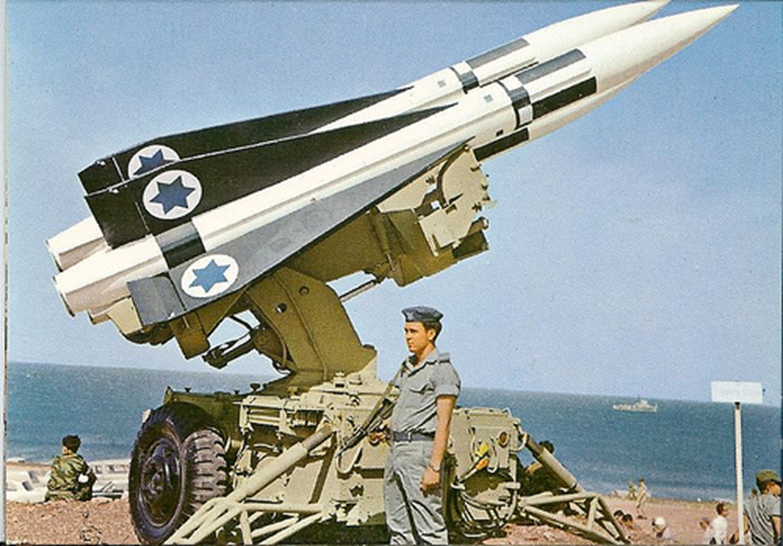
Wm. Bundy memo, 16 July 1962
The Joint Chiefs of Staff appraisal is inclosed. In summary, the Department of Defense views are:
Israel is vulnerable to UAR air attack and is becoming increasingly so with the arrival of additional Soviet TU-16's.
(b) The addition of the Hawk missile within Israel's air defense system would fill an important gap in their defense.
(c) Acquisition of the Hawk missile system by Israel would not alone act to shift the balance of military power between Israel and its neighbors.

Slide 17
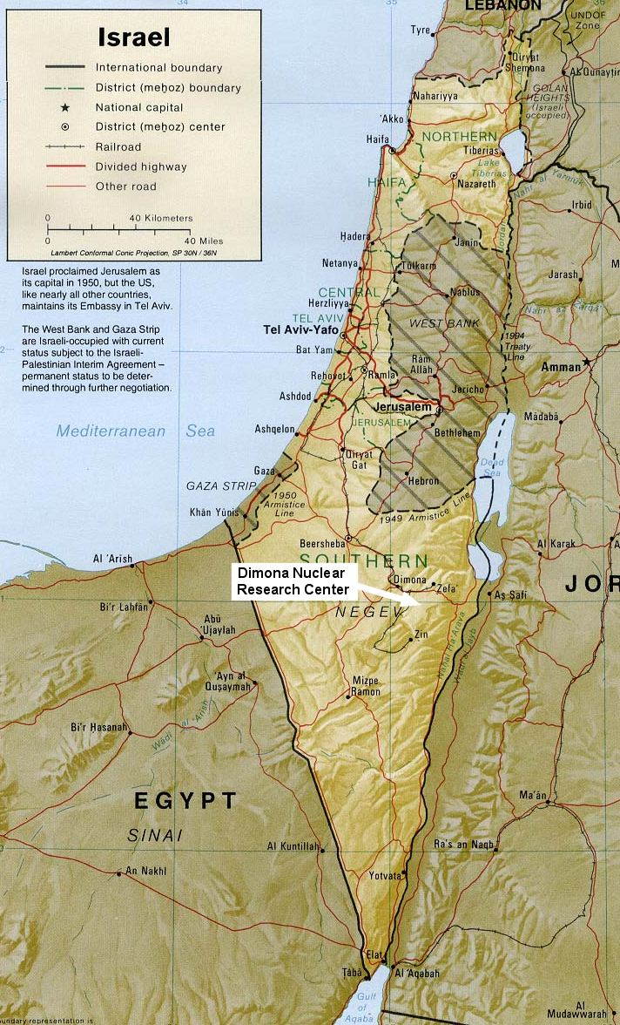
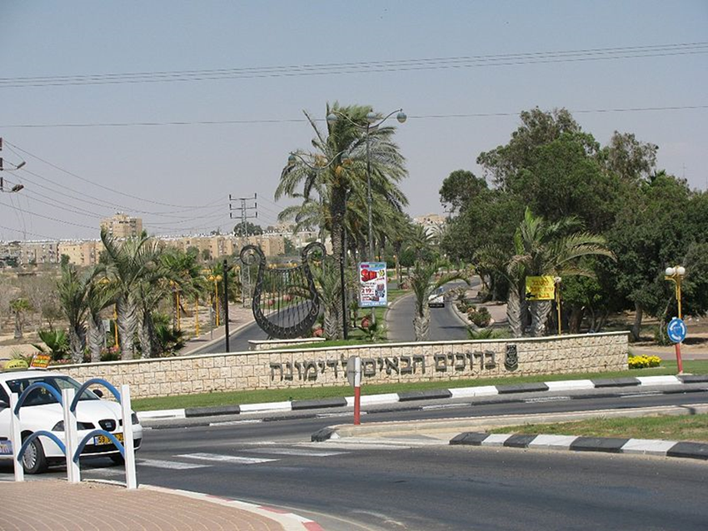
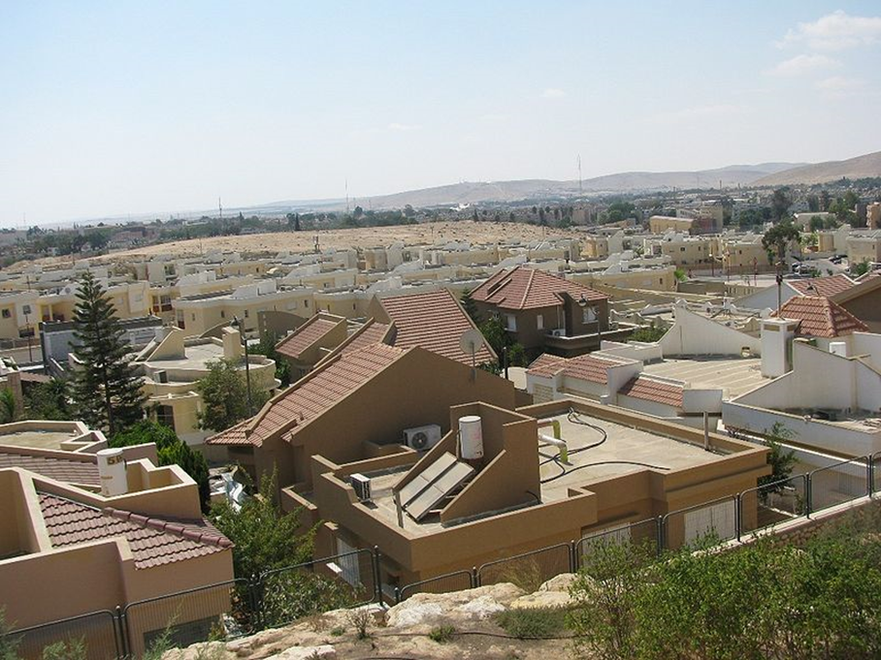

Slide 18

President Kennedy: My God, we wouldn’t continue our guarantee of [West] Germany if they started manufacturing nuclear weapons, which is really of vital importance to us compared to our position in Israel. Why should we guarantee Israel if they’re doing it? That’s . . .
Secretary of State Dean Rusk: A nuclear weapon explosion in Israel would drive the Arab world right into the Soviet arms. I can’t see that happening any other [way].
President Kennedy: It seems to me that if you’ve got this thing in there—a country, after all, who has received a good deal of assistance from us.
Is it fair to say the main source of foreign income is the United States?
Rusk: Without any question.
President Kennedy: Therefore, for them to do it—after all, they’re regarded as a very close associate of [ours], and a country which has been most recently the subject of a guarantee, of a commitment, by the President at a press conference—for there to be any question that this nation may be manufacturing nuclear weapons, and for this country, the United States, not to be concerned of that, places in my opinion, and the opinion of America, as well in the entire West—
Rusk: [Unclear] Middle East.
President Kennedy: If this should become public—we don’t want to sound threatening, but that’s the fact of the matter—it’s bound to have, I think, most adverse effects.
Rusk: [Unclear] lack of will.
President Kennedy: And I think if he [Ben Gurion] doesn’t do it [agree to U.S. inspections] then, we ought to leak it out to some paper that there’s a suspicion they won’t permit inspections, and all the rest.
Because I think, for them, the damage is just . . .
I mean, not only were they allowed to get the thing [nuclear weapon] themselves; it could encourage and stimulate them [the Arabs] to launch a military action before your [Israeli] program is completed.
So, therefore, it increases the dangers of war, and we’re quite obviously involved.
Notes:
17 May 63

Slide 19
Kennedy Letter to Ben Gurion, 18 May 1963
… The dangers in the proliferation of national nuclear weapons systems are so obvious that I am sure I need not repeat them here. It is because of our preoccupation with this problem that my Government has sought to arrange with you for periodic visits to Dimona . . .
We are concerned with the disturbing effects on world stability which would accompany the development of a nuclear weapons capability by Israel. I cannot imagine that the Arabs would refrain from turning to the Soviet Union for assistance if Israel were to develop a nuclear weapons capability--with all the consequences this would hold. But the problem is much larger than its impact on the Middle East. Development of a nuclear weapons capability by Israel would almost certainly lead other larger countries, that have so far refrained from such development, to feel that they must follow suit.
I can well appreciate your concern for developments in the UAR. But I see no present or imminent nuclear threat to Israel from there. I am assured that our intelligence on this question is good and that the Egyptians do not presently have any installation comparable to Dimona, nor any facilities potentially capable of nuclear weapons production . . .
I trust this message will convey the sense of urgency and the perspective in which I view your Government's early assent to the proposal first put to you by Ambassador Barbour on April 2.

Slide 20
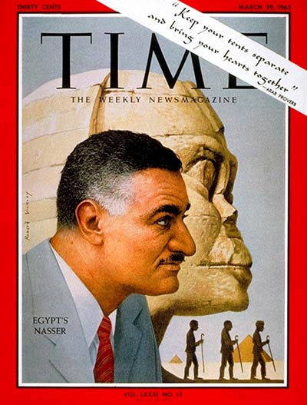

Slide 21
President Kennedy: So let’s see what kind of a message we can get out to them, which carries some force to them, as if our concern is not totally the Israelis. It may be that we’ll want to come out with some sort of a guarantee next week, or reinforcement of the Tripartite [Agreement, between Britain, France, and the US]. But we want it to be understood in advance that it’s not just because of our concern about Israel.
Really our concern is mutual, because the peril is mutual—that the Israelis will move in a preemptive way at a time when they have the power; [and] that therefore, the fellow who’s really in more trouble is Nasser, not so much the Israelis. We would certainly want to get that point [across]—that that’s the way it looks to us, and that therefore any Tripartite guarantee would at least carry with it an appearance of, as I said, mutuality.
Now, the other thing is what we can do about the Jordanians—what we ought to try to do with the British. I think we ought to encourage the British to be more ready to move under some conditions. After all, this has been their traditional area: we’re not supposed to do everything.
So let’s get [British ambassador to the US] David Ormsby-Gore—
George Ball: I talked to David already this morning, and told him we’d [unclear], so I’ll get moving—
President Kennedy: Well, I think we can say that we could visualize a situation where we’d have to have somebody move in. it seems to me it ought to be the British.

Slide 22
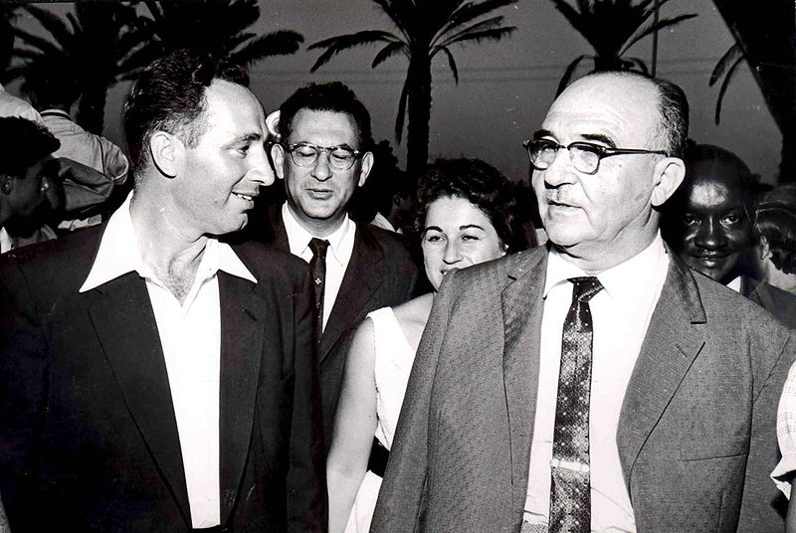
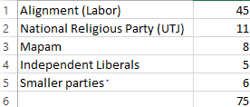
1965 Elections

Slide 23
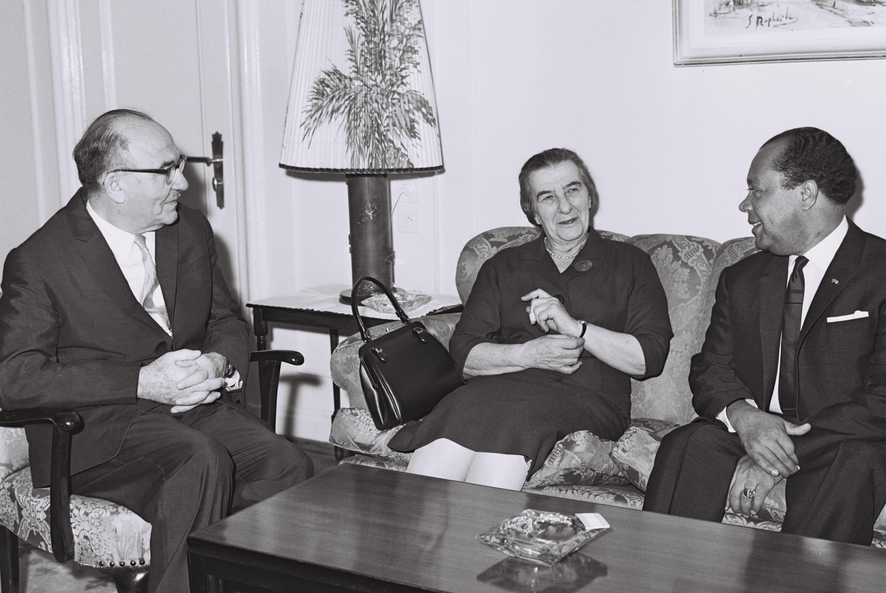

Slide 24
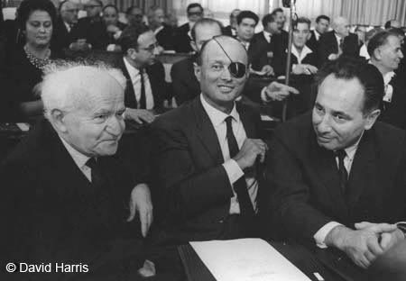
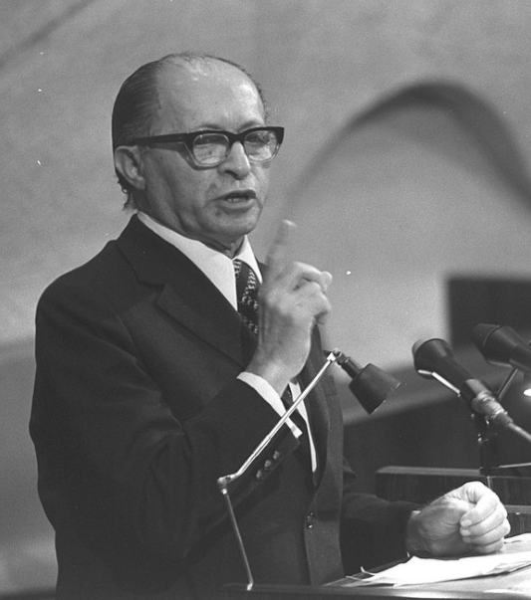

Slide 25
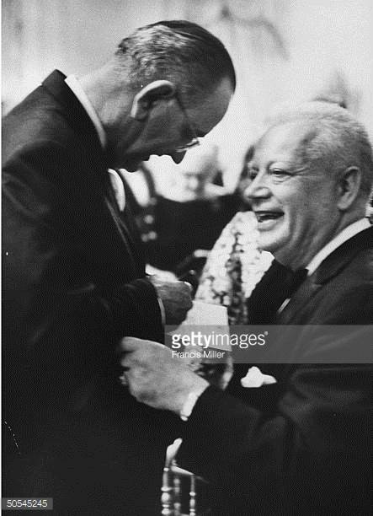
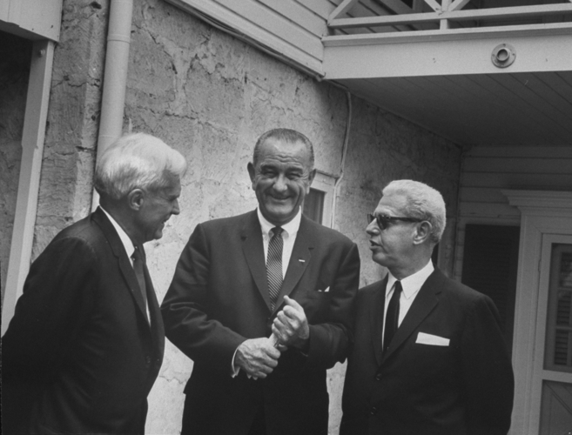

Slide 26
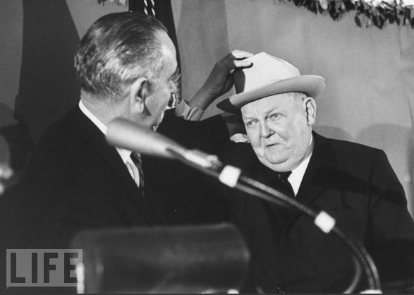
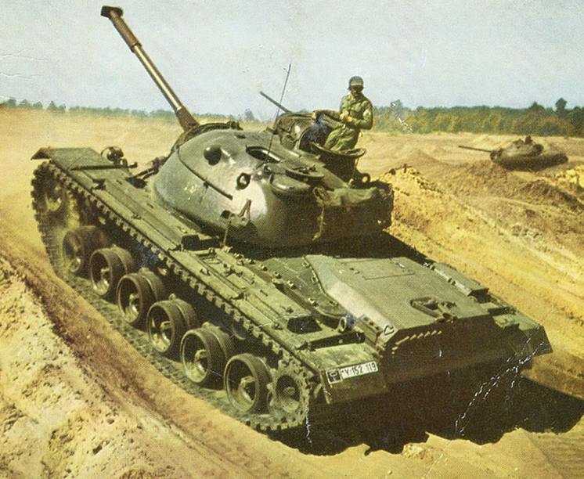

Slide 27
President Johnson: I like [Prime Minister Levi] Eshkol—I got along with him fine. I got along with [former prime minister David] Ben Gurion fine. I spent a lot of time with him, back when they were in real problems, and they were getting ready to [impose] sanctions [in 1963, over Dimona]. I just came down here and said, “Hell, no, that can’t be.”
Abe Feinberg: I remember that.
President Johnson: And I stopped it.
But they fight among themselves over there, and I’m not going to get in the middle of these clashes—have one of them leak it on me that I want to join up with the Arabs.
Feinberg: I gather that, for proper diplomatic reasons, you think that [Foreign Minister] Golda’s [Meir] visit here would be—
President Johnson: I just think—I think it would inflame the whole world. I think that the Germans would wonder if she’s coming to mess in that thing. I think that the Arabs would say, “Good God, what’s Johnson doing in here?” I think the Jews would all start sending telegrams . . .
I can’t imagine her getting off [the plane] with a suitcase without somebody saying, “Why?”
Feinberg: Yeah.
President Johnson: And then I don’t want to get another Arab/Ben Gurion/Eshkol/Erhard election in this thing if I can avoid it.
[Break.]
President Johnson: I’m friendly to these people, and I want to help them. But . . .
As our people see it, if they [the Israeli government] really, sincerely, genuinely feel that we oughtn’t to sell these planes to Jordan, and we oughtn’t to sell these tanks (we’re giving them as little as we can get by with; Nasser has got their feet to the fire)—well, we won’t do it. I’ll just say that, and I’m prepared to do it.
And I’m telling [special emissary Averell] Harriman to tell the prime minister that. Because I think it’s something that’s got to be settled with him . . .
Feinberg: With the prime minister of Israel?
President Johnson: Yeah. Yeah.
And now he’s [Harriman] going to say, “Now, you all decide this.” We have indications from our Jewish population in the United States that they think that’s the course we ought to follow.
Now, our judgment is we oughtn’t to do it. Our judgment is we oughtn’t to let this little king [King Hussein] go down the river. He’s got a million-and-a-half people, and he only controls a third of them—two-thirds [are] against him.
But he is the only voice that will stand up there. And if you want to turn him over and have a complete Soviet bloc, why, we’ll just have to—and we’ll get out of the arms business.

Slide 28
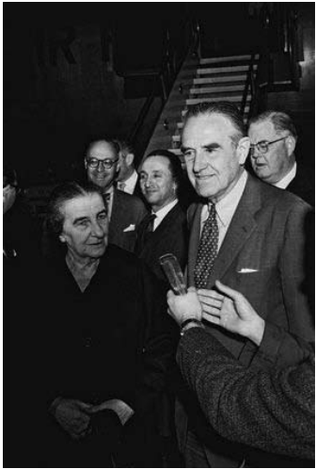

Slide 29
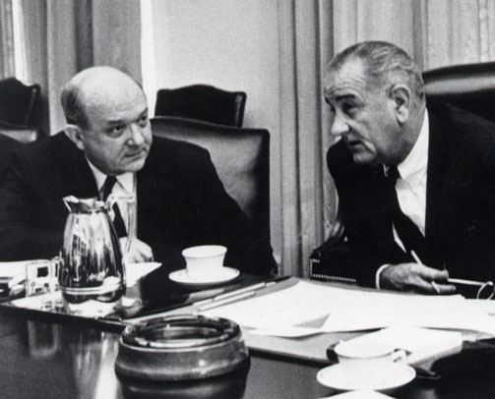

Slide 30
Dean Rusk: [reading from proposed telegram for Averell Harriman to present to Prime Minister Eshkol]
“ . . . Our deep concern about unification of Arab world behind Nasser with close working relationships with [the] Soviet bloc is [the] greatest threat to Israel we can imagine. The fact that it would be deeply injurious to U.S. interests in [the] Near East, including the security of Israel, seems to us to require that we and Israel would together to head it off. We agree to a private visit to Washington of [Shimon] Peres and [Yitzhak] Rabin. Must emphasize absence of publicity for such visit, as was accomplished on earlier occasions.” . . .
President Johnson: I had this feeling—I don’t know if it’s any good, but, God, I hate to transfer all those Jews into Washington, though, because I’m afraid that they’ll all move in at the slightest provocation. I wouldn’t be surprised if Golda’s [Meir] not on her way if we don’t watch.
But maybe not.
Do you think that we could say to Averell to strike out the [word] “sympathetically” [from the proposed agreement] and say, “We pledge to give you x tanks, and give ‘em the x tanks, plus the little beyond the tanks—without any planes? It seems that the basis of his [Eshkol’s] objection is that [the U.S. saying] “we view sympathetically” doesn’t commit us.
Rusk: Uh-huh.
President Johnson: And that he wants a commitment.
It seems that we might, without great danger, raise the ante a little bit to what the Germans are giving them, and say if the Germans don’t complete it, we’ll complete it, plus 20 or something.

Slide 31
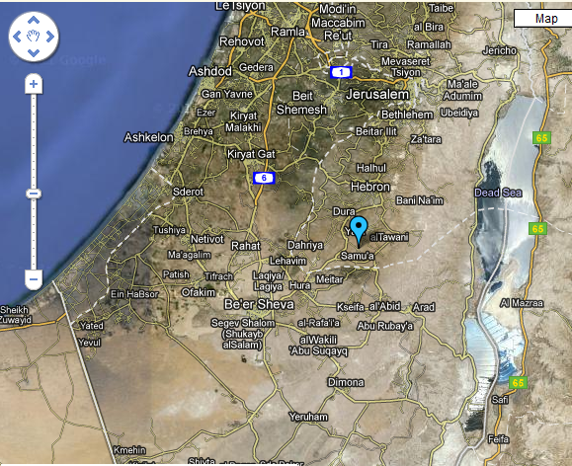
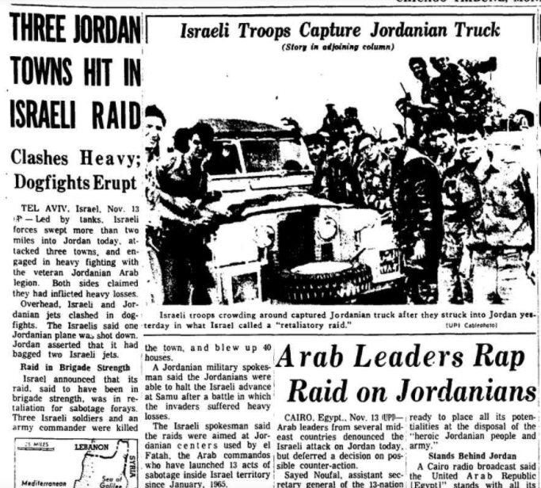
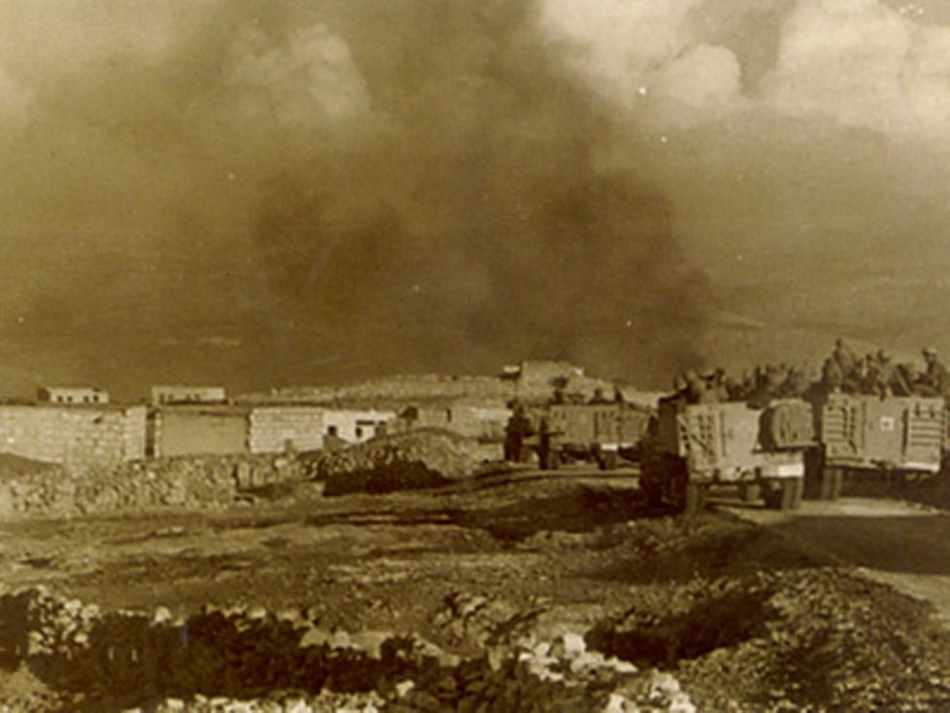

Slide 32
UN Resolution 228 (Nov. 1966)
The Security Council,
…Observing that this incident constituted a large-scale and carefully planned military action on the territory of Jordan by the armed forces of Israel,
…
Recalling the repeated resolutions of the Security Council asking for the cessation of violent incidents across the demarcation line, and not overlooking past incidents of this nature,
Reaffirming the necessity for strict adherence to the General Armistice Agreement,
1. Deplores the loss of life and heavy damage to property resulting from the action of the Government of Israel on 13 November 1966;
2. Censures Israel for this large-scale military action in violation of the United Nations Charter and of the General Armistice Agreement between Israel and Jordan;
3. Emphasizes to Israel that actions of military reprisal cannot be tolerated and that, if they are repeated, the Security Council will have to consider further and more effective steps as envisaged in the Charter to ensure against the repetition of such acts.

Slide 33
President Johnson: Have you got—have you got Jordan and Israel? I told them [the State Department] not to pee a drop on India, Pakistan, or Jordan and Israel without you. Have they checked all this stuff?
Arthur Goldberg: Nick [Katzenbach] gave you a memorandum of our conversation. And I’ve asked the Israel ambassador [to the United States], Abe Harman. He’ll come and see me Friday morning and I’ll get back to you.
President Johnson: What we’ll do is at the proper time—we won’t be chinchy with them, we’ll go back to [focusing on] Africa or something else. We can’t make a deal, but…
I just think they’re damn fools to let [King] Hussein get thrown out.
Goldberg: Yeah, I think they know that. And I’ll be glad to talk to them.
President Johnson: All right. OK.

Slide 34
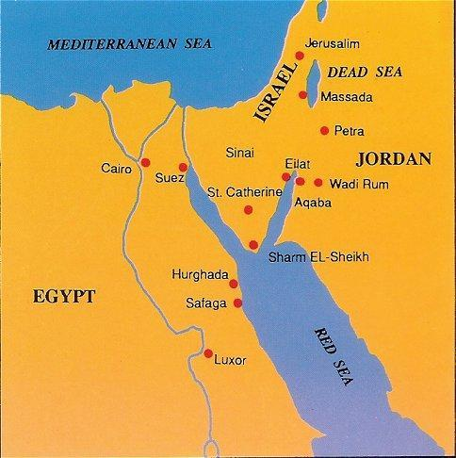

Slide 35
