Slide 1
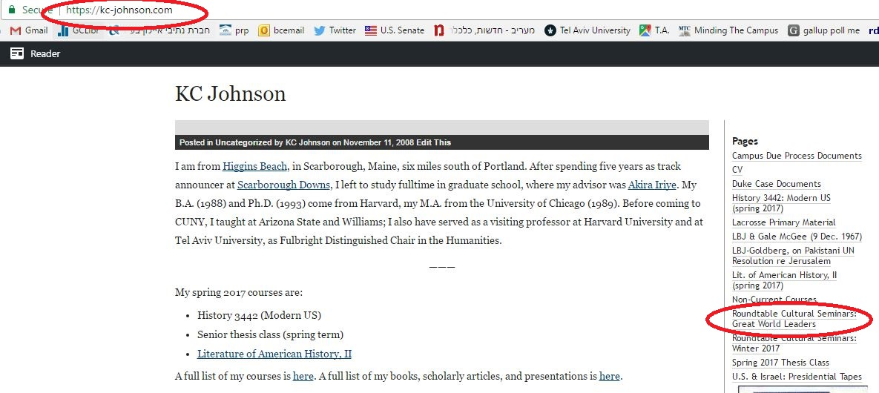

Slide 2
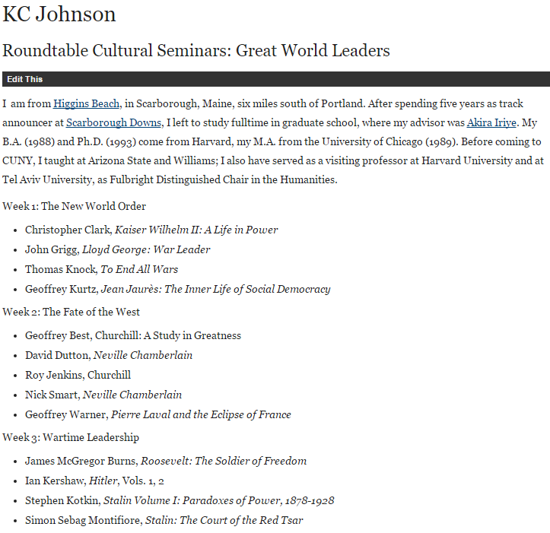

Slide 3
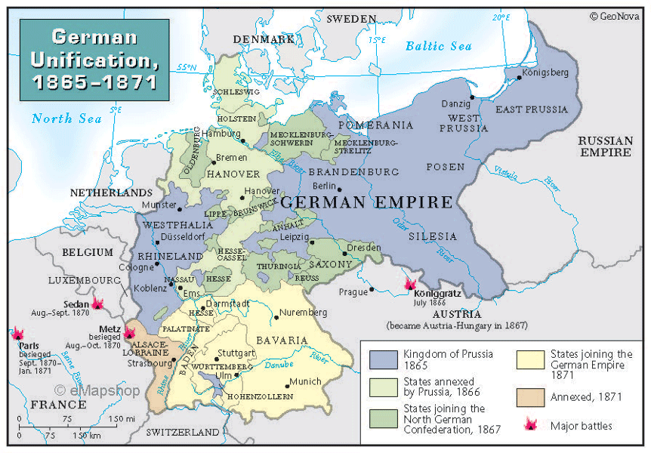

Slide 4
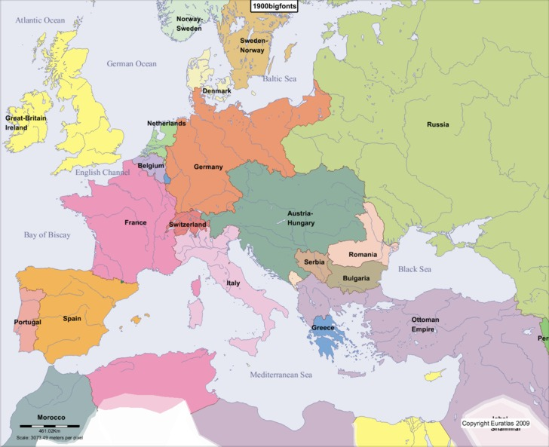

Slide 5
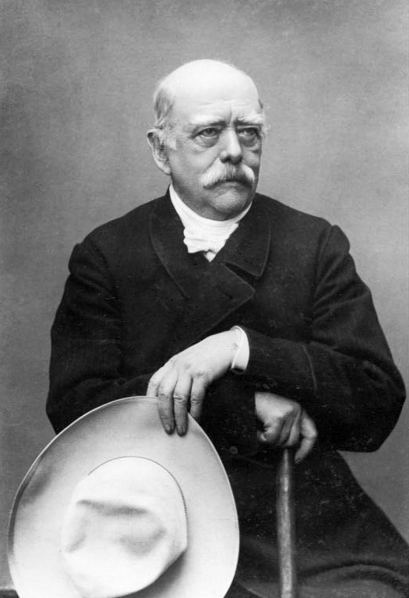

Slide 6
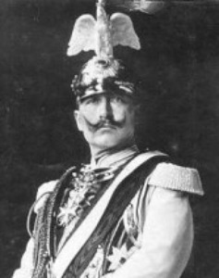

Slide 7
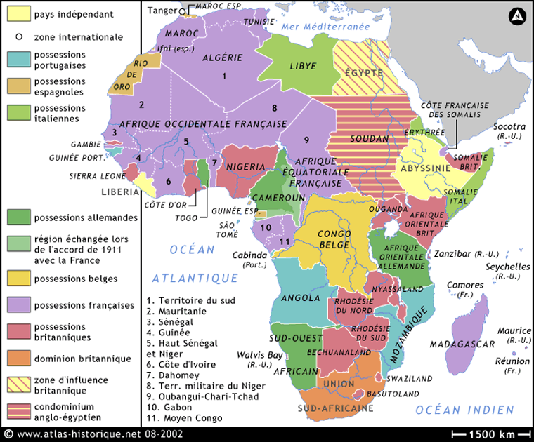

Slide 8
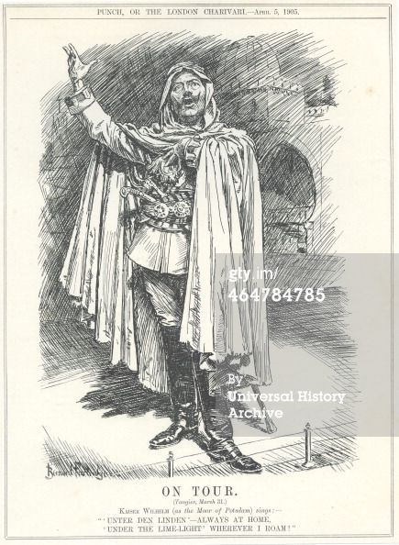
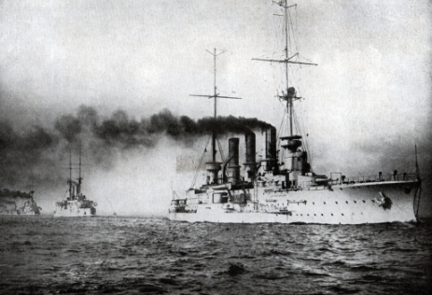
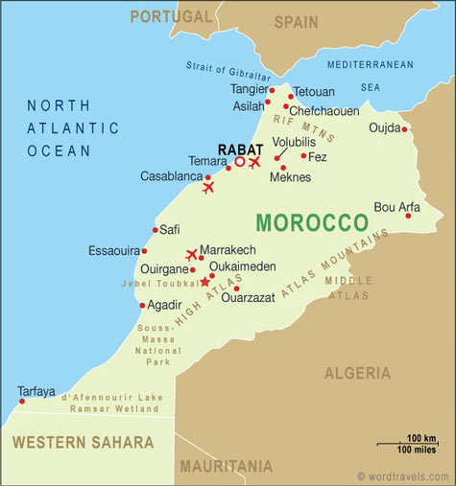

Slide 9
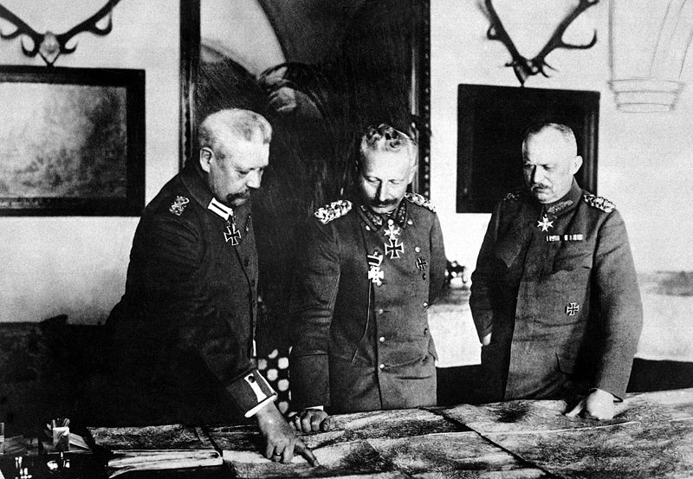
Notes:
Hin—lud-Kaiser 1917

Slide 10


Slide 11
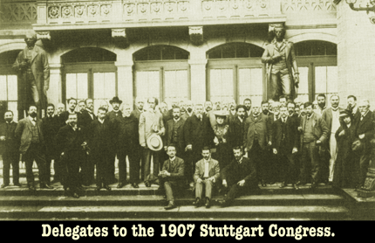
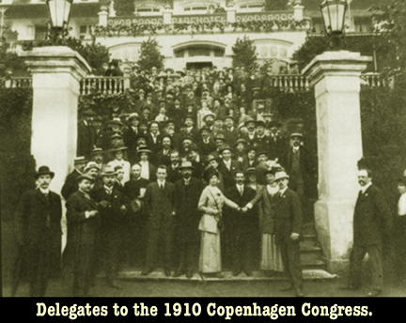

Slide 12
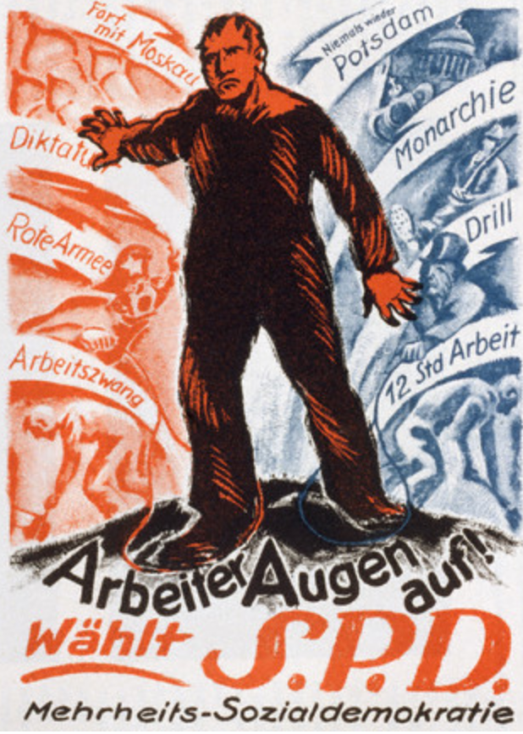
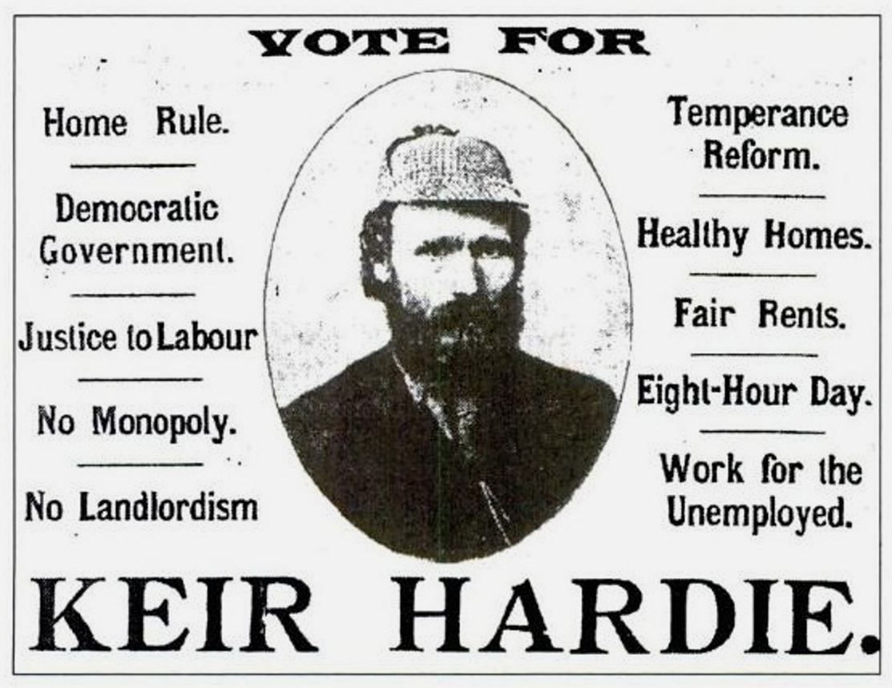

Slide 13
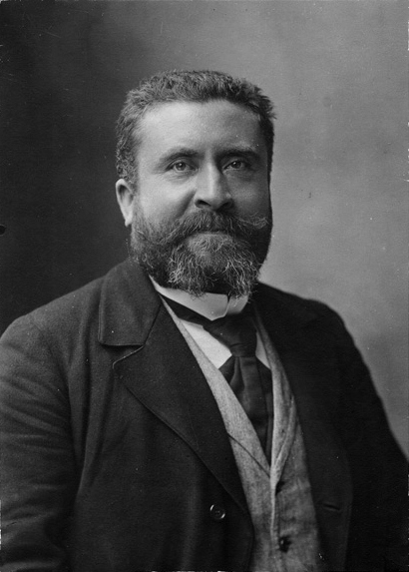

Slide 14
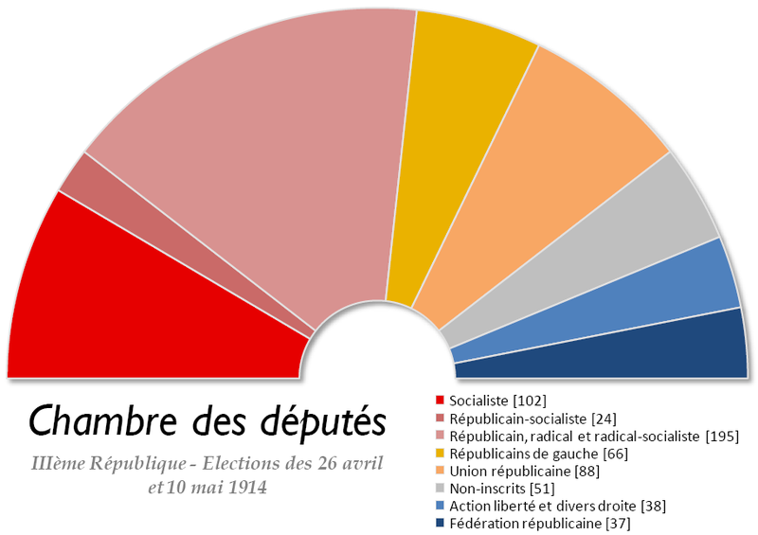

Slide 15
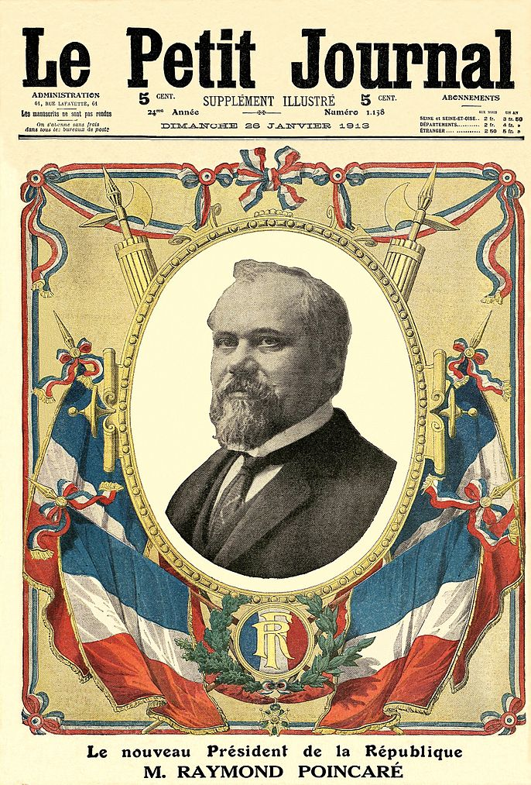

Slide 16
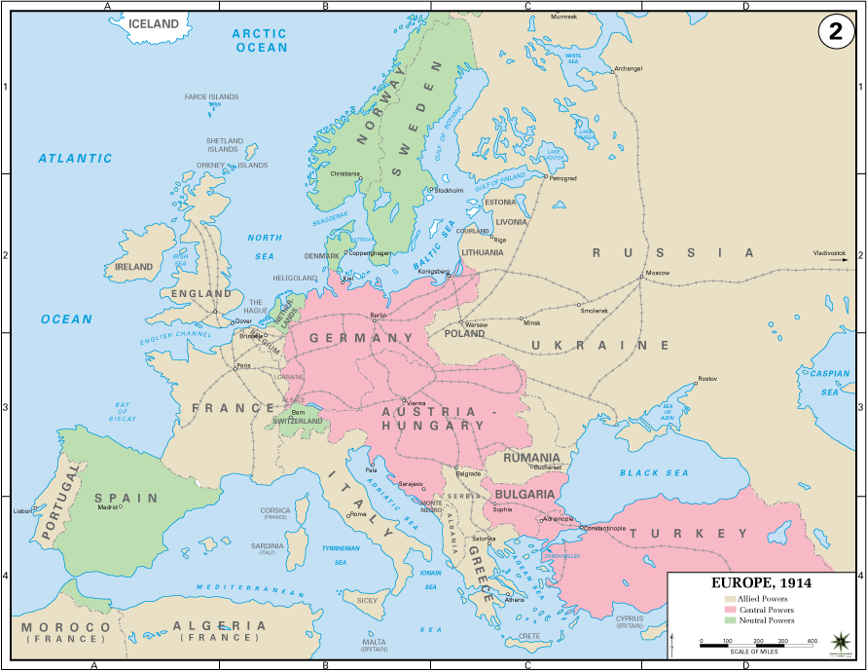

Slide 17
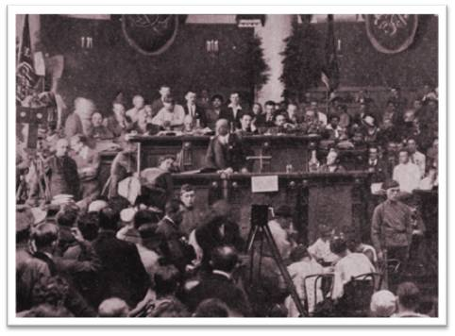
International Socialist Bureau, Brussels, July 29, 1914:
“resolved unanimously that it shall be the duty of the workers of all nations concerned not only to continue but to further intensify their demonstrations against the war, for peace, and for the settlement of the Austro-Serbian conflict by international arbitration, ...”

Slide 18
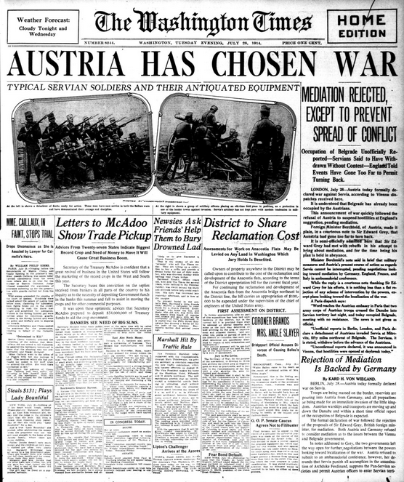

Slide 19
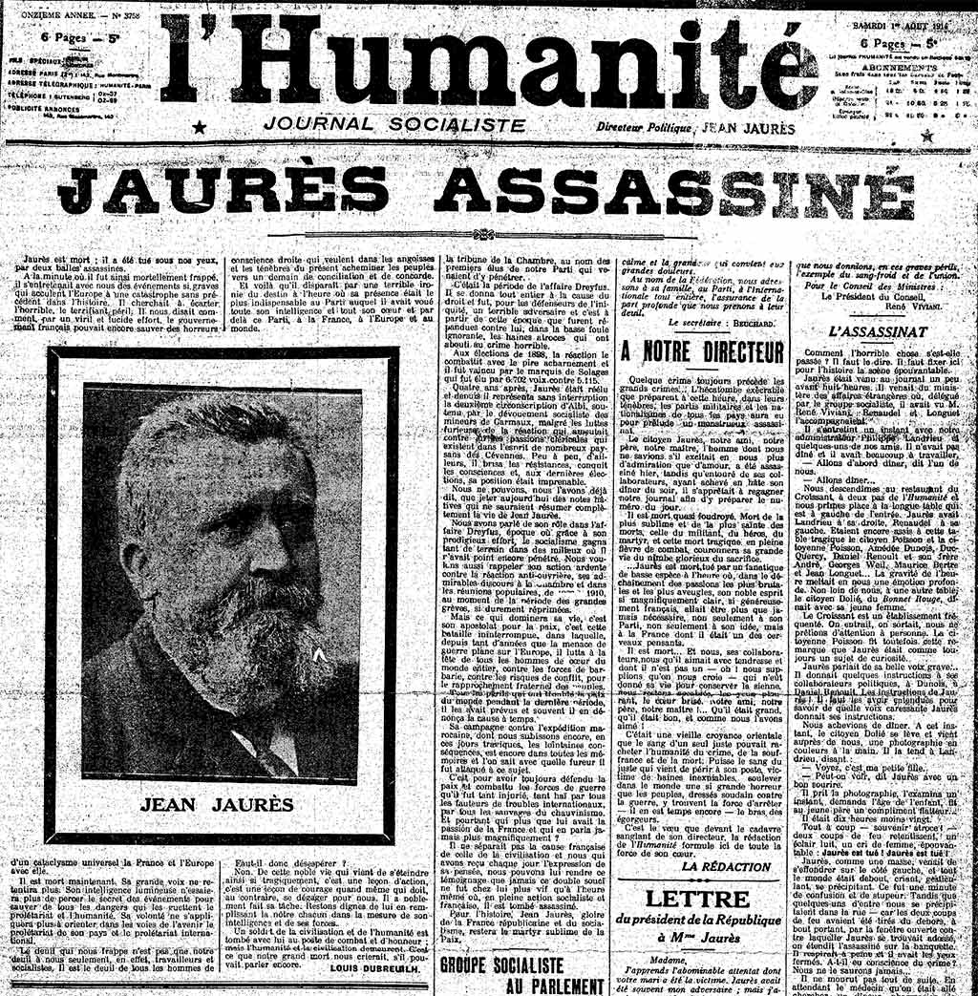

Slide 20
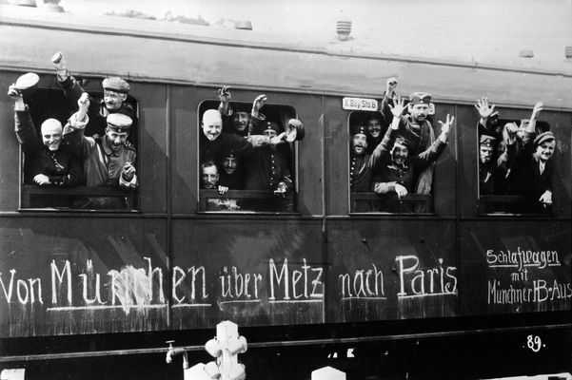

Slide 21
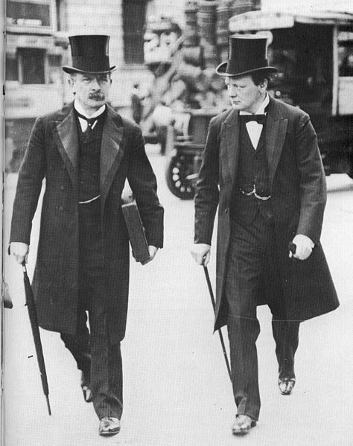

Slide 22
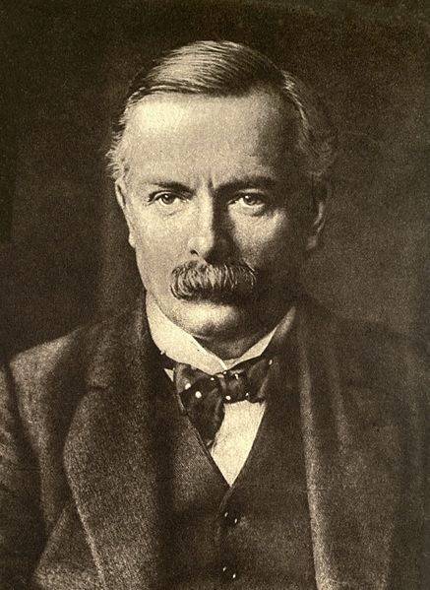

Slide 23
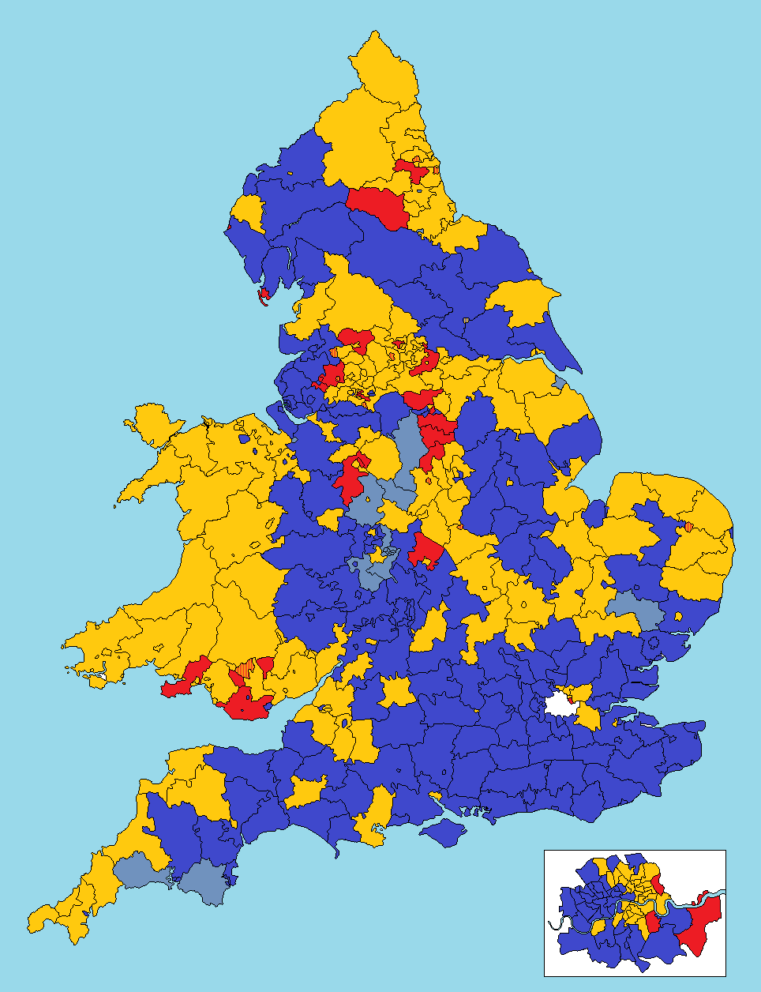
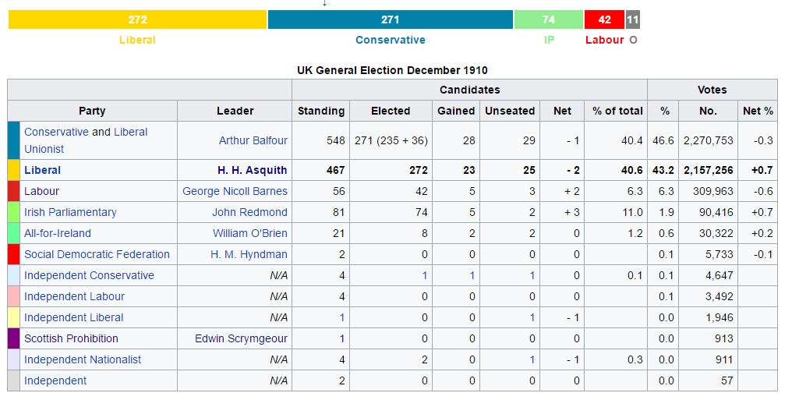

Slide 24
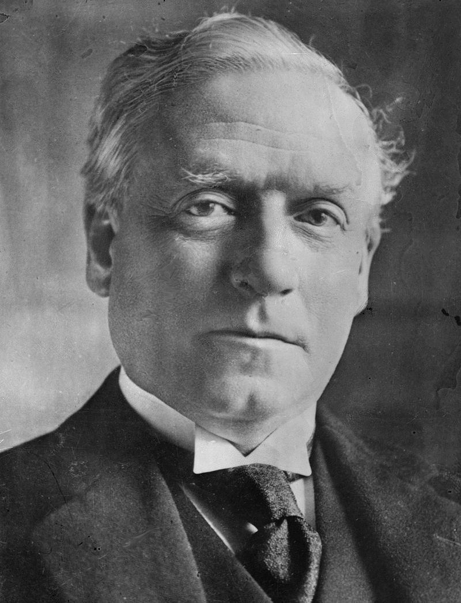

Slide 25
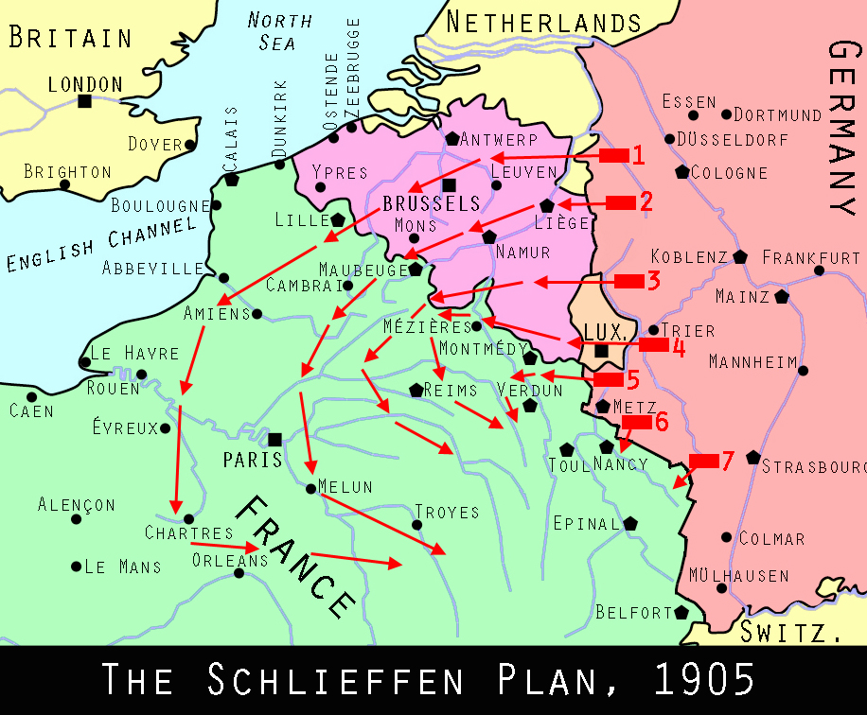
“To win, we must endeavour to be the stronger of the two at the point of impact. Our only hope of this lies in making our own choice of operations, not in waiting passively for whatever the enemy chooses for us.”

Slide 26
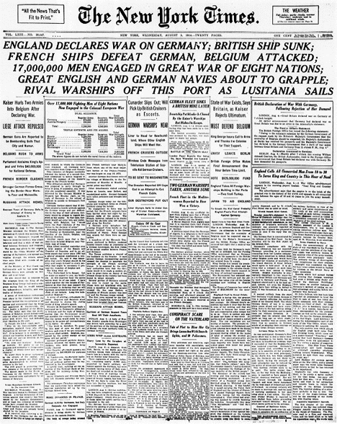

Slide 27
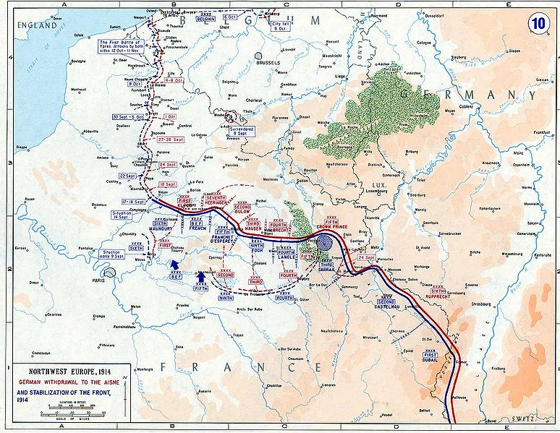

Slide 28
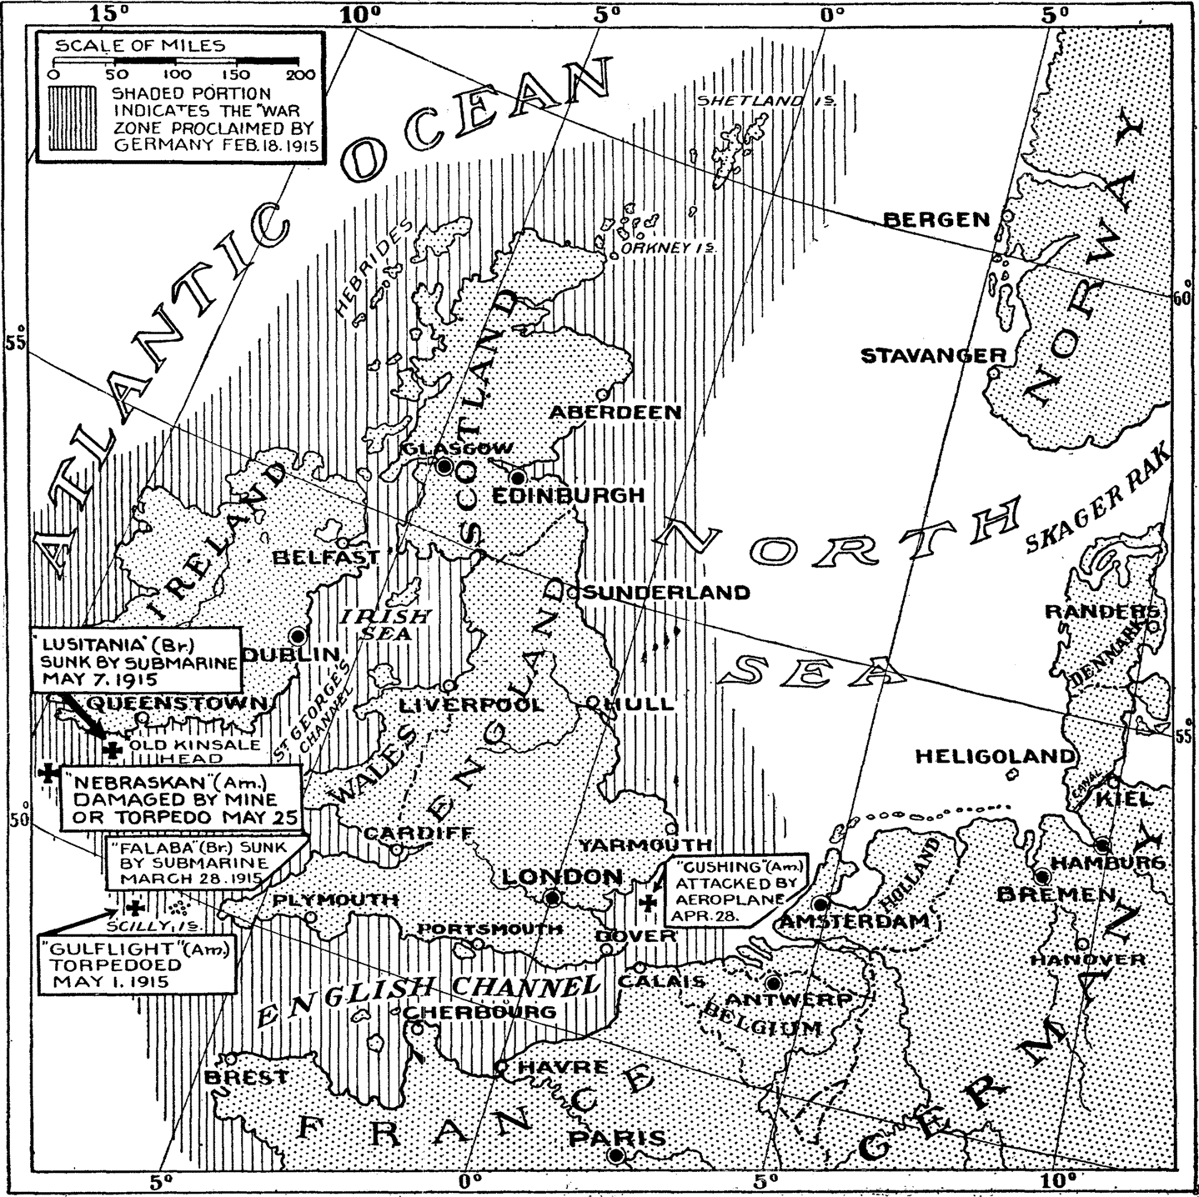

Slide 29
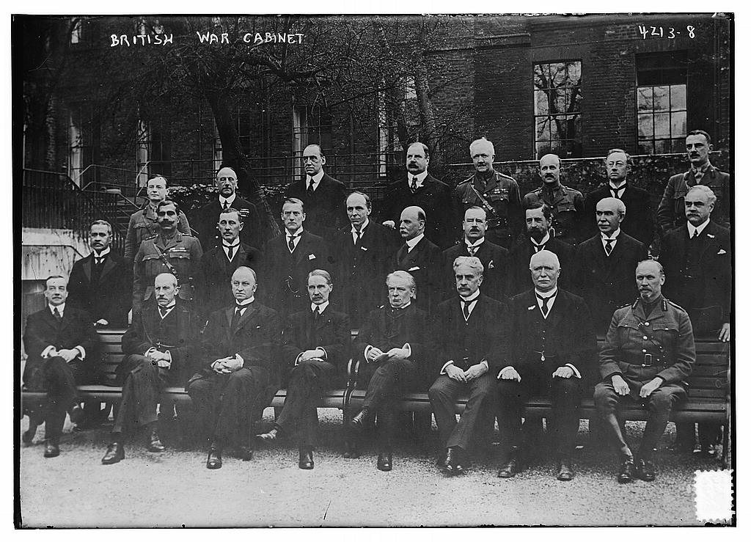

Slide 30
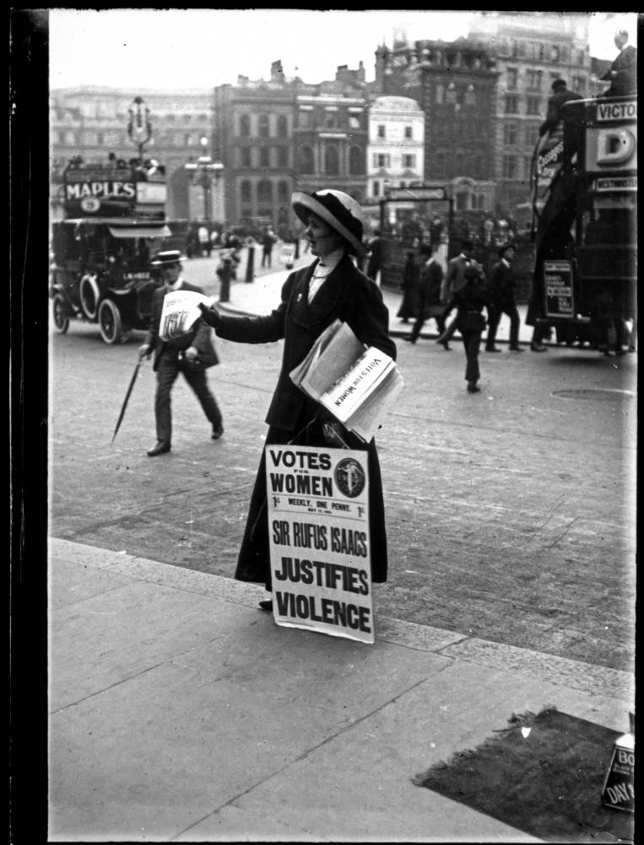

Slide 31
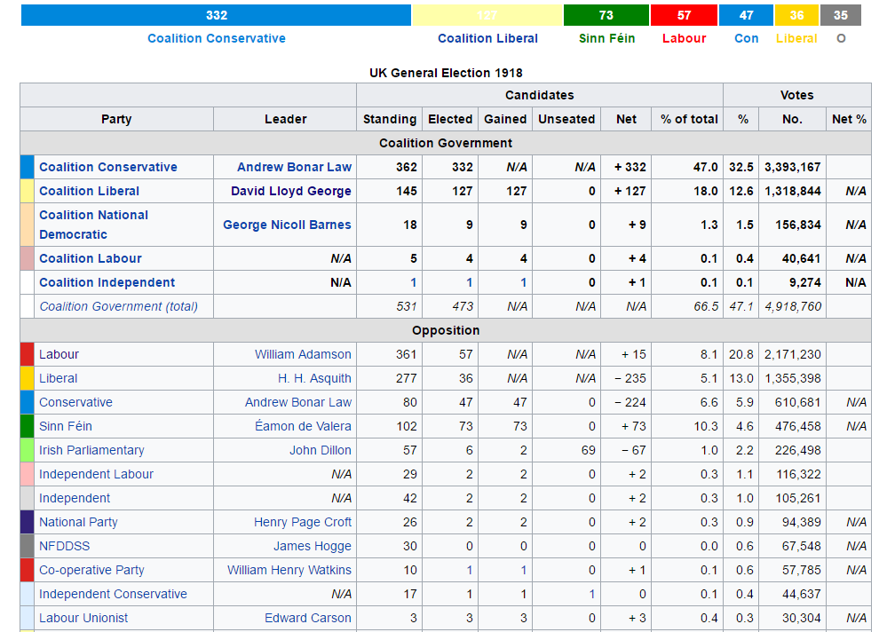

Slide 32
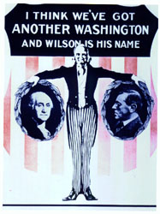

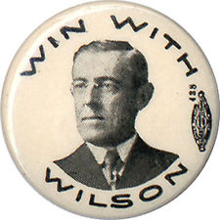

Slide 33

United States “must be neutral in fact as well as in name” and “impartial in thought as well as in action.”

Slide 34
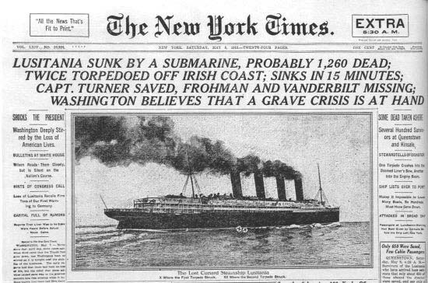

Slide 35
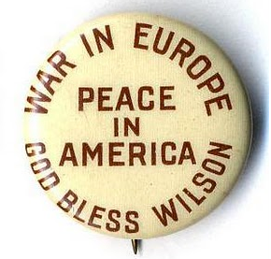
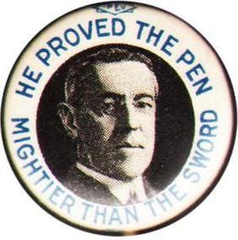

Slide 36
Wilson “Peace Without Victory” address, 22 Jan. 1917
It must be a peace without victory . . . Victory would mean peace forced upon the loser, a victor's terms imposed upon the vanquished. It would be accepted in humiliation, under duress, at an intolerable sacrifice, and would leave a sting, a resentment, a bitter memory upon which terms of peace would rest, not permanently, but only as upon quicksand. Only a peace between equals can last, only a peace the very principle of which is equality and a common participation in a common benefit . . .
The equality of nations upon which peace must be founded if it is to last must be an equality of rights; the guarantees exchanged must neither recognize nor imply a difference between big nations and small, between those that are powerful and those that are weak . . . No one asks or expects anything more than an equality of rights. Mankind is looking now for freedom of life, not for equipoises of power.
And there is a deeper thing involved than even equality of right among organized nations. No peace can last, or ought to last, which does not recognize and accept the principle that governments derive all their just powers from the consent of the governed, and that no right anywhere exists to hand peoples about from sovereignty to sovereignty as if they were property.

Slide 37
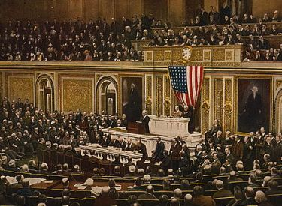

Slide 38
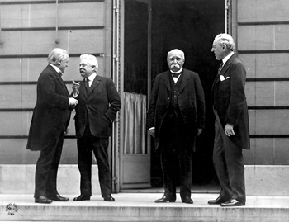

Slide 39
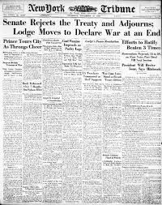

Slide 40
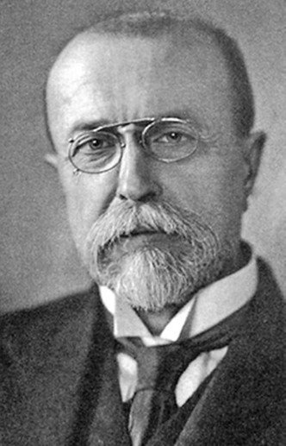

Slide 41
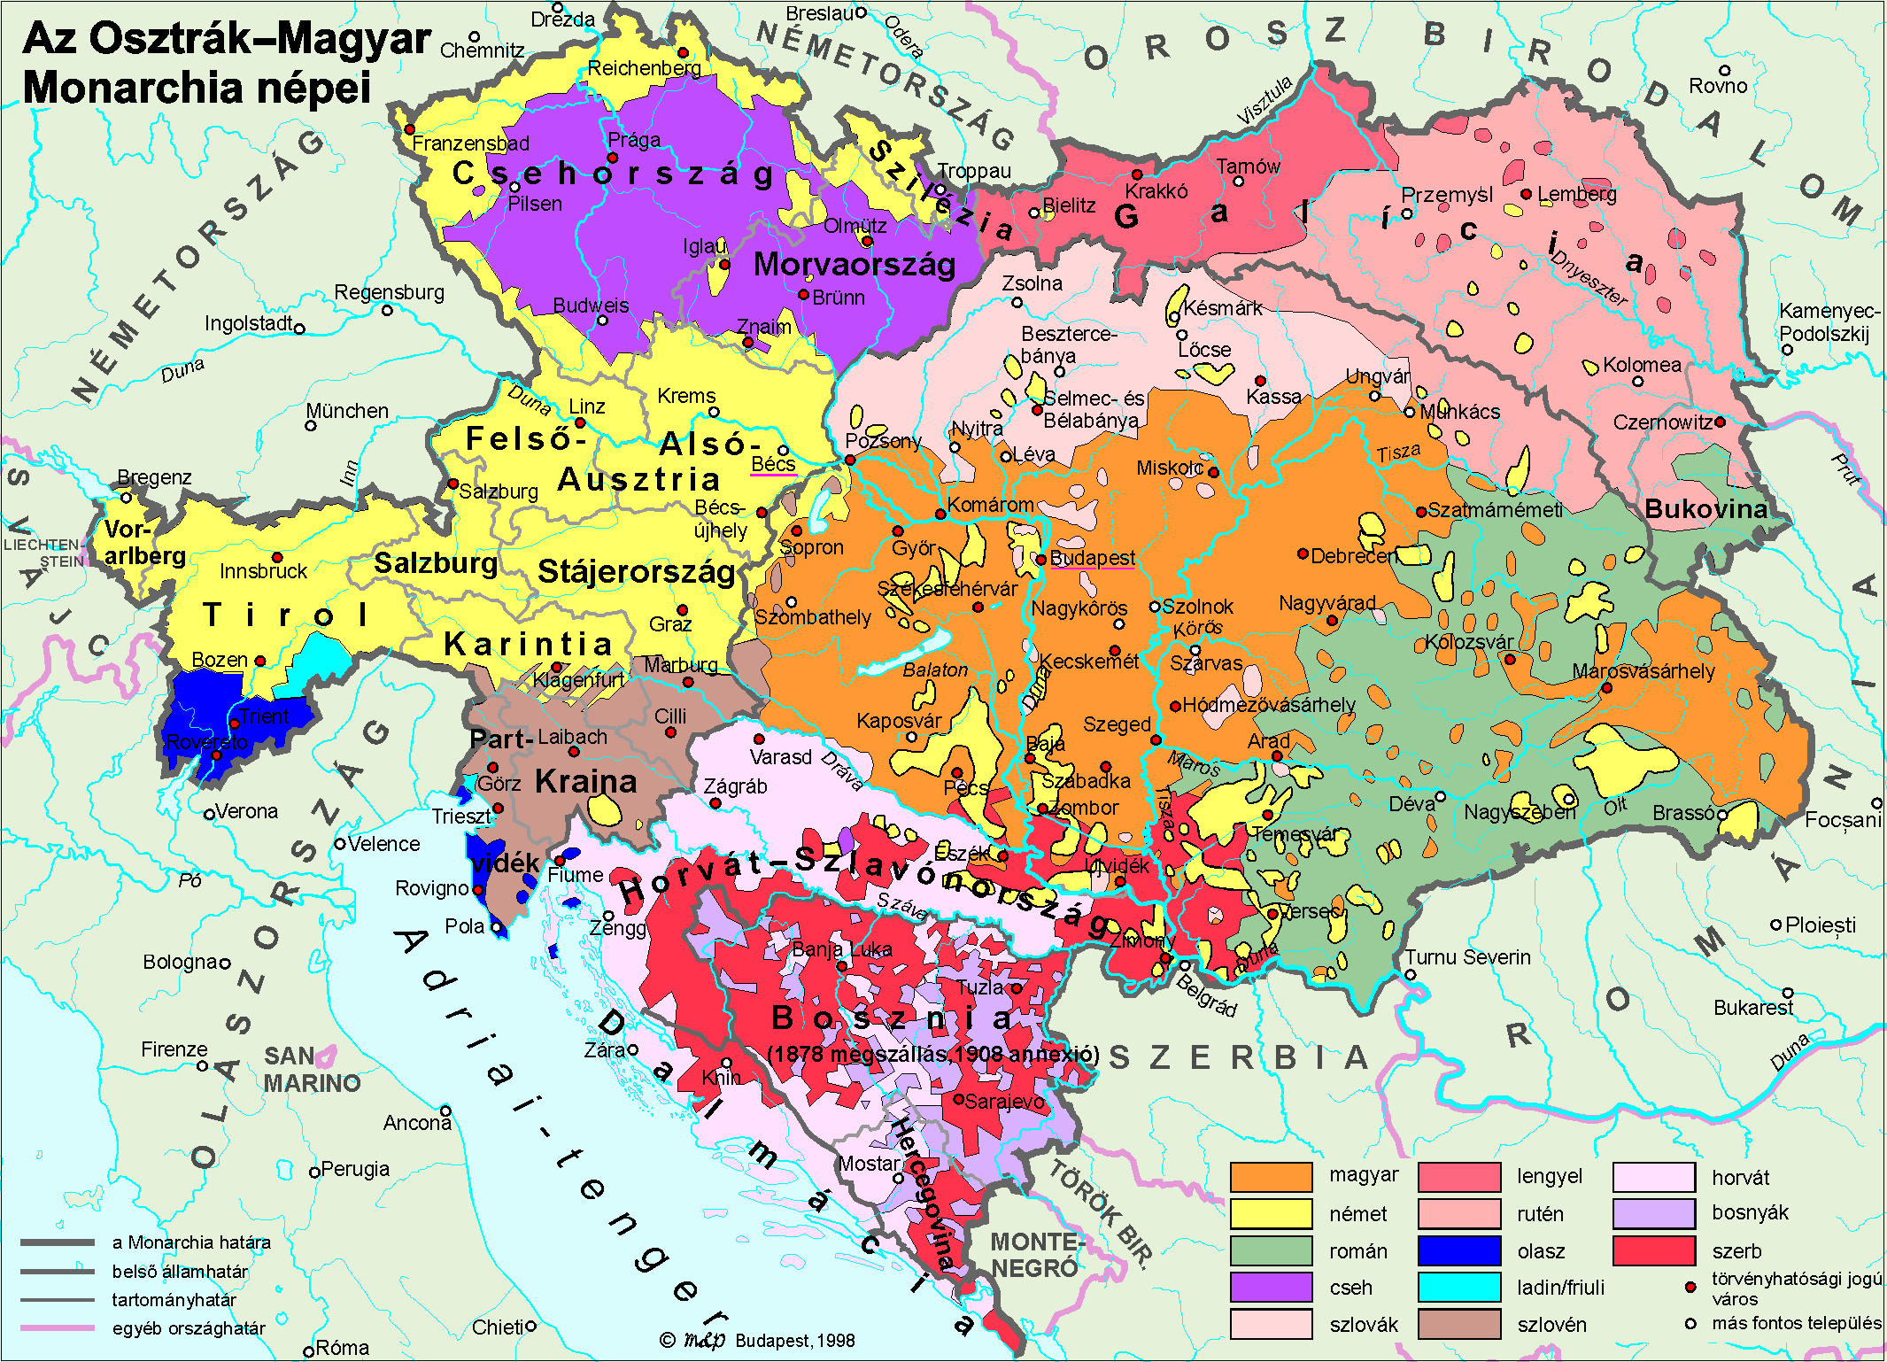

Slide 42
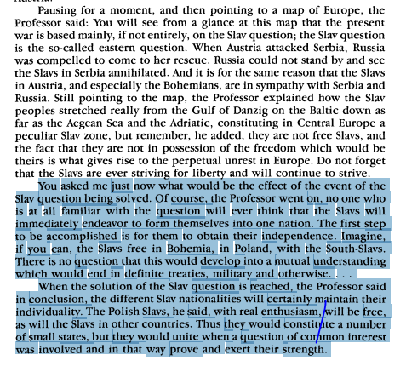
Christian Science Monitor, 1915

Slide 43
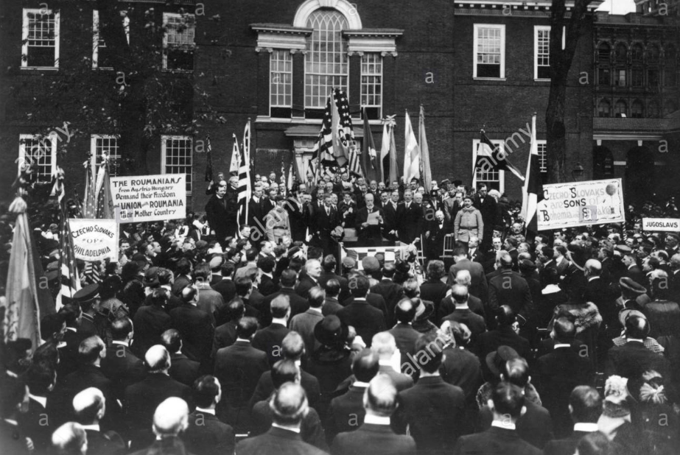

Slide 44
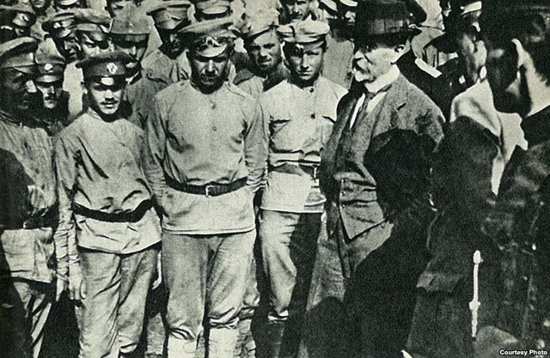

Slide 45
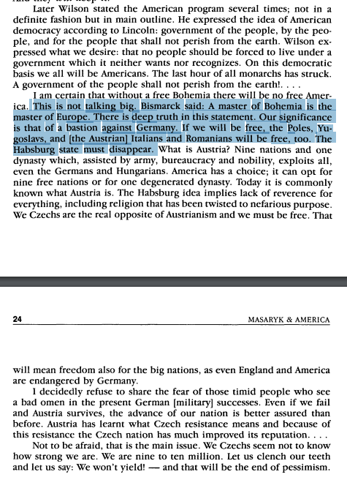
Chicago address, 1918

Slide 46
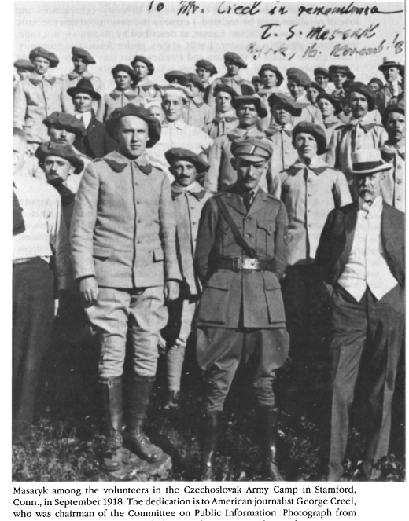

Slide 47


Slide 48


--New York, 1918

Slide 49


Slide 50


