Slide 1
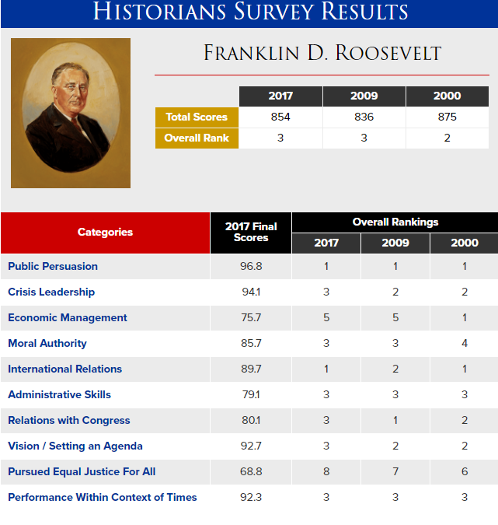

Slide 2
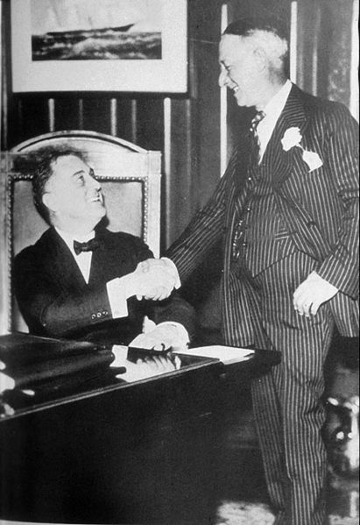

Slide 3


Slide 4
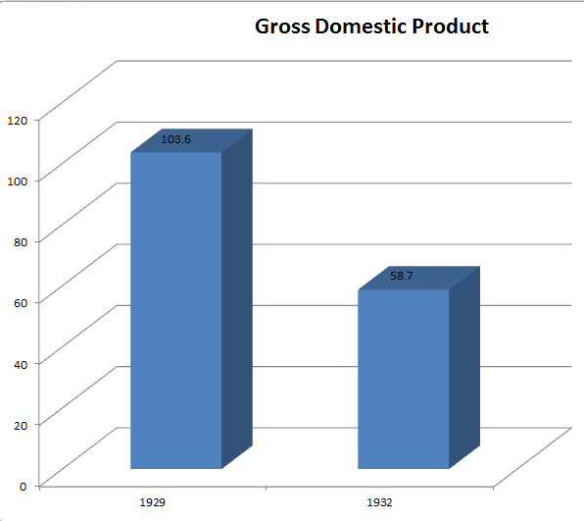
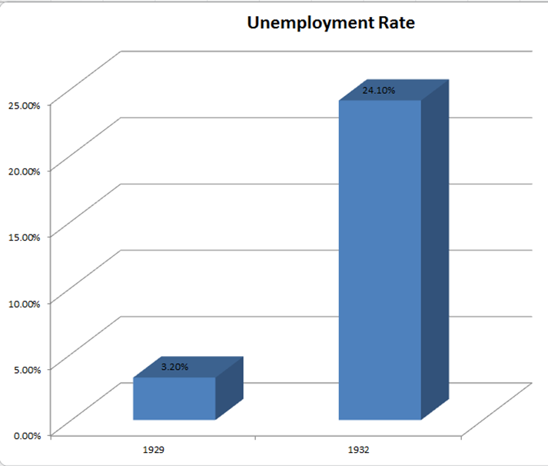
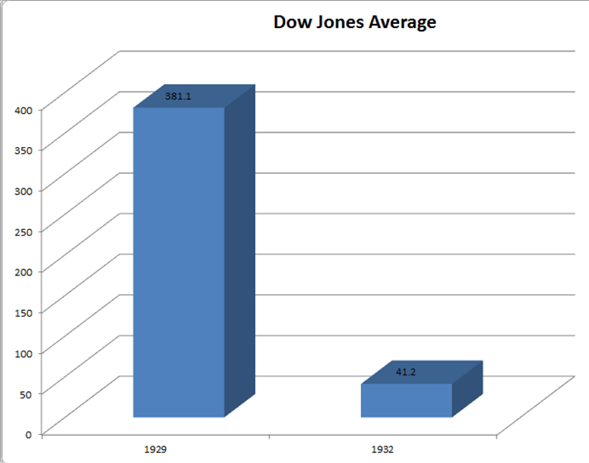

Slide 5
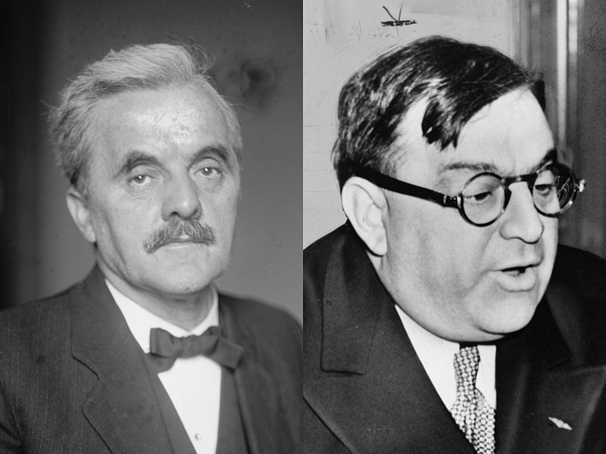

Slide 6
Norris-LaGuardia Act (1932)
--prohibits federal courts from enforcing “yellow dog" contracts
--bars federal courts from issuing injunctions against:
(*) joining or organizing a union, or assembling for union purposes;
(*) striking or refusing to work, or advising others to strike or organize;
(*) publicizing acts of a labor dispute; and
(*) providing lawful legal aid to persons participating in a labor dispute.

Slide 7
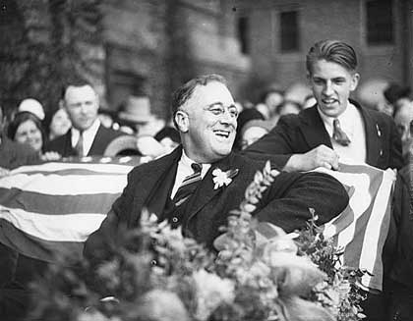

Slide 8
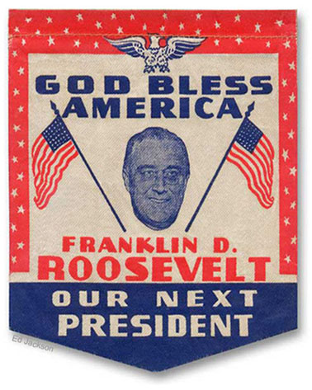

Slide 9
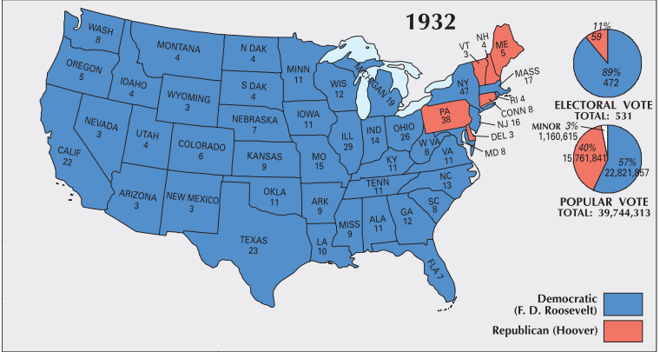

Slide 10
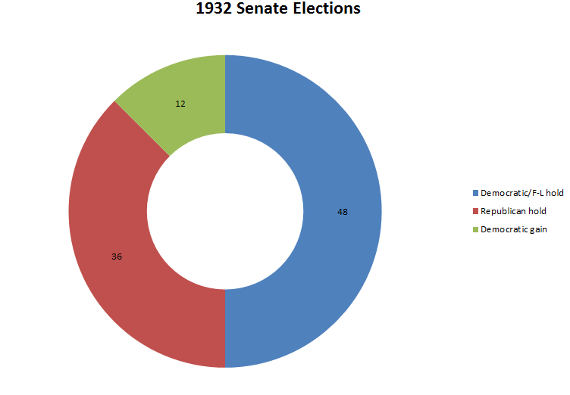
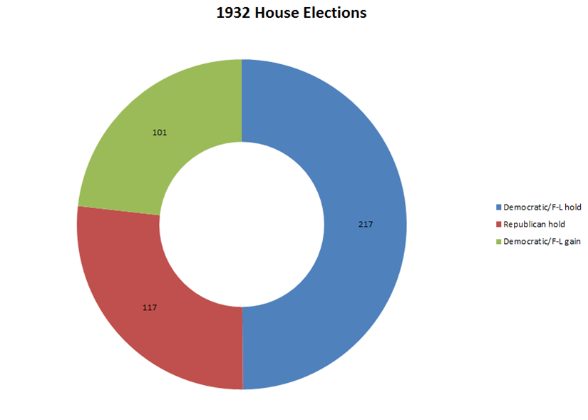

Slide 11
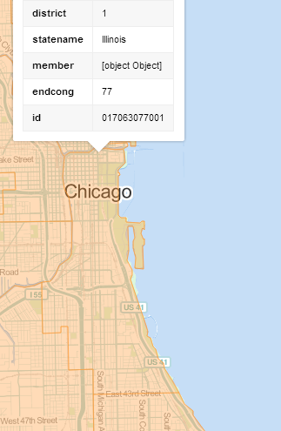
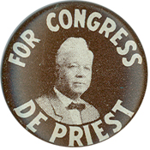
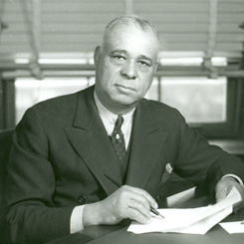
Notes:
Arthur mitchell

Slide 12
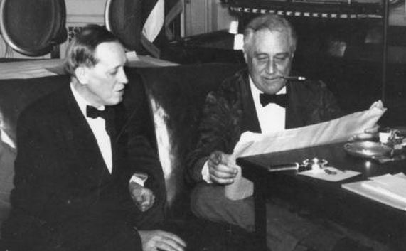
Notes:
Fdr harry hopkins

Slide 13

Bank Failures
1929: 659 failures;
1930: 1350
1931: 2293;
1932: 1453
1933: 4000
1934: 57
total # of banks:
24,633 1929;
15,015 1933

Slide 14


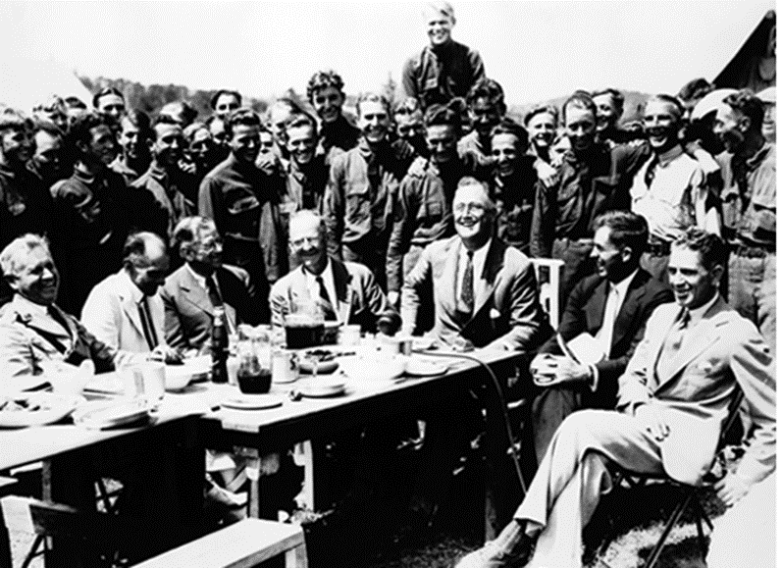

Slide 15
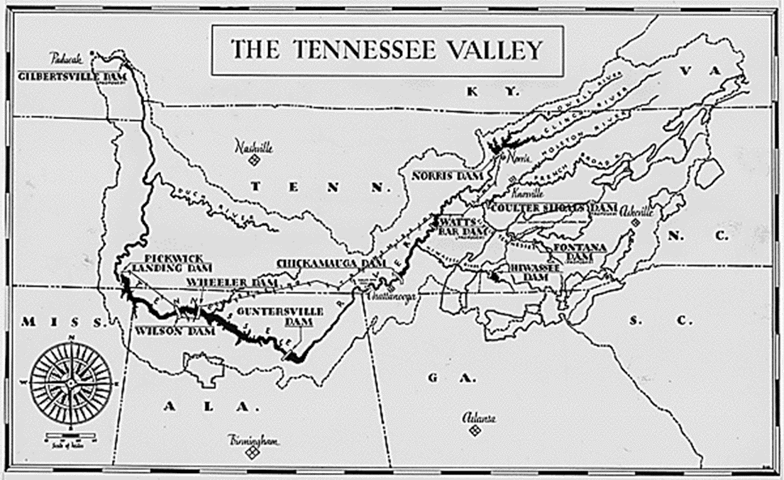
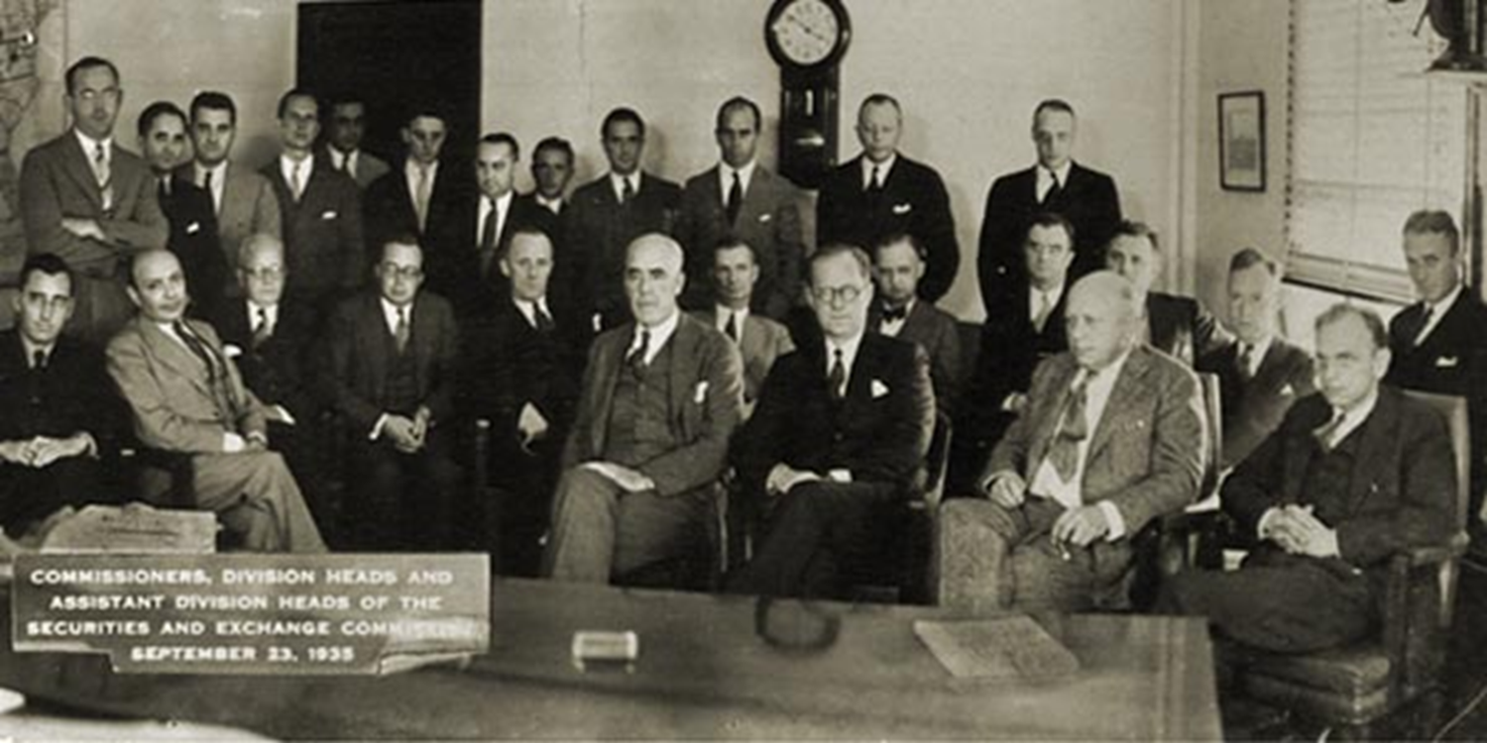

Slide 16
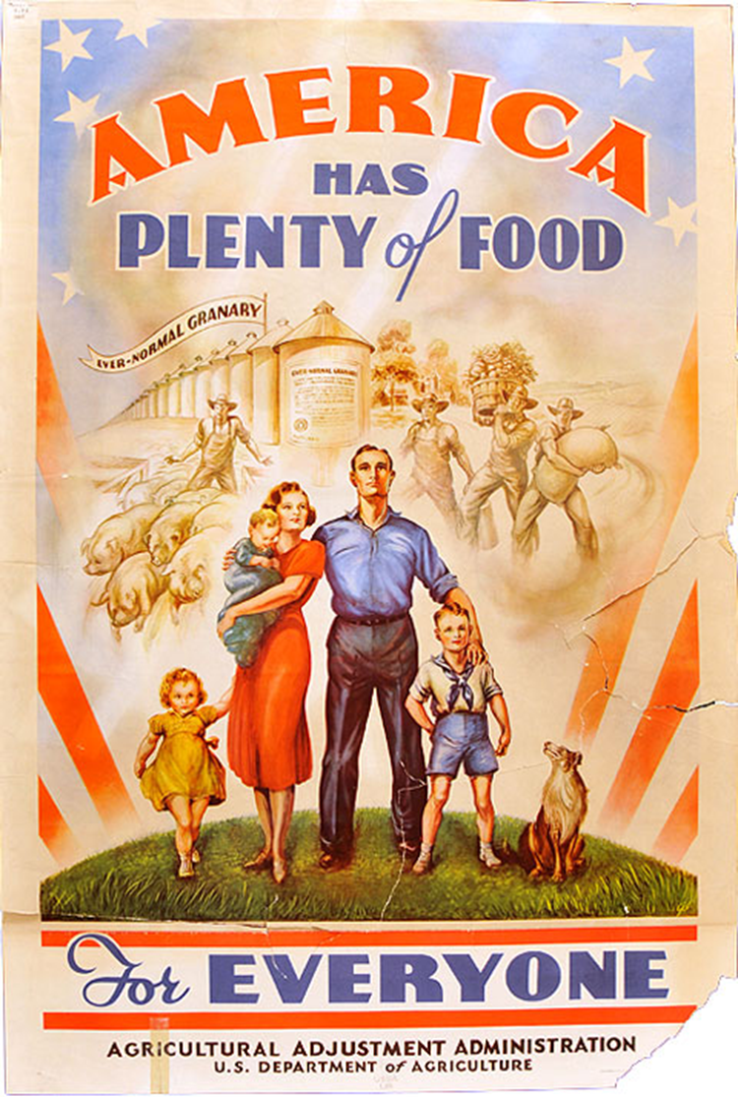
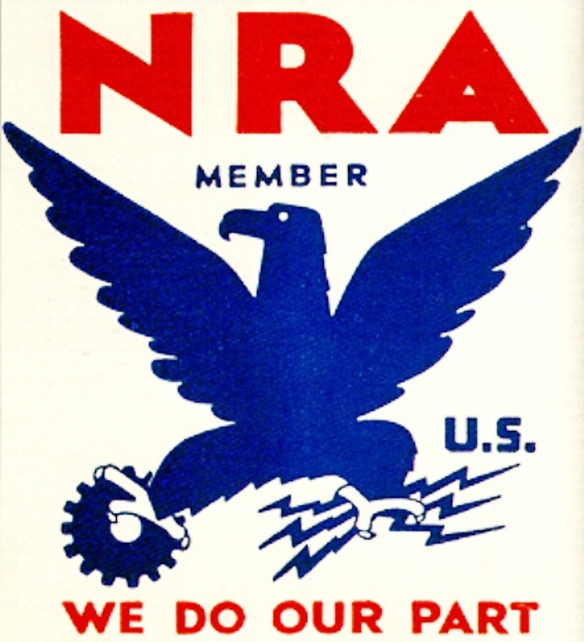

Slide 17
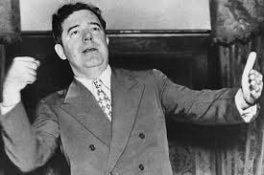


Slide 18
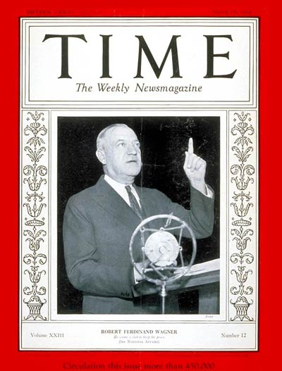

Slide 19
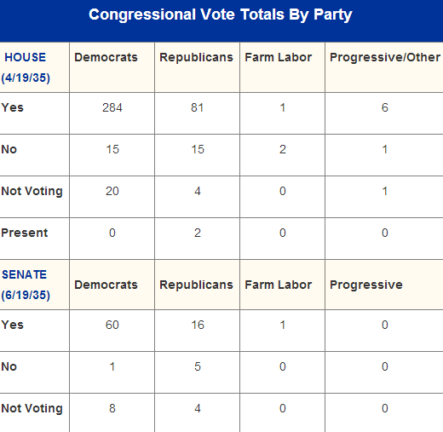
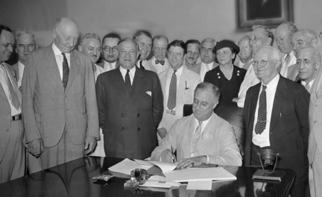

Slide 20


Slide 21
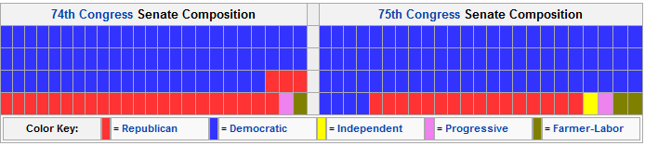
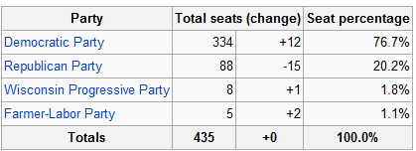
1936 Congressional Election Results

Slide 22
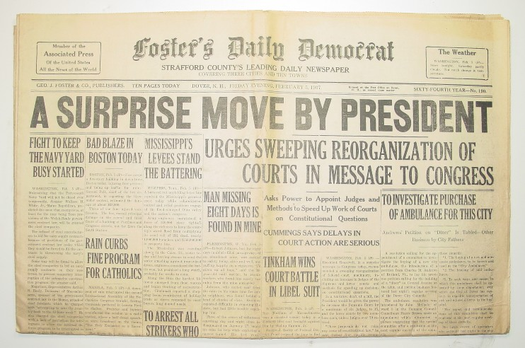

Slide 23
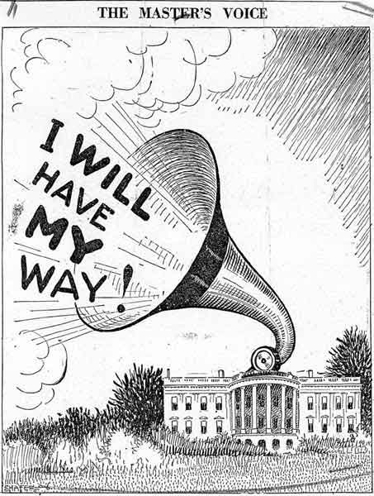
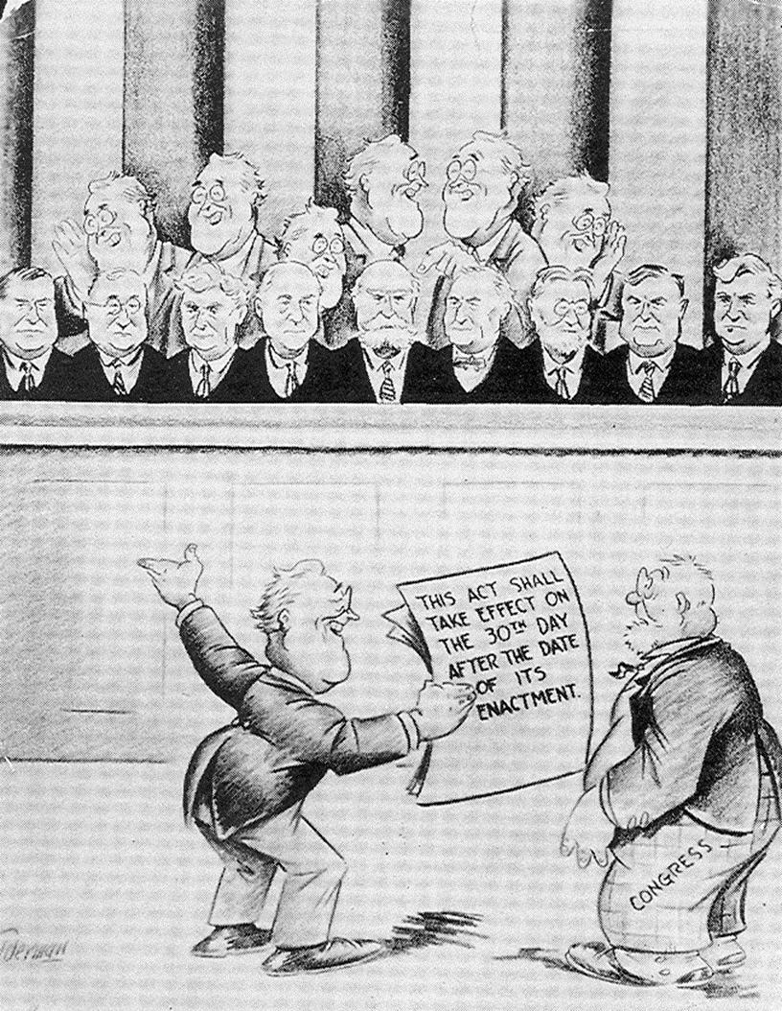

Slide 24
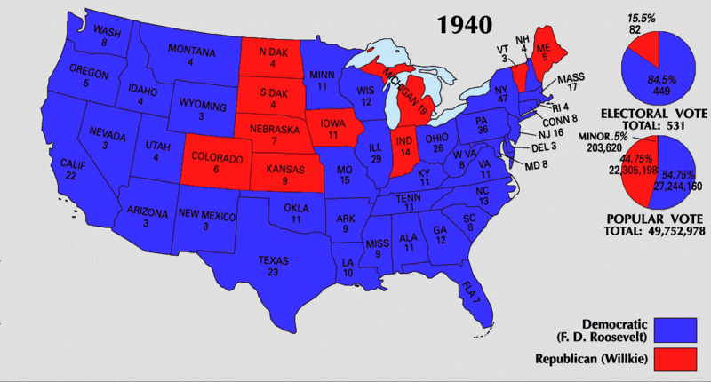

Slide 25
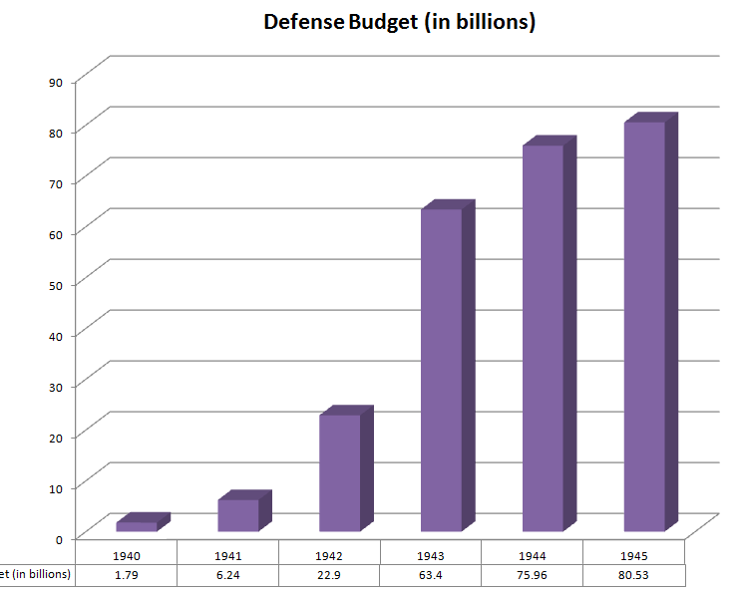

Slide 26

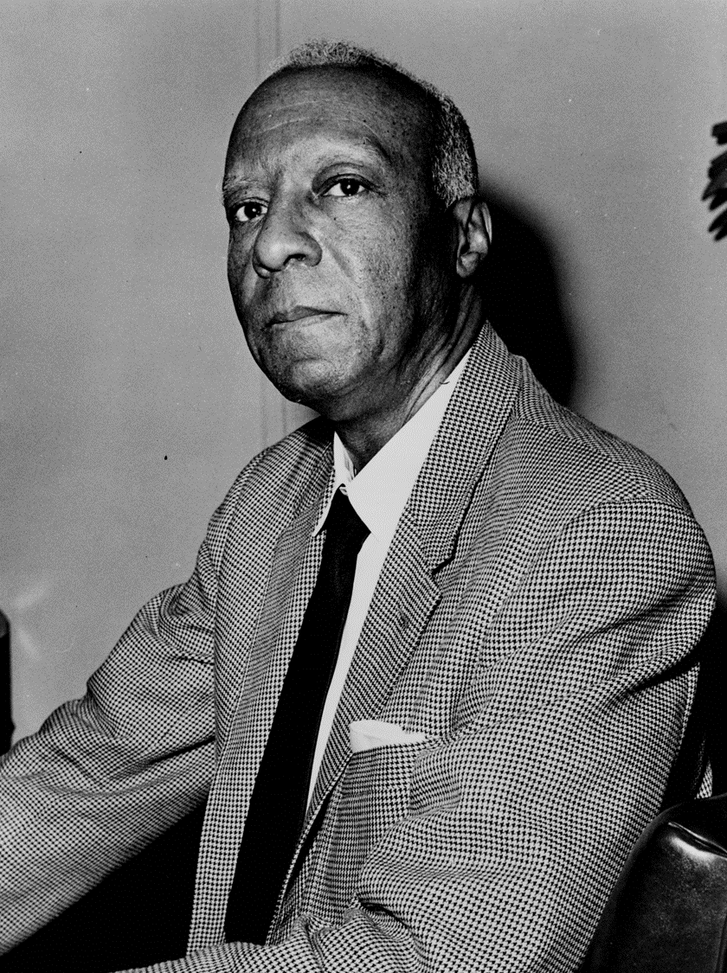

Slide 27


Slide 28
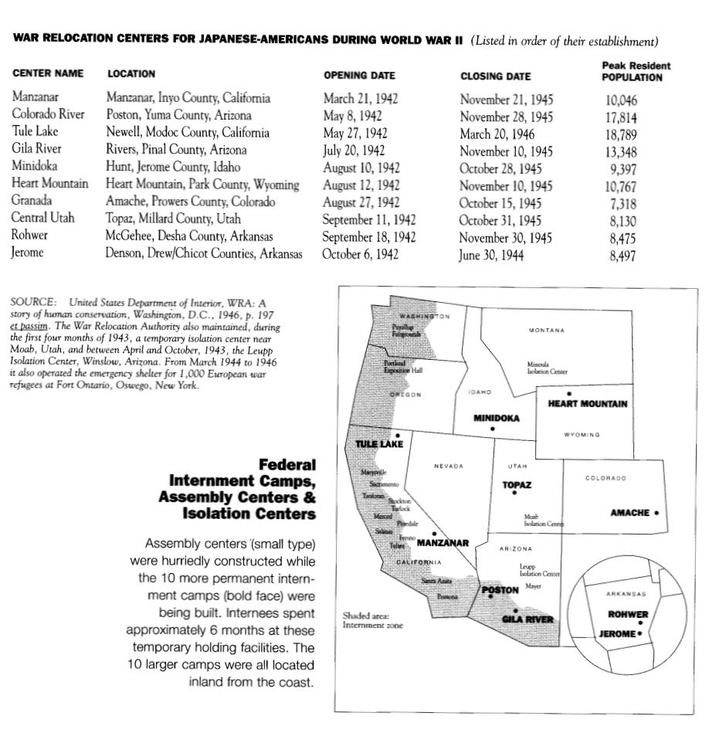

Slide 29
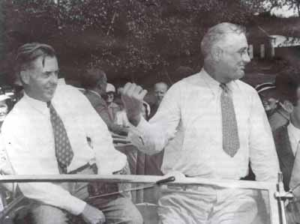

Slide 30
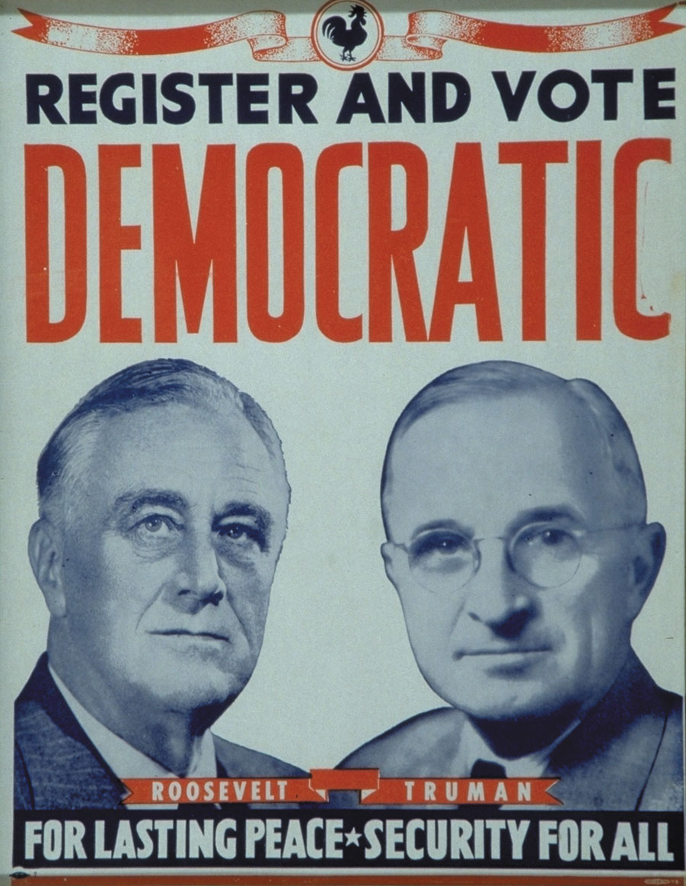

Slide 31
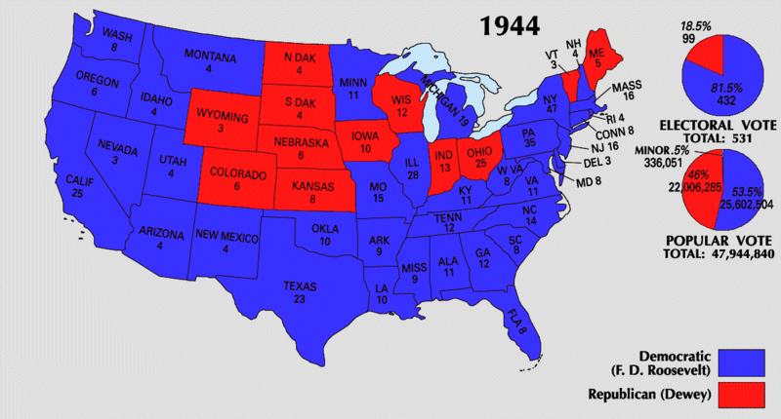

Slide 32
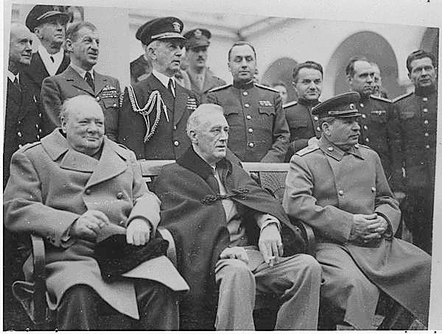

Slide 33
New Deal (1935, 1939)
--medical care as part of Social Security?
--Wagner proposal (1939)—block grants to states to administer
Wagner-Murray-Dingell (1943)
--health care as a right
--protection from “economic fears” of sickness
Truman plan (1945, 1949)
--single plan run by federal government
--citizens pay monthly fee
--government subsidizes costs of poor
--58% initial public support

Slide 34
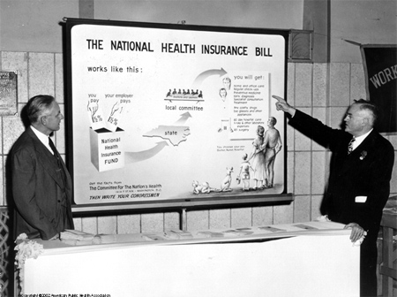

Slide 35

$1.5M lobbying effort
“Would socialized medicine lead to socialization of other phases of American life?” “Lenin thought so.”
He declared ”Socialized medicine is the keystone to the arch of the Socialist State.”
--late 1949, down to 36% approval
--national health insurance as “socialized medicine”

Slide 36
