Slide 1
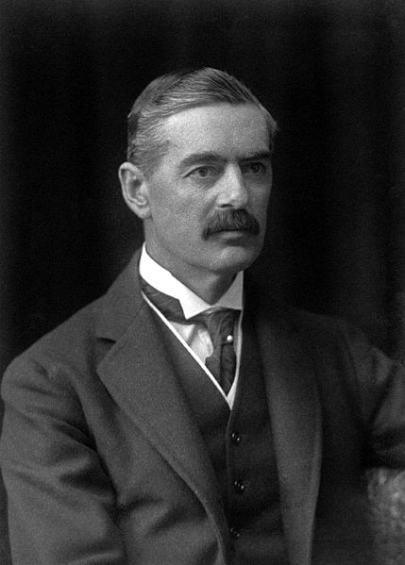

Slide 2
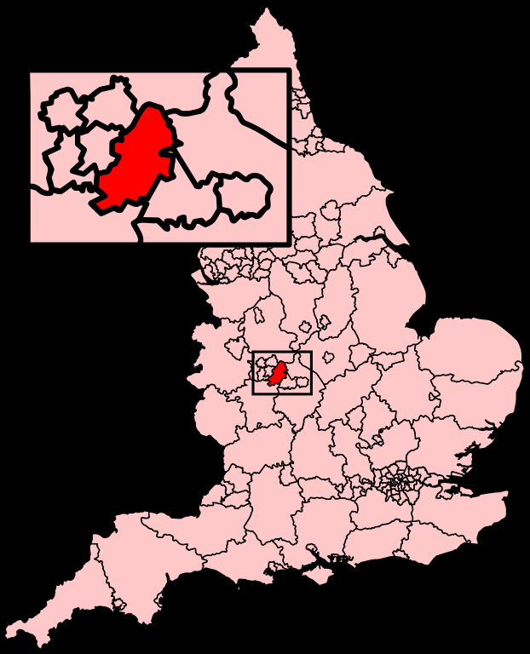
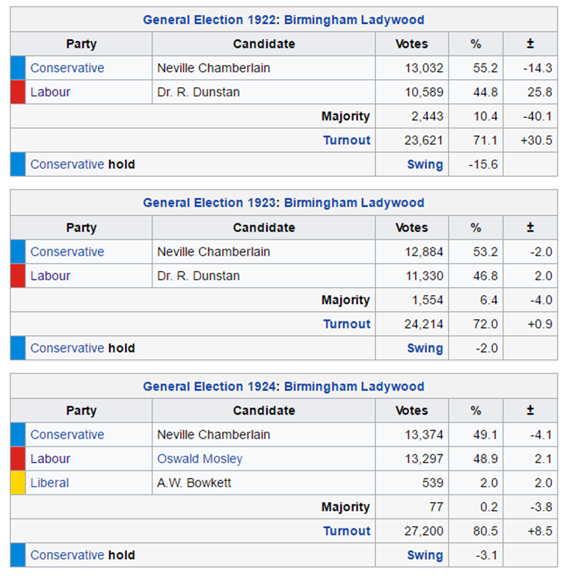

Slide 3
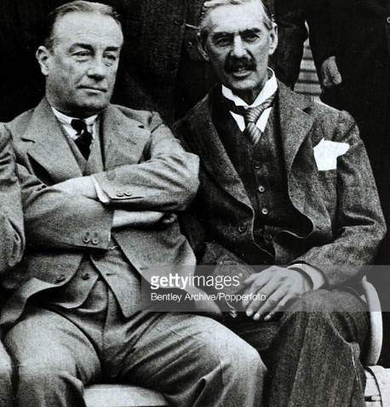

Slide 4
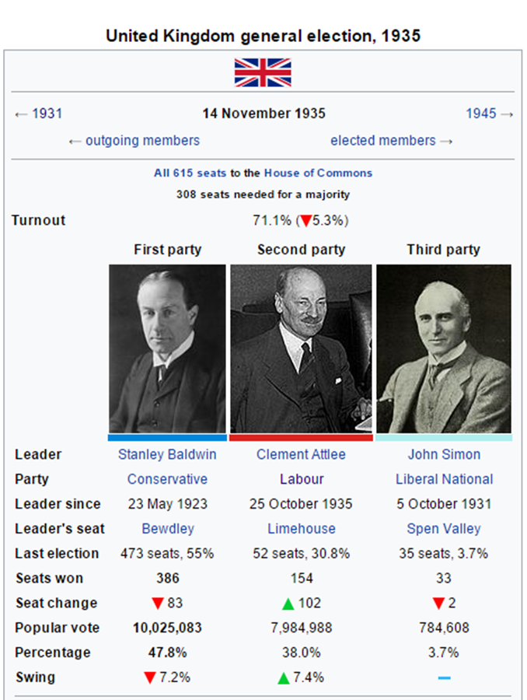
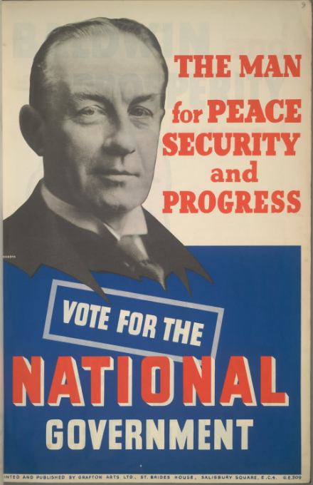

Slide 5
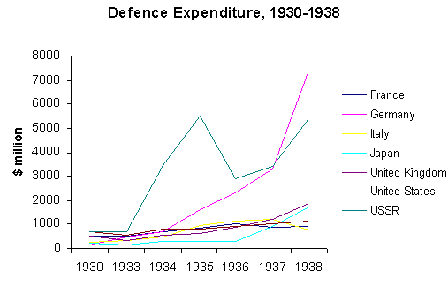

Slide 6
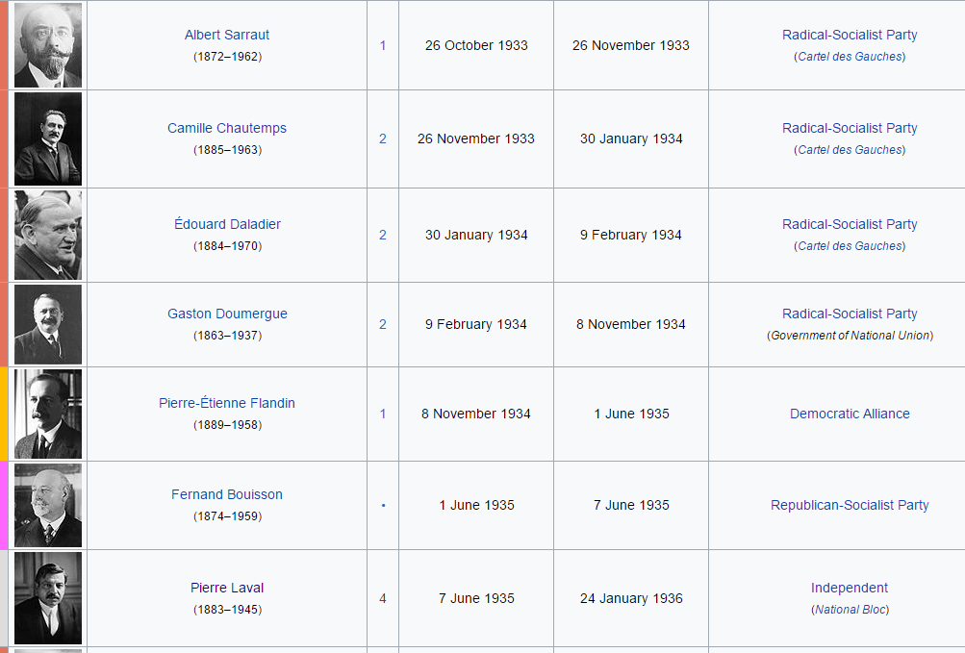

Slide 7
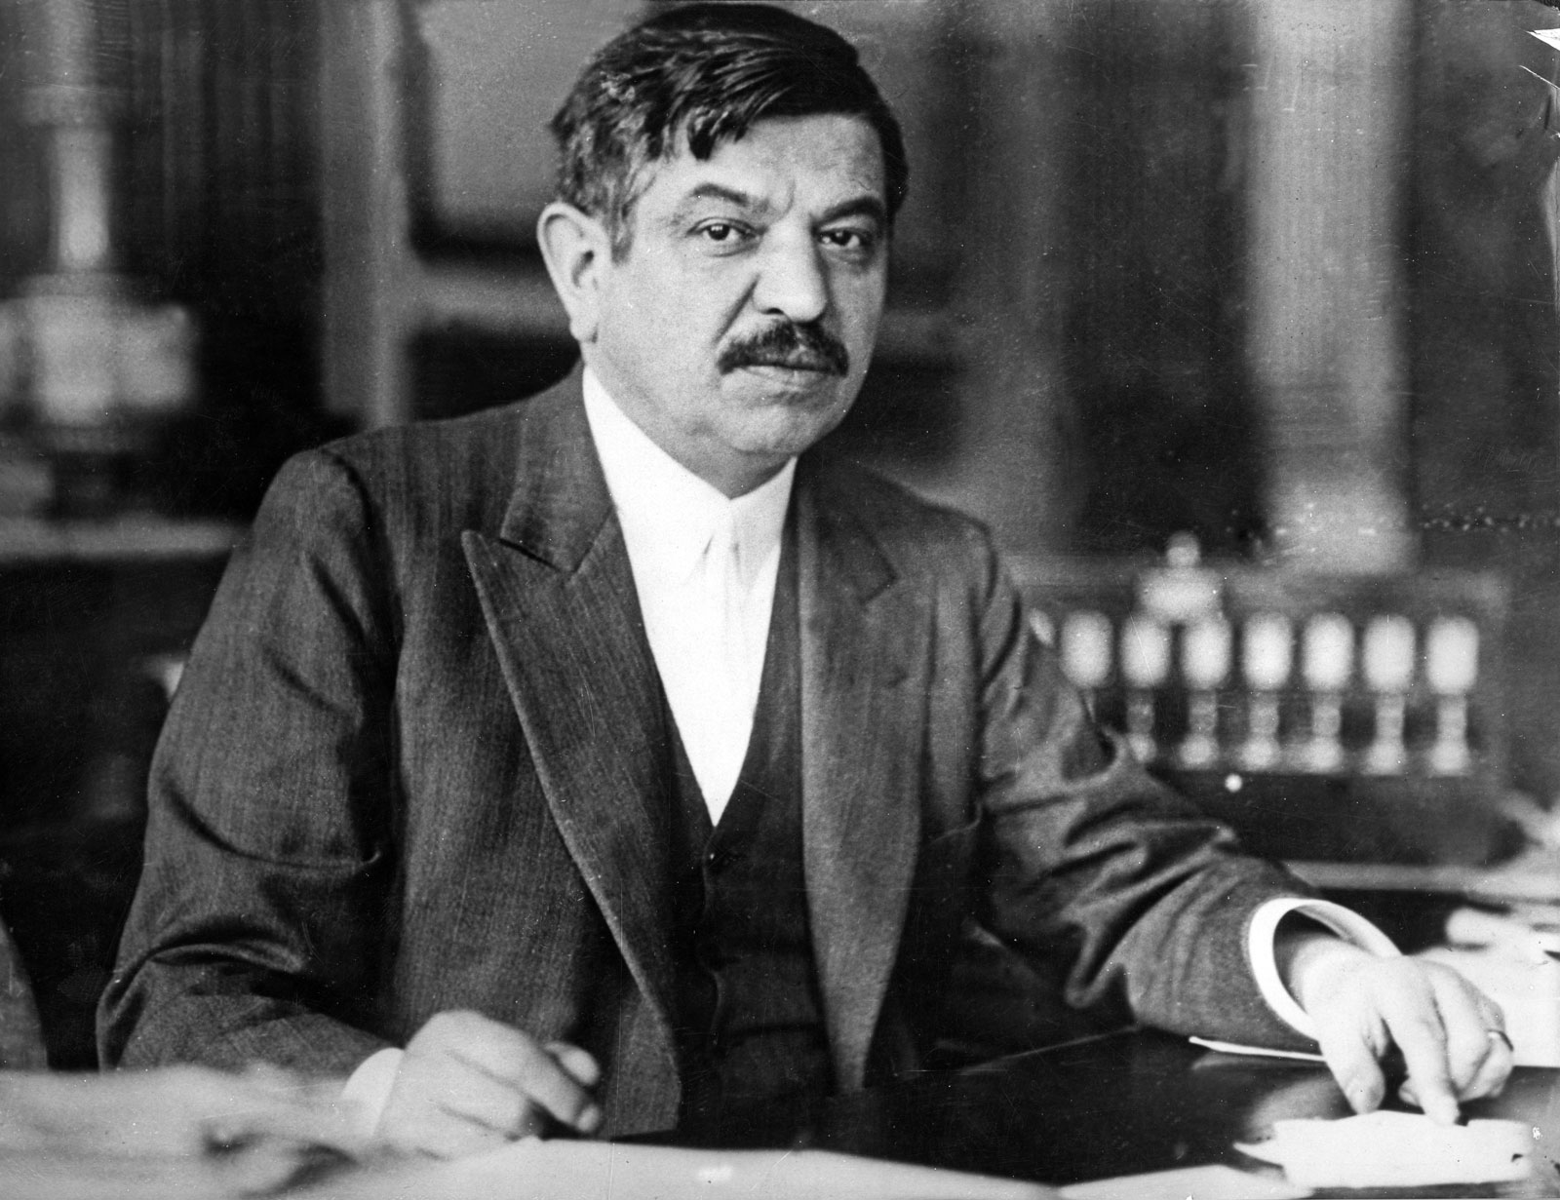

Slide 8
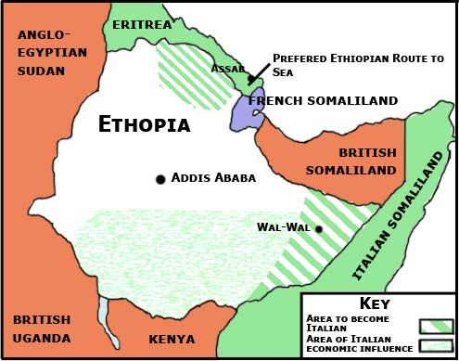

Slide 9
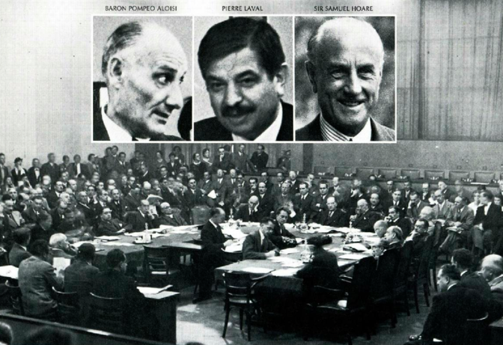

Slide 10
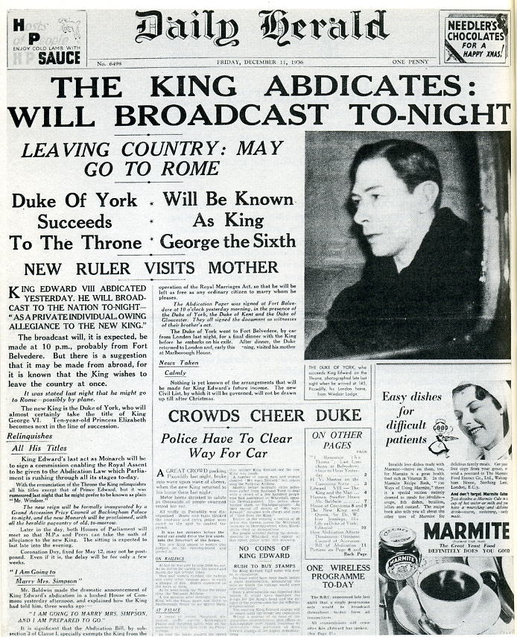

Slide 11
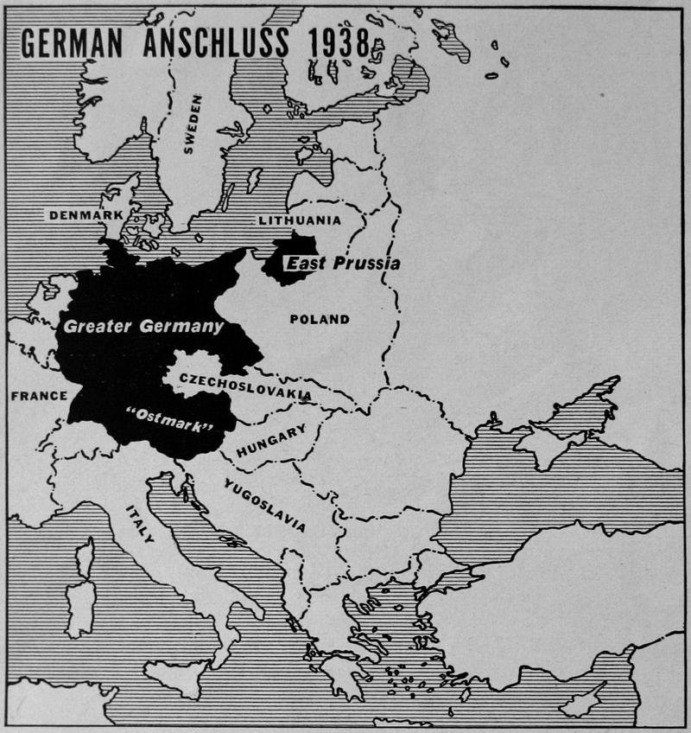

Slide 12
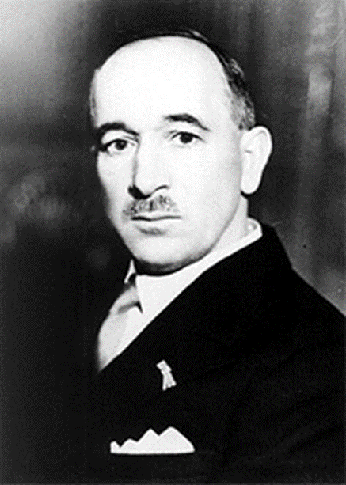
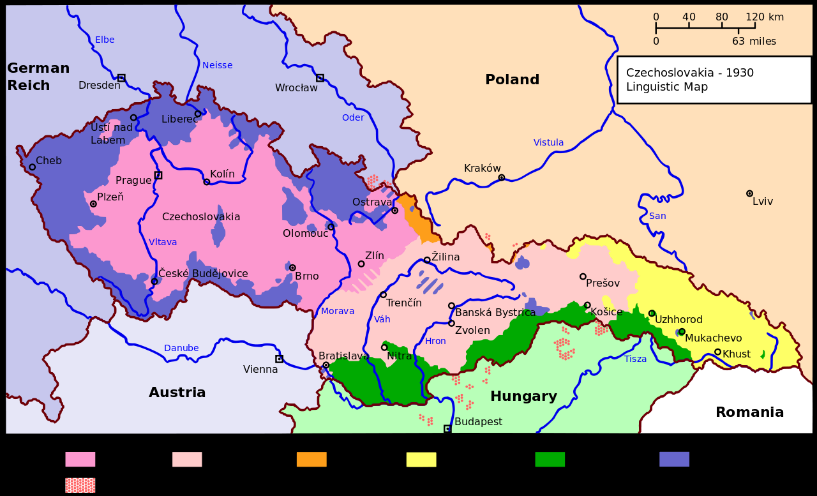

Slide 13
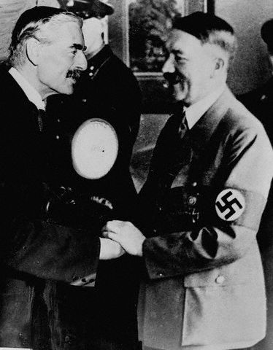
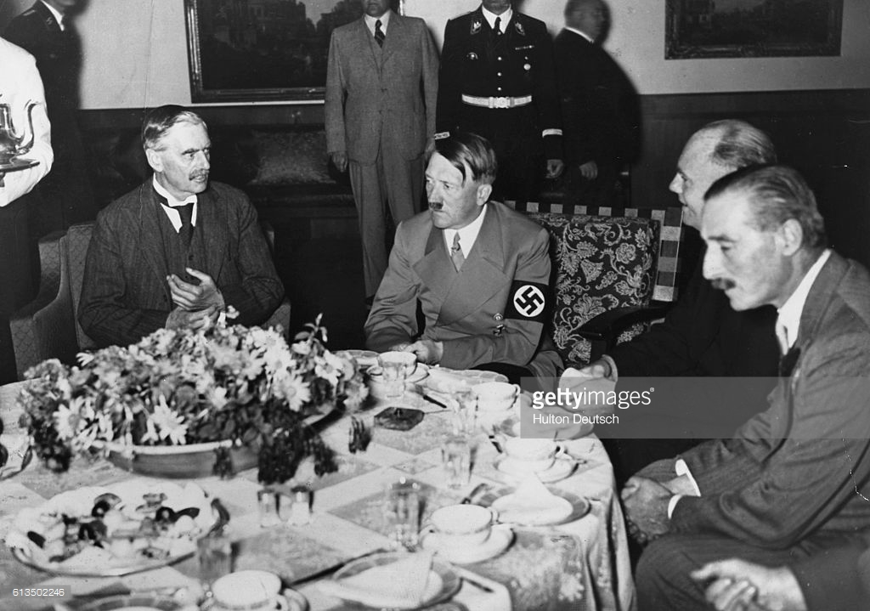

Slide 14
PRIME MINISTER NEVILLE CHAMBERLAIN, HOUSE OF COMMONS, OCTOBER 3, 1938.
In my view the strongest force of all, one which grew and took fresh shapes and forms every day was the force not of any one individual, but was that unmistakable sense of unanimity among the peoples of the world that war somehow must be averted . . . Ever since I assumed my present office my main purpose has been to work for the pacification of Europe, for the removal of those suspicions and those animosities which have so long poisoned the air. The path which leads to appeasement is long and bristles with obstacles. The question of Czechoslovakia is the latest and perhaps the most dangerous. Now that we have got past it, I feel that it may be possible to make further progress along the road to sanity.
WINSTON CHURCHILL, HOUSE OF COMMONS, OCTOBER 5, 1938.
Having thus fortified myself by the example of others, I will proceed to emulate them. I will, therefore, begin by saying the most unpopular and most unwelcome thing. I will begin by saying what everybody would like to ignore or forget but which must nevertheless be stated, namely, that we have sustained a total and unmitigated defeat, and that France has suffered even more than we have . . .
We in this country, as in other Liberal and democratic countries, have a perfect right to exalt the principle of self-determination, but it comes ill out of the mouths of those in totalitarian States who deny even the smallest element of toleration to every section and creed within their bounds. But, however you put it, this particular block of land, this mass of human beings to be handed over, has never expressed the desire to go into the Nazi rule. I do not believe that even now--if their opinion could be asked, they would exercise such an option….
I venture to think that in future the Czechoslovak State cannot be maintained as an independent entity. You will find that in a period of time which may be measured by years, but may be measured only by months, Czechoslovakia will be engulfed in the Nazi regime.

Slide 15
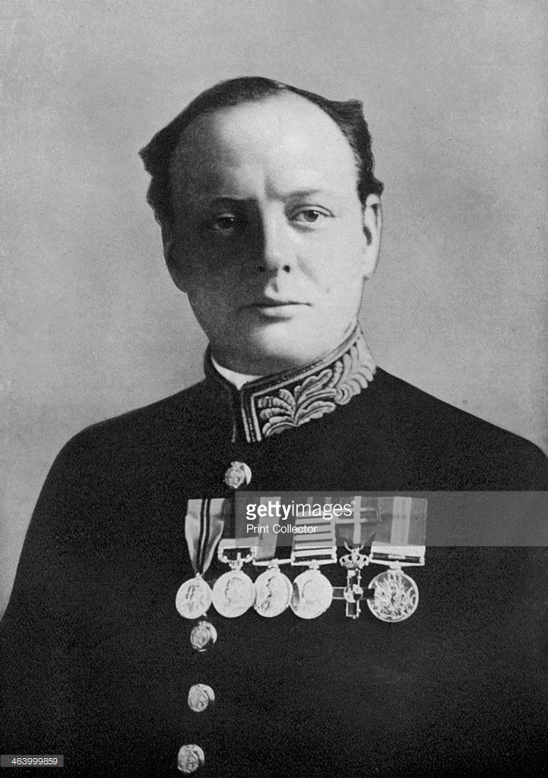
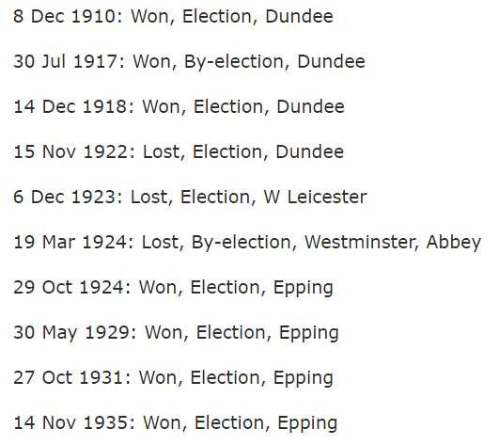

Slide 16
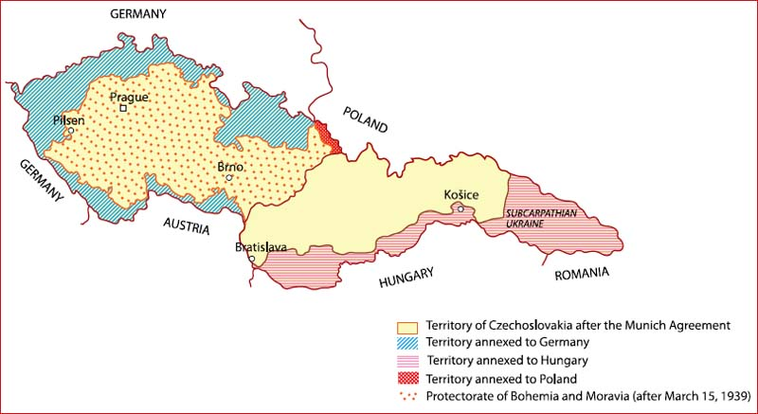

Slide 17
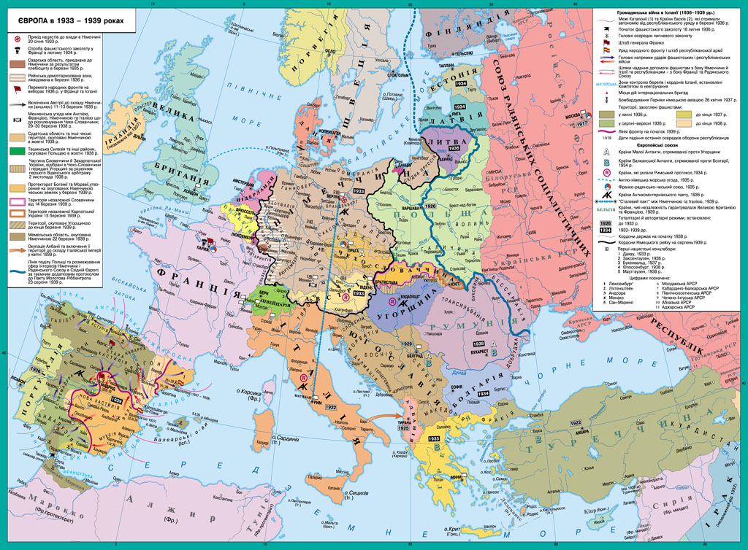

Slide 18
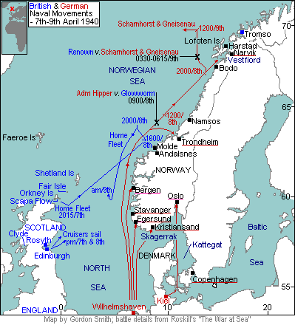

Slide 19
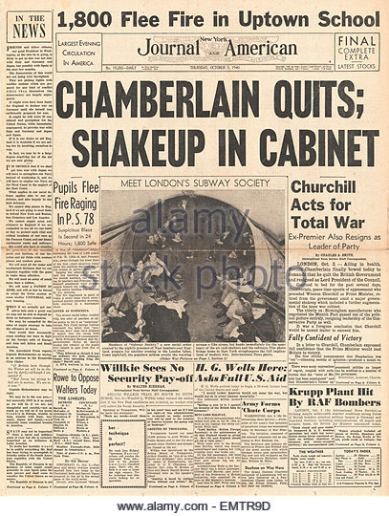

Slide 20
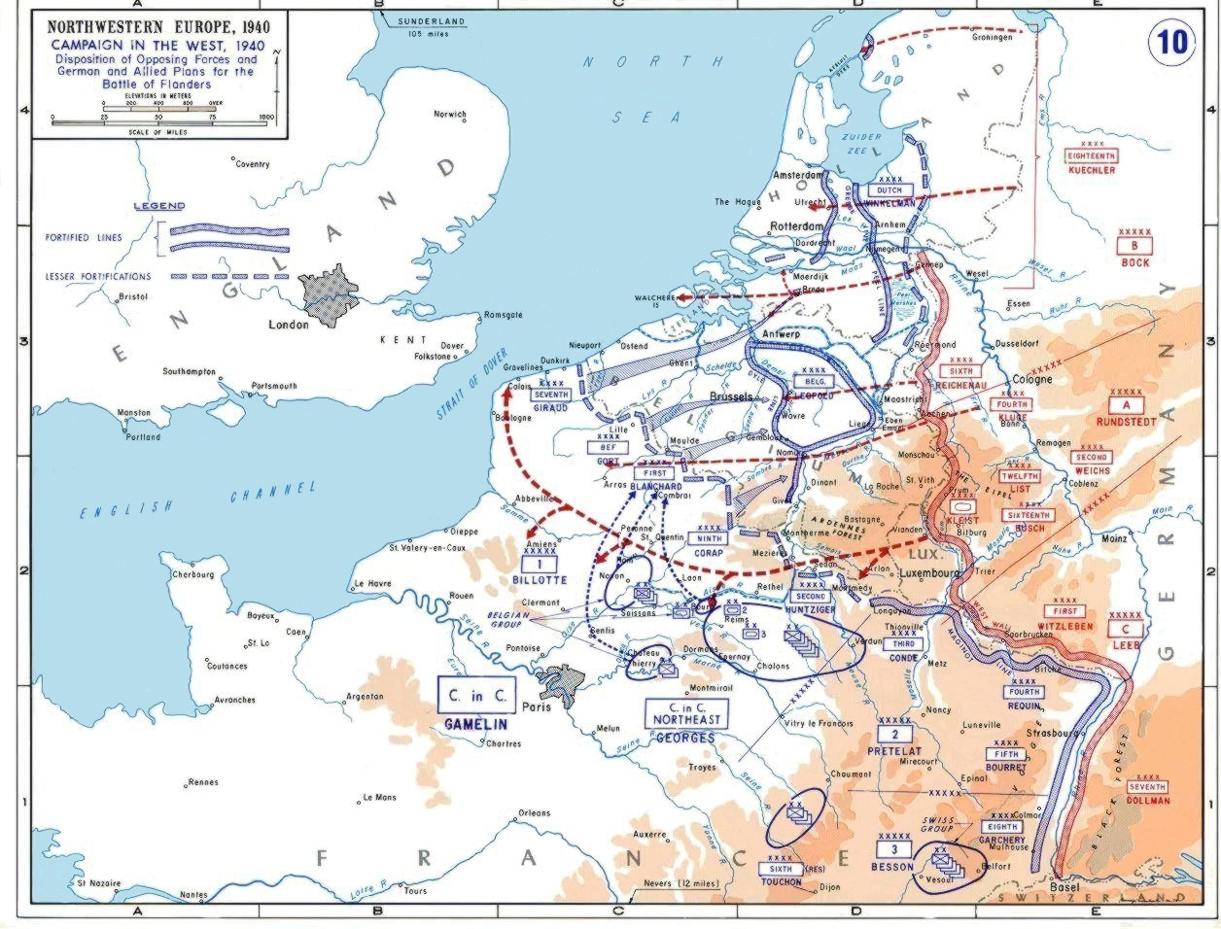

Slide 21
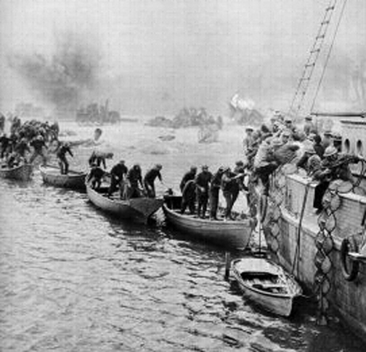
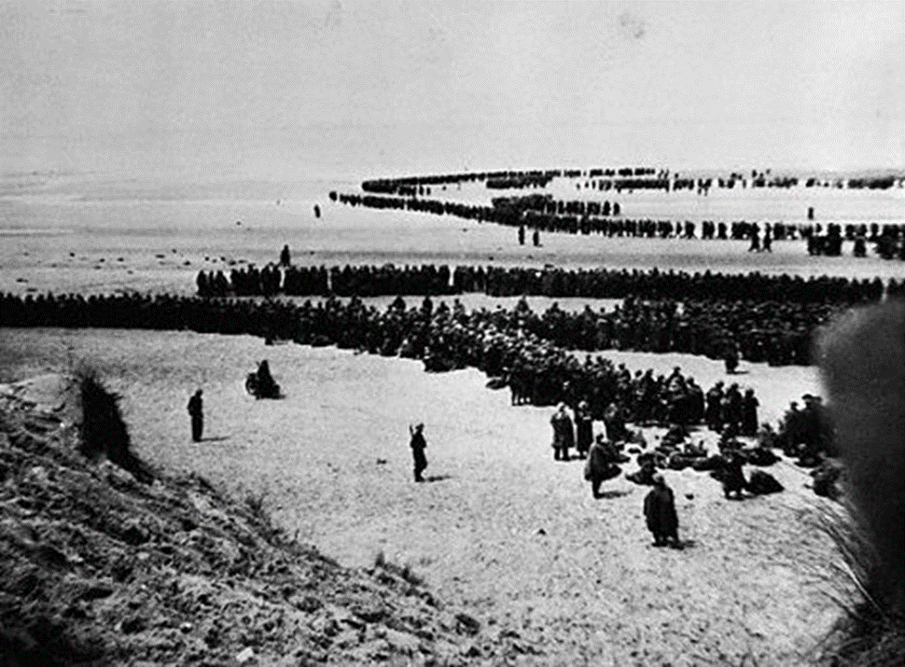

Slide 22
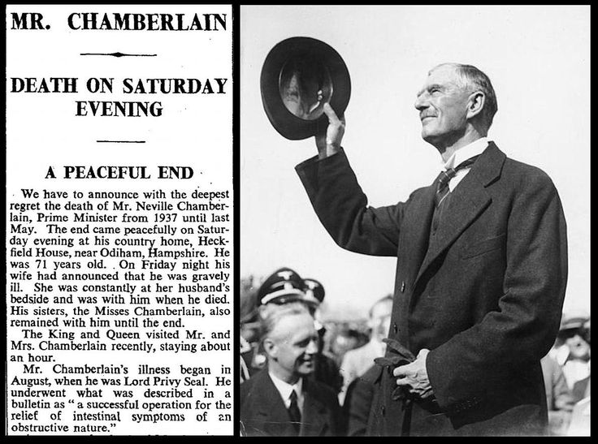

Slide 23
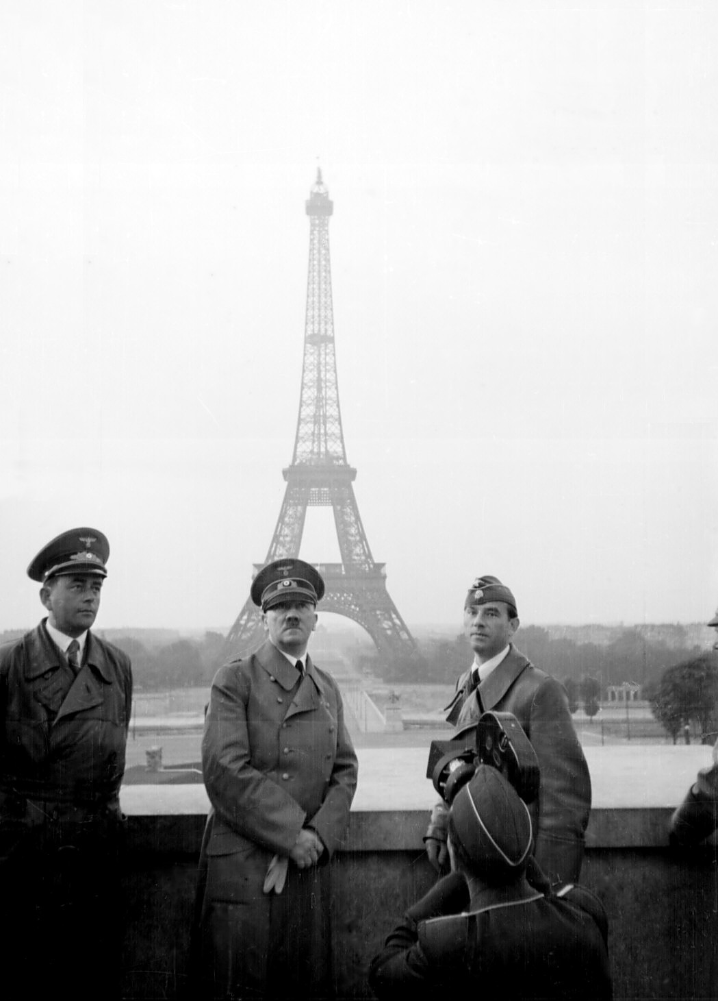
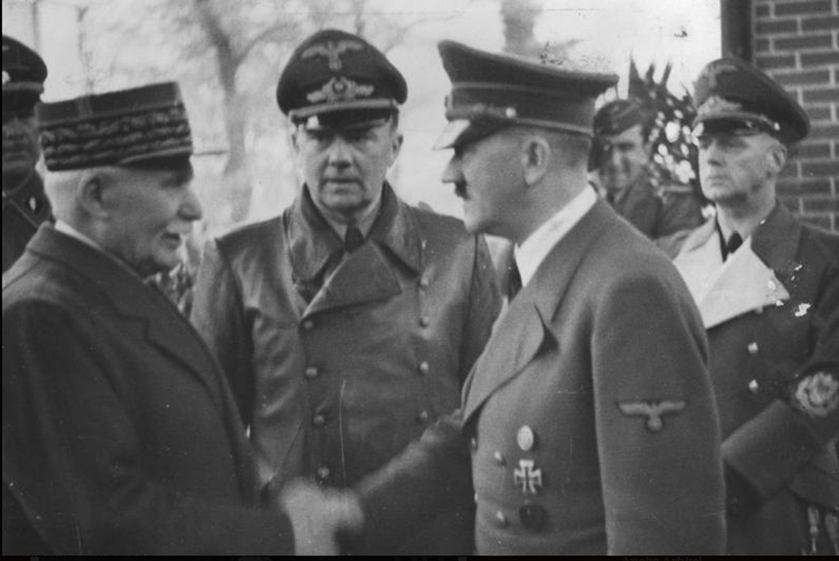

Slide 24
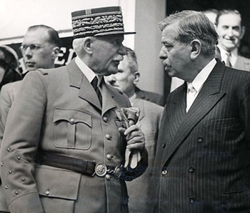

Slide 25
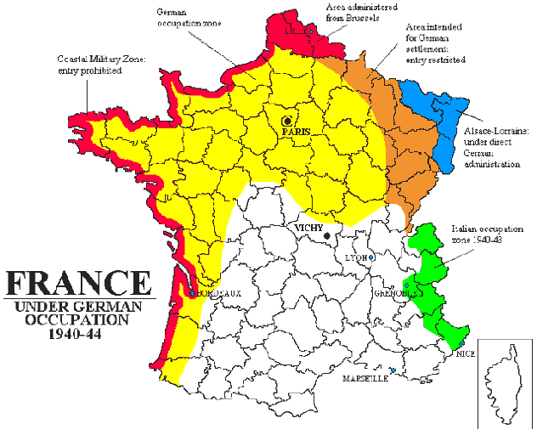

Slide 26


Slide 27
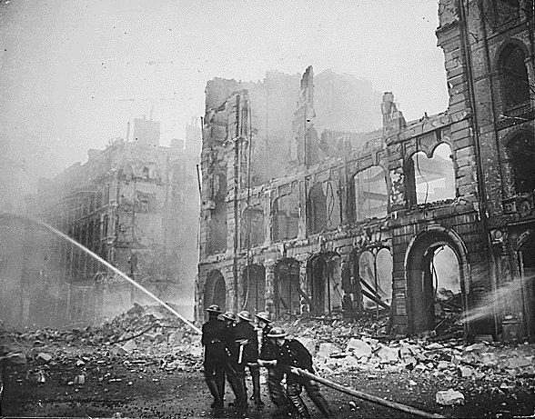
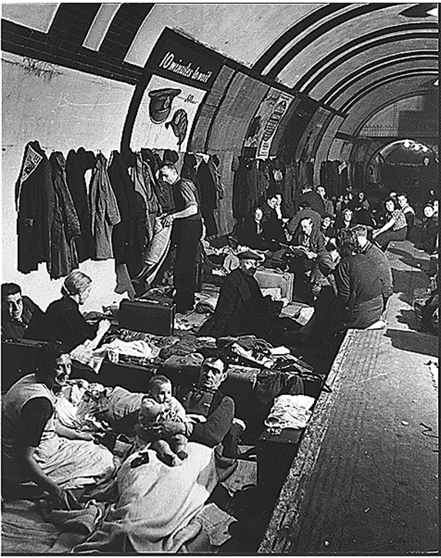
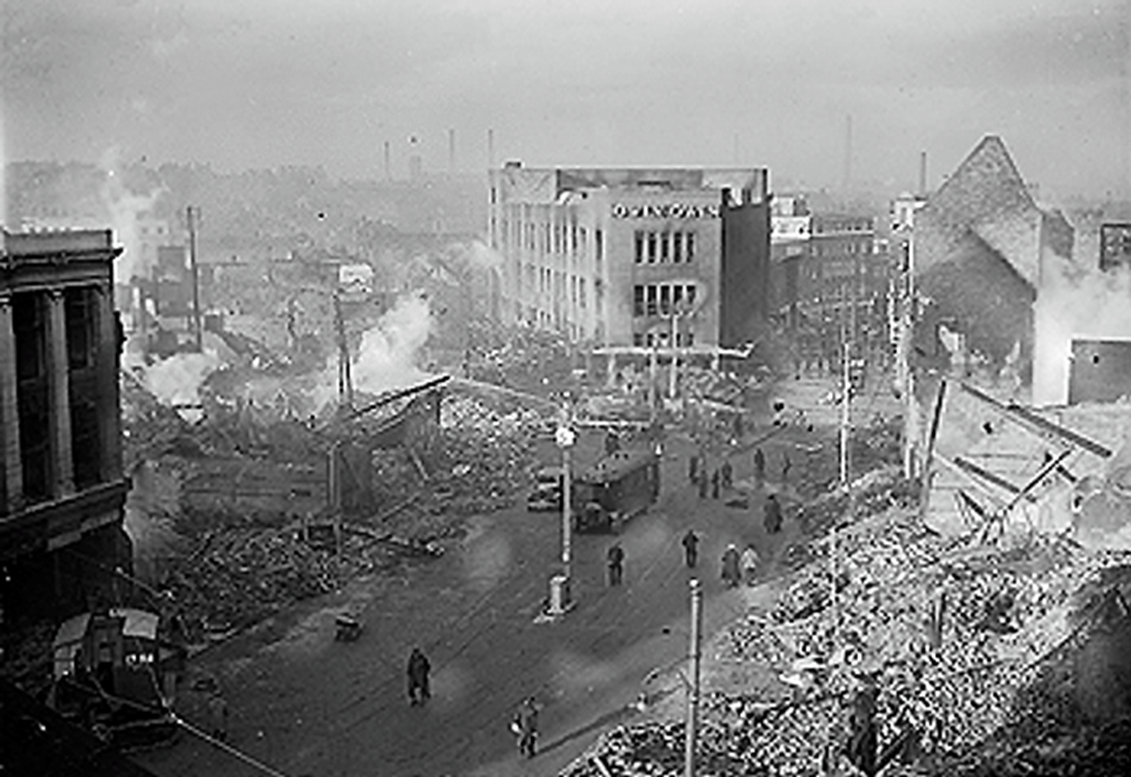

Slide 28
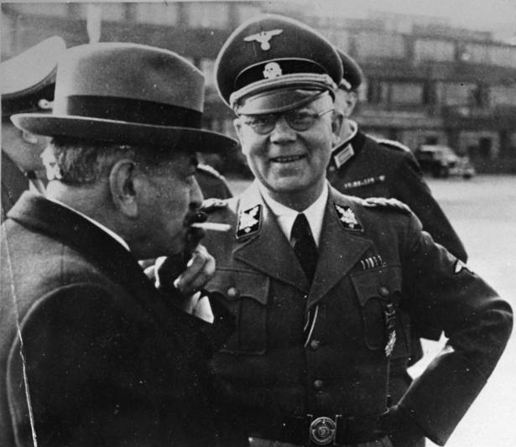

Slide 29
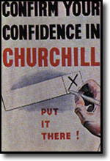
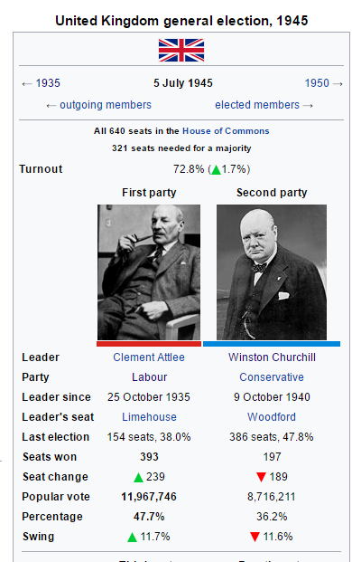

Slide 30
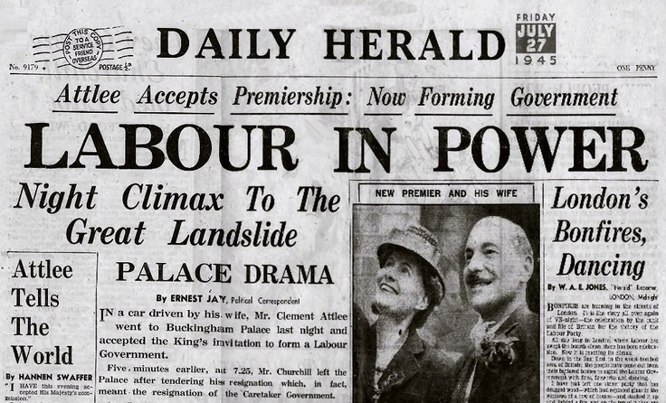

Slide 31
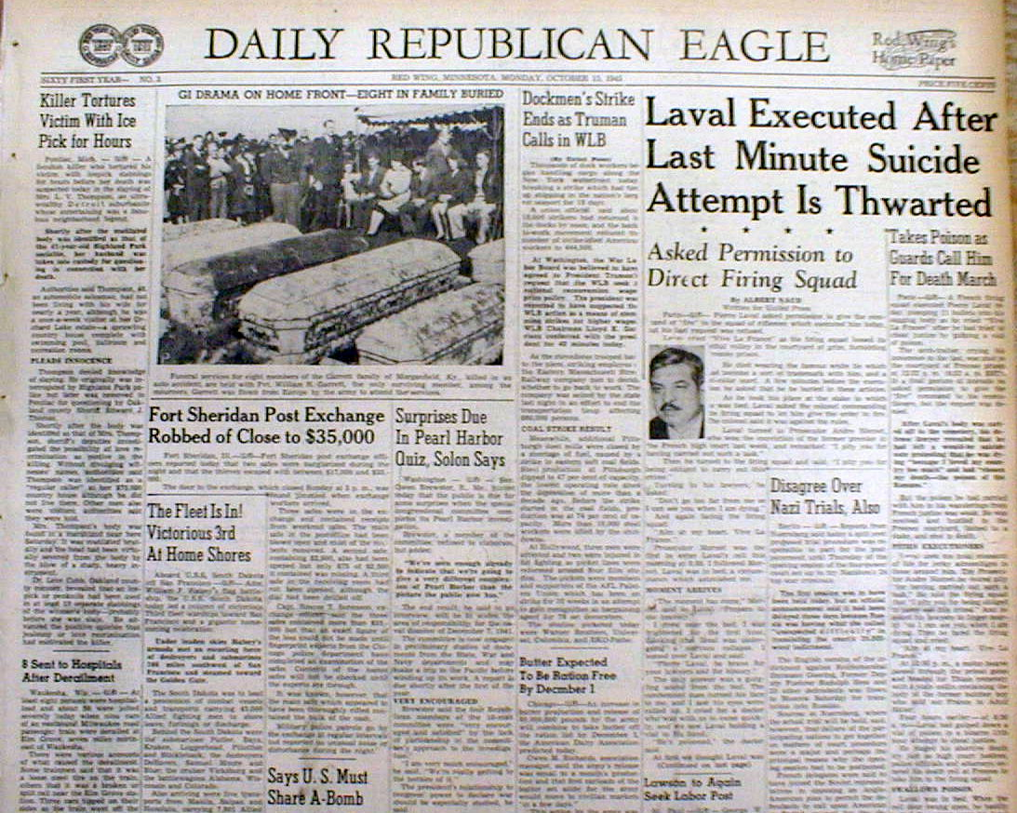

Slide 33
