Slide 1
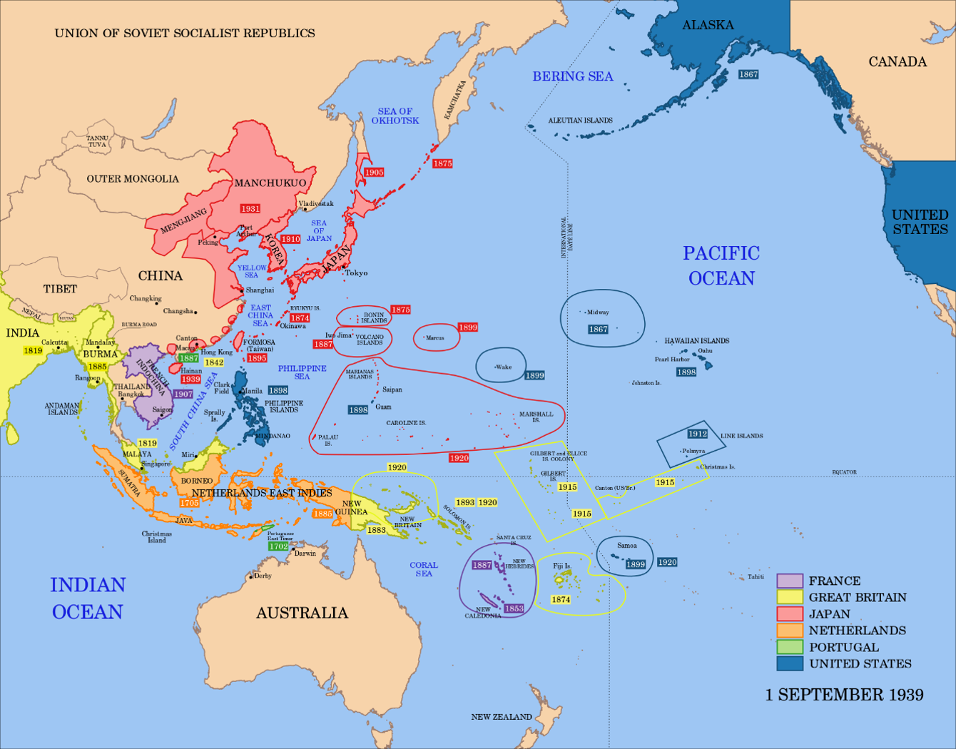

Slide 2
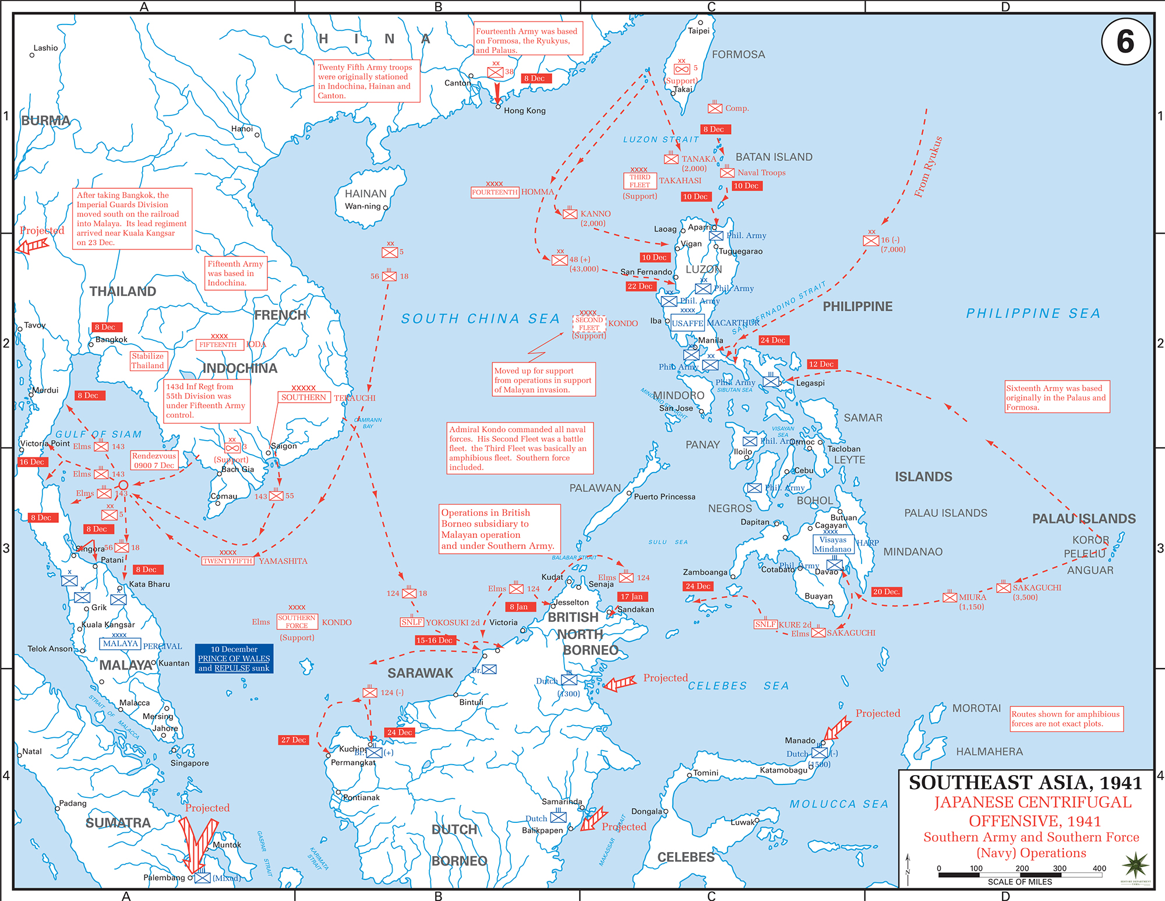

Slide 3
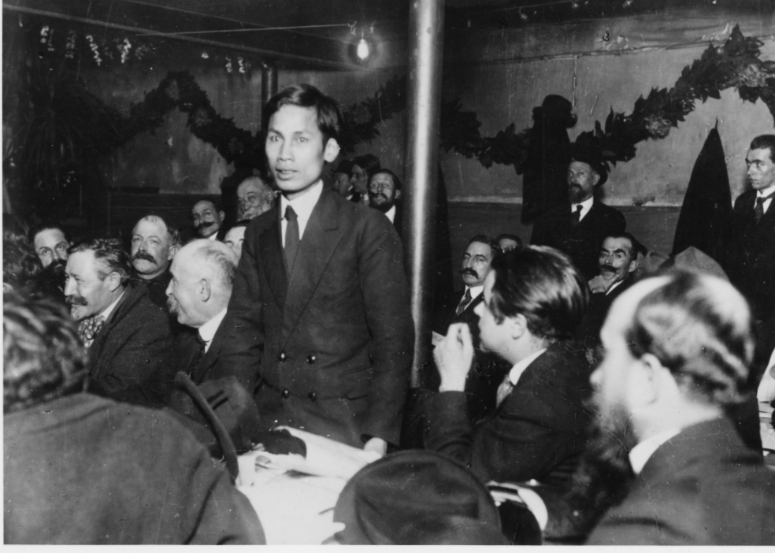

Slide 4
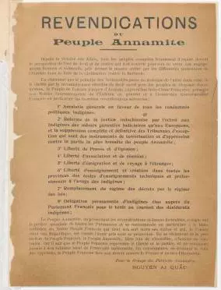

Slide 5
Demands of the Annamite [Vietnamese] People:
Since the victory of the Allies, all the subjects are frantic with hope at prospect of an era of right and justice, which should begin for them by virtue of the formal and solemn engagements made before the whole world by the various powers of the entente in the struggle of civilisation against barbarism.
While waiting for the principle of national self determination to pass from ideal to reality through the effective recognition of the sacred right of all peoples to decide their own destiny, the inhabitants of the ancient empire of Annam, present the following humble claims:
1. General amnesty for all the native people who have been condemned for political activity.
2. Reform of Indochinese justice by granting to the native population the same judicial guarantees as the Europeans have, and the total suppression of the special courts which are the instruments of terrorisation and oppression against the most responsible elements of the Annamite people.
3. Freedom of press and speech.
4. Freedom of association and assembly.
5. Freedom to emigrate and to travel abroad.
6. Freedom of education, and creation in every province of technical and professional schools for the native population.
7. Replacement of the regime of arbitrary decrees by a regime of law.
8. A permanent delegation of native people elected to attend the French parliament in order to keep the latter informed of their needs.

Slide 6
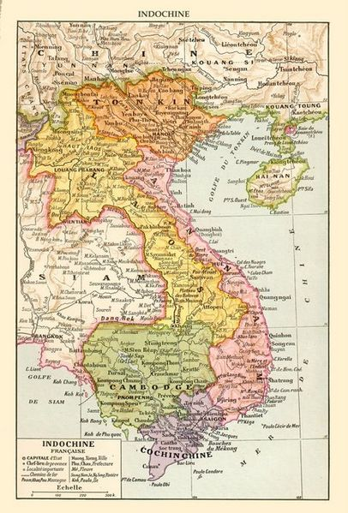

Slide 7
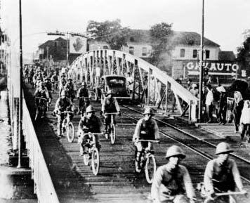

Slide 8
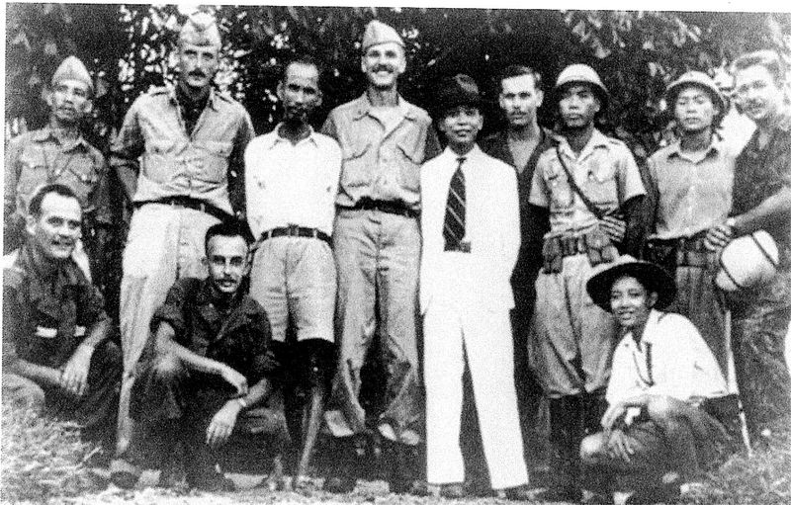

Slide 9
“All men are created equal. They are endowed by their Creator with certain inalienable rights, among them are Life, Liberty, and the pursuit of Happiness.”
This immortal statement was made in the Declaration of Independence of the United States of America in 1776. In a broader sense, this means: All the peoples on the earth are equal from birth, all the peoples have a right to live, to be happy and free . . .
The truth is that we have wrested our independence from the Japanese and not from the French.
The French have fled, the Japanese have capitulated, Emperor Bao Dai has abdicated. Our people have broken the chains which for nearly a century have fettered them and have won independence for the Fatherland. Our people at the same time have overthrown the monarchic regime that has reigned supreme for dozens of centuries. In its place has been established the present Democratic Republic.
For these reasons, we, members of the Provisional Government, representing the whole Vietnamese people, declare that from now on we break off all relations of a colonial character with France; we repeal all the international obligation that France has so far subscribed to on behalf of Vietnam and we abolish all the special rights the French have unlawfully acquired in our Fatherland.
The whole Vietnamese people, animated by a common purpose, are determined to fight to the bitter end against any attempt by the French colonialists to reconquer their country.
We are convinced that the Allied nations which at Tehran and San Francisco have acknowledged the principles of self-determination and equality of nations, will not refuse to acknowledge the independence of Vietnam.
A people who have courageously opposed French domination for more than eight years, a people who have fought side by side with the Allies against the Fascists during these last years, such a people must be free and independent.
For these reasons, we, members of the Provisional Government of the Democratic Republic of Vietnam, solemnly declare to the world that Vietnam has the right to be a free and independent country—and in fact is so already. The entire Vietnamese people are determined to mobilize all their physical and mental strength, to sacrifice their lives and property in order to safeguard their independence and liberty.

Slide 10
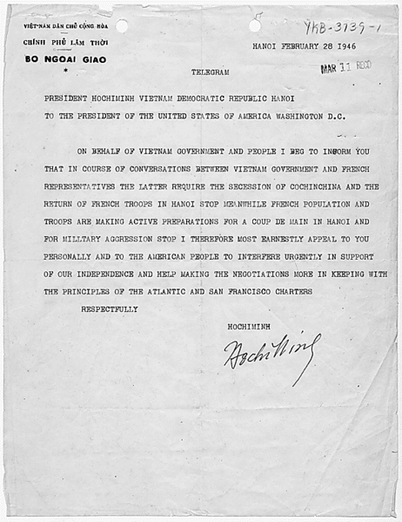

Slide 11
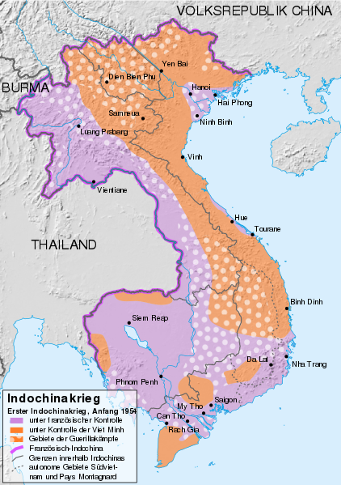

Slide 12


Slide 13
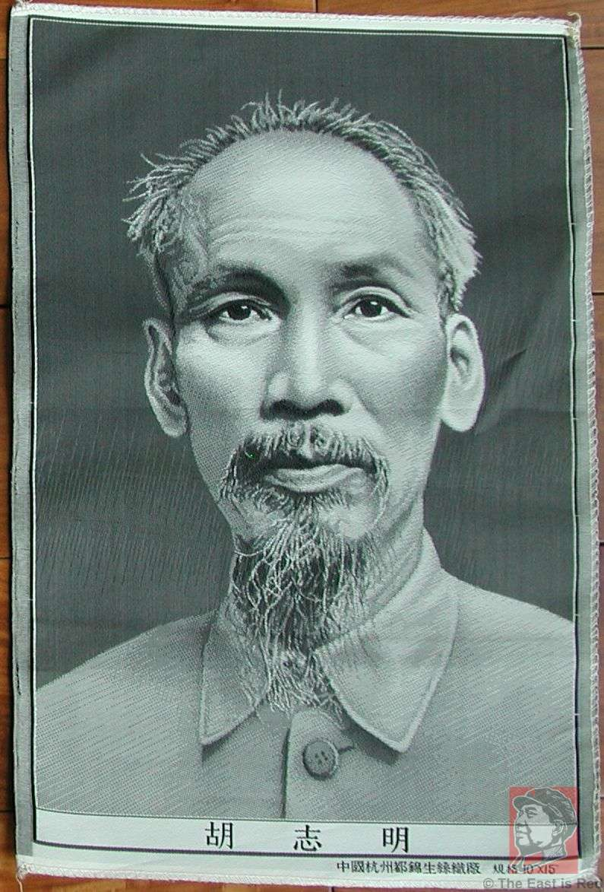

Slide 14
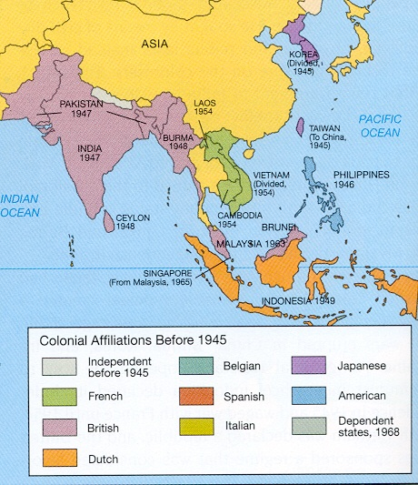

Slide 15
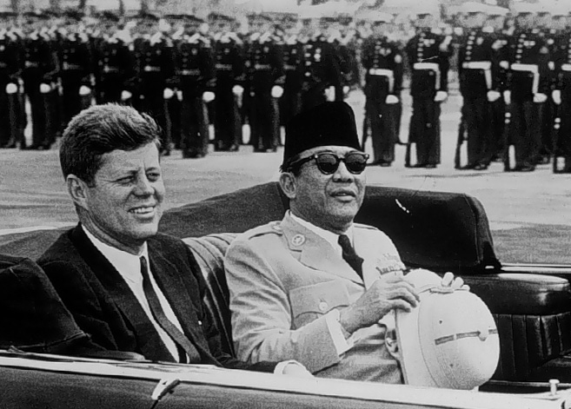

Slide 16
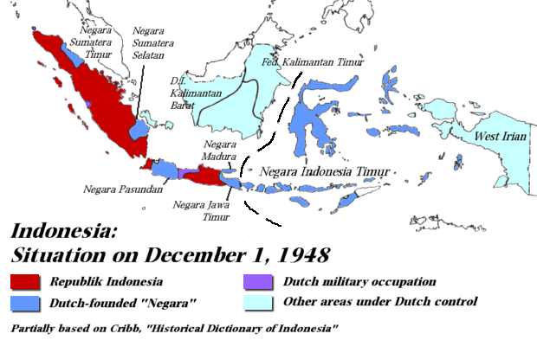

Slide 17
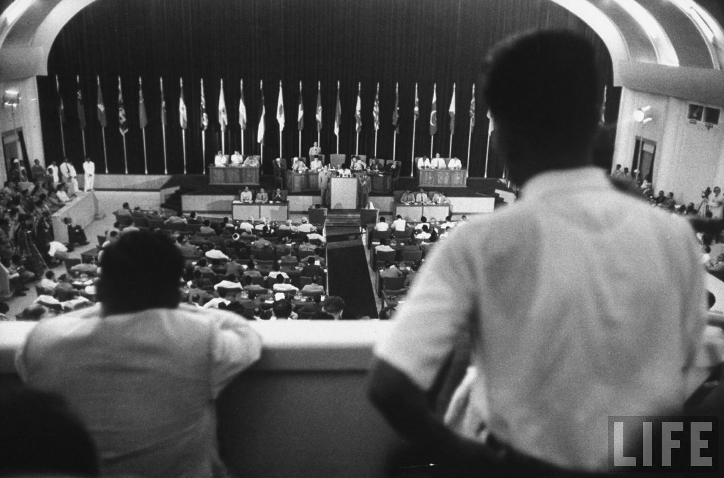

Slide 18
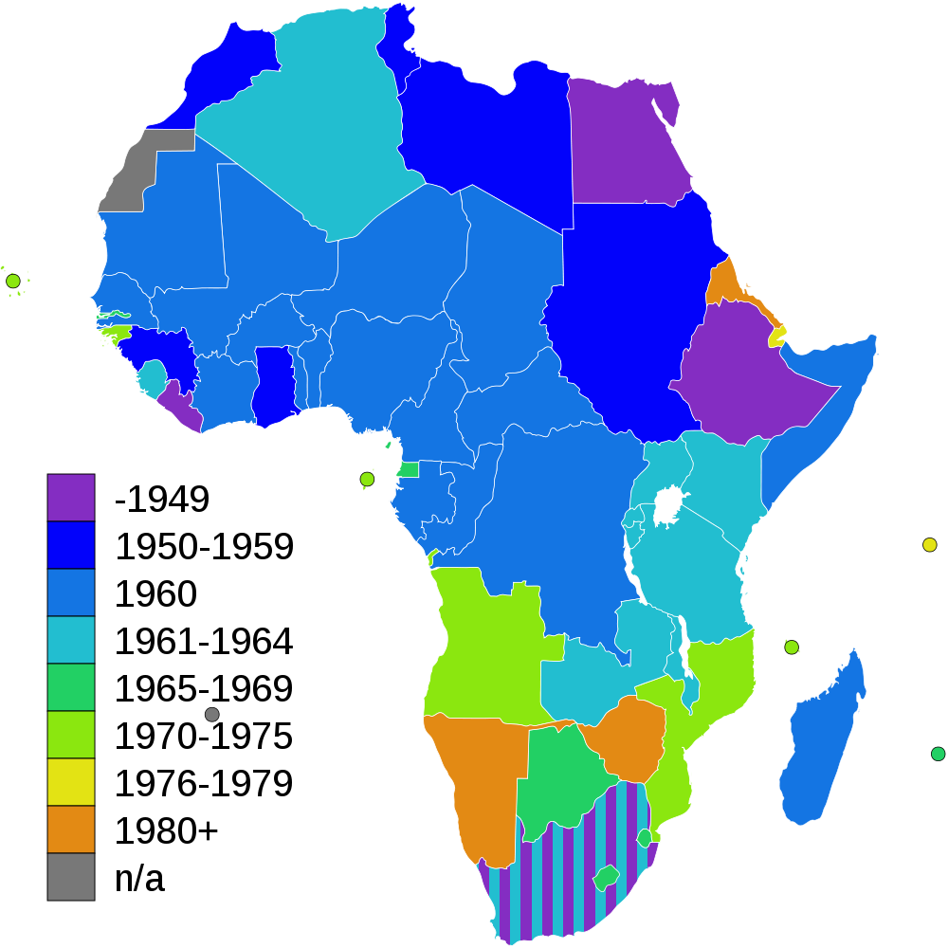

Slide 19
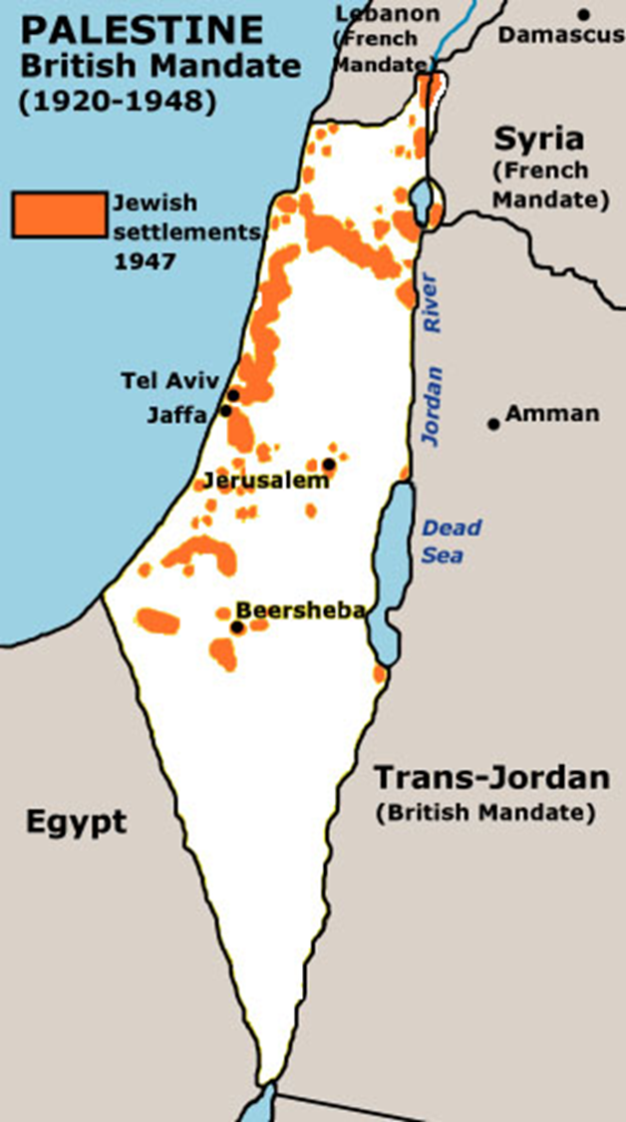
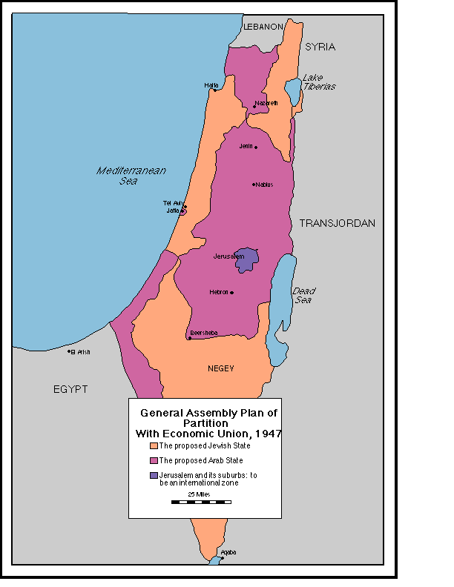

Slide 20
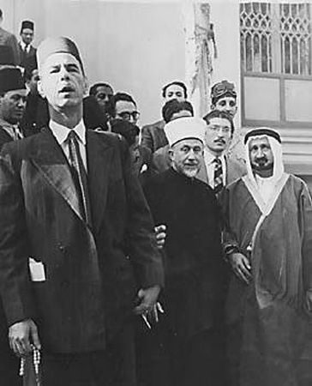
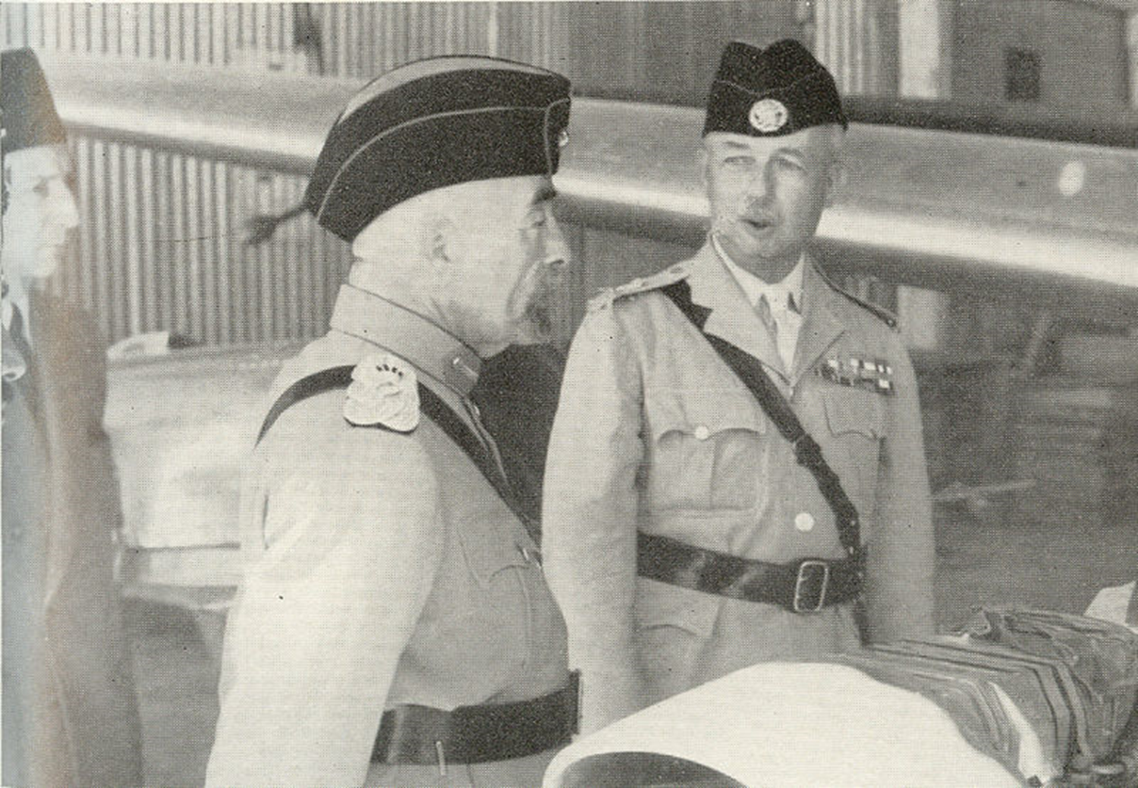
Notes:
Grand mufti in egypt

Slide 21
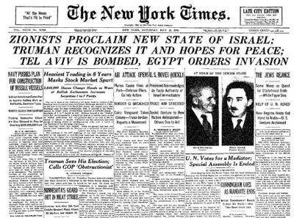

Slide 22
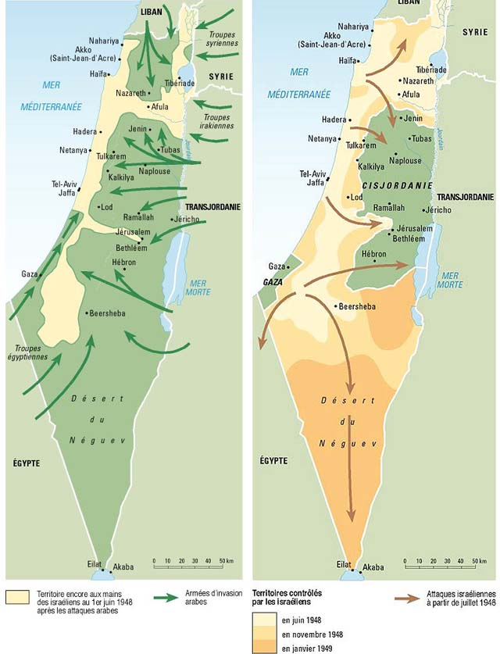

Slide 23
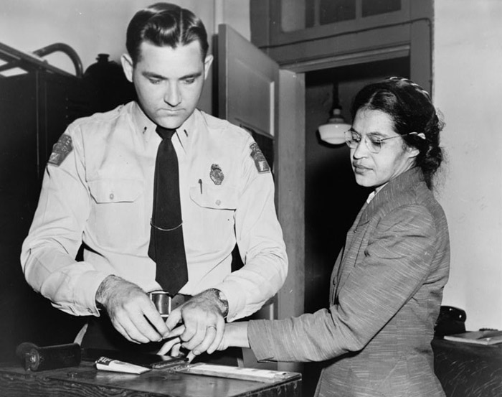

Slide 24
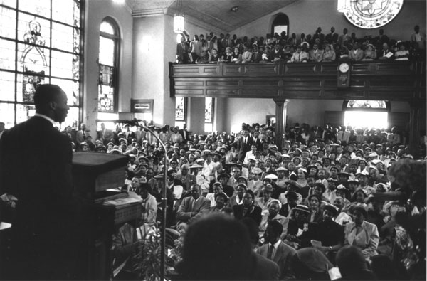

Slide 25
I am in Birmingham because injustice is here ...I am cognizant of the interrelatedness of all communities and states. I cannot sit idly by in Atlanta and not be concerned about what happens in Birmingham. Injustice anywhere is a threat to justice everywhere. We are caught in an inescapable network of mutuality, tied in a single garment of destiny. Whatever affects one directly affects all indirectly. Never again can we afford to live with the narrow, provincial "outside agitator" idea. Anyone who lives inside the United States can never be considered an outsider ...
I guess it is easy for those who have never felt the stinging darts of segregation to say “wait.”…
One may well ask, "How can you advocate breaking some laws and obeying others?" The answer is found in the fact that there are two types of laws: there are just laws, and there are unjust laws. I would agree with St. Augustine that "An unjust law is no law at all.“…
Of course, there is nothing new about this kind of civil disobedience. It was seen sublimely in the refusal of Shadrach, Meshach, and Abednego to obey the laws of Nebuchadnezzar because a higher moral law was involved. It was practiced superbly by the early Christians, who were willing to face hungry lions and the excruciating pain of chopping blocks before submitting to certain unjust laws of the Roman Empire. To a degree, academic freedom is a reality today because Socrates practiced civil disobedience.

Slide 26


Slide 27
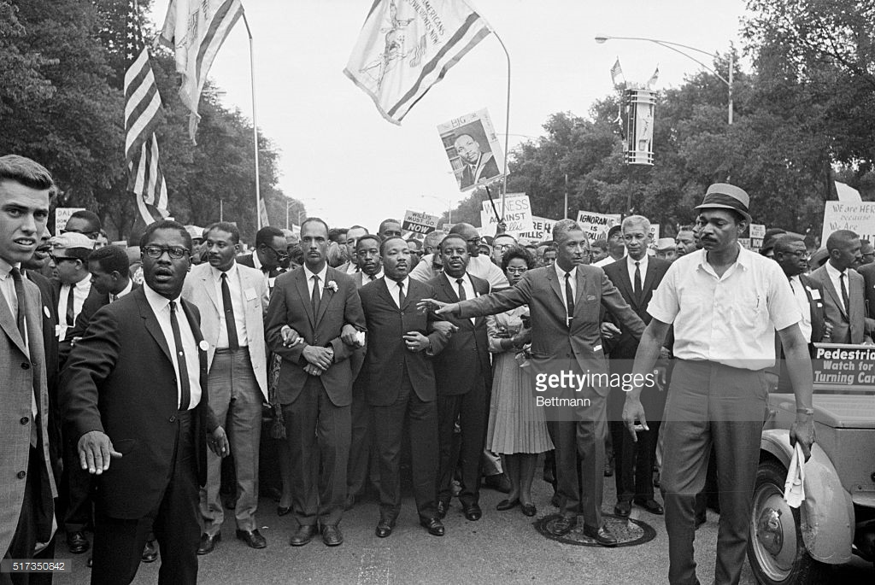

Slide 28
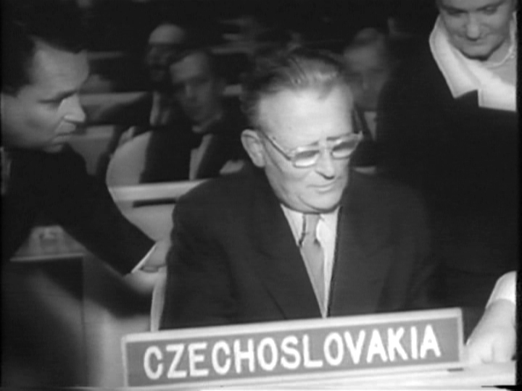

Slide 29
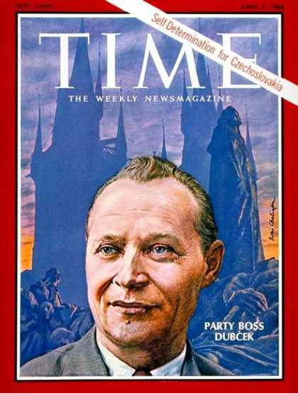

Slide 30
