Slide 1
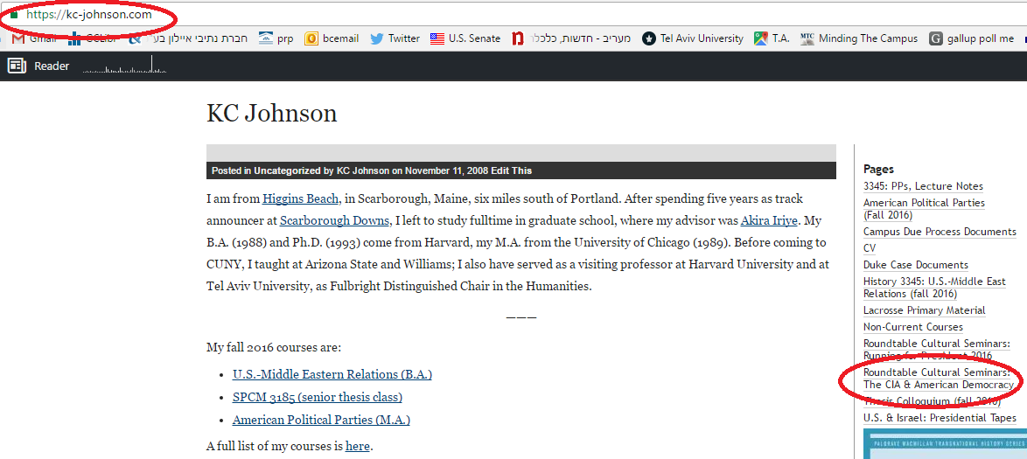

Slide 2
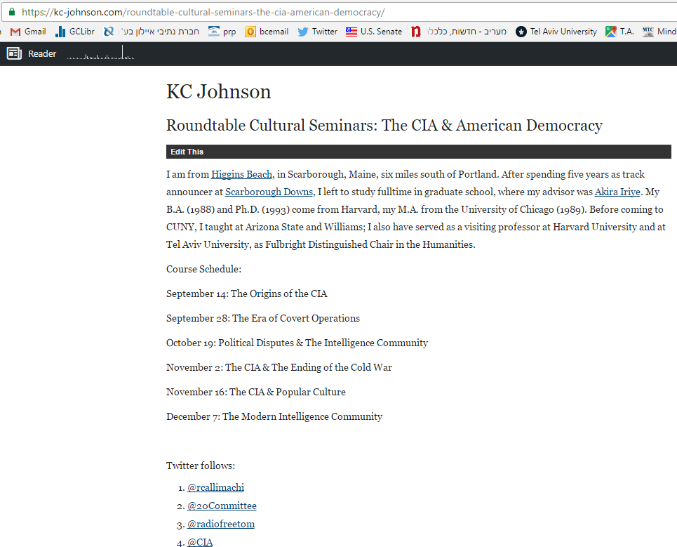

Slide 3

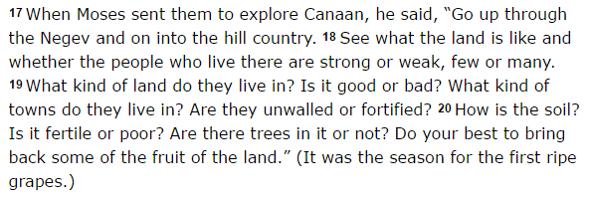
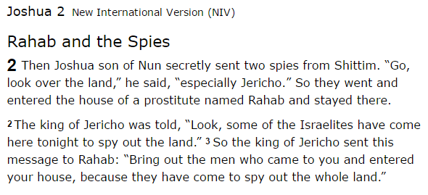

Slide 4
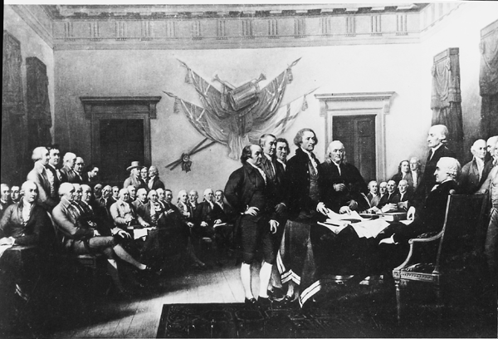
Notes:
Committee of secret correspondence

Slide 5
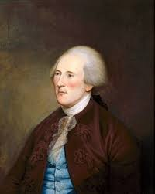
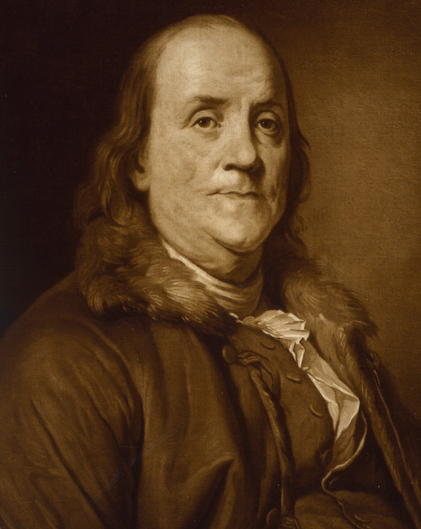
Notes:
Arthur lee

Slide 6
8 Miles East of Morris Town July 26: 1777.
Sir
By a Letter received this morning from Lord Stirling of the 22d Inst, I find he intends to pursue his Rout from Peeks Kill, thro Keckyate & Pyramus to the Great Falls -- From thence thro Watsessing -- Springfield & Brunswick or Bound Brook.
The reason of my being thus particular in describing Lord Stirling's Rout, is, Because I wish you to take every possible pains in your power, by sending trusty persons to Staten Island in whom you can confide, to obtain Intelligence of the Enemy's situation & numbers -- what kind of Troops they are, and what Guards they have -- their strength & where posted. -- …
The necessity of procuring good Intelligence is apparent & need not be further urged -- All that remains for me to add is, that you keep the whole matter as secret as possible. For upon Secrecy, Success depends in Most Enterprizes of the kind, and for want of it, they are generally defeated, however well planned & promising a favourable issue.
I am Sir
Yr Most Obed Sert
G. Washington

Slide 7
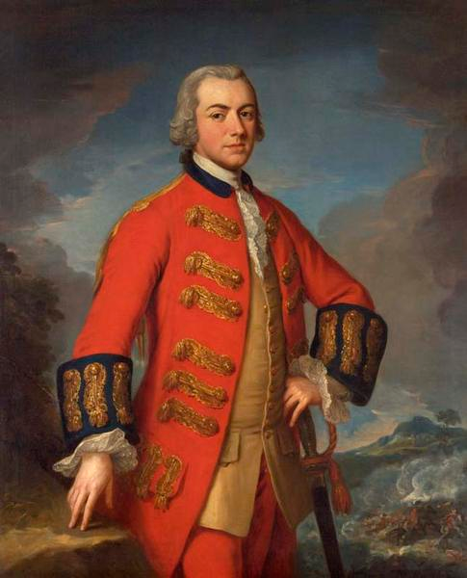

Slide 8
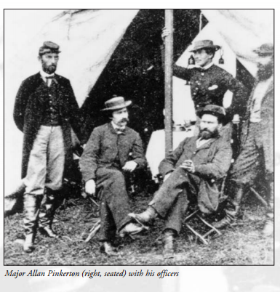

Slide 9
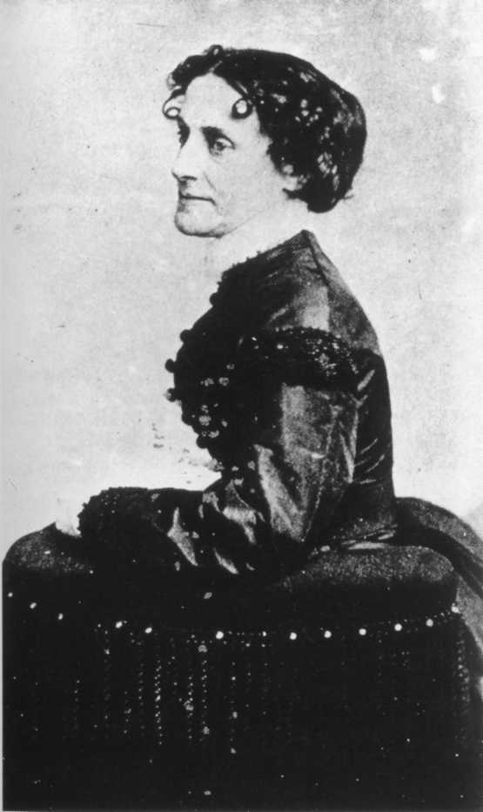
Notes:
Elizabeth van lew

Slide 10
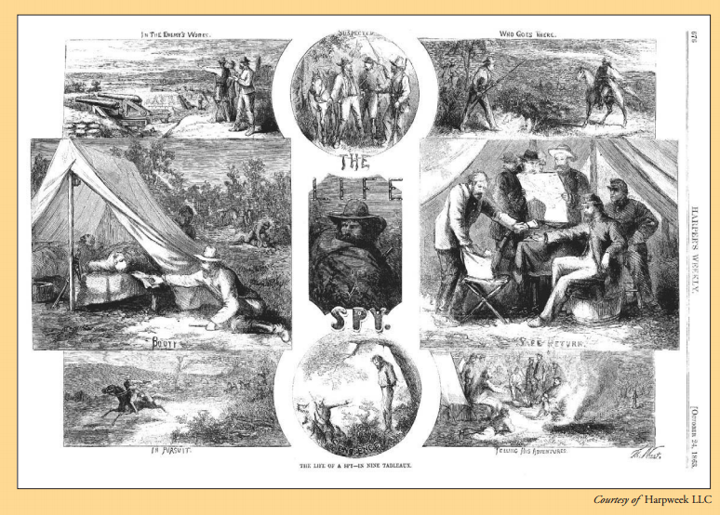
Notes:
Bureau of mil info

Slide 11


Slide 12
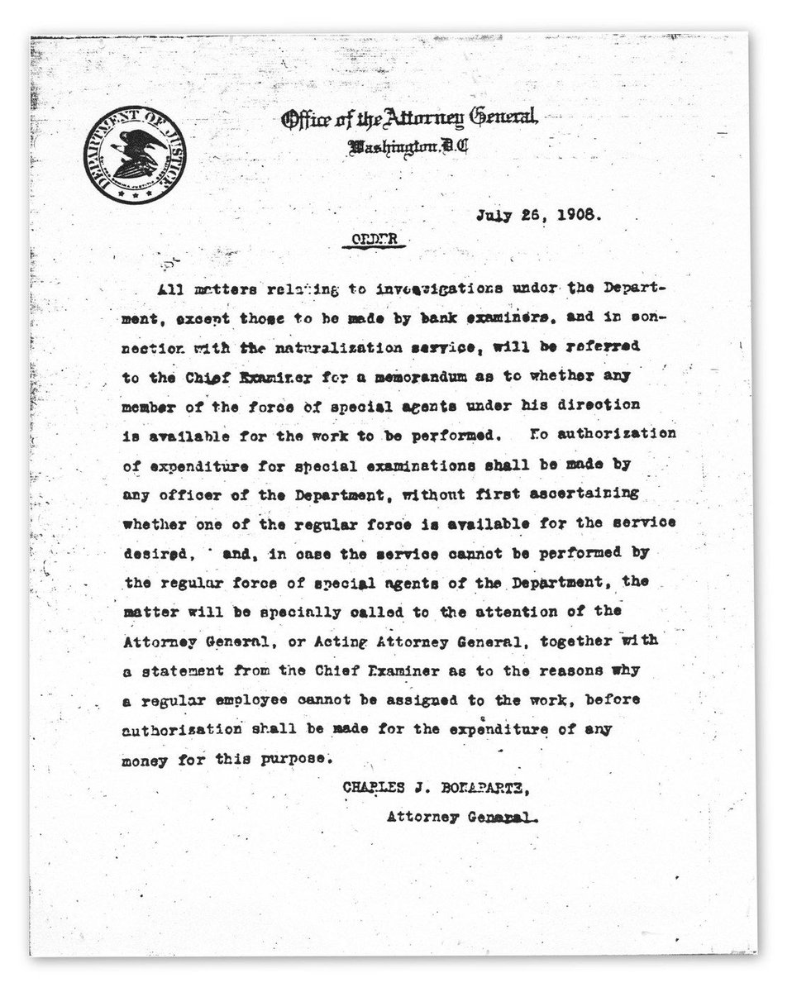

Slide 13
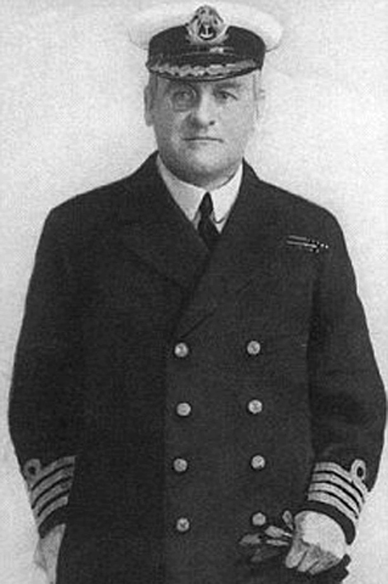

Notes:
Sir geo Mansfield-cummings (C)—MI6 1909

Slide 14
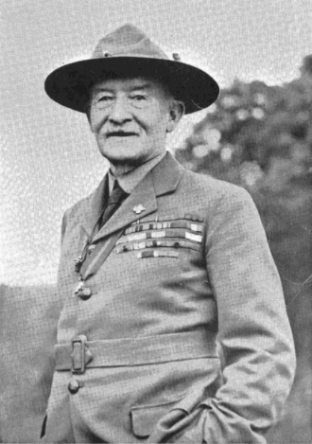
Notes:
Robert baden-powell

Slide 15
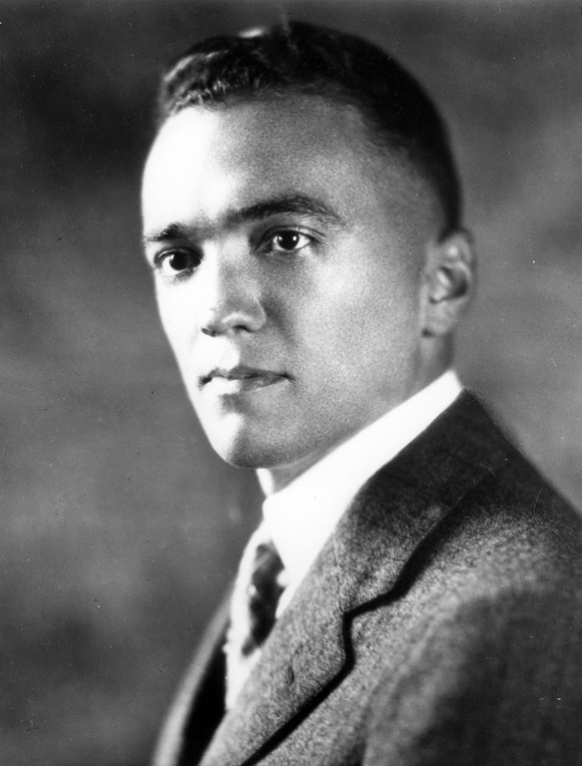

Slide 16
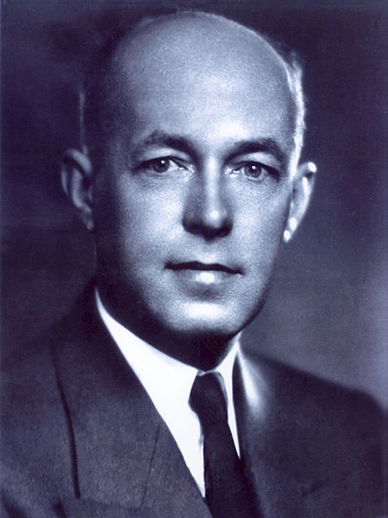
Notes:
yard;ley

Slide 17
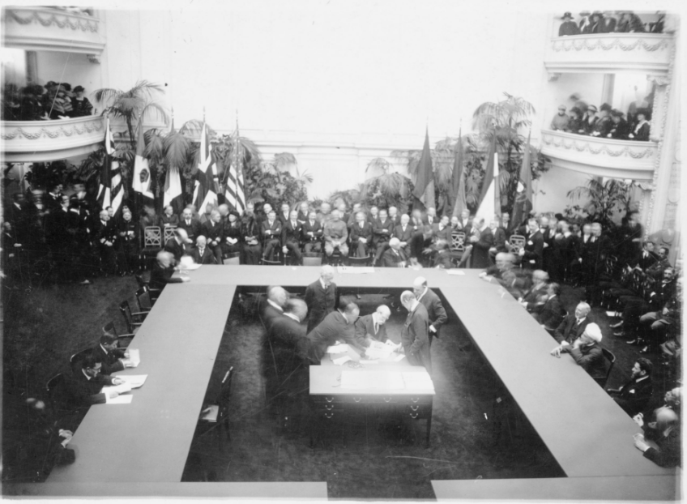

Slide 18


Slide 19
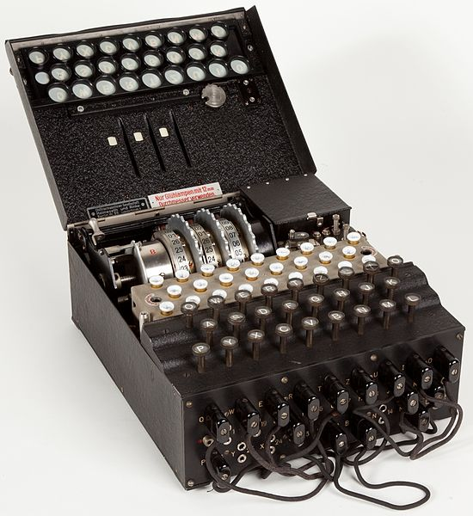
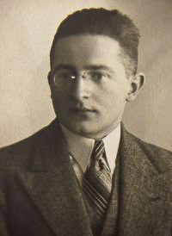
Notes:
Enigma machine==--marian rejewski

Slide 20
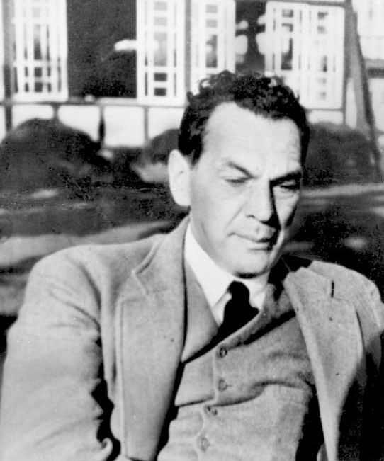
Notes:
sorge

Slide 21
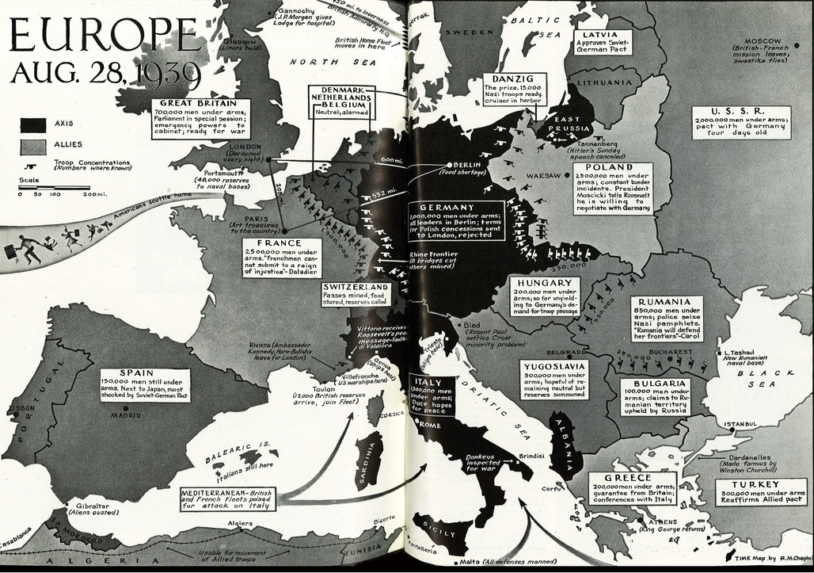

Slide 22
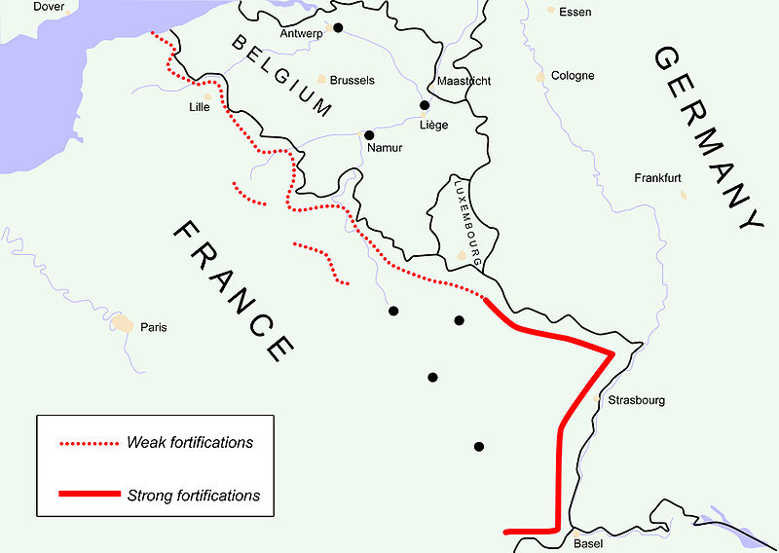
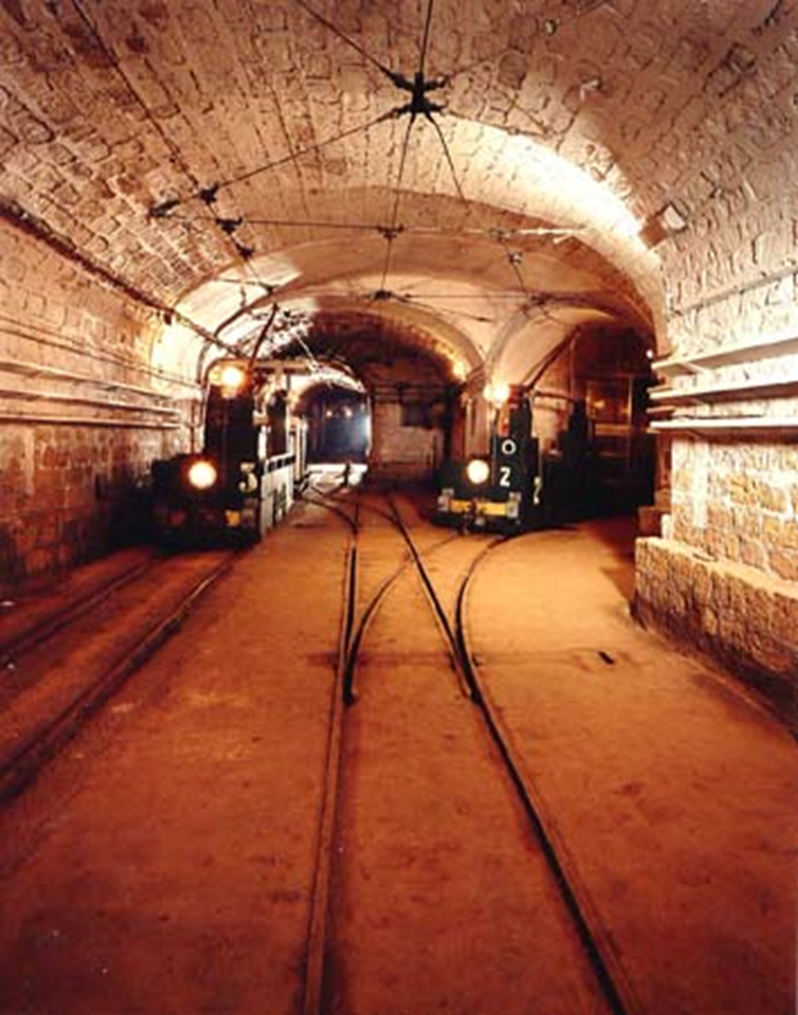

Slide 23
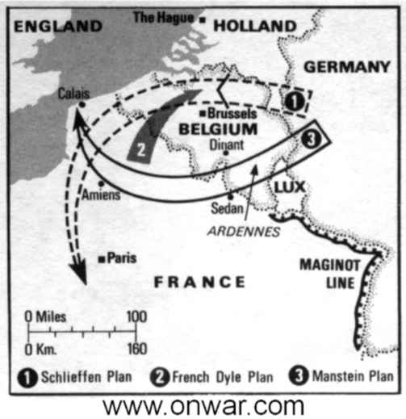
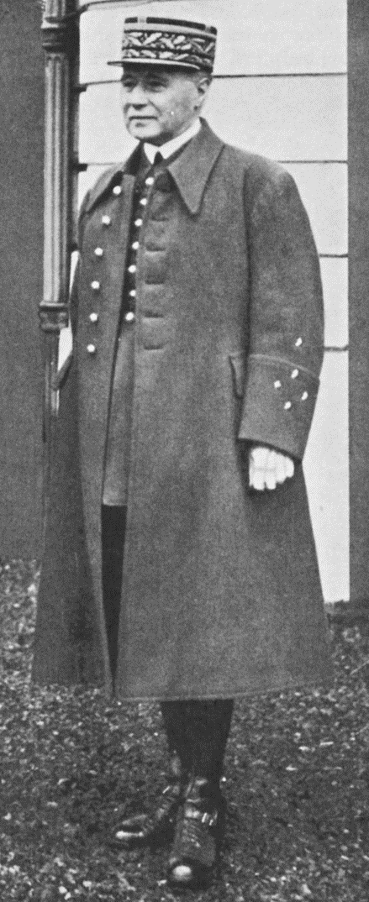

Slide 24
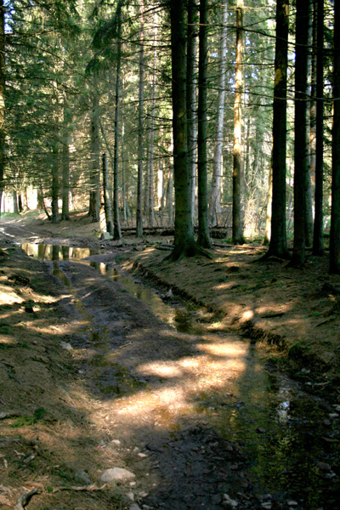
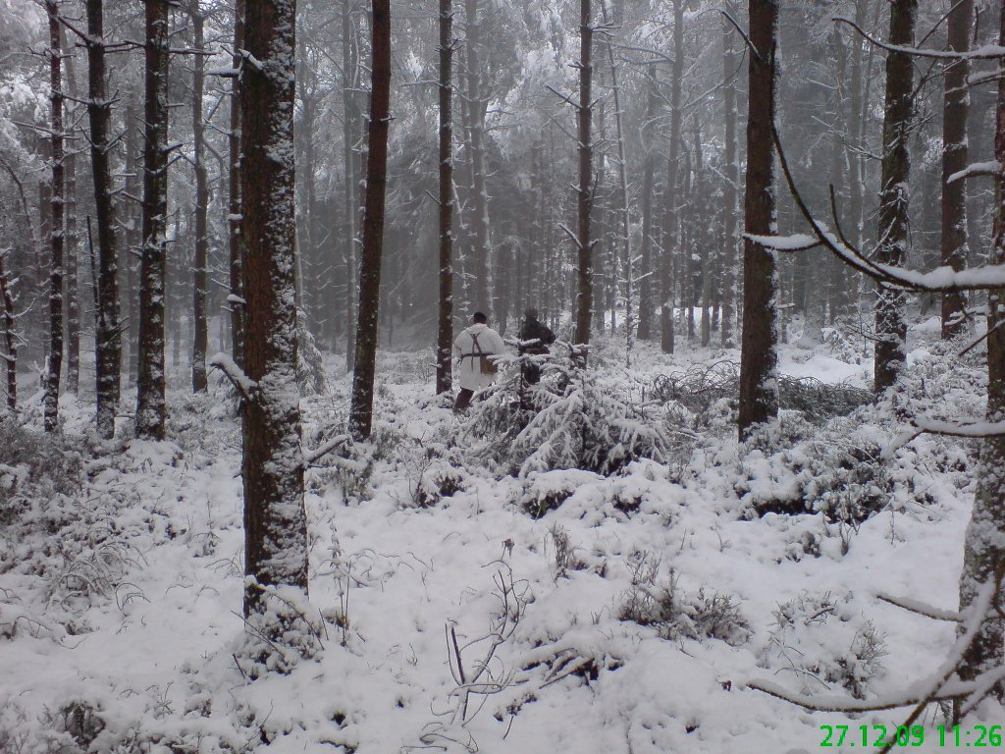

Slide 25
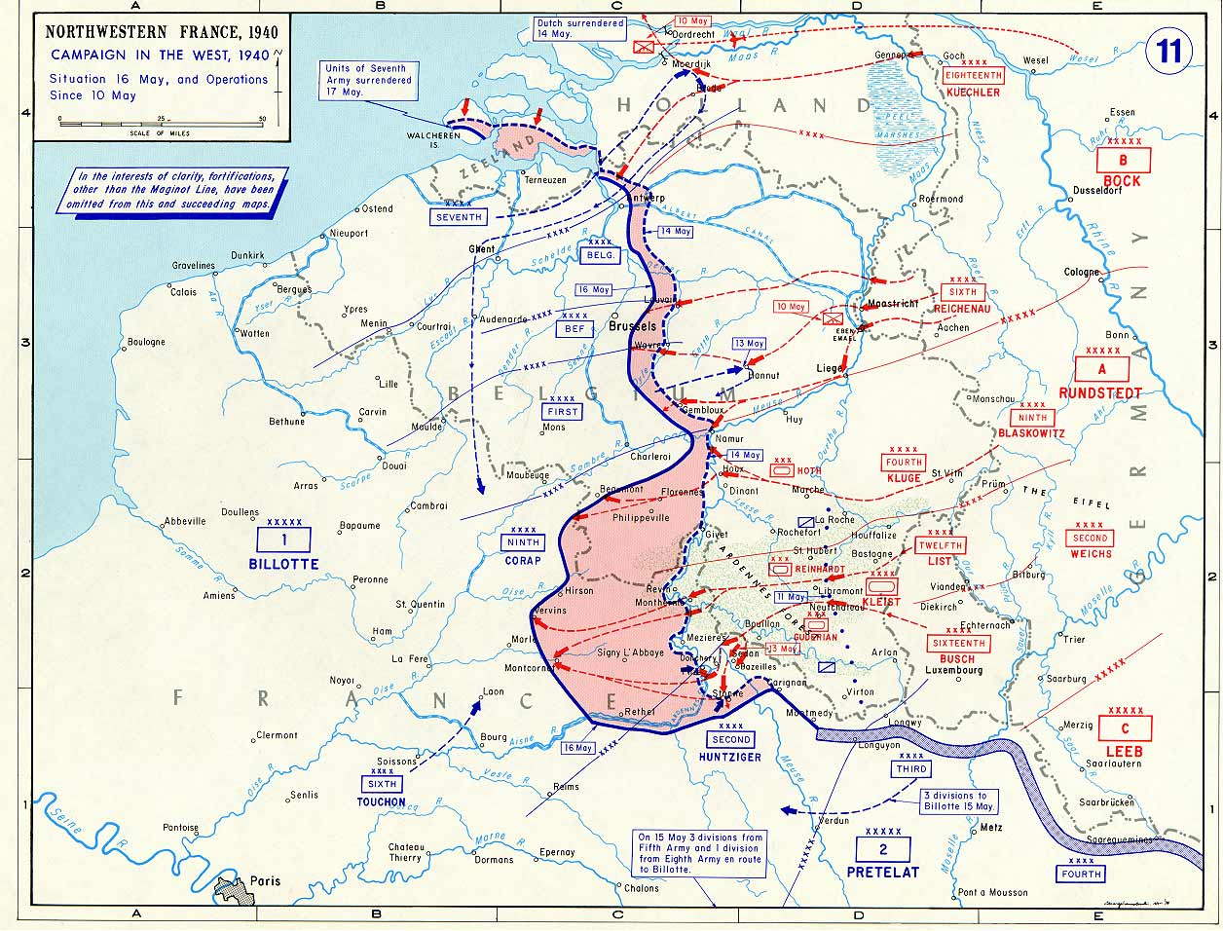

Slide 26
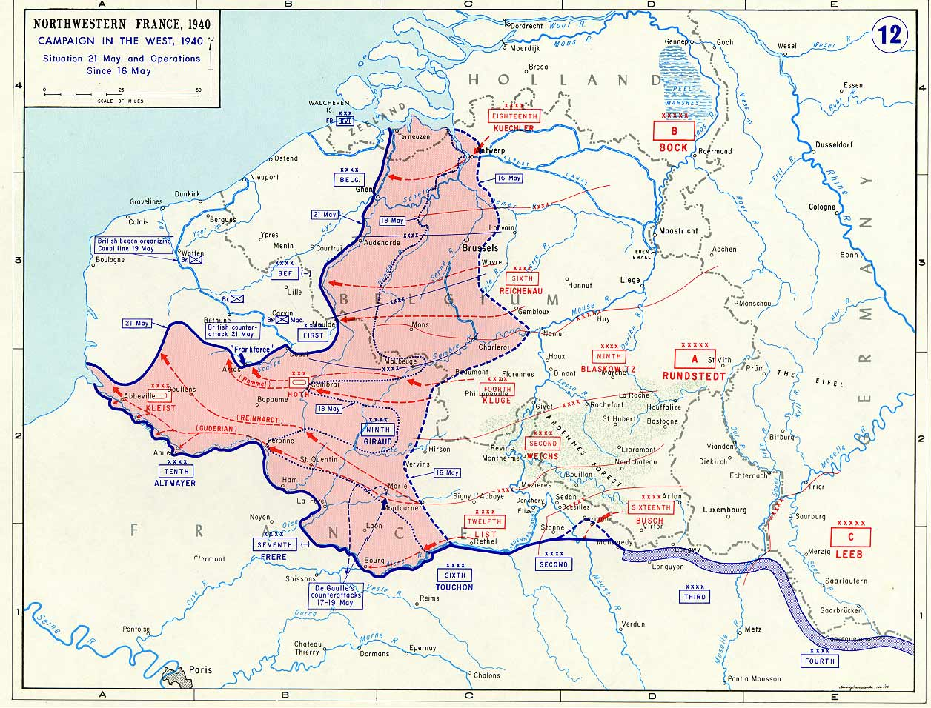

Slide 27
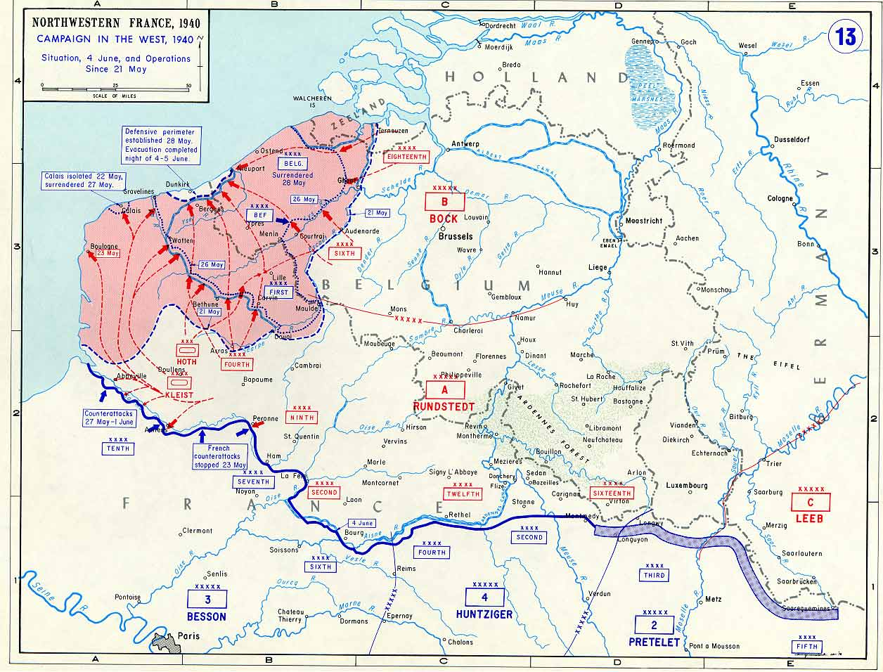

Slide 28
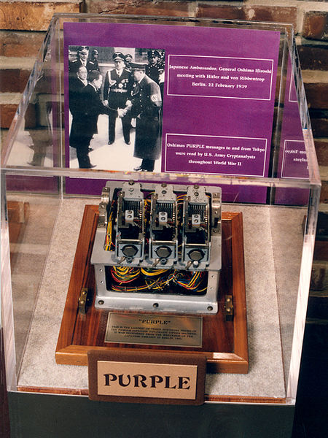

Slide 29
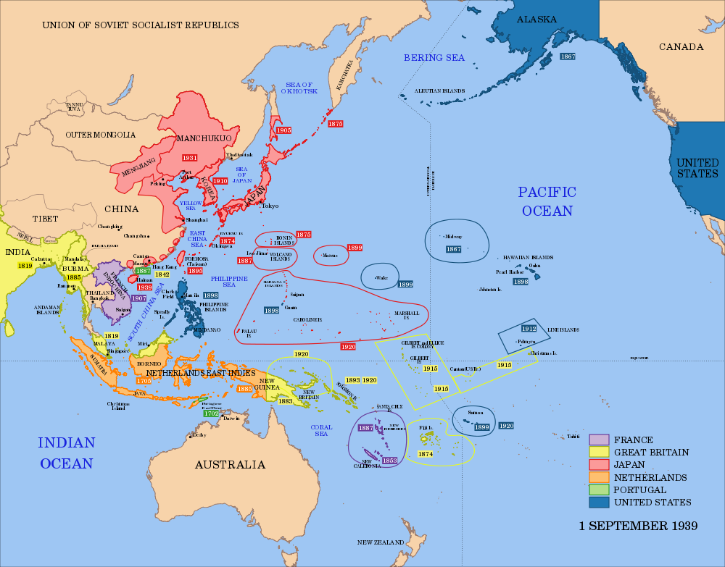

Slide 30
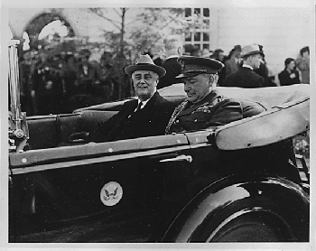

Slide 31
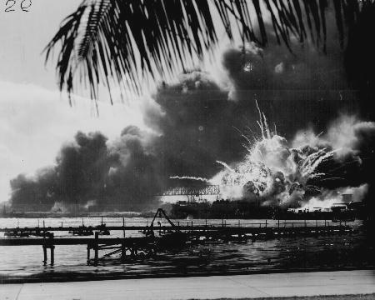

Slide 32
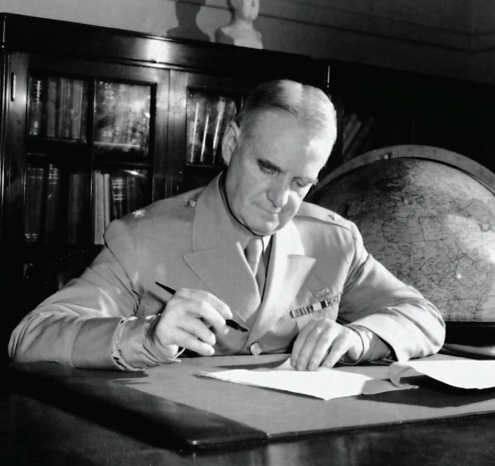


Slide 33
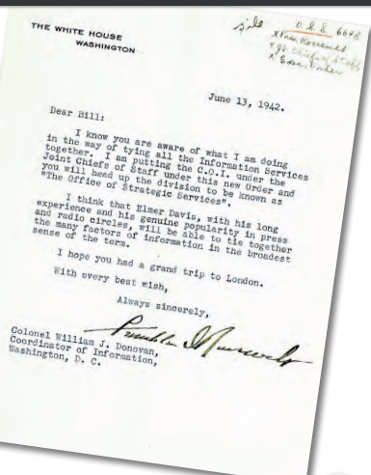

Slide 34
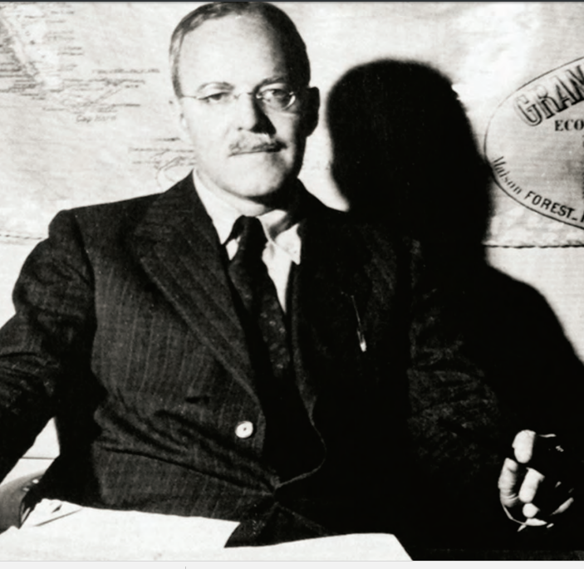

Slide 35
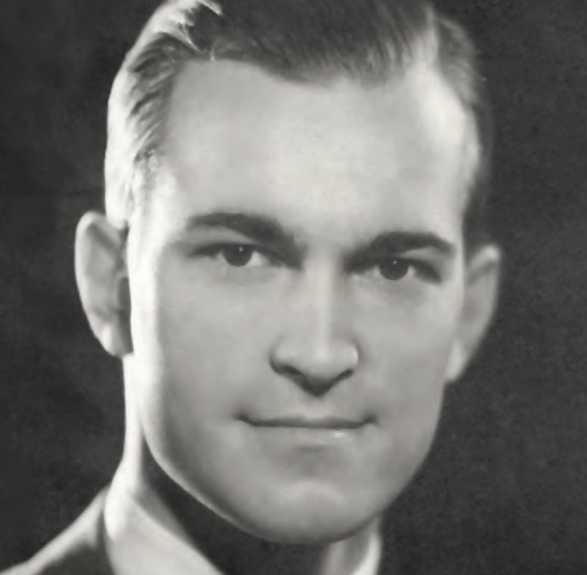
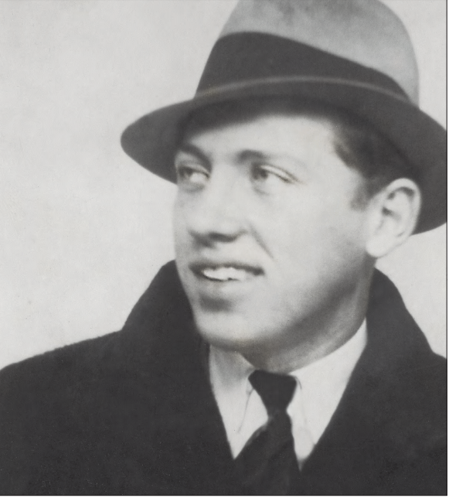
Notes:
Helms-casey

Slide 36


Slide 37


Slide 38
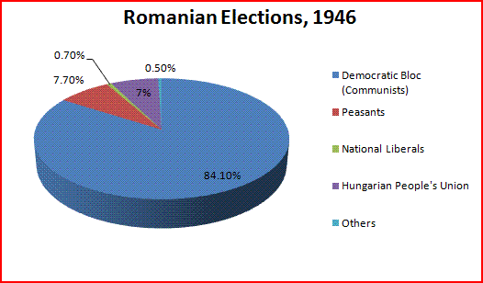
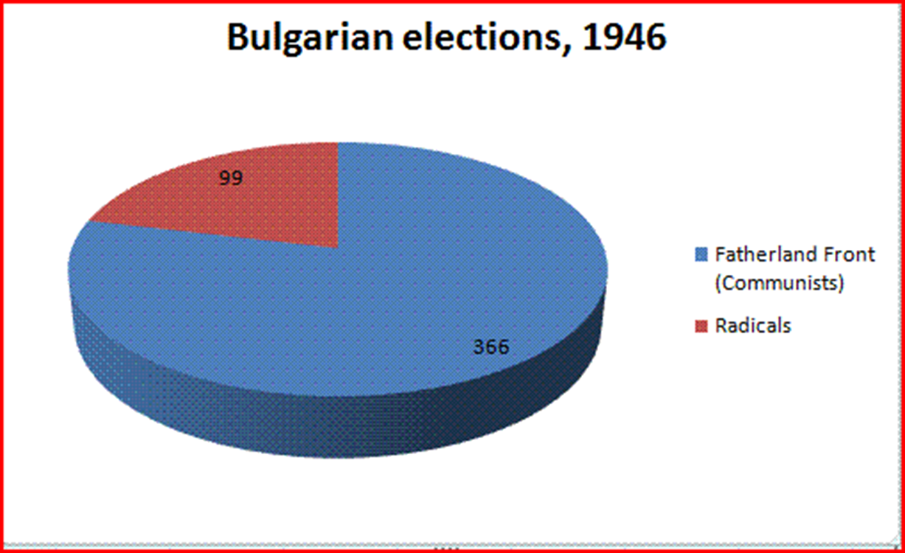

Slide 39
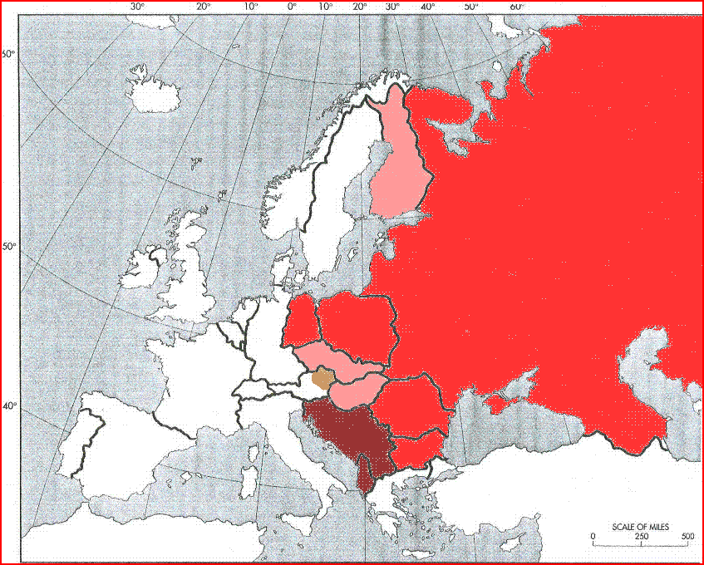

Slide 40
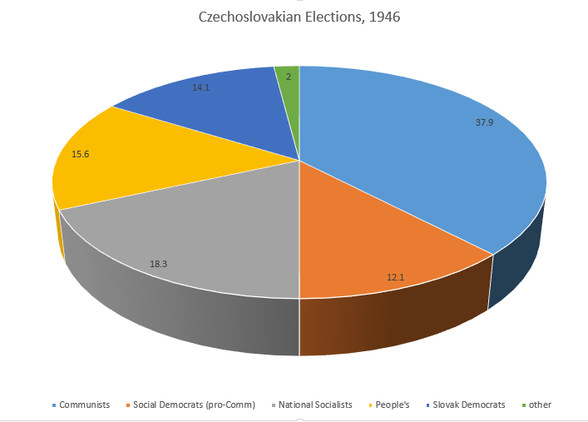

Slide 41
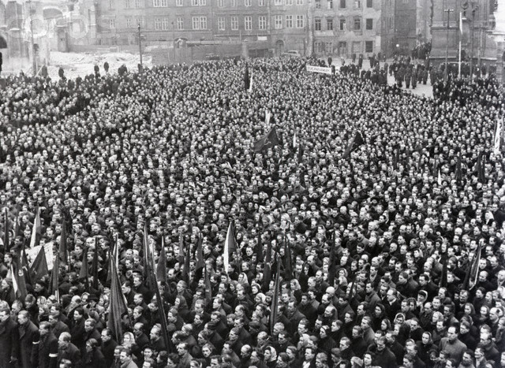

Slide 42


Slide 43
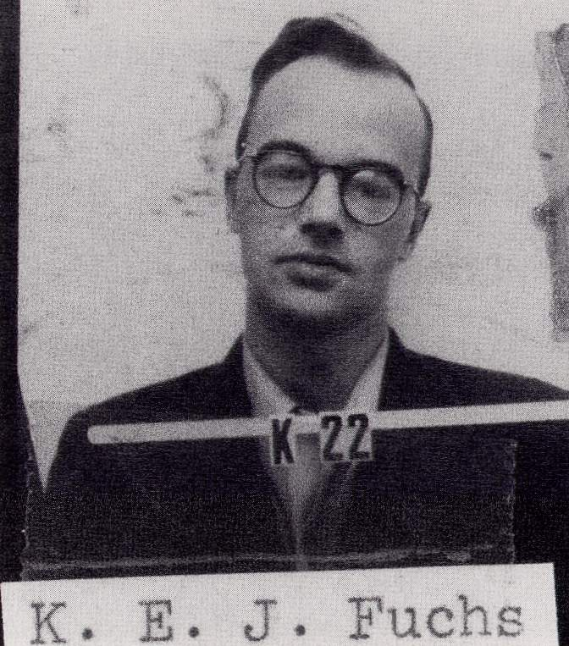

Slide 44
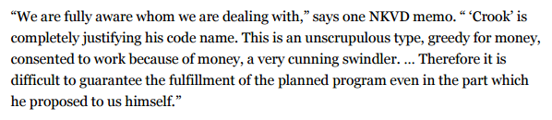
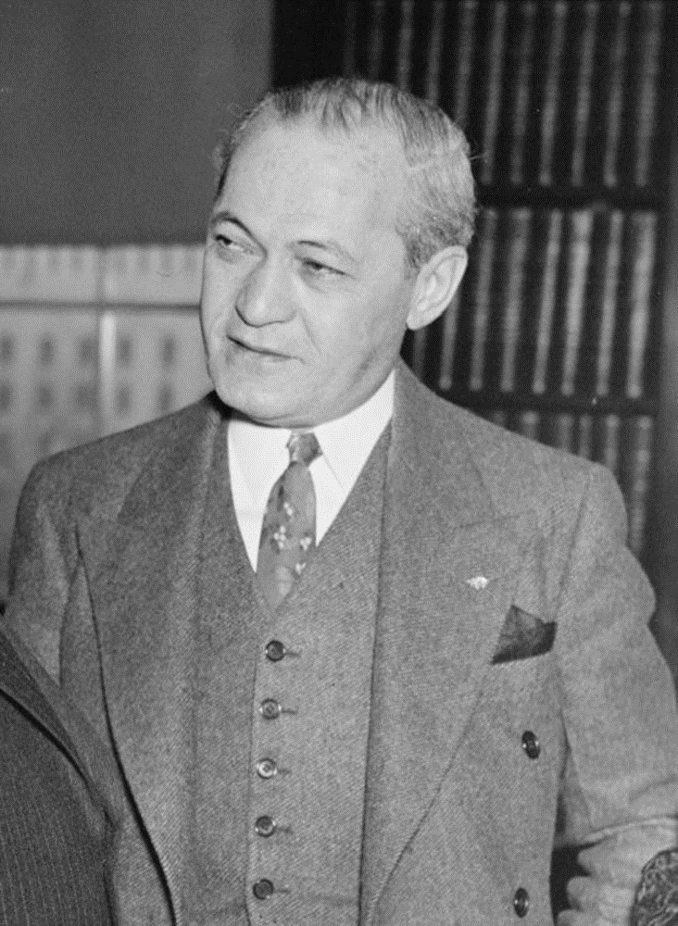
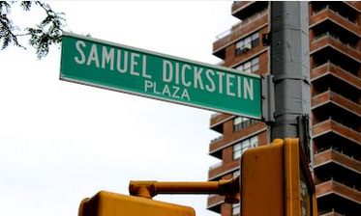

Slide 45
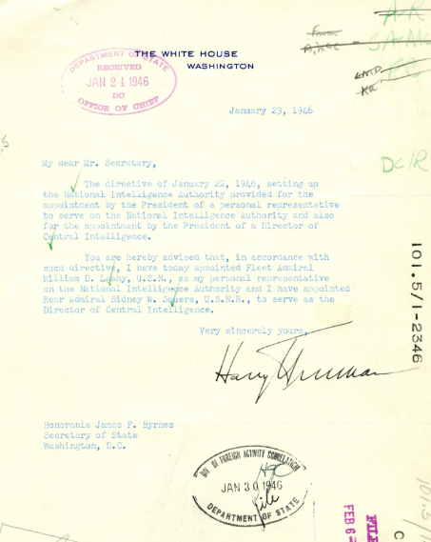

Slide 46


Slide 47
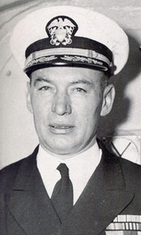
Notes:
Roscoe hillenkoeter

Slide 48


Slide 49


Slide 50



Slide 51


