Slide 1
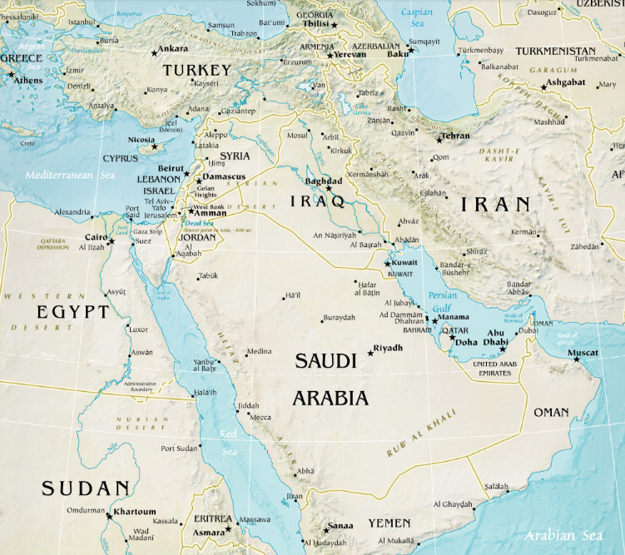

Slide 2
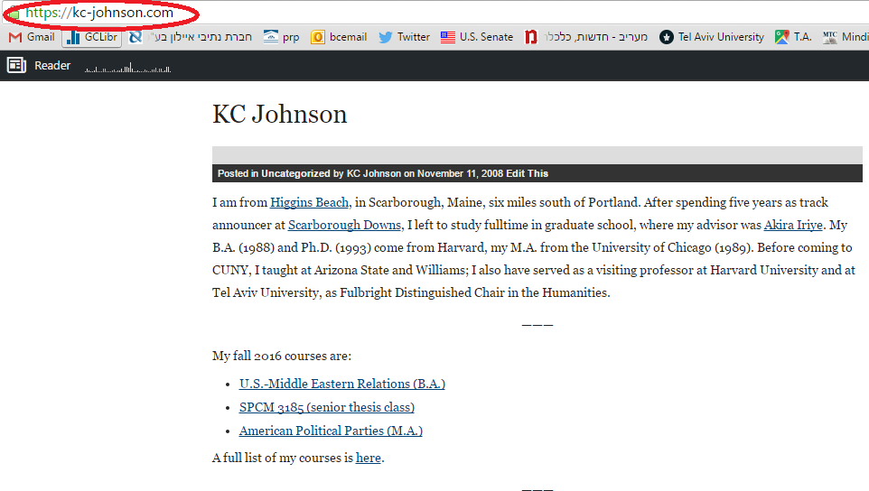

Slide 3
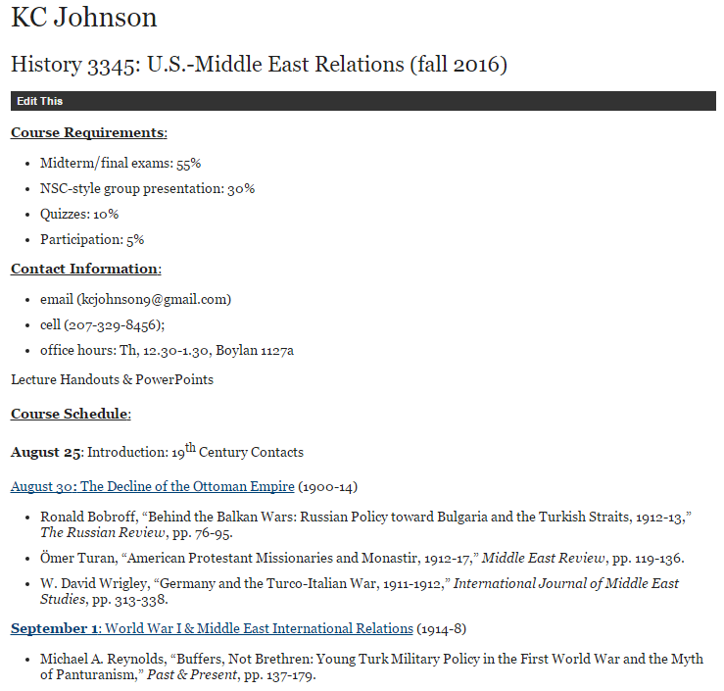

Slide 5
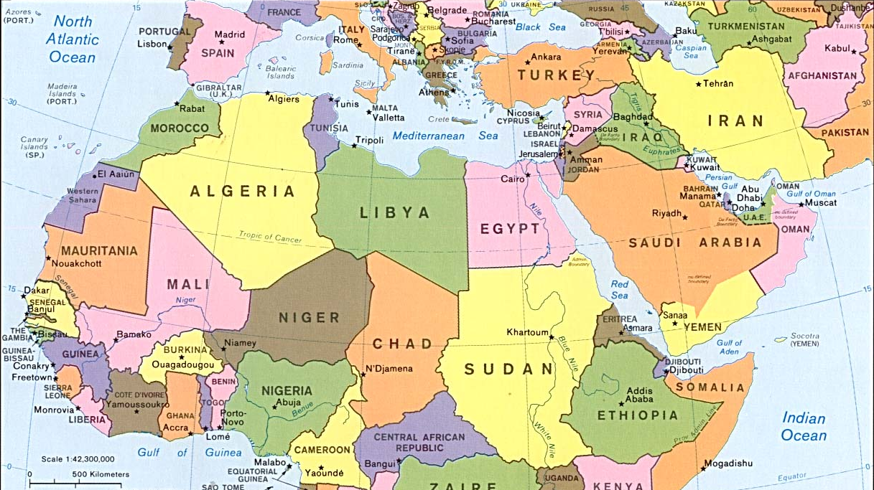

Slide 6
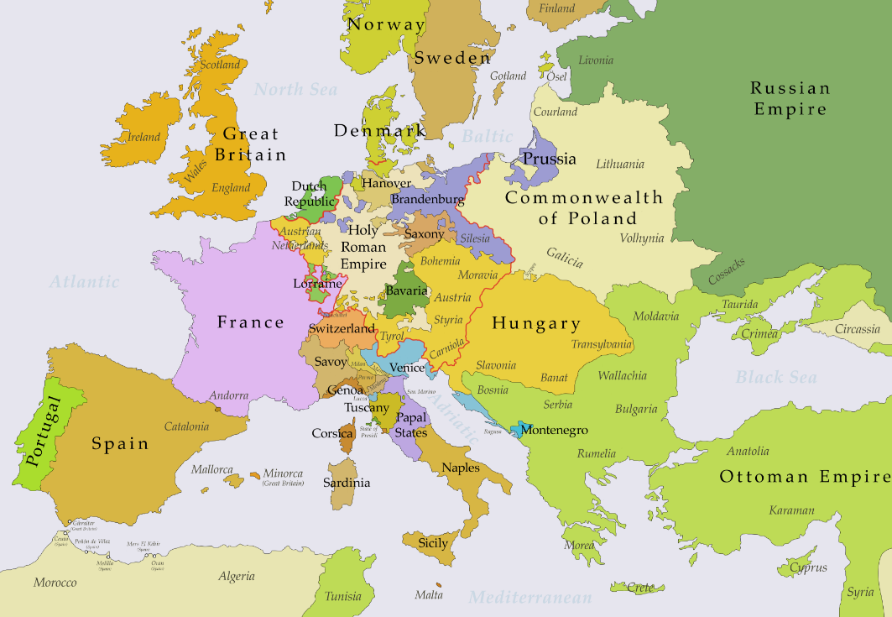

Slide 7
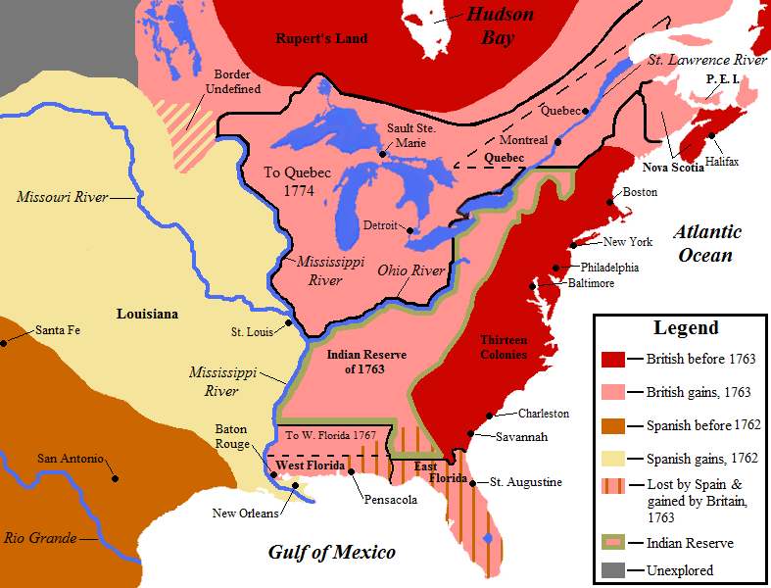

Slide 8
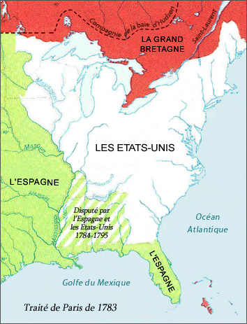

Slide 9
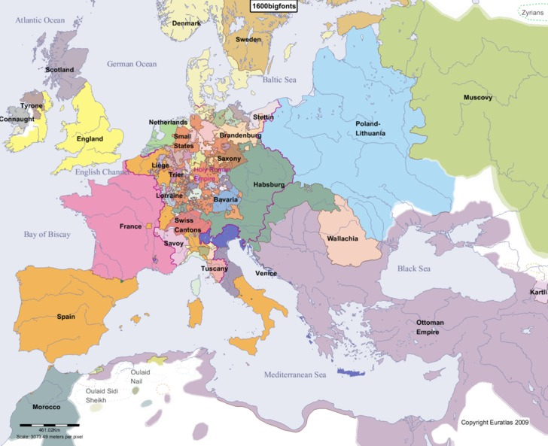

Slide 10
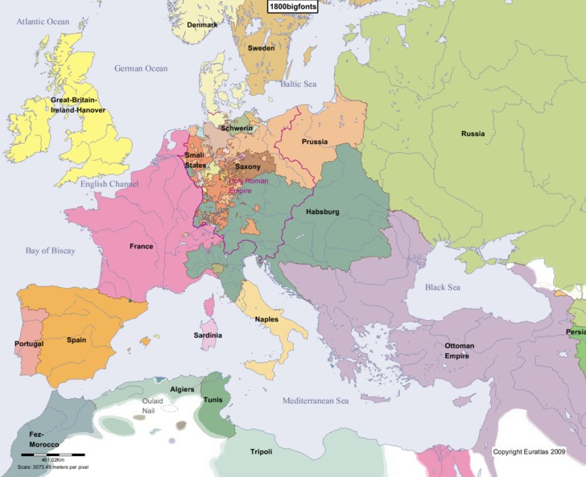

Slide 11
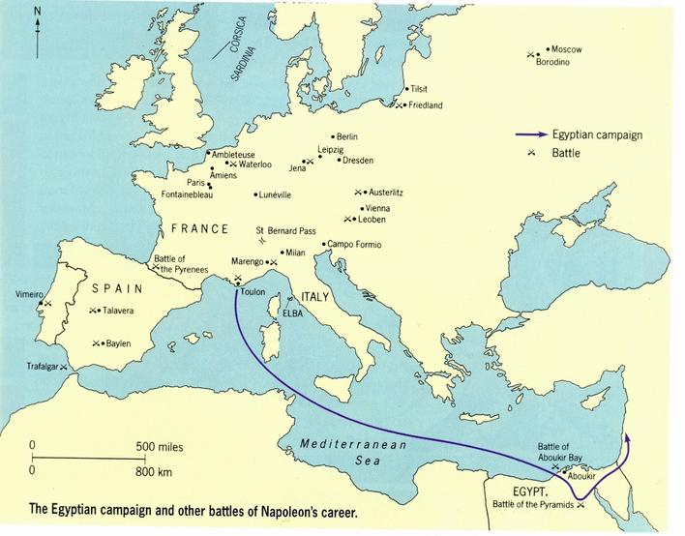

Slide 12
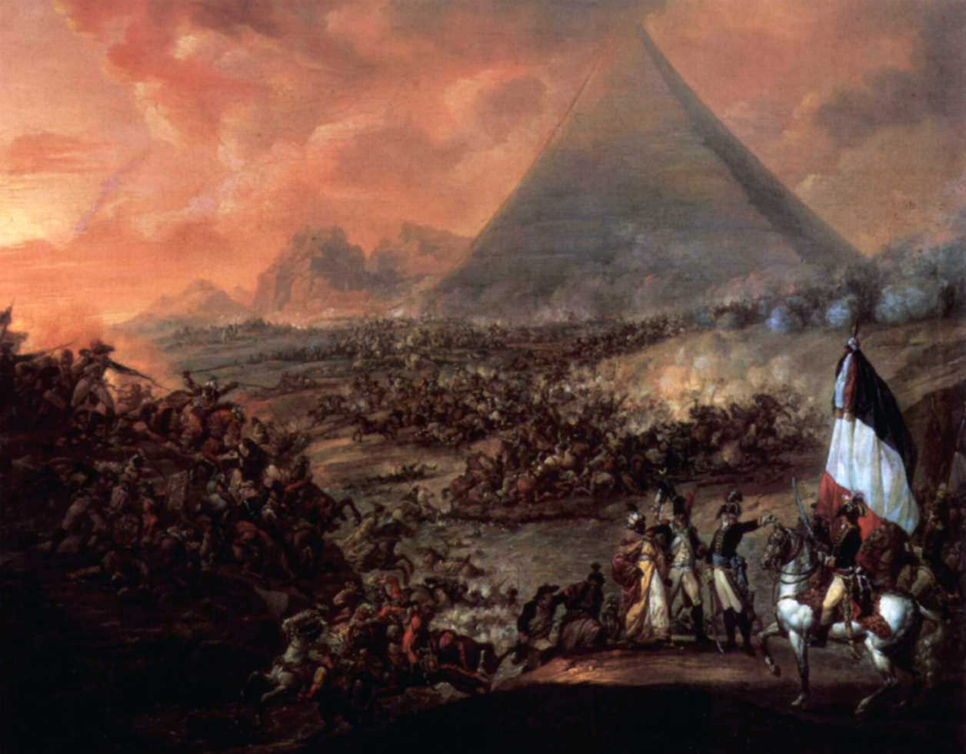

Slide 13
U.S.-Morocco Treaty of Friendship (1786)
Whereas the United States of America in Congress assembled by their Commission bearing date the twelvth day of May One thousand Seven hundred and Eighty four thought proper to constitute John Adams, Benjamin Franklin and Thomas Jefferson their Ministers Plenipotentiary, giving to them or a Majority of them full Powers to confer, treat & negotiate with the Ambassador, Minister or Commissioner of His Majesty the Emperor of Morocco concerning a Treaty of Amity and Commerce…
This is a Treaty of Peace and Friendship…
This Treaty shall continue in full Force, with the help of God for Fifty Years.

Slide 14
Article I, Section 8
The Congress shall have Power To lay and collect Taxes, Duties, Imposts and Excises, to pay the Debts and provide for the common Defence and general Welfare of the United States . . .
To regulate Commerce with foreign Nations, and among the several States, and with the Indian Tribes . . .
To establish an uniform Rule of Naturalization . . .
To define and punish Piracies and Felonies committed on the high Seas, and Offenses against the Law of Nations . . .
To declare War, grant Letters of Marque and Reprisal, and make Rules concerning Captures on Land and Water’
To raise and support Armies, but no Appropriation of Money to that Use shall be for a longer Term than two Years;
To provide and maintain a Navy;
To make Rules for the Government and Regulation of the land and naval Forces;
To provide for calling forth the Militia to execute the Laws of the Union, suppress Insurrections and repel Invasions;
To provide for organizing, arming, and disciplining, the Militia, and for governing such Part of them as may be employed in the Service of the United States, reserving to the States respectively, the Appointment of the Officers, and the Authority of training the Militia according to the discipline prescribed by Congress . . .

Slide 15
Article II, Section 2
The President shall be Commander in Chief of the Army and Navy of the United States, and of the Militia of the several States, when called into the actual Service of the United States; he may require the Opinion, in writing, of the principal Officer in each of the executive Departments, upon any subject relating to the Duties of their respective Offices, and he shall have Power to Grant Reprieves and Pardons for Offenses against the United States, except in Cases of Impeachment.
He shall have Power, by and with the Advice and Consent of the Senate, to make Treaties, provided two thirds of the Senators present concur; and he shall nominate, and by and with the Advice and Consent of the Senate, shall appoint Ambassadors, other public Ministers and Consuls, Judges of the supreme Court, and all other Officers of the United States . . .

Slide 16
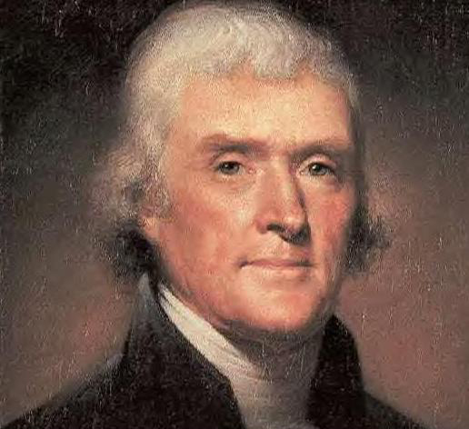

Slide 17


Slide 18
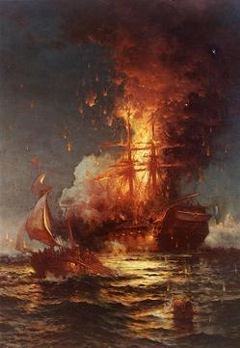

Slide 19
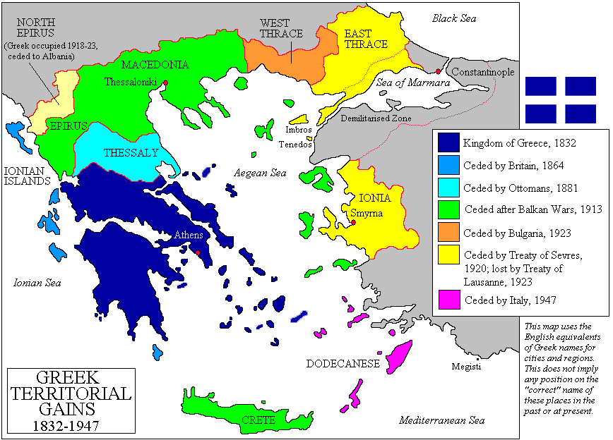

Slide 20
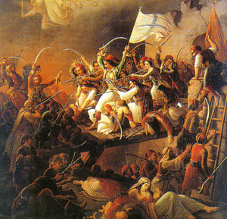

Slide 21


Slide 22
Monroe Doctrine (1823)
Of events in that quarter of the globe [Europe], with which we have so much intercourse and from which we derive our origin, we have always been anxious and interested spectators. The citizens of the United States cherish sentiments the most friendly in favor of the liberty and happiness of their fellow-men on that side of the Atlantic. In the wars of the European powers in matters relating to themselves we have never taken any part, nor does it comport with our policy to do so. It is only when our rights are invaded or seriously menaced that we resent injuries or make preparation for our defense. With the movements in this hemisphere we are of necessity more immediately connected, and by causes which must be obvious to all enlightened and impartial observers. The political system of the allied powers is essentially different in this respect from that of America. This difference proceeds from that which exists in their respective Governments; and to the defense of our own, which has been achieved by the loss of so much blood and treasure, and matured by the wisdom of their most enlightened citizens, and under which we have enjoyed unexampled felicity, this whole nation is devoted. We owe it, therefore, to candor and to the amicable relations existing between the United States and those powers to declare that we should consider any attempt on their part to extend their system to any portion of this hemisphere as dangerous to our peace and safety.

Slide 23
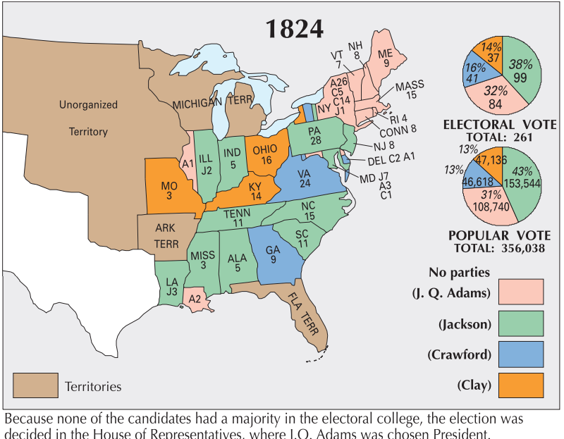

Slide 24
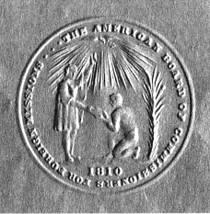
Notes:
ABCFM SEAL

Slide 25
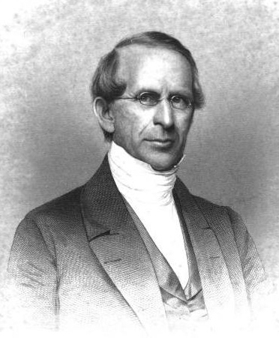
Notes:
Samuel worcester--abcfm

Slide 26
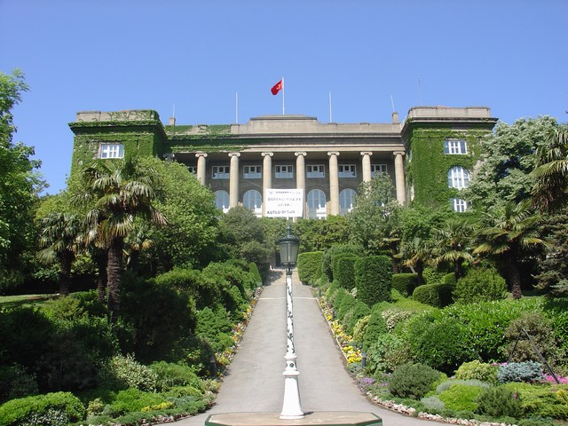
Notes:
Robert college, istanbul, oldest american school still in existence outside US

Slide 27
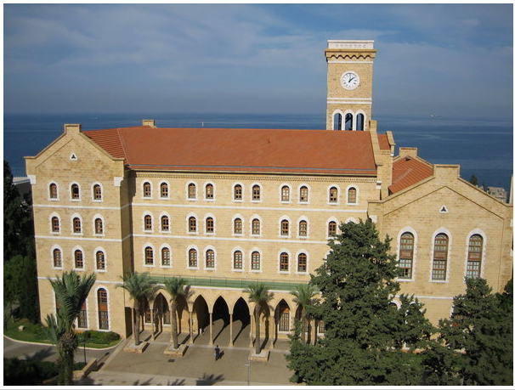
Notes:
Am univ beirut

Slide 28
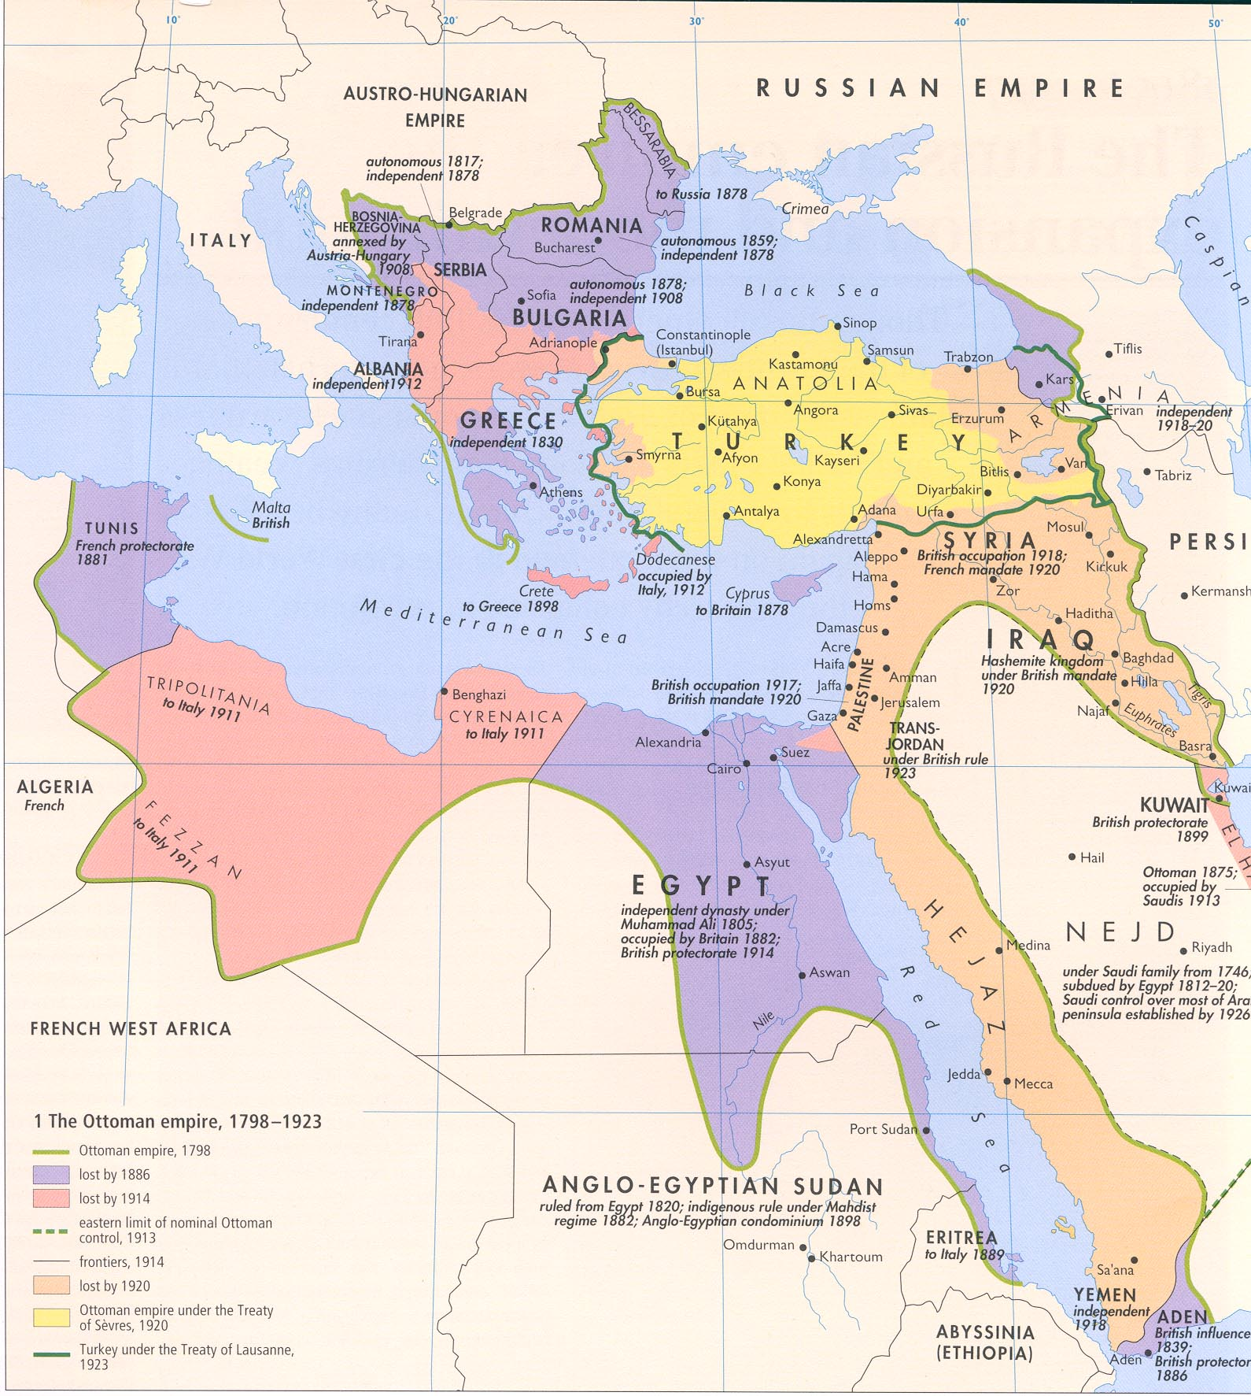

Slide 29
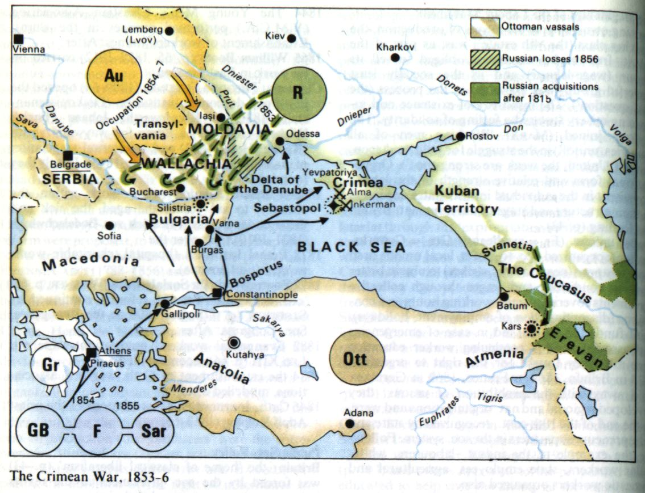

Slide 30
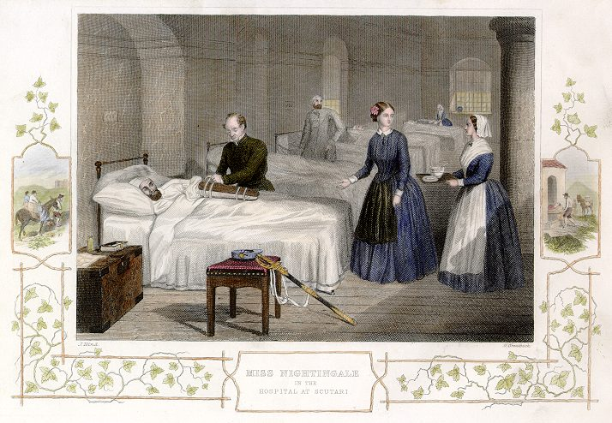

Slide 31
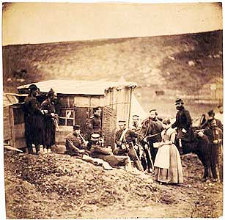

Slide 32
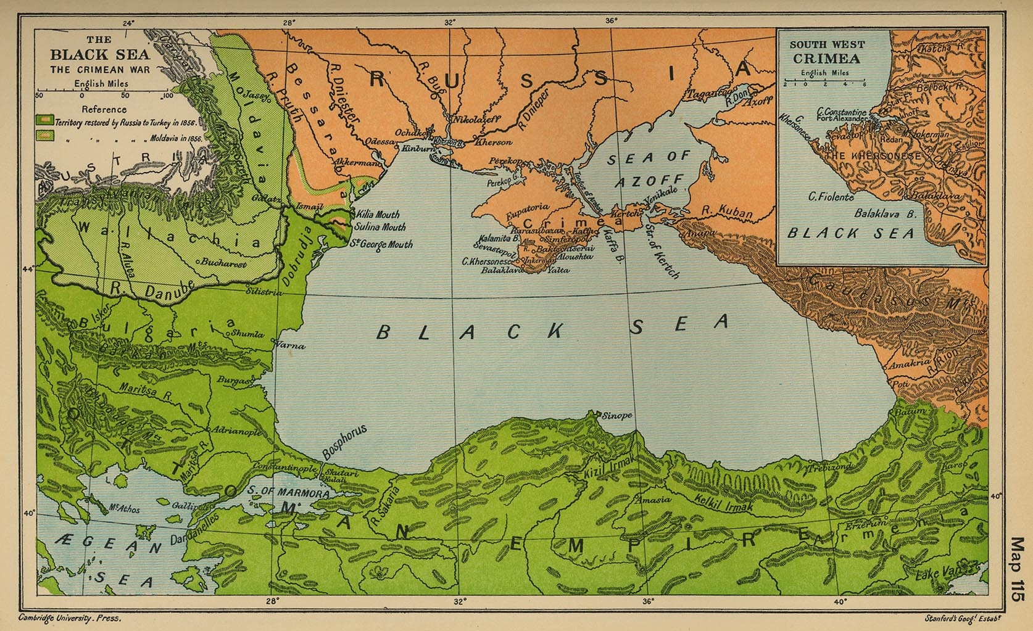

Slide 33
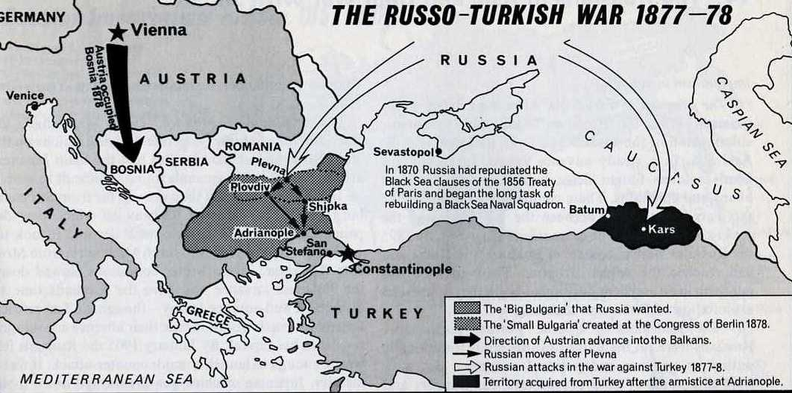

Slide 34
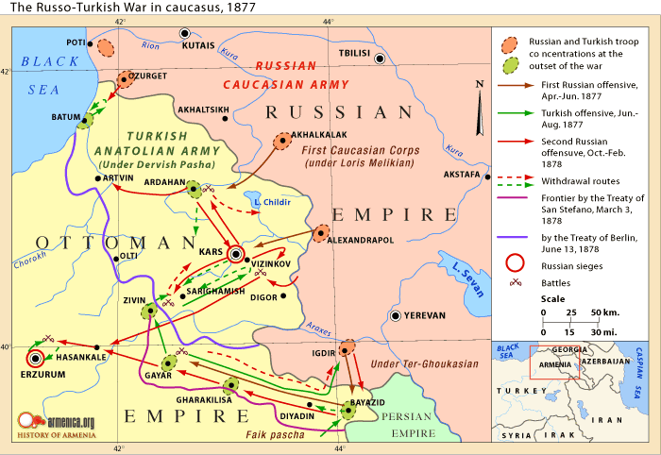

Slide 35
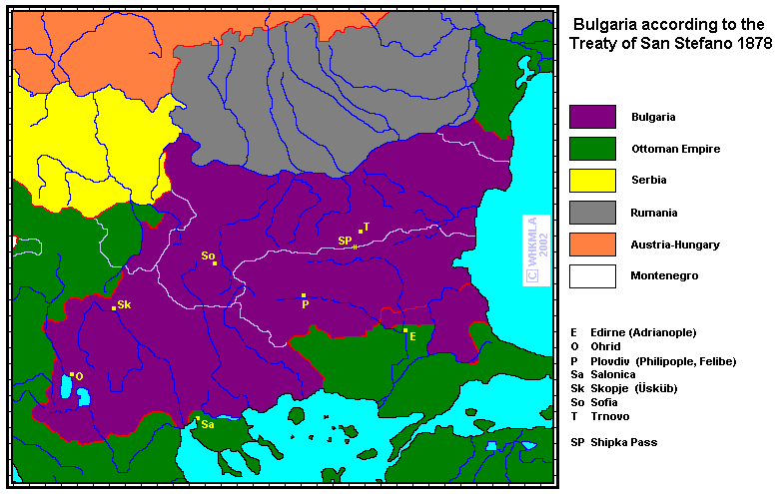

Slide 36
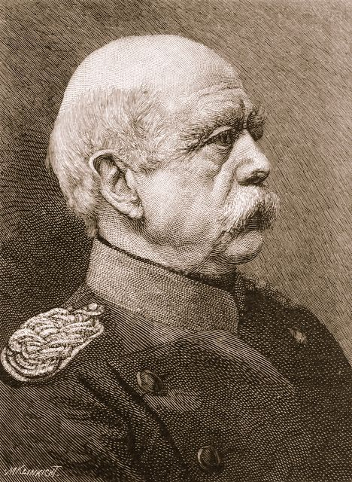

Slide 37
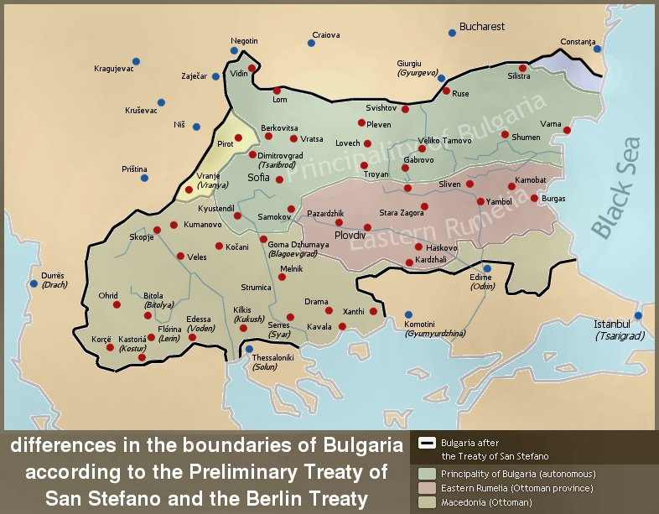

Slide 38
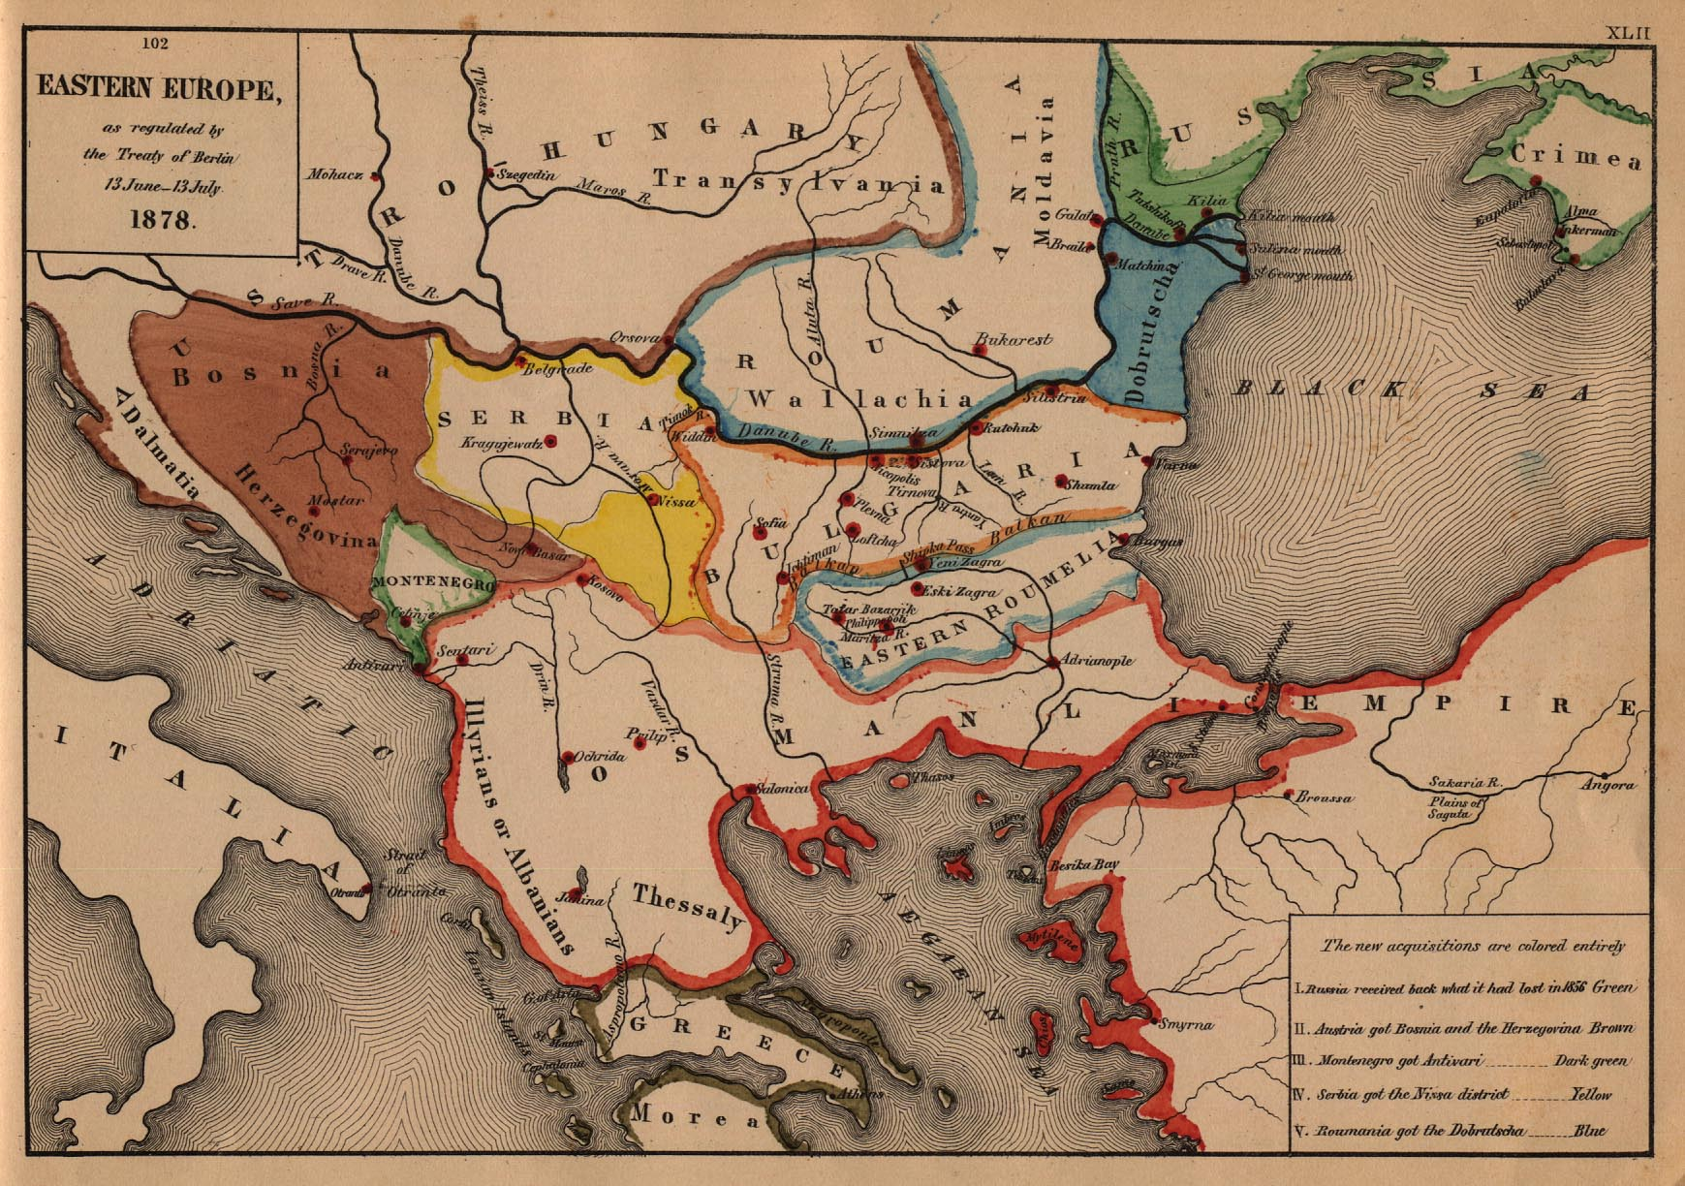

Slide 39
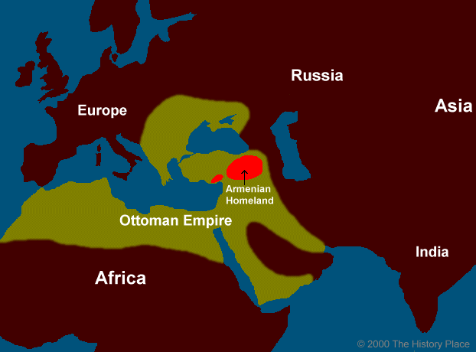

Slide 40
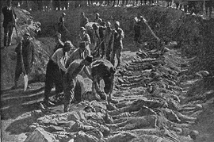
Notes:
Armenian cemetry massacre 1896

Slide 41
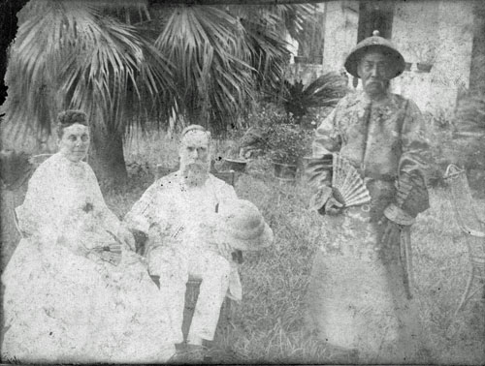

Slide 42
Year | 1865 | 1875 | 1890 | 1900
exports/OE | $614,187 | 4,224,918 | 4,624,818 | 7,743,676
imports/OE | $326,958 | 579,947 | 129,833 | 573,012

Slide 43
