Slide 1
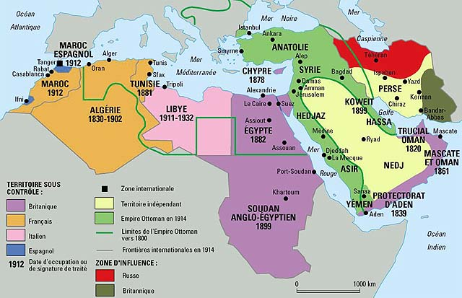

Slide 2
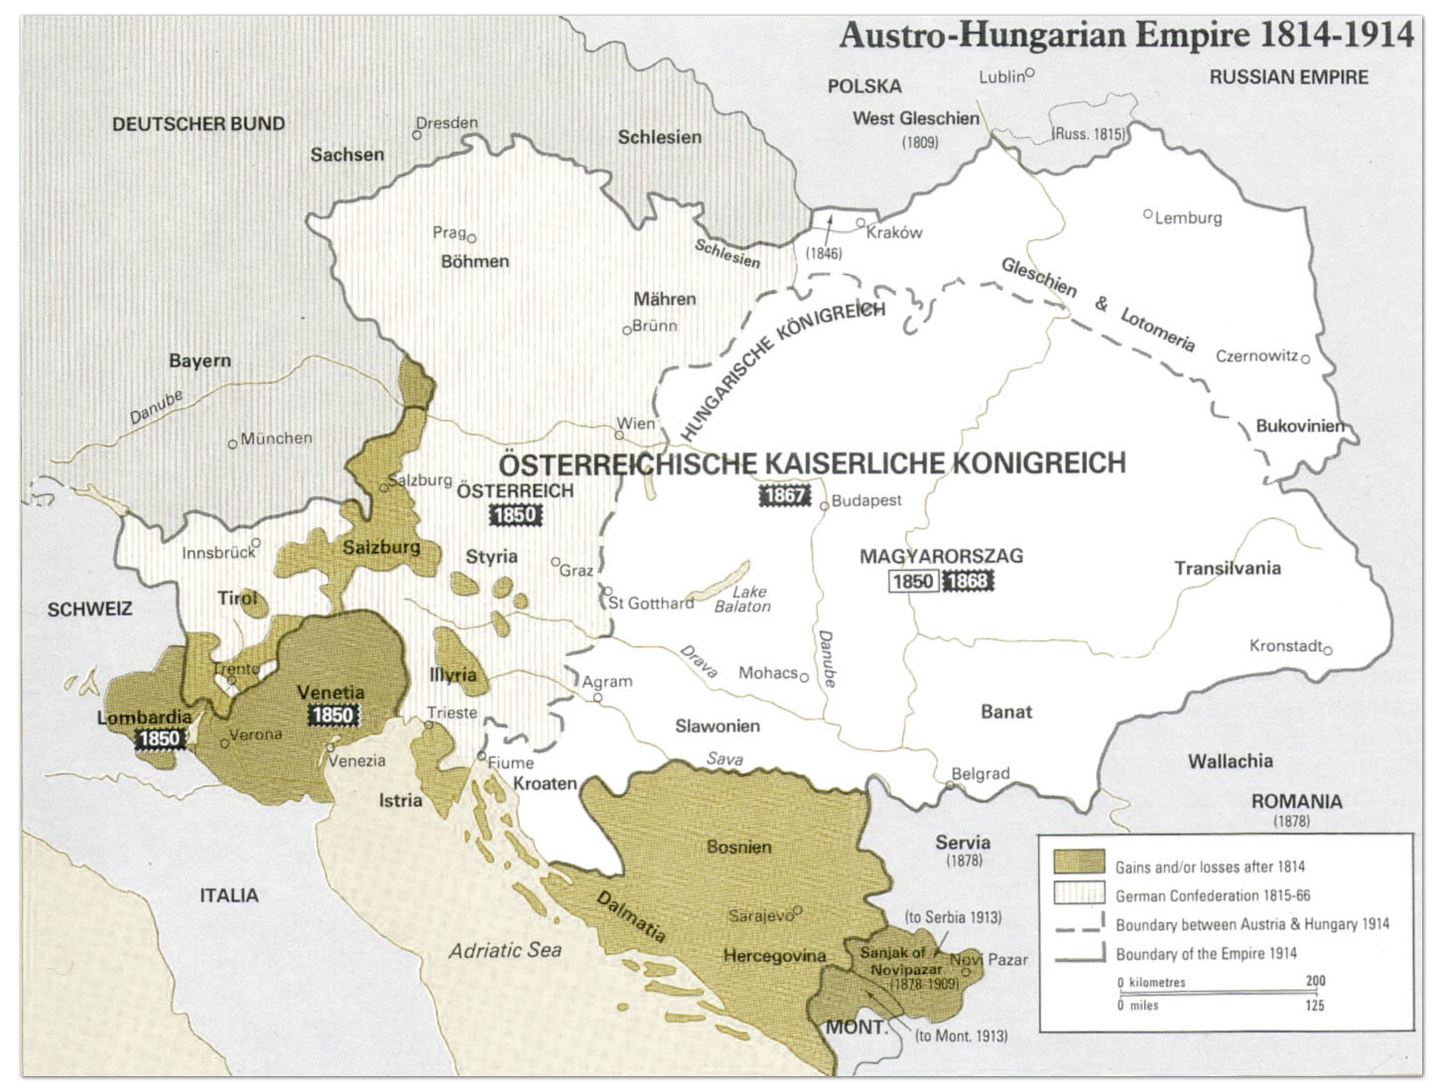

Slide 3

Notes:
Black hand symbol

Slide 4
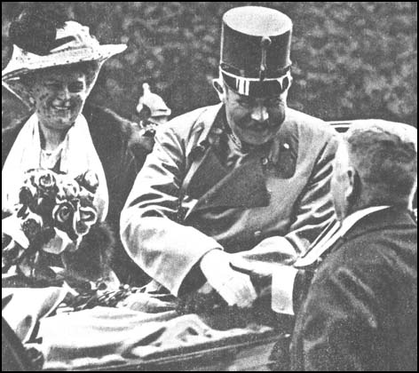

Slide 5
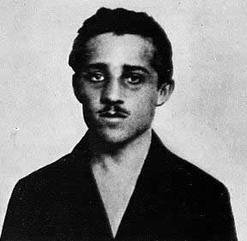
Notes:
Gavrilo princip

Slide 6
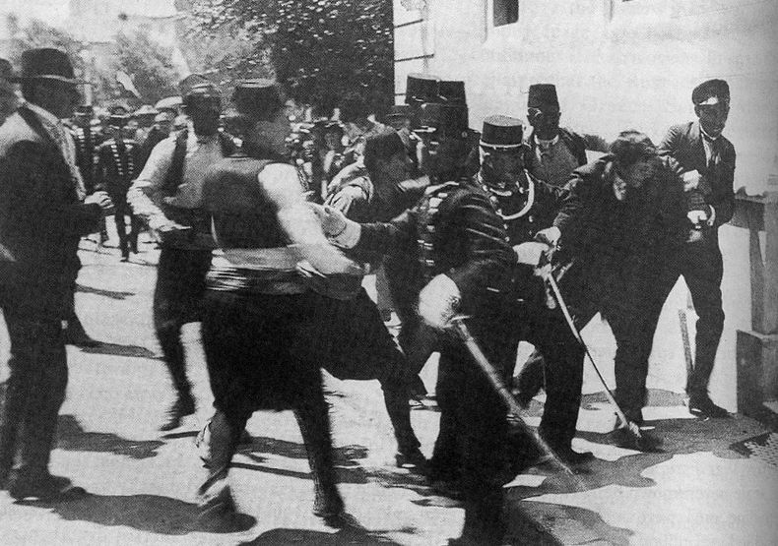

Slide 7
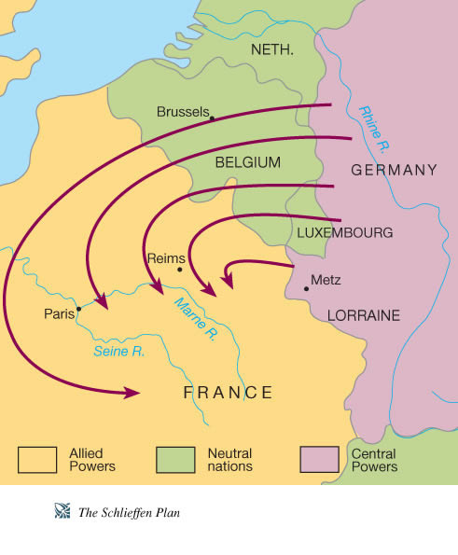

Slide 8
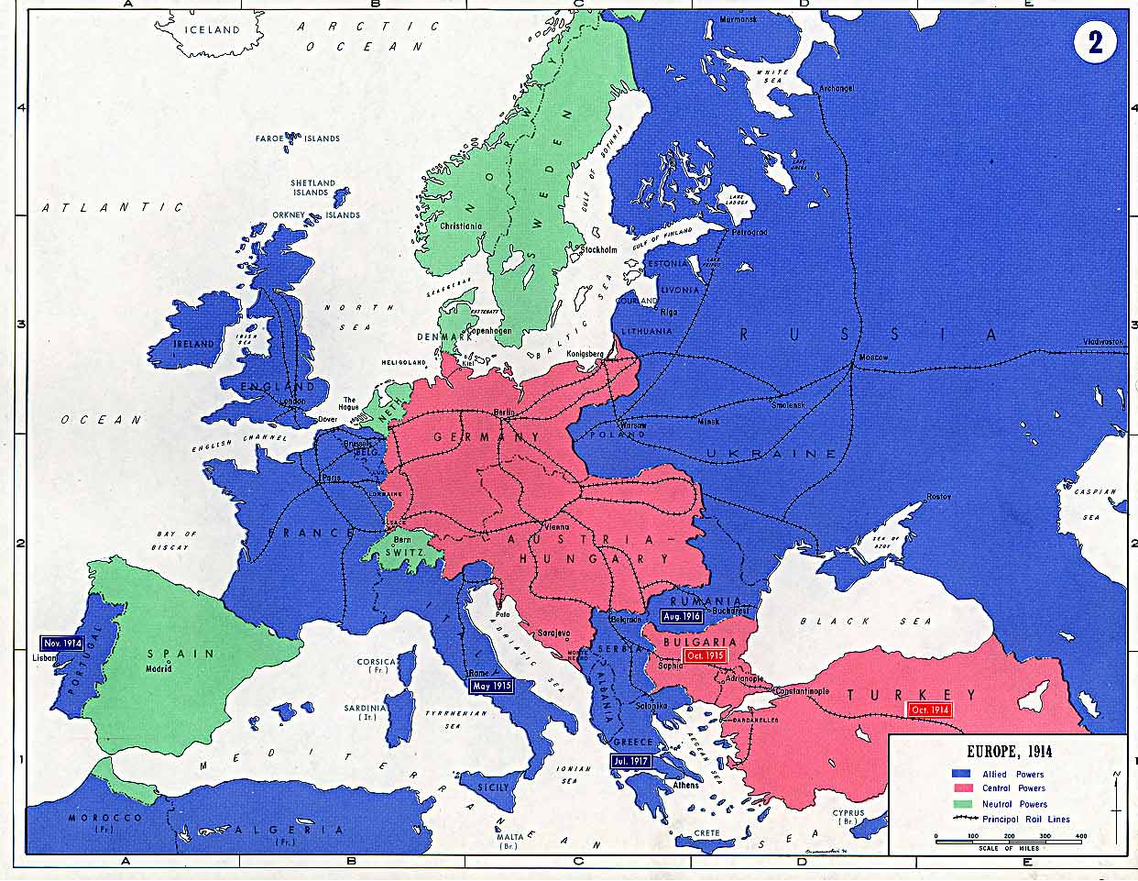

Slide 9
Treaty of Alliance Between Germany and Turkey, 2 August 1914
1. The two contracting parties agree to observe strict neutrality in regard to the present conflict between Austria-Hungary and Serbia.
2. In case Russia should intervene with active military measures, and should thus bring about a casus foederis for Germany with relation to Austria-Hungary, this casus foederis would also come into existence for Turkey.
3. In case of war, Germany will leave her military mission at the disposal of Turkey. The latter, for her part, assures the said military mission an effective influence on the general conduct of the army, in accordance with the understanding arrived at directly between His Excellency the Minister of War and His Excellency the Chief of the Military Mission.
4. Germany obligates herself, if necessary by force of arms, to protect Ottoman territory in case it should be threatened.
5. This agreement which has been concluded for the purpose of protecting both Empires from international complications which may result from the present conflict goes into force as soon as it is signed by the above-mentioned plenipotentiaries, and shall remain valid, together with any similar mutual agreements, until December 31, 1918.

Slide 10
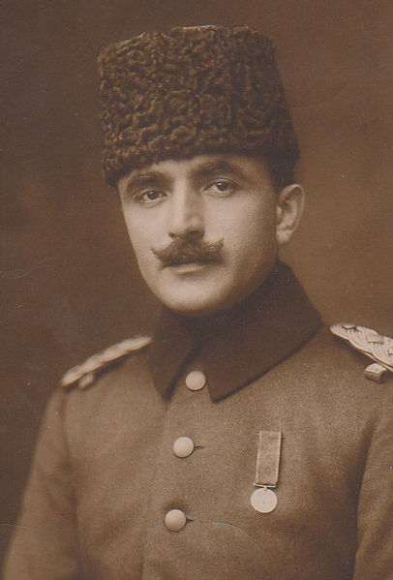
Notes:
Enver pasha

Slide 11
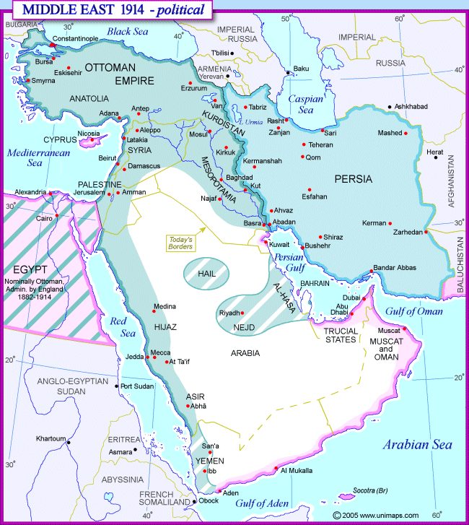

Slide 12
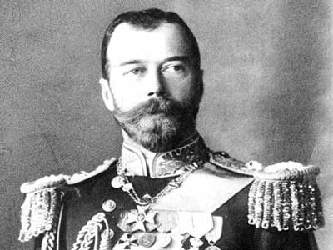

Slide 13
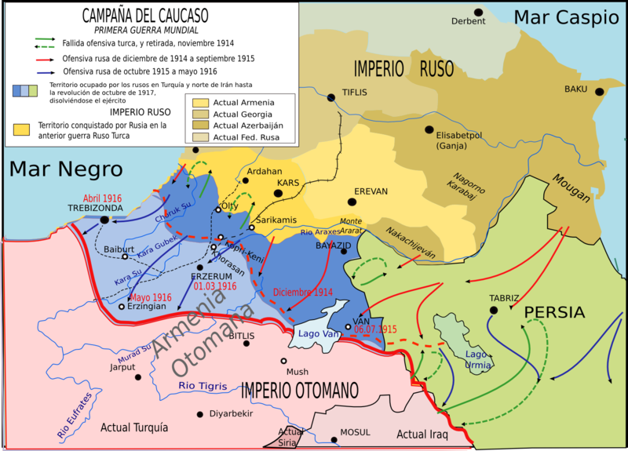

Slide 14
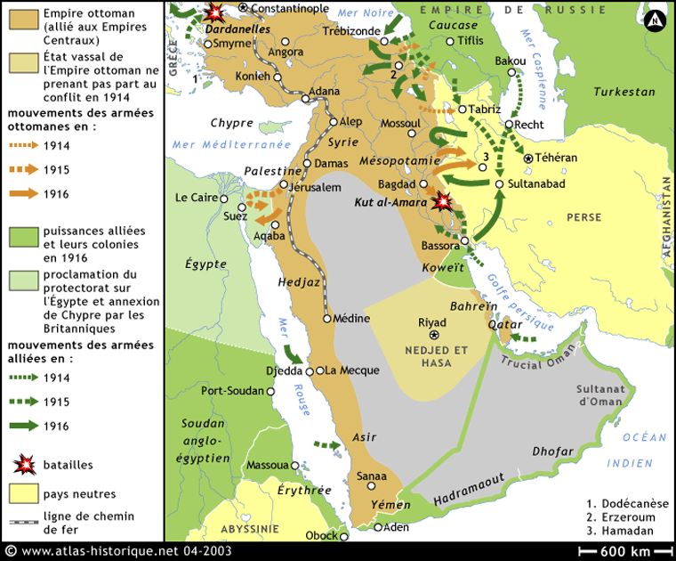

Slide 15
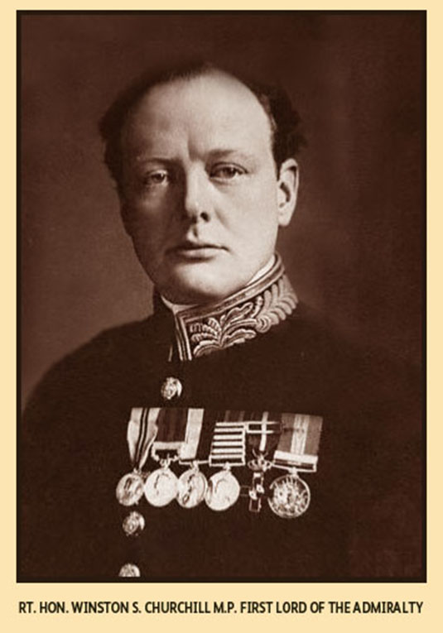

Slide 16
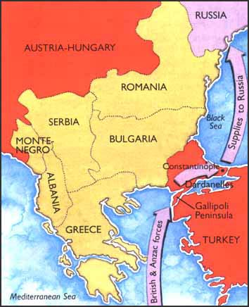

Slide 17
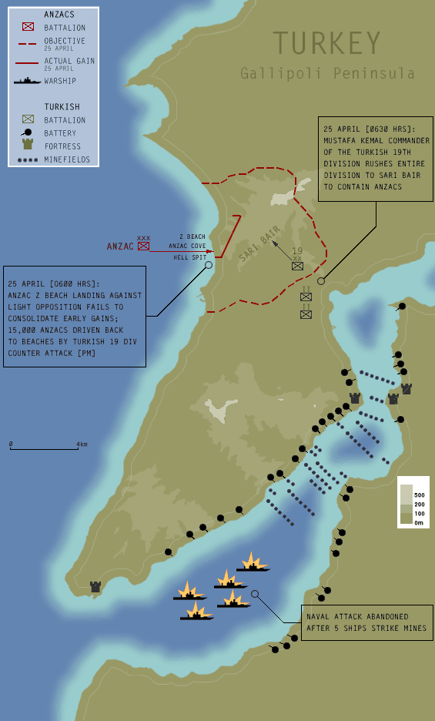

Slide 18
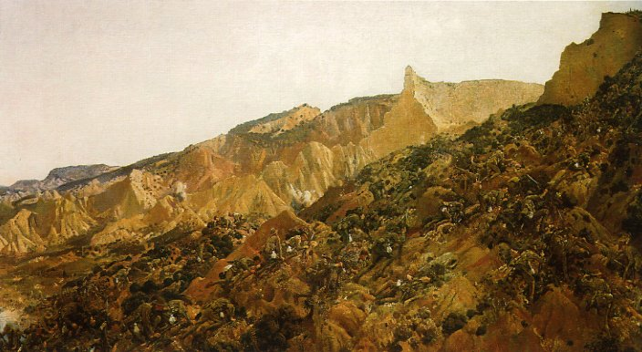

Slide 19
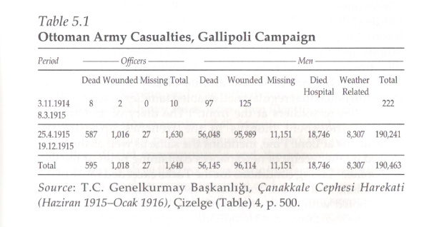

Slide 20
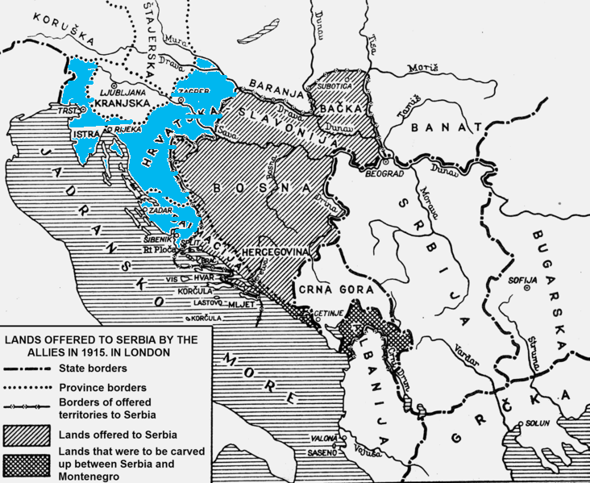

Slide 21
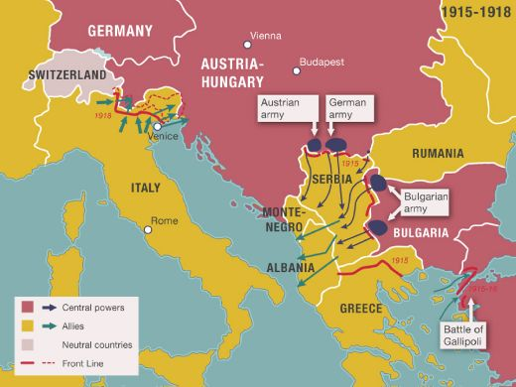

Slide 22
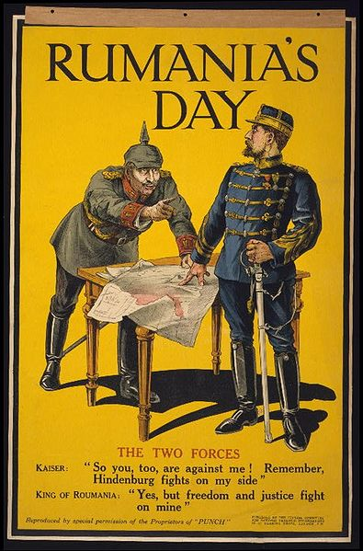

Slide 23
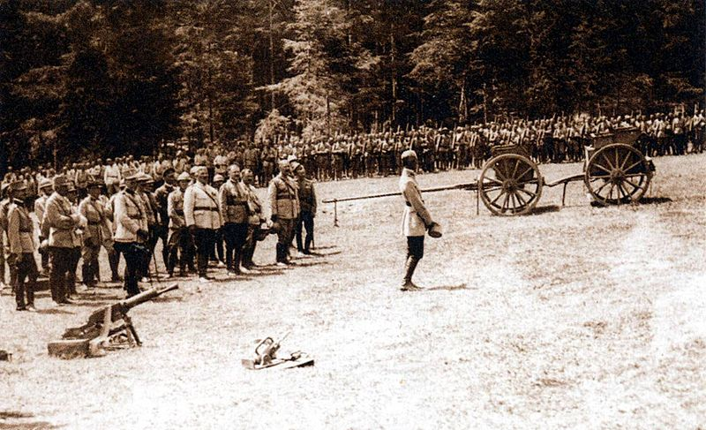

Slide 24
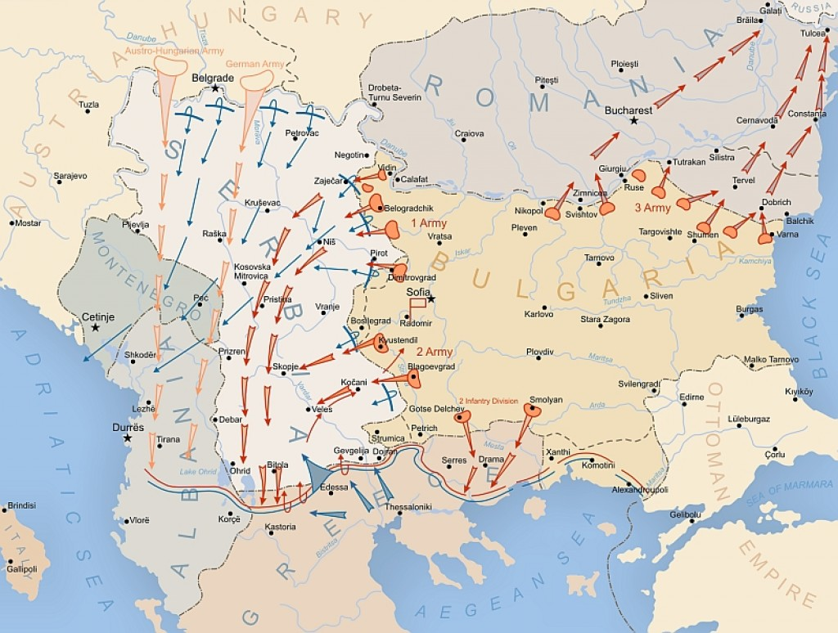

Slide 25
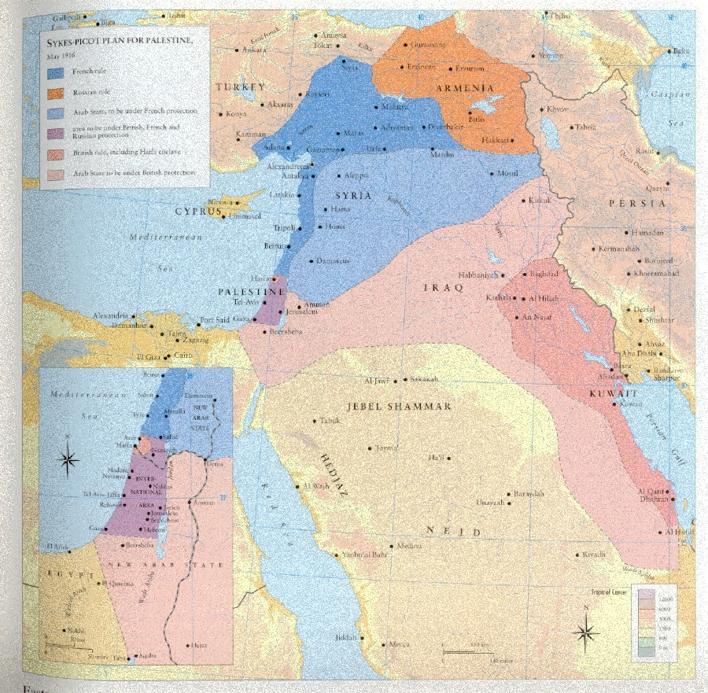

Slide 26
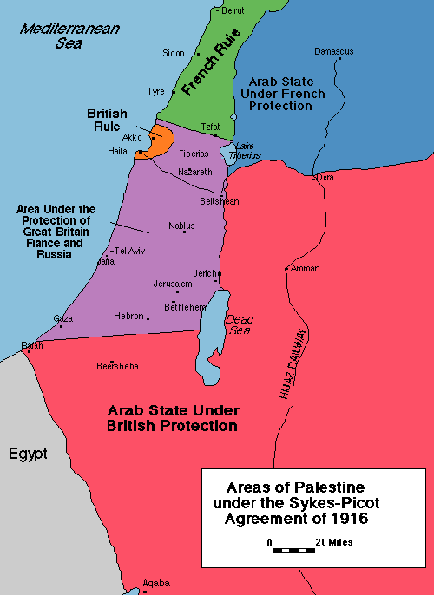

Slide 27
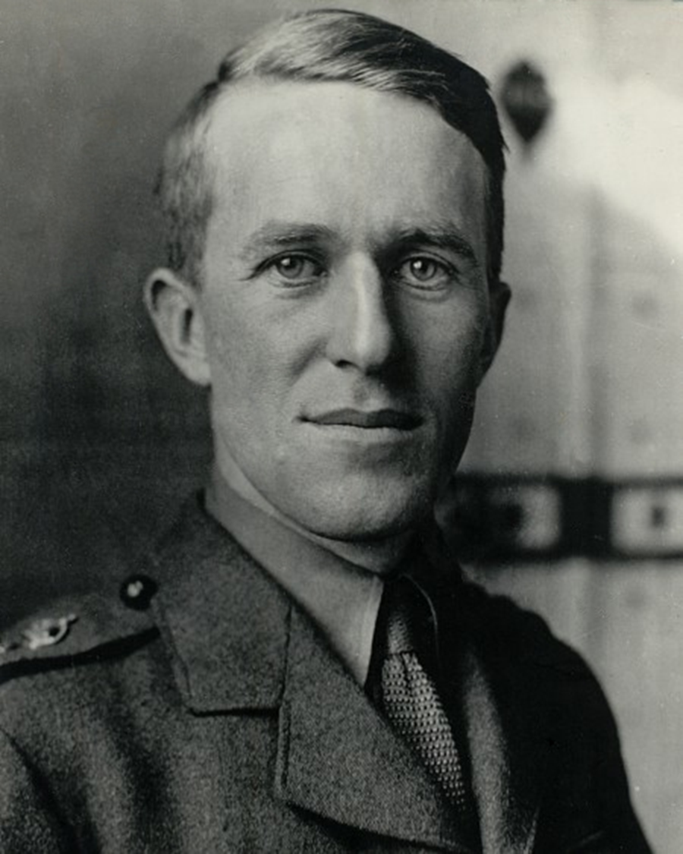
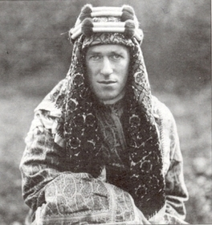

Slide 28
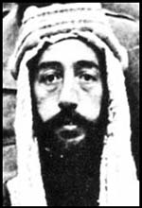

Slide 29
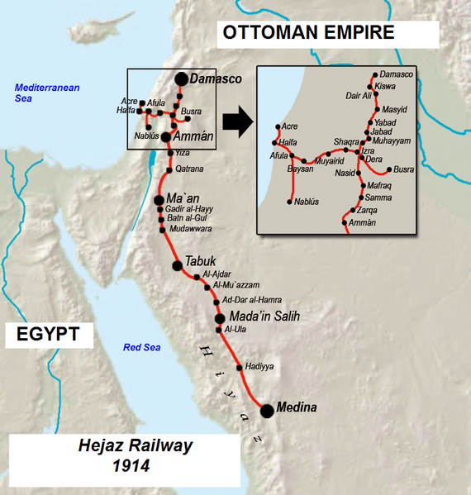

Slide 30
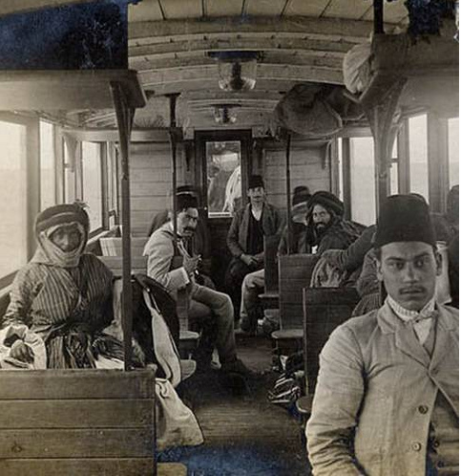
Notes:
Hejaz 1915

Slide 31
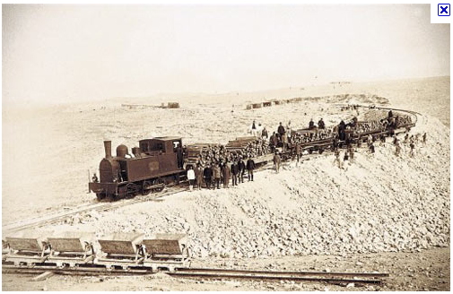
Notes:
Hejaz rr

Slide 32
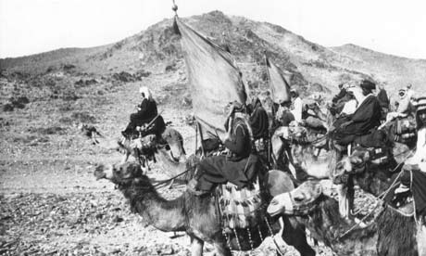

Slide 33
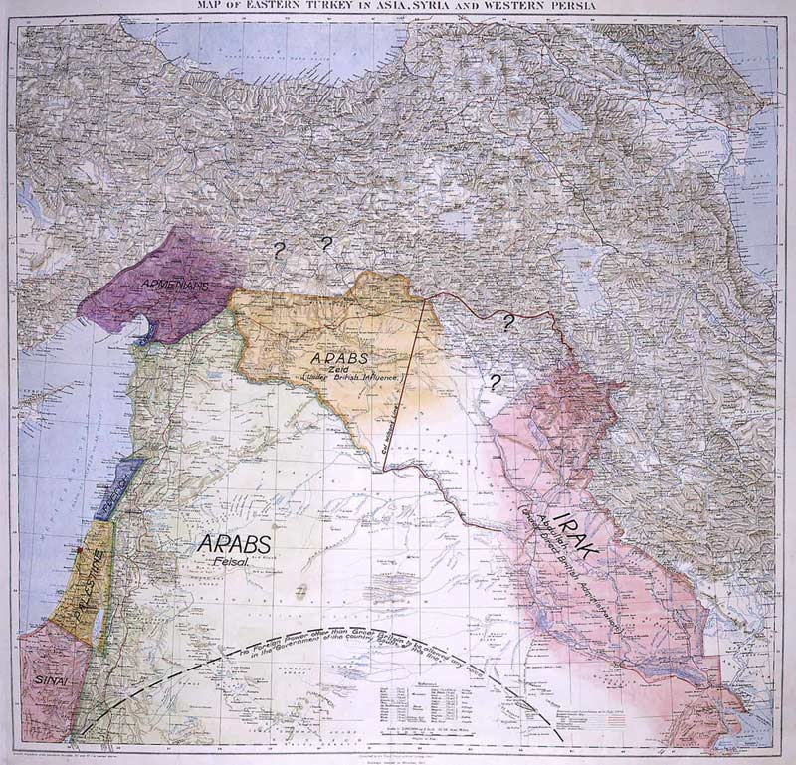
Notes:
Lawrence of arabia map

Slide 34
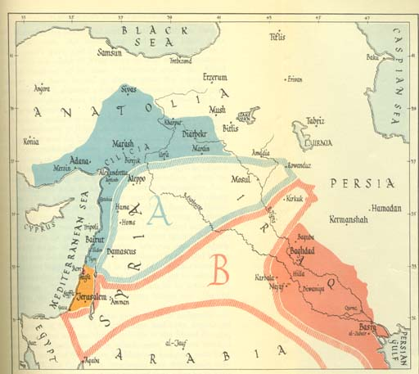

Slide 35


Slide 36
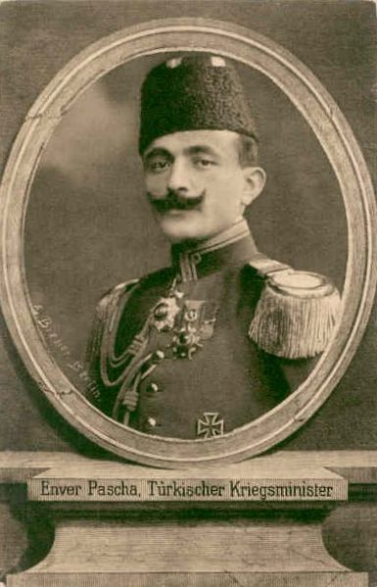

Slide 37
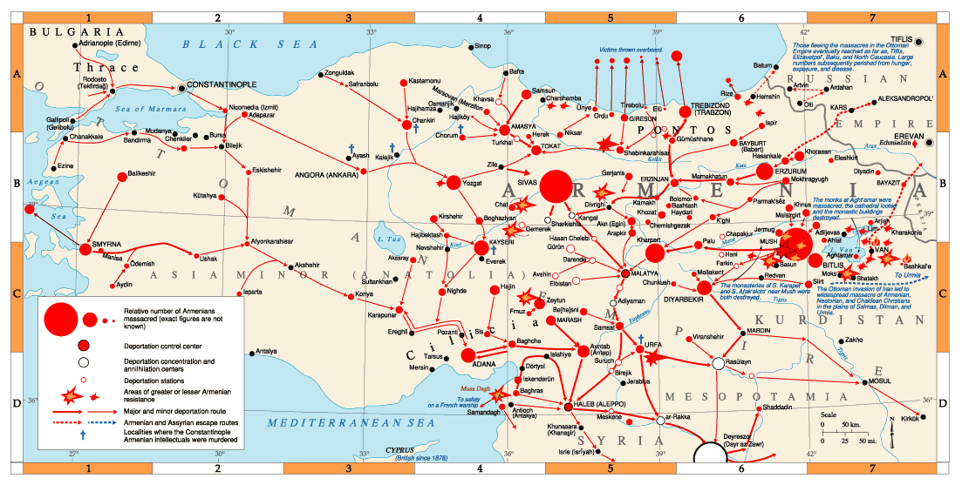

Slide 38
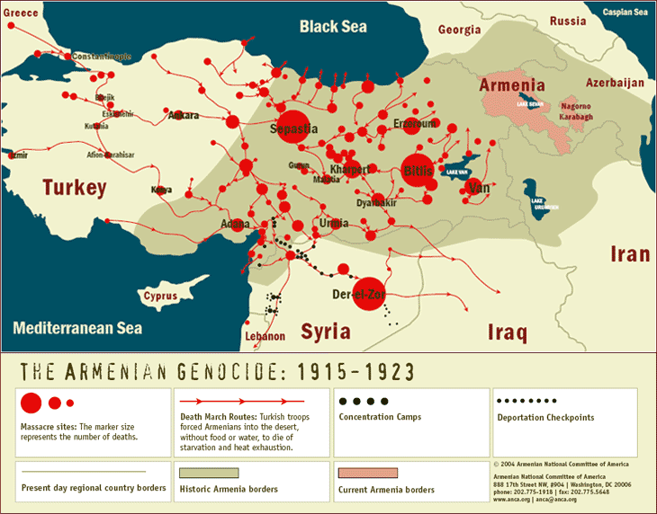

Slide 39
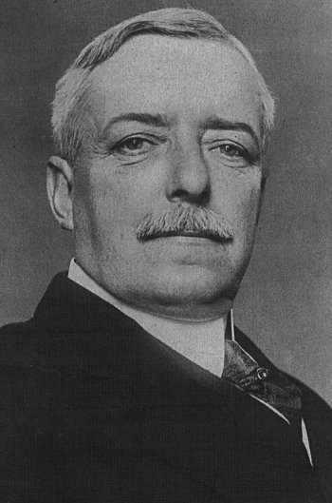
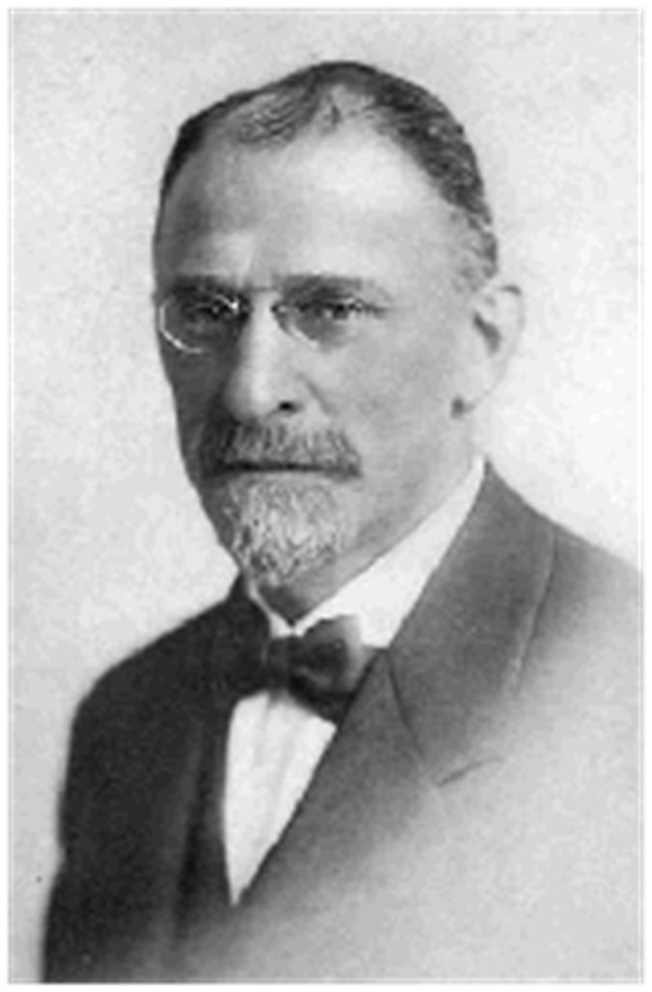

Slide 40
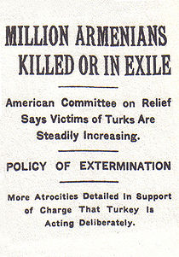


Slide 41
Wilson 14 Points address—8 Jan. 1918
The program of the world's peace, therefore, is our program; and that program, the only possible program, as we see it, is this: …
XI. Rumania, Serbia, and Montenegro should be evacuated; occupied territories restored; Serbia accorded free and secure access to the sea; and the relations of the several Balkan states to one another determined by friendly counsel along historically established lines of allegiance and nationality; and international guarantees of the political and economic independence and territorial integrity of the several Balkan states should be entered into.
XII. The Turkish portion of the present Ottoman Empire should be assured a secure sovereignty, but the other nationalities which are now under Turkish rule should be assured an undoubted security of life and an absolutely unmolested opportunity of autonomous development, and the Dardanelles should be permanently opened as a free passage to the ships and commerce of all nations under international guarantees.
In regard to these essential rectifications of wrong and assertions of right we feel ourselves to be intimate partners of all the governments and peoples associated together against the Imperialists.

Slide 42
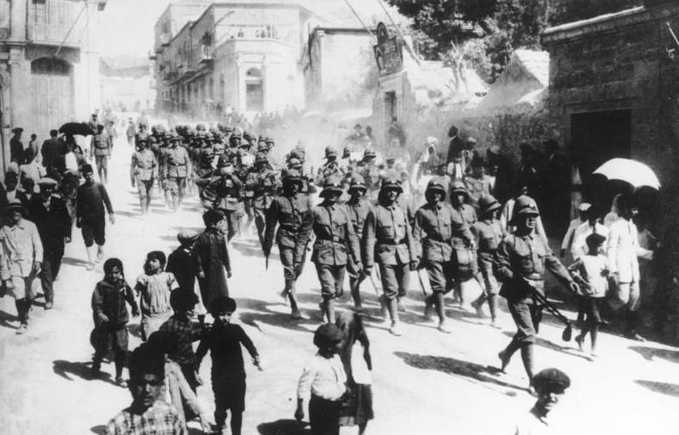
Notes:
German troops jerusalem 1916

Slide 43
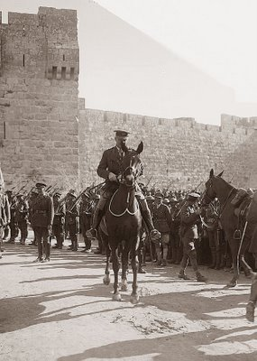
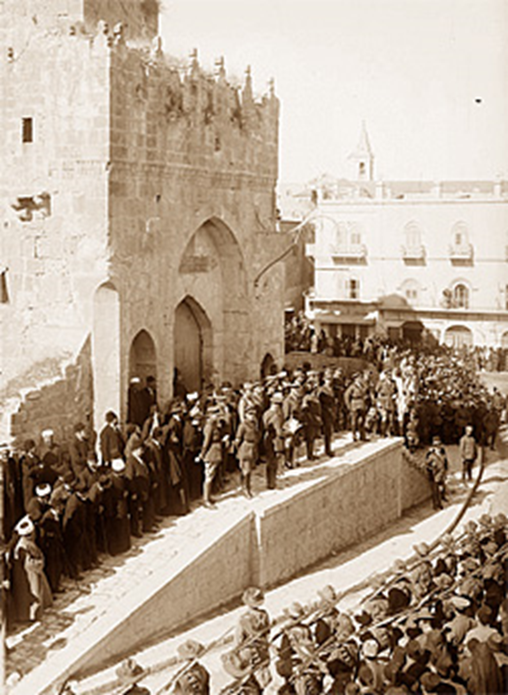
Notes:
allenby

Slide 44


Slide 45
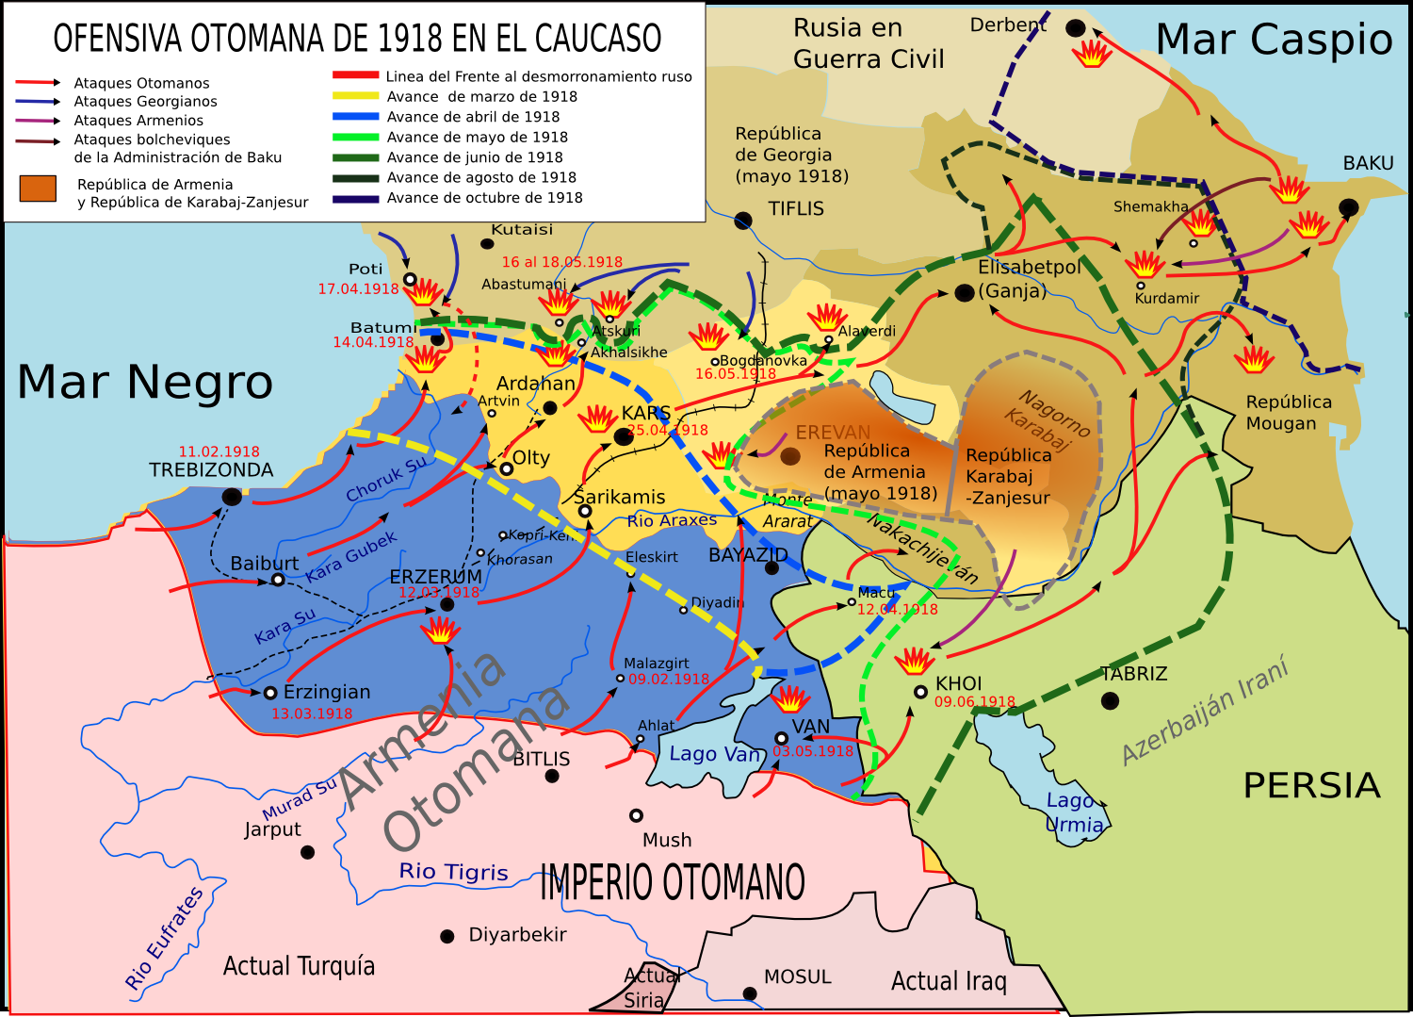

Slide 46
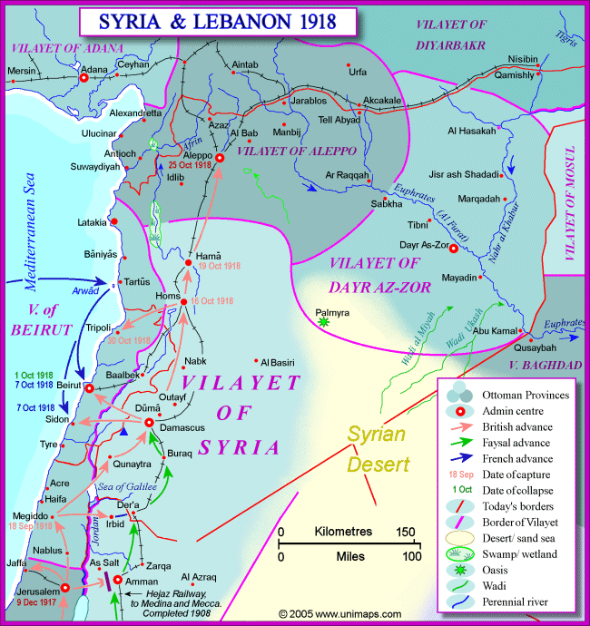

Slide 47
