Slide 1
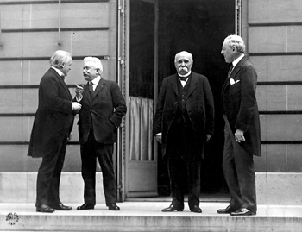

Slide 2
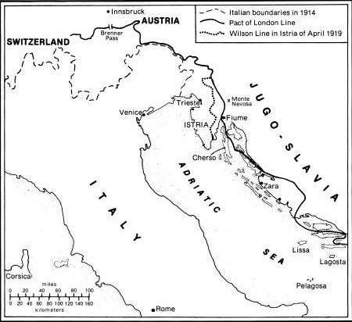

Slide 3
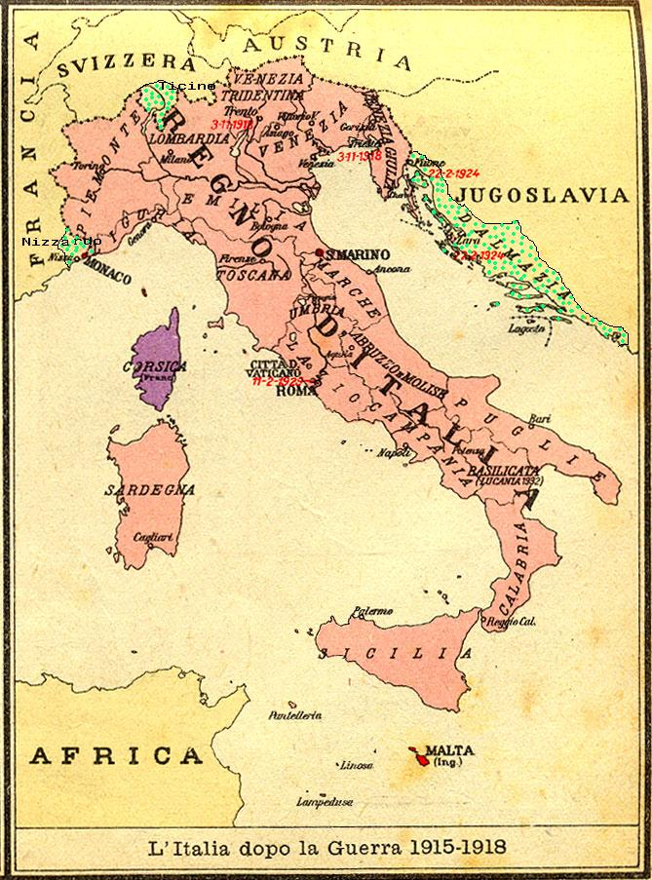

Slide 4
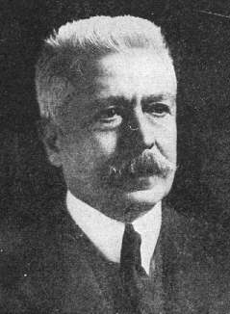

Slide 5
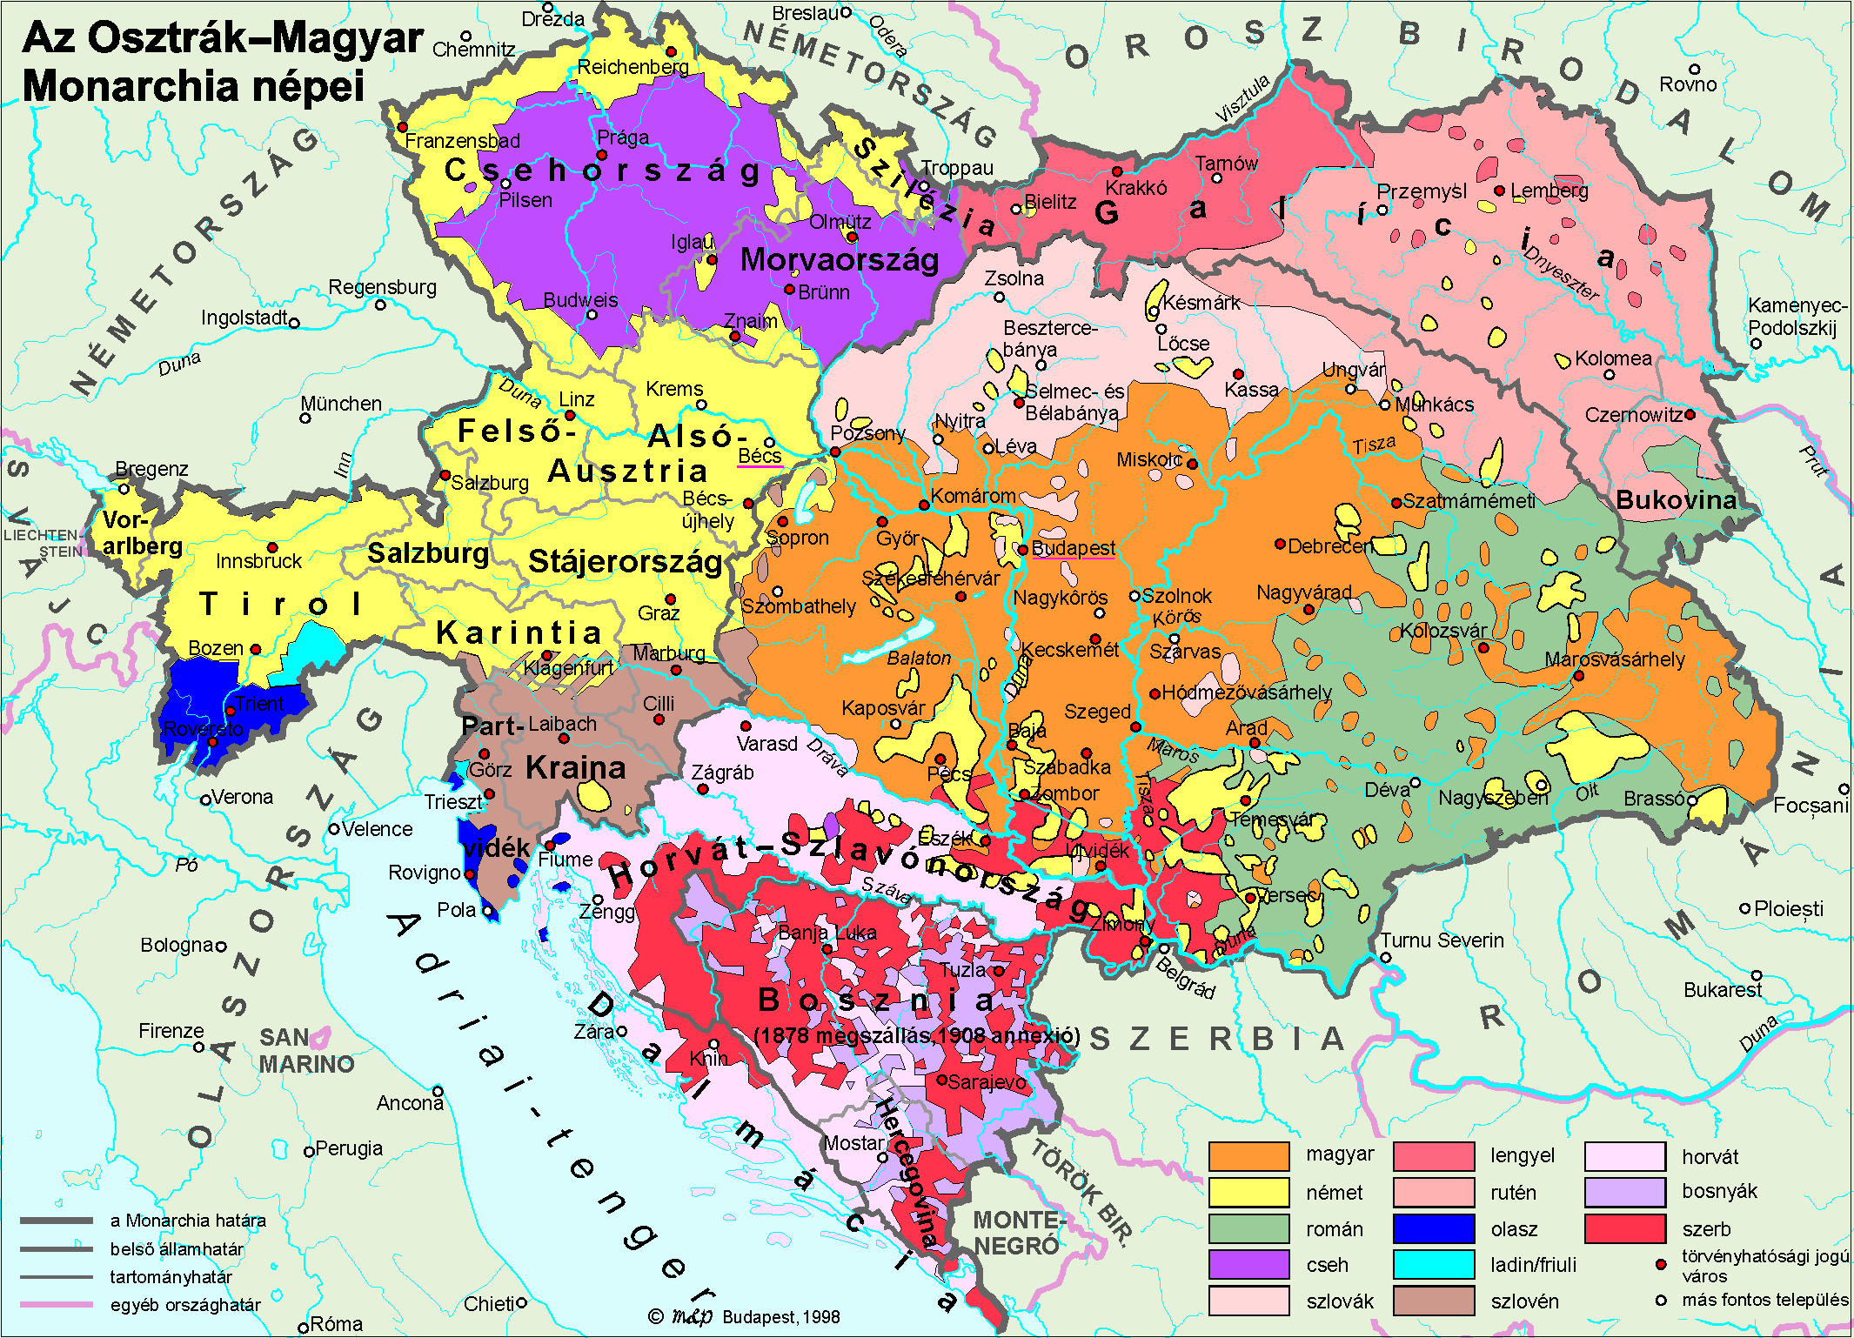

Slide 6
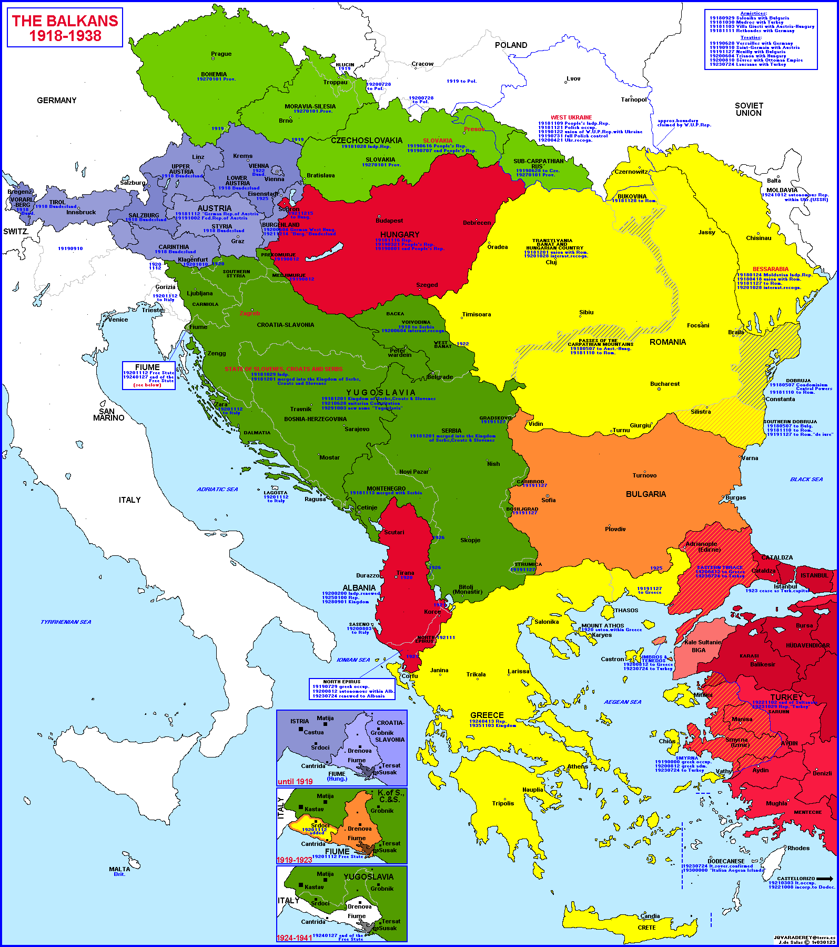

Slide 7
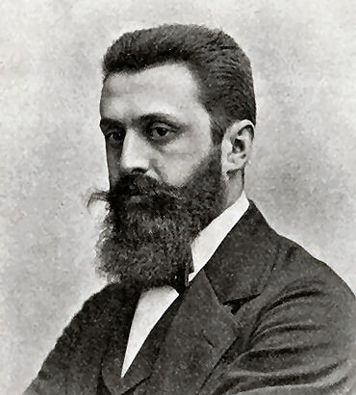
Notes:
herzl

Slide 8
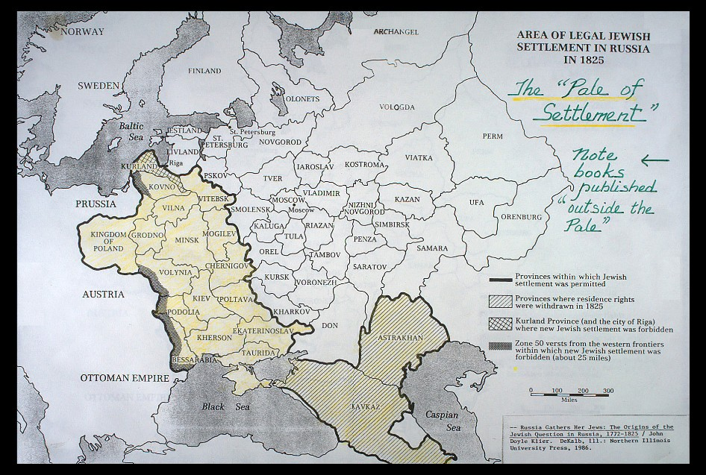

Slide 9
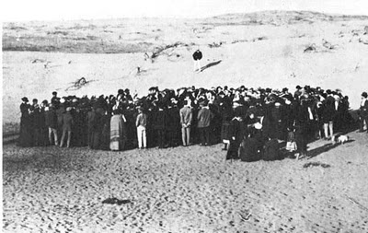
Notes:
1909 auction for land in tel aviv

Slide 10
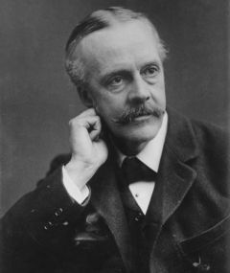
Notes:
balfour

Slide 11
Foreign Office
November 2nd, 1917
Dear Lord Rothschild,
I have much pleasure in conveying to you, on behalf of His Majesty's Government, the following declaration of sympathy with Jewish Zionist aspirations which has been submitted to, and approved by, the Cabinet.
"His Majesty's Government view with favour the establishment in Palestine of a national home for the Jewish people, and will use their best endeavours to facilitate the achievement of this object, it being clearly understood that nothing shall be done which may prejudice the civil and religious rights of existing non-Jewish communities in Palestine, or the rights and political status enjoyed by Jews in any other country.“
I should be grateful if you would bring this declaration to the knowledge of the Zionist Federation.
Yours sincerely,
Arthur James Balfour

Slide 12
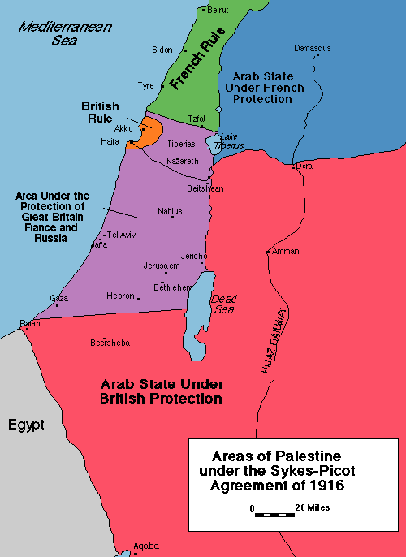

Slide 13
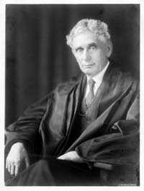

Slide 14
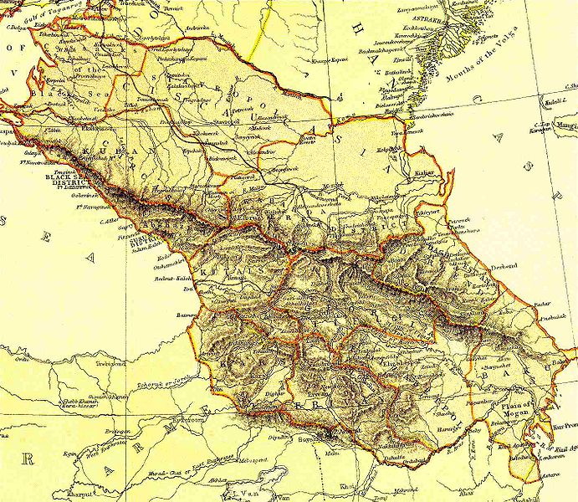
Notes:
Transcaucasian republic

Slide 15
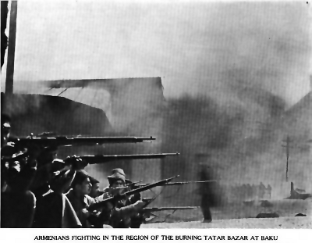

Slide 16
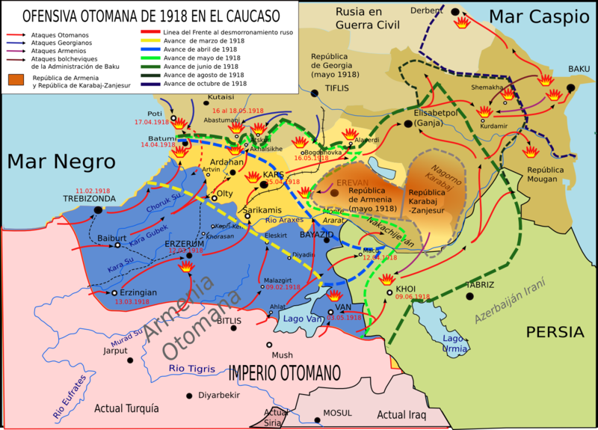

Slide 17
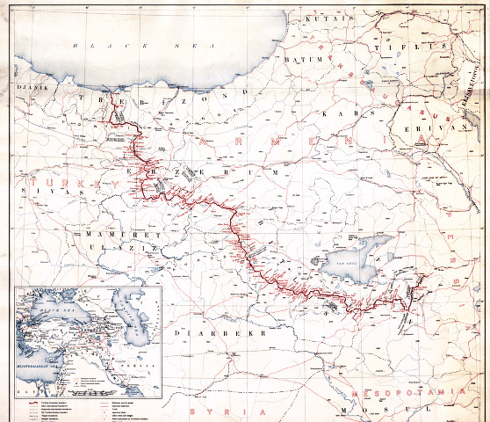

Slide 18


Slide 19
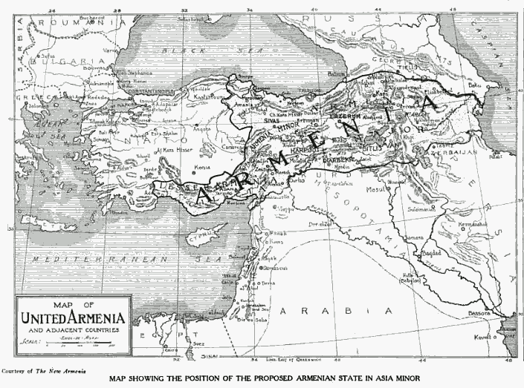

Slide 20
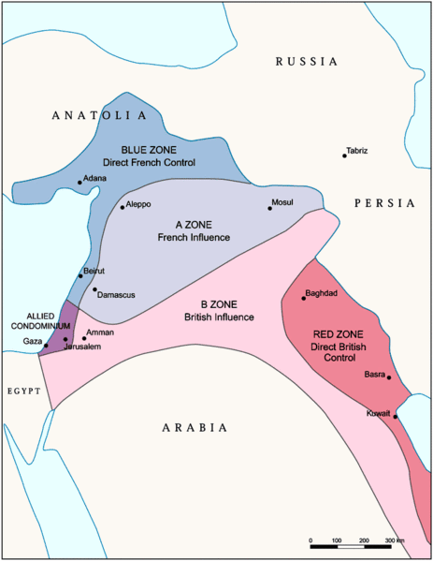

Slide 21
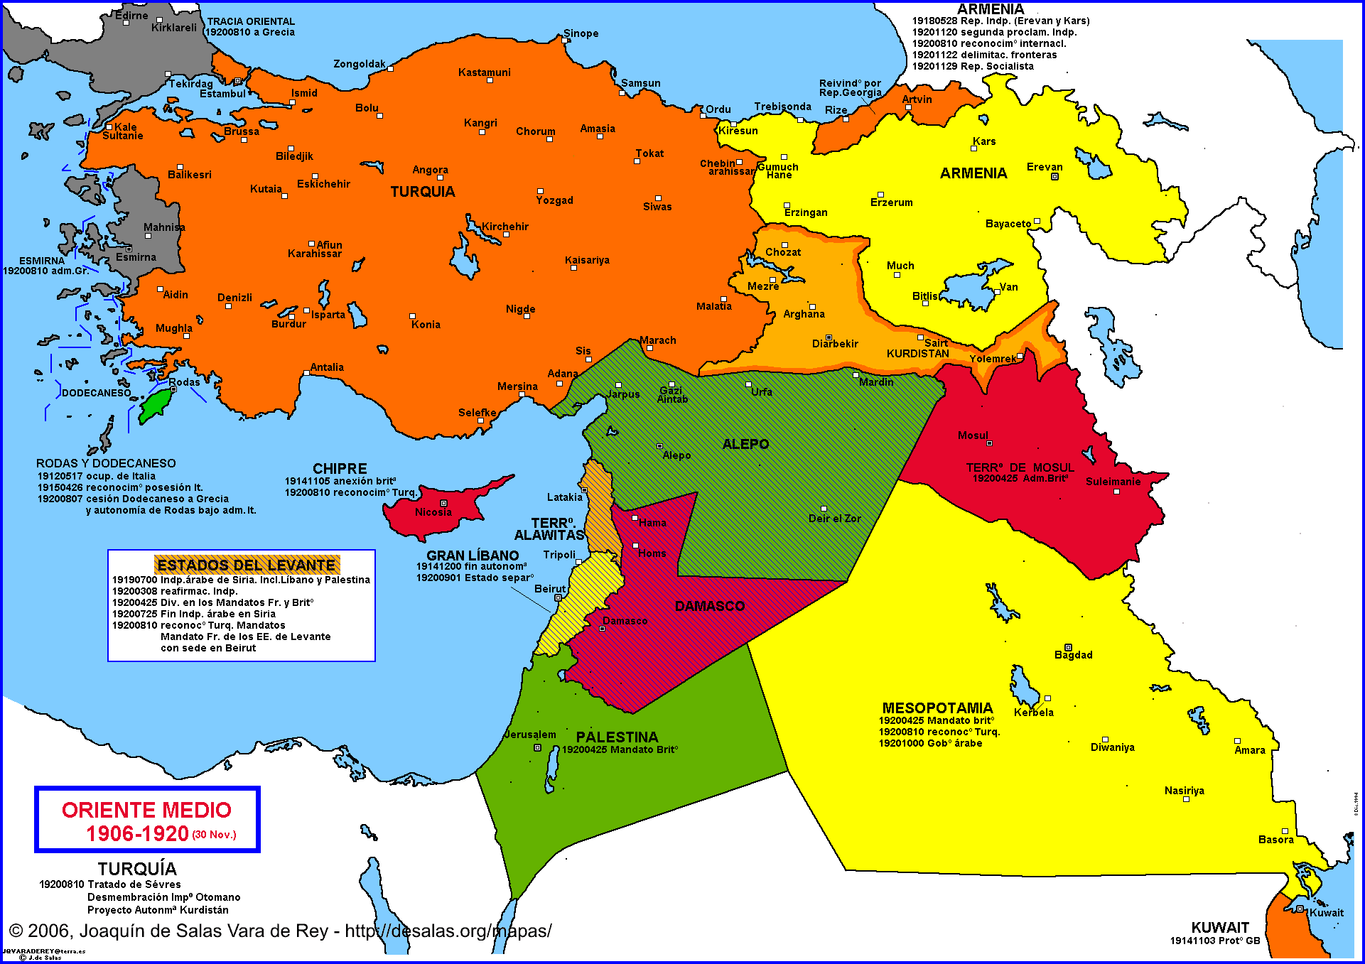

Slide 22
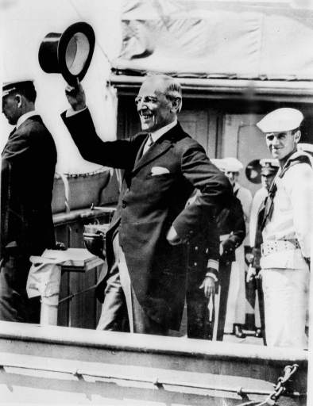

Slide 23
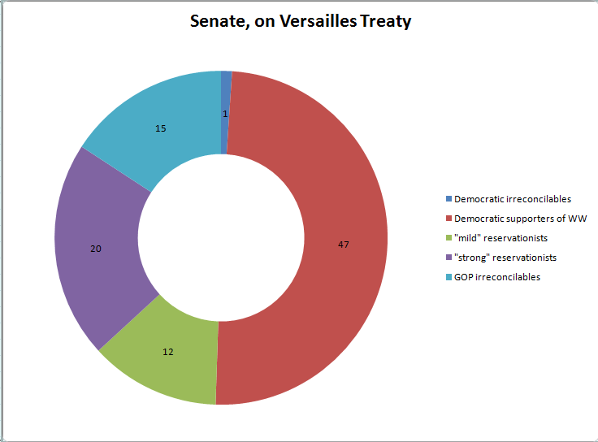

Slide 24
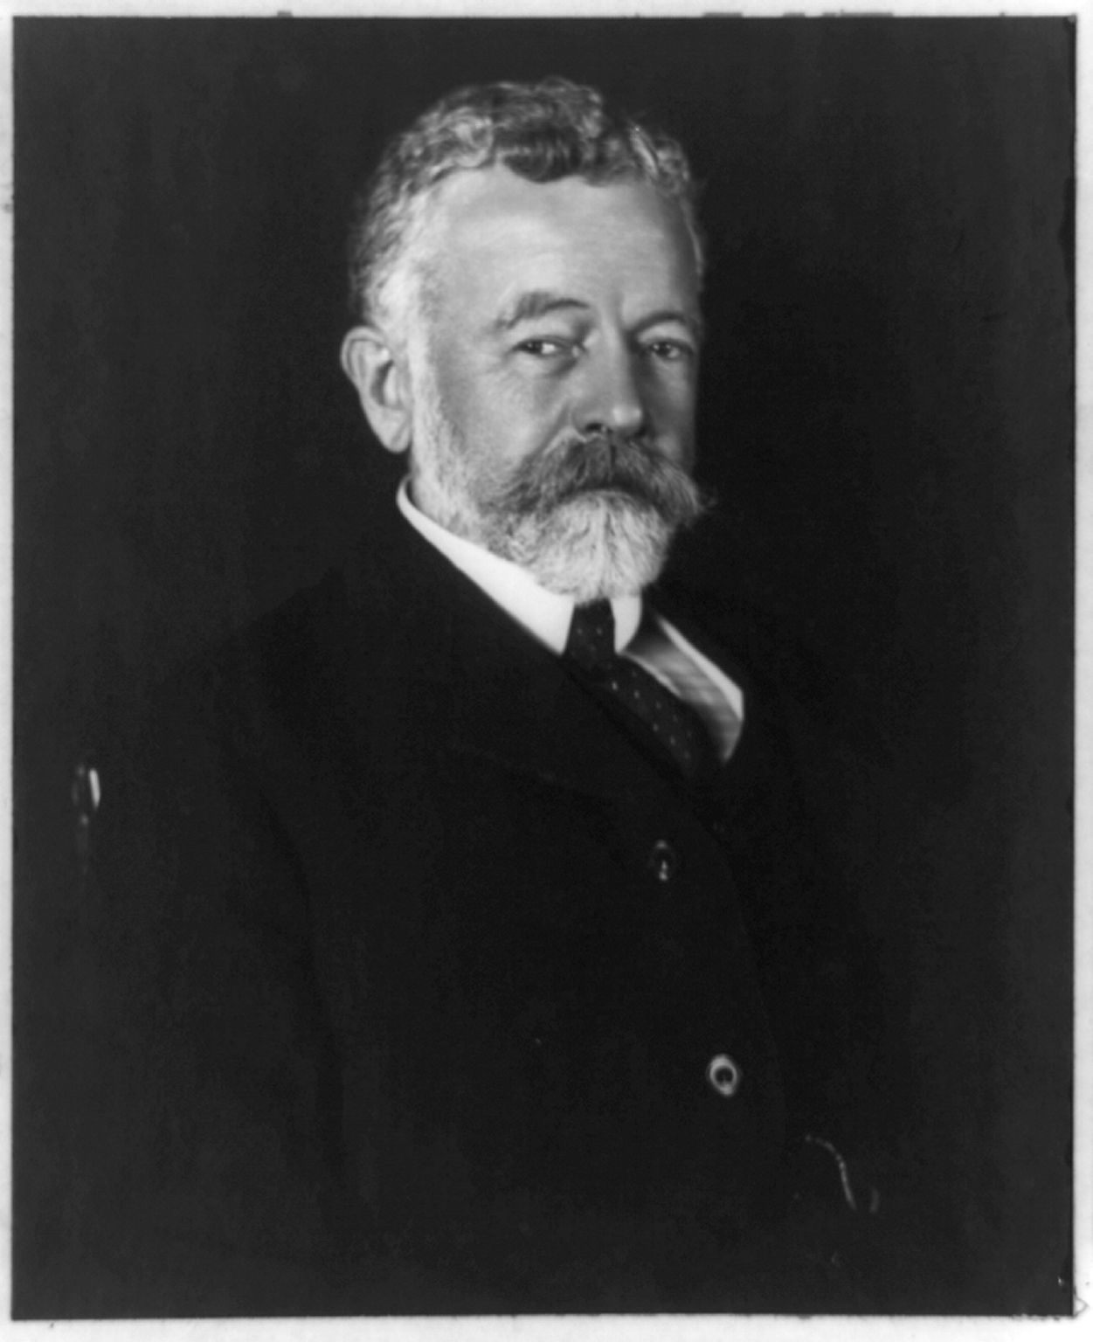

Slide 25
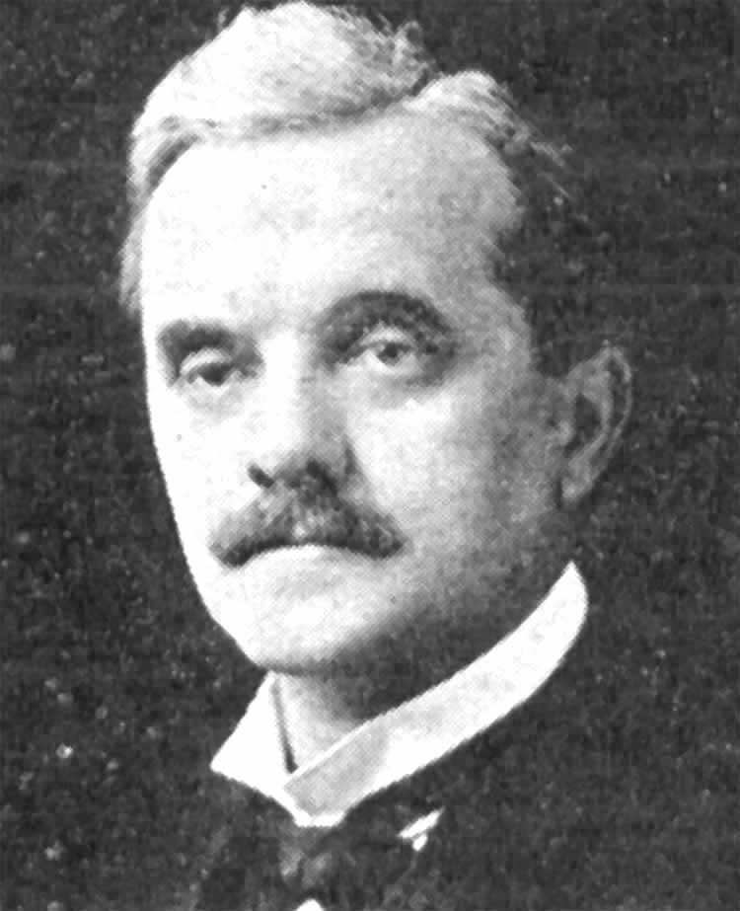

Slide 26
ARTICLE 22
To those colonies and territories which as a consequence of the late war have ceased to be under the sovereignty of the States which formerly governed them and which are inhabited by peoples not yet able to stand by themselves under the strenuous conditions of the modern world, there should be applied the principle that the well-being and development of such peoples form a sacred trust of civilisation and that securities for the performance of this trust should be embodied in this Covenant. The best method of giving practical effect to this principle is that the tutelage of such peoples should be entrusted to advanced nations who by reason of their resources, their experience or their geographical position can best undertake this responsibility, and who are willing to accept it, and that this tutelage should be exercised by them as Mandatories on behalf of the League. The character of the mandate must differ according to the stage of the development of the people, the geographical situation of the territory, its economic conditions, and other similar circumstances. Certain communities formerly belonging to the Turkish Empire have reached a stage of development where their existence as independent nations can be provisionally recognised subject to the rendering of administrative advice and assistance by a Mandatory until such time as they are able to stand alone. The wishes of these communities must be a principal consideration in the selection of the Mandatory.

Slide 27
ARTICLE 11
Any war or threat of war, whether immediately affecting any of the Members of the League or not, is hereby declared a matter of concern to the whole League, and the League shall take any action that may be deemed wise and effectual to safeguard the peace of nations. In case any such emergency should arise the Secretary General shall on the request of any Member of the League forthwith summon a meeting of the Council.
It is also declared to be the friendly right of each Member of the League to bring to the attention of the Assembly or of the Council any circumstance whatever affecting international relations which threatens to disturb international peace or the good understanding between nations upon which peace depends.

Slide 28
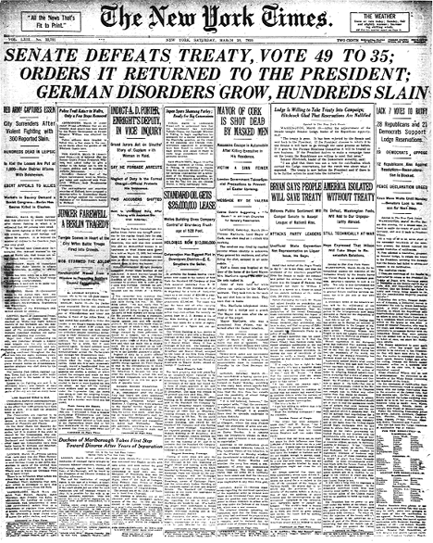

Slide 29
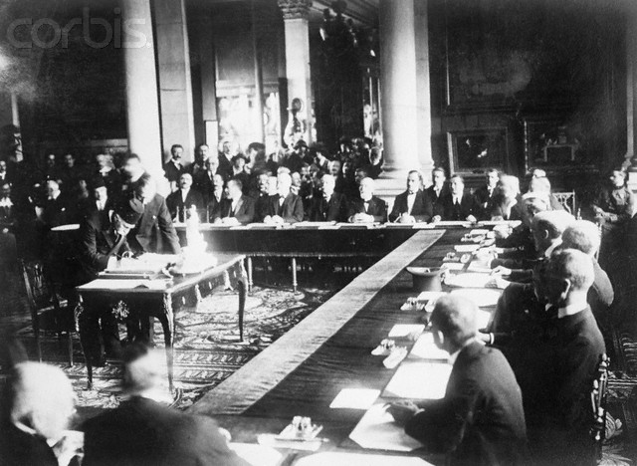
Notes:
Signing sevres

Slide 30
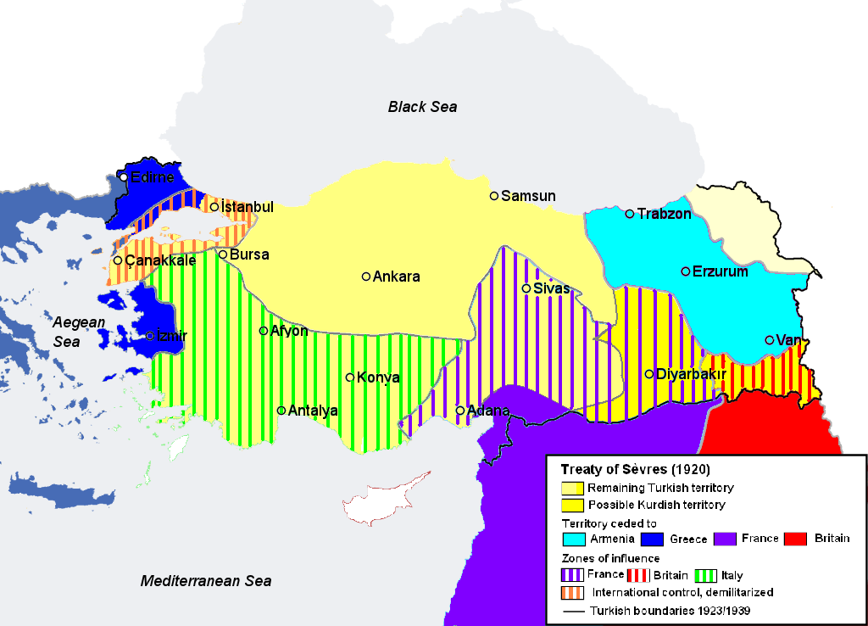

Slide 31
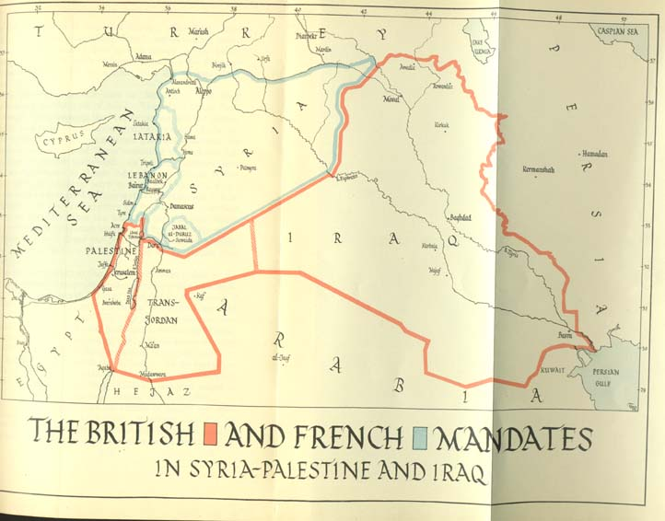

Slide 32
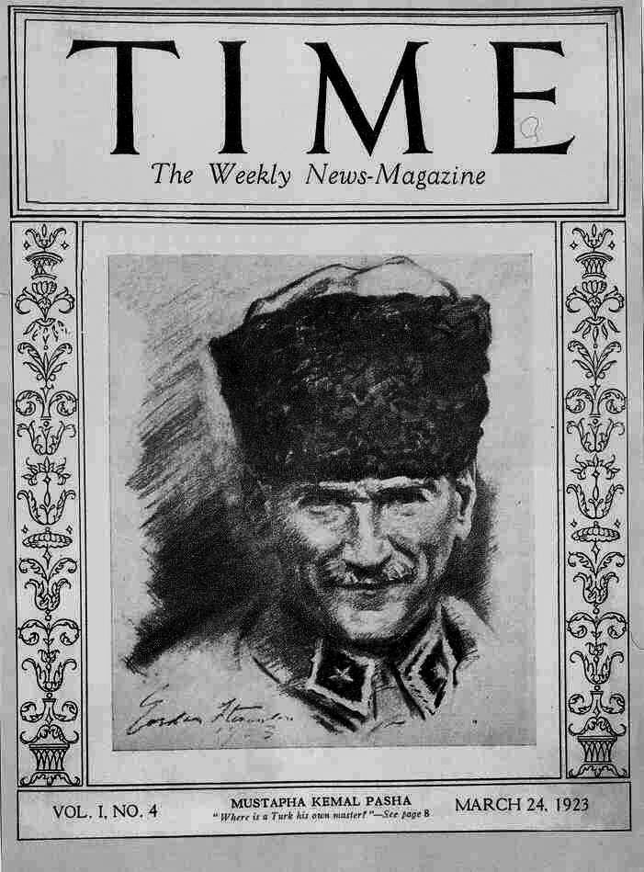

Slide 33
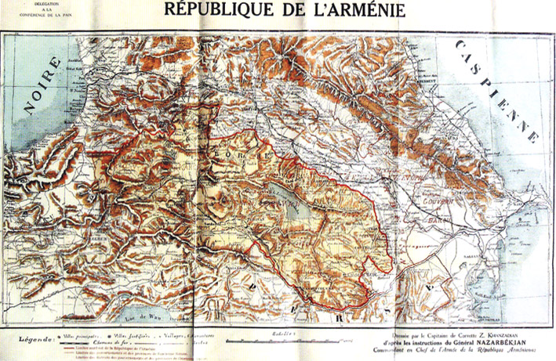

Slide 34
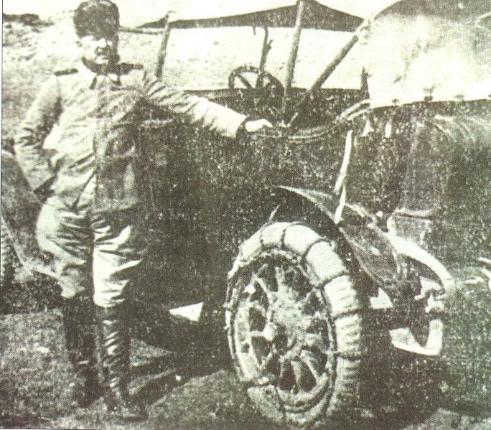
Notes:
Turkish general on offensive intro armenia

Slide 35
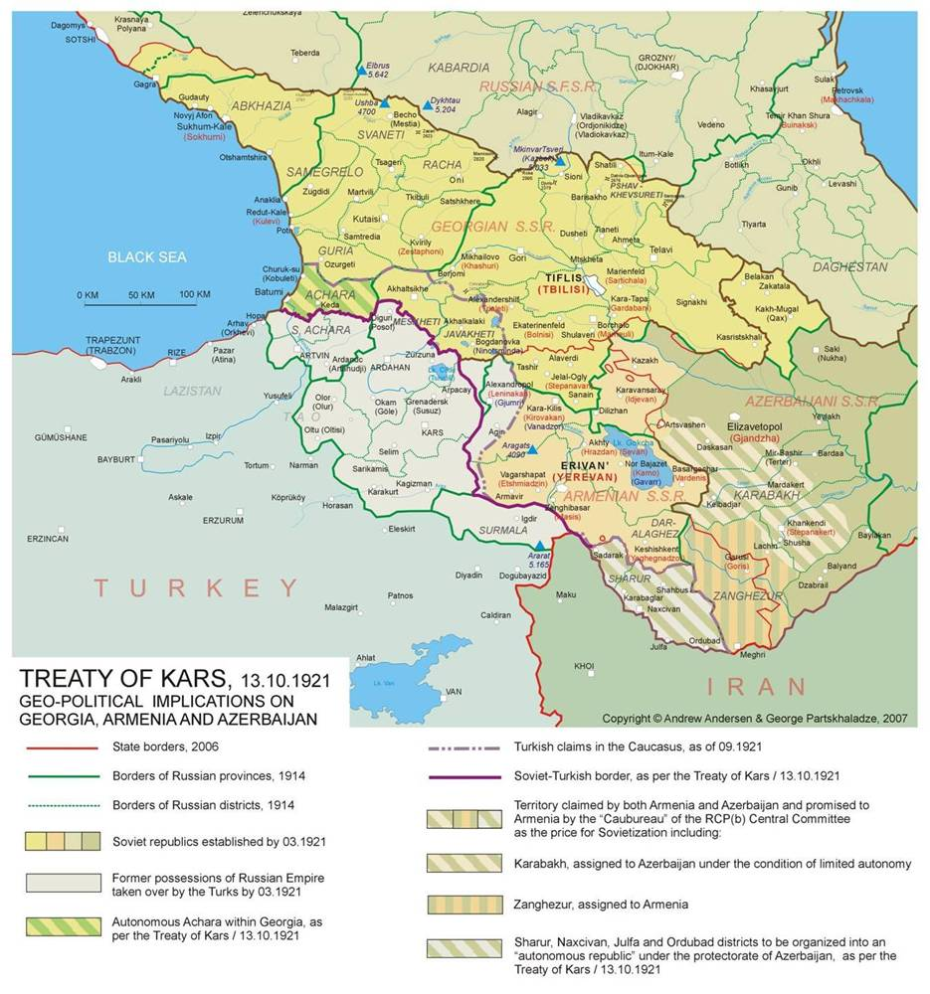

Slide 36
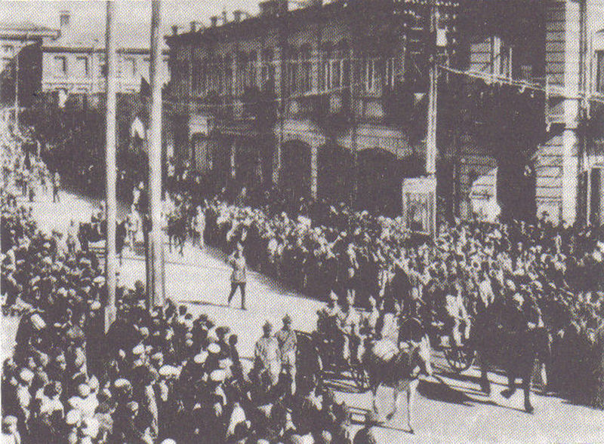
Notes:
Red army troops into yerevan

Slide 37
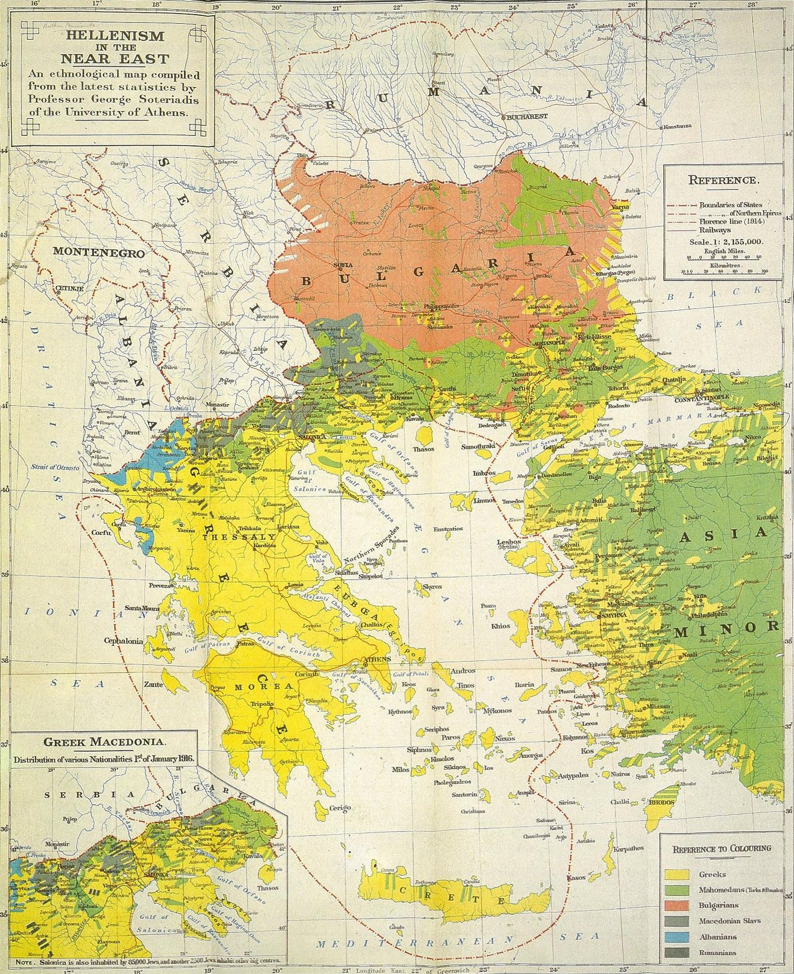

Slide 38
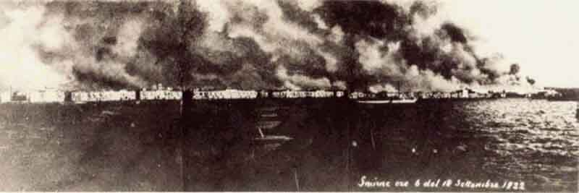
Notes:
Smyrna burning

Slide 39
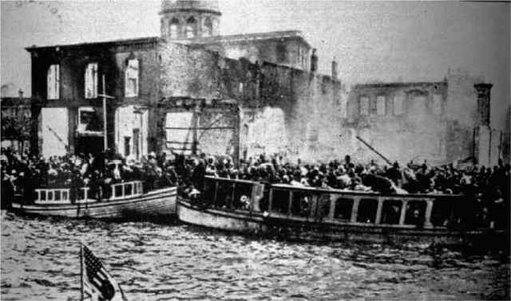
Notes:
Refugees fleeing smyrna—us sends ships

Slide 40
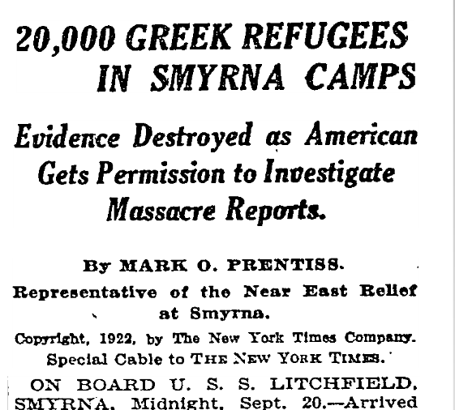

Slide 41
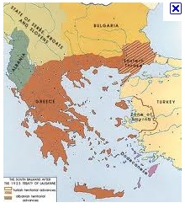

Slide 42
