Slide 1
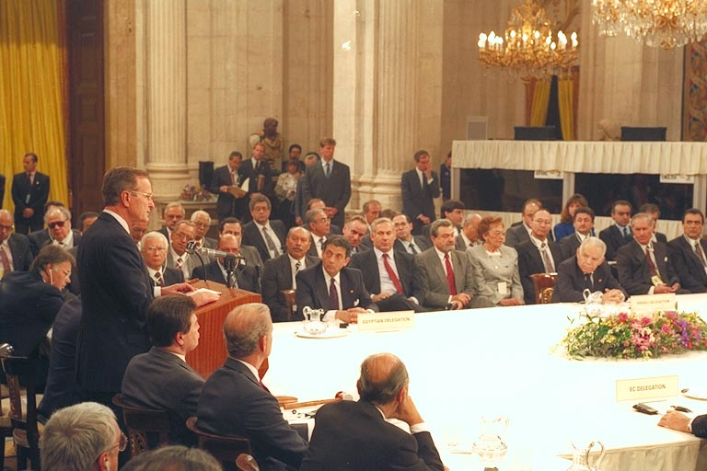
Notes:
Madrid conference opening

Slide 2
United Nations General Assembly Resolution 3379
(November 10, 1975)
THE GENERAL ASSEMBLY,
RECALLING its resolution 1904 (XVIII) of 20 November 1963, proclaiming the United Nations Declaration on the Elimination of All Forms of Racial Discrimination, and in particular its affirmation that "any doctrine of racial differentiation or superiority is scientifically false, morally condemnable, socially unjust and dangerous" and its expression of alarm at "the manifestations of racial discrimination still in evidence in some areas in the world, some of which are imposed by certain Governments by means of legislative, administrative or other measures",
…
TAKING NOTE ALSO of resolution 77 (XII) adopted by the Assembly of Heads of State and Government of the Organization of African Unity at its twelfth ordinary session, held at Kampala from 28 July to 1 August 1975, which considered "that the racist regime in occupied Palestine and the racist regime in Zimbabwe and South Africa have a common imperialist origin, forming a whole and having the same racist structure and being organically linked in their policy aimed at repression of the dignity and integrity of the human being",
…
DETERMINES that Zionism is a form of racism and racial discrimination.

Slide 3
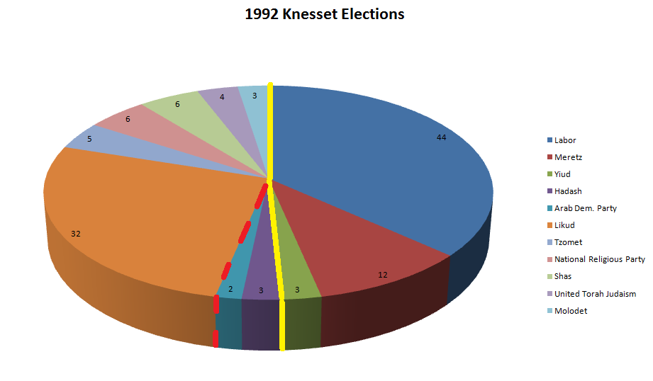

Slide 4
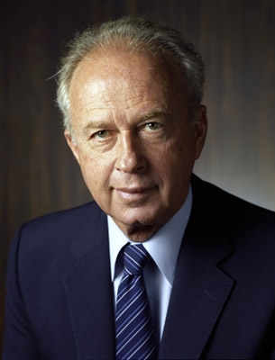

Slide 5
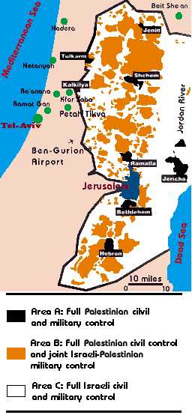

Slide 6
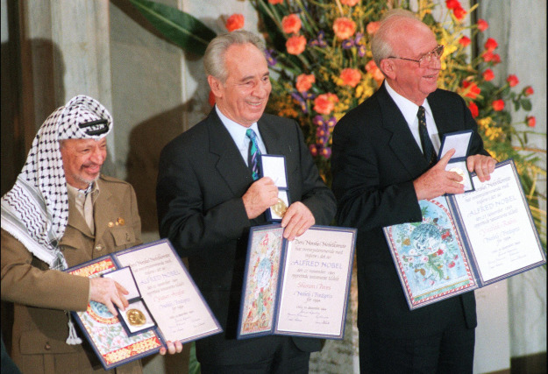

Slide 7
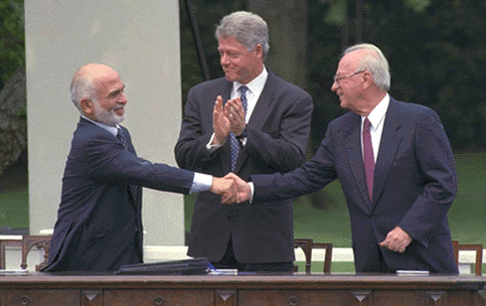

Slide 8
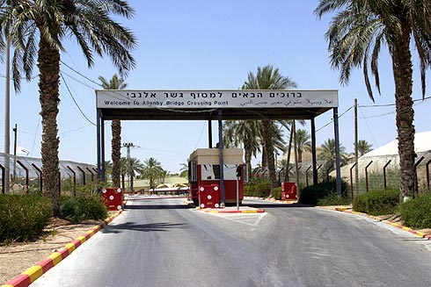

Slide 9
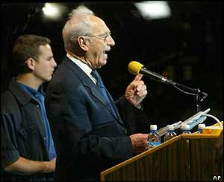

Slide 10
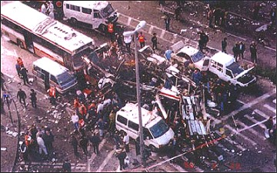
Notes:
Jerusalem 18 bus

Slide 11
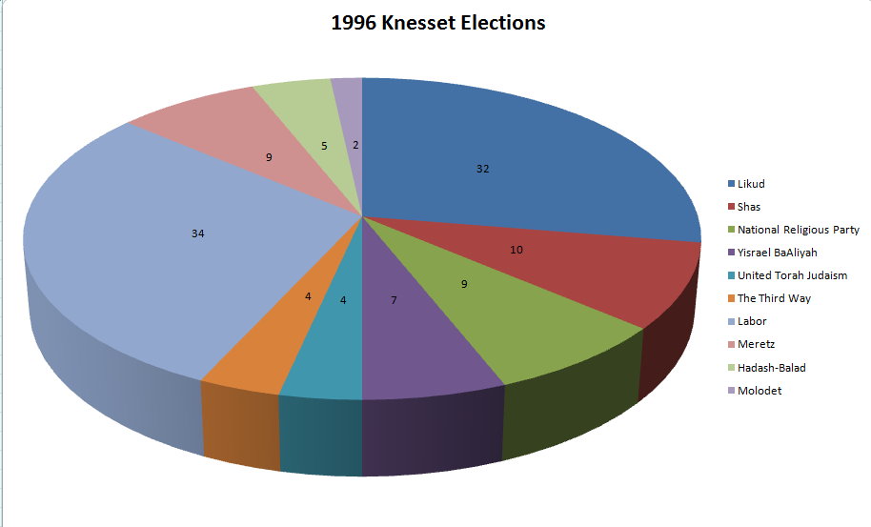

Slide 12
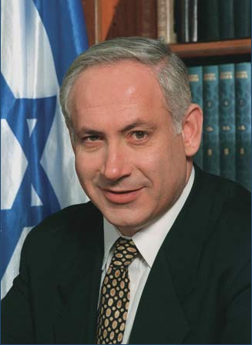
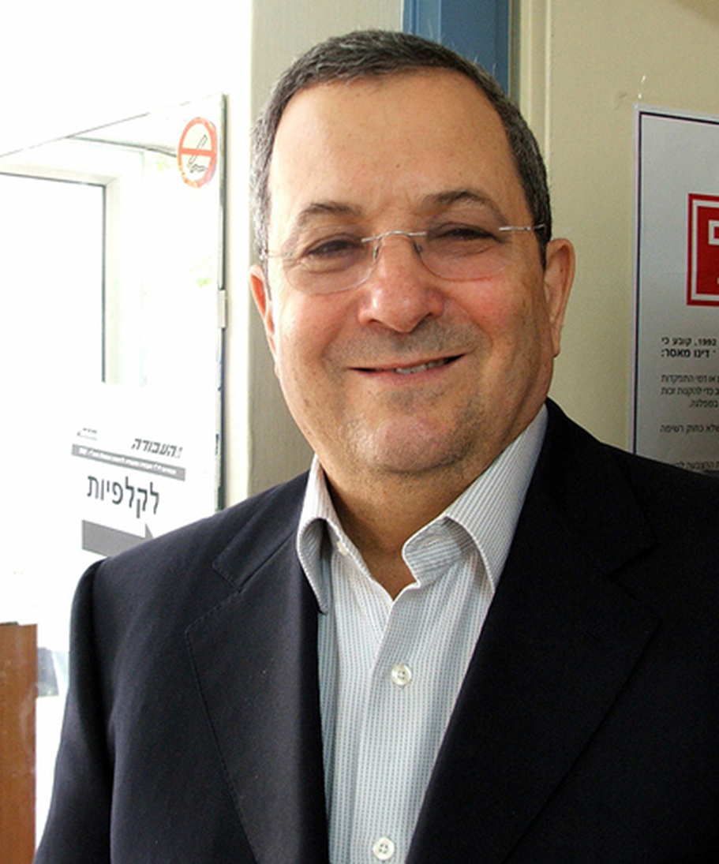

Slide 13
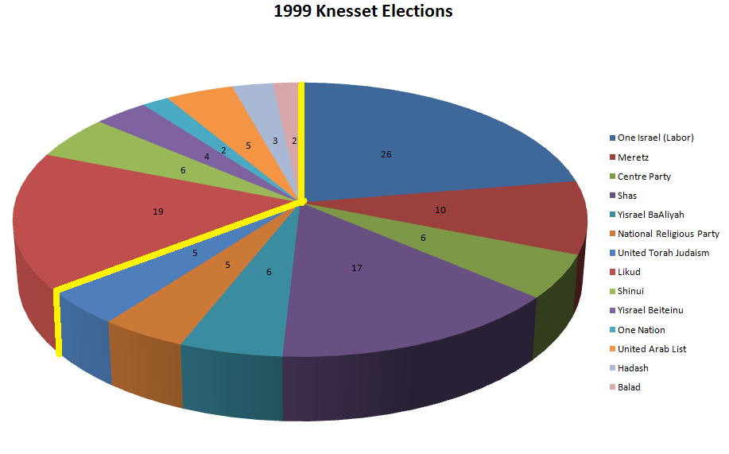

Slide 14

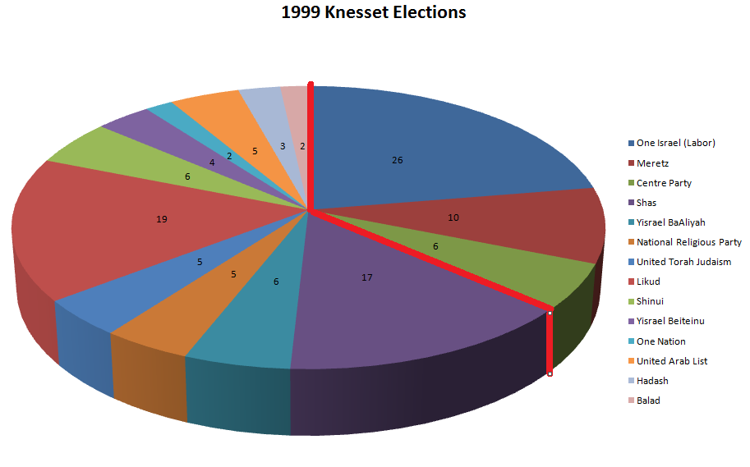

Slide 15
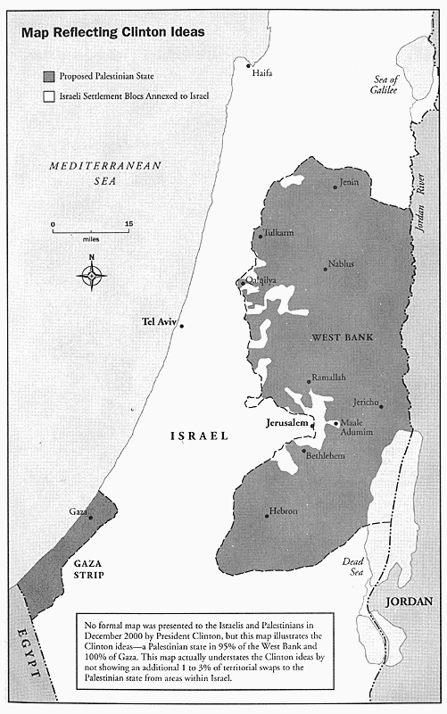

Slide 16
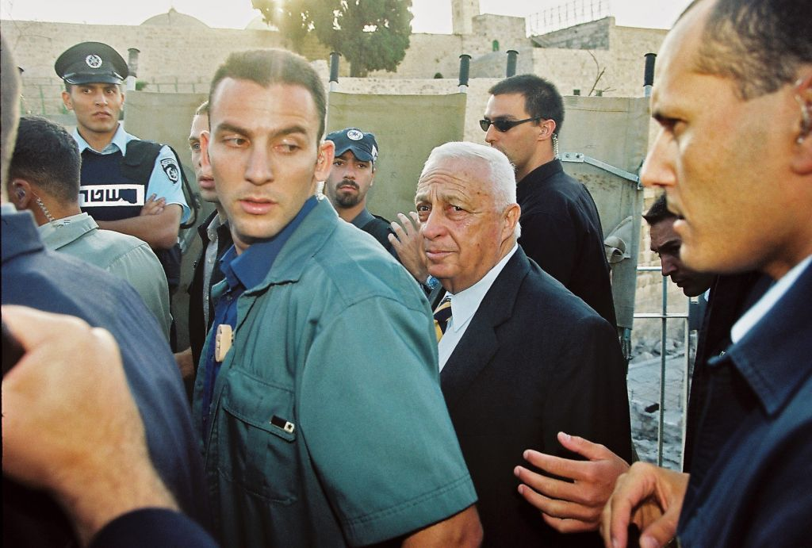

Slide 17
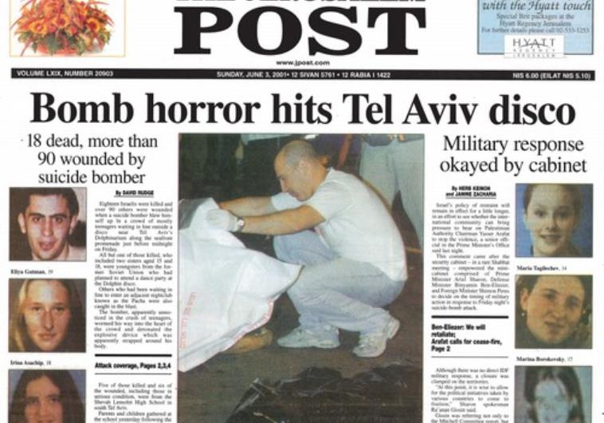
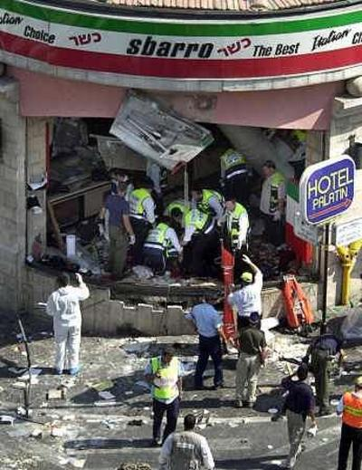
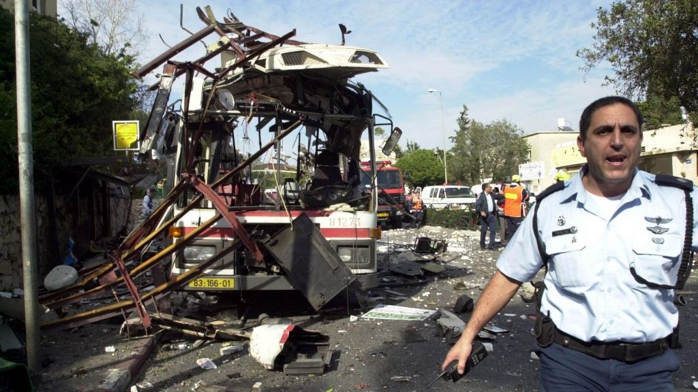

Slide 18
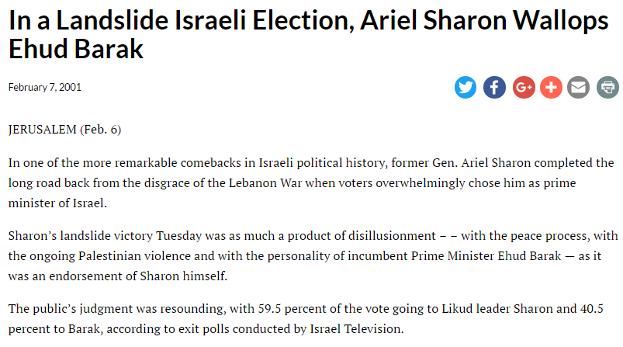

Slide 19
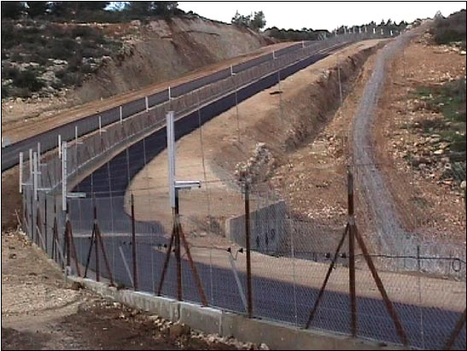

Slide 20
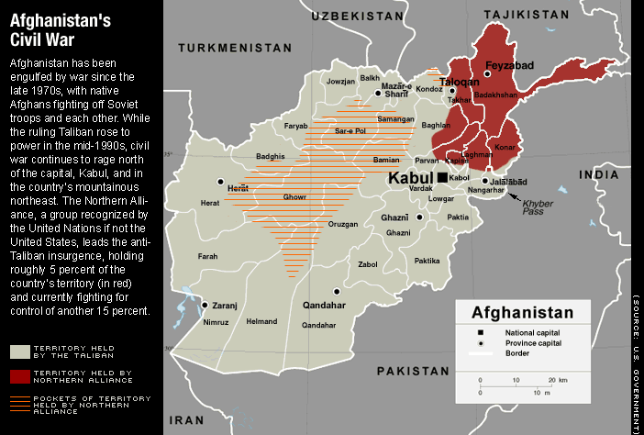

Slide 21
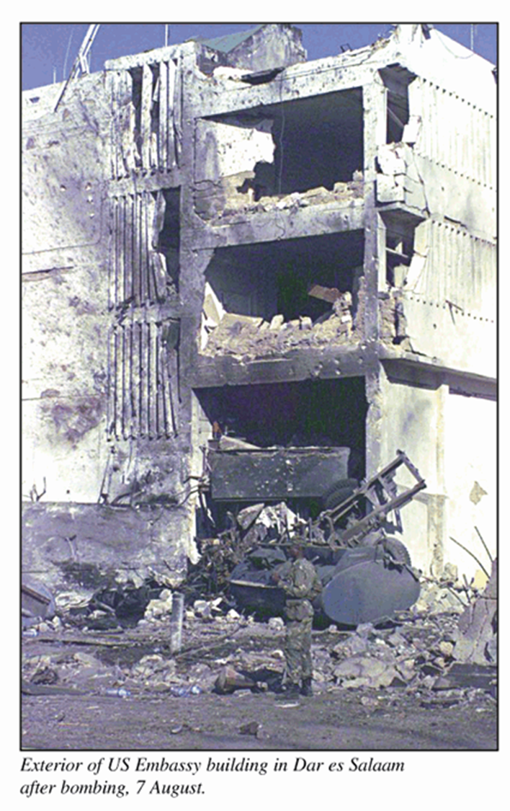
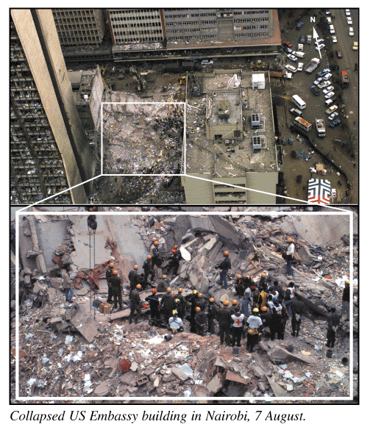

Slide 22
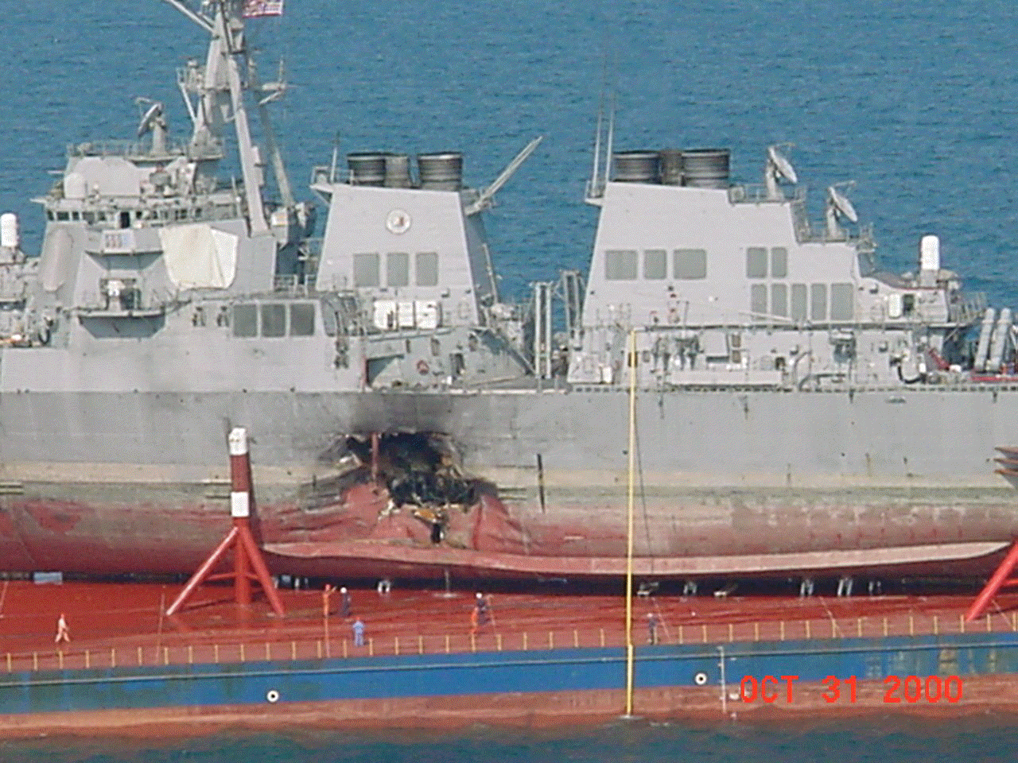

Slide 23
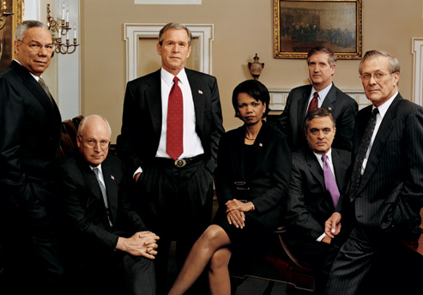

Slide 24
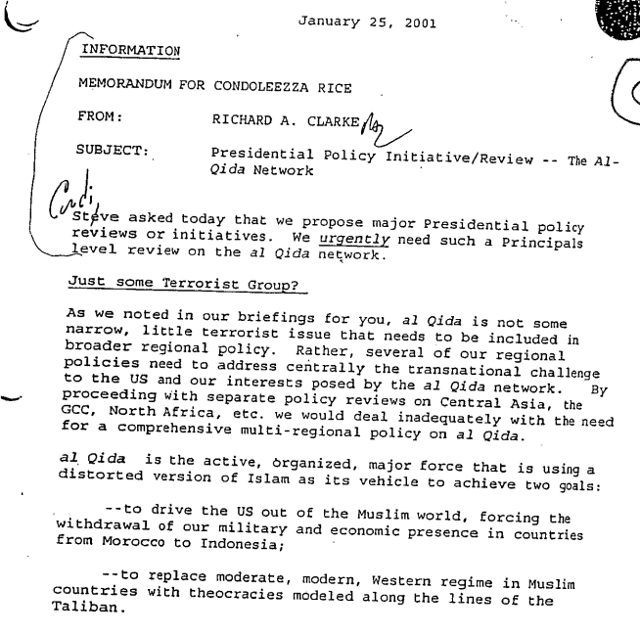

Slide 25
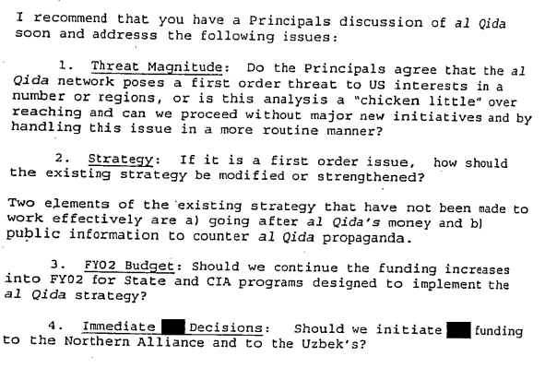

Slide 26
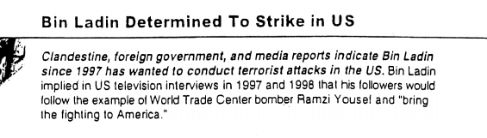

Slide 27


Slide 28
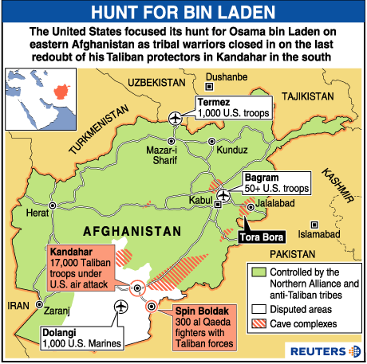

Slide 29


Slide 30
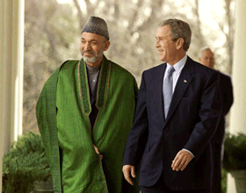

Slide 31
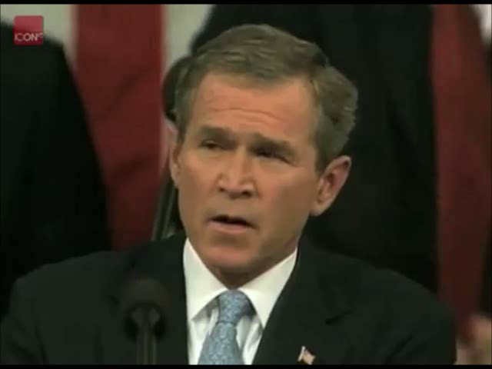

Slide 32


Slide 33
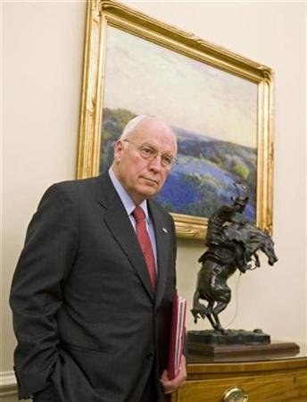

Slide 34
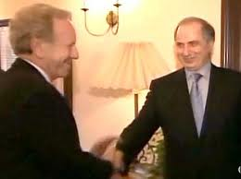

Slide 35
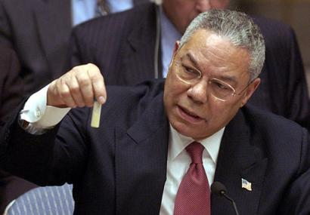

Slide 36
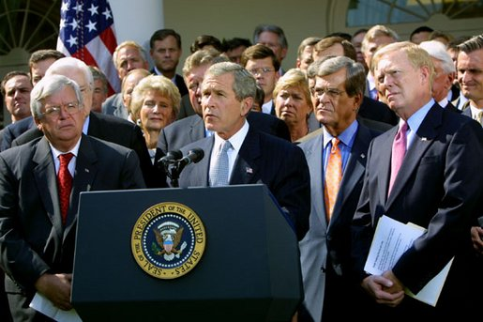

Slide 37

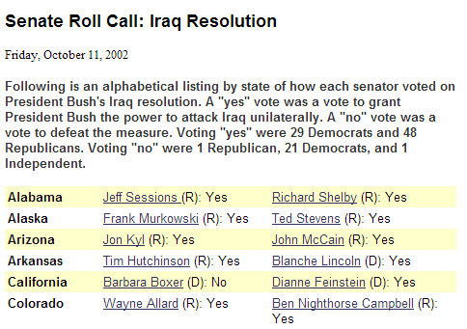

Slide 38


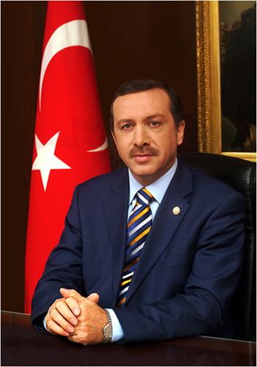

Slide 39
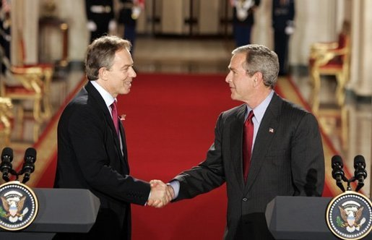

Slide 40
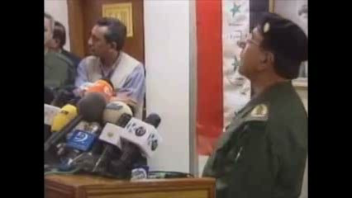

Slide 41


Slide 42
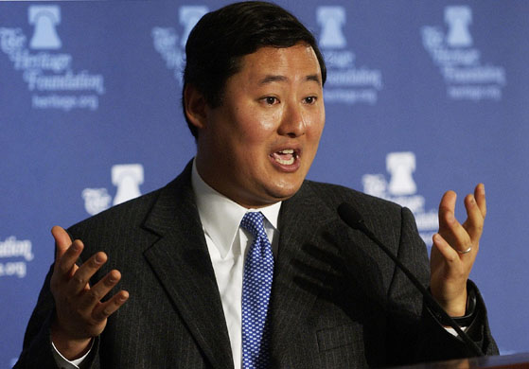

Slide 43
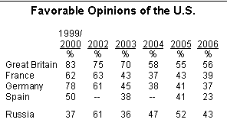

Slide 44
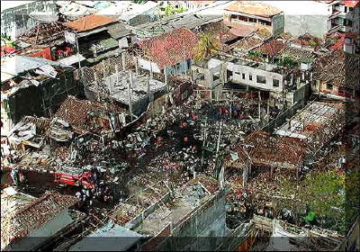

Slide 45
