Slide 1


Slide 2
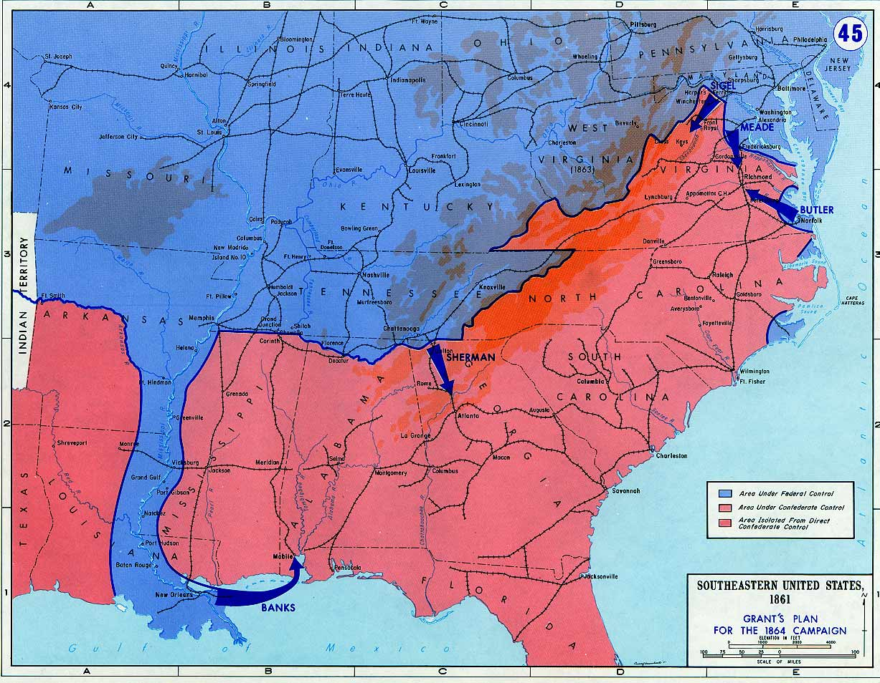

Slide 3
Reconstruction Plans
Lincoln
10% 1860 voters (white males) take oath of loyalty to Union
Wade-Davis bill
50% 1860 voters (white males) take oath of loyalty to Union
Confed. officeholders or those who “voluntarily” took up arms can’t vote/hold office
Confed. debt repudiated
New state constitutions that abolish slavery

Slide 4
13th Amendment
Section 1. Neither slavery nor involuntary servitude, except as a punishment for crime whereof the party shall have been duly convicted, shall exist within the United States, or any place subject to their jurisdiction.
Section 2. Congress shall have power to enforce this article by appropriate legislation.

Slide 5
Texas Black Code
That from and after the passage of this act, every Railroad Company heretofore incorporated, or which may hereafter be incorporated, by the Legislature of this State, shall be required to attach to each passenger train run by said Company, one car for the special accommodation of Freedmen . . .
That all laws and parts of laws relating to persons lately held as slaves, or free persons of color, contrary to, or in conflict with, the provisions of this act [that ensure non-discrimination], be and the same are herby repealed; Provided, nevertheless, that nothing herein shall be so construed as to repeal any law prohibiting the inter-marriage of the white and black races, nor to permit any other than white men to serve on juries, hold office, vote at any election, State, county, or municipal; Provided, further, that nothing herein contained shall be so construed as to allow them to testify, except in such cases and manner as is prescribed in the Constitution of the State . . .
That every able-bodied free white male inhabitant of this State between the ages of eighteen and forty-five years, shall be liable to perform military duty . . . .

Slide 6
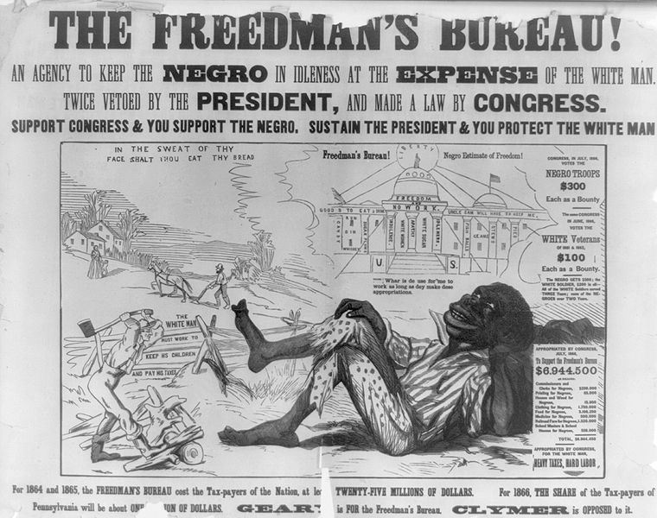

Slide 7
1866 Civil Rights Act
That all persons born in the United States and not subject to any foreign power, excluding Indians not taxed, are hereby declared to be citizens of the United States; and . . . shall have the same right, in every State and Territory in the United States, to make and enforce contracts, to sue, be parties, and give evidence, to inherit, purchase, lease, sell, hold, and convey real and personal property, and to full and equal benefit of all laws and proceedings for the security of person and property, as is enjoyed by white citizens, and shall be subject to like punishment, pains, and penalties, and to none other, any law, statute, ordinance, regulation, or custom, to the contrary notwithstanding . . .
That the district courts of the United States, within their respective districts, shall have, exclusively of the courts of the several States, cognizance of all crimes and offences committed against the provisions of this act . . .

Slide 8

Notes:
Johnson/Grant swing around circle

Slide 9


Slide 10


Slide 11
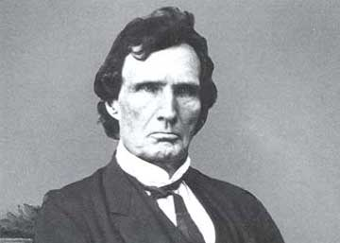

Slide 12
14th Amendment (1866-8)
Section 1.
All persons born or naturalized in the United States, and subject to the jurisdiction thereof, are citizens of the United States and of the state wherein they reside. No state shall make or enforce any law which shall abridge the privileges or immunities of citizens of the United States; nor shall any state deprive any person of life, liberty, or property, without due process of law; nor deny to any person within its jurisdiction the equal protection of the laws.
Section 2.
[States that deny right to vote lose representatives for voters disenfranchised.]
Section 3.
[No Confederate officeholder or military officer can serve in Congress.]
Section 4.
[Confederate debt repudiated.]

Slide 13
Reconstruction Acts (1867)
Creation of five military districts in the seceded states not including Tennessee, which had ratified the Fourteenth Amendment to the United States Constitution and was readmitted to the Union;
Requiring congressional approval for new state constitutions (which were required for Confederate states to rejoin the Union);
Confederate states give voting rights to all men;
All former Confederate states must ratify the 14th Amendment.

Slide 14


Slide 15
15th Amendment (1870)
Section 1.
The right of citizens of the United States to vote shall not be denied or abridged by the United States or by any state on account of race, color, or previous condition of servitude.
Section 2.
The Congress shall have power to enforce this article by appropriate legislation.

Slide 16
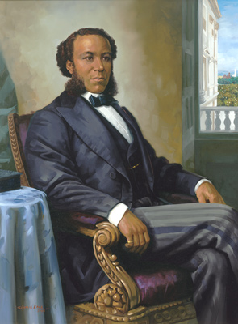
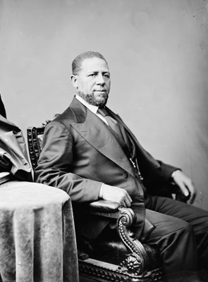
Notes:
Jpseph rainey—sc; hiram revels

Slide 17
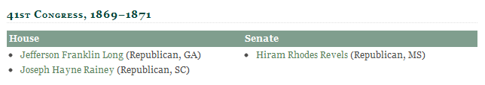
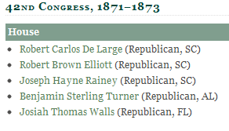
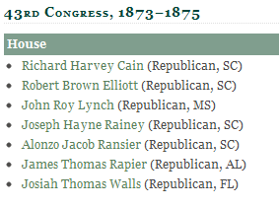
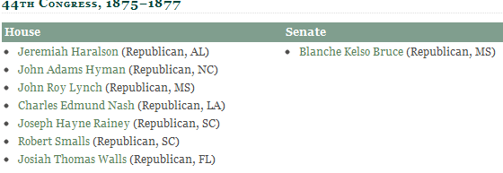
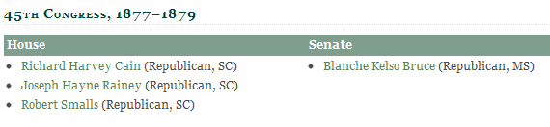

Slide 18
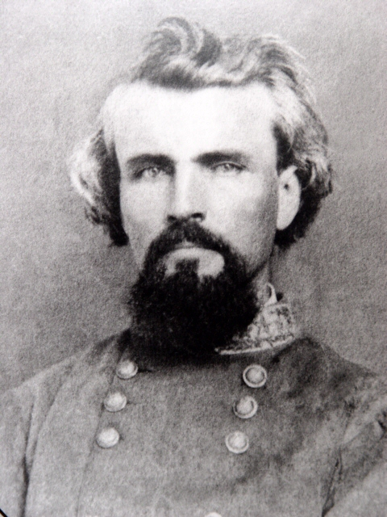
Notes:
Nathan fprrest

Slide 19
Force Act (1870)
Be it further enacted, That if any person shall prevent, hinder, control, or intimidate, or shall attempt to prevent, hinder, control, or intimidate, any person from exercising or in exercising the right of suffrage, to whom the right of suffrage is secured or guaranteed by the fifteenth amendment to the Constitution of the United States, by means of bribery, threats, or threats of depriving such person of employment or occupation, or of ejecting such person from rented house, lands, or other property, or by threats of refusing to renew leases or contracts for labor, or by threats of violence to himself or family, such person so offending shall be deemed guilty of a misdemeanor, and shall, on conviction thereof, be fined not less than five hundred dollars, or be imprisoned not less than one month and not more than one year, or both, at the discretion of the court . . .
And be it further enacted, That if two or more persons shall band or conspire together ... to violate any provision of this act, or to injure, oppress, threaten, or intimidate any citizen with intent to prevent or hinder his free exercise and enjoyment of any right or privilege granted or secured to him by the Constitution or laws of the United States, or because of his having exercised the same, such persons shall be held guilty of felony, and, on conviction thereof, shall be fined or imprisoned, or both, at the discretion of the court, -- the fine not to exceed five thousand dollars, and the imprisonment not to exceed ten years ...

Slide 20
Civil Rights Act (1871)
[Sec. 1983] Every person who under color of any statute, ordinance, regulation, custom, or usage, of any State or Territory or the District of Columbia, subjects, or causes to be subjected, any citizen of the United States or other person within the jurisdiction thereof to the deprivation of any rights, privileges, or immunities secured by the Constitution and laws, shall be liable to the party injured in an action at law, Suit in equity, or other proper proceeding for redress, except that in any action brought against a judicial officer for an act or omission taken in such officer's judicial capacity, injunctive relief shall not be granted unless a declaratory decree was violated or declaratory relief was unavailable. For the purposes of this section, any Act of Congress applicable exclusively to the District of Columbia shall be considered to be a statute of the District of Columbia.

Slide 21
Civil Rights Act (1875)
An act to protect all citizens in their civil and legal rights. Whereas, it is essential to just government we recognize the equality of all men before the law, and hold that it is the duty of government in its dealings with the people to mete out equal and exact justice to all, of whatever nativity, race, color, or persuasion, religious or political; and it being the appropriate object of legislation to enact great fundamental principles into law:
Therefore, Be it enacted by the Senate and House of Representatives of the United States of America in Congress assembled, That all persons within the jurisdiction of the United States shall be entitled to the full and equal and enjoyment of the accommodations, advantages, facilities, and privileges of inns, public conveyances on land or water, theaters, and other places of public amusement; subject only to the conditions and limitations established by law, and applicable alike to citizens of every race and color, regardless of any previous condition of servitude . . .
Sec. 3. That the district and circuit courts of the United States shall have, exclusively of the courts of the several States, cognizance of all crimes and offenses against, and violations of, the provisions of this act

Slide 22
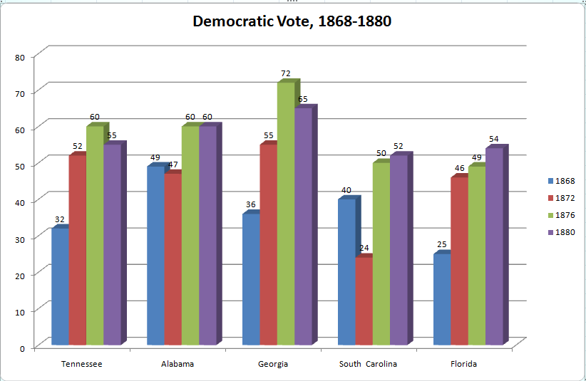

Slide 23
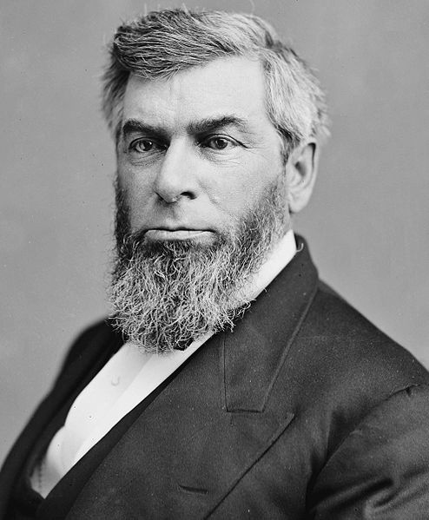
Notes:
Morrison Waite

Slide 24
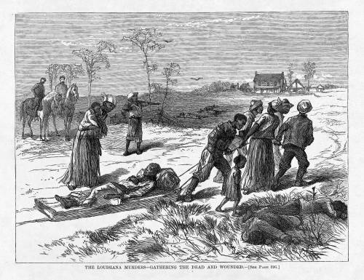
Notes:
Colfax massacre

Slide 25
U.S. v Cruikshank (1876)
The people of the United States resident within any State are subject to two governments: one State, and the other National; but there need be no conflict between the two. The powers which one possesses, the other does not . . .
The government of the United States is one of delegated powers alone. Its authority is defined and limited by the Constitution. All powers not granted to it by that instrument are reserved to the States or the people. No rights can be acquired under the constitution or laws of the United States, except such as the government of the United States has the authority to grant or secure. All that cannot be so granted or secured are left under the protection of the States . . .
Inasmuch, therefore, as it does not appear in these counts that the intent of the defendants was to prevent these parties from exercising their right to vote on account of their race, &c., it does not appear that it was their intent to interfere with any right granted or secured by the constitution or laws of the United States. We may suspect that race was the cause of the hostility; but it is not so averred.

Slide 26
U.S. v. Reese (1876)
Looking, then, to this statute, we find that its first section provides that all citizens of the United States, who are or shall be otherwise qualified by law to vote at any election, &c., shall be entitled and allowed to vote thereat, without distinction of race, color, or previous condition of servitude, any constitution, &c., of the State to the contrary notwithstanding. This simply declares a right, without providing a punishment for its violation . . .
The Fifteenth Amendment does not confer the right of suffrage upon any one. It prevents the States, or the United States, however, from giving preference, in this particular, to one citizen of the United States over another on account of race, color, or previous condition of servitude. . .
It has not been contended, nor can it be, that the amendment confers authority to impose penalties for every wrongful refusal to receive the vote of a qualified elector at State elections. It is only when the wrongful refusal at such an election is because of race, color, or previous condition of servitude, that Congress can interfere, and provide for its punishment.

Slide 27
Civil Rights Cases (1883)
[Regarding the 14th amendment] it is State action of a particular character that is prohibited. Individual invasion of individual rights is not the subject matter of the amendment. It has a deeper and broader scope. It nullifies and makes void all State legislation, and State action of every kind, which impairs the privileges and immunities of citizens of the United States…
It does not invest Congress with power to legislate upon subjects which are within the domain of State legislation, but to provide modes of relief against State legislation, or State action, of the kind referred to. It does not authorize Congress to create a code of municipal law for the regulation of private rights, but to provide modes of redress against the operation of State laws and the action of State officers executive or judicial when these are subversive of the fundamental rights specified in the amendment.

Slide 28
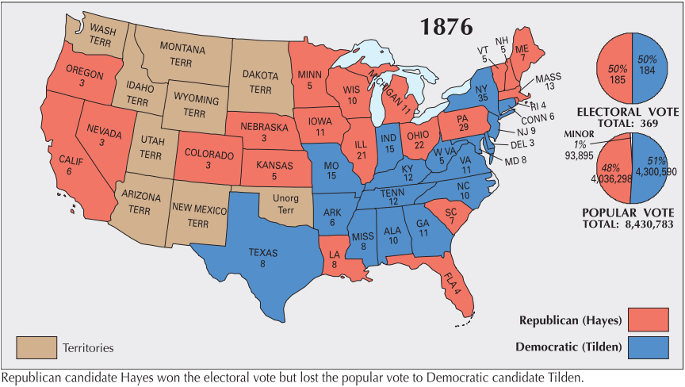

Slide 29
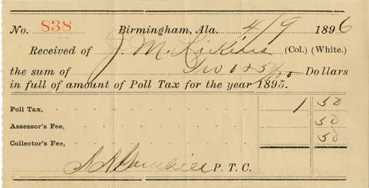

Slide 30
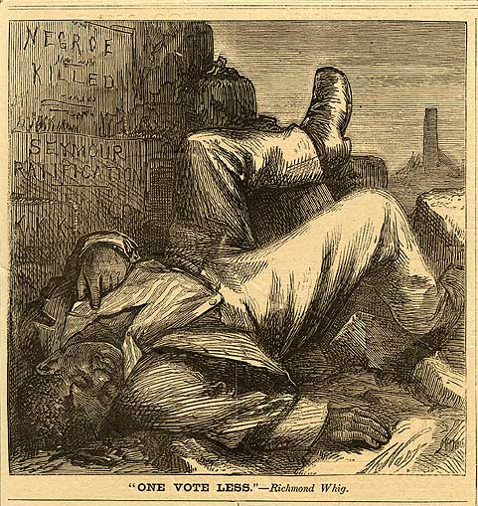

Slide 31
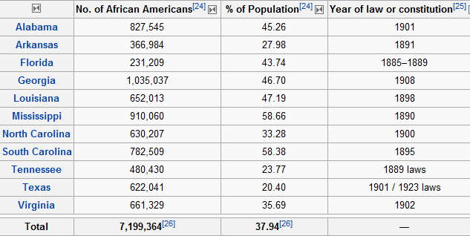

Slide 32
Mississippi
1880: Miscegenation [State Code]
Revised state code to declare marriage between white persons and Negroes or mulattoes or persons of one-quarter or more Negro blood as "incestuous and void." Penalty: Fine up to $500, or imprisonment in the penitentiary up to ten years, or both.
1890: Miscegenation [Constitution]
Prohibited marriage of a white person with a Negro or mulatto or person who has one-eighth or more of Negro blood.
1890: Education [Constitution]
Separate schools to be maintained for white and black children.
1902 [Statute]: Any person...who shall be guilty of printing, publishing or circulating printed, typewritten or written matter urging or presenting for public acceptance or general information, arguments or suggestions in favor of social equality or of intermarriage between whites and negroes, shall be guilty of a misdemeanor and subject to fine or not exceeding five hundred (500.00) dollars or imprisonment not exceeding six (6) months or both.

Slide 33
Georgia
1895: Education [State Code]
Black and white children not allowed to attend the same school. Penalty: Teachers who taught white and black pupils in the same school would not be compensated out of the public school fund.
[1897, Statute:] No colored barber shall serve as a barber [to] white women or girls.
[1897, Statute:] The officer in charge shall not bury, or allow to be buried, any colored persons upon ground set apart or used for the burial of white persons.
[1901, Statute:] All persons licensed to conduct a restaurant, shall serve either white people exclusively or colored people exclusively and shall not sell to the two races within the same room or serve the two races anywhere under the same license.

Slide 34
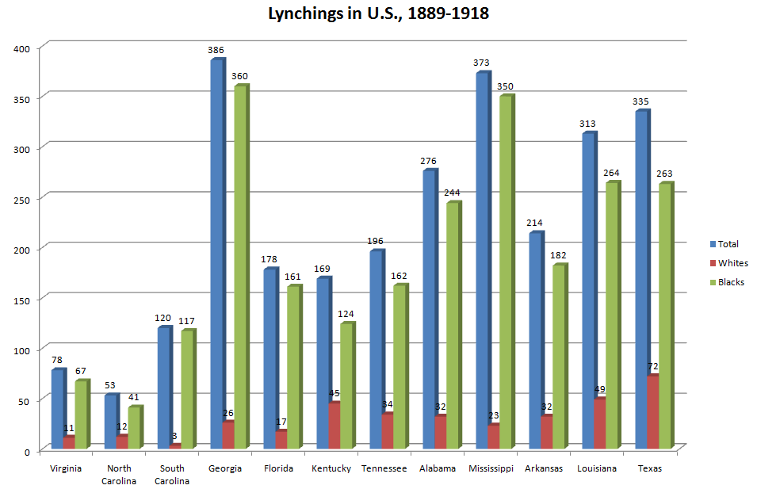

Slide 35
Louisiana:
[1890, Statute:]
Railway companies to provide equal but separate accommodations for white and colored passengers. Penalty: Passengers or conductors not complying with the law subject to a fine of $25 or imprisonment for 20 days. Officers and directors of railway companies that fail to comply guilty of a misdemeanor and could be fined between $100 and $500.
[1894, Statute:]
Depots must provide equal but separate waiting rooms for the white and colored races. "No person shall occupy the wrong room." Law must be posted in a conspicuous place. Penalty: Persons who insist on entering the improper place may be fined $25 or imprisoned up to 30 days. Agents failing to enforce the law guilty of misdemeanor, punishable by a fine of $25 to $50.

Slide 36
Plessy v. Ferguson (1896)
The object of the [14th] amendment was undoubtedly to enforce the absolute equality of the two races before the law, but, in the nature of things, it could not have been intended to abolish distinctions based upon color, or to enforce social, as distinguished from political, equality, or a commingling of the two races upon terms unsatisfactory to either . . .
In determining the question of reasonableness, [the legislature] is at liberty to act with reference to the established usages, customs, and traditions of the people, and with a view to the promotion of their comfort and the preservation of the public peace and good order. Gauged by this standard, we cannot say that a law which authorizes or even requires the separation of the two races in public conveyances is unreasonable, or more obnoxious to the Fourteenth Amendment than the acts of Congress requiring separate schools for colored children in the District of Columbia, the constitutionality of which does not seem to have been questioned, or the corresponding acts of state legislatures.

Slide 37
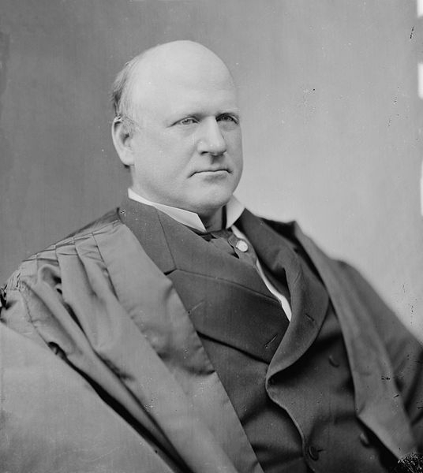
Notes:
Justice harlan

Slide 38
Plessy —Harlan dissent
The white race deems itself to be the dominant race in this country. And so it is in prestige, in achievements, in education, in wealth and in power. So, I doubt not, it will continue to be for all time if it remains true to its great heritage and holds fast to the principles of constitutional liberty. But in view of the Constitution, in the eye of the law, there is in this country no superior, dominant, ruling class of citizens. There is no caste here. Our Constitution is color-blind, and neither knows nor tolerates classes among citizens. In respect of civil rights, all citizens are equal before the law. The humblest is the peer of the most powerful. The law regards man as man, and takes no account of his surroundings or of his color when his civil rights as guaranteed by the supreme law of the land are involved. It is therefore to be regretted that this high tribunal, the final expositor of the fundamental law of the land, has reached the conclusion that it is competent for a State to regulate the enjoyment by citizens of their civil rights solely upon the basis of race.
In my opinion, the judgment this day rendered will, in time, prove to be quite as pernicious as the decision made by this tribunal in the Dred Scott Case.

Slide 39
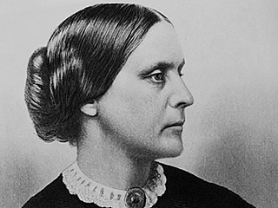
Notes:
Sb anthony

Slide 40
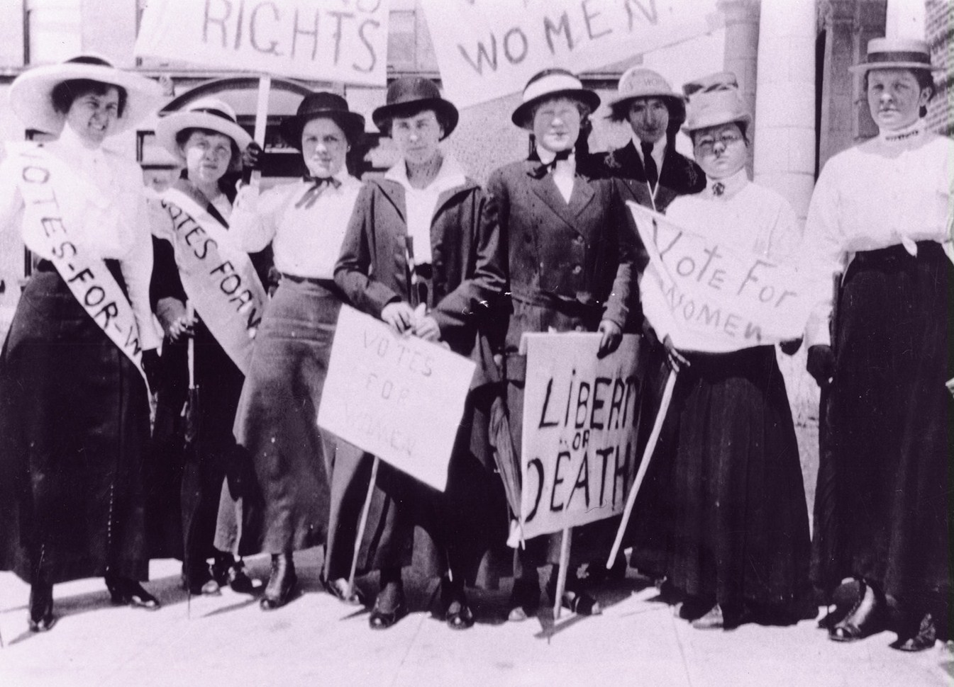

Slide 41
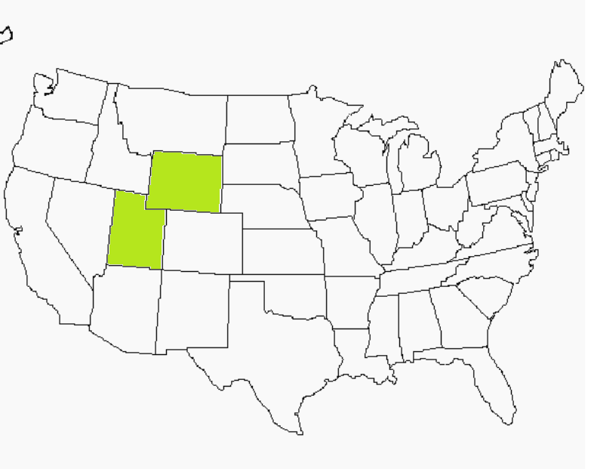

Slide 42
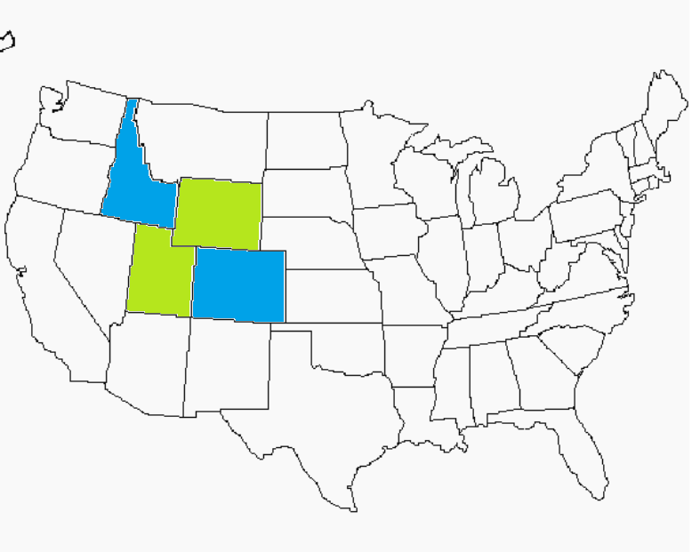

Slide 43
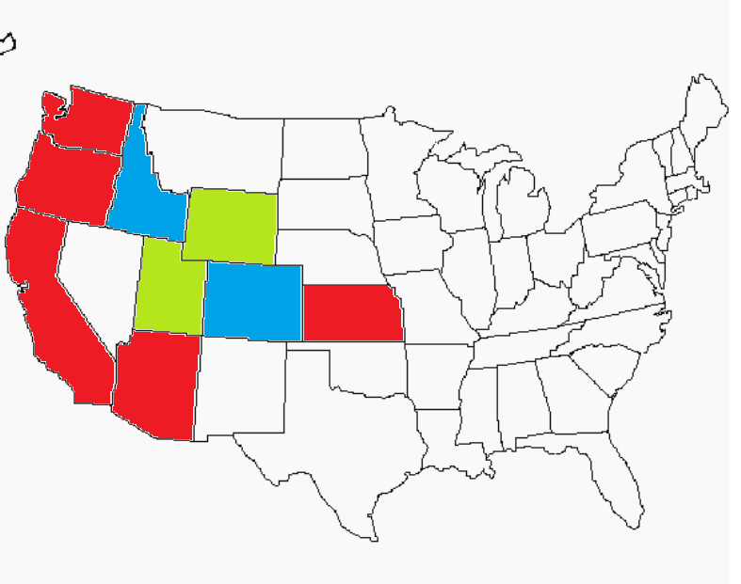

Slide 44


Slide 45
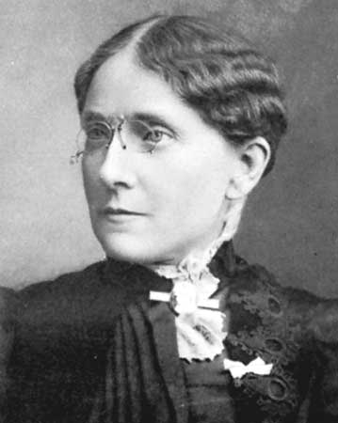
Notes:
Frances willard

Slide 46
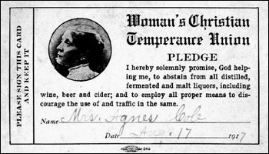

Slide 47
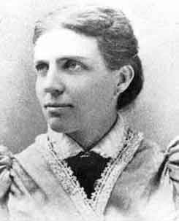
Notes:
Belle mansfield—iowa, 1869

Slide 48
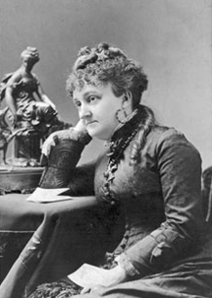
Notes:
Myra bradwell--illinois

Slide 49
Bradwell v. Illinois (1873)—Bradley, concurring
The civil law, as well as nature herself, has always recognized a wide difference in the respective spheres and destinies of man and woman. Man is, or should be, woman's protector and defender. The natural and proper timidity and delicacy which belongs to the female sex evidently unfits it for many of the occupations of civil life. The constitution of the family organization, which is founded in the divine ordinance, as well as in the nature of things, indicates the domestic sphere as that which properly belongs to the domain and functions of womanhood. The harmony, not to say identity, of interest and views which belong, or should belong, to the family institution is repugnant to the idea of a woman adopting a distinct and independent career from that of her husband. . . .
It is true that many women are unmarried and not affected by any of the duties, complications, and incapacities arising out of the married state, but these are exceptions to the general rule. The paramount destiny and mission of woman are to fulfil the noble and benign offices of wife and mother. This is the law of the Creator. And the rules of civil society must be adapted to the general constitution of things, and cannot be based upon exceptional cases.

Slide 50


Slide 51


Slide 52


Slide 53
Downes v. Bidwell (1901) [Insular Cases]
Choice in some cases, the natural gravitation of small bodies towards large ones in others, the result of a successful war in still others, may bring about conditions which would render the annexation of distant possessions desirable. If those possessions are inhabited by alien races, differing from us in religion, customs, laws, methods of taxation, and modes of thought, the administration of government and justice, according to Anglo-Saxon principles, may for a time be impossible; and the question at once arises whether large concessions ought not to be made for a time, that ultimately our own theories may be carried out, and the blessings of a free government under the Constitution extended to them. We decline to hold that there is anything in the Constitution to forbid such action.

Slide 54
Downes —Harlan dissent
It will be an evil day for American liberty if the theory of a government outside of the supreme law of the land finds lodgment in our constitutional jurisprudence. No higher duty rests upon this court than to exert its full authority to prevent all violation of the principles of the Constitution.
Again, it is said that Congress has assumed, in its past history, that the Constitution goes into territories acquired by purchase or conquest only when and as it shall so direct, and we are informed of the liberality of Congress in legislating the Constitution into all our contiguous territories. This is a view of the Constitution that may well cause surprise, if not alarm. Congress, as I have observed, has no existence except by virtue of the Constitution. It is the creature of the Constitution. It has no powers which that instrument has not granted, expressly or by necessary implication. I confess that I cannot grasp the thought that Congress, which lives and moves and has its being in the Constitution, and is consequently the mere creature of that instrument, can, at its pleasure, legislate or exclude its creator from territories which were acquired only by authority of the Constitution.

Slide 55
Dorr v. United States (1904)
If the right to trial by jury were a fundamental right which goes wherever the jurisdiction of the United States extends, or if Congress, in framing laws for outlying territory belonging to the United States, was obliged to establish that system by affirmative legislation, it would follow that, no matter what the needs or capacities of the people, trial by jury, and in no other way, must be forthwith established, although the result may be to work injustice and provoke disturbance, rather than to aid the orderly administration of justice. If the United States, impelled by its duty or advantage, shall acquire territory people by savages, and of which it may dispose or not hold for ultimate admission to statehood, if this doctrine is sound, it must establish there the trial by jury. To state such a proposition demonstrates the impossibility of carrying it into practice.

