Slide 1
Griswold v. Connecticut (1965)
The First Amendment has a penumbra where privacy is protected from governmental intrusion. In like context, we have protected forms of "association" that are not political in the customary sense, but pertain to the social, legal, and economic benefit of the members . . .
Specific guarantees in the Bill of Rights have penumbras, formed by emanations from those guarantees that help give them life and substance. Various guarantees create zones of privacy. The right of association contained in the penumbra of the First Amendment is one, as we have seen. The Third Amendment, in its prohibition against the quartering of soldiers "in any house" in time of peace without the consent of the owner, is another facet of that privacy. The Fourth Amendment explicitly affirms the "right of the people to be secure in their persons, houses, papers, and effects, against unreasonable searches and seizures." The Fifth Amendment, in its Self-Incrimination Clause, enables the citizen to create a zone of privacy which government may not force him to surrender to his detriment. The Ninth Amendment provides: "The enumeration in the Constitution, of certain rights, shall not be construed to deny or disparage others retained by the people."

Slide 2
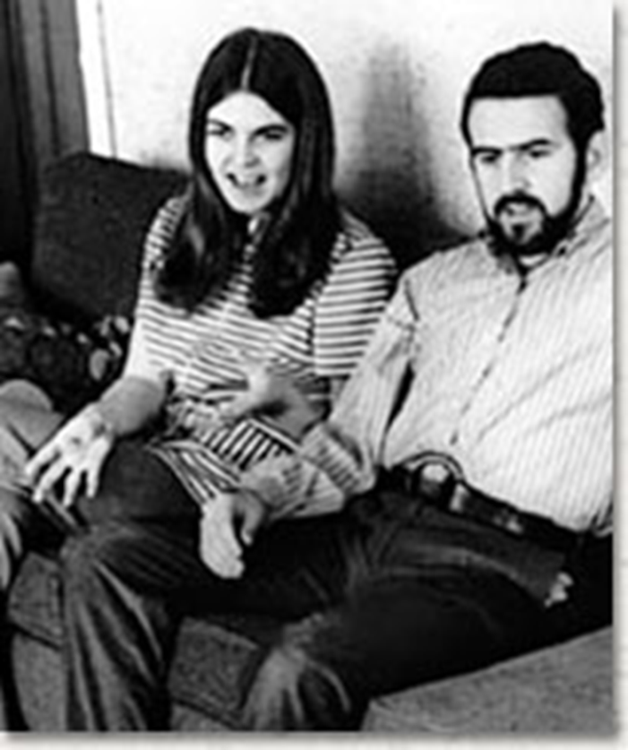
Frontiero v. Richardson (1973)
At the outset, appellants contend that classifications based upon sex, like classifications based upon race, alienage, and national origin, are inherently suspect, and must therefore be subjected to close judicial scrutiny. We agree.

Slide 3
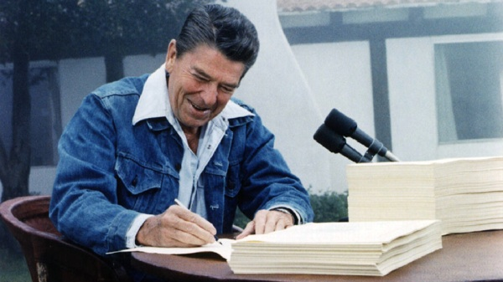
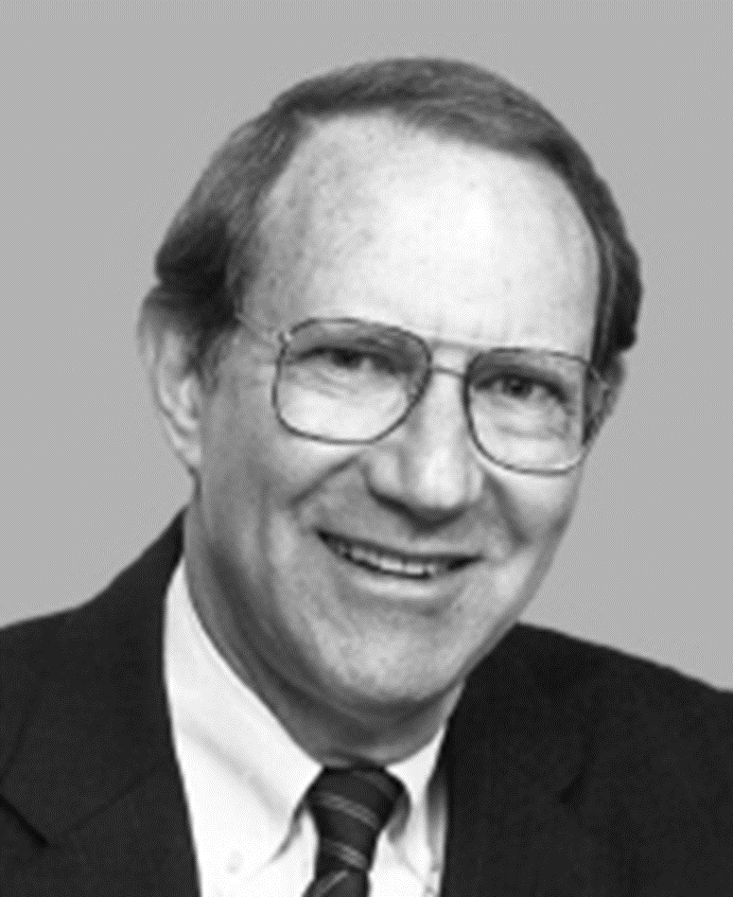
Notes:
Rr signing

Slide 4
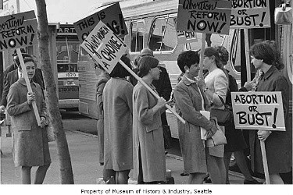
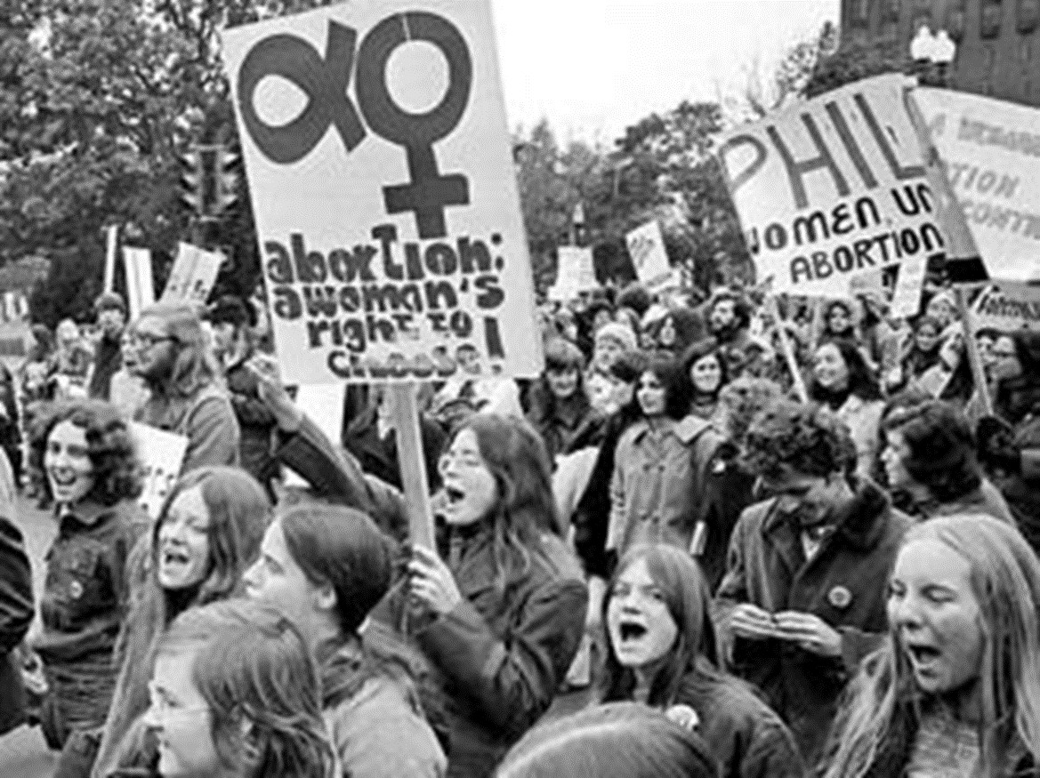
Notes:
washington

Slide 5

Michael Long (chairman, NYS Conservative Party):
We didn't really gear up over it because we didn't think it would pass. It came rather fast, and it even took the church by surprise, because their main concern was the aid for schools. I remember a lot of us being kind of angry at the Cardinal [Terence Cooke] and the bishops for not doing more, that if they had all gone to Albany, it would have changed the outcome.

Slide 6
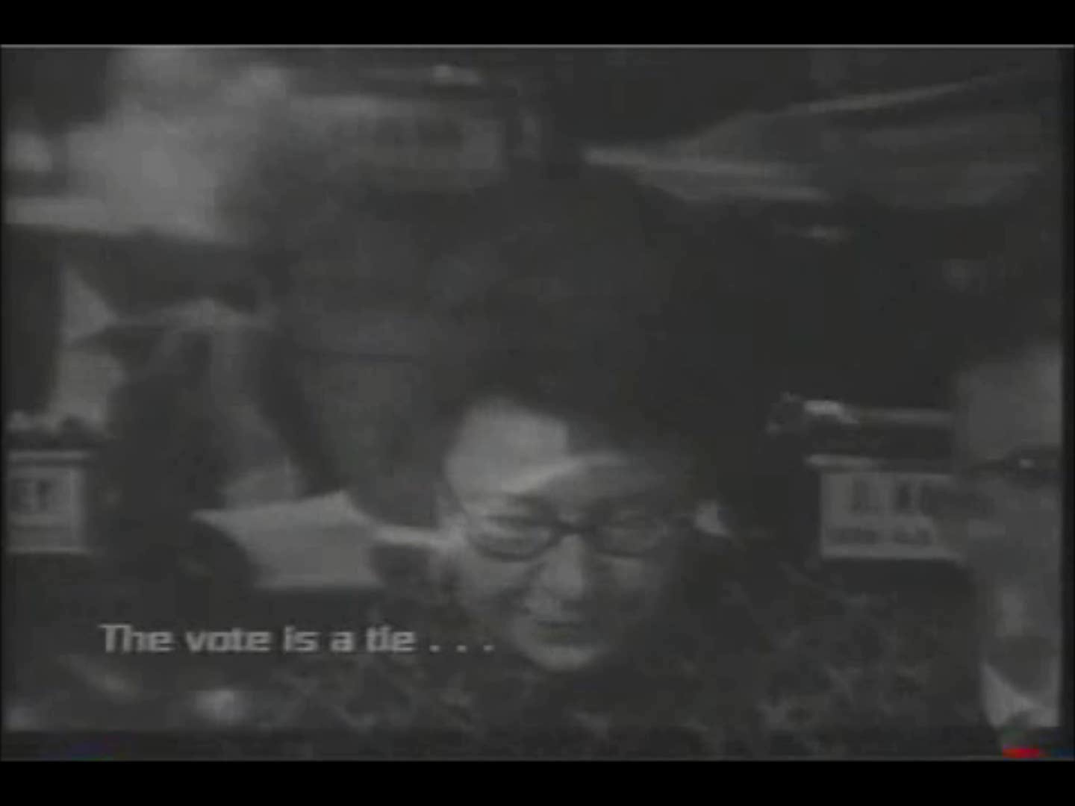

Slide 7
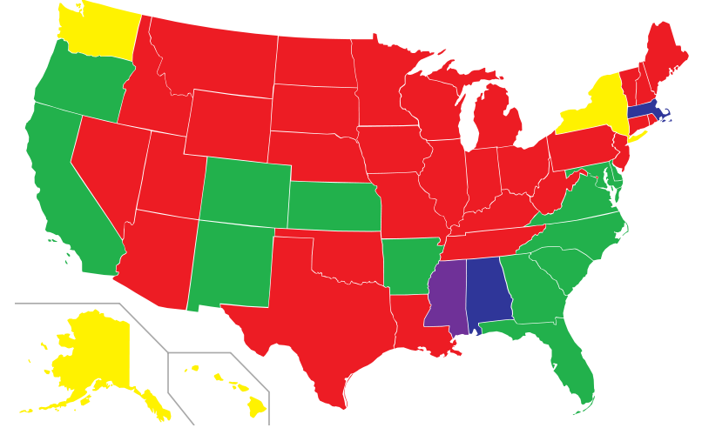
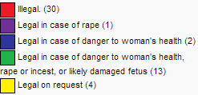
State Abortion Laws, Pre-Roe v. Wade

Slide 8
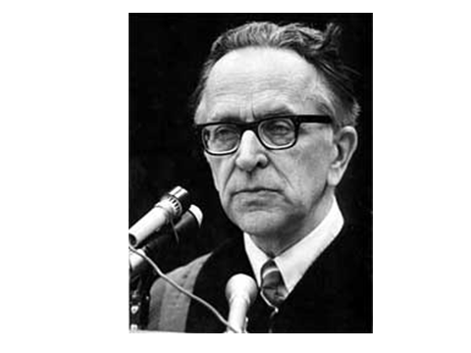

Slide 9
Roe v. Wade —White dissent
I find nothing in the language or history of the Constitution to support the Court's judgment. The Court simply fashions and announces a new constitutional right for pregnant women and, with scarcely any reason or authority for its action, invests that right with sufficient substance to override most existing state abortion statutes. The upshot is that the people and the legislatures of the 50 States are constitutionally disentitled to weigh the relative importance of the continued existence and development of the fetus, on the one hand, against a spectrum of possible impacts on the woman, on the other hand. As an exercise of raw judicial power, the Court perhaps has authority to do what it does today; but, in my view, its judgment is an improvident and extravagant exercise of the power of judicial review that the Constitution extends to this Court

Slide 10
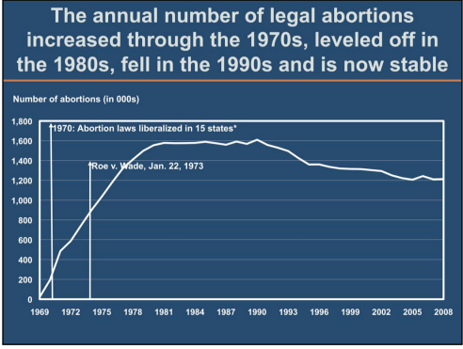
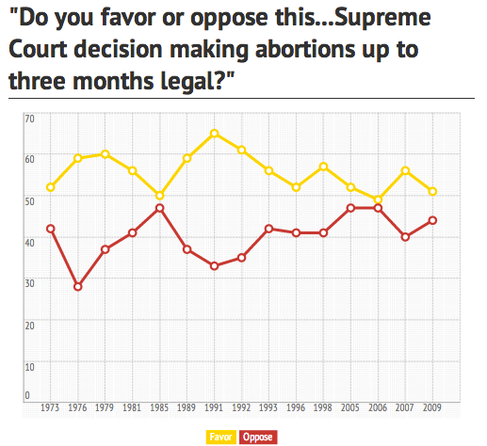

Slide 11

Equality of rights under the law shall not be denied or abridged by the United States or by any State on account of sex.

Slide 12
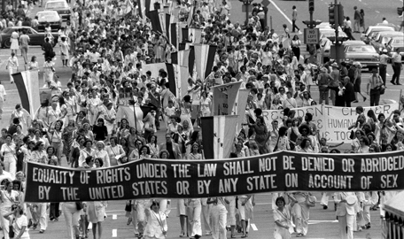

Slide 13
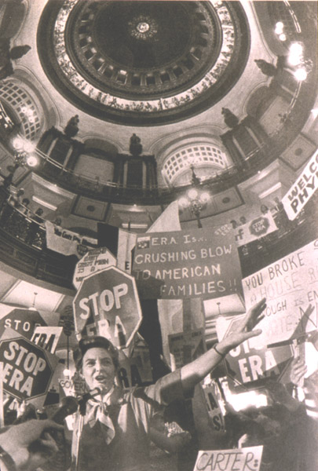

Slide 14



Slide 15


Slide 16


Slide 17
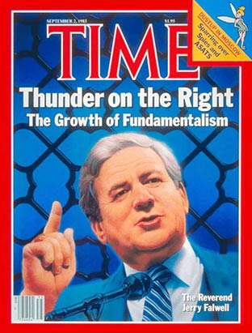

Slide 18
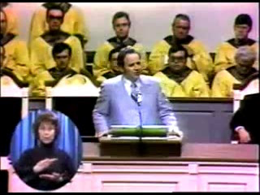

Slide 19
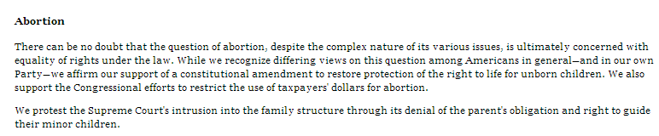
1980 Republican Platform

Slide 20
Webster v. Reproductive Health Services of Missouri (1989)
Blackmun dissent
Today, Roe v. Wade, and the fundamental constitutional right of women to decide whether to terminate a pregnancy, survive, but are not secure. Although the Court extricates itself from this case without making a single, even incremental, change in the law of abortion, the plurality and JUSTICE SCALIA would overrule Roe (the first silently, the other explicitly) and would return to the States virtually unfettered authority to control the quintessentially intimate, personal, and life-directing decision whether to carry a fetus to term. Although today, no less than yesterday, the Constitution and the decisions of this Court prohibit a State from enacting laws that inhibit women from the meaningful exercise of that right, a plurality of this Court implicitly invites every state legislature to enact more and more restrictive abortion regulations in order to provoke more and more test cases, in the hope that, sometime down the line, the Court will return the law of procreative freedom to the severe limitations that generally prevailed in this country before January 22, 1973. Never in my memory has a plurality announced a judgment of this Court that so foments disregard for the law and for our standing decisions.

Slide 21
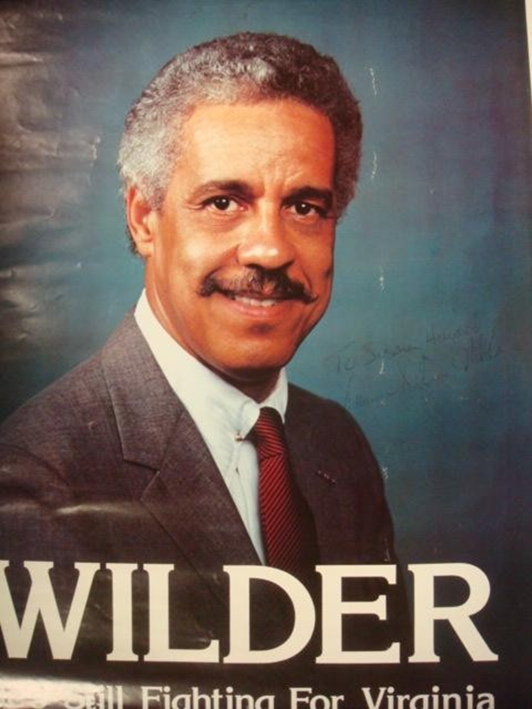
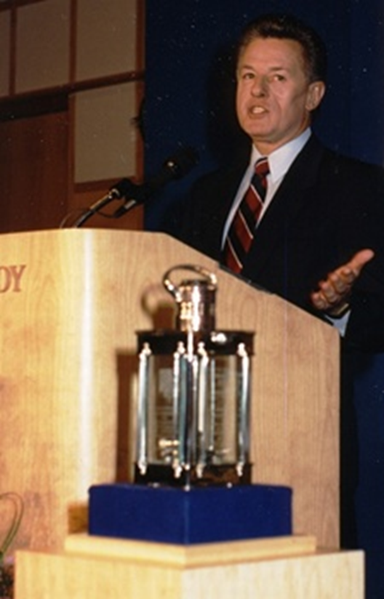

Slide 22
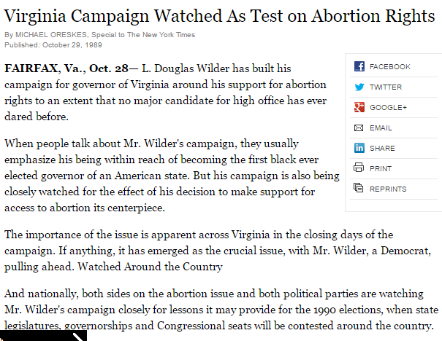

Slide 23










Slide 24

Justice Sandra Day O'Connor: Now, the provision does not require notification to a father who is not the husband, I take it--
Mr. Ernest Preate: That's correct, Justice O'Connor.
Justice O'Connor: --or notice if the woman is unmarried.
Mr. Preate: It only applies to married women.
Justice O'Connor: So what's the interest, to try to preserve the marriage?
Mr. Preate: There are several interests.
The interest, of course, in protecting the life of the unborn child.
Justice O'Connor: Well then, why not require notice to all fathers?
It's a curious sort of a provision, isn't it?
Mr. Preate: It is that, but the legislature has made the judgment that it wanted its statute to apply in this specific instance because it wanted to further the integrity of marriages.
Justice O'Connor: Would you say that the State could similarly require a woman to notify anyone with whom she had intercourse that she planned to use some means of birth control after the intercourse that operates, let's say, as an abortifacient?
Mr. Preate: Well--
Justice O'Connor: Could the State do that?
I mean, it would be the same State interest, I suppose.
[Break.]
Justice O'Connor: Well, we're talking about the provision for notification in this case under the statute to the husband, and I'm just asking whether a different type of State regulation would have to be upheld under your standard.
Mr. Preate: Well, if the State had posited its interest as protecting the life of the unborn, then utilizing the rational basis standard, then I would submit that it could legitimately require that kind of notification to all people.

Slide 25
Planned Parenthood v. Casey (1992)
Liberty finds no refuge in a jurisprudence of doubt. Yet 19 years after our holding that the Constitution protects a woman's right to terminate her pregnancy in its early stages, Roe v. Wade, that definition of liberty is still questioned…
Numerous forms of state regulation might have the incidental effect of increasing the cost or decreasing the availability of medical care, whether for abortion or any other medical procedure. The fact that a law which serves a valid purpose, one not designed to strike at the right itself, has the incidental effect of making it more difficult or more expensive to procure an abortion cannot be enough to invalidate it. Only where state regulation imposes an undue burden on a woman's ability to make this decision does the power of the State reach into the heart of the liberty protected by the Due Process Clause.

Slide 26
Planned Parenthood v. Casey (1992)—Scalia dissent
There is a poignant aspect to today’s opinion. Its length, and what might be called its epic tone, suggest that its authors believe they are bringing to an end a troublesome era in the history of our Nation and of our Court. “It is the dimension” of authority, they say, to “cal[l] the contending sides of national controversy to end their national division by accepting a common mandate rooted in the Constitution.”
There comes vividly to mind a portrait by Emanuel Leutze that hangs in the Harvard Law School: Roger Brooke Taney, painted in 1859, the 82nd year of his life, the 24th of his Chief Justiceship, the second after his opinion in Dred Scott…There seems to be on his face, and in his deep set eyes, an expression of profound sadness and disillusionment. Perhaps he always looked that way, even when dwelling upon the happiest of thoughts. But those of us who know how the lustre of his great Chief Justiceship came to be eclipsed by Dred Scott cannot help believing that he had that case--its already apparent consequences for the Court, and its soon to be played out consequences for the Nation--burning on his mind. I expect that two years earlier he, too, had thought himself “call[ing] the contending sides of national controversy to end their national division by accepting a common mandate rooted in the Constitution.”

Slide 27
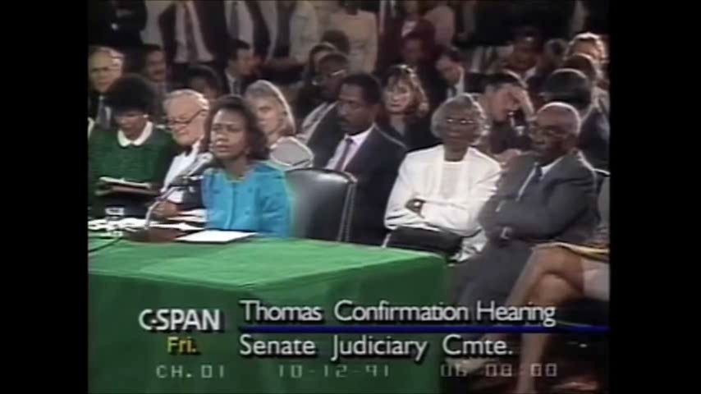

Slide 28
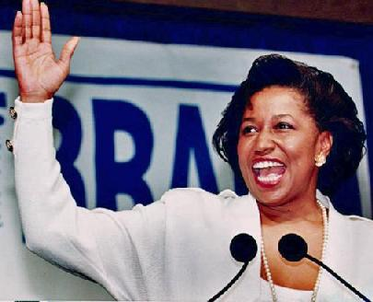

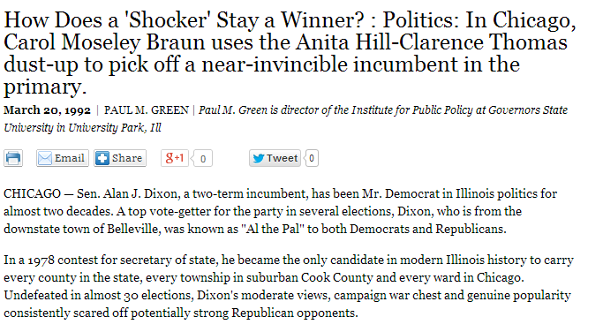

Slide 29


Slide 30
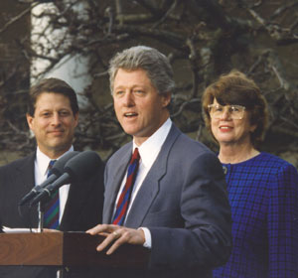

Slide 31
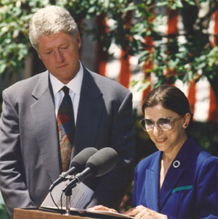

Slide 32
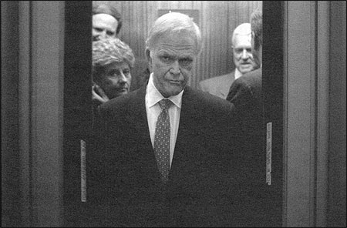

Slide 33


Slide 34
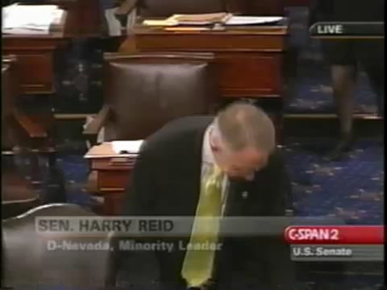

Slide 35
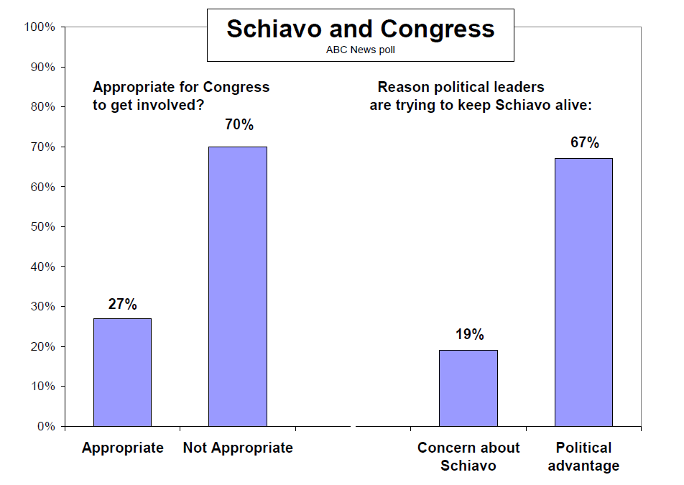

Slide 36
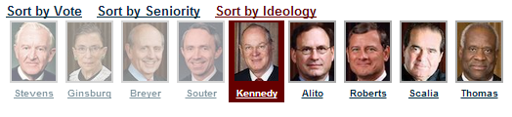
Gonzales v. Carhart (2007)
Whatever one’s views concerning the Casey joint opinion, it is evident a premise central to its conclusion—that the government has a legitimate and substantial interest in preserving and promoting fetal life—would be repudiated were the Court now to affirm the judgments of the Courts of Appeals [and overturn the NE law]…
The Act furthers the legitimate interest of the Government in protecting the life of the fetus that may become a child…
Respondents have not demonstrated that the Act, as a facial matter, is void for vagueness, or that it imposes an undue burden on a woman’s right to abortion based on its overbreadth or lack of a health exception.

Slide 37
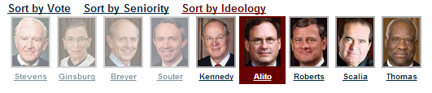
Ledbetter v. Goodyear Tire & Rubber (2007)—Ginsburg dissent
The Court’s insistence on immediate contest overlooks common characteristics of pay discrimination. Pay disparities often occur, as they did in Ledbetter’s case, in small increments; cause to suspect that discrimination is at work develops only over time. Comparative pay information, moreover, is often hidden from the employee’s view. Employers may keep under wraps the pay differentials maintained among supervisors, no less the reasons for those differentials…
This is not the first time the Court has ordered a cramped interpretation of Title VII, incompatible with the statute’s broad remedial purpose. Once again, the ball is in Congress’ court. As in 1991, the Legislature may act to correct this Court’s parsimonious reading of Title VII.

Slide 38
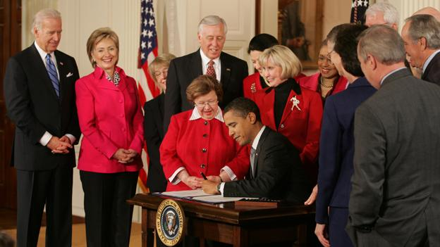

Slide 39
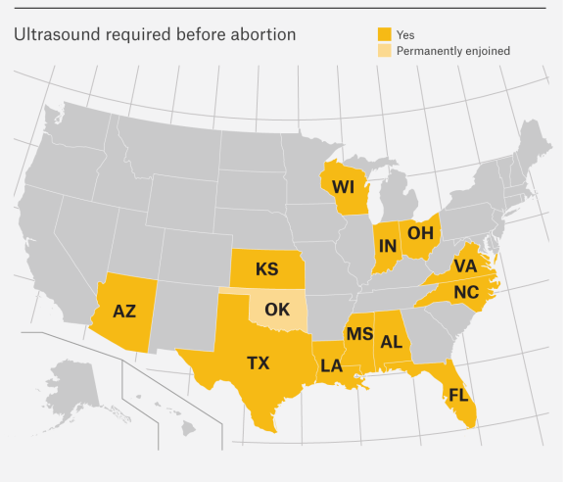
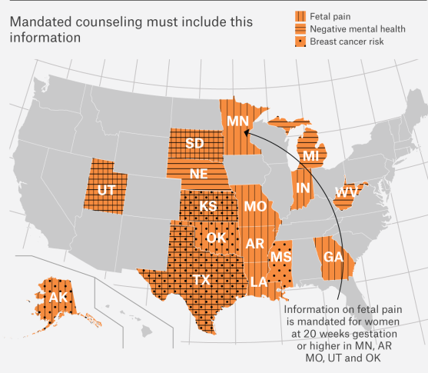

Slide 40
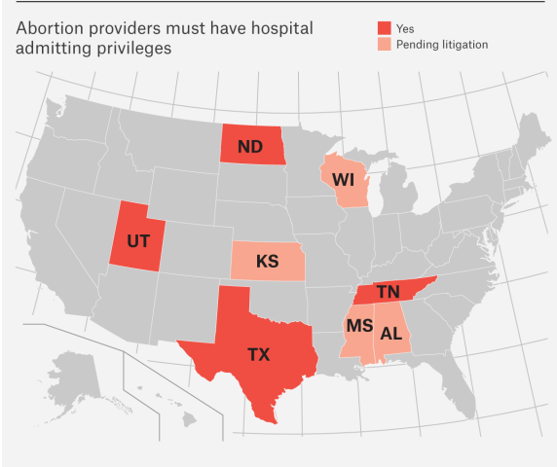
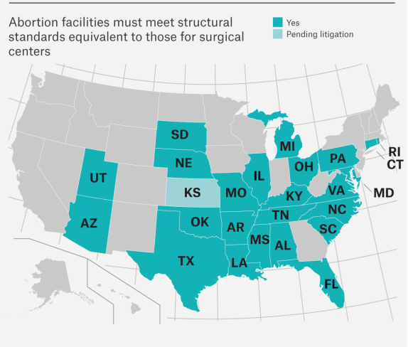

Slide 41
