Slide 1
U.S.-Morocco Treaty of Friendship (1786)
Whereas the United States of America in Congress assembled by their Commission bearing date the twelvth day of May One thousand Seven hundred and Eighty four thought proper to constitute John Adams, Benjamin Franklin and Thomas Jefferson their Ministers Plenipotentiary, giving to them or a Majority of them full Powers to confer, treat & negotiate with the Ambassador, Minister or Commissioner of His Majesty the Emperor of Morocco concerning a Treaty of Amity and Commerce…
This is a Treaty of Peace and Friendship…
This Treaty shall continue in full Force, with the help of God for Fifty Years.

Slide 2


Slide 3
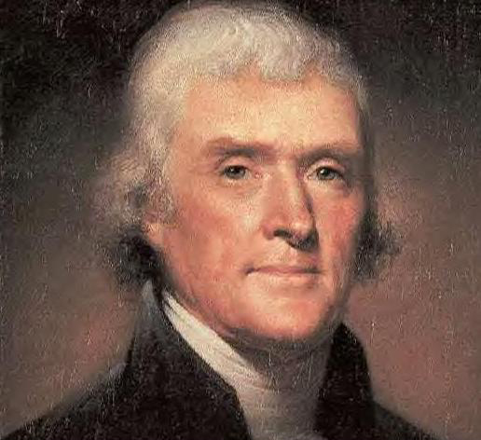
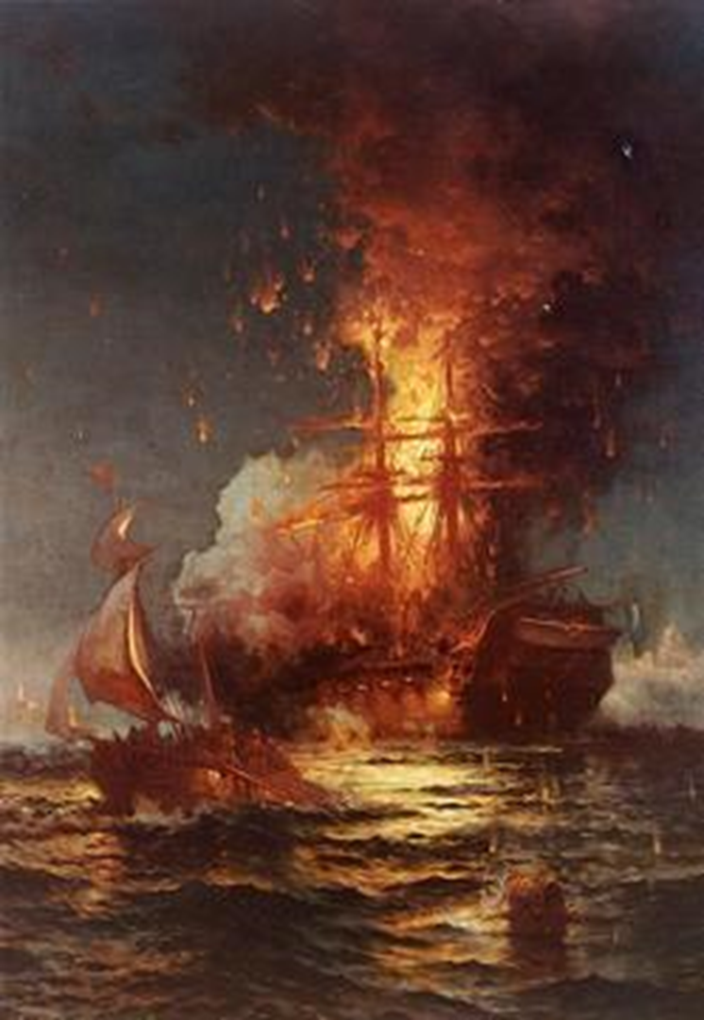

Slide 4
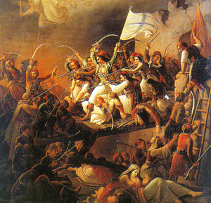

Slide 5
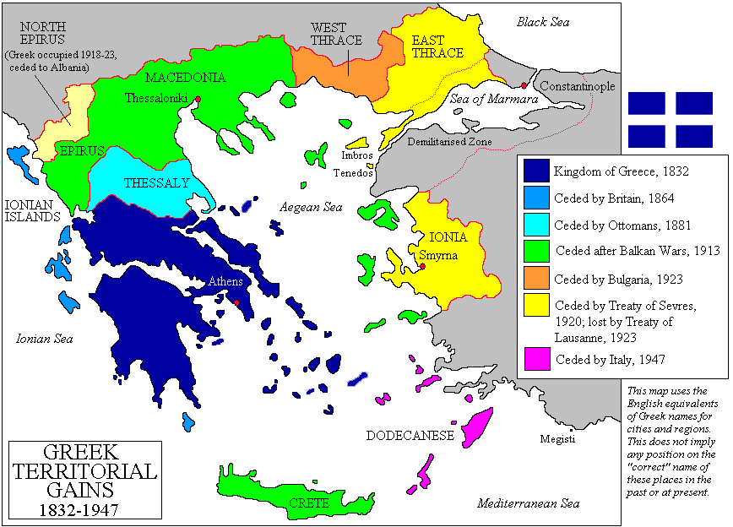

Slide 6


Slide 7
Monroe Doctrine (1823)
Of events in that quarter of the globe [Europe], with which we have so much intercourse and from which we derive our origin, we have always been anxious and interested spectators. The citizens of the United States cherish sentiments the most friendly in favor of the liberty and happiness of their fellow-men on that side of the Atlantic. In the wars of the European powers in matters relating to themselves we have never taken any part, nor does it comport with our policy to do so. It is only when our rights are invaded or seriously menaced that we resent injuries or make preparation for our defense. With the movements in this hemisphere we are of necessity more immediately connected, and by causes which must be obvious to all enlightened and impartial observers. The political system of the allied powers is essentially different in this respect from that of America. This difference proceeds from that which exists in their respective Governments; and to the defense of our own, which has been achieved by the loss of so much blood and treasure, and matured by the wisdom of their most enlightened citizens, and under which we have enjoyed unexampled felicity, this whole nation is devoted. We owe it, therefore, to candor and to the amicable relations existing between the United States and those powers to declare that we should consider any attempt on their part to extend their system to any portion of this hemisphere as dangerous to our peace and safety.

Slide 8
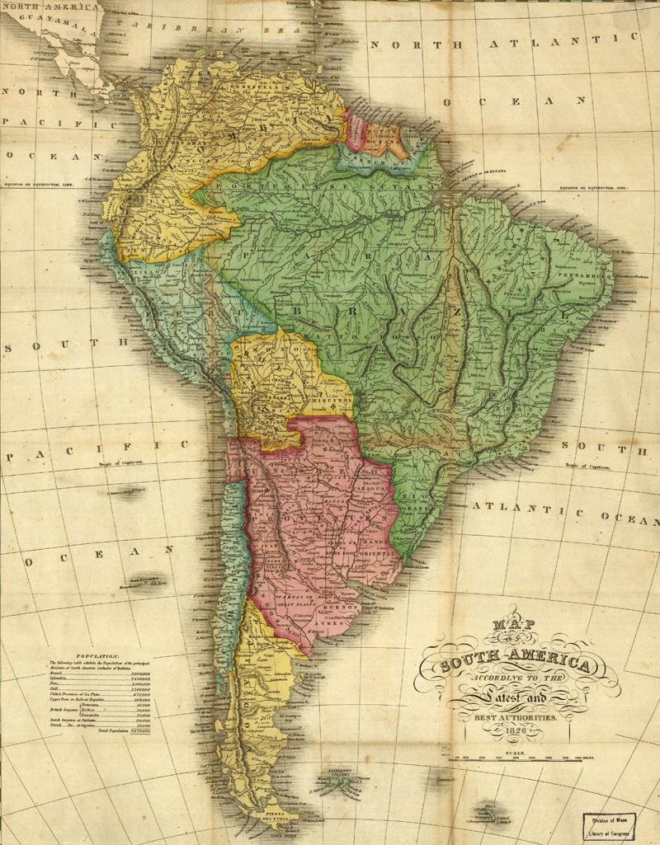

Slide 9
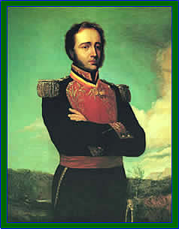

Slide 10

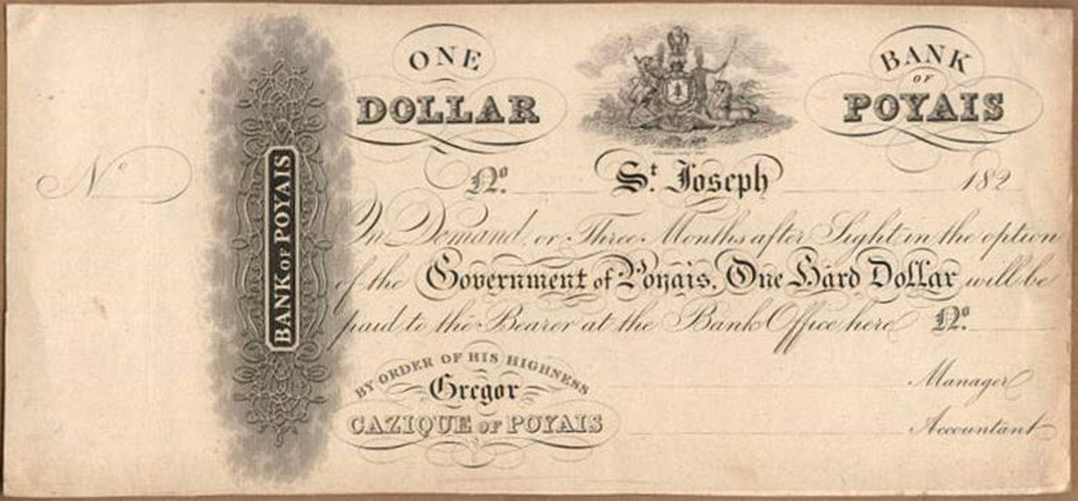

Slide 11
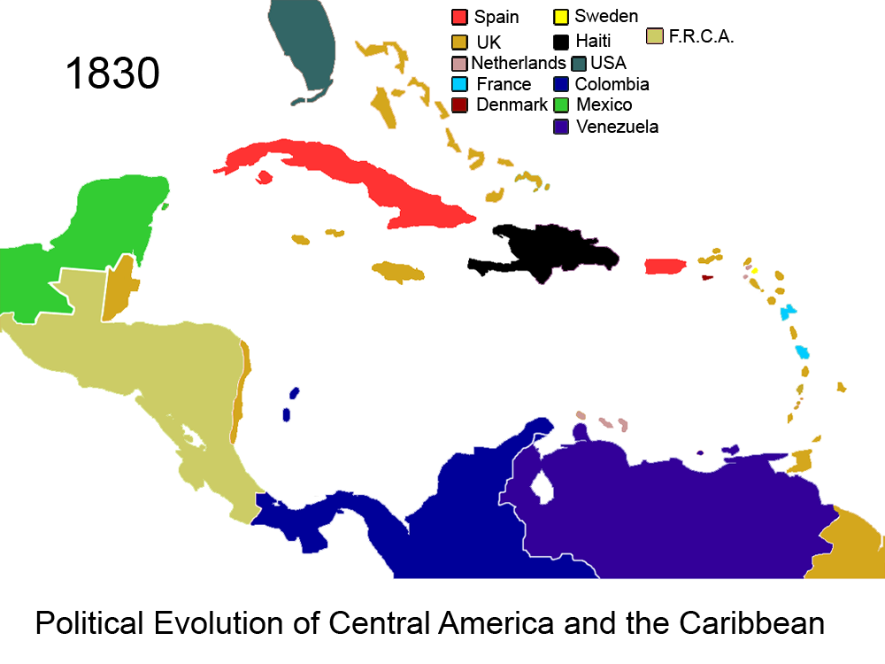

Slide 12
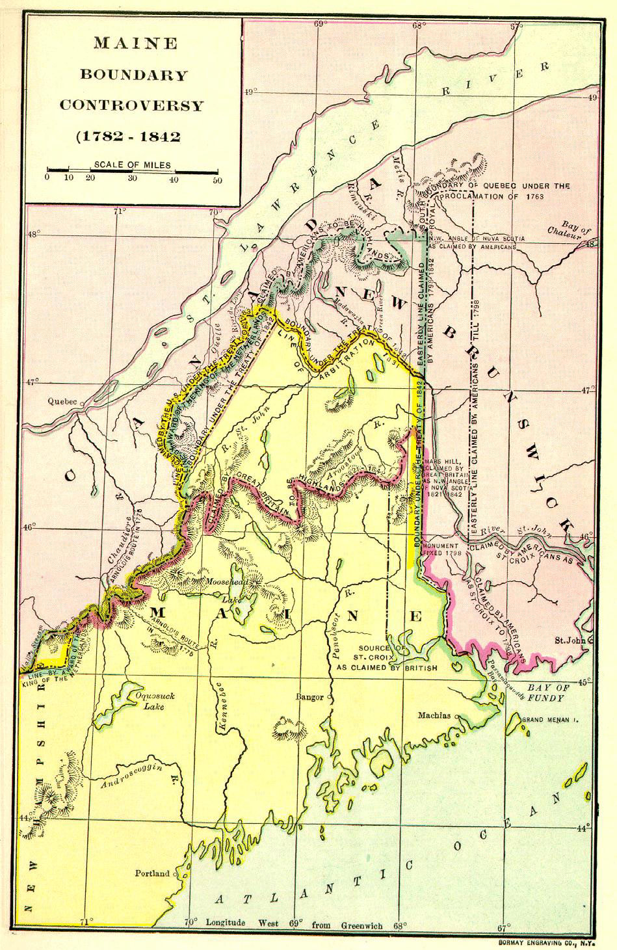

Slide 13
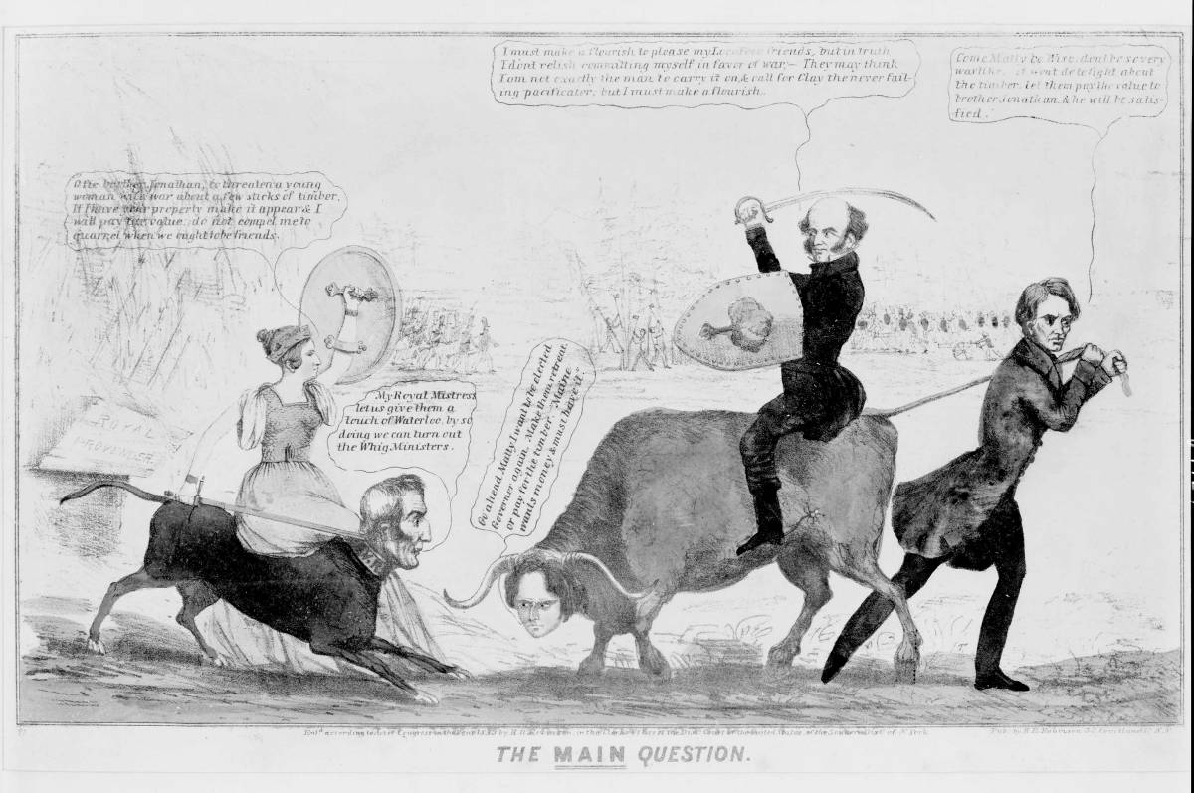

Slide 14
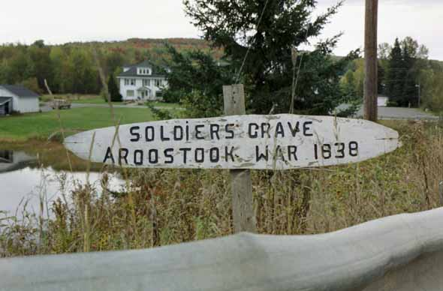

Slide 15
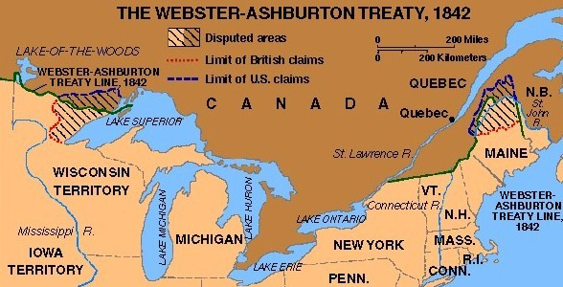

Slide 16
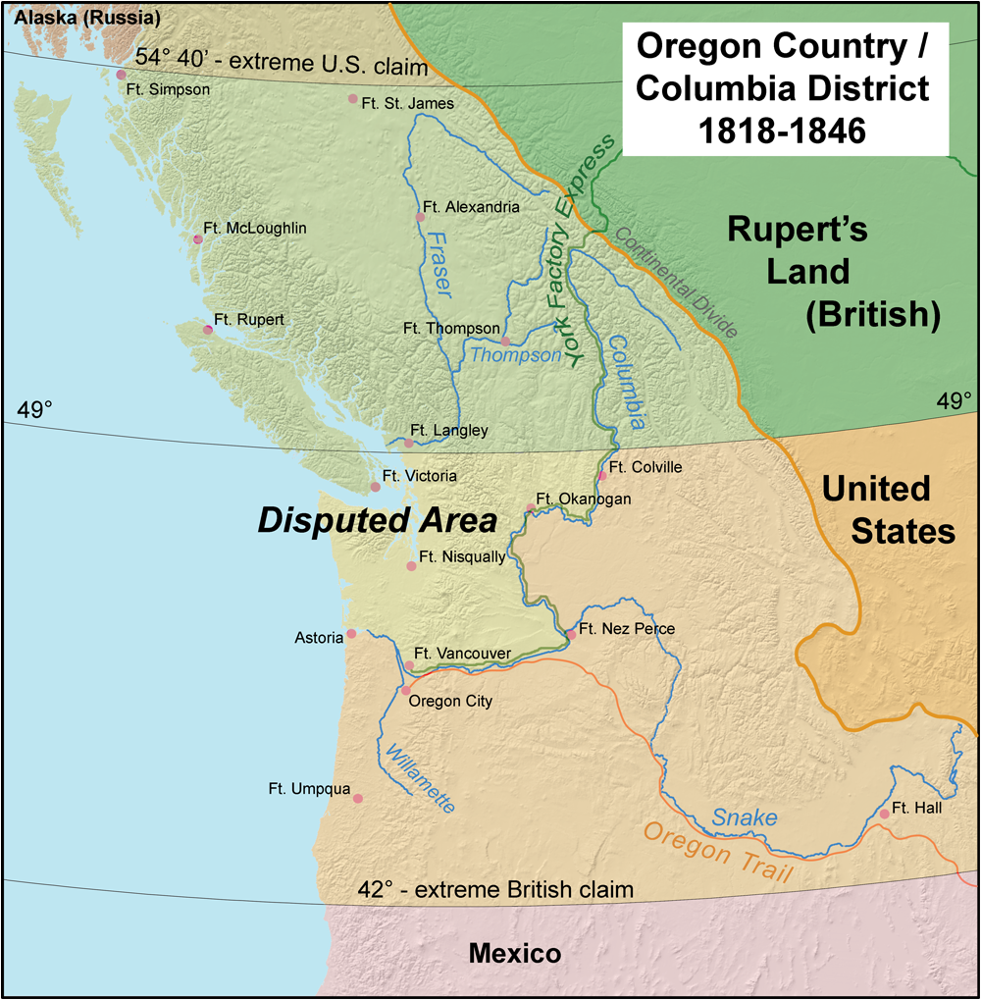

Slide 17
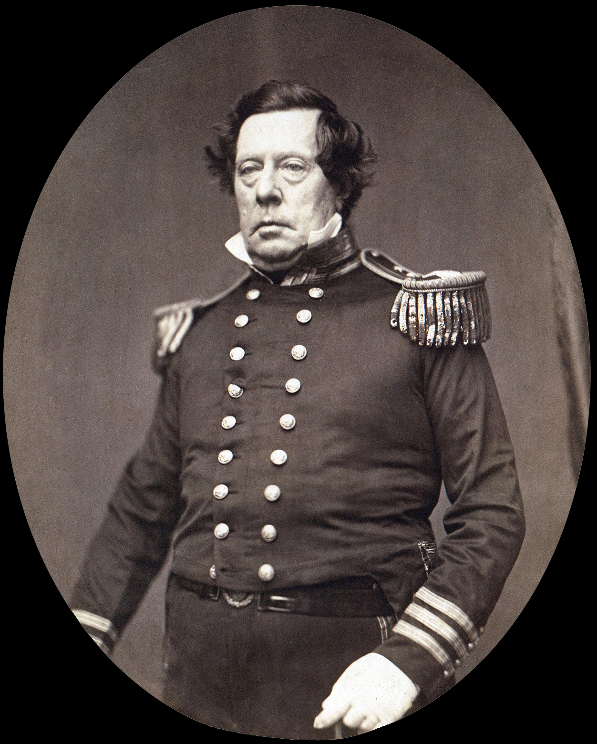

Slide 18
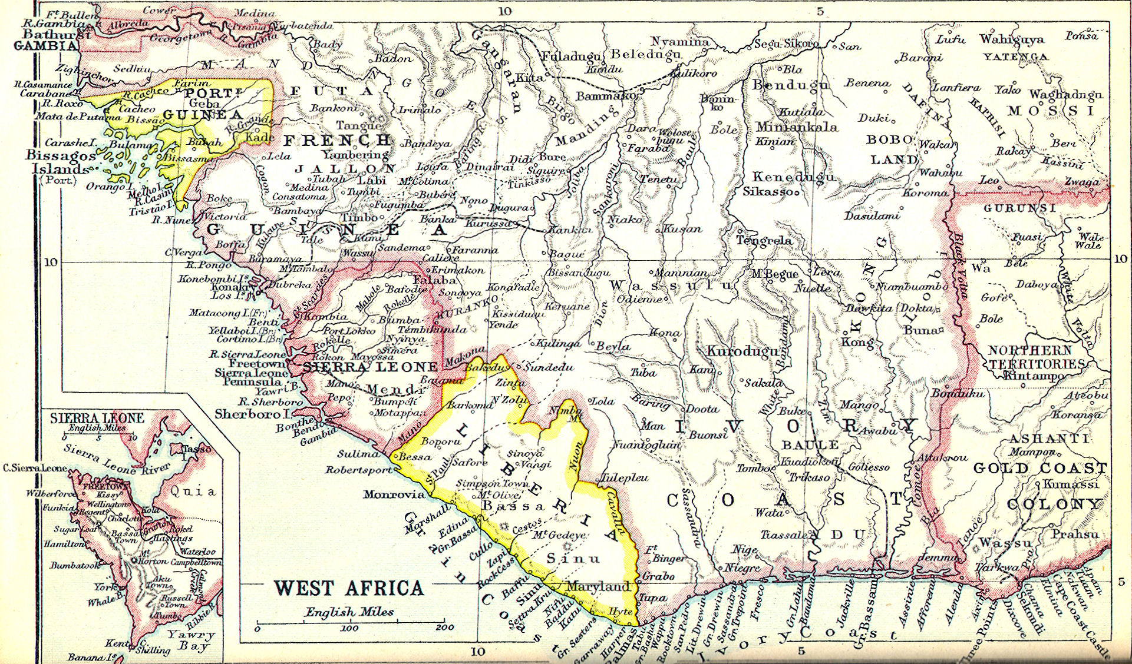

Slide 19
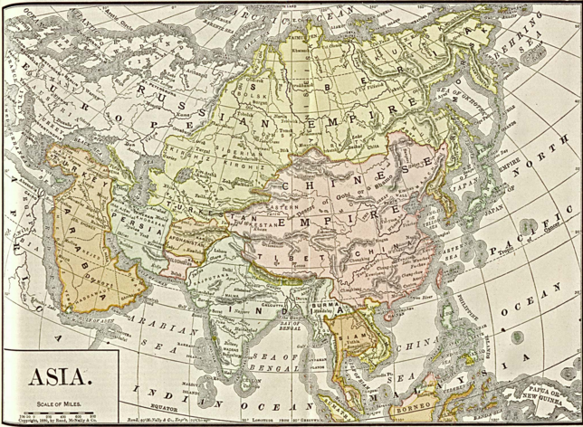

Slide 20
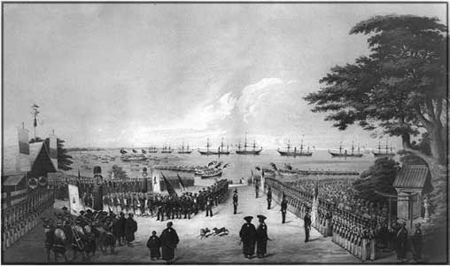

Slide 21
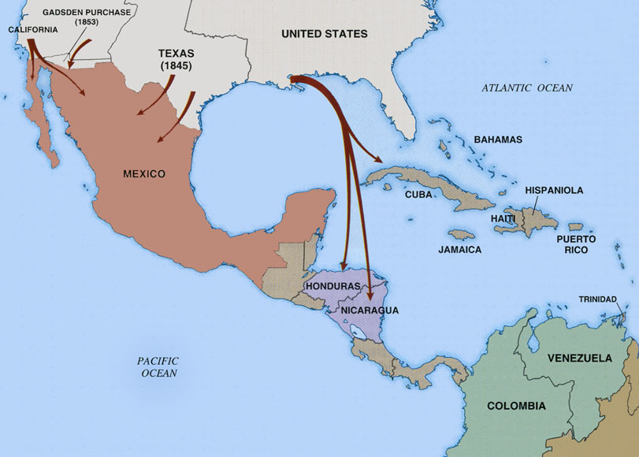

Slide 22
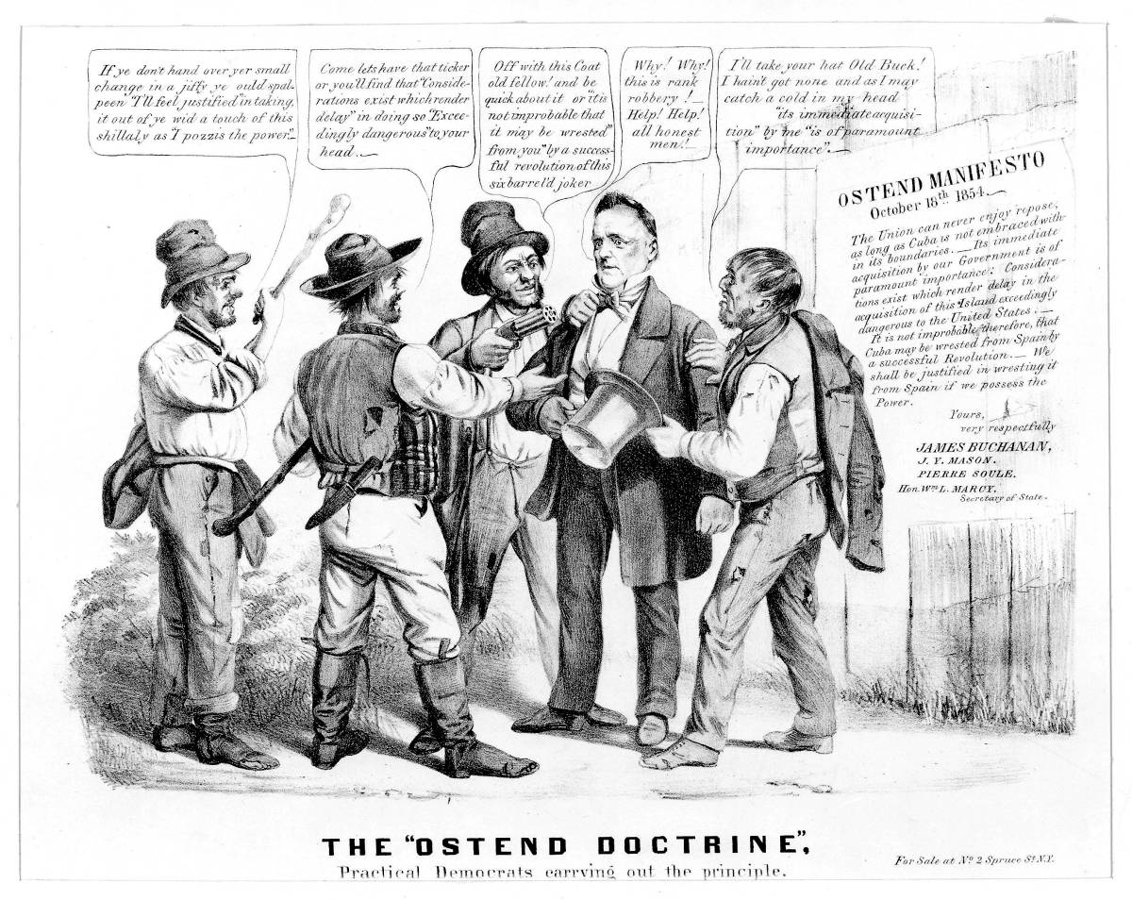

Slide 23
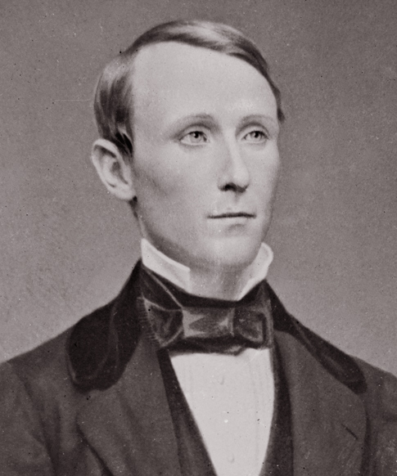

Slide 24
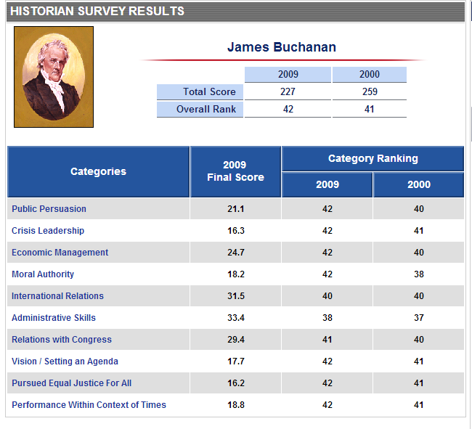

Slide 25
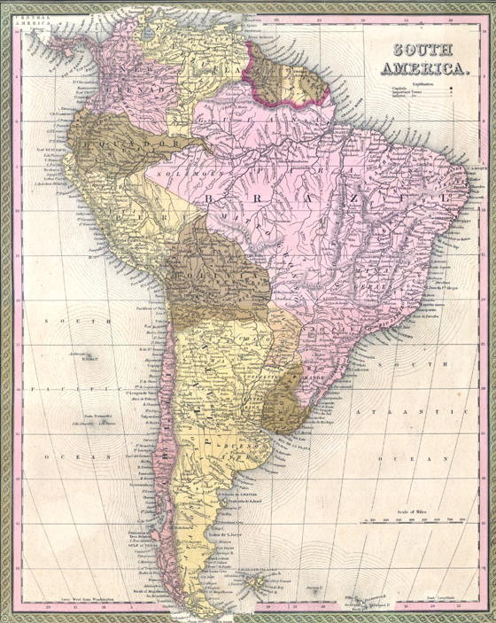

Slide 26
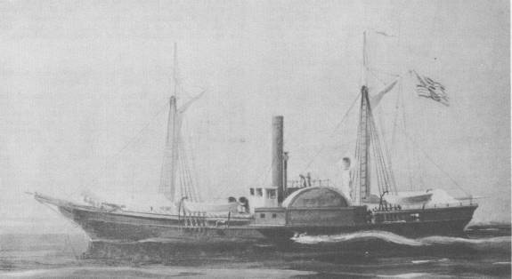
Notes:
Water witch

Slide 27

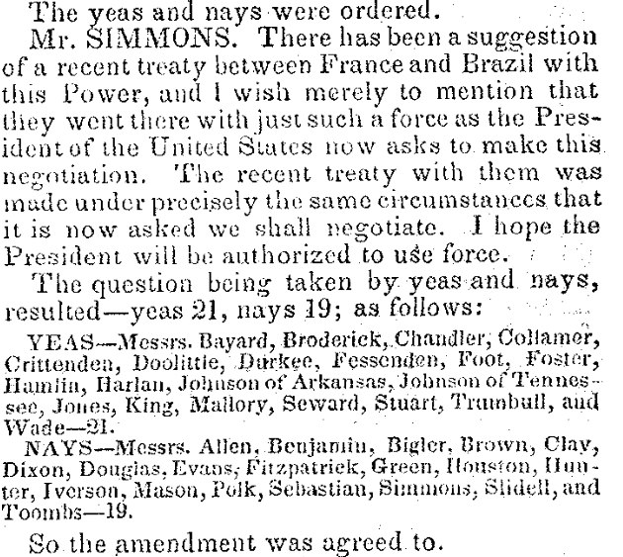

Slide 28
Buchanan message to Congress (Feb. 1859)
The republics south of the United States on this continent have unfortunately been frequently in a state of revolution and civil war ever since they achieved their independence . . . The Executive Governments of Great Britain, France, and other countries, possessing the war-making power, can promptly employ the necessary means to enforce immediate redress for similar outrages upon their subjects. Not so the Executive Government of the United States.
I therefore earnestly recommend to Congress, on whom the responsibility exclusively rests, to pass a law . . . conferring on the President the power to protect the lives and property of American citizens . . . The knowledge that such a law exists would of itself go far to prevent the outrages which it is intended to redress, and to render the employment of force unnecessary.
Such a grant of authority, thus limited in its extent, could in no just cause be regarded as a transfer of war-making power to the Executive, but only as an appropriate exercise of that power by the body to whom it exclusively belongs.

Slide 29
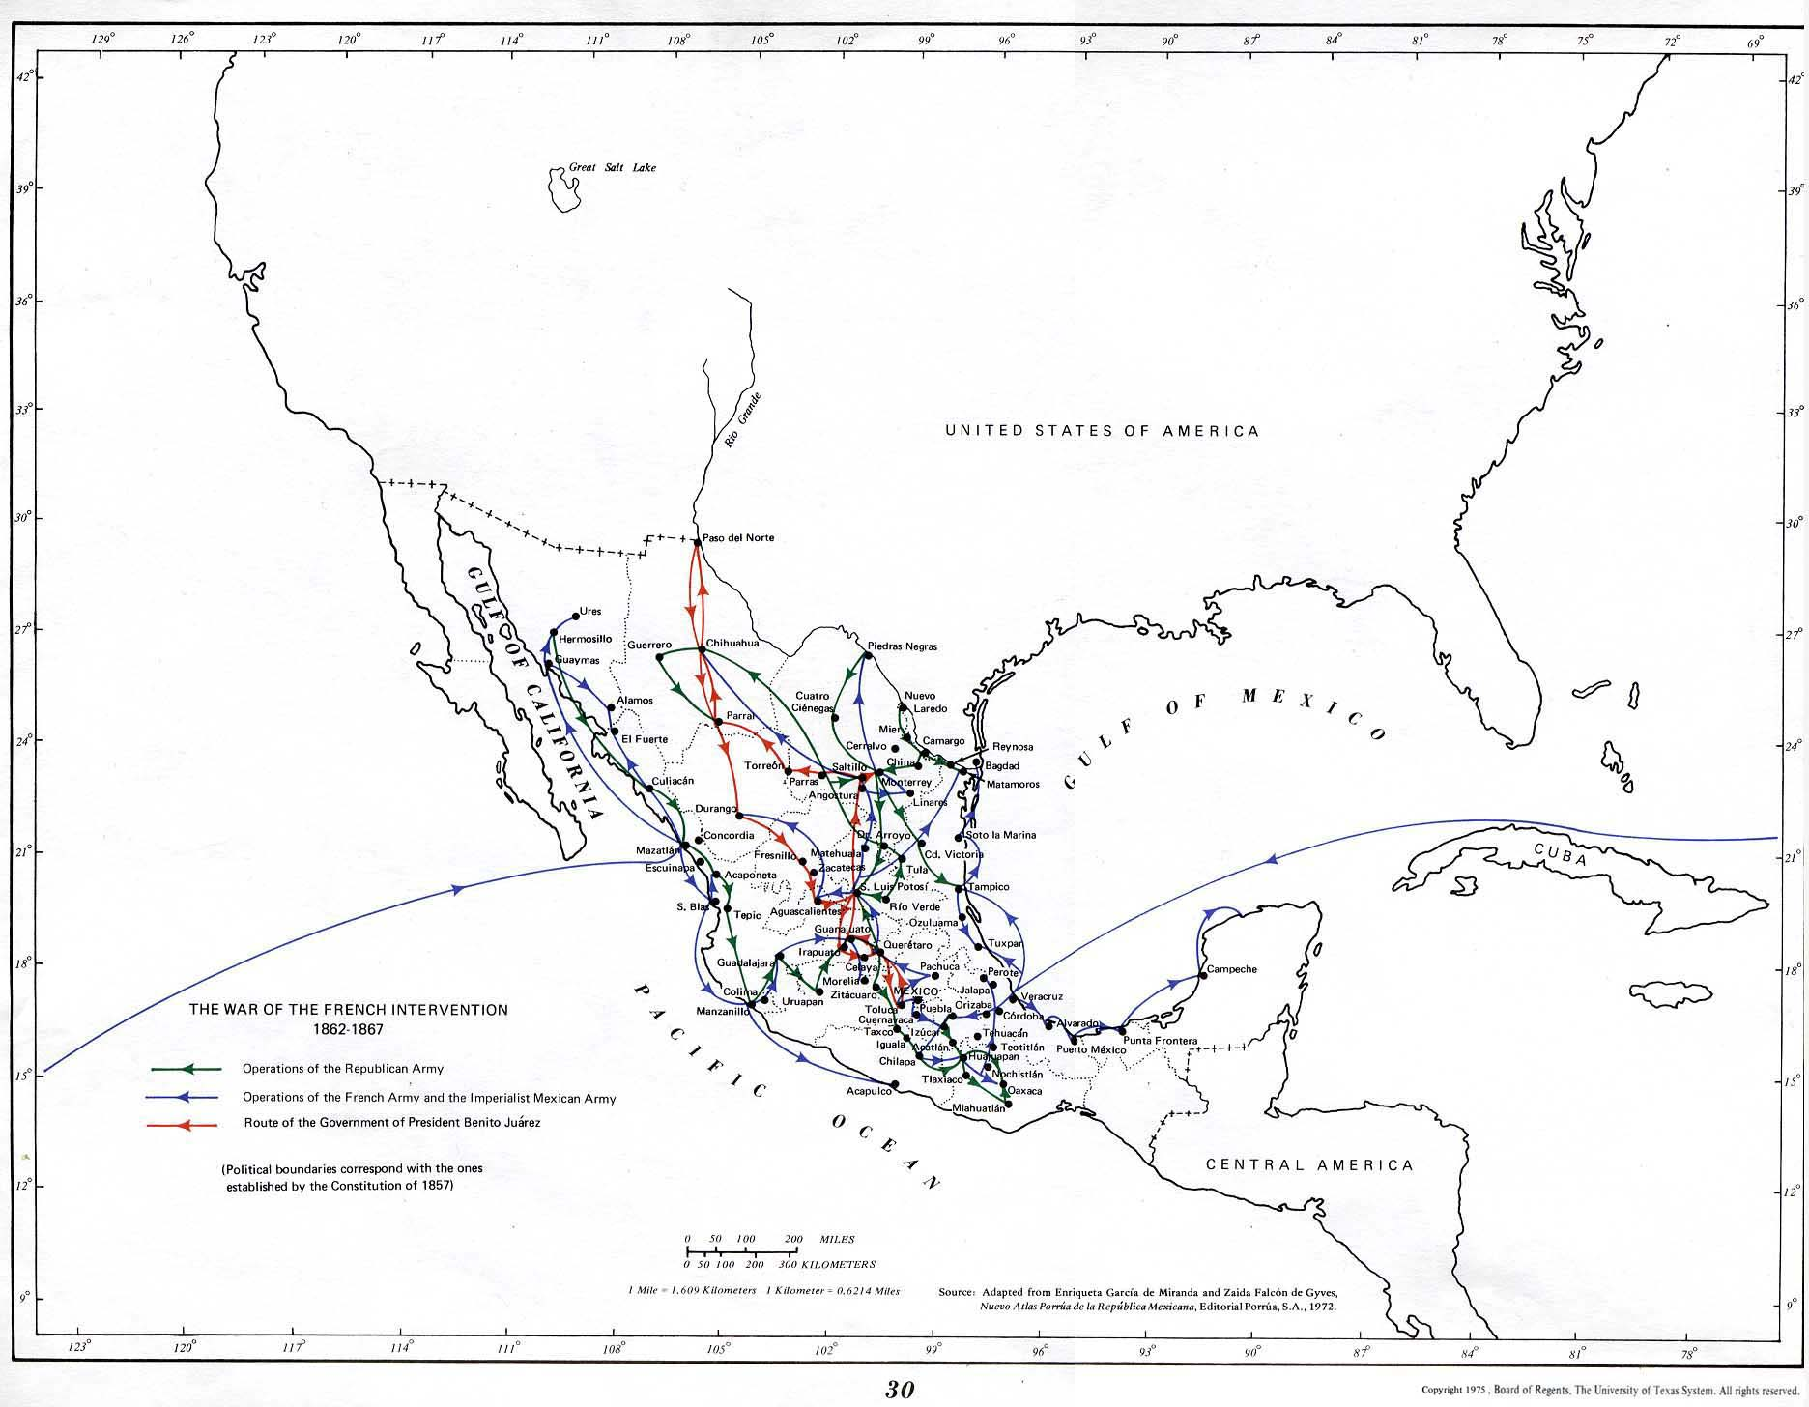

Slide 30
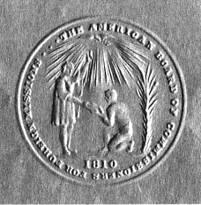
Notes:
ABCFM SEAL

Slide 31
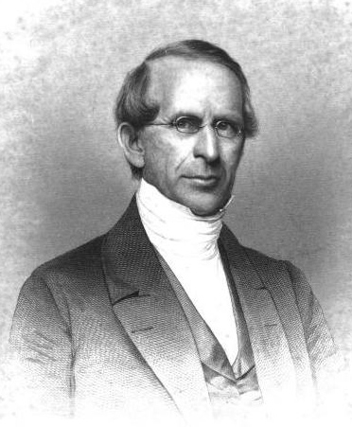
Notes:
Samuel worcester--abcfm

Slide 32
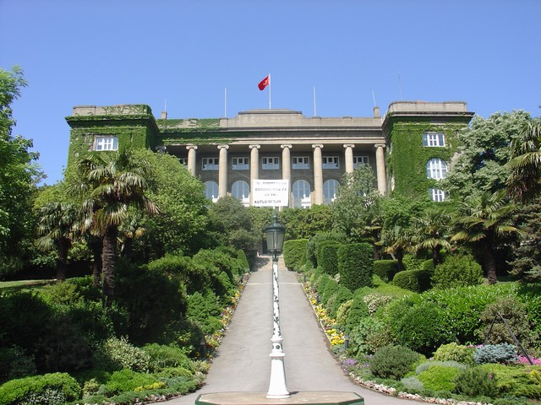
Notes:
Robert college, istanbul, oldest american school still in existence outside US

Slide 33
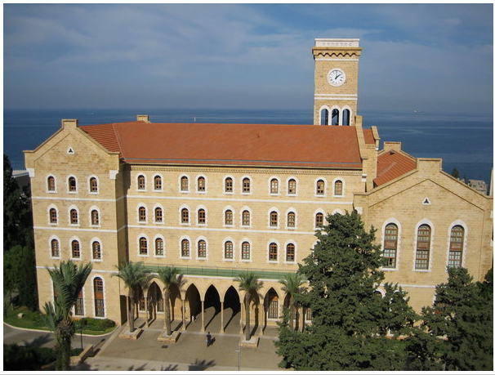
Notes:
Am univ beirut

Slide 34
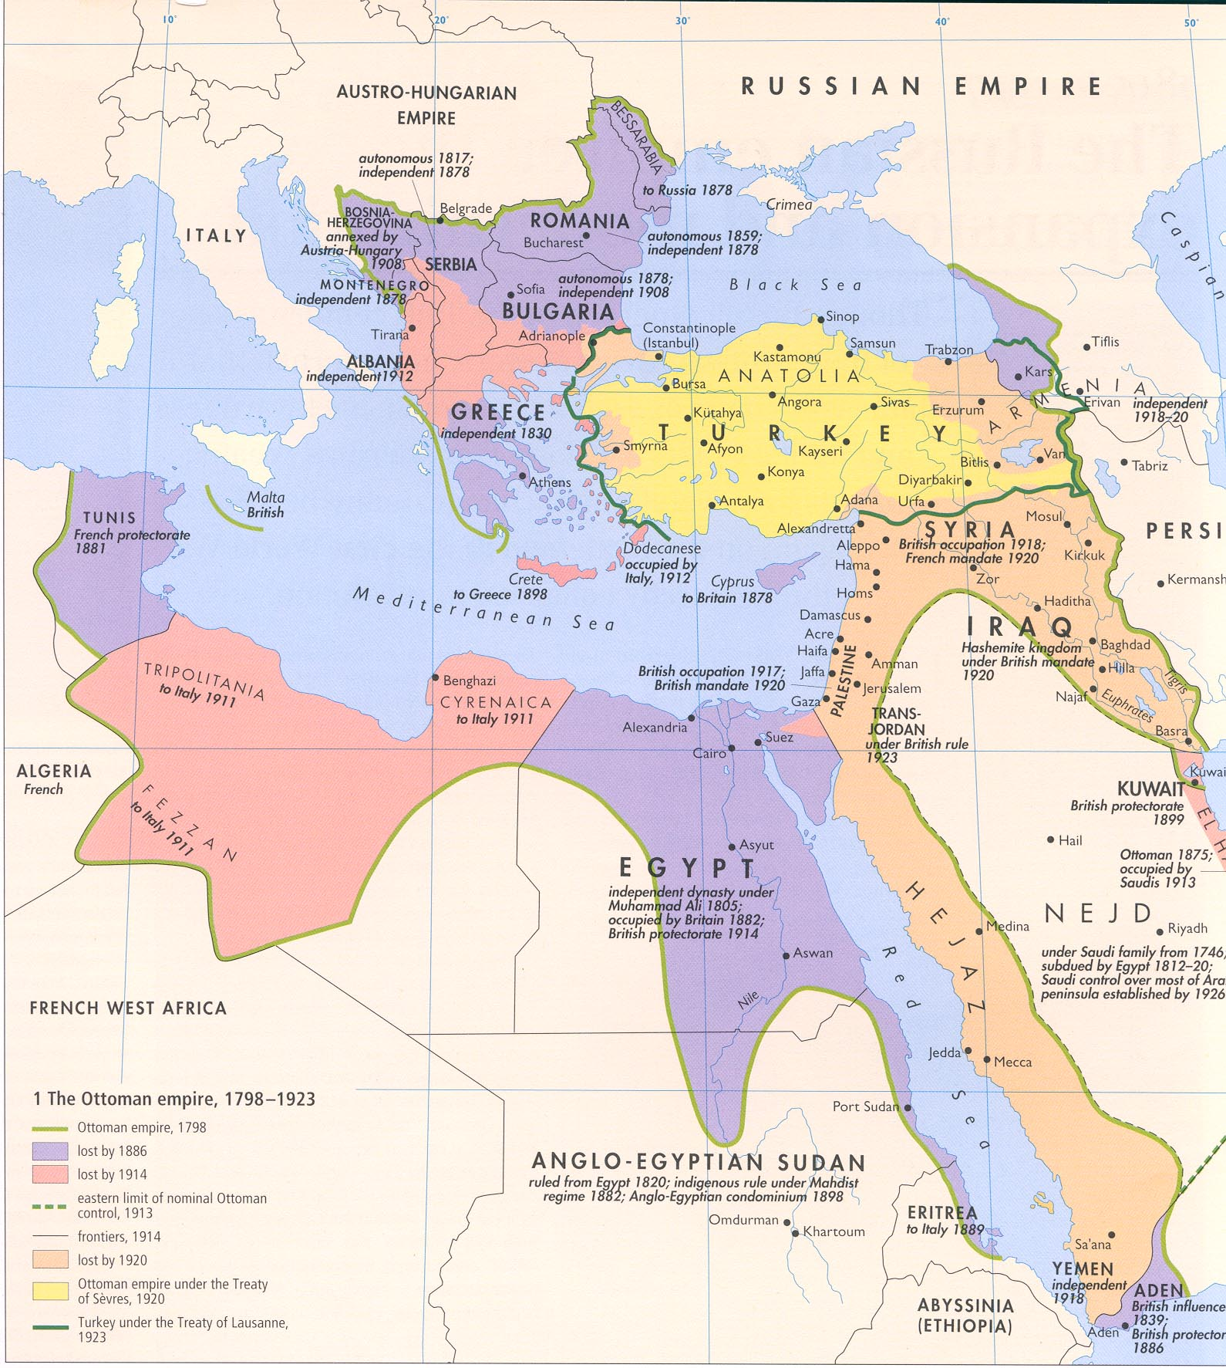

Slide 35
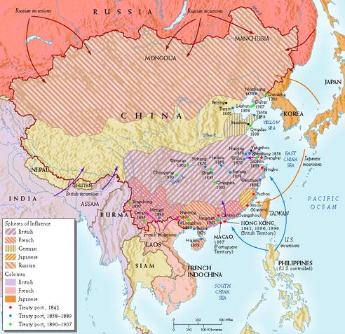

Slide 36
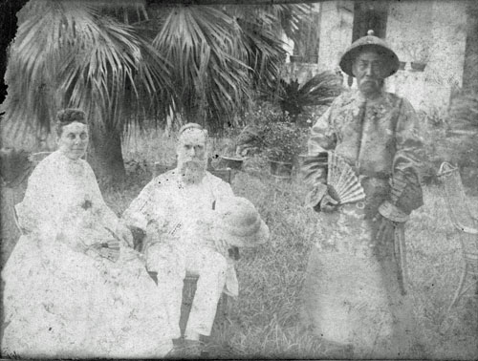

Slide 37
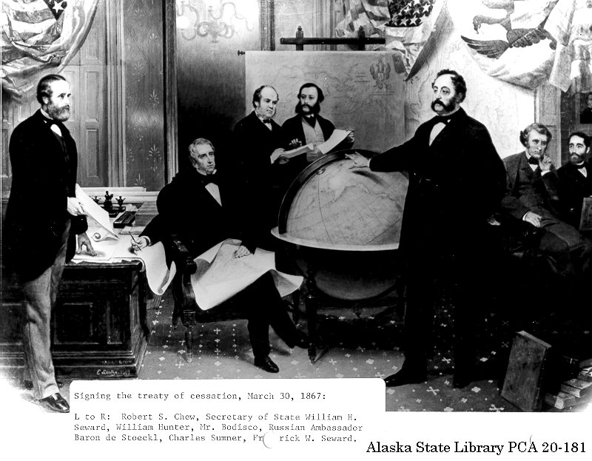

Slide 38
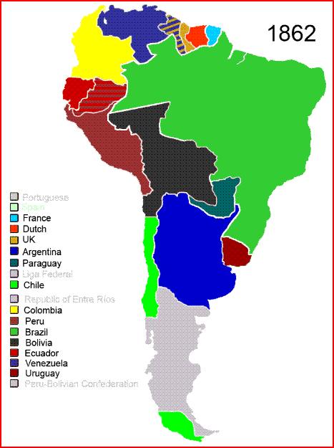

Slide 39
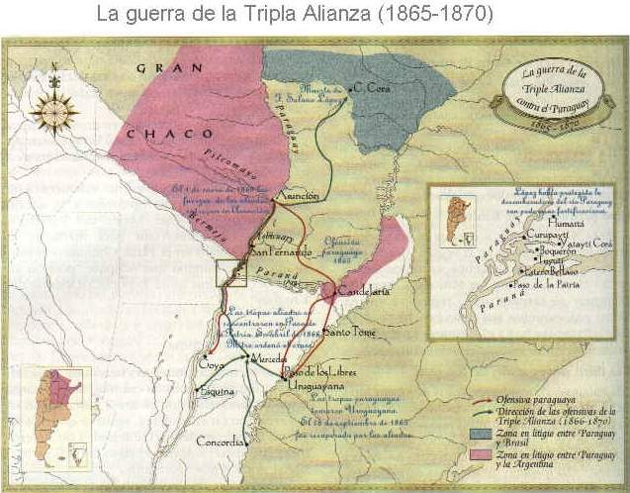

Slide 40
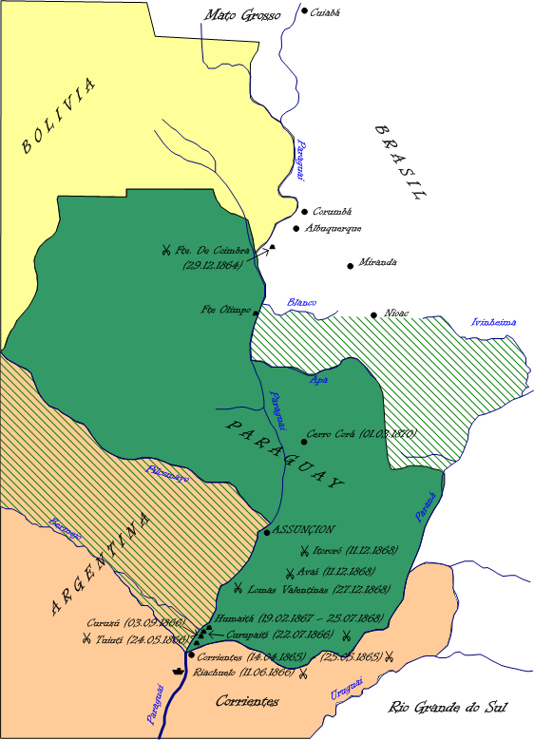

Slide 41
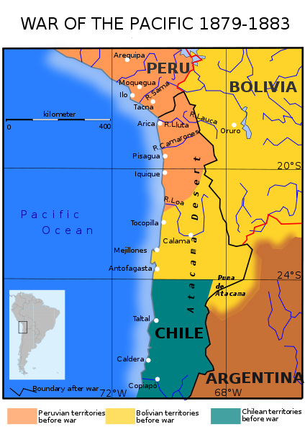

Slide 42
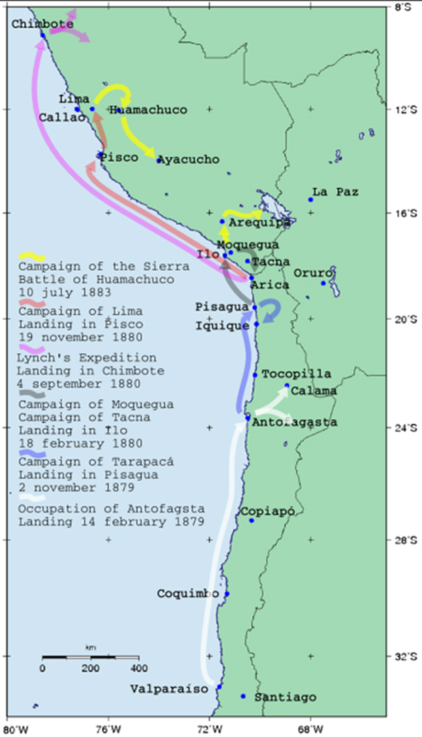
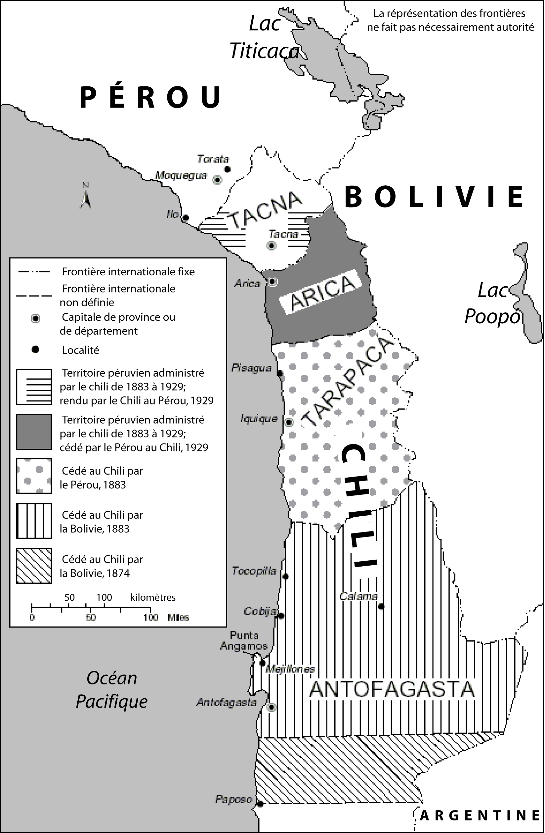

Slide 43
Year | Trade Deficit
1890 | $159M (14.3 percent of import total)
1888 | $227M (22.4 percent of import total)
1884 | $59M (6.4 percent of import total)
1882 | $56M (6.1 percent of import total)
1881 | $137M trade surplus

Slide 44
