Slide 1
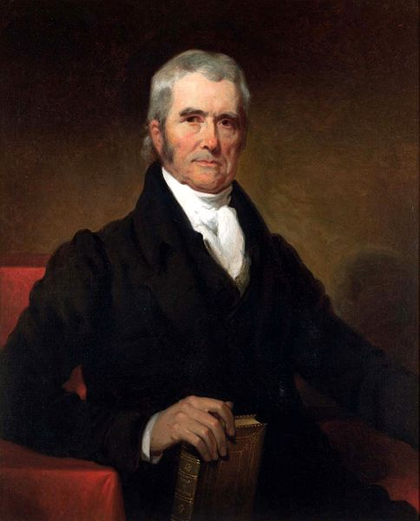

Slide 2
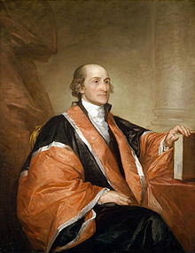
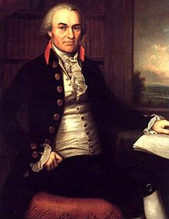
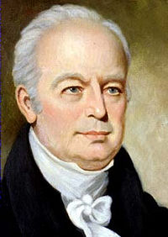
Notes:
Jay-john rutledge-ellsworth

Slide 3
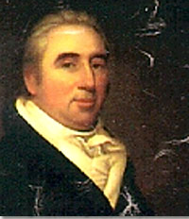
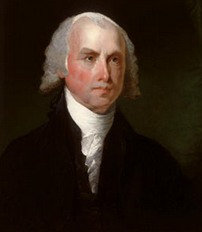
Marbury
v.
Madison
1803
The authority, therefore, given to the Supreme Court by the act establishing the judicial courts of the United States to issue writs of mandamus to public officers appears not to be warranted by the Constitution, and it becomes necessary to inquire whether a jurisdiction so conferred can be exercised…
The Constitution is either a superior, paramount law, unchangeable by ordinary means, or it is on a level with ordinary legislative acts, and, like other acts, is alterable when the legislature shall please to alter it.
If the former part of the alternative be true, then a legislative act contrary to the Constitution is not law; if the latter part be true, then written Constitutions are absurd attempts on the part of the people to limit a power in its own nature illimitable.

Slide 4
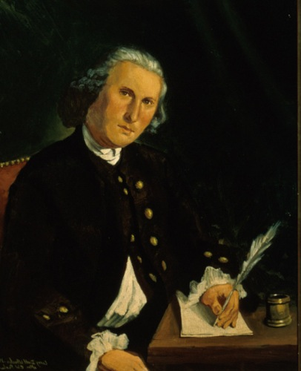
Notes:
Samuel chase

Slide 5
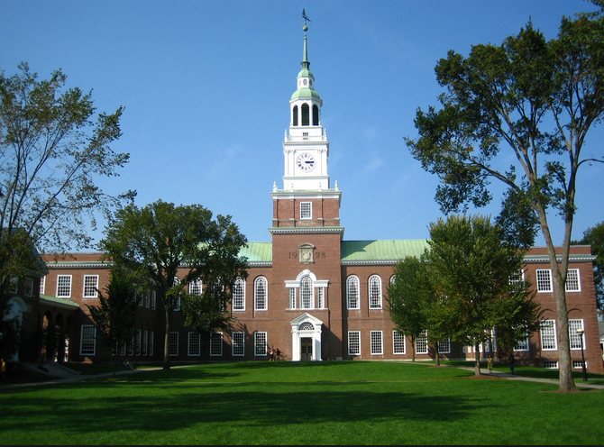


Slide 6
Dartmouth College v. Woodward (1819)
This court can be insensible neither to the magnitude nor delicacy of this question. The validity of a legislative act is to be examined; and the opinion of the highest law tribunal of a State is to be revised…
On more than one occasion, this Court has expressed the cautious circumspection with which it approaches the consideration of such questions, and has declared that in no doubtful case would it pronounce a legislative act to be contrary to the Constitution…
This is plainly a contract to which the donors, the Trustees, and the Crown (to whose rights and obligations New Hampshire succeeds) were the original parties. It is a contract made on a valuable consideration. It is a contract for the security and disposition of property. It is a contract on the faith of which real and personal estate has been conveyed to the corporation. It is, then, a contract within the letter of the Constitution, and within its spirit also… The opinion of the Court, after mature deliberation, is that this is a contract the obligation of which cannot be impaired without violating the Constitution of the United States.

Slide 7
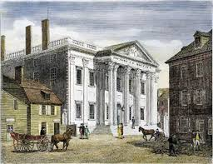

Slide 8
McCulloch v. Maryland (1819)
In discussing this question, the counsel for the State of Maryland have deemed it of some importance, in the construction of the Constitution, to consider that instrument not as emanating from the people, but as the act of sovereign and independent States . . . It would be difficult to sustain this proposition . . .
Among the enumerated powers, we do not find that of establishing a bank or creating a corporation. But there is no phrase in the instrument which, like the Articles of Confederation, excludes incidental or implied powers and which requires that everything granted shall be expressly and minutely described . . .
Let the end be legitimate, let it be within the scope of the constitution, and all means which are appropriate, which are plainly adapted to that end, which are not prohibited, but consist with the letter and spirit of the constitution, are constitutional…
A right to tax, without limit or control, is essentially a power to destroy. If one national institution may be destroyed in this manner, all may be destroyed in the same manner. If this power to tax the national property and institutions exists in the state of Maryland, it is unbounded in extent.

Slide 9
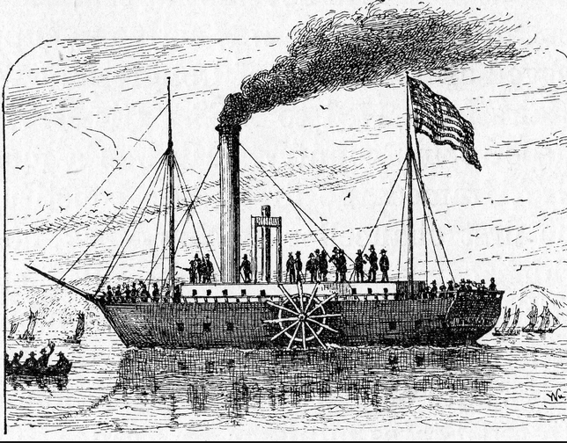
Notes:
Fulton steamboat

Slide 10
Gibbons v. Ogden (1828)
The federal government has the power to regulate; that is, to prescribe the rule by which commerce is to be governed. This power, like all others vested in Congress, is complete in itself, may be exercised to its utmost extent, and acknowledges no limitations, other than are prescribed in the Constitution . . .
The word “among” [the several states] means intermingled with. A thing which is among others, is intermingled with them. Commerce among the States, cannot stop at the external boundary line of each State, but may be introduced into the interior . . . Comprehensive as the word “among” is, it may very properly be restricted to that commerce which concerns more States than one . . .
The power of Congress, then, comprehends navigation, within the limits of every State in the Union; so far as that navigation may be, in any manner, connected with “commerce with foreign nations, or among the several States.

Slide 11
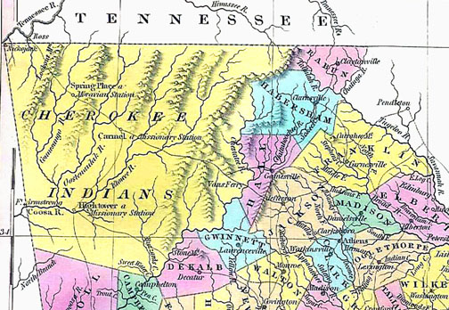

Slide 12
Worcester v. Georgia (1832)
The Cherokee Nation, then, is a distinct community, occupying its own territory, with boundaries accurately described, in which the laws of Georgia can have no force, and which the citizens of Georgia have no right to enter but with the assent of the Cherokees themselves or in conformity with treaties and with the acts of Congress. The whole intercourse between the United States and this nation is, by our Constitution and laws, vested in the government of the United States.
The act of the State of Georgia under which the plaintiff in error was prosecuted is consequently void, and the judgement a nullity. . . . The Acts of Georgia are repugnant to the Constitution, laws, and treaties of the United States.
They interfere forcibly with the relations established between the United States and the Cherokee Nation, the regulation of which according to the settled principles of our Constitution, are committed exclusively to the government of the Union.

Slide 13
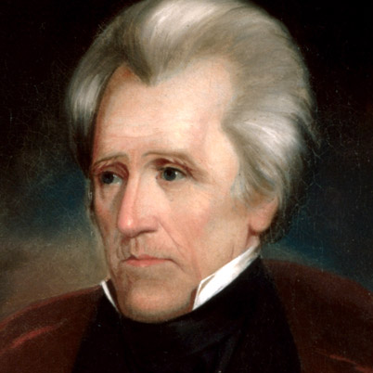

Slide 14
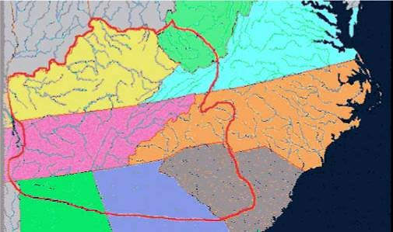

Slide 15
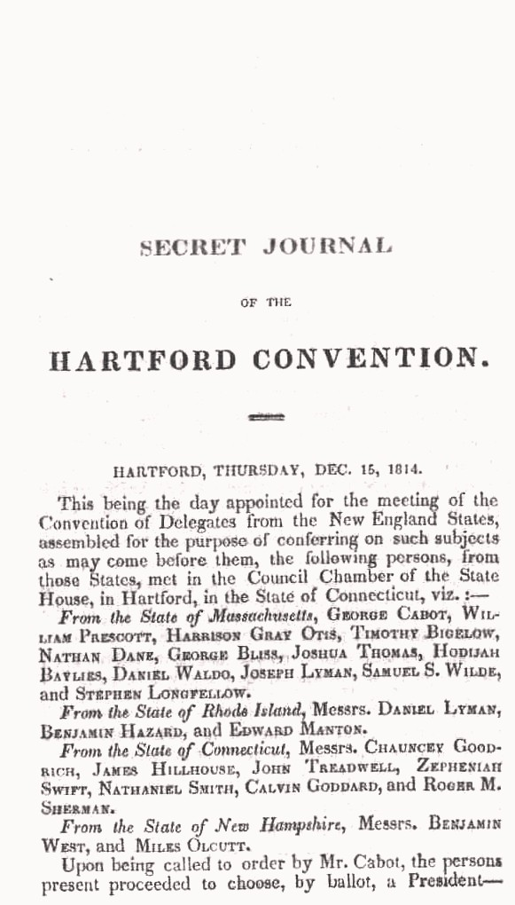

Slide 16
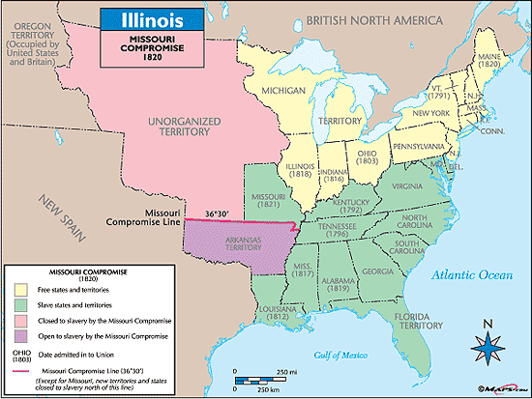

Slide 17
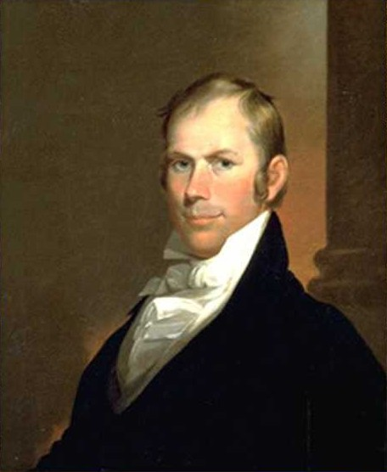
Notes:
Young clay

Slide 18
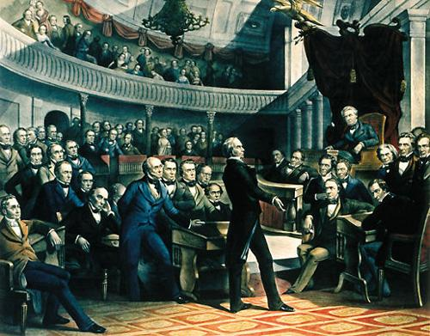
Notes:
Webster hayne

Slide 19
Webster reply to Hayne (1830)
This leads us to inquire into the origin of this government and the source of its power. Whose agent is it? Is it the creature of the State legislatures, or the creature of the people? If the government of the United States be the agent of the State governments, then they may control it, provided they can agree in the manner of controlling it; if it be the agent of the people, then the people alone can control it, restrain it, modify, or reform it. It is observable enough, that the doctrine for which the honorable gentleman contends leads him to the necessity of maintaining, not only that this general government is the creature of the States, but that it is the creature of each of the States severally, so that each may assert the power for itself of determining whether it acts whithin the limits of its authority. It is the servant of four-and-twenty masters, of different will and different purposes and yet bound to obey all. This absurdity (for it seems no less) arises from a misconception as to the origin of this government and its true character. It is, Sir, the people's Constitution, the people's government, made for the people, made by the people, and answerable to the people. The people of the United States have declared that the Constitution shall be the supreme law. We must either admit the proposition, or dispute their authority.

Slide 20
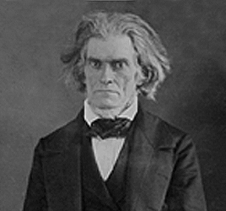

Slide 21
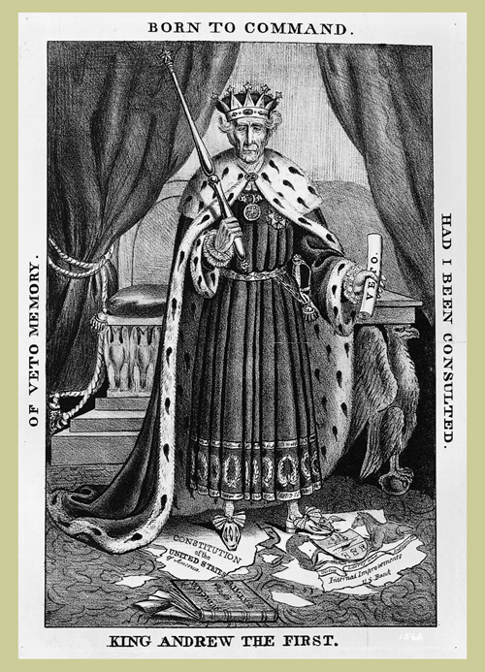
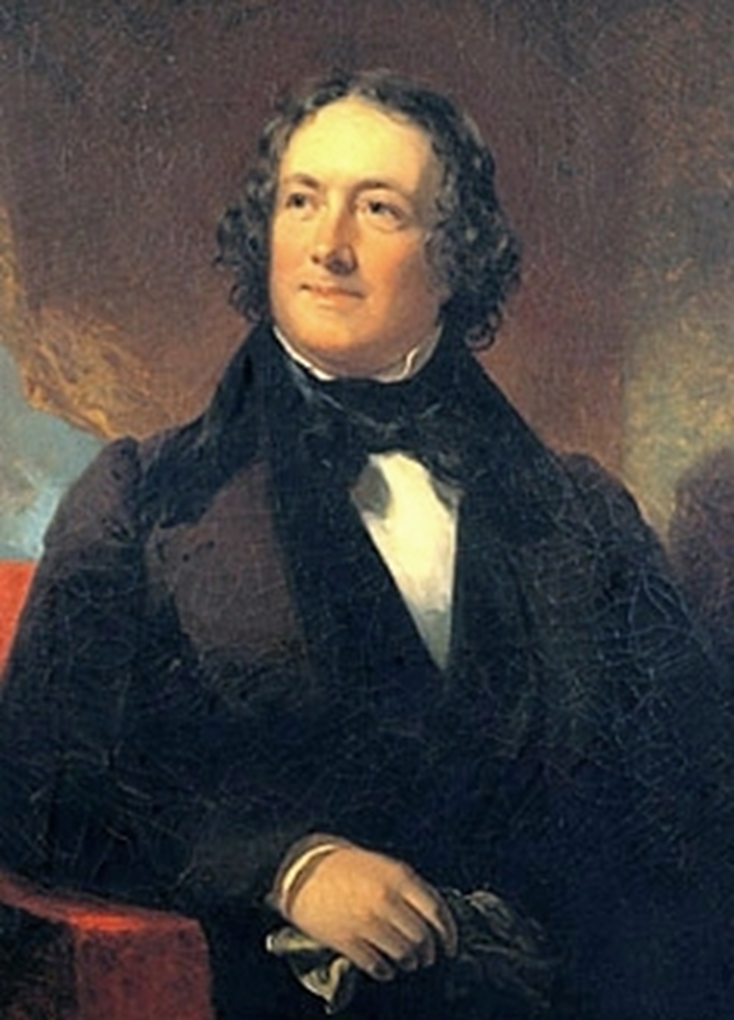

Slide 22
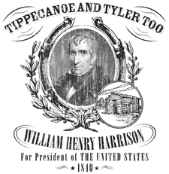

Slide 23
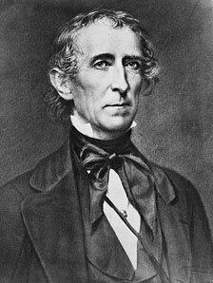

Slide 24
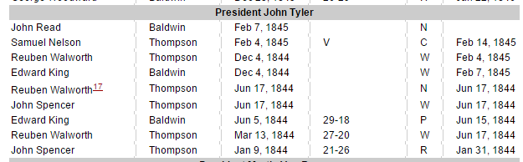
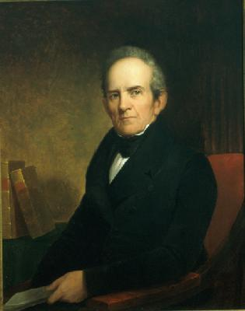
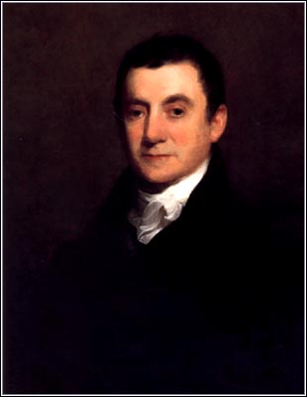
Notes:
Smith Thompson dies dec 1843; henry Baldwin dies ap 1844

Slide 25
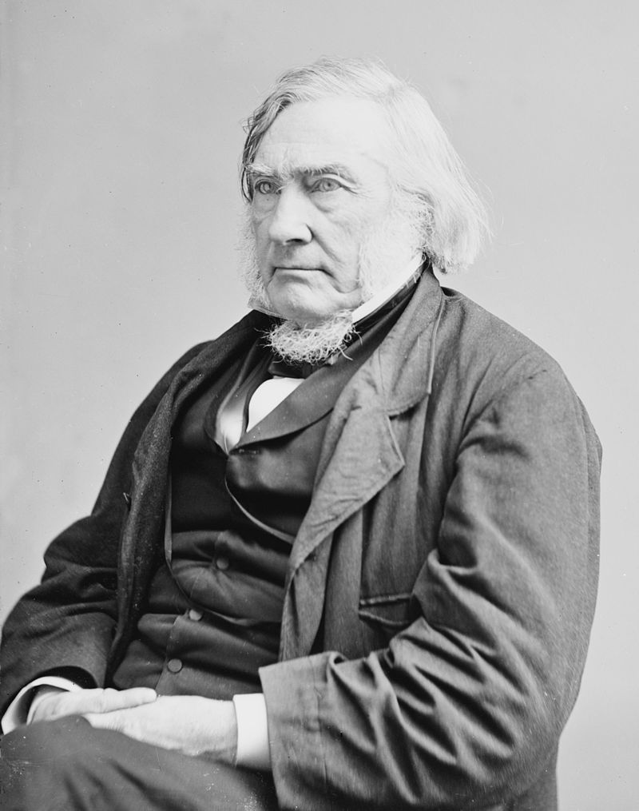
Notes:
Justice Samuel nelson

Slide 26
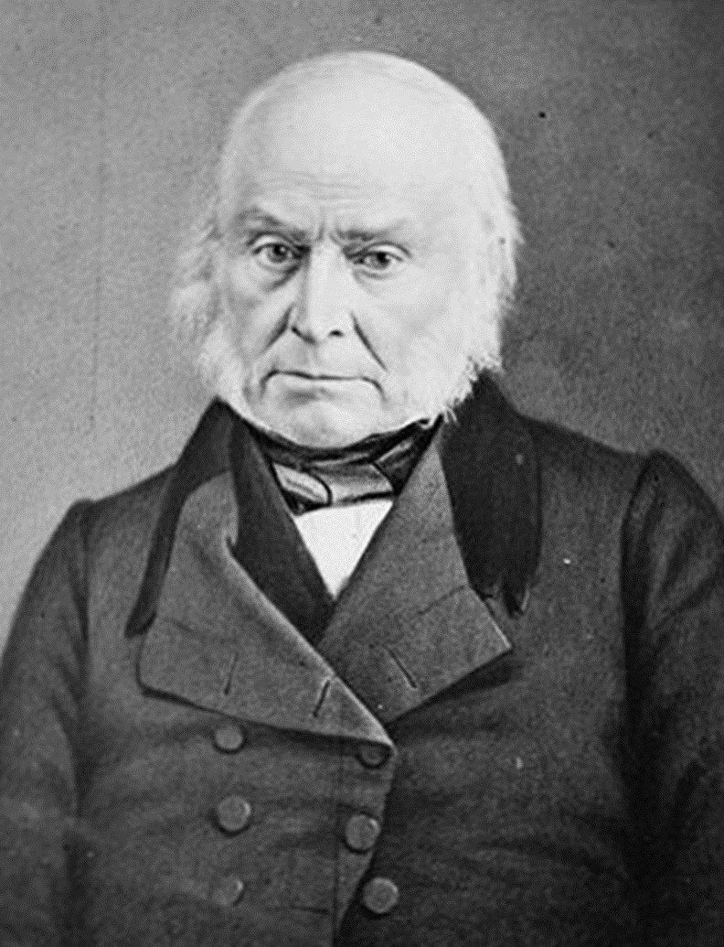
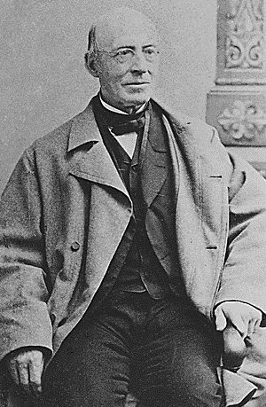
Notes:
garrison

Slide 27
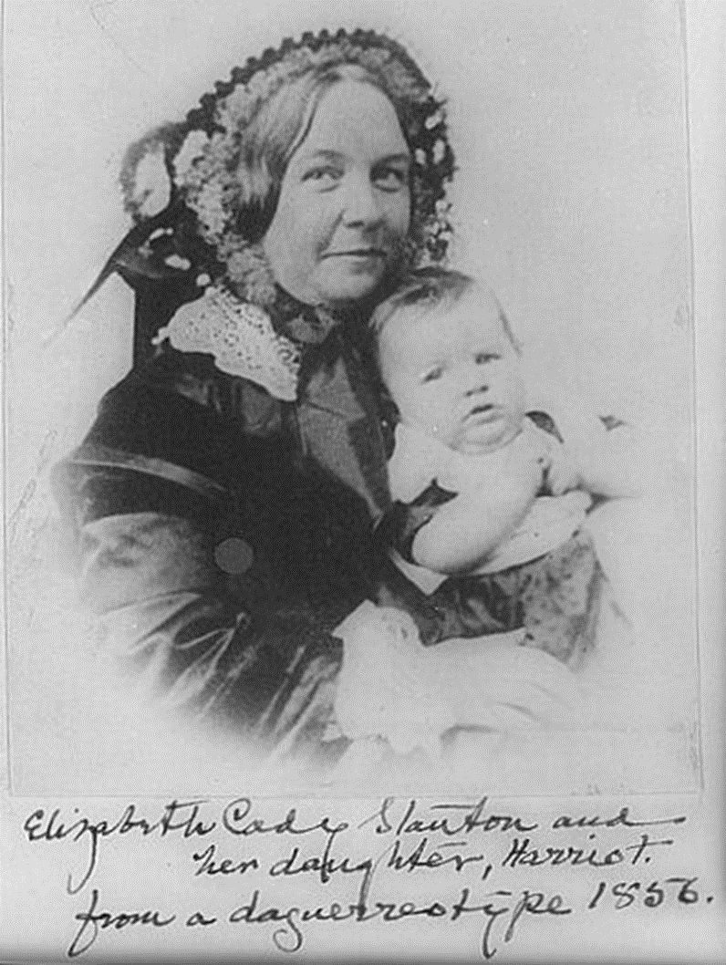
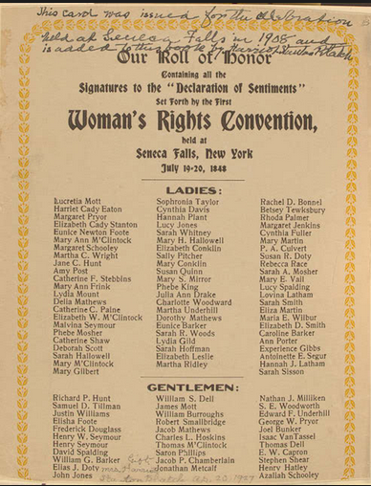

Slide 28
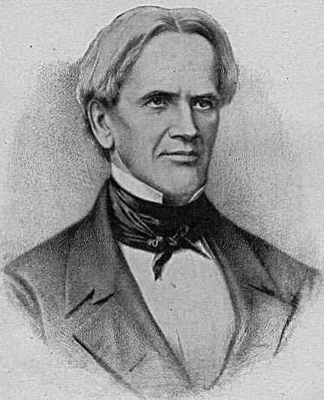
Notes:
Horace mann

Slide 29
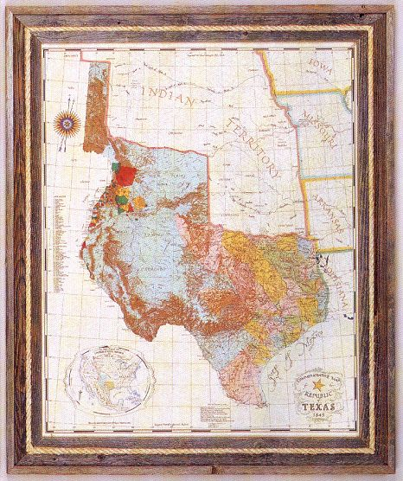

Slide 30
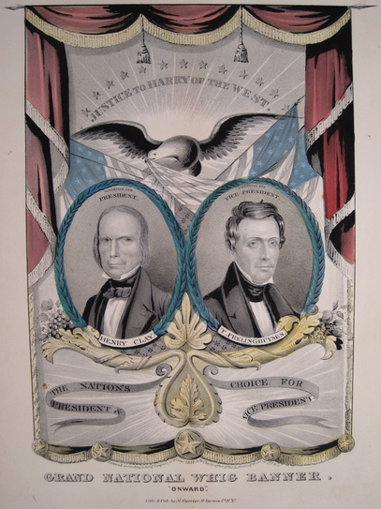
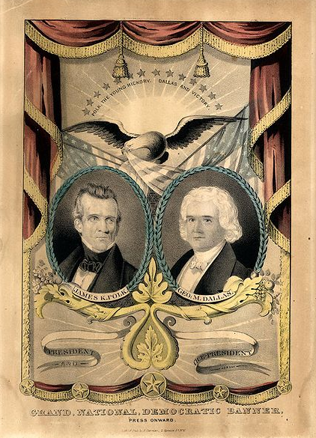

Slide 31
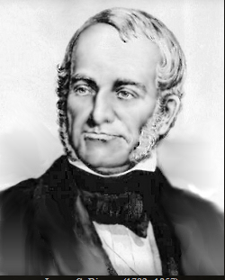
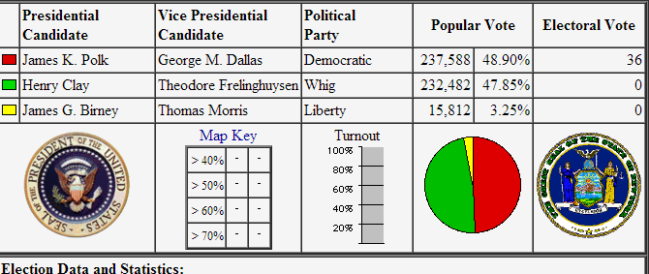

Slide 32
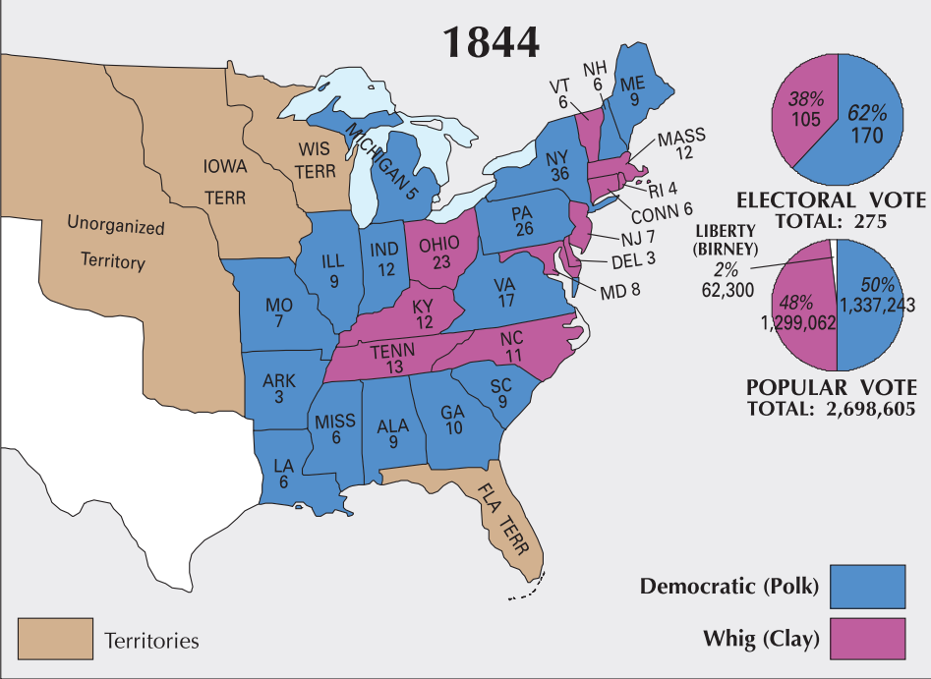

Slide 33
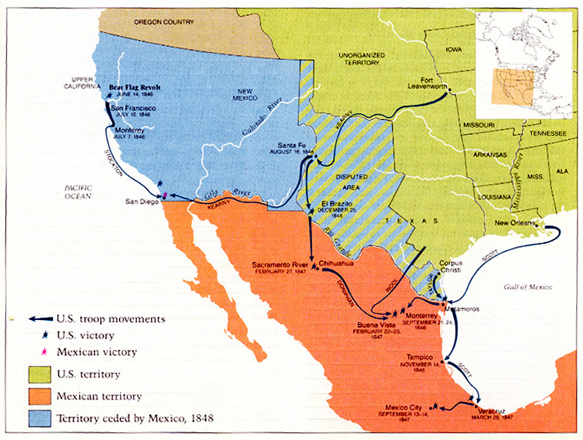

Slide 34
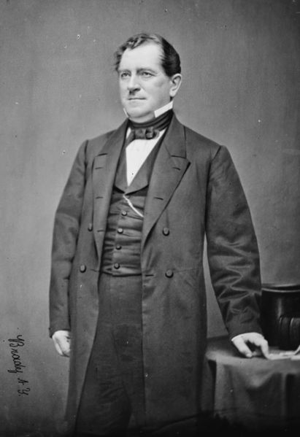
Notes:
giddings

Slide 35
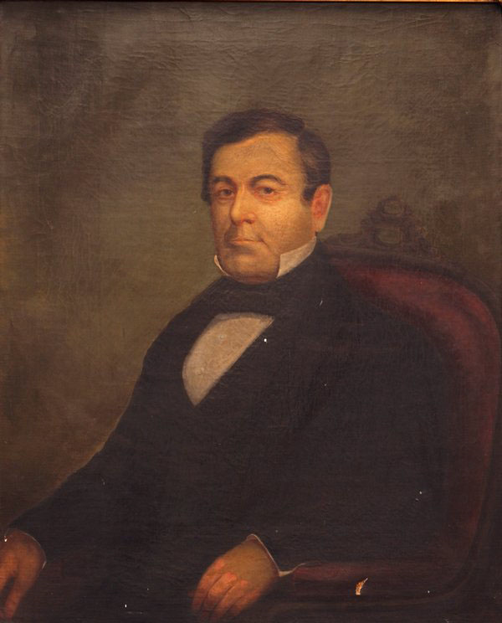
Notes:
wilmot

Slide 36
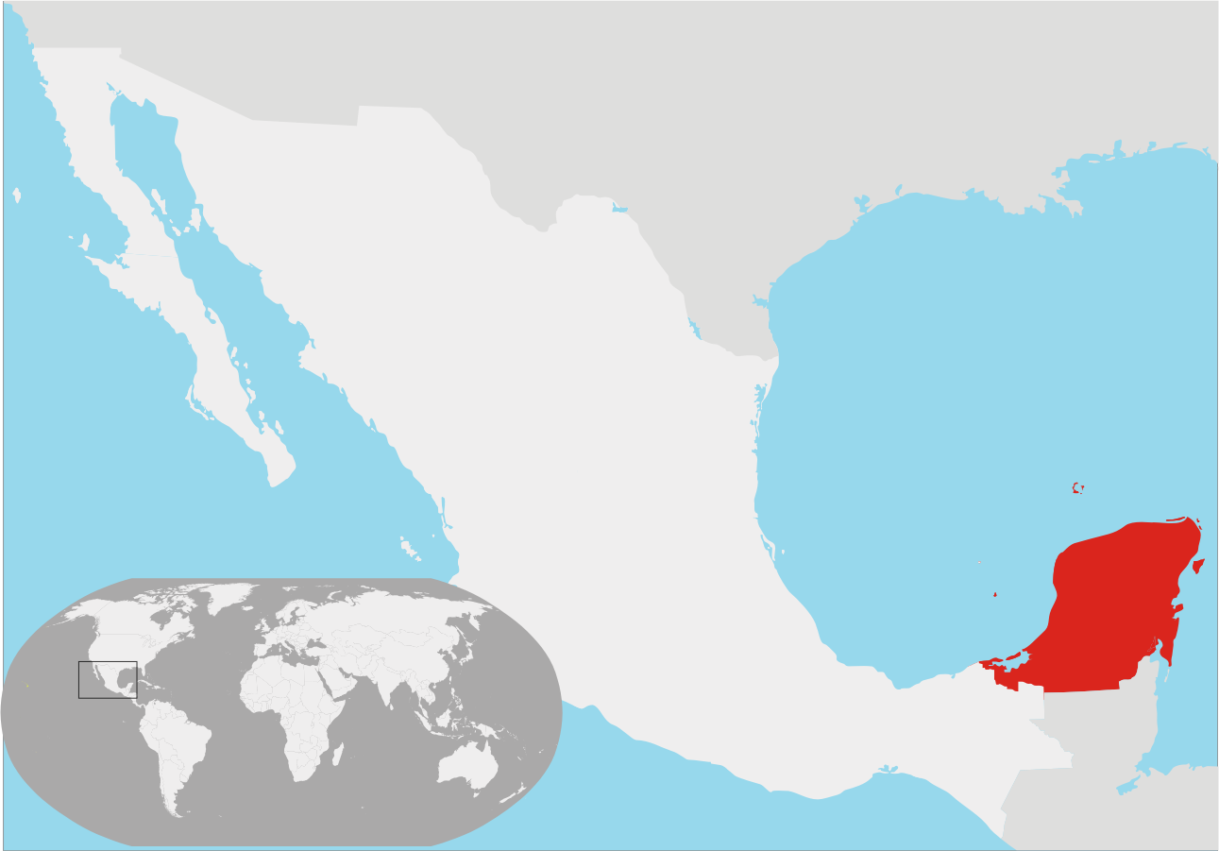

Slide 37
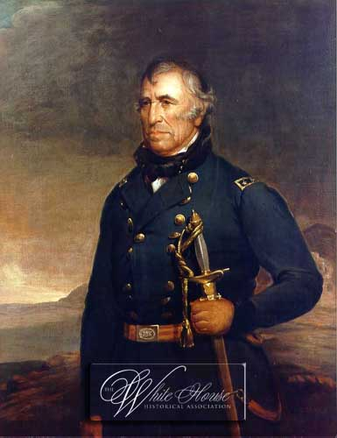

Slide 38
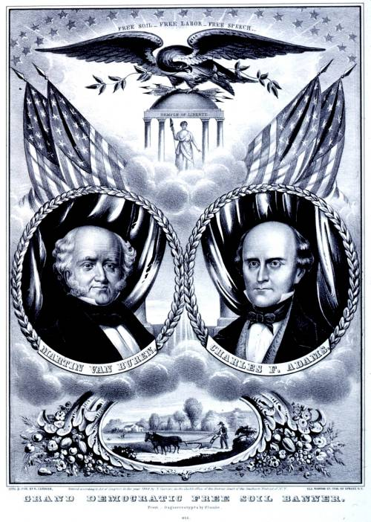

Slide 39
