Slide 1
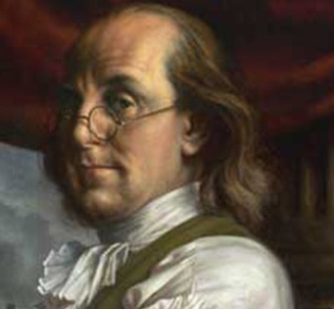

Slide 2
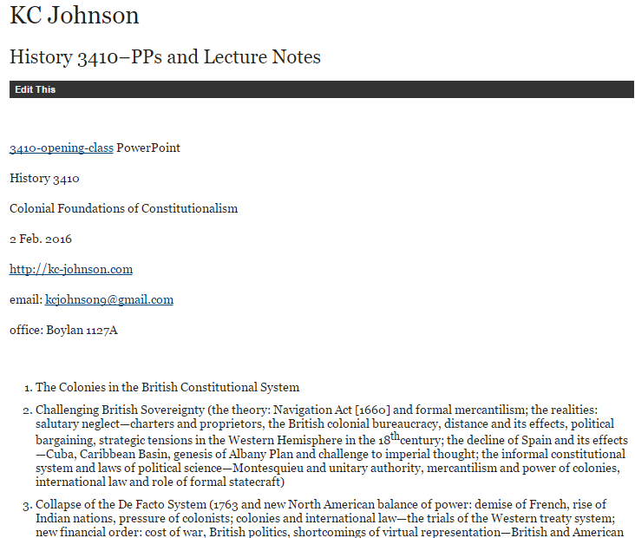

Slide 4
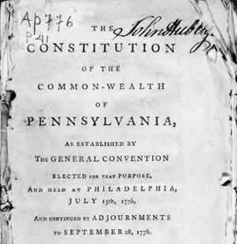

Slide 5
Pennsylvania (1776)—rights
That all men are born equally free and independent, and have certain natural, inherent and inalienable rights, amongst which are, the enjoying and defending life and liberty, acquiring, possessing and protecting property, and pursuing and obtaining happiness and safety.
IX. That in all prosecutions for criminal offences, a man hath a right to be heard by himself and his council, to demand the cause and nature of his accusation, to be confronted with the witnesses, to call for evidence in his favour, and a speedy public trial, by an impartial jury of the country, without the unanimous consent of which jury he cannot be found guilty; nor can he be compelled to give evidence against himself…
XII. That the people have a right to freedom of speech, and of writing, and publishing their sentiments; therefore the freedom of the press ought not to be restrained.
XVI. That the people have a right to assemble together, to consult for their common good, to instruct their representatives, and to apply to the legislature for redress of grievances, by address, petition, or remonstrance.

Slide 6
Pennsylvania (1776)--electorate
Every freemen of the full age of twenty-one Years, having resided in this state for the space of one whole Year next before the day of election for representatives, and paid public taxes during that time, shall enjoy the right of an elector: Provided always, that sons of freeholders of the age of twenty-one years shall be intitled to vote although they have not paid taxes.
SECT. 7. The house of representatives of the freemen of this commonwealth shall consist of persons most noted for wisdom and virtue, to be chosen by the freemen of every city and county of this commonwealth respectively…
SECT. 8. No person shall be capable of being elected a member to serve in the house of representatives of the freemen of this commonwealth more than four years in seven.
SECT. 9. The members of the house of representatives shall be chosen annually by ballot, by the freemen of the commonwealth.

Slide 7
Pennsylvania (1776)—executive power
SECT. 20. The president, and in his absence the vice-president, with the council, five of whom shall be a quorum, shall have power to appoint and commission judges, naval officers, judge of the admiralty, attorney general and all other officers, civil and military . . .
They are to correspond with other states, and transact business with the officers of government, civil and military; and to prepare such business as may appear to them necessary to lay before the general assembly . . .
And shall have power to grant pardons and remit fines, in all cases whatsoever, except in cases of impeachment; and in cases of treason and murder, shall have power to grant reprieves, but not to pardon, until the end of the next sessions of assembly . . .
The president shall be commander in chief of the forces of the state, but shall not command in person, except advised thereto by the council, and then only so long as they shall approve thereof. The president and council shall have a secretary, and keep fair books of their proceedings, wherein any counsellor may enter his dissent, with his reasons in support of it.

Slide 8
Pennsylvania (1776)—constitutional violations
The COUNCIL OF CENSORS . . . whose duty it shall be to enquire whether the constitution has been preserved inviolate in every part; and whether the legislative and executive branches of government have performed their duty as guardians of the people, or assumed to themselves, or exercised other or greater powers than they are intitled to by the constitution: They are also to enquire whether the public taxes have been justly laid and collected in all parts of this commonwealth, in what manner the public monies have been disposed of, and whether the laws have been duly executed. For these purposes they shall have power to send for persons, papers, and records; they shall have authority to pass public censures, to order impeachments, and to recommend to the legislature the repealing such laws as appear to them to have been enacted contrary to the principles of the constitution. These powers they shall continue to have, for and during the space of one year from the day of their election and no longer: The said council of censors shall also have power to call a convention….

Slide 9
Pennsylvania (1776)—religious tolerance
And each member, before he takes his seat, shall make and subscribe the following declaration, viz:
“I do believe in one God, the creator and governor of the universe, the rewarder of the good and the punisher of the wicked. And I do acknowledge the Scriptures of the Old and New Testament to be given by Divine inspiration.”
And no further or other religious test shall ever hereafter be required of any civil officer or magistrate in this State.
(Decl. of Rights): II. That all men have a natural and unalienable right to worship Almighty God according to the dictates of their own consciences and understanding…Nor can any man, who acknowledges the being of a God, be justly deprived or abridged of any civil right as a citizen, on account of his religious sentiments or peculiar mode of religious worship…

Slide 10
NEW HAMPSHIRE (1776)
WE DO Resolve, that this Congress assume the name, power and authority of a house of Representatives or Assembly for the Colony of New-Hampshire And that said House then proceed to choose twelve persons, being. reputable freeholders and inhabitants within this colony . . . to be a distinct and separate branch of the Legislature by the name of a COUNCIL for this colony . . . That such Council appoint their President, and in his absence that the senior counsellor preside; that a Secretary be appointed by both branches, who may be a counssellor, or otherwise, as they shall choose:
That no act or resolve shall be valid and put into execution unless agreed to, and passed by both branches of the legislature;
That all public officers for the said colony, and each county, for the current year, be appointed by the Council and Assembly.

Slide 11
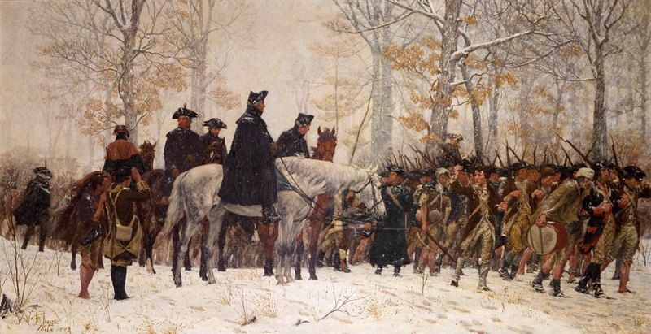

Slide 12
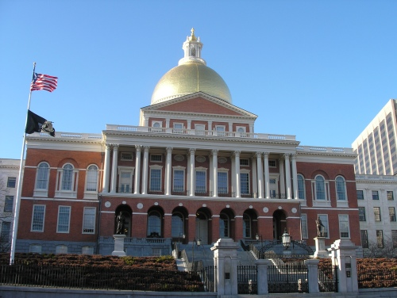

Slide 13
Massachusetts (1780)—legislative power
Article I. The department of legislation shall be formed by two branches, a senate and house of representatives; each of which shall have a negative on the other . . .
Art. II. The senate shall be the first branch of the legislature . . . Every male inhabitant of twenty-one year of age and upwards, having a freehold estate of the value of sixty pounds, shall have a right to give in his vote for the senators for the district of which he is an inhabitant.
--------------
Every male person being twenty-one years of age, and resident in any particular town in this commonwealth, for the space of one year next preceding, having a freehold estate within the same town, of the annual income of three pounds, or any estate of the value of sixty pounds, shall have a right to vote in the choice of a representative or representatives for the said town.

Slide 14
Massachusetts (1780)—executive power
Art. II. No bill or resolve of the senate or house of representatives shall become a law, and have force as such, until it shall have been laid before the governor for his revisal; and if he, upon such revision, approve thereof, he shall signify his approbation by signing the same.
----------------------
In cases of disagreement between the two houses, with regard to the necessity, expediency, or time of adjournment or prorogation, the governor, with advice of the council, shall have a right to adjourn or prorogue the general court, not exceeding ninety days, as he shall determine the public good shall require.

Slide 15
Massachusetts (1780)—Governor’s Council
Article IV. The governor shall have authority from time to time, at his discretion, to assemble and call together the councillors of this commonwealth for the time being; and the governor with the said councillors, or five of them at least, shall, and may, from time to time, hold and keep a council, for the ordering and directing the affairs of the commonwealth, agreeably to the constitution and the laws of the land…
All judicial officers, [the attorney-general,] the solicitor-general, [all sheriffs,] coroners, [and registers of probate,] shall be nominated and appointed by the governor, by and with the advice and consent of the council…

Slide 16
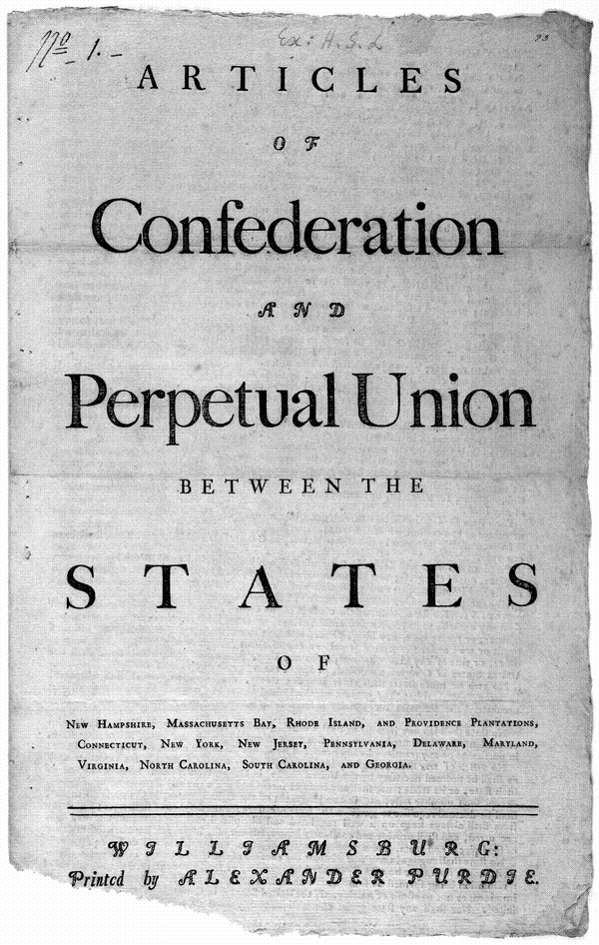

Slide 17
Article II. Each state retains its sovereignty, freedom, and independence, and every Power, Jurisdiction, and right, which is not by this confederation expressly delegated to the United States, in Congress assembled.
----------
Art. IX. All charges of war, and all other expenses that shall be incurred for the common defense or general welfare, and allowed by the united States in congress assembled, shall be defrayed out of a common treasury, which shall be supplied by the several States in proportion to the value of all land within each State, granted or surveyed for any person, as such land and the buildings and improvements thereon shall be estimated according to such mode as the united States in congress assembled, shall from time to time direct and appoint.
The taxes for paying that proportion shall be laid and levied by the authority and direction of the legislatures of the several States within the time agreed upon by the united States in congress assembled.

Slide 18
Delegates shall be annually appointed in such manner as the legislatures of each State shall direct . . . with a power reserved to each State to recall its delegates, or any of them, at any time within the year.
No State shall be represented in Congress by less than two, nor more than seven members; and no person shall be capable of being a delegate for more than three years in any term of six years.
In determining questions in the united States, in Congress assembled, each State shall have one vote.
----------------------
The united States in congress assembled shall never engage in a war, nor grant letters of marque or reprisal in time of peace, nor enter into any treaties or alliances, nor coin money, nor regulate the value thereof, nor ascertain the sums and expenses necessary for the defense and welfare of the United States, or any of them, nor emit bills, nor borrow money on the credit of the united States, nor appropriate money, nor agree upon the number of vessels of war, to be built or purchased, or the number of land or sea forces to be raised, nor appoint a commander in chief of the army or navy, unless nine States assent to the same: nor shall a question on any other point, except for adjourning from day to day be determined, unless by the votes of the majority of the united States in congress assembled.

Slide 19
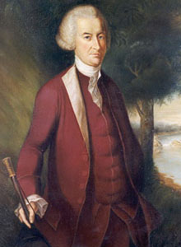

Slide 20
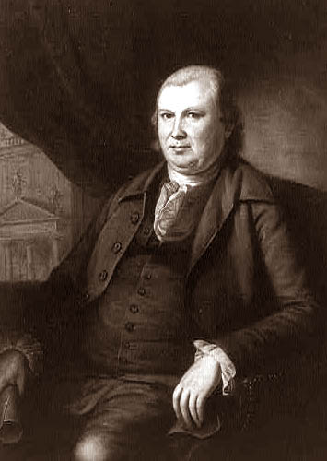
Notes:
Robert morris

Slide 21
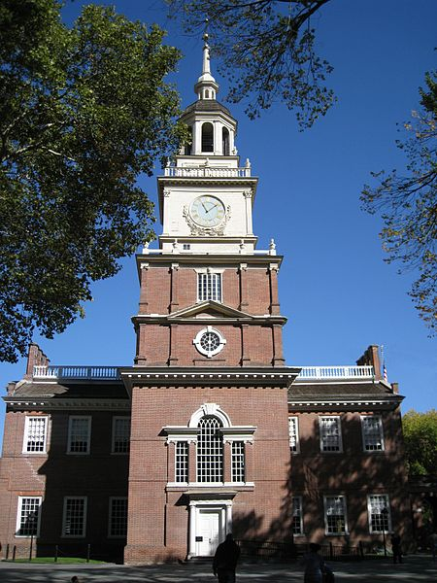
Notes:
Indpce hall

Slide 22
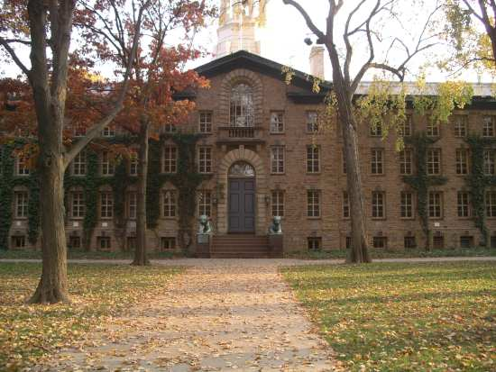
Notes:
Nassau hall princeton 1783

Slide 23
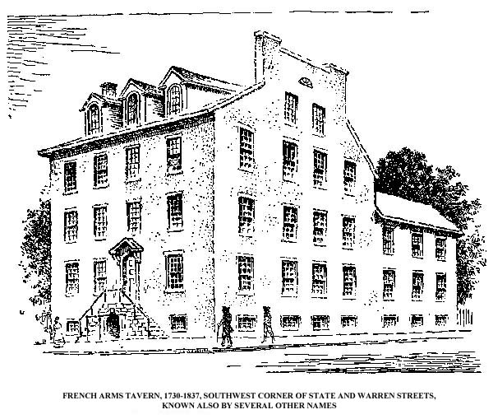
Notes:
French arms tavern 1785

Slide 24
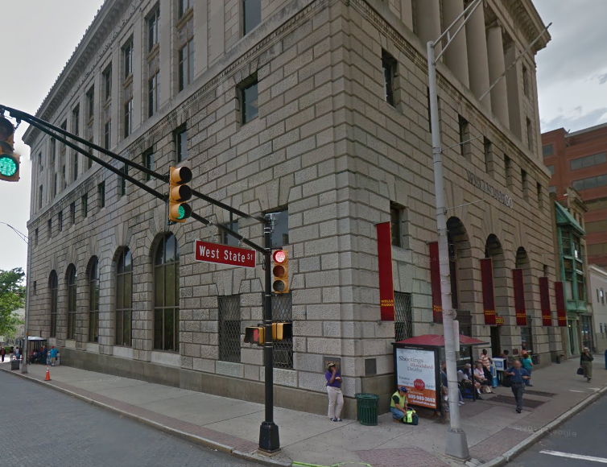

Slide 25
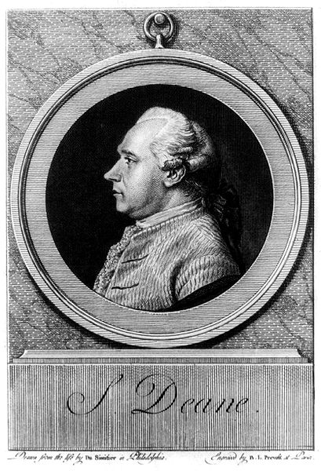

Slide 26
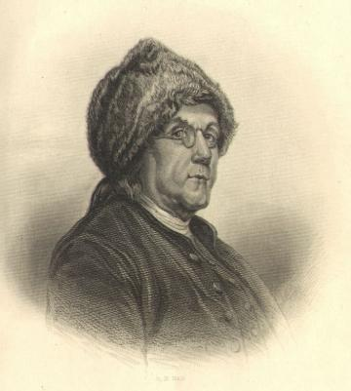

Slide 27
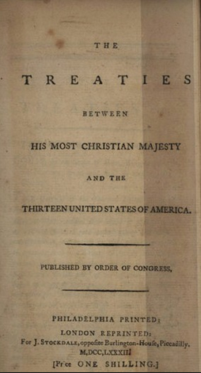

Slide 28
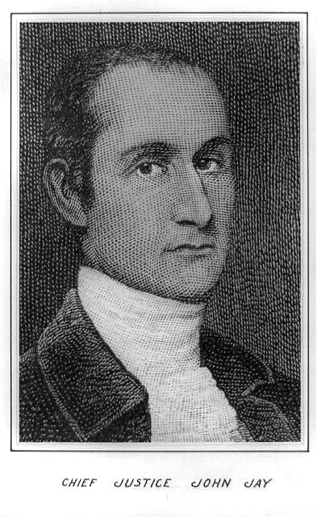
Notes:
jay

Slide 29


Slide 30
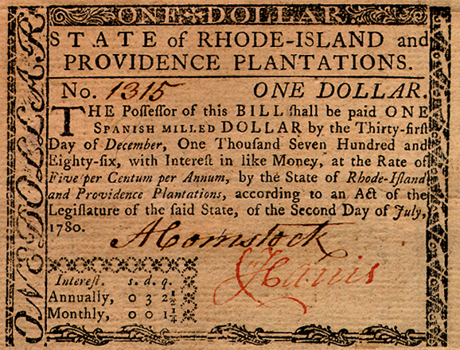

Slide 31

Notes:
Daniel shays

Slide 32
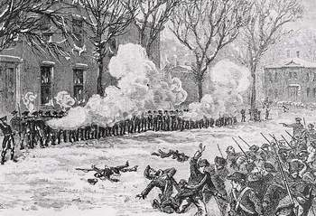
Notes:
shays

Slide 33
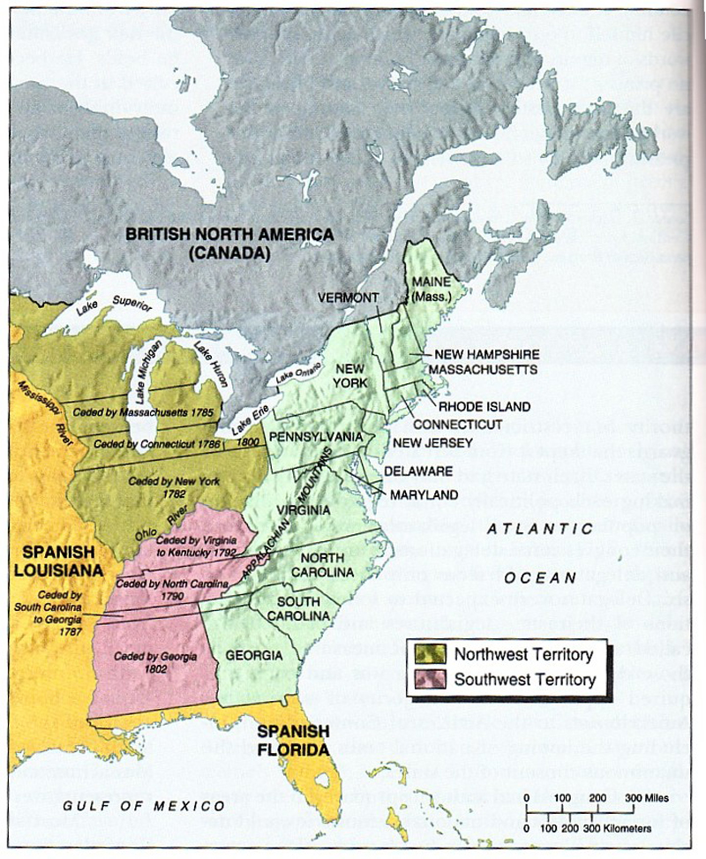

Slide 34
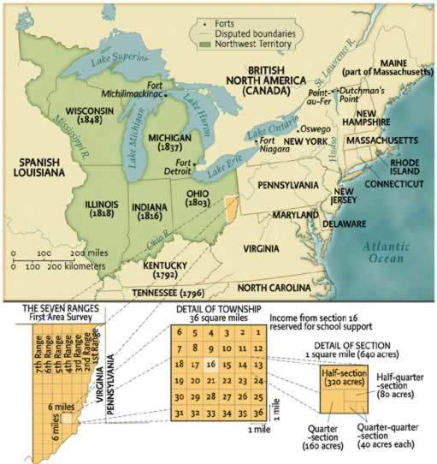

Slide 35
Northwest Ordinance (1787)
Art. 5. There shall be formed in the said territory, not less than three nor more than five States . . . And, whenever any of the said States shall have sixty thousand free inhabitants therein, such State shall be admitted, by its delegates, into the Congress of the United States, on an equal footing with the original States in all respects whatever, and shall be at liberty to form a permanent constitution and State government: Provided, the constitution and government so to be formed, shall be republican, and in conformity to the principles contained in these articles; and, so far as it can be consistent with the general interest of the confederacy, such admission shall be allowed at an earlier period, and when there may be a less number of free inhabitants in the State than sixty thousand.
Art. 6. There shall be neither slavery nor involuntary servitude in the said territory, otherwise than in the punishment of crimes whereof the party shall have been duly convicted.

Slide 36
Northwest Ordinance (1787)
Art. 3. Religion, morality, and knowledge, being necessary to good government and the happiness of mankind, schools and the means of education shall forever be encouraged. The utmost good faith shall always be observed towards the Indians; their lands and property shall never be taken from them without their consent; and, in their property, rights, and liberty, they shall never be invaded or disturbed, unless in just and lawful wars authorized by Congress; but laws founded in justice and humanity, shall from time to time be made for preventing wrongs being done to them, and for preserving peace and friendship with them.

