Slide 1


Slide 2


Slide 3
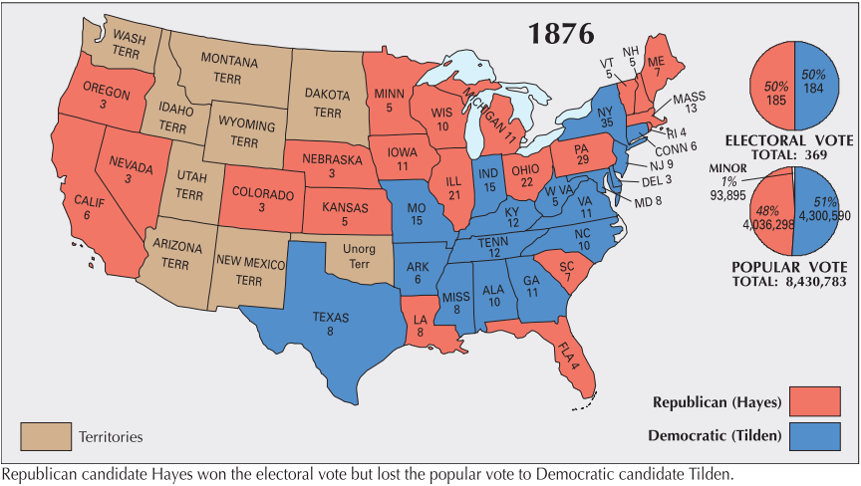

Slide 4
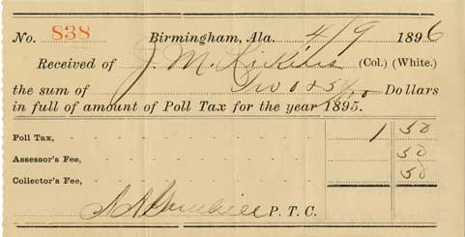

Slide 5
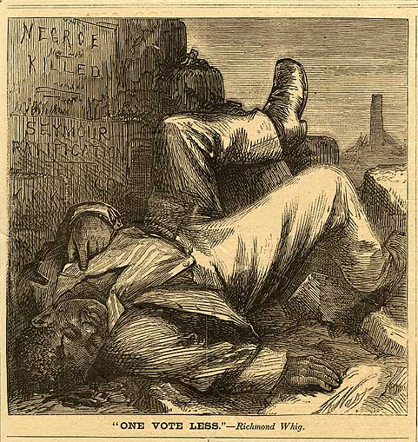

Slide 6
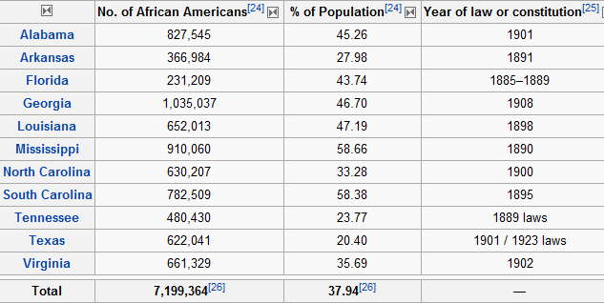

Slide 7
Mississippi
1880: Miscegenation [State Code]
Revised state code to declare marriage between white persons and Negroes or mulattoes or persons of one-quarter or more Negro blood as "incestuous and void." Penalty: Fine up to $500, or imprisonment in the penitentiary up to ten years, or both.
1890: Miscegenation [Constitution]
Prohibited marriage of a white person with a Negro or mulatto or person who has one-eighth or more of Negro blood.
1890: Education [Constitution]
Separate schools to be maintained for white and black children.
1902 [Statute]: Any person...who shall be guilty of printing, publishing or circulating printed, typewritten or written matter urging or presenting for public acceptance or general information, arguments or suggestions in favor of social equality or of intermarriage between whites and negroes, shall be guilty of a misdemeanor and subject to fine or not exceeding five hundred (500.00) dollars or imprisonment not exceeding six (6) months or both.

Slide 8
South Carolina
1895: Miscegenation [Constitution]
Prohibited marriage between a white person with a Negro or mulatto, or a person who had one-eighth or more Negro blood.
1895: Education [Constitution]
No children of either race "shall ever be permitted to attend a school provided for children of the other race."

Slide 9
Georgia
1895: Education [State Code]
Black and white children not allowed to attend the same school. Penalty: Teachers who taught white and black pupils in the same school would not be compensated out of the public school fund.
[1897, Statute:] No colored barber shall serve as a barber [to] white women or girls.
[1897, Statute:] The officer in charge shall not bury, or allow to be buried, any colored persons upon ground set apart or used for the burial of white persons.
[1901, Statute:] All persons licensed to conduct a restaurant, shall serve either white people exclusively or colored people exclusively and shall not sell to the two races within the same room or serve the two races anywhere under the same license.

Slide 10
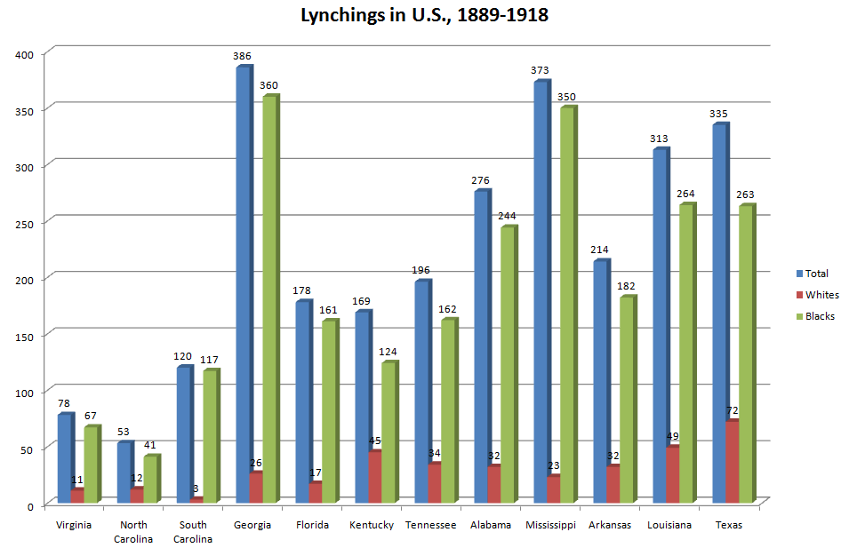

Slide 11
Louisiana:
[1890, Statute:]
Railway companies to provide equal but separate accommodations for white and colored passengers. Penalty: Passengers or conductors not complying with the law subject to a fine of $25 or imprisonment for 20 days. Officers and directors of railway companies that fail to comply guilty of a misdemeanor and could be fined between $100 and $500.
[1894, Statute:]
Depots must provide equal but separate waiting rooms for the white and colored races. "No person shall occupy the wrong room." Law must be posted in a conspicuous place. Penalty: Persons who insist on entering the improper place may be fined $25 or imprisoned up to 30 days. Agents failing to enforce the law guilty of misdemeanor, punishable by a fine of $25 to $50.

Slide 12
Plessy v. Ferguson (1896)
The object of the [14th] amendment was undoubtedly to enforce the absolute equality of the two races before the law, but, in the nature of things, it could not have been intended to abolish distinctions based upon color, or to enforce social, as distinguished from political, equality, or a commingling of the two races upon terms unsatisfactory to either . . .
In determining the question of reasonableness, [the legislature] is at liberty to act with reference to the established usages, customs, and traditions of the people, and with a view to the promotion of their comfort and the preservation of the public peace and good order. Gauged by this standard, we cannot say that a law which authorizes or even requires the separation of the two races in public conveyances is unreasonable, or more obnoxious to the Fourteenth Amendment than the acts of Congress requiring separate schools for colored children in the District of Columbia, the constitutionality of which does not seem to have been questioned, or the corresponding acts of state legislatures.

Slide 13
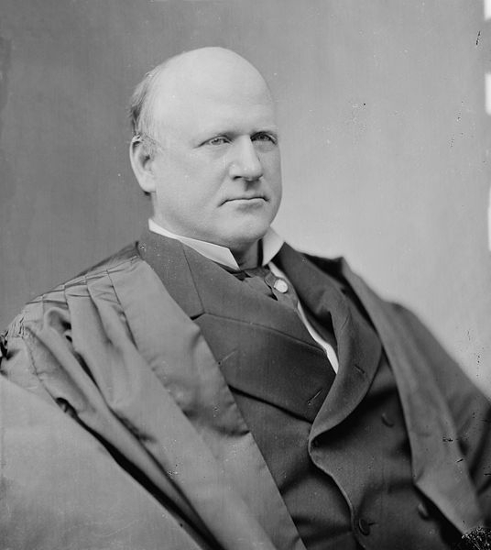
Notes:
Justice harlan

Slide 14
Plessy —Harlan dissent
The white race deems itself to be the dominant race in this country. And so it is in prestige, in achievements, in education, in wealth and in power. So, I doubt not, it will continue to be for all time if it remains true to its great heritage and holds fast to the principles of constitutional liberty. But in view of the Constitution, in the eye of the law, there is in this country no superior, dominant, ruling class of citizens. There is no caste here. Our Constitution is color-blind, and neither knows nor tolerates classes among citizens. In respect of civil rights, all citizens are equal before the law. The humblest is the peer of the most powerful. The law regards man as man, and takes no account of his surroundings or of his color when his civil rights as guaranteed by the supreme law of the land are involved. It is therefore to be regretted that this high tribunal, the final expositor of the fundamental law of the land, has reached the conclusion that it is competent for a State to regulate the enjoyment by citizens of their civil rights solely upon the basis of race.
In my opinion, the judgment this day rendered will, in time, prove to be quite as pernicious as the decision made by this tribunal in the Dred Scott Case.

Slide 15
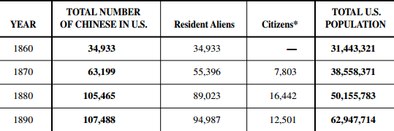
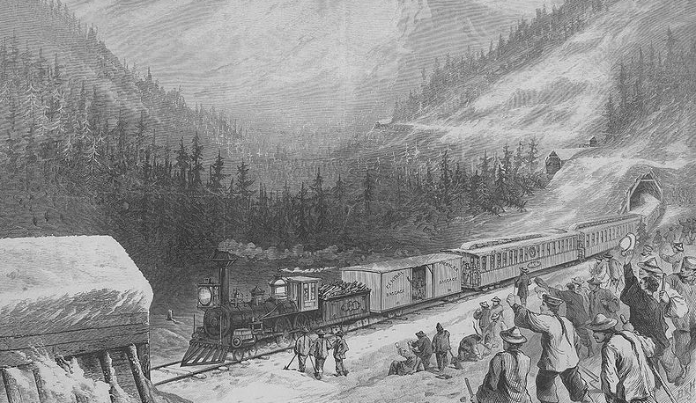

Slide 16
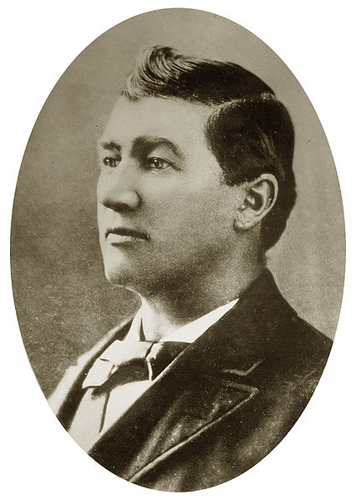
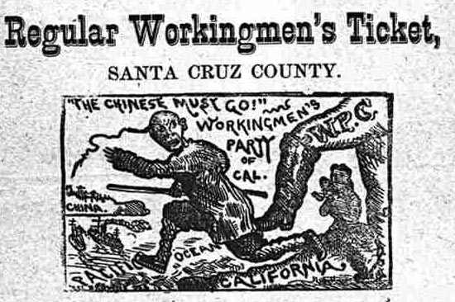
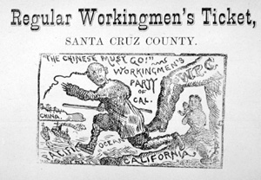
Notes:
Dennis kearney

Slide 17
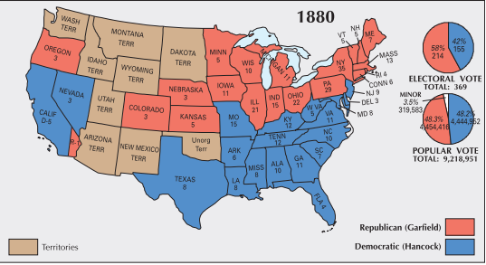
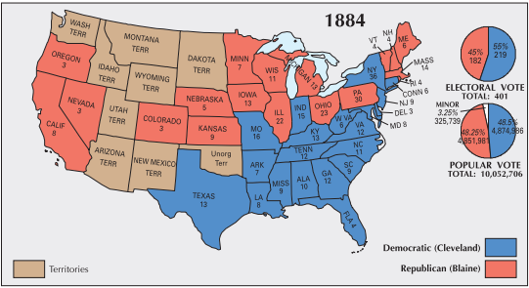

Slide 18
Chinese Exclusion Act (1882)
Be it enacted by the Senate and House of Representatives of the United States of America in Congress assembled, That from and after the expiration of ninety days next after the passage of this act, and until the expiration of ten years next after the passage of this act, the coming of Chinese laborers to the United States be, and the same is hereby, suspended; and during such suspension it shall not be lawful for any Chinese laborer to come, or having so come after the expiration of said ninety days to remain within the United States.

Slide 19
Yick Wo v. Hopkins (1886)
The rights of the petitioners, as affected by the proceedings of which they complain, are not less because they are aliens and subjects of the Emperor of China . . . The Fourteenth Amendment to the Constitution is not confined to the protection of citizens . . .
[Its] provisions are universal in their application to all persons within the territorial jurisdiction, without regard to any differences of race, of color, or of nationality, and the equal protection of the laws is a pledge of the protection of equal laws . . .
While this consent of the supervisors is withheld from them and from two hundred others who have also petitioned, all of whom happen to be Chinese subjects, eighty others, not Chinese subjects, are permitted to carry on the same business under similar conditions. The fact of this discrimination is admitted. No reason for it is shown, and the conclusion cannot be resisted that no reason for it exists except hostility to the race and nationality to which the petitioners belong, and which, in the eye of the law, is not justified. The discrimination is, therefore, illegal, and the public administration which enforces it is a denial of the equal protection of the laws and a violation of the Fourteenth Amendment of the Constitution.

Slide 20
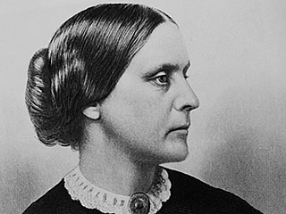
Notes:
Sb anthony

Slide 21
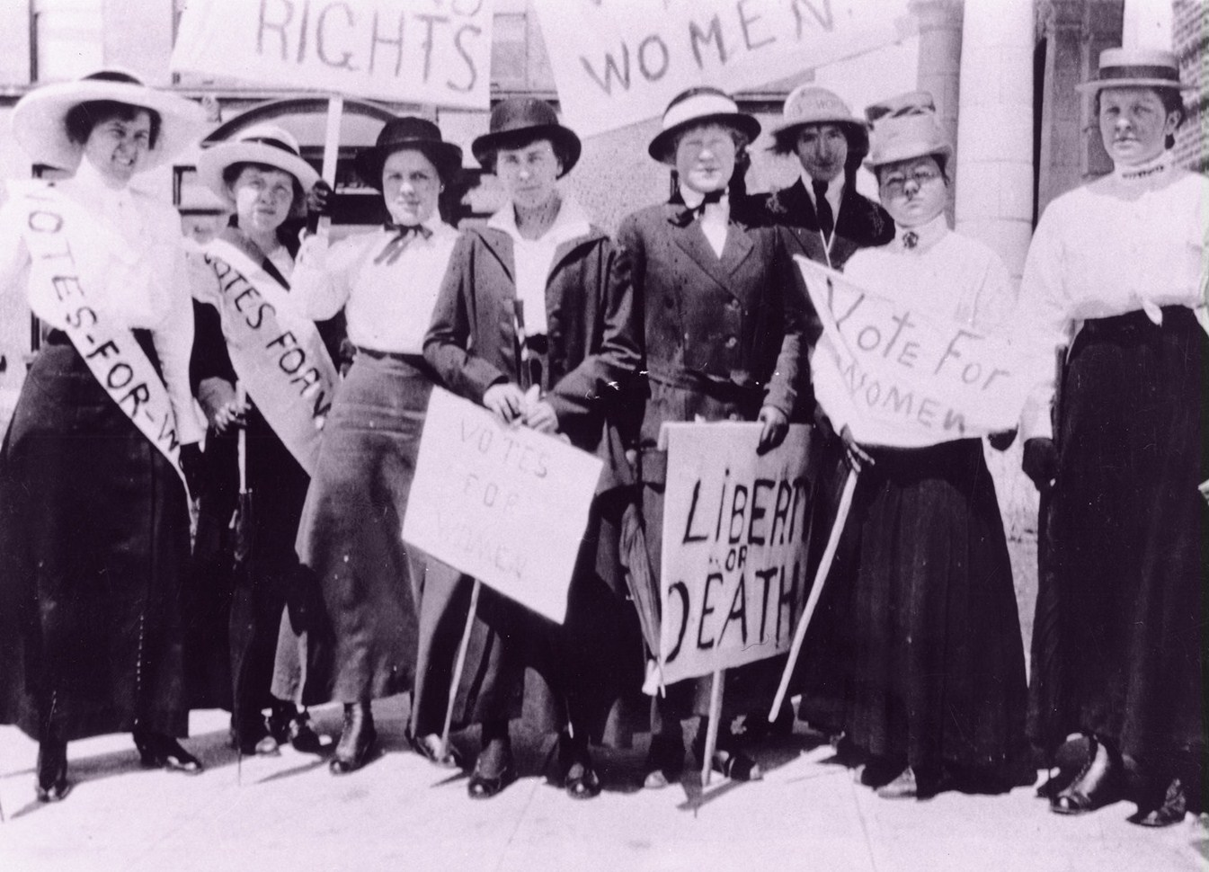

Slide 22
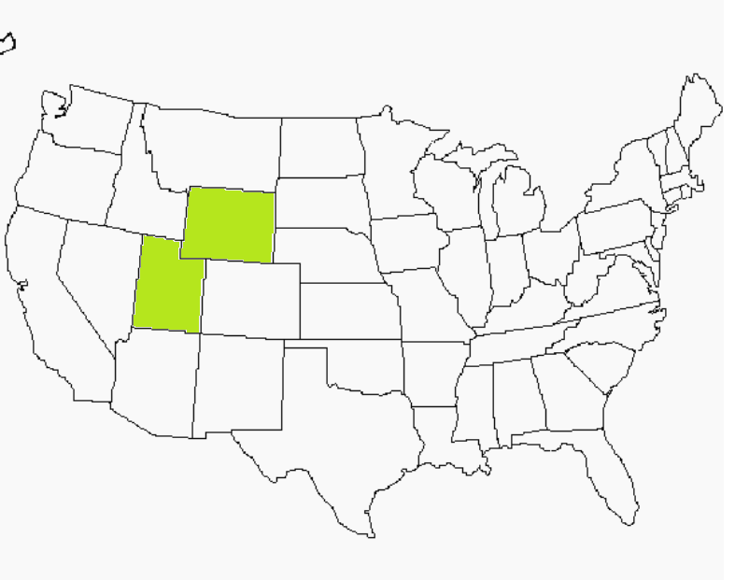

Slide 23
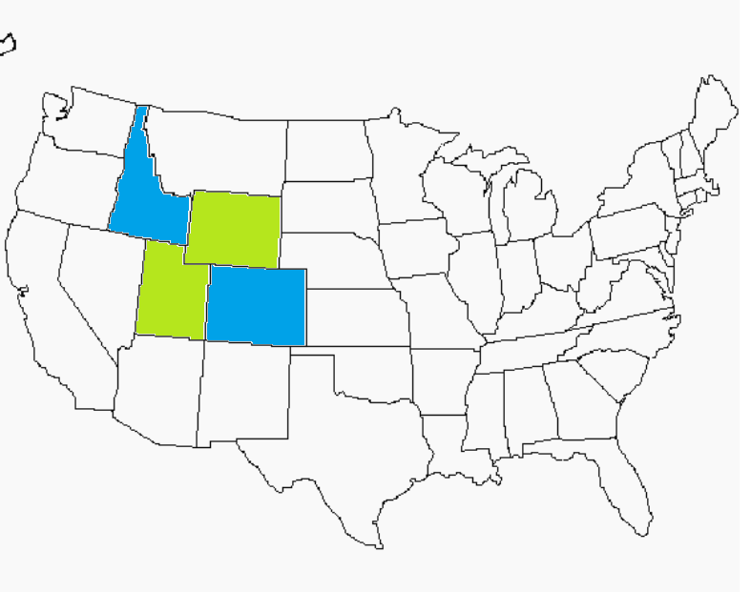

Slide 24
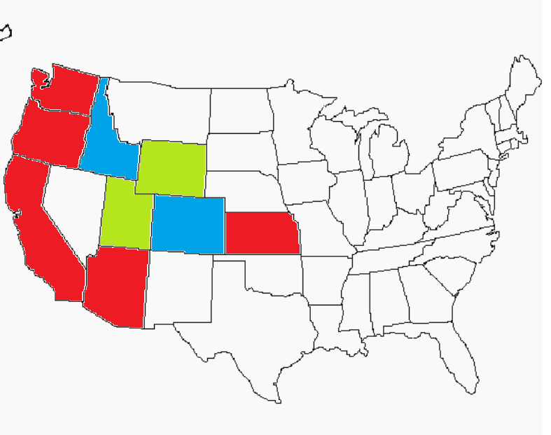

Slide 25


Slide 26
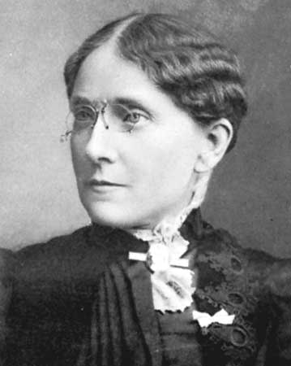
Notes:
Frances willard

Slide 27
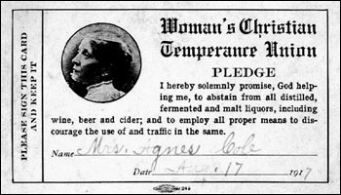

Slide 28
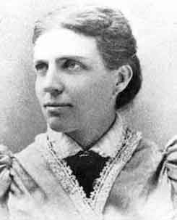
Notes:
Belle mansfield—iowa, 1869

Slide 29
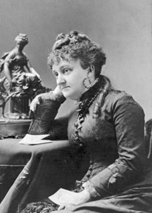
Notes:
Myra bradwell--illinois

Slide 30
Bradwell v. Illinois (1873)—Bradley, concurring
The civil law, as well as nature herself, has always recognized a wide difference in the respective spheres and destinies of man and woman. Man is, or should be, woman's protector and defender. The natural and proper timidity and delicacy which belongs to the female sex evidently unfits it for many of the occupations of civil life. The constitution of the family organization, which is founded in the divine ordinance, as well as in the nature of things, indicates the domestic sphere as that which properly belongs to the domain and functions of womanhood. The harmony, not to say identity, of interest and views which belong, or should belong, to the family institution is repugnant to the idea of a woman adopting a distinct and independent career from that of her husband. . . .
It is true that many women are unmarried and not affected by any of the duties, complications, and incapacities arising out of the married state, but these are exceptions to the general rule. The paramount destiny and mission of woman are to fulfil the noble and benign offices of wife and mother. This is the law of the Creator. And the rules of civil society must be adapted to the general constitution of things, and cannot be based upon exceptional cases.

Slide 31
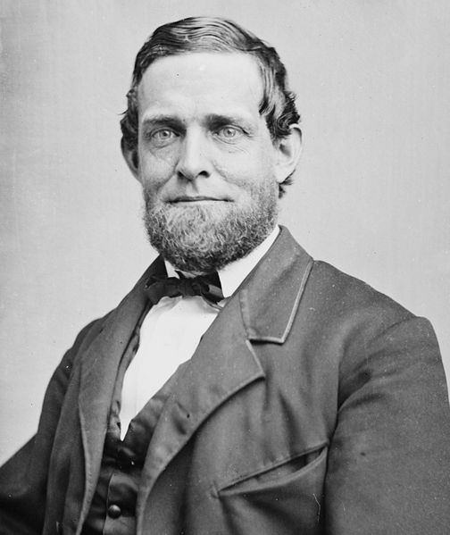
Notes:
Schuyler colfax

Slide 32
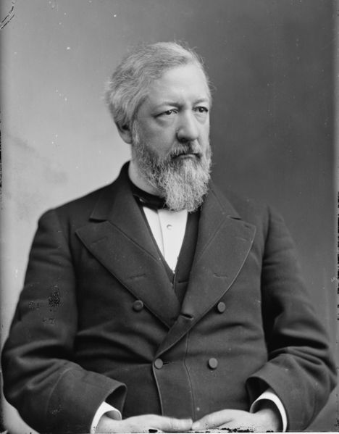
Notes:
James blaine

Slide 33
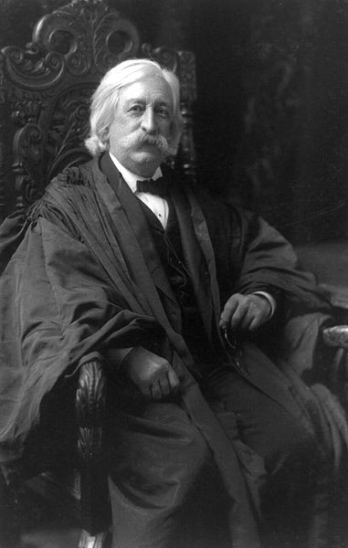
Notes:
Melville fuller—cf justice 1888-1910

Slide 34
Santa Clara Co. v Southern Pacific Railroad (1886)
… the provisions of the constitution and laws of California, in respect to the assessment for taxation of the property of railway corporations operating railroads in more than one county, are in violation of the fourteenth amendment of the constitution, in so far as they require the assessment of their property at its full money value, without making deduction, as in the case of railroads operated in one county, and of other corporations, and of natural persons, for the value of the mortgages covering the property assessed; thus imposing upon the defendant unequal burdens, and to that extent denying to it the equal protection of the laws.

Slide 35
Pollock v. Farmers’ Loan and Trust Co. (1895)
The States were about, for all national purposes embraced in the Constitution, to become one, united under the same sovereign authority and governed by the same laws. But as they still retained their jurisdiction over all persons and things within their territorial limits, except where surrendered to the general government or restrained by the Constitution…
The requirement of the Constitution is that no direct tax shall be laid otherwise than by apportionment -- the prohibition is not against direct taxes on land, from which the implication is sought to be drawn that indirect taxes on land would be constitutional, but it is against all direct taxes -- and it is admitted that a tax on real estate is a direct tax.

Slide 36
U.S. v. E.C. Knight (1895)
The argument is that the power to control the manufacture of refined sugar is a monopoly over a necessary of life, to the enjoyment of which by a large part of the population of the United States interstate commerce is indispensable, and that, therefore, the general government, in the exercise of the power to regulate commerce, may repress such monopoly directly, and set aside the instruments which have created it . . . Doubtless the power to control the manufacture of a given thing involves, in a certain sense, the control of its disposition, but this is a secondary, and not the primary, sense; and, although the exercise of that power may result in bringing the operation of commerce into play, it does not control it, and affects it only incidentally and indirectly…
It is vital that the independence of the commercial power and of the police power, and the delimitation between them, however sometimes perplexing, should always be recognized and observed, for, while the one furnishes the strongest bond of union, the other is essential to the preservation of the autonomy of the states as required by our dual form of government; and acknowledged evils, however grave and urgent they may appear to be, had better be borne, than the risk be run, in the effort to suppress them, of more serious consequences by resort to expedients of even doubtful constitutionality.

Slide 37
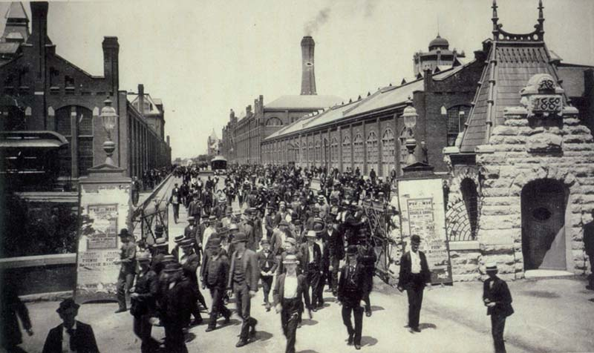
Notes:
Pullman workers walking out

Slide 38
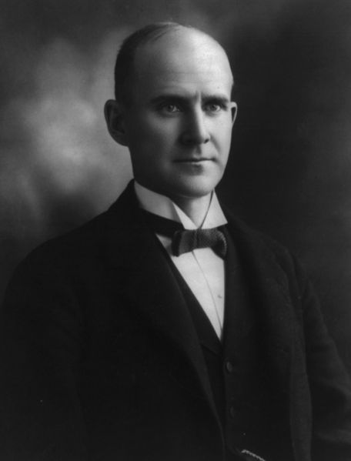

Slide 39
In re Debs (1895)
While it is a government of enumerated powers, it has full attributes of sovereignty within the limits of those powers, among which are the power over interstate commerce and the power over the transmission of the mails…
The complaint filed in this case clearly shows an existing obstruction of artificial highways for the passage of interstate commerce and the transmission of the mails, not only temporarily existing, but threatening to continue, and under it, the Circuit Court had power to issue its process of injunction.

Slide 40
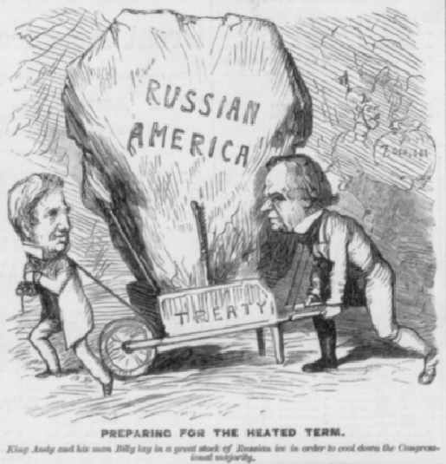

Slide 41


Slide 42


Slide 43


Slide 44
Downes v. Bidwell (1901) [Insular Cases]
Choice in some cases, the natural gravitation of small bodies towards large ones in others, the result of a successful war in still others, may bring about conditions which would render the annexation of distant possessions desirable. If those possessions are inhabited by alien races, differing from us in religion, customs, laws, methods of taxation, and modes of thought, the administration of government and justice, according to Anglo-Saxon principles, may for a time be impossible; and the question at once arises whether large concessions ought not to be made for a time, that ultimately our own theories may be carried out, and the blessings of a free government under the Constitution extended to them. We decline to hold that there is anything in the Constitution to forbid such action.

Slide 45
Downes —Harlan dissent
It will be an evil day for American liberty if the theory of a government outside of the supreme law of the land finds lodgment in our constitutional jurisprudence. No higher duty rests upon this court than to exert its full authority to prevent all violation of the principles of the Constitution.
Again, it is said that Congress has assumed, in its past history, that the Constitution goes into territories acquired by purchase or conquest only when and as it shall so direct, and we are informed of the liberality of Congress in legislating the Constitution into all our contiguous territories. This is a view of the Constitution that may well cause surprise, if not alarm. Congress, as I have observed, has no existence except by virtue of the Constitution. It is the creature of the Constitution. It has no powers which that instrument has not granted, expressly or by necessary implication. I confess that I cannot grasp the thought that Congress, which lives and moves and has its being in the Constitution, and is consequently the mere creature of that instrument, can, at its pleasure, legislate or exclude its creator from territories which were acquired only by authority of the Constitution.

Slide 46
Dorr v. United States (1904)
If the right to trial by jury were a fundamental right which goes wherever the jurisdiction of the United States extends, or if Congress, in framing laws for outlying territory belonging to the United States, was obliged to establish that system by affirmative legislation, it would follow that, no matter what the needs or capacities of the people, trial by jury, and in no other way, must be forthwith established, although the result may be to work injustice and provoke disturbance, rather than to aid the orderly administration of justice. If the United States, impelled by its duty or advantage, shall acquire territory people by savages, and of which it may dispose or not hold for ultimate admission to statehood, if this doctrine is sound, it must establish there the trial by jury. To state such a proposition demonstrates the impossibility of carrying it into practice.

