Slide 1


Slide 2

Notes:
breckenridge

Slide 3
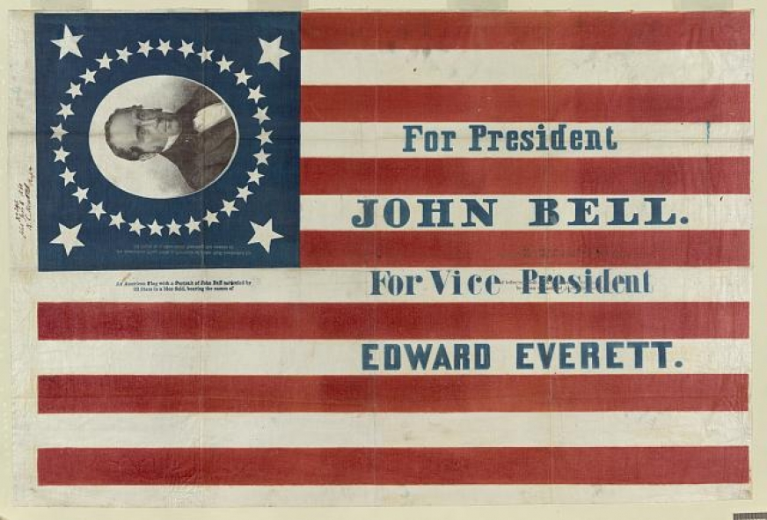

Slide 4
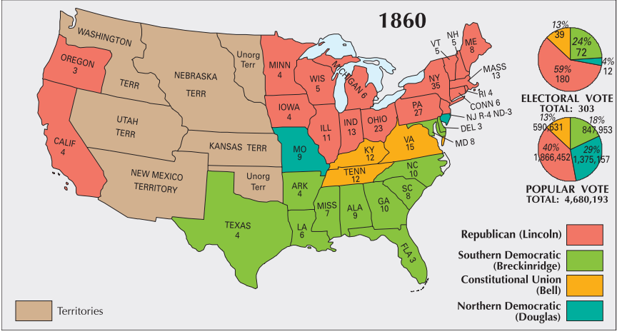

Slide 5
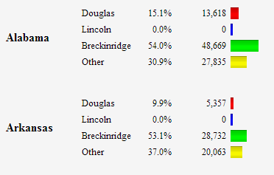
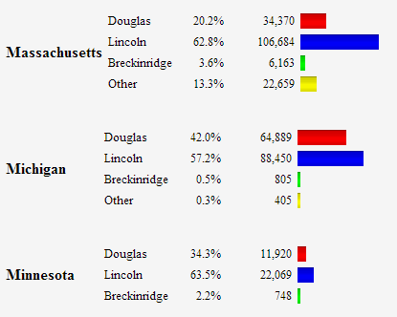


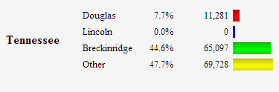
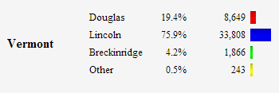
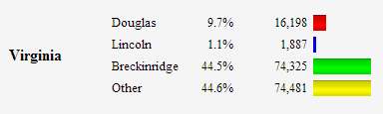

Slide 6


Slide 7
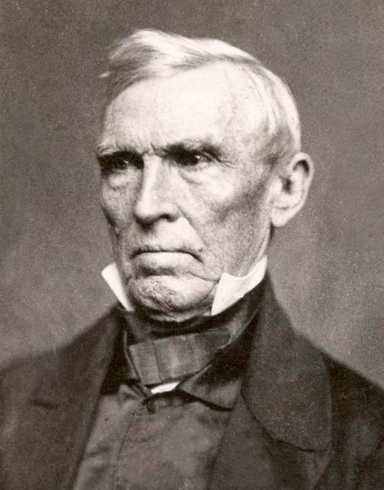
Notes:
crittenden

Slide 8
ARTICLE I.
In all the territory of the United States now held, or hereafter acquired, situated north of latitude 36° 30', slavery or involuntary servitude, except as a punishment for crime, is prohibited while such territory shall remain under territorial government. In all the territory south of said line of latitude, slavery of the African race is hereby recognized as existing, and shall not be interfered with by Congress …
ARTICLE II.
Congress shall have no power to abolish slavery in places under its exclusive jurisdiction, and situate within the limits of States that permit the holding of slaves.
ARTICLE III.
Congress shall have no power to abolish slavery within the District of Columbia, …
ARTICLE VI.
No future amendment of the Constitution shall affect the five preceding articles; nor the third paragraph of the second section of the first article of the Constitution, nor the third paragraph of the second section of the fourth article of said Constitution and no amendment shall be made to the Constitution which shall authorize or give to Congress any power to abolish or interfere with slavery in any of the States by whose laws it is, or may be allowed or permitted.

Slide 9
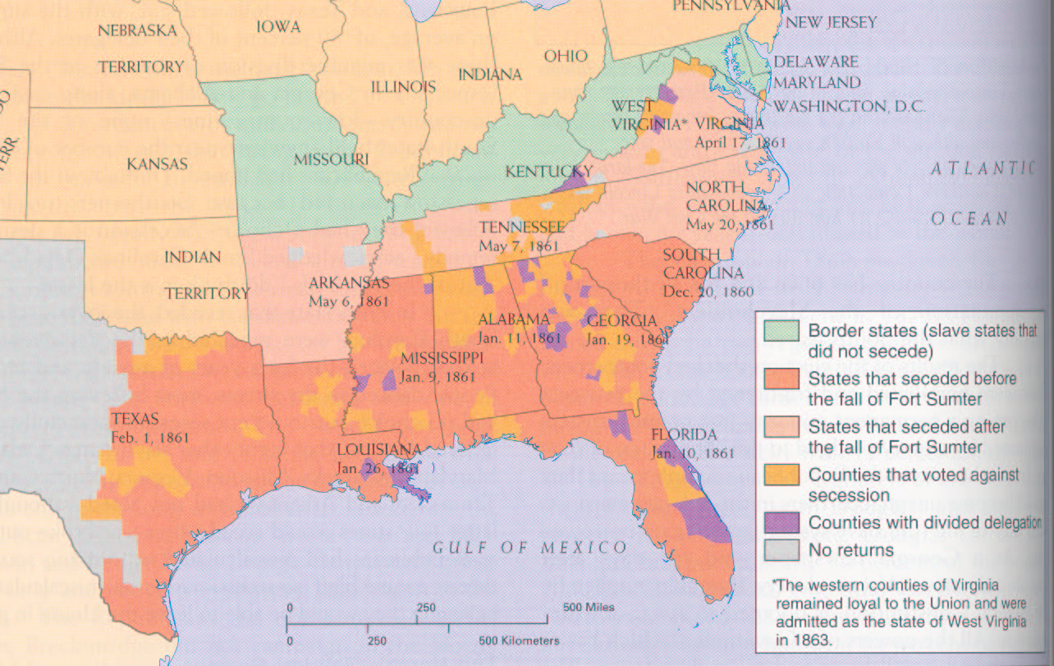

Slide 10


Slide 11
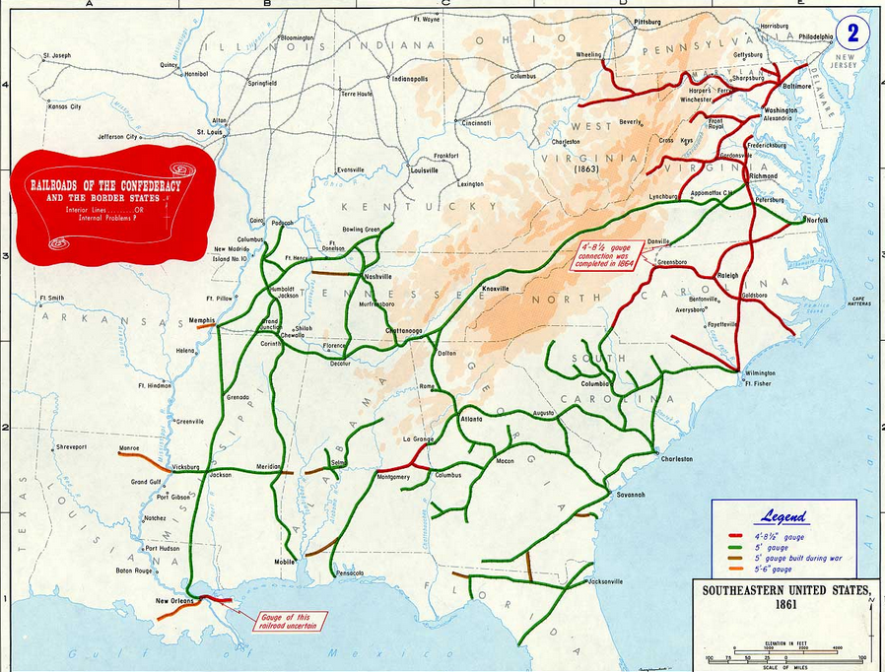

Slide 12
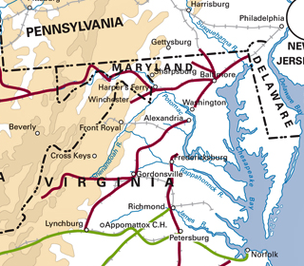

Slide 13
To the Commanding General,
Army of the United States
You are engaged in suppressing an insurrection against the laws of the United States. If at any point on or in the vicinity of any military line which is now or which shall be used between the city of Philadelphia and the city of Washington you find resistance which renders it necessary to suspend the writ of habeas corpus for the public safety, you personally, or through the officer in command at the point at which resistance occurs, are authorized to suspend that writ.
Abraham Lincoln.
Washington, April 27, 1861

Slide 14
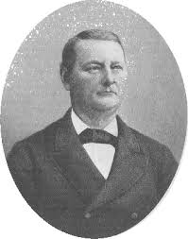
Notes:
John merryman

Slide 15
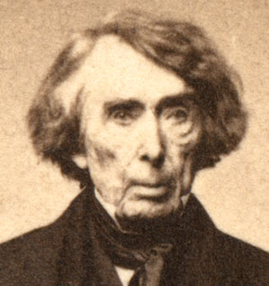

Slide 16
Ex Parte Merryman (1861)
The case, then, is simply this: A military officer residing in Pennsylvania issues an order to arrest a citizen of Maryland, upon vague and indefinite charges, without any proof, so far as appears . . .
With such provisions in the Constitution, expressed in language too clear to be misunderstood by any one, I can see no ground whatever for supposing that the President, in any emergency or in any state of things, can authorize the suspension of the privilege of the writ of habeas corpus, or arrest a citizen, except in aid of the judicial power. He certainly does not faithfully execute the laws if he takes upon himself legislative power by suspending the writ of habeas corpus and the judicial power, also, by arresting and imprisoning a person without due process of law. . .
The Government of the United States is one of delegated and limited powers. It derives it existence and authority altogether from the Constitution, and neither of its branches--executive, legislative or judicial--can exercise any of the powers of government beyond those specified and granted.

Slide 17
Lincoln, 4 July 1861 special session message
The whole of the laws which were required to be faithfully executed were being resisted and failing of execution in nearly one-third of the States. Must they be allowed to finally fail of execution, even had it been perfectly clear that by the use of the means necessary to their execution some single law, made in such extreme tenderness of the citizen's liberty that practically it relieves more of the guilty than of the innocent, should to a very limited extent be violated? To state the question more directly, Are all the laws but one to go unexecuted, and the Government itself go to pieces lest that one be violated? Even in such a case, would not the official oath be broken if the Government should be overthrown when it was believed that disregarding the single law would tend to preserve it?

Slide 18
Lincoln, 4 July 1861 special session message
This issue embraces more than the fate of these United States. It presents to the whole family of man the question whether a constitutional republic, or democracy--a government of the people by the same people--can or can not maintain its territorial integrity against its own domestic foes. It presents the question whether discontented individuals, too few in numbers to control administration according to organic law in any case, can always, upon the pretenses made in this case, or on any other pretenses, or arbitrarily without any pretense, break up their government, and thus practically put an end to free government upon the earth. It forces us to ask, Is there in all republics this inherent and fatal weakness? Must a government of necessity be too strong for the liberties of its own people, or too weak to maintain its own existence?

Slide 19
Edwin Stanton statement (Jan. 1862)
The breaking out of a formidable insurrection, based on a conflict of political ideas, being an event without precedent in the United States, was necessarily attended by a great confusion and perplexity of the public mind. Disloyalty, before unsuspected, suddenly became bold, and treason astonished the world by bringing at once in the field military forces superior in numbers to the standing army of the United States…
In this emergency the President felt it his duty to employ with energy the extraordinary powers which the Constitution confides to him in cases of insurrection…
Meantime a favorable change of public opinion has occurred. The line between loyalty and disloyalty is plainly defined; the whole structure of the government is firm and stable; apprehensions of public danger and facilities for treasonable practices have diminished with the passions which prompted heedless persons to adopt them. The insurrection is believed to have culminated and to be declining.
The President, in view of these facts, and anxious to favor a return to the normal course of the administration, as far as regard for the public welfare will allow, directs that all political prisoners or state prisoners now held in military custody be released on their subscribing to a parole engaging them to render no aid or comfort to the enemies in hostility to the United States.

Slide 20
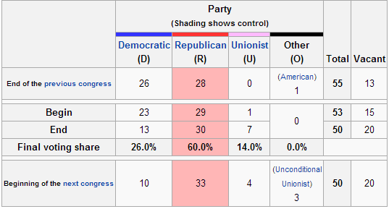
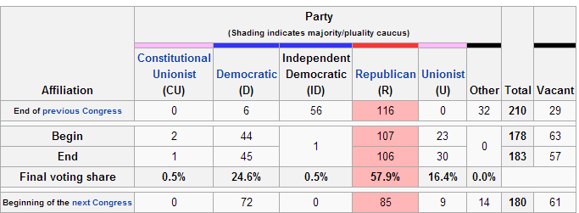

Slide 21
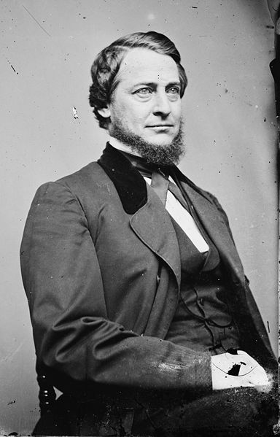
Notes:
vallandingham

Slide 22
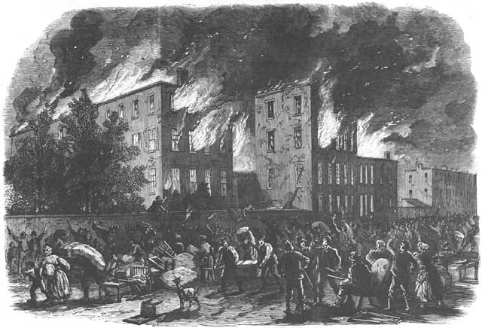
Notes:
Nyc draft riots

Slide 23
Homestead Act (1862)
Any person who is the head of a family, or who has arrived at the age of twenty-one years, and is a citizen of the United States, or who shall have filed his declaration of intention to become such, as required by the naturalization laws of the United States, and who has never borne arms against the United States Government or given aid and comfort to its enemies, shall, from and after the first January, eighteen hundred and sixty-three, be entitled to enter one quarter section or a less quantity of unappropriated public lands, upon which said person may have filed a preemption claim, or which may, at the time the application is made, be subject to preemption at one dollar and twenty-five cents, or less, per acre; or eighty acres or less of such unappropriated lands, at two dollars and fifty cents per acre, to be located in a body, in conformity to the legal subdivisions of the public lands, and after the same shall have been surveyed.
Passes House, 107-16; Senate 33-7.

Slide 24
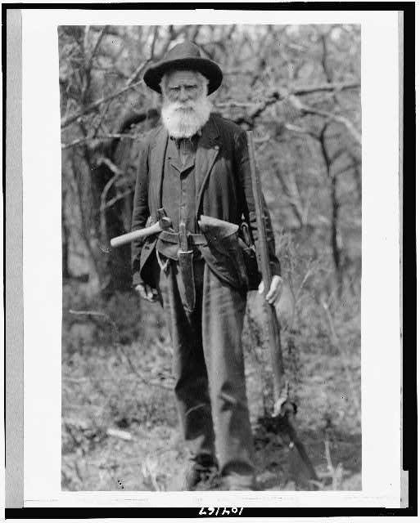
Notes:
Daniel Freeman, Nebraska, first homesteader, 1863

Slide 25
Morrill Land-Grant College Act (1862)
All moneys derived from the sale of the lands aforesaid by the States to which the lands are apportioned . . . and that the moneys so invested shall constitute a perpetual fund, the capital of which shall remain forever undiminished . . . and the interest of which shall be inviolably appropriated, by each State which may take and claim the benefit of this act, to the endowment, support, and maintenance of at least one college where the leading object shall be, without excluding other scientific and classical studies, and including military tactics, to teach such branches of learning as are related to agriculture and the mechanic arts, in such manner as the legislatures of the States may respectively prescribe, in order to promote the liberal and practical education of the industrial classes in the several pursuits and professions in life.
Passes House, 90-25, Senate 32-7.

Slide 26
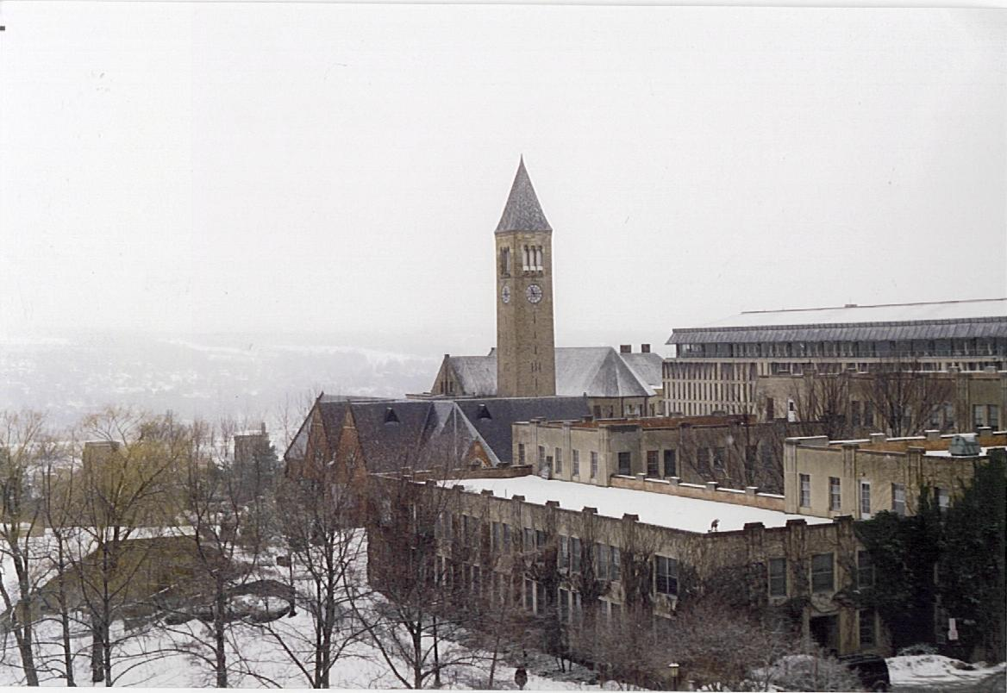
Notes:
69 univs total

Slide 27
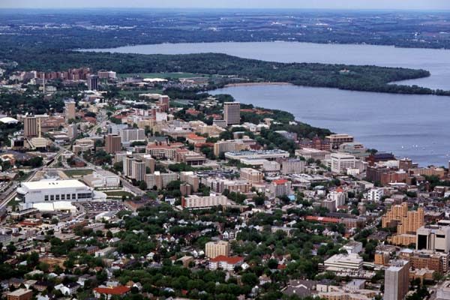

Slide 28


Slide 29
Pacific Railroad Act (1862)
The right of way through the public lands be, and the same is hereby, granted to said company for the construction of said railroad and telegraph line; and the right, power, and authority is hereby given to said company to take from the public lands adjacent to the line of said road, earth, stone, timber, and other materials for the construction thereof; said right of way is granted to said railroad to the extent of two hundred feet in width on each side of said railroad where it may pass over the public lands, including all necessary grounds for stations, buildings, workshops, and depots, machine shops, switches, side tracks, turntables, and, water stations. The United States shall extinguish as rapidly as may be the Indian titles to all lands falling under the operation of this act and required for the said right of way and; grants hereinafter made.

Slide 30
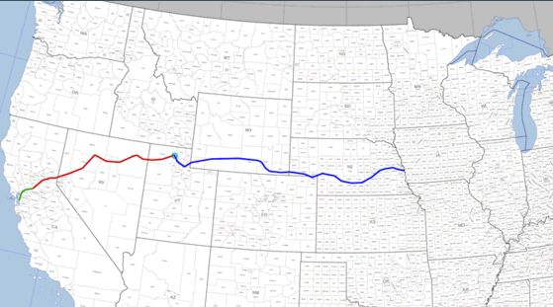

Slide 31
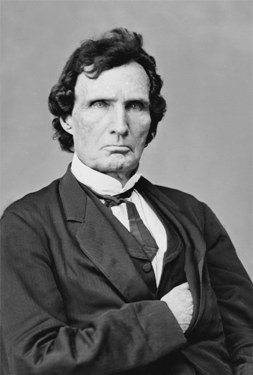
Notes:
Thaddeus stevens

Slide 32
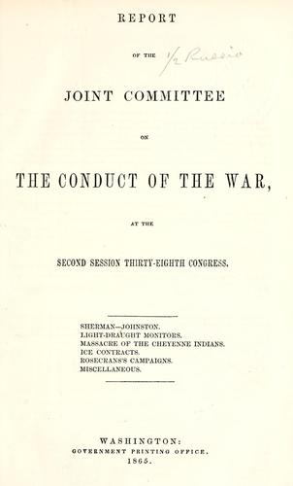

Slide 33
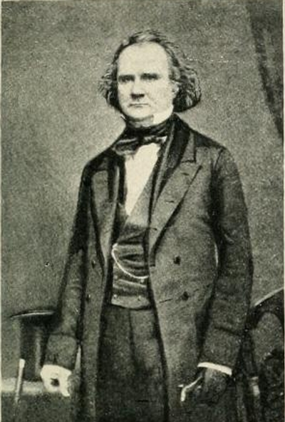
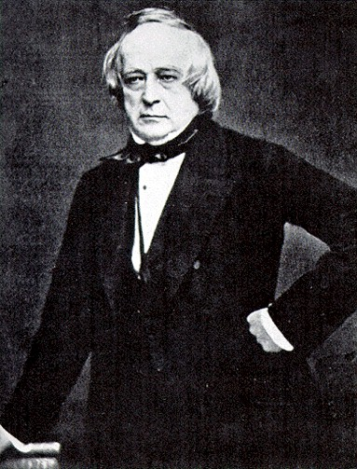
Notes:
Mason, slidell—trent affair

Slide 34
Prize Cases (1862)
[Plaintiffs] contend also that insurrection is the act of individuals, and not of a government or sovereignty; that the individuals engaged are subjects of law. That confiscation of their property can be effected only under a municipal law. That, by the law of the land, such confiscation cannot take place without the conviction of the owner of some offence, and finally that . . . the Constitution and Laws of the United States are still operative over persons in all the States for punishment, as well as protection.
This argument . . . assumes that where a civil war exists, the party belligerent claiming to be sovereign cannot, for some unknown reason, exercise the rights of belligerents, although the revolutionary party may. Being sovereign, he can exercise only sovereign rights over the other party. The insurgent may be killed on the battlefield or by the executioner; his property on land may be confiscated under the municipal law; but the commerce on the ocean, which supplies the rebels with means to support the war, cannot be made the subject of capture under the laws of war, because it is "unconstitutional!!!" Now it is a proposition never doubted that the belligerent party who claims to be sovereign may exercise both belligerent and sovereign rights. Treating the other party as a belligerent and using only the milder modes of coercion which the law of nations has introduced to mitigate the rigors of war cannot be a subject of complaint by the party to whom it is accorded as a grace or granted as a necessity.

Slide 35
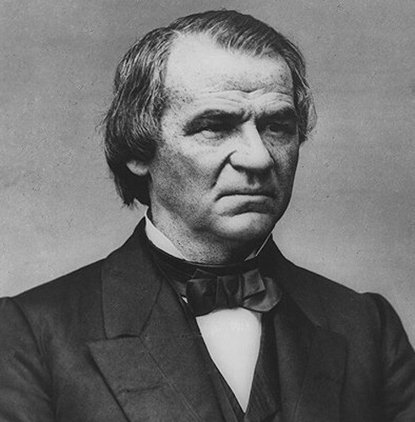

Slide 36
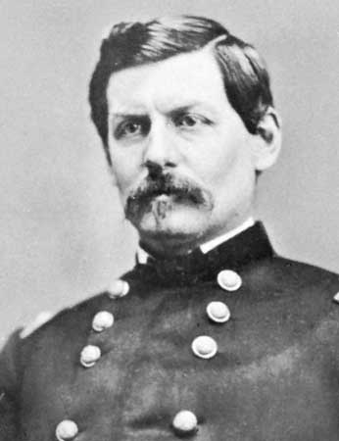
Notes:
mcclellan

Slide 37
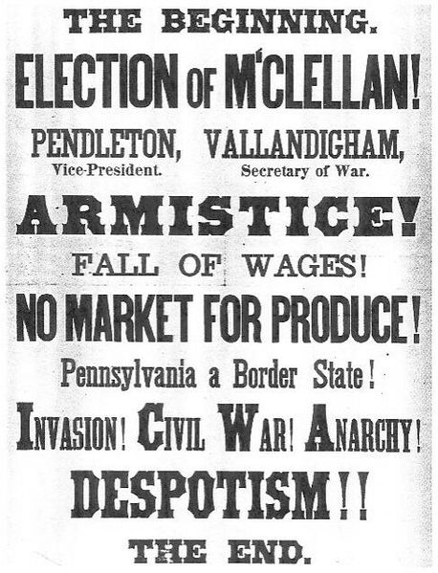

Slide 38
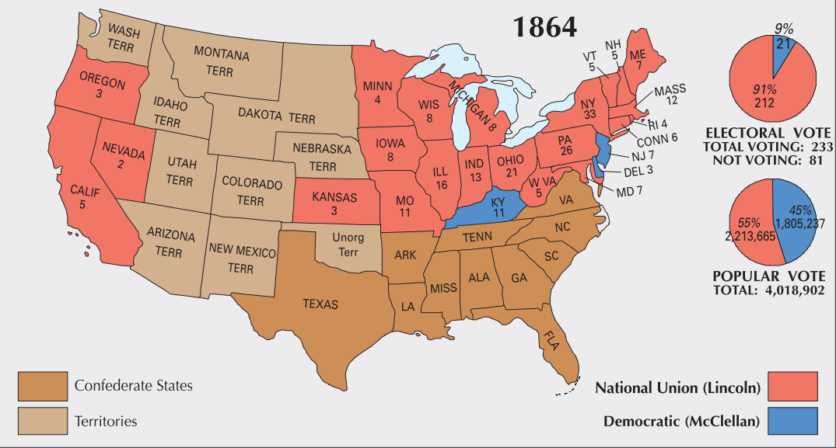

Slide 39
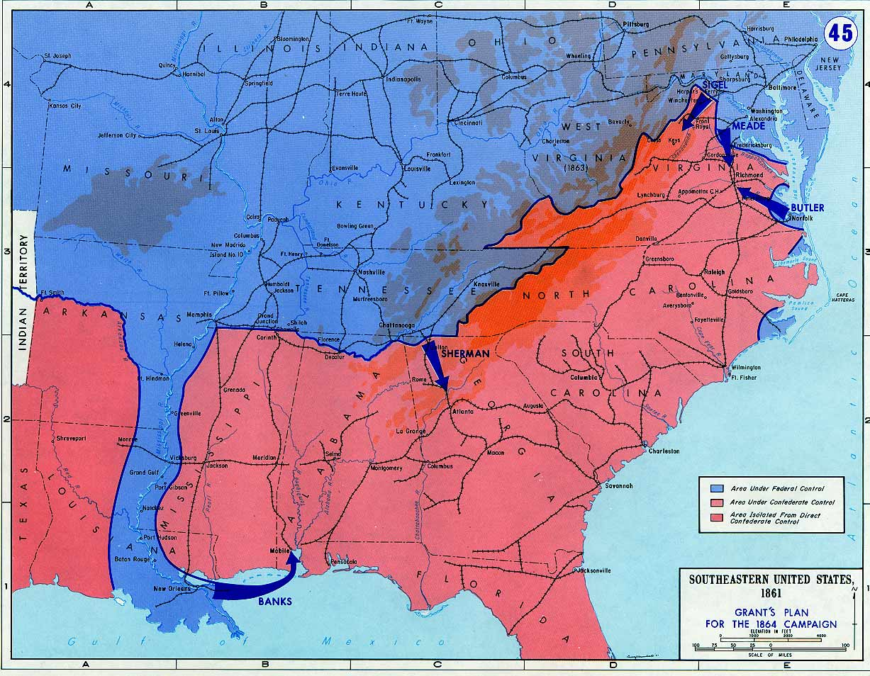

Slide 40
Reconstruction Plans
Lincoln
10% 1860 voters (white males) take oath of loyalty to Union
Wade-Davis bill
50% 1860 voters (white males) take oath of loyalty to Union
Confed. officeholders or those who “voluntarily” took up arms can’t vote/hold office
Confed. debt repudiated
New state constitutions that abolish slavery

Slide 41
13th Amendment
Section 1. Neither slavery nor involuntary servitude, except as a punishment for crime whereof the party shall have been duly convicted, shall exist within the United States, or any place subject to their jurisdiction.
Section 2. Congress shall have power to enforce this article by appropriate legislation.

