Slide 1
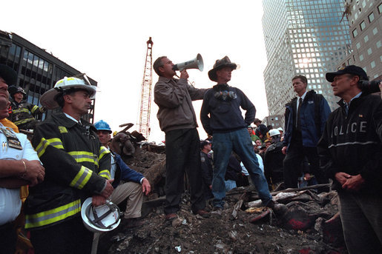

Slide 2
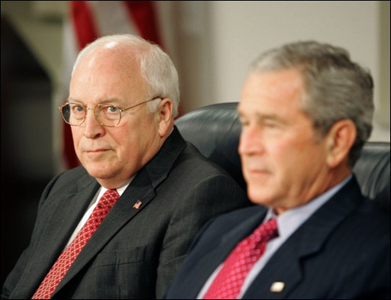

Slide 3
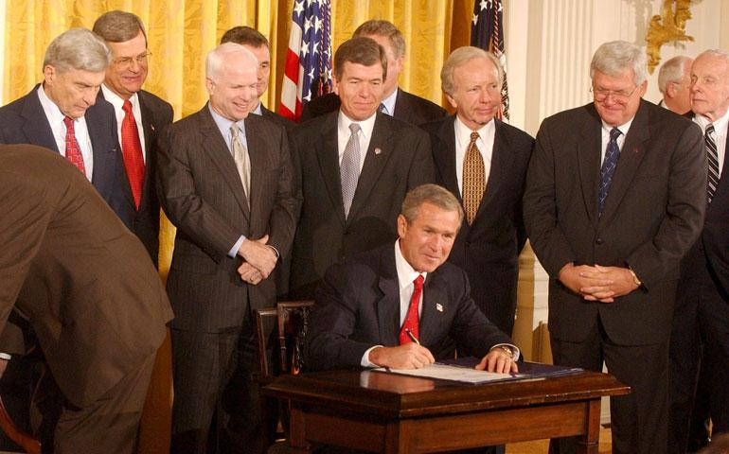

Slide 4
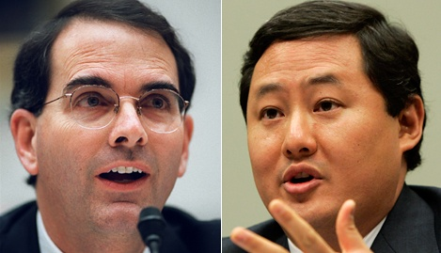

Slide 5
We have explained the scope of the President's Commander-in Chief power. In those opinions, we explained that the text, structure and history of the Constitution establish that the Founders entrusted the President with the primary responsibility, and therefore the power, to protect the security of the United States…
The structure of the Constitution demonstrates that any power traditionally understood as pertaining to the executive -which includes the conduct of warfare and the defense of the nation-unless expressly assigned to Congress, is vested in the President…
Ordinary federal criminal statutes do not apply to the properly-authorized interrogation of enemy combatants by the United States Armed Forces during an armed conflict…
Even if these [anti-torture] statutes were misconstrued to apply to persons acting at the direction of the President during the conduct of war, the Department of Justice could not enforce this law or any of the other criminal statutes applicable to the special maritime and territorial jurisdiction against federal officials acting pursuant to the President's constitutional authority to direct a war.

Slide 6
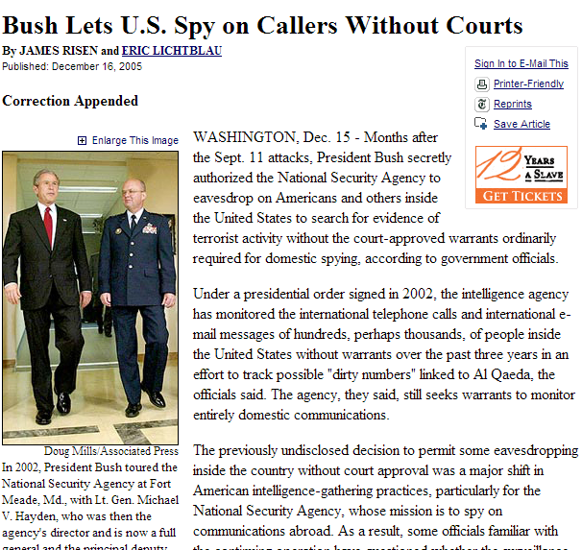

Slide 7
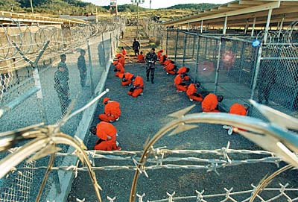

Slide 8
Hamdi v. Rumsfeld (2004)
Striking the proper constitutional balance here is of great importance to the Nation during this period of ongoing combat. But it is equally vital that our calculus not give short shrift to the values that this country holds dear or to the privilege that is American citizenship. It is during our most challenging and uncertain moments that our Nation's commitment to due process is most severely tested; and it is in those times that we must preserve our commitment at home to the principles for which we fight abroad…
We therefore hold that a citizen-detainee seeking to challenge his classification as an enemy combatant must receive notice of the factual basis for his classification, and a fair opportunity to rebut the Government's factual assertions before a neutral decisionmaker…
In so holding, we necessarily reject the Government's assertion that separation of powers principles mandate a heavily circumscribed role for the courts in such circumstances. Indeed, the position that the courts must forgo any examination of the individual case and focus exclusively on the legality of the broader detention scheme cannot be mandated by any reasonable view of separation of powers, as this approach serves only to condense power into a single branch of government. We have long since made clear that a state of war is not a blank check for the President when it comes to the rights of the Nation's citizens.

Slide 9

Justice Kennedy: I’m interested in your arguments on the... on the legitimacy and the regularity of these commissions.
Solicitor General Paul Clement: And if I could talk to various aspects of that, I’m happy--
Justice Breyer: Can I put the--
Mr. Clement: --to do so.
Justice Breyer: --that issue in... And ignore my question, which is the same as Justice Kennedy's, if it doesn't help.
I’m trying to focus this. And, in my mind, I take their argument as saying,
“Look, you want to try a war crime. You want to say this is a war crimes tribunal.
“One, this is not a war, at least not an ordinary war. Two, it's not a war crime, because that doesn't fall under international law. And, three, it's not a war crime tribunal or commission, because no emergency, not on the battlefield, civil courts are open, there is no military commander asking for it, it's not in any of those in other respects, like past history.
“And if the President can do this, well, then he can set up commissions to go to Toledo, and, in Toledo, pick up an alien, and not have any trial at all, except before that special commission.”

Slide 10
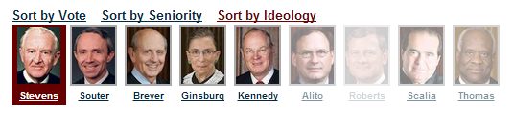
Hamdan v. Rumsfeld (2006)
At a minimum, the Government must make a substantial showing that the crime for which it seeks to try a defendant by military commission is acknowledged to be an offense against the law of war. That burden is far from satisfied here. The crime of “conspiracy” has rarely if ever been tried as such in this country by any law-of-war military commission not exercising some other form of jurisdiction, and does not appear in either the Geneva Conventions or the Hague Conventions—the major treaties on the law of war . . .
The charge's shortcomings are not merely formal, but are indicative of a broader inability on the Executive's part here to satisfy the most basic precondition—at least in the absence of specific congressional authorization—for establishment of military commissions: military necessity. . . .
In undertaking to try Hamdan and subject him to criminal punishment, the Executive is bound to comply with the Rule of Law that prevails in this jurisdiction.

Slide 11
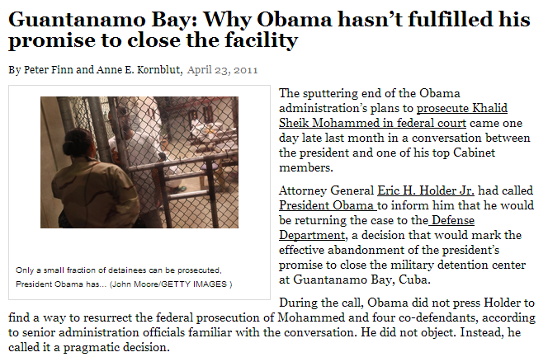

Slide 12
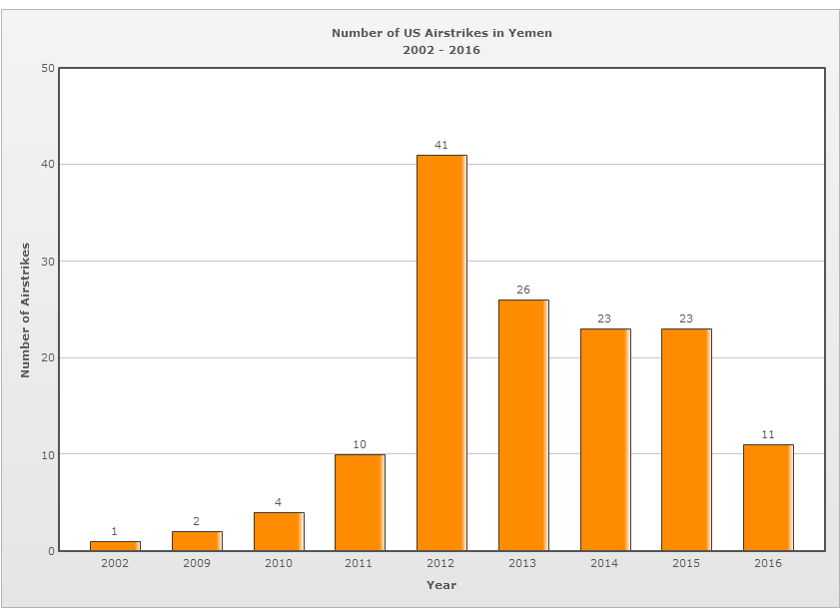

Slide 13
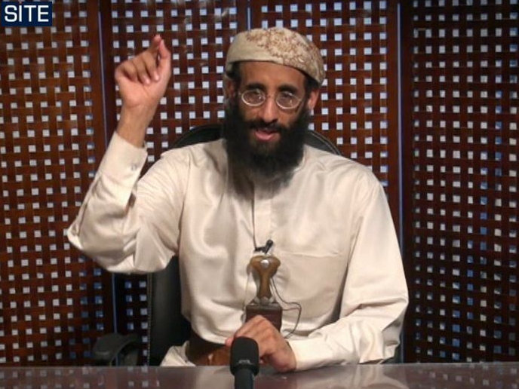

Slide 14
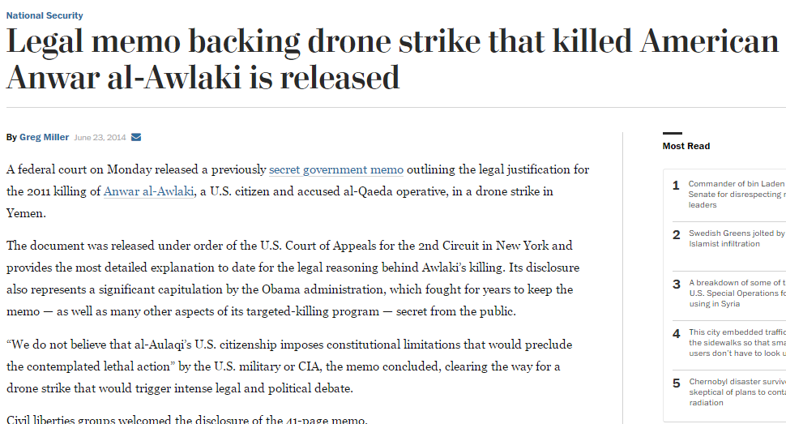

Slide 15
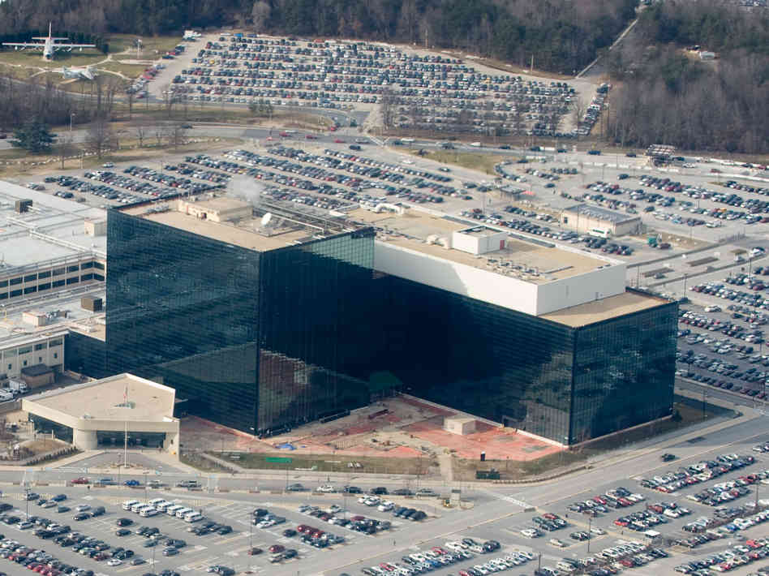

Slide 16
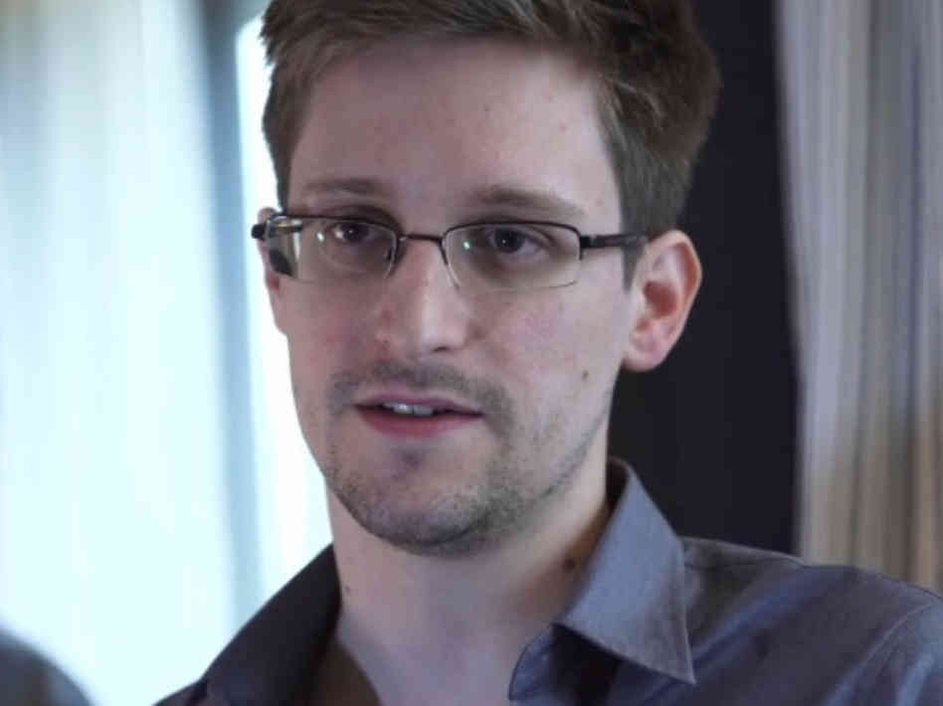
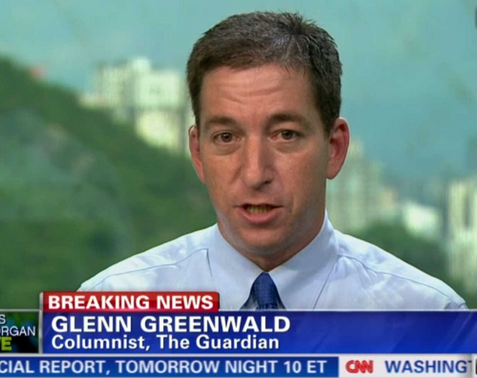

Slide 17
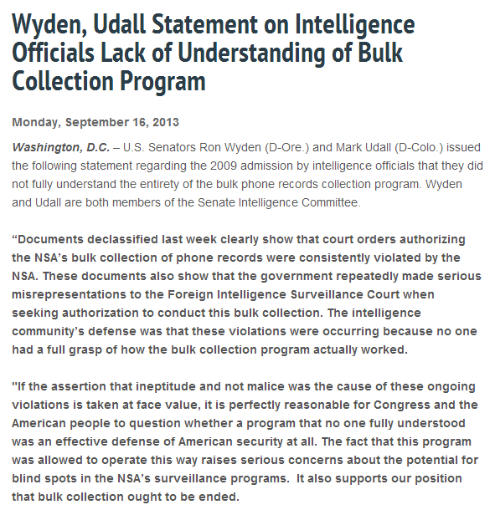

Slide 18
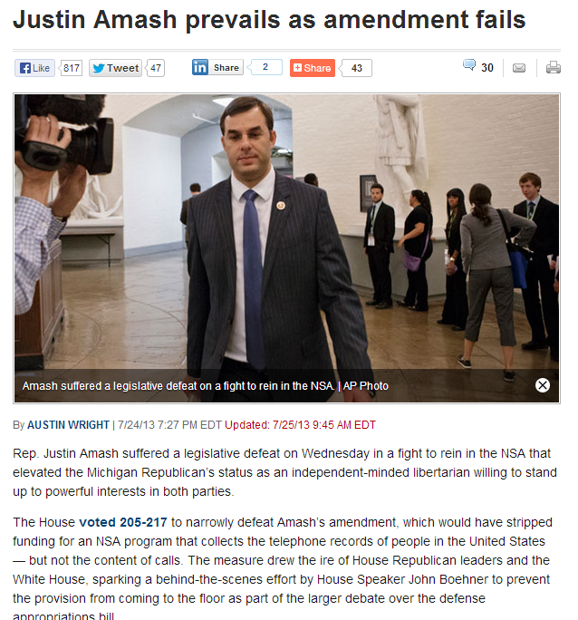
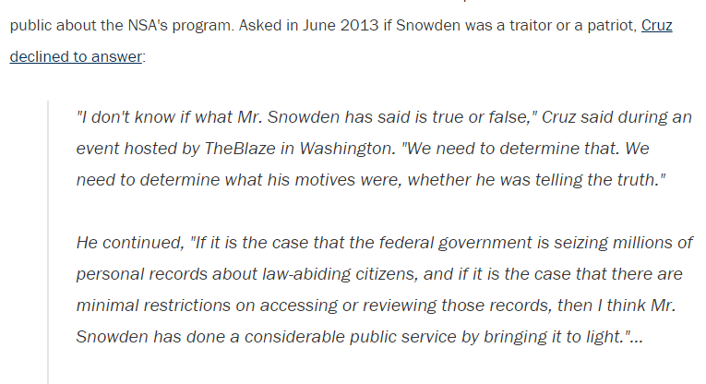

Slide 19
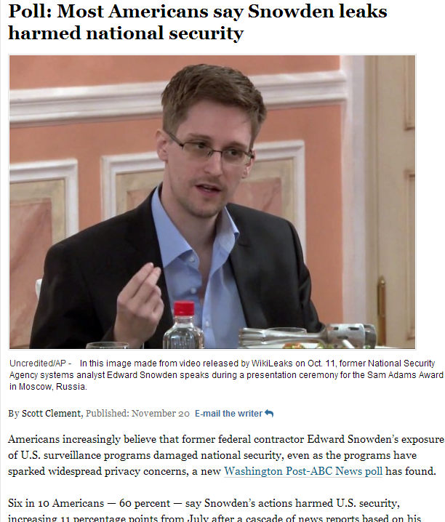

Slide 20
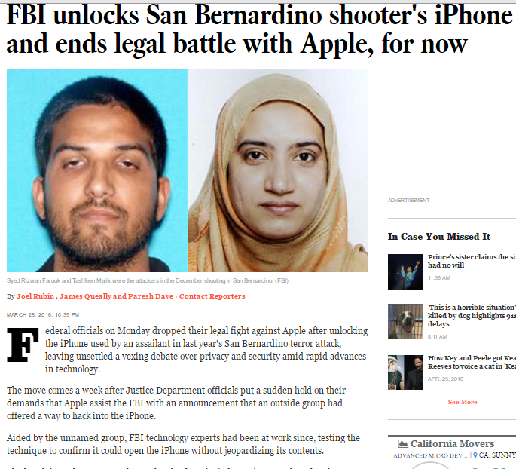

Slide 21
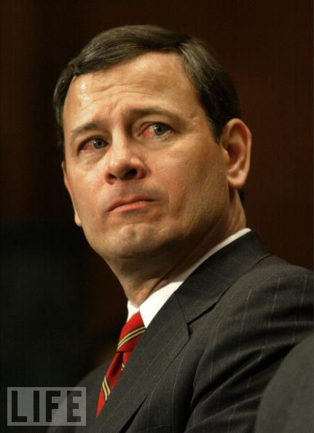
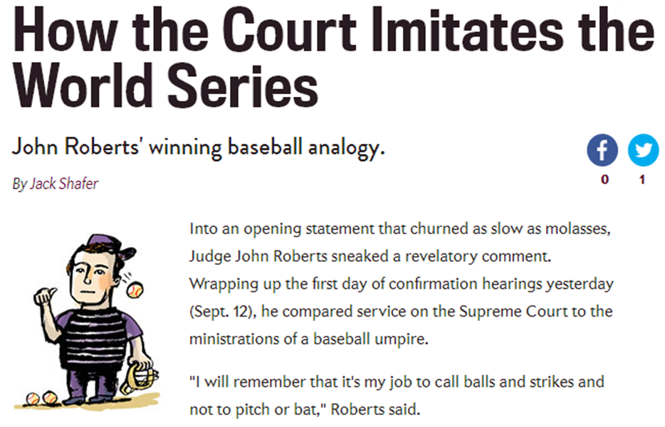

Slide 22

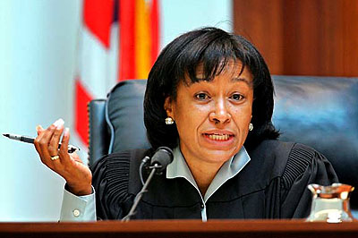
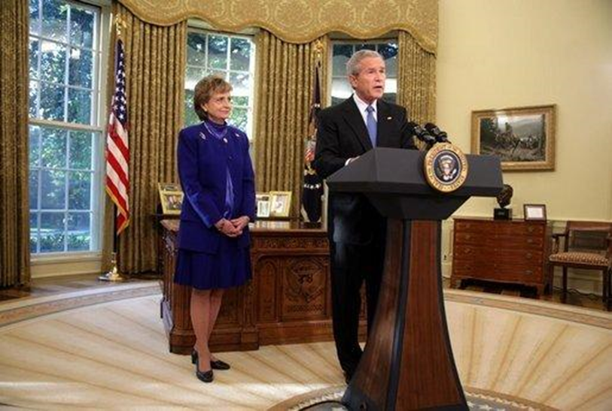

Slide 23
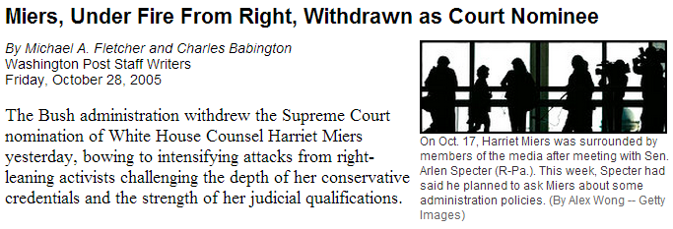

Slide 24
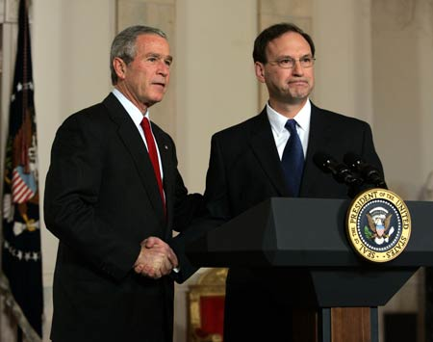

Slide 25
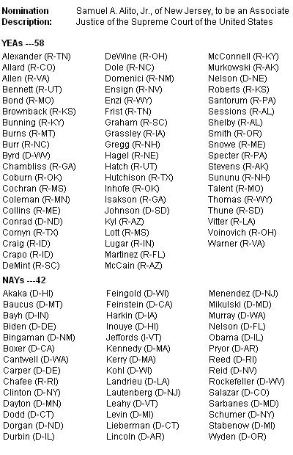

Slide 26
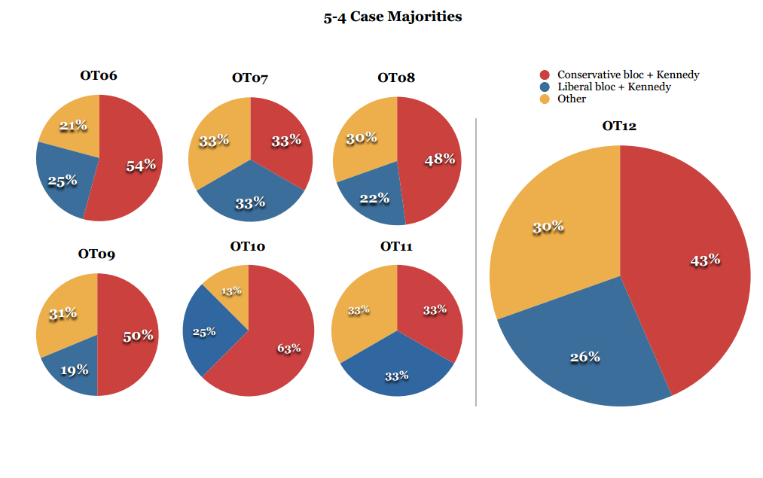
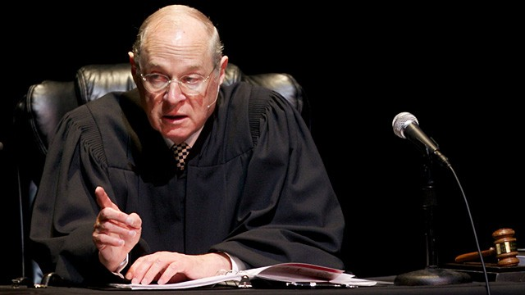
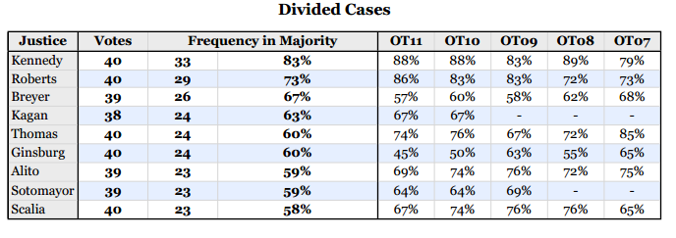

Slide 27


Slide 28
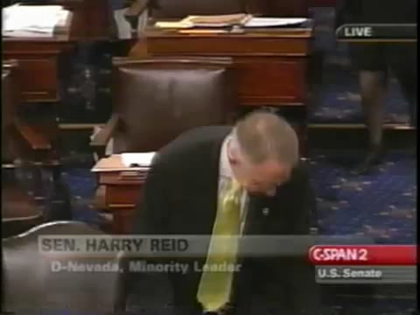

Slide 29
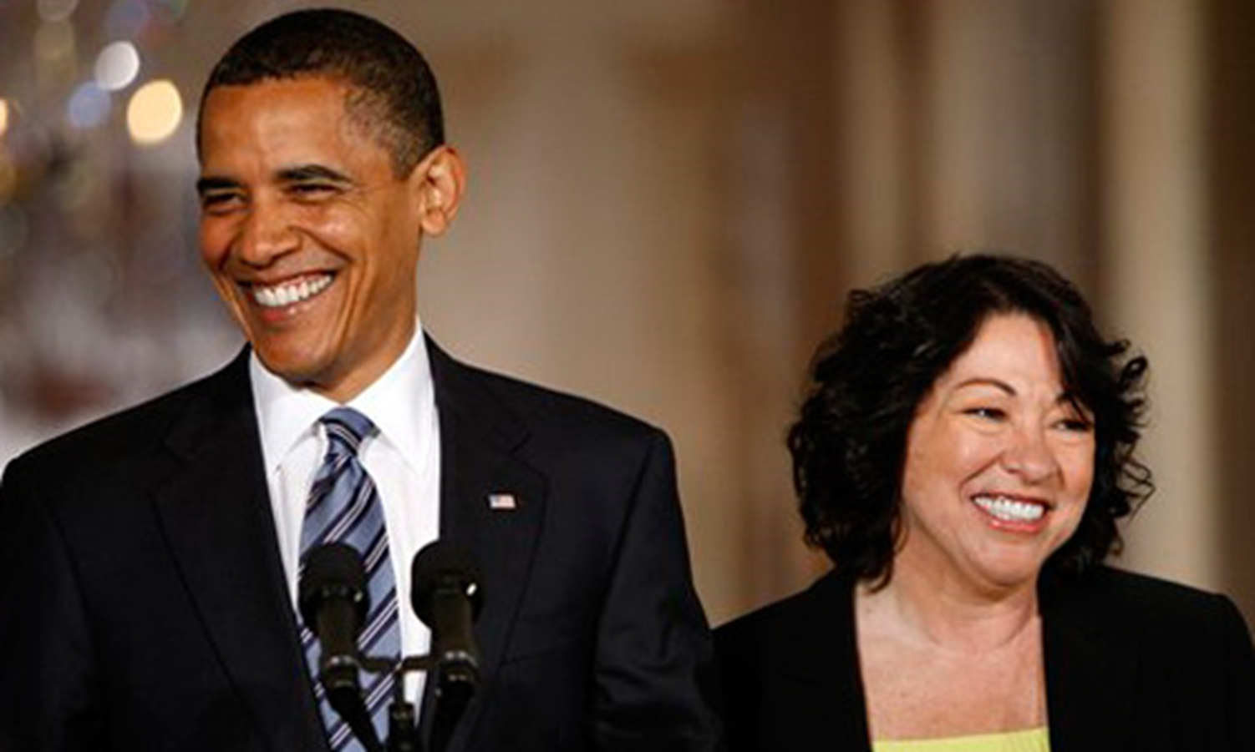
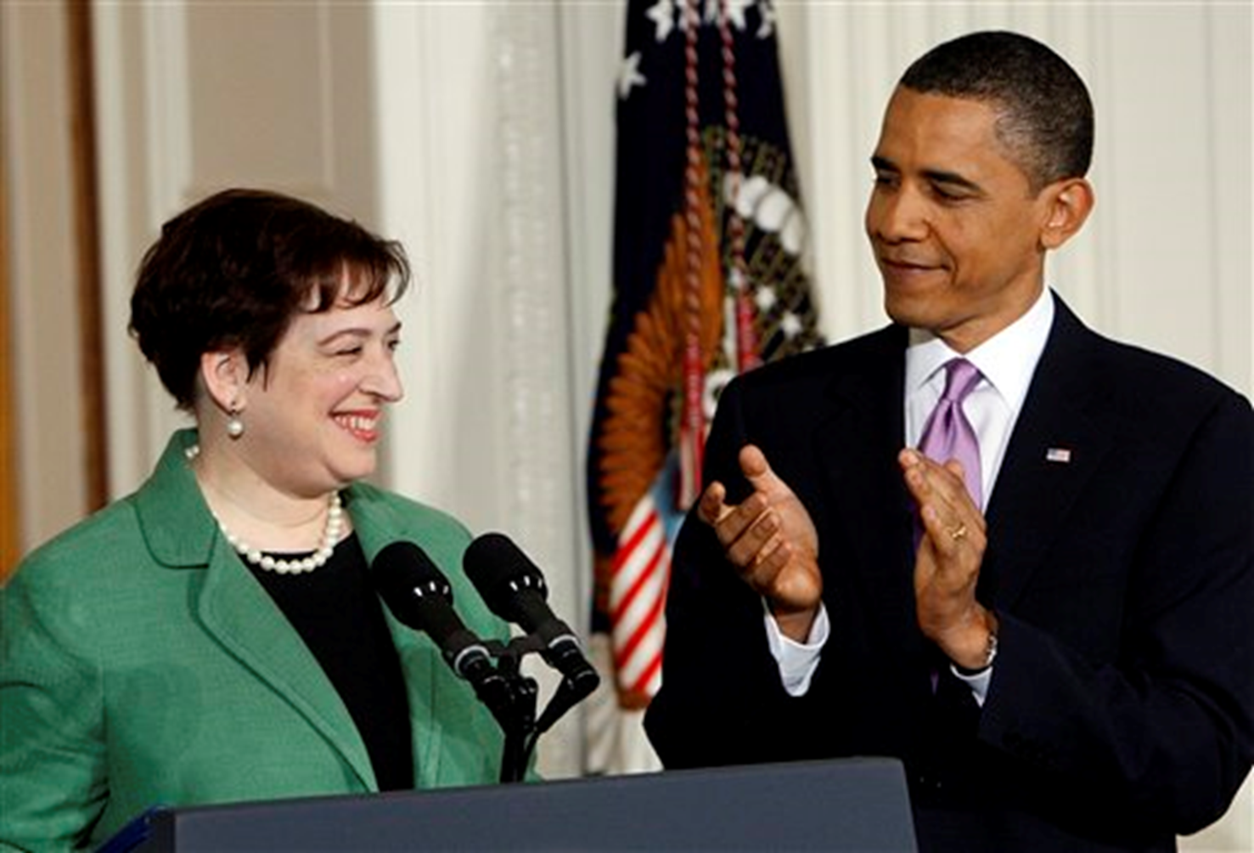

Slide 30
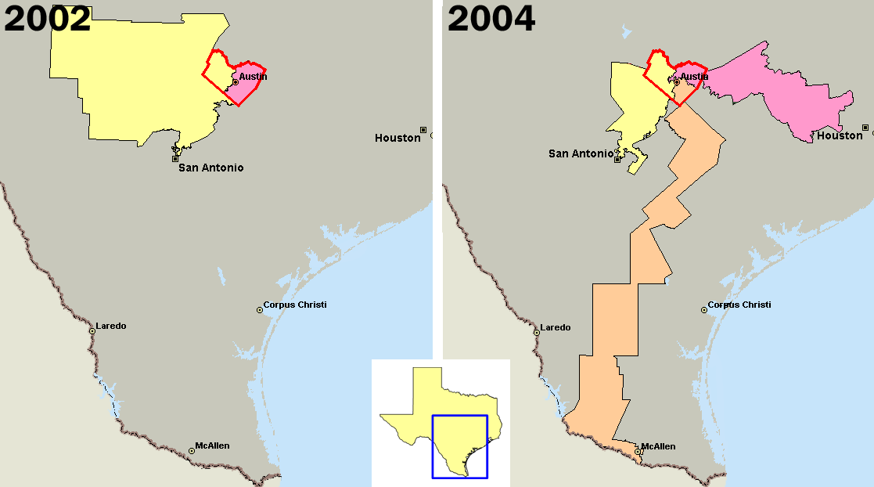

Slide 31
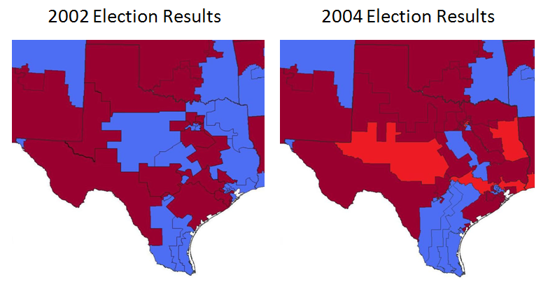

Slide 32
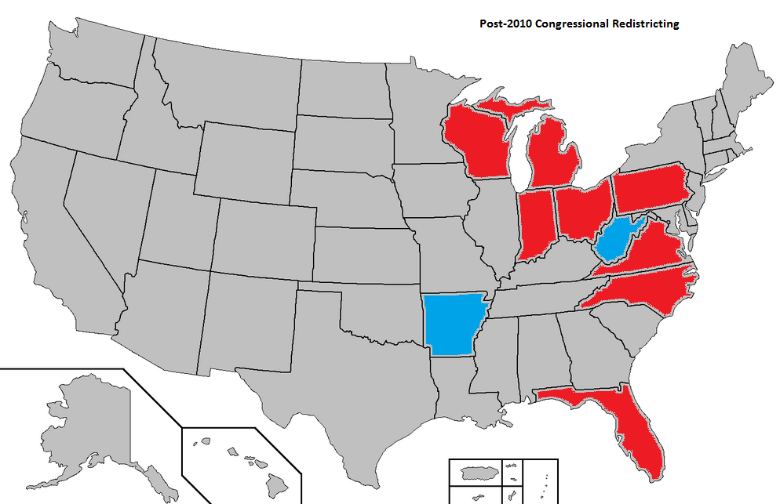

Slide 33
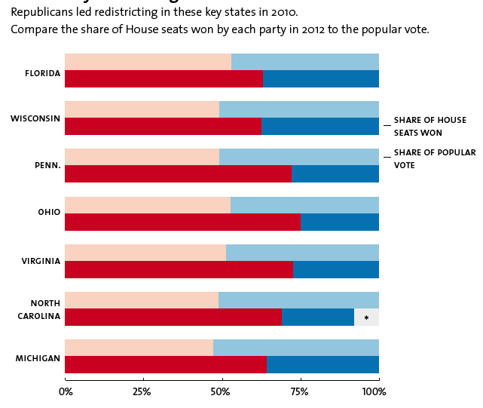

Slide 34
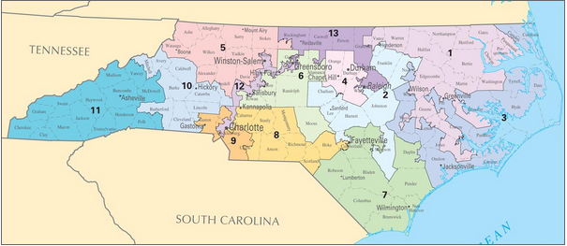
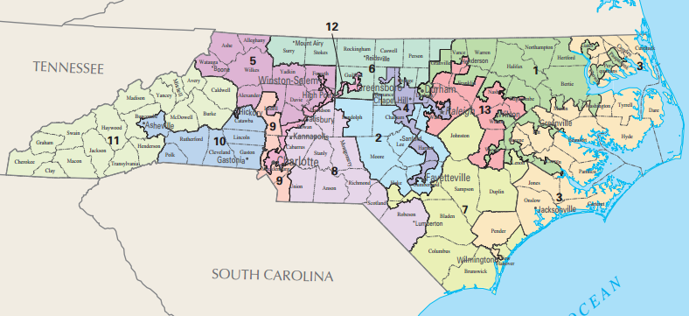
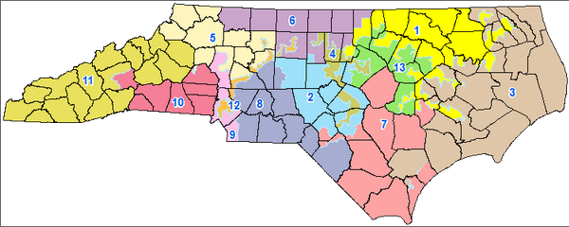

Slide 35
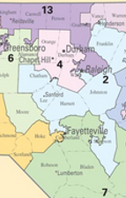


Slide 36
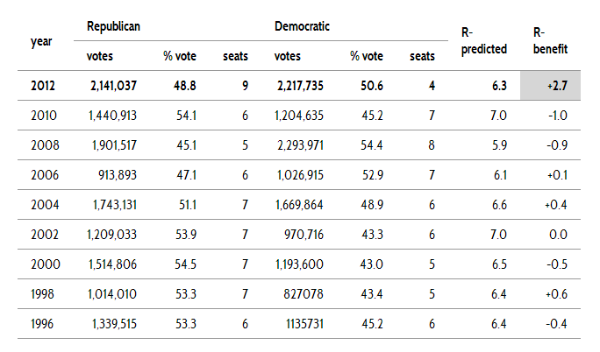

Slide 37
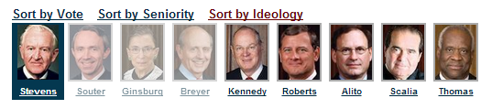
Crawford v. Marion County Election Board (2008)--Souter dissent
Without a shred of evidence that in-person voter impersonation is a problem in the State, much less a crisis, Indiana has adopted one of the most restrictive photo identification requirements in the country. …The State hardly even tries to explain its decision to force indigents or religious objectors to travel all the way to their county seats every time they wish to vote, and if there is any waning of confidence in the administration of elections it probably owes more to the State's violation of federal election law than to any imposters at the polling places. It is impossible to say, on this record, that the State's interest in adopting its signally inhibiting photo identification requirement has been shown to outweigh the serious burdens it imposes on the right to vote.
If more were needed to condemn this law, our own precedent would provide it, for the calculation revealed in the Indiana statute crosses a line when it targets the poor and the weak.

Slide 38
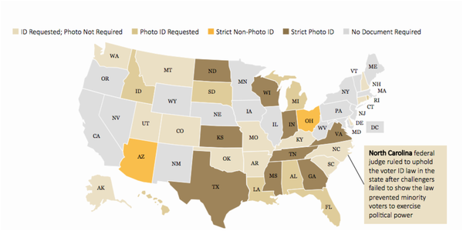

Slide 39
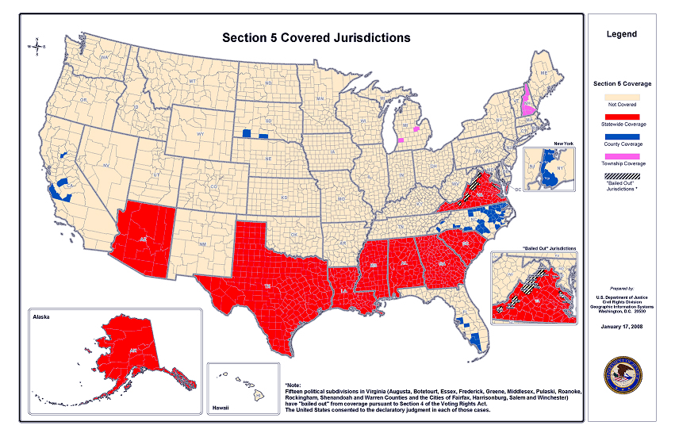

Slide 40
Solicitor General Verrilli: The covered jurisdictions [under Section 5 of the Voting Rights Act] contain only 14 percent of the subjurisdictions in the nation.
And so 14 percent of the subjurisdictions in the nation are generating up to 81 percent of the successful Section 2 litigation.
And I think--
Chief Justice Roberts: General, is it -- is it the government’s submission that the citizens in the South are more racist than the citizens in the North?
Solicitor General Verrilli: --It is not. And I do not know the answer to that, Your Honor, but I do think it was reasonable for Congress--
Chief Justice Roberts: Well, which: you said it is not, and [you said that] you don’t know the answer to it.
Solicitor General Verrilli: --I – it’s not our submission.
As an objective matter, I don’t know the answer to that question.

Slide 41
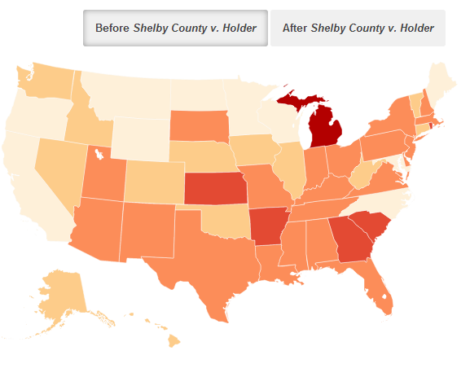
State—Restrictive Voting Policies

Slide 42
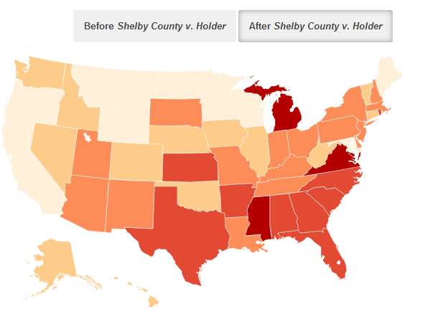
State—Restrictive Voting Policies

Slide 43
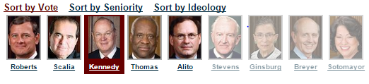
Citizens United v. FEC (2010)
Speech is an essential mechanism of democracy, for it is the means to hold officials accountable to the people. The right of citizens to inquire, to hear, to speak, and to use information to reach consensus is a precondition to enlightened self-government and a necessary means to protect it. The First Amendment “‘has its fullest and most urgent application’ to speech uttered during a campaign for political office.”…
The fact that a corporation, or any other speaker, is willing to spend money to try to persuade voters presupposes that the people have the ultimate influence over elected officials. This is inconsistent with any suggestion that the electorate will refuse “‘to take part in democratic governance’” because of additional political speech made by a corporation or any other speaker.

Slide 44
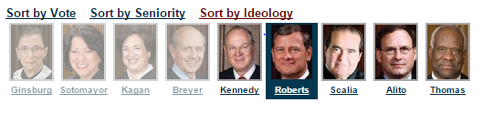
McCutcheon v. FEC (2014)
Spending large sums of money in connection with elections, but not in connection with an effort to control the exercise of an officeholder’s duties, does not give rise to quid pro quo corruption. Nor does the possibility that an individual who spends large sums may garner ‘influence over or access to’ elected officials . . .
The Government may no more restrict how many candidates or causes a donor may support than it may tell a newspaper how many candidates to endorse…
In assessing the First Amendment interests at stake, the proper focus is on an individual’s right to engage in political speech, not a collective conception of the public good.

Slide 45
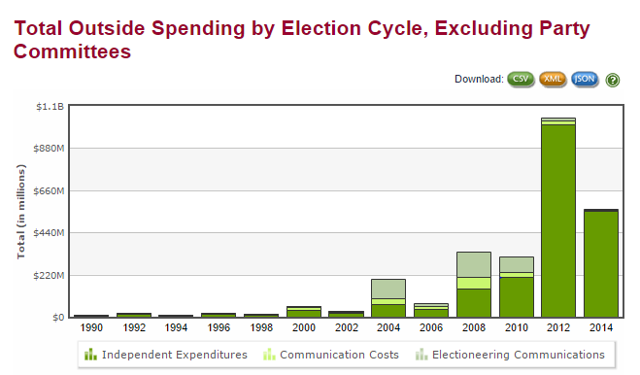

Slide 46
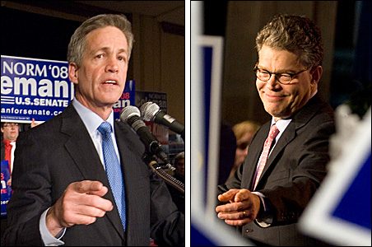

Slide 47


Slide 48



Slide 49



Slide 50


Slide 51


Slide 52


