Slide 1
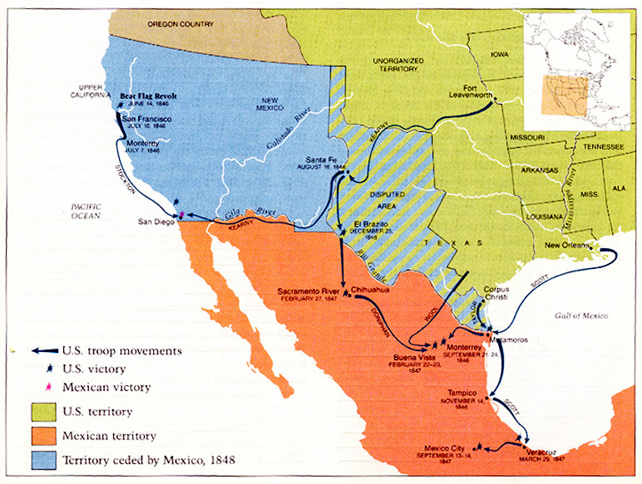

Slide 2
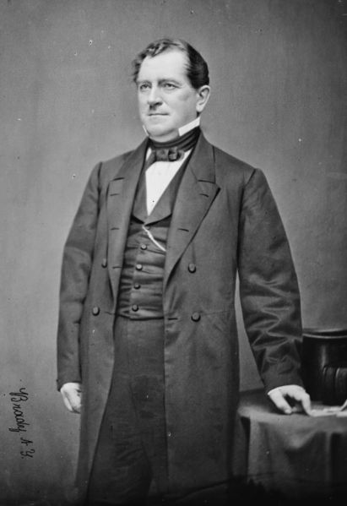
Notes:
giddings

Slide 3
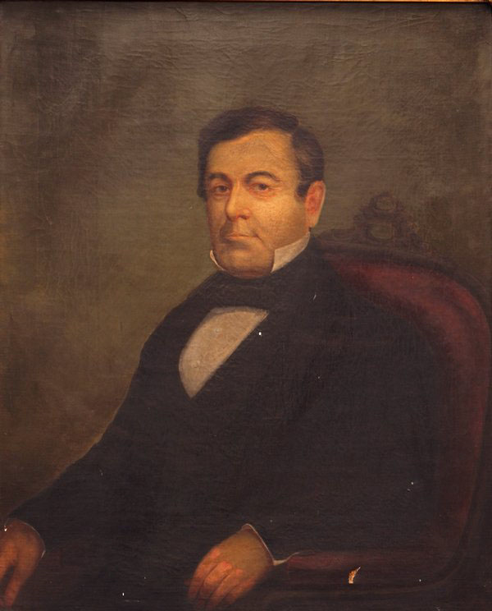
Notes:
wilmot

Slide 4
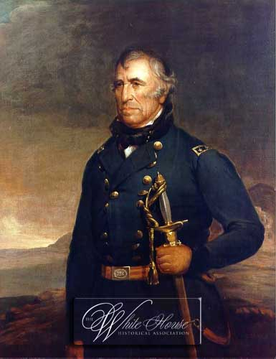

Slide 5
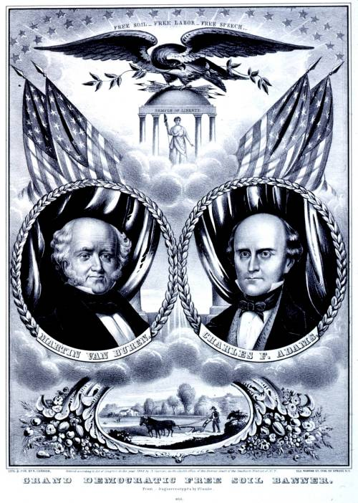

Slide 6
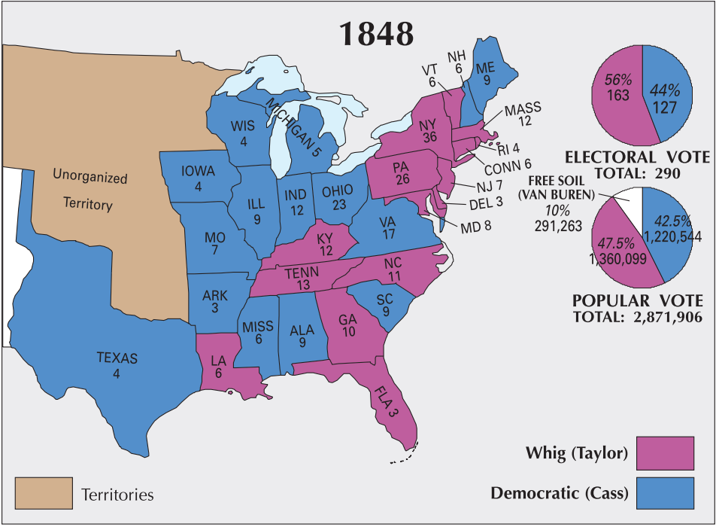

Slide 7
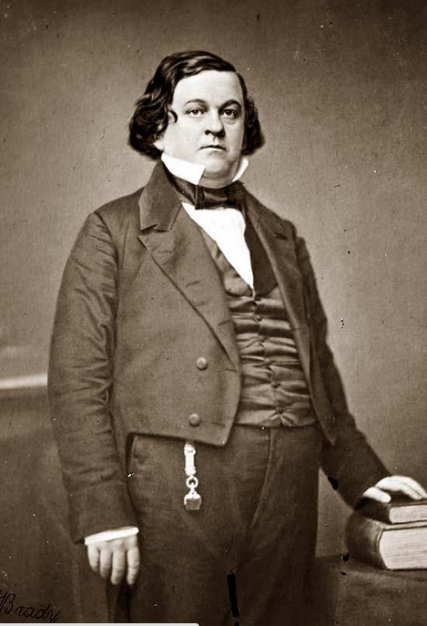
Notes:
Howell cobb

Slide 8
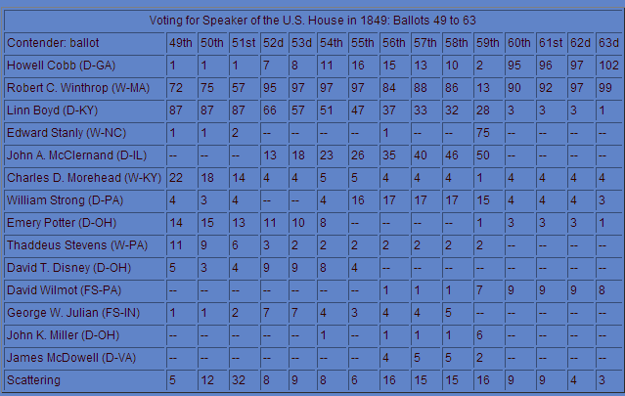
Notes:
No majority—only time in US history

Slide 9
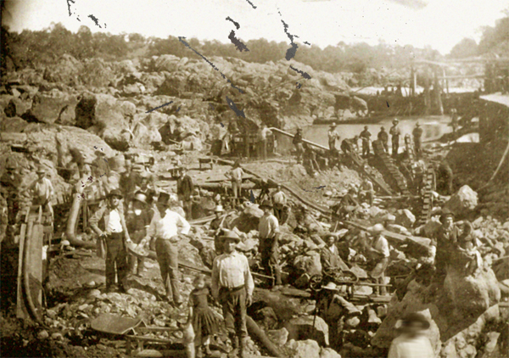

Slide 10
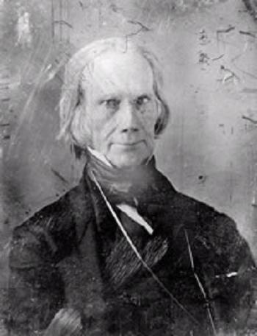
Notes:
Old clay

Slide 11
Compromise of 1850
California as free state
Slave trade abolished in DC; slavery remains legal
Texas gets $10M in exchange for boundary adjustment
Utah/New Mexico territories according to “popular sovereignty”
Fugitive slave law strengthened

Slide 12
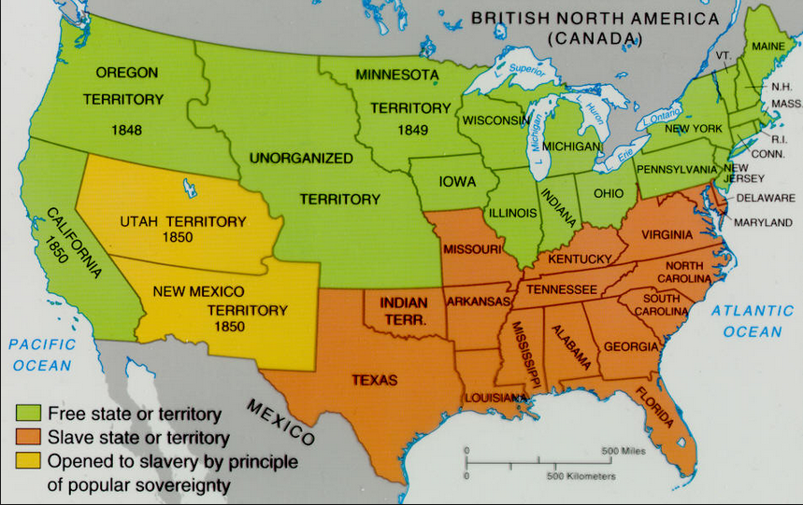

Slide 13
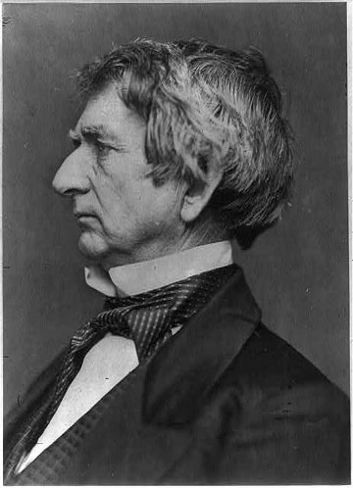

Slide 14
William Seward: 11 March 1850
But there is a higher law than the Constitution, which regulates our authority over the domain, and devotes it to the same noble purposes. The territory is a part, no inconsiderable part, of the common heritage of mankind, bestowed upon them by the Creator if the universe. We are his stewards, and must so discharge our trust as to secure in the highest attainable degree their happiness . . .
And now the simple, bold, and even awful question which presents itself to us is this: Shall we, who are founding institutions, social and political, for countless millions; shall we, who know by experience the wise and the just, and are free to choose them, and to reject the erroneous and the unjust; shall we establish human bondage, or permit it by our sufferance to be established? Sir, our forefathers would not have hesitated an hour. They found slavery existing here, and they left it only because they could not remove it. There is not only no free state which would now establish it, but there is no slave state, which, if it had had the free alternative as we now have, would have founded slavery. Indeed, our revolutionary predecessors had precisely the same question before them in establishing an organic law under which the states of Ohio, Indiana, Michigan, Illinois, and Wisconsin, have since come into the Union, and they solemnly repudiated and excluded slavery from those states forever. I confess that the most alarming evidence of our degeneracy which has yet been given is found in the fact that we even debate such a question.

Slide 15
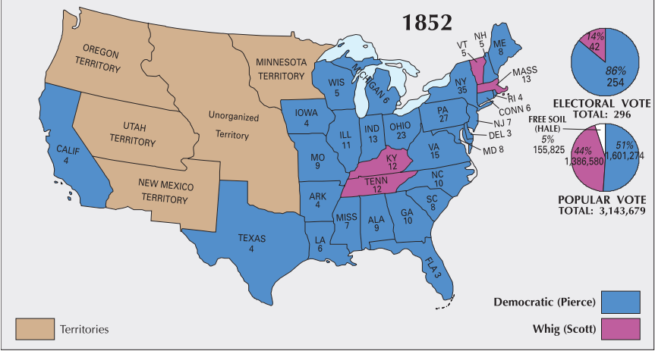

Slide 16
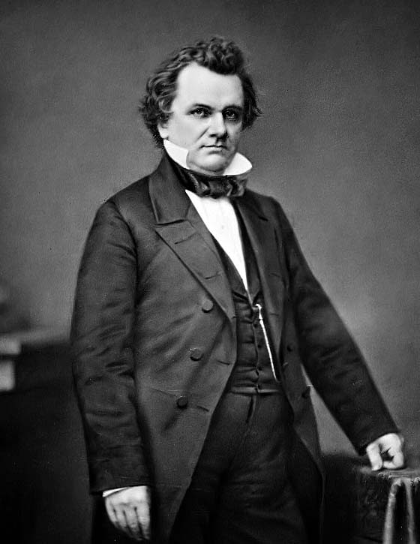

Slide 17
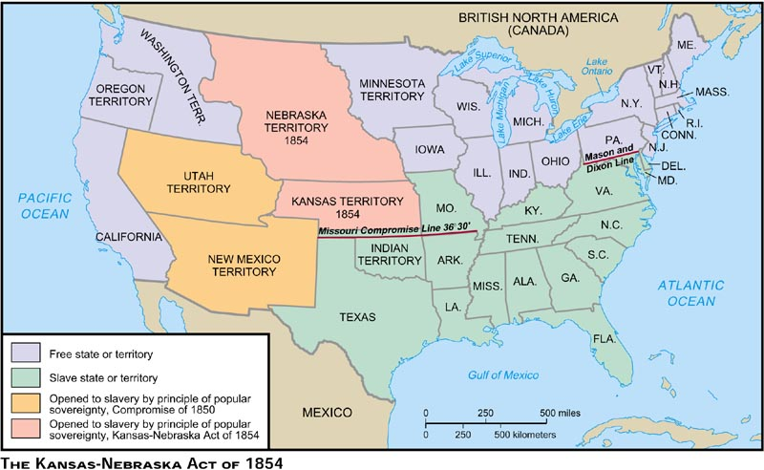

Slide 18
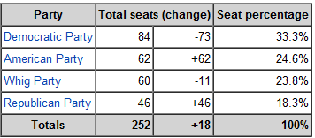
1854 House Elections:
Change in Seat Allocation

Slide 19
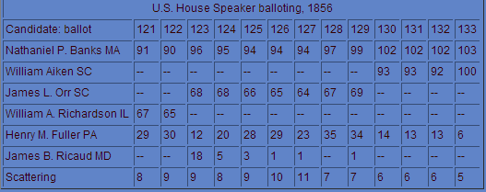
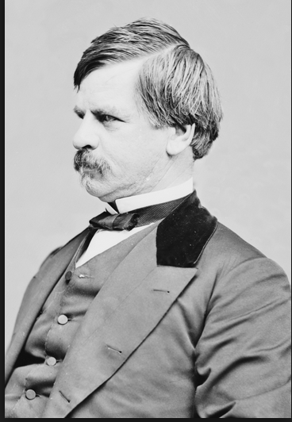
Notes:
2.5 months--banks

Slide 20
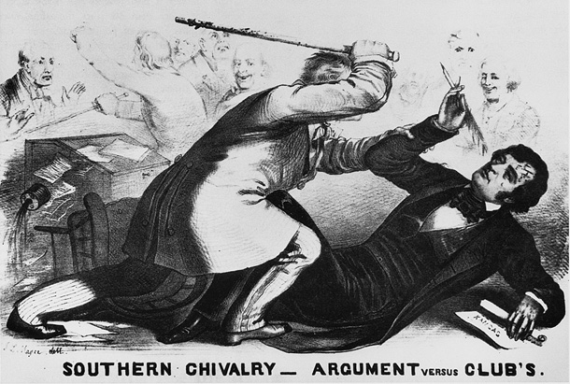

Slide 21
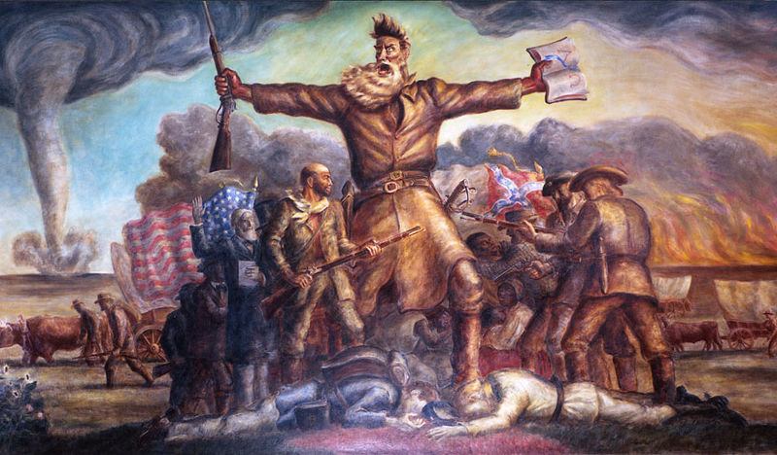

Slide 22
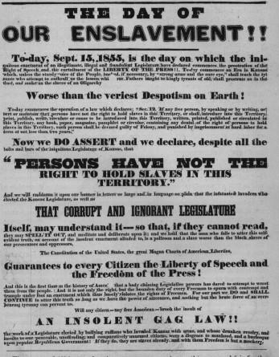

Slide 23
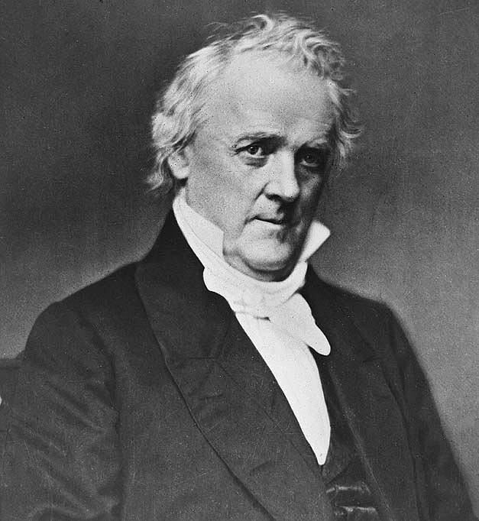

Slide 24
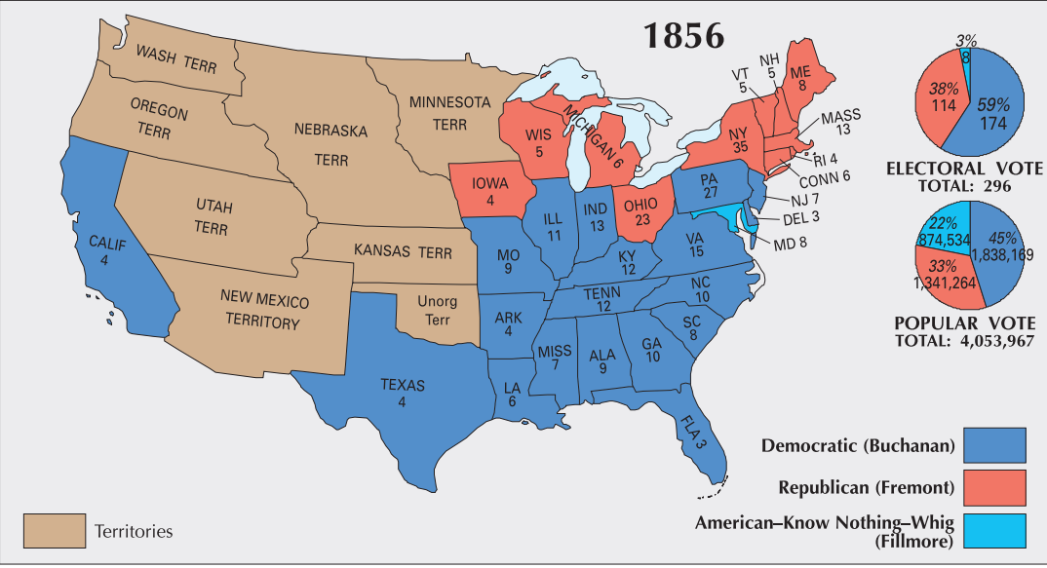

Slide 25
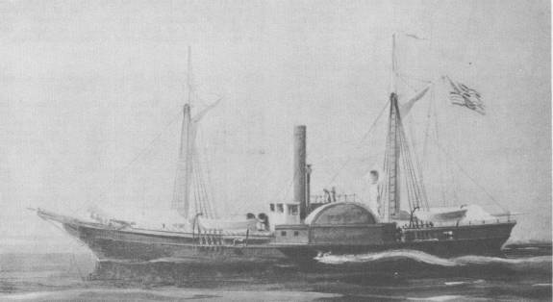
Notes:
Water witch

Slide 26

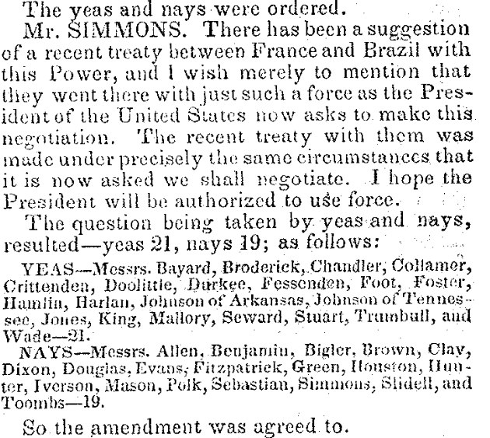

Slide 27
Buchanan message to Congress (Feb. 1859)
The republics south of the United States on this continent have unfortunately been frequently in a state of revolution and civil war ever since they achieved their independence . . . The Executive Governments of Great Britain, France, and other countries, possessing the war-making power, can promptly employ the necessary means to enforce immediate redress for similar outrages upon their subjects. Not so the Executive Government of the United States.
I therefore earnestly recommend to Congress, on whom the responsibility exclusively rests, to pass a law . . . conferring on the President the power to protect the lives and property of American citizens . . . The knowledge that such a law exists would of itself go far to prevent the outrages which it is intended to redress, and to render the employment of force unnecessary.
Such a grant of authority, thus limited in its extent, could in no just cause be regarded as a transfer of war-making power to the Executive, but only as an appropriate exercise of that power by the body to whom it exclusively belongs.

Slide 28
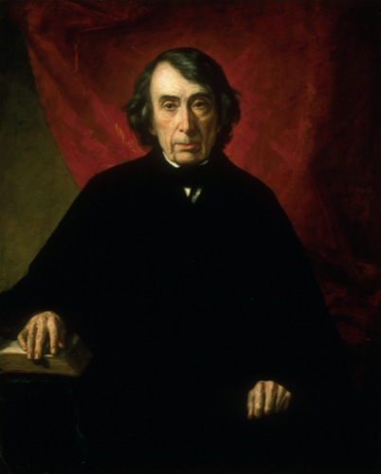
Notes:
taney

Slide 29
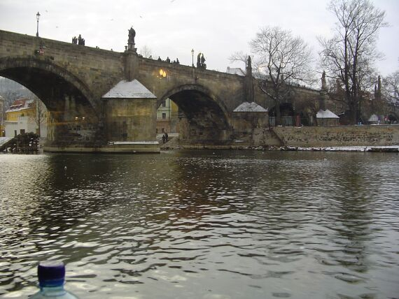

Slide 30
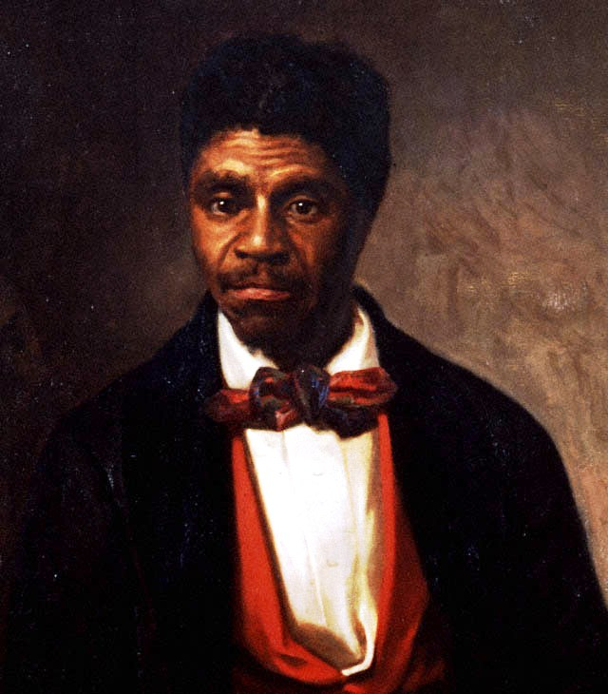

Slide 31
Dred Scott v. Sandford (1857)
The question then arises, whether the provisions of the Constitution, in relation to the personal rights and privileges to which the citizen of a State should be entitled, embraced the negro African race, at that time in this country or who might afterwards be imported, who had then or should afterwards be made free in any State, and to put it in the power of a single State to make him a citizen of the United States and endue him with the full rights of citizenship in every other State without their consent? Does the Constitution of the United States act upon him whenever he shall be made free under the laws of a State, and raised there to the rank of a citizen, and immediately clothe him with all the privileges of a citizen in every other State, and in its own courts?
The court think the affirmative of these propositions cannot be maintained. And if it cannot, the plaintiff in error could not be a citizen of the State of Missouri within the meaning of the Constitution of the United States, and, consequently, was not entitled to sue in its courts.

Slide 32
. . . The right of property in a slave is distinctly and expressly affirmed in the Constitution. The right to traffic in it, like an ordinary article of merchandise and property, was guarantied to the citizens of the United States in every State that might desire it for twenty years. And the Government in express terms is pledged to protect it in all future time if the slave escapes from his owner.
This is done in plain words — too plain to be misunderstood. And no word can be found in the Constitution which gives Congress a greater power over slave property or which entitles property of that kind to less protection that property of any other description. The only power conferred is the power coupled with the duty of guarding and protecting the owner in his rights.
Upon these considerations, it is the opinion of the court that the act of Congress [MO Compromise] which prohibited a citizen from holding and owning property of this kind in the territory of the United States north of the line therein mentioned is not warranted by the Constitution, and is therefore void.

Slide 33
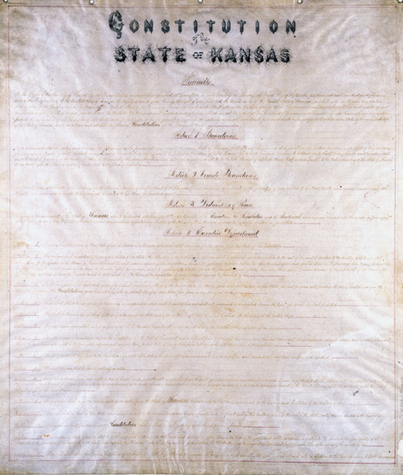
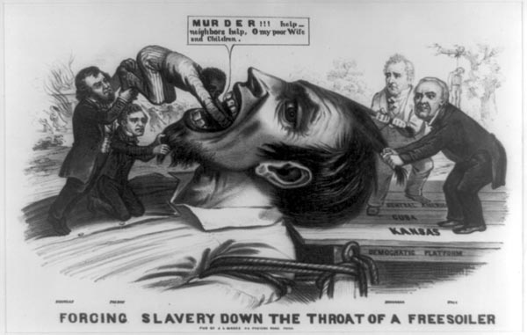

Slide 34
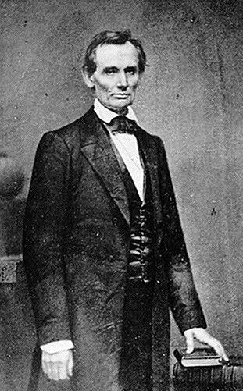

Slide 35
Lincoln “House Divided” speech (1858)
We are now far into the fifth year, since a policy was initiated, with the avowed object, and confident promise, of putting an end to slavery agitation.
Under the operation of that policy, that agitation has not only, not ceased, but has constantly augmented.
In my opinion, it will not cease, until a crisis shall have been reached, and passed.
"A house divided against itself cannot stand.“
I believe this government cannot endure, permanently half slave and half free.
I do not expect the Union to be dissolved -- I do not expect the house to fall -- but I do expect it will cease to be divided.
It will become all one thing or all the other.
Either the opponents of slavery, will arrest the further spread of it, and place it where the public mind shall rest in the belief that it is in the course of ultimate extinction; or its advocates will push it forward, till it shall become alike lawful in all the States, old as well as new -- North as well as South.

Slide 36
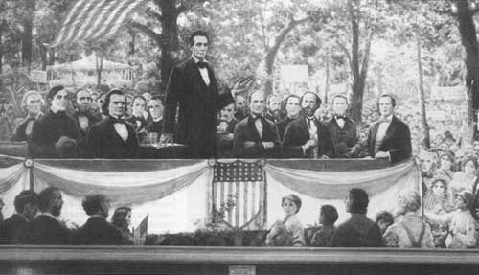

Slide 37
Senator Stephen Douglas (Lincoln-Douglas debates)
I ask you, are you in favor of conferring upon the negro the rights and privileges of citizenship? Do you desire to strike out of our State Constitution that clause which keeps slaves and free negroes out of the State, and allow the free negroes to flow in, and cover your prairies with black settlements? . . . I am opposed to negro citizenship in any and every form. I believe this Government was made on the white basis. I believe it was made by white men for the benefit of white men and their posterity forever, and I am in favor of confining citizenship to white men, men of European birth and descent, instead of conferring it upon negroes, Indians, and other inferior races.
Mr. Lincoln, following the example and lead of all the little Abolition orators, who go around and lecture in the basements of schools and churches, reads from the Declaration of Independence, that all men were created equal, and then asks, how can you deprive a negro of that equality which God and the Declaration of Independence awards to him? ... Now, I hold that Illinois had a right to abolish and prohibit slavery as she did, and I hold that Kentucky has the same right to continue and protect slavery that Illinois had to abolish it. I hold that New York had as much right to abolish slavery as Virginia has to continue it, and that each and every State of this Union is a sovereign power, with the right to do as it pleases upon this question of slavery, and upon all its domestic institutions. ...

Slide 38
Abraham Lincoln (Lincoln-Douglas debates)
I agree with Judge Douglas [the Negro] is not my equal in many respects—certainly not in color, perhaps not in moral or intellectual endowment. But in the right to eat the bread, without the leave of anybody else, which his own hand earns, he is my equal and the equal of Judge Douglas, and the equal of every living man . . .
This declared indifference, but, as I must think, covert real zeal for the spread of slavery, I cannot but hate. I hate it because of the monstrous injustice of slavery itself. I hate it because it deprives our republican example of its just influence in the world—enables the enemies of free institutions, with plausibility, to taunt us as hypocrites—causes the real friends of freedom to doubt our sincerity, and especially because it forces so many really good men amongst ourselves into an open war with the very fundamental principles of civil liberty—criticizing the Declaration of Independence, and insisting that there is no right principle of action but self-interest.

Slide 39
It is the eternal struggle between these two principles — right and wrong — throughout the world. They are the two principles that have stood face to face from the beginning of time; and will ever continue to struggle. The one is the common right of humanity, and the other the divine right of kings. It is the same principle in whatever shape it develops itself. It is the same spirit that says, "You toil and work and earn bread, and I'll eat it.“
No matter in what shape it comes, whether from the mouth of a king who seeks to bestride the people of his own nation and live by the fruit of their labor, or from one race of men as an apology for enslaving another race, it is the same tyrannical principle.

Slide 40
1858 Midterm Elections (House of Representatives)
Republicans 114 seats +22
Democrats 101 seats -30
“Opposition” (pro-GOP) 17 seats +17
American 6 seats -8
1858 Midterm Elections (Senate, 22 seats up for election)
Democrats 38 seats -3
Republicans 26 seats +6
American 2 seats -3

Slide 41
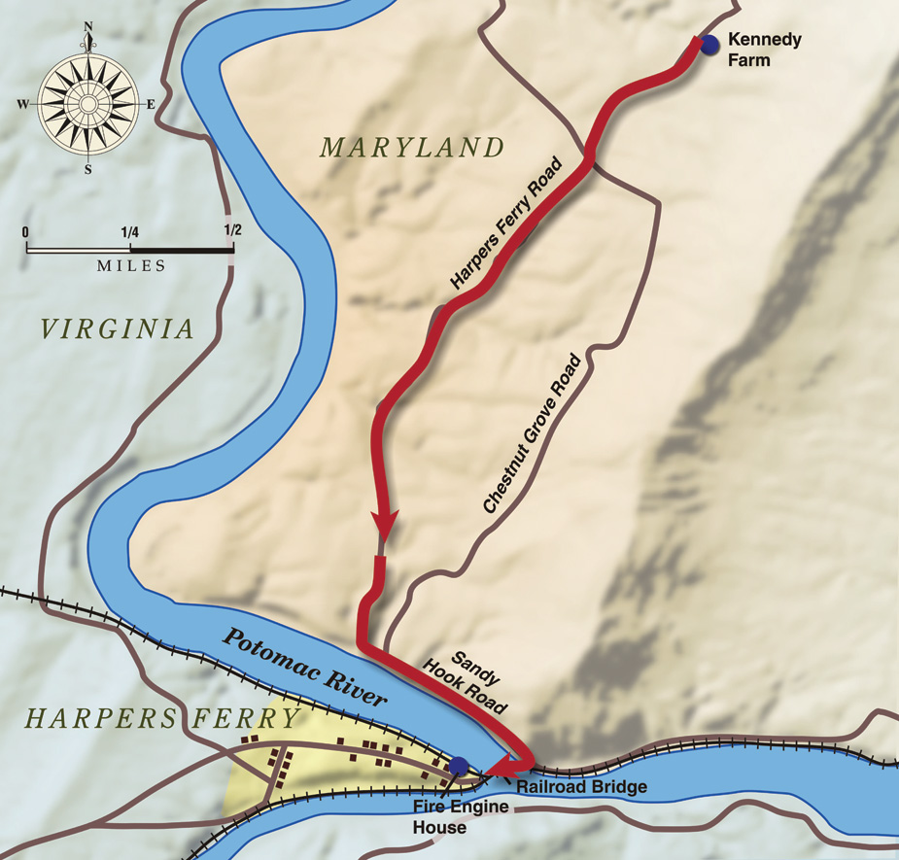

Slide 42
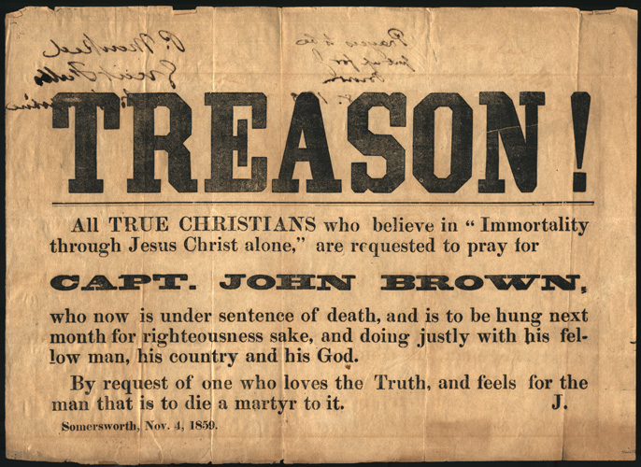

Slide 43

Notes:
breckenridge

Slide 44
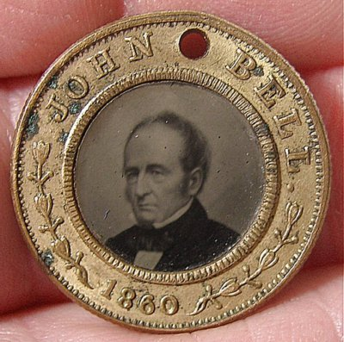

Slide 45
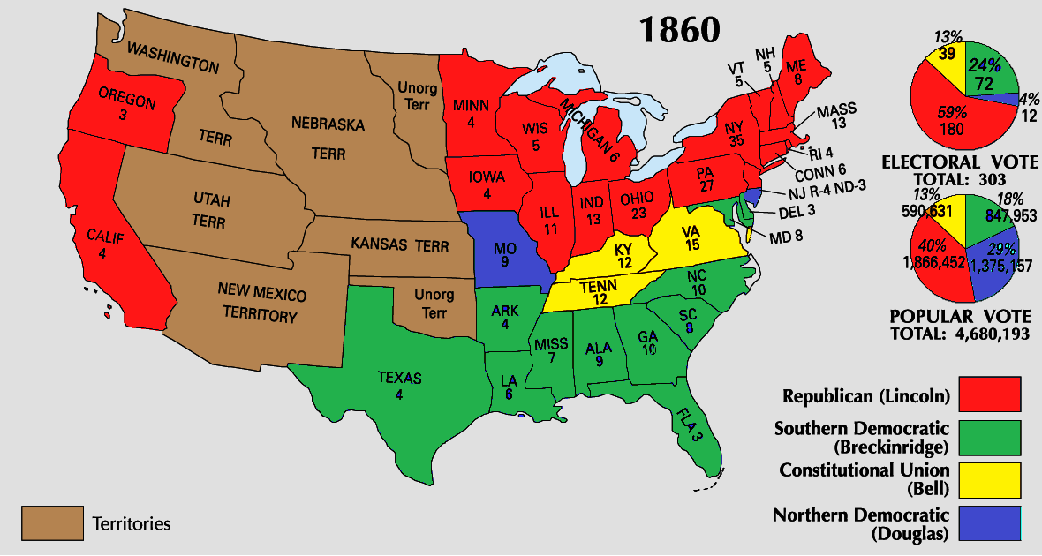

Slide 46


Slide 47
