Slide 1
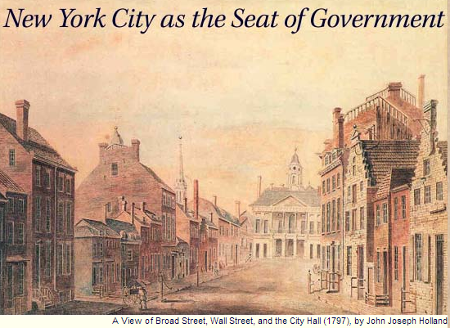

Slide 2
Judiciary Act (1789)
The supreme court of the United States shall consist of a chief justice and five associate justices…
And be it further enacted, That the United States shall be, and they hereby are divided into thirteen districts . . . That there be a court called a District Court, in each of the afore mentioned districts, to consist of one judge . . .
That the before mentioned districts, except those of Maine and Kentucky, shall be divided into three circuits, and be called the eastern, the middle, and the southern circuit…
The district courts shall have, exclusively of the courts of the several States, cognizance of all crimes and offences that shall be cognizable under the authority of the United States.

Slide 3
Judiciary Act (1789)
SEC. 25. And be it further enacted, That a final judgment or decree in any suit, in the highest court of law or equity of a State in which a decision in the suit could be had, where is drawn in question the validity of a treaty or statute of, or an authority exercised under the United States, and the decision is against their validity; or where is drawn in question the validity of a statute of, or an authority exercised under any State, on the ground of their being repugnant to the constitution, treaties or laws of the United States, and the decision is in favour of such their validity, or where is drawn in question the construction of any clause of the constitution, or of a treaty, or statute of, or commission held under the United States, and the decision is against the title, right, privilege or exemption specially set up or claimed by either party, under such clause of the said Constitution, treaty, statute or commission, may be re-examined and reversed or affirmed in the Supreme Court of the United States upon a writ of error….
SEC. 34. And be it further enacted, That the laws of the several states, except where the constitution, treaties or statutes of the United States shall otherwise require or provide, shall be regarded as rules of decision in trials at common law in the courts of the United States in cases where they apply.

Slide 4
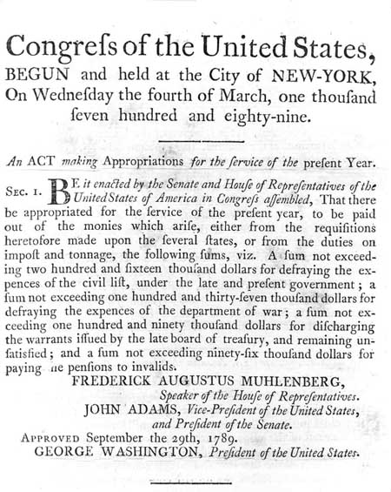
Notes:
1st federal budget

Slide 5
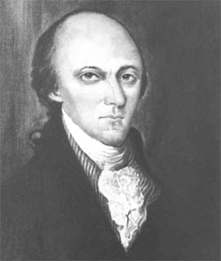
Faced with a motion to commit the report on negotiations with the southern Indians and questions that he and his Secretary of War had brought to the Senate, the President started up in a Violent fret. This defeats every purpose of my coming here, were the first words that he said. he then went on that he had brought his Secretary at War with him to give every necessary information, that the Secretary knew all about the Business--and yet he was delayed and could not go on with the Matter--… a pause for some time ensued. We Waited for him to withdraw, he did so with a discontented Air.
Wm. Maclay (PA)

Slide 6
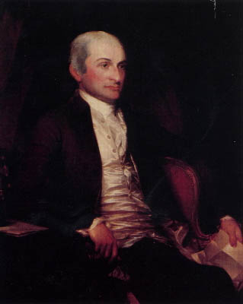

Slide 7
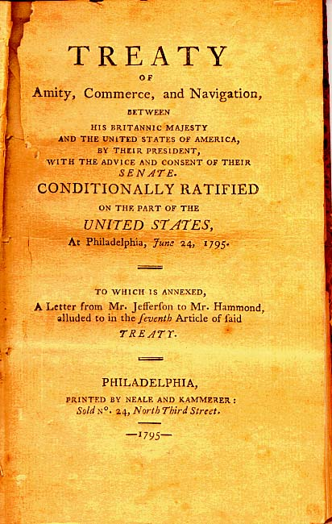

Slide 8
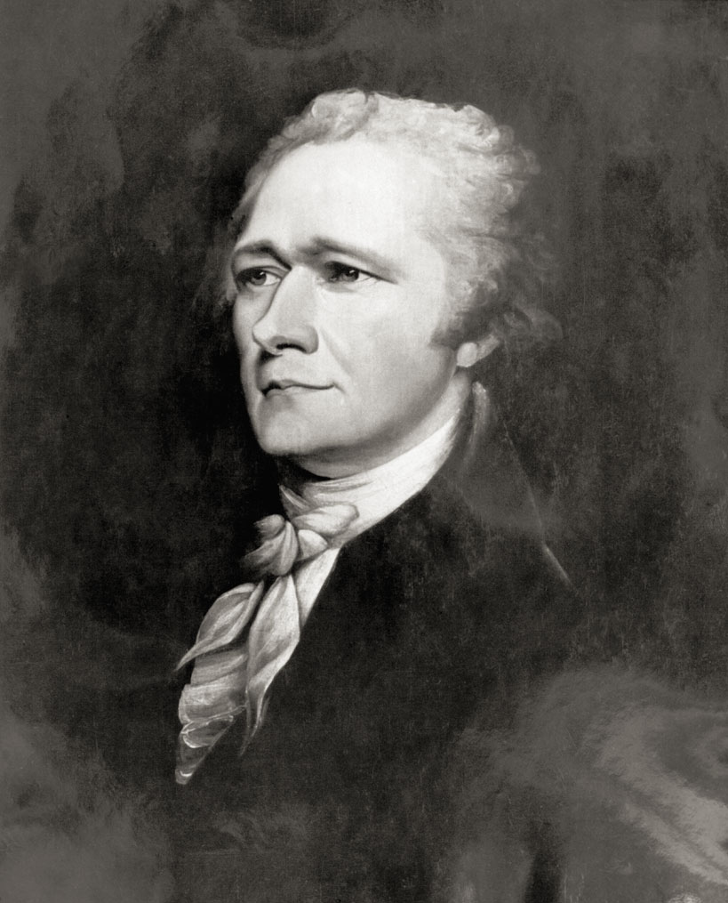

Slide 9
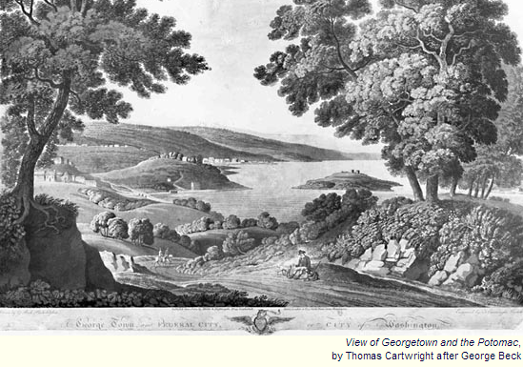

Slide 10
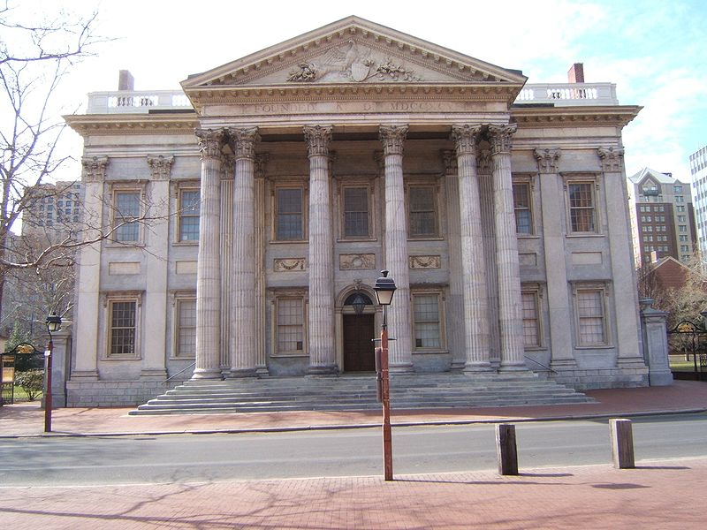
Notes:
Bank of us--philly

Slide 11
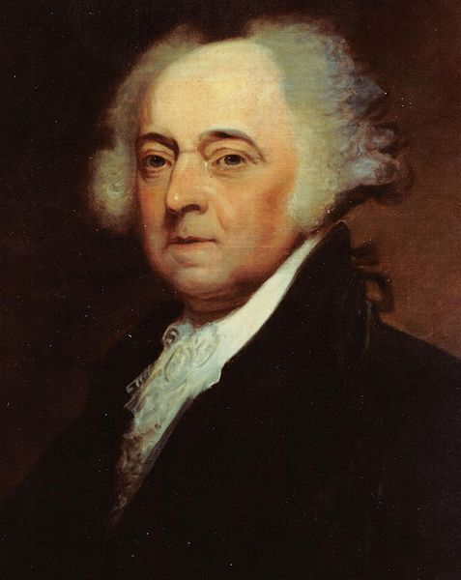

Slide 12
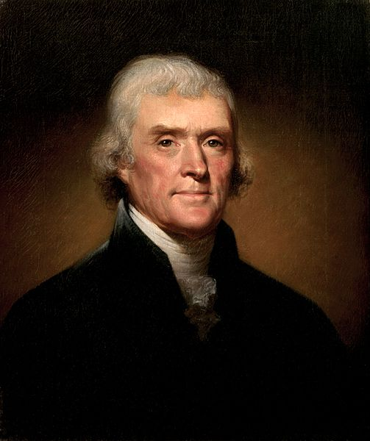

Slide 13
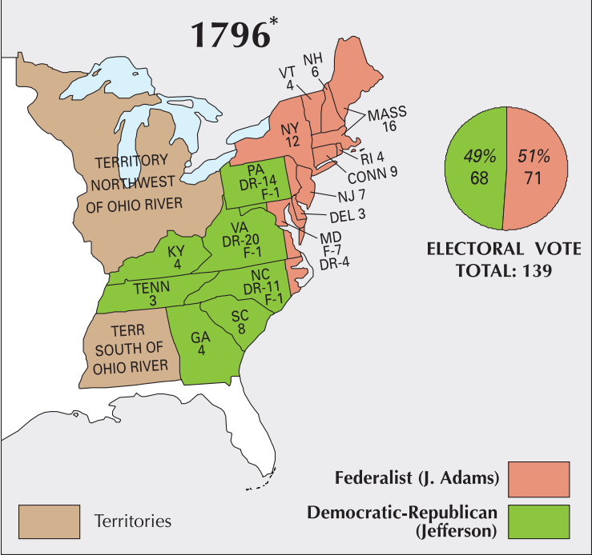

Slide 14
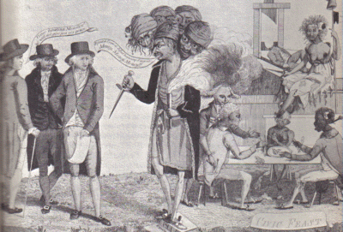

Slide 15
Sedition Act (1798)
If any person shall write, print, utter or publish, or shall cause or procure to be written, printed, uttered or published, or shall knowingly and willingly assist or aid in writing, printing, uttering or publishing any false, scandalous and malicious writing or writings against the government of the United States, or either house of the Congress of the United States, or the President of the United States, with intent to defame the said government, or either house of the said Congress, or the said President, or to bring them, or either of them, into contempt or disrepute; or to excite against them, or either or any of them, the hatred of the good people of the United States, or to stir up sedition within the United States, or to excite any unlawful combinations therein, for opposing or resisting any law of the United States, or any act of the President of the United States, done in pursuance of any such law, or of the powers in him vested by the constitution of the United States, or to resist, oppose, or defeat any such law or act, or to aid, encourage or abet any hostile designs of any foreign nation against United States, their people or government, then such person, being thereof convicted before any court of the United States having jurisdiction thereof, shall be punished by a fine not exceeding two thousand dollars, and by imprisonment not exceeding two years.

Slide 16
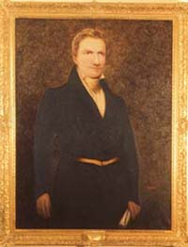
Notes:
Matthew lyon

Slide 17
Kentucky Resolution (Jefferson)
1. Resolved, That the several States composing, the United States of America, are not united on the principle of unlimited submission to their general government; but that, by a compact under the style and title of a Constitution for the United States, and of amendments thereto, they constituted a general government for special purposes — delegated to that government certain definite powers, reserving, each State to itself, the residuary mass of right to their own self-government; and that whensoever the general government assumes undelegated powers, its acts are unauthoritative, void, and of no force: that to this compact each State acceded as a State, and is an integral part, its co-States forming, as to itself, the other party: that the government created by this compact was not made the exclusive or final judge of the extent of the powers delegated to itself; since that would have made its discretion, and not the Constitution, the measure of its powers; but that, as in all other cases of compact among powers having no common judge, each party has an equal right to judge for itself, as well of infractions as of the mode and measure of redress.

Slide 18
3. Resolved, That it is true as a general principle, and is also expressly declared by one of the amendments to the Constitutions, that “the powers not delegated to the United States by the Constitution, our prohibited by it to the States, are reserved to the States respectively, or to the people”; and that no power over the freedom of religion, freedom of speech, or freedom of the press being delegated to the United States by the Constitution, nor prohibited by it to the States, all lawful powers respecting the same did of right remain, and were reserved to the States or the people: that thus was manifested their determination to retain to themselves the right of judging how far the licentiousness of speech and of the press may be abridged without lessening their useful freedom, and how far those abuses which cannot be separated from their use should be tolerated, rather than the use be destroyed . . . That, therefore, the act of Congress of the United States, passed on the 14th day of July, 1798, intituled “An Act in addition to the act intituled An Act for the punishment of certain crimes against the United States,” which does abridge the freedom of the press, is not law, but is altogether void, and of no force.

Slide 19
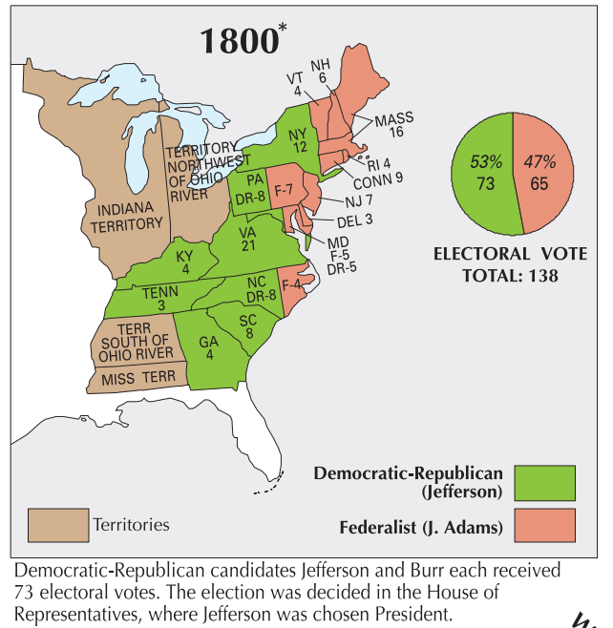

Slide 20
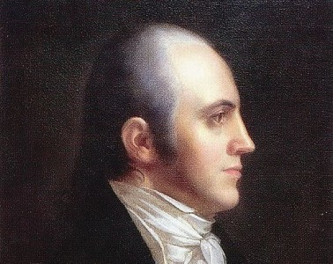

Slide 21
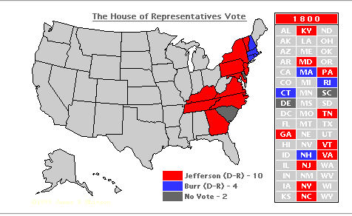

Slide 22
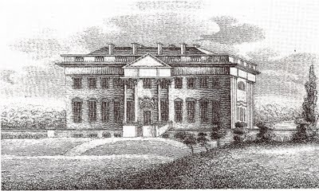
Notes:
Jefferson white house

Slide 23
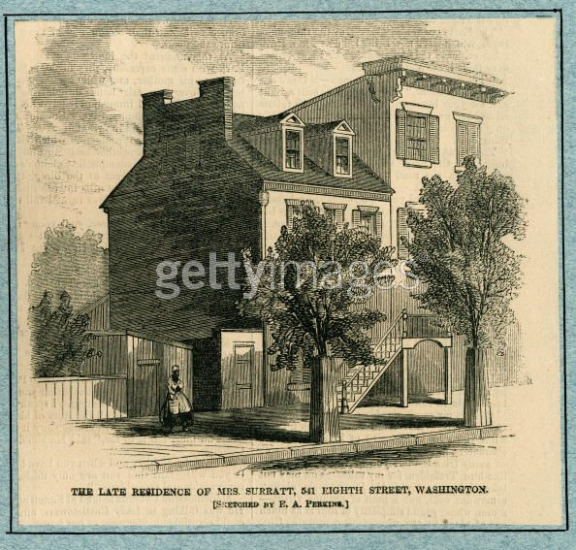
Notes:
boardinghouse

Slide 24
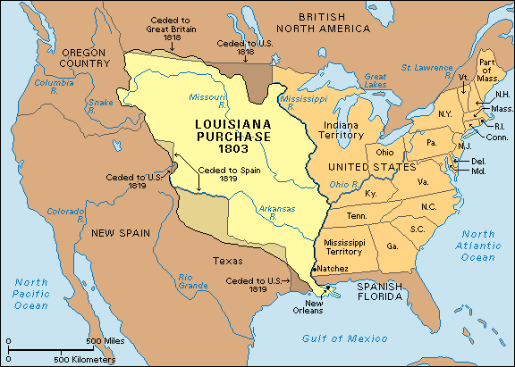

Slide 25


Slide 26
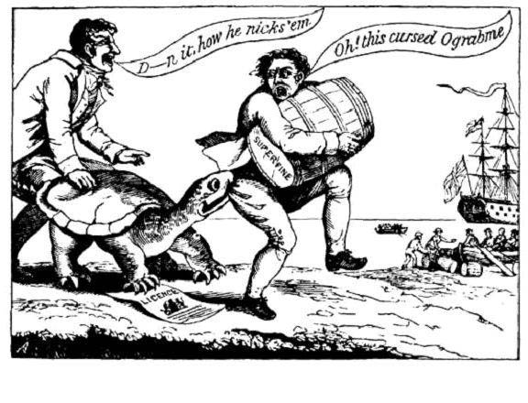

Slide 27
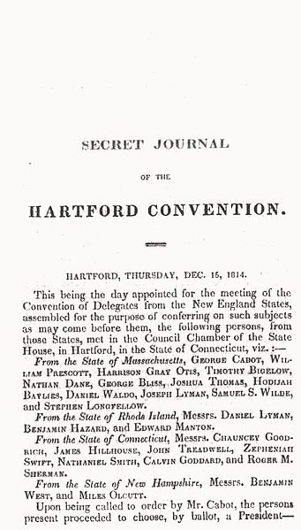

Slide 28
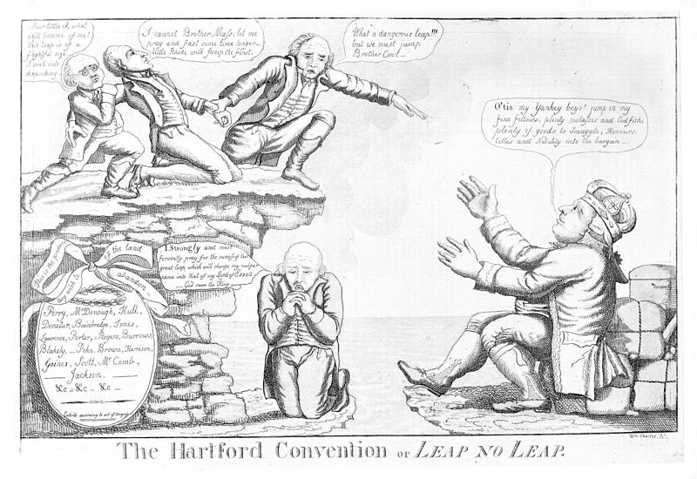

Slide 29
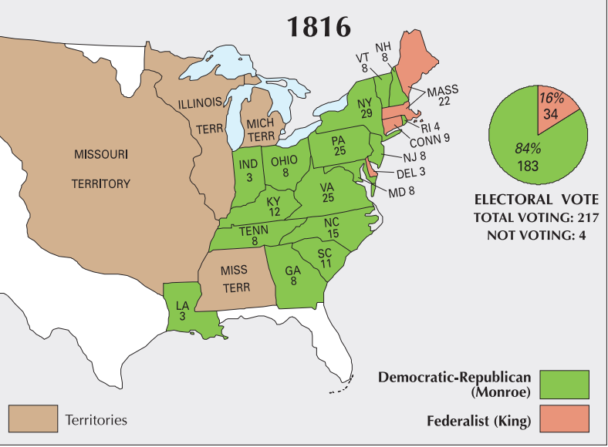

Slide 30
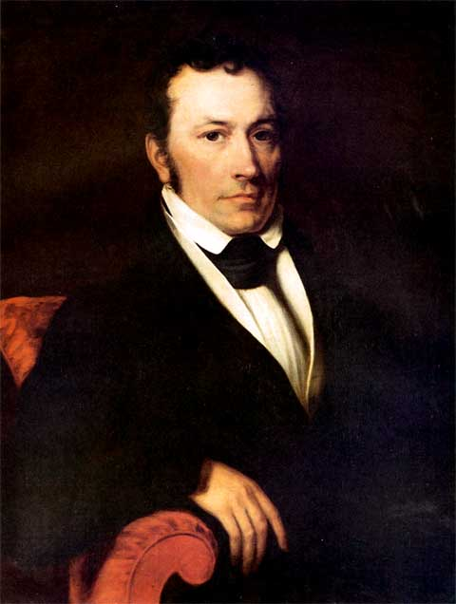
Notes:
Joel poinsett

Slide 31
12th amendment
The Electors shall meet in their respective states, and vote by ballot for President and Vice-President, one of whom, at least, shall not be an inhabitant of the same state with themselves; they shall name in their ballots the person voted for as President, and in distinct ballots the person voted for as Vice-President, and they shall make distinct lists of all persons voted for as President, and of all persons voted for as Vice-President and of the number of votes for each, which lists they shall sign and certify, and transmit sealed to the seat of the government of the United States, directed to the President of the Senate;

Slide 32

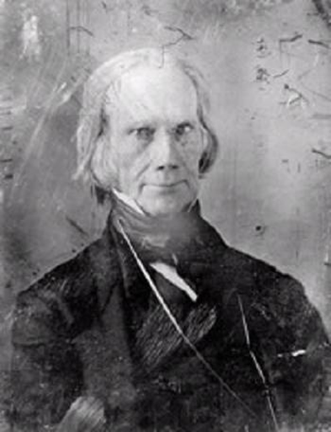
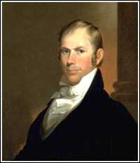
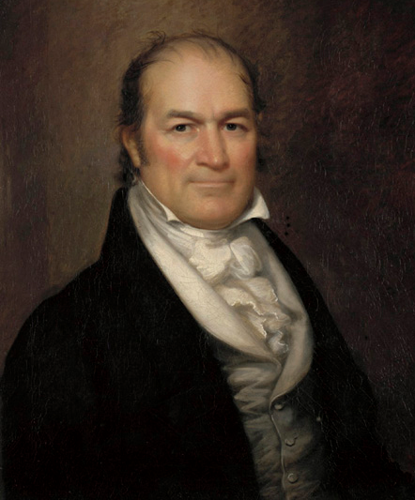

Slide 33
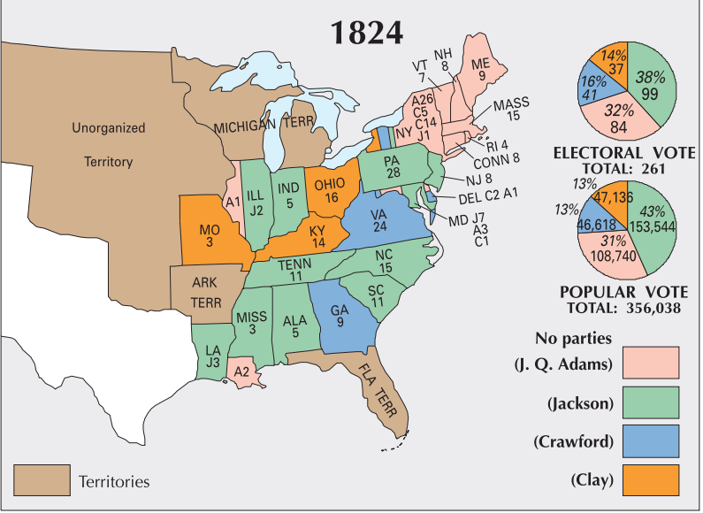

Slide 34
