Slide 1
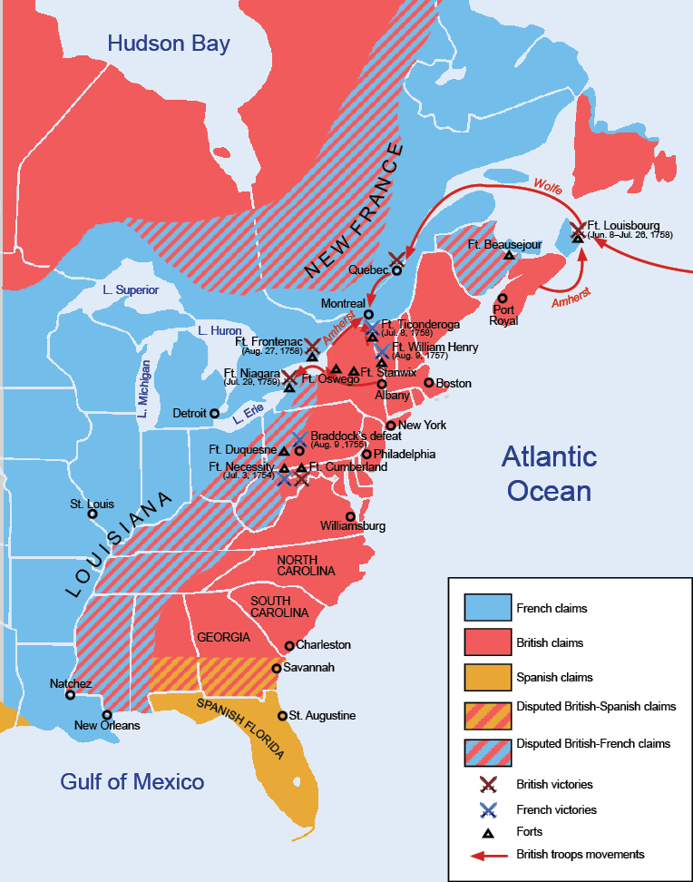

Slide 2
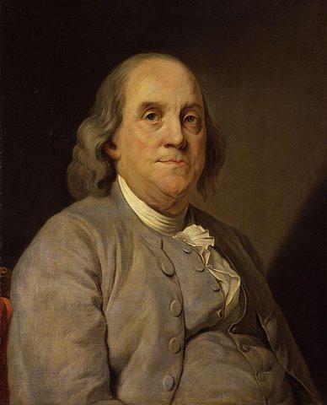

Slide 3


Slide 4
Albany Plan of Union
It is proposed that humble application be made for an act of Parliament of Great Britain, by virtue of which one general government may be formed in America, including all the said colonies, within and under which government each colony may retain its present constitution, except in the particulars wherein a change may be directed by the said act, as hereafter follows.
1. That the said general government be administered by a President-General, to be appointed and supported by the crown; and a Grand Council, to be chosen by the representatives of the people of the several Colonies met in their respective assemblies.
2. That within -- months after the passing such act, the House of Representatives that happen to be sitting within that time, or that shall be especially for that purpose convened, may and shall choose members for the Grand Council . . .
16. That for these [SECURITY] purposes they have power to make laws, and lay and levy such general duties, imposts, or taxes, as to them shall appear most equal and just (considering the ability and other circumstances of the inhabitants in the several Colonies), and such as may be collected with the least inconvenience to the people; rather discouraging luxury, than loading industry with unnecessary burdens.

Slide 5


Slide 6


Slide 7



Slide 8
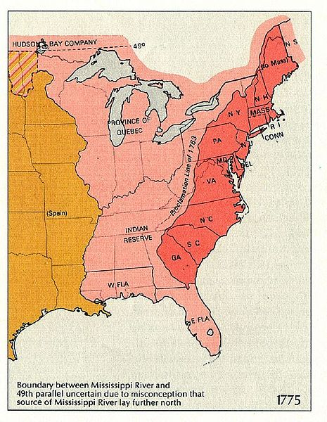

Slide 9
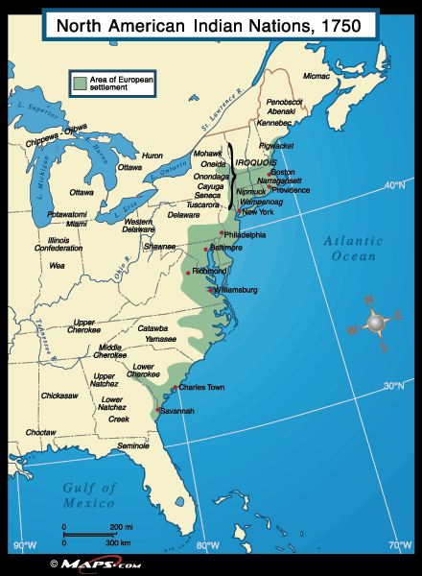

Slide 10
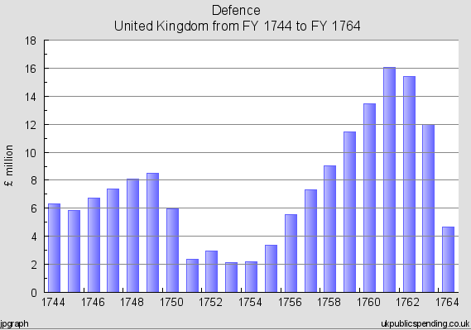
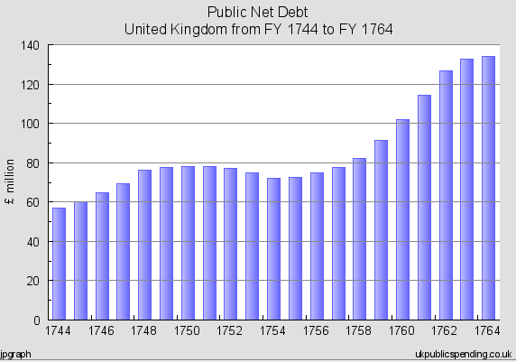

Slide 11
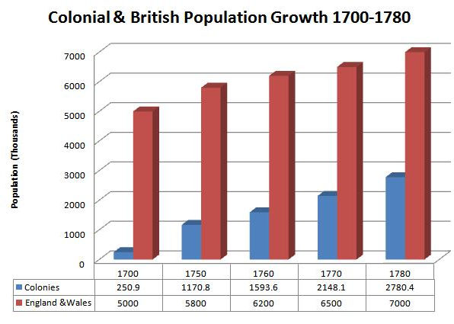

Slide 12

Notes:
Old sarum

Slide 13
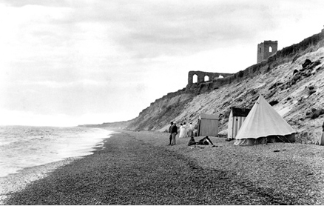
Notes:
dunwich

Slide 14
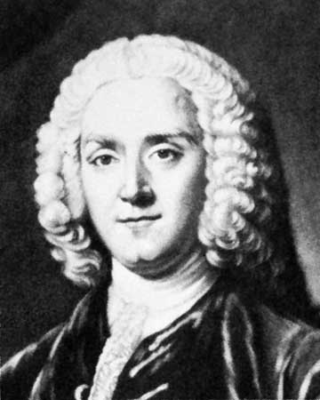

Slide 15


Slide 16
Declaratory Act; March 18, 1766
An act for the better securing the dependency of his majesty's dominions in America upon the crown and parliament of Great Britain.
Whereas several of the houses of representatives in his Majesty's colonies and plantations in America, have of late against law, claimed to themselves, or to the general assemblies of the same, the sole and exclusive right of imposing duties and taxes upon his majesty's subjects in the said colonies and plantations;…
May it therefore please your most excellent Majesty, that it may be declared ; …That the said colonies and plantations in America have been, are, and of right ought to be, subordinate unto, and dependent upon the imperial crown and parliament of Great Britain; and that the King's majesty, by and with the advice and consent of the lords spiritual and temporal, and commons of Great Britain, in parliament assembled, had, and of right ought to have, full power and authority to make laws and statutes of sufficient force and validity to bind the colonies and people of America, subjects of the crown of Great Britain, in all cases whatsoever.

Slide 17
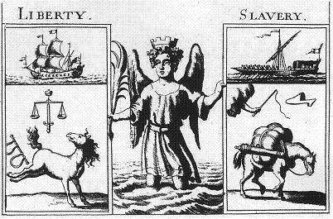

Slide 18
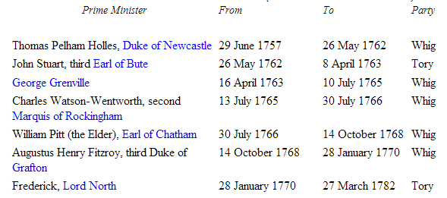

Slide 19
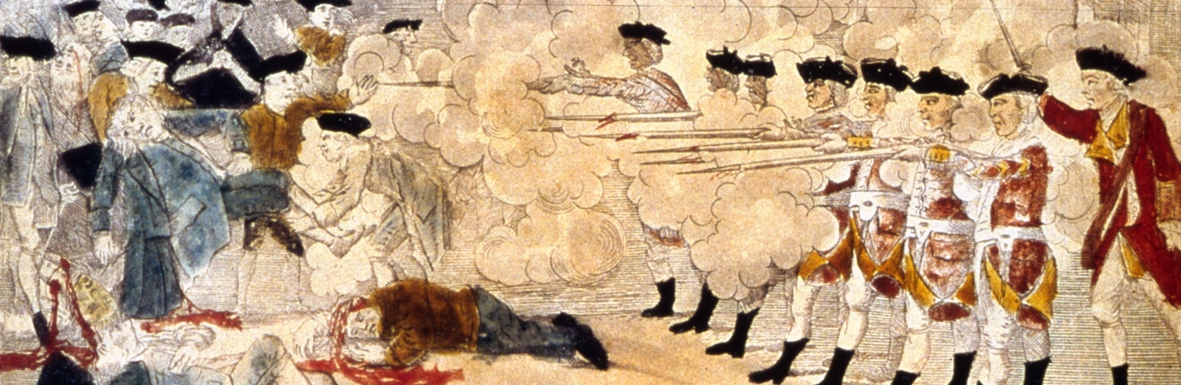

Slide 20
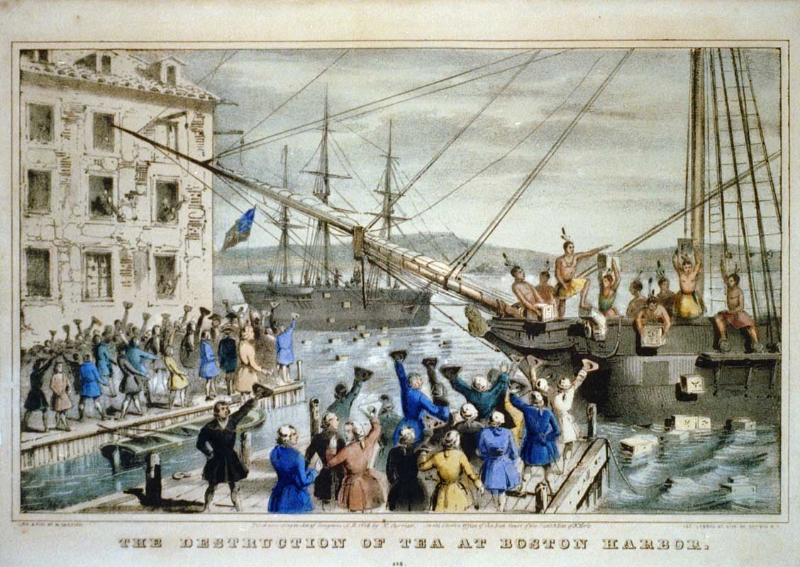

Slide 21
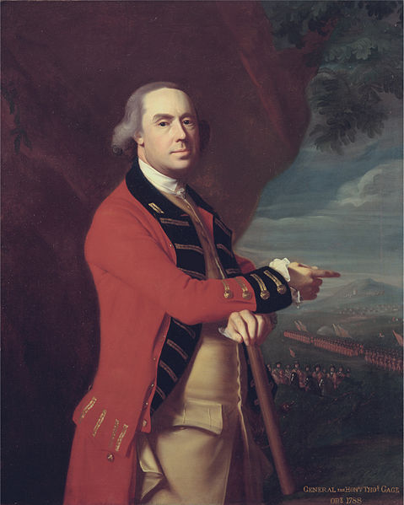
Notes:
Thomas gage

Slide 22
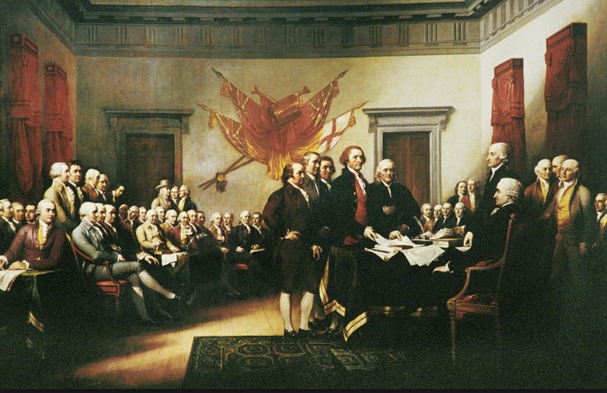

Slide 23
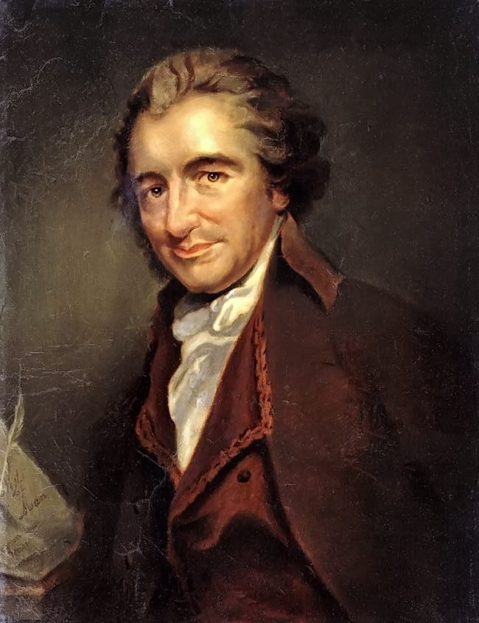

Slide 24
Common Sense
Small islands not capable of protecting themselves are the proper objects for kingdoms to take under their care; but there is something very absurd in supposing a continent to be perpetually governed by an island.
--------
There is something exceedingly ridiculous in the composition of monarchy; it first excludes a man from the means of information, yet empowers him to act in cases where the highest judgment is required…
Some writers have so confounded society with government, as to leave little or no distinction between them; whereas they are not only different, but have different origins. Society is produced by our wants, and government by our wickedness; the former promotes our happiness POSITIVELY by uniting our affections, the latter NEGATIVELY by restraining our vices. The one encourages intercourse, the other creates distinctions. The first a patron, the last a punisher.
---------------------
We have every opportunity and every encouragement before us, to form the noblest purest constitution on the face of the earth. We have it in our power to begin the world over again.

Slide 25
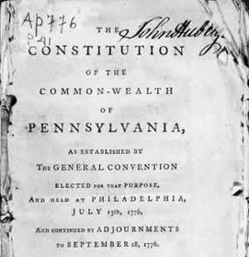

Slide 26
Pennsylvania (1776)—rights
That all men are born equally free and independent, and have certain natural, inherent and inalienable rights, amongst which are, the enjoying and defending life and liberty, acquiring, possessing and protecting property, and pursuing and obtaining happiness and safety.
IX. That in all prosecutions for criminal offences, a man hath a right to be heard by himself and his council, to demand the cause and nature of his accusation, to be confronted with the witnesses, to call for evidence in his favour, and a speedy public trial, by an impartial jury of the country, without the unanimous consent of which jury he cannot be found guilty; nor can he be compelled to give evidence against himself…
XII. That the people have a right to freedom of speech, and of writing, and publishing their sentiments; therefore the freedom of the press ought not to be restrained.
XVI. That the people have a right to assemble together, to consult for their common good, to instruct their representatives, and to apply to the legislature for redress of grievances, by address, petition, or remonstrance.

Slide 27
Pennsylvania (1776)--electorate
Every freemen of the full age of twenty-one Years, having resided in this state for the space of one whole Year next before the day of election for representatives, and paid public taxes during that time, shall enjoy the right of an elector: Provided always, that sons of freeholders of the age of twenty-one years shall be intitled to vote although they have not paid taxes.
SECT. 7. The house of representatives of the freemen of this commonwealth shall consist of persons most noted for wisdom and virtue, to be chosen by the freemen of every city and county of this commonwealth respectively…
SECT. 8. No person shall be capable of being elected a member to serve in the house of representatives of the freemen of this commonwealth more than four years in seven.
SECT. 9. The members of the house of representatives shall be chosen annually by ballot, by the freemen of the commonwealth.

Slide 28
Pennsylvania (1776)—executive power
SECT. 20. The president, and in his absence the vice-president, with the council, five of whom shall be a quorum, shall have power to appoint and commission judges, naval officers, judge of the admiralty, attorney general and all other officers, civil and military . . .
They are to correspond with other states, and transact business with the officers of government, civil and military; and to prepare such business as may appear to them necessary to lay before the general assembly . . .
And shall have power to grant pardons and remit fines, in all cases whatsoever, except in cases of impeachment; and in cases of treason and murder, shall have power to grant reprieves, but not to pardon, until the end of the next sessions of assembly . . .
The president shall be commander in chief of the forces of the state, but shall not command in person, except advised thereto by the council, and then only so long as they shall approve thereof. The president and council shall have a secretary, and keep fair books of their proceedings, wherein any counsellor may enter his dissent, with his reasons in support of it.

Slide 29
Pennsylvania (1776)—constitutional violations
The COUNCIL OF CENSORS . . . whose duty it shall be to enquire whether the constitution has been preserved inviolate in every part; and whether the legislative and executive branches of government have performed their duty as guardians of the people, or assumed to themselves, or exercised other or greater powers than they are intitled to by the constitution: They are also to enquire whether the public taxes have been justly laid and collected in all parts of this commonwealth, in what manner the public monies have been disposed of, and whether the laws have been duly executed. For these purposes they shall have power to send for persons, papers, and records; they shall have authority to pass public censures, to order impeachments, and to recommend to the legislature the repealing such laws as appear to them to have been enacted contrary to the principles of the constitution. These powers they shall continue to have, for and during the space of one year from the day of their election and no longer: The said council of censors shall also have power to call a convention….

Slide 30
Pennsylvania (1776)—religious tolerance
And each member, before he takes his seat, shall make and subscribe the following declaration, viz:
“I do believe in one God, the creator and governor of the universe, the rewarder of the good and the punisher of the wicked. And I do acknowledge the Scriptures of the Old and New Testament to be given by Divine inspiration.”
And no further or other religious test shall ever hereafter be required of any civil officer or magistrate in this State.
(Decl. of Rights): II. That all men have a natural and unalienable right to worship Almighty God according to the dictates of their own consciences and understanding…Nor can any man, who acknowledges the being of a God, be justly deprived or abridged of any civil right as a citizen, on account of his religious sentiments or peculiar mode of religious worship…

Slide 31
NEW HAMPSHIRE (1776)
WE DO Resolve, that this Congress assume the name, power and authority of a house of Representatives or Assembly for the Colony of New-Hampshire And that said House then proceed to choose twelve persons, being. reputable freeholders and inhabitants within this colony . . . to be a distinct and separate branch of the Legislature by the name of a COUNCIL for this colony . . . That such Council appoint their President, and in his absence that the senior counsellor preside; that a Secretary be appointed by both branches, who may be a counssellor, or otherwise, as they shall choose:
That no act or resolve shall be valid and put into execution unless agreed to, and passed by both branches of the legislature;
That all public officers for the said colony, and each county, for the current year, be appointed by the Council and Assembly.

