Slide 1
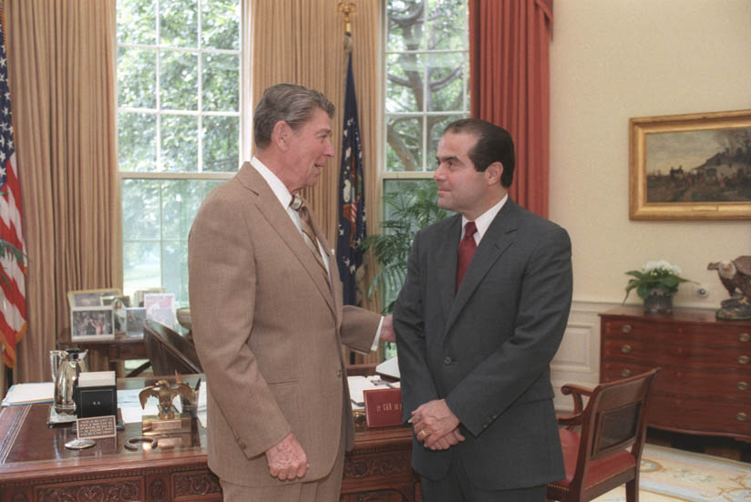
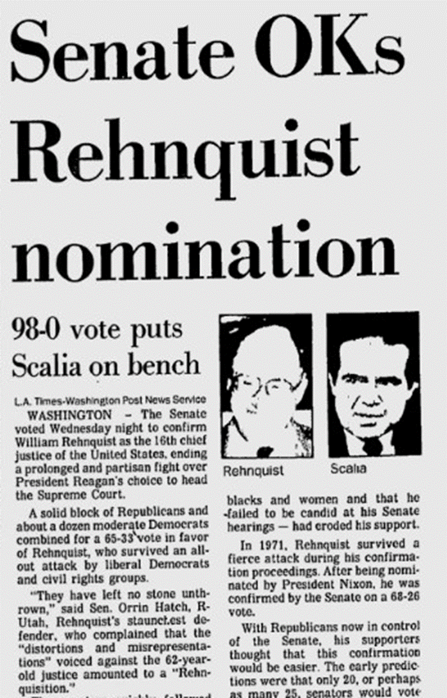

Slide 2
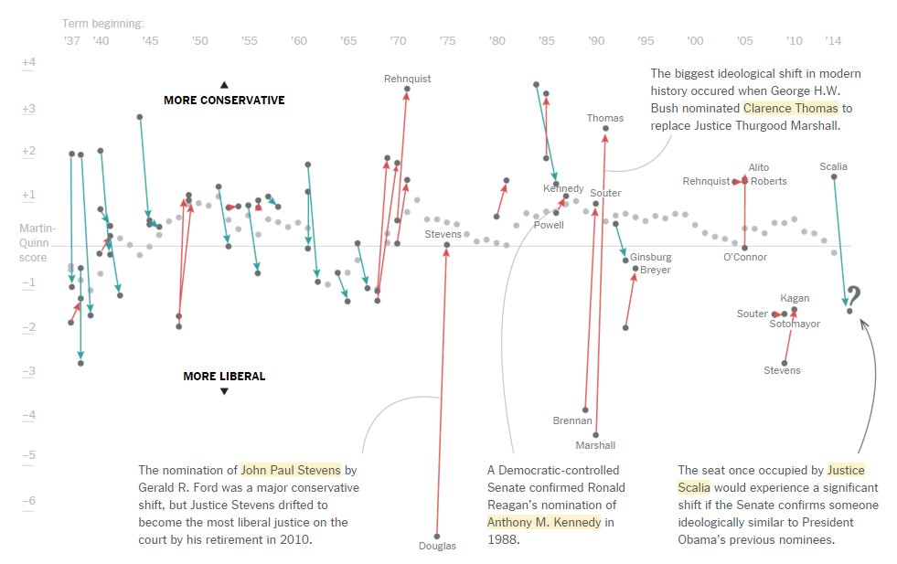

Slide 3
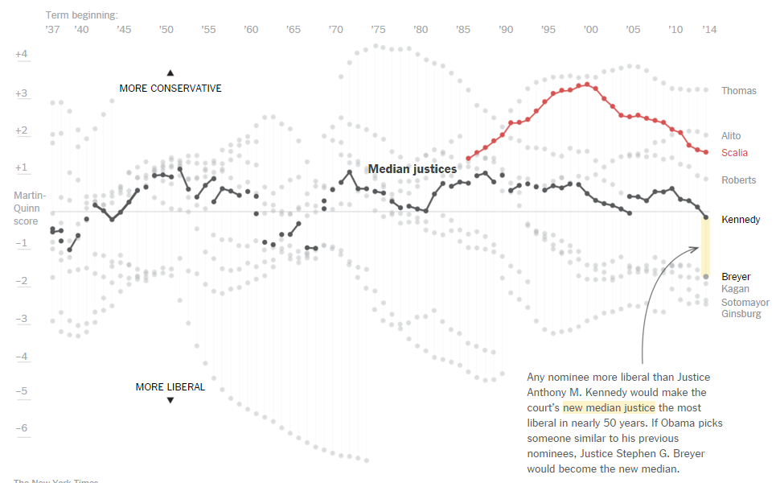

Slide 4
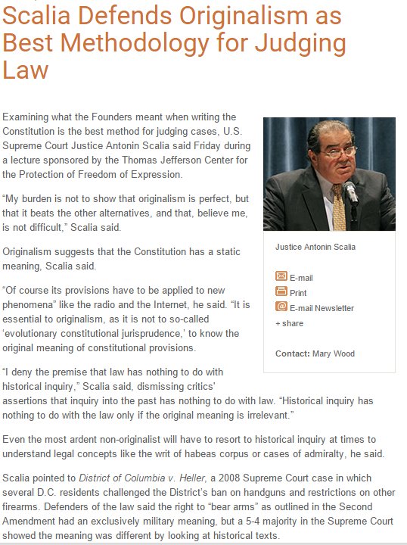

Slide 5
Heller v. District of Columbia (2008)
Nowhere else in the Constitution does a ‘right’ attributed to "the people’ refer to anything other than an individual right . . . ‘[T]he people,’ refers to all members of the political community, not an unspecified subset…
There seems to us no doubt, on the basis of both text and history, that the Second Amendment conferred an individual right to keep and bear arms . . . the phrase ‘security of a free state’ and close variations seem to have been terms of art in 18th-century political discourse, meaning a ‘free country’ or free polity . . .
That history showed that the way tyrants had eliminated a militia consisting of all the able-bodied men was not by banning the militia but simply by taking away the people’s arms, enabling a select militia or standing army to suppress political opponents . . . During the 1788 ratification debates, the fear that the federal government would disarm the people in order to impose rule through a standing army or select militia was pervasive in Anti-federalist rhetoric.

Slide 6
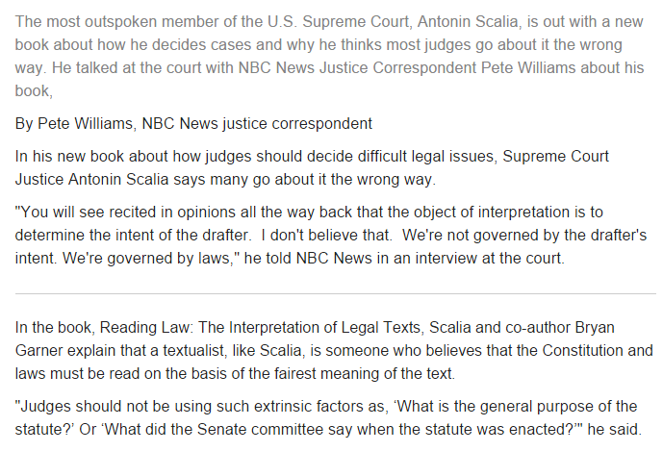

Slide 7
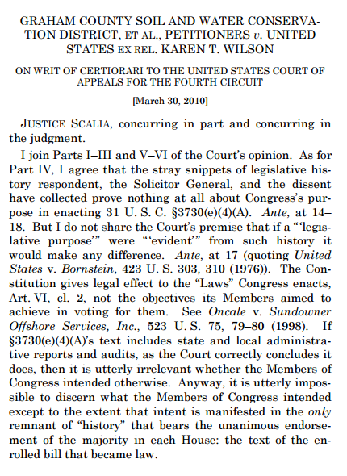
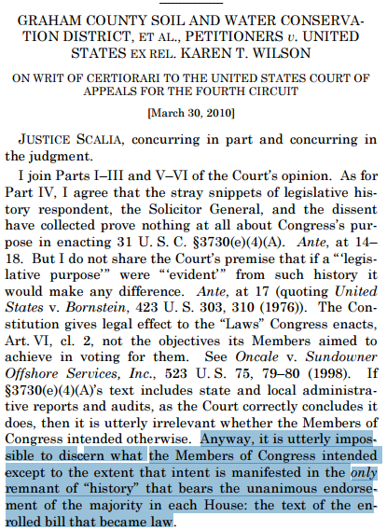

Slide 8
Morrison v. Olson (1988)
Only someone who has worked in the field of law enforcement can fully appreciate the vast power and the immense discretion that are placed in the hands of a prosecutor with respect to the objects of his investigation…
What if [the judges] are politically partisan, as judges have been known to be, and select a prosecutor antagonistic to the administration, or even to the particular individual who has been selected for this special treatment? There is no remedy for that, not even a political one. Judges, after all, have life tenure, and appointing a surefire enthusiastic prosecutor could hardly be considered an impeachable offense. So if there is anything wrong with the selection, there is effectively no one to blame. The independent counsel thus selected proceeds to assemble a staff . . . One thing is certain, however: it involves investigating and perhaps prosecuting a particular individual. Can one imagine a less equitable manner of fulfilling the executive responsibility to investigate and prosecute? What would be the reaction if, in an area not covered by this statute, the Justice Department posted a public notice inviting applicants to assist in an investigation and possible prosecution of a certain prominent person?
Frequently an issue of this sort will come before the Court clad, so to speak, in sheep’s clothing: the potential of the asserted principle to effect important change in the equilibrium of power is not immediately evident, and must be discerned by a careful and perceptive analysis. But this wolf comes as a wolf . . .

Slide 9
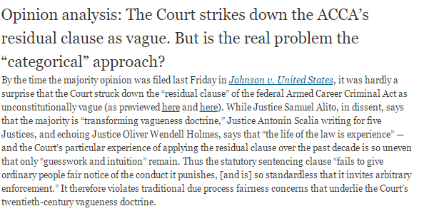

Slide 10

Justice Scalia: I thought that, you know, sometimes Congress says that these provisions will—all the provisions of this Act will be severable.
And we ignore that when the Act really won’t work.
When the remaining provisions just won’t work.
Now, how can you square that reality with the proposition that what we’re looking for here is what would this Congress have wanted?
[Break.]
Justice Scalia: All right. The consequence of your [Paul Clement’s] proposition, “Would Congress have enacted it without this provision?” OK. That’s the consequence.
That would mean that if we struck down nothing in this legislation but the -- what you call the corn husker kickback, okay, we find that to violate the constitutional proscription of venality, okay? [Laughter.]
When we strike that down, it’s clear that Congress would not have passed it without that. It was the means of getting the last necessary vote in the Senate.

Slide 11
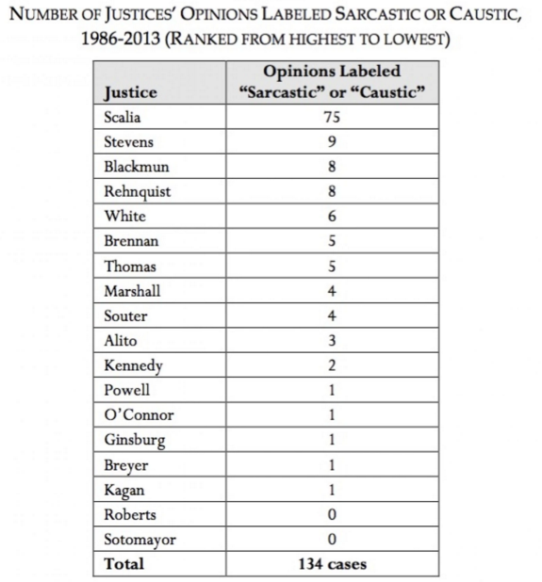
In dissenting opinions, Justice Scalia describes the majority’s approaches as “nothing short of ludicrous” and “beyond the absurd,” “entirely irrational,” and not “pass[ing] the most gullible scrutiny.” He has declared that a majority opinion is “nothing short of preposterous” and “has no foundation in American constitutional law, and barely pretends to.” He talks about how “one must grieve for the Constitution” because of a majority’s approach. He calls the approaches taken in majority opinions “preposterous,” and “so unsupported in reason and so absurd in application [as] unlikely to survive.” He speaks of how a majority opinion “vandaliz[es] . . . our people’s traditions.”

Slide 12
Romer v. Evans (1996)
Of course it is our moral heritage that one should not hate any human being or class of human beings. But I had thought that one could consider certain conduct reprehensible—murder, for example, or polygamy, or cruelty to animals—and could exhibit even “animus” toward such conduct. Surely that is the only sort of “animus” at issue here: moral disapproval of homosexual conduct, the same sort of moral disapproval that produced the centuries old criminal laws that we held constitutional in Bowers . . . Coloradans are, as I say, entitled to be hostile toward homosexual conduct.
Lawrence v. Texas (2003)
Many Americans do not want persons who openly engage in homosexual conduct as partners in their business, as scoutmasters for their children, as teachers in their children’s schools, or as boarders in their home. They view this as protecting themselves and their families from a life style that they believe to be immoral and destructive.

Slide 13
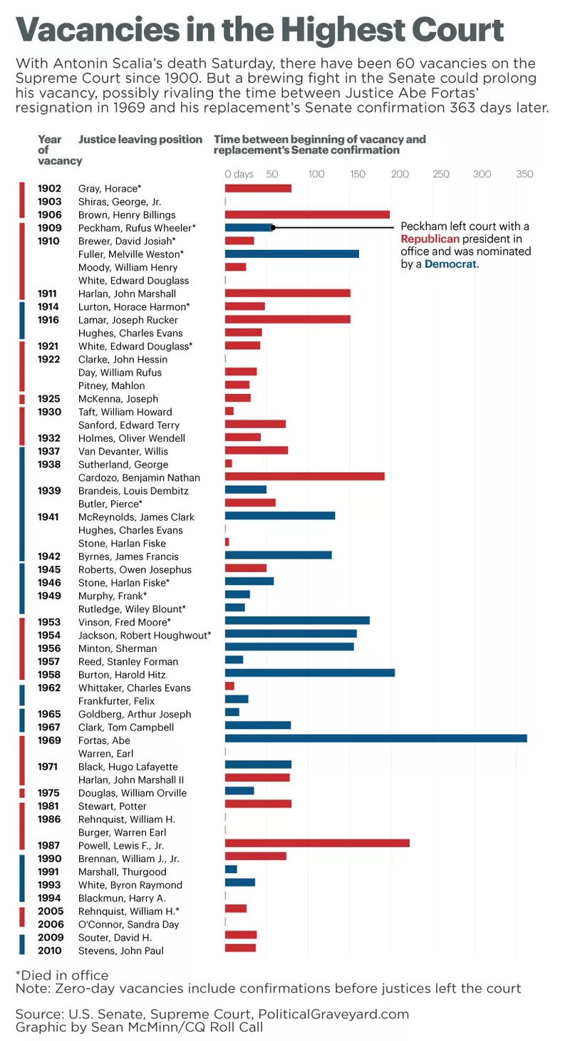

Slide 14
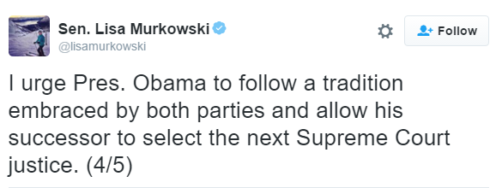

Slide 15
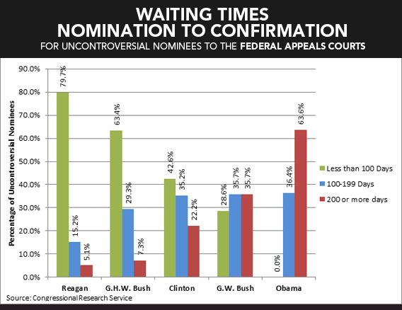
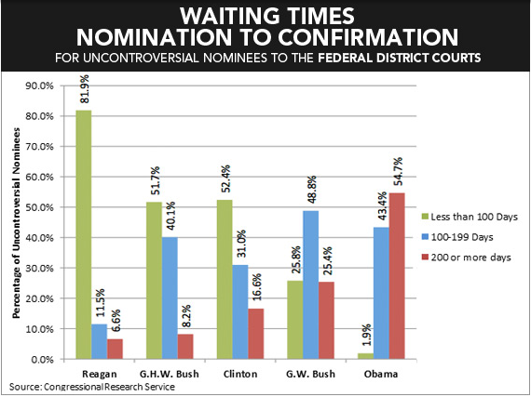

Slide 17
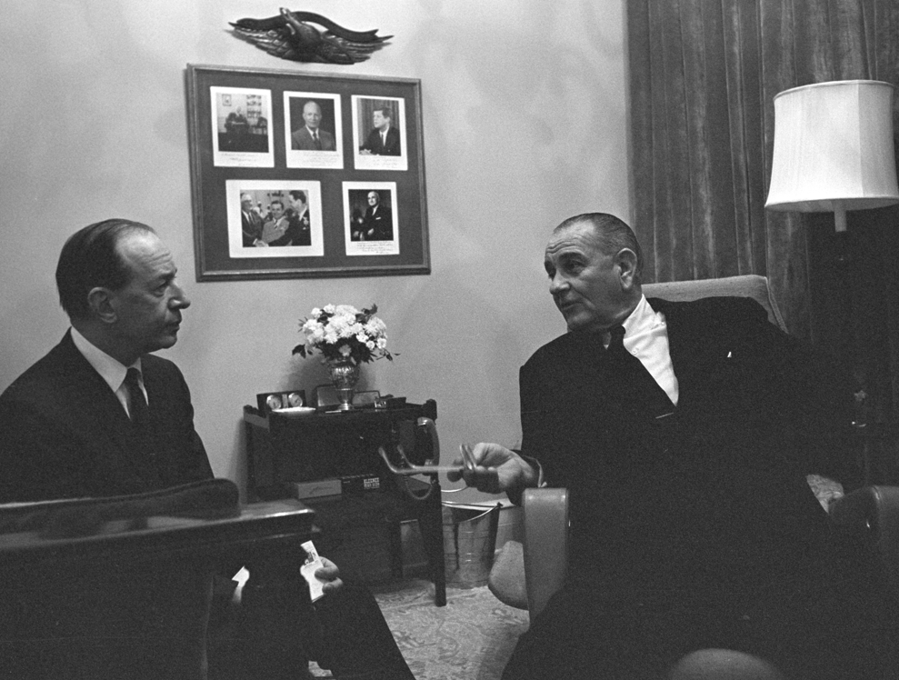

Slide 18
President Johnson: [Homer] Thornberry has some disadvantages. I think the fact he was a congressman, a city councilman, a state legislator. I think that would be awfully good on the Court, and knowing every department of this government.
But from the standpoint of the liberal press, that just will not give me a fair trial—hell, I’d be nominated by acclamation on my record for civil liberties and civil rights—but the Times and the Post are against me, because they’re just anti-Semitic, by God. They’re anti-South. Just because I live in Texas, I don’t have style. And that’s the only damn thing they’ve got against me. I’ve adopted their platform . . .
[Break.]
President Johnson: I know you’ve got to go, and I just got to get some more . . .
How are you going to rate these people—one, two, three, four, five?
Abe Fortas: I—
President Johnson: From the standpoint of my practical problem, and what I may want to do here on all the other things. I’ve got geography, I’ve got the Senate, I’ve got these philosophies, I’ve got to have sure votes.
I want a little continuity, I want a little age—now, look at this not from your standpoint.
Fortas: Well—
President Johnson: Look at it from my standpoint, of knowing me as you know me, and what I want. I want somebody that I’ll always be proud of his vote. That’s the first thing. I may not be proud of his opinion, but I want to be proud of the side he was on. He may not be as eloquent as [Justice] Hugo Black, or you, or somebody. But I want to be damn sure he votes right. That’s the first thing.

Slide 19
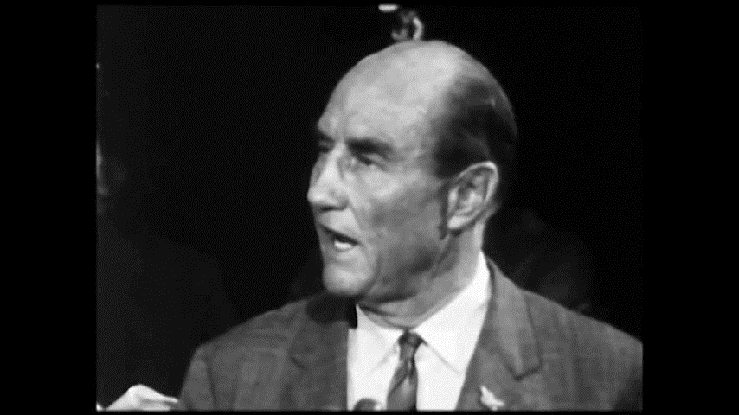

Slide 20
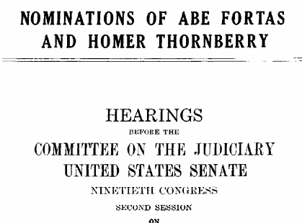
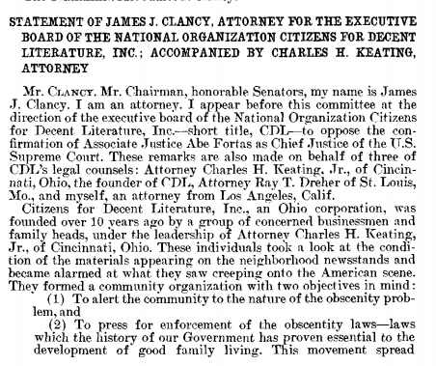

Slide 21
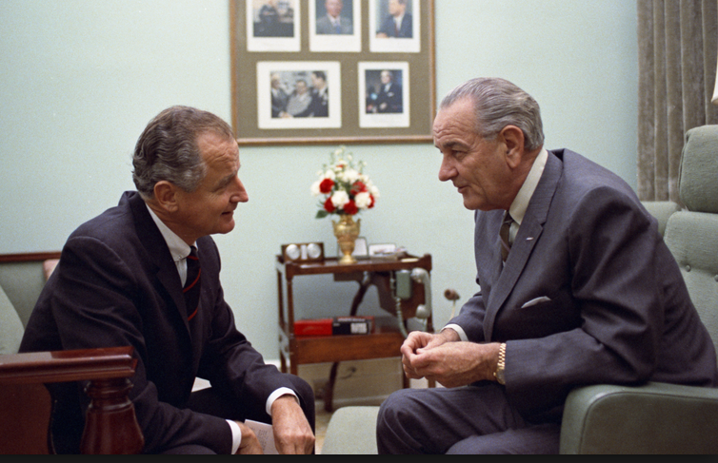

Slide 22
George Smathers: Now, you get a real nut like Strom Thurmond, who up to this point hadn’t really made much sense . . . There are just enough people who will fall for a line like this, that it worries me, very much. And they’ve invited Abe back to talk about it, and I just think that—frankly, my first reaction is that he just ought not to come. And just see . . .
And my other reaction is at the moment—[Michigan senator] Phil [Hart] went to see the movie. I said, “I’m not going to see the damn movie.” Because I want to be in a position to say, as far as I’m concerned, I don’t look at any kind of goddamned pornographic stuff. It’s all over the streets, and always has been. And it’s a man’s choice. And I choose not to look at it. But others may choose to look at it. And if a fella wants to look at it, why, the Court’s voted that he can. That’s a matter of choice.
I don’t look at it. I haven’t seen it, so I’m not passing judgment on whether or not this is the kind of thing that should be shown around, or it shouldn’t.
[Break.]
Smathers: [Arkansas senator] John [McClellan, a very conservative Democrat] was preaching, and rantin’ and ravin’ about how this kind of thing was ruining the life of his grandchildren, and everybody else. He wanted a long time to look into this, and he was going to look into it very deeply.
President Johnson: He ought to go see this Graduates [sic]. [Chuckles.]
Smathers: That’s right.
[Break.]
President Johnson: Well, will you vote on it next Wednesday?
Smathers: So, we’re due to vote on it next Wednesday.
President Johnson: Well, won’t they filibuster it?
Smathers: Yeah. They’re going to filibuster it again.
President Johnson: In the committee?!
Smathers: In the committee.
President Johnson: Well, can you just do that, constantly?
Smathers: Well, with the cooperation of [Jim] Eastland, I just don’t know you’re going to stop it.

Slide 23
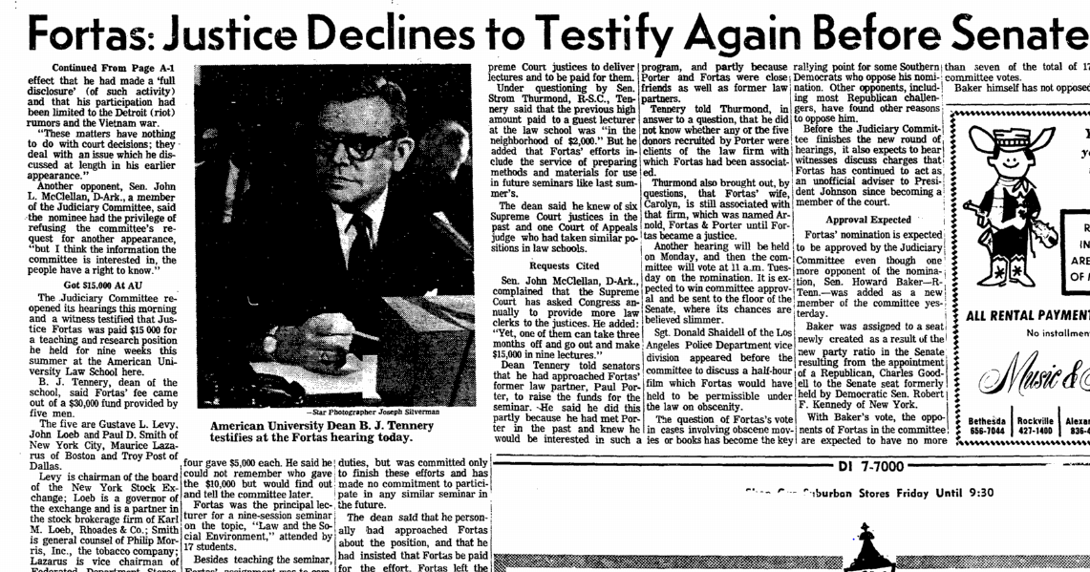

Slide 24
President Johnson: But I just hear every 30 minutes, these fellows, they have press conferences—you know, [Robert] Griffin’s on all the time. He’s having a big press conference this morning. And they make 40 allegations, and we just get tried and convicted every day, and our side—the other side—doesn’t get in.
Ramsey Clark: Yeah.
[Break.]
President Johnson: Get somebody that can write some mean damn speeches that allege some things that they’ve got to deny. Let them do some research . . . That’s what you got to do: you’ve got to employ their resources and their talents doing research instead of attacking you.
Now, we don’t ever keep ‘em busy. I’d find some reason that Griffin’s in this thing. I don’t think that anybody’s ever pointed out that Griffin said a week before the appointment that he was against anybody that was appointed. He wasn’t worried about pornography. Anybody’d look at his face and tell he’s not—that doesn’t bother him! [Clark chuckles.] Pornography!
He was just worried that, by God, he couldn’t make a partisan, political deal out of the Chief Justice [nomination]. And the Republican Chief Justice [Warren] hadn’t delayed it and played politics with it till he could get in.
Now, that’s what he said! He said it days before we even decided to name Fortas. Somebody ought to point that out.

Slide 25
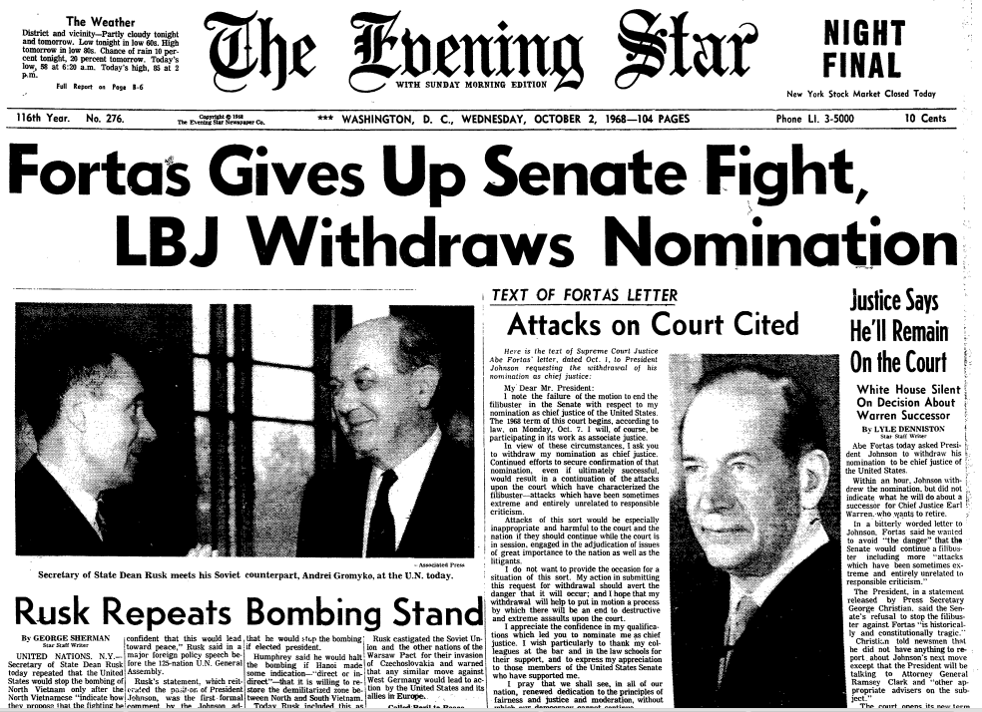

Slide 26
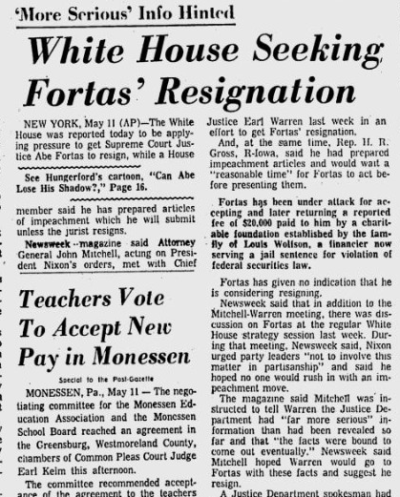

Slide 27
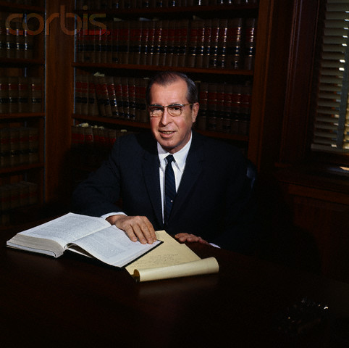
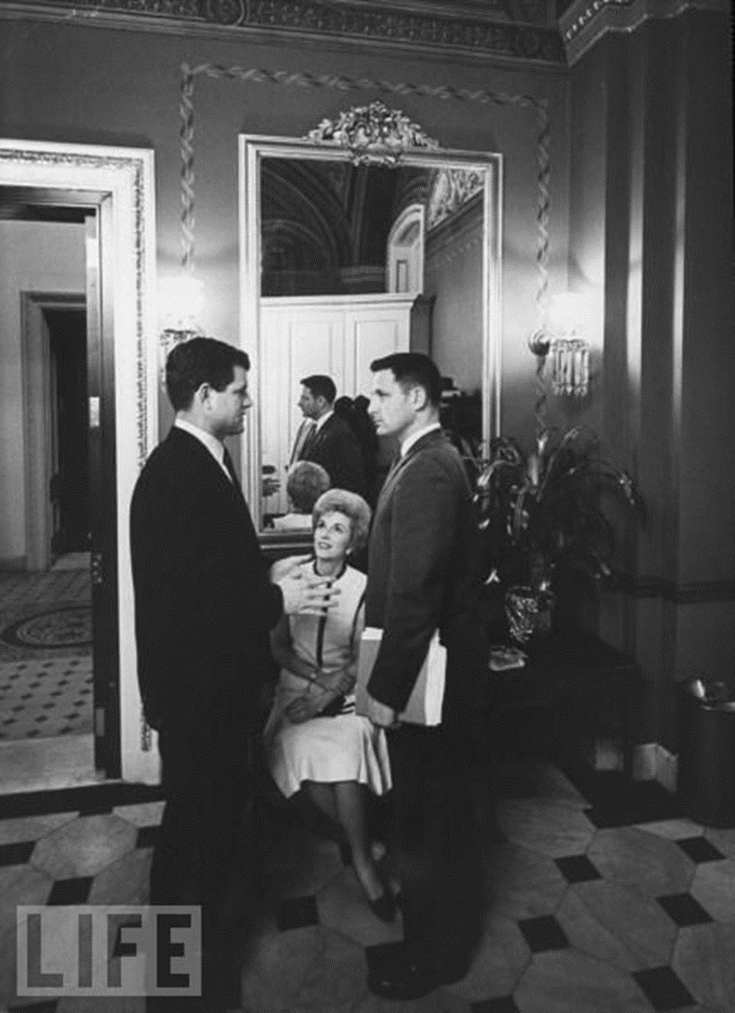

Slide 28
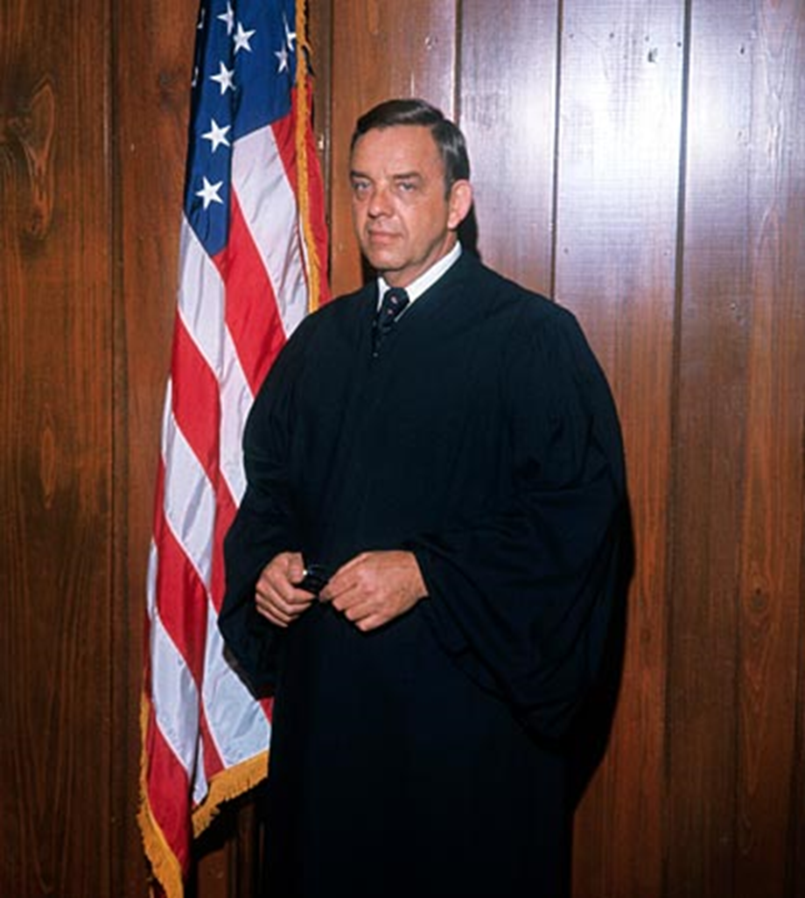
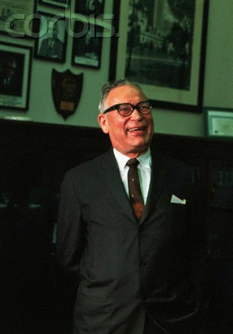
“Even if he were mediocre, there are a lot of mediocre judges and people and lawyers. They are entitled to a little representation, aren't they, and a little chance? We can't have all Brandeises, Frankfurters and Cardozos.”—Senator Roman Hruska
Notes:
hruska

Slide 29
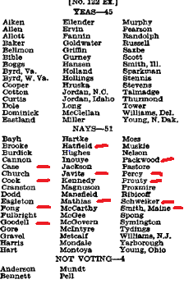

Slide 30
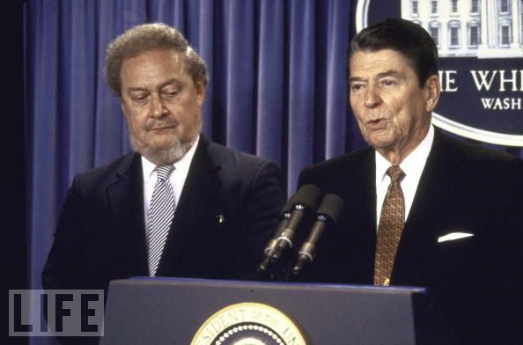

Slide 31
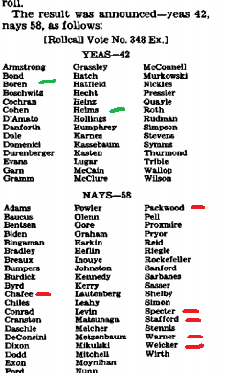

Slide 32
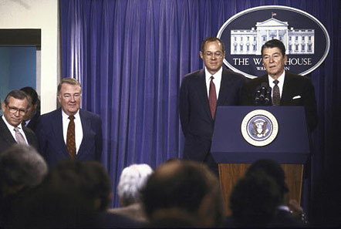

Slide 33
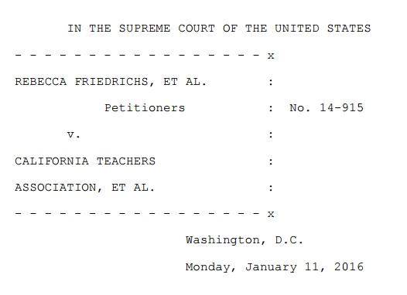
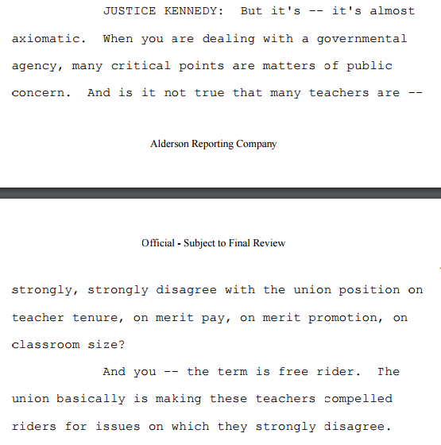

Slide 34
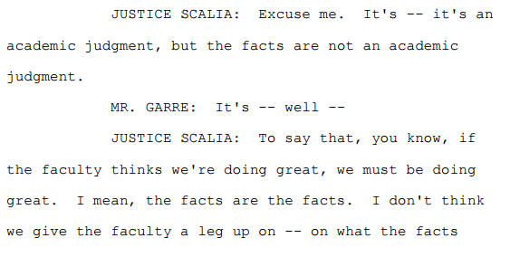
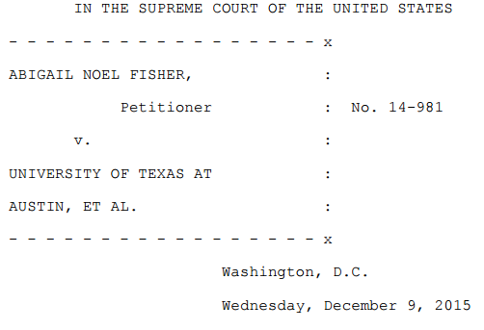

Slide 35
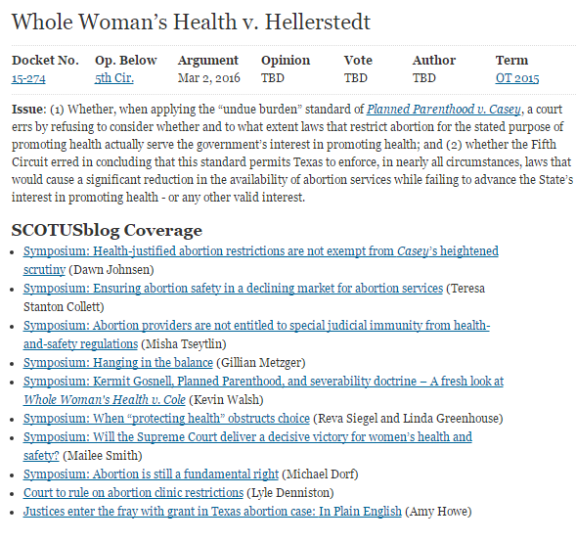

Slide 36
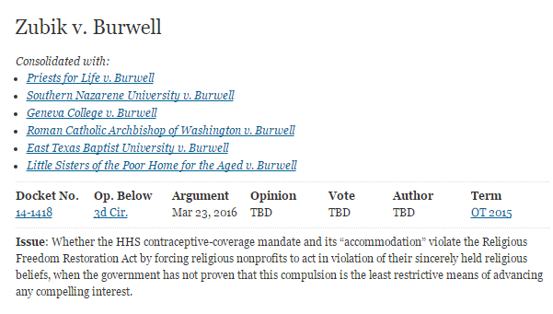

Slide 37
