Slide 1
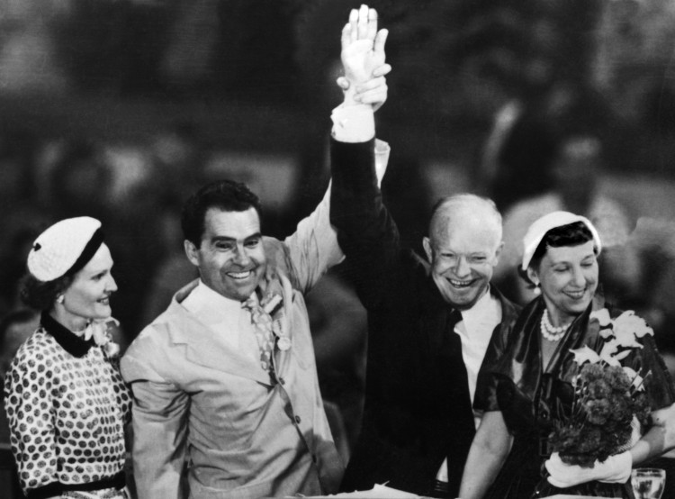

Slide 2


Slide 3
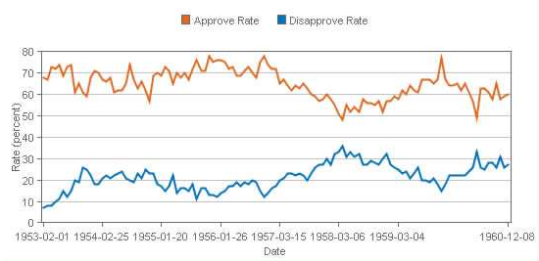

Slide 4


Slide 5
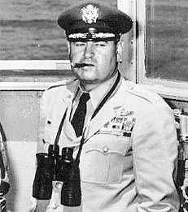


Slide 6
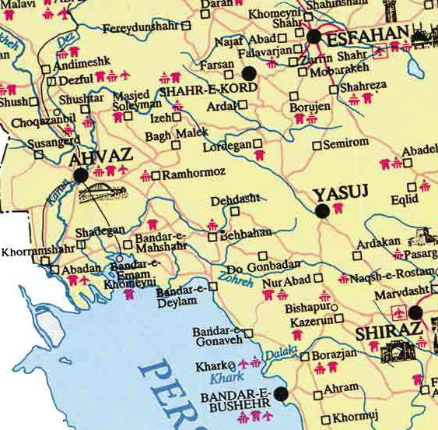

Slide 7
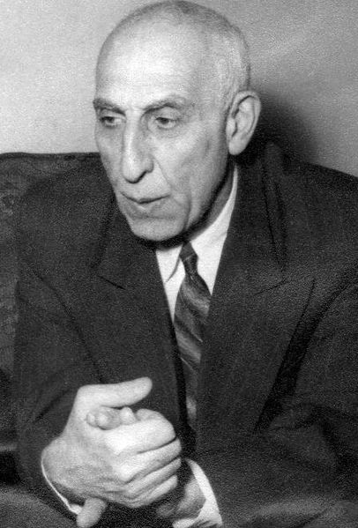
Notes:
mossadeq

Slide 8
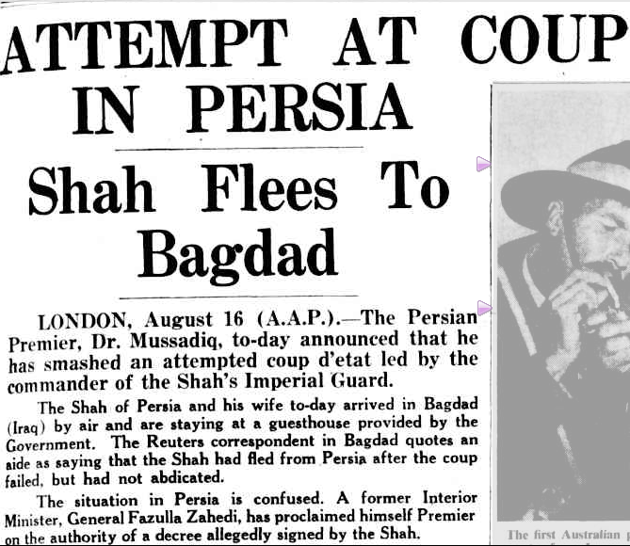

Slide 9
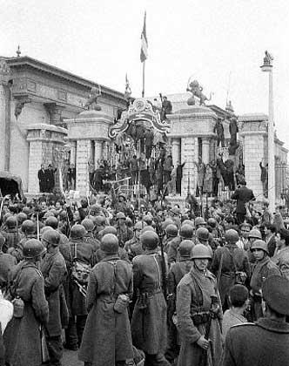
Notes:
Soldiers surrounding parliament

Slide 10
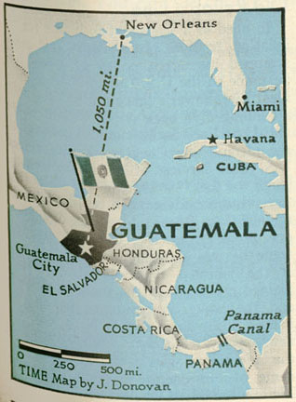

Slide 11
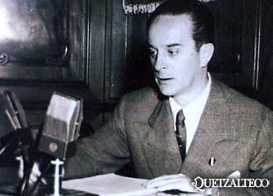

Slide 12
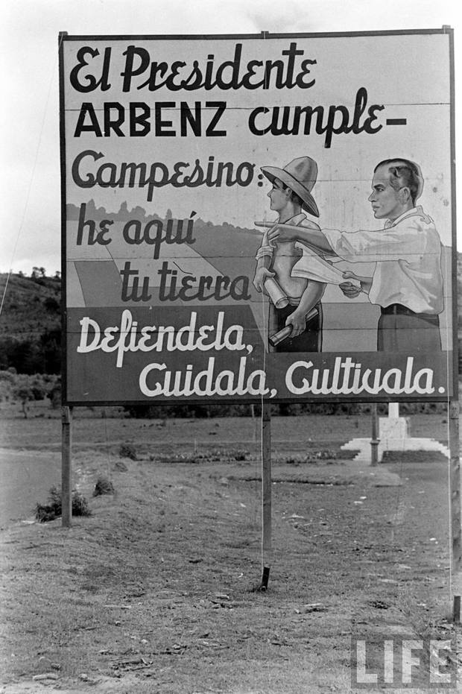

Slide 13
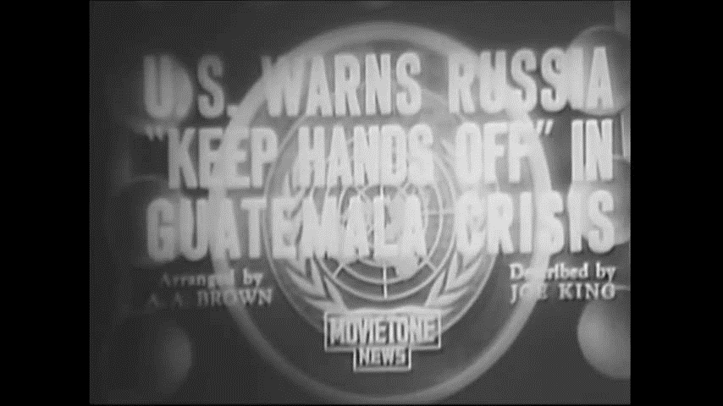

Slide 14


Slide 15


Slide 16
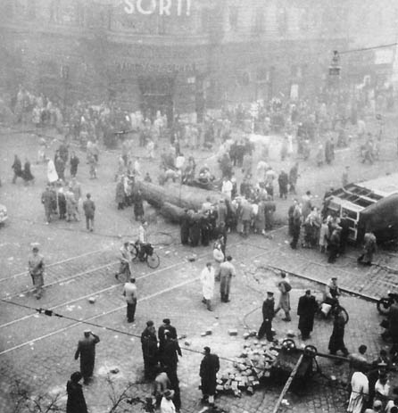
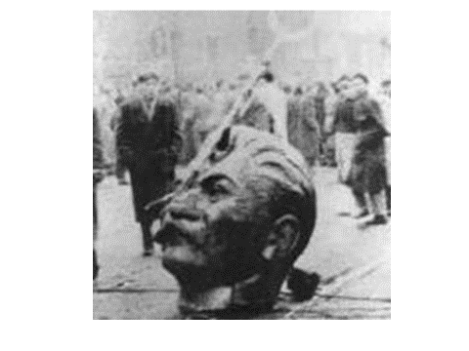

Slide 17

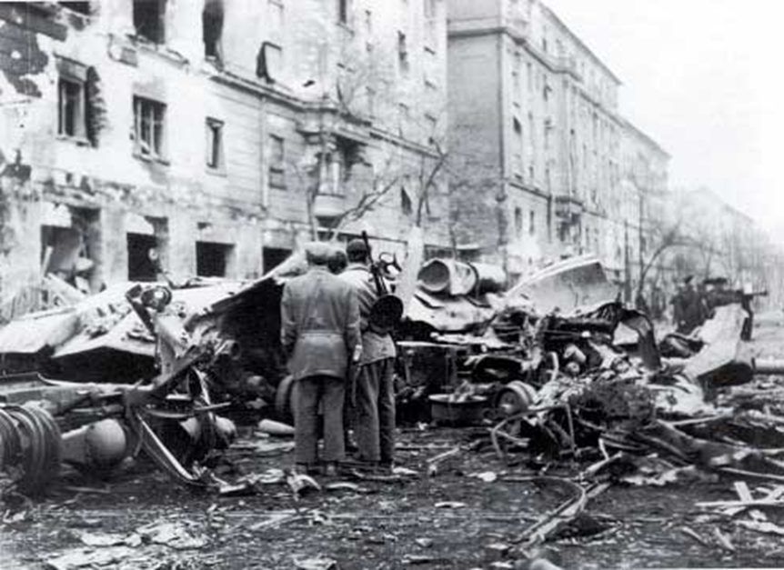

Slide 18
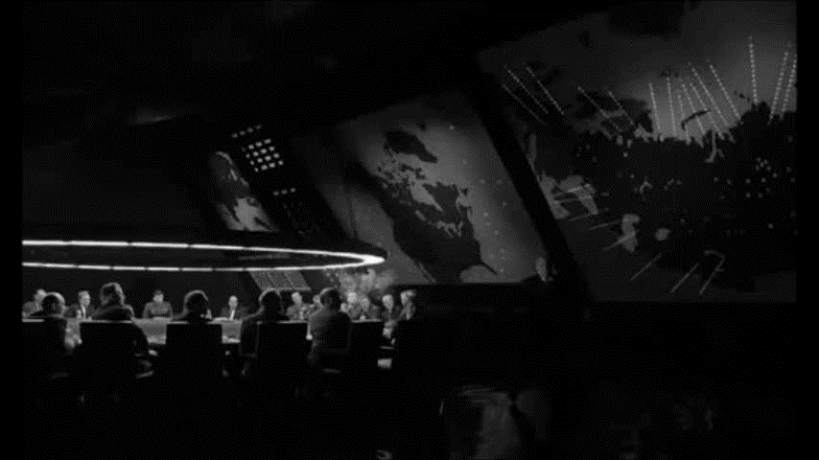

Slide 19
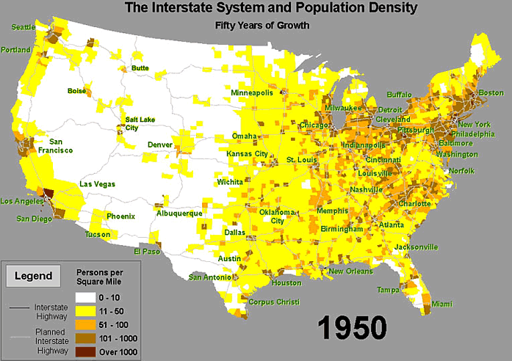

Slide 20
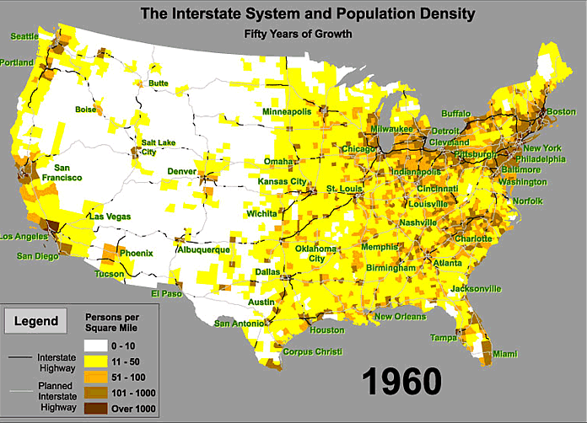

Slide 21
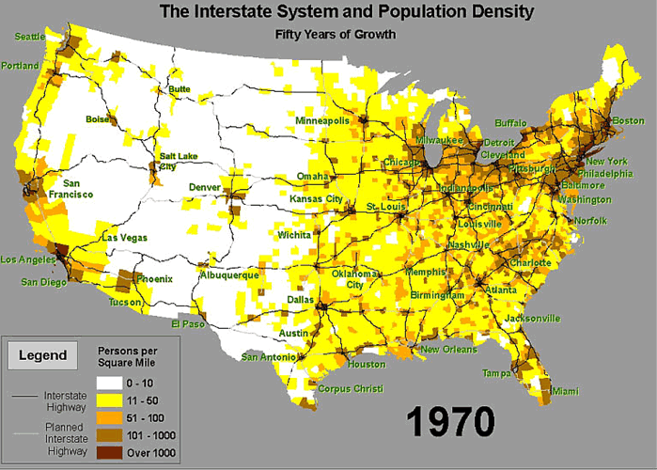

Slide 22
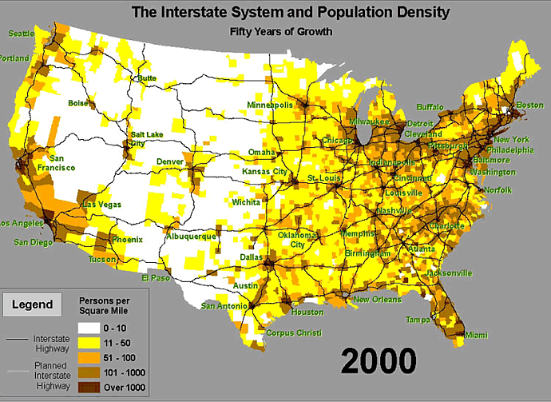

Slide 23
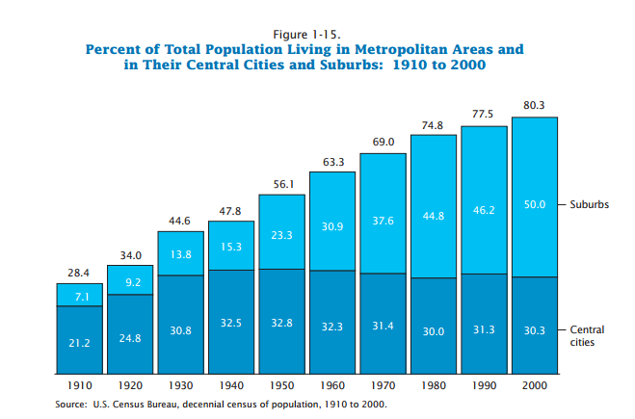

Slide 24
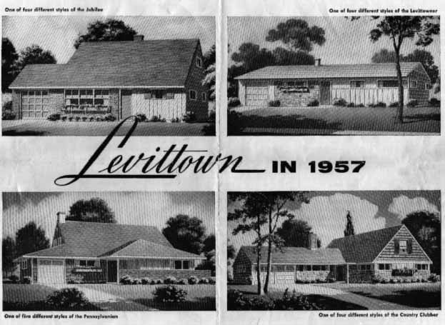

Slide 25
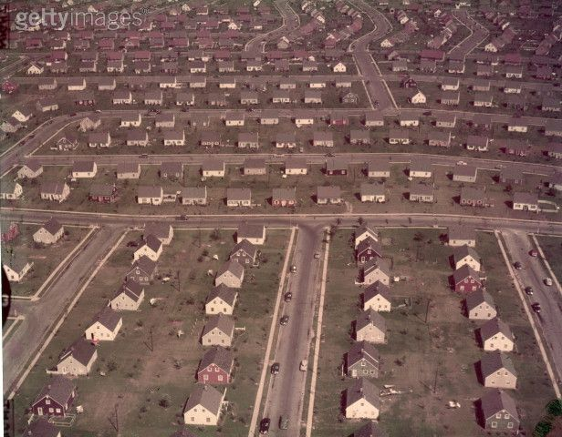

Slide 26
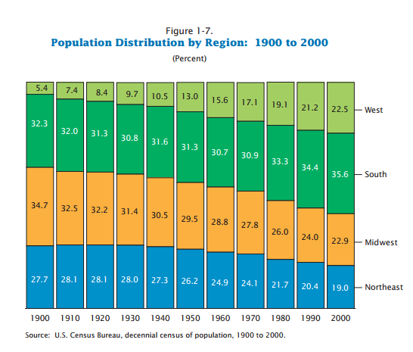

Slide 27
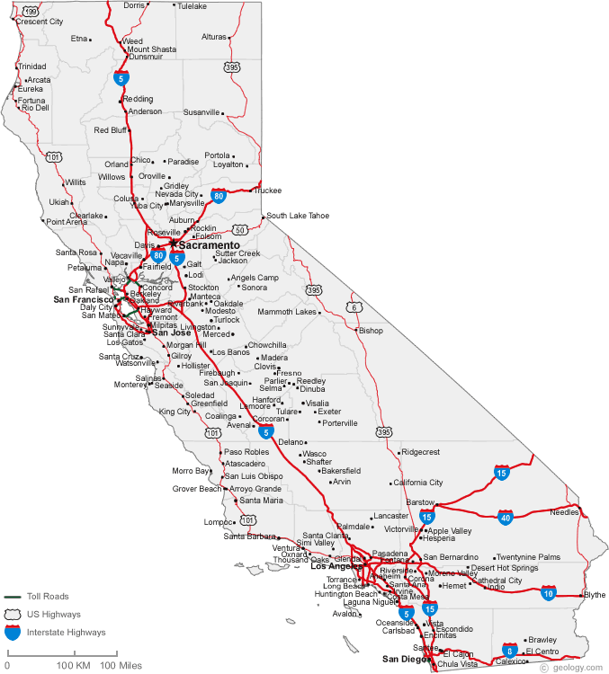

Slide 28
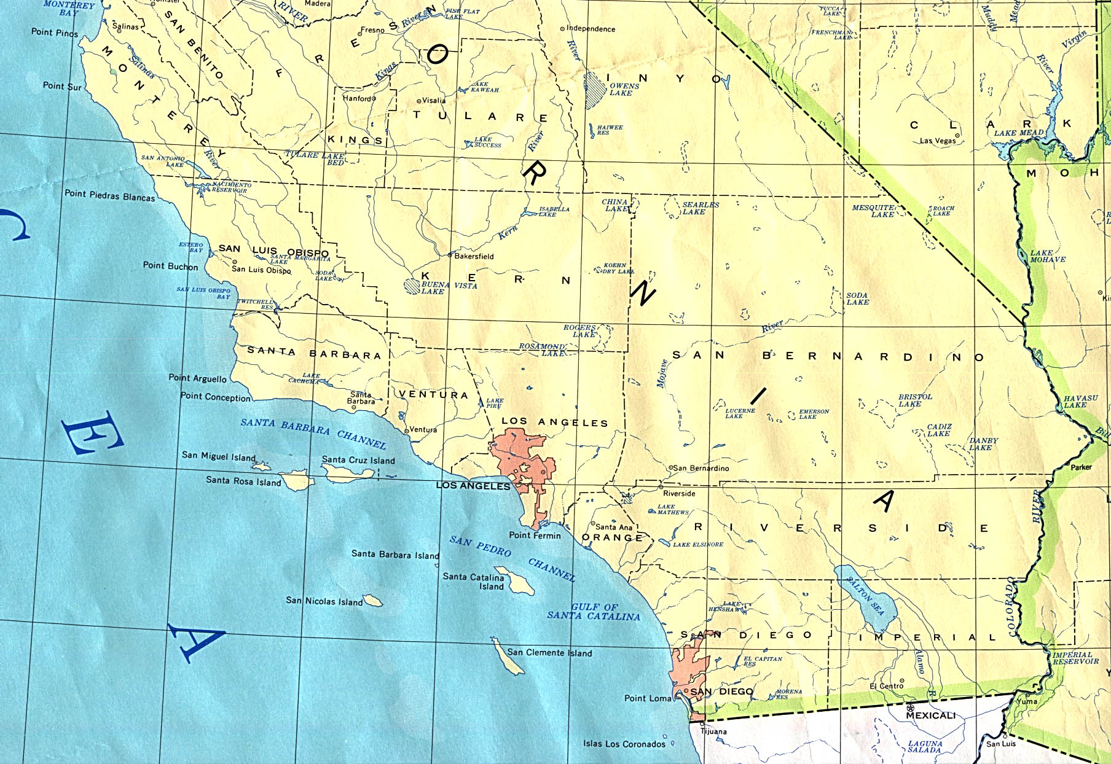

Slide 29
Orange County Population
1930 118,674
130,760 10.2%
216,224 65.4%
1960 703,925 225.6%
1,420,386 101.8%
(current population, 3.2M)

Slide 30
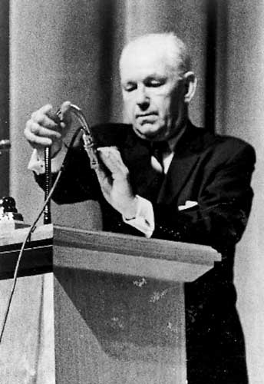
Notes:
Robert welch

Slide 31


Slide 32
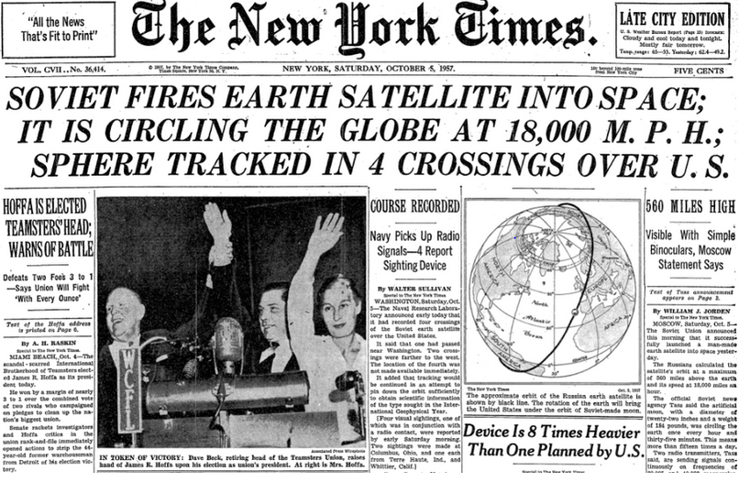

Slide 33
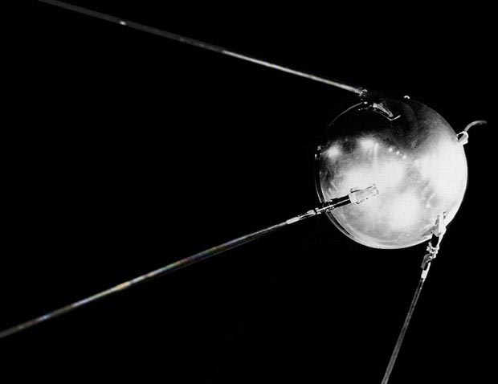
Notes:
sputnik

Slide 34
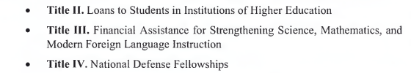
Nothing contained in this Act shall be construed to authorize any department, agency, officer or employee of the United States to exercise any direction, supervision, or control over the curriculum, program of instruction, administration, or personnel of any educational institution or school system.

Slide 35
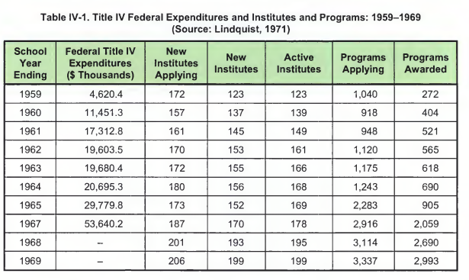

Slide 36


Slide 37
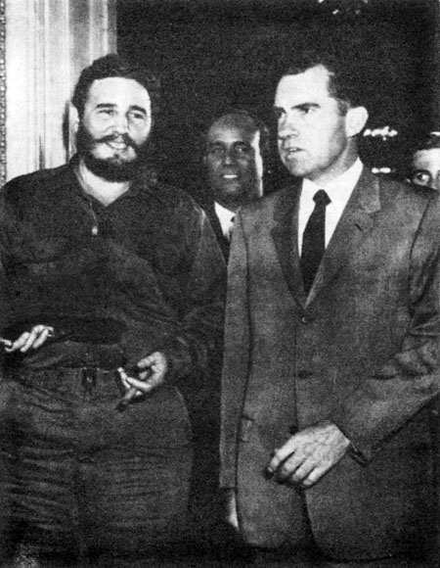

Slide 38
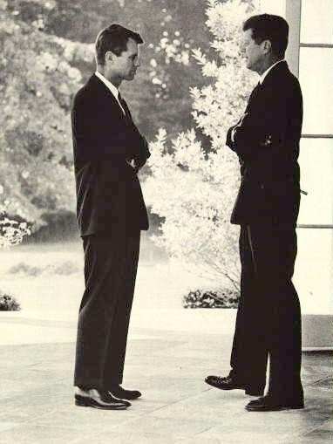

Slide 39



Slide 40


Slide 41


Slide 42


Slide 43


Slide 44

Deputy Sec’y of State George Ball: We did it on a basis where, if we talked to the Turks, I mean, this would be an extremely unsettling business.
President Kennedy: Well, this is unsettling now, George, because he’s [Khrushchev’s] got us in a pretty good spot here. Because most people would regard this as not an unreasonable proposal. I’ll just tell you that. In fact, in many ways—
National Security Advisor McGeorge Bundy: But what “most people,” Mr. President?
President Kennedy: I think you’re going to have it very difficult to explain why we are going to take hostile military action in Cuba, against these sites, which is what we’re thinking about, when he’s [Khrushchev’s] saying, “If you’ll get yours out of Turkey, we’ll get ours out of Cuba.” I think you’ve got a very touchy point here . . .
Bundy: It isn’t as if we’d got the [Jupiter] missiles out, Mr. President. It would be different. Or if we had any understanding with the Turks that they ought to come out, it would be different. Neither of these is the case.
President Kennedy: Well, I’d just like to know how much we’ve done about it; because, as I say, we talked about it—
Bundy: We decided not to, Mr. President. We decided not to play this directly with the Turks.
    Secretary of State Dean Rusk: Our own representative is—
Ball: If we talked to the Turks, they would bring it up in NATO. This thing would be all over Western Europe, and our position would have been undermined.
Bundy: That’s right.
Ball: Because immediately the Soviet Union would know that this thing was being discussed. The Turks feel very strongly about this. We persuaded them that this [stationing of missiles, in 1959] was an essential requirement, and they feel that it’s a matter of prestige and a matter of real—
Bundy: If we had talked to the Turks, it would already be clear that we were trying to sell our allies for our interests. That would be the view in all of NATO. Now, that’s irrational and it’s crazy, but it’s a terribly powerful fact.
Former ambassador to the USSR Tommy Thompson: Particularly in the case that this is a [Soviet] message to you and [UN General Secretary] U Thant.
Ass’t Secretary of State U. Alexis Johnson: It seems to me we ought to get word to [UN ambassador Adlai] Stevenson that, if this is put out up there, he should immediately saw we will not discuss this question of the Turkish bases.
Bundy: The problem is Cuba. The Turks are not a threat to the peace. Nobody tells the Turks as—
President Kennedy: I think it would be better, rather than saying that, until we get some time to think about it, just saying: “Well, the fact of the matter is that we received a letter last night from Khrushchev and it’s an entirely different proposal.” So, therefore, we first ought to get clarification from the Soviet Union of what they’re talking, at least to give us a …
As I say, you’re going to find a lot of people who will find this is a rather reasonable position.
Bundy: That’s true.
President Kennedy: Let’s not kid ourselves.

Slide 45
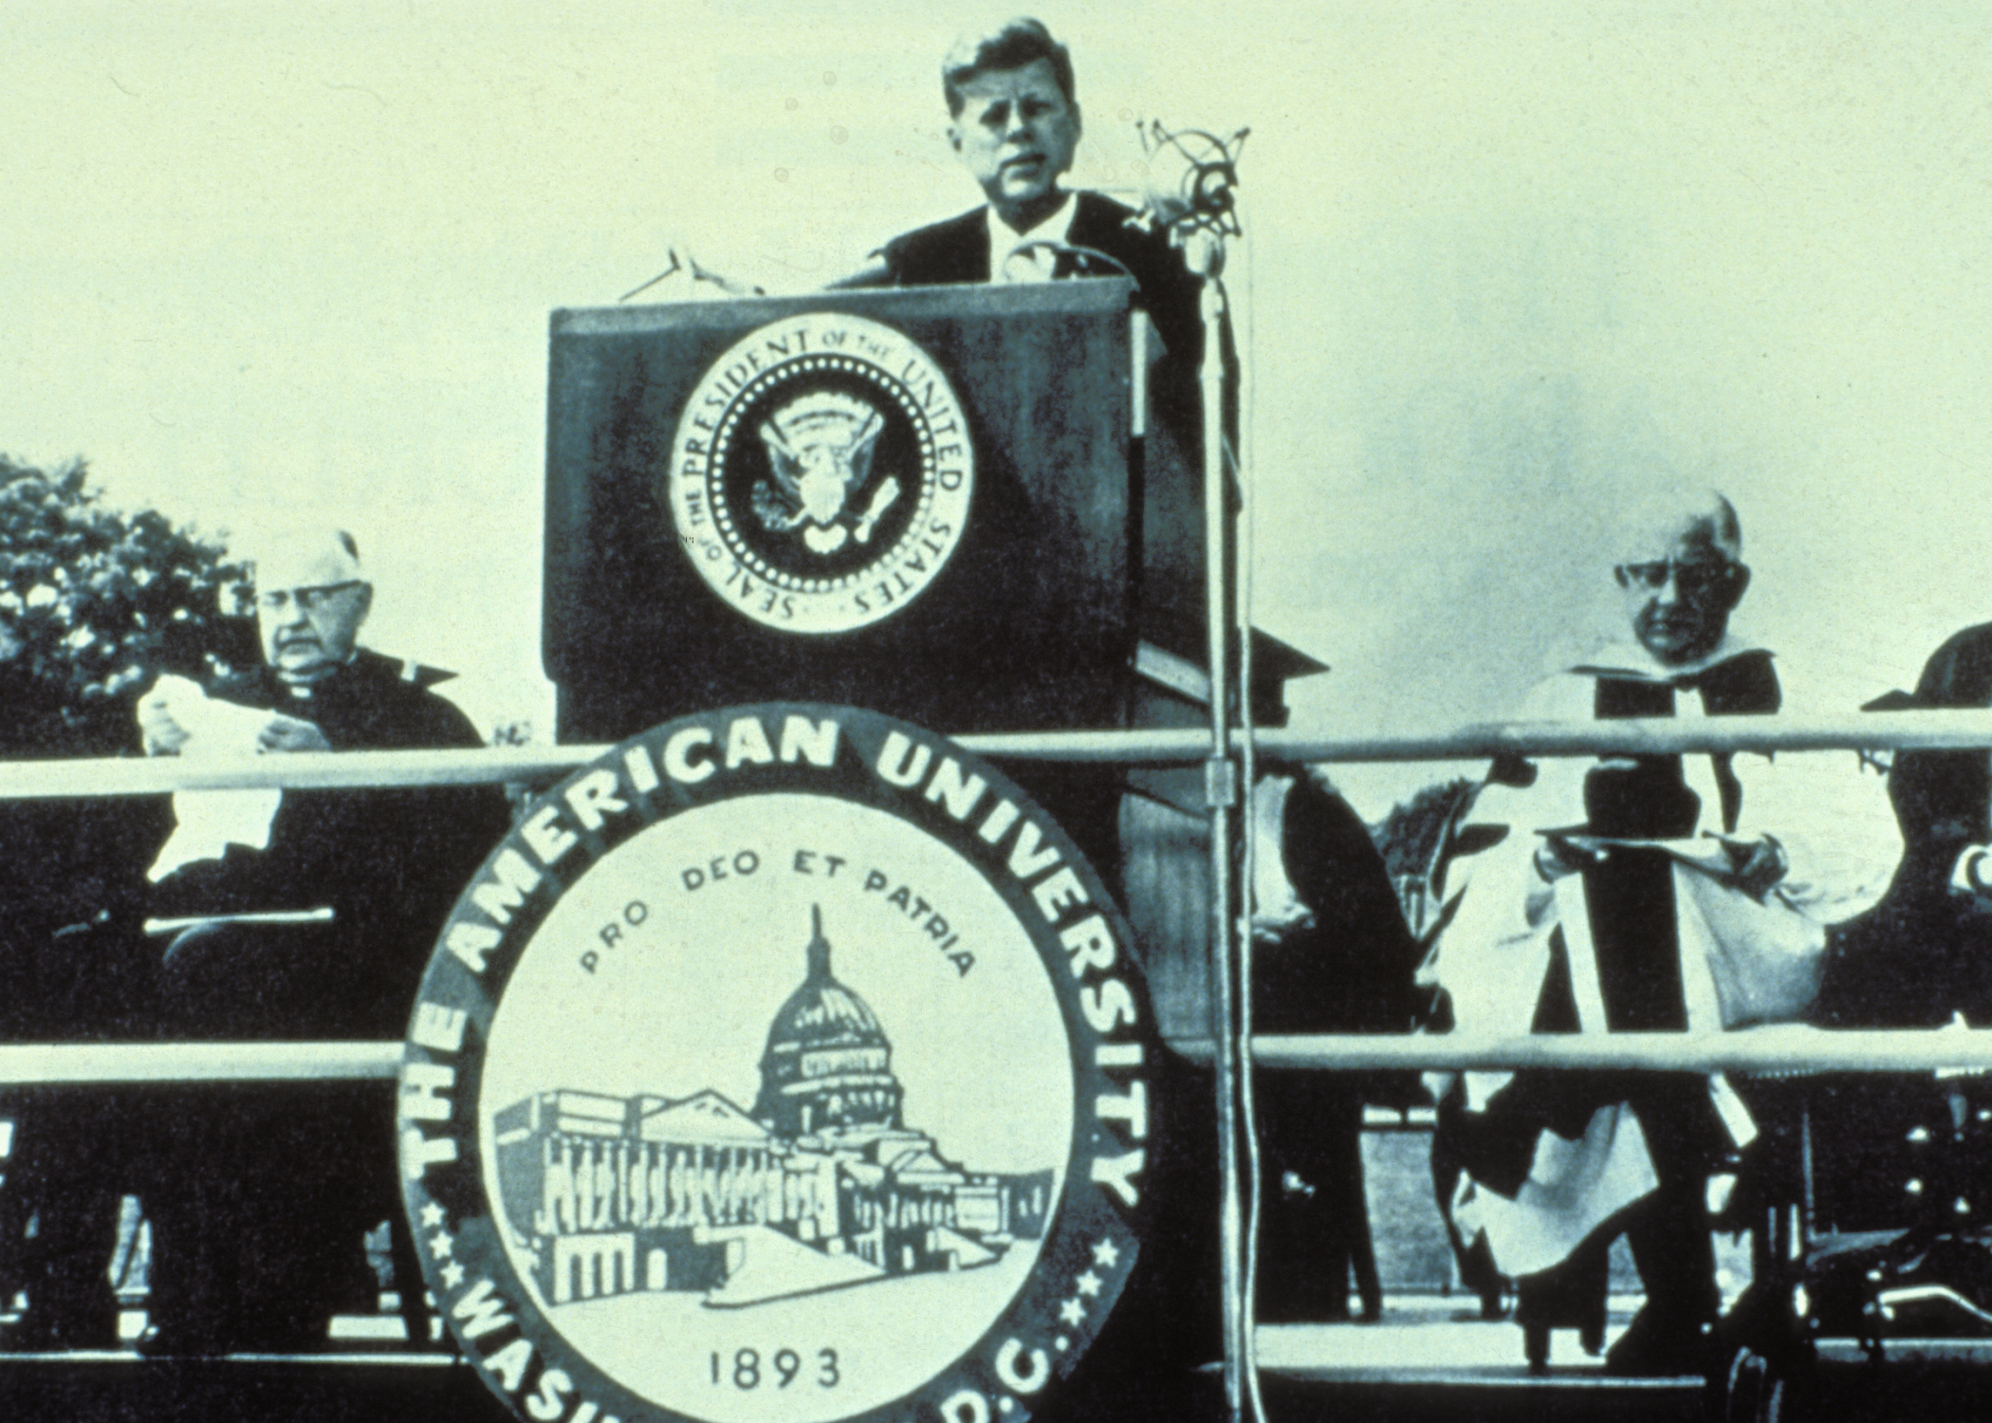

Slide 46
