Slide 2
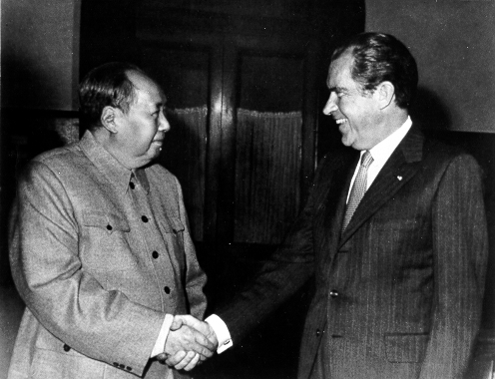

Slide 3
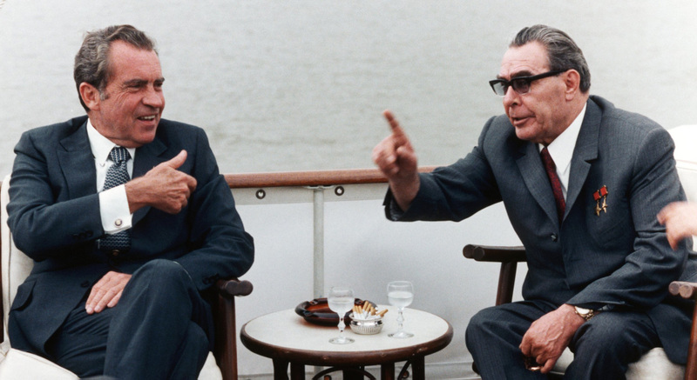

Slide 4

President Nixon: I said [to UN ambassador George H.W. Bush prepare a memo entitled], “Proposed Reward and Punishment to UN Vote.”
There it is. It’s an historical note that will go in the files. By God, we’re going to do it. I’m—we’re going to do it.
Oh, boy, let one of those black bastards who voted against us ask to come in and see me. Never will they cross the threshold of this room again, one of those little countries. Botswana, some of those others. Screw ‘em! Never!
I’ll see Ghana, because they voted with us. But I ain’t going to see Botswana.
Now, of course, you’ve got to see England and France and the rest. That has something else to .. . but I’ll be goddamned cool to Italy the next time they park around in here, because they should have voted with us. They didn’t have a reason to vote the other way, except they decided that that’s where their fish were fried.
But George [H.W. Bush] wants us to screw ‘em? All right. But he doesn’t want me to say it, though, he knows I can’t say it.
Bob Haldeman: No, but he—
President Nixon: He agreed with what I said to these bastards.
[Break.]
President Nixon: Oh, ask Henry [Kissinger] to do this: I want Bush on a confidential basis to give to Henry the list of the countries he particularly wants to have shafted. You know, just give us a list. In absolute confidence. I don’t want it on a piece of—I just want it on a piece of blank paper. Or have him send it to me. And a list of those that he really feels we ought to do something for. Would he do that?
You can’t get that—State would never go for this. That poor [Ass’t Secretary of State for African Affairs David] Newsom—that poor son of a bitch is so soft in the head. But I’ve been sick of the African countries for so many years that I’ve—
Haldeman: Well, they’re a pain in the ass anyway.
President Nixon: Well, for chrissakes, do you know how many people Botswana’s got? It shouldn’t even be a country. They put it in there as a buffer to South Africa. As Henry [Kissinger] said, it’s a desert land. They’ve got 300,000 people. In Botswana! Botswana! [Cross-talk.] They created the goddamn place!
Haldeman: How many people does [mis-pronouncing it] Qatar have? I didn’t even know there was a country called Qatar.
President Nixon: Oh, sure.
Chuck Colson: I’d say two or three hundred—
President Nixon: 250 thousand [people].
Haldeman: I had never heard of the country, and there they were.

