Slide 1


Slide 2
NSC-68 (1950)
Need “effort by all means short of war to (1) block further expansion of Soviet power, (2) expose the falsities of Soviet pretensions, (3) induce a retraction of the Kremlin’s control and influence and (4) in general, so foster the seeds of destruction within the Soviet system that the Kremlin is brought at least to the point of modifying its behavior to conform to a generally accepted international standard.”

Slide 3
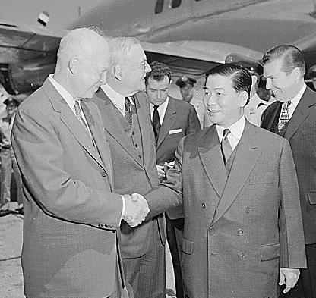

Slide 4
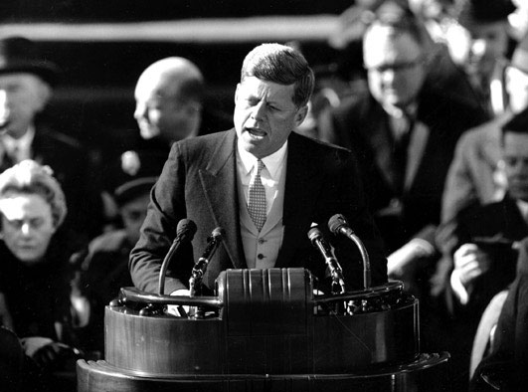
23199505891

Slide 5
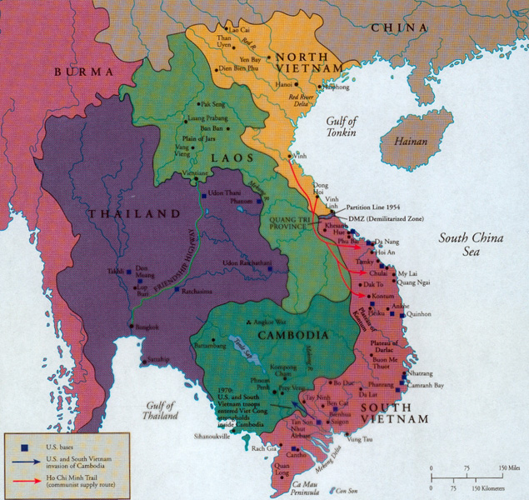

Slide 6
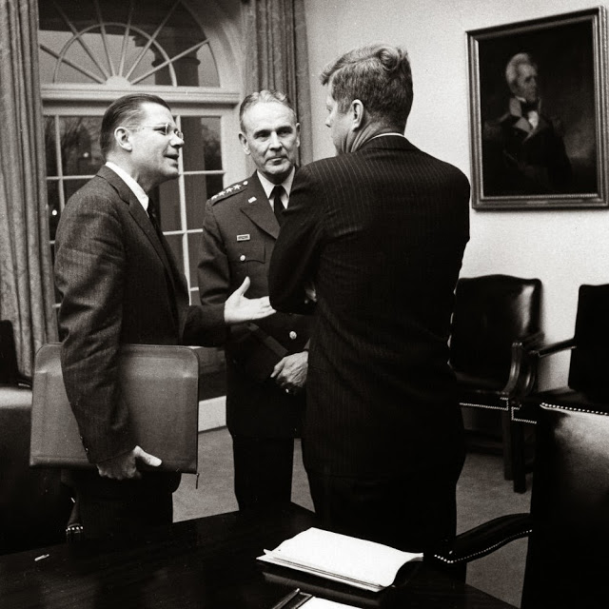

Slide 7
Robert McNamara: If you saw the weapons that they’re using, the ammunition they’re using, I think you’d agree most of the effort is indigenous.
[Break.]
McNamara: But in any case, I believe that we will be able to get it under control. It may take . . . two years or three years, possibly, but we should now be looking to the time when we’ll have a normal military aid program there.
Instead, they’re proposing fantastic military assistance programs. I think we ought to take 75 to 100 million [dollars] out of the ‘65, ‘66, ‘67 military assistance programs they’re talking about and be looking to a normal relationship so we don’t build up another Korea.
[Break.]
McNamara: And secondly, I think that, as I’ve mentioned before, that both for domestic political purposes and also because of the psychological effect it would have in South Vietnam, we ought to think about the possibility of bringing a thousand men home by the end of the year. Now, I’ve asked them to lay out that plan, without at the present time making any decision to—
President Kennedy: That’s right. [McNamara unclear.] Because in the case that—if it isn’t in very good shape you don’t want to make—
McNamara: Absolutely.
President Kennedy: Yeah; yeah.
McNamara: It would be . . . have a negative influence. But on the other hand, if we had two or three victories, this would be [Kennedy assents] just exactly the shot in the arm we ought to have. So they’re going to do that.

Slide 8
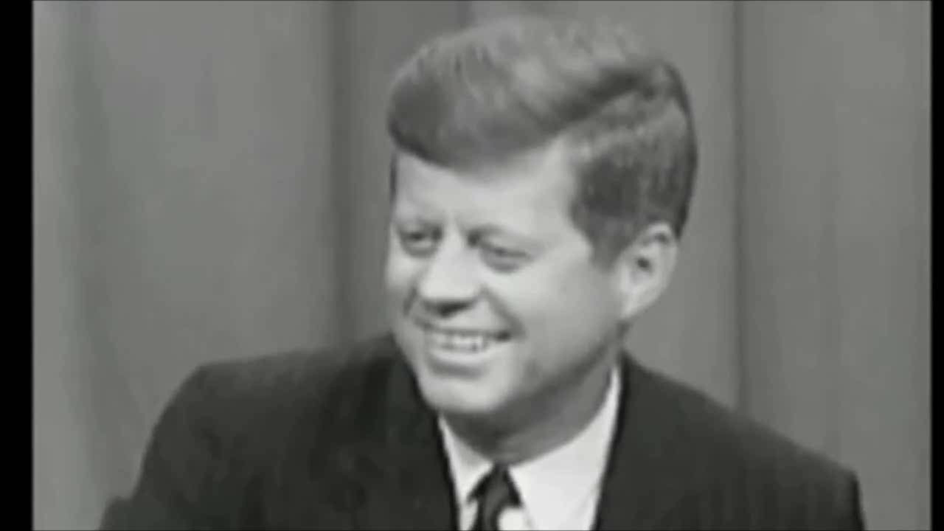

Slide 9
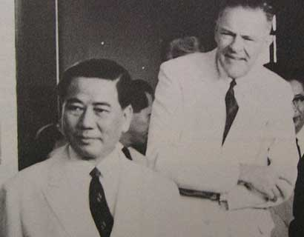

Slide 10

Robert Kennedy: Could I just make a suggestion?
President Kennedy: Yeah.
Robert Kennedy: I—this may be a minority, but I just don’t see that this [idea of a coup] makes any sense on the face of it, Mr. President.
I mean: it’s different from a coup in Iraq, or a South American country; we are so intimately involved in this . . . We’re putting the whole future of the country and really Southeast Asia in the hands of somebody that we don’t know very well, that one official of the United States government [Ambassador Lodge] has had contact with him, and he, in turn, says he’s lined up some others.
It’s clear from the MAP [military assistance program] and from—Diem, he’s a fighter. He’s not somebody like [Juan] Bosch [the former president of the Dominican Republic, ousted in a bloodless coup], who’s just going to get out of there. He’s a determined figure who’s going to stick around and I should think go down fighting; that he’s going to have some troops there that are going to fight, too.
That if it’s a failure, that we risk such a hell of a lot.
[Break.]
Robert Kennedy: I would think that we’re just going down the road to disaster. Now, maybe this is going to be successful, but I don’t think that anybody . . . any reports that I’ve seen indicate that anybody has a plan to show where this is going.

Slide 11
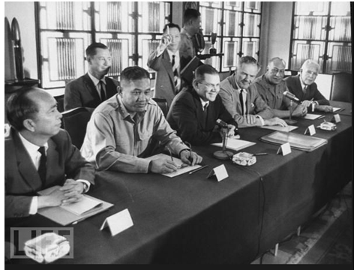

Slide 12
Time Period | U.S. Troops in Vietnam | U.S. Personnel Killed
End of 1961 | 2,067 | 16
End of 1962 | 11,500 | 52
End of 1963 | 19,000+ | 118

Slide 13


Slide 14


Slide 15
President Johnson: Do you think it’s a mistake to explain what I’m saying now about Vietnam, and what we’re faced with?
Robert McNamara: Well, I do think, Mr. President, that it would be wise for you to say as little as possible.
The frank answer is we don’t know what’s going on out there. The signs I see coming through the cables are disturbing signs—poor morale in Vietnamese forces, poor morale in the armed forces, disunity, a tremendous amount of coup planning against [South Vietnamese leader Nguyen] Khanh. About what you’d expect in a situation that’s had three governments in four months—
President Johnson: Well, then why don’t we take some pretty offensive steps pretty quickly, then? Why don’t we commend Khanh on his operation and try to prop him up? Why don’t we raise the salary of their soldiers to improve that morale, instead of waiting a long time? Why don’t we do some of these things that are inclined to bolster ‘em?
McNamara: Well, I’m not sure that they here . . .
President Johnson: I sure as hell don’t want to get in the position of Lodge recommending to me—the one thing he recommended is “please give us a little more pay for our soldiers,” and we turned him down.
McNamara: Oh, no, we’ve done that, sir.
President Johnson: We haven’t acted. We said we’re going to wait till you go out there [to Vietnam].
McNamara: Well, no. He knows there’s money for that. There’s no problem on that issue.
President Johnson: Well, then, why don’t we clear it up, so that we get him answered?
Now, I think that politically—I’m not a military strategist—but I think that as long as we’ve got him [Lodge] there, and he makes recommendations, and we act on ‘em, particularly if we act favorably, we’re not in too bad a condition politically.
But I think when he wires us and says, “The only damn thing I want you to do is to give ‘em an increase in pay because morale’s terrible,” and we say, “Well, wait,” then if something happens in between, I think we are caught with our britches down.

Slide 16


Slide 17
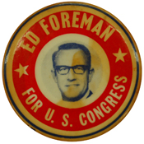

Slide 18



Slide 19
President Johnson: That was a good vote you had today.
Speaker McCormack: Yes, it was very good. 414 to nothing; one present. What’d the Senate do?
President Johnson: 88 to 2. Morse and Gruening.
McCormack: I don’t understand Gruening.
President Johnson: Oh, he’s no good. He’s worse than Morse. He’s just no good. I’ve spent millions on him up in Alaska [in reconstruction funds after the March 1964 Alaska earthquake]. He’s just no good.
And Morse is just as undependable and erratic as he can be.
McCormack: I know that. But I can’t understand the other fellow.
President Johnson: Say, I wanted to point out this little shitass [Ed] Foreman today got up and said that we [Johnson] acted impulsively by announcing that we had an answer on the way [to the Tonkin Gulf incidents] before the planes dropped their bombs.
[Break.]
President Johnson: It’s just a pure lie, and smokescreen.
McCormack: But he was booed two or three times. Tremendous booing on the Democratic side. He was—everybody knew he was just cheap and mean and contemptible. Well, you know what he is.
President Johnson: Yeah. Yeah, he’s no good.

Slide 20
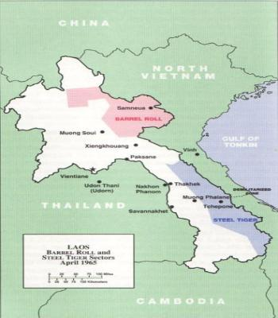

Slide 21
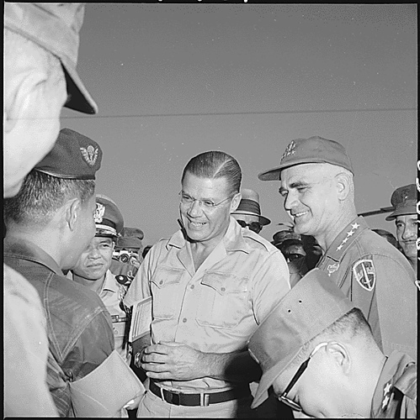

Slide 22


Slide 23


Slide 24
President Johnson: What they [adherents to the Bull Fulbright line on Vietnam] really think is that we oughtn’t to be there, and we ought to get out.
Well, I know we oughtn’t to be there, but I can’t get out. I just can’t be the architect of surrender. And don’t see—I’m trying every way in the world I can to find a way to . . . thing.
But they [the North Vietnamese] don’t have the pressure to bring them to the table as of yet. We don’t know whether they ever will.
I’m willing to do damn near anything. If I told you what I was willing to do, I wouldn’t have any program. [Senate Minority Leader Everett] Dirksen wouldn’t give me a dollar to operate the war. I just can’t operate in a glass bowl with all these things. But I’m willing to do nearly anything a human can do, if I can do it with any honor at all. But . . .
They started with me on Diem, you remember?
Eugene McCarthy: Yeah.
President Johnson: That he was corrupt and he ought to be killed. So we killed him. We all got together and got a goddamned bunch of thugs and we went in and assassinated him. Now, we’ve really had no political stability since then.
McCarthy: Yeah.

Slide 25


Slide 26
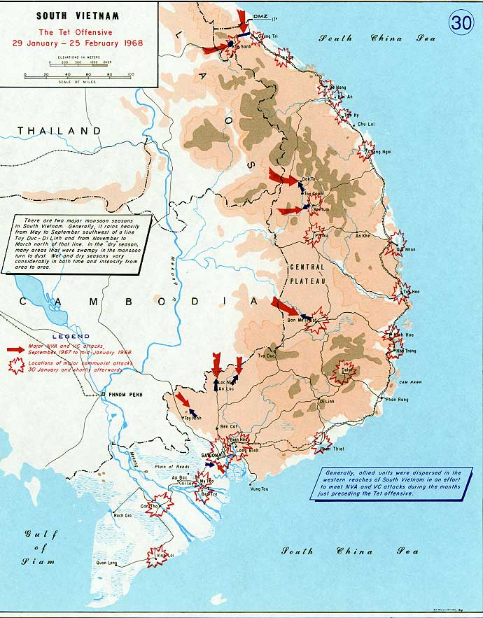

Slide 27
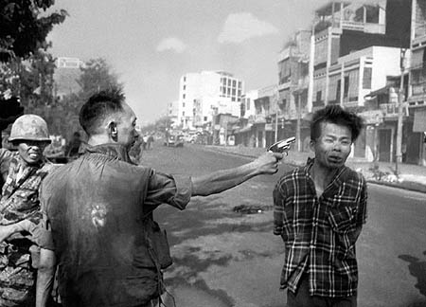

Slide 28
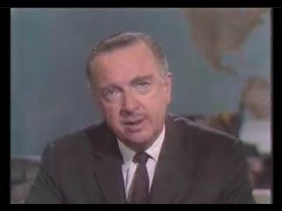

Slide 29
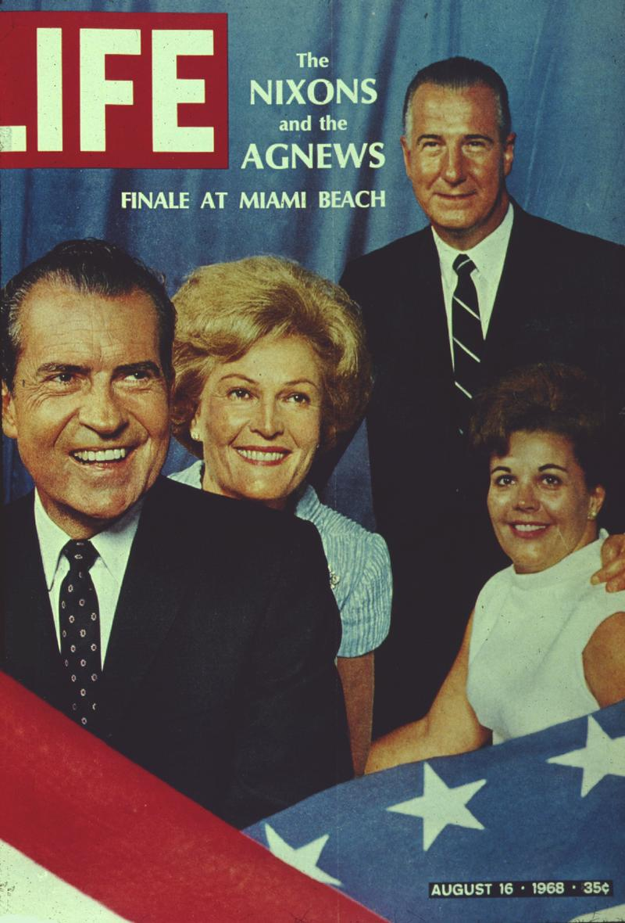

Slide 30
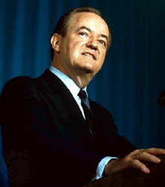
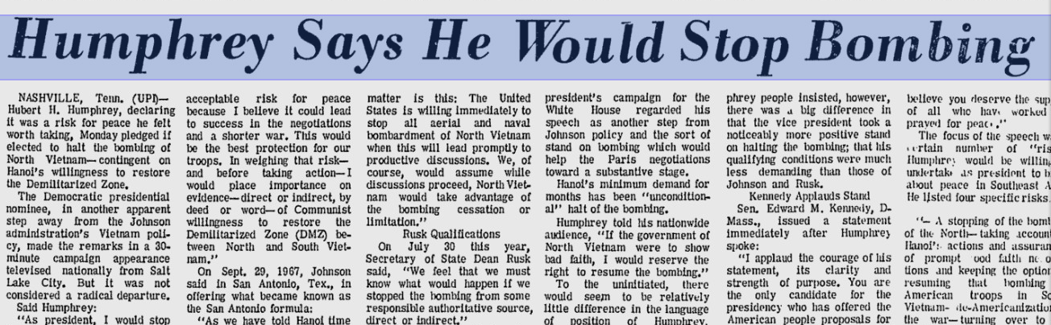

Slide 31
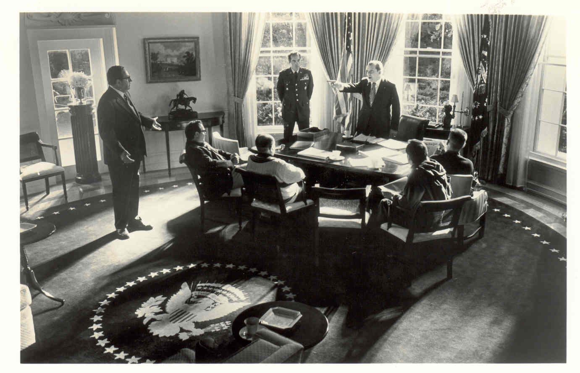

Slide 32
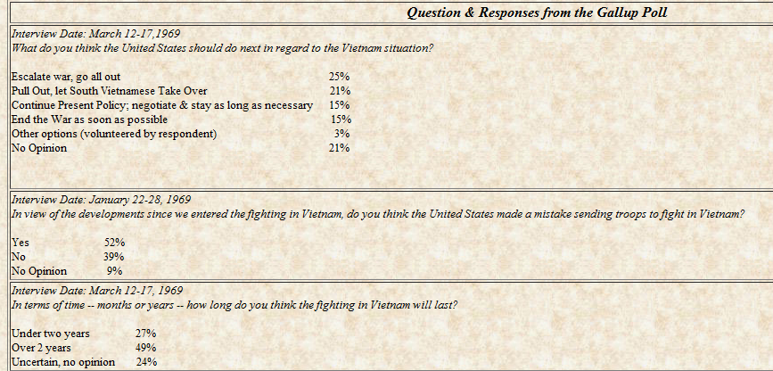

Slide 33
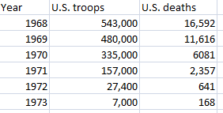

Slide 34
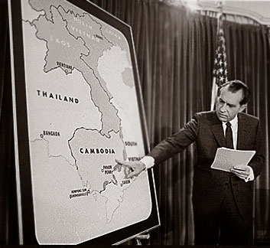

Slide 35
President Nixon: Of course, we’re fighting a very tough battle here, you know; everybody wants to pull out. But I have to fight against the tide. I got to do the right thing.
[Edit.]
Billy Graham: I’ve got a [sic] editorial in the New York Times on Friday, which I wrote this morning. They—
President Nixon: Good for you.
Graham: —asked for it yesterday—
President Nixon: Good.
Graham: And I’m putting all the blame for this whole thing on [President] Kennedy.
President Nixon: That’s right! He started the damn thing!
Graham: Well, I—
President Nixon: He killed Diem—
Graham: Right.
President Nixon: —and he sent the first 16,000 combat people there himself!
Graham: Well, I’m saying that the first time I ever heard of our involvement was four days before he was inaugurated, playing golf with him; he said, “We”—I quote—“We cannot allow Laos [mis-pronounced] and South Vietnam to fall to the Communists.” [Nixon belatedly laughs.]
And then I said when President Johnson took over, we had 16,000 troops there.
President Nixon: That’s right.
Graham: And I said the political climate in the United States—
President Nixon: Well, and Diem had been murdered. See, you see, Billy, the key thing here was Kennedy’s, and, I must say, our friend [Henry Cabot] Lodge’s agreement to the murder of Diem. Diem—that’s what killed the whole, that opened the whole thing.

Slide 36
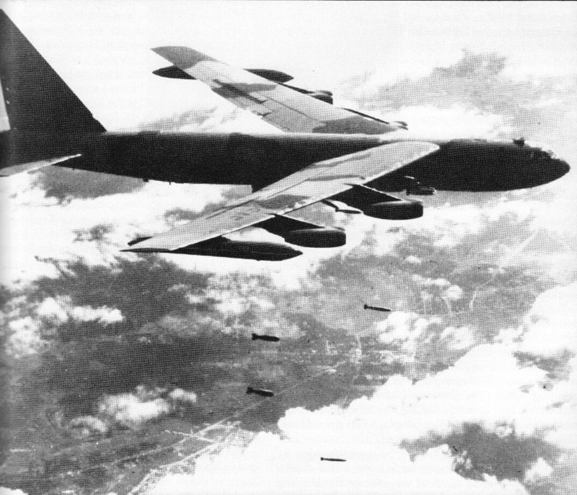

Slide 37
Henry Kissinger: So this is another spectacular [success] for you, Mr. President—
President Nixon: Yeah, yeah; [unclear] don’t know where it’s at—
Kissinger: —Showed terrific courage to do it.
President Nixon: Yeah. Well, at least it took the boil, didn’t it?
Kissinger: Mr. President, anything else would have been [unclear] in the long run.
President Nixon: Hmm.
Kissinger: And . . . The guys who are now saying, “Why did we do it with B-52s?” [Nixon sighs with exasperation.] People who—if you did it with P-3s, they’d be offended.
President Nixon: The point is, as we know, we couldn’t do it with anything but B-52s, because, goddamnit, there’s nothing else that can fly at this time of year.
Kissinger: Mr. President, within 10 days you got these guys [the North Vietnamese] to the table, which no other method could have done.
President Nixon: That’s just . . . Keep right on, and . . .
Kissinger: And I think that this way it makes the weekend papers, and the excitement is going to die—
President Nixon: Well, it will make the news magazines, too.
Kissinger: Yeah.
President Nixon: They’ll open up for this, don’t worry.
Kissinger: [McGeorge] Bundy calls me last night. He said he’s going to write a letter—a public letter—to you.
President Nixon: Protesting?
Kissinger: Yeah.
President Nixon: Yeah, well, of course.
Kissinger: I said, “Why?” [He said,] “Because what am I going to tell my sons?” I said, “I’ll tell you what you can tell your sons. Tell them, ‘I got us into this war, and now I’m keeping us from getting out,’” and hung up on him.
That New York establishment hasn’t—
President Nixon: They’re done. They’re done.
Kissinger:–hasn’t ever come—
President Nixon: Well, the main thing now, Henry, is that we have to pull this off.

Slide 38
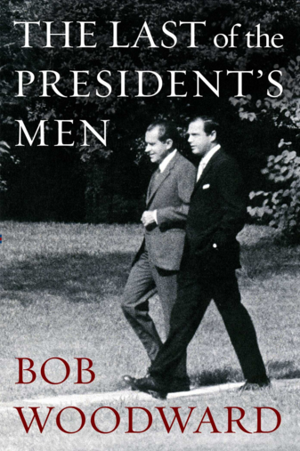

Slide 39
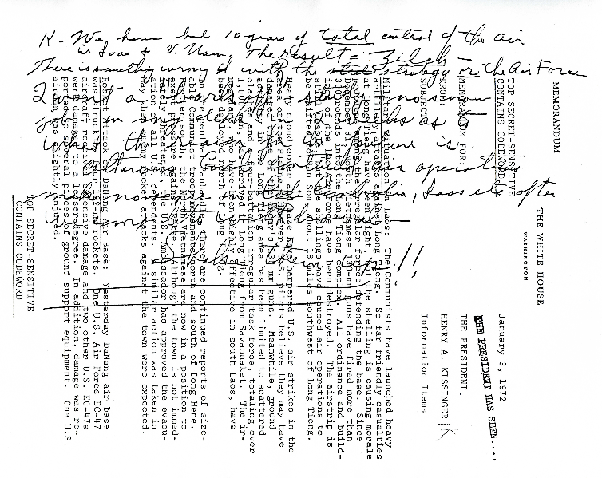

Slide 40
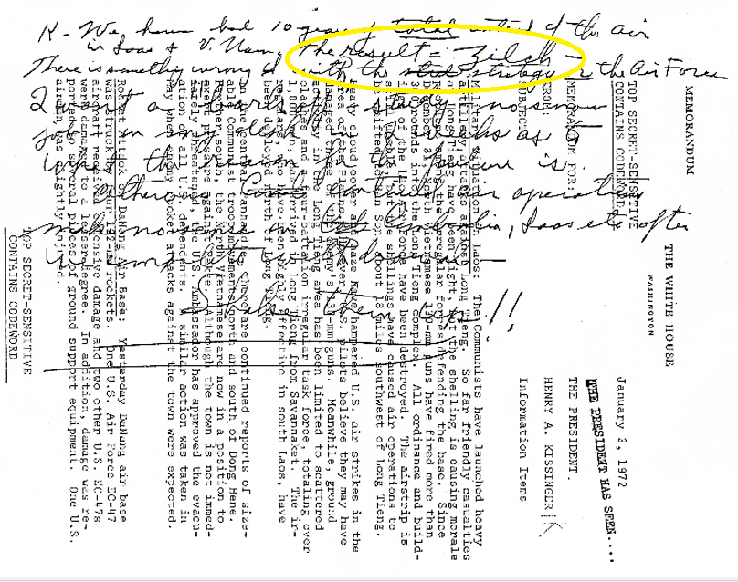

Slide 41
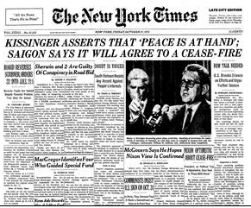

Slide 42
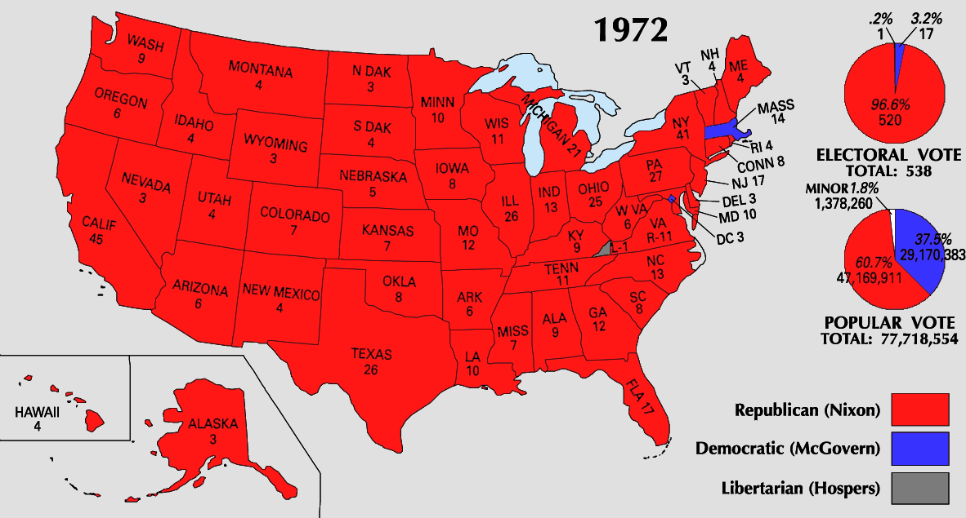

Slide 43
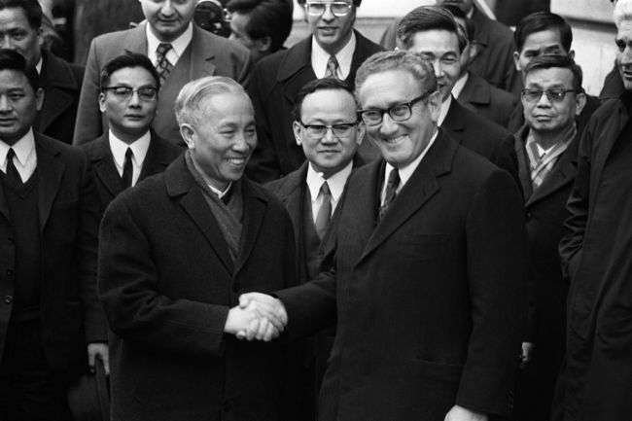

Slide 44
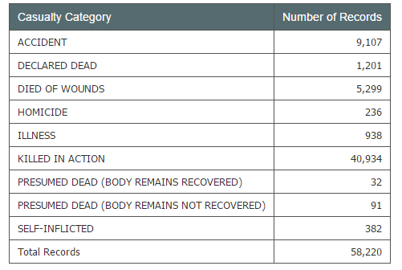
Total U.S. Casualties, Vietnam

Slide 45
