Slide 1
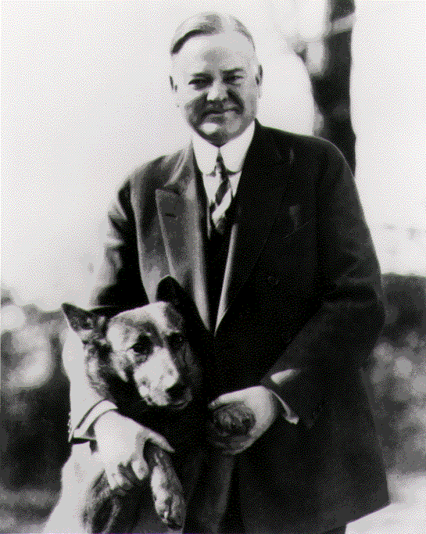

Slide 2
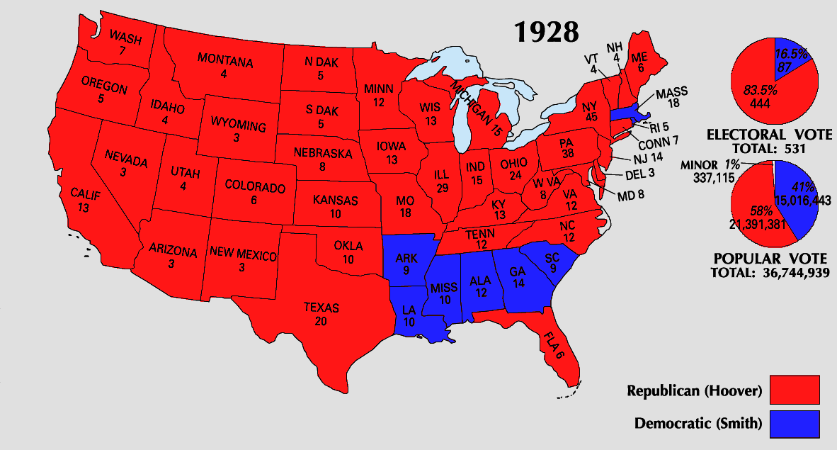

Slide 3

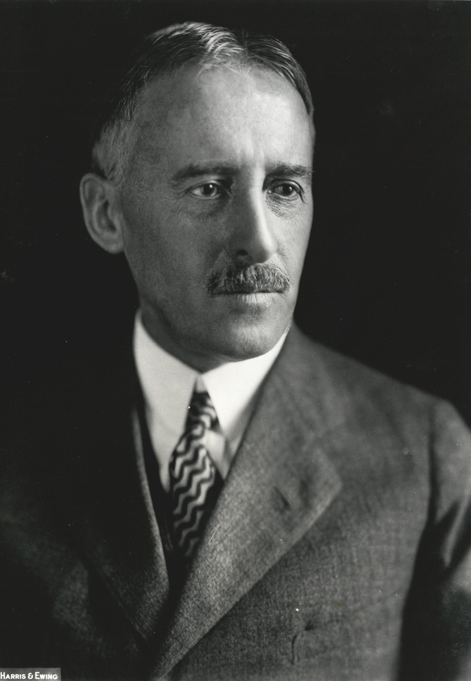

Slide 4
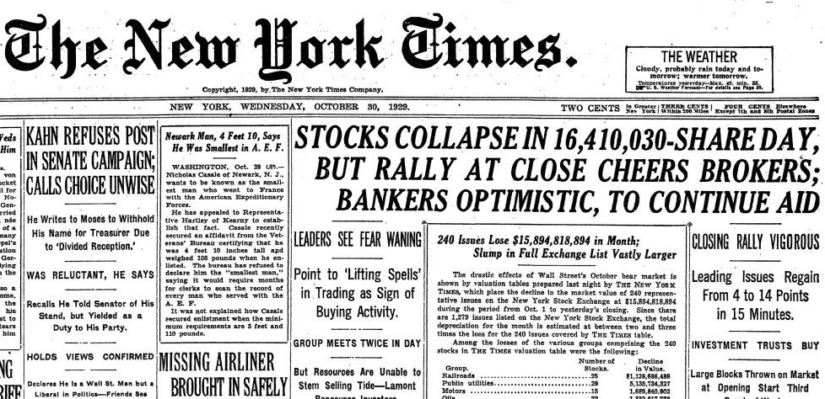

Slide 5


Slide 6
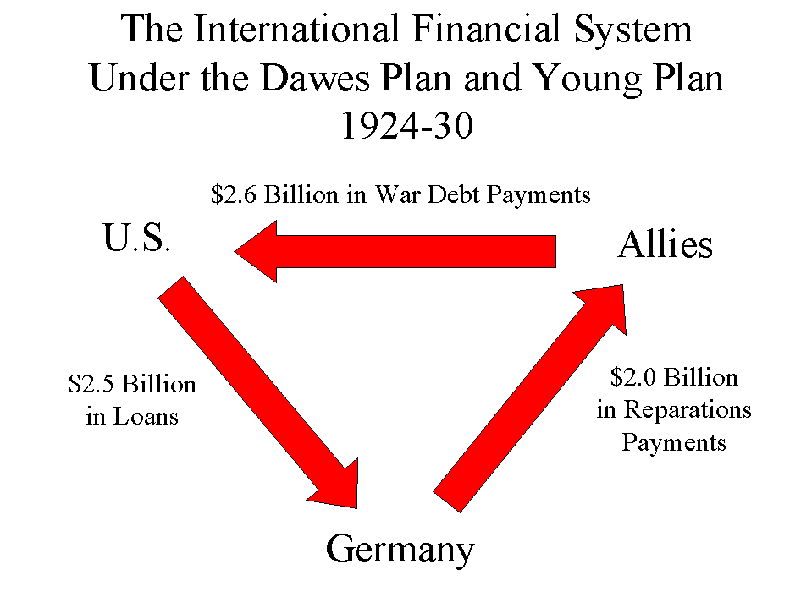

Slide 7
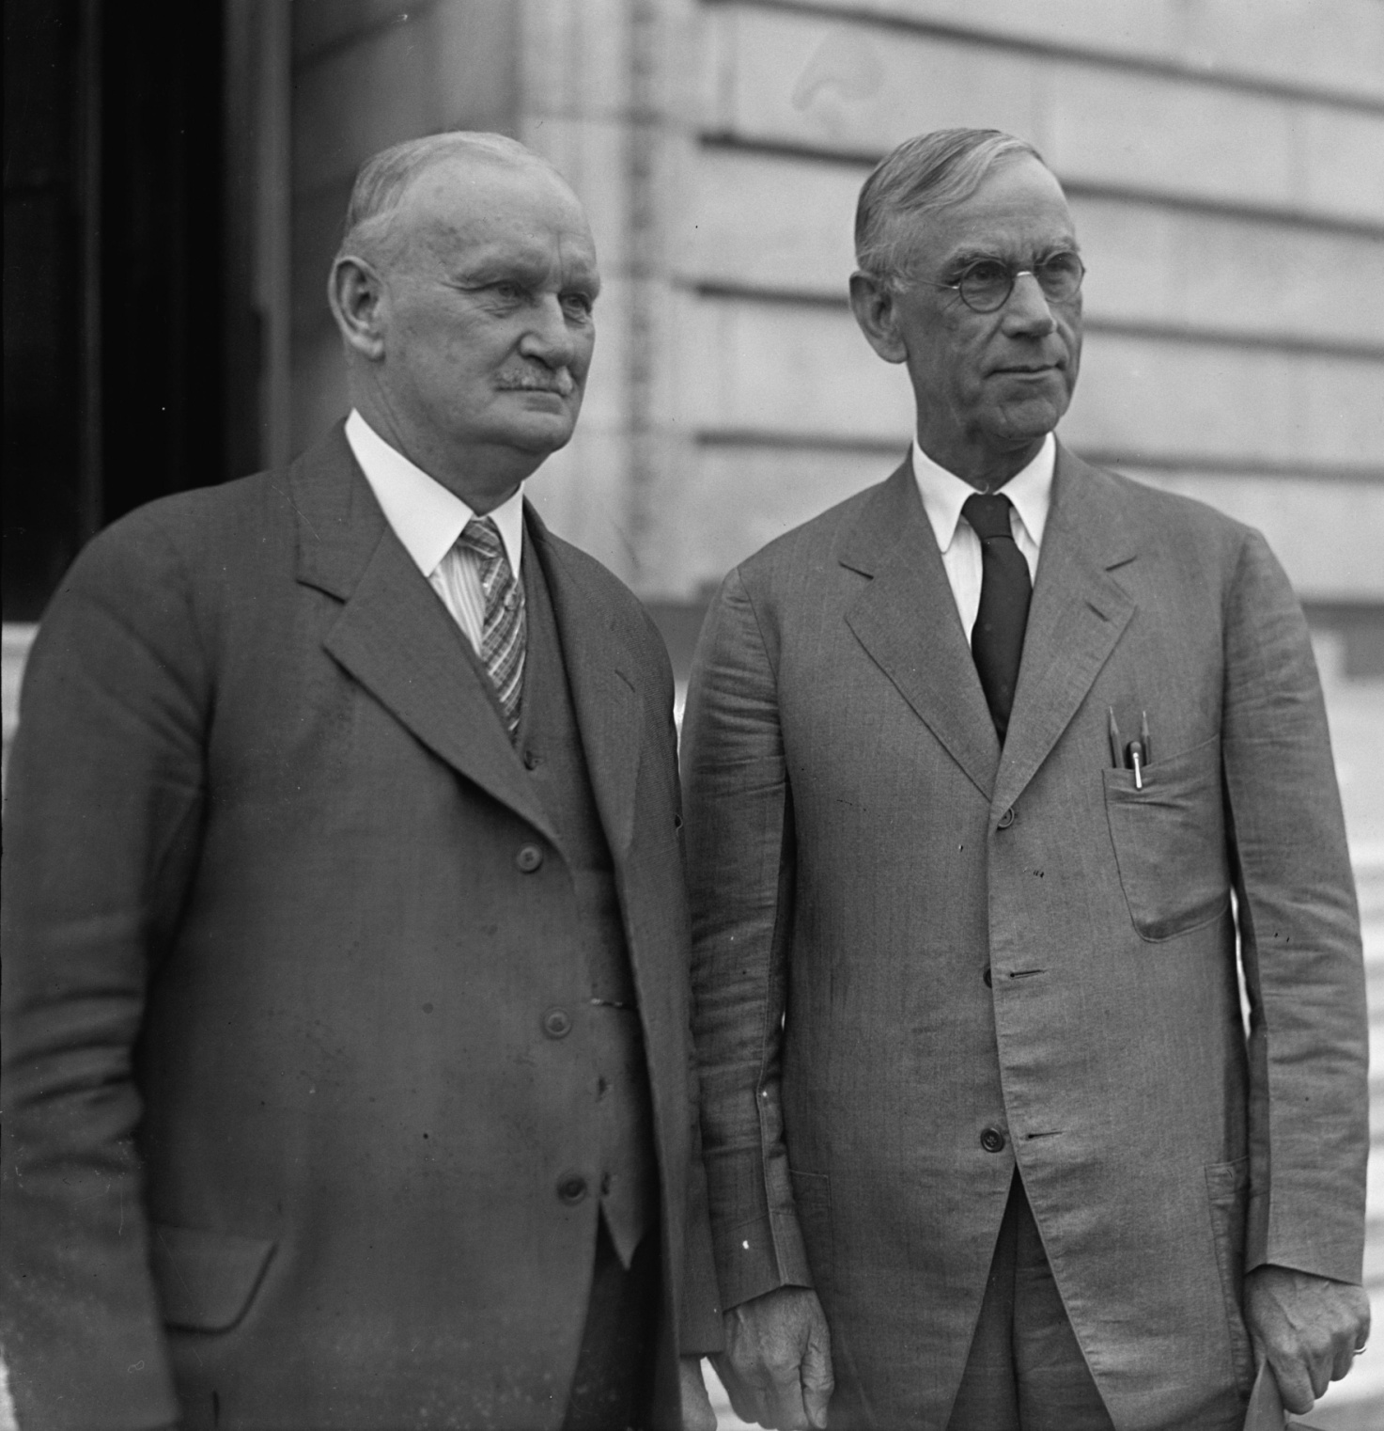

Slide 8
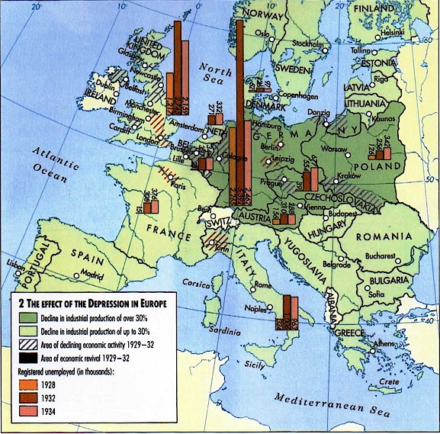

Slide 9
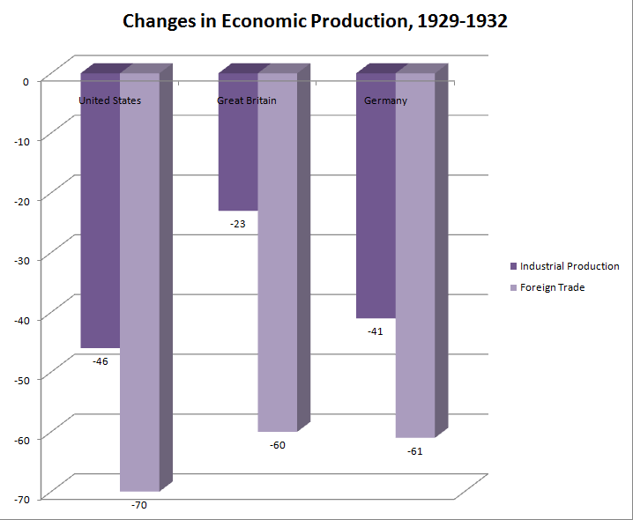

Slide 10
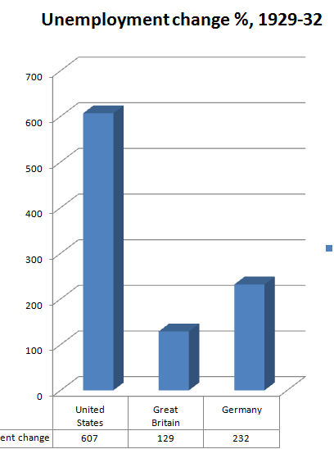

Slide 11
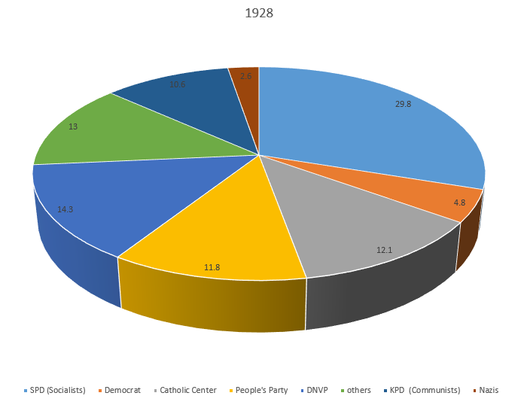

Slide 12
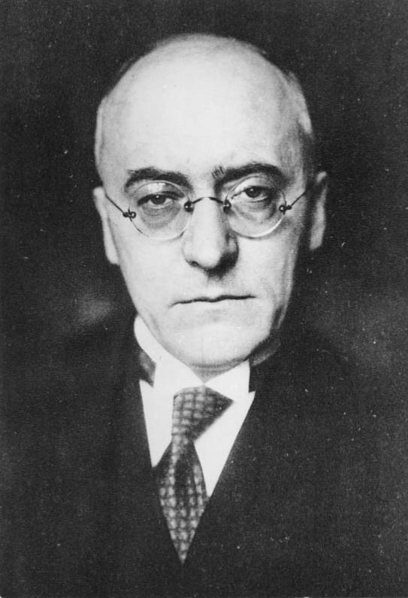

Slide 13
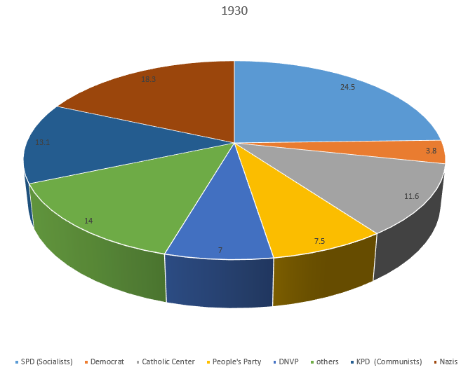

Slide 14
Article 48 (Weimar)
If public security and order are seriously disturbed or endangered within the German Reich, the President of the Reich may take measures necessary for their restoration, intervening if need be with the assistance of the armed forces. For this purpose he may suspend for a while, in whole or in part, the fundamental rights provided in Articles 114, 115, 117, 118, 123, 124 and 153.

Slide 15
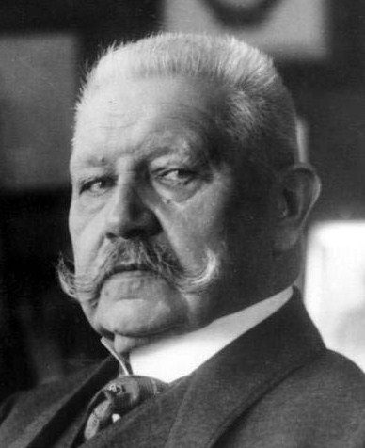

Slide 16
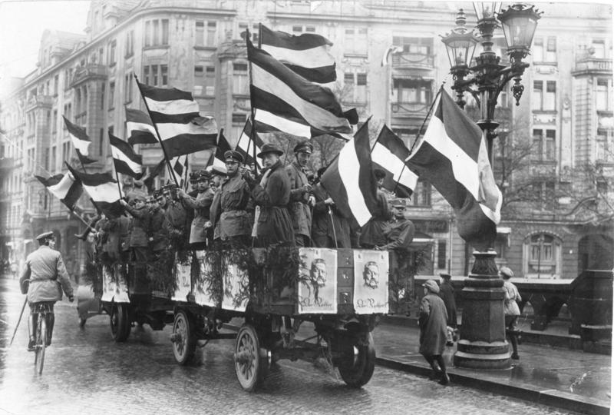

Slide 17
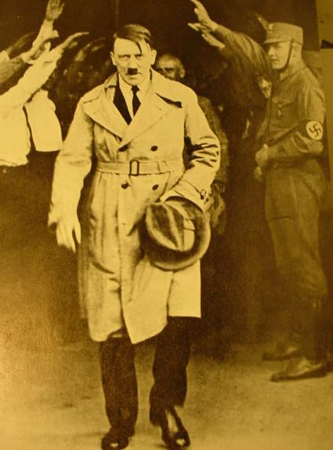

Slide 18


Notes:
Our last hope

Slide 19
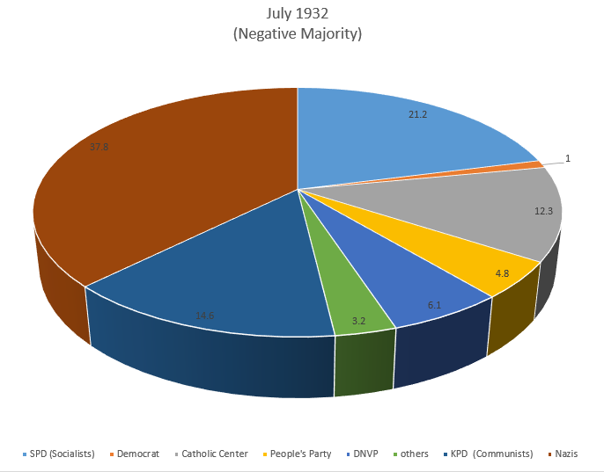

Slide 20
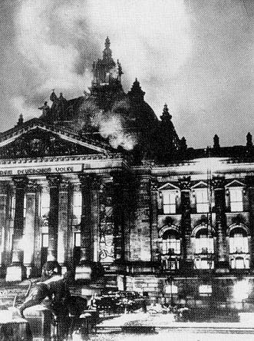

Slide 21
Enabling Act (1933)
In addition to the procedure prescribed by the constitution, laws of the Reich may also be enacted by the government of the Reich. …
Laws enacted by the government of the Reich may deviate from the constitution as long as they do not affect the institutions of the Reichstag and the Reichsrat….
Laws enacted by the Reich government shall be issued by the Chancellor …
Treaties of the Reich with foreign states, which relate to matters of Reich legislation shall for the duration of the validity of these laws not require the consent of the Reichstag.

Slide 22
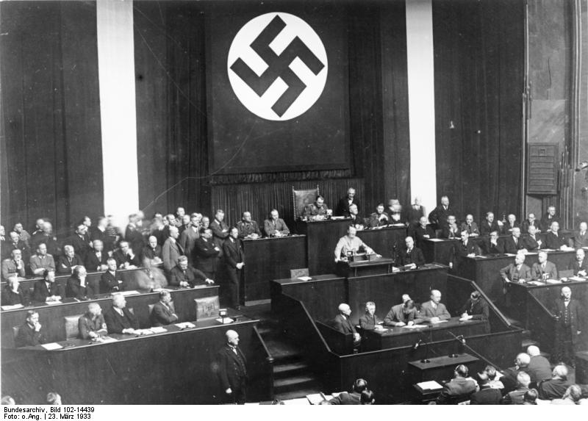

Slide 23
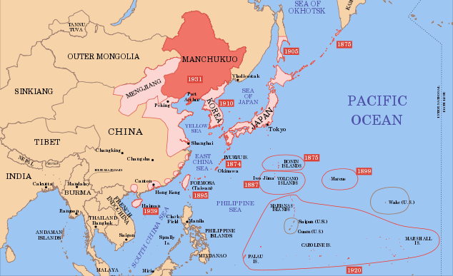

Slide 24
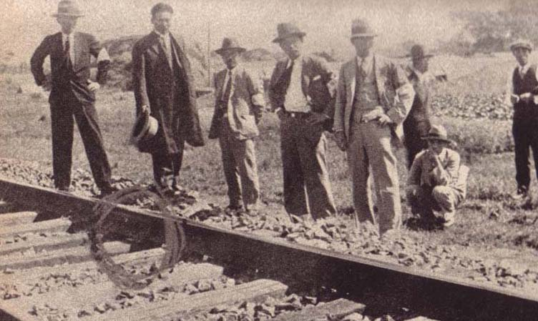

Slide 25
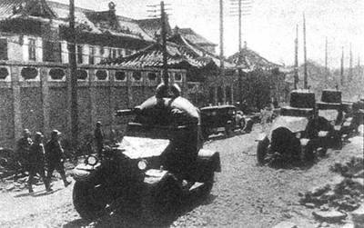

Slide 26
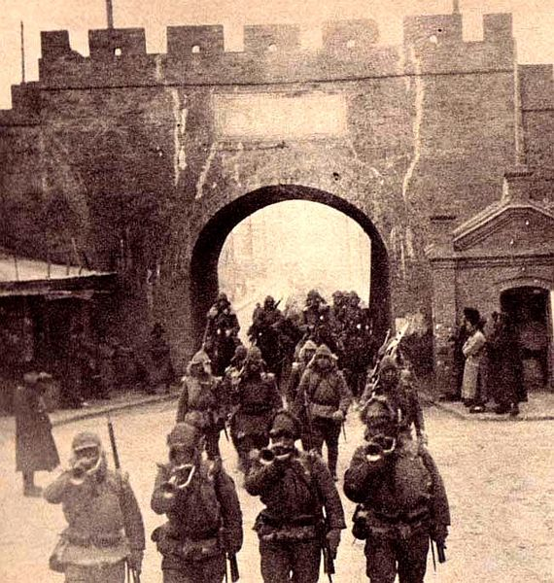

Slide 27
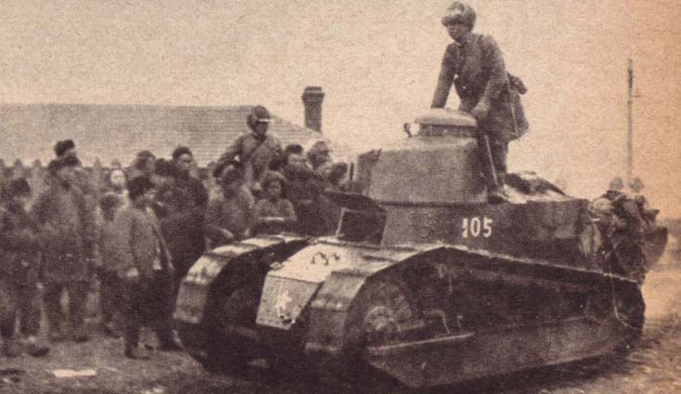

Slide 28
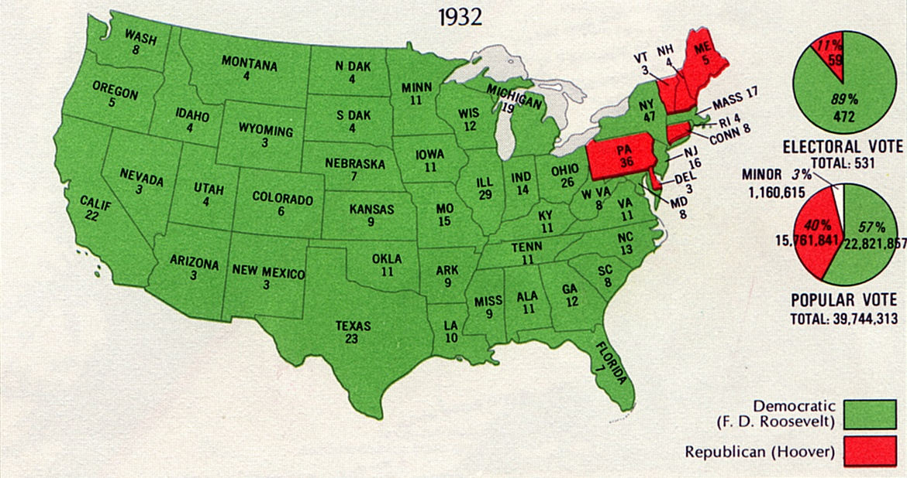

Slide 29
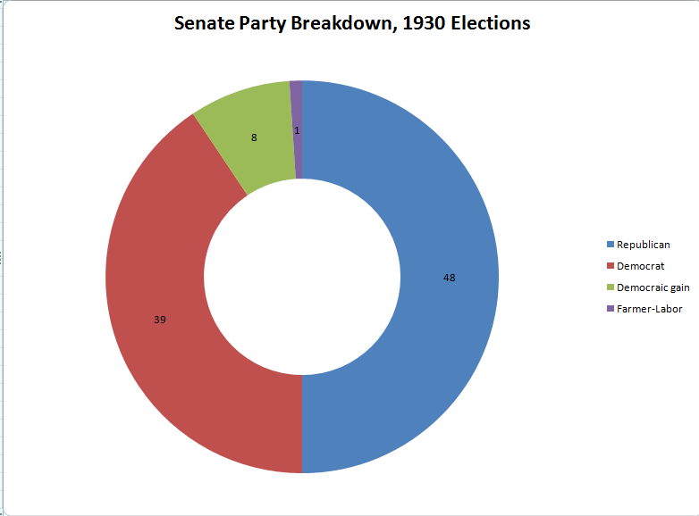

Slide 30
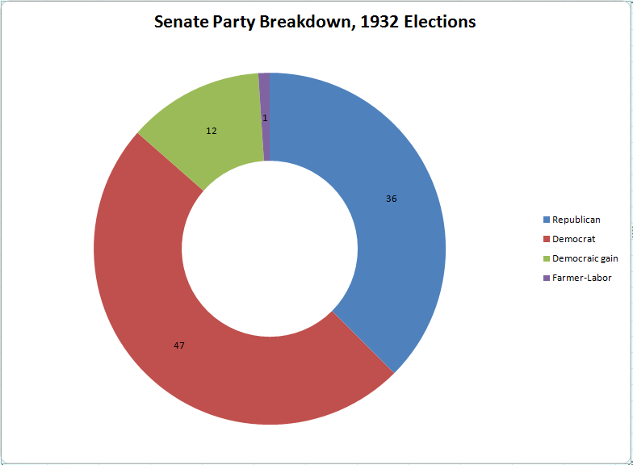

Slide 31
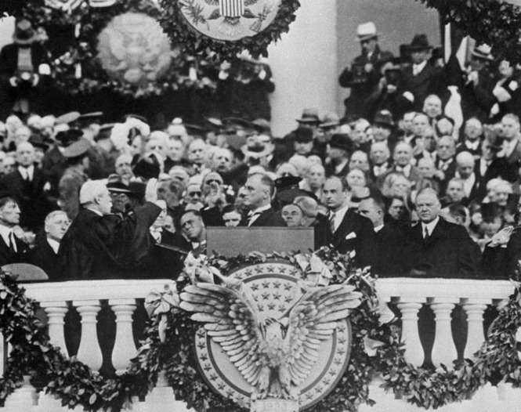

Slide 32
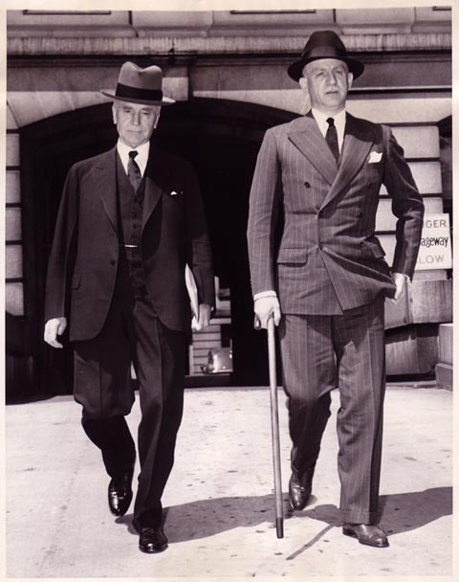

Slide 33
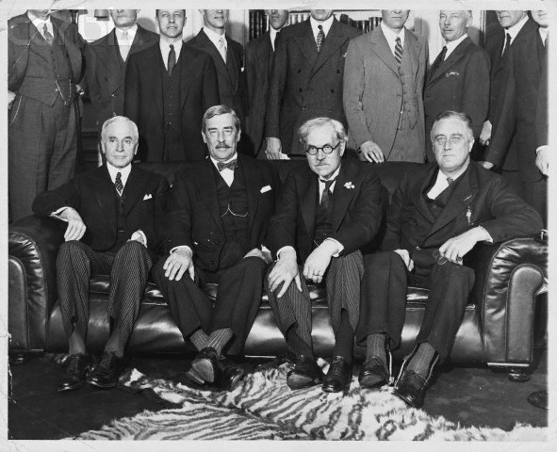
Notes:
Fdr with briish delegation ore London

Slide 34
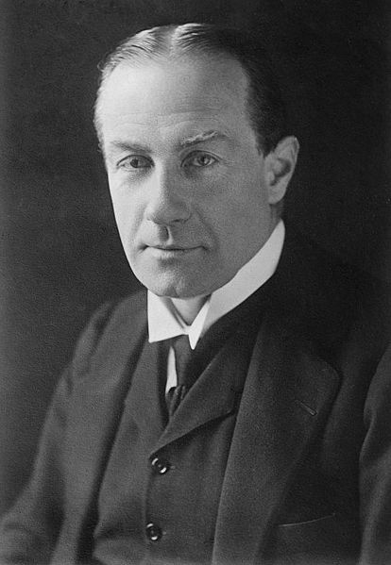

Slide 35
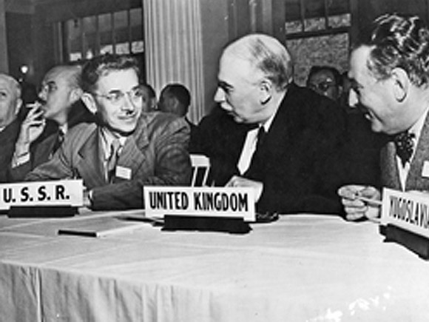

Slide 36
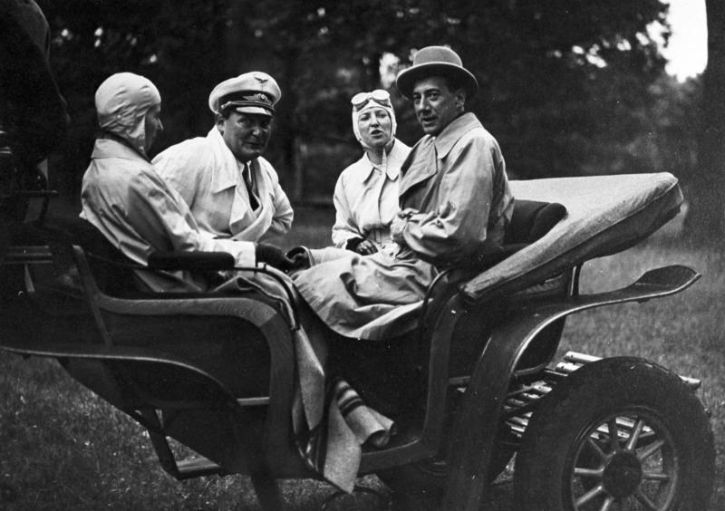
Notes:
Beck and goring

Slide 37
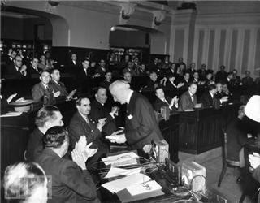
Notes:
montevideo

Slide 38
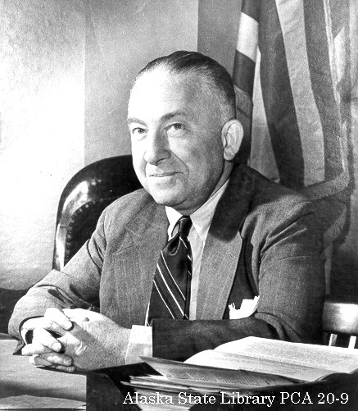

Slide 39
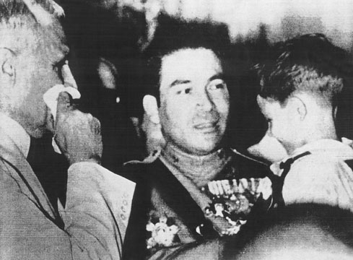
Notes:
batista

Slide 40

Notes:
trujillo

Slide 41
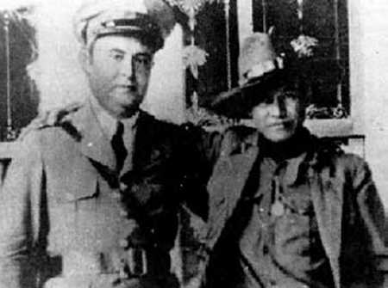
Notes:
Sandino and somoza

Slide 42
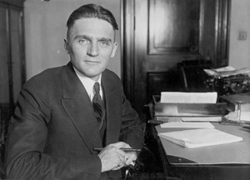

Slide 43
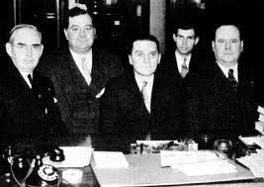

Slide 44
Resolved by the Senate and House of Representatives of the United States of America in Congress assembled, That upon the outbreak or during the progress of war between, or among, two or more foreign states, the President shall proclaim such fact, and it shall thereafter be unlawful to export arms, ammunition, or implements of war from any place in the United States, or possessions of the United States, to any port of such belligerent states, or to any neutral port for transshipment to, or for the use of, a belligerent country . . .
The President, by proclamation, shall definitely enumerate the arms, ammunition, or implements of war, the export of which is prohibited by this Act.
The President may, from time to time, by proclamation, extend such embargo upon the export of arms, ammunition, or implements of war to other states as and when they may become involved in such war.

Slide 45
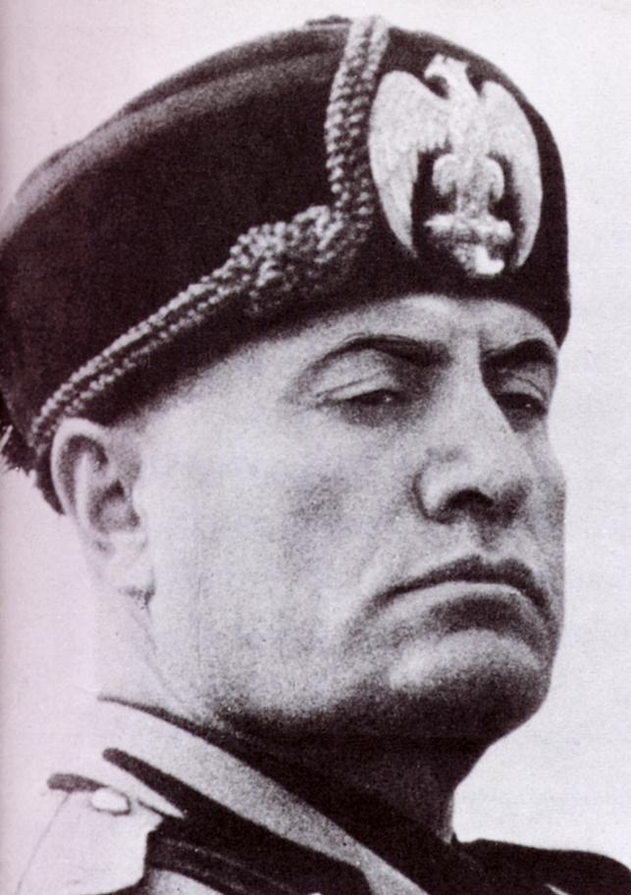

Slide 46
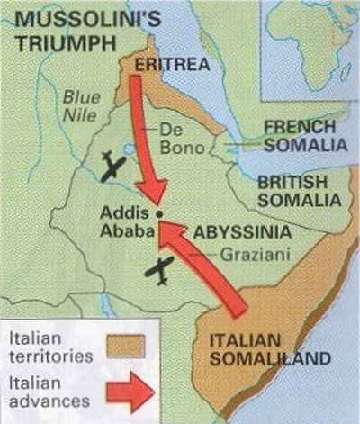

Slide 47
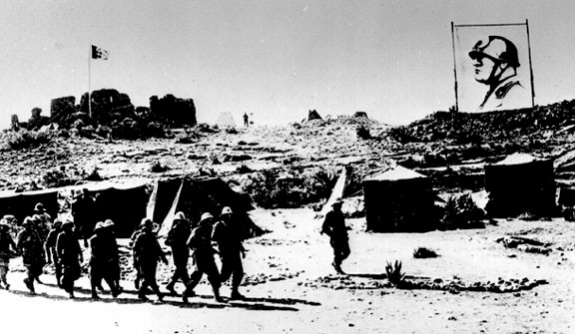

Slide 48
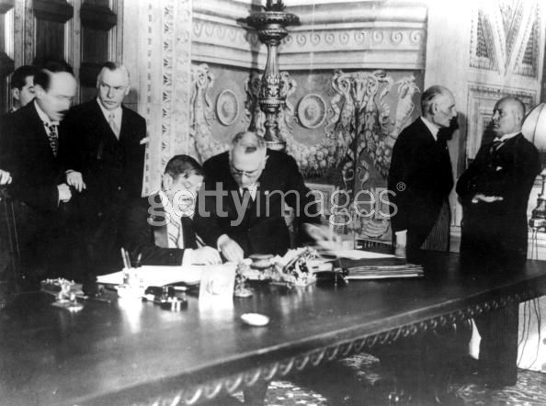
Notes:
Laval signing h-laval pact

