Slide 1
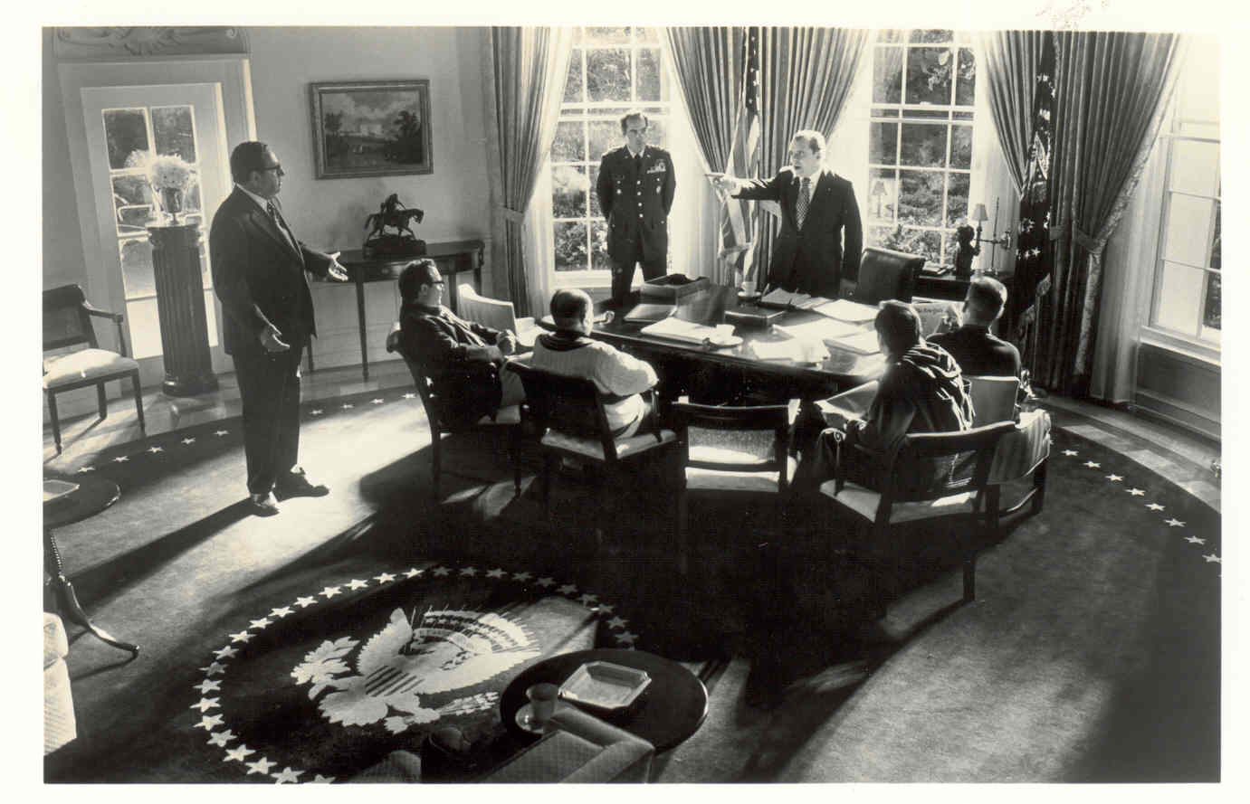

Slide 2
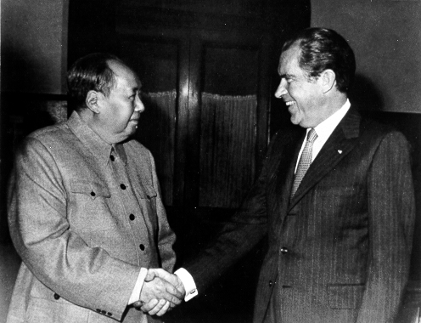

Slide 3
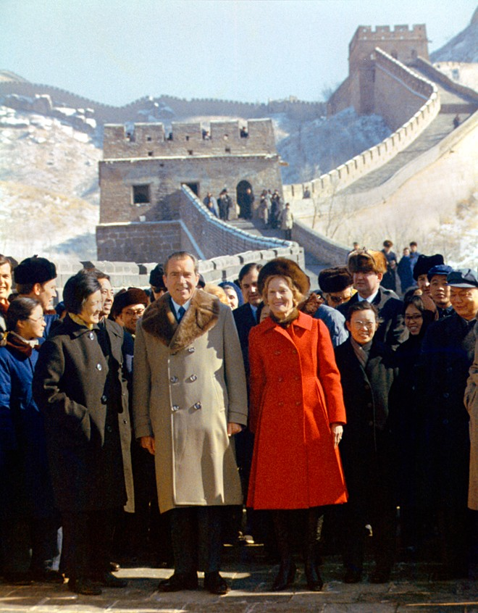

Slide 4
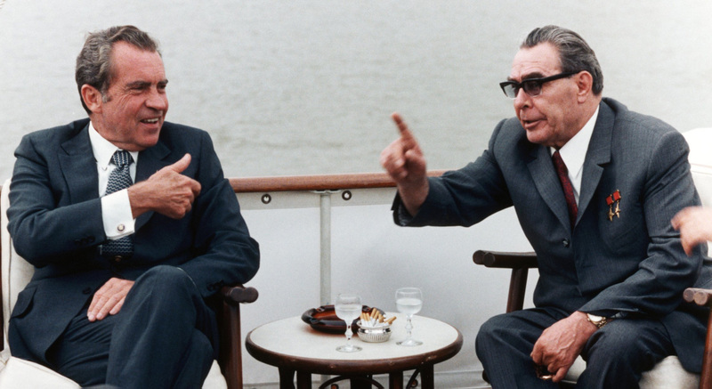

Slide 5
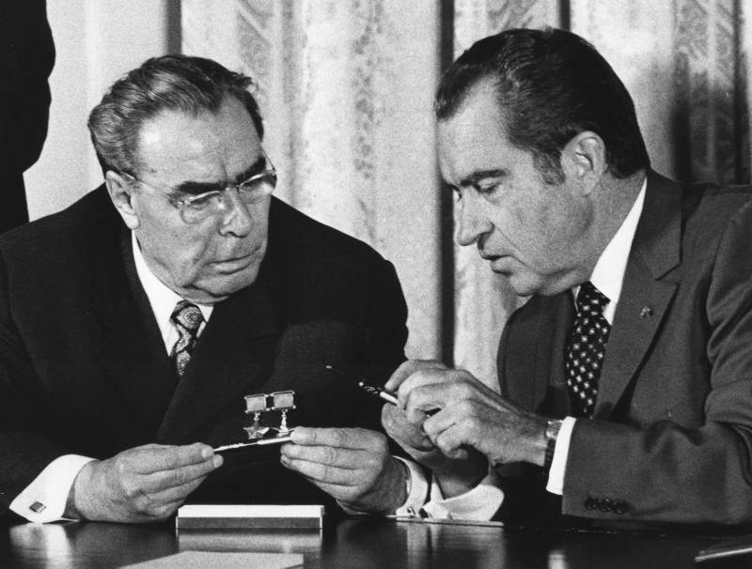

Slide 6
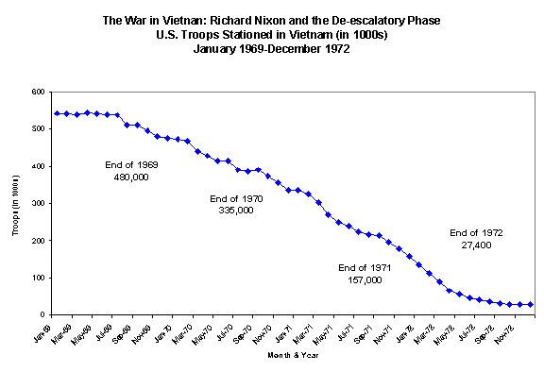

Slide 7
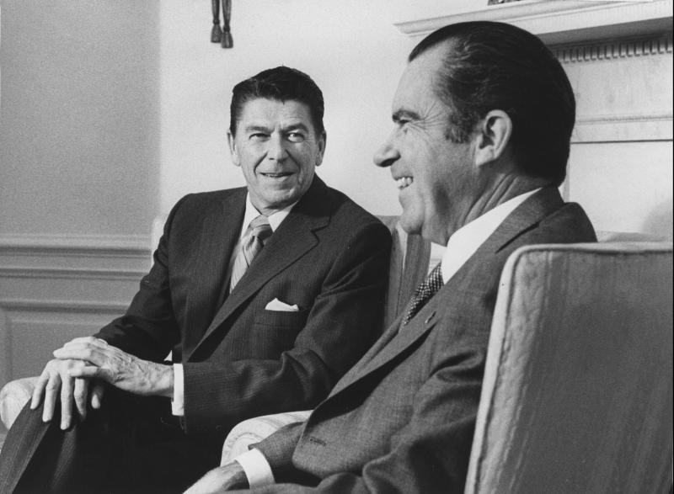

Slide 8

President Nixon:.. . we learned a lot from Mr. [Ronald] Reagan.
Henry Kissinger: Oh, yeah, yeah. Well, he started bleeding. He said that you have a real problem with the conservatives.
President Nixon: Oh, I know.
Kissinger: Which is no news to you. He says you’re going to wind up without any friends, because you can’t win the liberals anyway.
President Nixon: Jesus.
Kissinger: And the conservatives are just saying—
President Nixon: Henry, let me tell you part of his problem, of course, is that he’s in a very, very poor position in California, you know.
[Break.]
Kissinger: Well, I think he’s a—actually I think he’s a pretty decent guy.
President Nixon: Oh, decent, no question, but his brains?
Kissinger: Well, his brains, are negligible. I—
President Nixon: He’s really pretty shallow, Henry.
Kissinger: He’s shallow. He’s got no . . . He’s an actor. When he gets a line he does it very well. He said, “Hell, people are remembered not for what they do, but for what they say. Can’t you find a few good lines?” [Chuckles.] That’s really an actor’s approach to foreign policy—to substantive—
President Nixon: I’ve said a lot of good things, too, you know damn well.
Kissinger: Well, that too.
[Break.]
President Nixon: Can you think though, Henry, can you think, though, that Reagan with certain forces running in the direction could be sitting right here?
Kissinger: Inconceivable.
President Nixon: No, but it could have happened.
Kissinger: It could have happened.
President Nixon: It could have happened in ‘68. What would have happened—
Kissinger: If Rockefeller had stayed in—I mean if Rockefeller had gone in competently—
President Nixon: That’s right.
Kissinger: I don’t think he [Rockefeller] had a chance, but he might just have been able to [unclear].
President Nixon: [Unclear.] That right. Can you imagine? The fellow really is a decent guy, a decent guy. But there isn’t—there’s no, in other words, everything is . . .
[Break.]
President Nixon: Back to Reagan though. It shows you how a man of limited mental capacity simply doesn’t know what the Christ is going on in the foreign area.

Slide 9
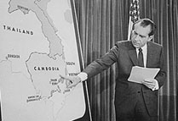

Slide 10
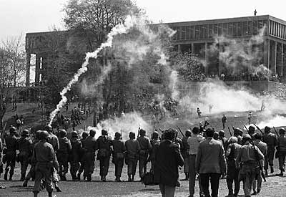

Slide 11
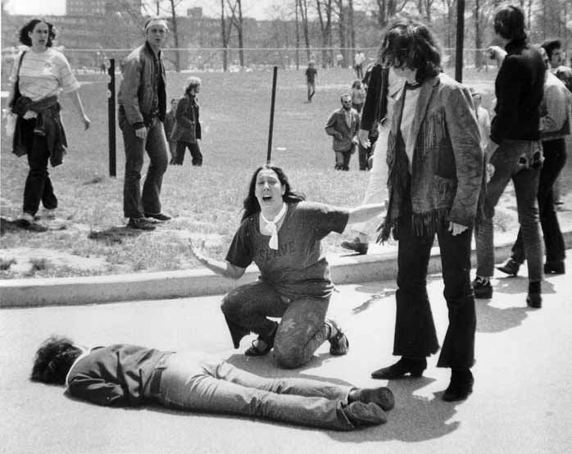

Slide 12


Slide 13
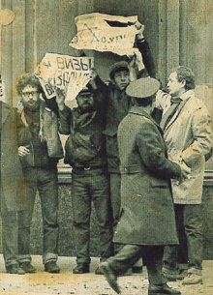

Slide 14
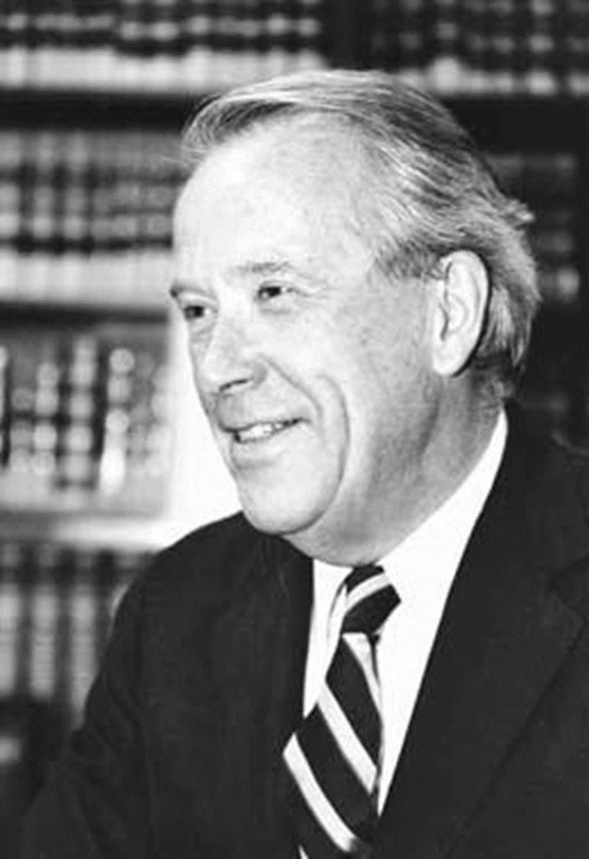
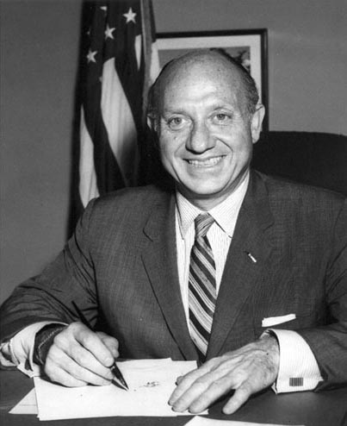
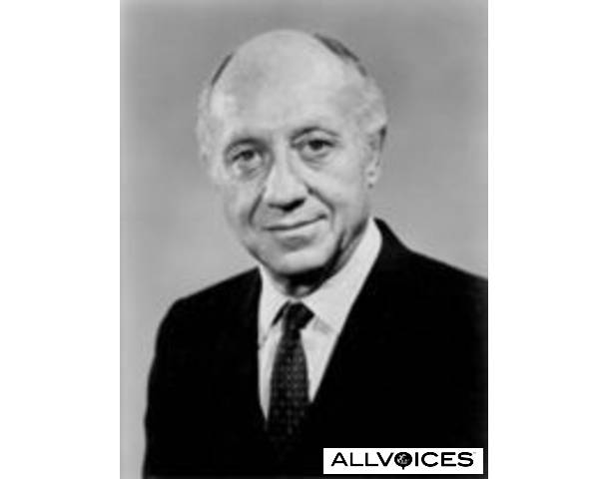

Slide 15
President Nixon: But it’s important to get across to them, Henry, and I hope you’ll talk to [New York senator Jacob] Javits and the rest of ‘em on this, even [Washington senator Henry] Jackson: by God, if the Jewish community in this country makes Israel exit permits the condition for the Russian initiative, listen, they’re going to be hurting. That will not work.
Henry Kissinger: [forcefully] Let’s face it: The emigration of Jews from the Soviet Union is not an objective of American foreign policy. And if they put Jews into gas chambers in the Soviet Union, it is not an American concern. It may be a humanitarian concern.
President Nixon: I know.
Kissinger:: And . . .
President Nixon: Well, we can’t blow up the world because of it.
Kissinger: It’d be an outrage, but we cannot make out where gas chambers would go as far as I’m concerned.
President Nixon: I know.
Kissinger: There is no unrestricted right to emigration. If the Indians don’t let Farsis out, it would never occur to us to attach a rider to a foreign policy decision. And I think that the Jewish community in this country, on that issue, is behaving unconscionably. It’s behaving traitorously. I find—
President Nixon: Why can’t we get Jackson to get off the damn thing? He feels it, though. He is. He’s close to the Jewish community; he’s close to the Israelis.
Kissinger: Although, I suppose—
President Nixon: Well, of course, he’s taken a lot of money from them, too.
Kissinger: Exactly. They’re financing his [presidential] campaign in ’76. But Javits . . . I’m going to have a talk with Javits, and I’m going to tell him that it is unconscionable for the Jewish community to . . .
President Nixon: You see, what they [the pro-Jewish emigration forces in Congress] will do is to work that way with the radical, the nuthead, basically the anti-semitic nutheads, say. Anti-communists in the Senate, the House—a lot of them are anti-semitic—who want to screw the Russians for other reasons. And between them . . . You know, we’ve got to get most-favored-nation [status for Russia, in trade relations], don’t we?
Kissinger:[forcefully] Mr. President, let’s face it: we have screwed Brezhnev.
I mean, you have outmaneuvered Brezhnev in a way that is almost pathetic.

Slide 16
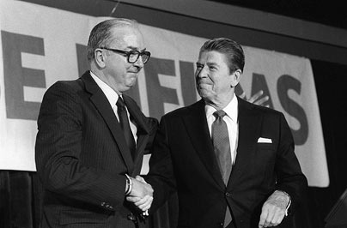

Slide 17
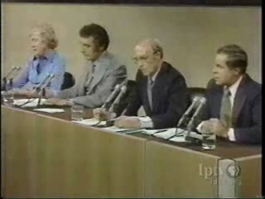

Slide 18
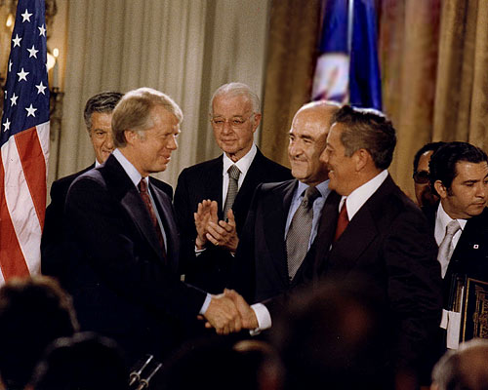

Slide 19
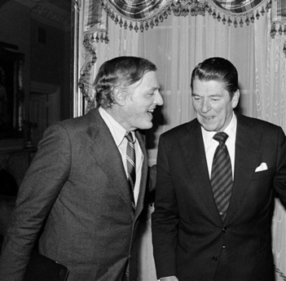

Slide 20
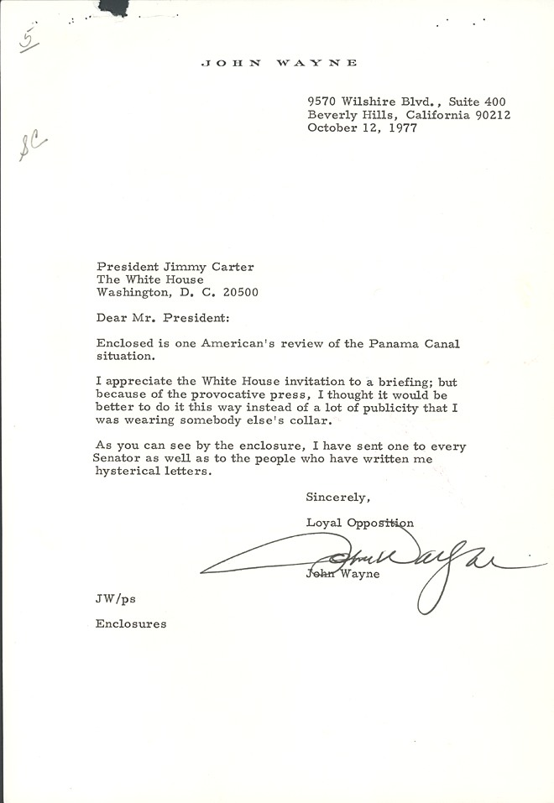

Slide 21
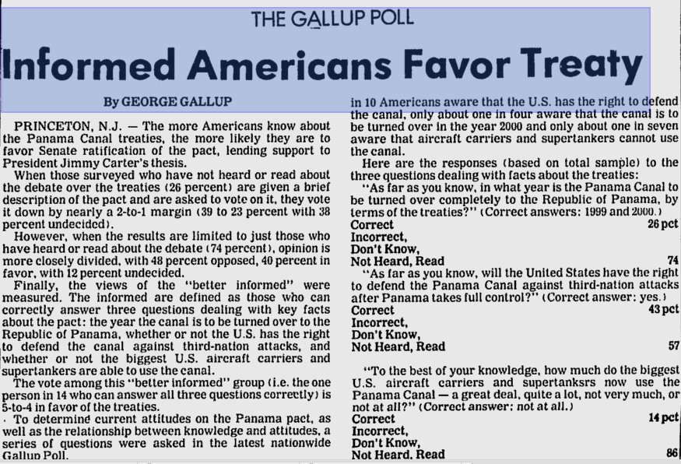

Slide 22
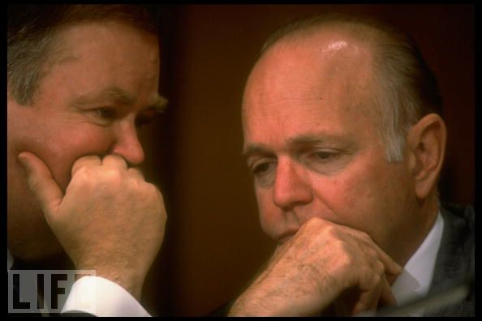

Slide 23
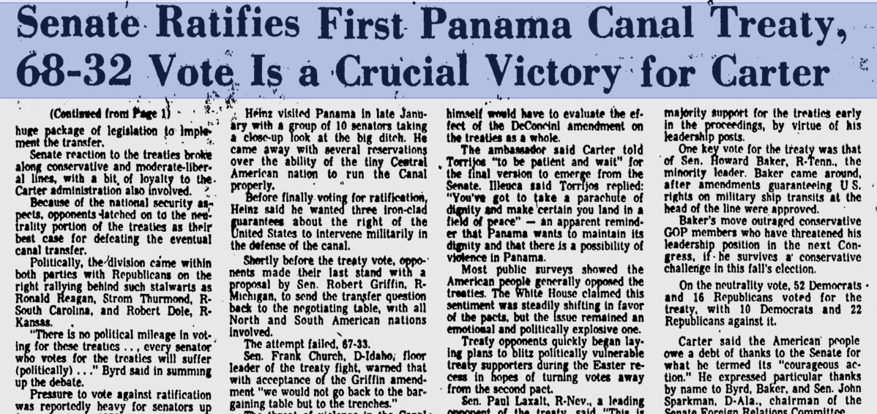

Slide 24
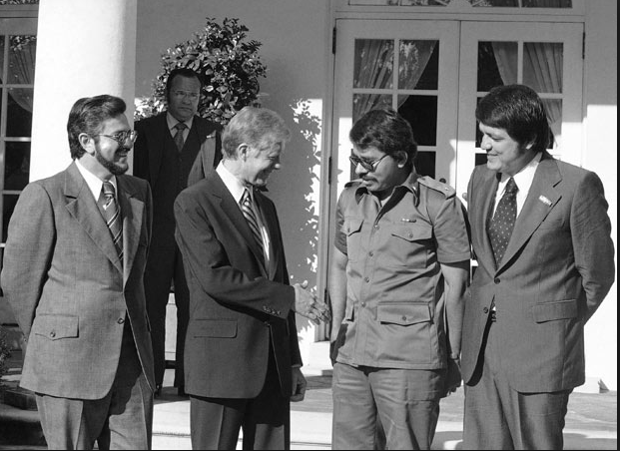

Slide 25
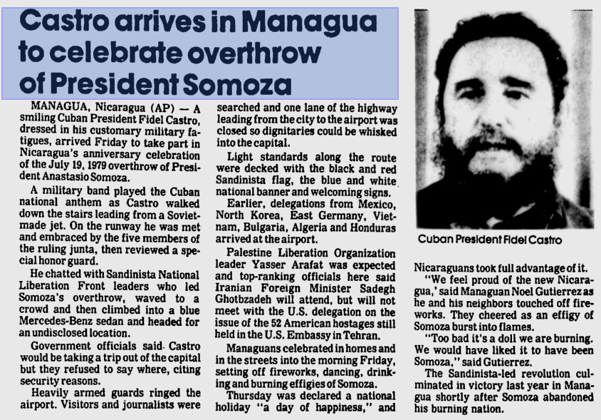

Slide 26
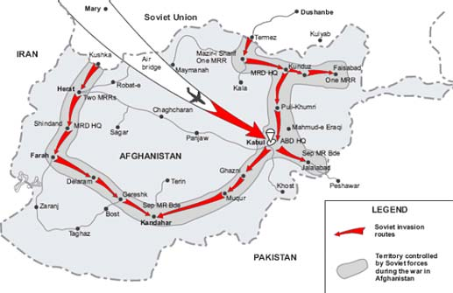

Slide 27
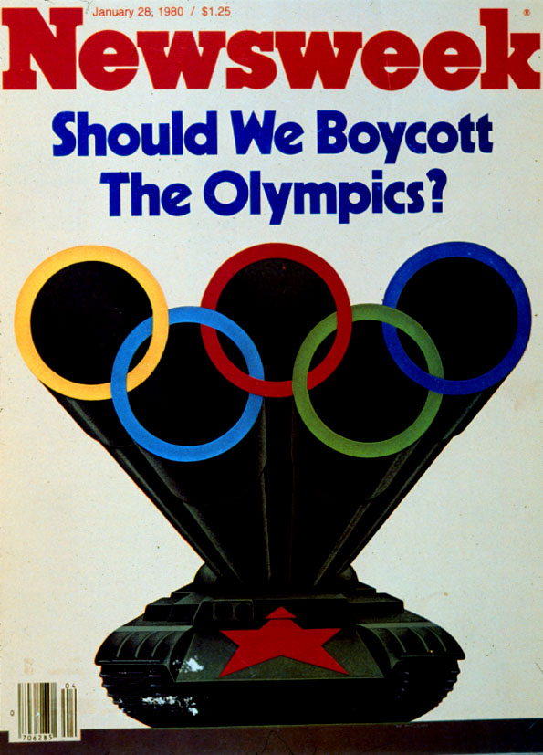

Slide 28
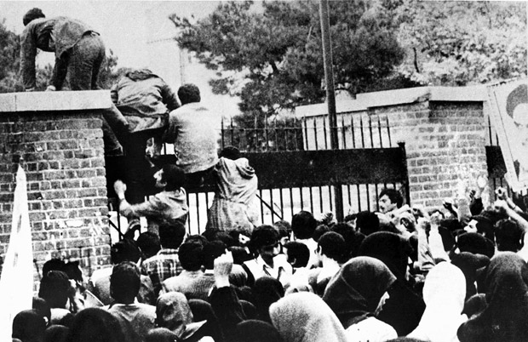

Slide 29
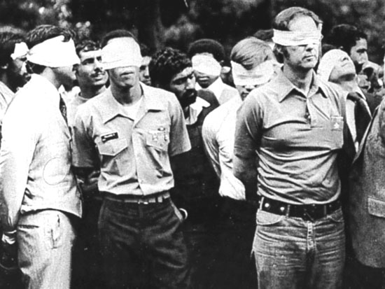
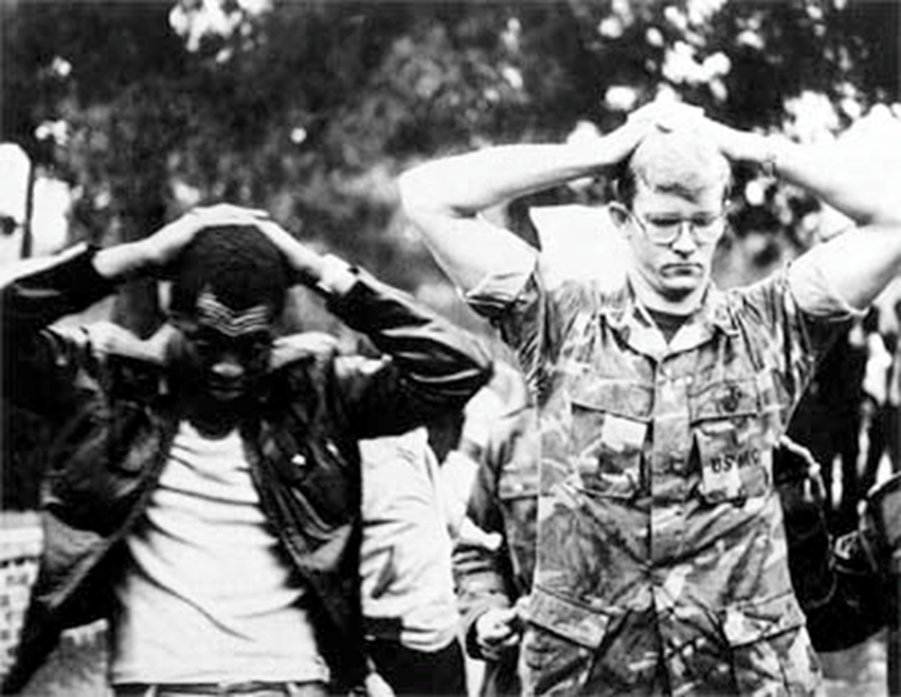

Slide 30


Slide 31
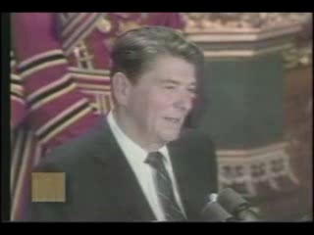

Slide 32
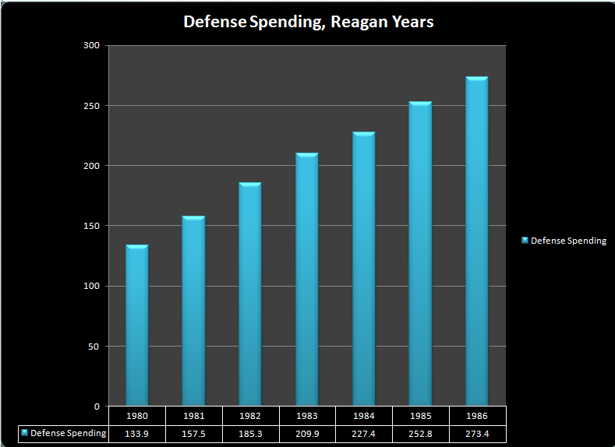

Slide 33
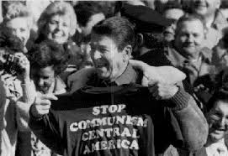

Slide 34
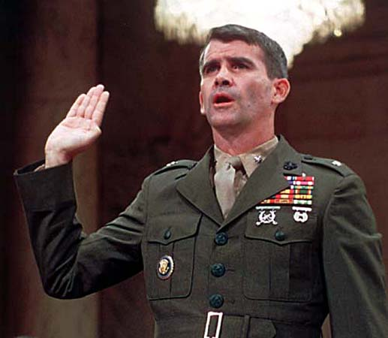

Slide 35
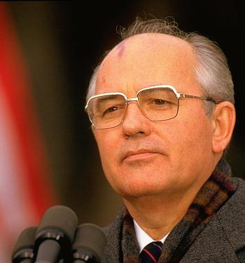

Slide 36
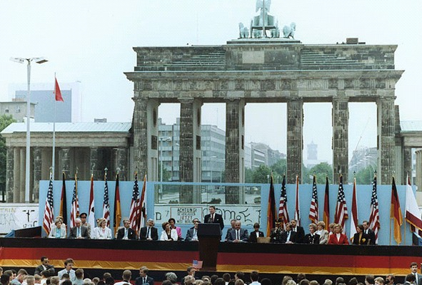

Slide 37
