Slide 1
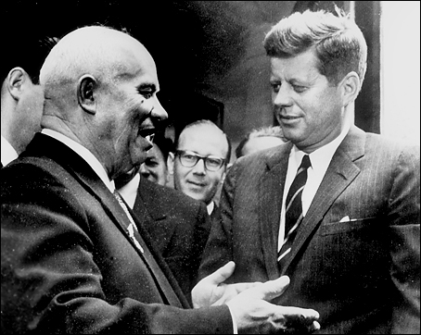

Slide 2


Slide 3
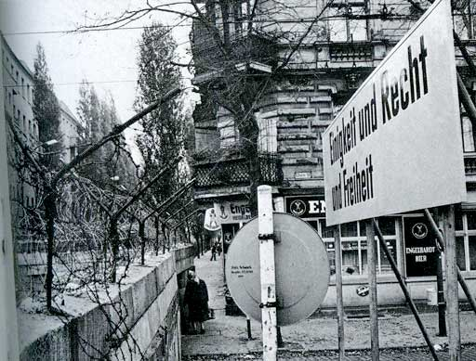

Slide 4


Slide 5


Slide 6


Slide 7


Slide 8

Deputy Sec’y of State George Ball: We did it on a basis where, if we talked to the Turks, I mean, this would be an extremely unsettling business.
President Kennedy: Well, this is unsettling now, George, because he’s [Khrushchev’s] got us in a pretty good spot here. Because most people would regard this as not an unreasonable proposal. I’ll just tell you that. In fact, in many ways—
National Security Advisor McGeorge Bundy: But what “most people,” Mr. President?
President Kennedy: I think you’re going to have it very difficult to explain why we are going to take hostile military action in Cuba, against these sites, which is what we’re thinking about, when he’s [Khrushchev’s] saying, “If you’ll get yours out of Turkey, we’ll get ours out of Cuba.” I think you’ve got a very touchy point here . . .
Bundy: It isn’t as if we’d got the [Jupiter] missiles out, Mr. President. It would be different. Or if we had any understanding with the Turks that they ought to come out, it would be different. Neither of these is the case.
President Kennedy: Well, I’d just like to know how much we’ve done about it; because, as I say, we talked about it—
Bundy: We decided not to, Mr. President. We decided not to play this directly with the Turks.
    Secretary of State Dean Rusk: Our own representative is—
Ball: If we talked to the Turks, they would bring it up in NATO. This thing would be all over Western Europe, and our position would have been undermined.
Bundy: That’s right.
Ball: Because immediately the Soviet Union would know that this thing was being discussed. The Turks feel very strongly about this. We persuaded them that this [stationing of missiles, in 1959] was an essential requirement, and they feel that it’s a matter of prestige and a matter of real—
Bundy: If we had talked to the Turks, it would already be clear that we were trying to sell our allies for our interests. That would be the view in all of NATO. Now, that’s irrational and it’s crazy, but it’s a terribly powerful fact.
Former ambassador to the USSR Tommy Thompson: Particularly in the case that this is a [Soviet] message to you and [UN General Secretary] U Thant.
Ass’t Secretary of State U. Alexis Johnson: It seems to me we ought to get word to [UN ambassador Adlai] Stevenson that, if this is put out up there, he should immediately saw we will not discuss this question of the Turkish bases.
Bundy: The problem is Cuba. The Turks are not a threat to the peace. Nobody tells the Turks as—
President Kennedy: I think it would be better, rather than saying that, until we get some time to think about it, just saying: “Well, the fact of the matter is that we received a letter last night from Khrushchev and it’s an entirely different proposal.” So, therefore, we first ought to get clarification from the Soviet Union of what they’re talking, at least to give us a …
As I say, you’re going to find a lot of people who will find this is a rather reasonable position.
Bundy: That’s true.
President Kennedy: Let’s not kid ourselves.

Slide 9
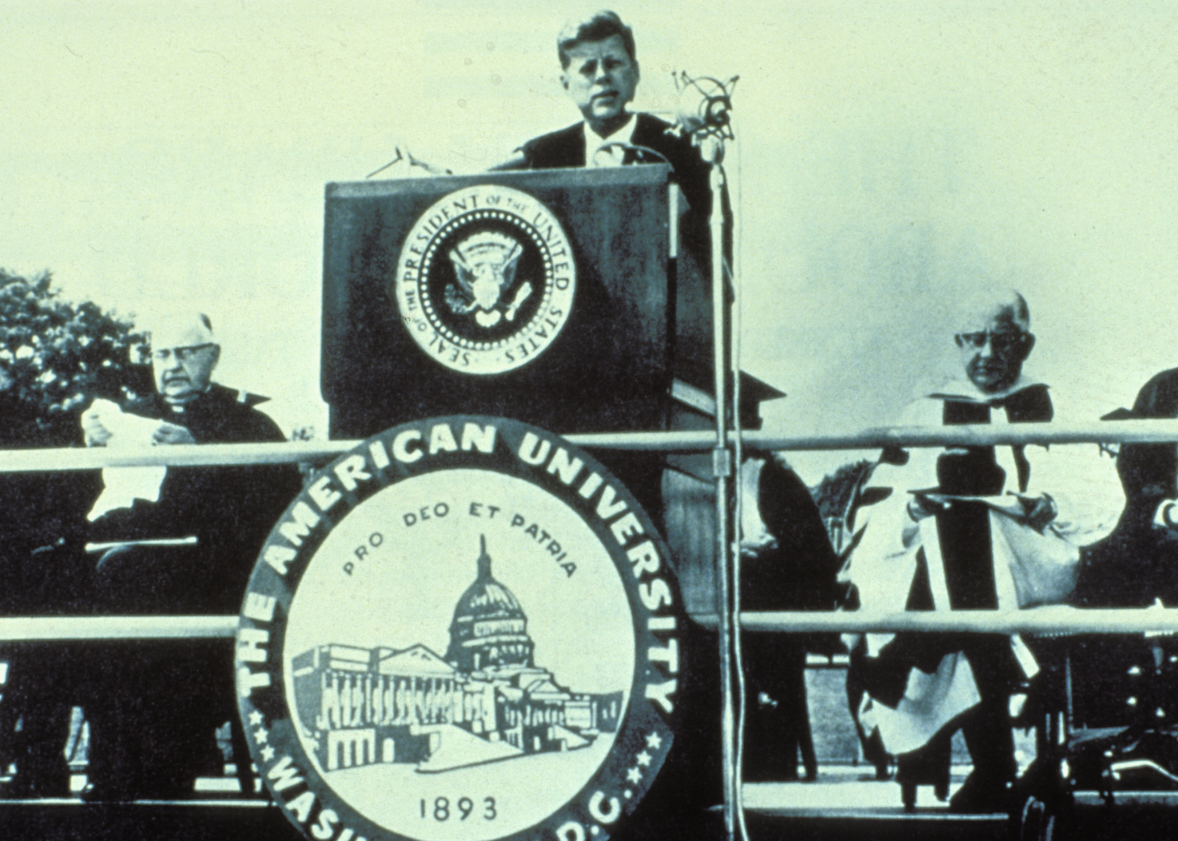

Slide 10
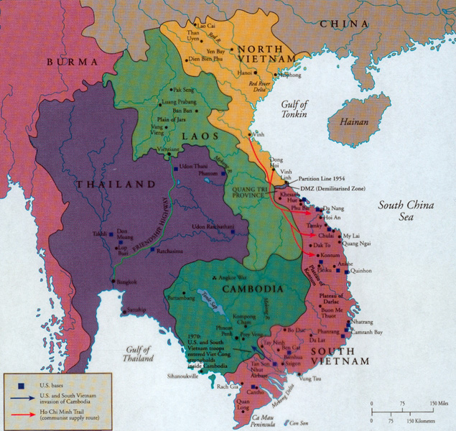

Slide 11
Time Period | U.S. Troops in Vietnam | U.S. Personnel Killed
End of 1961 | 2,067 | 16
End of 1962 | 11,500 | 52
End of 1963 | 19,000+ | 118

Slide 12


Slide 13
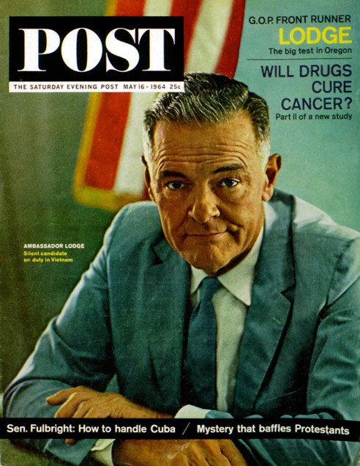

Slide 14


Slide 15
President Johnson: Do you think it’s a mistake to explain what I’m saying now about Vietnam, and what we’re faced with?
Robert McNamara: Well, I do think, Mr. President, that it would be wise for you to say as little as possible.
The frank answer is we don’t know what’s going on out there. The signs I see coming through the cables are disturbing signs—poor morale in Vietnamese forces, poor morale in the armed forces, disunity, a tremendous amount of coup planning against [South Vietnamese leader Nguyen] Khanh. About what you’d expect in a situation that’s had three governments in four months—
President Johnson: Well, then why don’t we take some pretty offensive steps pretty quickly, then? Why don’t we commend Khanh on his operation and try to prop him up? Why don’t we raise the salary of their soldiers to improve that morale, instead of waiting a long time? Why don’t we do some of these things that are inclined to bolster ‘em?
McNamara: Well, I’m not sure that they here . . .
President Johnson: I sure as hell don’t want to get in the position of Lodge recommending to me—the one thing he recommended is “please give us a little more pay for our soldiers,” and we turned him down.
McNamara: Oh, no, we’ve done that, sir.
President Johnson: We haven’t acted. We said we’re going to wait till you go out there [to Vietnam].
McNamara: Well, no. He knows there’s money for that. There’s no problem on that issue.
President Johnson: Well, then, why don’t we clear it up, so that we get him answered?
Now, I think that politically—I’m not a military strategist—but I think that as long as we’ve got him [Lodge] there, and he makes recommendations, and we act on ‘em, particularly if we act favorably, we’re not in too bad a condition politically.
But I think when he wires us and says, “The only damn thing I want you to do is to give ‘em an increase in pay because morale’s terrible,” and we say, “Well, wait,” then if something happens in between, I think we are caught with our britches down.

Slide 16


Slide 17

Notes:
Lbj signing tgr

Slide 18
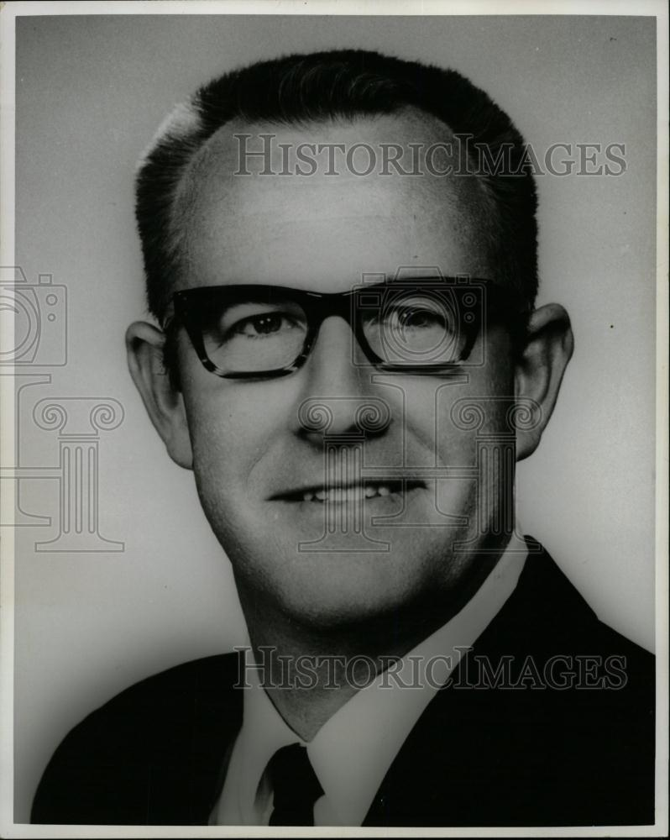

Slide 19



Slide 20
President Johnson: That was a good vote you had today.
Speaker McCormack: Yes, it was very good. 414 to nothing; one present. What’d the Senate do?
President Johnson: 88 to 2. Morse and Gruening.
McCormack: I don’t understand Gruening.
President Johnson: Oh, he’s no good. He’s worse than Morse. He’s just no good. I’ve spent millions on him up in Alaska [in reconstruction funds after the March 1964 Alaska earthquake]. He’s just no good.
And Morse is just as undependable and erratic as he can be.
McCormack: I know that. But I can’t understand the other fellow.
President Johnson: Say, I wanted to point out this little shitass [Ed] Foreman today got up and said that we [Johnson] acted impulsively by announcing that we had an answer on the way [to the Tonkin Gulf incidents] before the planes dropped their bombs.
[Break.]
President Johnson: It’s just a pure lie, and smokescreen.
McCormack: But he was booed two or three times. Tremendous booing on the Democratic side. He was—everybody knew he was just cheap and mean and contemptible. Well, you know what he is.
President Johnson: Yeah. Yeah, he’s no good.

Slide 21
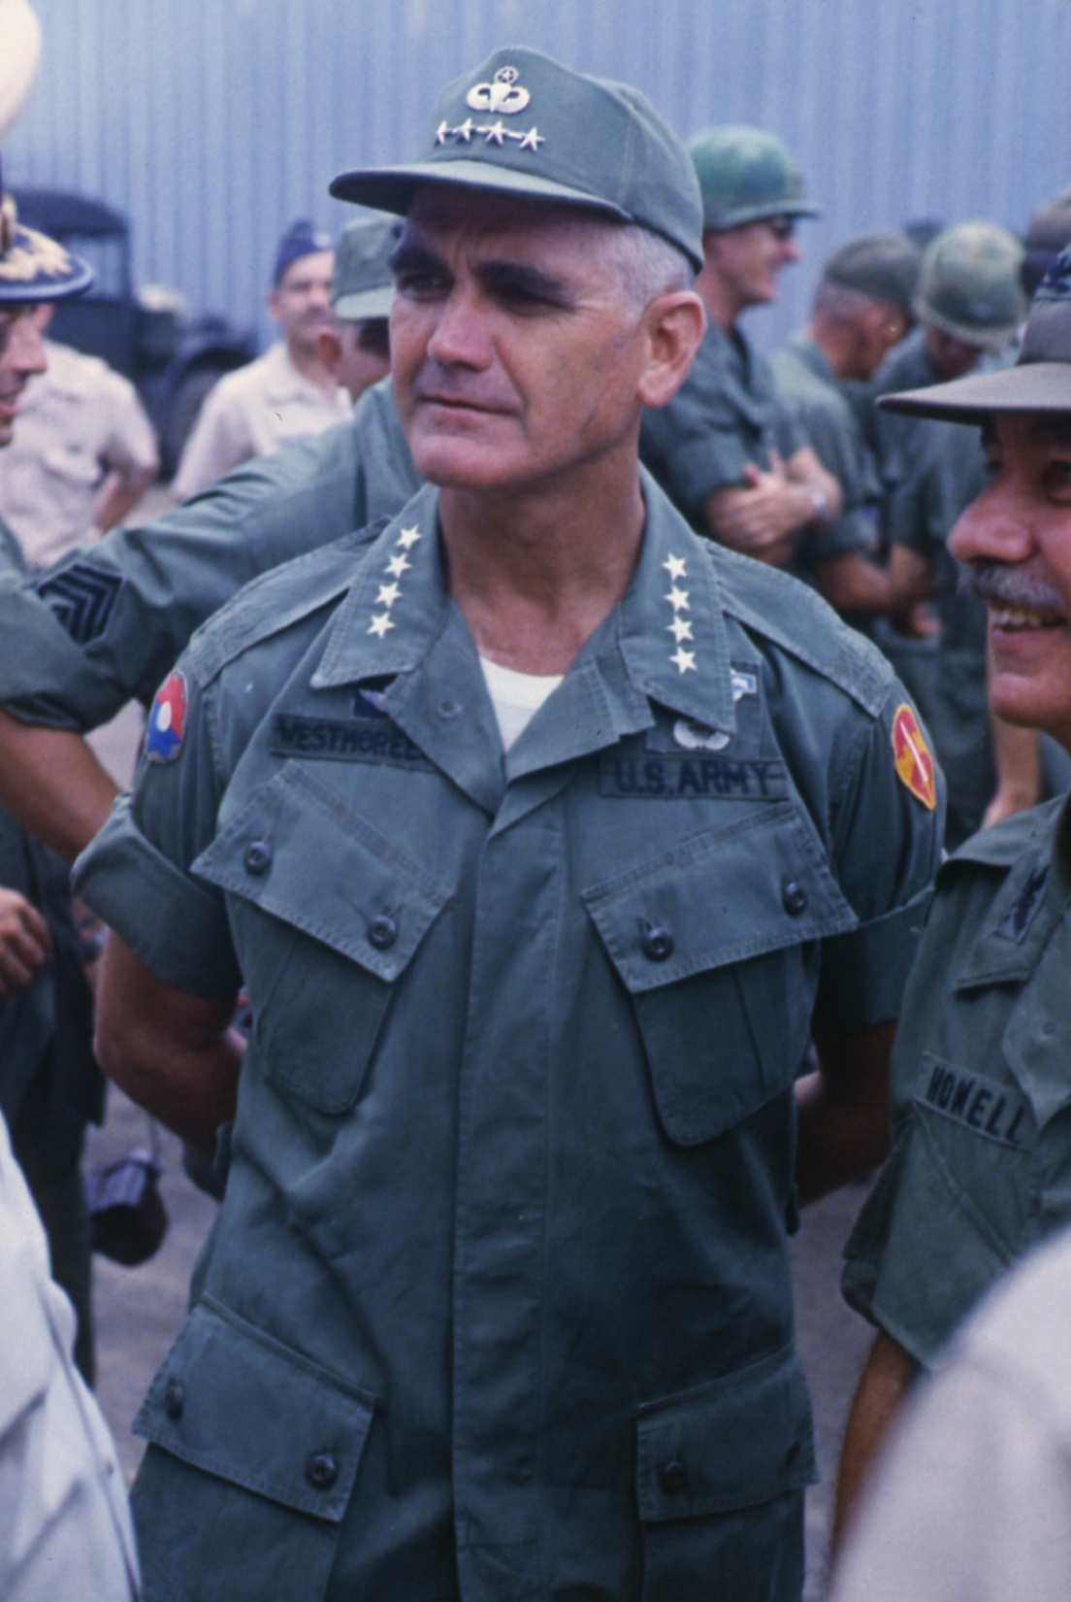

Slide 22


Slide 23
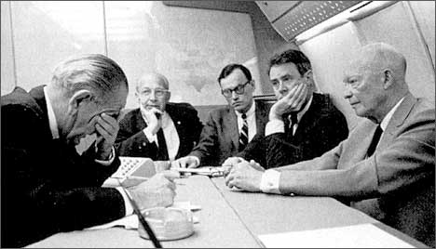
Notes:
Lbj rostow

Slide 24
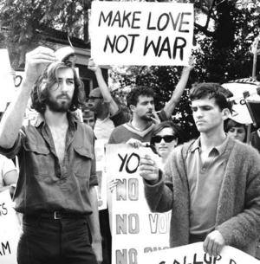

Slide 25
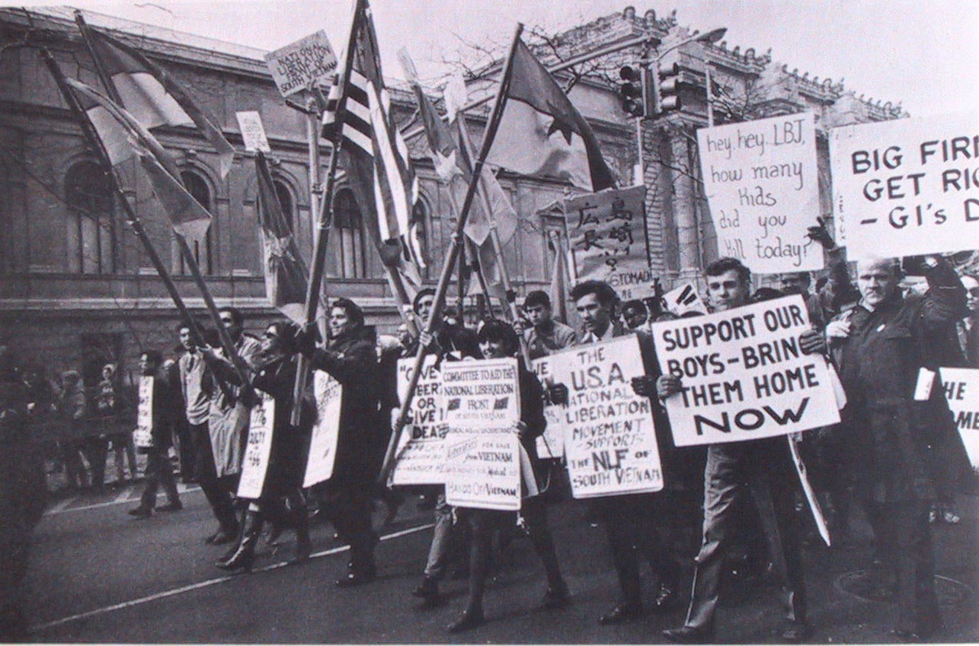

Slide 26
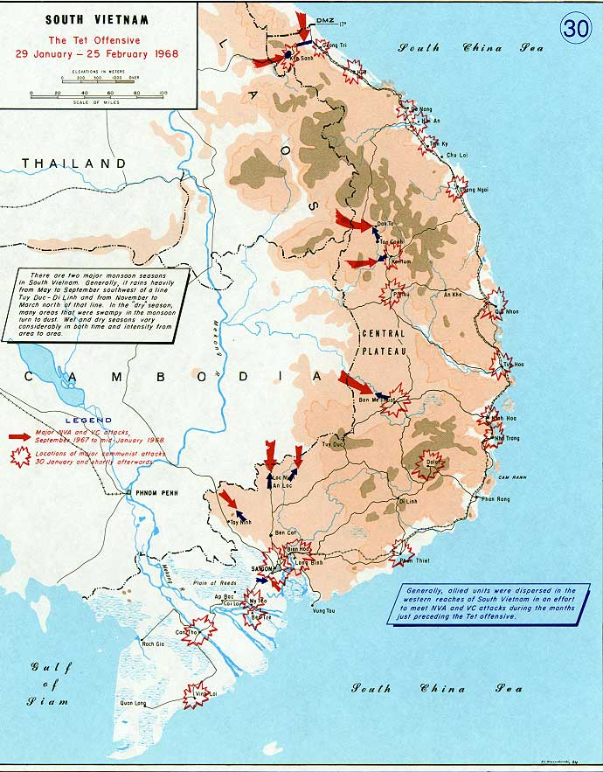

Slide 27
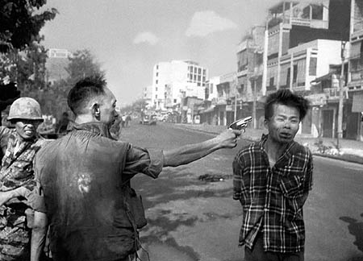

Slide 28
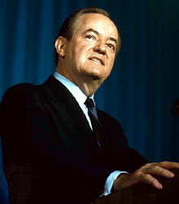
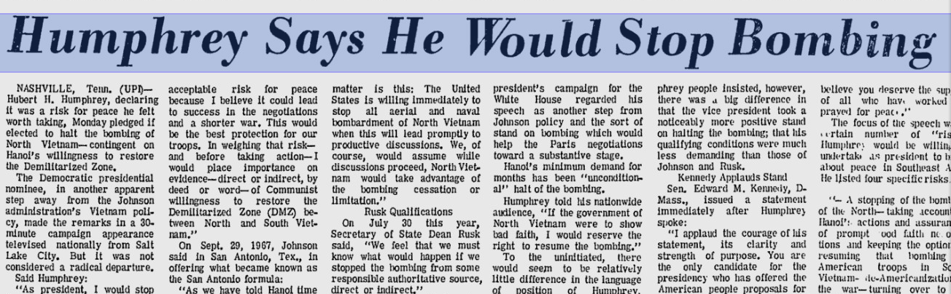

Slide 29
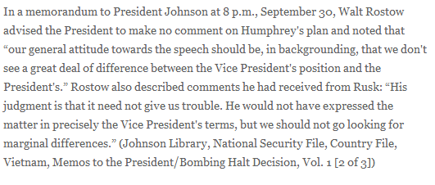

Slide 30
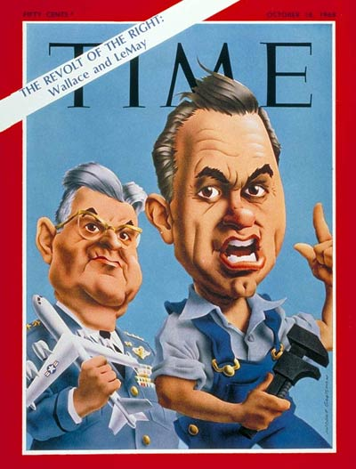

Slide 31
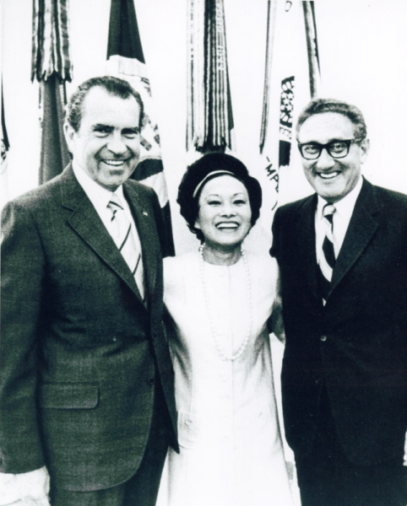

Slide 32
President Johnson: Now, I’m reading their hand, Everett. I don’t want to get this in the campaign.
Everett Dirksen: That’s right.
President Johnson And they oughtn’t to be doing this. This is treason.
Dirksen: I know.
[Break.]
President Johnson: [with Dirksen assenting] Now, I can identify ‘em, because I know who’s doing this. I don’t want to identify it. I think it would shock America if a principal candidate was playing with a source like this on a matter this important.
I don’t want to do that. But if they’re going to put this kind of stuff out, they ought to know that we know what they’re doing. I know who they’re talking to, and I know what they’re saying.
Well, now, what do you think we ought to do about it?
Dirksen: I better get in touch with him, I think, and tell him about it.
President Johnson: I think you better tell him that his people are saying to these folks that they oughtn’t to go through with this meeting [in Paris]. Now, if they don’t go through with the meeting, it’s not going to be me that’s hurt. I think it’s going to be whoever’s elected.
Dirksen: That’s right.
President Johnson: It may be—my guess—him.
Dirksen: Yeah.
President Johnson: And I think they’re making a very serious mistake. And I don’t want to say this.
Dirksen: Yeah.
President Johnson: And you’re the only one I’m going to say it to.
Dirksen: Yeah.
[Break.]
President Johnson: Well, I don’t know who it is that’s with Nixon. It may be [Wisconsin congressman Mel] Laird. It may be [aide Bryce] Harlow. It may be [campaign manager John] Mitchell. I don’t know who it is.
I know this: that they’re contacting a foreign power in the middle of a war.
Dirksen: That’s a mistake!
President Johnson: And it’s a damn bad mistake.
Dirksen: Oh, it is.
President Johnson: [with Dirksen assenting] And I don’t want to say you, and you’re the only man that I have enough confidence in to tell ‘em. But you better tell ‘em they better quit playing with it. You just tell ‘em that their people are messing around in this thing, and if they don’t want it on the front pages, they better quit it!

