Slide 1
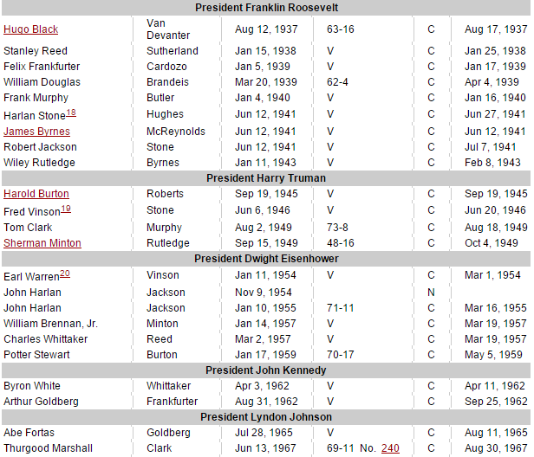

Slide 2
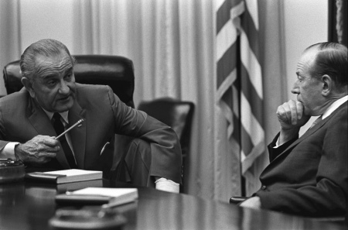

Slide 3
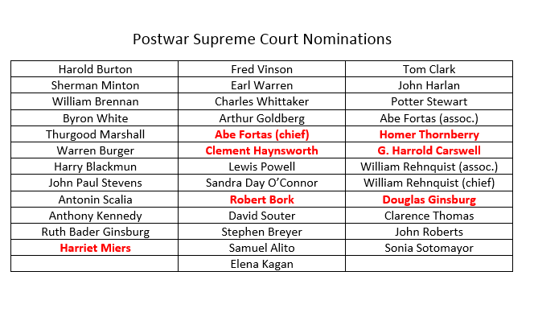

Slide 4
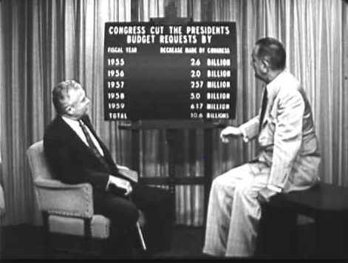

Slide 5

President Johnson: [Homer] Thornberry has some disadvantages. I think the fact he was a congressman, a city councilman, a state legislator. I think that would be awfully good on the Court, and knowing every department of this government.
But from the standpoint of the liberal press, that just will not give me a fair trial—hell, I’d be nominated by acclamation on my record for civil liberties and civil rights—but the Times and the Post are against me, because they’re just anti-Semitic, by God. They’re anti-South. Just because I live in Texas, I don’t have style. And that’s the only damn thing they’ve got against me. I’ve adopted their platform . . .
[Break.]
President Johnson: I know you’ve got to go, and I just got to get some more . . .
How are you going to rate these people—one, two, three, four, five?
Abe Fortas: I—
President Johnson: From the standpoint of my practical problem, and what I may want to do here on all the other things. I’ve got geography, I’ve got the Senate, I’ve got these philosophies, I’ve got to have sure votes.
I want a little continuity, I want a little age—now, look at this not from your standpoint.
Fortas: Well—
President Johnson: Look at it from my standpoint, of knowing me as you know me, and what I want. I want somebody that I’ll always be proud of his vote. That’s the first thing. I may not be proud of his opinion, but I want to be proud of the side he was on. He may not be as eloquent as Hugo Black, or you, or somebody. But I want to be damn sure he votes right. That’s the first thing.

Slide 6
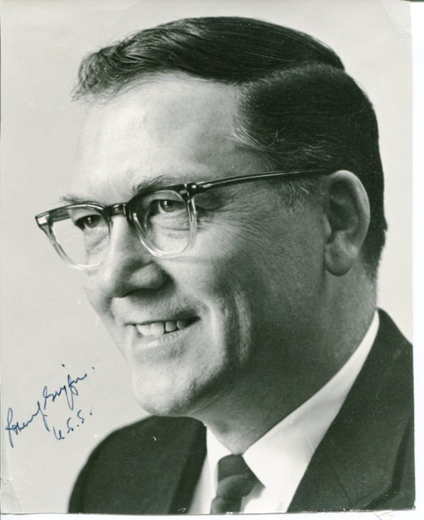
Republican Round Robin
“It is the strongly held view of the undersigned that the next Chief Justice of the United States, and any nominees for vacancies on the Supreme Court should be selected by the newly-elected President of the United States, after the people have expressed themselves in November’s elections. We will, therefore, because of the above principle, and with absolutely no reflection on any individuals involved, vote against confirming any Supreme Court nominations of the incumbent President.”

Slide 7
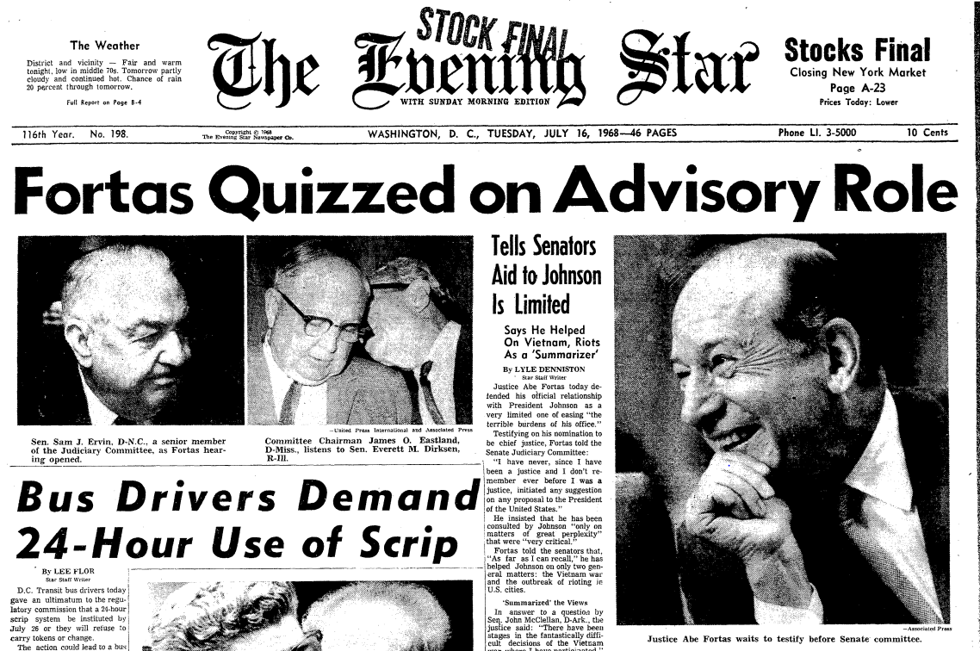

Slide 8
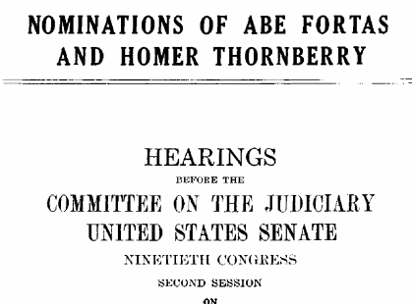
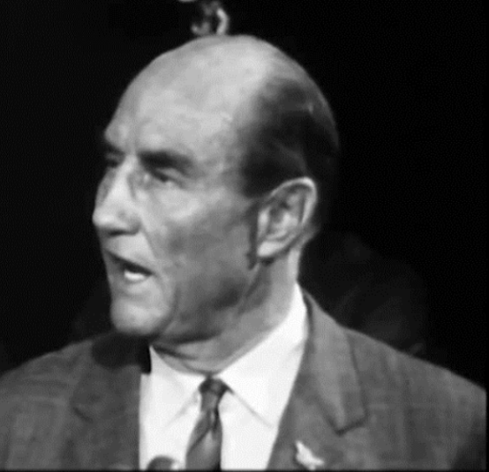
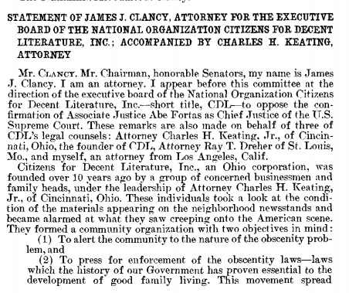

Slide 9
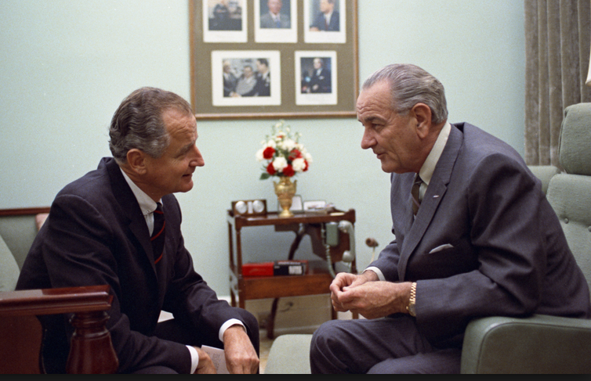

Slide 10
George Smathers: Now, you get a real nut like Strom Thurmond, who up to this point hadn’t really made much sense . . . There are just enough people who will fall for a line like this, that it worries me, very much. And they’ve invited Abe back to talk about it, and I just think that—frankly, my first reaction is that he just ought not to come. And just see . . .
And my other reaction is at the moment—[Michigan senator] Phil [Hart] went to see the movie. I said, “I’m not going to see the damn movie.” Because I want to be in a position to say, as far as I’m concerned, I don’t look at any kind of goddamned pornographic stuff. It’s all over the streets, and always has been. And it’s a man’s choice. And I choose not to look at it. But others may choose to look at it. And if a fella wants to look at it, why, the Court’s voted that he can. That’s a matter of choice.
I don’t look at it. I haven’t seen it, so I’m not passing judgment on whether or not this is the kind of thing that should be shown around, or it shouldn’t.
[Break.]
Smathers: [Arkansas senator] John [McClellan, a very conservative Democrat] was preaching, and rantin’ and ravin’ about how this kind of thing was ruining the life of his grandchildren, and everybody else. He wanted a long time to look into this, and he was going to look into it very deeply.
President Johnson: He ought to go see this Graduates [sic]. [Chuckles.]
Smathers: That’s right.
[Break.]
President Johnson: Well, will you vote on it next Wednesday?
Smathers: So, we’re due to vote on it next Wednesday.
President Johnson: Well, won’t they filibuster it?
Smathers: Yeah. They’re going to filibuster it again.
President Johnson: In the committee?!
Smathers: In the committee.
President Johnson: Well, can you just do that, constantly?
Smathers: Well, with the cooperation of [Jim] Eastland, I just don’t know you’re going to stop it.

Slide 11
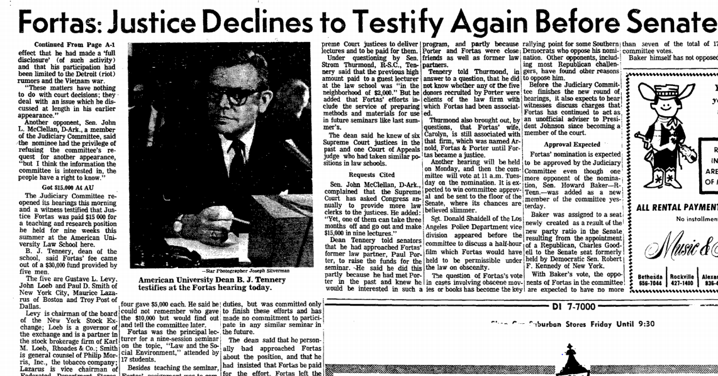

Slide 12
President Johnson: But I just hear every 30 minutes, these fellows, they have press conferences—you know, [Robert] Griffin’s on all the time. He’s having a big press conference this morning. And they make 40 allegations, and we just get tried and convicted every day, and our side—the other side—doesn’t get in.
Ramsey Clark: Yeah.
[Break.]
President Johnson: Get somebody that can write some mean damn speeches that allege some things that they’ve got to deny. Let them do some research . . . That’s what you got to do: you’ve got to employ their resources and their talents doing research instead of attacking you.
Now, we don’t ever keep ‘em busy. I’d find some reason that Griffin’s in this thing. I don’t think that anybody’s ever pointed out that Griffin said a week before the appointment that he was against anybody that was appointed. He wasn’t worried about pornography. Anybody’d look at his face and tell he’s not—that doesn’t bother him! [Clark chuckles.] Pornography!
He was just worried that, by God, he couldn’t make a partisan, political deal out of the Chief Justice [nomination]. And the Republican Chief Justice [Warren] hadn’t delayed it and played politics with it till he could get in.
Now, that’s what he said! He said it days before we even decided to name Fortas. Somebody ought to point that out.

Slide 13
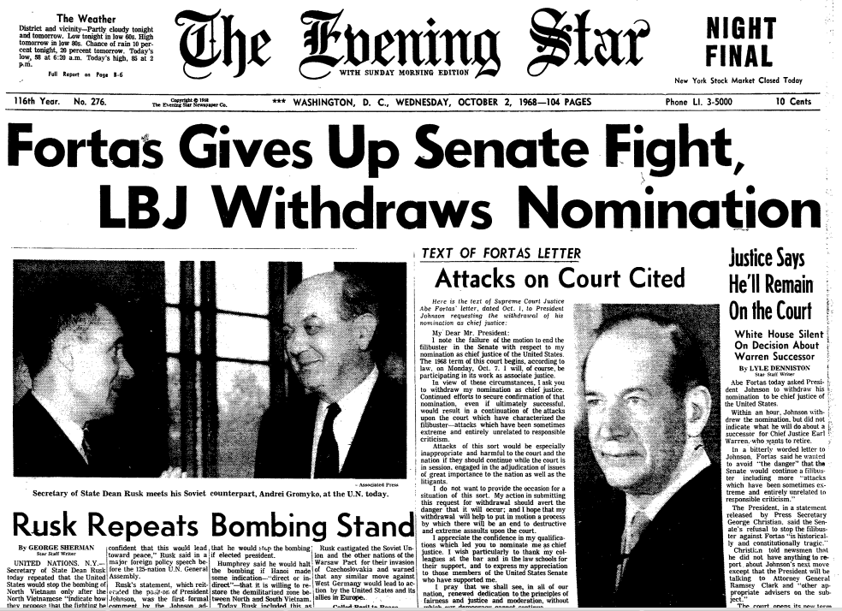

Slide 14
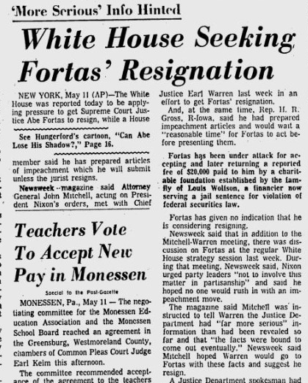

Slide 15
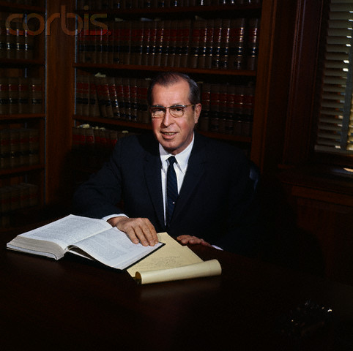
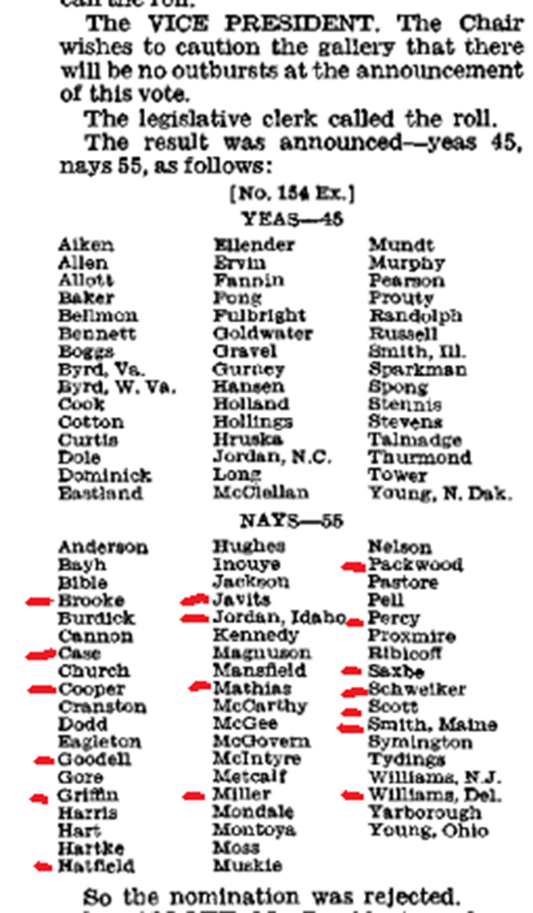

Slide 16
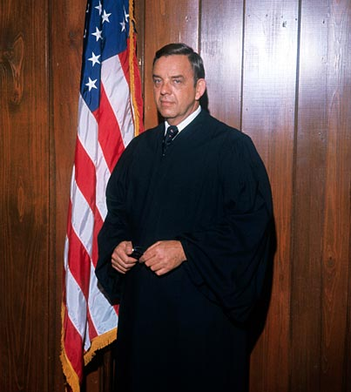
Notes:
carswell

Slide 17
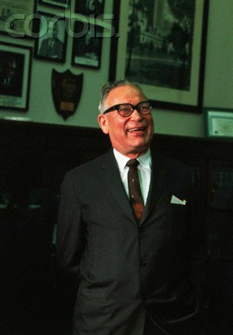
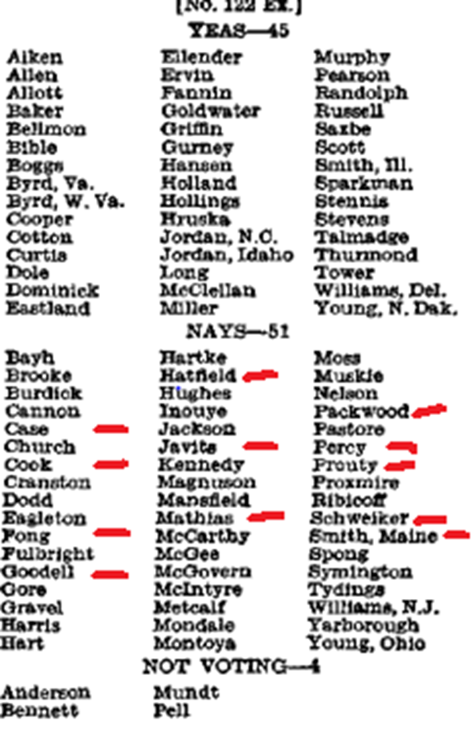
"Even if he were mediocre, there are a lot of mediocre judges and people and lawyers. They are entitled to a little representation, aren't they, and a little chance? We can't have all Brandeises, Frankfurters and Cardozos.“
--Roman Hruska (R-Nebraska)
Notes:
hruska

Slide 18
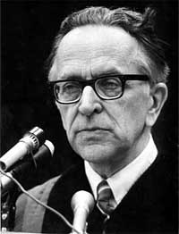

Slide 19
President Nixon: Now, on the other thing, John, on the second one, if it comes: can I urge you to try to examine everything to see if you can find a Catholic—a good Catholic?
John Mitchell: You want another [Justice William] Brennan?
President Nixon: No, Christ no! That’s what I mean. I mean—
Mitchell: You know, you went down—the Eisenhower administration went down that track before, you know . . .
President Nixon: And they got Brennan, I know. But you don’t have an honest Italian, do you?
Mitchell: [Chuckles.] God, they’re awful hard to find.
President Nixon: A Pole?
Mitchell: Uh . . .
President Nixon: No.
Mitchell: [California attorney and future Reagan AG] William French Smith—he isn’t one, is he?
President Nixon: Oh, Christ, no. He’s a Protestant.
Mitchell: WASP.
President Nixon: Rich and everything else.
Mitchell: All right.
President Nixon: Well, take a look at the Catholics, will you?
[Break.]
Mitchell: Do you think that’s a good line to take?
President Nixon: I do. Politically, we are going to gain a lot more from a Catholic. Look, the Protestants will just figure—if he’s a conservative, a Catholic conservative’s better than a Protestant conservative. We really need that—
Mitchell: Well, they’re more engrained, I’m sure.
President Nixon: Yeah. The point is, it’ll mean more to the Catholics—that’s my point—than it will to the Protestants. The Protestants expect to have things. The Catholics don’t.
Mitchell: When are you going to fill that Jewish seat on the Supreme Court?
President Nixon: Well, about . . . after I die. [Mitchell laughs.] You know and I know, there aren’t any.
Mitchell: There are no conservatives, I’ll say that.
President Nixon: Never.

Slide 20
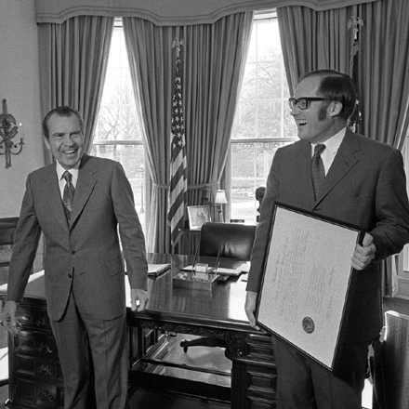

Slide 21
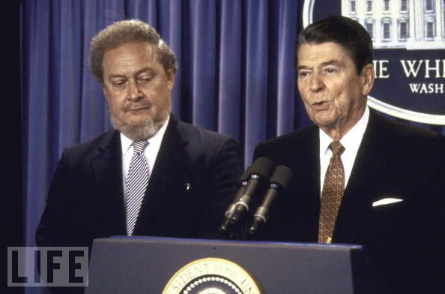

Slide 22
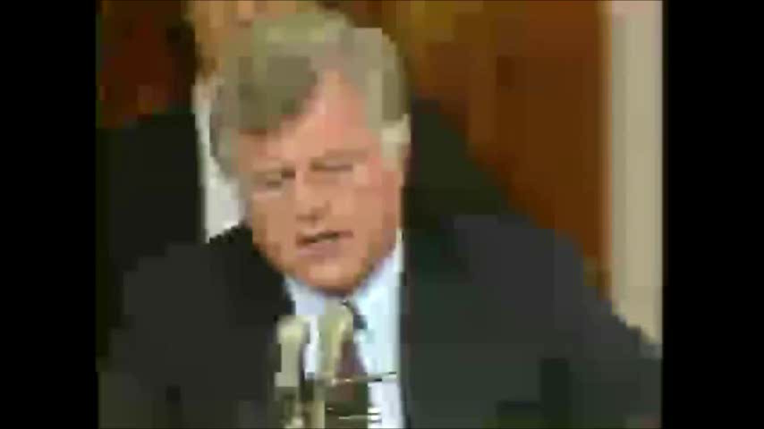

Slide 23
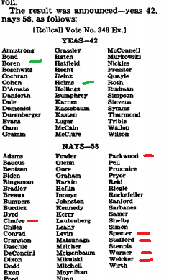

Slide 24
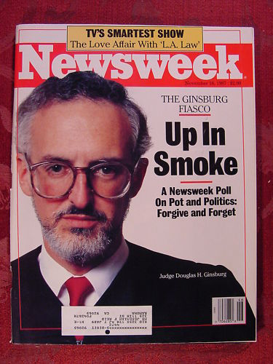

Slide 25
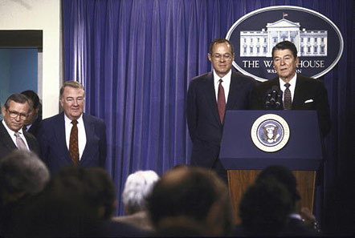

Slide 26
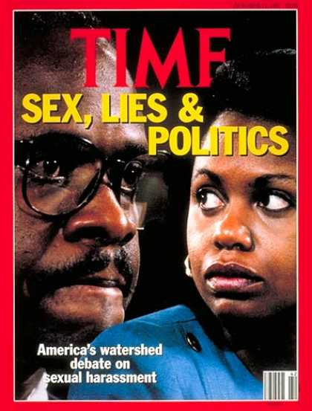

Slide 27
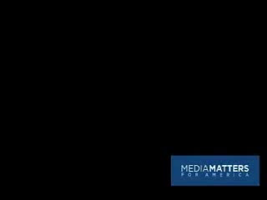

Slide 28
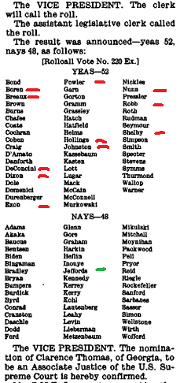
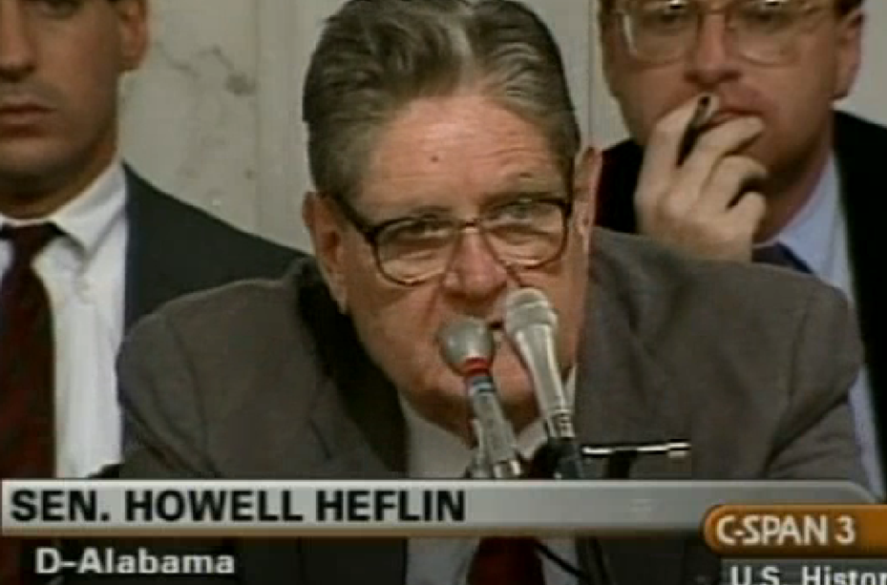

Slide 29
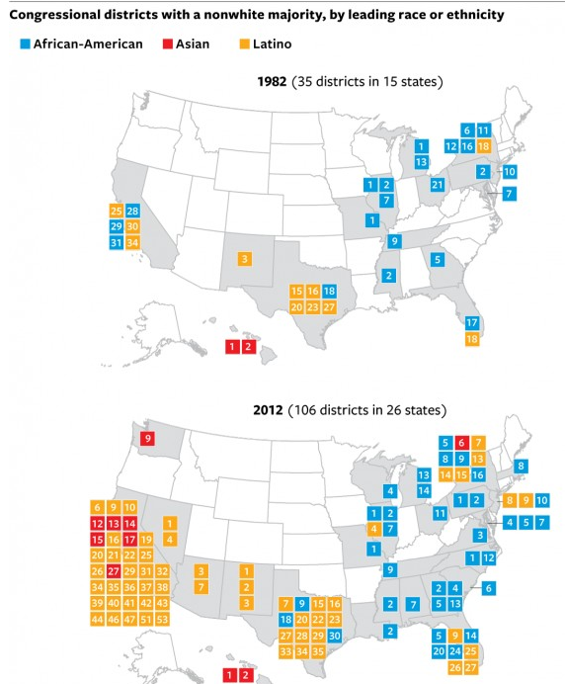
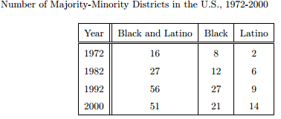

Slide 30
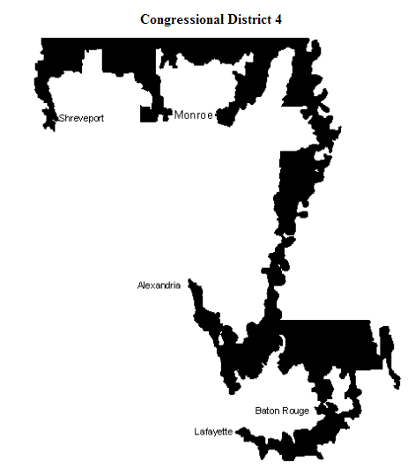
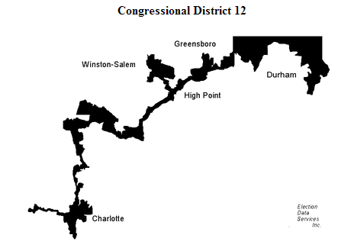

Slide 31
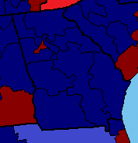
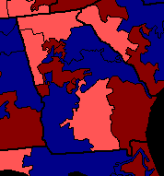
Georgia House Districts, 1990-1994

Slide 32
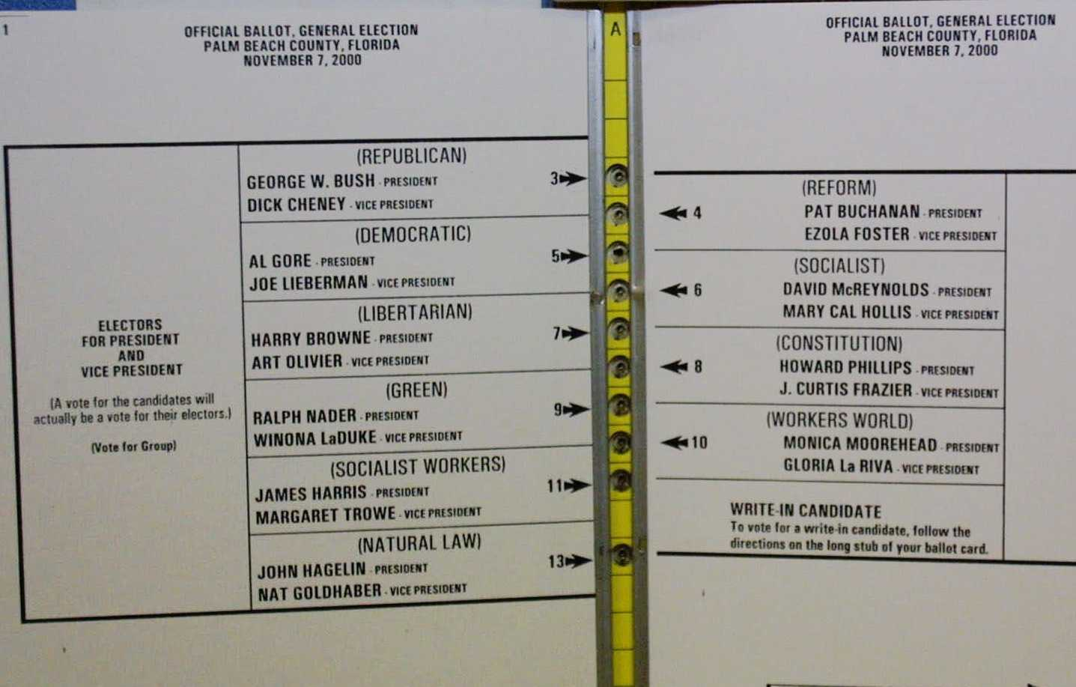

Slide 33
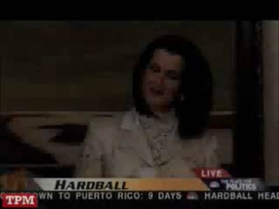

Slide 34
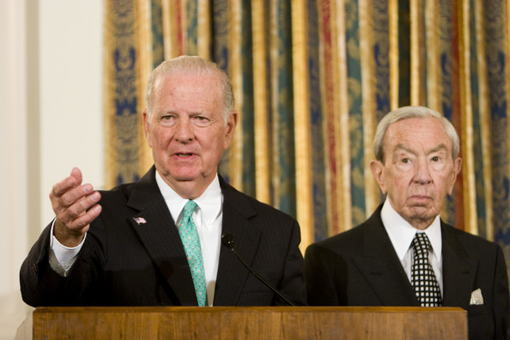

Slide 35
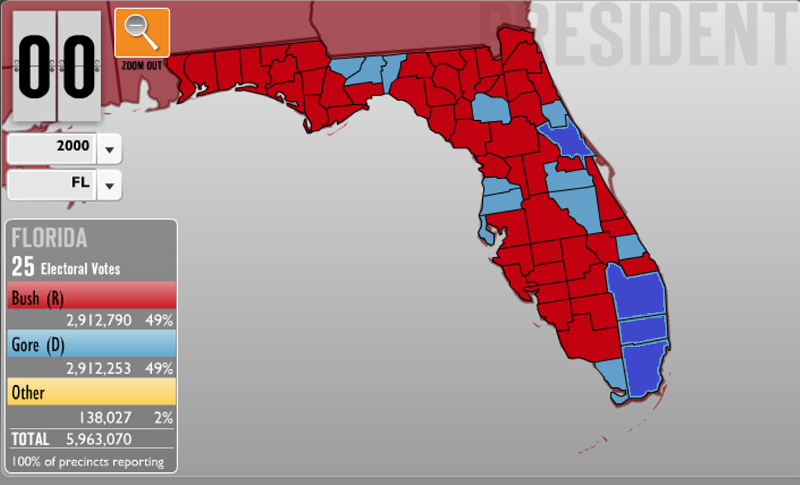

Slide 36
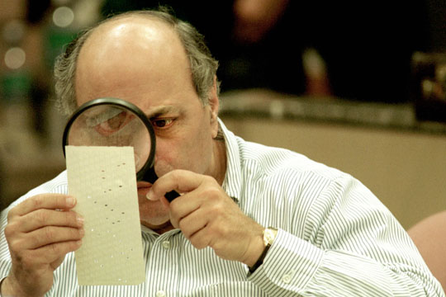

Slide 37
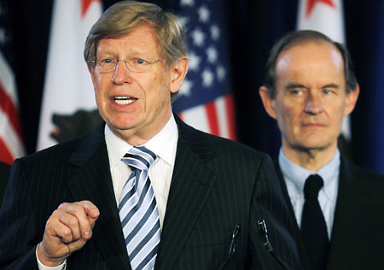

Slide 38
Bush v. Gore (2000)
The want of those rules here has led to unequal evaluation of ballots in various respects. As seems to have been acknowledged at oral argument, the standards for accepting or rejecting contested ballots might vary not only from county to county but indeed within a single county from one recount team to another . . .
The recount process, in its features here described, is inconsistent with the minimum procedures necessary to protect the fundamental right of each voter in the special instance of a statewide recount under the authority of a single state judicial officer. Our consideration is limited to the present circumstances, for the problem of equal protection in election processes generally presents many complexities . . .

Slide 39
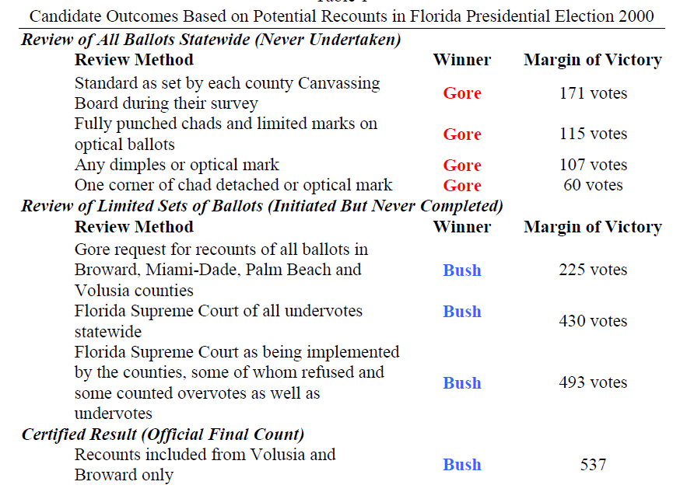

Slide 40
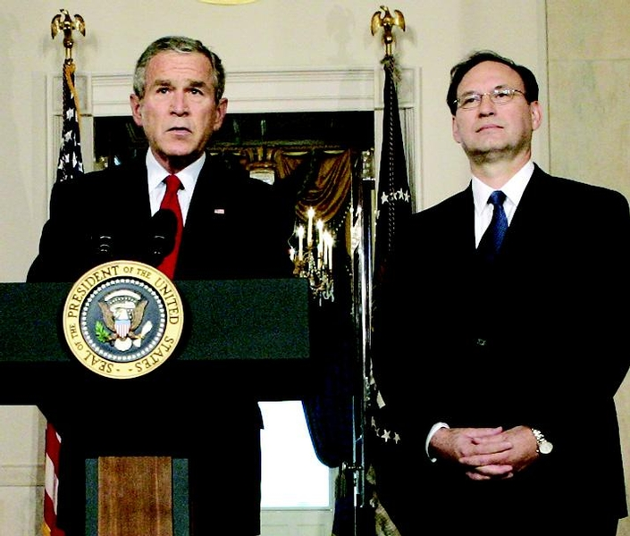

Slide 41
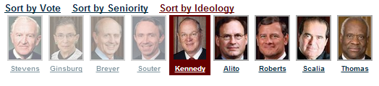
Gonzales v. Carhart (2007)
Whatever one’s views concerning the Casey joint opinion, it is evident a premise central to its conclusion—that the government has a legitimate and substantial interest in preserving and promoting fetal life—would be repudiated were the Court now to affirm the judgments of the Courts of Appeals [and overturn the NE law]…
The Act furthers the legitimate interest of the Government in protecting the life of the fetus that may become a child…
Respondents have not demonstrated that the Act, as a facial matter, is void for vagueness, or that it imposes an undue burden on a woman’s right to abortion based on its overbreadth or lack of a health exception.

Slide 42
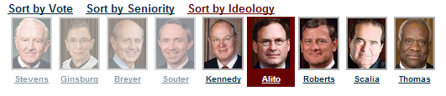
Ledbetter v. Goodyear Tire & Rubber (2007)—Ginsburg dissent
The Court’s insistence on immediate contest overlooks common characteristics of pay discrimination. Pay disparities often occur, as they did in Ledbetter’s case, in small increments; cause to suspect that discrimination is at work develops only over time. Comparative pay information, moreover, is often hidden from the employee’s view. Employers may keep under wraps the pay differentials maintained among supervisors, no less the reasons for those differentials…
This is not the first time the Court has ordered a cramped interpretation of Title VII, incompatible with the statute’s broad remedial purpose. Once again, the ball is in Congress’ court. As in 1991, the Legislature may act to correct this Court’s parsimonious reading of Title VII.

Slide 43
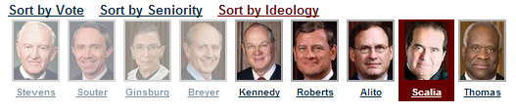
District of Columbia v. Heller (2008)
From our review of founding-era sources, we conclude that this natural meaning was also the meaning that “bear arms” had in the 18th century. In numerous instances, “bear arms” was unambiguously used to refer to the carrying of weapons outside of an organized militia…
Constitutional rights are enshrined with the scope they were understood to have when the people adopted them, whether or not future legislatures or (yes) even future judges think that scope too broad.

Slide 44
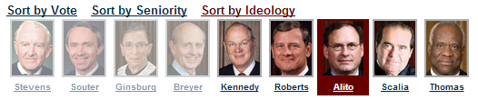
Davis v. FEC (2008)
Davis contends that §319(a) unconstitutionally burdens his exercise of his First Amendment right to make unlimited expenditures of his personal funds because making expenditures that create the imbalance has the effect of enabling his opponent to raise more money and to use that money to finance speech that counteracts and thus diminishes the effectiveness of Davis’ own speech…
We have never upheld the constitutionality of a law that imposes different contribution limits for candidates who are competing against each other…
The unprecedented step of imposing different contribution and coordinated party expenditure limits on candidates vying for the same seat is antithetical to the First Amendment .

Slide 45
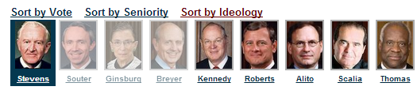
Crawford v. Marion County Election Board (2008)--Souter dissent
Without a shred of evidence that in-person voter impersonation is a problem in the State, much less a crisis, Indiana has adopted one of the most restrictive photo identification requirements in the country. …The State hardly even tries to explain its decision to force indigents or religious objectors to travel all the way to their county seats every time they wish to vote, and if there is any waning of confidence in the administration of elections it probably owes more to the State’s violation of federal election law than to any imposters at the polling places. It is impossible to say, on this record, that the State’s interest in adopting its signally inhibiting photo identification requirement has been shown to outweigh the serious burdens it imposes on the right to vote.
If more were needed to condemn this law, our own precedent would provide it, for the calculation revealed in the Indiana statute crosses a line when it targets the poor and the weak.

Slide 46
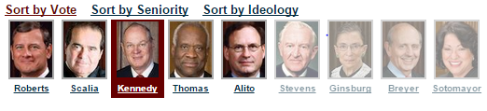
Citizens United v. FEC (2010)
Speech is an essential mechanism of democracy, for it is the means to hold officials accountable to the people. The right of citizens to inquire, to hear, to speak, and to use information to reach consensus is a precondition to enlightened self-government and a necessary means to protect it. The First Amendment “‘has its fullest and most urgent application’ to speech uttered during a campaign for political office.”…
The fact that a corporation, or any other speaker, is willing to spend money to try to persuade voters presupposes that the people have the ultimate influence over elected officials. This is inconsistent with any suggestion that the electorate will refuse “‘to take part in democratic governance’” because of additional political speech made by a corporation or any other speaker.

Slide 47
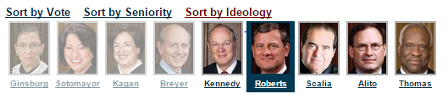
McCutcheon v. FEC (2014)
Spending large sums of money in connection with elections, but not in connection with an effort to control the exercise of an officeholder’s duties, does not give rise to quid pro quo corruption. Nor does the possibility that an individual who spends large sums may garner ‘influence over or access to’ elected officials . . .
The Government may no more restrict how many candidates or causes a donor may support than it may tell a newspaper how many candidates to endorse…
In assessing the First Amendment interests at stake, the proper focus is on an individual’s right to engage in political speech, not a collective conception of the public good.

Slide 48

Shelby County v. Holder (2013)
History did not end in 1965. By the time the Act was reauthorized in 2006, there had been 40 more years of it. In assessing the “current need[]” for a preclearance system that treats States differently from one another today, that history cannot be ignored. During that time, largely because of the Voting Rights Act, voting tests were abolished, disparities in voter registration and turnout due to race were erased, and African-Americans attained political office in record numbers. And yet the coverage formula that Congress reauthorized in 2006 ignores these developments, keeping the focus on decades-old data relevant to decades-old problems, rather than current data reflecting current needs.
The Fifteenth Amendment commands that the right to vote shall not be denied or abridged on account of race or color, and it gives Congress the power to enforce that command. The Amendment is not designed to punish for the past; its purpose is to ensure a better future.

Slide 49

Burwell v. Hobby Lobby Stores (2014)
As applied to closely held corporations, the HHS regulations imposing the contraceptive mandate violate RFRA [[the Religious Freedom Restoration Act] . . .
RFRA’s text shows that Congress designed the statute to provide very broad protection for religious liberty…
Protecting the free-exercise rights of closely held corporations thus protects the religious liberty of the humans who own and control them.
HHS has also provided no evidence that the purported problem of determining the sincerity of an asserted religious belief moved Congress to exclude for-profit corporations from RFRA’s protection.

Slide 50

State—Restrictive Voting Policies

Slide 51

State—Restrictive Voting Policies

Slide 52

Voter ID Laws (2015)

Slide 53


Slide 54


Slide 55



Slide 56
Romer v. Evans (1996)
Its sheer breadth is so discontinuous with the reasons offered for it that the amendment seems inexplicable by anything but animus toward the class that it affects; it lacks a rational relationship to legitimate state interests…
Amendment 2 … is at once too narrow and too broad. It identifies persons by a single trait and then denies them protection across the board. The resulting disqualification of a class of persons from the right to seek specific protection from the law is unprecedented in our jurisprudence . . .
We must conclude that Amendment 2 classifies homosexuals not to further a proper legislative end but to make them unequal to everyone else. This Colorado cannot do. A State cannot so deem a class of persons a stranger to its laws.

Slide 57
Romer v. Evans —Scalia dissent
The constitutional amendment before us here is not the manifestation of a “`bare . . . desire to harm'” homosexu­als, but is rather a modest attempt by seemingly tolerant Coloradans to preserve traditional sexual mores against the efforts of a politically powerful minority to revise those mores through use of the laws…
This Court has no business imposing upon all Americans the resolution favored by the elite class from which the Members of this institution are selected, pronouncing that "animosity" toward homosexuality is evil…
Coloradans are, as I say, entitled to be hostile toward homosexual conduct... The people of Colorado have adopted an entirely reasonable provision which does not even disfavor homosexuals in any substantive sense, but merely denies them preferential treatment. Amendment 2 is designed to prevent piecemeal deterioration of the sexual morality favored by a majority of Coloradans, and is an appropriate means to that legitimate end.

Slide 58


Slide 59
Windsor v. United States
DOMA writes inequality into the entire United States Code. The particular case at hand concerns the estate tax, but DOMA is more than a simple determination of what should or should not be allowed as an estate tax refund. Among the over 1,000 statutes and numerous federal regulations that DOMA controls are laws pertaining to Social Security, housing, taxes, criminal sanctions, copyright, and veterans’ benefits. DOMA’s principal effect is to identify a subset of state-sanctioned marriages and make them unequal. The principal purpose is to impose inequality, not for other reasons like governmental efficiency…
The differentiation demeans the couple, whose moral and sexual choices the Constitution protects, see Lawrence v. Texas, and whose relationship the State has sought to dignify. And it humiliates tens of thousands of children now being raised by same-sex couples. The law in question makes it even more difficult for the children to understand the integrity and closeness of their own family and its concord with other families in their community and in their daily lives…

Slide 60


Slide 61
John Bursch: I want you to think about two couples that are identically situated. They’ve been married for 5 years and they each have a 3-year-old child. One grows up believing that marriage is about keeping that couple bound to that child forever. The other couple believes that marriage is more about their emotional commitment to each other, and if that commitment fades, they may not stay together.
A reasonable voter, which is what we're talking about here, could believe that there would be a different outcome if those two marriages were influenced by those two different belief systems. Ideas matter, Your Honors, and, you know, the out-of-wedlock birthrate—
Justice Kennedy: But that ­­assumes that same-­sex couples could not have the more noble purpose [of devoting themselves to their children], and that’s the whole point. Same­-sex couples say, “Of course, we understand the nobility and the sacredness of the marriage. We know we can’t procreate, but we want the other attributes of it, in order to show that we, too, have a dignity that can be fulfilled.”
[Break.]
Bursch: But here the state’s entire interest springs out of the fact that we want to forever link children with their biological mom and dad when that’s possible . . . And what they’re [the gay and lesbian couples] asking you to do is to take an institution, which was never intended to be dignitary-bestowing, and make it dignitary-bestowing. That’s their whole argument. And when you do that, tens of thousands of other children who don’t meet their definition will likewise be left out, and suffer those exact same dignitary harms.
When you’re talking about a spectrum of marriage definitions, different places to draw the line, and potential harms on both sides, that is the quintessential place for the democratic process to work. And there’s another harm—
Justice Kennedy: Just in fairness to you, I don’t understand this “not dignity-bestowing.” I thought that was the whole purpose of marriage. It bestows dignity on both man and woman in a traditional marriage.
Bursch: It’s supposed to—
Justice Kennedy: It’s dignity-bestowing and these parties say they want to have that–that same ennoblement.
Bursch: Sure.
Justice Kennedy: Or am I missing your point?

Slide 62



