Slide 1


Slide 2
Article I, Section 8
Congress shall have power . . . to declare war, grant letters of marque and reprisal, and make rules concerning captures on land and water;
To raise and support armies, but no appropriation of money to that use shall be for a longer term than two years;
To provide and maintain a navy;
To make rules for the government and regulation of the land and naval forces;
To provide for calling forth the militia to execute the laws of the union, suppress insurrections and repel invasions.

Slide 3
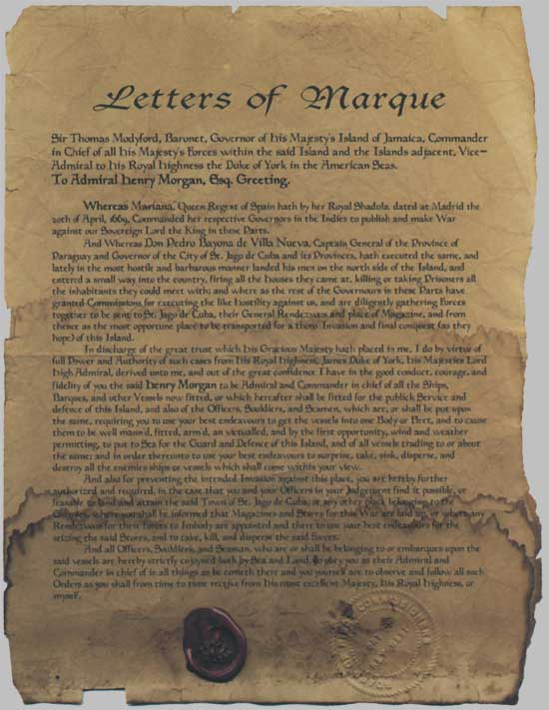

Slide 4
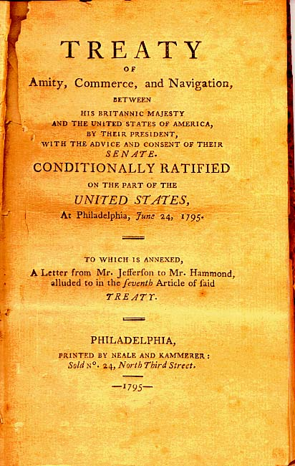
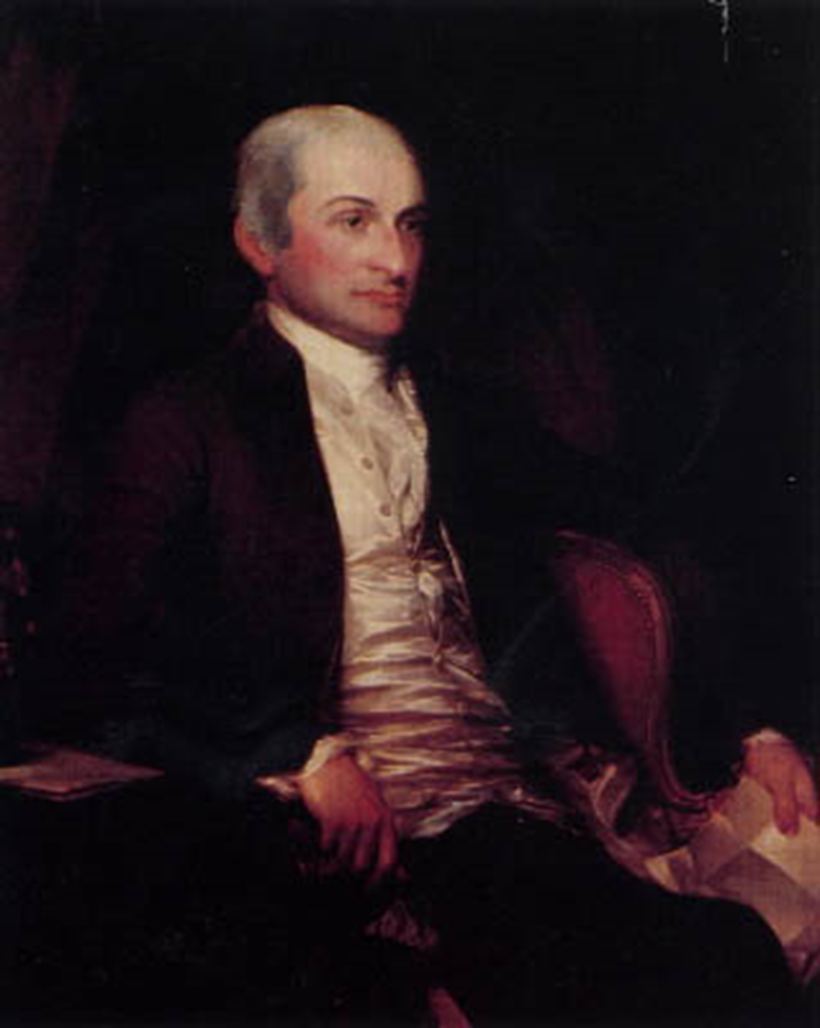

Slide 5
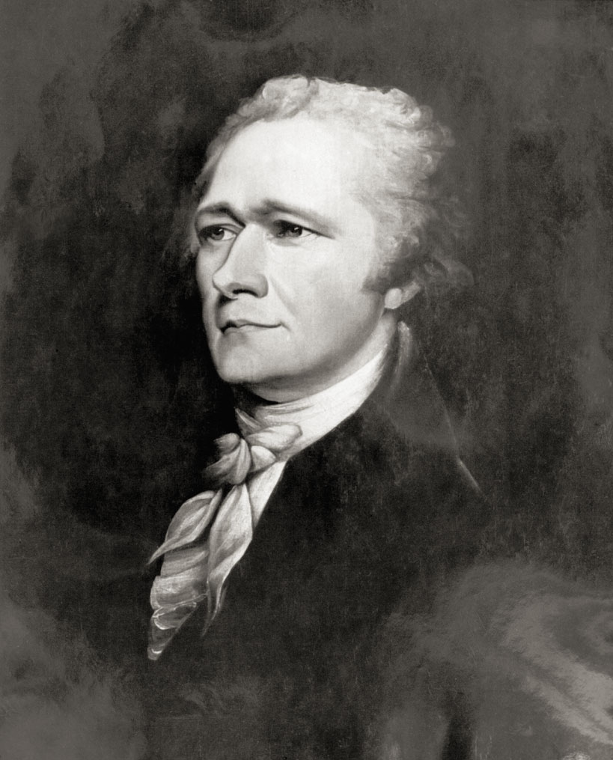

Slide 6
Buchanan message to Congress (Feb. 1859)
The republics south of the United States on this continent have unfortunately been frequently in a state of revolution and civil war ever since they achieved their independence . . . The Executive Governments of Great Britain, France, and other countries, possessing the war-making power, can promptly employ the necessary means to enforce immediate redress for similar outrages upon their subjects. Not so the Executive Government of the United States.
I therefore earnestly recommend to Congress, on whom the responsibility exclusively rests, to pass a law . . . conferring on the President the power to protect the lives and property of American citizens . . . The knowledge that such a law exists would of itself go far to prevent the outrages which it is intended to redress, and to render the employment of force unnecessary.
Such a grant of authority, thus limited in its extent, could in no just cause be regarded as a transfer of war-making power to the Executive, but only as an appropriate exercise of that power by the body to whom it exclusively belongs.

Slide 7
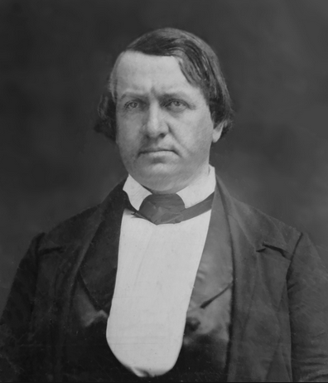

Slide 8


Slide 9


Slide 10
Downes v. Bidwell (1901) [Insular Cases]
Choice in some cases, the natural gravitation of small bodies towards large ones in others, the result of a successful war in still others, may bring about conditions which would render the annexation of distant possessions desirable. If those possessions are inhabited by alien races, differing from us in religion, customs, laws, methods of taxation, and modes of thought, the administration of government and justice, according to Anglo-Saxon principles, may for a time be impossible; and the question at once arises whether large concessions ought not to be made for a time, that ultimately our own theories may be carried out, and the blessings of a free government under the Constitution extended to them. We decline to hold that there is anything in the Constitution to forbid such action.

Slide 11
Downes —Harlan dissent
It will be an evil day for American liberty if the theory of a government outside of the supreme law of the land finds lodgment in our constitutional jurisprudence. No higher duty rests upon this court than to exert its full authority to prevent all violation of the principles of the Constitution.
Again, it is said that Congress has assumed, in its past history, that the Constitution goes into territories acquired by purchase or conquest only when and as it shall so direct, and we are informed of the liberality of Congress in legislating the Constitution into all our contiguous territories. This is a view of the Constitution that may well cause surprise, if not alarm. Congress, as I have observed, has no existence except by virtue of the Constitution. It is the creature of the Constitution. It has no powers which that instrument has not granted, expressly or by necessary implication. I confess that I cannot grasp the thought that Congress, which lives and moves and has its being in the Constitution, and is consequently the mere creature of that instrument, can, at its pleasure, legislate or exclude its creator from territories which were acquired only by authority of the Constitution.

Slide 12
ARTICLE XI
Any war or threat of war, whether immediately affecting any of the Members of the League or not, is hereby declared a matter of concern to the whole League, and the League shall take any action that may be deemed wise and effectual to safeguard the peace of nations. In case any such emergency should arise the Secretary General shall on the request of any Member of the League forthwith summon a meeting of the Council.
It is also declared to be the friendly right of each Member of the League to bring to the attention of the Assembly or of the Council any circumstance whatever affecting international relations which threatens to disturb international peace or the good understanding between nations upon which peace depends.

Slide 13
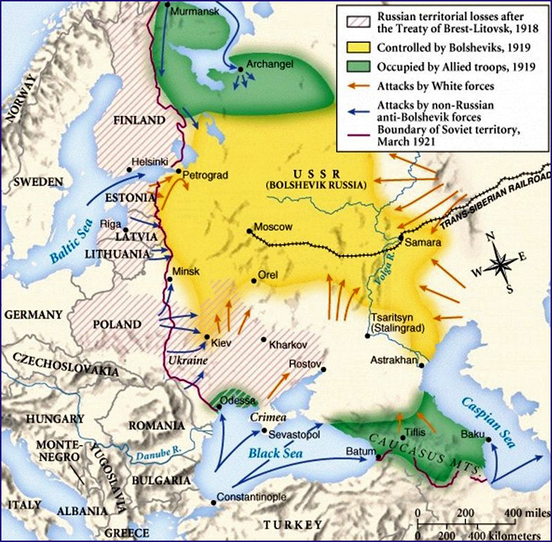

Slide 14
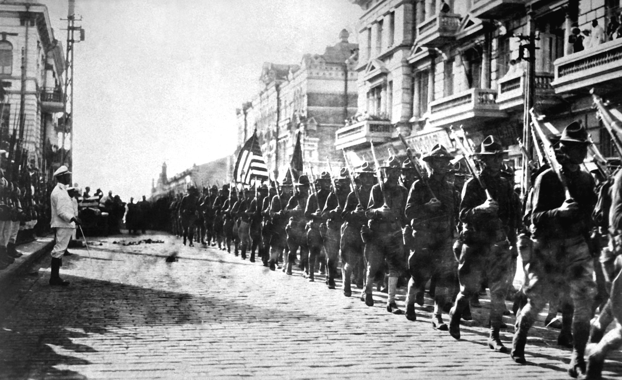

Slide 15
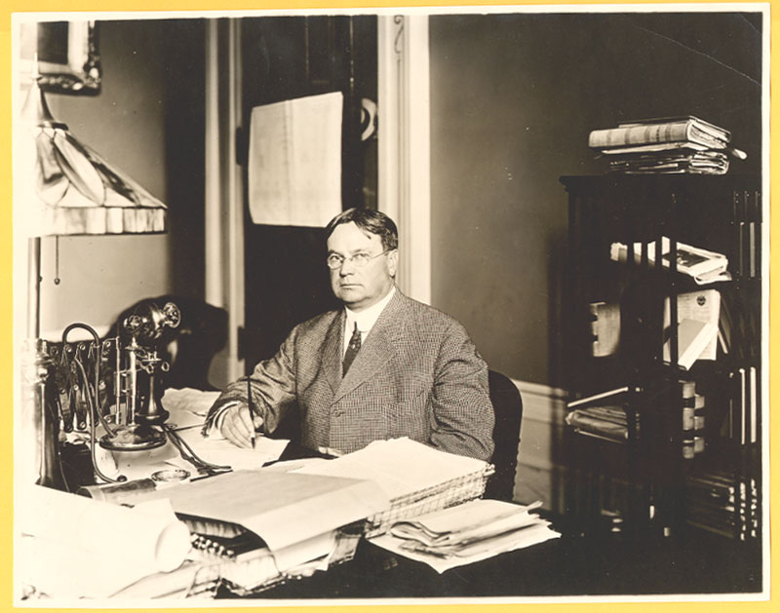

Slide 16
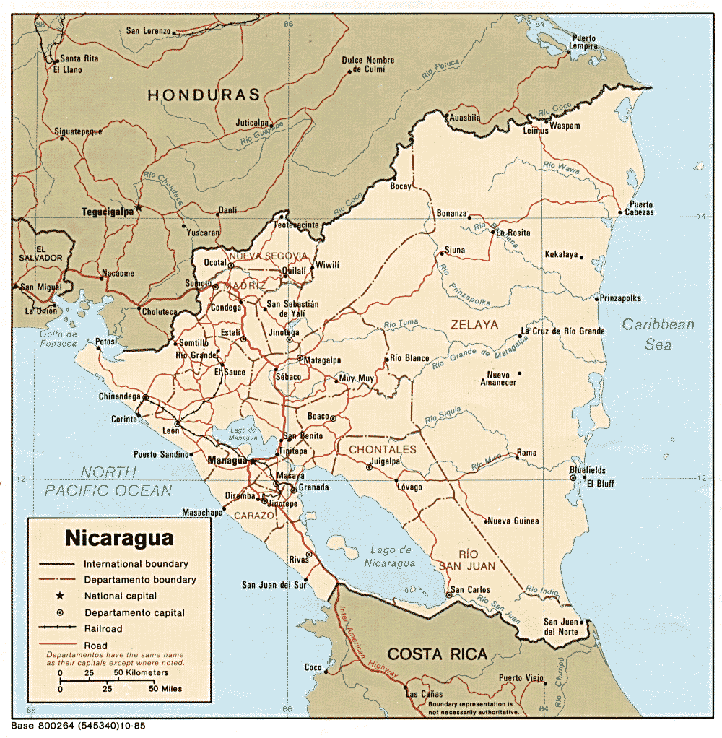

Slide 17
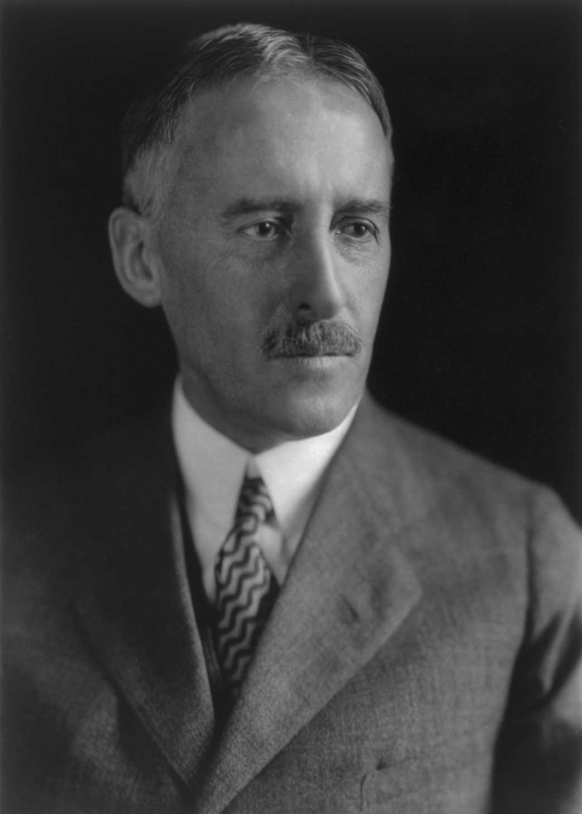
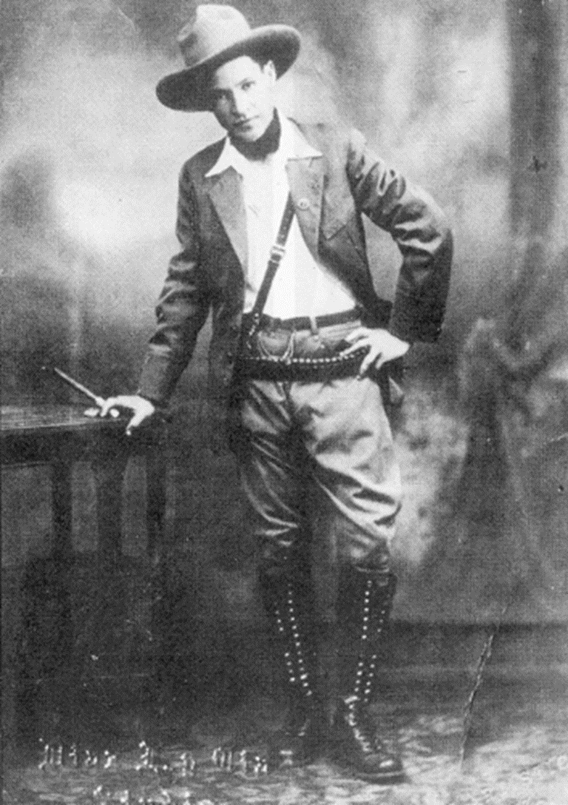
Notes:
stimson

Slide 18
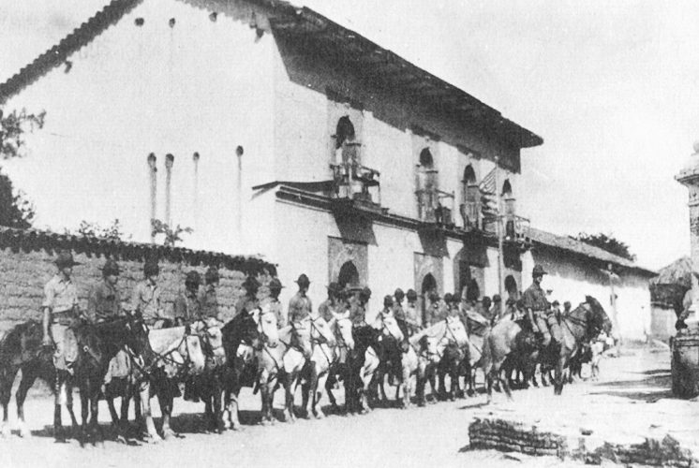

Slide 19
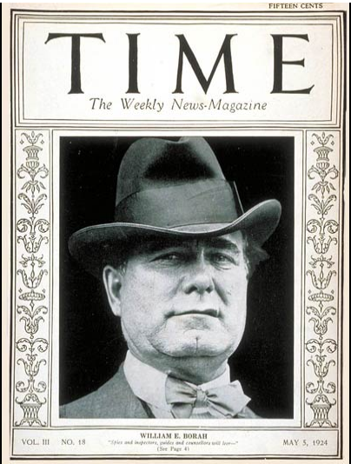
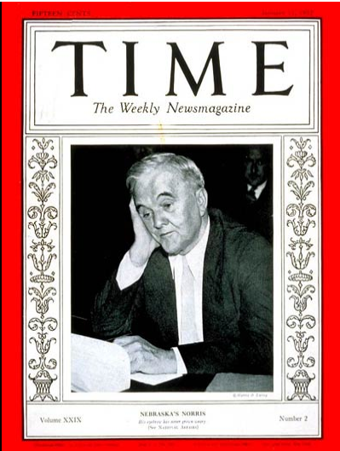

Slide 20
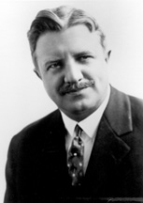
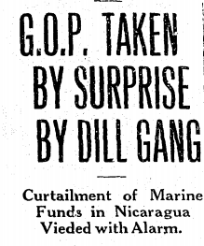
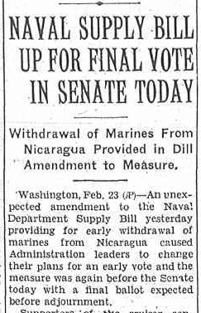

Slide 21
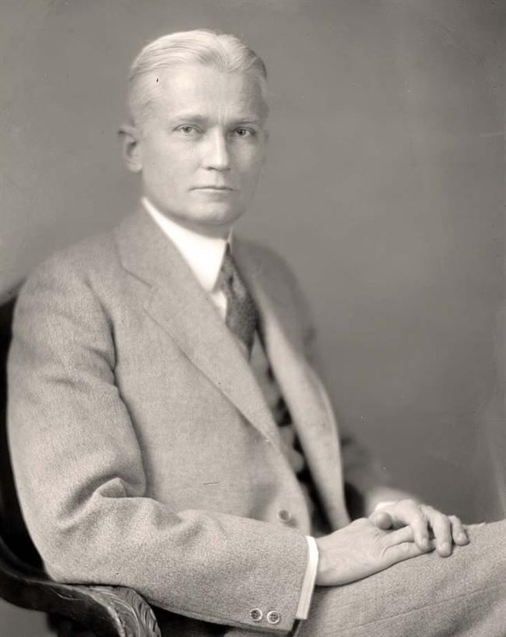
“When [George Norris] wants to be technical about the use of the term ‘war,’ he should be careful to distinguish the use of the word ‘marines,’ who, everyone recognizes, may be properly used in foreign countries for the protection of American life and property.”

Slide 22
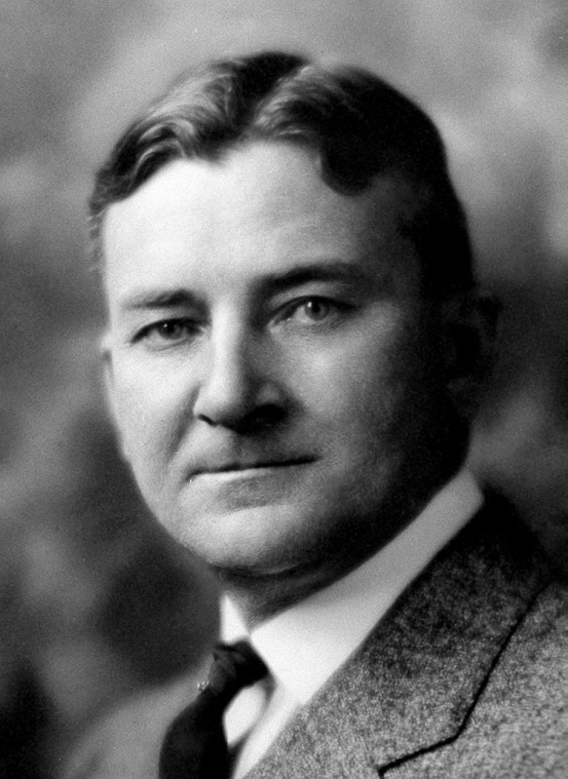
“The blood of these [Nicaraguan] boys, of these men, of these women and children, is upon the hands of those who have directed the hostile and war activities against the Republic of Nicaragua, acts contrary to all precedent in the history of this Republic, contrary to the law and the Constitution of this Republic, contrary to the rules and customs that prevail among the nations of the world.”

Slide 23
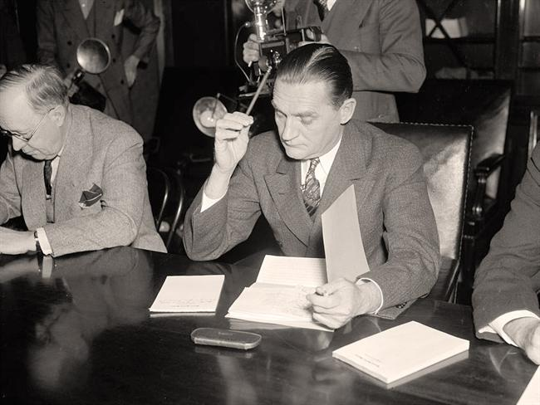
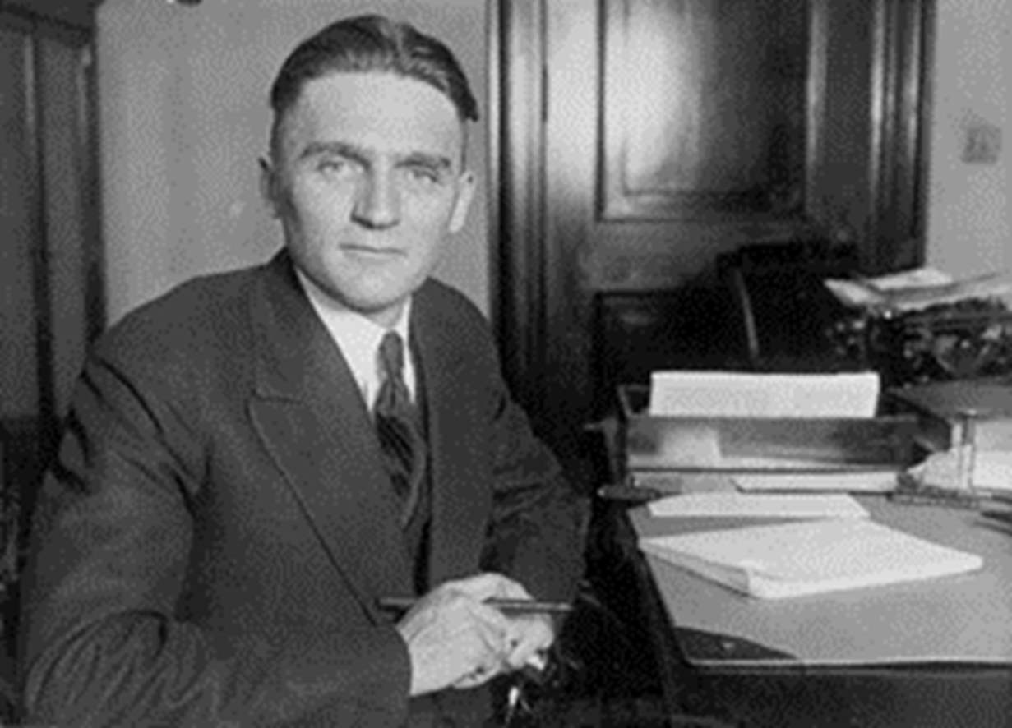
Neutrality Act (1935)
Embargo on all war materiel (arms, ammunition, etc.) to countries at war—applies to all U.S.-owned companies
American citizens travel on ships of warring countries at their own risk

Slide 24
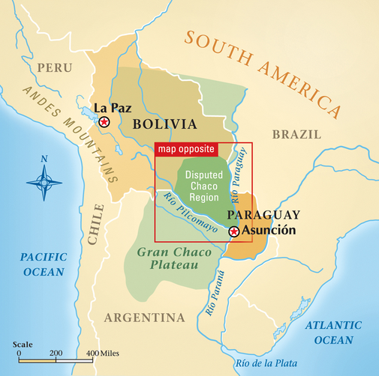

Slide 25
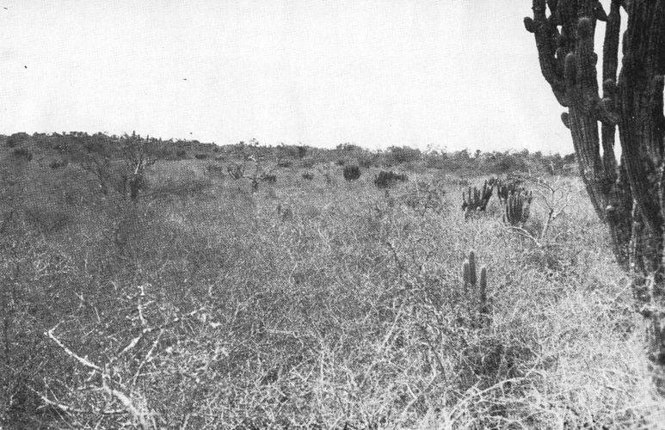
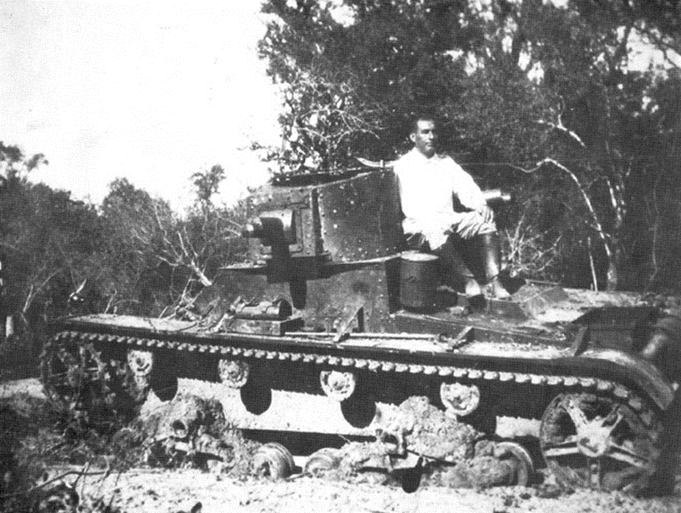

Slide 26
Neutrality Act (1935)
Embargo on all war materiel (arms, ammunition, etc.) to countries at war—applies to all U.S.-owned companies
American citizens travel on ships of warring countries at their own risk

Slide 27
U.S. v. Curtiss-Wright Export Co. (1936)
The whole aim of the resolution is to affect a situation entirely external to the United States, and falling within the category of foreign affairs . . . In other words, assuming (but not deciding) that the challenged delegation, if it were confined to internal affairs, would be invalid, may it nevertheless be sustained on the ground that its exclusive aim is to afford a remedy for a hurtful condition within foreign territory? . . .
The President is the constitutional representative of the United States with regard to foreign nations . . . Not only is the federal power over external affairs in origin and essential character different from that over internal affairs, but participation in the exercise of the power is significantly limited. In this vast external realm, with its important, complicated, delicate and manifold problems, the President alone has the power to speak or listen as a representative of the nation. He makes treaties with the advice and consent of the Senate; but he alone negotiates. Into the field of negotiation the Senate cannot intrude, and Congress itself is powerless to invade it.

Slide 28
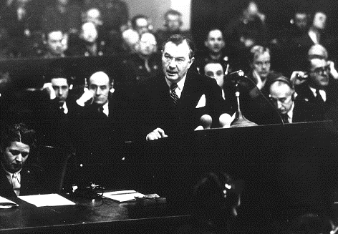

Slide 29
Jackson at Nuremberg (1945)
The privilege of opening the first trial in history for crimes against the peace of the world imposes a grave responsibility. The wrongs which we seek to condemn and punish have been so calculated, so malignant, and so devastating, that civilization cannot tolerate their being ignored, because it cannot survive their being repeated. That four great nations, flushed with victory and stung with injury stay the hand of vengeance and voluntarily submit their captive enemies to the judgment of the law is one of the most significant tributes that Power has ever paid to Reason . . .
Let me make clear that while this law is first applied against German aggressors, the law includes, and if it is to serve a useful purpose it must condemn aggression by any other nations, including those which sit here now in judgment.”

Slide 30
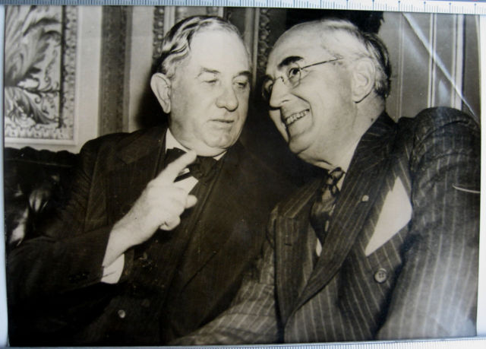
Notes:
Connally, vandenberg

Slide 31
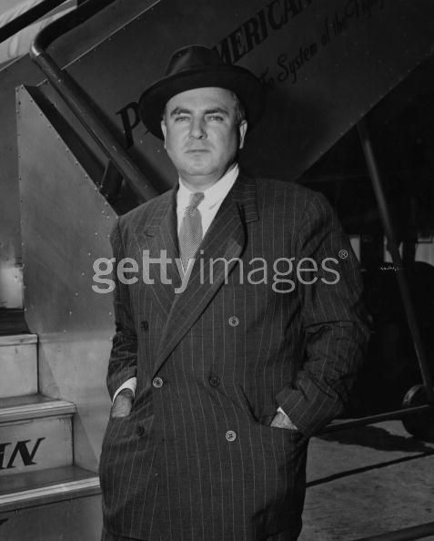
Notes:
mcmahon

Slide 32
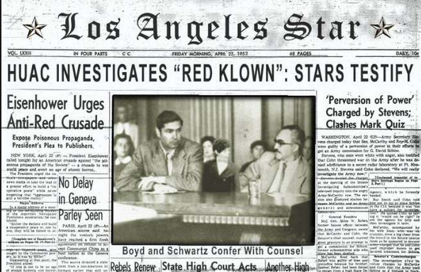

Slide 33
Dennis v. United States (1951)
Overthrow of the Government by force and violence is certainly a substantial enough interest for the Government to limit speech. Indeed, this is the ultimate value of any society, for if a society cannot protect its very structure from armed internal attack, it must follow that no subordinate value can be protected. If, then, this interest may be protected, the literal problem which is presented is what has been meant by the use of the phrase “clear and present danger” of the utterances bringing about the evil within the power of Congress to punish.
Obviously, the words cannot mean that, before the Government may act, it must wait until the putsch is about to be executed, the plans have been laid and the signal is awaited. If Government is aware that a group aiming at its overthrow is attempting to indoctrinate its members and to commit them to a course whereby they will strike when the leaders feel the circumstances permit, action by the Government is required.
Notes:
Vinson opinion

Slide 34
Dennis –Black dissent
The opinions for affirmance indicate that the chief reason for jettisoning the rule is the expressed fear that advocacy of Communist doctrine endangers the safety of the Republic. Undoubtedly a governmental policy of unfettered communication of ideas does entail dangers. To the Founders of this Nation, however, the benefits derived from free expression were worth the risk. They embodied this philosophy in the First Amendment's command that “Congress shall make no law . . . abridging the freedom of speech, or of the press. . . .” I have always believed that the First Amendment is the keystone of our Government, that the freedoms it guarantees provide the best insurance against destruction of all freedom. . .
Public opinion being what it now is, few will protest the conviction of these Communist petitioners. There is hope, however, that, in calmer times, when present pressures, passions and fears subside, this or some later Court will restore the First Amendment liberties to the high preferred place where they belong in a free society.

Slide 35
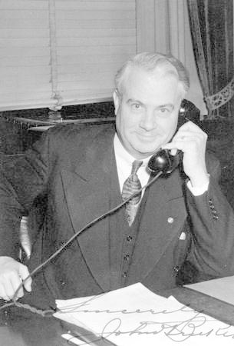
Notes:
bricker

Slide 36
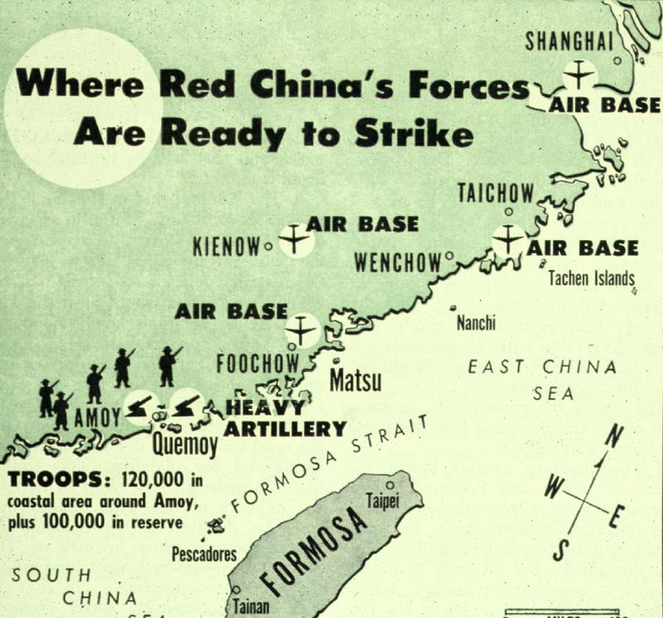

Slide 37
U.S. Congress
(Approved by House vote 409-3 on January 25, 1955
and by Senate vote 85-3 on January 28, 1955)
U.S. Congressional Authorization for the President to Employ the Armed Forces of the United States to Protect Formosa, the Pescadores, and Related Positions and Territories of That Area
Resolved by the Senate and House of Representatives of the United States of America in Congress assembled, That the President of the United States be and he hereby is authorized to employ the Armed Forces of the United States as he deems necessary for the specific purpose of securing and protecting Formosa and the Pescadores against armed attack, this authority to include the securing and protection of such related positions and territories of that area now in friendly hands and the taking of such other measures as he judges to be required or appropriate in assuring the defense of Formosa and the Pescadores.
This resolution shall expire when the President shall determine that the peace and security of the area is reasonably assured by international conditions created by action of the United Nations or otherwise, and shall so report to the Congress.

Slide 38


Slide 39

Notes:
Lbj signing tgr

Slide 40
Tonkin Gulf Resolution
Resolved … That the Congress approves and supports the determination of the President, as Commander in Chief, to take all necessary measures to repel any armed attack against the forces of the United States and to prevent further aggression.
Section 2. The United States regards as vital to its national interest and to world peace the maintenance of international peace and security in southeast Asia. Consonant with the Constitution of the United States and the Charter of the United Nations and in accordance with its obligations under the Southeast Asia Collective Defense Treaty, the United States is, therefore, prepared, as the President determines, to take all necessary steps, including the use of armed force, to assist any member or protocol state of the Southeast Asia Collective Defense Treaty requesting assistance in defense of its freedom.
Section 3. This resolution shall expire when the President shall determine that the peace and security of the area is reasonably assured by international conditions created by action of the United Nations or otherwise, except that it may be terminated earlier by concurrent resolution of the Congress.

Slide 41
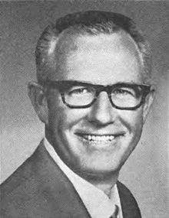
LBJ guilty of “publicity-happy political irresponsibility . . . shooting from the lip.”

Slide 42
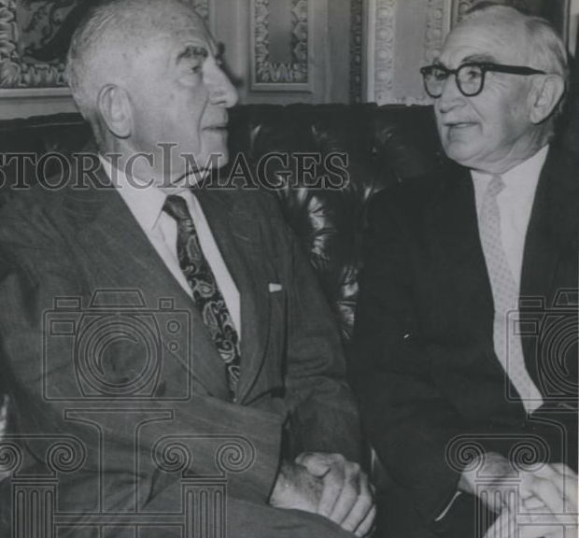

Slide 43

President Johnson: That was a good vote you had today.
Speaker McCormack: Yes, it was very good. 414 to nothing; one present. What’d the Senate do?
President Johnson: 88 to 2. Morse and Gruening.
McCormack: I don’t understand Gruening.
President Johnson: Oh, he’s no good. He’s worse than Morse. He’s just no good. I’ve spent millions on him up in Alaska [in reconstruction funds after the March 1964 Alaska earthquake]. He’s just no good.
And Morse is just as undependable and erratic as he can be.
McCormack: I know that. But I can’t understand the other fellow.
President Johnson: Say, I wanted to point out this little shitass [Ed] Foreman today got up and said that we [Johnson] acted impulsively by announcing that we had an answer on the way [to the Tonkin Gulf incidents] before the planes dropped their bombs.
[Break.]
President Johnson: It’s just a pure lie, and smokescreen.
McCormack: But he was booed two or three times. Tremendous booing on the Democratic side. He was—everybody knew he was just cheap and mean and contemptible. Well, you know what he is.
President Johnson: Yeah. Yeah, he’s no good.

Slide 44


Slide 45
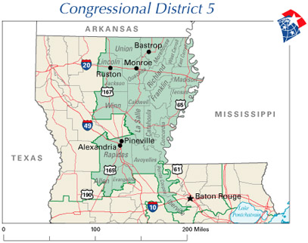

Slide 46
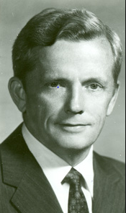
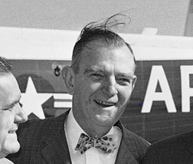

Slide 48
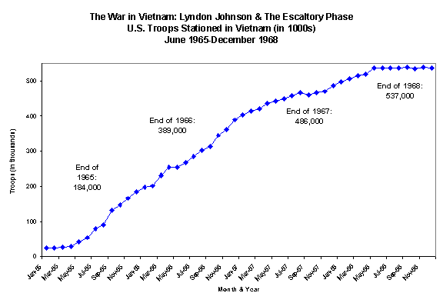

Slide 49


Slide 50
President Johnson: Everything we’ve done in the Pacific, we’ve done with the knowledge and the consent of the Senate. Most of it was done before I became President—was authorized.
Mike Manatos: Yeah.
President Johnson: And we haven’t done anything that hasn’t been.
And when he [Fulbright] says that, “Well, you bombed the oil storage [in North Vietnam],” or “You put people in [to South Vietnam],” the very simple answer is: they said [in the Tonkin Gulf Resolution] “we approve by any means to deter an aggression.”
Manatos: Mm-hmm.
President Johnson: “Any means he [the President] may select.”
Manatos: Right.
President Johnson: Now, he ought to be listed those things, and you ought to say, “The President says that what he was talking about the other night about in this speech”—and you ought to see the record of that speech, a copy is obtained, so you can show it—“was authorized by all of these things, and that’s what he’s talking about doing.”
Manatos: Right.
President Johnson: And Fulbright’s approved every one of ‘em, and either his speechwriter didn’t write it, or didn’t see [that].

Slide 51
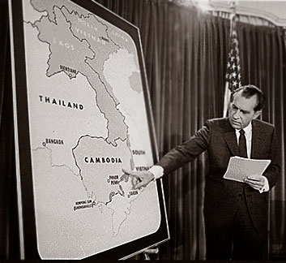

Slide 52
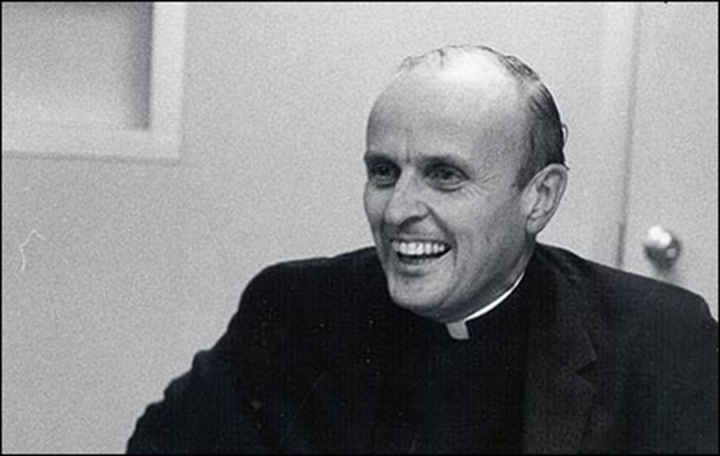

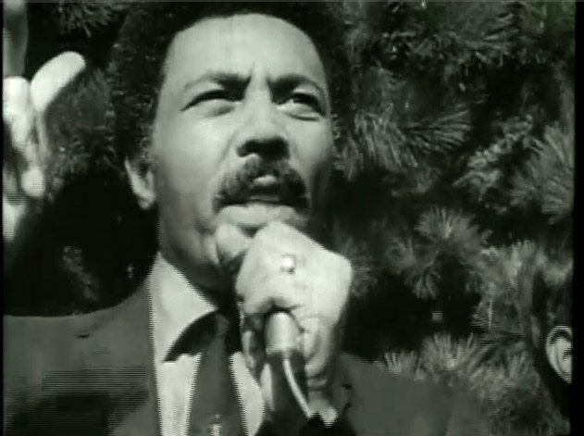

Slide 53
Within sixty calendar days after a report is submitted or is required to be submitted, whichever is earlier, the President shall terminate any use of United States Armed Forces with respect to which such report was submitted (or required to be submitted), unless the Congress (1) has declared war or has enacted a specific authorization for such use of United States Armed Forces, (2) has extended by law such sixty-day period, or (3) is physically unable to meet as a result of an armed attack upon the United States. Such sixty-day period shall be extended for not more than an additional thirty days if the President determines and certifies to the Congress in writing that unavoidable military necessity respecting the safety of United States Armed Forces requires the continued use of such armed forces in the course of bringing about a prompt removal of such forces..

Slide 54
President Nixon: I believe we support whoever are our friends anyplace in the world. And I believe that in most Latin countries you kind of need not dictators—that’s a horrible word, and a reprehensible word to most Americans—but, that strong leadership is essential.
[General and former French president Charles] De Gaulle proved that. I mean, France is a Latin country. It couldn’t—Even France, with all of its sophistication, couldn’t handle a democracy . . . You can’t.
The Italians? That’s their problem. They can’t afford the luxury of democracy. Neither can Spain, and no country in Latin America can
that I know of.
[Break.]
President Nixon: The real thing you need to have from me is, first, this assurance—
DCI Richard Helms: That’s all I want.
President Nixon: I am not going to embarrass the CIA, because it’s terribly important.
Second, I believe in “dirty tricks.” I think we’ve got to do it. As we go into this period now, Dick, with the Chinese, and, you know, with the Russians in Berlin, and the rest, who knows what’s going to happen there?
And I am—I’m going to keep you very closely posted on what’s going to happen. But as we do that, the “dirty tricks” thing may become more and more important because all over the world, particularly if you look at Vietnam, probably, or the rest, but there is going to be the goddamnedest bunch of, you know, of a rash of screwing up of the Chilean things—that sort of thing.

Slide 55
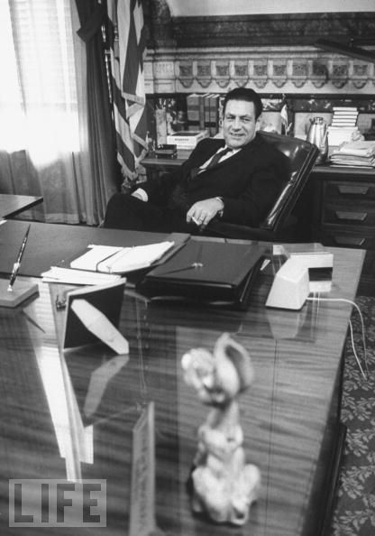

Slide 56
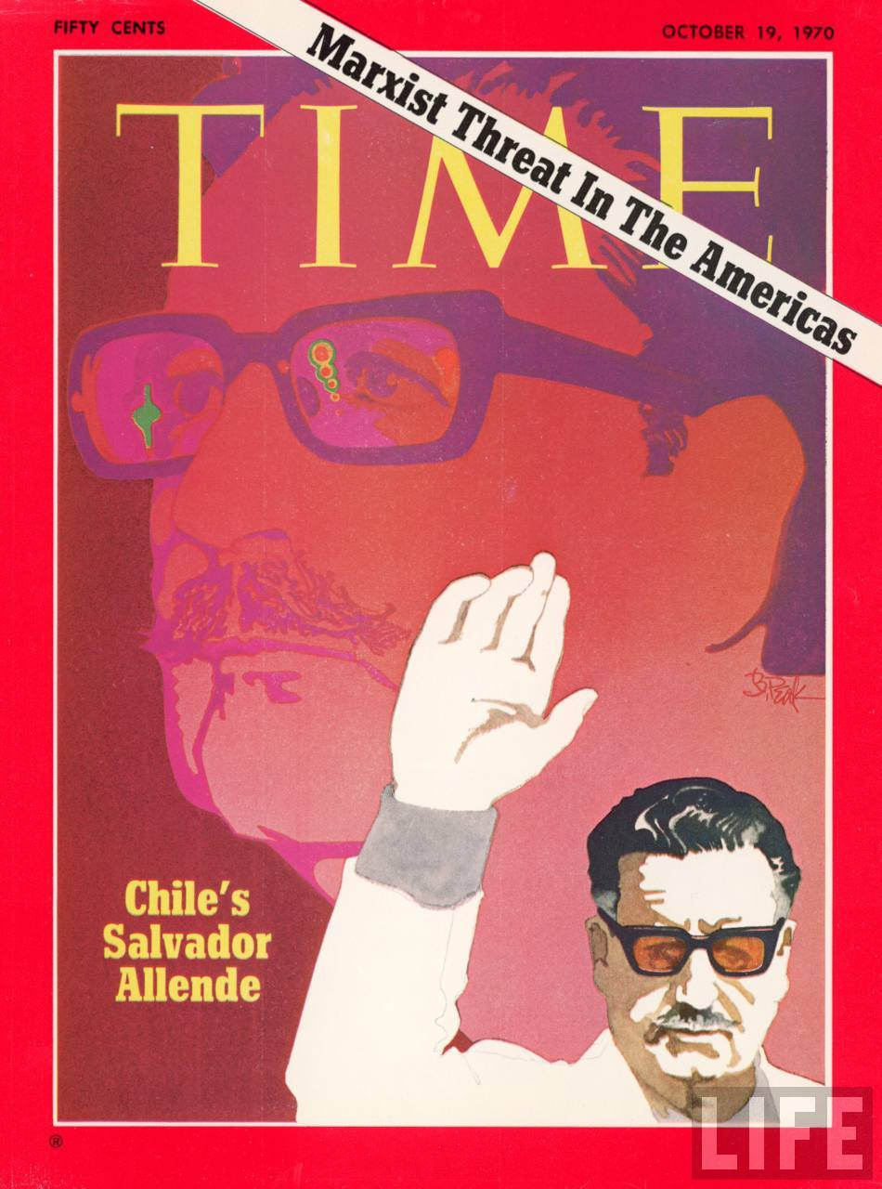
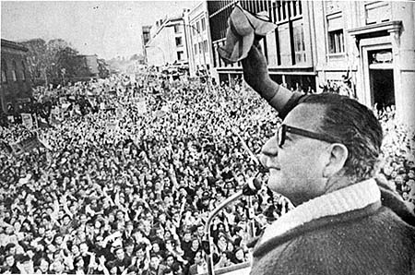

Slide 57
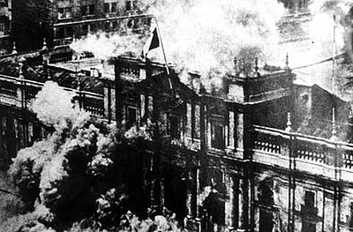

Slide 58
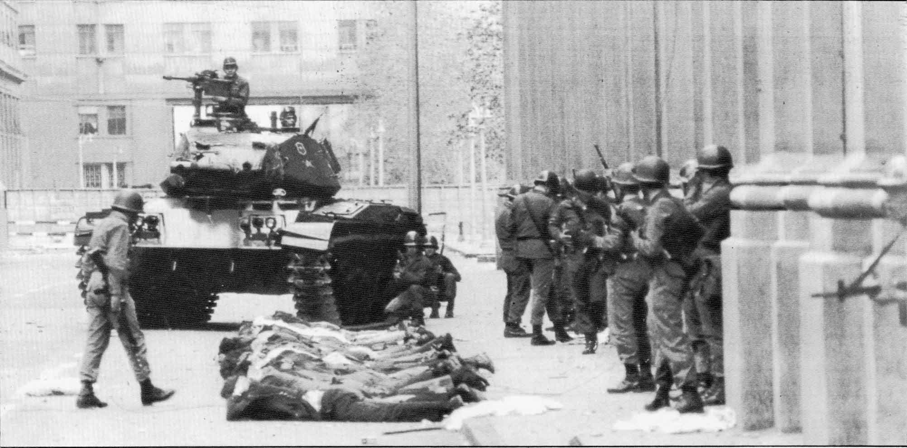

Slide 59
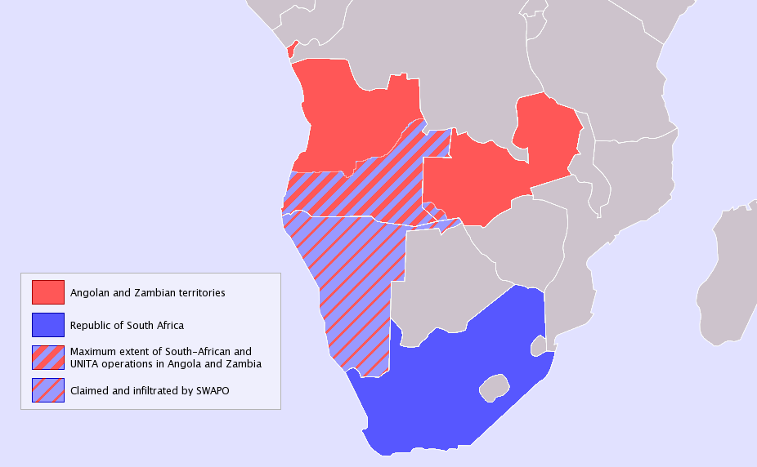

Slide 60
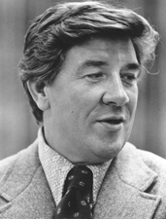

Slide 61
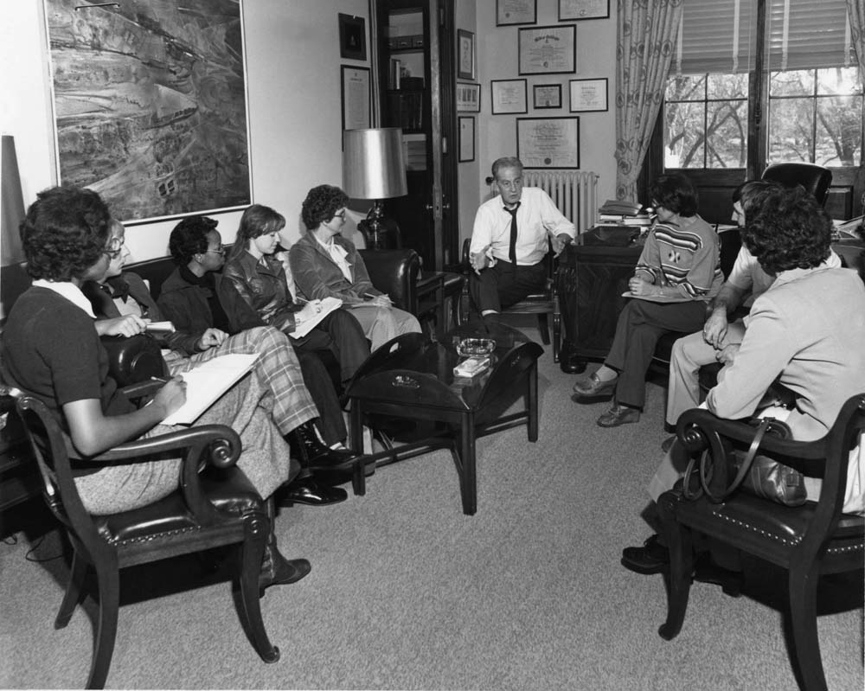

Slide 62
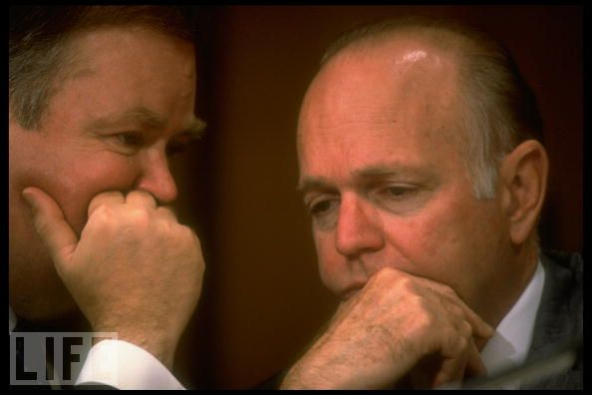

Slide 63
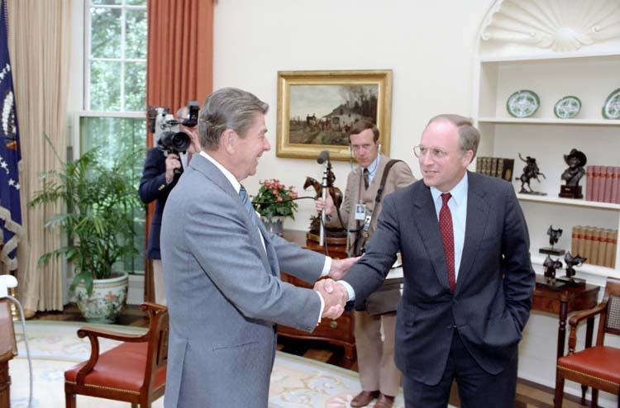

Slide 64
INS v. Chadha (1983)—White dissent
The prominence of the legislative veto mechanism in our contemporary political system and its importance to Congress can hardly be overstated. It has become a central means by which Congress secures the accountability of executive and independent agencies. Without the legislative veto, Congress is faced with a Hobson's choice: either to refrain from delegating the necessary authority, leaving itself with a hopeless task of writing laws with the requisite specificity to cover endless special circumstances across the entire policy landscape, or, in the alternative, to abdicate its lawmaking function to the Executive Branch and independent agencies. To choose the former leaves major national problems unresolved; to opt for the latter risks unaccountable policymaking by those not elected to fill that role. Accordingly, over the past five decades, the legislative veto has been placed in nearly 200 statutes. The device is known in every field of governmental concern: reorganization, budgets, foreign affairs, war powers, and regulation of trade, safety, energy, the environment, and the economy . . .
The history of the legislative veto also makes clear that it has not been a sword with which Congress has struck out to aggrandize itself at the expense of the other branches -- the concerns of Madison and Hamilton. Rather, the veto has been a means of defense, a reservation of ultimate authority necessary if Congress is to fulfill its designated role under Art. I as the Nation's lawmaker.

Slide 65
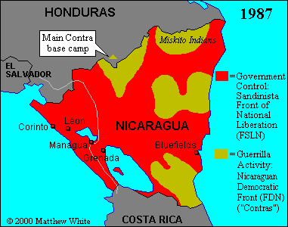

Slide 66


Slide 67


Slide 68


Slide 69
Missouri v. Holland (1920)
To answer this question, it is not enough to refer to the Tenth Amendment, reserving the powers not delegated to the United States, because, by Article II, § 2, the power to make treaties is delegated expressly, and by Article VI treaties made under the authority of the United States, along with the Constitution and laws of the United States made in pursuance thereof, are declared the supreme law of the land. If the treaty is valid, there can be no dispute about the validity of the statute under Article I, § 8, as a necessary and proper means to execute the powers of the Government. The language of the Constitution as to the supremacy of treaties being general, the question before us is narrowed to an inquiry into the ground upon which the present supposed exception is placed . . .
Here, a national interest of very nearly the first magnitude is involved. It can be protected only by national action in concert with that of another power.

Slide 70


Slide 71



Slide 72


Slide 73
Bond v. United States (2014)
The horrors of chemical warfare were vividly captured by John Singer Sargent in his 1919 painting Gassed. The nearly life-sized work depicts two lines of soldiers, blinded by mustard gas, clinging single file to orderlies guiding them to an improvised aid station. There they would receive little treatment and no relief; many suffered for weeks only to have the gas claim their lives. The soldiers were shown staggering through piles of comrades too seriously burned to even join the procession . . .
The question presented by this case is whether the Implementation Act also reaches a purely local crime: an amateur attempt by a jilted wife to injure her husband’s lover, which ended up causing only a minor thumb burn readily treated by rinsing with water. Because our constitutional structure leaves local criminal activity primarily to the States, we have generally declined to read federal law as intruding on that responsibility, unless Congress has clearly indicated that the law should have such reach. The Chemical Weapons Convention Implementation Act contains no such clear indication, and we accordingly conclude that it does not cover the unremarkable local offense at issue here.

Slide 74
Solicitor General Donald Verrilli: We have had policies in place for decades in this country that align place of birth designations with our official recognition policy.
The reason we do that is because foreign sovereigns look to these communications as indicative of where we stand on what--
Justice Scalia: If it -- if it is within Congress's -- if it is within Congress's power, what difference does it make whether it antagonizes foreign countries?
Verrilli: --Well, there are certain things that are within Congress's power that would antagonize foreign countries that wouldn't raise a separation of powers problem, of course, like a trade embargo or a travel ban. But--
Justice Scalia: And this may be one of them. So--
Verrilli: --This is not one of them.
Justice Scalia: --the mere fact that it upsets foreign relations doesn't prove a thing.
Verrilli: No. The critical point, Your Honor, is that what this statute does that those other statutes don't do is it requires the Executive Branch, the President himself and the Executive Branch itself, to communicate a message that contradicts the official recognition position of the United States, undermining the President's credibility and preventing the President from being able to speak with one voice credibly.
Justice Kennedy: But why couldn't you have a disclaimer of the kind that I've explained to the Petitioners' counsel? She said that would be perfectly lawful, for you to say it's not the position of the State Department, this is not an indication that Israel is -- has jurisdiction over Jerusalem.
Verrilli: Your Honor--
Justice Kennedy: Why wouldn't that solve the problem?
Verrilli: --It doesn't solve the problem because the issuance of the disclaimer is a credibility hit. It undermines the credibility of the President because what is -- think about what it's actually saying.
What it's actually saying in this context is yes, we're issuing thousands of passports that identify persons born in Jerusalem as being born in Israel; yes, the Congress of the United States required that; but pay no attention to it really; it doesn't have any bearing on recognition.
Chief Justice Roberts: If it had -- if it were such a big deal, why did the Chief Executive at the time sign it?
Verrilli: Well, the Chief Executive issued a signing statement which really was, in effect, a disclaimer, in 2002. President Bush's statement said in 2002, this does not change our official recognition policy and we're going to treat it as advisory, and that did not have the effect of--
Chief Justice Roberts: So we should give no weight to the fact that the Chief Executive signed the law that he is now saying has such a dramatic that his successor, but I gather the position is the same -- is now saying has such deleterious effects on American foreign policy? Well, as a general matter, does that have any consequence at all?

