Slide 1
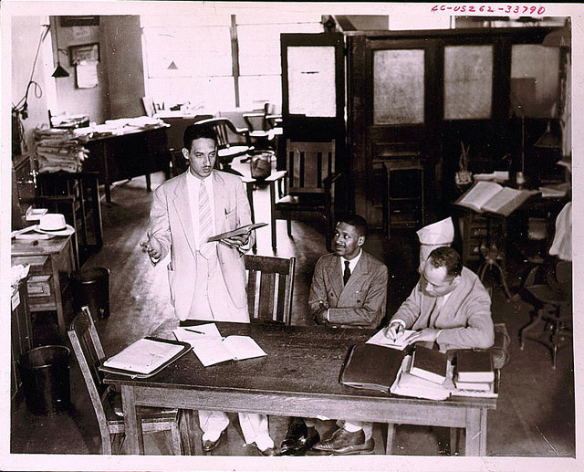

Slide 2
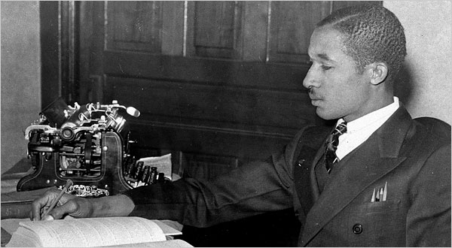
Notes:
Lloyd gaines

Slide 3
Missouri ex rel Gaines v. Canada (1938, 6-2 decision)
In answering petitioner's contention that this discrimination constituted a denial of his constitutional right, the state court has fully recognized the obligation of the State to provide negroes with advantages for higher education substantially equal to the advantages afforded to white students. The State has sought to fulfill that obligation by furnishing equal facilities in separate schools, a method the validity of which has been sustained by our decisions…
The basic consideration is not as to what sort of opportunities other States provide, or whether they are as good as those in Missouri, but as to what opportunities Missouri itself furnishes to white students and denies to negroes solely upon the ground of color. The admissibility of laws separating the races in the enjoyment of privileges afforded by the State rests wholly upon the equality of the privileges which the laws give to the separated groups within the State.

Slide 4
Pre-Brown key civil rights cases
Smith v. Allwright (1944): abolition of “all-white” primaries
Shelley v. Kramer (1948): courts can’t enforce “racial covenants” in house sales
Sweatt v. Painter (1950): separate law schools for blacks and whites unconstitutional
McLaurin v. Oklahoma (1950): separate graduate programs for blacks and whites unconstitutional

Slide 5
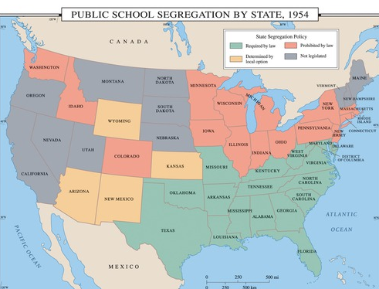

Slide 6
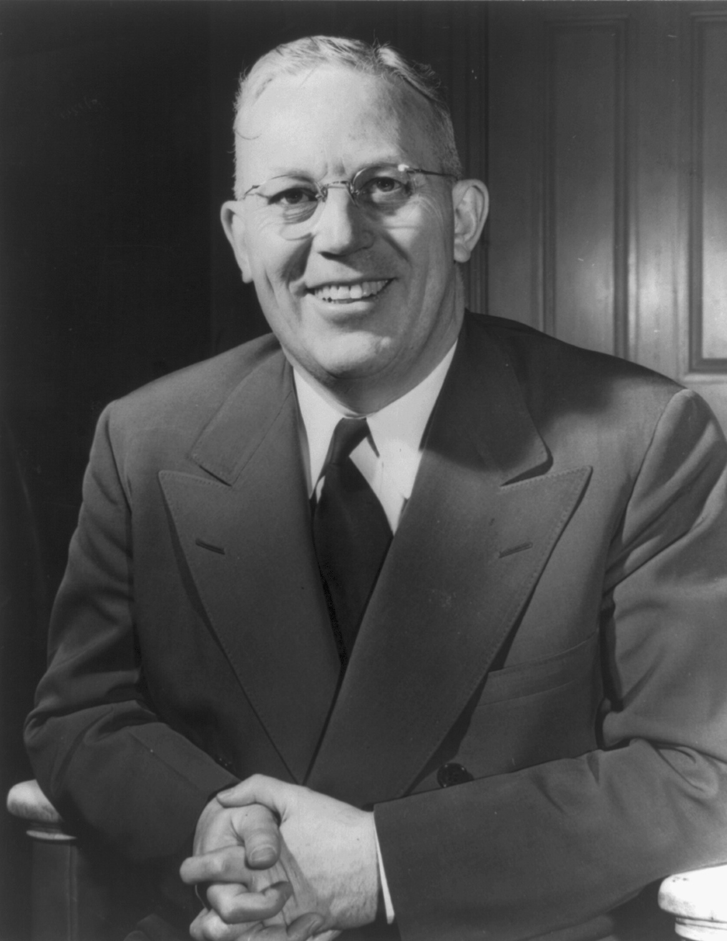
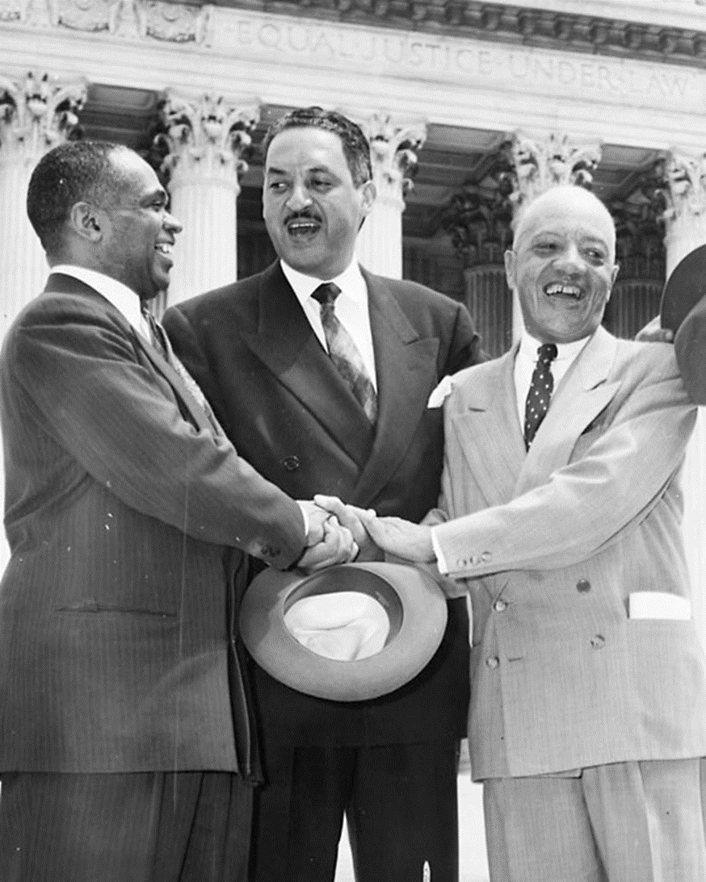

Slide 7
Brown v. Board of Education (1954, unanimous decision)
Does segregation of children in public schools solely on the basis of race, even though the physical facilities and other “tangible” factors may be equal, deprive the children of the minority group of equal educational opportunities? We believe that it does... Segregation of white and colored children in public schools has a detrimental effect upon the colored children. The impact is greater when it has the sanction of the law, for the policy of separating the races is usually interpreted as denoting the inferiority of the negro group...
We conclude that, in the field of public education, the doctrine of “separate but equal” has no place. Separate educational facilities are inherently unequal. Therefore, we hold that the plaintiffs and others similarly situated for whom the actions have been brought are, by reason of the segregation complained of, deprived of the equal protection of the laws guaranteed by the Fourteenth Amendment.

Slide 8


Slide 9


Slide 10
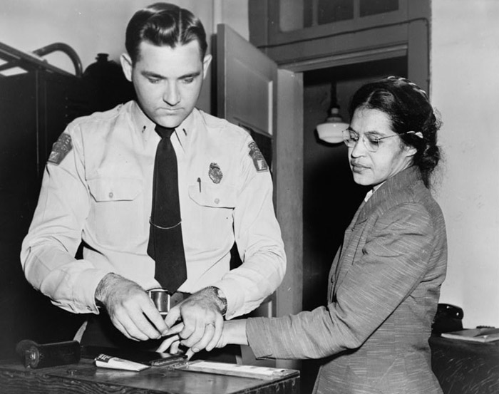

Slide 11
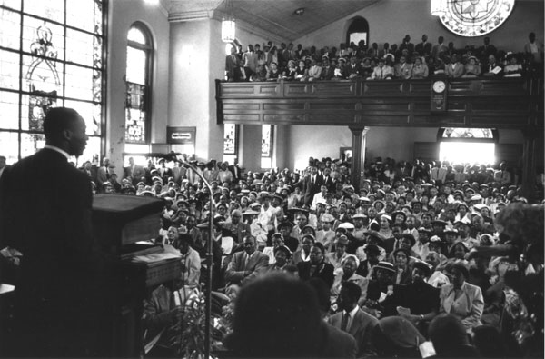

Slide 12
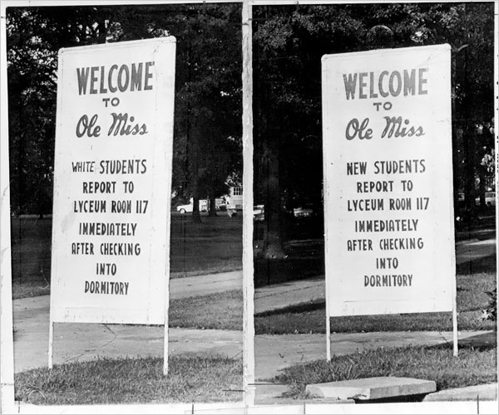

Slide 13
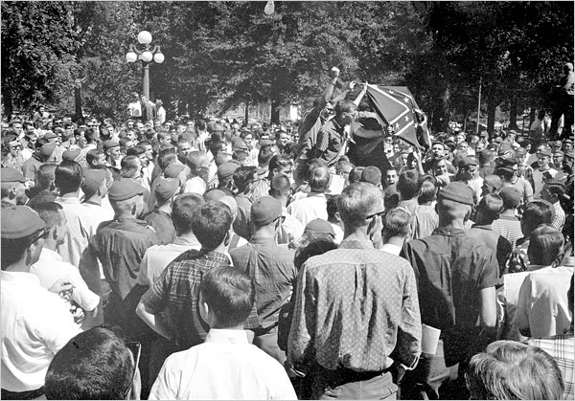

Slide 14


Slide 15
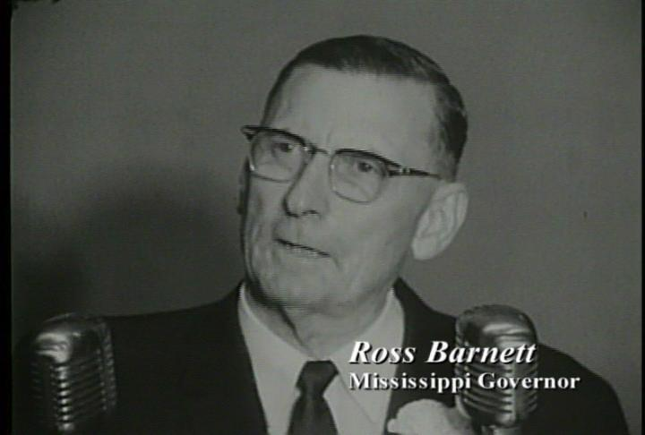

Slide 16

President Kennedy: We can’t consider moving [James] Meredith as long as, you know, there’s a riot outside, because he wouldn’t be safe.
Ross Barnett: Sir?
President Kennedy: We couldn’t consider moving Meredith if we haven’t been able to restore order outside. That’s the problem, Governor.
Barnett: Well, I’ll tell you what I’ll do, Mr. President--
President Kennedy: Yeah.
Barnett: I’ll go up there myself—
President Kennedy: Well, now, how long will it take you to get there?
Barnett: [ignoring Kennedy] And I’ll get a microphone and tell ‘em that you have agreed to re--, to, for him [Meredith] to be removed—
President Kennedy: [sharply] No. No. Now, wait a minute. How long—
Barnett: [Unclear interjection.]
President Kennedy: Wait a minute, Governor. Now, how long is it going to take you to get up there?
Barnett: About an hour.
President Kennedy: Now, I’ll tell you what, if you want to go up there and then you call me from up there. Then we’ll decide what we’re going to do, before you make any speeches about it.
Barnett: Well, all right.
President Kennedy: No sense in—
Barnett: Whatever you want—if you’d offer—
President Kennedy: You see, we’ve got an hour to go, and that’s not—we may not have an hour…
Barnett: Mr. President, please, why don’t you, can’t you give an order up there to remove Meredith?
President Kennedy: How can I remove him, Governor, when there’s a riot in the streets? He may step out of that building and something would happen to him. I can’t remove him under those conditions.

Slide 17
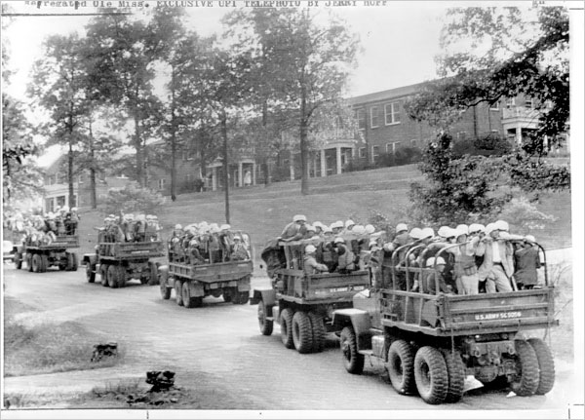

Slide 18


Slide 19


Slide 20
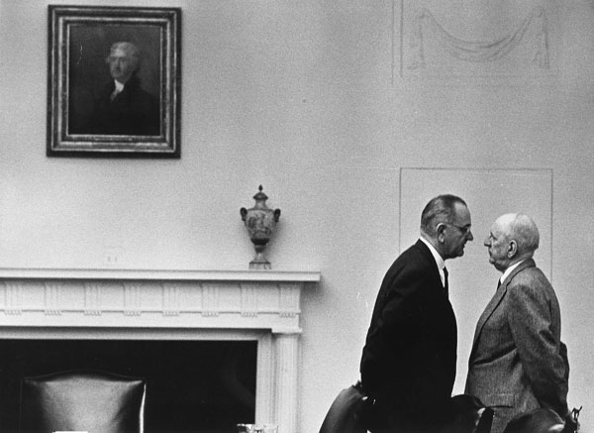

Slide 21
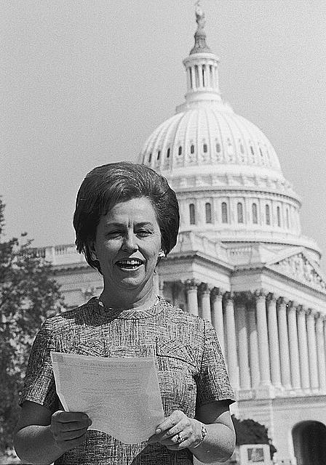

Slide 22
Major Features: Civil Rights Act (1964)
Title I
Barred unequal application of voter registration requirements, but did not abolish literacy tests sometimes used to disqualify African Americans and poor white voters.
Title II
Outlawed discrimination in hotels, motels, restaurants, theaters, and all other public accommodations engaged in interstate commerce; exempted private clubs without defining "private," thereby allowing a loophole.
Title III
Encouraged the desegregation of public schools and authorized the U. S. Attorney General to file suits to force desegregation, but did not authorize busing as a means to overcome segregation based on residence.
Title IV
Authorized but did not require withdrawal of federal funds from programs which practiced discrimination.
Title V
Outlawed discrimination in employment in any business exceeding twenty five people and creates an Equal Employment Opportunities Commission to review complaints, although it lacked meaningful enforcement powers.

Slide 23
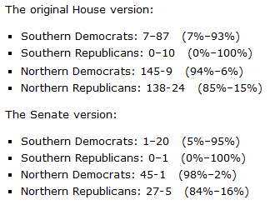

Slide 24


Slide 25
President Johnson: What’s happening is we’re doing four or five things. Number one: we’re coming in there and seating the state of Mississippi. Every damn one of them. Now, they oughtn’t to be, Carl. They oughtn’t to …
Carl Sanders: I don’t—
President Johnson: You and I just can’t survive our political modern life with these goddamned fellows down there [white Mississippi leaders] that are eating ‘em for breakfast every morning. They’ve got to quit that. And they’ve got to let ‘em [African-Americans] vote. And they’ve got to let ‘em shave. And they’ve got to let ‘em eat, and things like that. And they don’t do it.
However much we love [Democratic Senators] Jim Eastland and John Stennis, they get a governor like Ross Barnett, and he’s messing around there with [George] Wallace, and they won’t let one [black] man go in a precinct convention. We’ve got to put a stop to that, because that’s just like the old days, by God, when they wouldn’t let ‘em go in and cast a vote of any kind.
You’ve put a stop to it in your state. But we’re going to ignore that. We’re going to say, “Hell, yes, you did it. You’re wrong. You violated the ’57 [civil rights] law, and you violated the ’60 [civil rights] law, and you violated the ’64 [civil rights] law, but we’re going to seat you—every damn one of you. [dripping with sarcasm] You lily white babies, we’re going to salute you.”

Slide 26
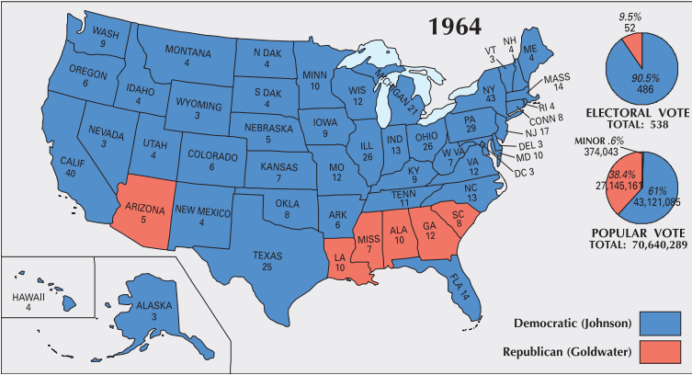

Slide 27
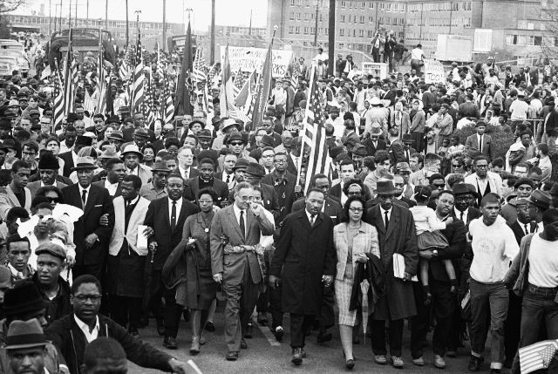

Slide 28
President Johnson: How are you?
Everett Dirksen: I’m all right; how are you?
President Johnson: Oh, a little bit grinding away.
Dirksen: I am bushed. This goddamn voting rights bill . . .
[Break.]
Dirksen: I hated like hell to leave some of them [senators] in the dark [about pending legislative strategy] because we had [South Carolina senator] Strom [Thurmond] this morning, and [Mississippi senator] John Stennis. We’ve modified this rather substantially to make damn sure that we’ll be on good constitutional ground.
President Johnson: Yeah?
Dirksen: But I couldn’t say it to ‘em. Now, they’re going to have to have a little time to look it over, and peck around. And I think if we work it out that way, that’s going to be all to the good, and it’s going to save us time in the end.
President Johnson: It is if we don’t get into another situation [like] Selma while we’re waiting.
Dirksen: Yeah.
President Johnson: That’s the damn danger.
Dirksen: Well—
President Johnson: Now, these boys—Strom and John are going to be as strong against it when they end, stronger than they are when they start. You got no chance there. And I sure don’t want to have to send another—go through a Selma, because we got through it locally pretty good.
Dirksen: Yeah.
President Johnson: But if they think we’re dilly-dallying, and off for Easter, why, it creates a hell of a lot of problems.
Dirksen: When you stop to consider the amount of staff work we’ve done on that damn bill, the senators are entitled to some time to have a good look-see; and that’s all the more reason, I think, why we ought to take that Easter recess as planned.

Slide 29


Slide 30
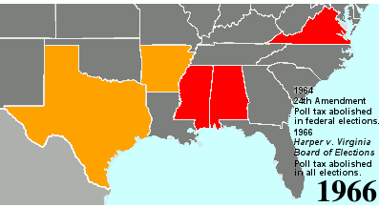

Slide 31
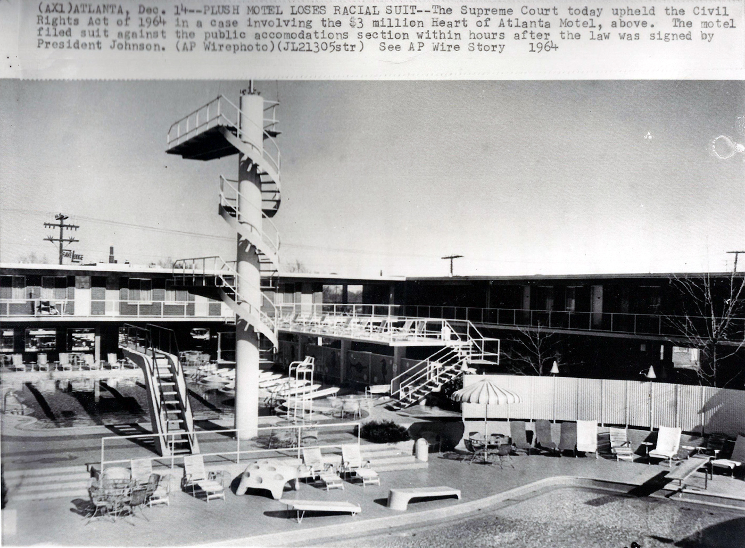

Slide 32
Heart of Atlanta Motel v. United States (1964)
That Congress was legislating against moral wrongs in many of these areas rendered its enactments no less valid. In framing Title II of this Act, Congress was also dealing with what it considered a moral problem. But that fact does not detract from the overwhelming evidence of the disruptive effect that racial discrimination has had on commercial intercourse. It was this burden which empowered Congress to enact appropriate legislation, and, given this basis for the exercise of its power, Congress was not restricted by the fact that the particular obstruction to interstate commerce with which it was dealing was also deemed a moral and social wrong…
Nor does the Act deprive appellant of liberty or property under the Fifth Amendment… There is nothing novel about such legislation. Thirty-two States now have it on their books either by statute or executive order, and many cities provide such regulation. Some of these Acts go back four-score years. It has been repeatedly held by this Court that such laws do not violate the Due Process Clause of the Fourteenth Amendment.

Slide 33


Slide 34


Slide 35
Reitman v. Mulkey (1967)
[We recognize] the necessity for a court to assess the potential impact of official action in determining whether the State has significantly involved itself with invidious discriminations. Here we are dealing with a provision which does not just repeal an existing law forbidding private racial discriminations…
[Proposition 14] was intended to authorize, and does authorize, racial discrimination in the housing market. The right to discriminate is now one of the basic policies of the State. The California Supreme Court believes that the section will significantly encourage and involve the State in private discriminations. We have been presented with no persuasive considerations indicating that these judgments should be overturned.

Slide 36
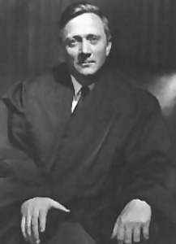

Slide 37
Griswold v. Connecticut (1965)
Specific guarantees in the Bill of Rights have penumbras, formed by emanations from those guarantees that help give them life and substance. Various guarantees create zones of privacy. The right of association contained in the penumbra of the First Amendment is one, as we have seen. The Third Amendment, in its prohibition against the quartering of soldiers “in any house” in time of peace without the consent of the owner, is another facet of that privacy. The Fourth Amendment explicitly affirms the “right of the people to be secure in their persons, houses, papers, and effects, against unreasonable searches and seizures.” The Fifth Amendment, in its Self-Incrimination Clause, enables the citizen to create a zone of privacy which government may not force him to surrender to his detriment. The Ninth Amendment provides: “The enumeration in the Constitution, of certain rights, shall not be construed to deny or disparage others retained by the people.”

Slide 38
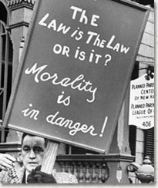
Notes:
Protester outside pp in new haven

Slide 39
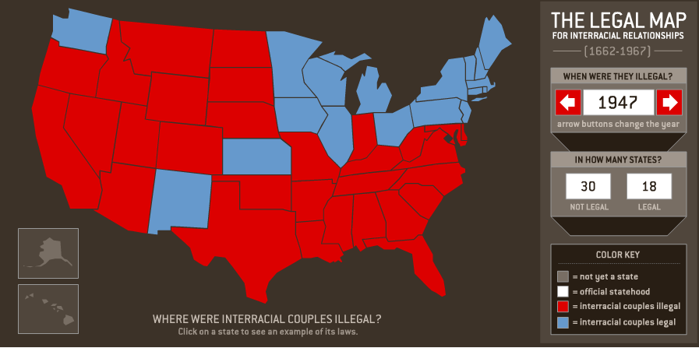

Slide 40
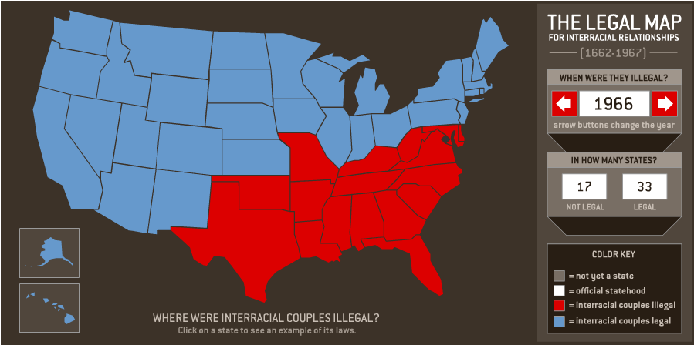

Slide 41
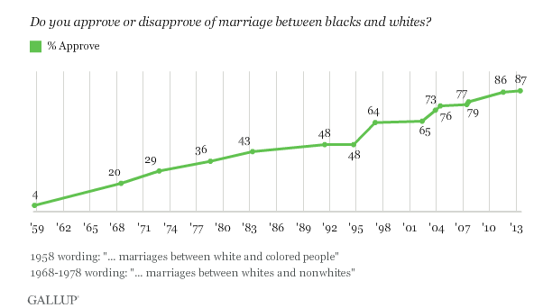

Slide 42
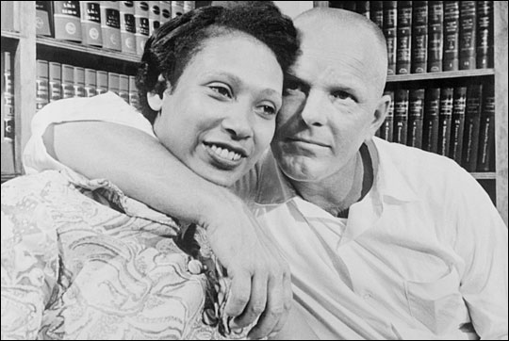

Slide 43
Naim v. Naim (VA Supreme Court, 1965)
Almighty God created the races, white, black, yellow, Malay, and red and placed them on separate continents, and but for the interference with his arrangement there would be no cause for such marriages. The fact that he separated the races shows that he did not intend the races to mix.
“State's legitimate purposes were ‘to preserve the racial integrity of its citizens,’ and to prevent ‘the corruption of blood,’ ‘a mongrel breed of citizens,’ and ‘the obliteration of racial pride.’”

Slide 44
Loving v. Virginia (1967)
There is patently no legitimate overriding purpose independent of invidious racial discrimination which justifies this classification. The fact that Virginia prohibits only interracial marriages involving white persons demonstrates that the racial classifications must stand on their own justification, as measures designed to maintain White Supremacy. We have consistently denied the constitutionality of measures which restrict the rights of citizens on account of race. There can be no doubt that restricting the freedom to marry solely because of racial classifications violates the central meaning of the Equal Protection Clause . . .
Marriage is one of the “basic civil rights of man,” fundamental to our very existence and survival. To deny this fundamental freedom on so unsupportable a basis as the racial classifications embodied in these statutes, classifications so directly subversive of the principle of equality at the heart of the Fourteenth Amendment, is surely to deprive all the State's citizens of liberty without due process of law.
The Fourteenth Amendment requires that the freedom of choice to marry not be restricted by invidious racial discriminations. Under our Constitution, the freedom to marry, or not marry, a person of another race resides with the individual, and cannot be infringed by the State.

Slide 45

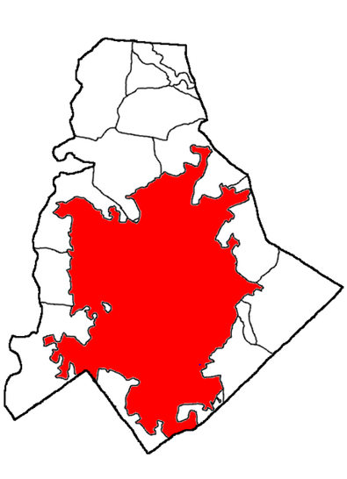
Mecklenburg County Schools
1968-1969 school year
84,000 students: 71% white, 29% black.
2/3^{rds} of African-American students (24,000 total) attended schools that were at least 99% black in enrollment.

Slide 46
Swann v. Mecklenburg County (1971)—unanimous decision
Nearly 17 years ago, this Court held, in explicit terms, that state-imposed segregation by race in public schools denies equal protection of the laws. At no time has the Court deviated in the slightest degree from that holding or its constitutional underpinnings… The objective today remains to eliminate from the public schools all vestiges of state-imposed segregation . . .
The constant theme and thrust of every holding from Brown I to date is that state-enforced separation of races in public schools is discrimination that violates the Equal Protection Clause. The remedy commanded was to dismantle dual school systems . . .
In seeking to define the scope of remedial power or the limits on remedial power of courts in an area as sensitive as we deal with here, words are poor instruments to convey the sense of basic fairness inherent in equity. Substance, not semantics, must govern, and we have sought to suggest the nature of limitations without frustrating the appropriate scope of equity.
At some point, these school authorities and others like them should have achieved full compliance with this Court's decision in Brown I.

Slide 47
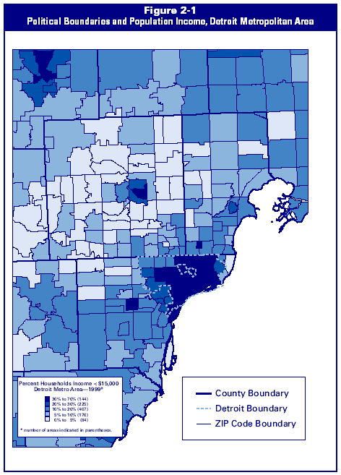

Slide 48
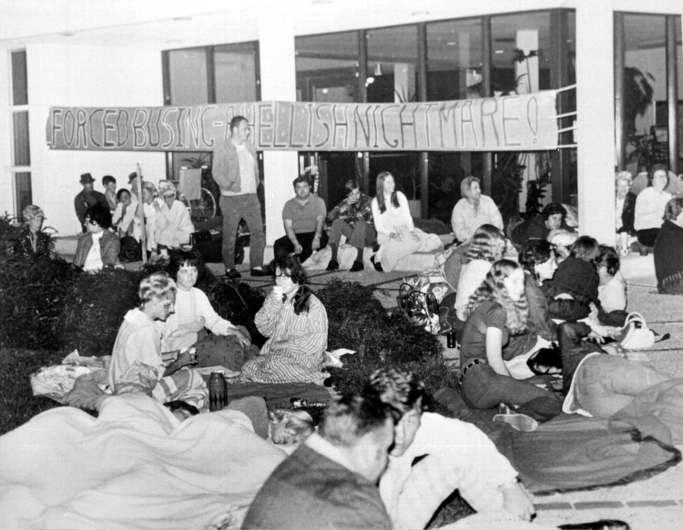
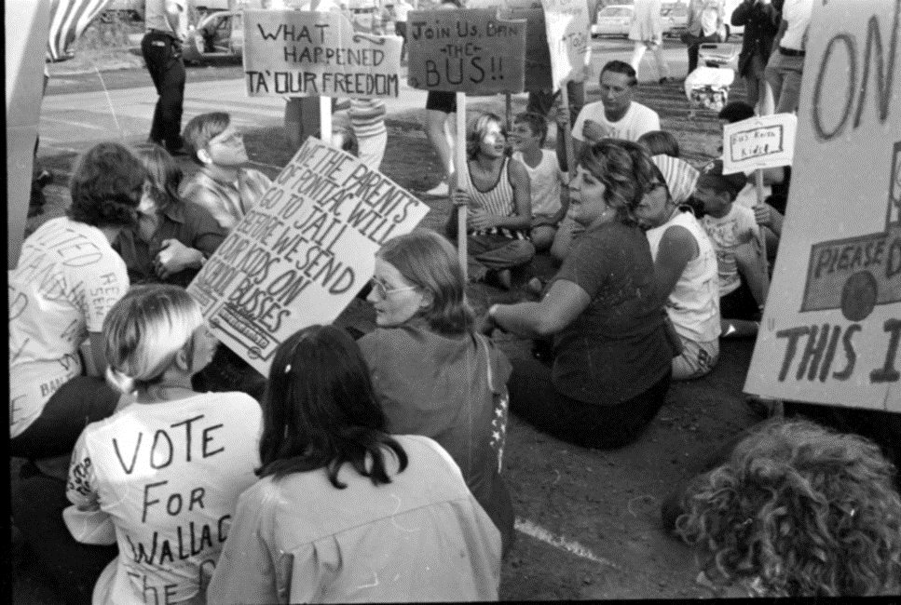

Slide 49
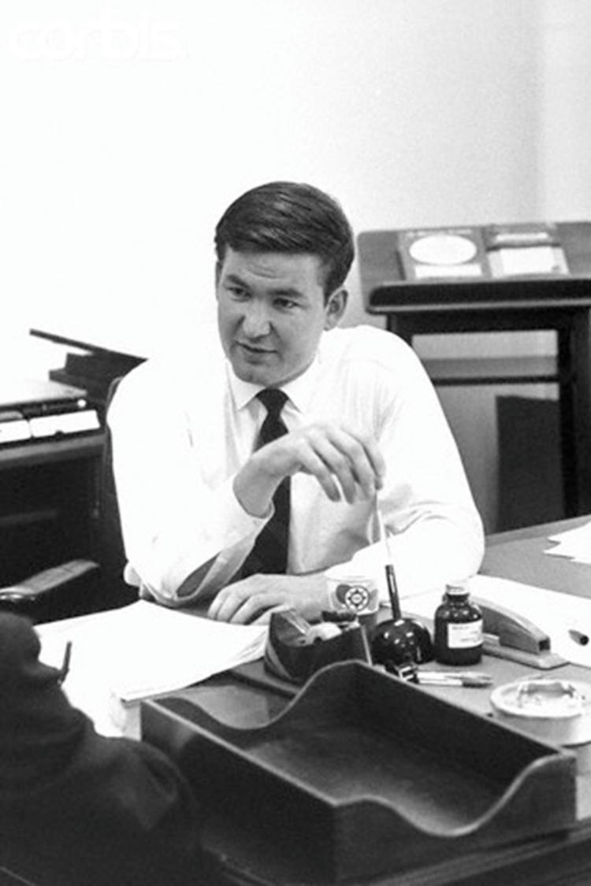
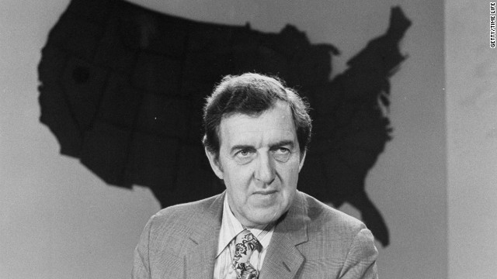

Slide 50
President Nixon: Well, I’ve basically—we’ve got to say that it’s only the extent that it is required by law—
Pat Buchanan: Right.
President Nixon: By a court order, do I think busing should be used.
Buchanan: Mm-hmm.
President Nixon: Don’t you think that’s really what you get down to?
Buchanan: Right. Right.
President Nixon: Because the line, actually, between my line and Muskie’s, is not as clear as—I mean, it’s just the way he said it. He starts at the other end. He says, “Well, I think busing is a legitimate tool—
Buchanan: Yeah.
President Nixon: And then, “but I’m against it.” I start at the other end. I say, “I’m against busing, but, if the law requires it, to the minimum extent necessary, I, of course, will not resist it.”
Buchanan: Mm-hmm.
President Nixon: Right?
Buchanan: Right.
President Nixon: It’s purely a question of tone.
Buchanan: Well, we’ve got to push Muskie’s emphasis up in the headlines; that’s the problem.
President Nixon: That’s right. That’s right. Yeah. It’s got to be—well, I think it probably is going to get some play in the South now—
Buchanan: I think, well, that’s something you could really move by various statements exaggerating his position, and then Muskie would come back sort of drawing it back and it raises—identifies him with it.
President Nixon: Yeah, the thing to do really is rather to, is to praise him—have some civil rights people praise him for his defense of busing.
Buchanan: Mm-hmm.
President Nixon: That’s the way to really get that, you know. It’s much the better way than to have people attack him for it—
Buchanan: Mm-hmm.
President Nixon: —is to praise him for his defense of busing, see?
Buchanan: Mm-hmm. Mm-hmm.
President Nixon: And I don’t know if you’ve got any people that can do that or not. But I would think that would be very clever.
Buchanan: Mm-hmm. OK.

Slide 51
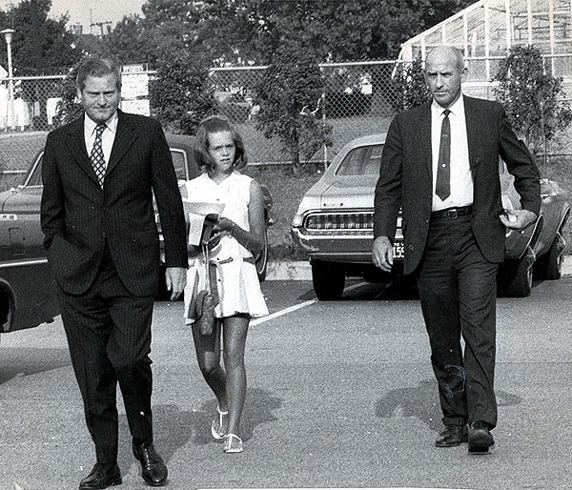

Slide 52
President Nixon: I think that poor, nice, little guy we’ve got in as governor in Virginia—when he goes, “It’s really great for my kids to go to schools that are 90 percent black,” I think he’s lying through his teeth. Do you agree or not?
John Ehrlichman: Yes, sir . . . Lin Holton called me and said, “Listen, I want to know what you guys are gonna do on busing, because,” he says, “I’ve to get off this wicket I’m on. I’ve got to get with you.”
President Nixon: Does he think he’s too far away? Well, look, he’s gone too far. When he got up at that Governor’s [conference] thing and went through that business about what a wonderful experience it was to take his children to school, and I thought, poor Lin—he’s an awful nice guy but, goddamnit, you don’t do that.
I mean, I have, as you fellows know, I have less hatred on racial things, Jewish things, than anybody else. But goddamnit, I know who those are [unclear] are. And I know what people are about. And there is anti-Semitism. And there is anti-black problems. And black children are not equal to white children. And black teachers are not as good as white teachers. Now goddamn it, that happens to be the truth. So why the hell do you [buck?] against the truth? Isn’t that the problem?
Ehrlichman: Yes, sir.
President Nixon: Now you can’t tell them that. That’s the problem.
I totally agree with [Daniel Patrick] Moynihan. Moynihan, you know, he points out that, if you want to put it another way, that the people with the highest IQs are the Asians—the Japanese and the Chinese. The people with the lowest are the blacks. He also points out that British have higher IQs by half a step than do Irish. You don’t tell anybody that—you can’t tell an Irish [person] he’s gonna be inferior, and then they say, “Well, what about Edmund Burke?”
I understand all that. But the point is, having understood it, it doesn’t mean that we write into law a lot of absolute crap.

Slide 53
Milliken v. Bradley (1974)
Both courts proceeded on an assumption that the Detroit schools could not be truly desegregated -- in their view of what constituted desegregation -- unless the racial composition of the student body of each school substantially reflected the racial composition of the population of the metropolitan area as a whole . . .
Boundary lines may be bridged where there has been a constitutional violation calling for inter-district relief, but the notion that school district lines may be casually ignored or treated as a mere administrative convenience is contrary to the history of public education in our country. No single tradition in public education is more deeply rooted than local control over the operation of schools; local autonomy has long been thought essential both to the maintenance of community concern and support for public schools and to quality of the educational process . . .
The constitutional right of the Negro respondents residing in Detroit is to attend a unitary school system in that district. Unless petitioners drew the district lines in a discriminatory fashion, or arranged for white students residing in the Detroit District to attend schools in Oakland and Macomb Counties, they were under no constitutional duty to make provisions for Negro students to do so.

Slide 54
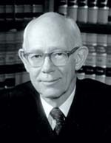

Slide 55
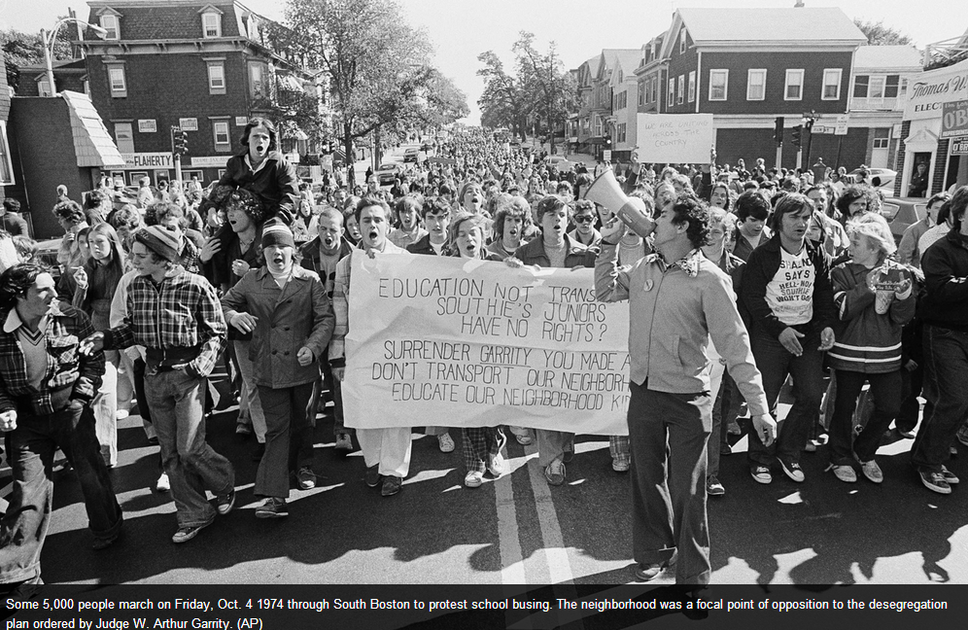

Slide 56
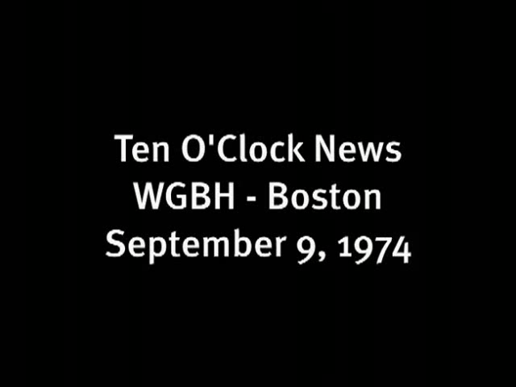

Slide 57
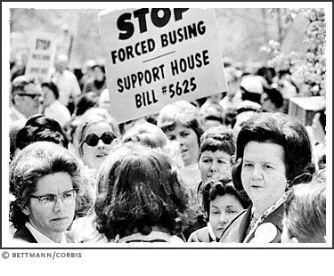

Slide 58
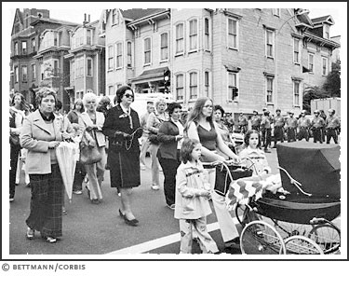

Slide 59
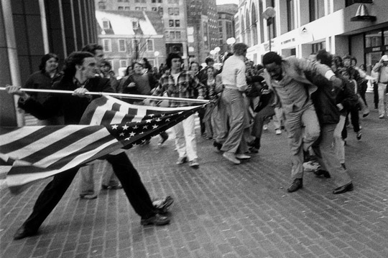

Slide 60
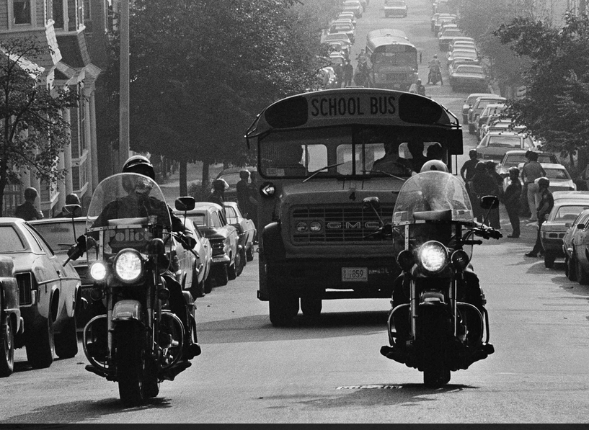

Slide 61
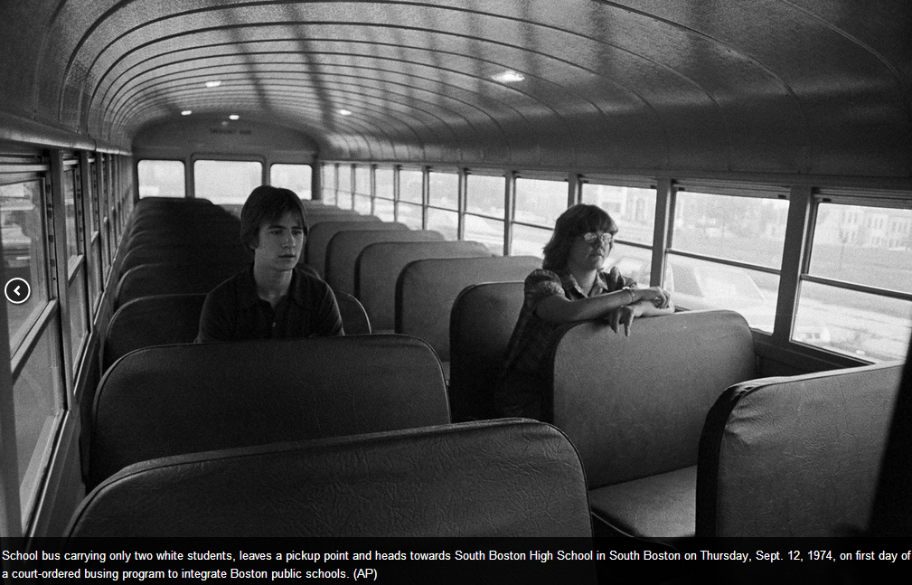

Slide 62
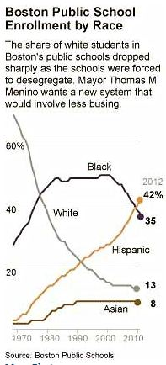

Slide 63
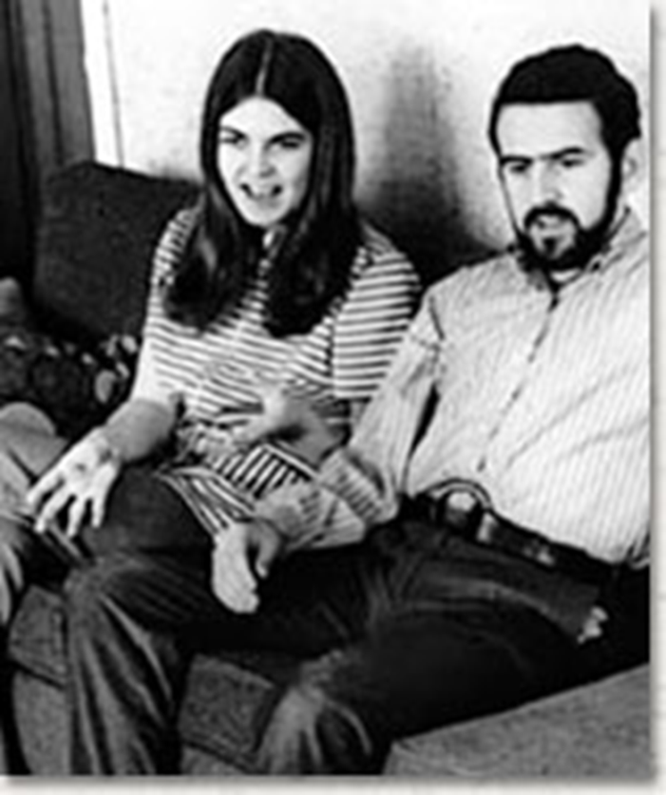
Frontiero v. Richardson (1973)
At the outset, appellants contend that classifications based upon sex, like classifications based upon race, alienage, and national origin, are inherently suspect, and must therefore be subjected to close judicial scrutiny. We agree.

Slide 64
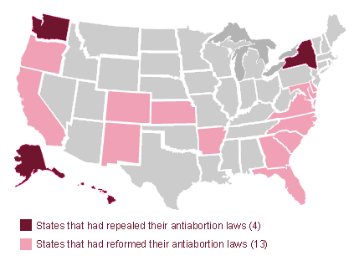
State Abortion Laws--1972

Slide 65
Roe v. Wade (1973)—Rehnquist dissent
I have difficulty in concluding, as the Court does, that the right of "privacy" is involved in this case. Texas, by the statute here challenged, bars the performance of a medical abortion by a licensed physician on a plaintiff such as Roe. A transaction resulting in an operation such as this is not "private" in the ordinary usage of that word. Nor is the "privacy" that the Court finds here even a distant relative of the freedom from searches and seizures protected by the Fourth Amendment to the Constitution . . .
The decision here to break pregnancy into three distinct terms and to outline the permissible restrictions the State may impose in each one, for example, partakes more of judicial legislation than it does of a determination of the intent of the drafters of the Fourteenth Amendment . . .
The fact that a majority of the States reflecting, after all, the majority sentiment in those States, have had restrictions on abortions for at least a century is a strong indication, it seems to me, that the asserted right to an abortion is not “so rooted in the traditions and conscience of our people as to be ranked as fundamental.” . . .

Slide 66

Equality of rights under the law shall not be denied or abridged by the United States or by any State on account of sex.

Slide 67
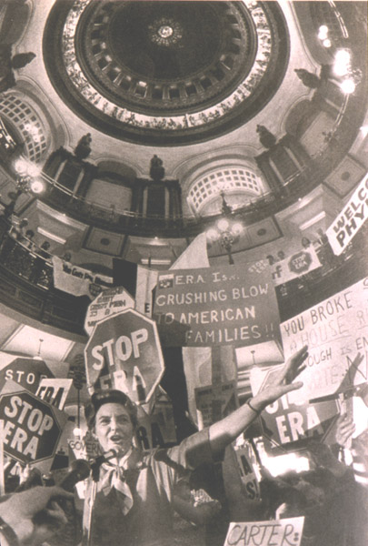

Slide 68



Slide 69


Slide 70
Webster v. Reproductive Health Services of Missouri (1989)
Blackmun dissent
Today, Roe v. Wade, and the fundamental constitutional right of women to decide whether to terminate a pregnancy, survive, but are not secure. Although the Court extricates itself from this case without making a single, even incremental, change in the law of abortion, the plurality and JUSTICE SCALIA would overrule Roe (the first silently, the other explicitly) and would return to the States virtually unfettered authority to control the quintessentially intimate, personal, and life-directing decision whether to carry a fetus to term. Although today, no less than yesterday, the Constitution and the decisions of this Court prohibit a State from enacting laws that inhibit women from the meaningful exercise of that right, a plurality of this Court implicitly invites every state legislature to enact more and more restrictive abortion regulations in order to provoke more and more test cases, in the hope that, sometime down the line, the Court will return the law of procreative freedom to the severe limitations that generally prevailed in this country before January 22, 1973. Never in my memory has a plurality announced a judgment of this Court that so foments disregard for the law and for our standing decisions.

Slide 71










Slide 72
Justice Sandra Day O'Connor: Now, the provision does not require notification to a father who is not the husband, I take it--
Ernest Preate: That's correct, Justice O'Connor.
Justice O'Connor: --or notice if the woman is unmarried.
Preate: It only applies to married women.
Justice O'Connor: So what's the interest, to try to preserve the marriage?
Preate: There are several interests.
The interest, of course, in protecting the life of the unborn child.
Justice O'Connor: Well then, why not require notice to all fathers?
It's a curious sort of a provision, isn't it?
Preate: It is that, but the legislature has made the judgment that it wanted its statute to apply in this specific instance because it wanted to further the integrity of marriages.
Justice O'Connor: Would you say that the State could similarly require a woman to notify anyone with whom she had intercourse that she planned to use some means of birth control after the intercourse that operates, let's say, as an abortifacient?
Preate: Well--
Justice O'Connor: Could the State do that?
I mean, it would be the same State interest, I suppose.
[Break.]
Justice O'Connor: Well, we're talking about the provision for notification in this case under the statute to the husband, and I'm just asking whether a different type of State regulation would have to be upheld under your standard.
Preate: Well, if the State had posited its interest as protecting the life of the unborn, then utilizing the rational basis standard, then I would submit that it could legitimately require that kind of notification to all people.

Slide 73
Planned Parenthood v. Casey (1992)
Liberty finds no refuge in a jurisprudence of doubt. Yet 19 years after our holding that the Constitution protects a woman's right to terminate her pregnancy in its early stages, Roe v. Wade, that definition of liberty is still questioned…
Numerous forms of state regulation might have the incidental effect of increasing the cost or decreasing the availability of medical care, whether for abortion or any other medical procedure. The fact that a law which serves a valid purpose, one not designed to strike at the right itself, has the incidental effect of making it more difficult or more expensive to procure an abortion cannot be enough to invalidate it. Only where state regulation imposes an undue burden on a woman's ability to make this decision does the power of the State reach into the heart of the liberty protected by the Due Process Clause.

Slide 74
Planned Parenthood v. Casey (1992)—Scalia dissent
There is a poignant aspect to today’s opinion. Its length, and what might be called its epic tone, suggest that its authors believe they are bringing to an end a troublesome era in the history of our Nation and of our Court. “It is the dimension” of authority, they say, to “cal[l] the contending sides of national controversy to end their national division by accepting a common mandate rooted in the Constitution.”
There comes vividly to mind a portrait by Emanuel Leutze that hangs in the Harvard Law School: Roger Brooke Taney, painted in 1859, the 82nd year of his life, the 24th of his Chief Justiceship, the second after his opinion in Dred Scott…There seems to be on his face, and in his deep set eyes, an expression of profound sadness and disillusionment. Perhaps he always looked that way, even when dwelling upon the happiest of thoughts. But those of us who know how the lustre of his great Chief Justiceship came to be eclipsed by Dred Scott cannot help believing that he had that case--its already apparent consequences for the Court, and its soon to be played out consequences for the Nation--burning on his mind. I expect that two years earlier he, too, had thought himself “call[ing] the contending sides of national controversy to end their national division by accepting a common mandate rooted in the Constitution.”

