Slide 1
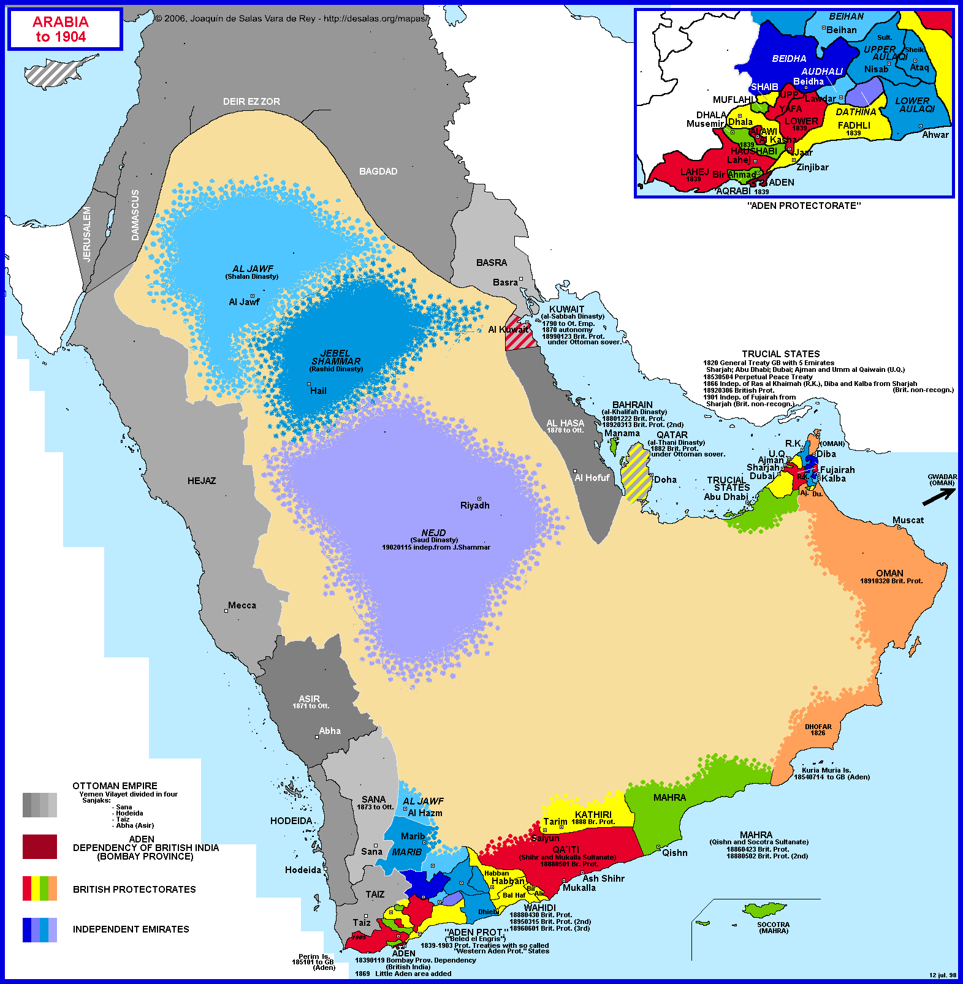

Slide 2
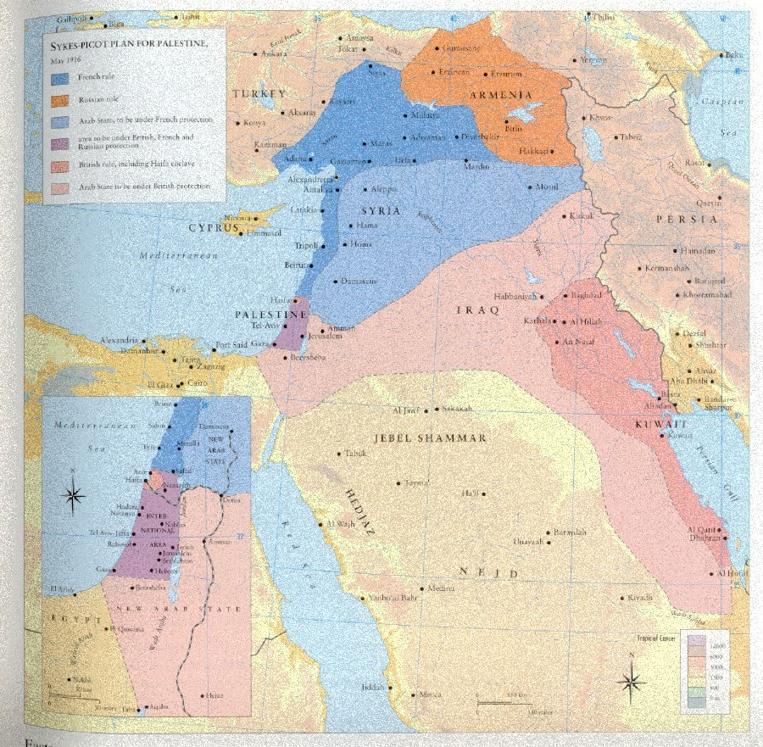

Slide 3
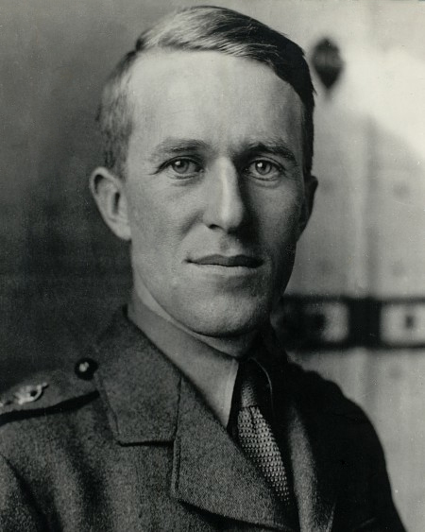
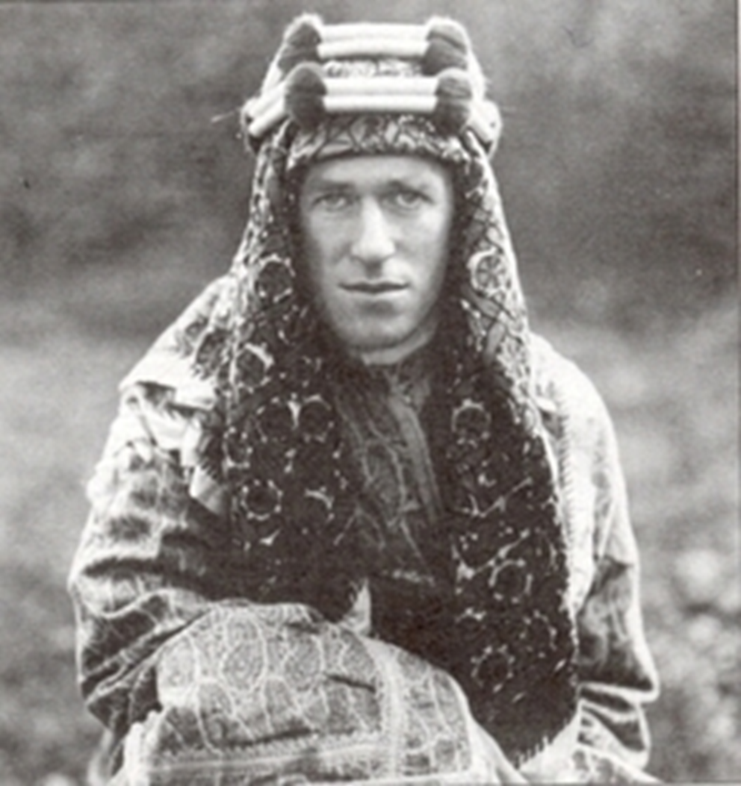
Notes:
Te lawrence

Slide 4
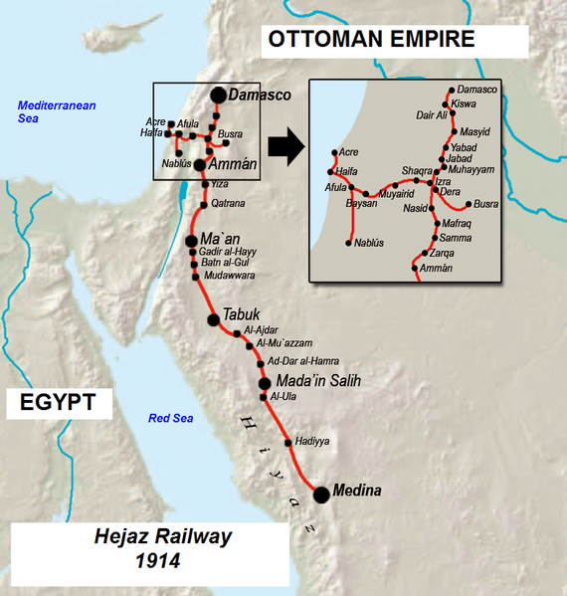
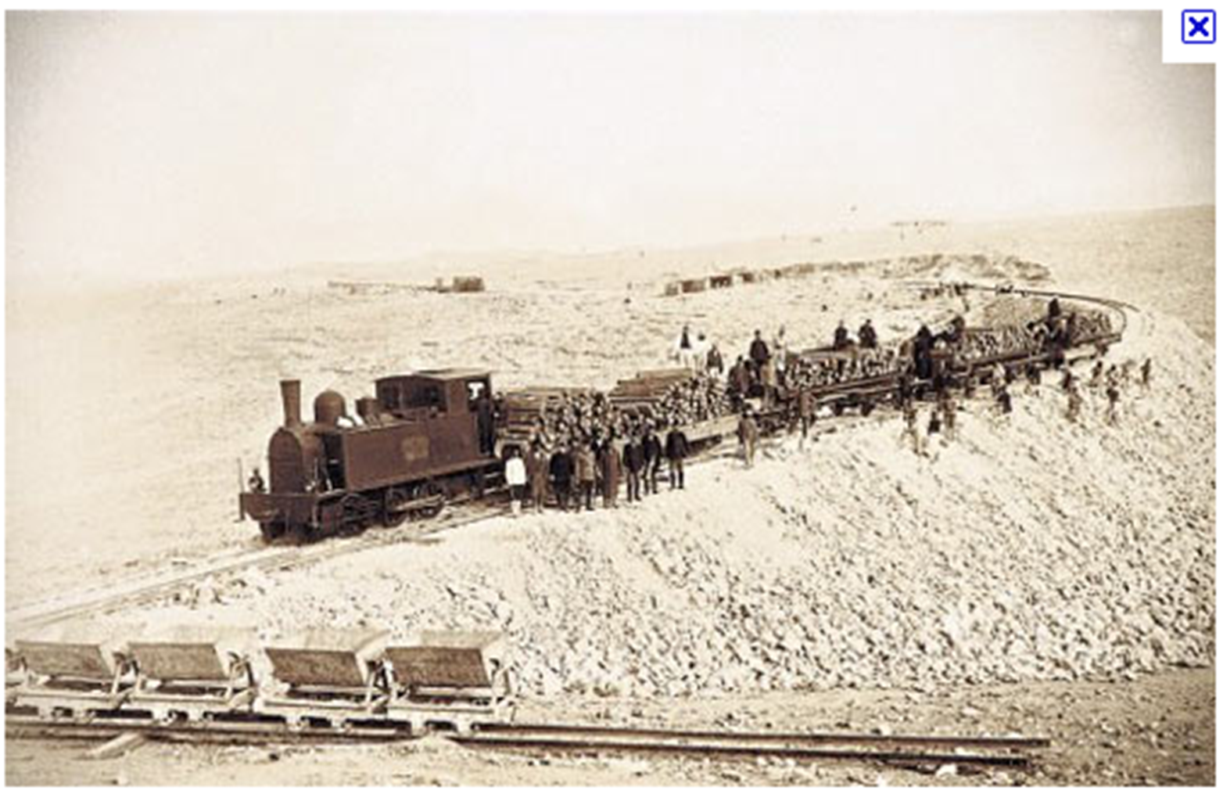

Slide 5
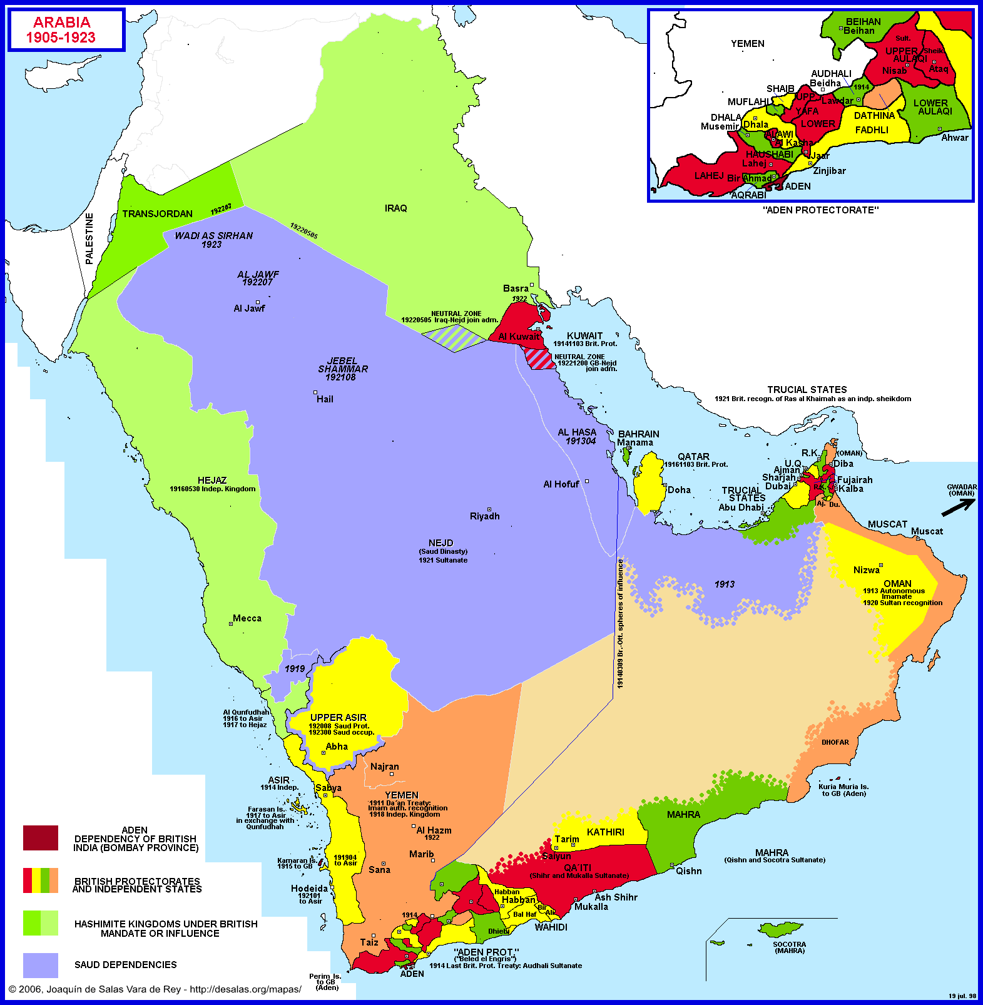

Slide 6
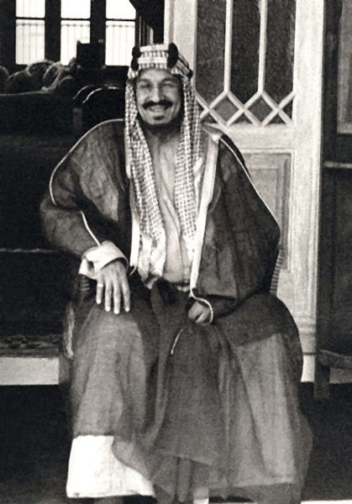
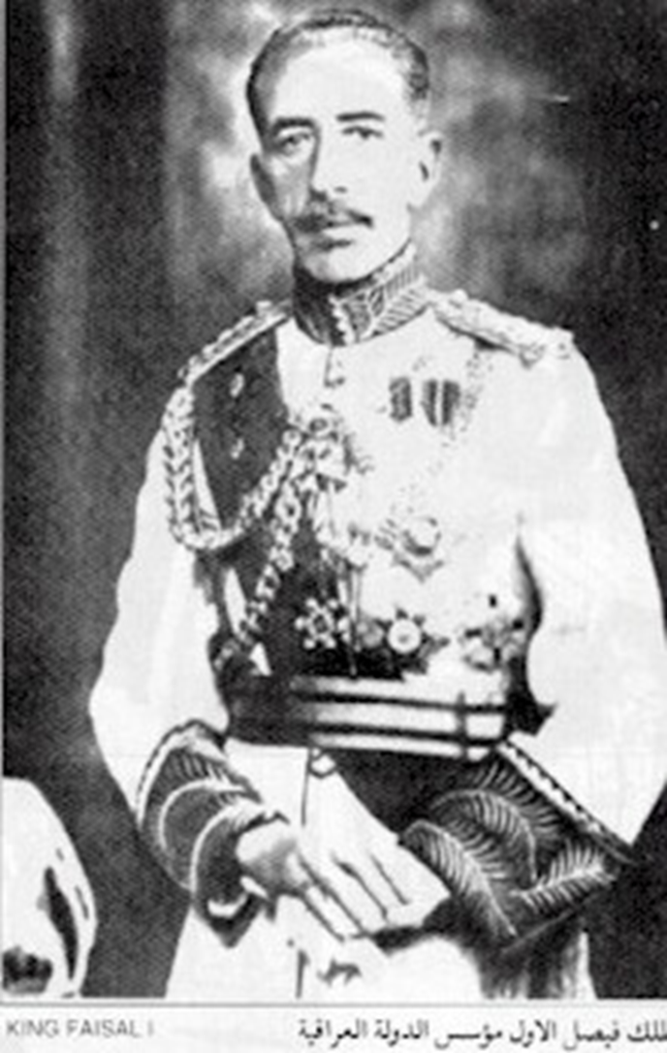
Notes:
Ibn saud

Slide 7


Slide 8
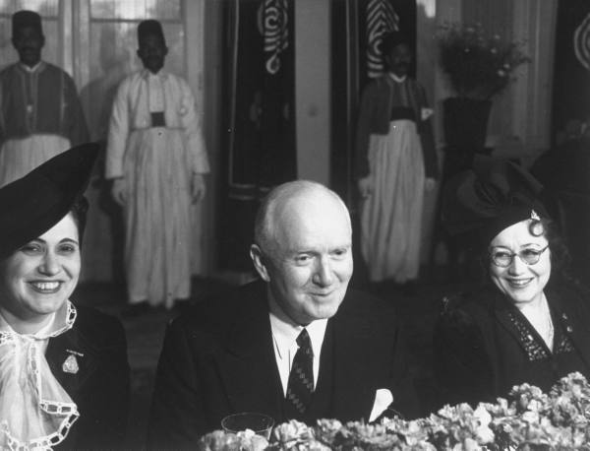
Notes:
Bert fish, 1st us ambassador to sarab

Slide 9
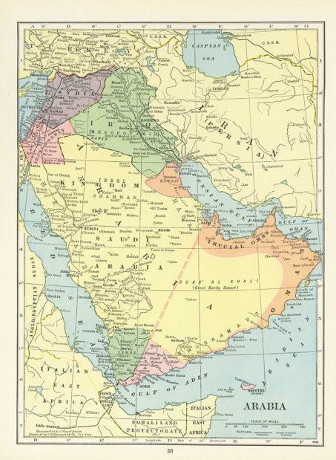

Slide 10
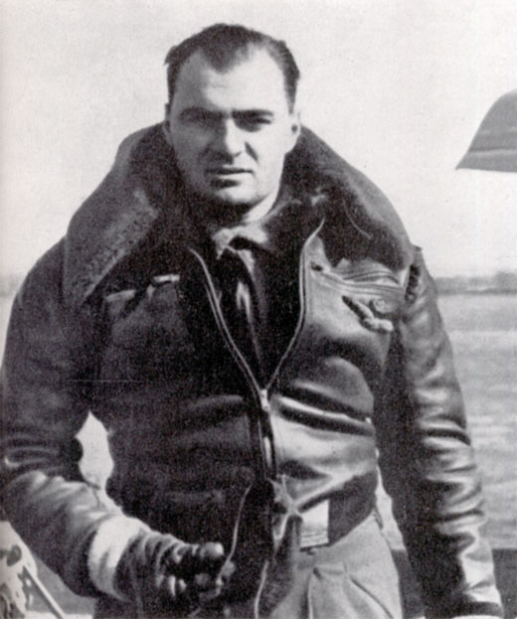
Notes:
Ettore muti—commander of italian attack squadron bahrain.dhahran

Slide 11
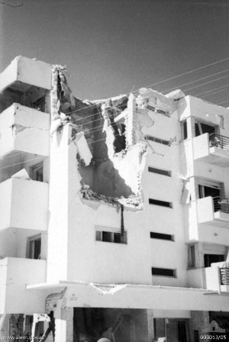
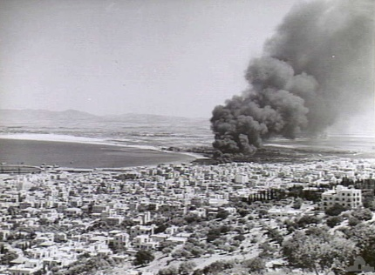

Slide 12

Notes:
“for the sake of freedom”—Bahrain prop poster wwii

Slide 13
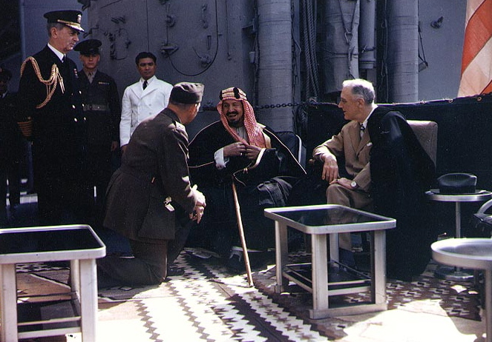
Notes:
Fdr and ibn saud

Slide 14
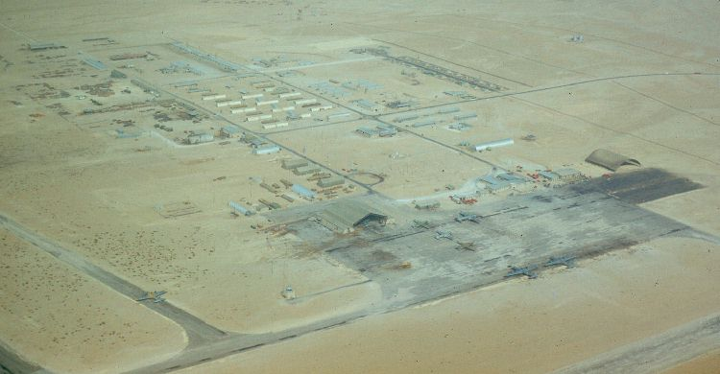
Notes:
Dharhan air field (1950)

Slide 15
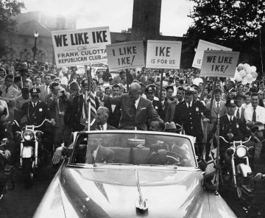

Slide 16
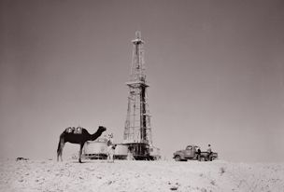
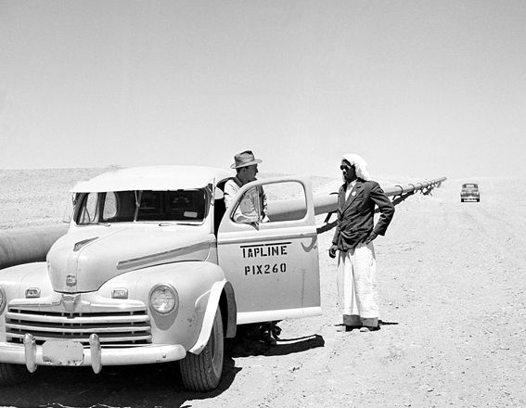
Notes:
Transarabian pipeline—to medit

Slide 17
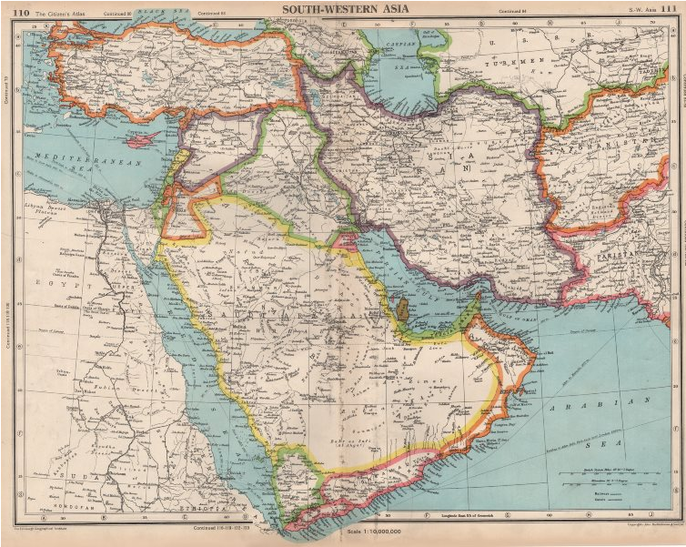

Slide 18
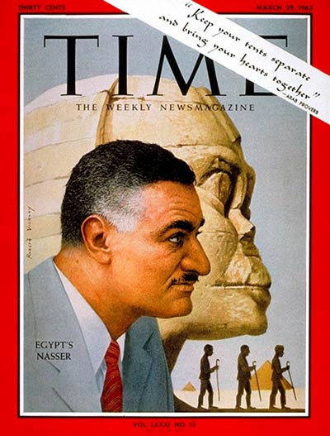

Slide 19
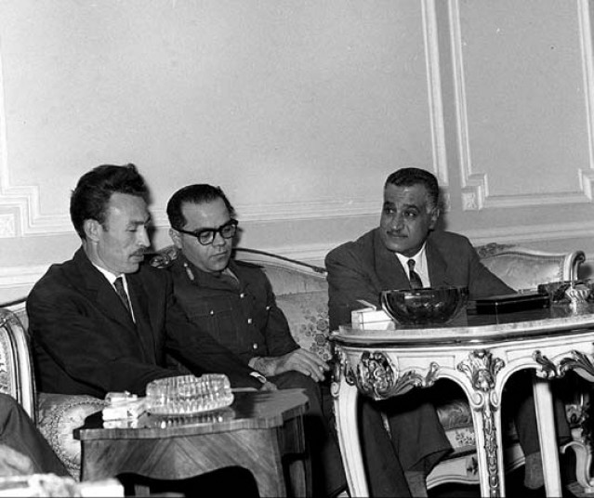
Notes:
w/ presidents of algeria, syria at cairo summit, 1963

Slide 20

President Kennedy: So let’s see what kind of a message we can get out to them, which carries some force to them, as if our concern is not totally the Israelis. It may be that we’ll want to come out with some sort of a guarantee next week, or reinforcement of the Tripartite [Agreement, between Britain, France, and the US]. But we want it to be understood in advance that it’s not just because of our concern about Israel.
Really our concern is mutual, because the peril is mutual—that the Israelis will move in a preemptive way at a time when they have the power; [and] that therefore, the fellow who’s really in more trouble is Nasser, not so much the Israelis. We would certainly want to get that point [across]—that that’s the way it looks to us, and that therefore any Tripartite guarantee would at least carry with it an appearance of, as I said, mutuality.
Now, the other thing is what we can do about the Jordanians—what we ought to try to do with the British. I think we ought to encourage the British to be more ready to move under some conditions. After all, this has been their traditional area: we’re not supposed to do everything.
So let’s get [British ambassador to the US] David Ormsby-Gore—
George Ball: I talked to David already this morning, and told him we’d [unclear], so I’ll get moving—
President Kennedy: Well, I think we can say that we could visualize a situation where we’d have to have somebody move in. it seems to me it ought to be the British.

Slide 21
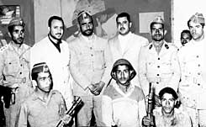
Notes:
Yemen oct 62 coup

Slide 22
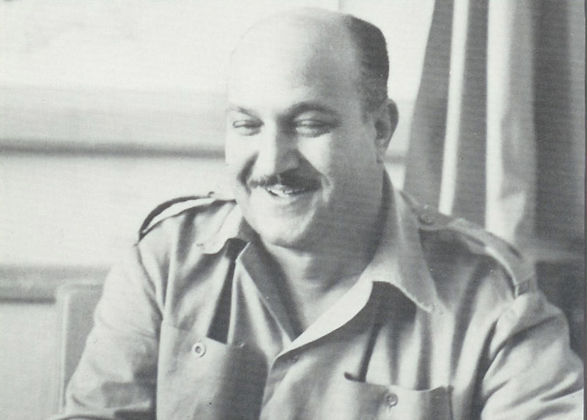
Notes:
Col hassan ali kamal—head of egy forces in yemen

Slide 23
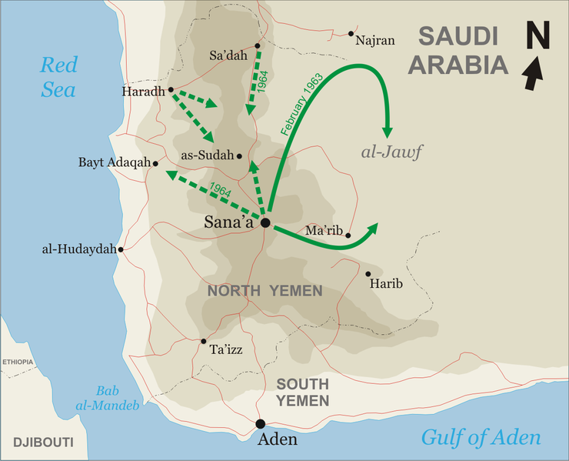

Slide 24
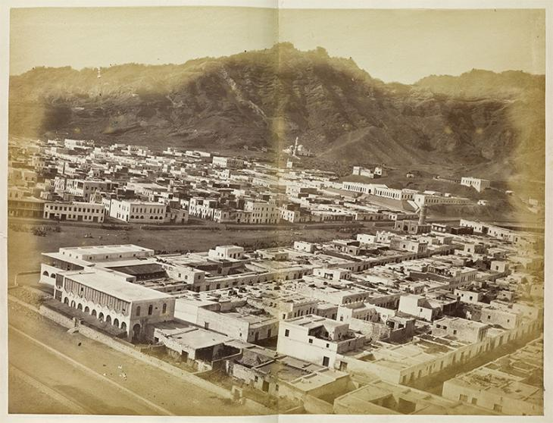
Notes:
Aden turn of century

Slide 25
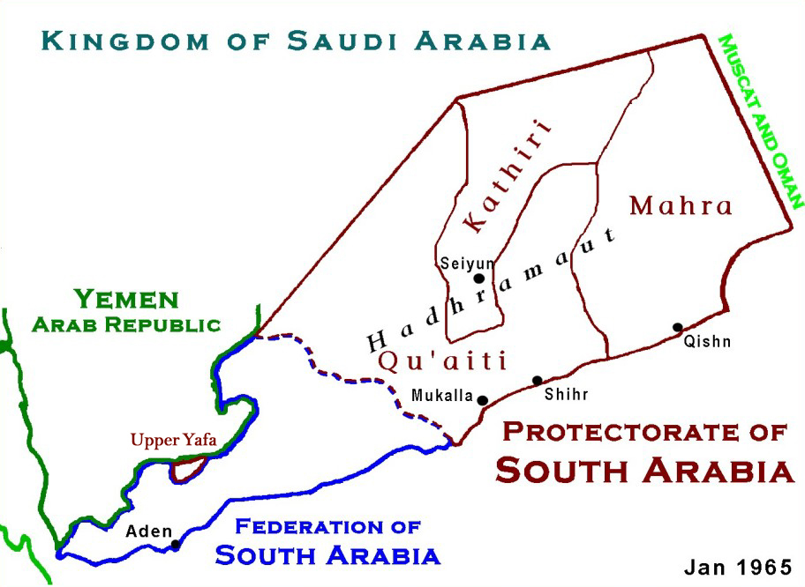

Slide 26
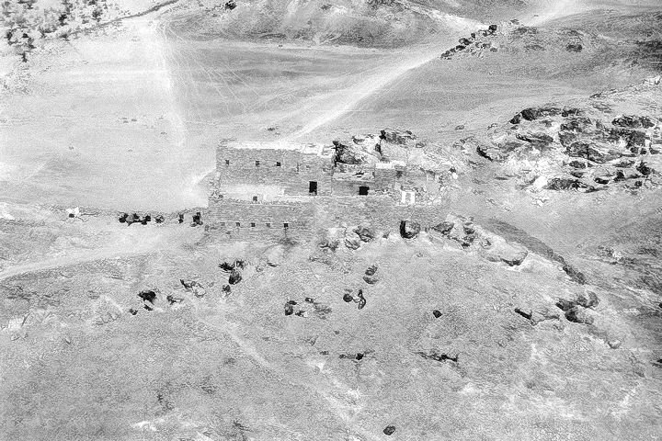
Notes:
British raid fort harib 28 March 1964

Slide 27
UN Resolution 188
The Security Council,
Having considered the complaint of the Yemen Arab Republic regarding the British air attack on Yemeni territory on 28 March 1964,
Deeply concerned a the serious situation prevailing in the area,
Recalling Article 2, paragraphs 3 and 4, of the Charter of the United Nations,
Having heard the statements made in the Security Council on this matter,
1. Condemns reprisals as incompatible with the purposes and principles of the United Nations;
2. Deplores the British military action at Harib on 28 March 1964
3. Deplores all attacks and incidents which have occurred in the area;
4. Calls upon the Yemen Arab Republic and the United Kingdom of Great Britain and Northern Ireland to exercise the maximum restraint in order to avoid further incidents and to restore peace in the area:
5. Requests the Secretary-General to use his good offices to try to settle outstanding issues, in agreement with the two parties.

Slide 28
Dean Rusk: In a lot of places here . . . He [Nasser] has not performed in Yemen, he is undermining us in the Wheelus Base [in Libya], and he is pitching this arms race into the Near East.
President Johnson: Well, this [vote on the pending UN resolution] is not going to help us with him, is it?
Rusk: But I think it's important for Nasser to know that we're not … that he mustn't take us for granted on these things … I think an abstention on this is something of a warning to Nasser that we're coming close to the end of the trail on this business.
President Johnson: Don't you think they'll pound us like hell all over the United Nations and all over the papers of the country?
Rusk: Oh, I think that there will be … there will be …
President Johnson: [UN ambassador Adlai] Stevenson will be running around raising hell like he was about the Venezuela delegation, won't he?
Rusk: Oh, I think he will be … he will be personally unhappy for two or three days, but I don't think there's going to be any major press campaign picking this up.
President Johnson: Have you already told him what to do?
Rusk: Yes. Well, I told him—we had an instruction for him several days ago not to have a resolution that condemned the British, and this does. It says it “deplores”—this thing the other day—but to express a general regret about violence along that frontier.
The resolution went beyond the point where we felt we could, in our total interests here, support it. But as it now stands, he is willing to—he is ready to do what we talked about this morning. But he just wanted to be sure that you knew that it’s a close, balanced decision, and that he had some concern about it.
President Johnson: Well, you just tell him that I do know, but I knew at the last minute. Didn’t know anything about it beforehand, I don’t know anything else.

Slide 29
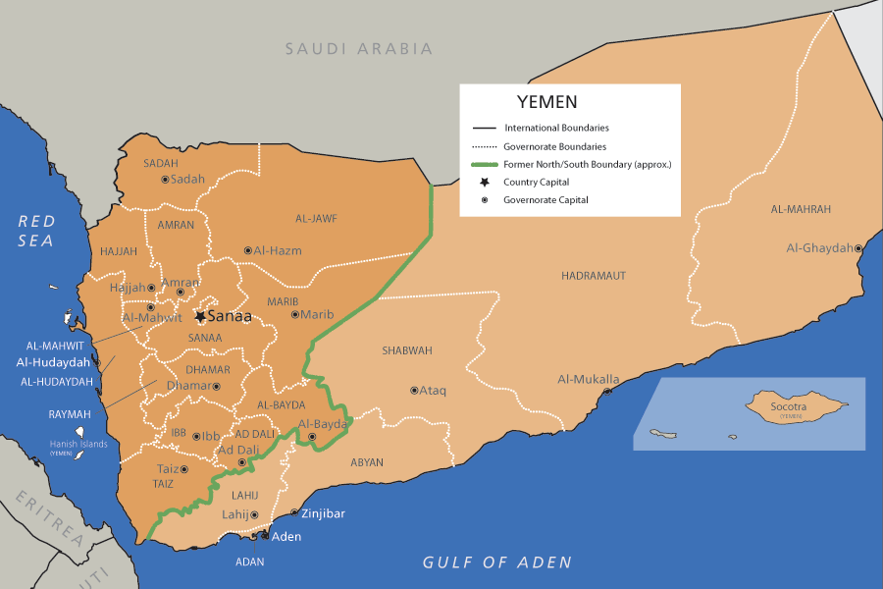

Slide 30
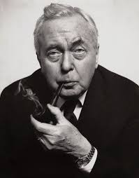

Slide 31
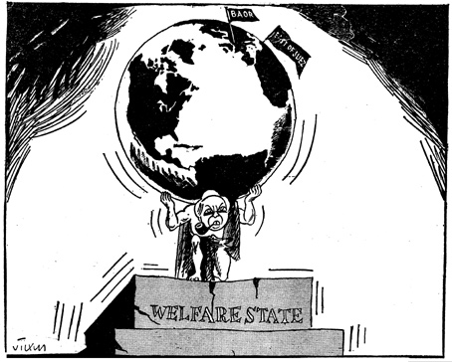

Slide 32
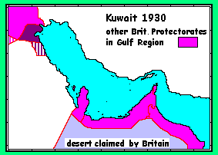

Slide 33
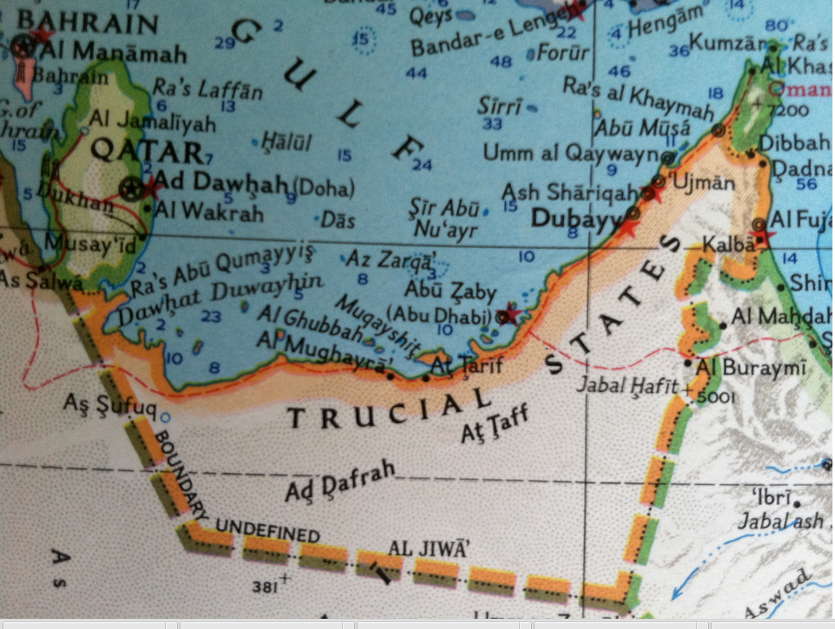

Slide 34
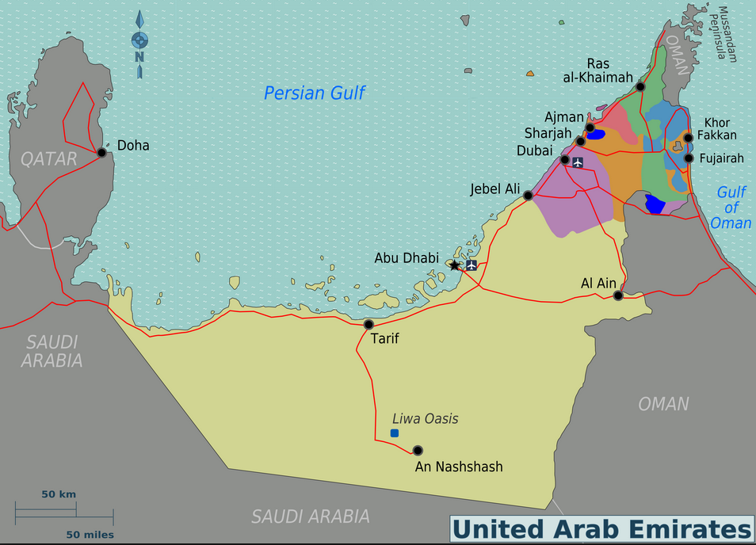

Slide 35
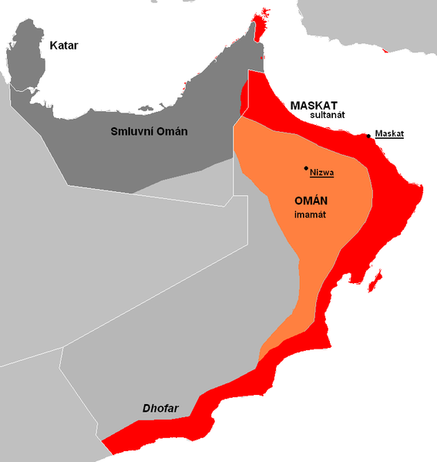

Slide 36
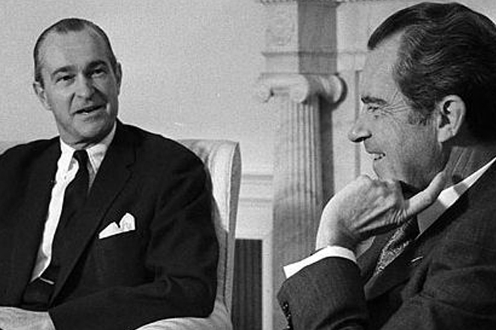

Slide 37
President Nixon: The Iranian oil thing, as you know, is in a, apparently one hell of a [mess?] . . .
[Break.]
President Nixon: What I have in mind: I’ve talked to—and everybody here thinks it’s a great idea (and I was talking to Henry [Kissinger] about something) . . . What I really have in mind is for you, basically, to be sort of the—without downgrading the other ambassadors—the ambassador in charge of that sort of area, you know what I mean?
Richard Helms: Yes, sir.
President Nixon: Particularly with [unclear] . . . So you could go down to those sheikdoms, and . . . and these other places, and pull this thing to—and then give us the recommendation, you know? And in charge of the area not only in terms of oil, and so forth, but in terms of the stability of the governments [excised for national security purposes].

Slide 38
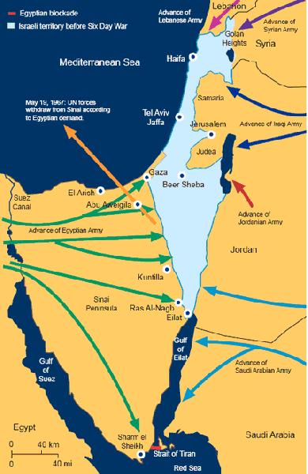

Slide 39
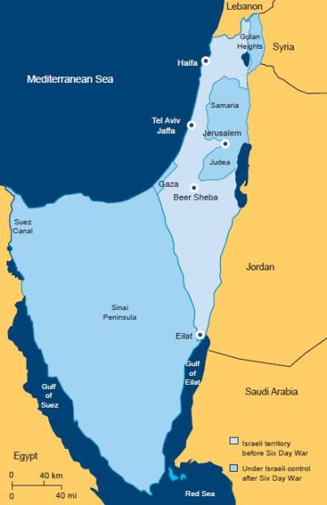

Slide 40
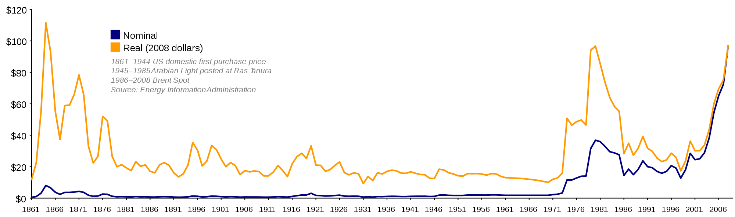

Slide 41
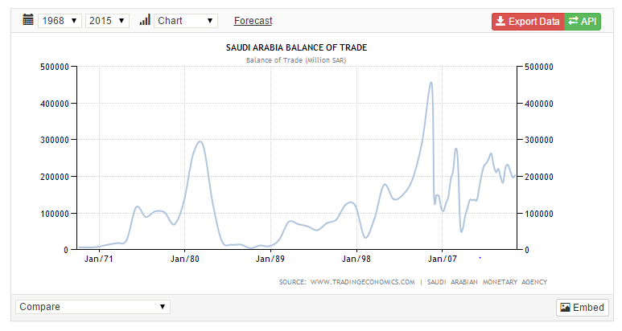

Slide 42
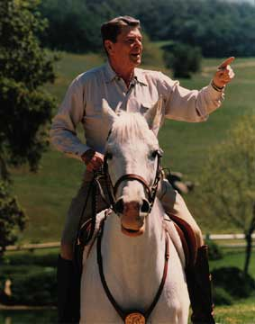

Slide 43


Slide 44

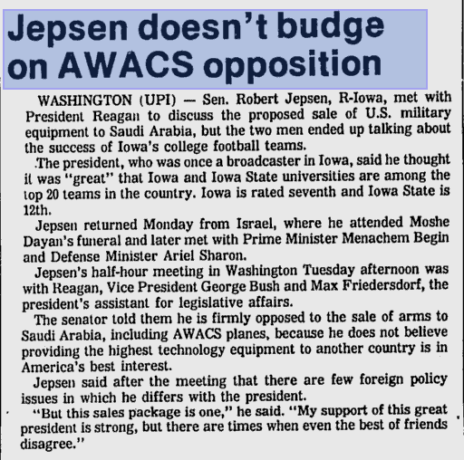
“This sale to an unstable country jeopardizes the security of our most advanced technology . . . This sale undermines the security of Israel . . . I pledge my efforts and my vote to block this sale.”

Slide 45
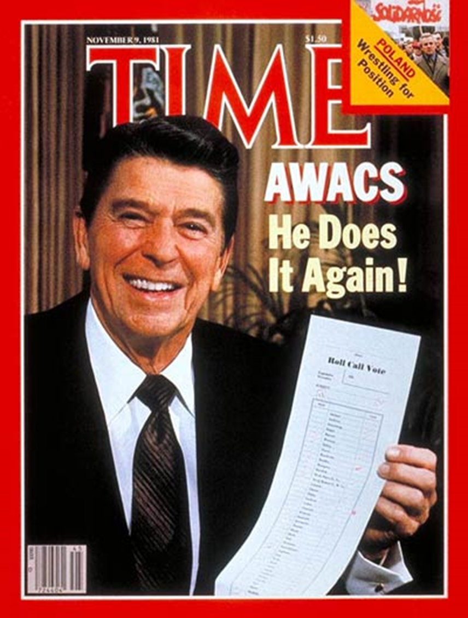
White House aide Ed Rollins:
“We just beat his brains out. We stood him up in front of an open grave and told him he could jump in if he wanted to.”

Slide 46
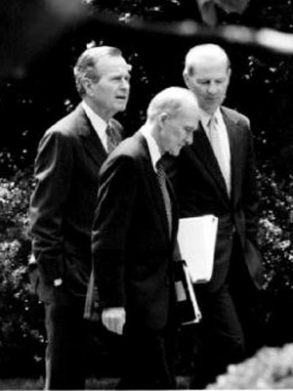
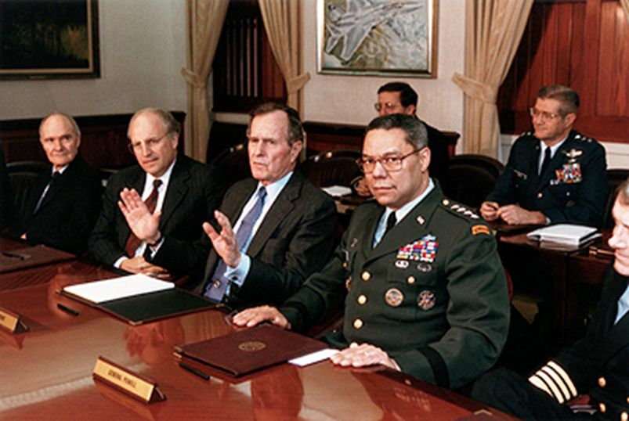

Slide 47
National Security Directive (NSD) 26
Access to Persian Gulf oil and the security of key friendly states in the area are vital to US national security. The United States remains committed to defend its vital interests in the region, if necessary and appropriate through the use of US military force, against the Soviet Union or any other regional power with interests inimical to our own. The United States also remains committed to support the individual and collective self-defense of friendly countries in the area to enable them to play a more active role in their own defense and thereby reduce the necessity for unilateral US military intervention.

Slide 48
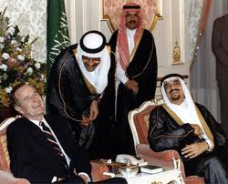

Slide 49
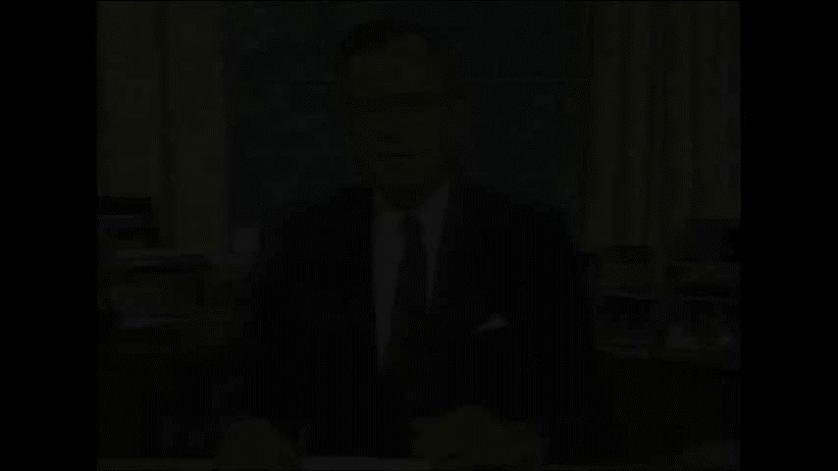

Slide 50
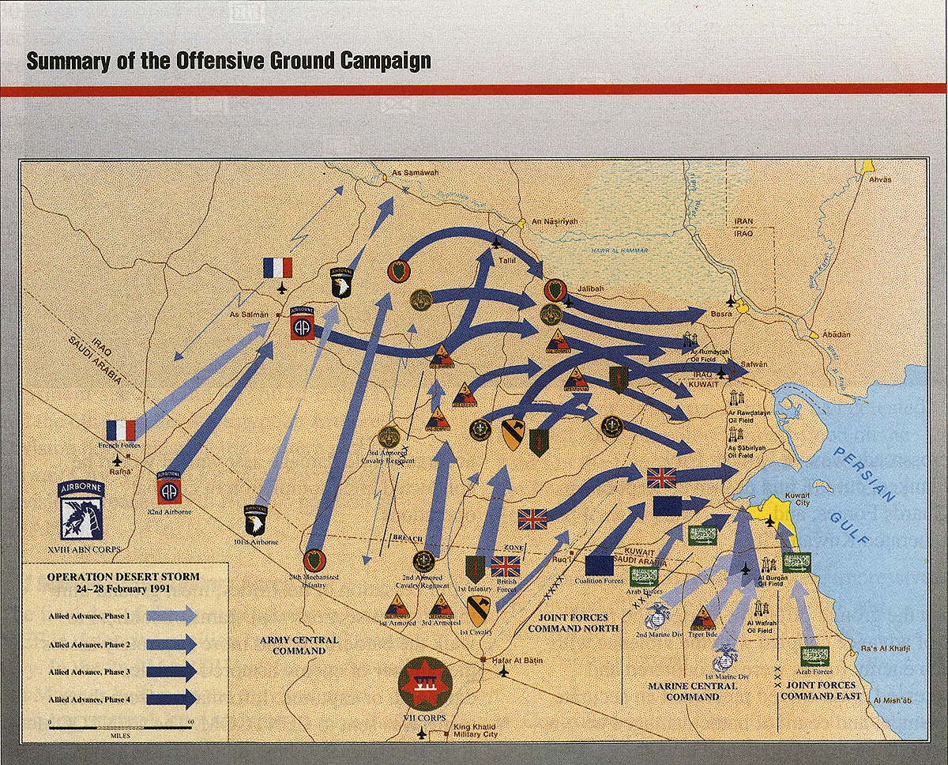

Slide 51
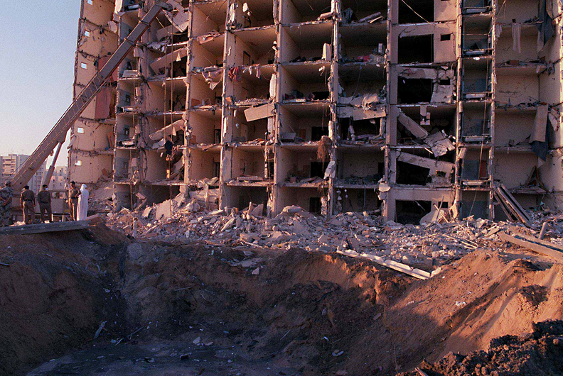
Notes:
Khobar towers

Slide 52
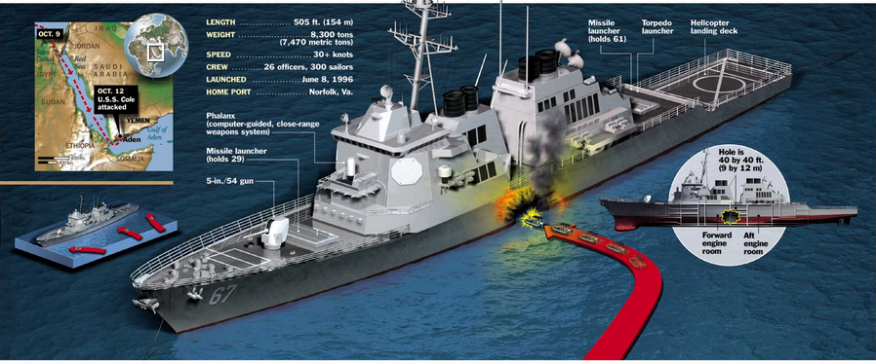

Slide 53



Slide 54


Slide 55


Slide 56



Slide 57


Slide 58


Slide 59


Slide 60


Slide 61


Slide 62


Slide 63



Slide 64



Slide 65


Slide 66


Slide 67



Slide 68


