Slide 1
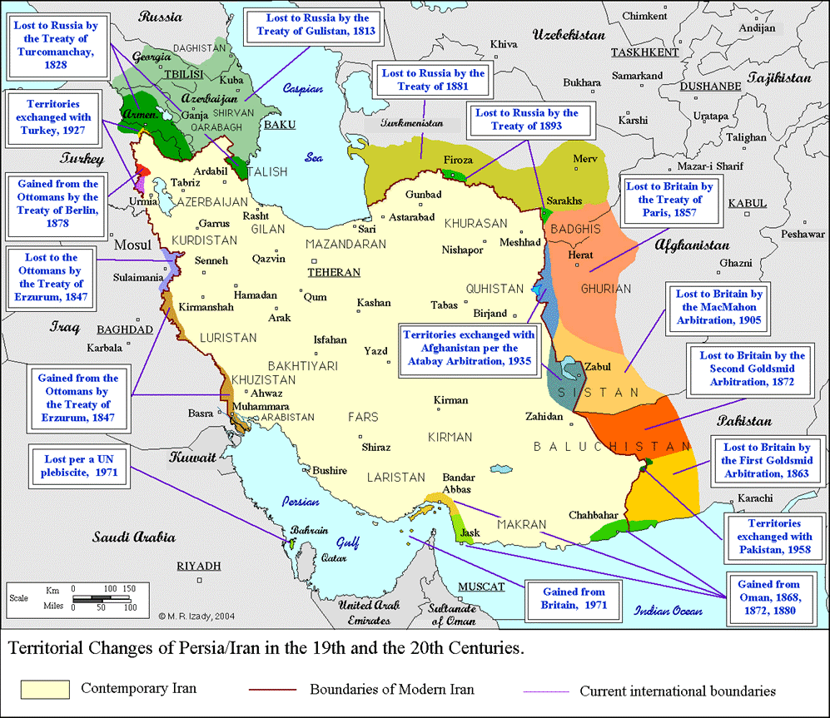

Slide 2


Slide 3
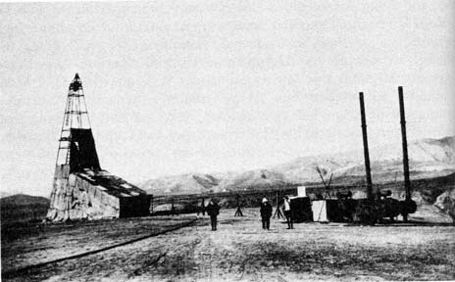
Notes:
1st oil well Iran 1908 (Masjid Sulaiman)

Slide 4
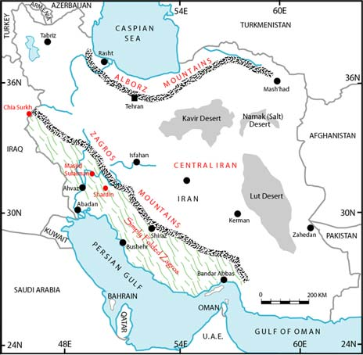
Notes:
Oil wells in shaded area

Slide 5
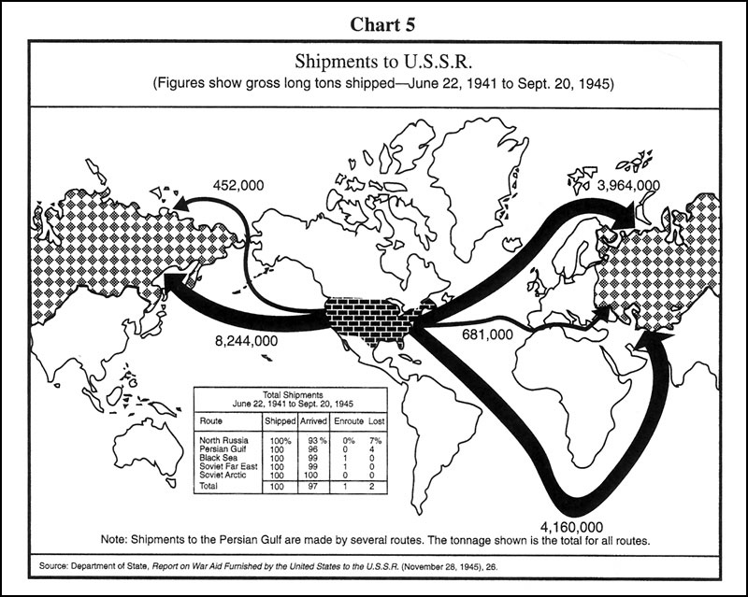

Slide 6
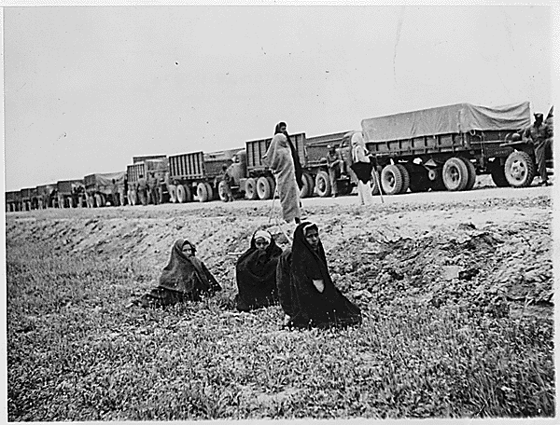
Notes:
Persian corridor

Slide 7
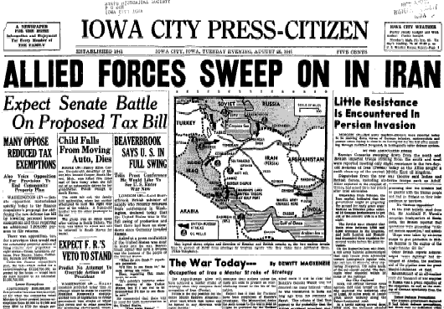

Slide 8
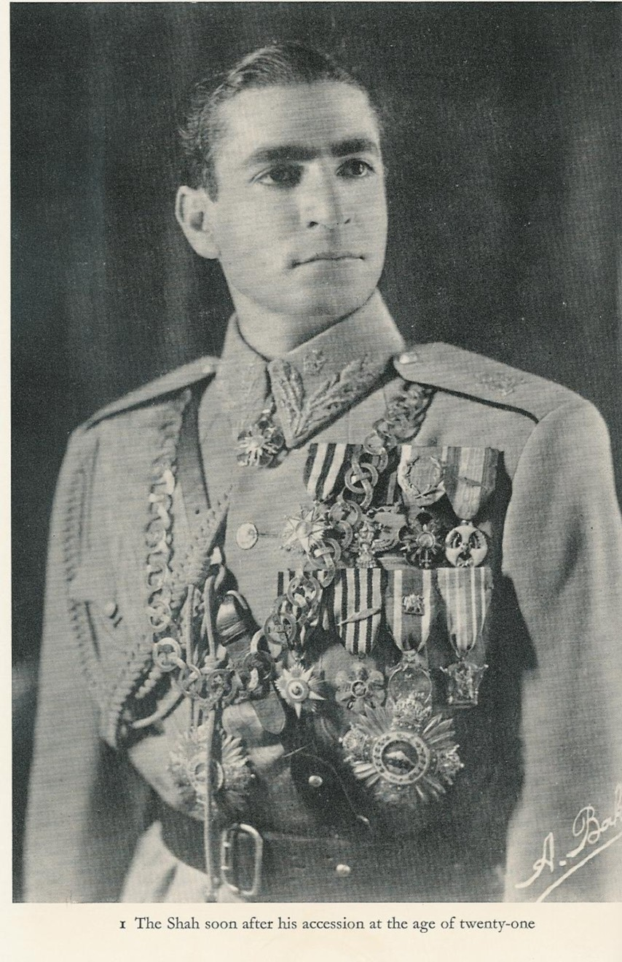

Slide 9
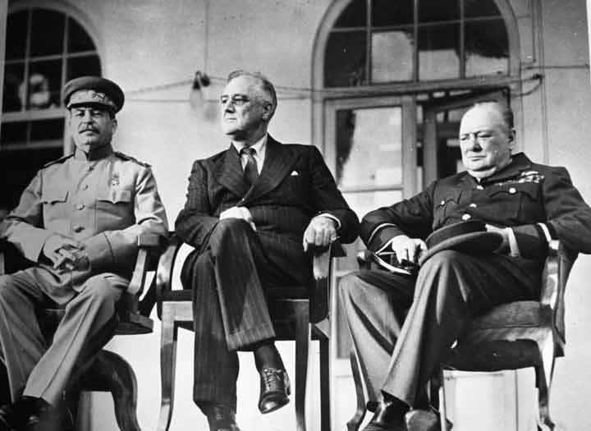
Notes:
teheran

Slide 10
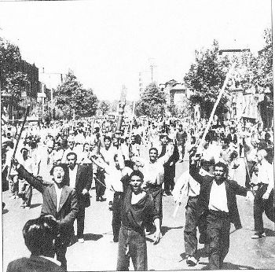
Notes:
Tudeh protesters

Slide 11
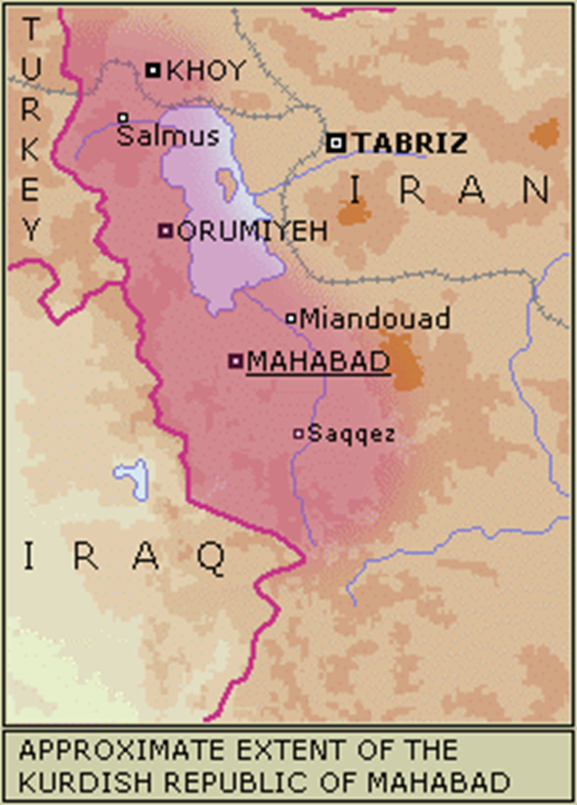
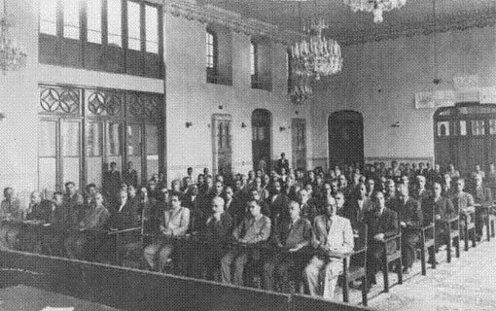
Notes:
Puppet azeri parl

Slide 12
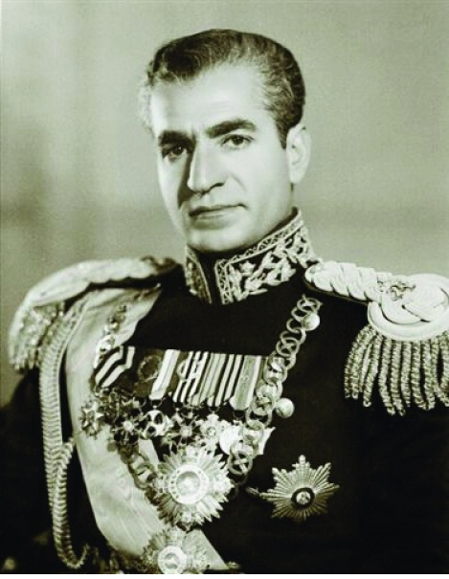
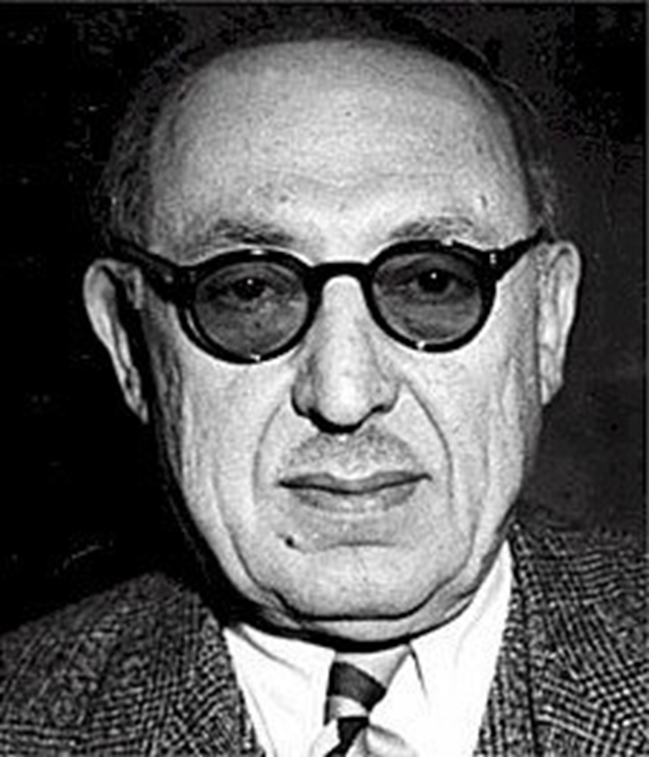

Slide 13
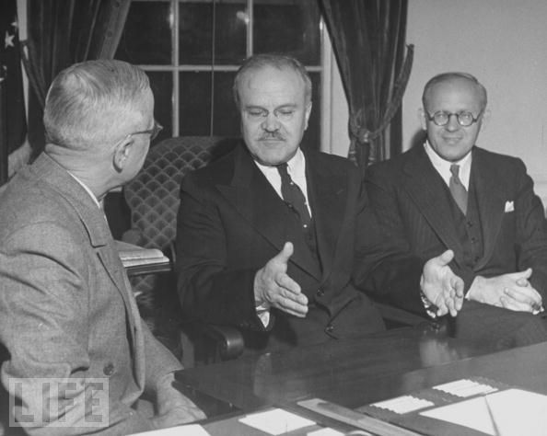
Notes:
Truman molotov

Slide 14
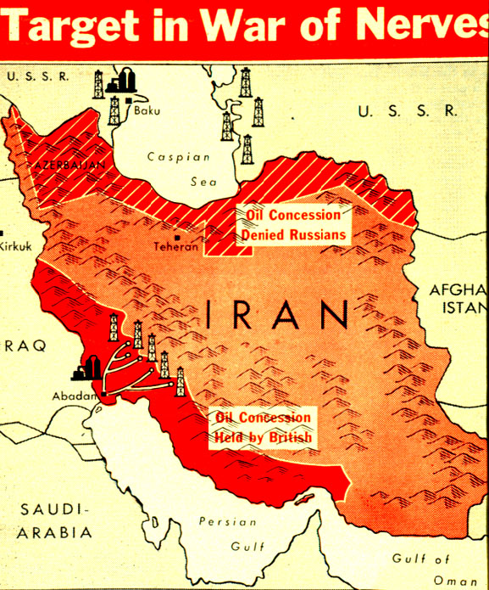

Slide 15
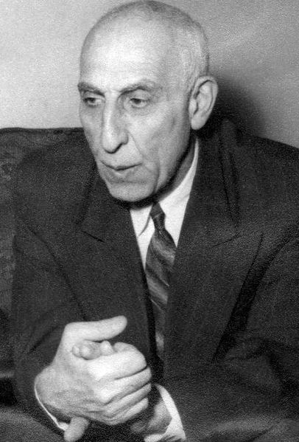
Notes:
mossadeq

Slide 16
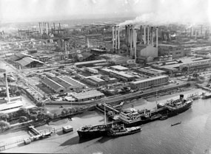
Notes:
Abadan refinery

Slide 17
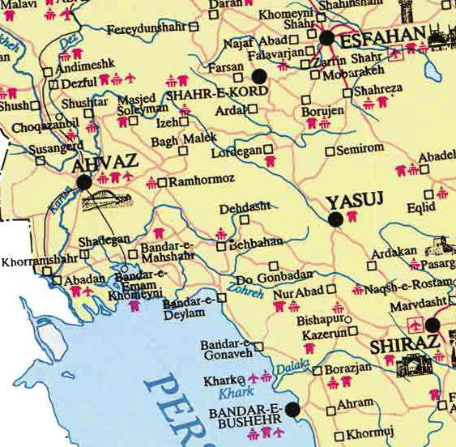

Slide 18
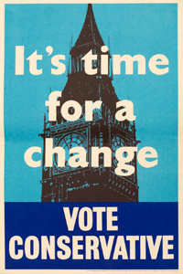
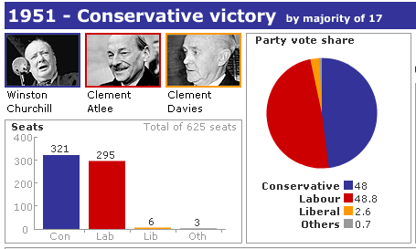

Slide 19
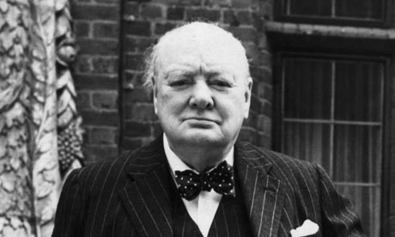

Slide 20
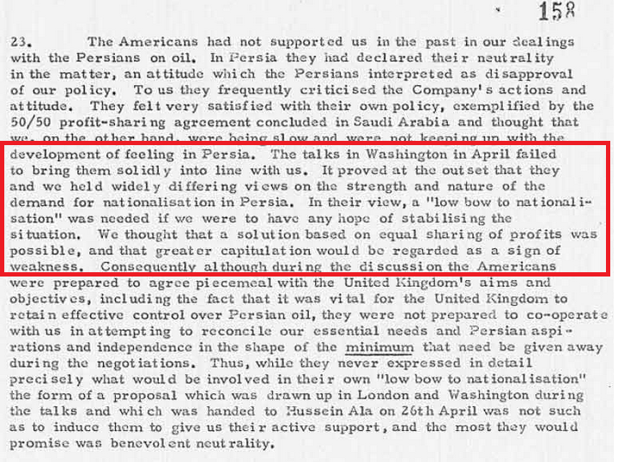
Notes:
Bri memo, 1951

Slide 21

Notes:
Allen dulles

Slide 22
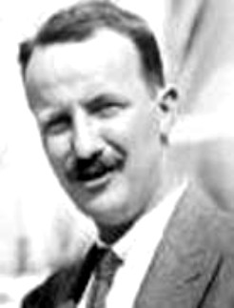
Notes:
Kermit roosevelt (grandson TR)

Slide 23
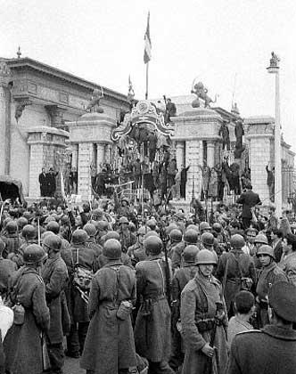
Notes:
Soldiers surrounding parliament

Slide 24
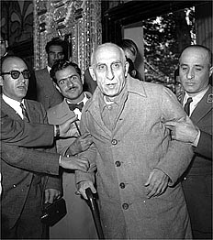

Slide 25
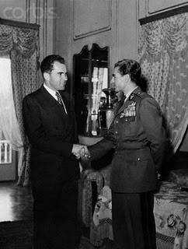
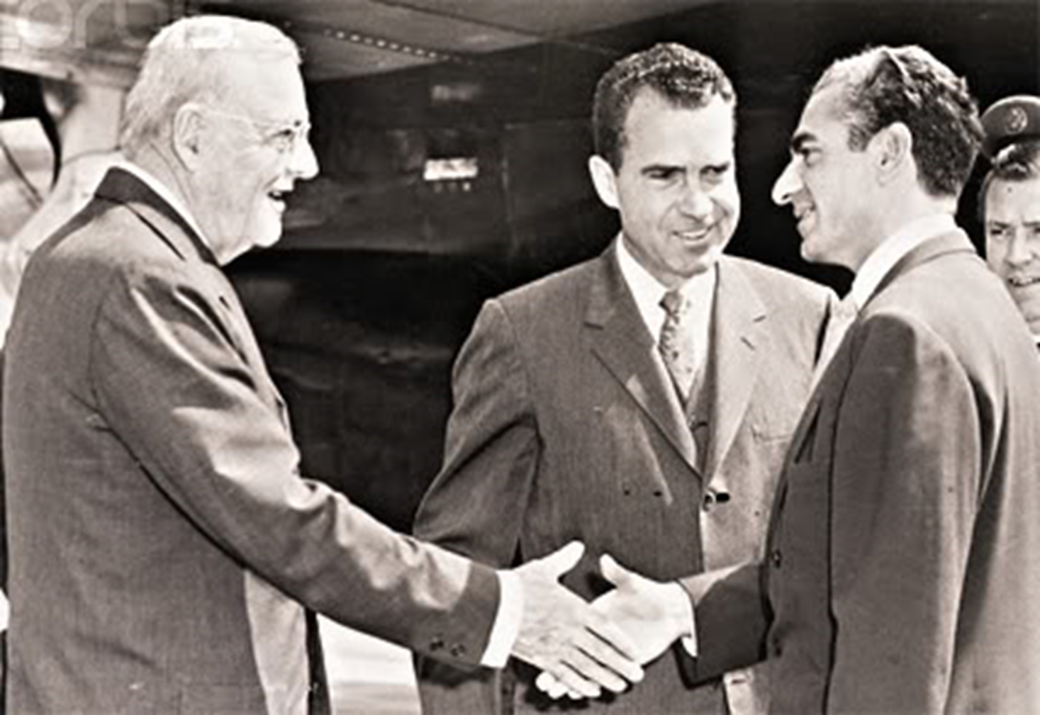

Slide 26
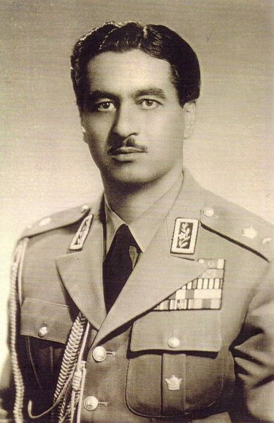
Notes:
Teymour bakhtiar—1st director SAVAK

Slide 27
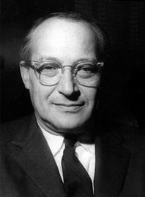
Notes:
rostow

Slide 28
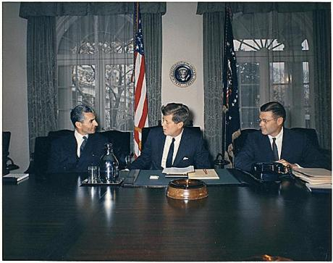

Slide 29
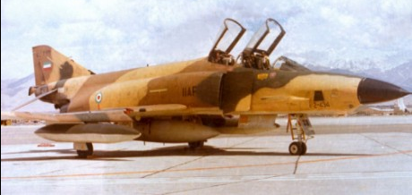
Notes:
RF-4

Slide 30
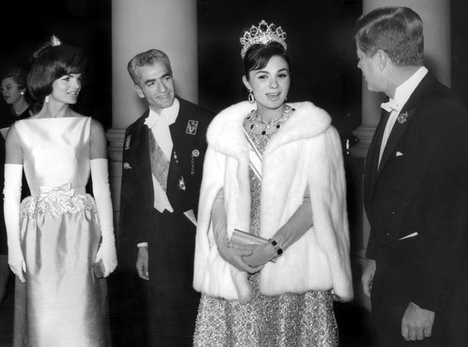

Slide 31
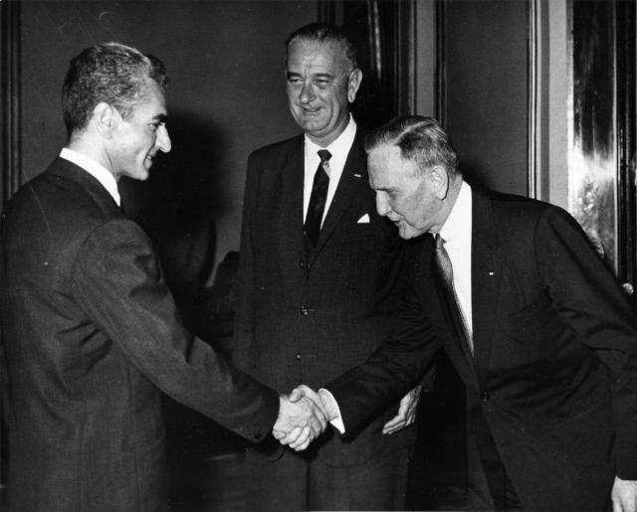
Notes:
1962 visit

Slide 32
From Time magazine:
Lyndon Johnson hit Teheran as though he were running for Shah—and if the warmth of his welcome was an indication, he might be able to get the job. With Wife Lady Bird and Daughter Lynda Bird, 18, the Vice President swept down Eisenhower Boulevard, so named after Ike's 1959 visit. Three times Johnson confused his smartly uniformed police escort by halting the motorcade and hopping out of his car to grasp all the outstretched hands within reach (one observer counted 300 in five minutes). The crowds responded with the highest praise they knew: "Javid Shah!" (Long live the King!).

Slide 33

President Johnson: Your majesty, how are ya’?
Shah of Iran: Mr. President, I am so glad to hear you.
President Johnson: Well, it’s wonderful to hear your voice. And we’re so happy to have you and the Empress back in our country again, even if it’s very brief.
Shah of Iran: Yes, unfortunately, we could not pay you, pay our—I mean, pay you our respects.
President Johnson: Oh, I would so much like to see you. I was oh-so-relieved, though, that you escaped the recent [assassination] attempt. You know from your own role at the time of President Kennedy’s [death] what a shock such an experience is.
Shah of Iran: Yes, it was rather true [chuckles a bit].
President Johnson: Yeah. [Abruptly changes topic.] Well, we were so pleased that you were so well-received in Brazil and Argentina.
[Break.]
President Johnson: Well, we certainly are grateful to you for your Dominican and Vietnamese position [in support of the United States], and . . . I’m very concerned that the Afro-Asian conference in Algiers next month will degenerate—I’m afraid it will be an anti-U.S. operation—unless some responsible delegation like Iran strands up against these steamrollers.
Shah of Iran: Yes—we shall do our duty. And we are grateful to you to have taken these attitudes, Mr. President.
President Johnson: Well, we have to take this when liberty’s at stake.
Shah of Iran: Oh, yes.
[Break.]
President Johnson: Everyone tells me you have just made phenomenal progress!
Shah of Iran: Yes, we have been very lucky.
President Johnson: Well, no, you’ve been very courageous—that’s what.

Slide 34

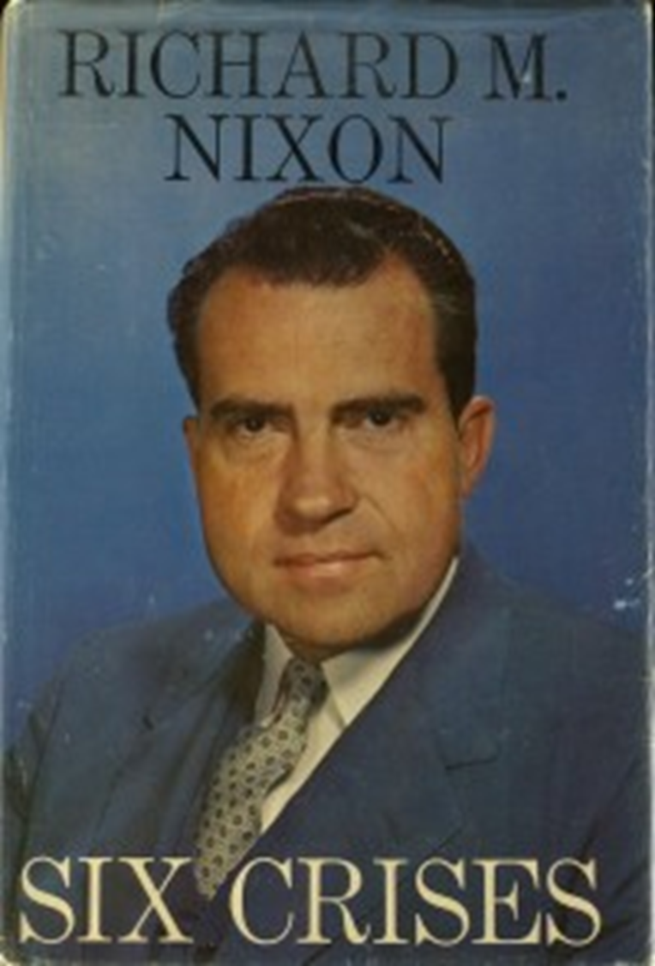

Slide 35
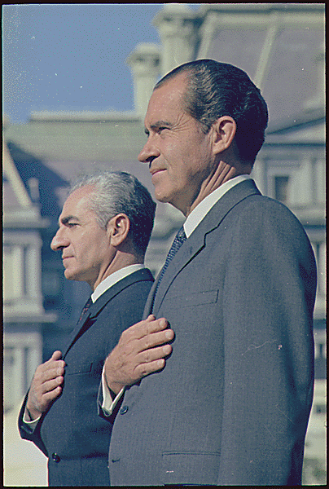
Notes:
Rn shah dc 1969

Slide 36
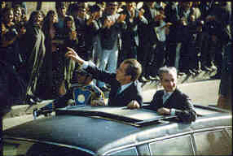
Notes:
1972—RN in Teheran

Slide 37
Douglas MacArthur, II: A strong Iran, sir, in terms of your conviction (which I share, 200 percent) that we must not see the basic balance between East and West altered radically . . . A strong Iran—
President Nixon: Yeah.
MacArthur: You know, the Soviets have been able, through their polarization of this Arab-Israel conflict—they have been able to gain increasing influence—
President Nixon: Oh!
MacArthur: —in these places, no question about it. A strong Iran helps to counterbalance that.
President Nixon: That’s right. It’s just one friend there. Face it, Iran is not of either world, really, in a sense. I guess. But the point it—if I felt, if we can go with that, we can have them strong. They’re at the center of it, and a friend of the United States. I couldn’t agree more, it’s something.
Because if you look around there, it just happens: Who else do we have, except for Europe? The Southern Mediterranean—it’s all gone.
[Morocco’s King] Hassan will be here—he’s a nice fellow, but Morocco, Christ, they can’t last [against the Soviets].
Morocco, Tunisia, Libya, Algeria. Sudan. Naturally, the UAR. All those little miserable countries around—Jordan, and Lebanon, and the rest . . . They’re like—they’d go down like ten-pins, just like that.
Some of them would like to be our friends. But central to every one of those countries (even as far off as Morocco) is the fact that the United States is aligned with Israel. And because we’re aligned with Israel [bangs the desk for emphasis], we are their enemy.
MacArthur: That’s right.
President Nixon: That’s what it is.
Now, this doesn’t mean that we let Israel go down the drain—because that would play into the Soviet hands, too. But it does mean that right now, we’re in a hell of a difficult spot. Because our Israeli tie makes us unpalatable to everybody in the Arab world, doesn’t it?
MacArthur: It does. To varying degrees.
President Nixon: Yes, some are like—but the Shah—the Shah—
MacArthur: Not wholly—
President Nixon: He’s awfully good with that stuff, you’d have to say.
MacArthur: He is.

Slide 38
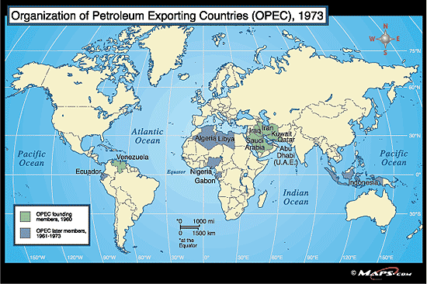

Slide 39
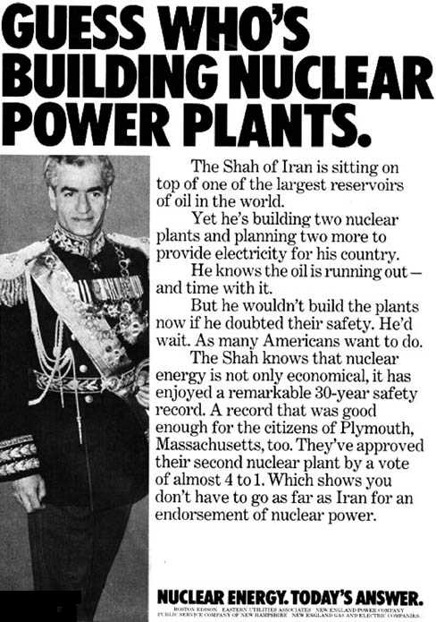

Slide 40
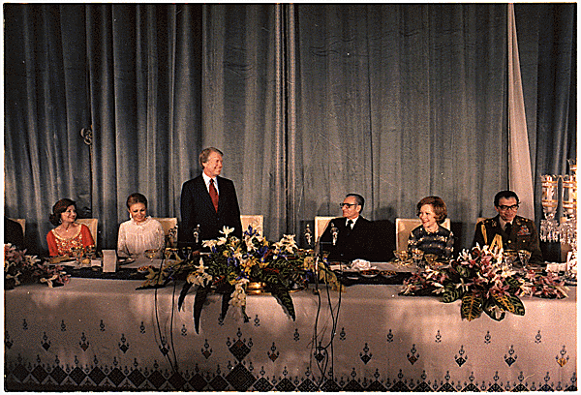
Notes:
Carter late 77 teheran state visit—shah as oasis of stability

Slide 41
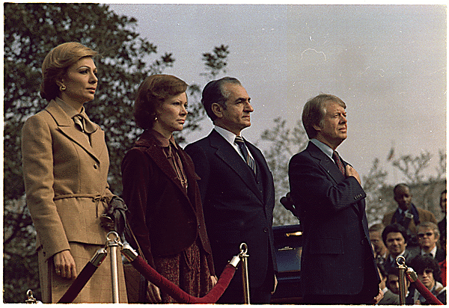
Notes:
State visit to US

Slide 42


Slide 43
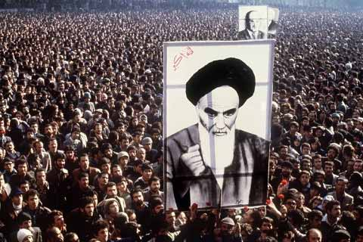

Slide 44
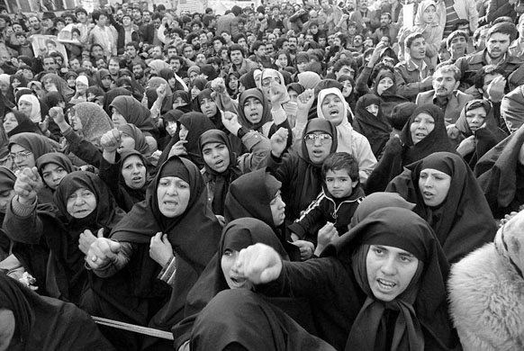

Slide 45
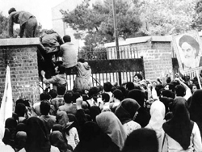

Slide 46
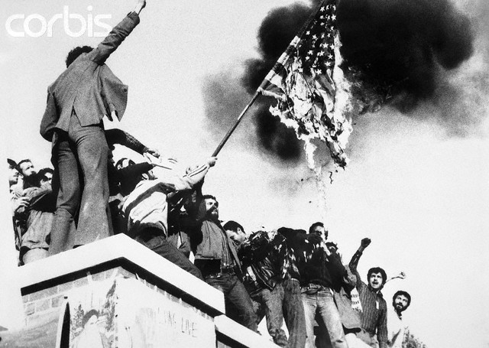
Notes:
seizure

Slide 47
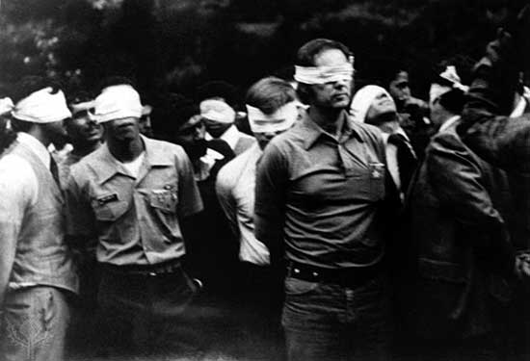

Slide 48
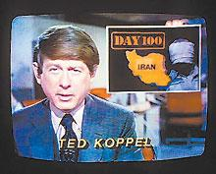

Slide 49
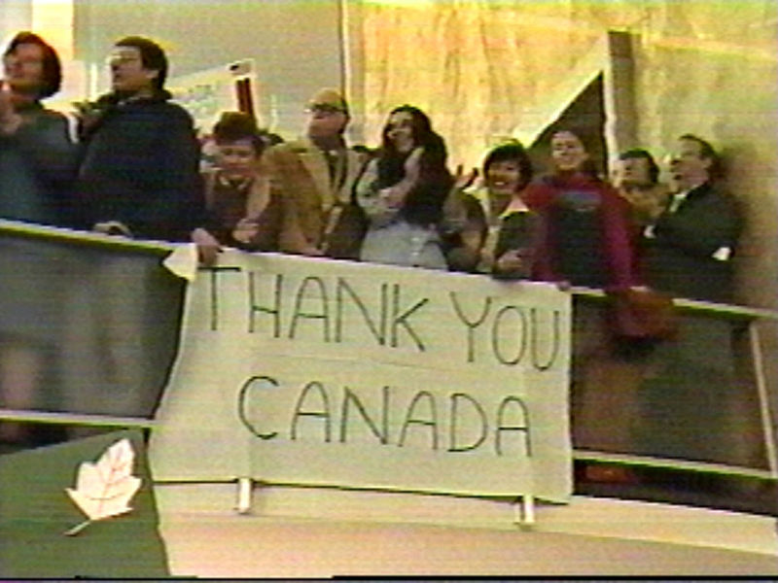
Notes:
Canadian caper

Slide 50
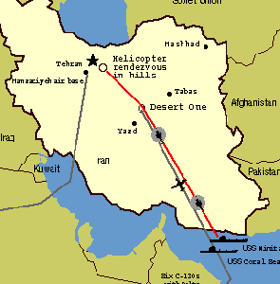

Slide 51
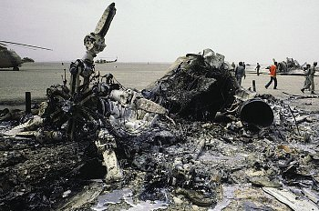

Slide 52
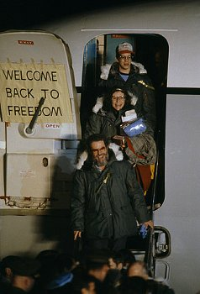

Slide 53


Slide 54



Slide 55


Slide 56


Slide 57
US shipment of weapons to Iran
1985
Aug. 20: Israel sends 96 TOW anti-tank missiles to Iran.
Sept. 14: Israel sends 408 more TOW missiles to Iran.
Nov. 24-25: The C.I.A. arranges for a shipment of 18 Hawk anti-aircraft missiles from Israel to Iran aboard a C.I.A. front company plane
1986
Feb. 17: The United States sends 500 TOW missiles to Israel, from American stocks, for shipment to Iran.
Feb. 27: Another shipment of 500 TOW missiles are sent to Israel, once again for shipment to Iran.
May 23-24: 508 TOW missiles and 240 spare parts for Hawk missiles are shipped to Israel.
Aug. 4: The United States sends Iran a shipment of spare parts for Hawk anti-aircraft missiles.
Oct. 28: 500 TOW missiles are sent from Israel to Iran.

Slide 58


Slide 59


Slide 60


Slide 61


Slide 62


Slide 63


Slide 64

Notes:
Silkworm missile—prc missile

Slide 65

Notes:
Iran air flt 655 path—290 killed; ghwb: "I'll never apologize for the United States of America. Ever. I don't care what the facts are."

Slide 66



Slide 67


Slide 68


Slide 69


Slide 70




Slide 71


Slide 72


Slide 73


Slide 74



Slide 75


Slide 76


