Slide 1
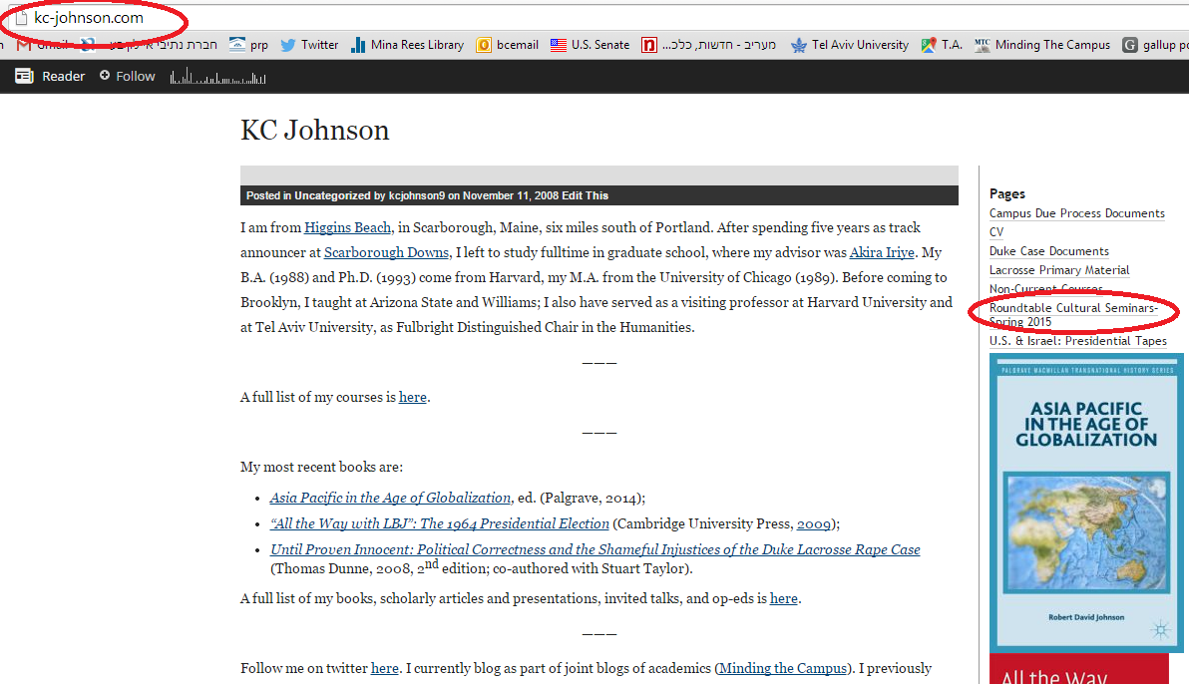

Slide 2
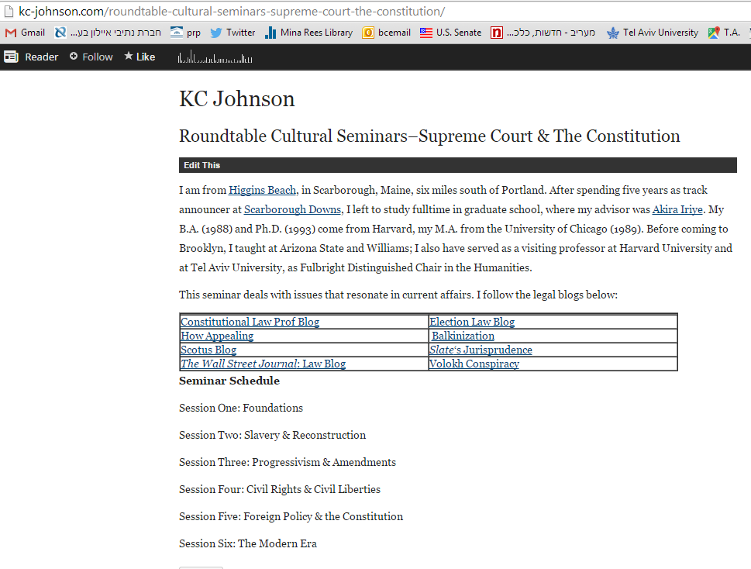

Slide 3
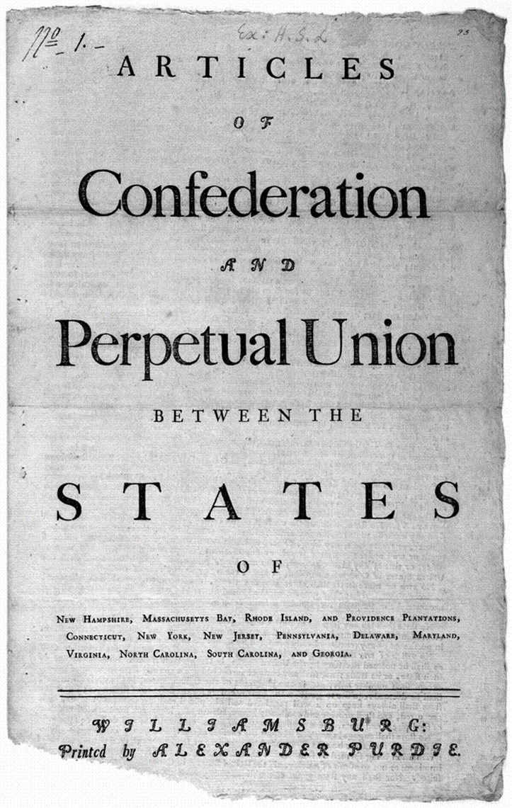
Article II. Each state retains its sovereignty, freedom, and independence, and every Power, Jurisdiction, and right, which is not by this confederation expressly delegated to the United States, in Congress assembled.
----------
Art. IX. All charges of war, and all other expenses that shall be incurred for the common defense or general welfare, and allowed by the united States in congress assembled, shall be defrayed out of a common treasury, which shall be supplied by the several States in proportion to the value of all land within each State.
The taxes for paying that proportion shall be laid and levied by the authority and direction of the legislatures of the several States within the time agreed upon by the united States in congress assembled . . .
In determining questions in the united States, in Congress assembled, each State shall have one vote . . .

Slide 4
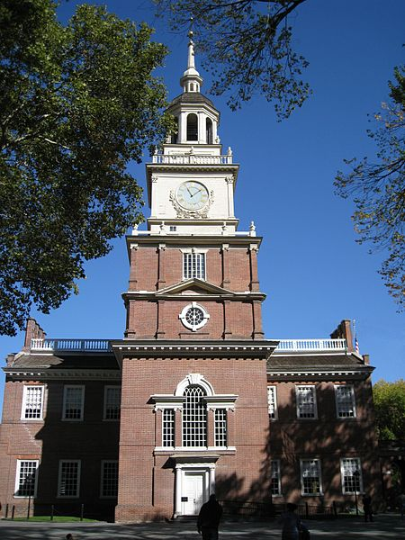
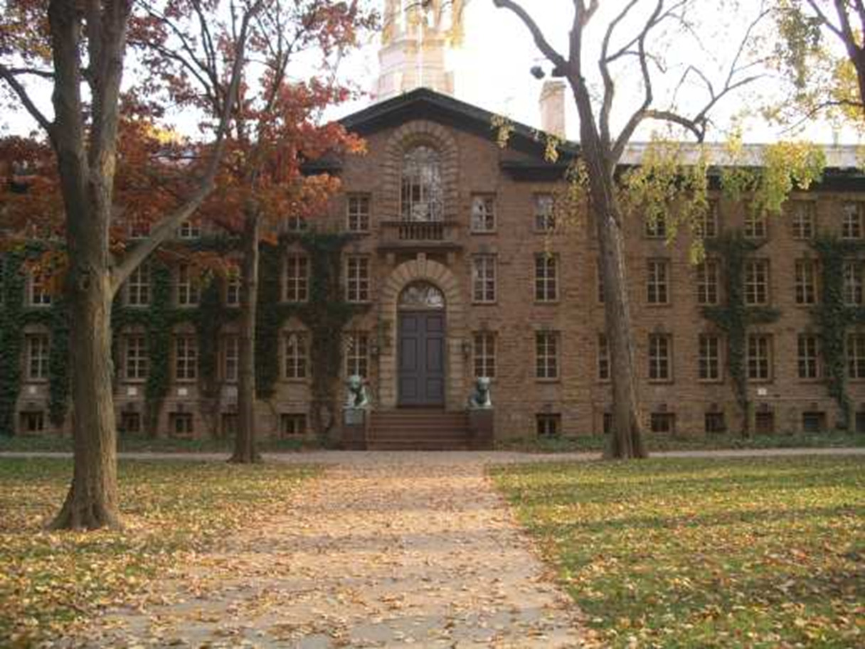
Notes:
Indpce hall

Slide 5
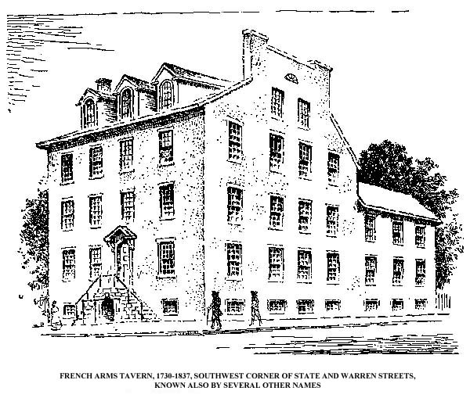
Notes:
French arms tavern 1785

Slide 6
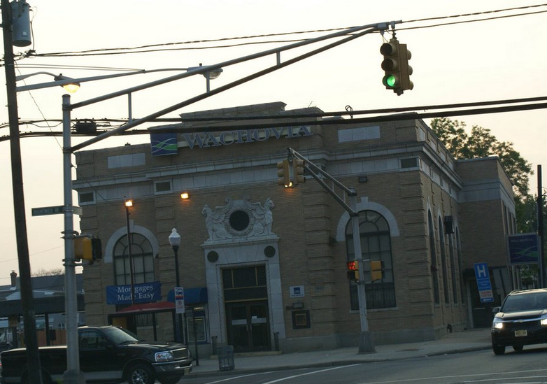
Notes:
Now—a wells fargoBank

Slide 7


Slide 8
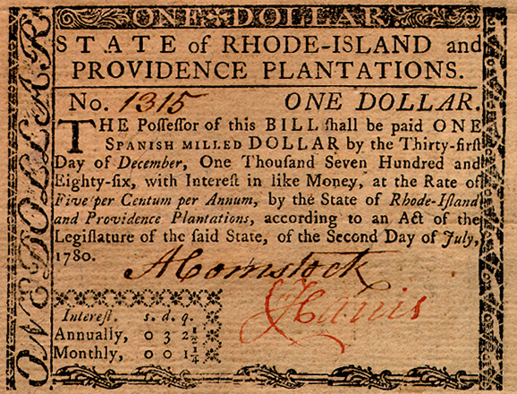

Slide 9

Notes:
Daniel shays

Slide 10
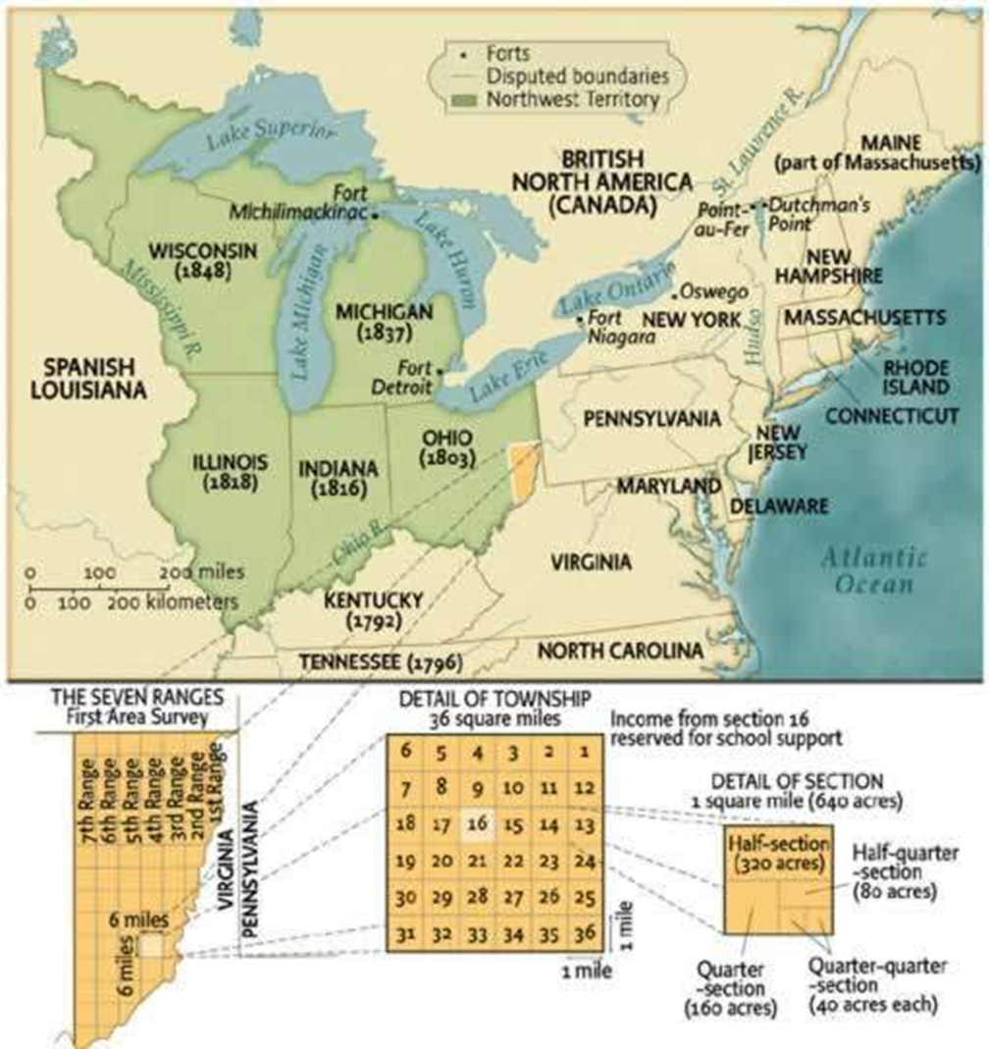
Northwest Ordinance (1786)
Art. 5. There shall be formed in the said territory, not less than three nor more than five States . . . And, whenever any of the said States shall have sixty thousand free inhabitants therein, such State shall be admitted, by its delegates, into the Congress of the United States, on an equal footing with the original States in all respects whatever, and shall be at liberty to form a permanent constitution and State government: Provided, the constitution and government so to be formed, shall be republican, and in conformity to the principles contained in these articles; and, so far as it can be consistent with the general interest of the confederacy, such admission shall be allowed at an earlier period, and when there may be a less number of free inhabitants in the State than sixty thousand.
Art. 6. There shall be neither slavery nor involuntary servitude in the said territory, otherwise than in the punishment of crimes whereof the party shall have been duly convicted.

Slide 11


Slide 12
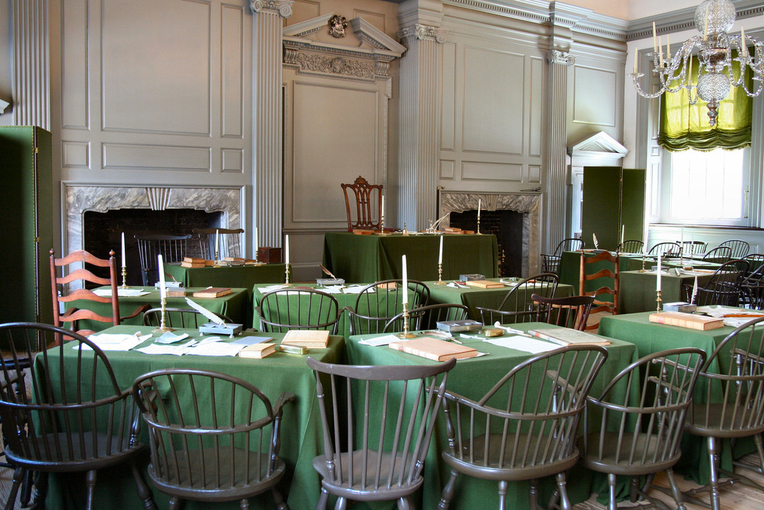

Slide 13
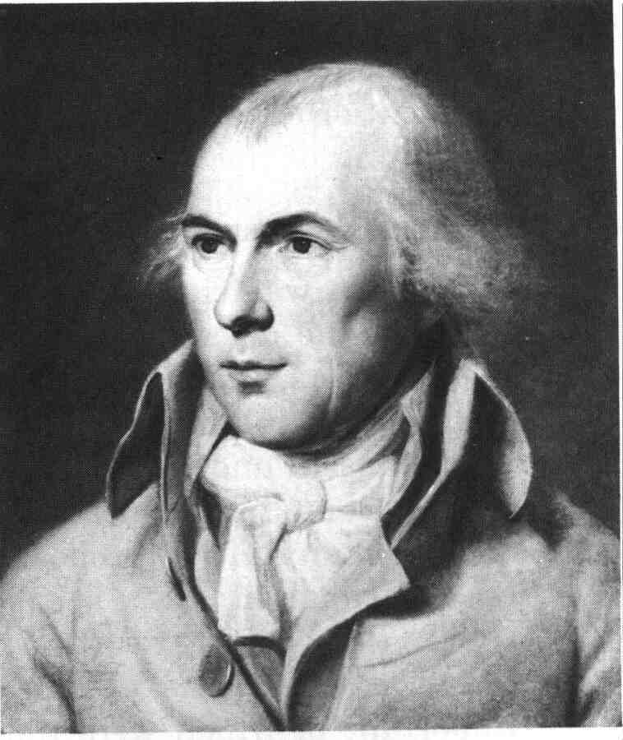


Slide 14
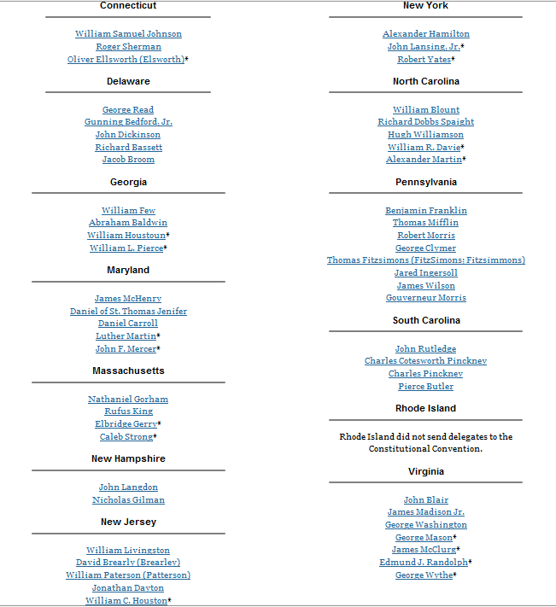

Slide 15
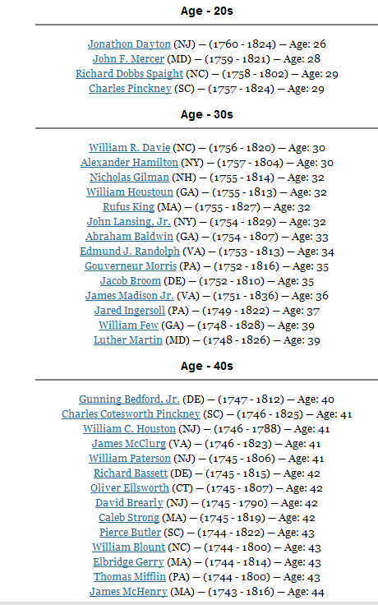
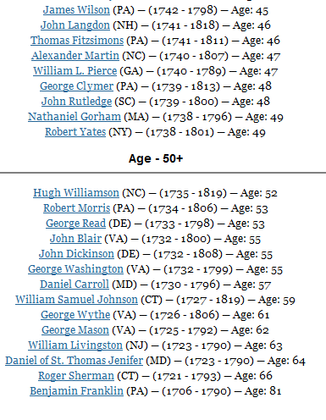

Slide 16
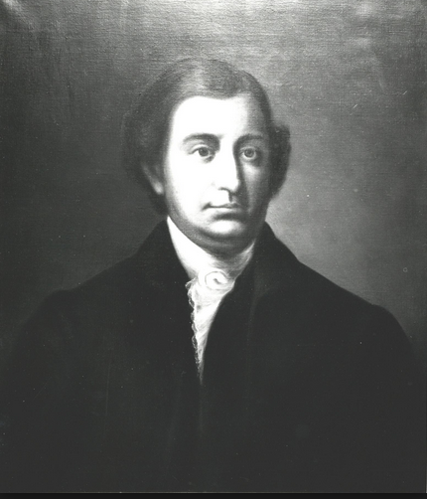
Notes:
Edmund randolph

Slide 17
Virginia Plan
2. Res^{d} therefore that the rights of suffrage in the National Legislature ought to be proportioned to the Quotas of contribution, or to the number of free inhabitants, as the one or the other rule may seem best in different cases.
5. Resol^{d} that the members of the second branch of the National Legislature ought to be elected by those of the first, out of a proper number of persons nominated by the individual Legislatures . . .
6. Resolved that each branch ought to possess the right of originating Acts . . . to negative all laws passed by the several States, contravening in the opinion of the National Legislature the articles of Union; and to call forth the force of the Union agst any member of the Union failing to fulfill its duty under the articles thereof.
7. Res^{d} that a National Executive be instituted; to be chosen by the National Legislature for the term of years . ..
8. Res^{d} that the Executive and a convenient number of the National Judiciary, ought to compose a Council of revision with authority to examine every act of the National Legislature before it shall operate, & every act of a particular Legislature before a Negative thereon shall be final.

Slide 18
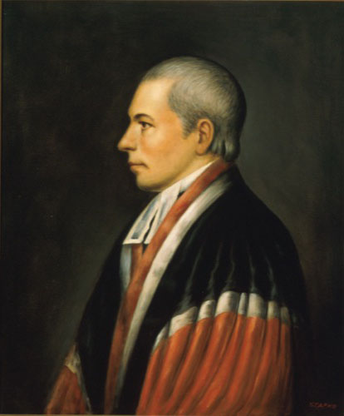
Notes:
William paterson (NJ)

Slide 19
New Jersey Plan
Resolved, that an union of the states, merely federal, ought to be the sole object of the exercise of the powers vested in this convention.
2. Resolved, that the articles of the confederation ought to be so revised, corrected, and enlarged, as to render the federal constitution adequate to the exigencies of government, and the preservation of the union.
3. Resolved, that in addition to the powers vested in the united states in congress, by the present existing articles of confederation, they be authorized to pass acts for raising a revenue by laying a duty or duties on all goods and merchandise of foreign growth or manufacture, imported into any part of the united states; by imposing stamps on paper, parchment, and vellum; and by a postage on all letters and packages passing through the general post office, to be applied to such federal purposes, as they shall deem proper and expedient;
6. Resolved, that the united states in congress, shall be authorised to elect a federal executive, to consist of _____ person or persons . . . to be ineligible a second time.

Slide 20


Slide 21
Article I, Section 8
The Congress shall have power . . . to make all laws which shall be necessary and proper for carrying into execution the foregoing powers, and all other powers vested by this Constitution in the government of the United States, or in any department or officer thereof…
The Congress shall have power to lay and collect taxes, duties, imposts and excises, to pay the debts and provide for the common defense and general welfare of the United States; but all duties, imposts and excises shall be uniform throughout the United States . . .

Slide 22
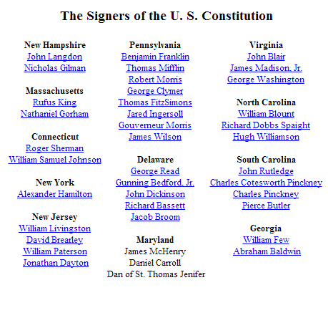

Slide 23

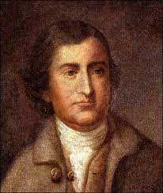
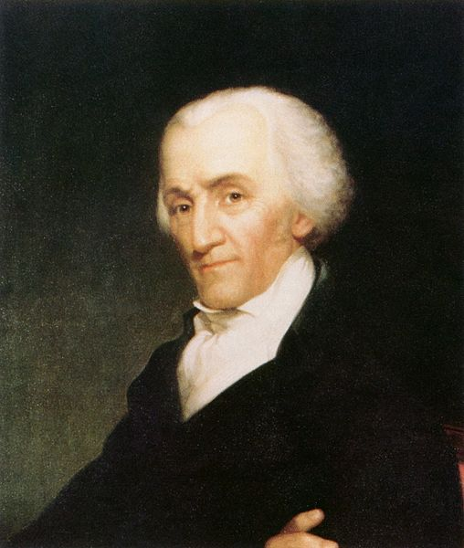
Notes:
Mason-gerry-randolph

Slide 24
Article II
Section 1. The executive power shall be vested in a President of the United States of America. He shall hold his office during the term of four years, and, together with the Vice President, chosen for the same term, be elected, as follows:
Each state shall appoint, in such manner as the Legislature thereof may direct, a number of electors, equal to the whole number of Senators and Representatives to which the State may be entitled in the Congress: but no Senator or Representative, or person holding an office of trust or profit under the United States, shall be appointed an elector.
---------------------
Section 2. [The President] shall have power, by and with the advice and consent of the Senate, to make treaties, provided two thirds of the Senators present concur; and he shall nominate, and by and with the advice and consent of the Senate, shall appoint ambassadors, other public ministers and consuls, judges of the Supreme Court, and all other officers of the United States, whose appointments are not herein otherwise provided for, and which shall be established by law: but the Congress may by law vest the appointment of such inferior officers, as they think proper, in the President alone, in the courts of law, or in the heads of departments.

Slide 25
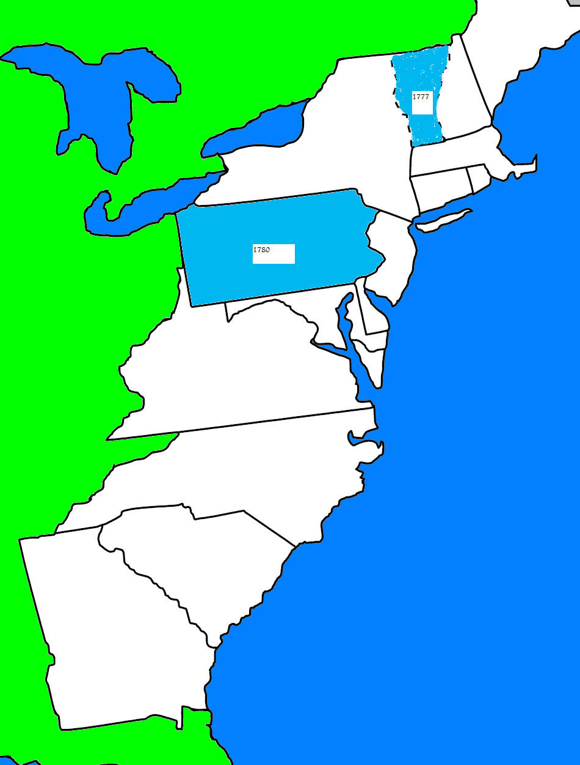

Slide 26
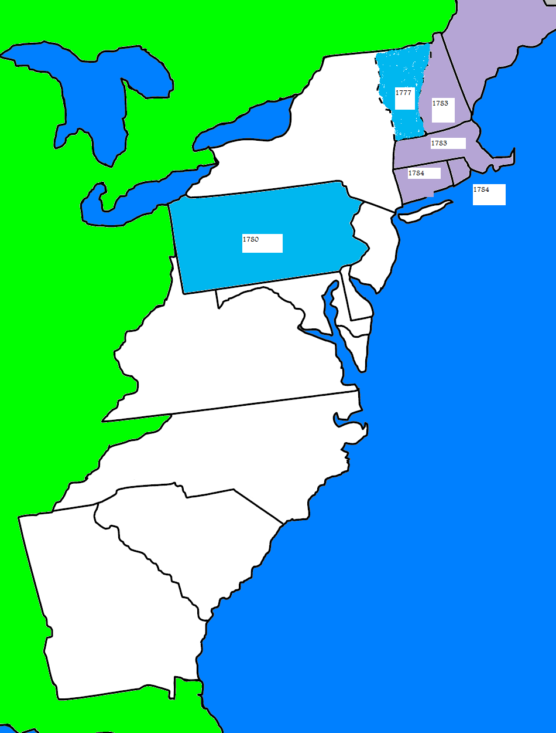

Slide 27
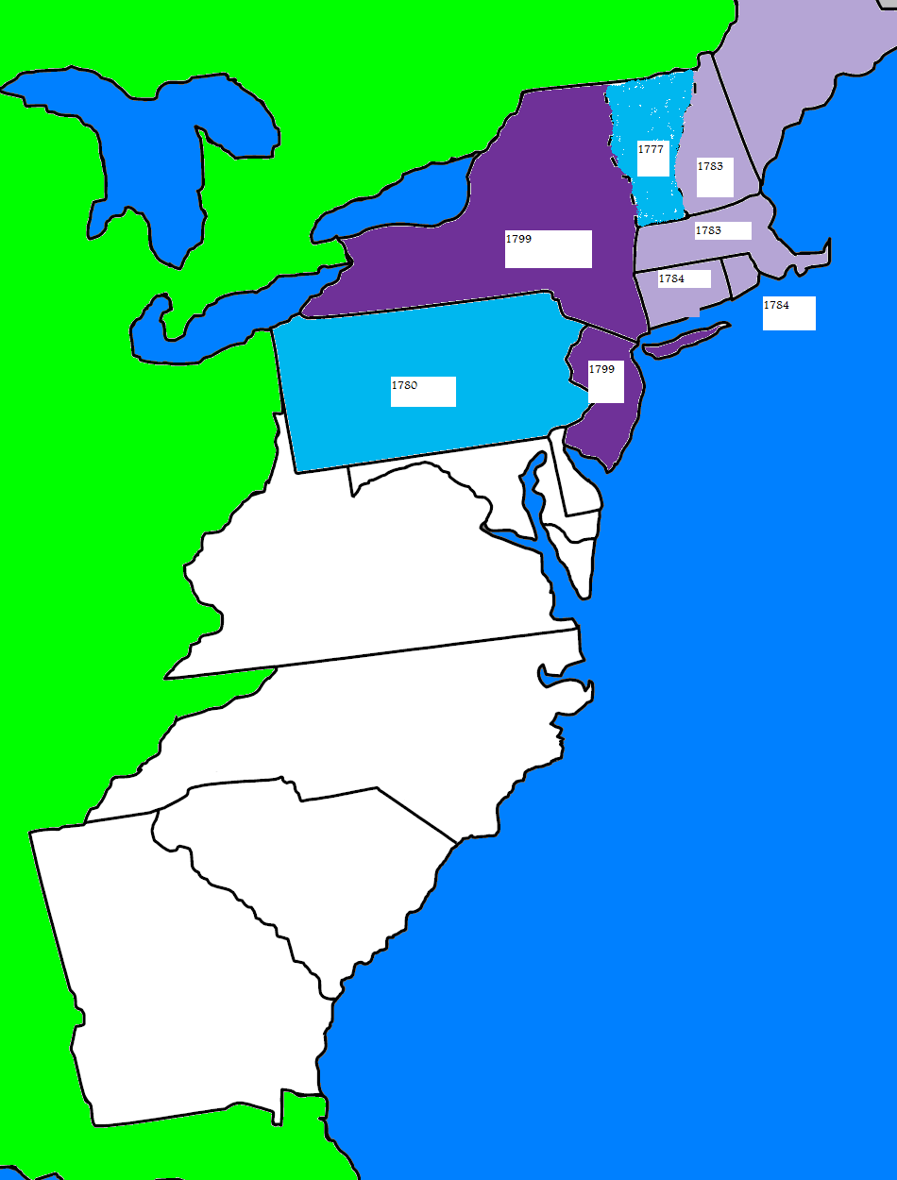

Slide 28
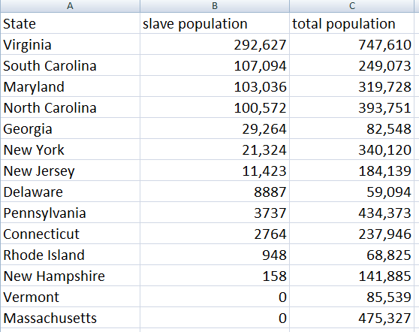

Slide 29
I: 2: Representatives and direct taxes shall be apportioned among the several states which may be included within this union, according to their respective numbers, which shall be determined by adding to the whole number of free persons, including those bound to service for a term of years, and excluding Indians not taxed, three fifths of all other Persons.
I:9: The migration or importation of such persons as any of the states now existing shall think proper to admit, shall not be prohibited by the Congress prior to the year one thousand eight hundred and eight, but a tax or duty may be imposed on such importation, not exceeding ten dollars for each person.
IV: 1: No person held to service or labor in one state, under the laws thereof, escaping into another, shall, in consequence of any law or regulation therein, be discharged from such service or labor, but shall be delivered up on claim of the party to whom such service or labor may be due.

Slide 30


Slide 31


Slide 32


Slide 33
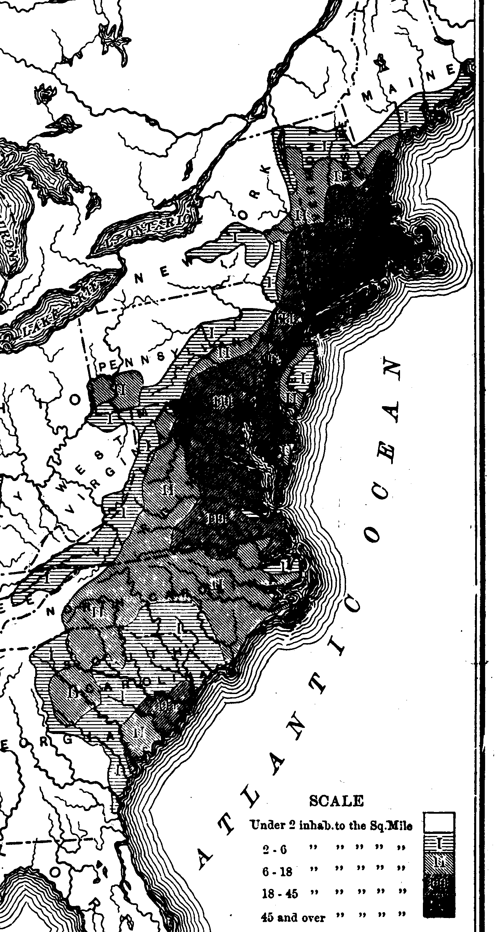

Slide 34

Article I, Section 9.
The privilege of the writ of habeas corpus shall not be suspended, unless when in cases of rebellion or invasion the public safety may require it.
No bill of attainder or ex post facto Law shall be passed.
No title of nobility shall be granted by the United States: and no person holding any office of profit or trust under them, shall, without the consent of the Congress, accept of any present, emolument, office, or title, of any kind whatever, from any king, prince, or foreign state.

Slide 36
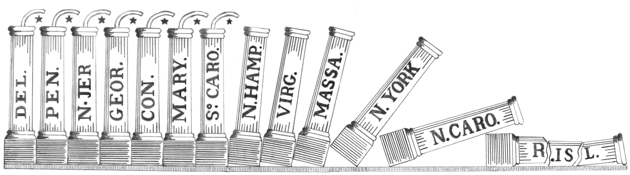

Slide 37
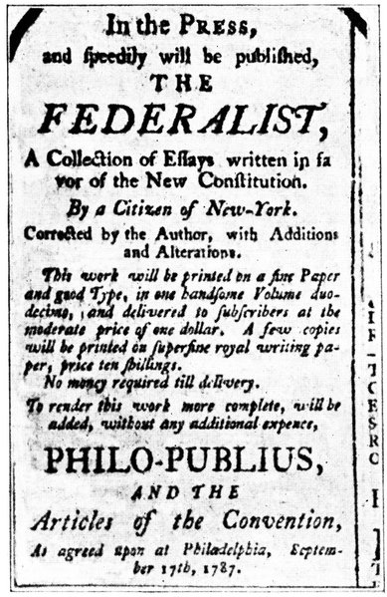
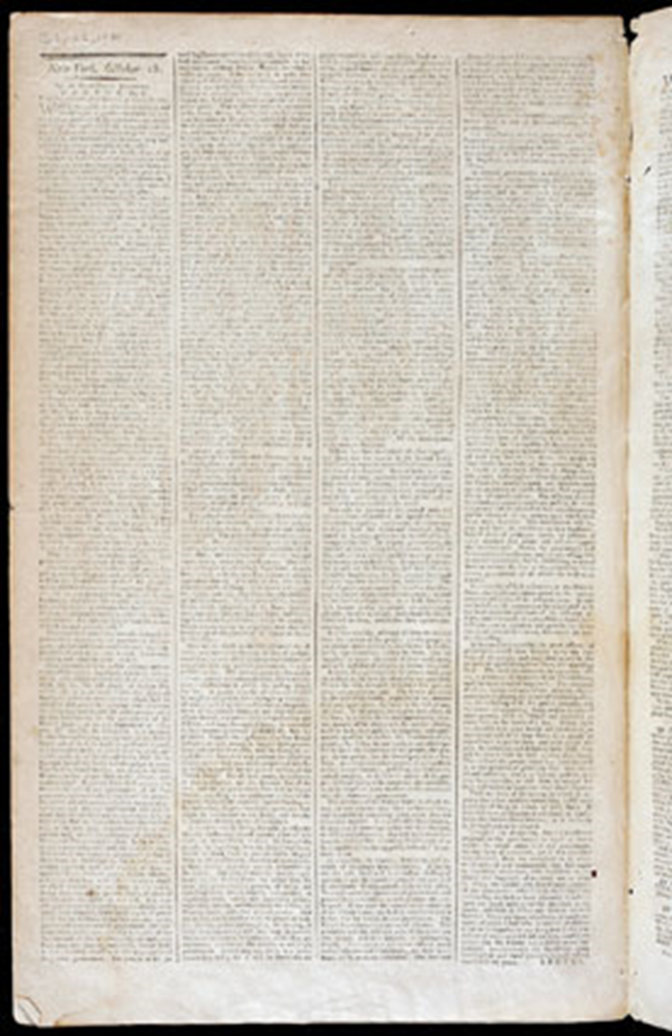

Slide 38
Brutus I
If respect is to be paid to the opinion of the greatest and wisest men who have ever thought or wrote on the science of government, we shall be constrained to conclude, that a free republic cannot succeed over a country of such immense extent, containing such a number of inhabitants, and these encreasing in such rapid progression as that of the whole United States . . .
History furnishes no example of a free republic, any thing like the extent of the United States. The Grecian republics were of small extent; so also was that of the Romans. Both of these, it is true, in process of time, extended their conquests over large territories of country; and the consequence was, that their governments were changed from that of free governments to those of the most tyrannical that ever existed in the world.

Slide 39
Federalist 10
From this view of the subject it may be concluded that a pure democracy, by which I mean a society consisting of a small number of citizens, who assemble and administer the government in person, can admit of no cure for the mischiefs of faction . . .
A republic, by which I mean a government in which the scheme of representation takes place, opens a different prospect, and promises the cure for which we are seeking. Let us examine the points in which it varies from pure democracy, and we shall comprehend both the nature of the cure and the efficacy which it must derive from the Union.
The two great points of difference between a democracy and a republic are: first, the delegation of the government, in the latter, to a small number of citizens elected by the rest; secondly, the greater number of citizens, and greater sphere of country, over which the latter may be extended . . . Extend the sphere, and you take in a greater variety of parties and interests; you make it less probable that a majority of the whole will have a common motive to invade the rights of other citizens; or if such a common motive exists, it will be more difficult for all who feel it to discover their own strength, and to act in unison with each other.

Slide 40
Federalist 78
Whoever attentively considers the different departments of power must perceive, that, in a government in which they are separated from each other, the judiciary, from the nature of its functions, will always be the least dangerous to the political rights of the Constitution; because it will be least in a capacity to annoy or injure them. The Executive not only dispenses the honors, but holds the sword of the community. The legislature not only commands the purse, but prescribes the rules by which the duties and rights of every citizen are to be regulated. The judiciary, on the contrary, has no influence over either the sword or the purse; no direction either of the strength or of the wealth of the society; and can take no active resolution whatever. It may truly be said to have neither FORCE nor WILL, but merely judgment; and must ultimately depend upon the aid of the executive arm even for the efficacy of its judgments.

Slide 41
Brutus V
The great objects then are declared in this preamble in general and indefinite terms to be to provide for the common defence, promote the general welfare, and an express power being vested in the legislature to make all laws which shall be necessary and proper for carrying into execution all the powers vested in the general government. The inference is natural that the legislature will have an authority to make all laws which they shall judge necessary for the common safety, and to promote the general welfare. This amounts to a power to make laws at discretion: No terms can be found more indefinite than these, and it is obvious, that the legislature alone must judge what laws are proper and necessary for the purpose. It may be said, that this way of explaining the constitution, is torturing and making it speak what it never intended. This is far from my intention, and I shall not even insist upon this implied power, but join issue with those who say we are to collect the idea of the powers given from the express words of the clauses granting them; and it will not be difficult to shew that the same authority is expressly given which is supposed to be implied in the forgoing paragraphs.

Slide 42
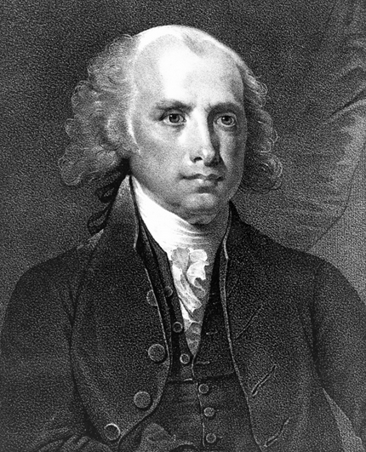
Notes:
madison

Slide 43
Bill of Rights in Context
Amendments 1-4: limitations on congressional power (speech, religion, assembly, right to bear arms, search/seizure, quartering soldiers)
Amendments 5-8: protections for accused criminals (5th amendment protections, speedy trial, jury, no excessive bail)
Amendments 9-10: structural (rights of the people, reservations of state powers)

Slide 44
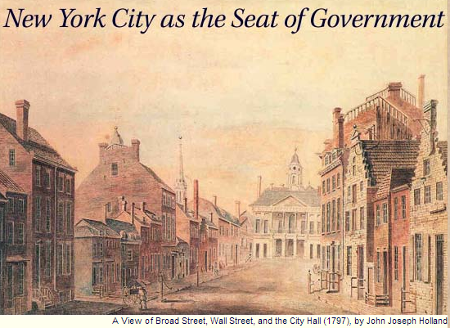

Slide 45
Judiciary Act (1789)
The supreme court of the United States shall consist of a chief justice and five associate justices…
And be it further enacted, That the United States shall be, and they hereby are divided into thirteen districts . . . That there be a court called a District Court, in each of the afore mentioned districts, to consist of one judge . . .
That the before mentioned districts, except those of Maine and Kentucky, shall be divided into three circuits, and be called the eastern, the middle, and the southern circuit…
The district courts shall have, exclusively of the courts of the several States, cognizance of all crimes and offences that shall be cognizable under the authority of the United States.

Slide 46
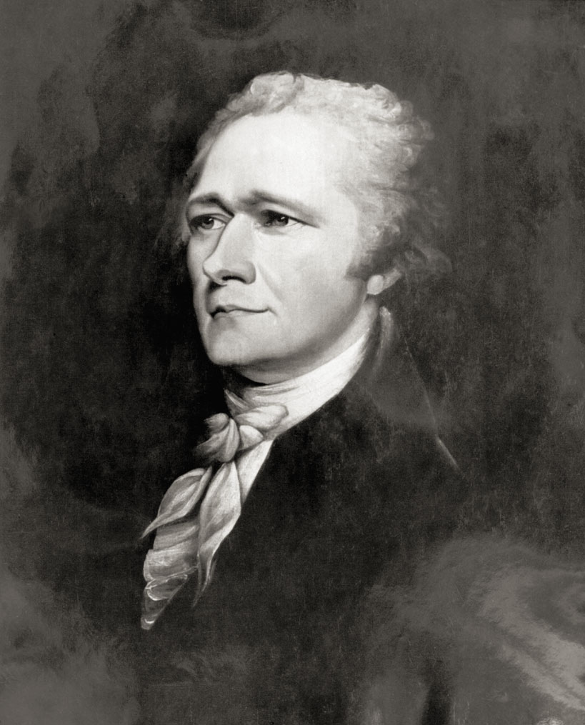

Slide 47
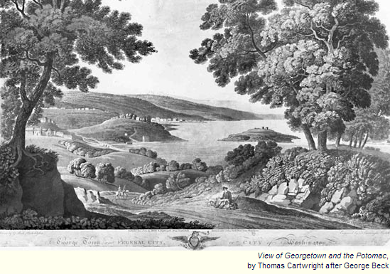

Slide 48
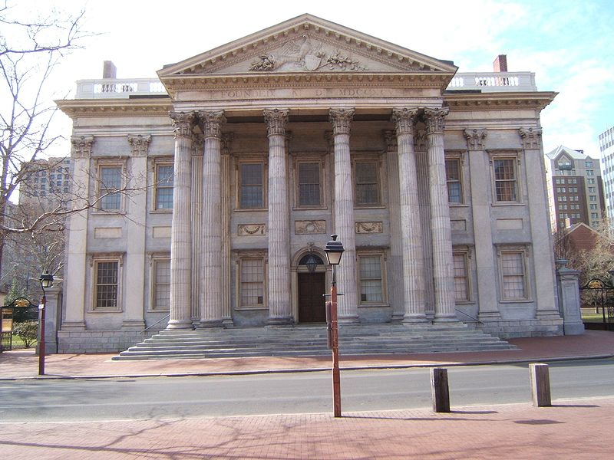
Notes:
Bank of us--philly

Slide 49
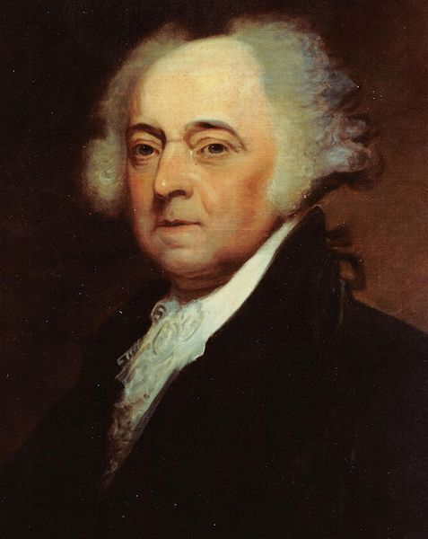
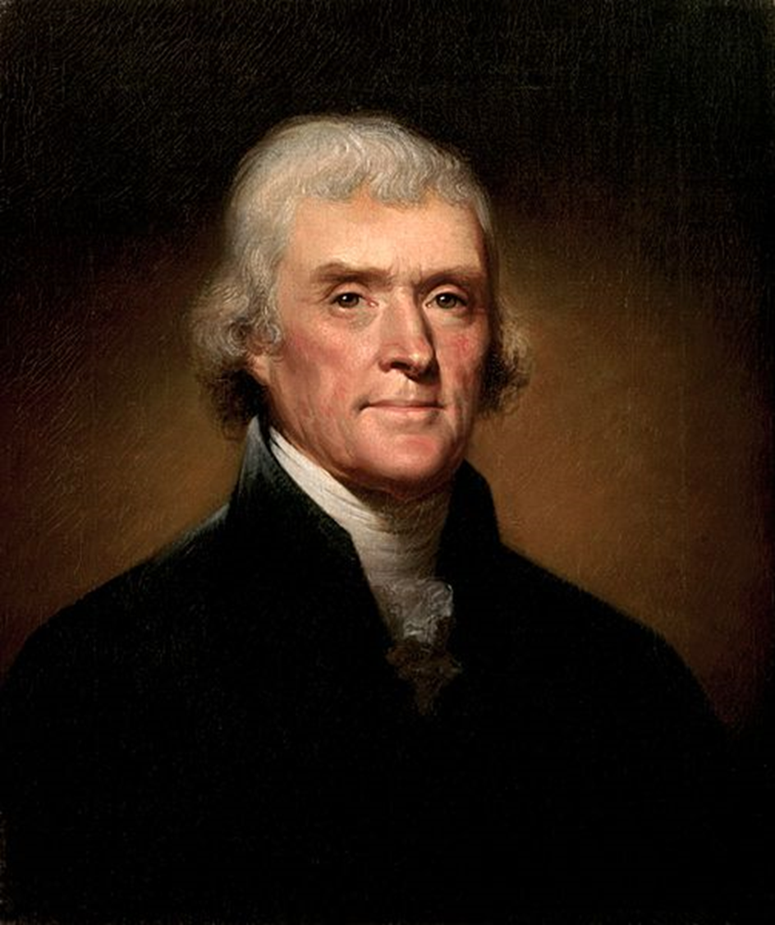

Slide 50
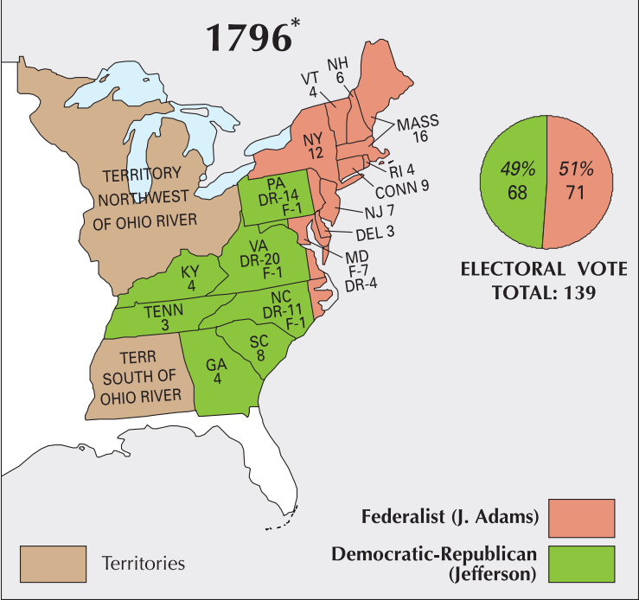

Slide 51
Sedition Act (1798)
If any person shall write, print, utter or publish, or shall cause or procure to be written, printed, uttered or published, or shall knowingly and willingly assist or aid in writing, printing, uttering or publishing any false, scandalous and malicious writing or writings against the government of the United States, or either house of the Congress of the United States, or the President of the United States, with intent to defame the said government, or either house of the said Congress, or the said President, or to bring them, or either of them, into contempt or disrepute; or to excite against them, or either or any of them, the hatred of the good people of the United States, or to stir up sedition within the United States, or to excite any unlawful combinations therein, for opposing or resisting any law of the United States, or any act of the President of the United States, done in pursuance of any such law, or of the powers in him vested by the constitution of the United States, or to resist, oppose, or defeat any such law or act, or to aid, encourage or abet any hostile designs of any foreign nation against United States, their people or government, then such person, being thereof convicted before any court of the United States having jurisdiction thereof, shall be punished by a fine not exceeding two thousand dollars, and by imprisonment not exceeding two years.

Slide 52
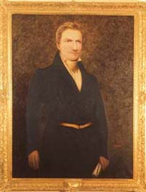
Notes:
Matthew lyon

Slide 53
Kentucky Resolution (Jefferson)
1. Resolved, That the several States composing, the United States of America, are not united on the principle of unlimited submission to their general government; but that, by a compact under the style and title of a Constitution for the United States, and of amendments thereto, they constituted a general government for special purposes — delegated to that government certain definite powers, reserving, each State to itself, the residuary mass of right to their own self-government; and that whensoever the general government assumes undelegated powers, its acts are unauthoritative, void, and of no force: that to this compact each State acceded as a State, and is an integral part, its co-States forming, as to itself, the other party: that the government created by this compact was not made the exclusive or final judge of the extent of the powers delegated to itself; since that would have made its discretion, and not the Constitution, the measure of its powers; but that, as in all other cases of compact among powers having no common judge, each party has an equal right to judge for itself, as well of infractions as of the mode and measure of redress.

Slide 54
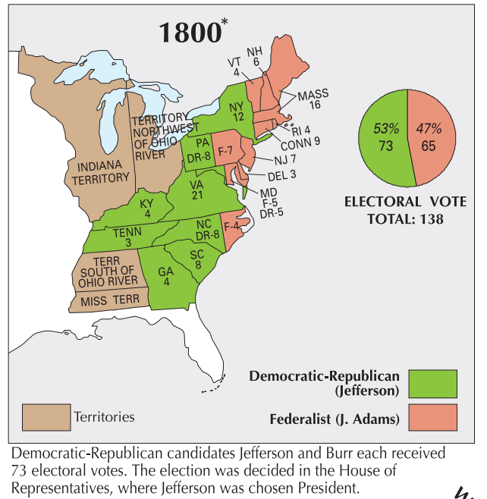

Slide 55
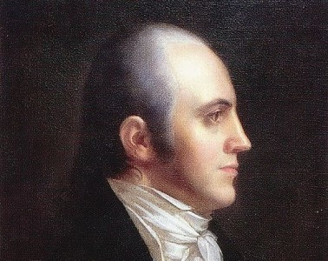

Slide 56
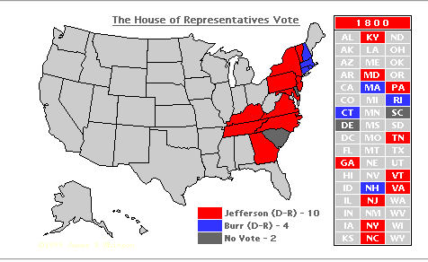

Slide 57
12th amendment
The Electors shall meet in their respective states, and vote by ballot for President and Vice-President, one of whom, at least, shall not be an inhabitant of the same state with themselves; they shall name in their ballots the person voted for as President, and in distinct ballots the person voted for as Vice-President, and they shall make distinct lists of all persons voted for as President, and of all persons voted for as Vice-President and of the number of votes for each, which lists they shall sign and certify, and transmit sealed to the seat of the government of the United States, directed to the President of the Senate;

Slide 58
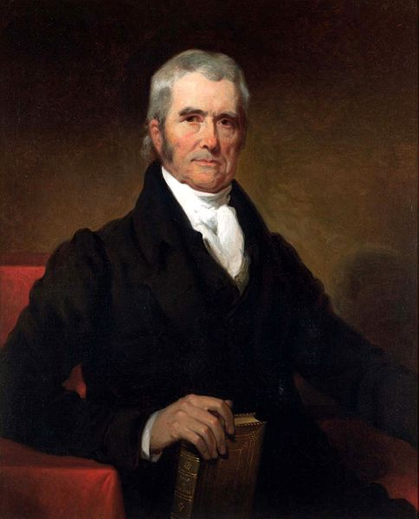

Slide 59
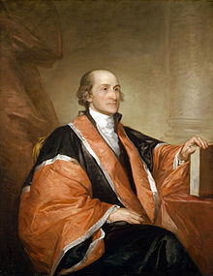
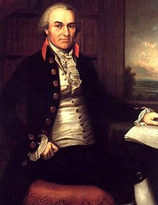
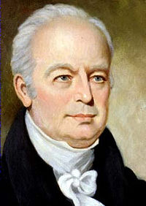
Notes:
Jay-john rutledge-ellsworth

Slide 60
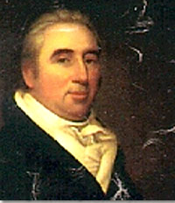
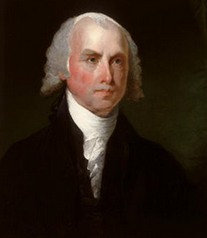
Marbury
v.
Madison
1803
The authority, therefore, given to the Supreme Court by the act establishing the judicial courts of the United States to issue writs of mandamus to public officers appears not to be warranted by the Constitution, and it becomes necessary to inquire whether a jurisdiction so conferred can be exercised…
The Constitution is either a superior, paramount law, unchangeable by ordinary means, or it is on a level with ordinary legislative acts, and, like other acts, is alterable when the legislature shall please to alter it.
If the former part of the alternative be true, then a legislative act contrary to the Constitution is not law; if the latter part be true, then written Constitutions are absurd attempts on the part of the people to limit a power in its own nature illimitable.

Slide 61
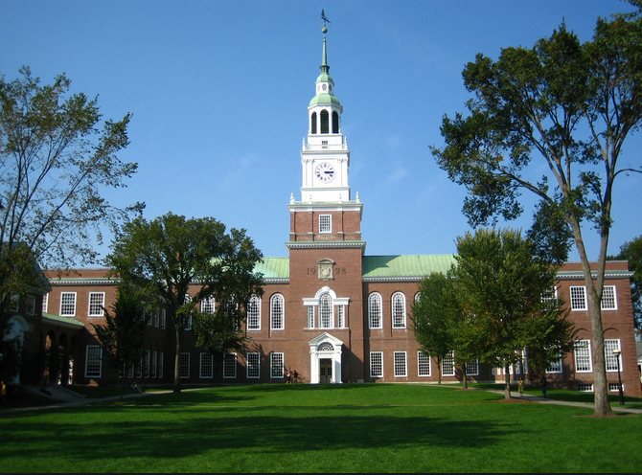


Slide 62
Dartmouth College v. Woodward (1819)
This court can be insensible neither to the magnitude nor delicacy of this question. The validity of a legislative act is to be examined; and the opinion of the highest law tribunal of a State is to be revised…
On more than one occasion, this Court has expressed the cautious circumspection with which it approaches the consideration of such questions, and has declared that in no doubtful case would it pronounce a legislative act to be contrary to the Constitution…
This is plainly a contract to which the donors, the Trustees, and the Crown (to whose rights and obligations New Hampshire succeeds) were the original parties. It is a contract made on a valuable consideration. It is a contract for the security and disposition of property. It is a contract on the faith of which real and personal estate has been conveyed to the corporation. It is, then, a contract within the letter of the Constitution, and within its spirit also… The opinion of the Court, after mature deliberation, is that this is a contract the obligation of which cannot be impaired without violating the Constitution of the United States.

Slide 63
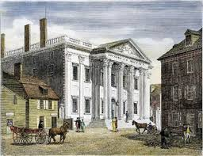

Slide 64
McCulloch v. Maryland (1819)
In discussing this question, the counsel for the State of Maryland have deemed it of some importance, in the construction of the Constitution, to consider that instrument not as emanating from the people, but as the act of sovereign and independent States . . . It would be difficult to sustain this proposition . . .
Among the enumerated powers, we do not find that of establishing a bank or creating a corporation. But there is no phrase in the instrument which, like the Articles of Confederation, excludes incidental or implied powers and which requires that everything granted shall be expressly and minutely described . . .
Let the end be legitimate, let it be within the scope of the constitution, and all means which are appropriate, which are plainly adapted to that end, which are not prohibited, but consist with the letter and spirit of the constitution, are constitutional…
A right to tax, without limit or control, is essentially a power to destroy. If one national institution may be destroyed in this manner, all may be destroyed in the same manner. If this power to tax the national property and institutions exists in the state of Maryland, it is unbounded in extent.

