Slide 1
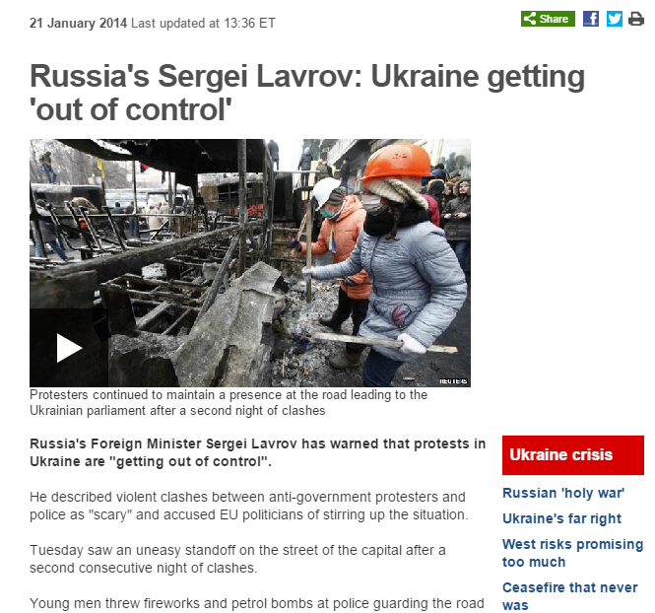
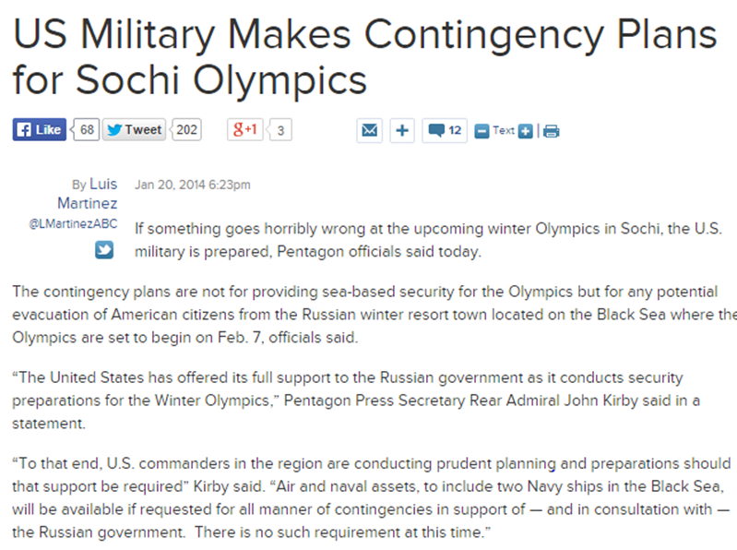

Slide 2
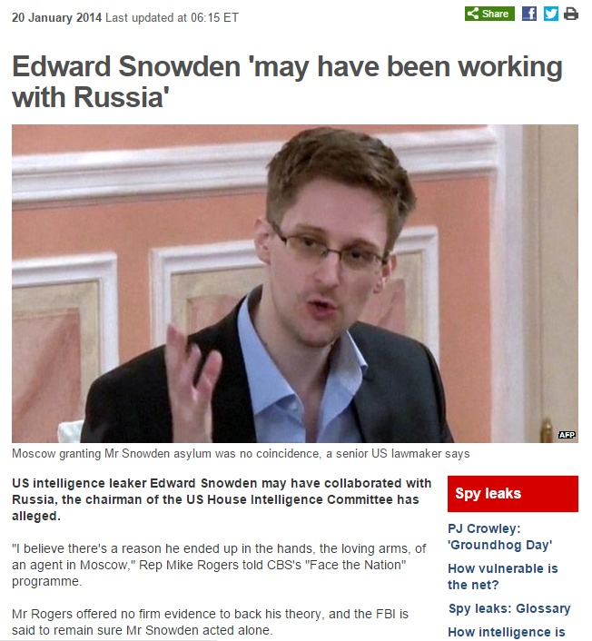

Slide 3
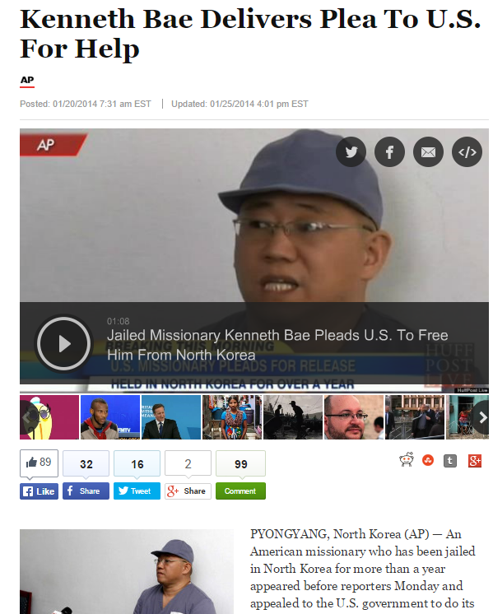
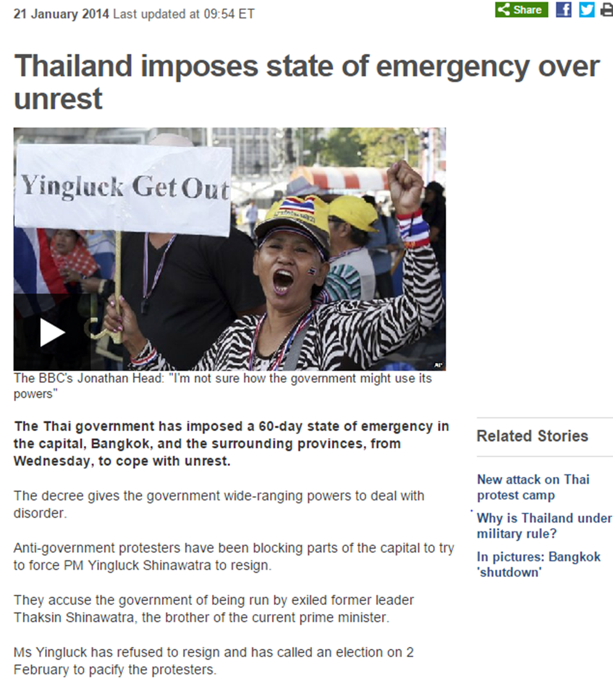

Slide 4
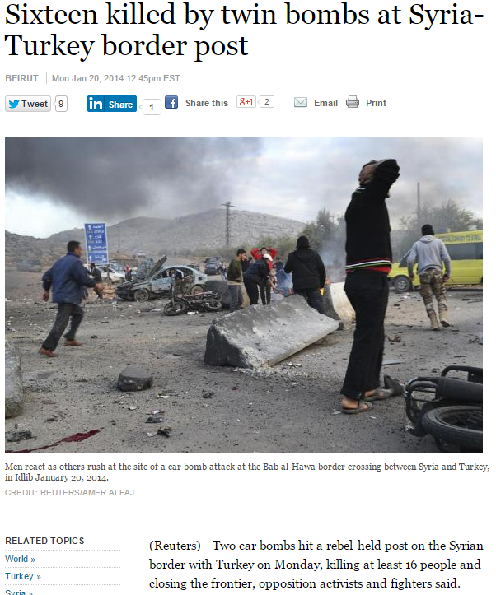
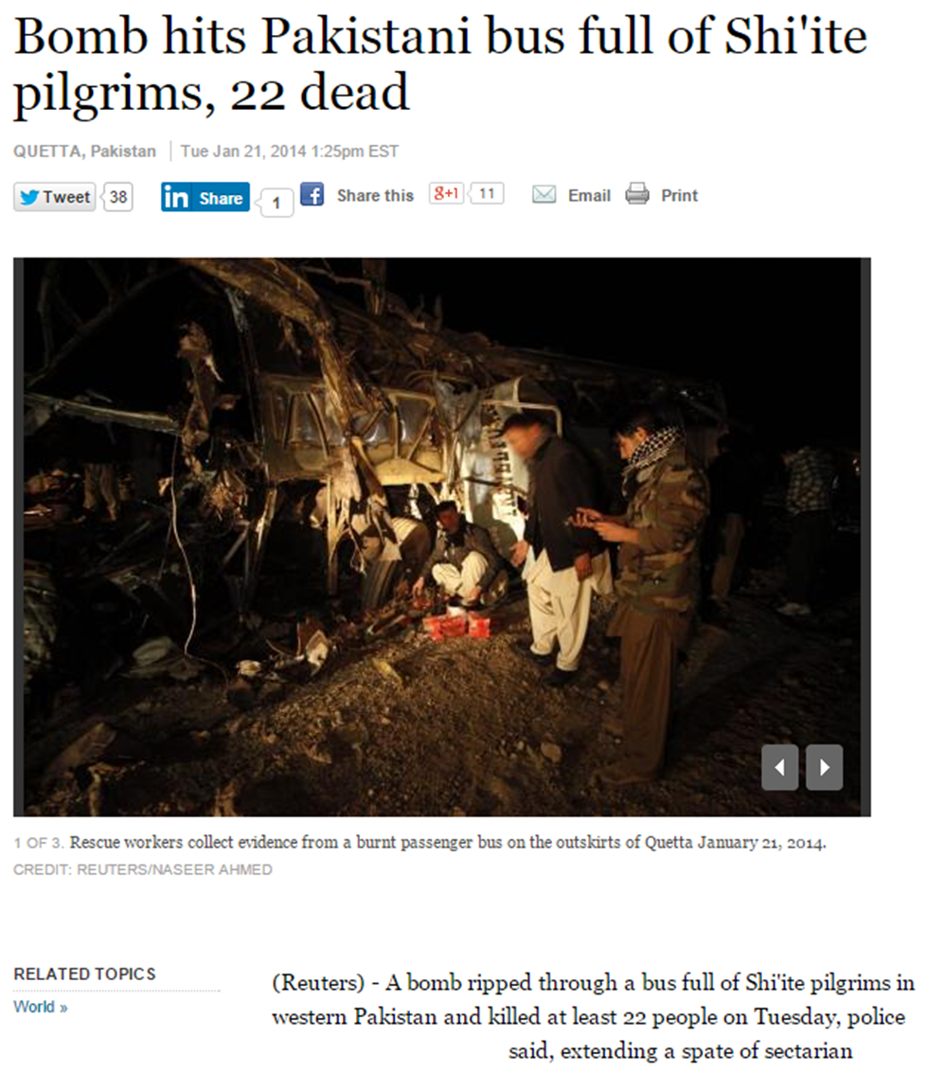

Slide 5
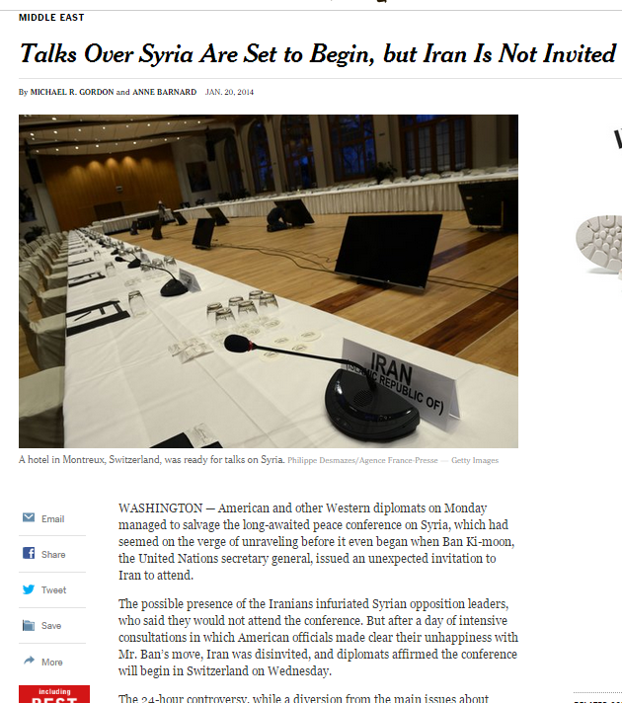
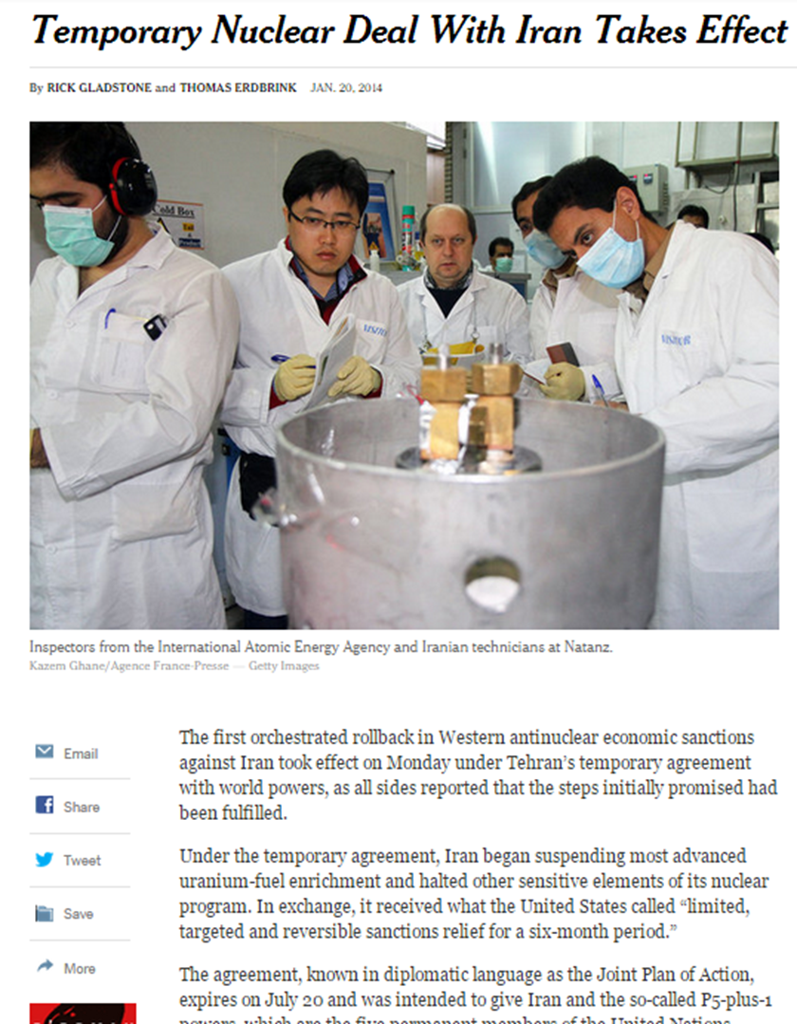

Slide 6
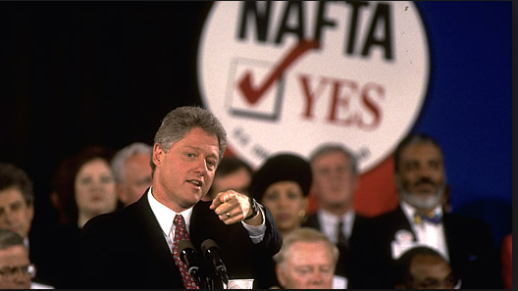
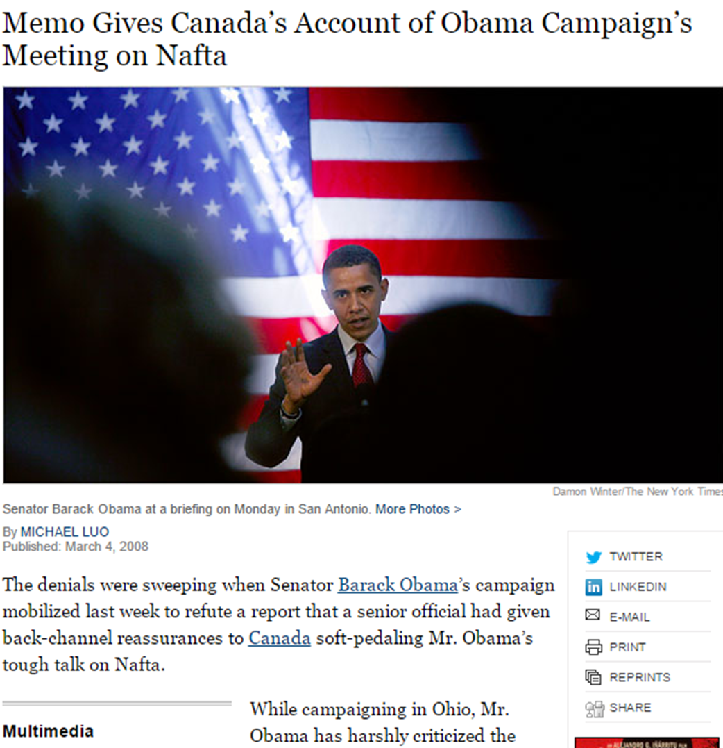

Slide 7
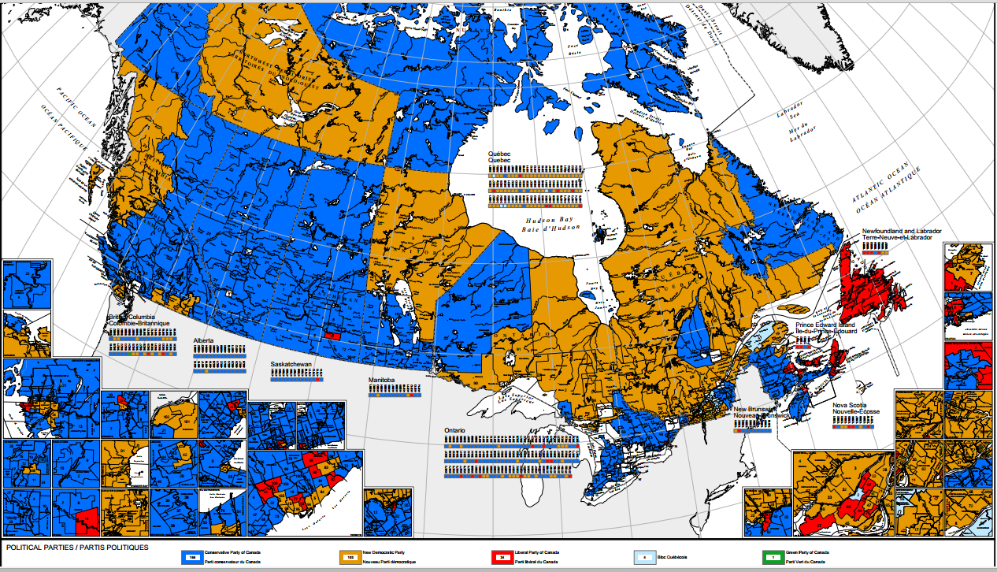

Slide 8
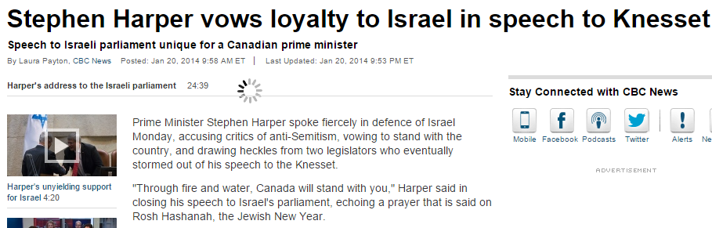
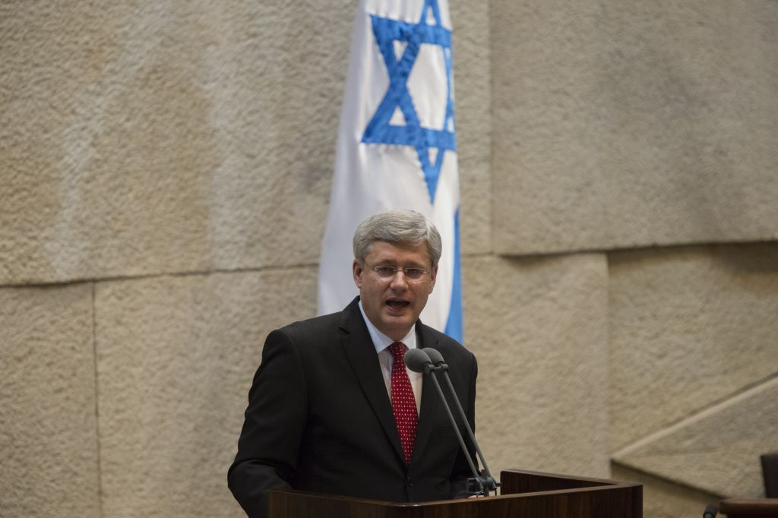

Slide 9
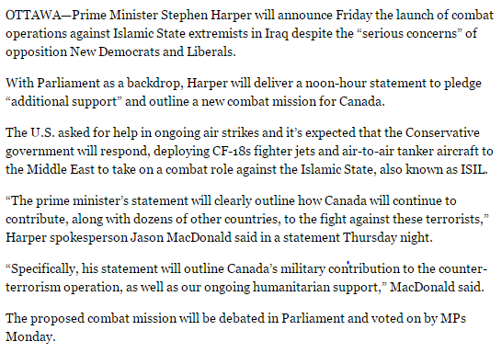

Slide 10
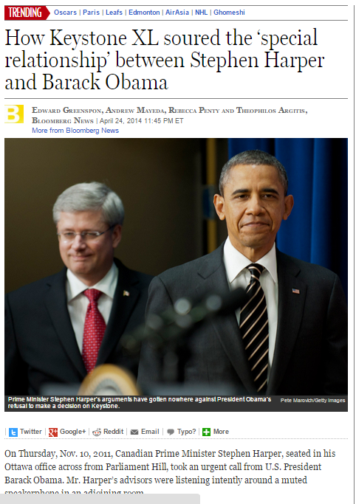

Slide 11
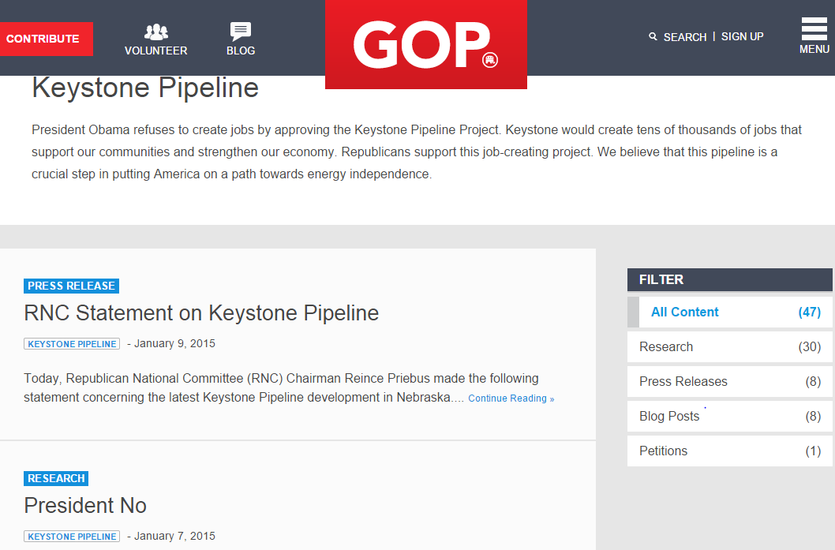

Slide 12
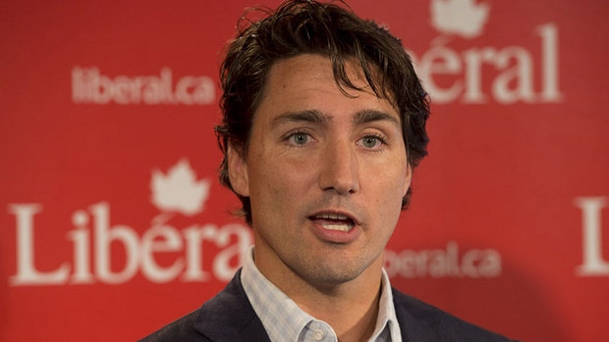
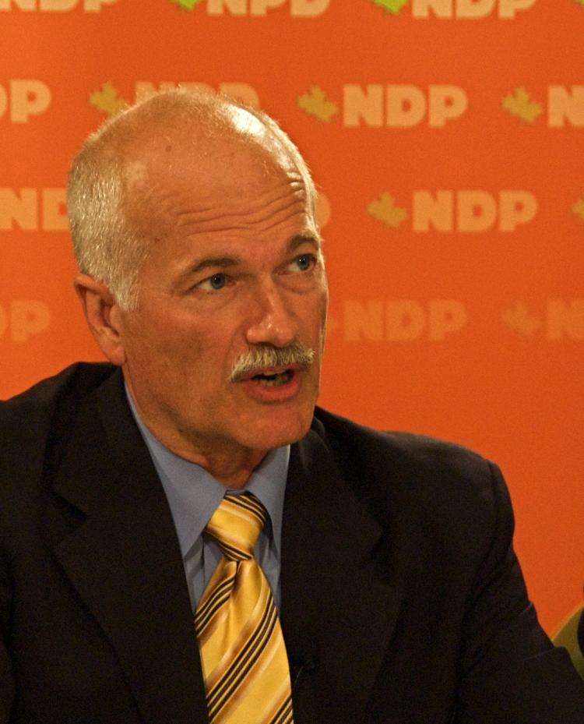

Slide 13
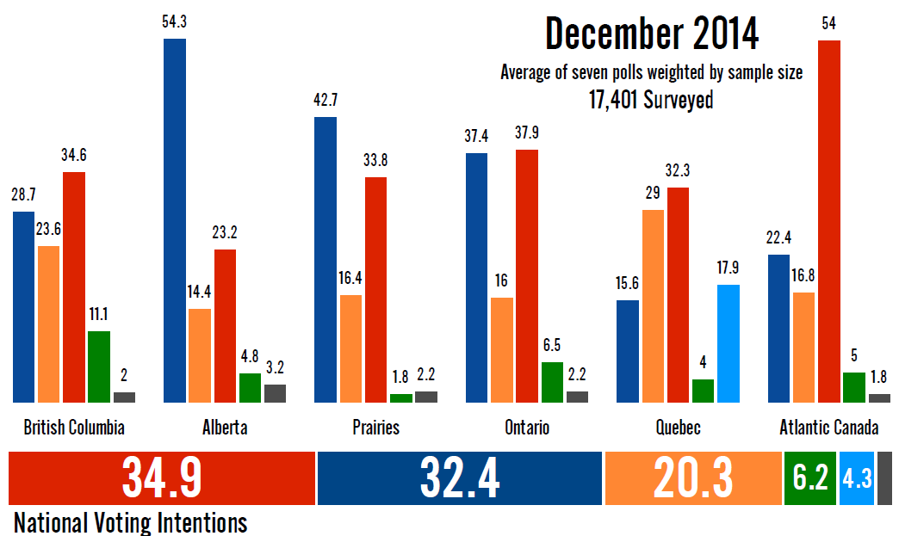

Slide 14
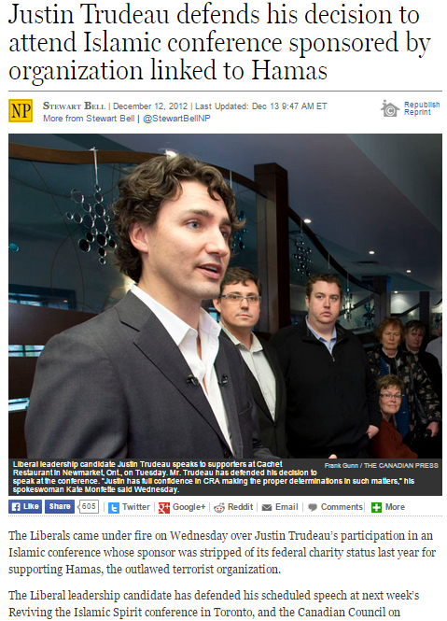

Slide 15
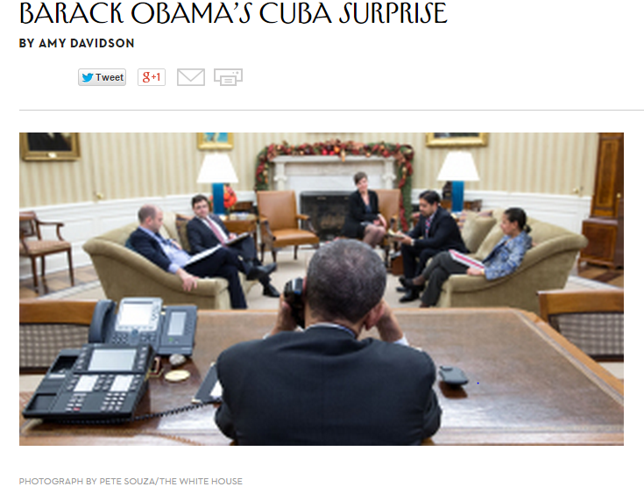

Slide 16
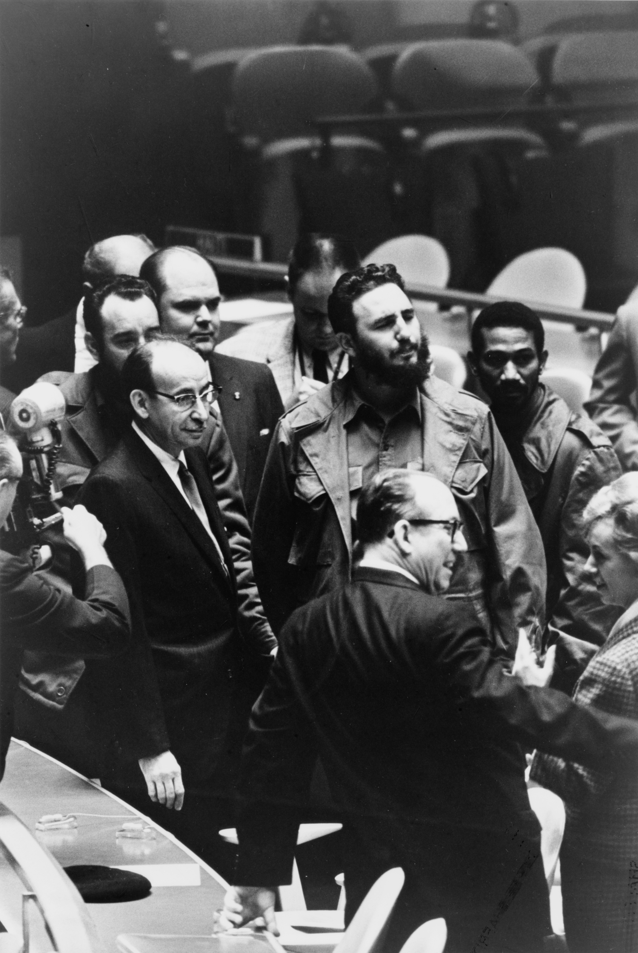
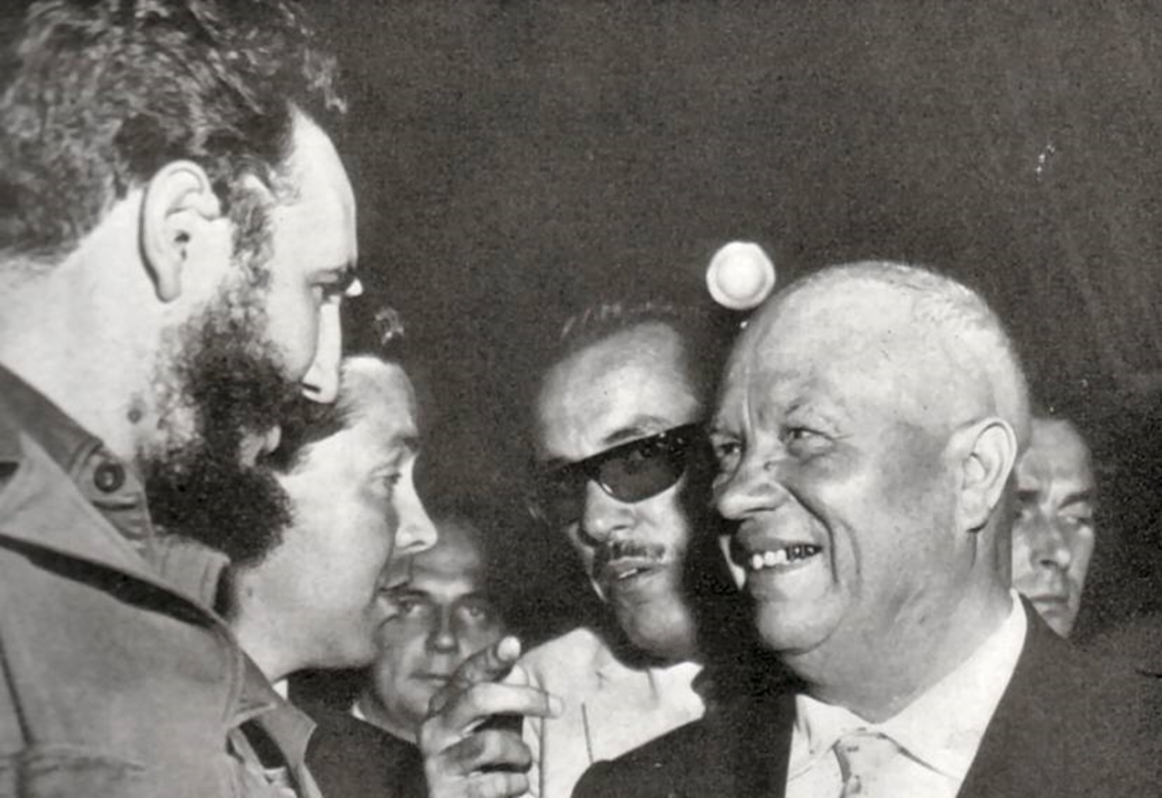

Slide 17



Slide 18


Slide 19


Slide 20

President Kennedy: I would think the first thing we have to do is, as I say, rather than get into the details—the fact that work is going on is the one defensible public position we’ve got.
They’ve got a very good product. This one is going to be very tough, I think, for us. It’s going to be tough in England, I’m sure, as well as other places on the Continent. If we then are forced to take action, this will be, in my opinion, not a blank check but a pretty good check [for the Soviets] to take action in Berlin on the grounds that we are wholly unreasonable. Emotionally, people will think this is a rather even trade and we ought to take advantage of it. Therefore, it makes it much more difficult for us to move [against Cuba] with world support. These are all the things that—why this is a pretty good play of his [Khrushchev’s].
That being so, I think that the only thing we’ve got him on is the fact that, while they put forward varying proposals in short periods of time, all of which are complicated, under that shield this work goes on. Until we can get somewhat of an agreement on the cessation of work, how can we possibly negotiate with proposals coming as fast as the wires will carry?
National Security Advisor McGeorge Bundy: And the ships are still moving, in spite of his [Khrushchev’s] assurances to [UN Sec’y. General] U Thant. His ships still—
President Kennedy: Well, we ought to emphasize the ships, but that is certainly no . . .
Treasury Secretary Douglas Dillon: There is one other very—might be a very dangerous sentence in this thing that no one has particularly mentioned. But it’s a thing I’ve been afraid of all along on the Cuban trade. And it’s where he says: ‘How are we to react when you have surrounded our country with bases about which your military speaks demonstratively?’ That will affect our whole base system.
President Kennedy: He has only intended this for Turkey though, hasn’t he?
  Dillon: Well, no. Then he goes on and says that. But he’s left it open to be able to say it’s—
President Kennedy: That is propaganda. But the direct trade is suggested with Turkey.

Slide 21
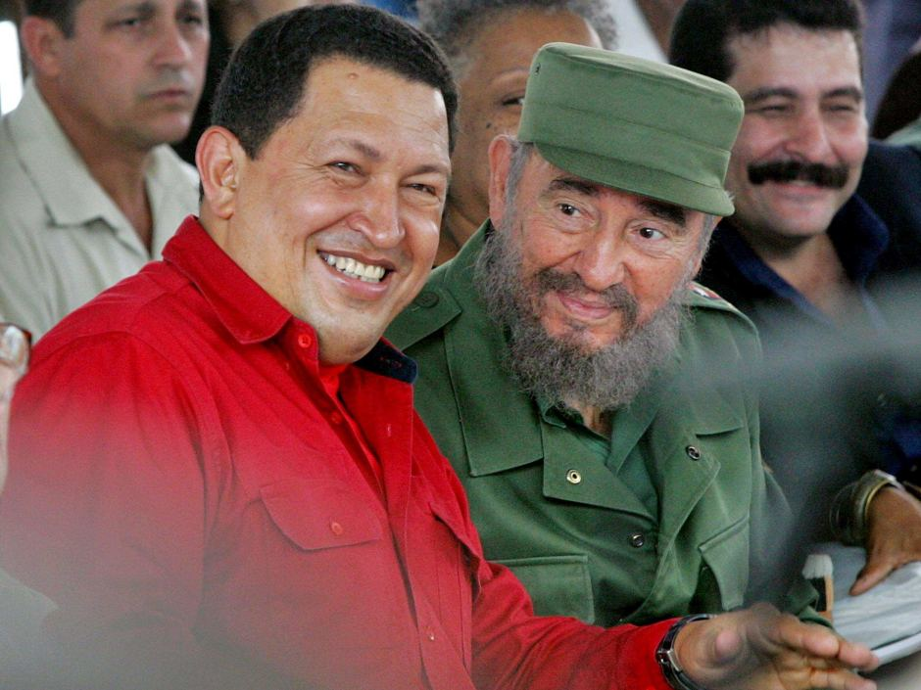

Slide 22
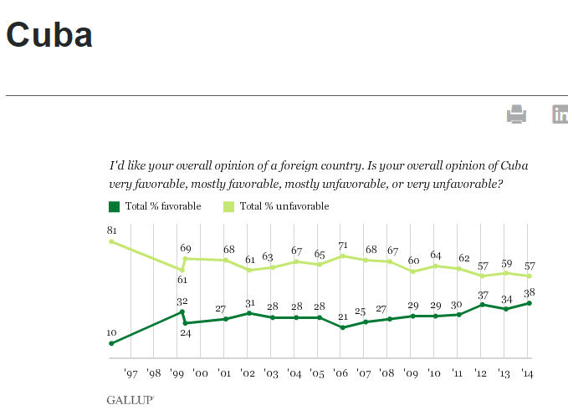

Slide 23
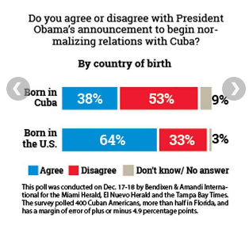
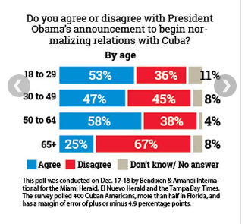

Slide 24
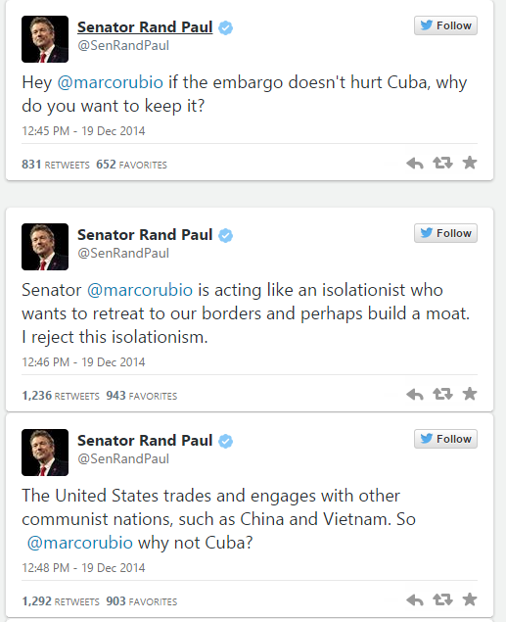

Slide 25
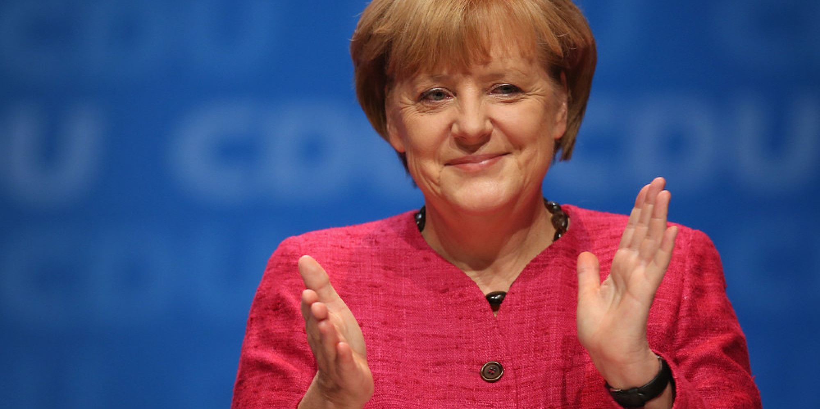

Slide 26
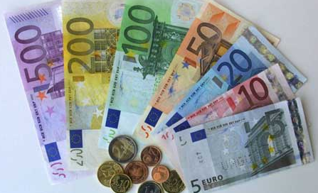

Slide 27
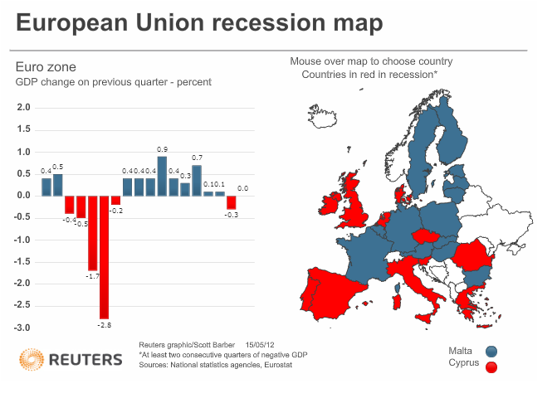

Slide 28
2.) Foreign Populations in Western Europe, 1950-2003 (percent foreigners among resident population)
Country | 1950 | 1990 | 2003
Austria | 4.7 | 5.3 | 12.5
Belgium | 4.3 | 9.1 | 10.7
Denmark | - | 3.1 | 6.8
France | 4.1 | 6.4 | 10.0
Germany | 1.1 | 8.2 | 12.5
Italy | 0.1 | 1.4 | n/a
Netherlands | 1.1 | 4.6 | 10.1
Norway | 0.5 | 3.4 | 7.3
Sweden | 1.8 | 5.6 | 12.0
Switzerland | 6.1 | 16.3 | 22.4
UK | 3.2 | 6.0 | 8.3

Slide 29
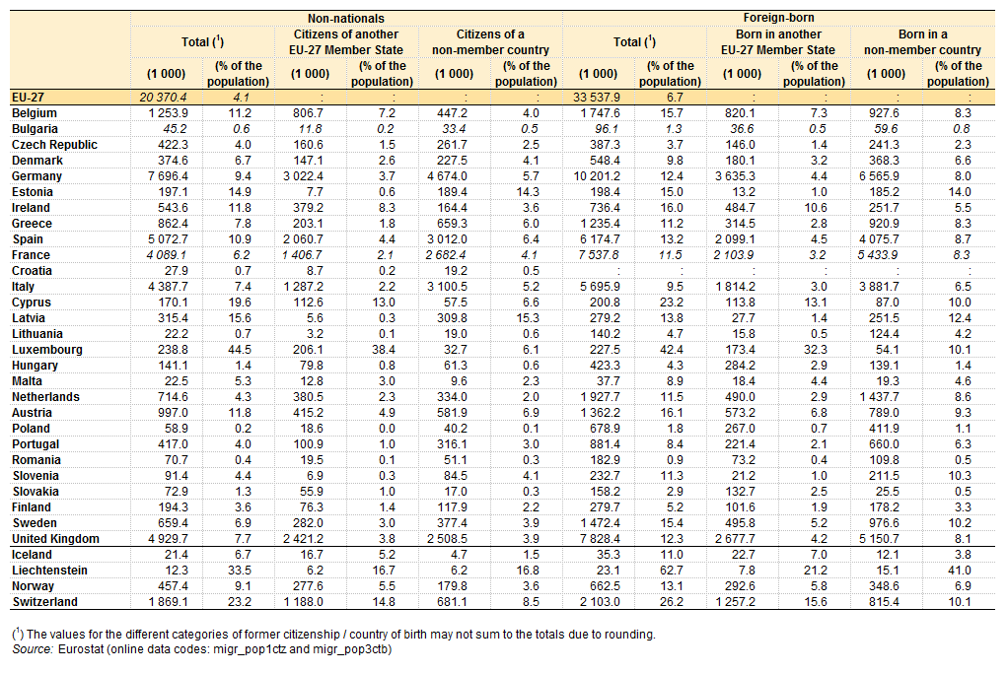

Slide 30
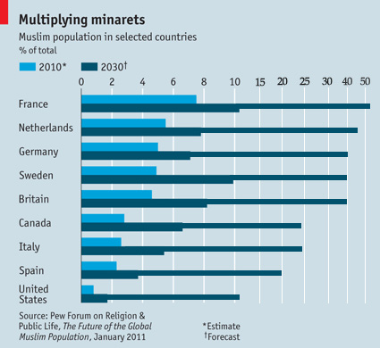
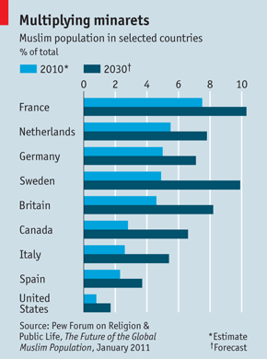

Slide 31


Slide 32


Slide 33
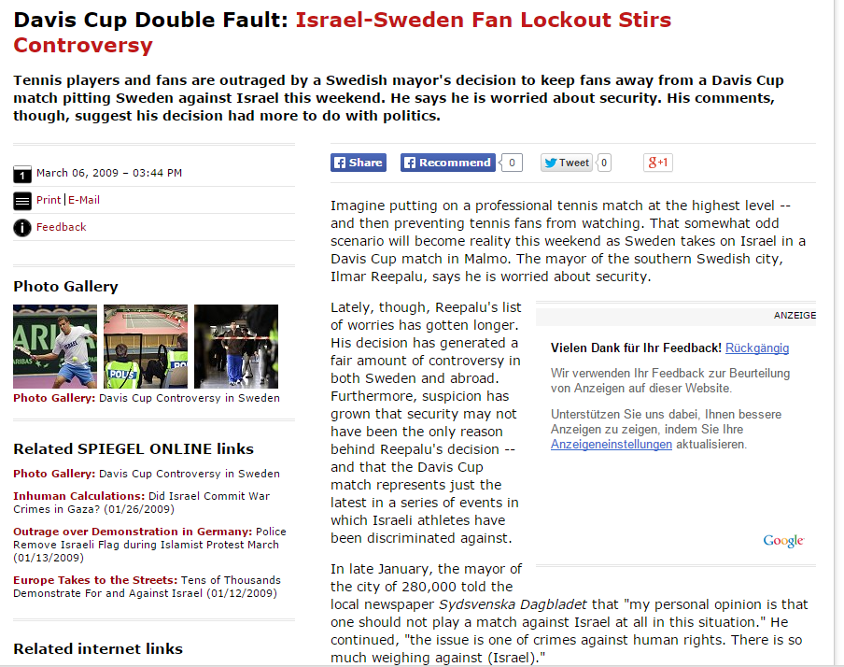

Slide 34
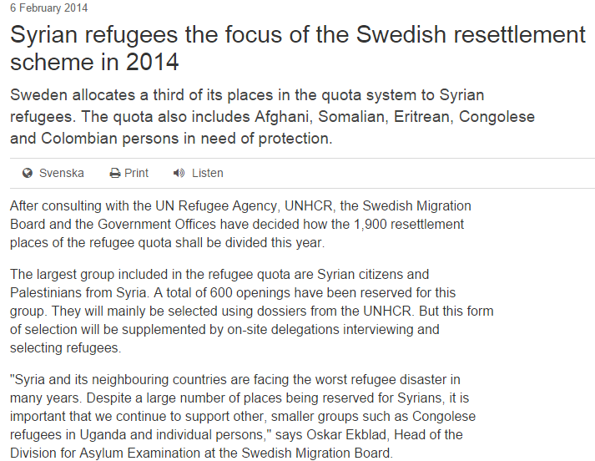

Slide 35
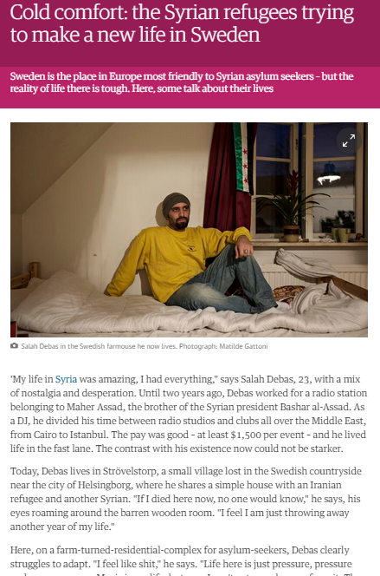

Slide 36
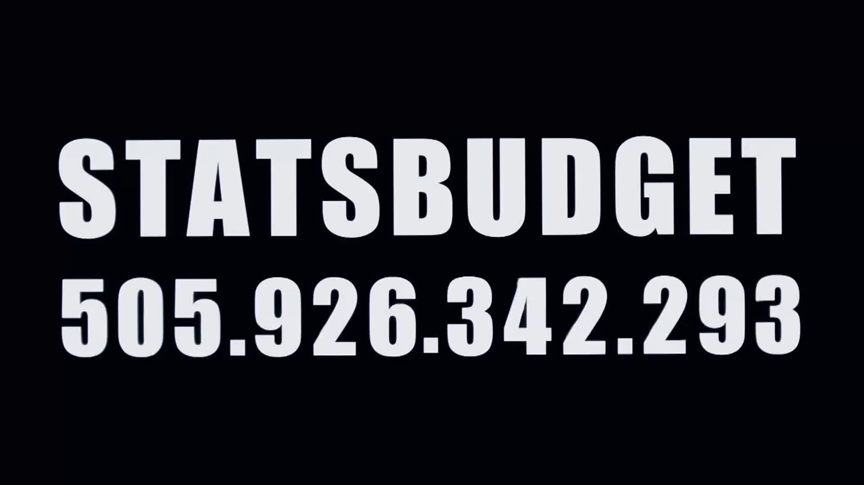

Slide 37
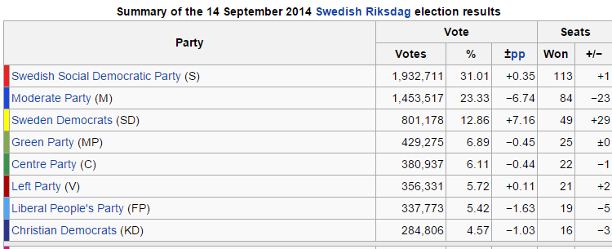

Slide 38
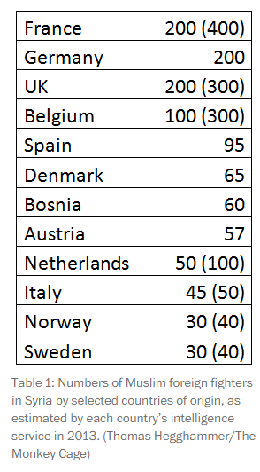
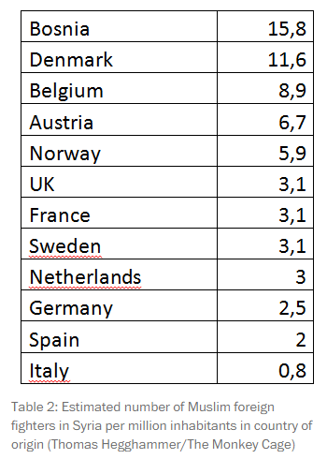
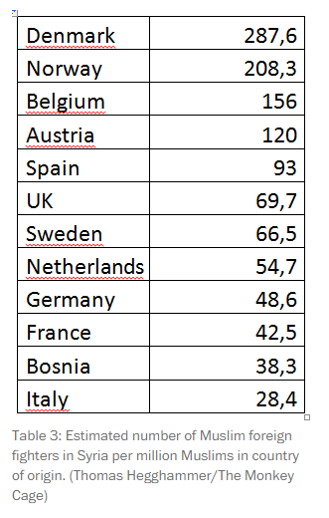

Slide 39
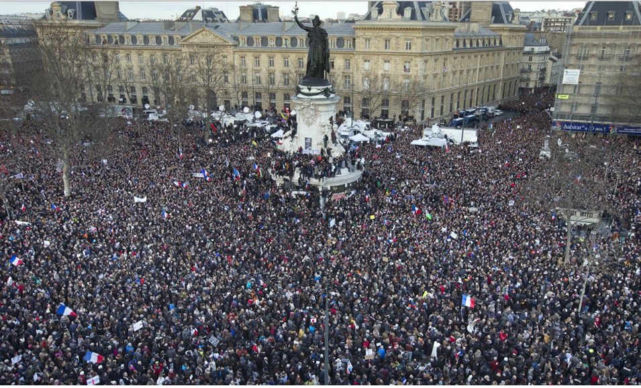

Slide 40
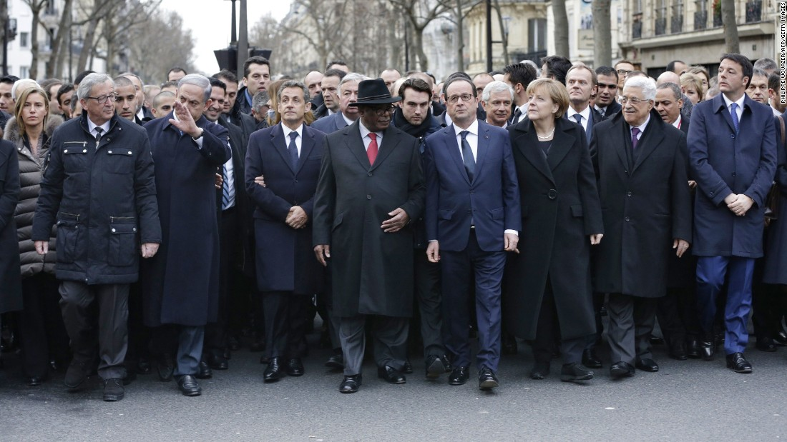

Slide 41
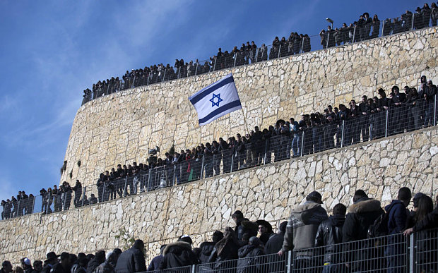

Slide 42


Slide 43
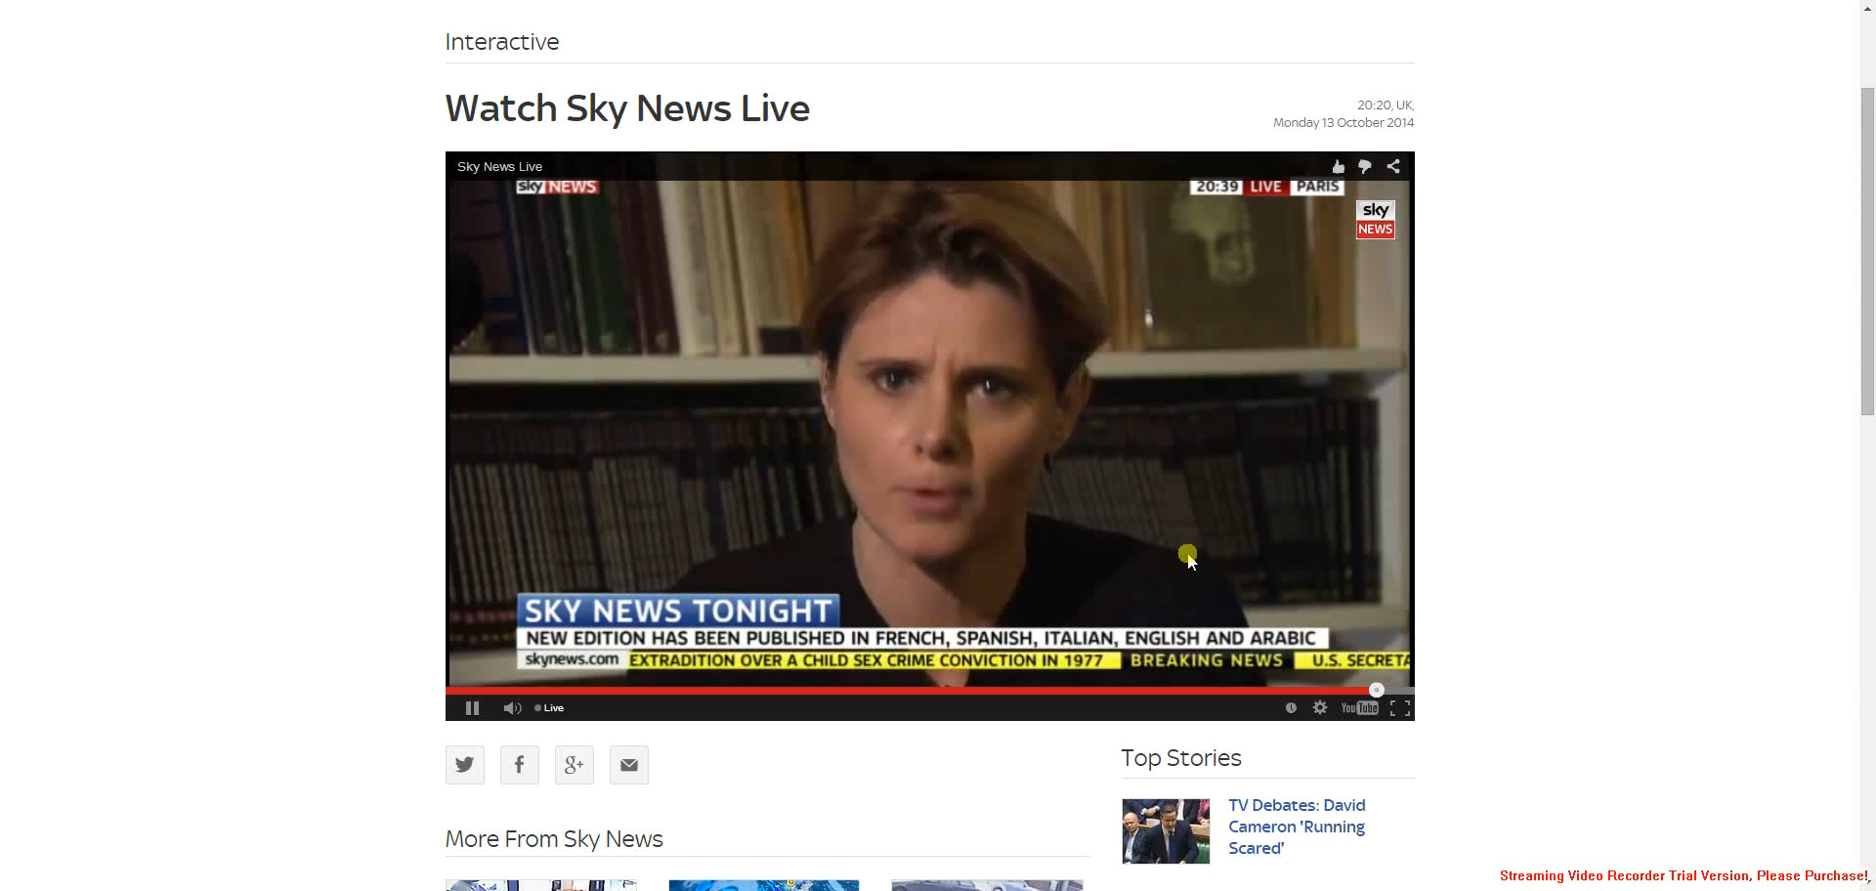

Slide 44
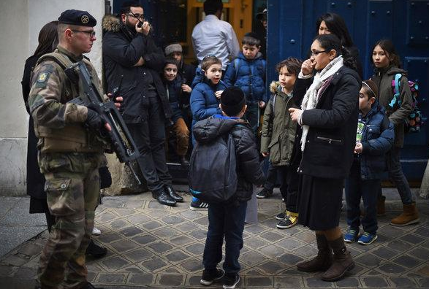

Slide 45
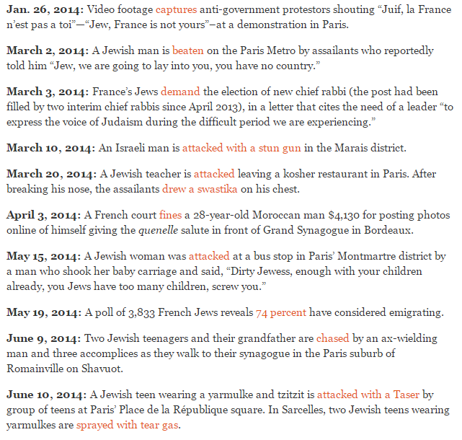
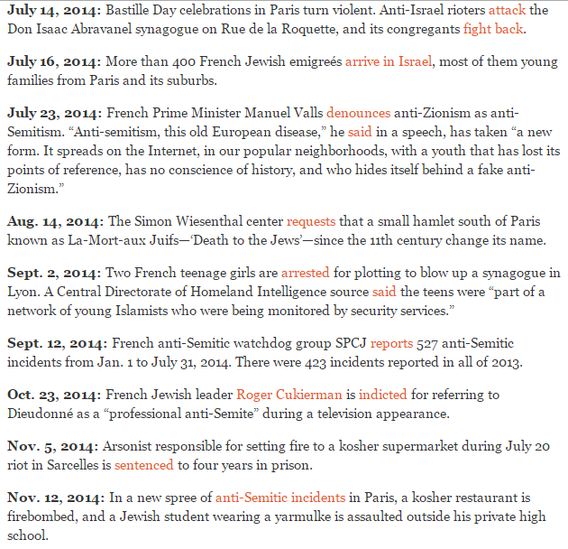

Slide 46



Slide 47


Slide 48


Slide 49





Slide 50


Slide 51


Slide 52


Slide 53



Slide 54



Slide 55


Slide 56


Slide 57


Slide 58


Slide 59


Slide 60


Slide 61


Slide 62


Slide 63


Slide 64


