Slide 1


Slide 2
NSC-68 (1950)
Need “effort by all means short of war to (1) block further expansion of Soviet power, (2) expose the falsities of Soviet pretensions, (3) induce a retraction of the Kremlin’s control and influence and (4) in general, so foster the seeds of destruction within the Soviet system that the Kremlin is brought at least to the point of modifying its behavior to conform to a generally accepted international standard.”

Slide 3
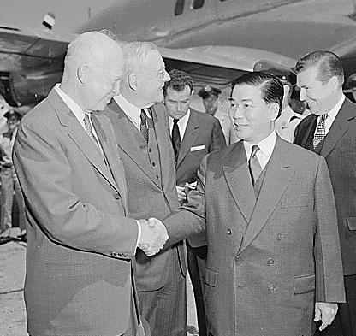

Slide 4
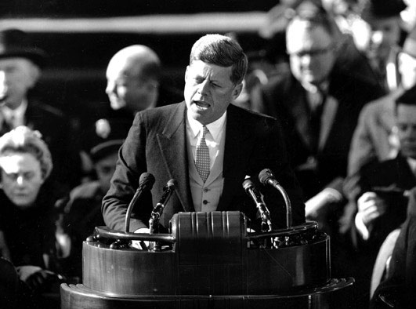
23199505891

Slide 5
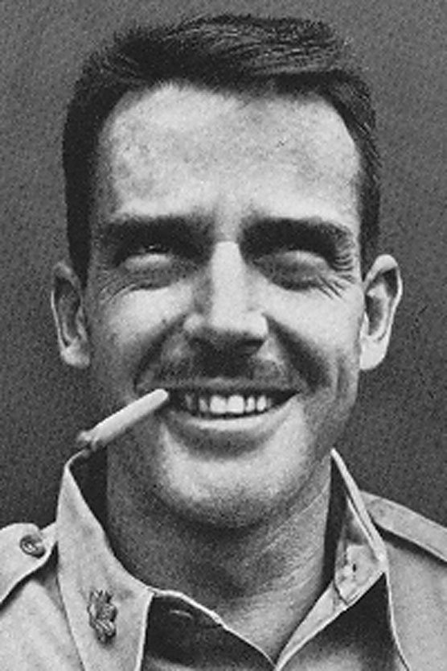
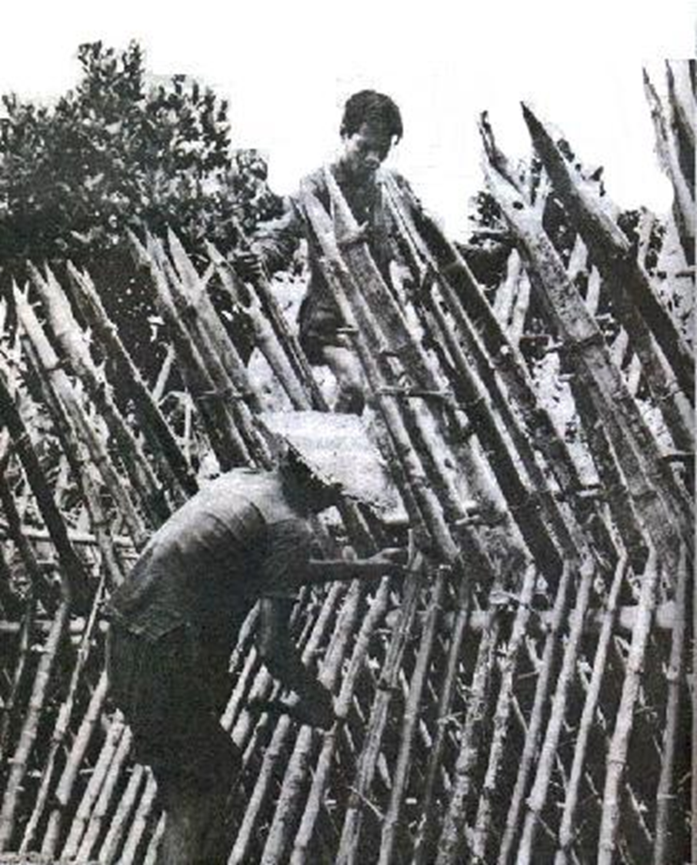
Notes:
lansdale

Slide 6
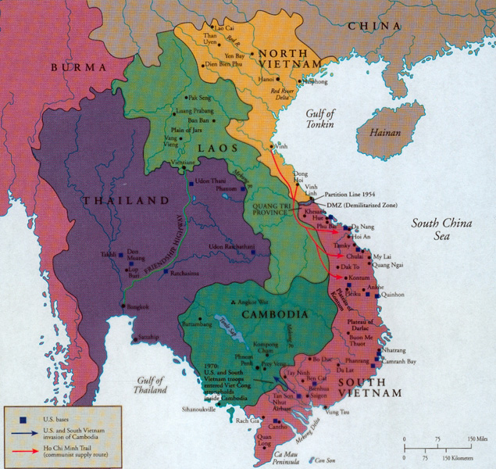

Slide 7
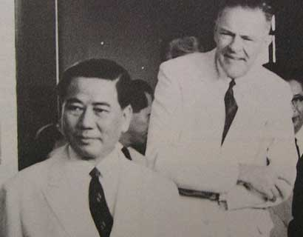

Slide 8

Robert Kennedy: Could I just make a suggestion?
President Kennedy: Yeah.
Robert Kennedy: I—this may be a minority, but I just don’t see that this [idea of a coup] makes any sense on the face of it, Mr. President.
I mean: it’s different from a coup in Iraq, or a South American country; we are so intimately involved in this . . . We’re putting the whole future of the country and really Southeast Asia in the hands of somebody that we don’t know very well, that one official of the United States government [Ambassador Lodge] has had contact with him, and he, in turn, says he’s lined up some others.
It’s clear from the MAP [military assistance program] and from—Diem, he’s a fighter. He’s not somebody like [Juan] Bosch [the former president of the Dominican Republic, ousted in a bloodless coup], who’s just going to get out of there. He’s a determined figure who’s going to stick around and I should think go down fighting; that he’s going to have some troops there that are going to fight, too.
That if it’s a failure, that we risk such a hell of a lot.
[Break.]
Robert Kennedy: I would think that we’re just going down the road to disaster. Now, maybe this is going to be successful, but I don’t think that anybody . . . any reports that I’ve seen indicate that anybody has a plan to show where this is going.

Slide 9
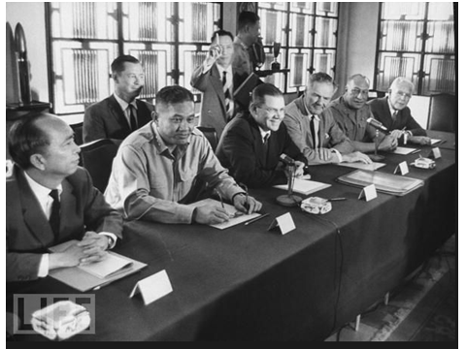

Slide 10
Time Period | U.S. Troops in Vietnam | U.S. Personnel Killed
End of 1961 | 2,067 | 16
End of 1962 | 11,500 | 52
End of 1963 | 19,000+ | 118

Slide 11


Slide 12


Slide 13
President Johnson: Do you think it’s a mistake to explain what I’m saying now about Vietnam, and what we’re faced with?
Robert McNamara: Well, I do think, Mr. President, that it would be wise for you to say as little as possible.
The frank answer is we don’t know what’s going on out there. The signs I see coming through the cables are disturbing signs—poor morale in Vietnamese forces, poor morale in the armed forces, disunity, a tremendous amount of coup planning against [South Vietnamese leader Nguyen] Khanh. About what you’d expect in a situation that’s had three governments in four months—
President Johnson: Well, then why don’t we take some pretty offensive steps pretty quickly, then? Why don’t we commend Khanh on his operation and try to prop him up? Why don’t we raise the salary of their soldiers to improve that morale, instead of waiting a long time? Why don’t we do some of these things that are inclined to bolster ‘em?
McNamara: Well, I’m not sure that they here . . .
President Johnson: I sure as hell don’t want to get in the position of Lodge recommending to me—the one thing he recommended is “please give us a little more pay for our soldiers,” and we turned him down.
McNamara: Oh, no, we’ve done that, sir.
President Johnson: We haven’t acted. We said we’re going to wait till you go out there [to Vietnam].
McNamara: Well, no. He knows there’s money for that. There’s no problem on that issue.
President Johnson: Well, then, why don’t we clear it up, so that we get him answered?
Now, I think that politically—I’m not a military strategist—but I think that as long as we’ve got him [Lodge] there, and he makes recommendations, and we act on ‘em, particularly if we act favorably, we’re not in too bad a condition politically.
But I think when he wires us and says, “The only damn thing I want you to do is to give ‘em an increase in pay because morale’s terrible,” and we say, “Well, wait,” then if something happens in between, I think we are caught with our britches down.

Slide 14


Slide 15

Notes:
Lbj signing tgr

Slide 16
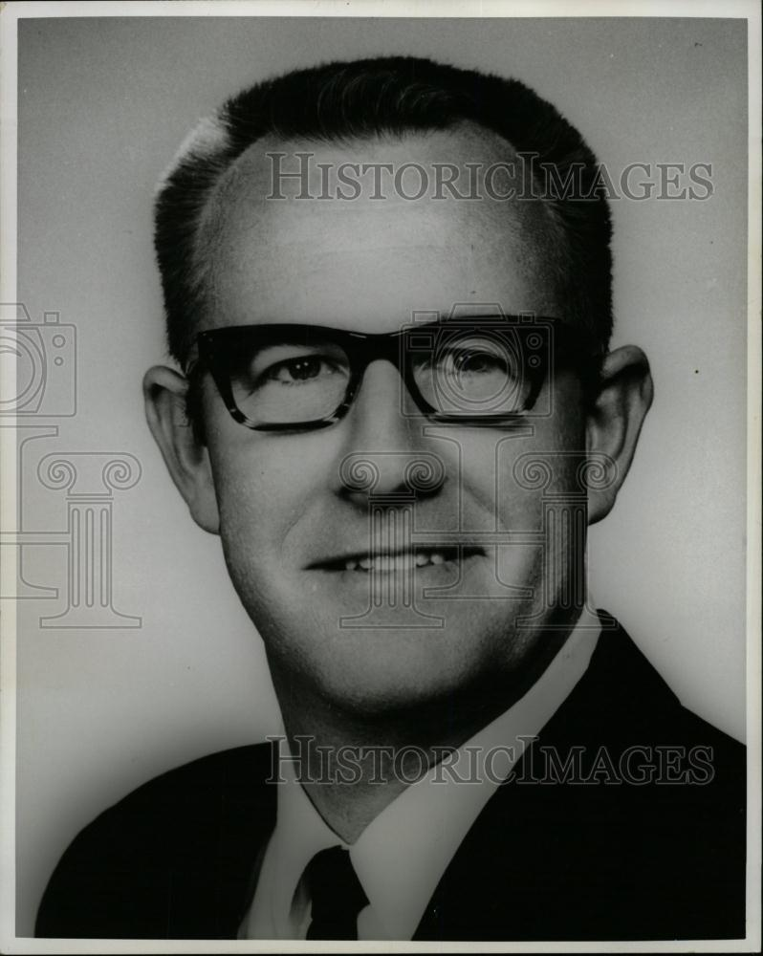

Slide 17



Slide 18
President Johnson: That was a good vote you had today.
Speaker McCormack: Yes, it was very good. 414 to nothing; one present. What’d the Senate do?
President Johnson: 88 to 2. Morse and Gruening.
McCormack: I don’t understand Gruening.
President Johnson: Oh, he’s no good. He’s worse than Morse. He’s just no good. I’ve spent millions on him up in Alaska [in reconstruction funds after the March 1964 Alaska earthquake]. He’s just no good.
And Morse is just as undependable and erratic as he can be.
McCormack: I know that. But I can’t understand the other fellow.
President Johnson: Say, I wanted to point out this little shitass [Ed] Foreman today got up and said that we [Johnson] acted impulsively by announcing that we had an answer on the way [to the Tonkin Gulf incidents] before the planes dropped their bombs.
[Break.]
President Johnson: It’s just a pure lie, and smokescreen.
McCormack: But he was booed two or three times. Tremendous booing on the Democratic side. He was—everybody knew he was just cheap and mean and contemptible. Well, you know what he is.
President Johnson: Yeah. Yeah, he’s no good.

Slide 19
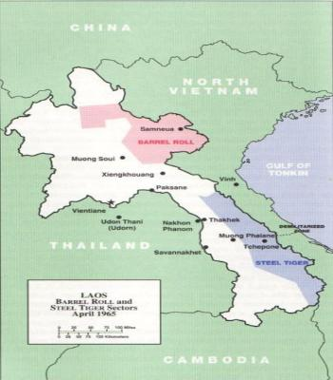

Slide 20
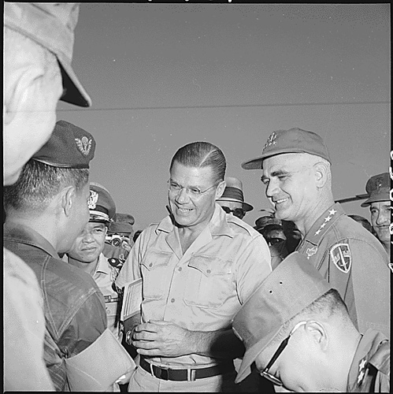

Slide 21
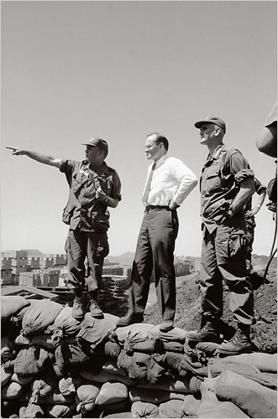
Notes:
Bundy and westnmireland after pleiku

Slide 22
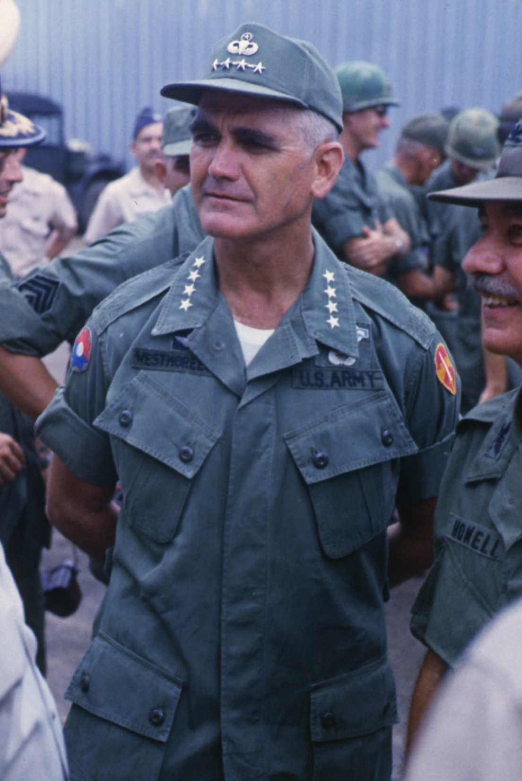

Slide 23


Slide 24
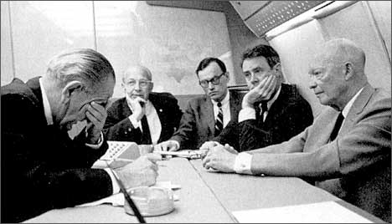
Notes:
Lbj rostow

Slide 25
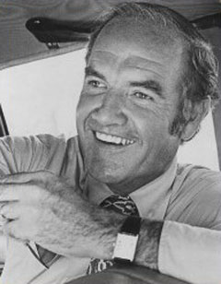
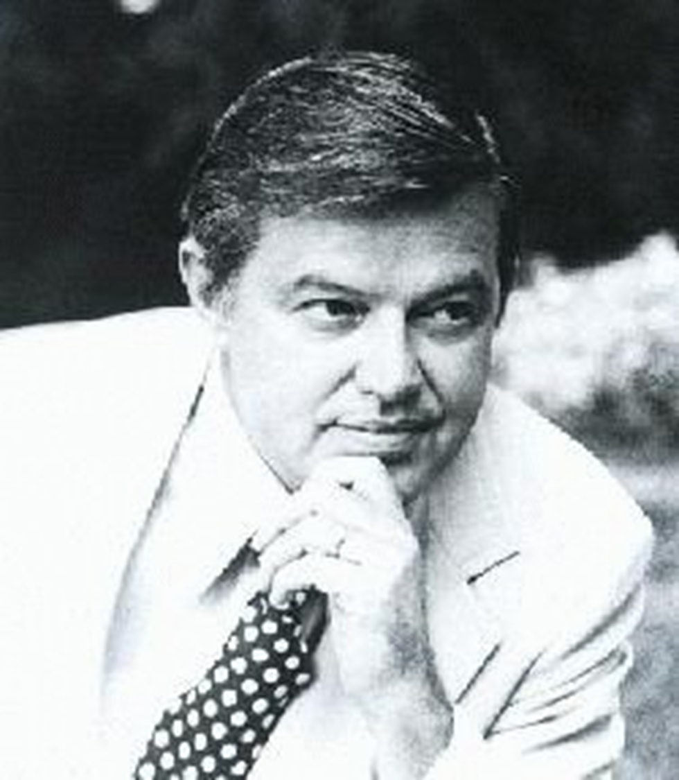

Slide 26


Slide 27
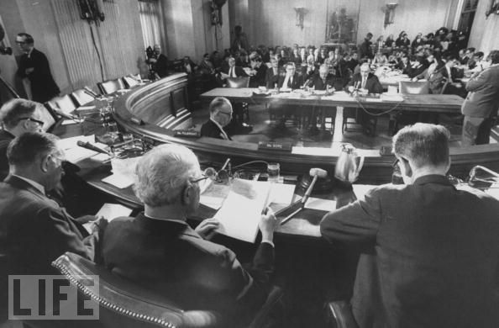

Slide 28
President Johnson: What they [adherents to the Bull Fulbright line on Vietnam] really think is that we oughtn’t to be there, and we ought to get out.
Well, I know we oughtn’t to be there, but I can’t get out. I just can’t be the architect of surrender. And don’t see—I’m trying every way in the world I can to find a way to . . . thing.
But they [the North Vietnamese] don’t have the pressure to bring them to the table as of yet. We don’t know whether they ever will.
I’m willing to do damn near anything. If I told you what I was willing to do, I wouldn’t have any program. [Senate Minority Leader Everett] Dirksen wouldn’t give me a dollar to operate the war. I just can’t operate in a glass bowl with all these things. But I’m willing to do nearly anything a human can do, if I can do it with any honor at all. But . . .
They started with me on Diem, you remember?
Eugene McCarthy: Yeah.
President Johnson: That he was corrupt and he ought to be killed. So we killed him. We all got together and got a goddamned bunch of thugs and we went in and assassinated him. Now, we’ve really had no political stability since then.
McCarthy: Yeah.

Slide 29
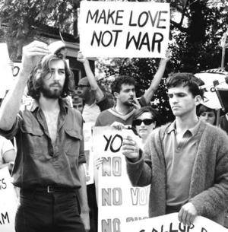

Slide 30
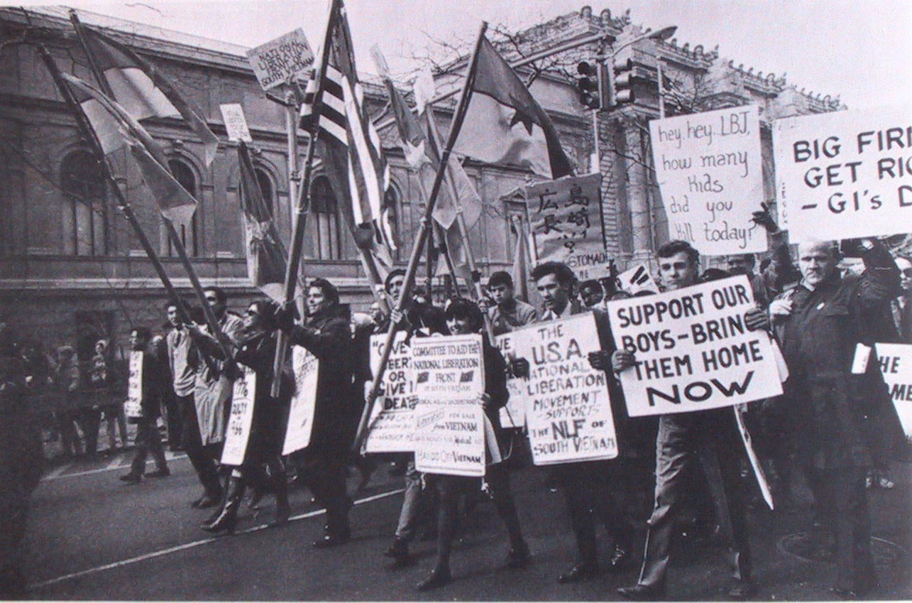

Slide 31


Slide 32
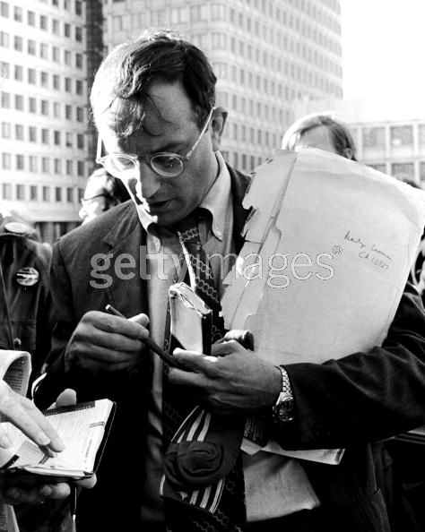

Slide 33
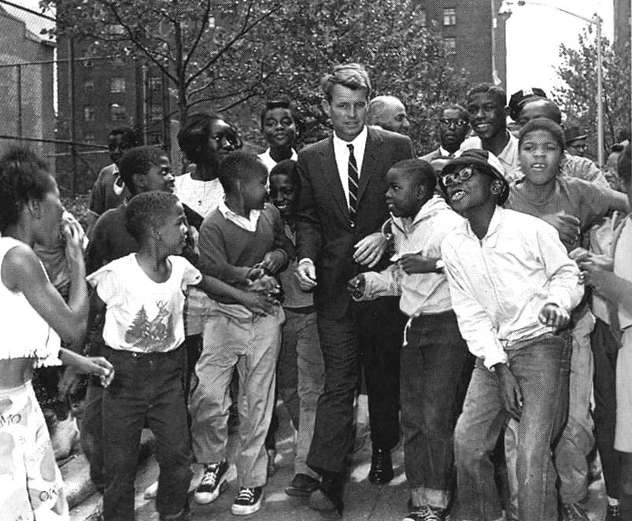

Slide 34
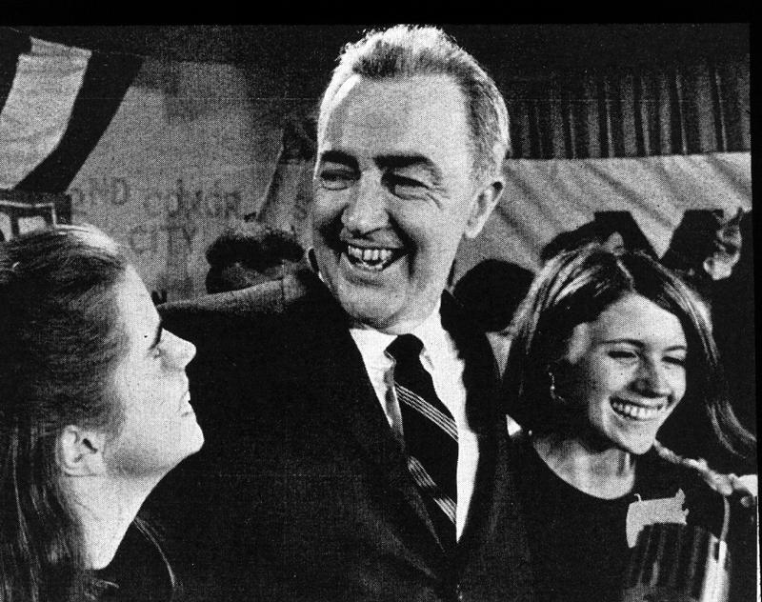

Slide 35
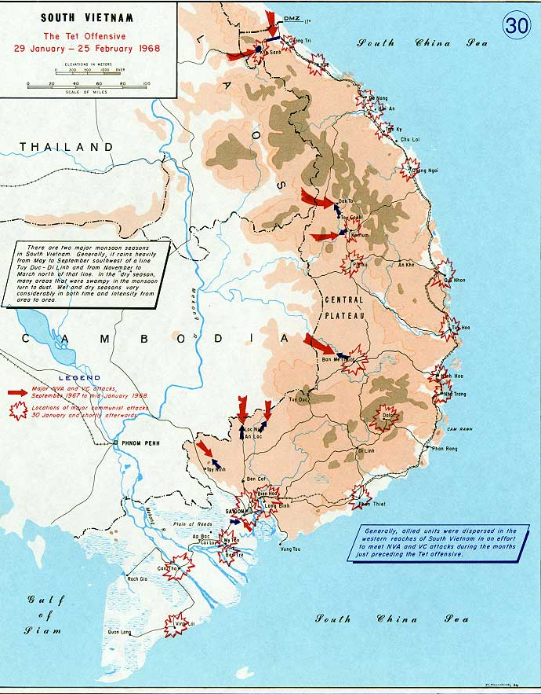

Slide 36
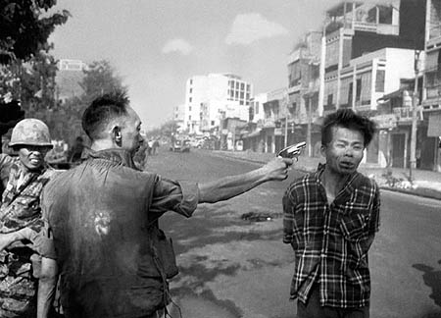

Slide 37
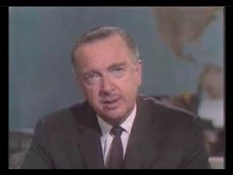

Slide 38


Slide 39
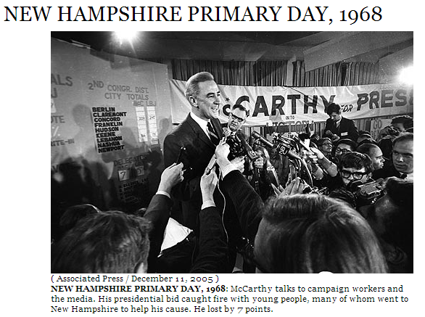

Slide 40
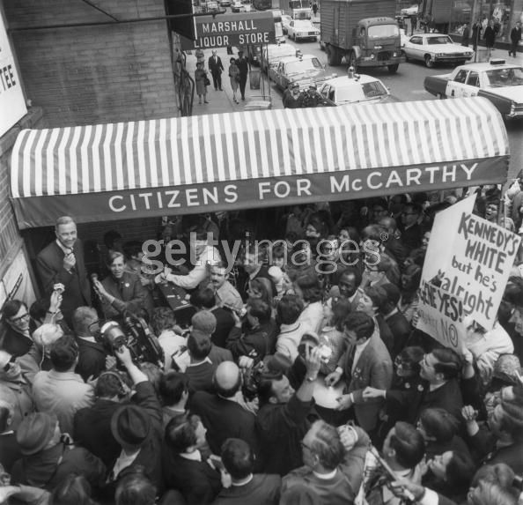

Slide 41
President Johnson: The cold hard facts are we do not have control [in Vietnam], and [Eugene] McCarthy doesn’t, and Bobby doesn’t, and no one else does at this stage, unless and until they [the North Vietnamese] see that this second wave of theirs—we have their documents; we know what their plans are—is not successful.
Now, I can’t get out and promise that they’re not going to . . . There is no question but that their attitude is harder. They just do not want to talk. And I guess it’s like you [the UAW] are when you are negotiating, and you’ve got the upper hand, and they’ve got to come to you—they can’t pee a drop without you. I think that’s the position they’re [the North Vietnamese] in.
They’re being well-supported. They’re not hurting. We’re not destroying anything they’ve got. We’re not invading ‘em. We’re not trying to capture them, we’re not taking their cities, we’re not killing their civilians. When we hit a target in North Vietnam—we’re hitting damn few. Last year, we had 6½ months that we had a complete pause at both Hanoi and Haiphong.
I can’t stress those things. Because when I do, I get every hawk in the country who thinks I’m not doing enough. And they want me to take out Haiphong immediately—and when I do, I take out a Russian ship, and I got a lot more problems.
Now, when you look at these plans, there’s not much [that] anybody’s got to do. They [McCarthy and Kennedy] say they don’t want withdrawal; they say they don’t want surrender. McCarthy said he wants negotiation. Well, goddamnit, we do, too!
Walter Reuther: Surely.
President Johnson: But we have the responsibility.
Now, you’ve got to be responsible, too. And I know your [union] board will give you hell; and I get hell from all of my people all the time. But this is a period and a time—these boys can’t get this nomination. They’re not going to get it. We’re going to take these states, and they’re not going to come close to it. They’ll win some primaries, because I don’t have much time to make calls like this.

Slide 42
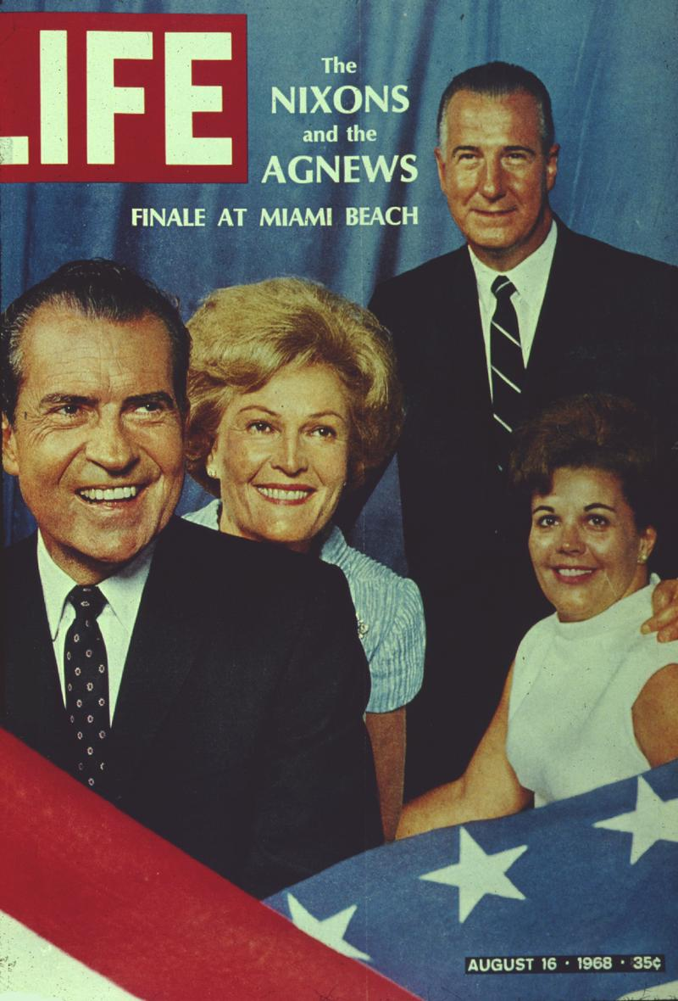

Slide 43
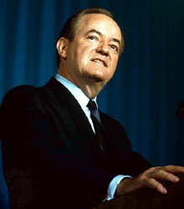
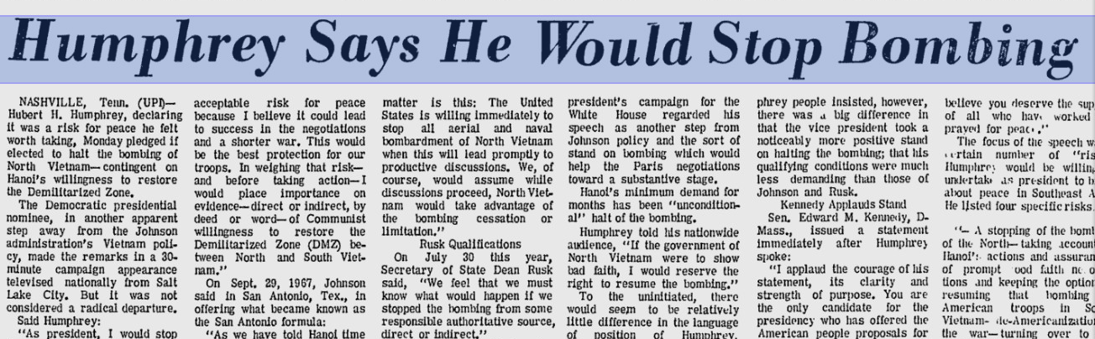

Slide 44
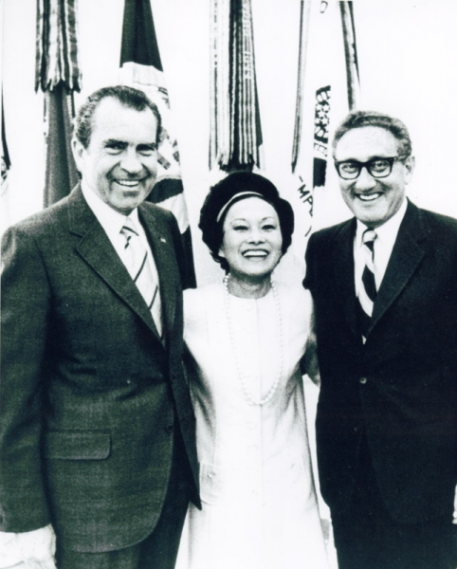

Slide 45
President Johnson: Now, I’m reading their hand, Everett. I don’t want to get this in the campaign.
Everett Dirksen: That’s right.
President Johnson And they oughtn’t to be doing this. This is treason.
Dirksen: I know.
[Break.]
President Johnson: [with Dirksen assenting] Now, I can identify ‘em, because I know who’s doing this. I don’t want to identify it. I think it would shock America if a principal candidate was playing with a source like this on a matter this important.
I don’t want to do that. But if they’re going to put this kind of stuff out, they ought to know that we know what they’re doing. I know who they’re talking to, and I know what they’re saying.
Well, now, what do you think we ought to do about it?
Dirksen: I better get in touch with him, I think, and tell him about it.
President Johnson: I think you better tell him that his people are saying to these folks that they oughtn’t to go through with this meeting [in Paris]. Now, if they don’t go through with the meeting, it’s not going to be me that’s hurt. I think it’s going to be whoever’s elected.
Dirksen: That’s right.
President Johnson: It may be—my guess—him.
Dirksen: Yeah.
President Johnson: And I think they’re making a very serious mistake. And I don’t want to say this.
Dirksen: Yeah.
President Johnson: And you’re the only one I’m going to say it to.
Dirksen: Yeah.
[Break.]
President Johnson: Well, I don’t know who it is that’s with Nixon. It may be [Wisconsin congressman Mel] Laird. It may be [aide Bryce] Harlow. It may be [campaign manager John] Mitchell. I don’t know who it is.
I know this: that they’re contacting a foreign power in the middle of a war.
Dirksen: That’s a mistake!
President Johnson: And it’s a damn bad mistake.
Dirksen: Oh, it is.
President Johnson: [with Dirksen assenting] And I don’t want to say you, and you’re the only man that I have enough confidence in to tell ‘em. But you better tell ‘em they better quit playing with it. You just tell ‘em that their people are messing around in this thing, and if they don’t want it on the front pages, they better quit it!

Slide 46
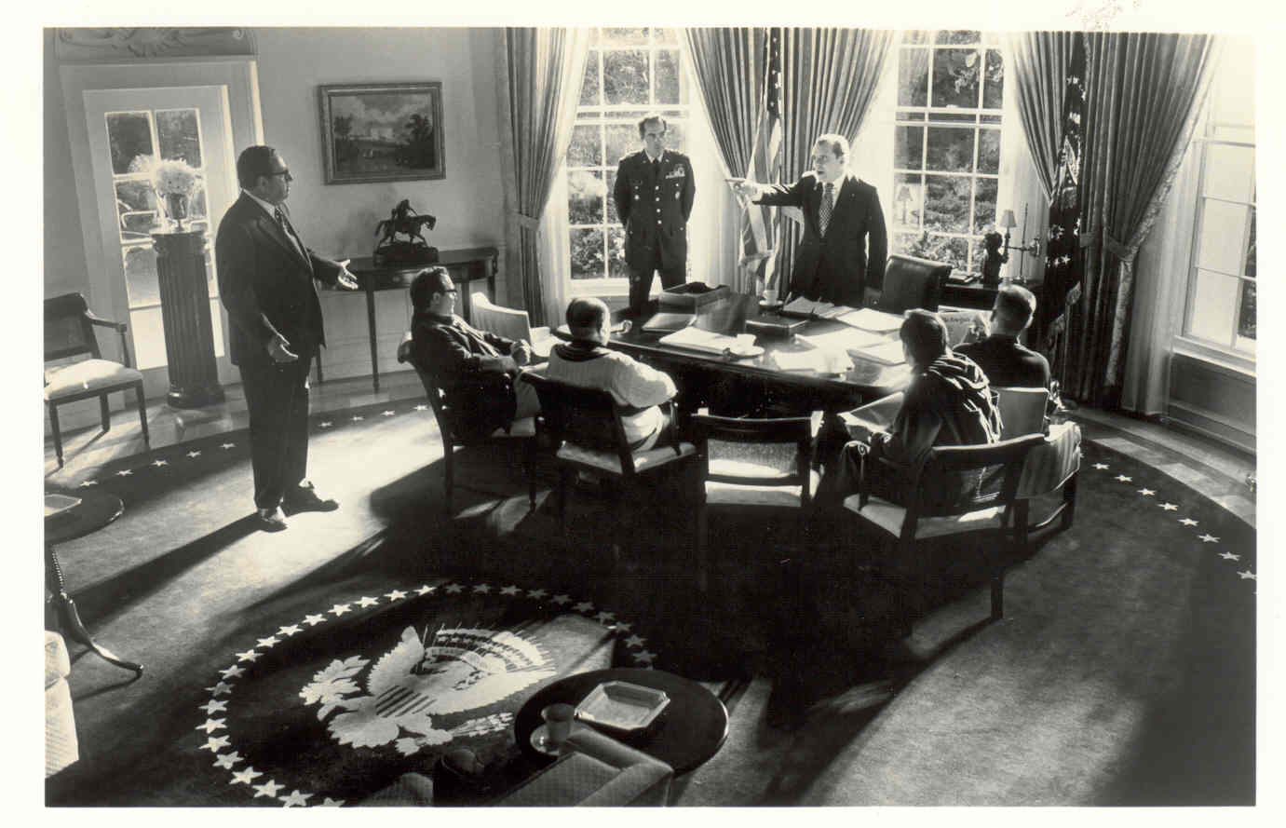

Slide 47
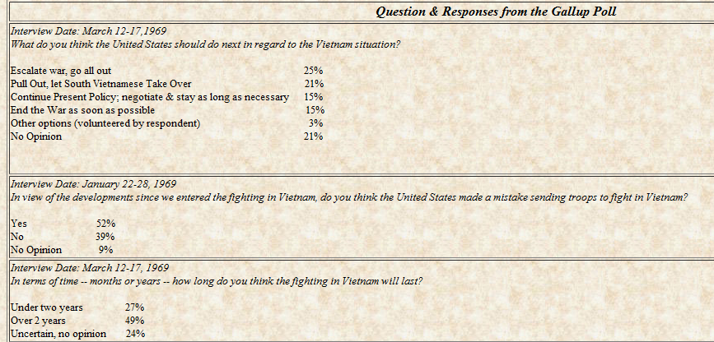

Slide 48
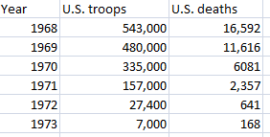

Slide 49
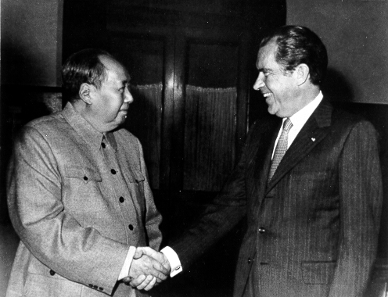

Slide 50
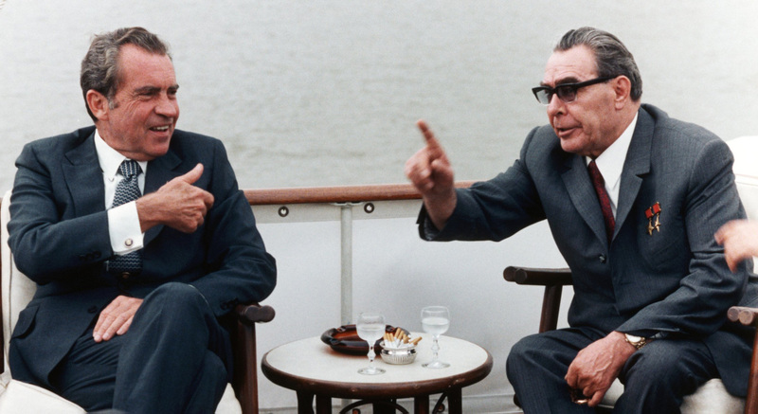

Slide 51
President Nixon: I said [to UN ambassador George H.W. Bush prepare a memo entitled], “Proposed Reward and Punishment to UN Vote.”
There it is. It’s an historical note that will go in the files. By God, we’re going to do it. I’m—we’re going to do it.
Oh, boy, let one of those black bastards who voted against us ask to come in and see me. Never will they cross the threshold of this room again, one of those little countries. Botswana, some of those others. Screw ‘em! Never!
I’ll see Ghana, because they voted with us. But I ain’t going to see Botswana.
Now, of course, you’ve got to see England and France and the rest. That has something else to .. . but I’ll be goddamned cool to Italy the next time they park around in here, because they should have voted with us. They didn’t have a reason to vote the other way, except they decided that that’s where their fish were fried.
But George [H.W. Bush] wants us to screw ‘em? All right. But he doesn’t want me to say it, though, he knows I can’t say it.
Bob Haldeman: No, but he—
President Nixon: He agreed with what I said to these bastards.
[Break.]
President Nixon: Oh, ask Henry [Kissinger] to do this: I want Bush on a confidential basis to give to Henry the list of the countries he particularly wants to have shafted. You know, just give us a list. In absolute confidence. I don’t want it on a piece of—I just want it on a piece of blank paper. Or have him send it to me. And a list of those that he really feels we ought to do something for. Would he do that?
You can’t get that—State would never go for this. That poor [Ass’t Secretary of State for African Affairs David] Newsom—that poor son of a bitch is so soft in the head. But I’ve been sick of the African countries for so many years that I’ve—
Haldeman: Well, they’re a pain in the ass anyway.
President Nixon: Well, for chrissakes, do you know how many people Botswana’s got? It shouldn’t even be a country. They put it in there as a buffer to South Africa. As Henry [Kissinger] said, it’s a desert land. They’ve got 300,000 people. In Botswana! Botswana! [Cross-talk.] They created the goddamn place!
Haldeman: How many people does [mis-pronouncing it] Qatar have? I didn’t even know there was a country called Qatar.
President Nixon: Oh, sure.
Chuck Colson: I’d say two or three hundred—
President Nixon: 250 thousand [people].
Haldeman: I had never heard of the country, and there they were.

Slide 52
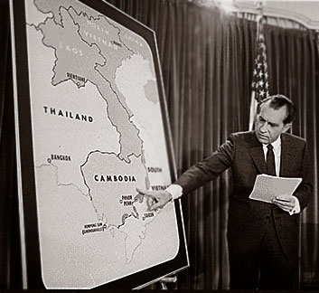

Slide 53
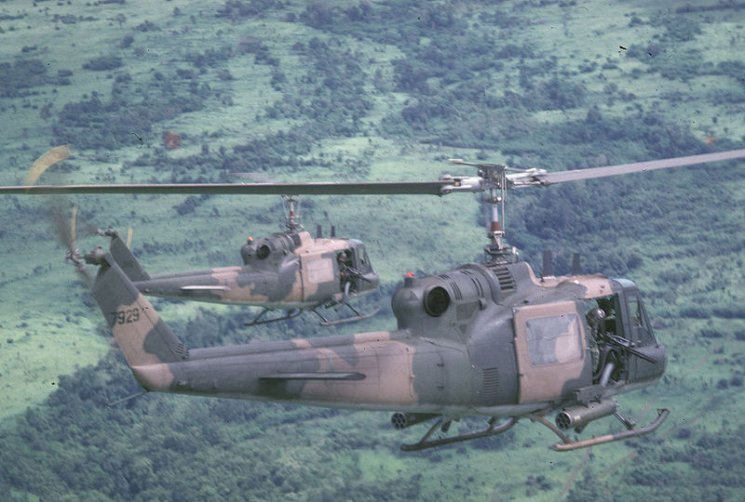

Slide 54
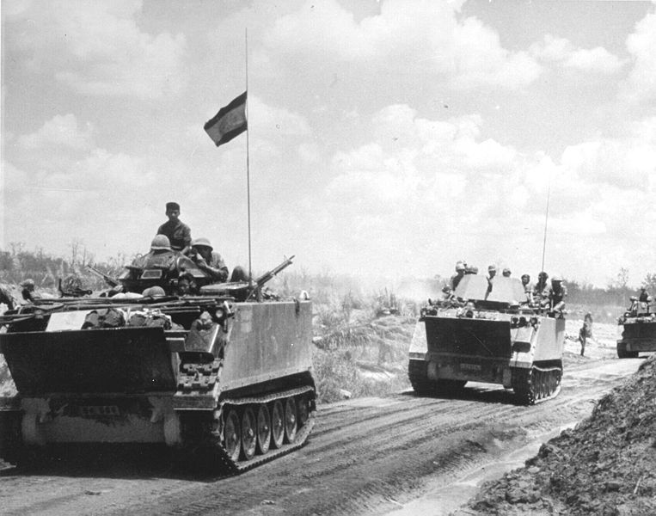

Slide 55
President Nixon: Of course, we’re fighting a very tough battle here, you know; everybody wants to pull out. But I have to fight against the tide. I got to do the right thing.
[Edit.]
Billy Graham: I’ve got a [sic] editorial in the New York Times on Friday, which I wrote this morning. They—
President Nixon: Good for you.
Graham: —asked for it yesterday—
President Nixon: Good.
Graham: And I’m putting all the blame for this whole thing on [President] Kennedy.
President Nixon: That’s right! He started the damn thing!
Graham: Well, I—
President Nixon: He killed Diem—
Graham: Right.
President Nixon: —and he sent the first 16,000 combat people there himself!
Graham: Well, I’m saying that the first time I ever heard of our involvement was four days before he was inaugurated, playing golf with him; he said, “We”—I quote—“We cannot allow Laos [mis-pronounced] and South Vietnam to fall to the Communists.” [Nixon belatedly laughs.]
And then I said when President Johnson took over, we had 16,000 troops there.
President Nixon: That’s right.
Graham: And I said the political climate in the United States—
President Nixon: Well, and Diem had been murdered. See, you see, Billy, the key thing here was Kennedy’s, and, I must say, our friend [Henry Cabot] Lodge’s agreement to the murder of Diem. Diem—that’s what killed the whole, that opened the whole thing.

Slide 56
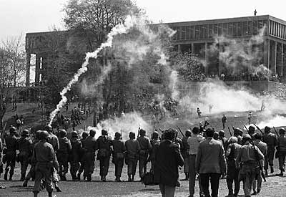

Slide 57
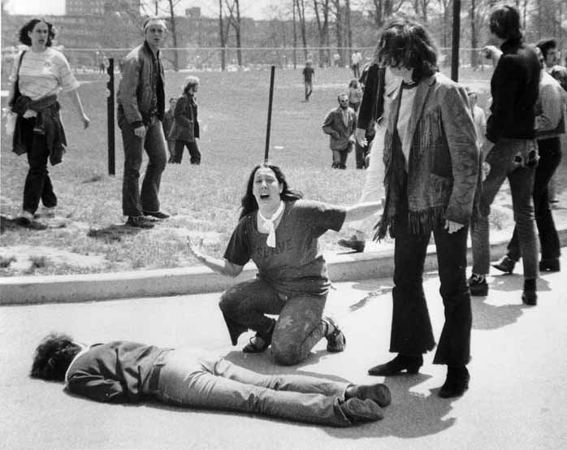

Slide 58
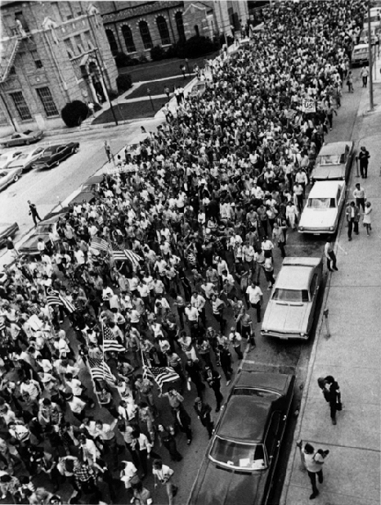

Slide 59
President Nixon: Nothing else of interest in the world today?
Alexander Haig: Yes, sir, very significant, this goddamn New York Times exposé of the most highly classified documents of the [Vietnam] war.
President Nixon: Oh, that. I see.
Haig: That, that—
President Nixon: I didn’t read the story, but you mean that was leaked out of the Pentagon?
Haig: Sir, the whole study that was done for [former Defense Secretary Robert] McNamara and then carried on after McNamara left by [former Defense Secretary Clark] Clifford and the peaceniks over there. This is a devastating security breach of the greatest magnitude of anything I’ve ever seen.
President Nixon: Well, what’s being done about it, then? I mean, I didn’t—
Haig: Well, I called—
President Nixon: Did we know this was coming out?
Haig: No, we did not, sir.
President Nixon: Yeah.
Haig: There are just a few copies of this—
President Nixon: Well, what about the—
Haig: —12-volume report.
President Nixon: Well, what about the—Let me ask you this, though, what about the—what about [Defense Secretary Melvin] Laird? What’s he going to do about it? Is—
Haig: Well, I [unclear]—
President Nixon: Now, I’d just start right at the top and fire some people. I mean, whoever—whatever department it came out of, I’d fire the top guy.
Haig: Yes, sir. Well, I’m sure it came from Defense, and I’m sure it was stolen at the time of the turnover of the administration.
President Nixon: Oh, it’s two years old, then.
Haig: I’m sure it is, and they’ve been holding it for a juicy time, and I think they’ve thrown it out to affect Hatfield-McGovern [a Senate amendment to end funding for the Vietnam War]. That’s my own estimate. But it’s something that is a mixed bag. It’s a tough attack on [President John] Kennedy. It shows that the genesis of the war really occurred during the ‘61 period.
President Nixon: [laughing] Yeah. Yeah. That’s Clifford. I see.
Haig: And it’s brutal on President [Lyndon] Johnson. They’re going to end up in a massive gut fight in the Democratic Party on this thing.
President Nixon: Are they?
Haig: It’s a—there’s some very—
President Nixon: But also, massive against the war.
Haig: Against the war.
President Nixon: But it’s a Pentagon study, huh?

Slide 60
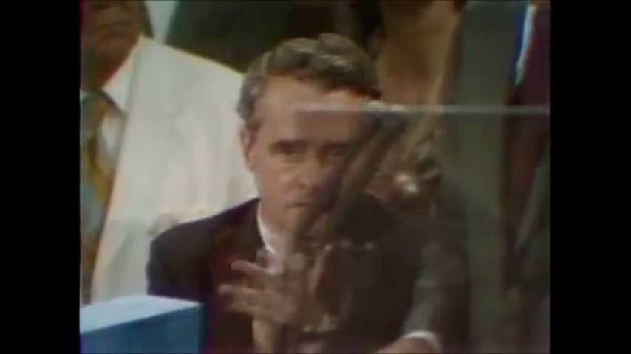

Slide 61
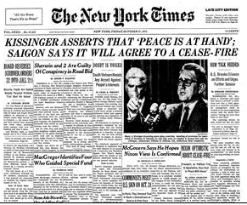

Slide 62
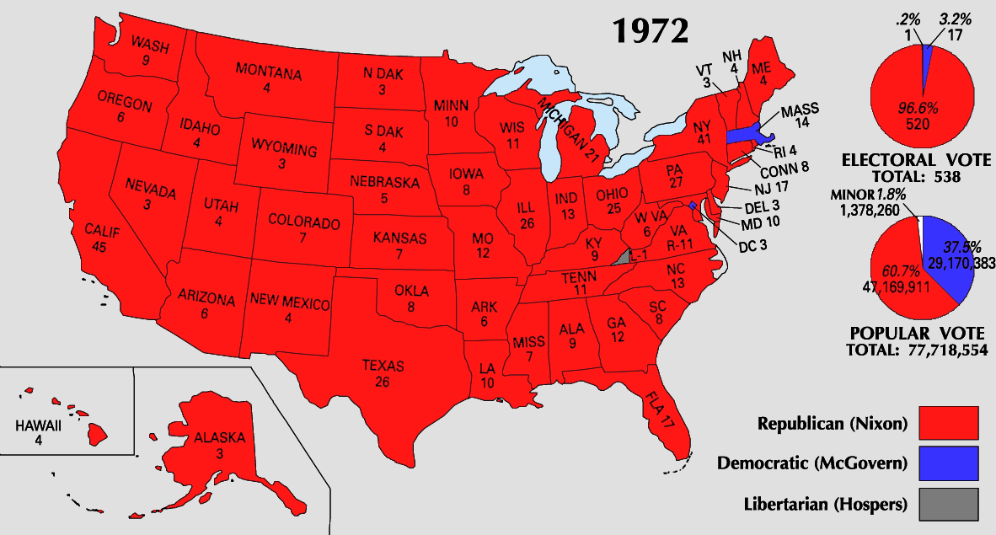

Slide 63
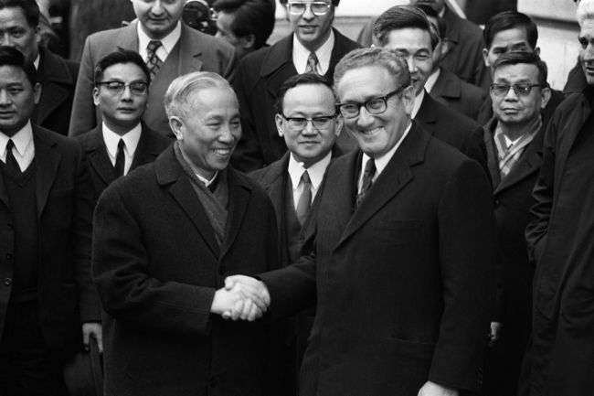

Slide 64
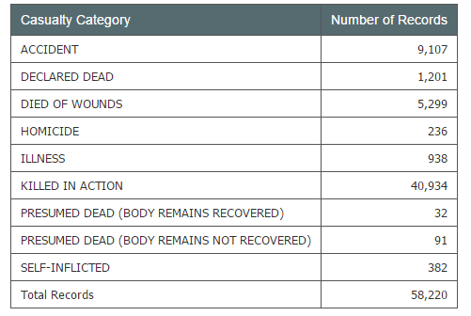
Total U.S. Casualties, Vietnam

Slide 65
