Slide 1
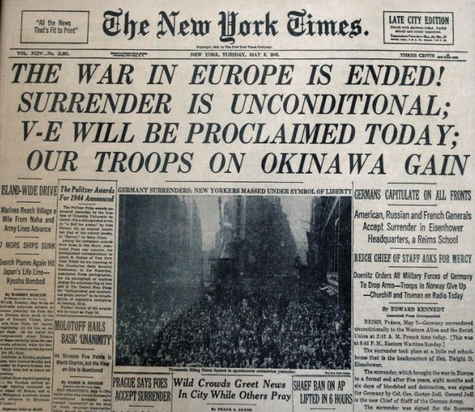

Slide 2
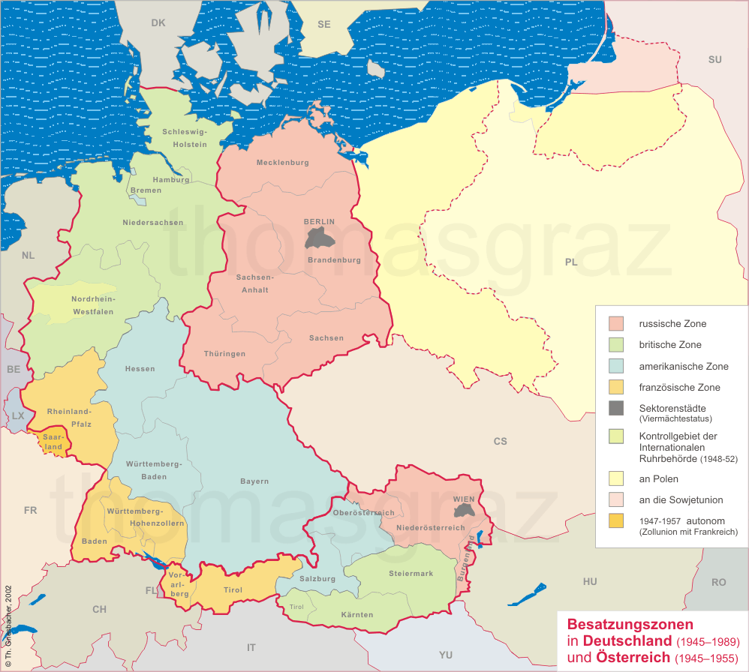

Slide 3
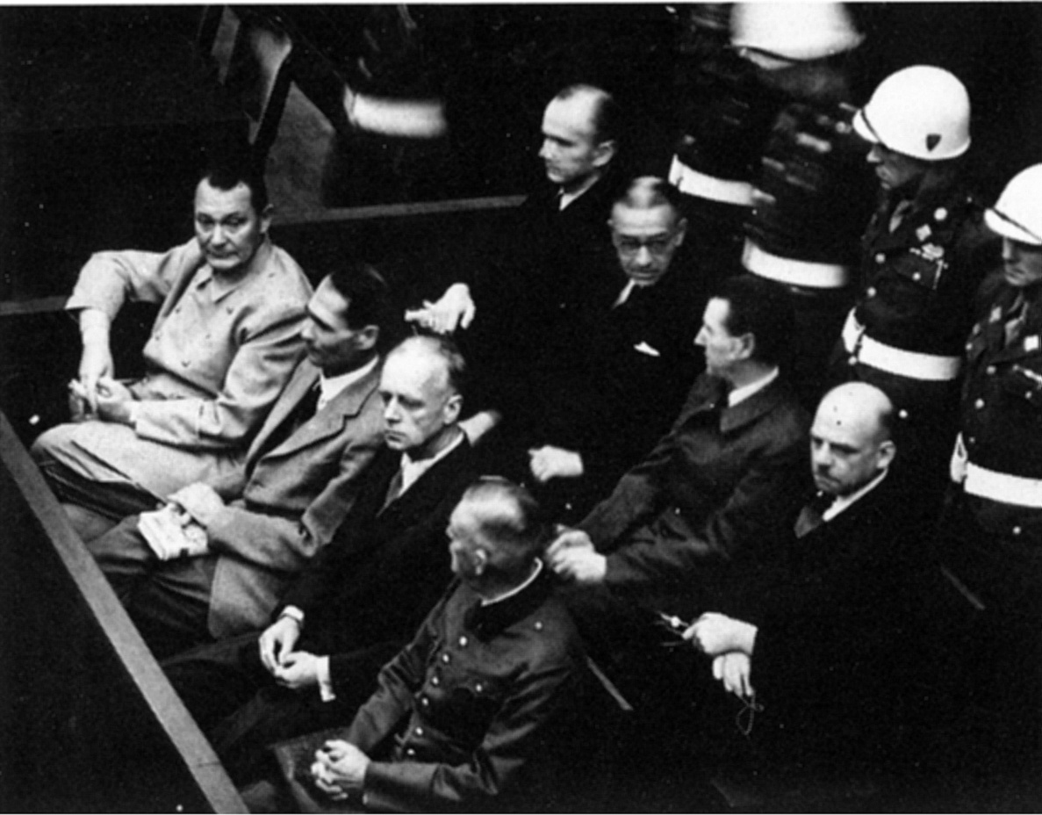

Slide 4


Slide 5
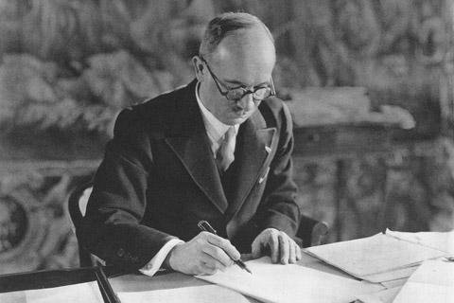

Slide 6
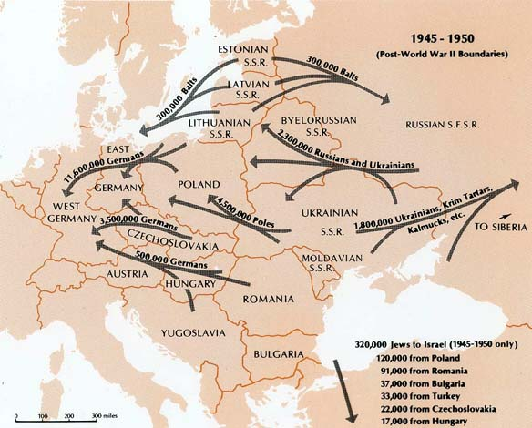

Slide 7
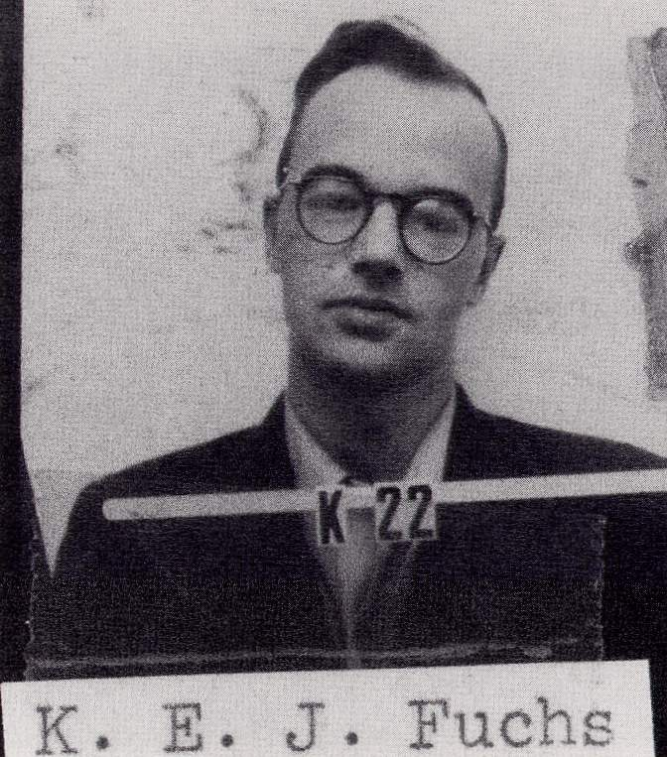

Slide 8
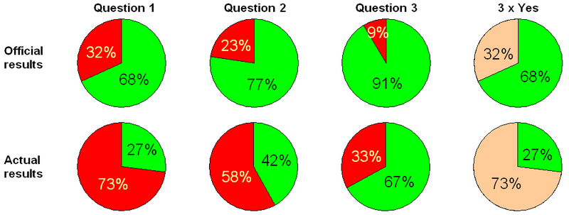
Polish (“three times yes”) referendum, 1946
Q1: abolish the Senate?
Q2: nationalize the economy?
Q3: accept postwar borders?

Slide 9
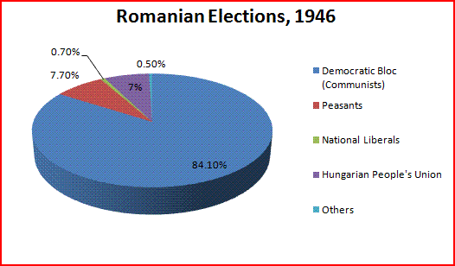
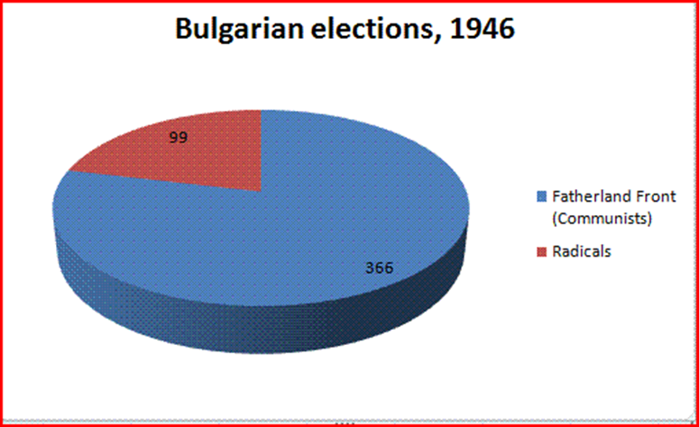

Slide 10
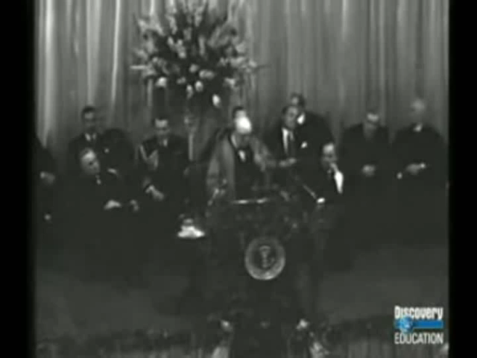

Slide 11
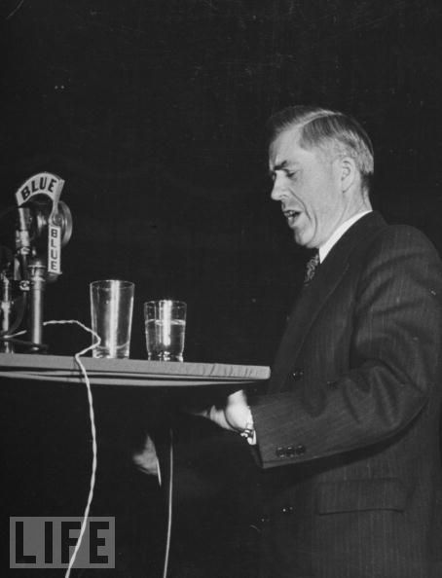

Slide 12
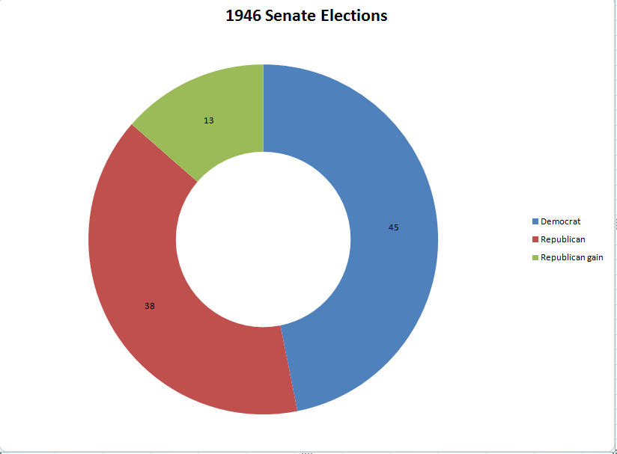

Slide 13
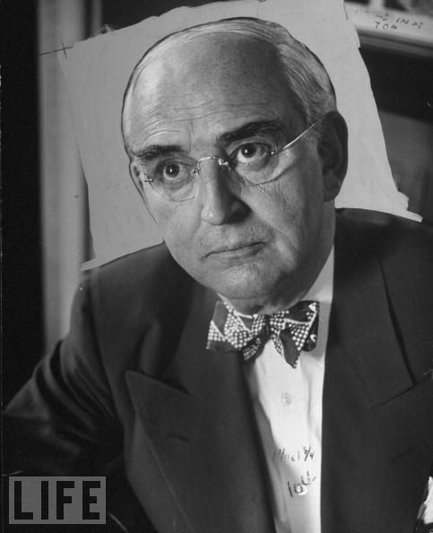
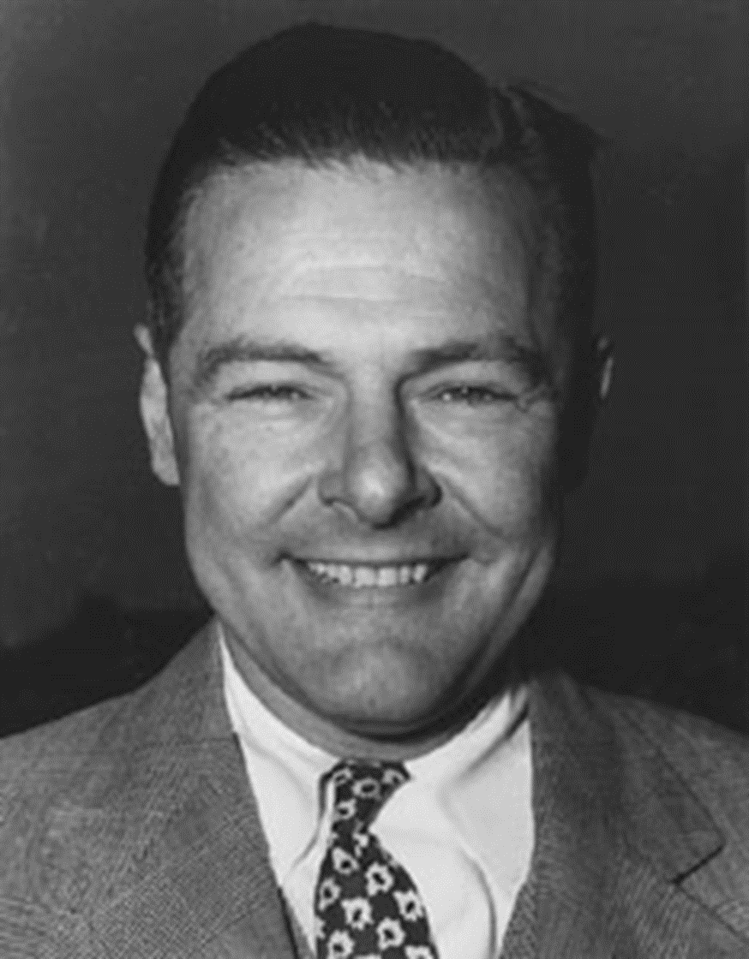
Notes:
vberg

Slide 14


Slide 15
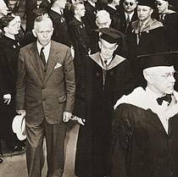

Slide 16
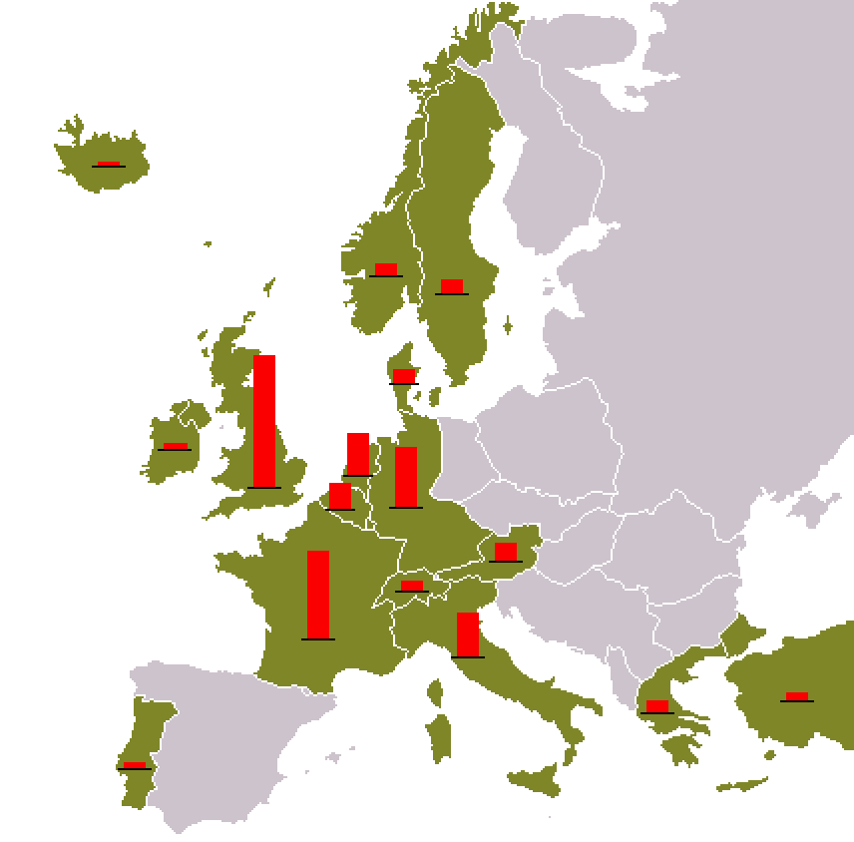

Slide 17
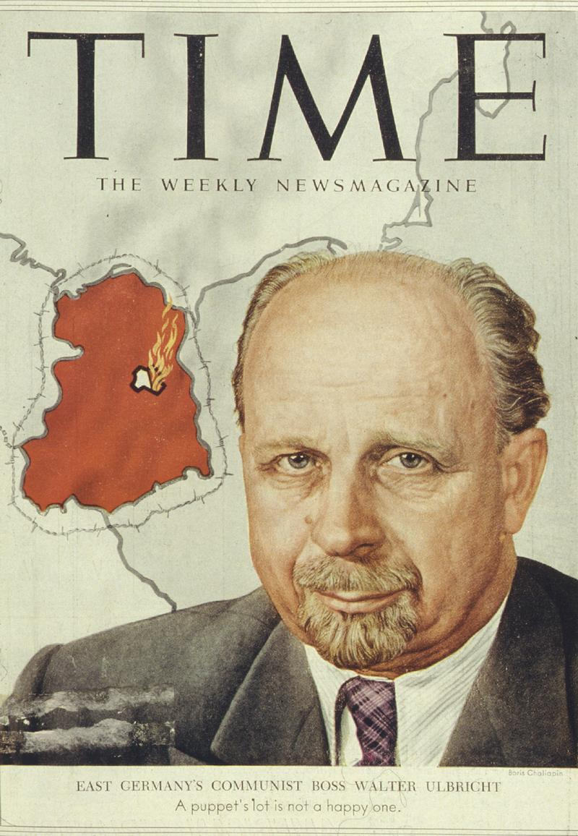

Slide 18
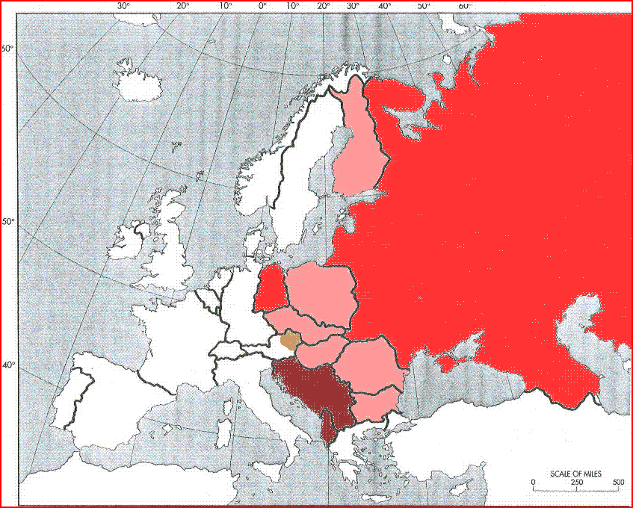

Slide 19
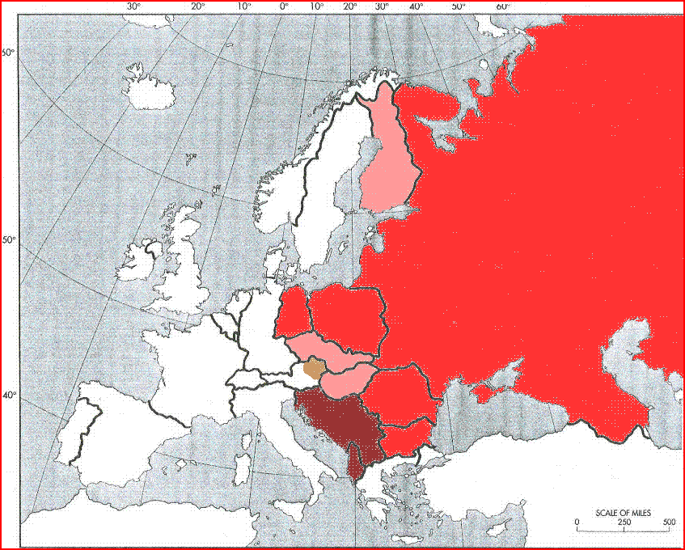

Slide 20
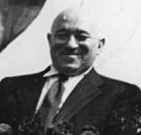
Notes:
rakosi

Slide 21
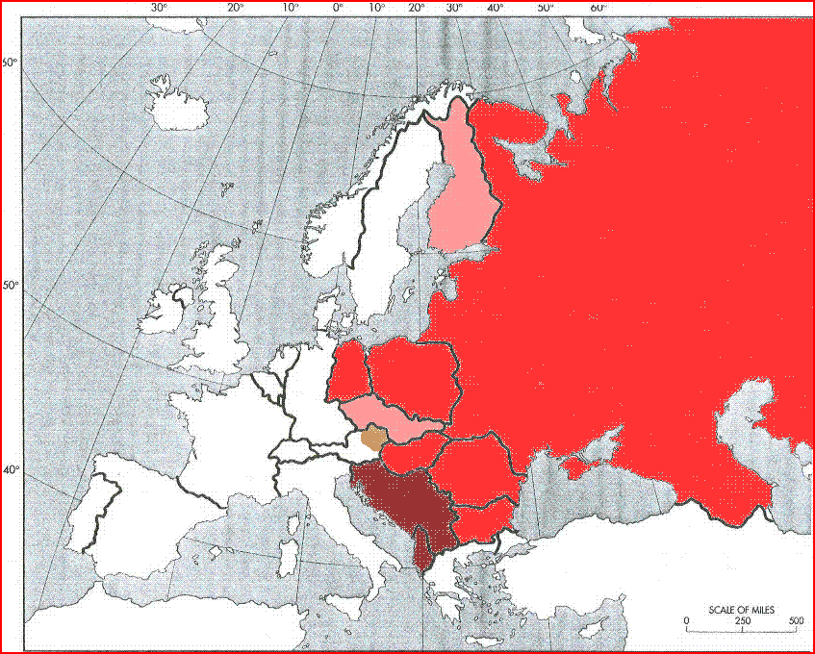

Slide 22
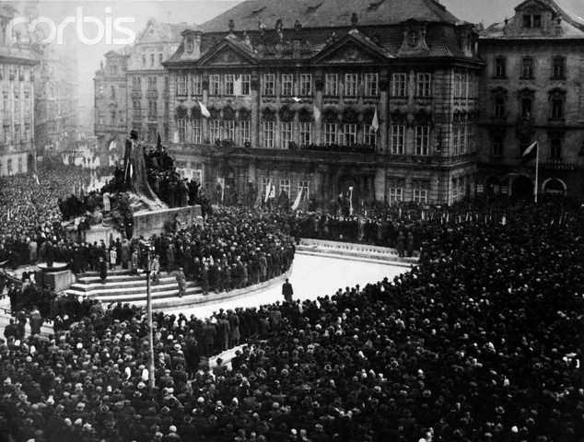

Slide 23
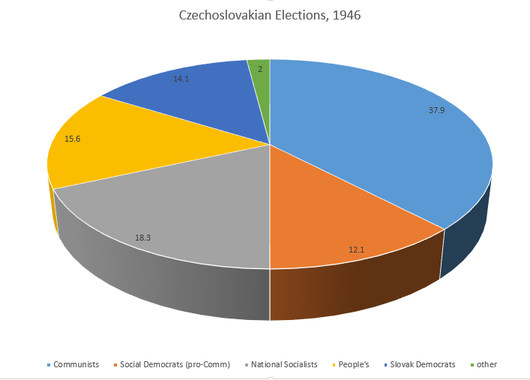

Slide 24
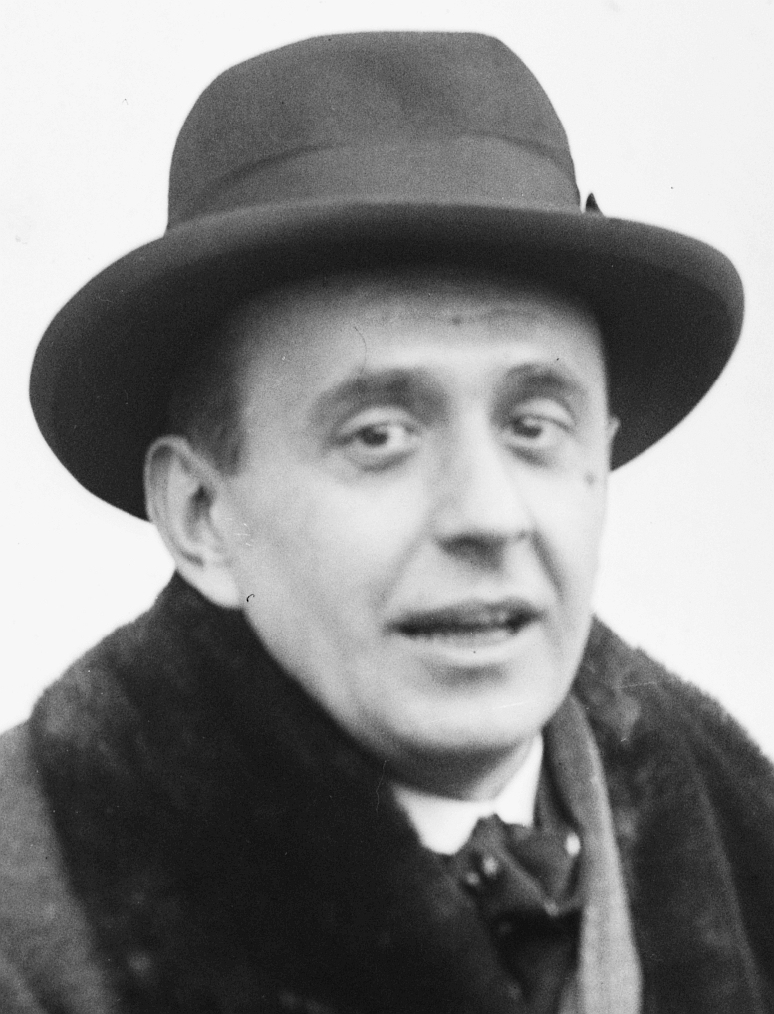

Slide 25
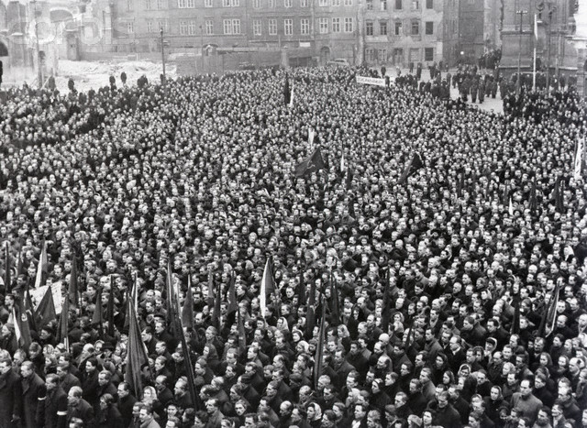

Slide 26


Slide 27


Slide 28
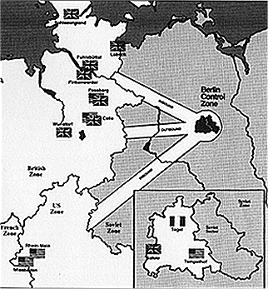

Slide 29
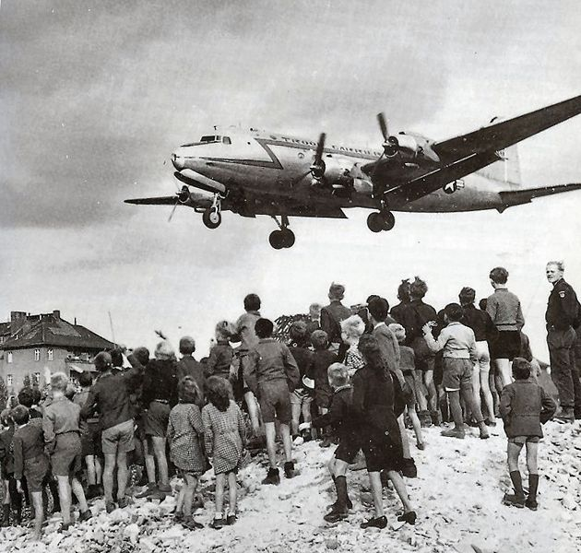

Slide 30
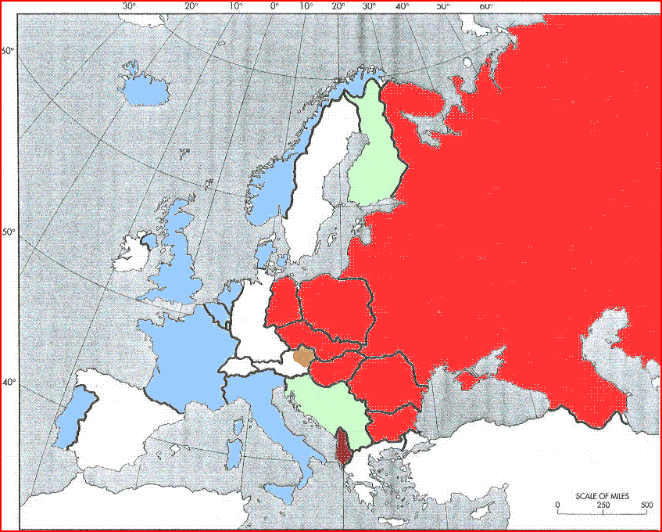

Slide 31
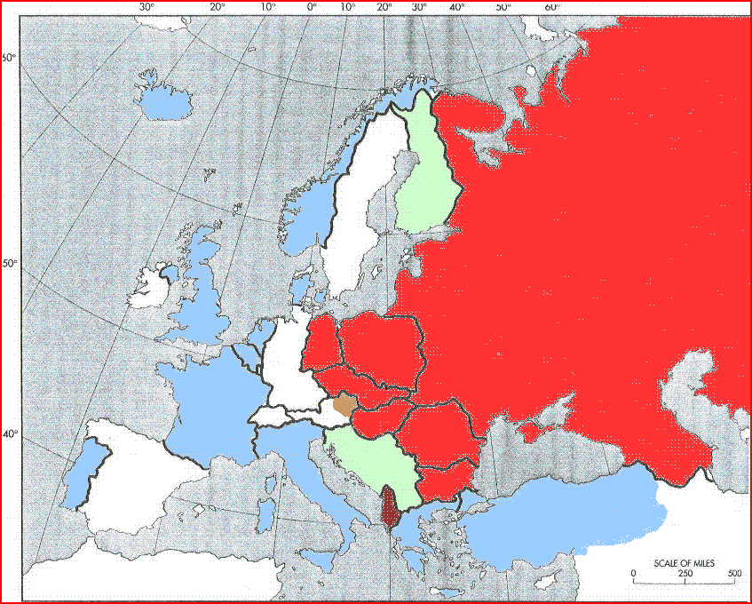

Slide 32
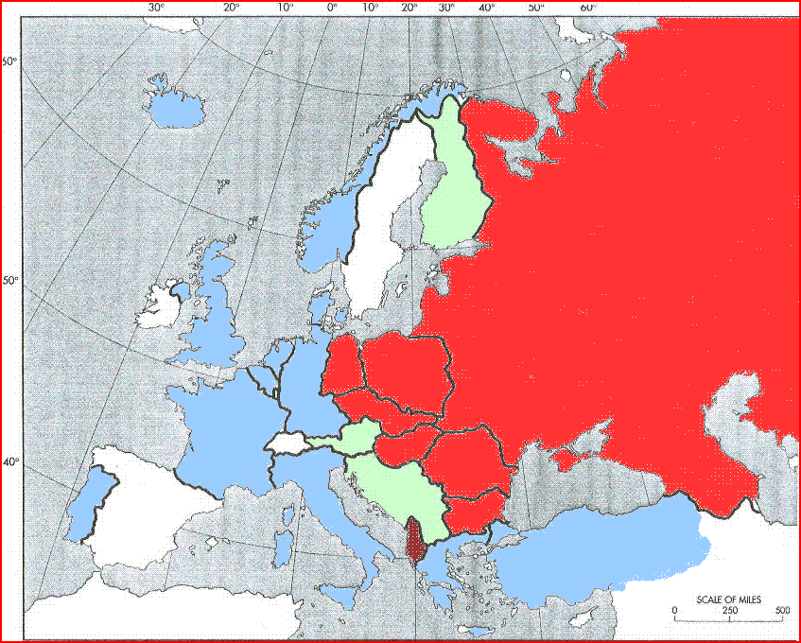

Slide 33
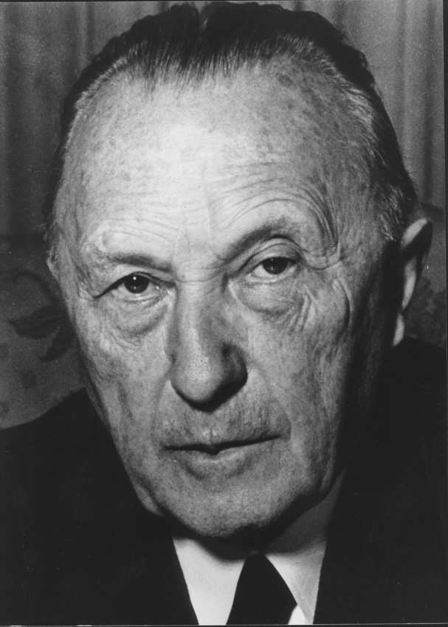

Slide 34
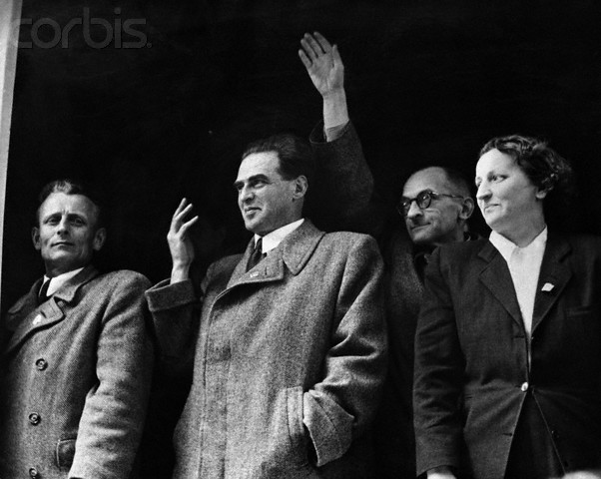

Slide 35
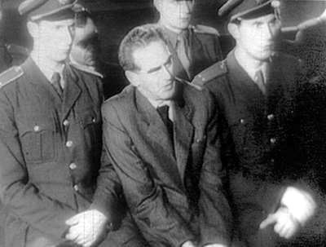

Slide 37
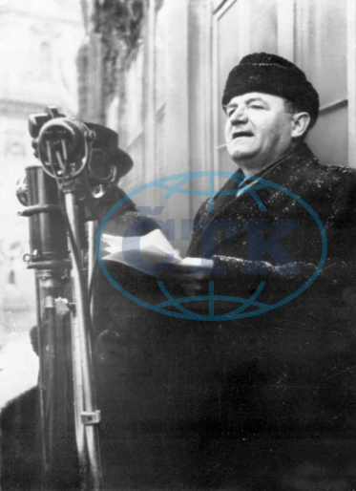

Slide 38
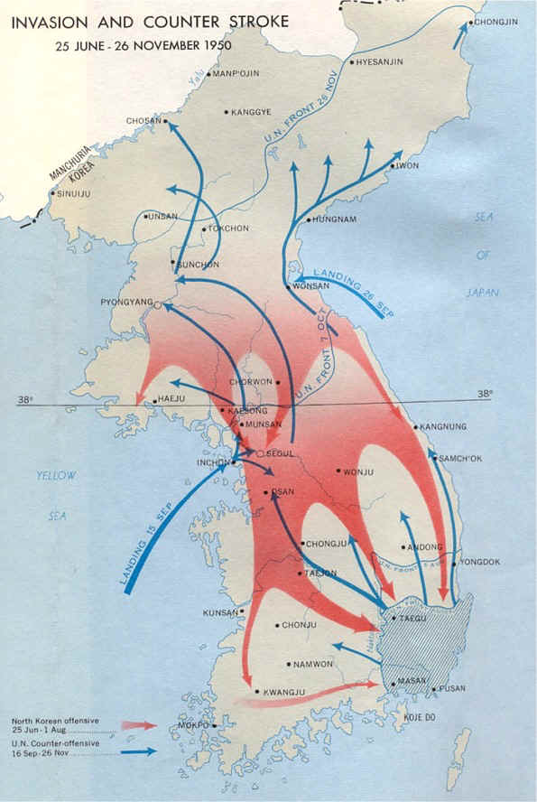

Slide 39


Slide 40
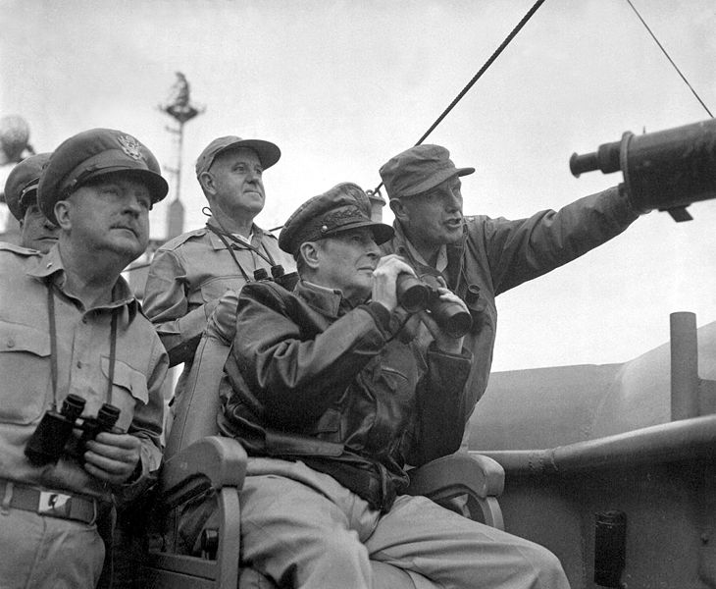
Notes:
inchon

Slide 41
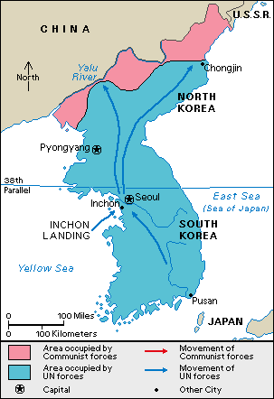

Slide 42
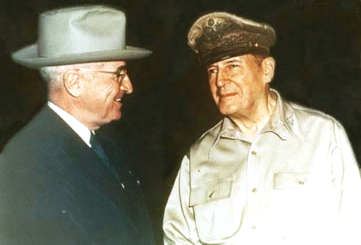
Notes:
wake

Slide 43
 | 1950 | 1951 | 1952
Defense budget | $13.3 B | $60.4B | $44 B
Army | 591,000 | 1.55 million | 1.595 million
Navy | 451,000 | 1.01 million | 1.05 million
Air Force | 411,000 | 1.06 million | 973,000

Slide 44
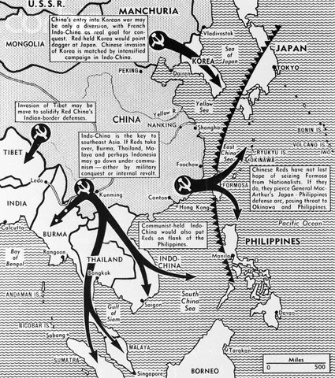

Slide 45
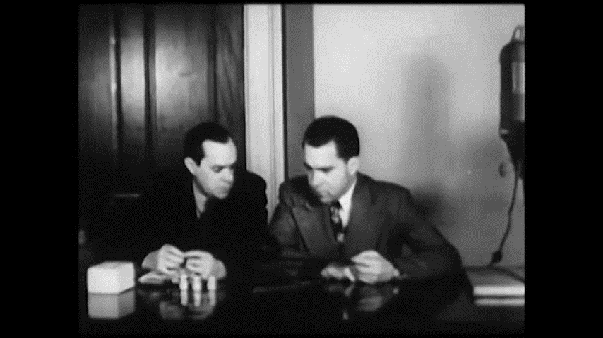

Slide 46


Slide 47


Slide 48


Slide 49
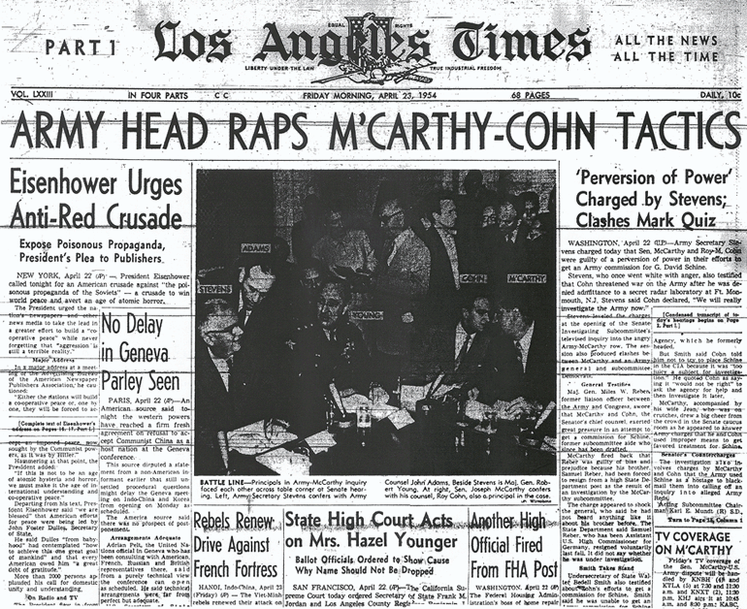

Slide 50


Slide 51
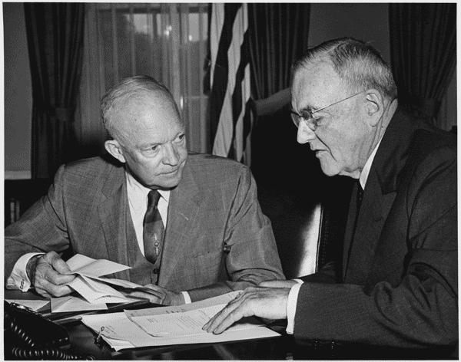

Slide 52
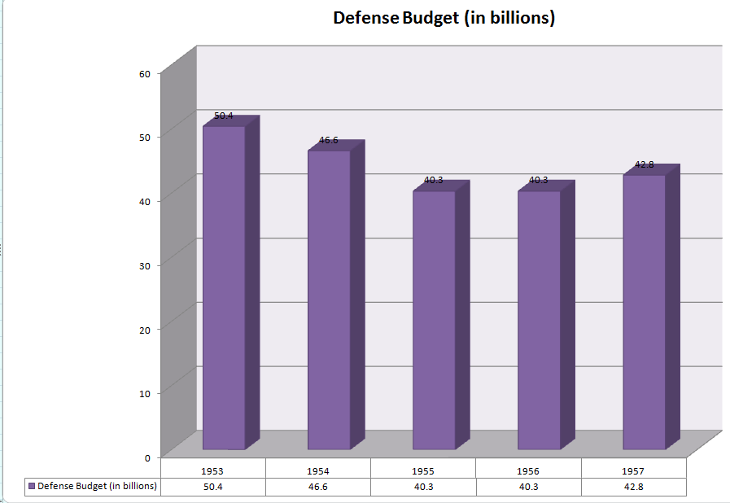

Slide 53
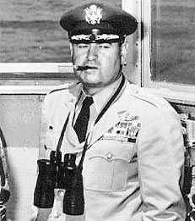


Slide 54
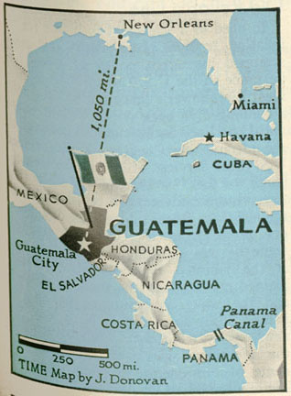

Slide 55
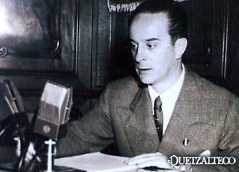

Slide 56


Slide 57


Slide 58
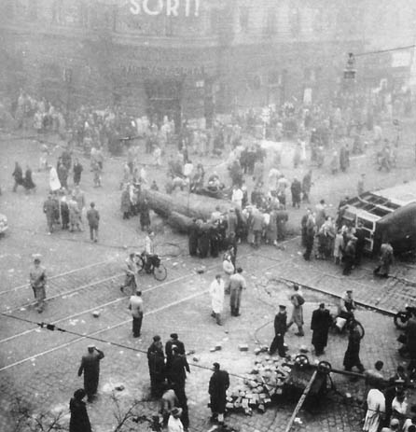
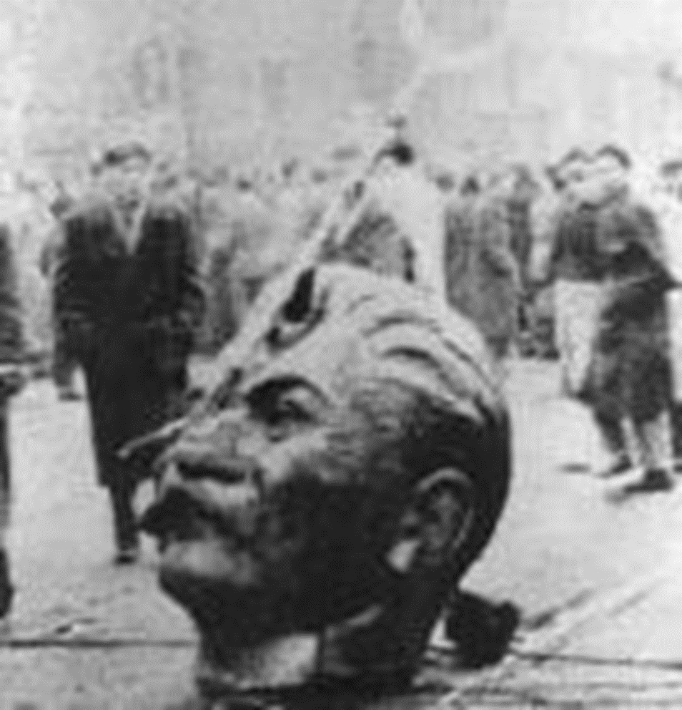

Slide 59


Slide 60
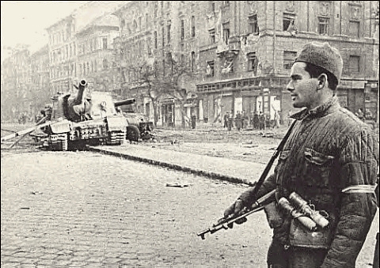

Slide 61
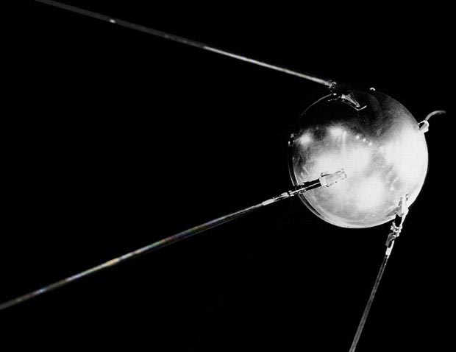
Notes:
sputnik

Slide 62


Slide 63


Slide 64


Slide 65




Slide 66



Slide 67


Slide 68


Slide 69


Slide 70


Slide 71


Slide 72


Slide 73


Slide 74


Slide 75

Curtis LeMay: There’s one other factor that I didn’t mention that’s not quite in our field. But you invited us to comment on this at one time. And that is that we have had a talk about Cuba and the SAM [surface-to-air-missile] sites down there. And you have made some pretty strong statements about their being defensive, and that we would take action against offensive weapons.
I think that a blockade and political talk would be considered by a lot of our friends and neutrals as being a pretty weak response to this. And I’m sure a lot of our own citizens would feel that way, too.
In other words: you’re in a pretty bad fix at the present time.
President Kennedy: What did you say?
LeMay: You’re in a pretty bad fix.
President Kennedy: You’re in there with me. [Slight laughter.] Personally.

