Slide 1
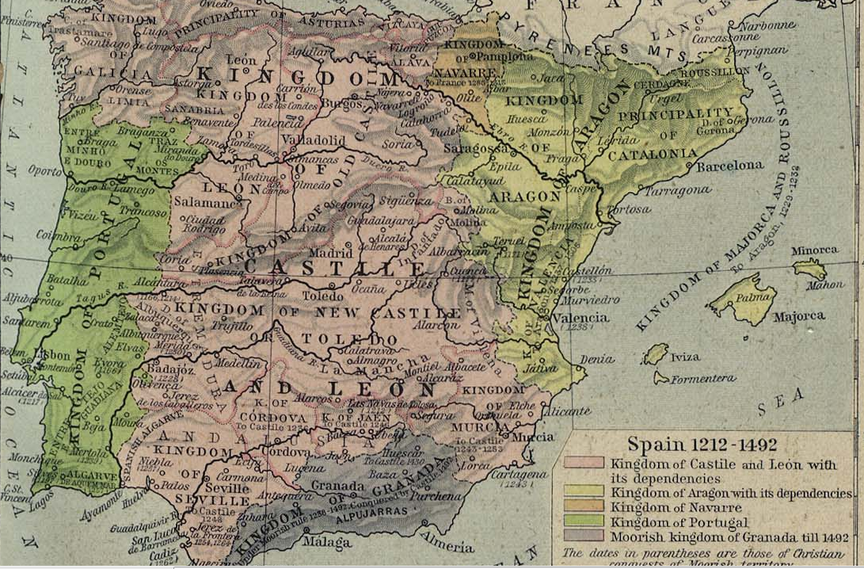

Slide 2
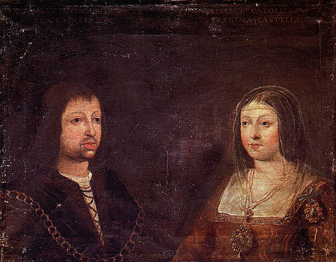

Slide 3
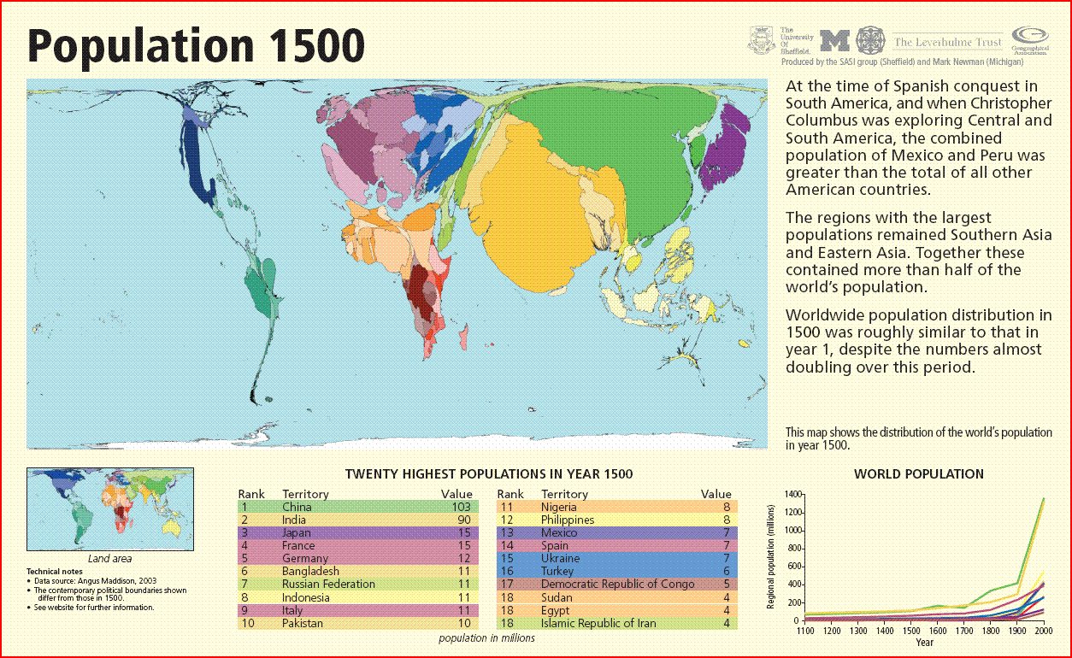

Slide 4

Notes:
cortes

Slide 5
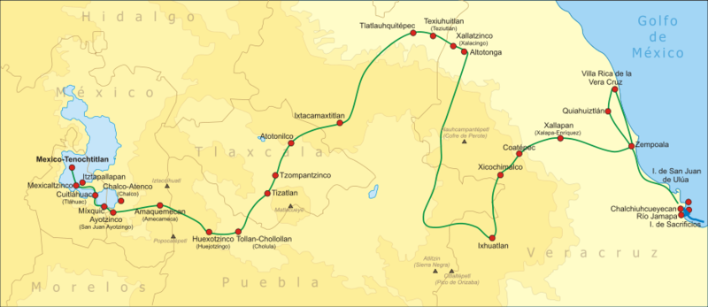

Slide 6


Slide 7
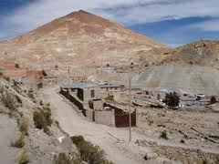
Notes:
Potosi

Slide 8
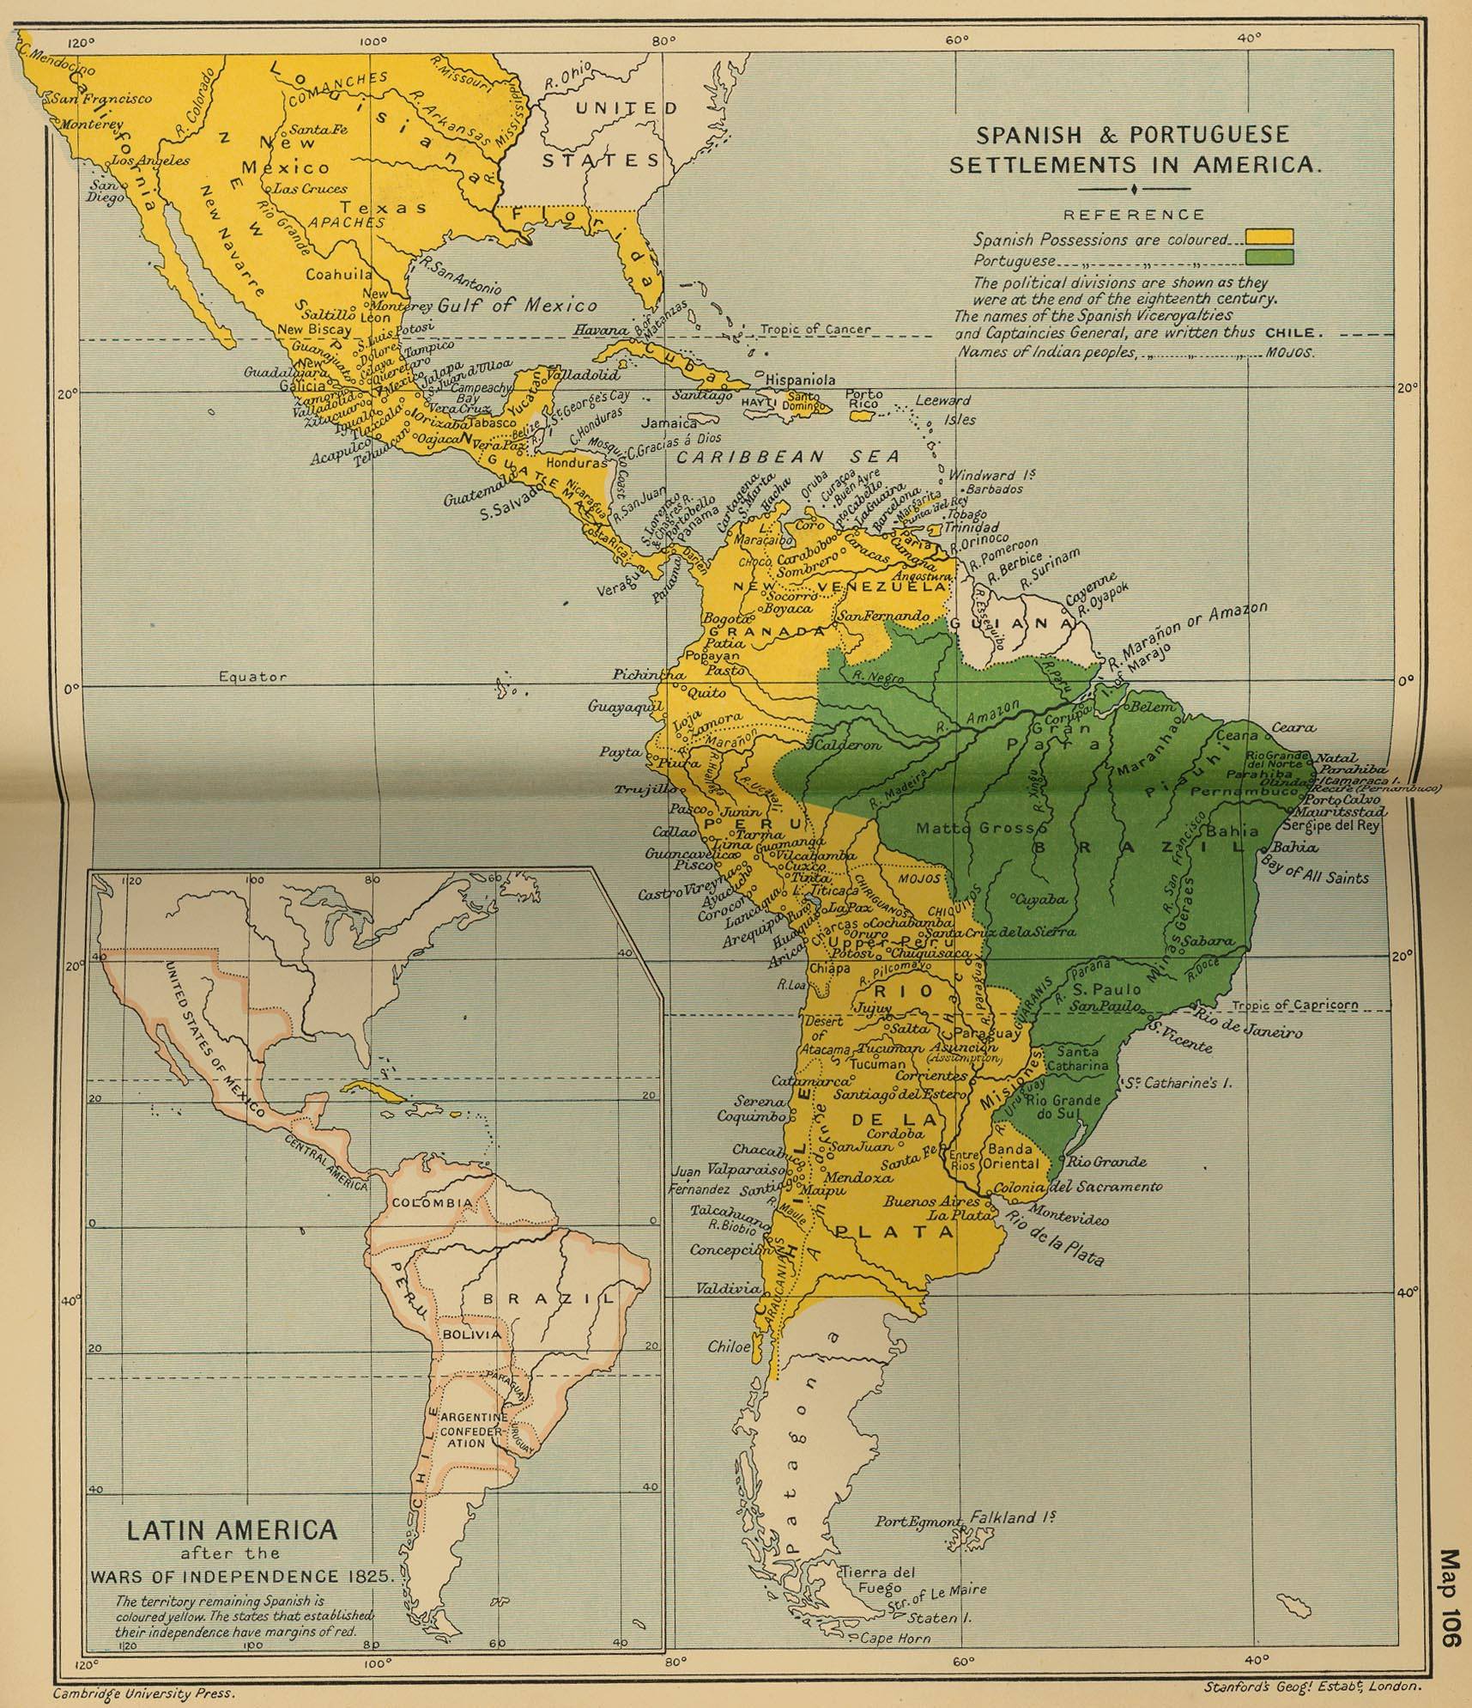

Slide 9
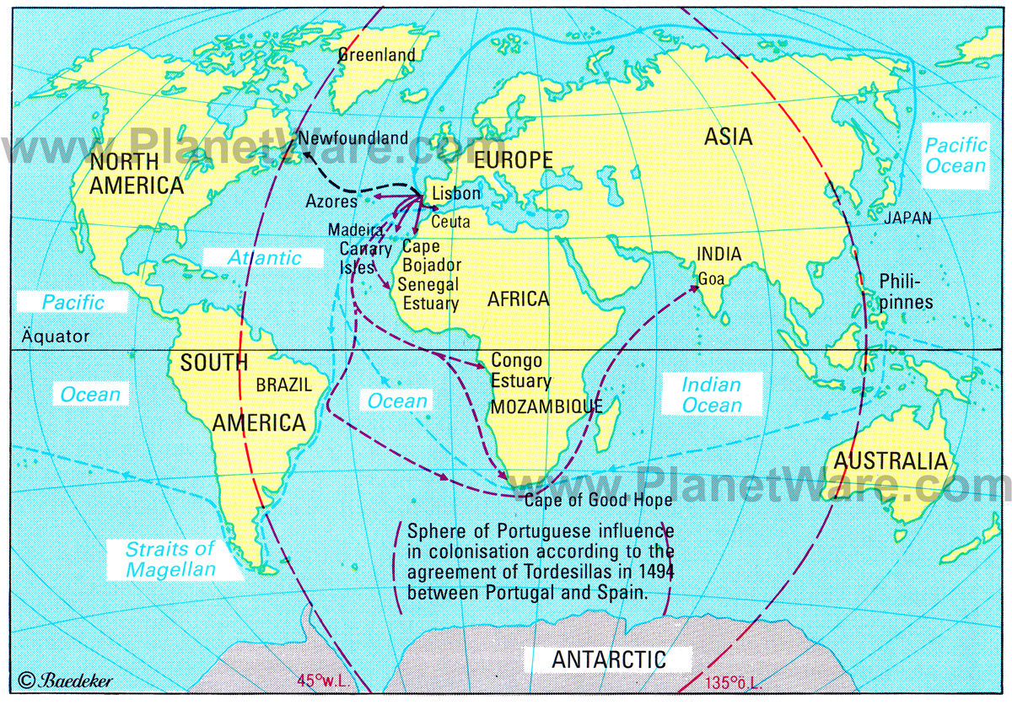

Slide 10
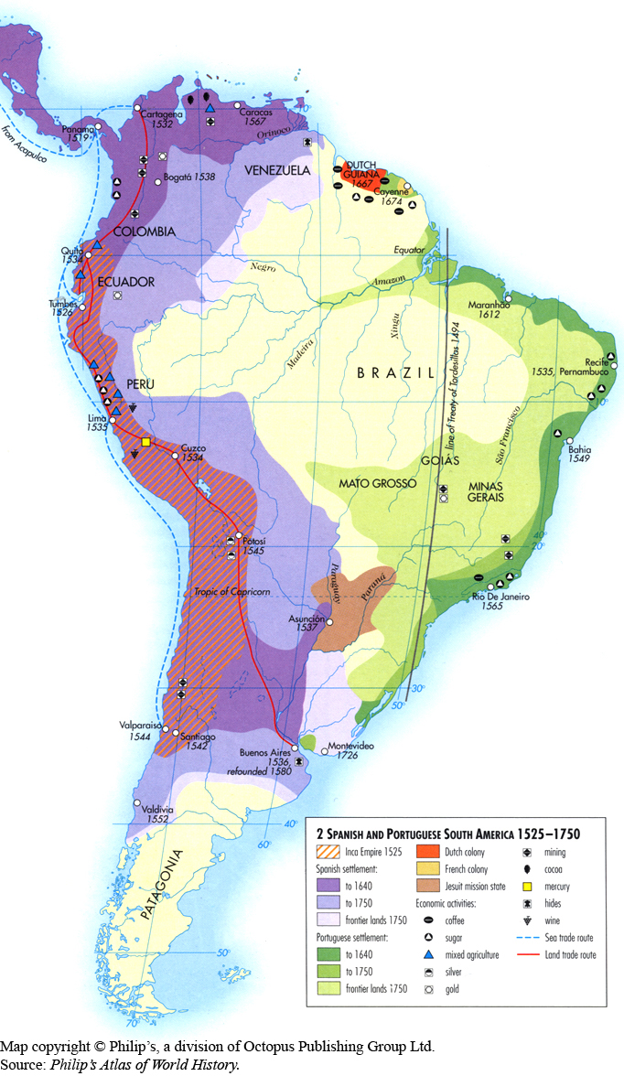

Slide 11
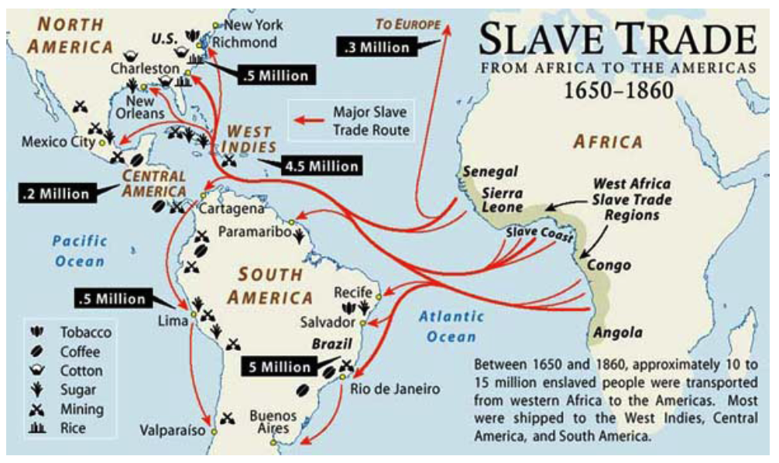

Slide 12
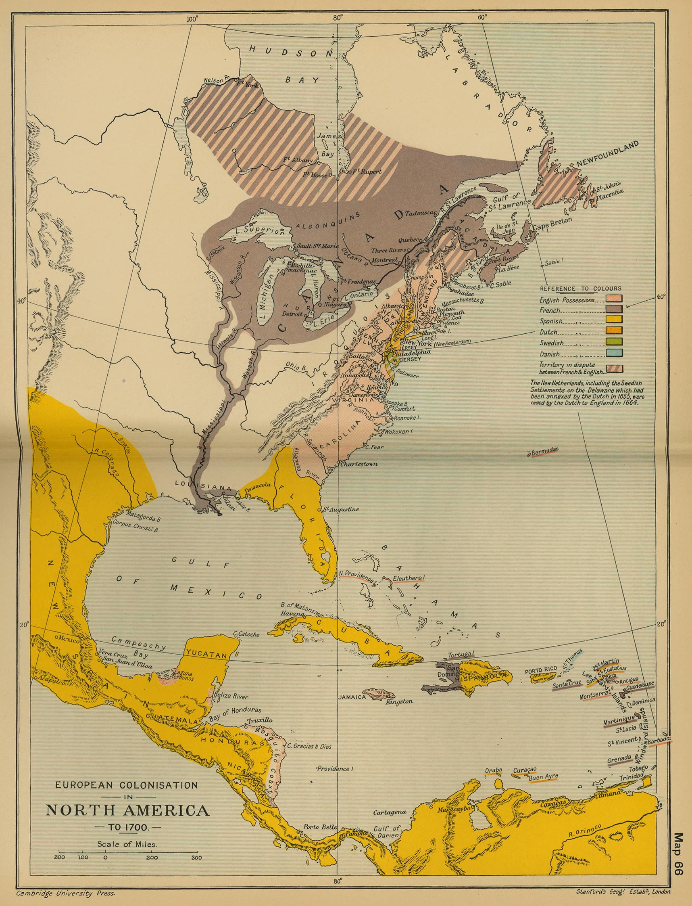

Slide 13
Navigation Act (1660)
From and after the first day of December 1660, and from thenceforward, no goods or commodities whatsoever shall be imported into or exported out of any lands, islands, plantations or territories to his Majesty belonging or in his possession . . . but in such ships or vessels as do truly and without fraud belong only to the people of England or Ireland . . .
III. And it is further enacted, That no goods or commodities whatsoever, of the growth, production or manufacture of Africa, Asia, or America, or any part thereof . . . be imported into England, Ireland, or Wales . . . in any other ship or ships, vessel or vessels whatsoever, but in such as do truly and without fraud belong only to the people of England, Ireland or Wales. . . .
XVIII. And be it further enacted, That from and after the first day of April, 1661, no sugars, tobacco, cotton-wool, indigos, ginger, fustick, or other dying wood, of the growth, production or manufacture of any English plantations in America, Asia, or Africa, shall be shipped, carried, conveyed or transported from any of the said English plantations to any land . . . other than to such English plantations as do belong to his Majesty. . . .

Slide 14
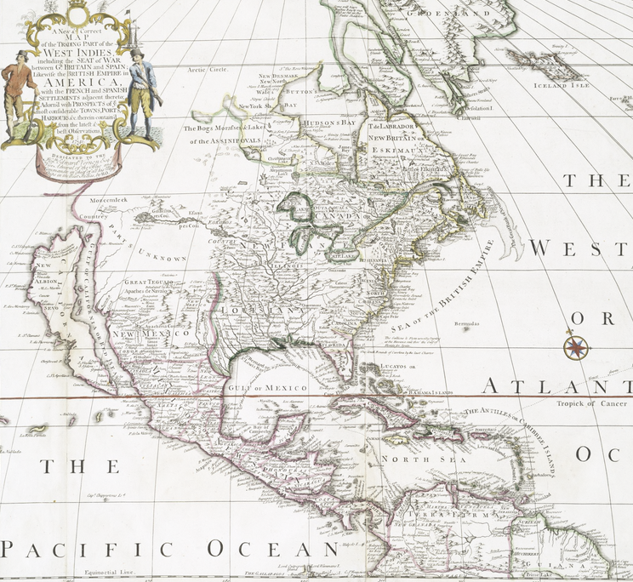

Slide 15
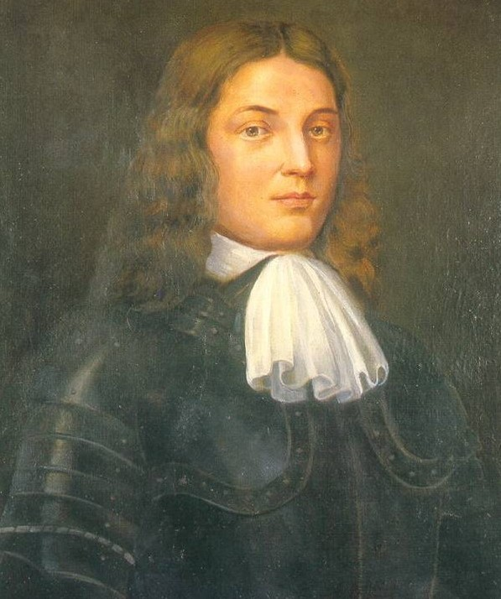
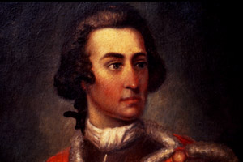
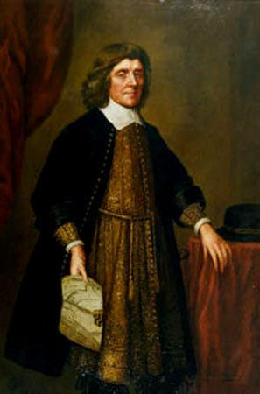
Notes:
Penn—baltimore-oglethorpe

Slide 16
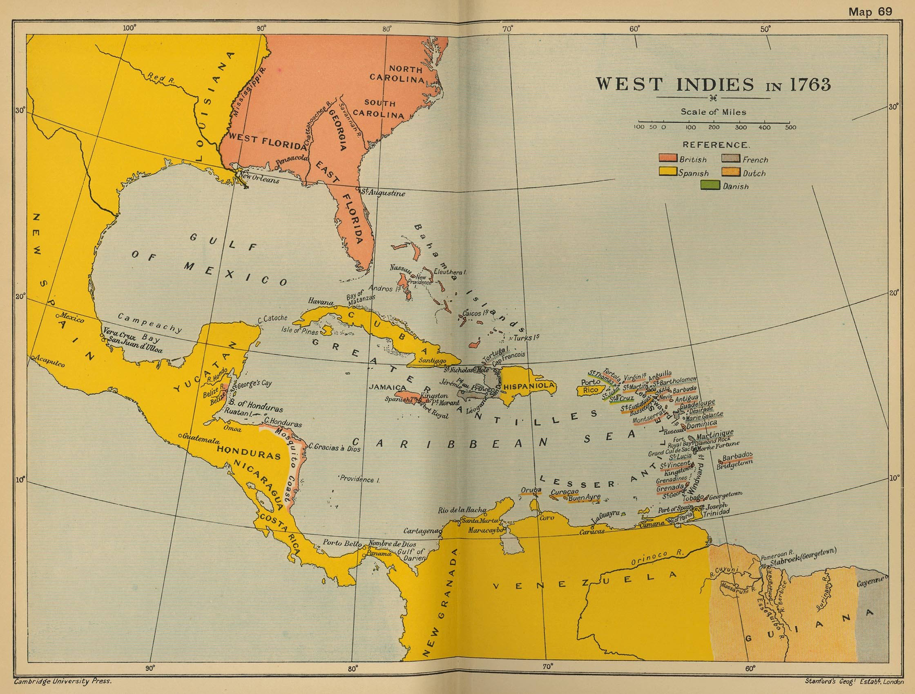

Slide 17
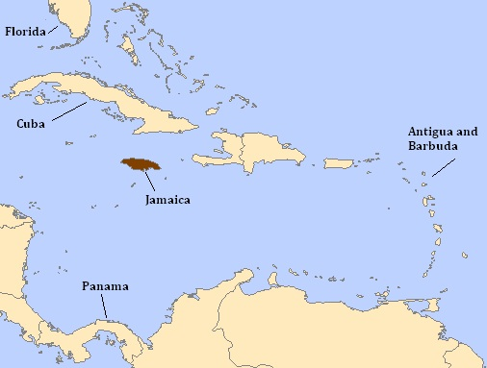

Slide 18
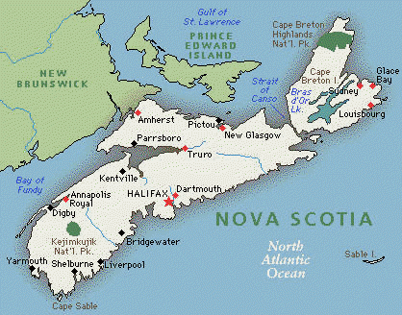

Slide 19
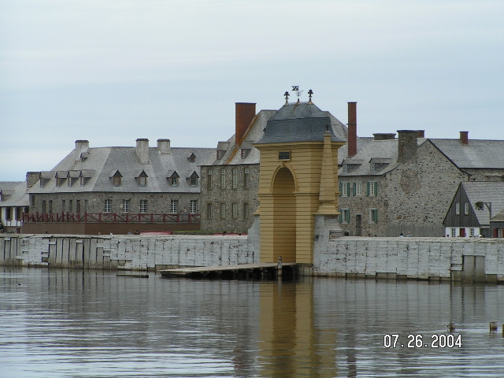

Slide 20
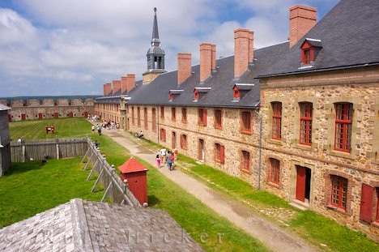

Slide 21


Slide 22
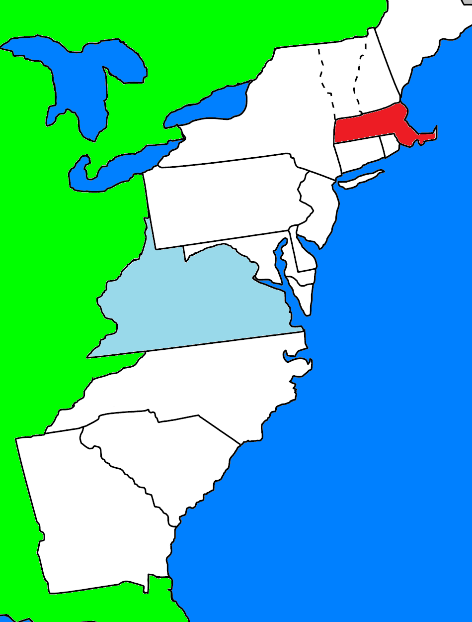

Slide 23
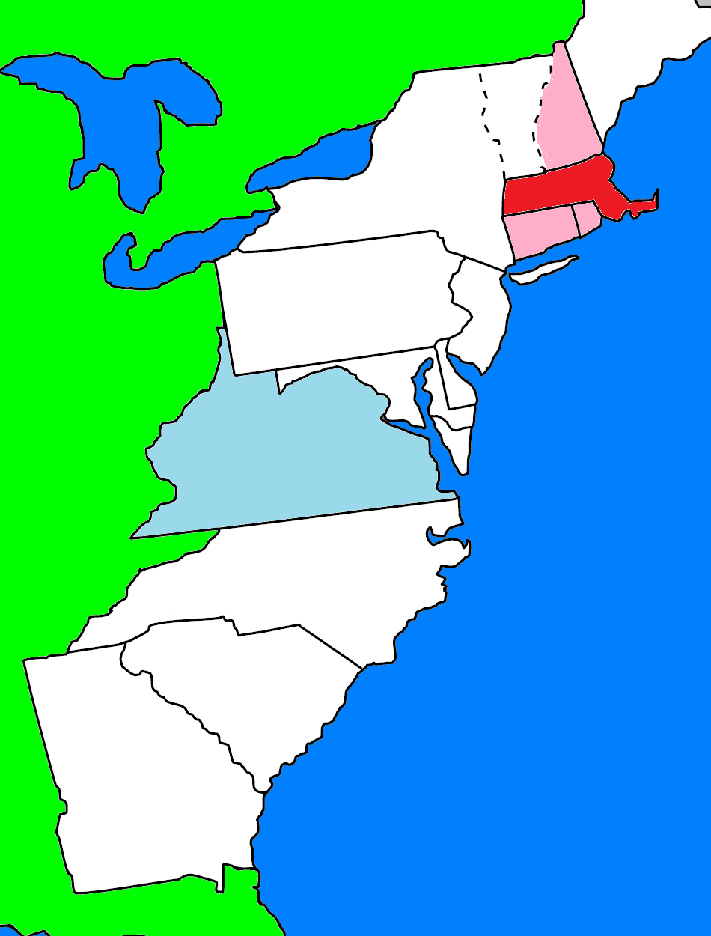

Slide 24
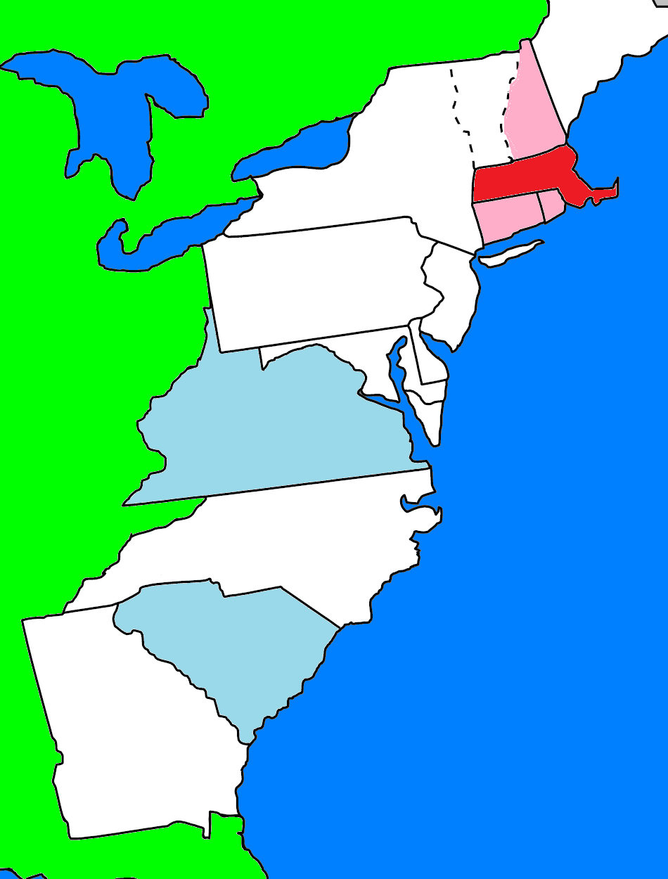

Slide 25
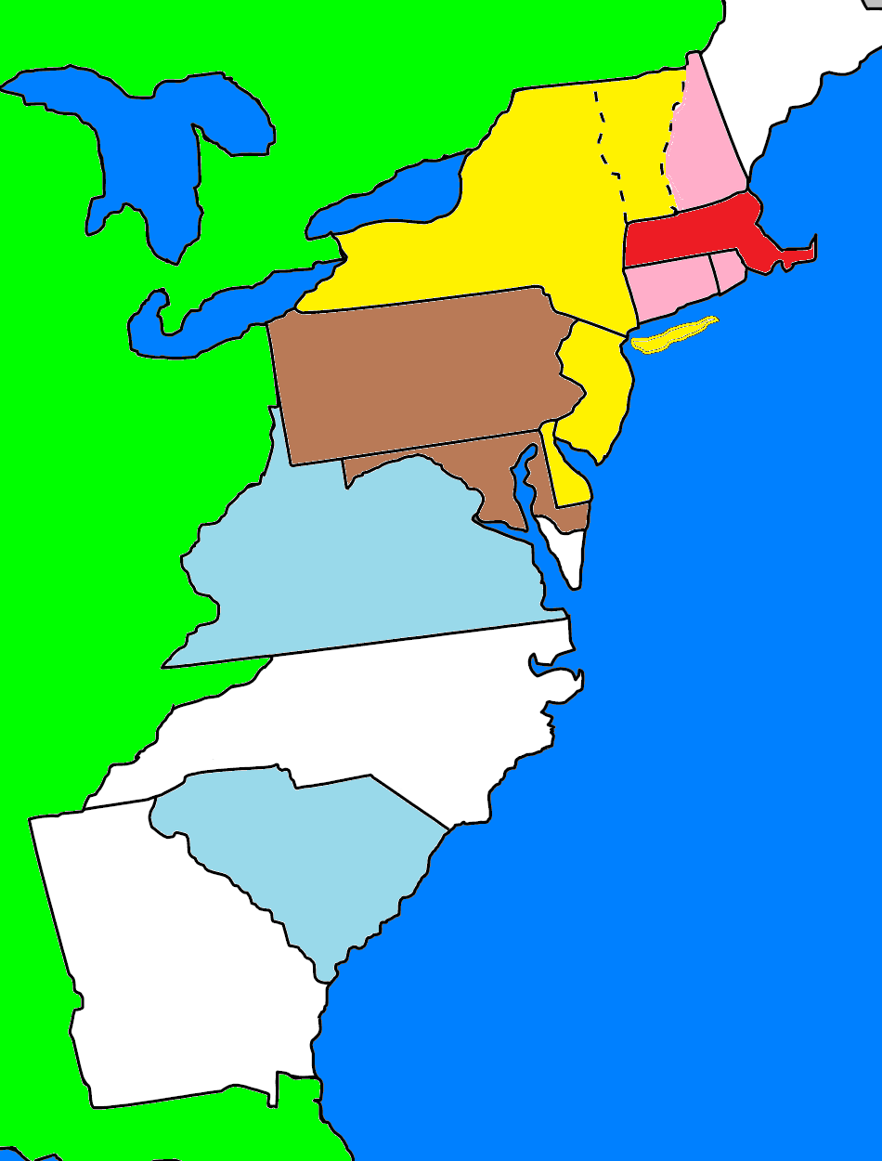

Slide 26
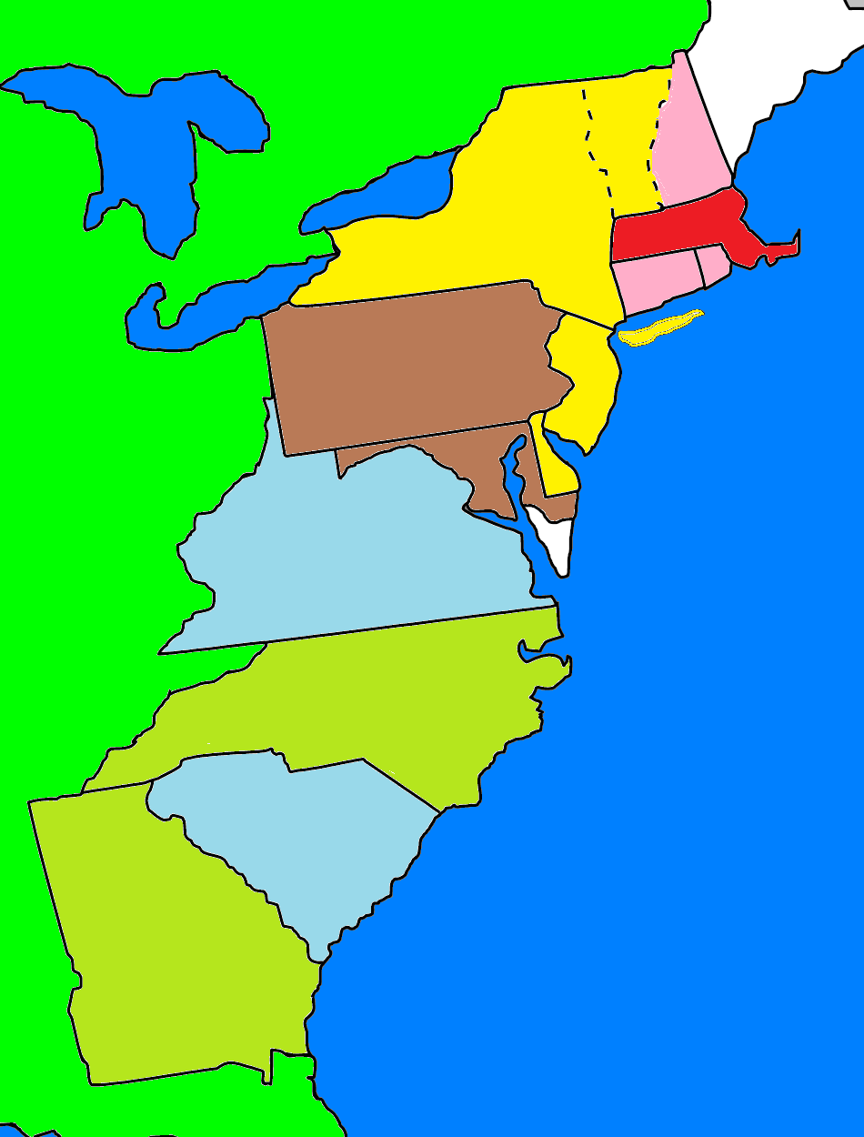

Slide 27
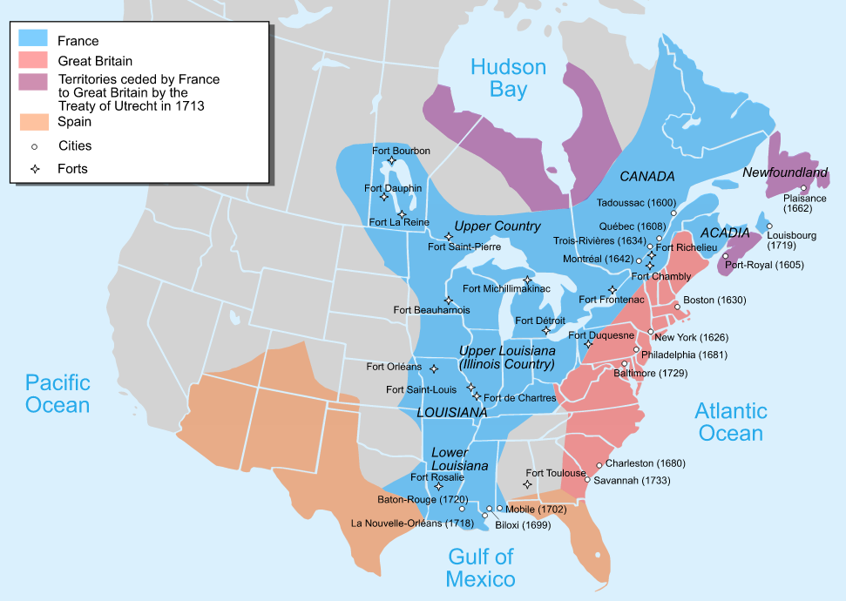

Slide 28
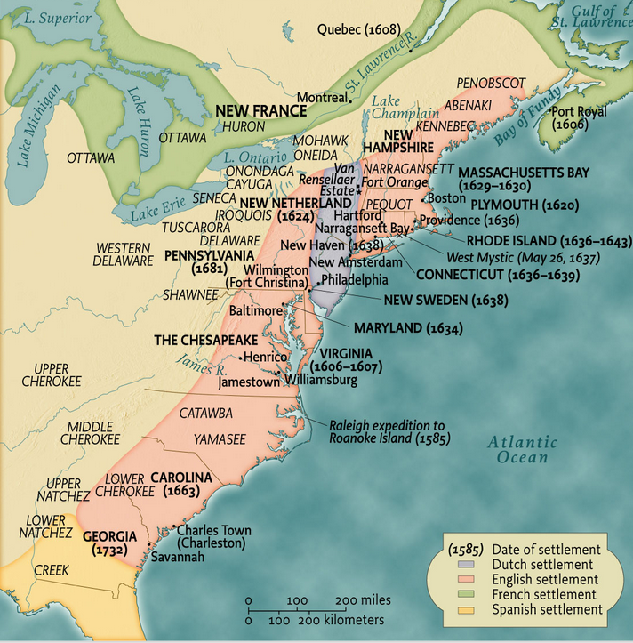

Slide 29
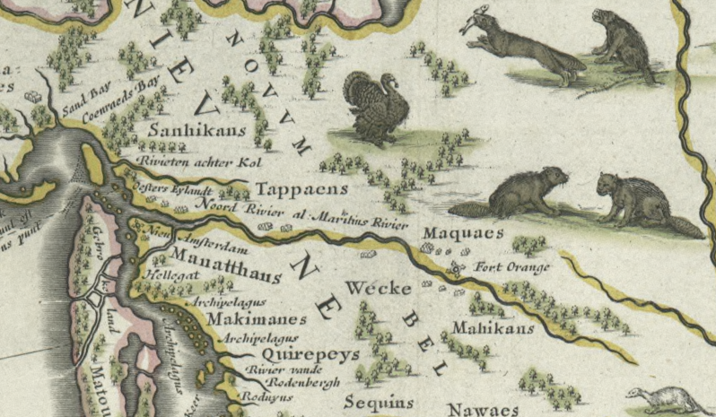

Slide 30
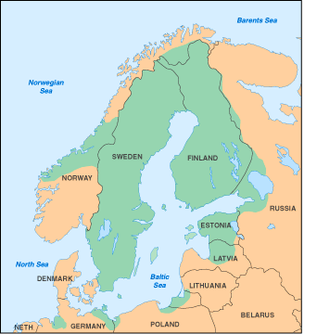

Slide 31
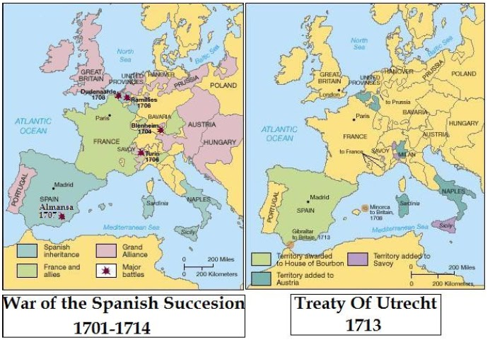

Slide 32
