Slide 1
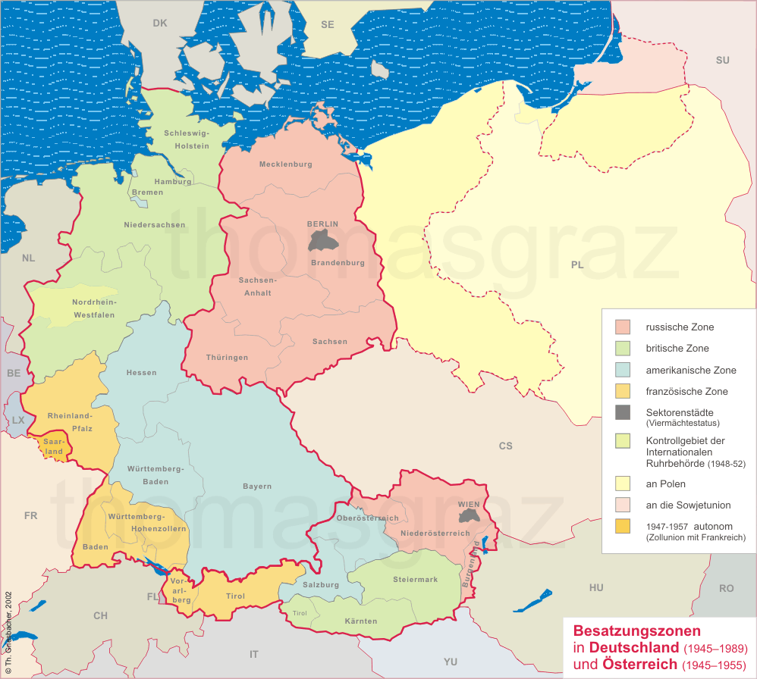

Slide 2
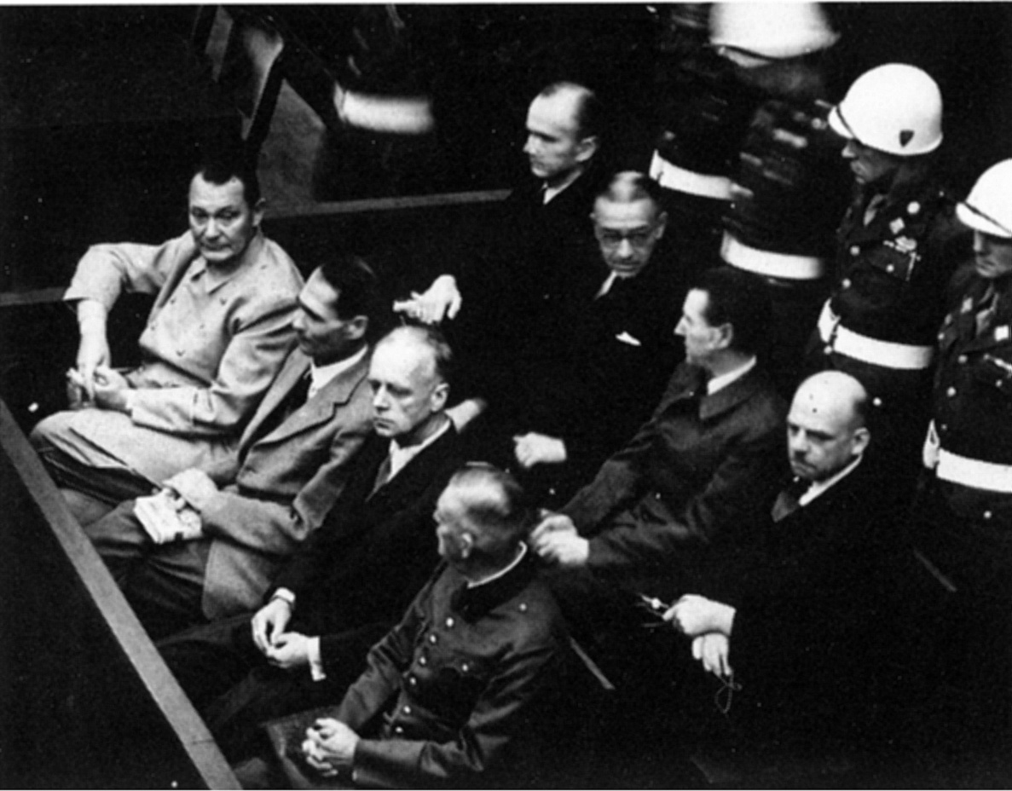

Slide 3
2.) Inmates and Dead in Special Camps, Soviet-occupied Germany
Camp | Number Interned | Number Dead
Bautzen | 30,000 | 16,700
Buchenwald | 30,600 | 13,200
Hohenschönhausen | 12,000 | 3,500
Jamlitz | 14,200 | 5,200
Ketschendorf | 19,850 | 7,200
Landsberg | 9,800 | 3,800
Mühlberg | 21,750 | 8,800
Neubrandenburg | 17,200 | 6,700
Sachsenhausen | 60,000 | 26,143
Weesow | 13,750 | 1,400
Torgau | 11,050 | 3,000
Total | 240,000 | 95,643

Slide 4
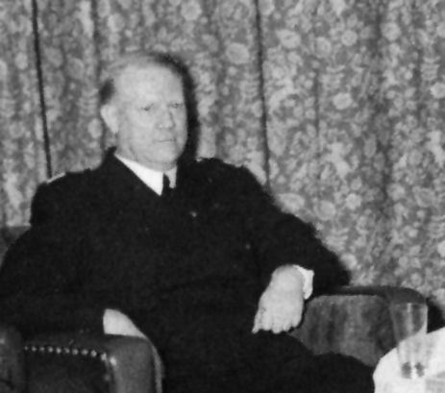
Notes:
quisling

Slide 5


Slide 6
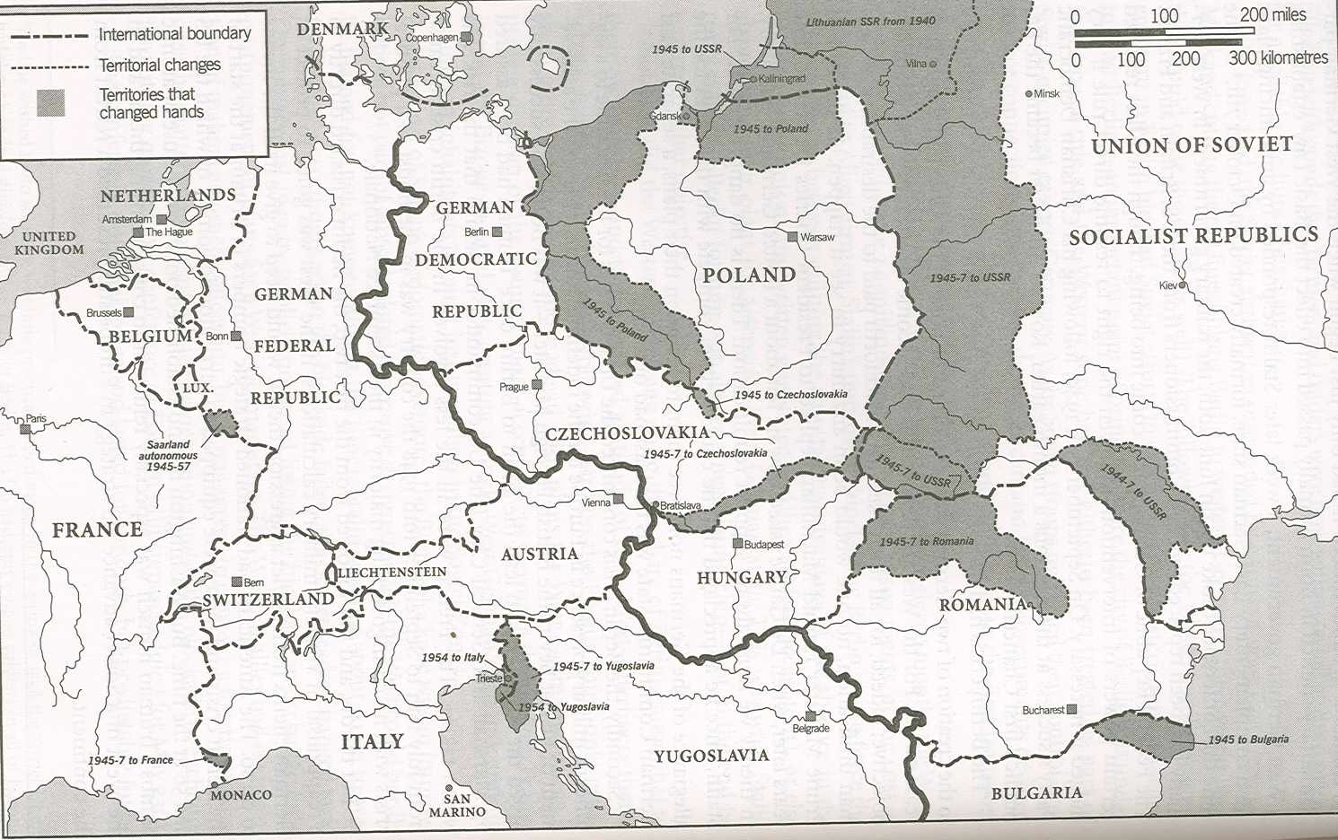

Slide 7
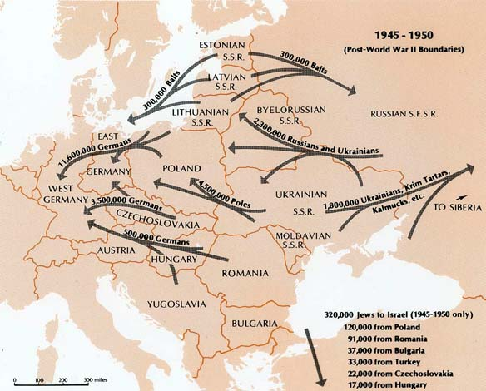

Slide 8
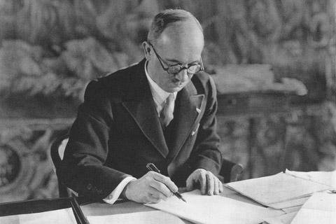

Slide 9
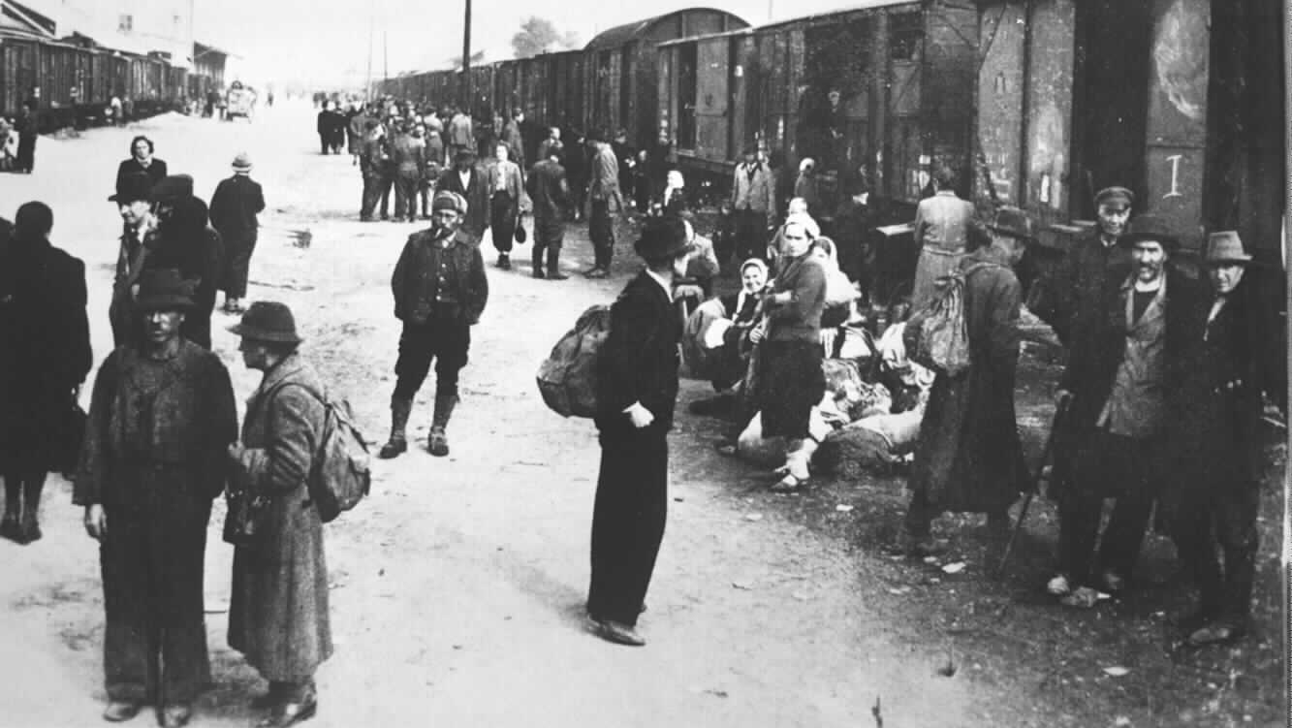

Slide 10
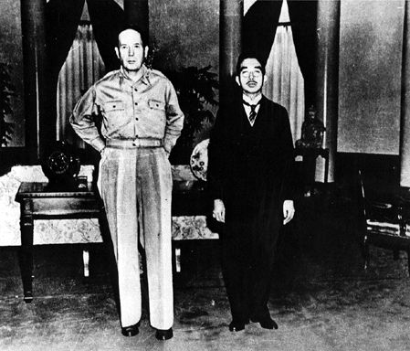

Slide 11
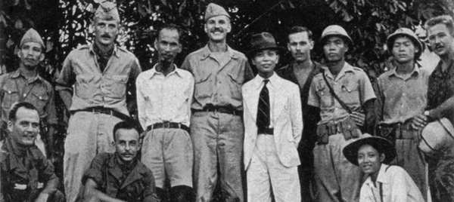
Notes:
ho45

Slide 12
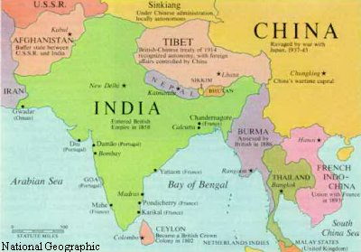

Slide 13
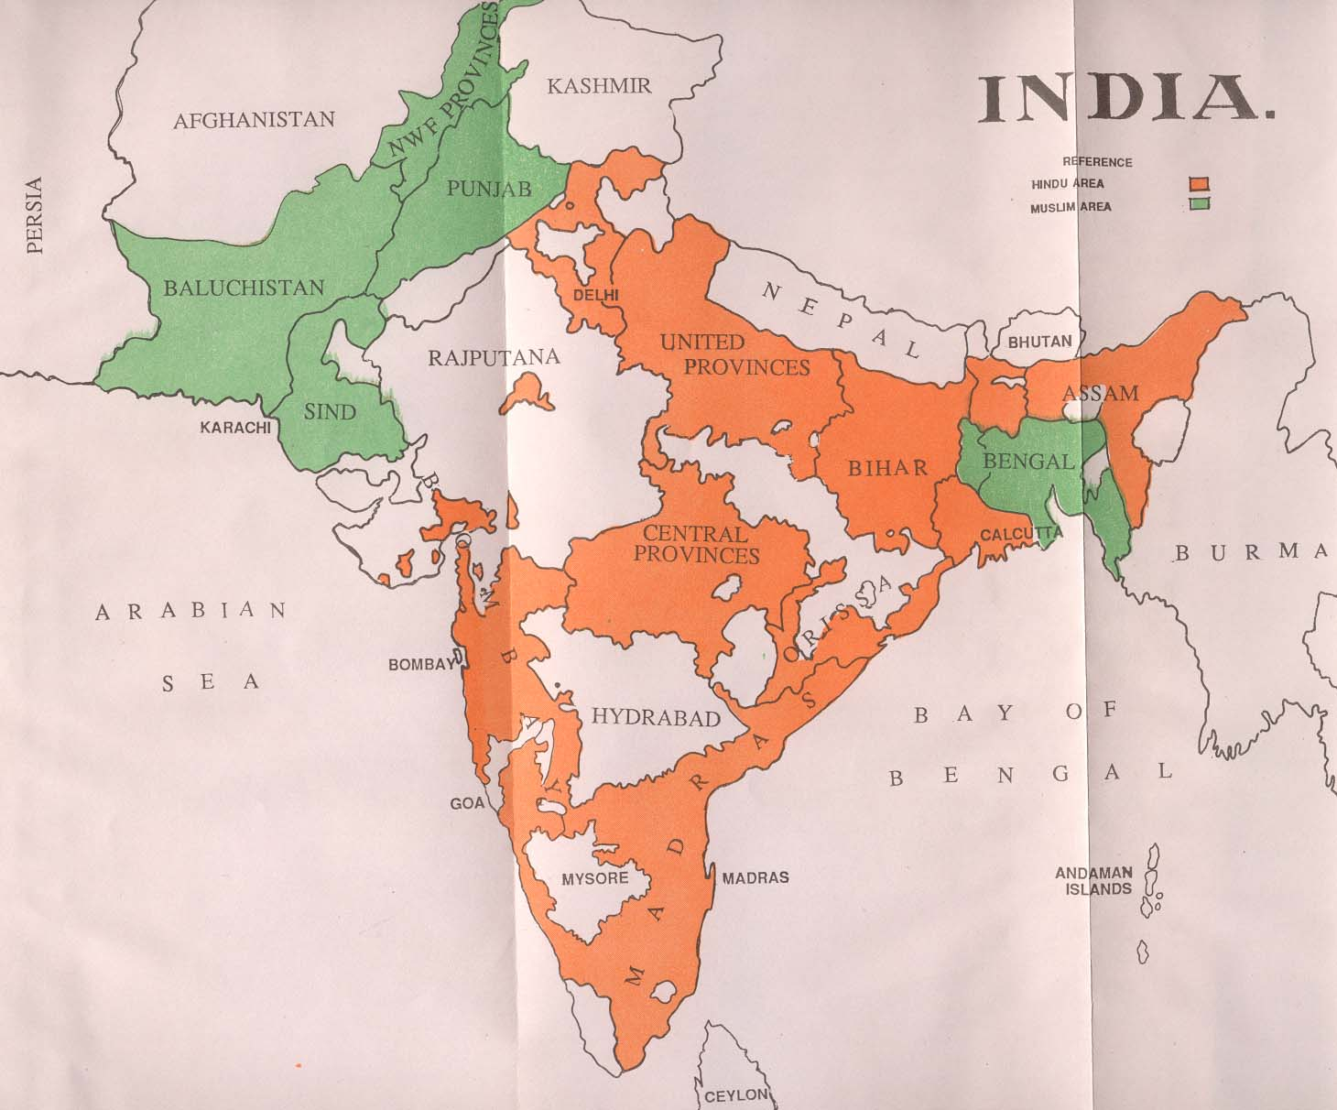

Slide 14
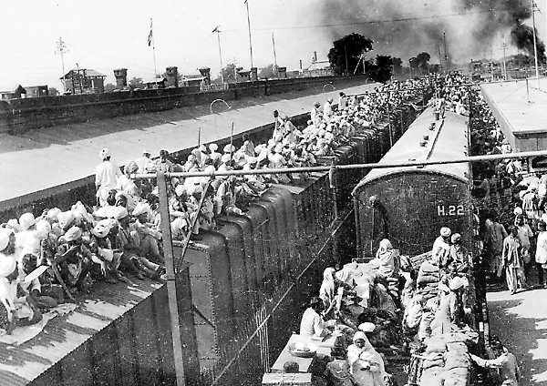

Slide 15
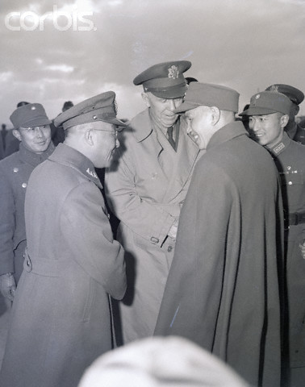
Notes:
Marshall and chiang

Slide 16


Slide 17
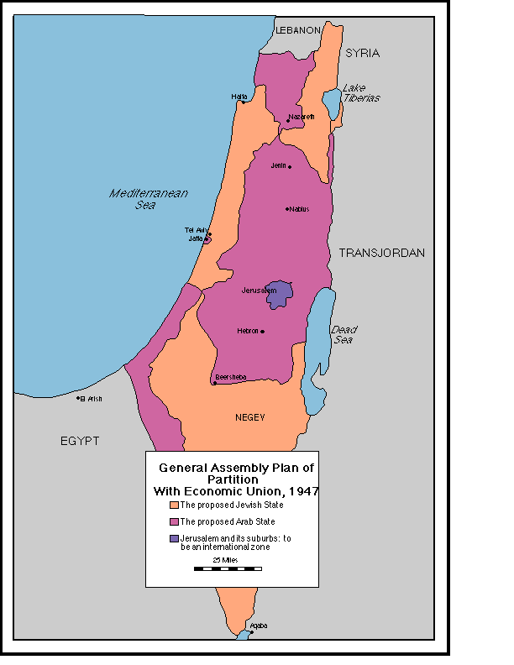

Slide 18
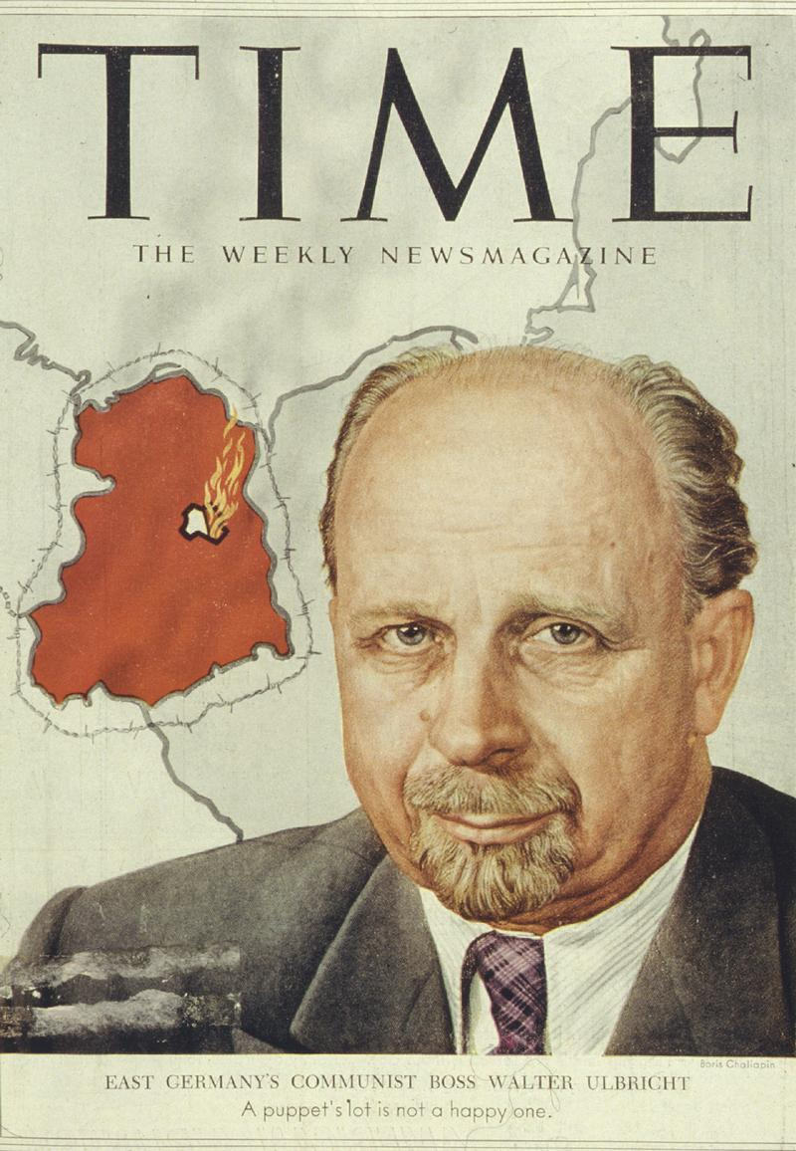

Slide 19
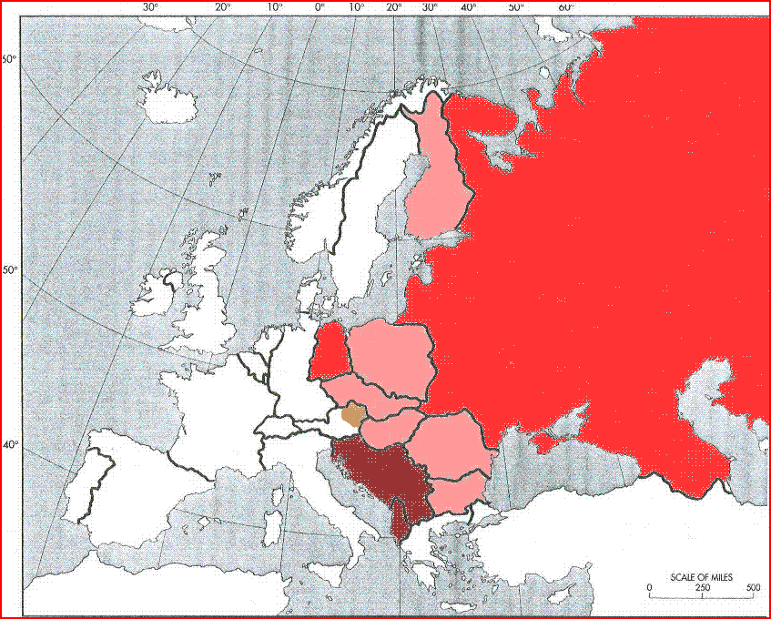

Slide 20
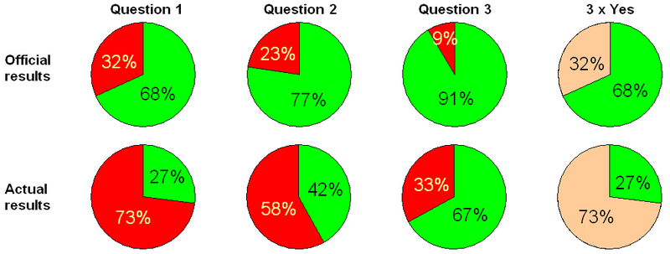
Polish (“three times yes”) referendum, 1946
Q1: abolish the Senate?
Q2: nationalize the economy?
Q3: accept postwar borders?

Slide 21
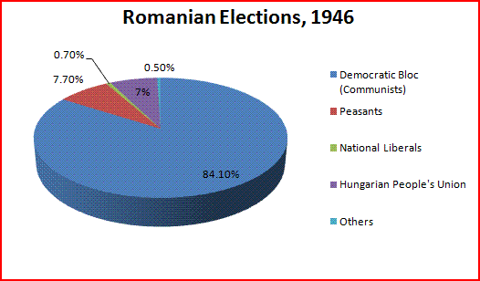
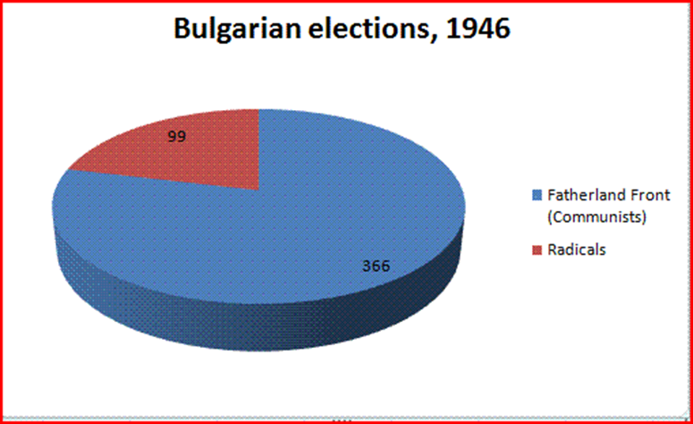

Slide 22
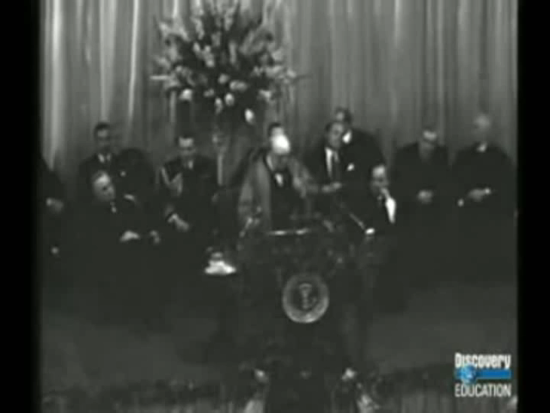

Slide 23
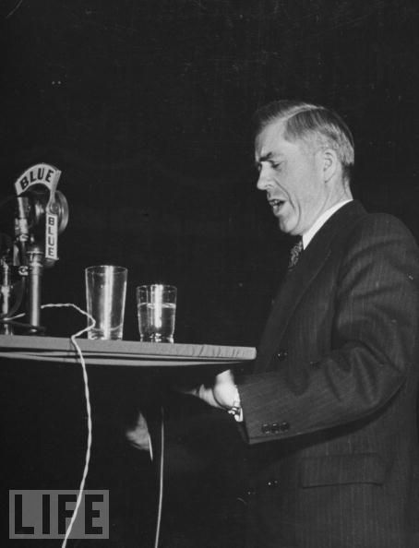

Slide 24
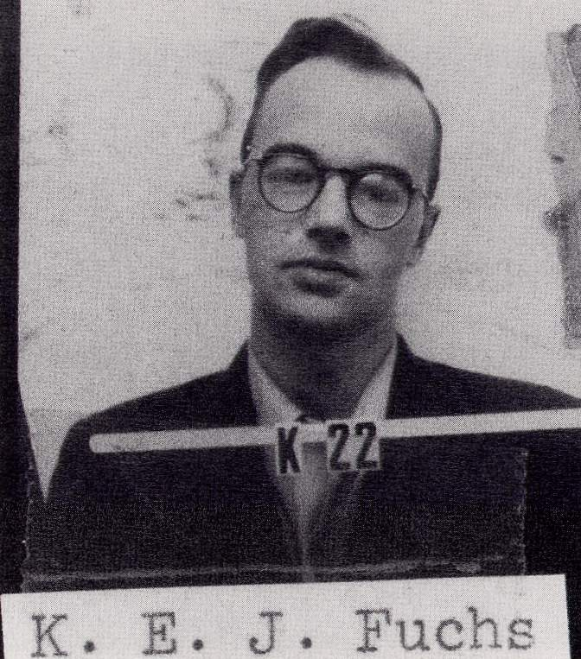

Slide 25
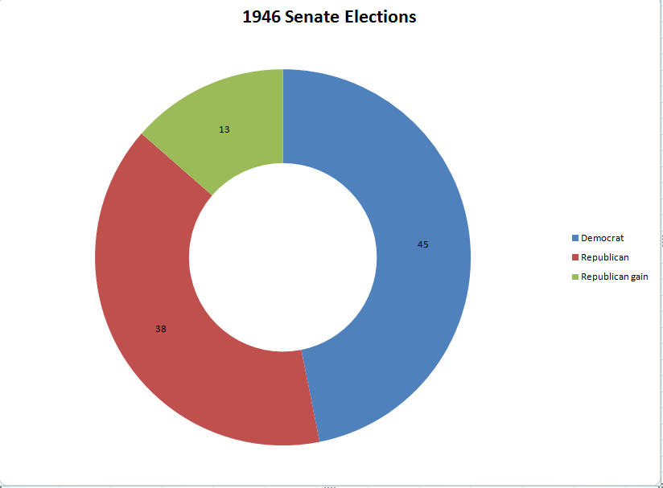

Slide 26
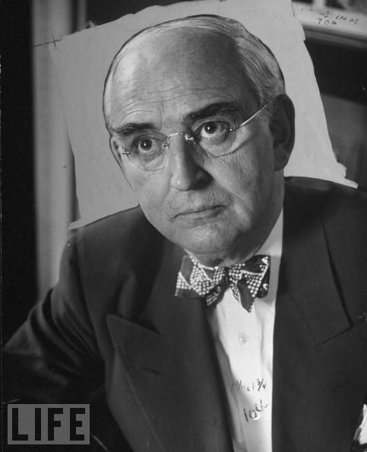
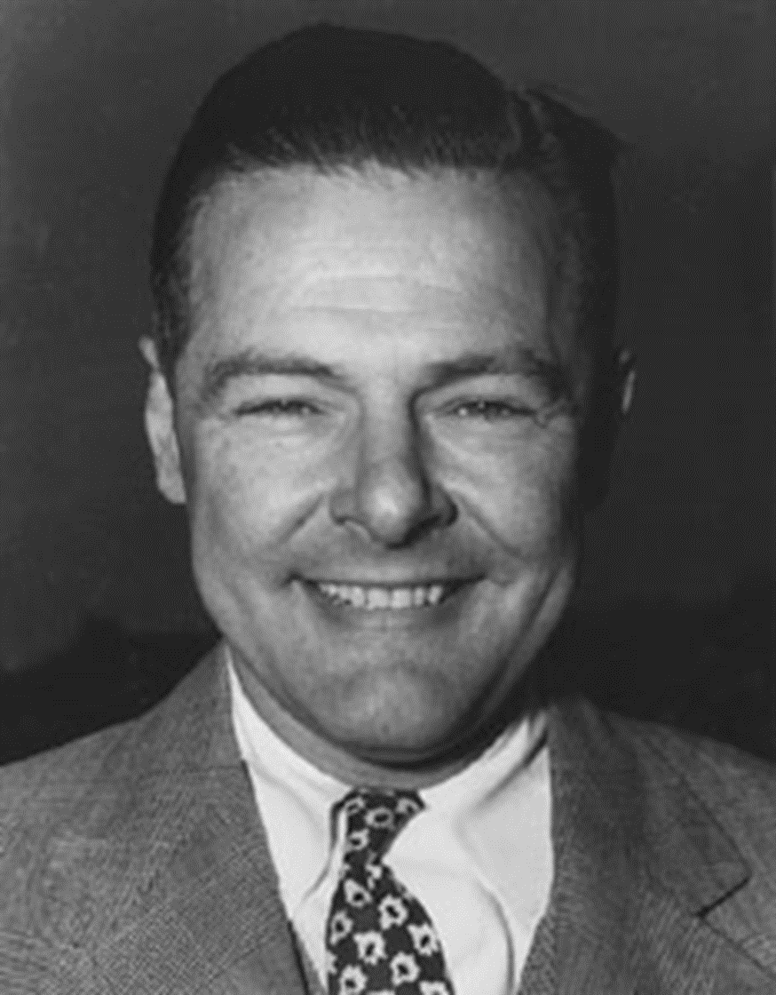
Notes:
vberg

Slide 27


Slide 28
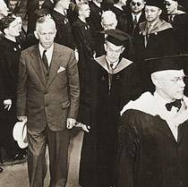

Slide 29
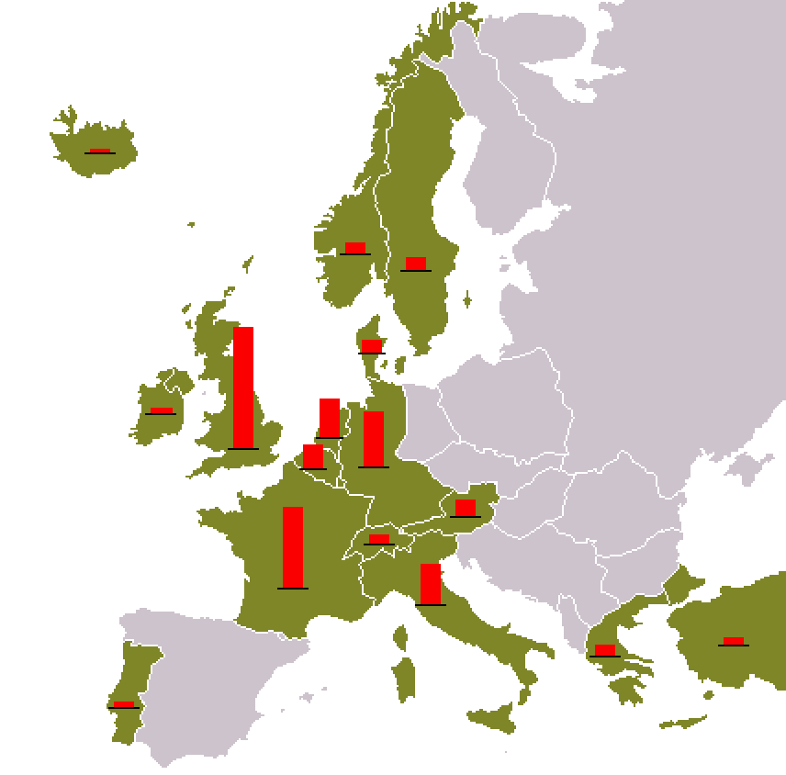

Slide 30
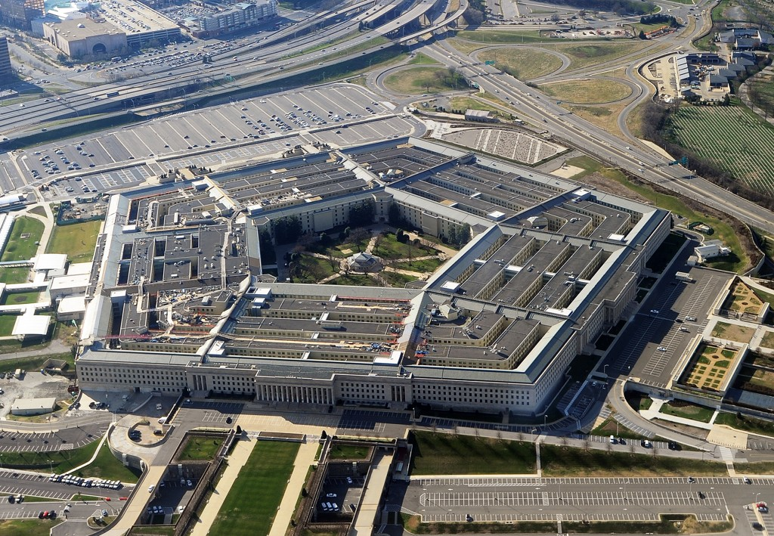

Slide 31
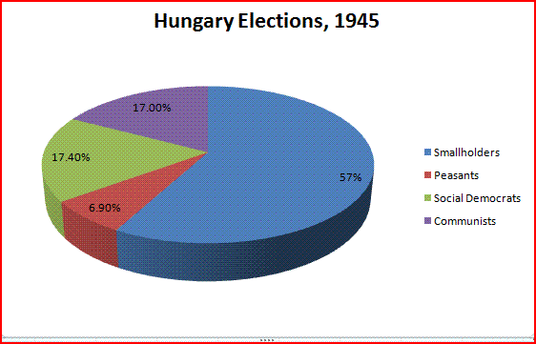

Slide 32
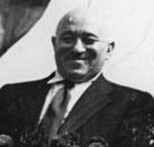
Notes:
rakosi

Slide 33
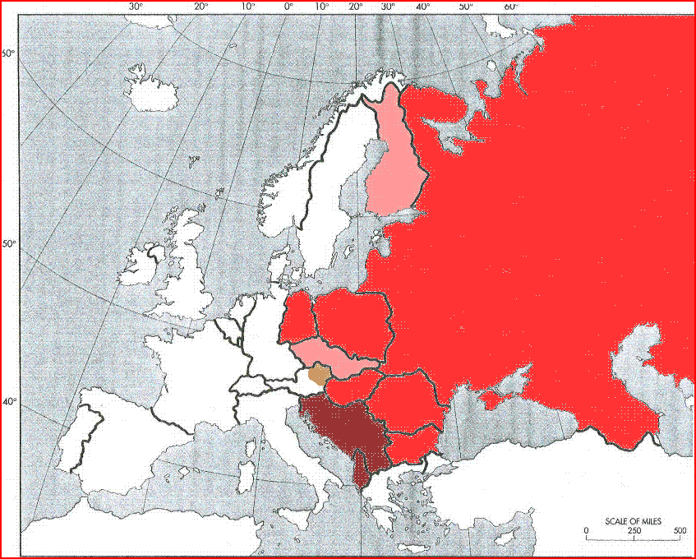

Slide 34
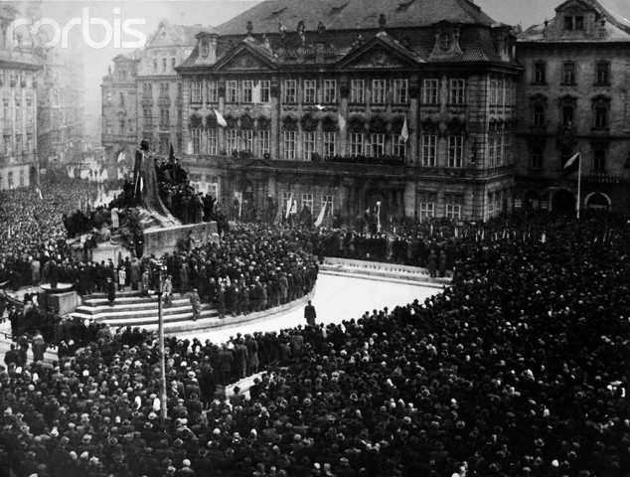

Slide 35
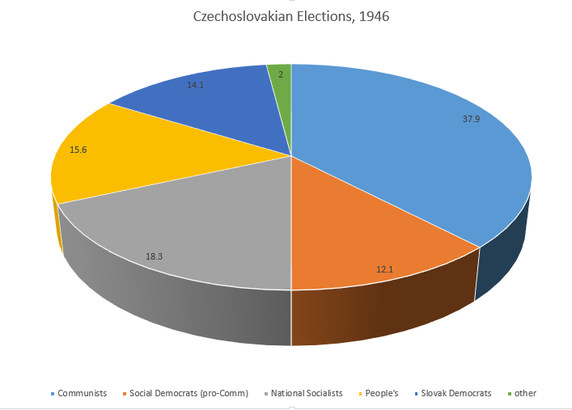

Slide 36
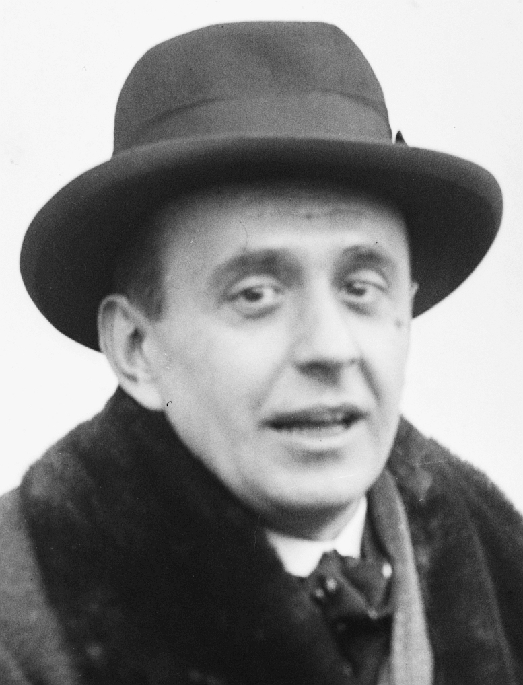

Slide 37
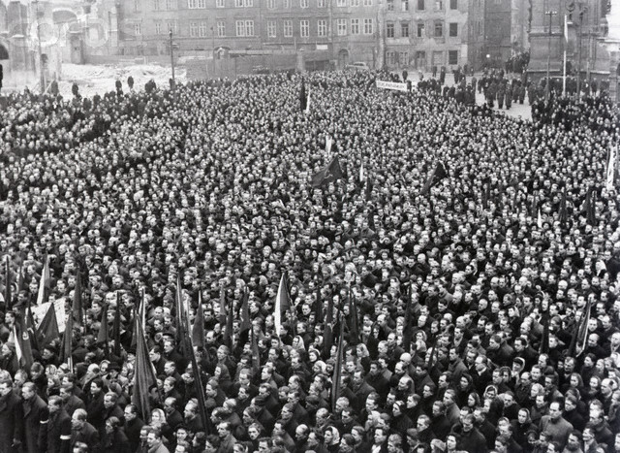

Slide 38


Slide 39


Slide 40
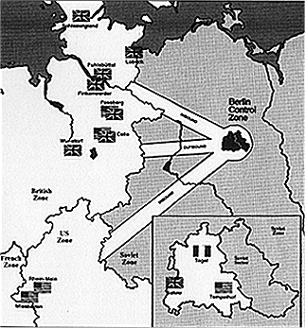

Slide 41
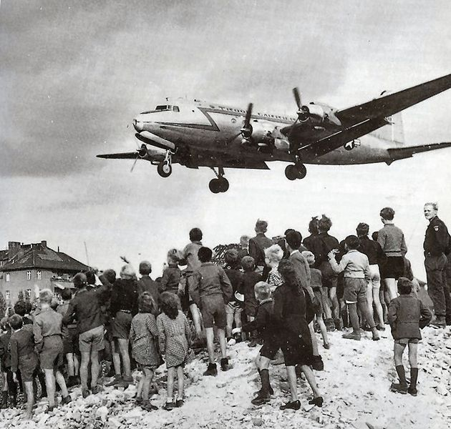

Slide 42
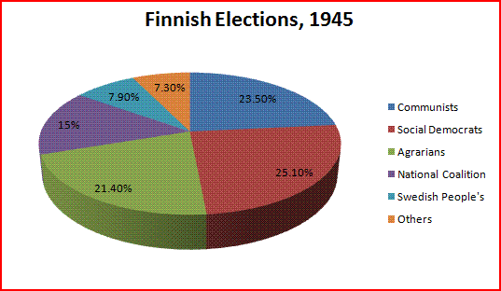

Slide 43
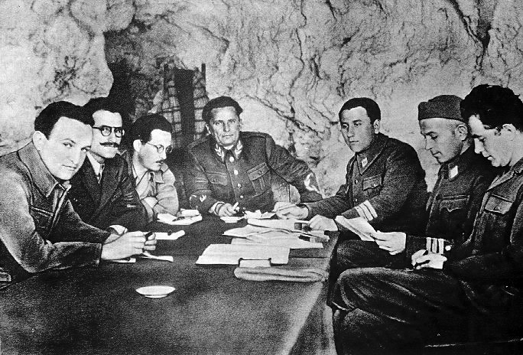

Slide 44
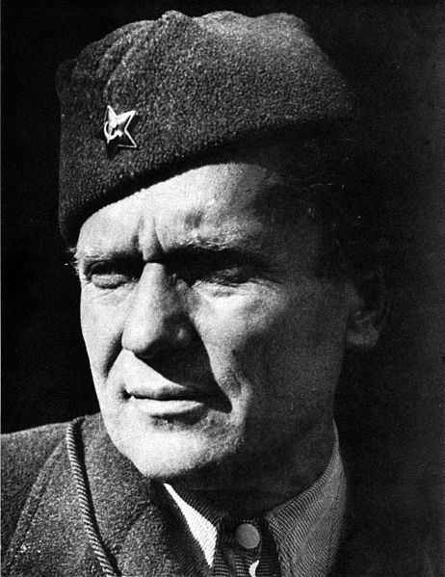

Slide 45
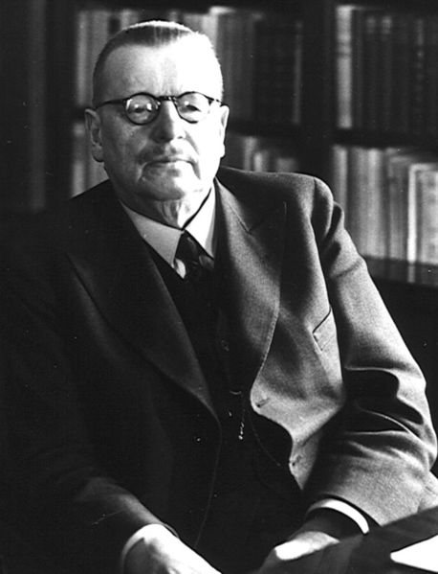
Notes:
Juho paasiviki

Slide 46
