Slide 1
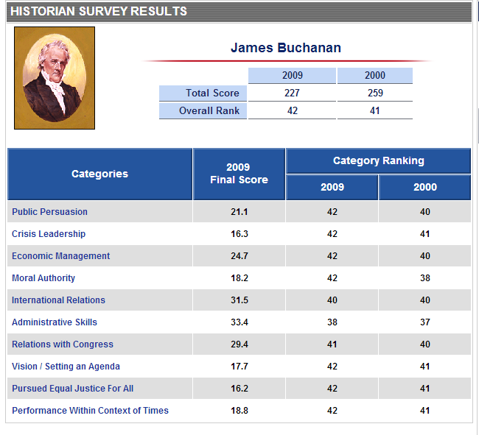

Slide 2
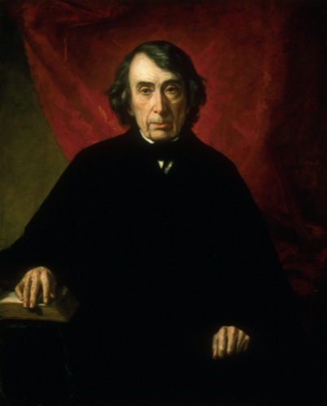
Notes:
taney

Slide 3
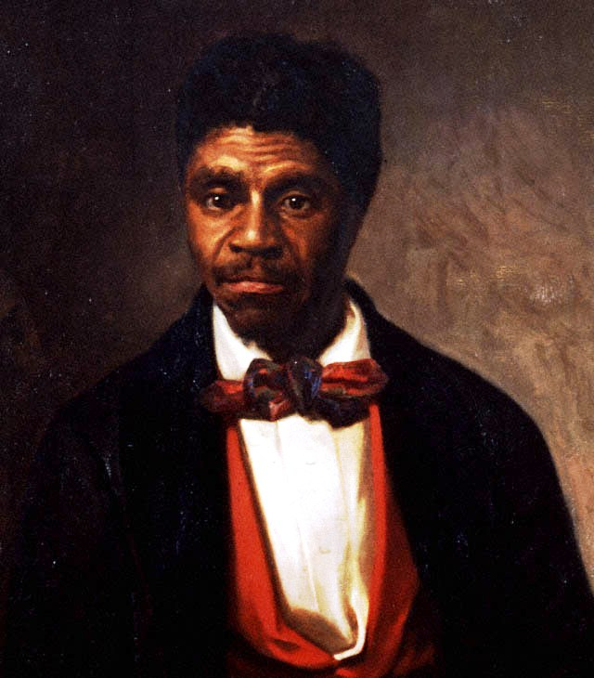

Slide 4
Dred Scott v. Sandford (1857)
Does the Constitution of the United States act upon [a slave] whenever he shall be made free under the laws of a State, and raised there to the rank of a citizen, and immediately clothe him with all the privileges of a citizen in every other State, and in its own courts?
The court think the affirmative of these propositions cannot be maintained. And if it cannot, the plaintiff in error could not be a citizen of the State of Missouri within the meaning of the Constitution of the United States, and, consequently, was not entitled to sue in its courts…
. . . The right of property in a slave is distinctly and expressly affirmed in the Constitution. The right to traffic in it, like an ordinary article of merchandise and property, was guarantied to the citizens of the United States in every State that might desire it for twenty years. And the Government in express terms is pledged to protect it in all future time if the slave escapes from his owner.
This is done in plain words — too plain to be misunderstood. And no word can be found in the Constitution which gives Congress a greater power over slave property or which entitles property of that kind to less protection that property of any other description.

Slide 5
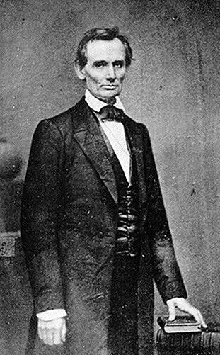

Slide 6
Lincoln “House Divided” speech (1858)
We are now far into the fifth year, since a policy was initiated, with the avowed object, and confident promise, of putting an end to slavery agitation.
Under the operation of that policy, that agitation has not only, not ceased, but has constantly augmented.
In my opinion, it will not cease, until a crisis shall have been reached, and passed.
"A house divided against itself cannot stand.“
I believe this government cannot endure, permanently half slave and half free.
I do not expect the Union to be dissolved -- I do not expect the house to fall -- but I do expect it will cease to be divided.
It will become all one thing or all the other.
Either the opponents of slavery, will arrest the further spread of it, and place it where the public mind shall rest in the belief that it is in the course of ultimate extinction; or its advocates will push it forward, till it shall become alike lawful in all the States, old as well as new -- North as well as South.

Slide 7
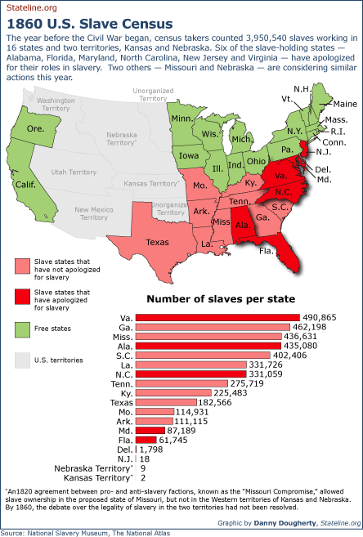

Slide 8


Slide 9
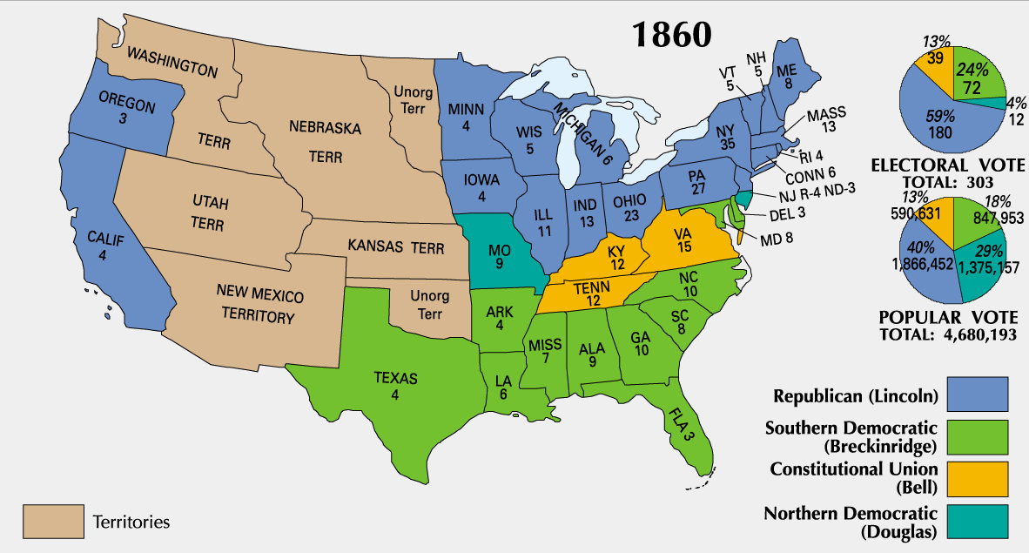

Slide 10
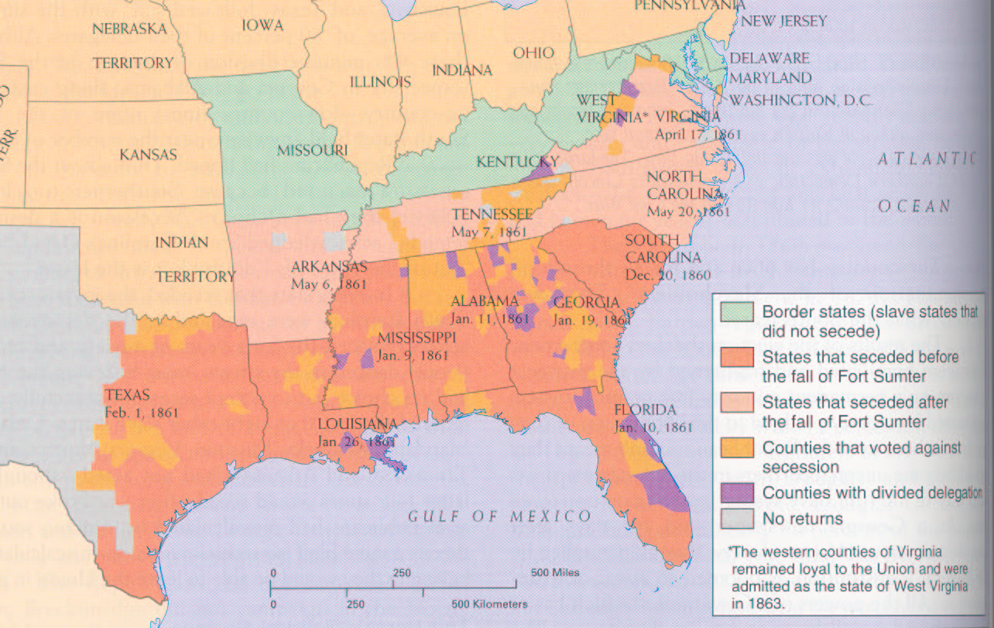

Slide 11


Slide 12
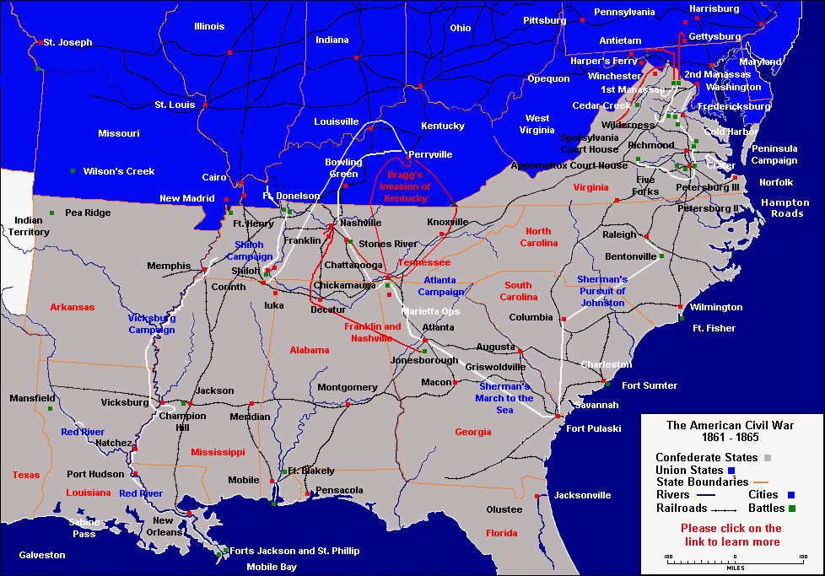

Slide 13
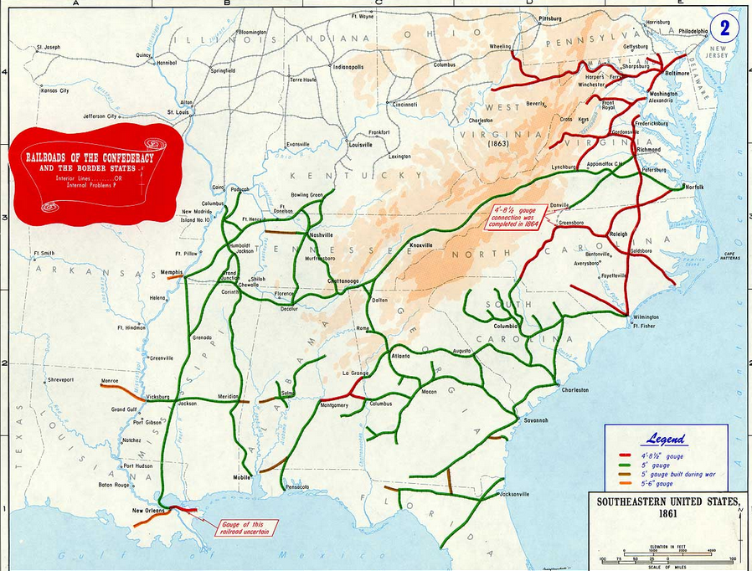

Slide 14
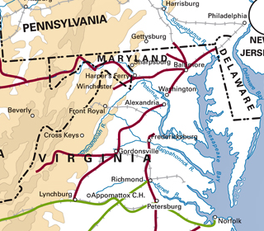

Slide 15
To the Commanding General,
Army of the United States
You are engaged in suppressing an insurrection against the laws of the United States. If at any point on or in the vicinity of any military line which is now or which shall be used between the city of Philadelphia and the city of Washington you find resistance which renders it necessary to suspend the writ of habeas corpus for the public safety, you personally, or through the officer in command at the point at which resistance occurs, are authorized to suspend that writ.
Abraham Lincoln.
Washington, April 27, 1861

Slide 16
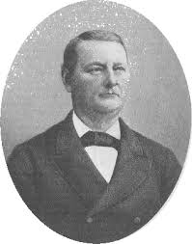
Notes:
John merryman

Slide 17
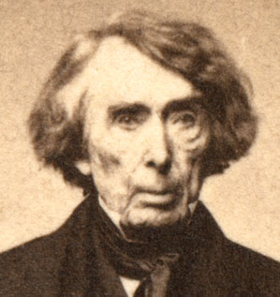

Slide 18
Ex Parte Merryman (1861)
The case, then, is simply this: A military officer residing in Pennsylvania issues an order to arrest a citizen of Maryland, upon vague and indefinite charges, without any proof, so far as appears . . .
With such provisions in the Constitution, expressed in language too clear to be misunderstood by any one, I can see no ground whatever for supposing that the President, in any emergency or in any state of things, can authorize the suspension of the privilege of the writ of habeas corpus, or arrest a citizen, except in aid of the judicial power. He certainly does not faithfully execute the laws if he takes upon himself legislative power by suspending the writ of habeas corpus and the judicial power, also, by arresting and imprisoning a person without due process of law. . .
The Government of the United States is one of delegated and limited powers. It derives it existence and authority altogether from the Constitution, and neither of its branches--executive, legislative or judicial--can exercise any of the powers of government beyond those specified and granted.

Slide 19
Lincoln, 4 July 1861 special session message
To state the question more directly, Are all the laws but one to go unexecuted, and the Government itself go to pieces lest that one be violated? Even in such a case, would not the official oath be broken if the Government should be overthrown when it was believed that disregarding the single law would tend to preserve it? …
This issue embraces more than the fate of these United States. It presents to the whole family of man the question whether a constitutional republic, or democracy--a government of the people by the same people--can or can not maintain its territorial integrity against its own domestic foes. It presents the question whether discontented individuals, too few in numbers to control administration according to organic law in any case, can always, upon the pretenses made in this case, or on any other pretenses, or arbitrarily without any pretense, break up their government, and thus practically put an end to free government upon the earth. It forces us to ask, Is there in all republics this inherent and fatal weakness? Must a government of necessity be too strong for the liberties of its own people, or too weak to maintain its own existence?

Slide 20
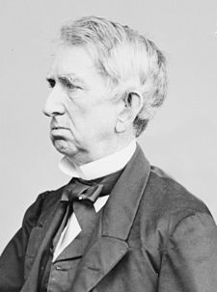

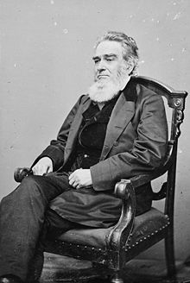
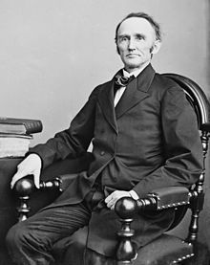
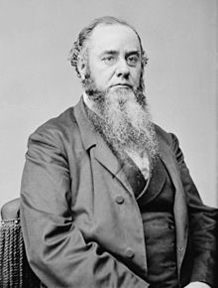
Notes:
3rd—Edward bates, ag, 4—Montgomery blair, postmaster; 5--stanton

Slide 21
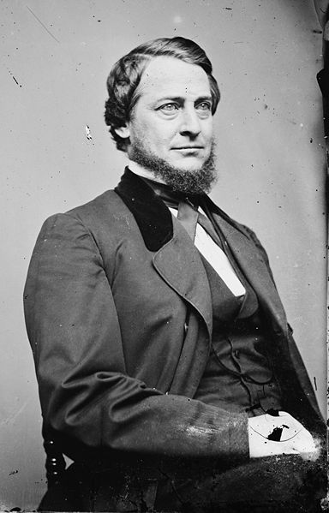
Notes:
vallandingham

Slide 22
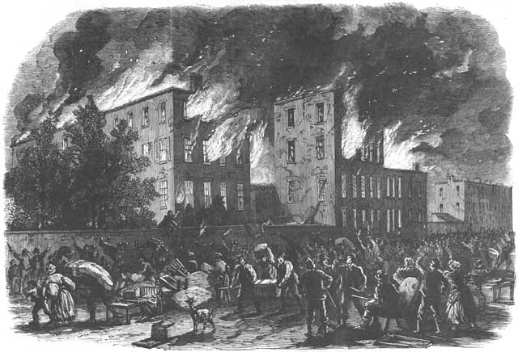
Notes:
Nyc draft riots

Slide 23
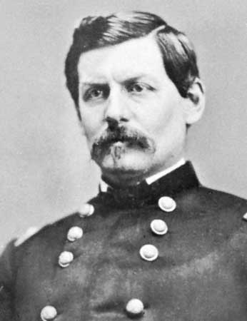
Notes:
mcclellan

Slide 24
Emancipation Proclamation
That on the 1st day of January, A.D. 1863, all persons held as slaves within any State or designated part of a State the people whereof shall then be in rebellion against the United States shall be then, thenceforward, and forever free; and the executive government of the United States, including the military and naval authority thereof, will recognize and maintain the freedom of such persons and will do no act or acts to repress such persons, or any of them, in any efforts they may make for their actual freedom…
Now, therefore, I, Abraham Lincoln, President of the United States, by virtue of the power in me vested as Commander-In-Chief of the Army and Navy of the United States in time of actual armed rebellion against the authority and government of the United States, and as a fit and necessary war measure for supressing said rebellion…
And by virtue of the power and for the purpose aforesaid, I do order and declare that all persons held as slaves within said designated States and parts of States are, and henceforward shall be, free; and that the Executive Government of the United States, including the military and naval authorities thereof, will recognize and maintain the freedom of said persons.

Slide 25
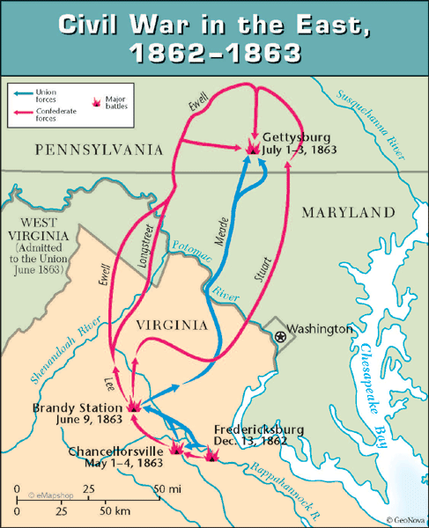

Slide 26
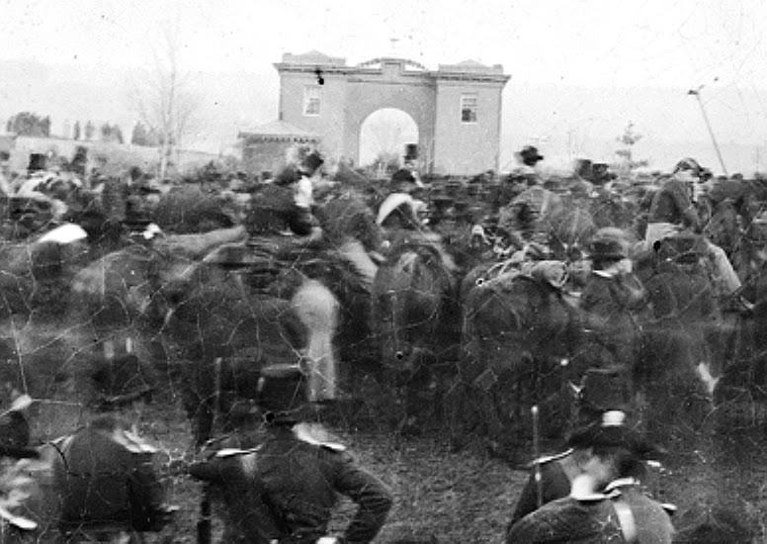

Slide 27
Four score and seven years ago our fathers brought forth on this continent, a new nation, conceived in Liberty, and dedicated to the proposition that all men are created equal.
Now we are engaged in a great civil war, testing whether that nation, or any nation so conceived and so dedicated, can long endure. We are met on a great battle-field of that war. We have come to dedicate a portion of that field, as a final resting place for those who here gave their lives that that nation might live. It is altogether fitting and proper that we should do this.
But, in a larger sense, we can not dedicate -- we can not consecrate -- we can not hallow -- this ground. The brave men, living and dead, who struggled here, have consecrated it, far above our poor power to add or detract. The world will little note, nor long remember what we say here, but it can never forget what they did here. It is for us the living, rather, to be dedicated here to the unfinished work which they who fought here have thus far so nobly advanced. It is rather for us to be here dedicated to the great task remaining before us -- that from these honored dead we take increased devotion to that cause for which they gave the last full measure of devotion -- that we here highly resolve that these dead shall not have died in vain -- that this nation, under God, shall have a new birth of freedom -- and that government of the people, by the people, for the people, shall not perish from the earth.

Slide 28
Contemporary Reaction (Democratic newspapers)
“The cheek of every American must tingle with shame as he reads the silly, flat and dishwatery utterances of the man who has to be pointed out to intelligent foreigners as the President of the United States.”
--Chicago Times
Pray “that the veil of oblivion shall be dropped over them and that they shall no more be repeated or thought of.”
-- Harrisburg Patriot and Union

Slide 29
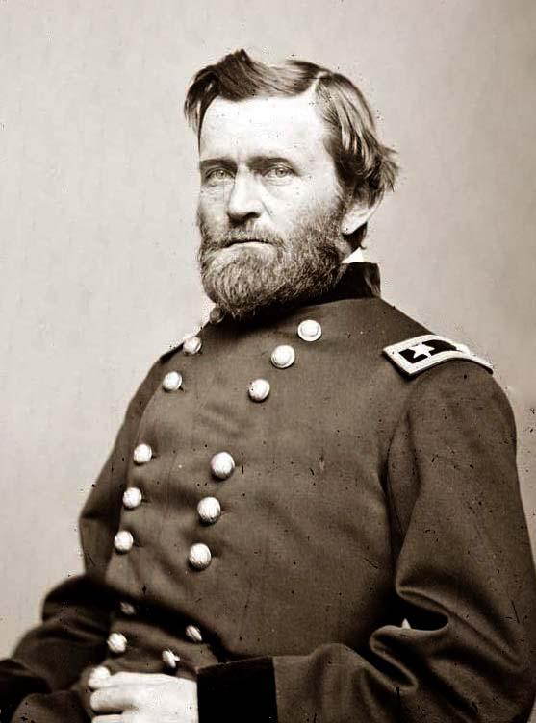

Slide 30
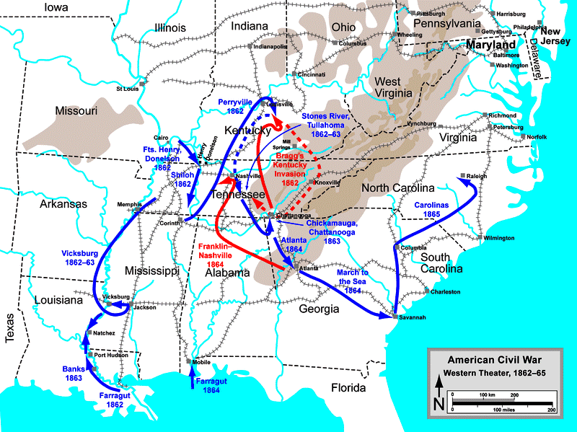

Slide 31
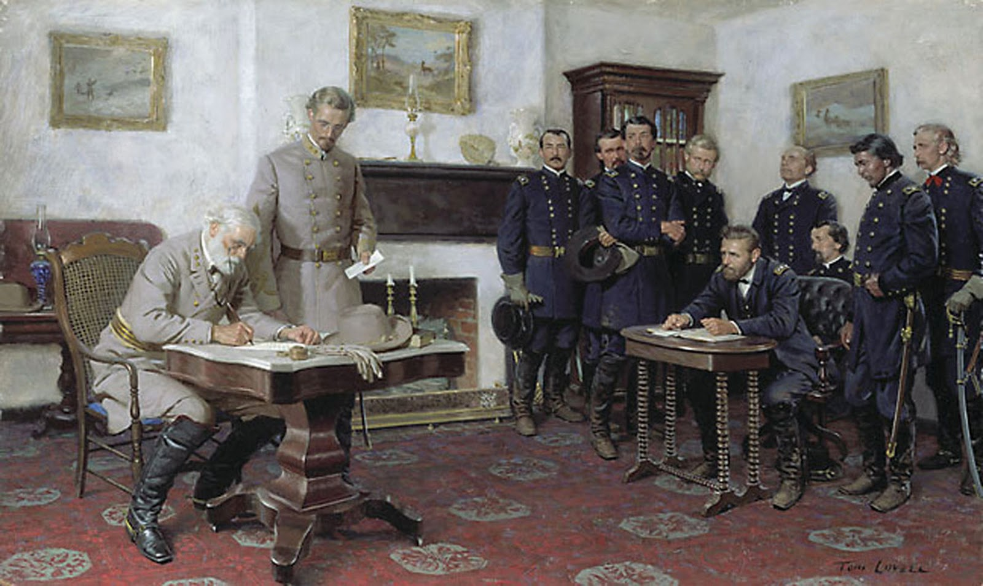

Slide 32
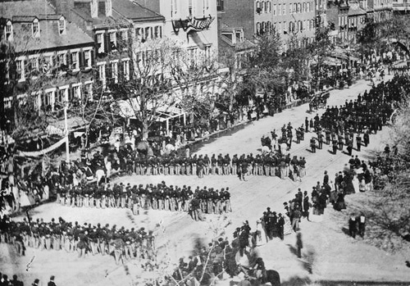

Slide 33
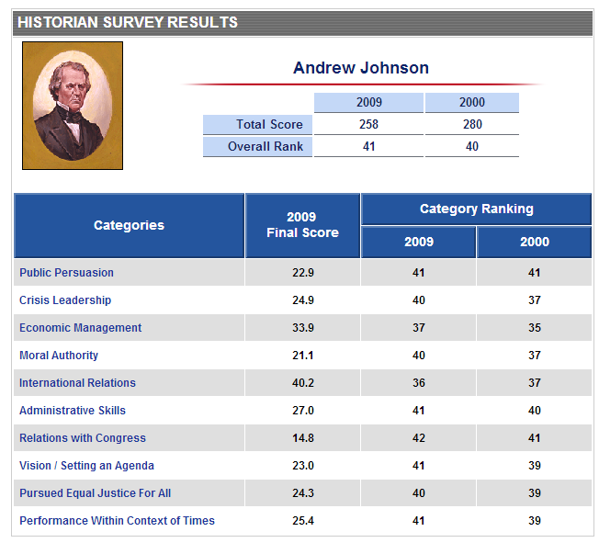

Slide 34
13th Amendment
Section 1. Neither slavery nor involuntary servitude, except as a punishment for crime whereof the party shall have been duly convicted, shall exist within the United States, or any place subject to their jurisdiction.
Section 2. Congress shall have power to enforce this article by appropriate legislation.

Slide 35
1866 Civil Rights Act
That all persons born in the United States and not subject to any foreign power, excluding Indians not taxed, are hereby declared to be citizens of the United States; and . . . shall have the same right, in every State and Territory in the United States, to make and enforce contracts, to sue, be parties, and give evidence, to inherit, purchase, lease, sell, hold, and convey real and personal property, and to full and equal benefit of all laws and proceedings for the security of person and property, as is enjoyed by white citizens, and shall be subject to like punishment, pains, and penalties, and to none other, any law, statute, ordinance, regulation, or custom, to the contrary notwithstanding . . .
That the district courts of the United States, within their respective districts, shall have, exclusively of the courts of the several States, cognizance of all crimes and offences committed against the provisions of this act . . .

Slide 36
14th Amendment (1866-8)
Section 1.
All persons born or naturalized in the United States, and subject to the jurisdiction thereof, are citizens of the United States and of the state wherein they reside. No state shall make or enforce any law which shall abridge the privileges or immunities of citizens of the United States; nor shall any state deprive any person of life, liberty, or property, without due process of law; nor deny to any person within its jurisdiction the equal protection of the laws.
Section 2.
[States that deny right to vote lose representatives for voters disenfranchised.]
Section 3.
[No Confederate officeholder or military officer can serve in Congress.]
Section 4.
[Confederate debt repudiated.]

Slide 37
Reconstruction Acts (1867)
Creation of five military districts in the seceded states not including Tennessee, which had ratified the Fourteenth Amendment to the United States Constitution and was readmitted to the Union;
Requiring congressional approval for new state constitutions (which were required for Confederate states to rejoin the Union);
Confederate states give voting rights to all men;
All former Confederate states must ratify the 14th Amendment.

Slide 38


Slide 39
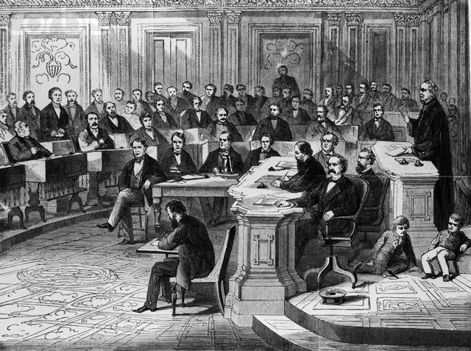

Slide 40
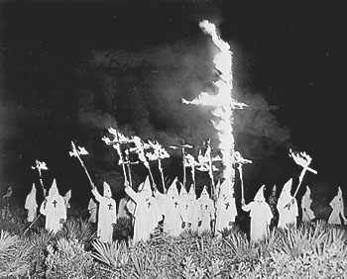

Slide 41
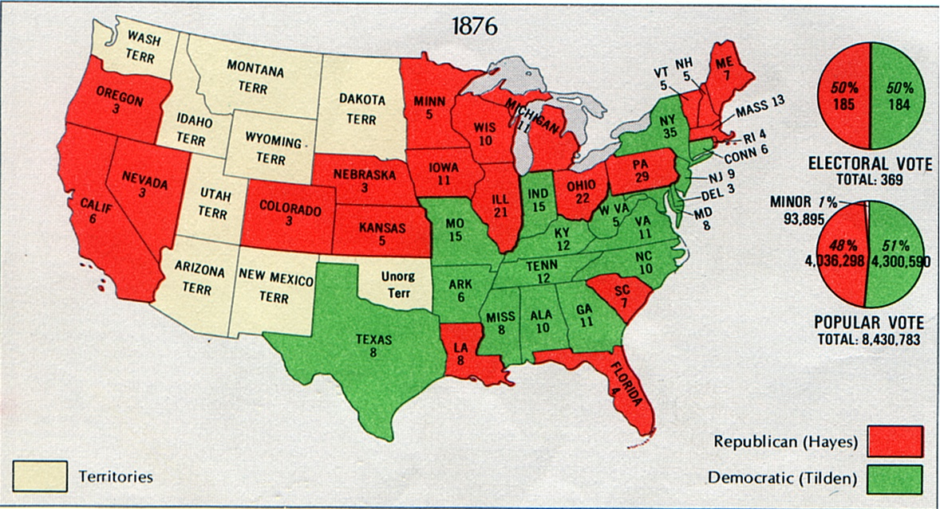

Slide 42
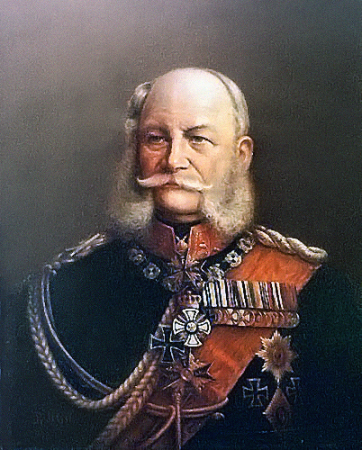
Notes:
Wilhelm i

Slide 43
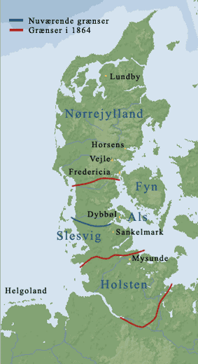

Slide 44
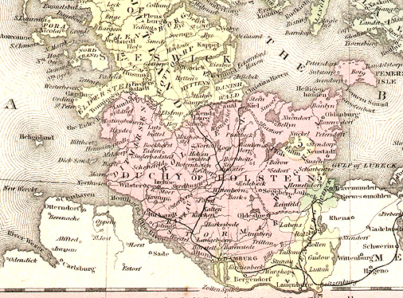

Slide 45
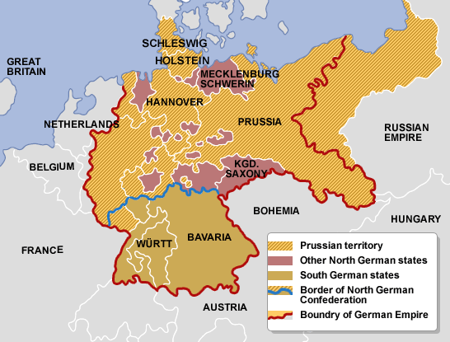

Slide 46
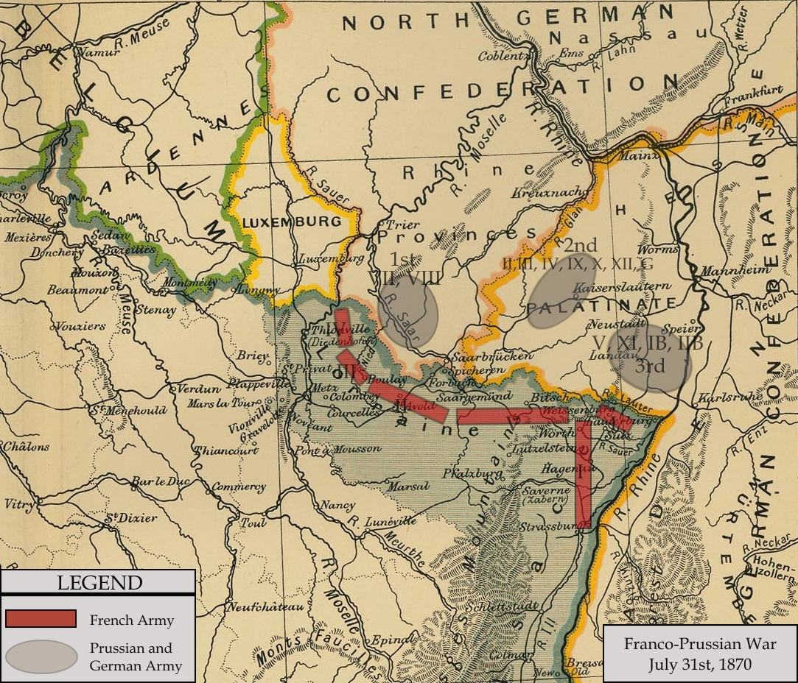

Slide 47
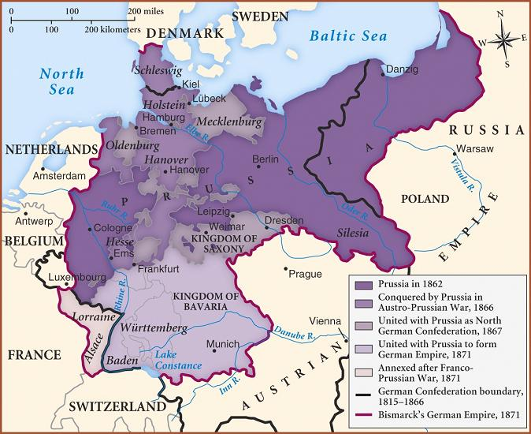

Slide 48
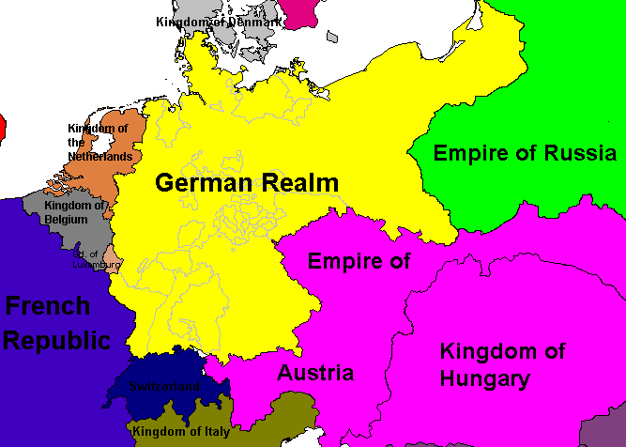

Slide 49
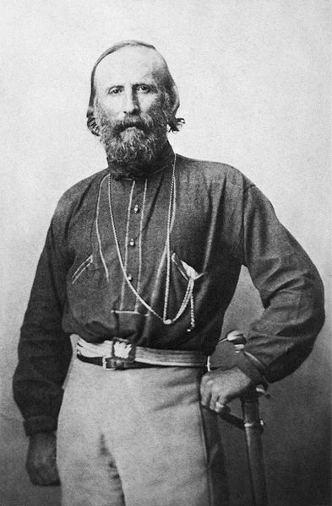
Notes:
garibaldi

Slide 50
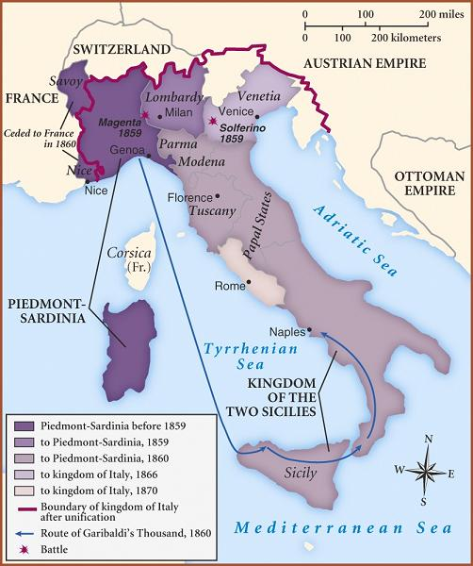

Slide 51
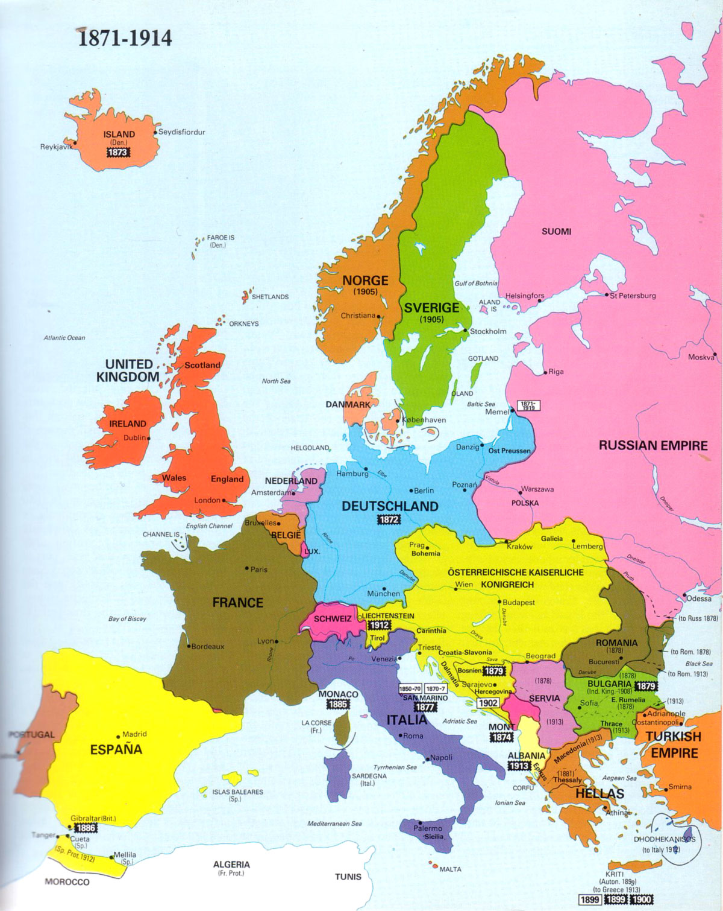

Slide 52
