Slide 1
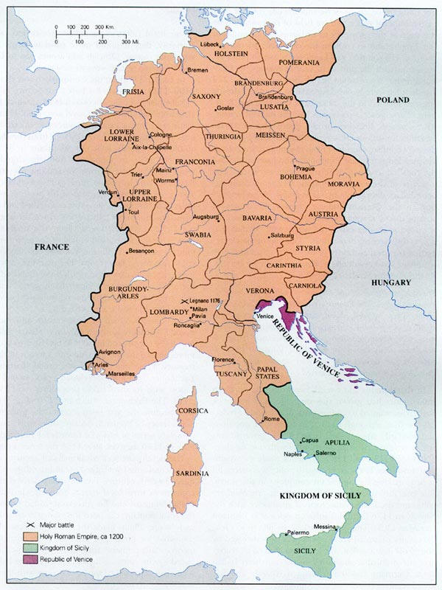

Slide 2
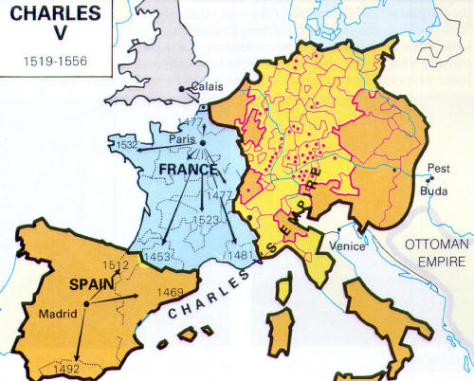

Slide 3
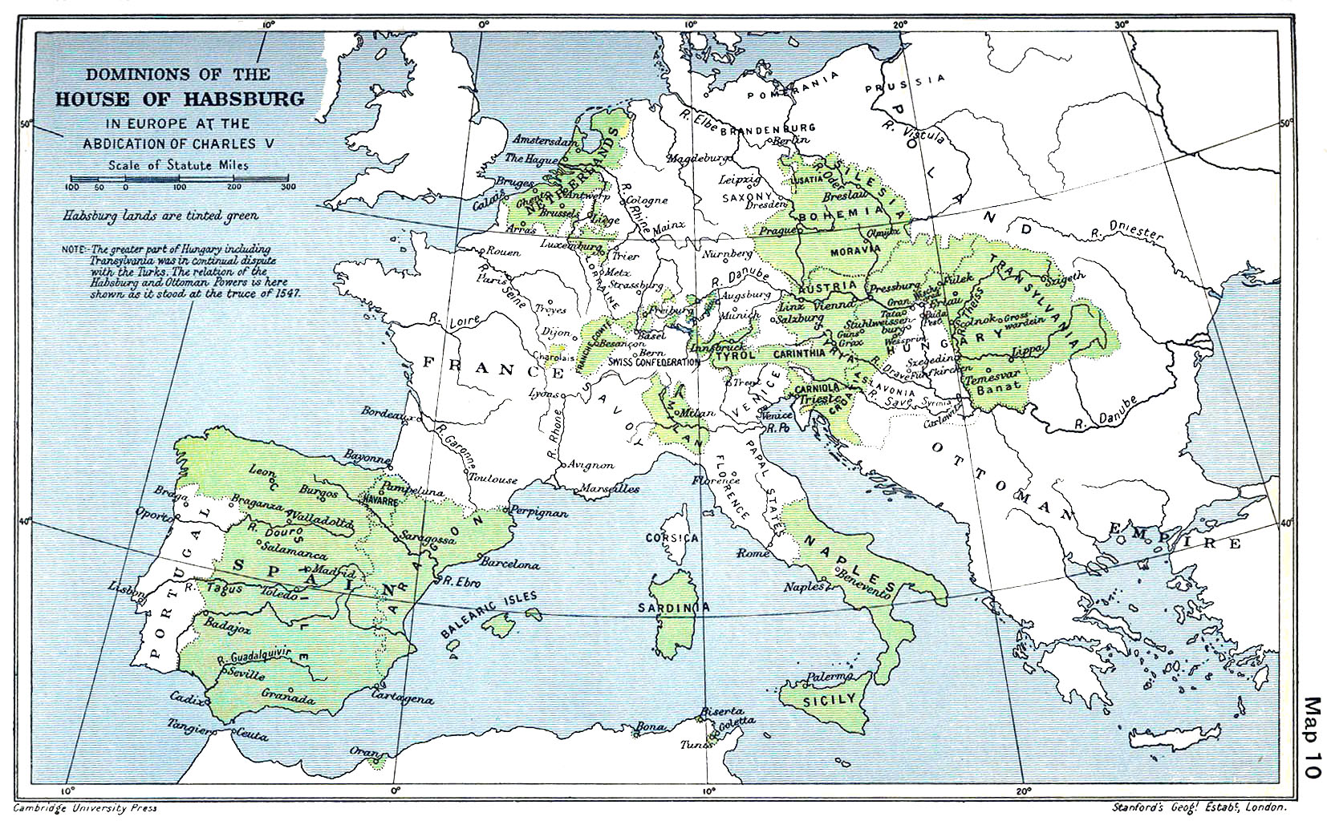

Slide 4
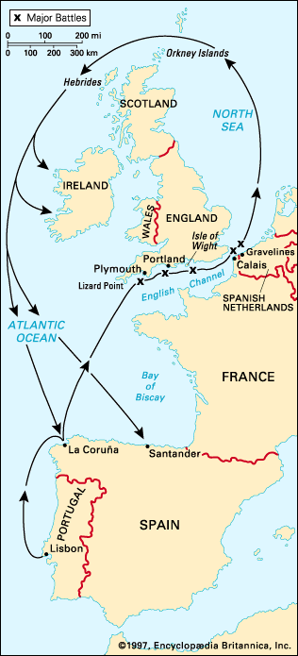

Slide 5

Notes:
cromwell

Slide 6
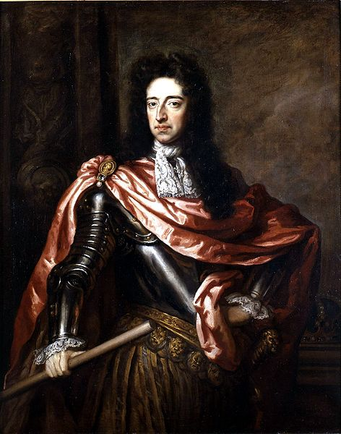
Notes:
william

Slide 7
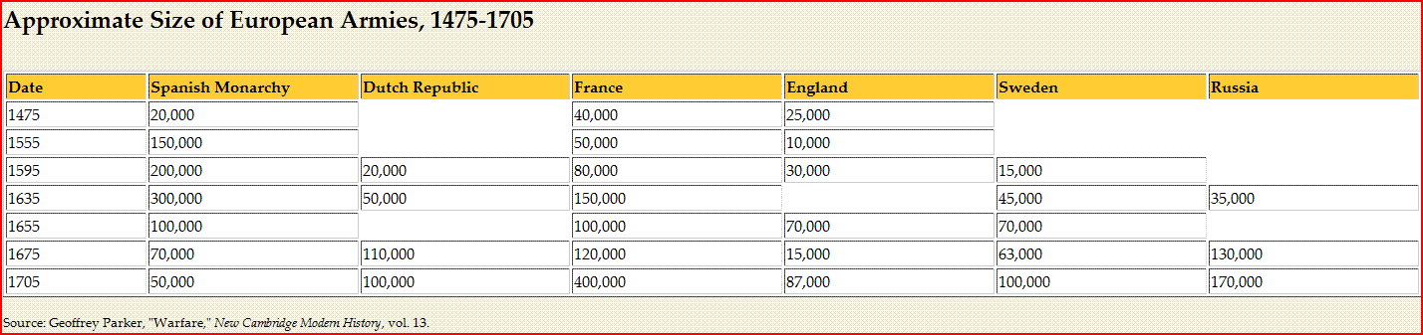

Slide 8
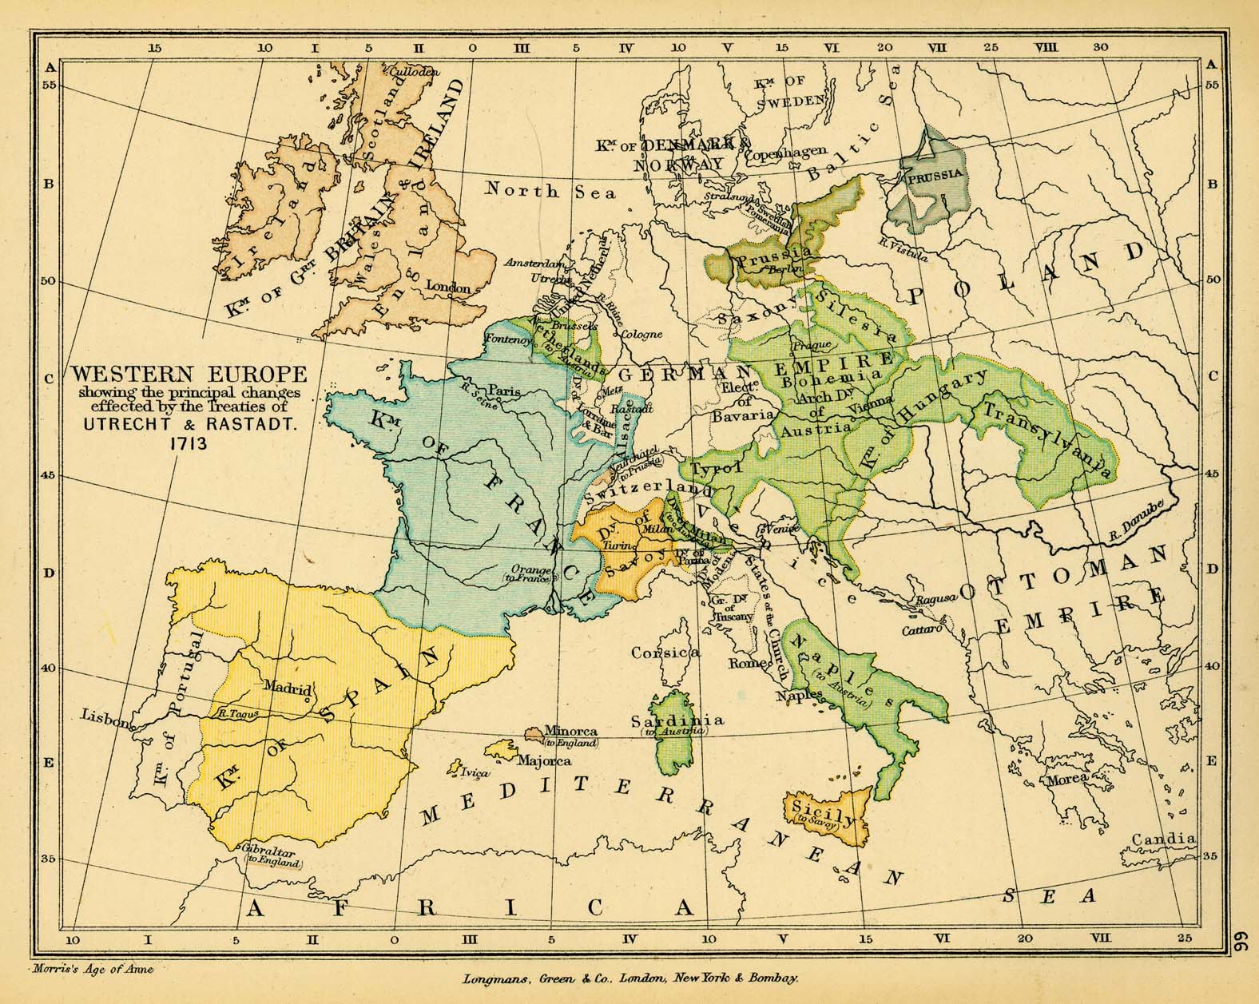

Slide 9
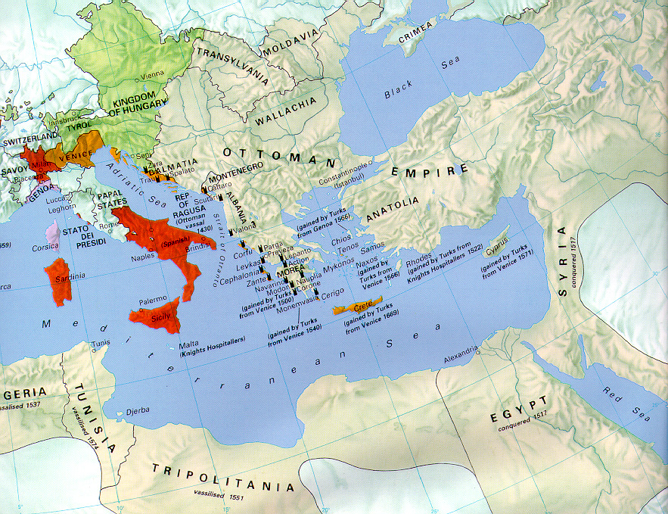

Slide 10
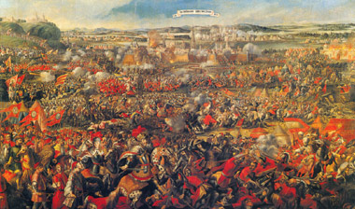

Slide 11
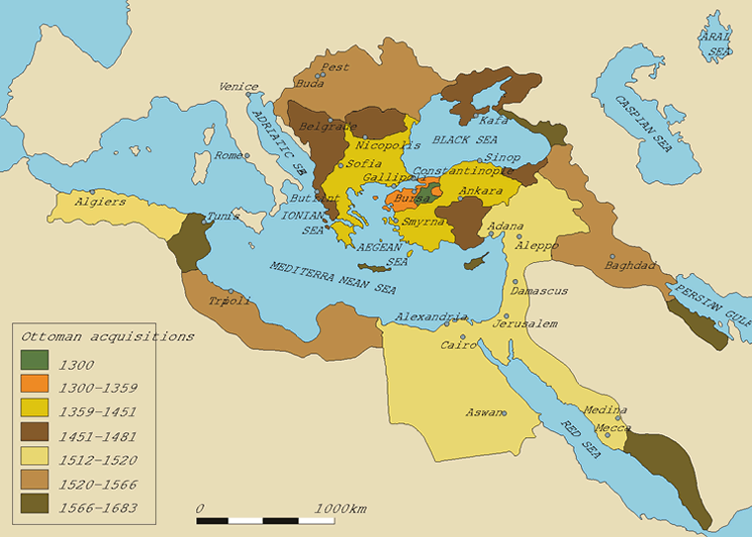

Slide 12
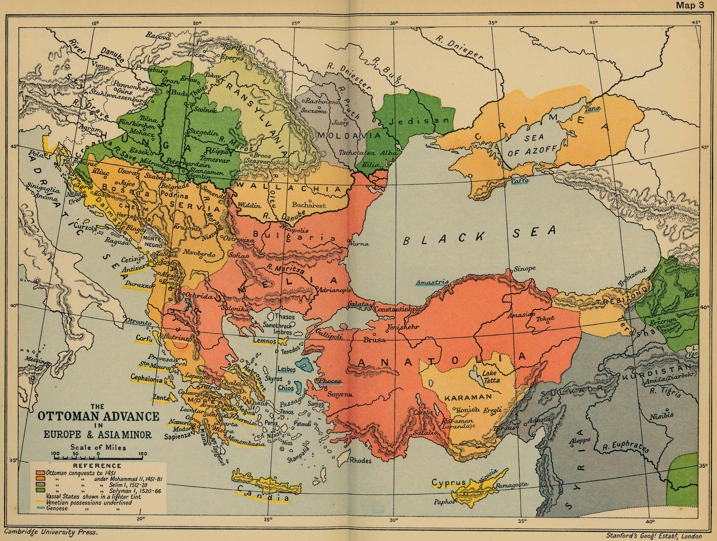

Slide 13
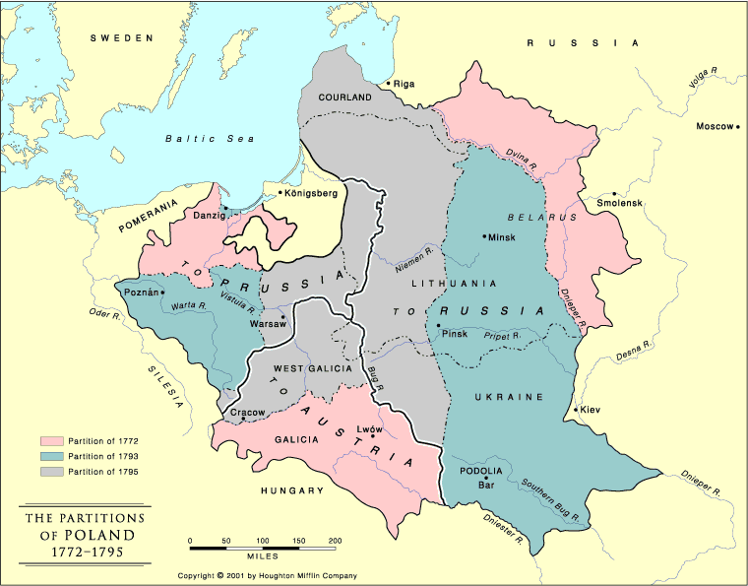

Slide 14


Slide 15
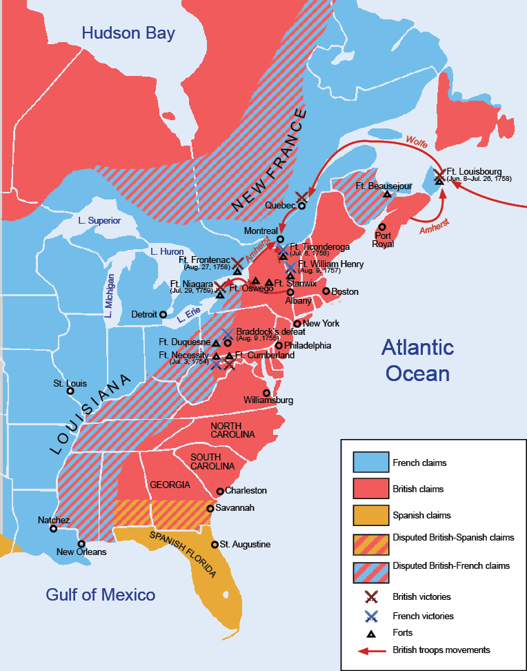

Slide 16
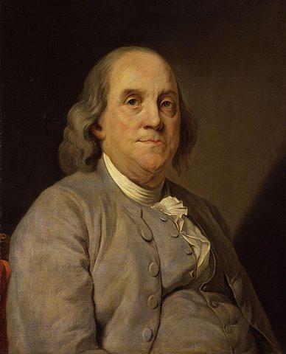

Slide 17


Slide 18
Albany Plan of Union
It is proposed that humble application be made for an act of Parliament of Great Britain, by virtue of which one general government may be formed in America, including all the said colonies, within and under which government each colony may retain its present constitution, except in the particulars wherein a change may be directed by the said act, as hereafter follows.
1. That the said general government be administered by a President-General, to be appointed and supported by the crown; and a Grand Council, to be chosen by the representatives of the people of the several Colonies met in their respective assemblies.
2. That within -- months after the passing such act, the House of Representatives that happen to be sitting within that time, or that shall be especially for that purpose convened, may and shall choose members for the Grand Council . . .
16. That for these [SECURITY] purposes they have power to make laws, and lay and levy such general duties, imposts, or taxes, as to them shall appear most equal and just (considering the ability and other circumstances of the inhabitants in the several Colonies), and such as may be collected with the least inconvenience to the people; rather discouraging luxury, than loading industry with unnecessary burdens.

Slide 19



Slide 20
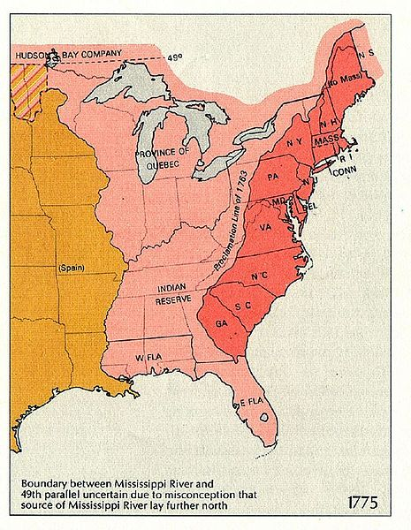

Slide 21
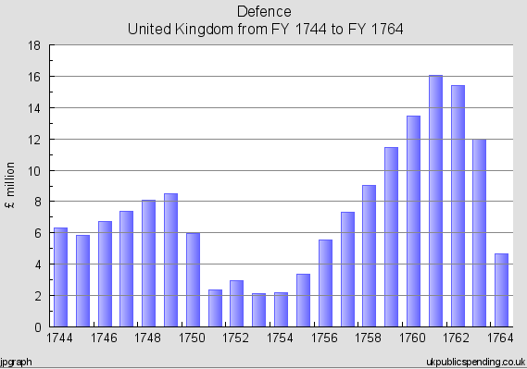
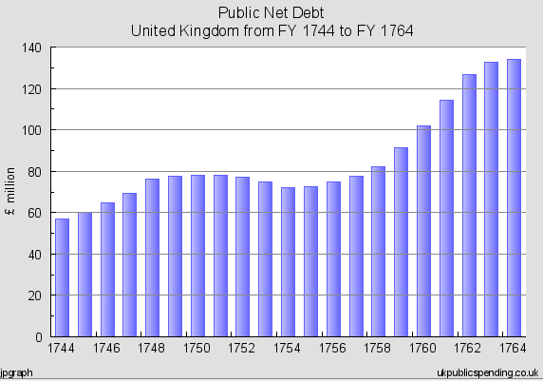

Slide 22
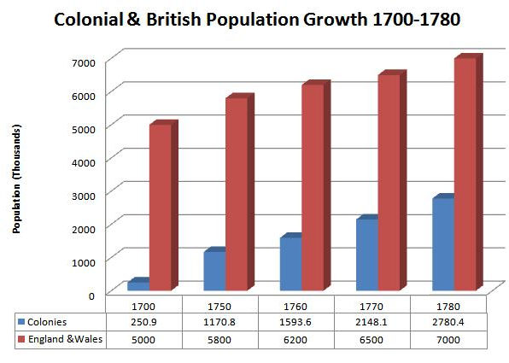

Slide 23

Notes:
Old sarum

Slide 24
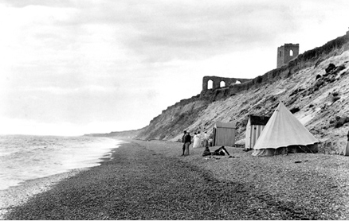
Notes:
dunwich

Slide 25


Slide 26
Great Britain : Parliament - The Declaratory Act; March 18, 1766
An act for the better securing the dependency of his majesty's dominions in America upon the crown and parliament of Great Britain.
Whereas several of the houses of representatives in his Majesty's colonies and plantations in America, have of late against law, claimed to themselves, or to the general assemblies of the same, the sole and exclusive right of imposing duties and taxes upon his majesty's subjects in the said colonies and plantations;…
May it therefore please your most excellent Majesty, that it may be declared ; …That the said colonies and plantations in America have been, are, and of right ought to be, subordinate unto, and dependent upon the imperial crown and parliament of Great Britain; and that the King's majesty, by and with the advice and consent of the lords spiritual and temporal, and commons of Great Britain, in parliament assembled, had, and of right ought to have, full power and authority to make laws and statutes of sufficient force and validity to bind the colonies and people of America, subjects of the crown of Great Britain, in all cases whatsoever.

Slide 27
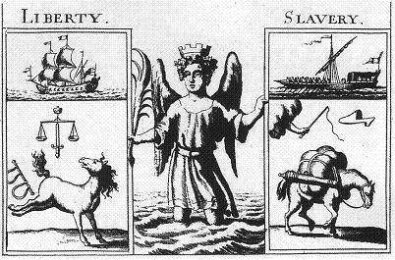

Slide 28
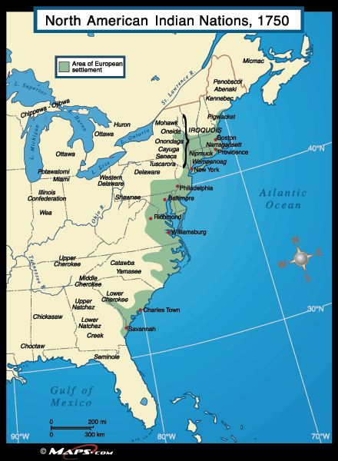

Slide 29
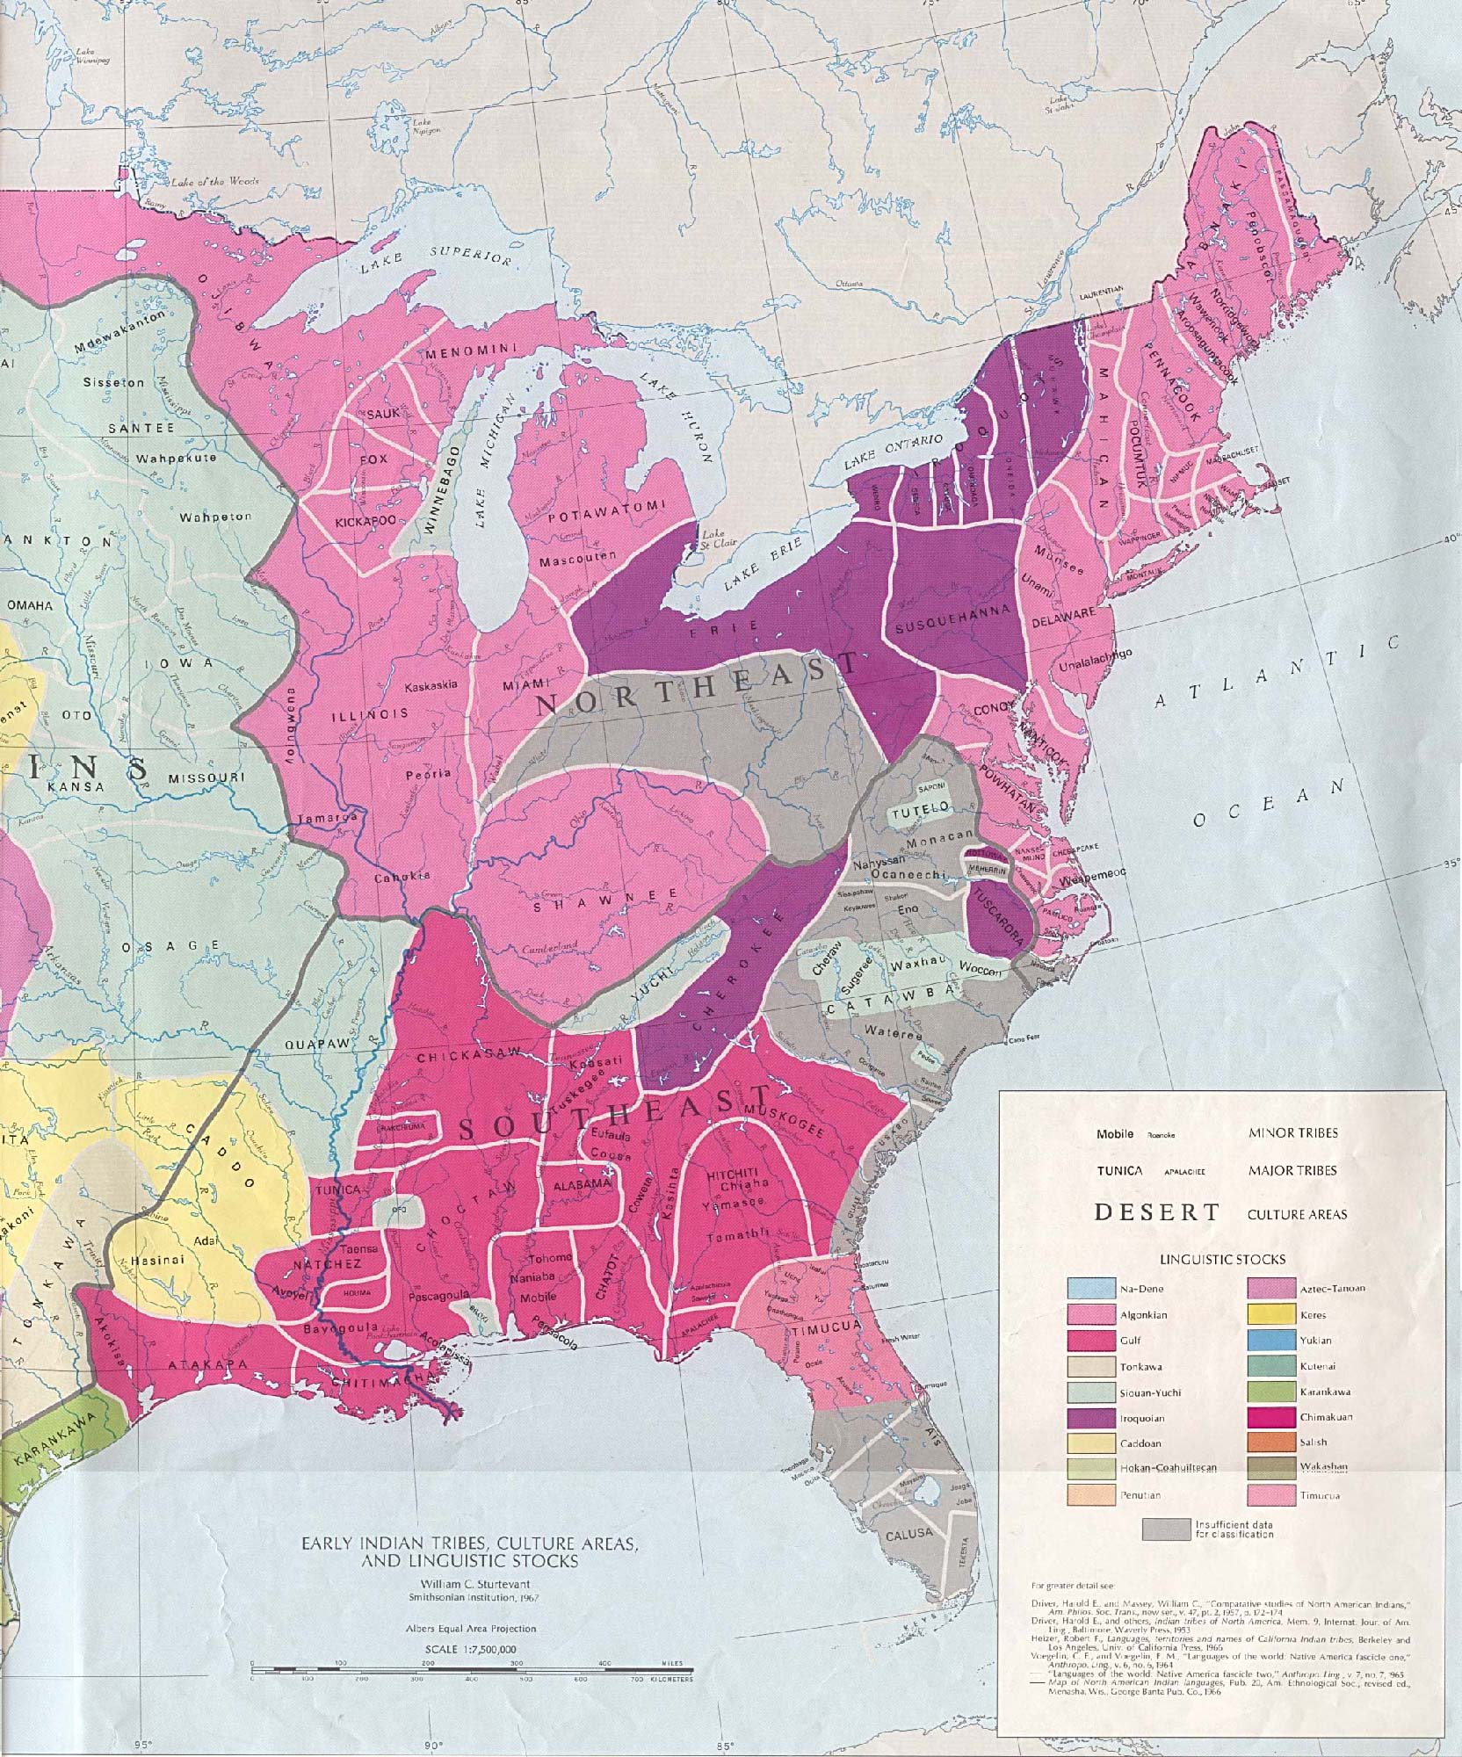

Slide 30
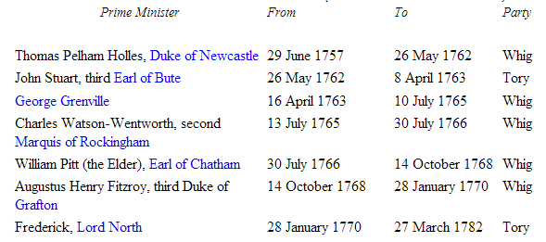

Slide 31
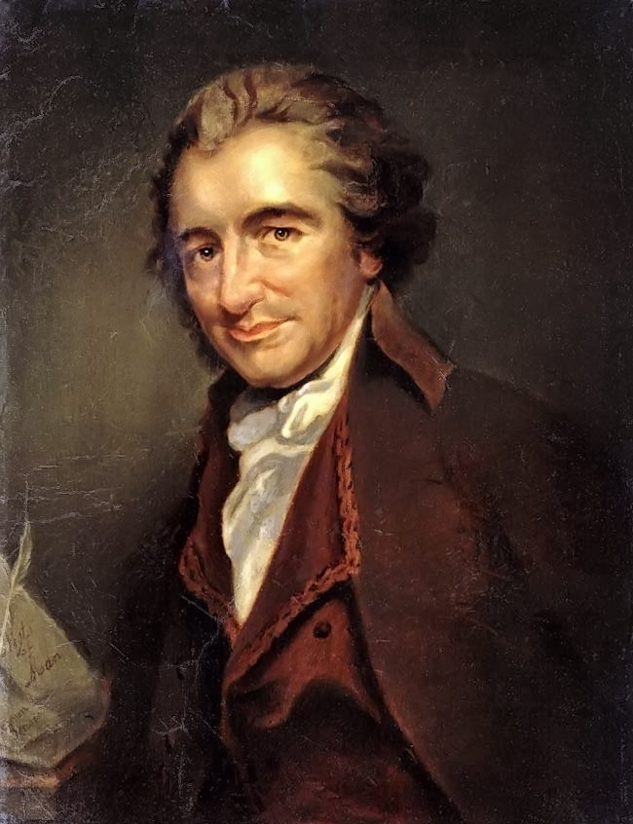

Slide 32
Common Sense
Small islands not capable of protecting themselves are the proper objects for kingdoms to take under their care; but there is something very absurd in supposing a continent to be perpetually governed by an island.
--------
There is something exceedingly ridiculous in the composition of monarchy; it first excludes a man from the means of information, yet empowers him to act in cases where the highest judgment is required…
Some writers have so confounded society with government, as to leave little or no distinction between them; whereas they are not only different, but have different origins. Society is produced by our wants, and government by our wickedness; the former promotes our happiness POSITIVELY by uniting our affections, the latter NEGATIVELY by restraining our vices. The one encourages intercourse, the other creates distinctions. The first a patron, the last a punisher.
---------------------
We have every opportunity and every encouragement before us, to form the noblest purest constitution on the face of the earth. We have it in our power to begin the world over again.

Slide 33
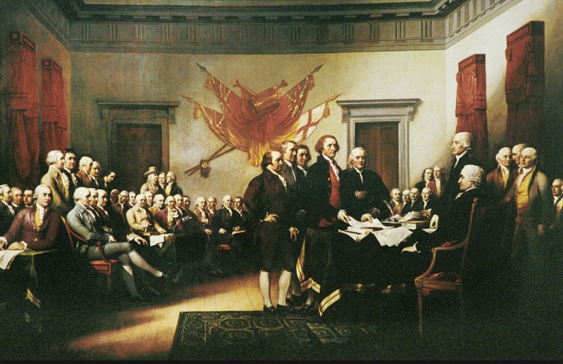

Slide 34
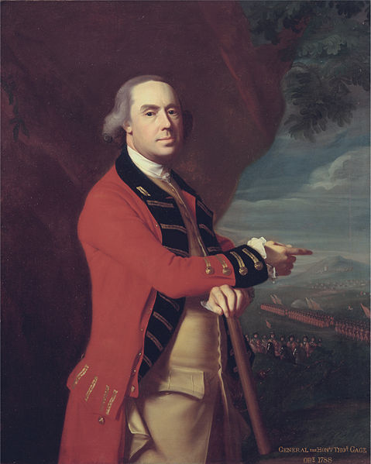
Notes:
Thomas gage

Slide 35
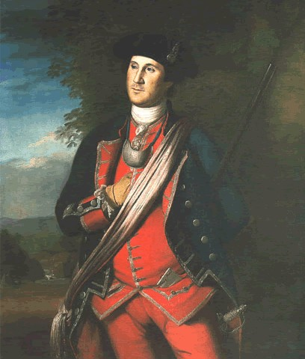
Notes:
gw

Slide 36
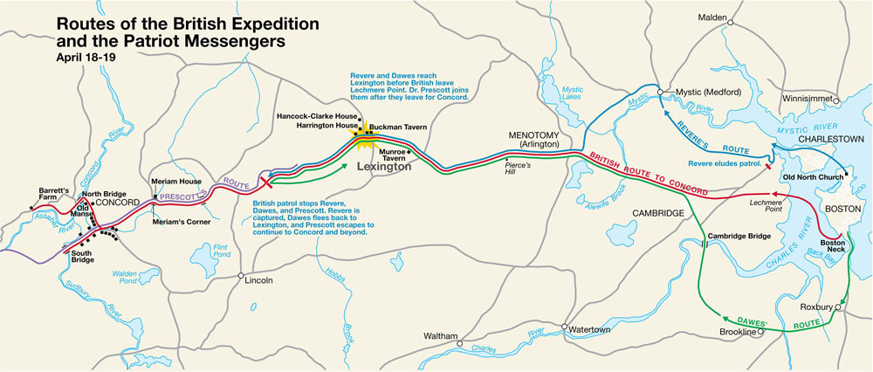

Slide 37
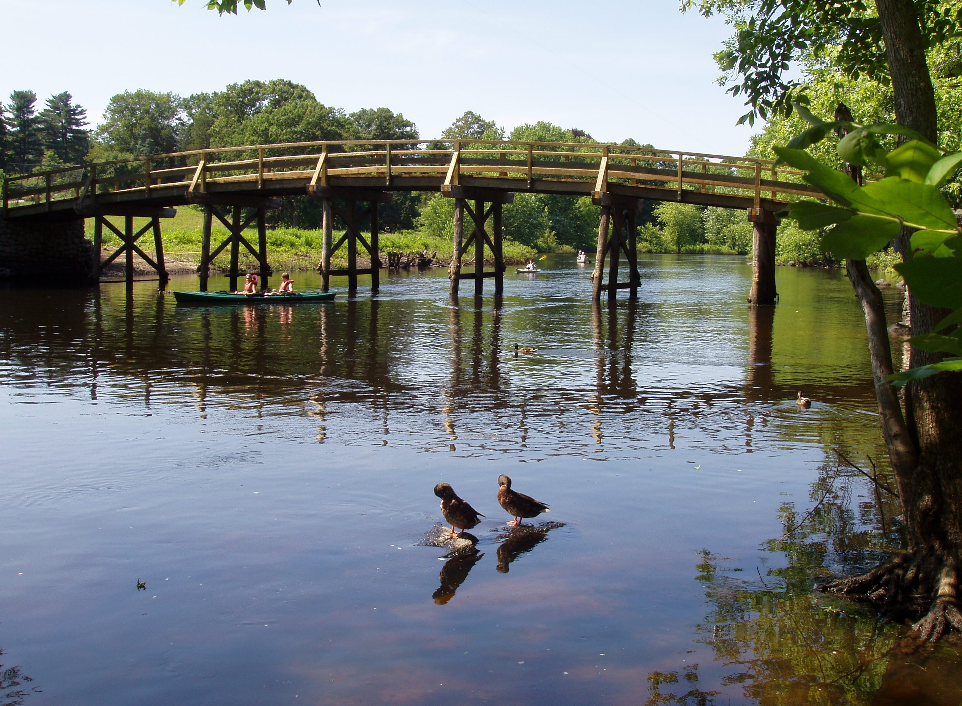

Slide 38
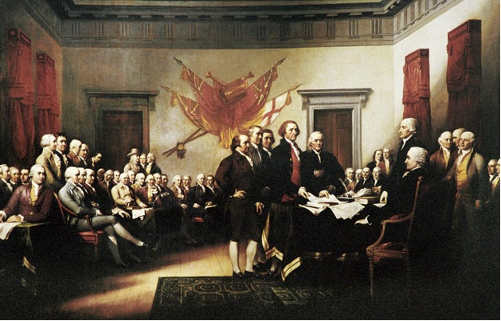

Slide 39
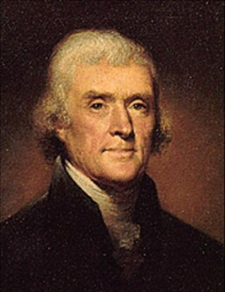

Slide 40
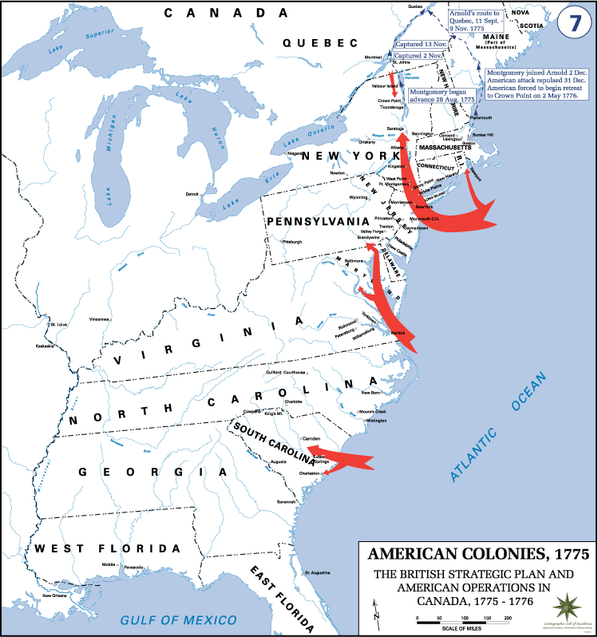

Slide 41
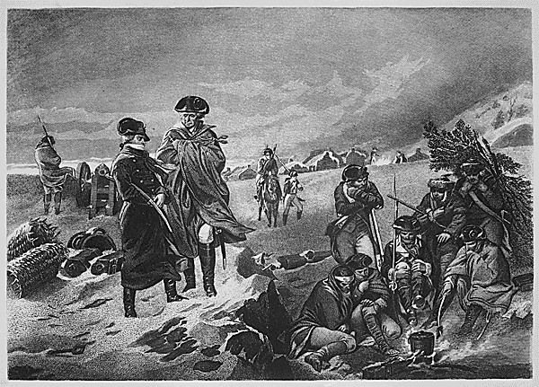

Slide 42
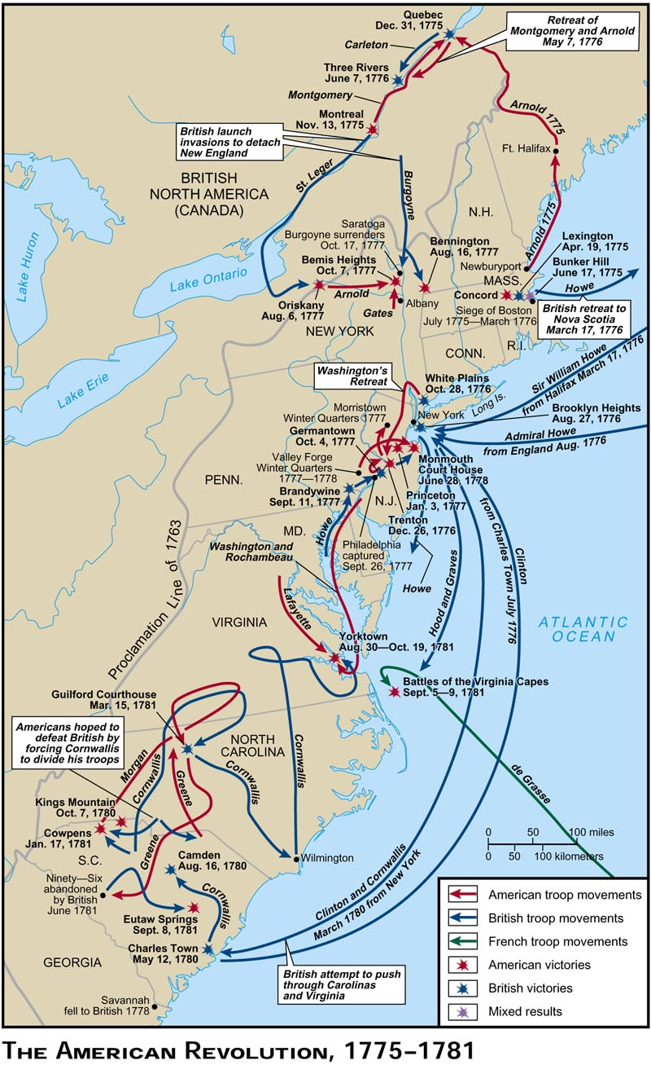

Slide 43
Battle | Date | Force | Killed | Wounded | Captured
Lexington / Concord | 4/19/75 | 3,763 | 49 | 41
Bunker Hill | 6/17/75 | 2000 | 140 | 271 | 30
Quebec | 12/30/75 | 800 | 27 | 33 | 426
Long Island | 8/27/76 | 19,000 | 300 | 700 | 400
White Plains | 10/28/76 | 14,500 | 28 | 126
Fort Washington | 11/16/76 | 2,967 | 53 | 96 | 2,818
Trenton | 12/26/76 | 2,400 |  | 4
Princeton | 1/3/77 | 4,000 | 30 | 75
Germantown | 10/4/77 | 11,000 | 152 | 521 | 400
Saratoga | 10/17/77 | 7,000 / 11,000 | 65 / 50 | 218 / 150
Monmouth | 6/28/78 | 13,462 | 152 | 300
Savannah | 12/29/78 | 850 | 83
Charleston | 5/12/80 | 5,000 | 92 | 148 | 4,650
Camden | 8/16/80 | 3,052 | 400 | 650
King's Mountain | 10/7/80 | 900 | 28 | 62
Cowpens | 1/17/81 | 1,025 | 12 | 60
Guilford | 3/15/81 | 4,400 | 78 | 183
Eutaw Springs | 9/8/81 | 2,200 | 139 | 375
Yorktown | 10/19/81 | 18,933 | 83 | 258

Slide 44
