Slide 1


Slide 2
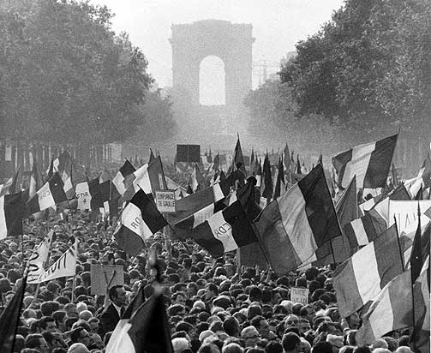
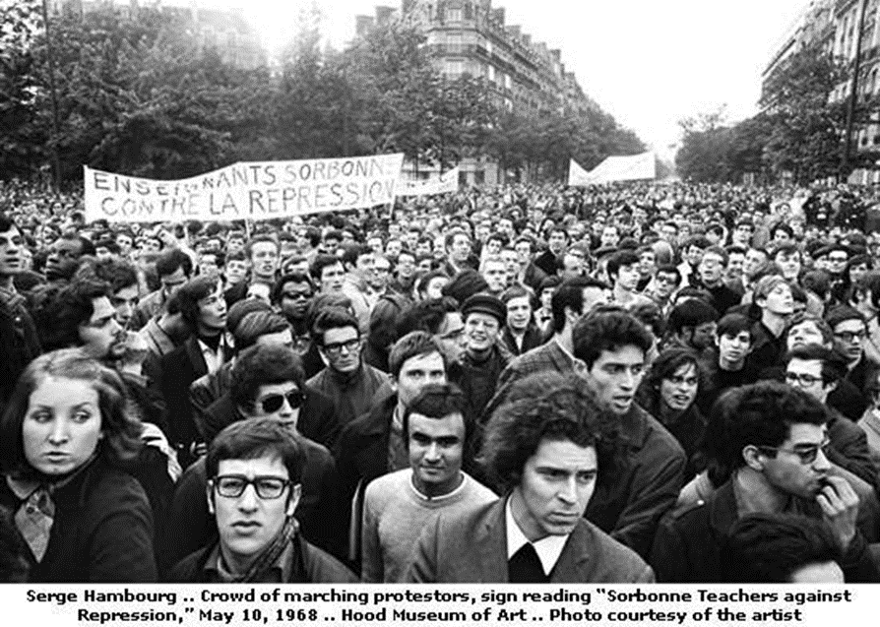

Slide 3
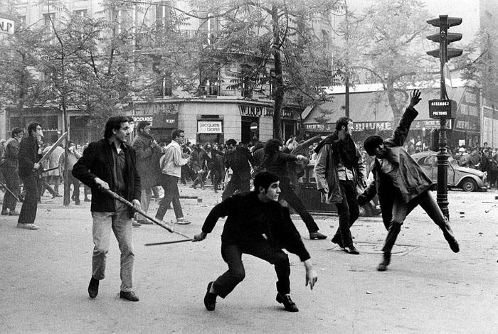
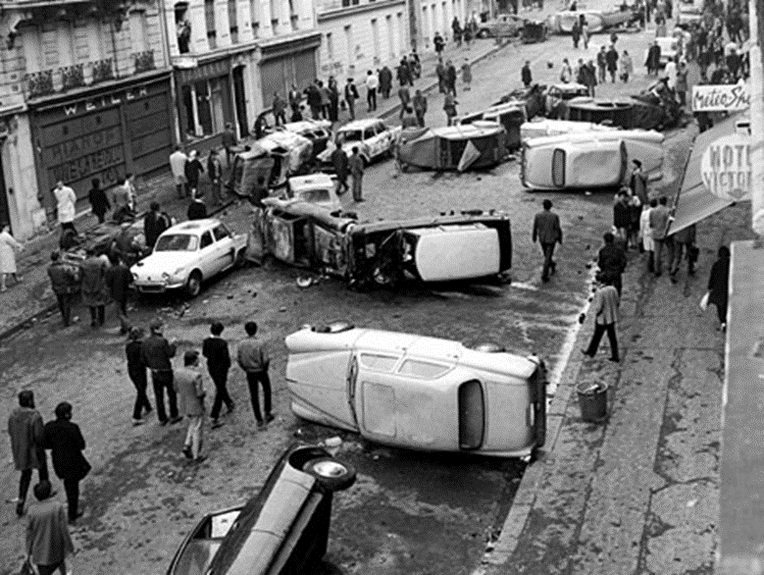

Slide 4
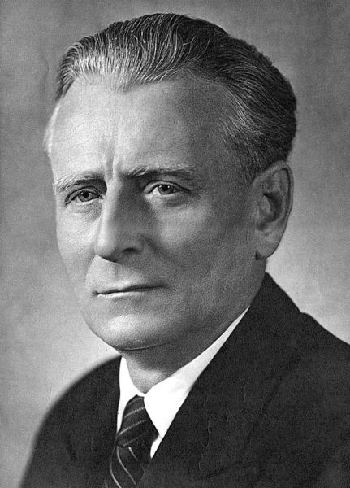
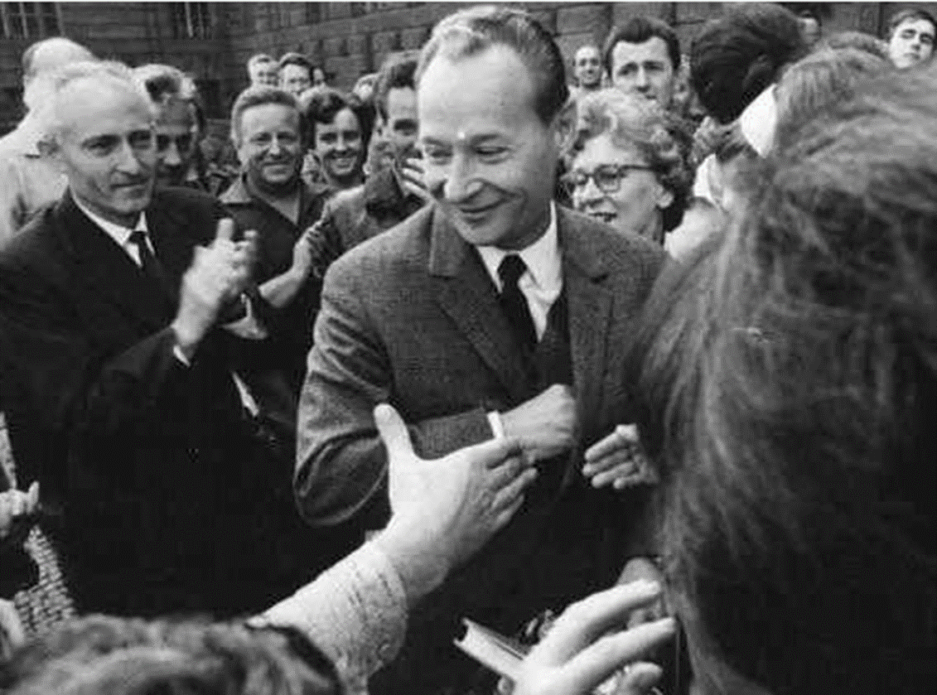

Slide 5
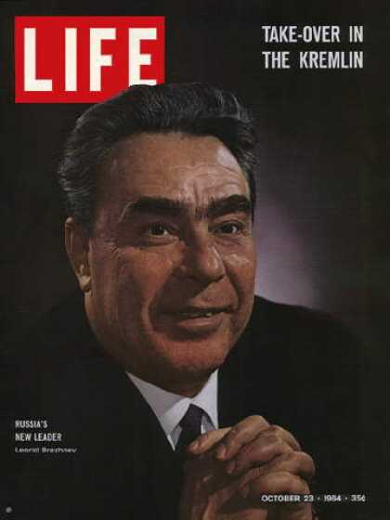

Slide 6
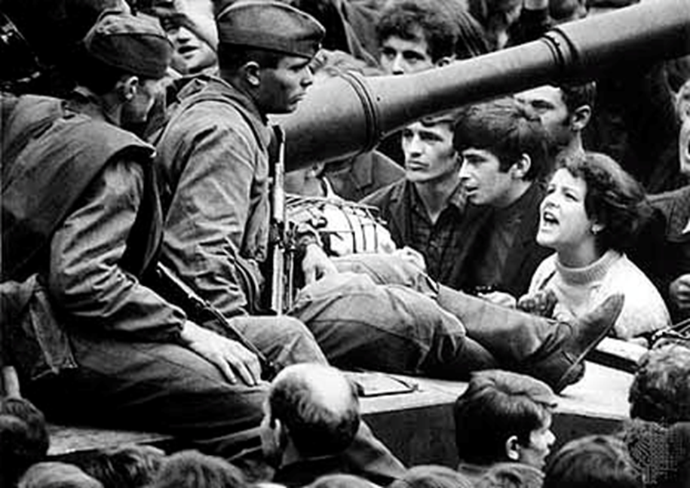
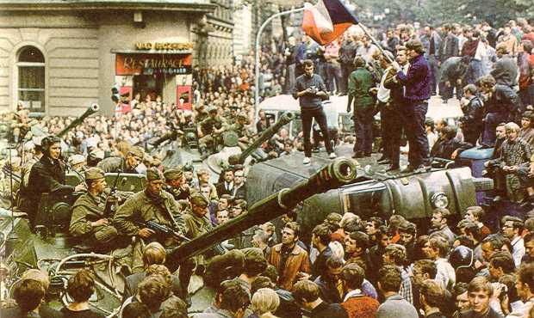

Slide 7
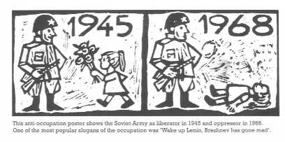

Slide 8
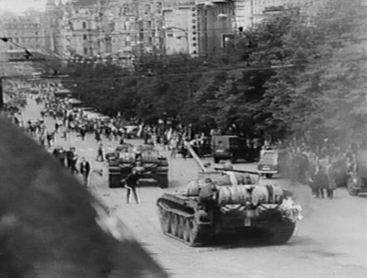

Slide 9
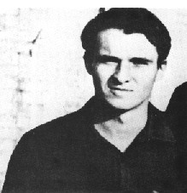
Notes:
Jan Palach

Slide 11
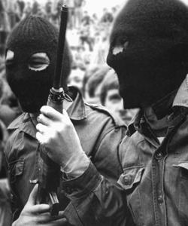
Notes:
ira

Slide 12
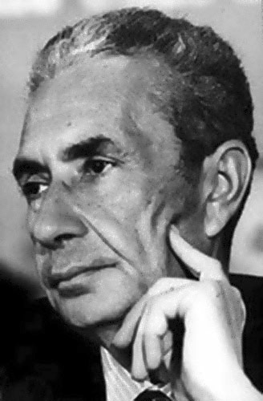
Notes:
Aldo moro

Slide 13
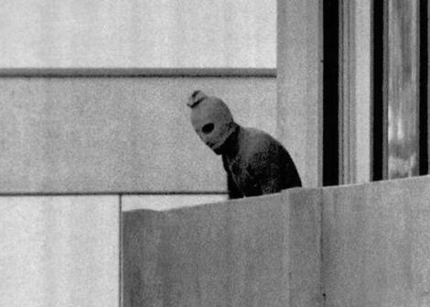

Slide 14


Slide 15
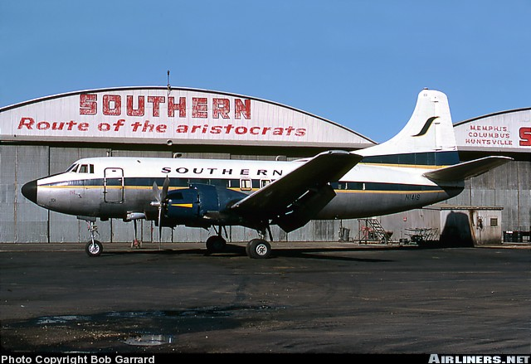

Slide 16
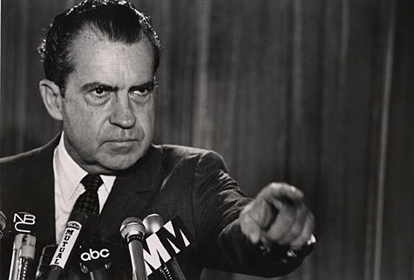

Slide 17
President Nixon: We have to develop now a program, a program for leaking out information, for destroying these people in the papers. That’s one side of it, get after the conspiracy [against him].
The other side of it is the declassification. Declassification. And then leaking to, or giving up, to our friends the stories that they would like to have, such as the Cuban conflagration [Bay of Pigs?]. Do you get what I mean? Let’s have a little fun.
Let me tell you what the declassification of the previous years’ [events] that helps us [unclear], you know. It takes the eyes off of Vietnam. It gets them thinking about the past rather than our present problems. You get the point?
H.R. Haldeman: Yeah.
President Nixon: You’ve got to win some things in the press. These guys don’t understand. They have no understanding of politics. They have no understanding of public relations.

Slide 18
[Attorney General] John Mitchell’s that way. John Mitchell is always worried about: is it technically correct? Do you think, for Christ’s sakes, the New York Times is worrying about all the legal niceties? Those sons of bitches are killing me. Every minute [unclear] by leaking to the press.
This is what we’ve got to get—I want you to shake these sons of bitches up around here. Now, you do it! Shake them up! Get them off their goddamned dead asses and say, “Now, this is what we’re talking about. We’re up against an enemy, a conspiracy, that are using any means. [Pounding the desk for emphasis.] We are going to use any means.” Is that clear?
Did they get the Brookings Institute [a liberal think-tank with which Daniel Ellsberg was affiliated] raided last night? No?
Haldeman: [Unclear.]
President Nixon: Get it done. I want it done. I want the Brookings Institute’s safe cleaned out.

Slide 19
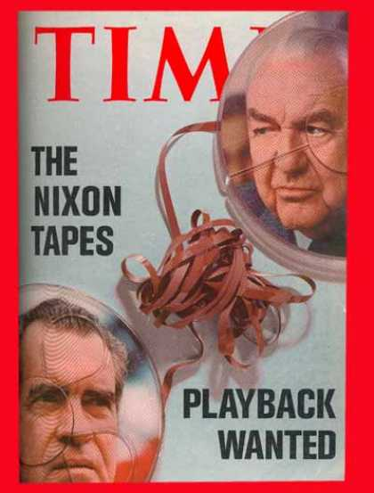

Slide 20


Slide 21
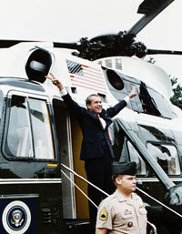

Slide 22
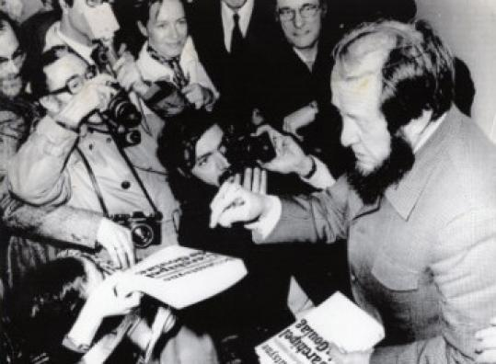

Slide 23
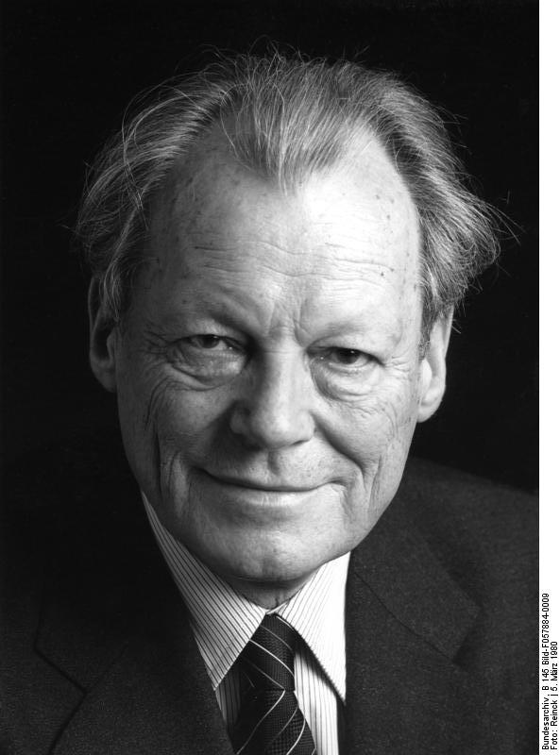

Slide 24
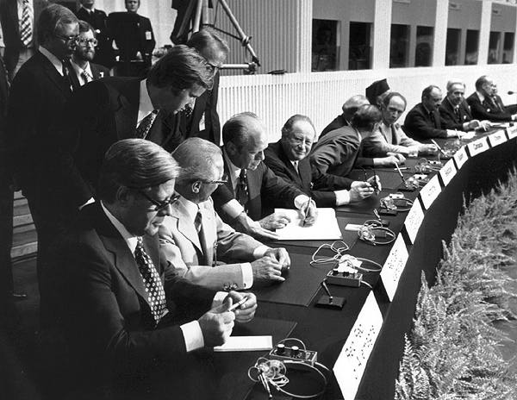

Slide 25
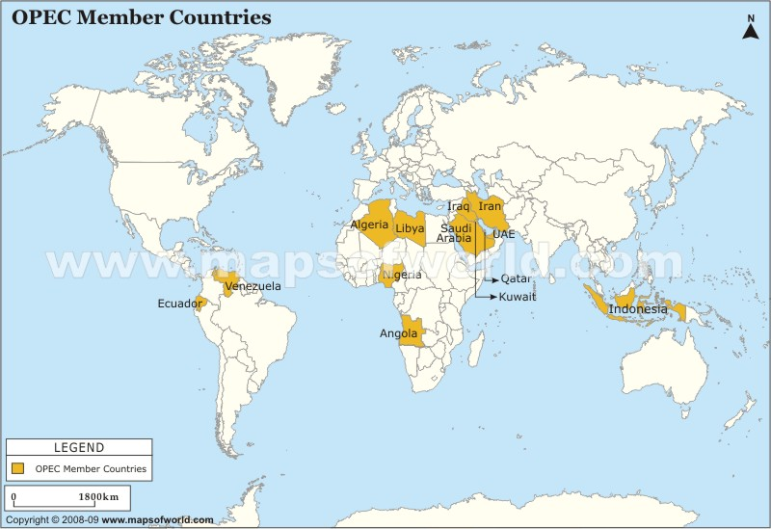

Slide 26
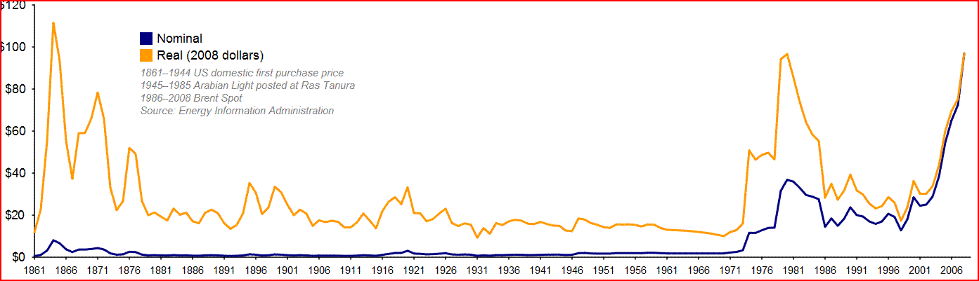

Slide 27
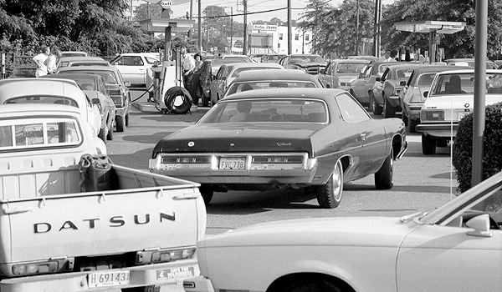

Slide 28
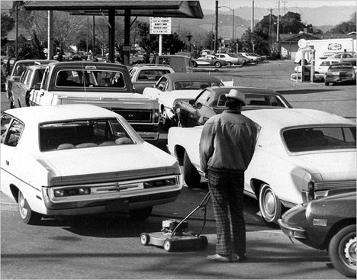

Slide 29
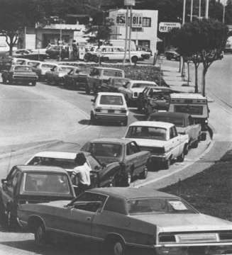

Slide 30
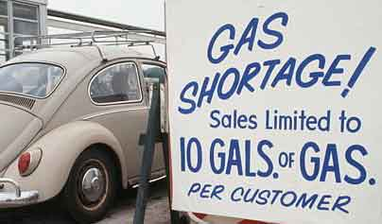

Slide 31
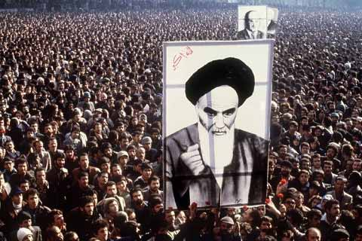

Slide 32
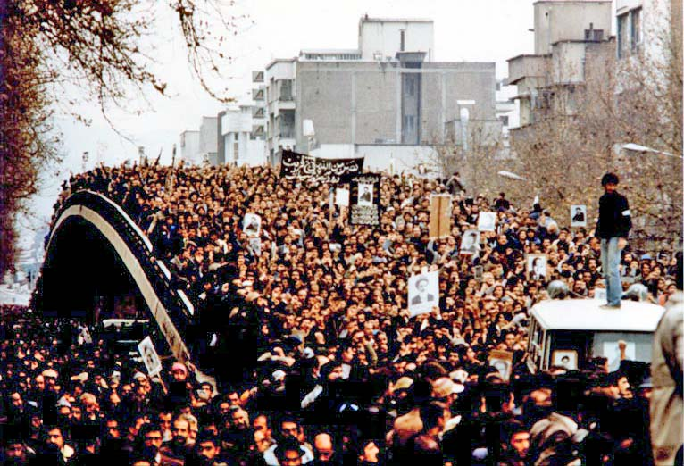

Slide 34
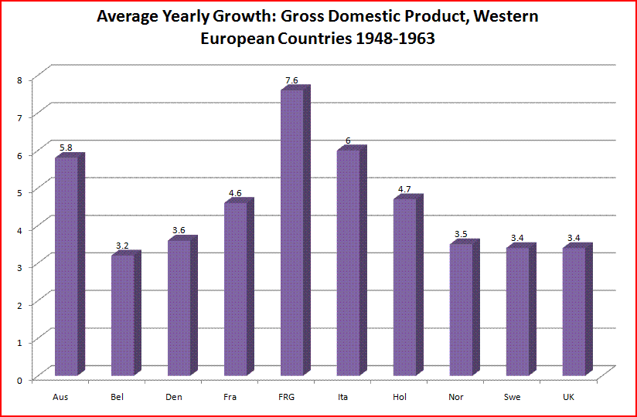

Slide 35
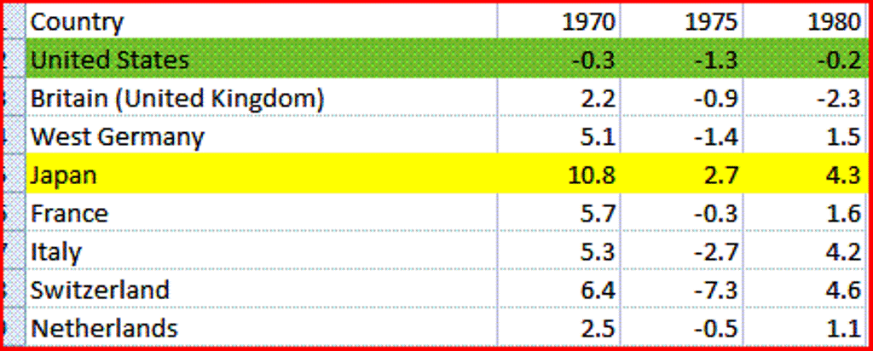

Slide 36
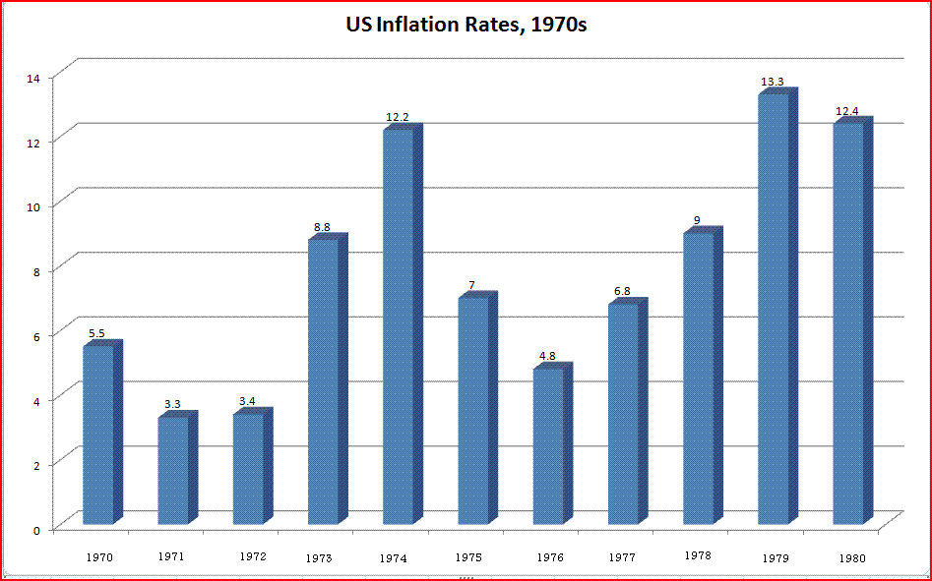

Slide 37
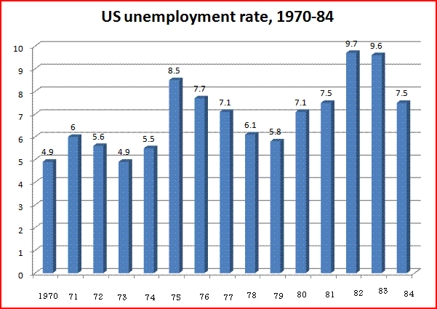

Slide 38
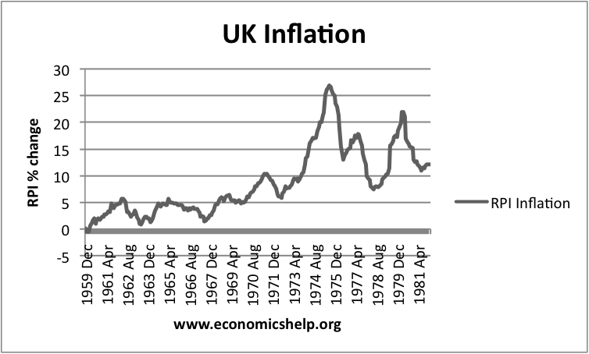

Slide 39
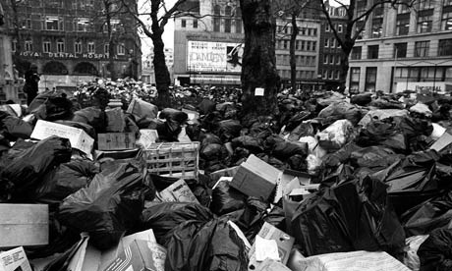

Slide 40


Slide 41
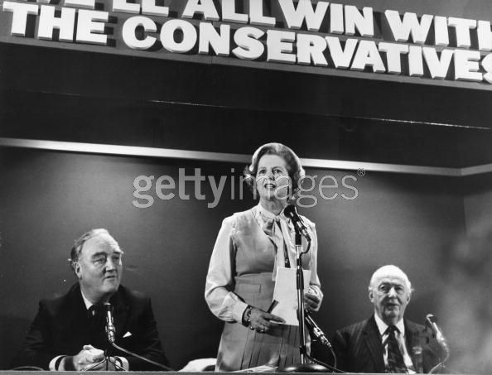

Slide 42
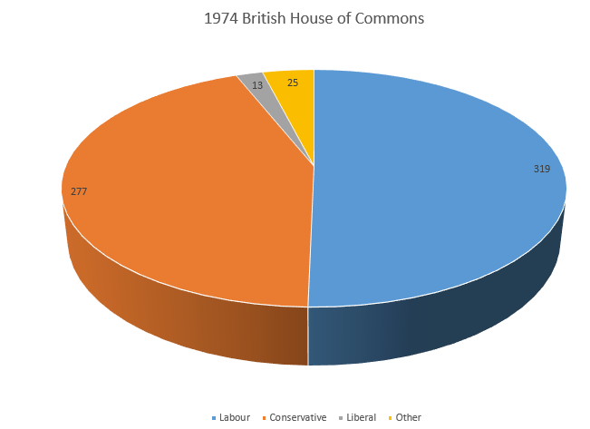

Slide 43
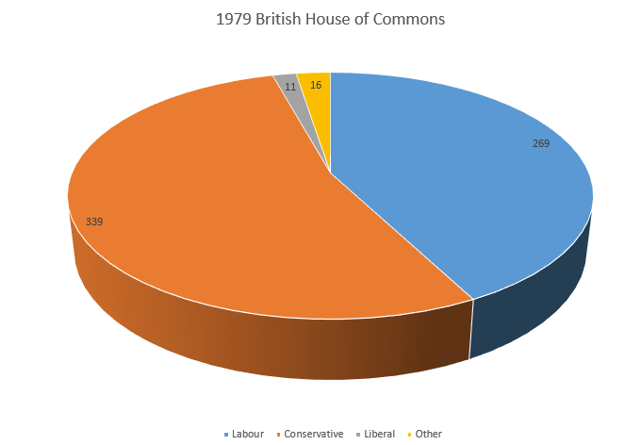

Slide 44
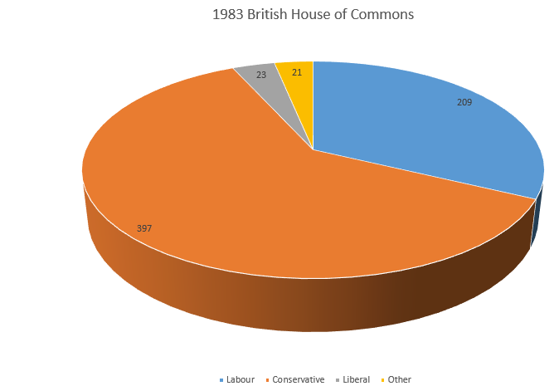

Slide 45
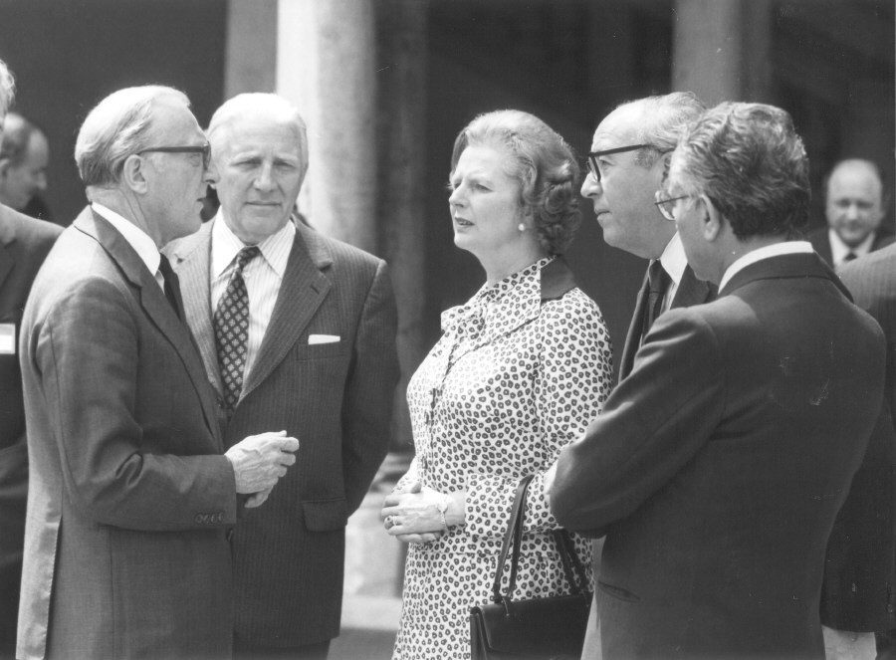

Slide 46
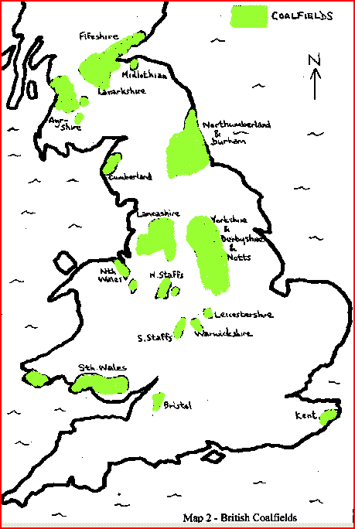

Slide 47
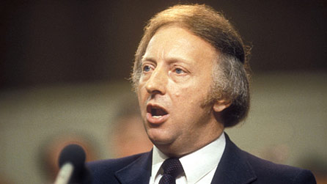

Slide 48
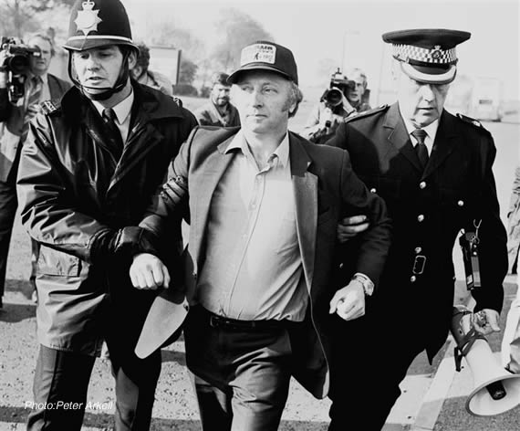

Slide 49
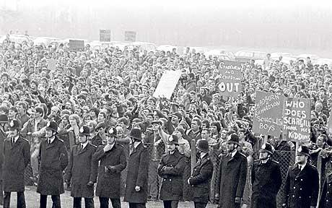

Slide 50
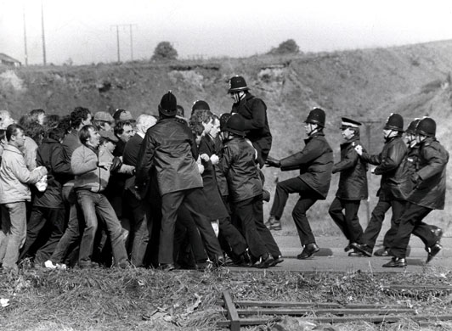

Slide 51
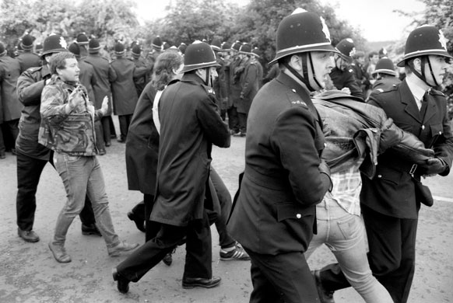

Slide 52
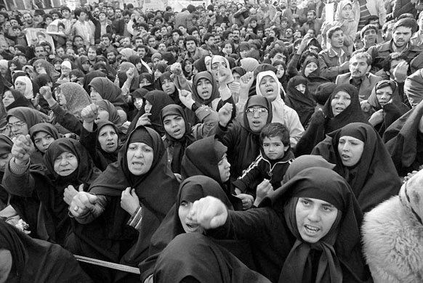

Slide 53
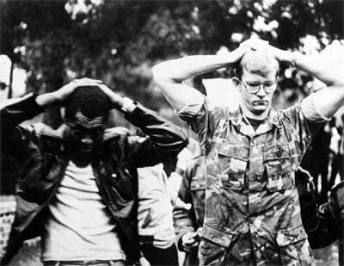

Slide 54
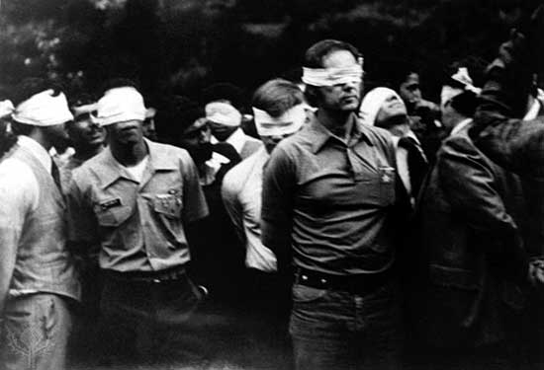

Slide 55


Slide 56


Slide 57


Slide 58


Slide 59


Slide 60


Slide 61


Slide 62


Slide 63


Slide 65


Slide 66


Slide 67


Slide 68


Slide 69


Slide 70


Slide 71


